Slide 1
Intro
“Big Idea” Question
Review Concepts
Check-In Questions
Teacher Engagement
Vocabulary
Student-Friendly Definition
Examples & Non-Examples
Frayer Model
Simulation/Activity
Notes:
OK everyone, get ready for our next lesson. Just as a reminder, these are the different components that our lesson may include, and you’ll see these icons in the top left corner of each slide so that you can follow along more easily!

Slide 2
Intro
Visible Light
Notes:
Today we’re going to learn about visible light.

Slide 3
Big Question: How does light make our day better and help us see and understand things around us?
Notes:
Before we start, let’s think about our “big question”: How does light make our day better and help us see and understand things around us?
[Pause and illicit predictions from students.]
I love all these thoughtful scientific hypotheses! Be sure to keep this question and your predictions in mind as we move through these next few lessons, and we’ll continue to revisit it.

Slide 4
Notes:
Before we move on to our new vocabulary term, let’s review some other words & concepts that you already learned and make sure you are firm in your understanding.

Slide 5
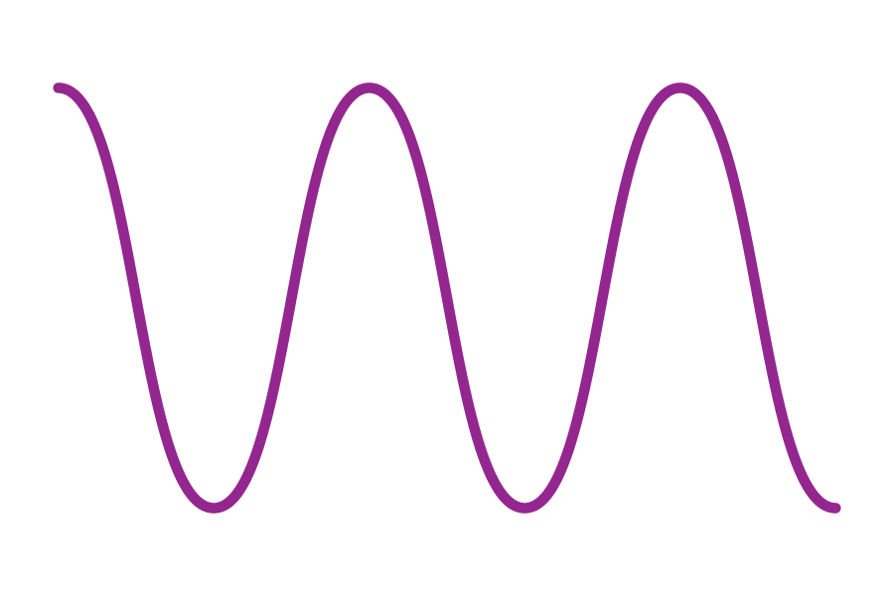
Waves: a pattern of motions that move through stuff, carrying energy from one place to another, but without carrying any matter.
Notes:
Waves are a pattern of motions that move through stuff, carrying energy from one place to another, but without carrying any matter

Slide 6
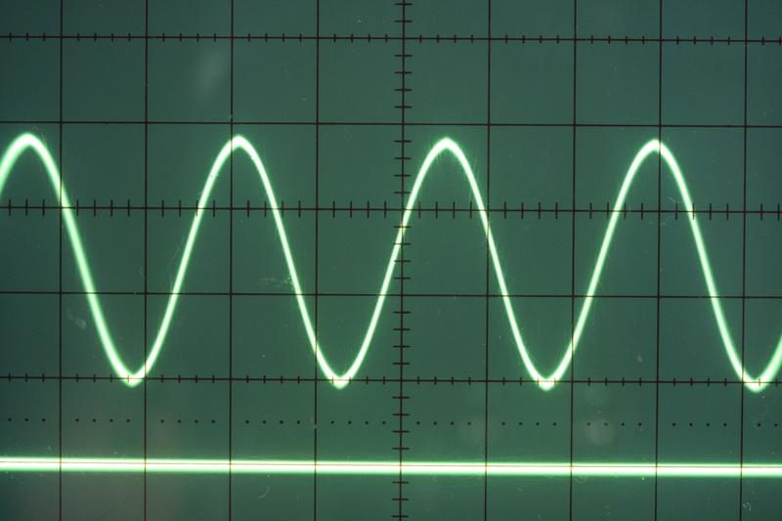
Transverse Waves: waves that travel sideways to the direction they are moving
Notes:
Transverse waves are waves that travel sideways to the direction they are moving.

Slide 7
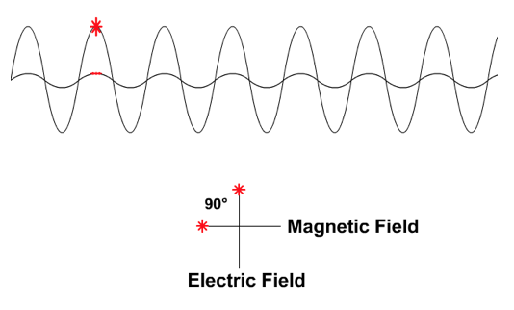
Electromagnetic Waves: waves that are created as a result of vibrations between an electric field and a magnetic field
Notes:
Electromagnetic waves are waves that are created as a result of vibrations between an electric field and a magnetic field.

Slide 8
Electromagnetic Spectrum: range of all types of electromagnetic waves
Notes:
The electromagnetic spectrum is the range of all types of magnetic waves.

Slide 9
Notes:
Now let’s pause for a moment to check your understanding.
Feedback: It's really important to make sure that you're providing students with frequent opportunities to respond as you're activating prior knowledge – it will save so you so much time if you confirm understanding before asking them to try something independently.

Slide 10
What is the difference between waves and transverse waves?
Notes:
What is the difference between waves and transverse waves?
[Transverse waves are simply a type of wave that moves sideways to the direction they are moving. This is not the case for all waves.]

Slide 11
What are electromagnetic waves?
Notes:
What are electromagnetic waves?
[Electromagnetic waves are waves that are created as a result of vibrations between an electric field and a magnetic field.]

Slide 12
What is the electromagnetic spectrum?
Notes:
What is the electromagnetic spectrum?
[The electromagnetic spectrum is the range of all types of electromagnetic waves. These are created as result of vibrations between an electric field and a magnetic field.]

Slide 13
Visible Light
Notes:
Now that we’ve reviewed, let’s define our new term, visible light.

Slide 14
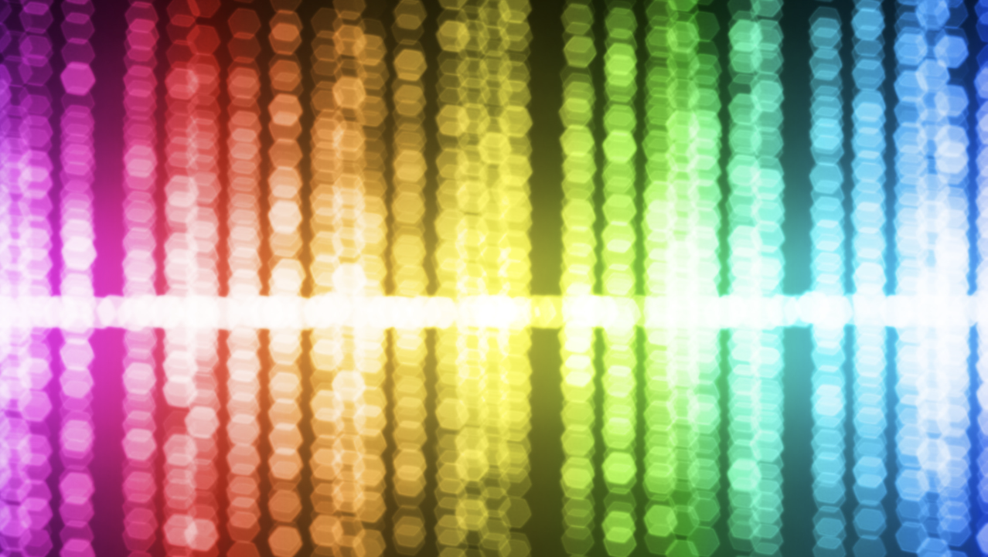
Visible Light: wavelengths on the electromagnetic spectrum that people can see with their eyes
Notes:
Visible light is wavelengths on the electromagnetic spectrum that people can see with their eyes
Feedback: When providing more student-friendly definitions, it is helpful to provide students with cues so that they can be prepared and know what to expect and be ready to copy down the information.

Slide 15
Notes:
Let’s check-in for understanding.

Slide 16
What is visible light?
Notes:
What is visible light?
[wavelengths on the electromagnetic spectrum that people can see with their eyes]

Slide 17
Notes:
That is the basic definition, but there is a bit more you need to know.

Slide 18
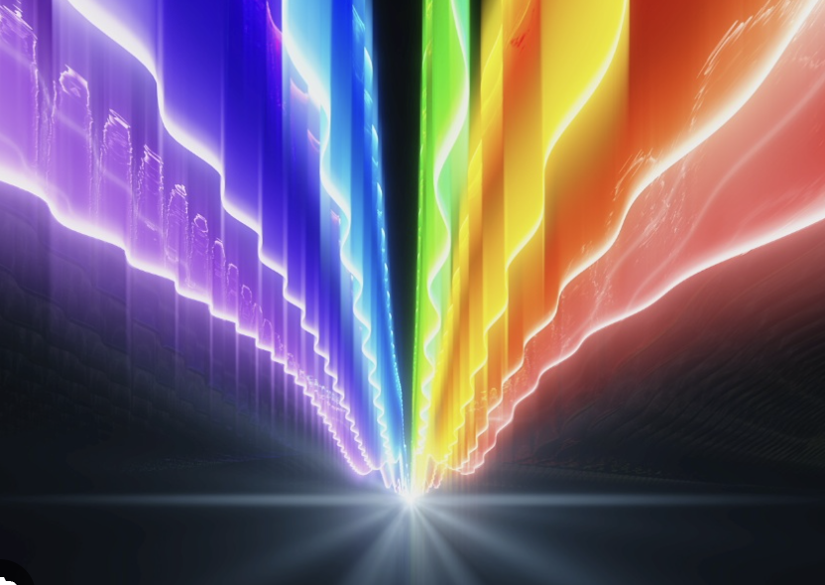
Travels as waves
Notes:
Visible light travels in the form of waves. These waves move in straight lines unless they encounter an obstacle or a different medium (like air changing to water or glass).

Slide 19
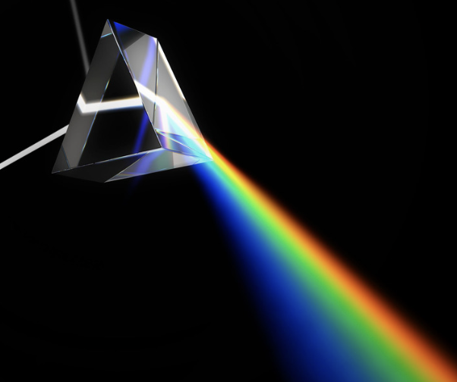
As visible light shines through a prism we see all the different colors as their wavelengths change
Notes:
As visible light shines through a prism we see all the different colors as their wavelengths change

Slide 20
Notes:
Let’s check-in for understanding.

Slide 21
How does visible light travel?
Notes:
How does visible light travel?
[Visible light travels in the form of waves. These waves move in straight lines unless they encounter an obstacle or a different medium (like air changing to water or glass).

Slide 22
True/False: As visible light shines through a prism we see all the different colors as their wavelengths change
Notes:
True/False: As visible light shines through a prism we see all the different colors as their wavelengths change
[True]

Slide 23
True/False: As visible light shines through a prism we see all the different colors as their wavelengths change
Notes:
True/False: As visible light shines through a prism we see all the different colors as their wavelengths change
[True]

Slide 24
Notes:
Now, let’s talk about some examples of visible light.
Feedback: It's good to pick a variety of examples to work through with your students. This prepares them for some types that might trip them up when they try it on their own.

Slide 25
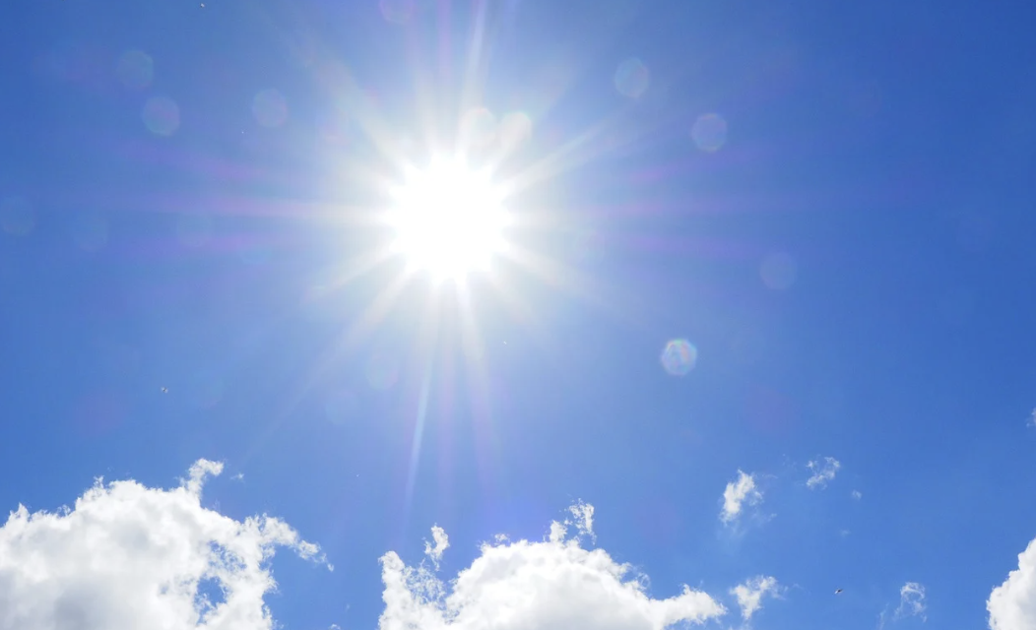
Sunlight is an example of visible light.
Notes:
Sunlight is a natural source of visible light. It provides illumination during the day and allows us to see the world around us.

Slide 26
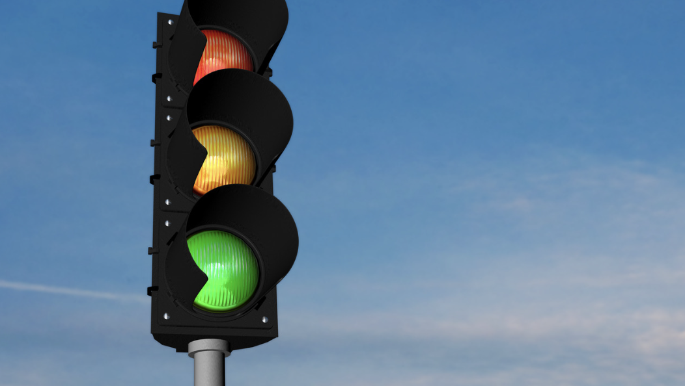
Traffic lights are an example of visible light.
Notes:
Traffic signals use red, yellow, and green lights to control the flow of vehicles. These colored lights are examples of visible light signals used for communication.

Slide 27
Fireworks are an example of visible light.
Notes:
Fireworks displays during festivals and celebrations feature colorful lights generated by reactions that show visible light when set off.

Slide 28
Notes:
Next, let’s talk about some non-examples of visible light.

Slide 29
Sound Waves are NOT an example of visible light
Notes:
Sound waves are not an example of visible light. They are waves of mechanical energy and require a medium and we cannot see them
Feedback: Non-examples often need some explanation to make it clear to students the difference. Using clear and simple language can help with this.

Slide 30
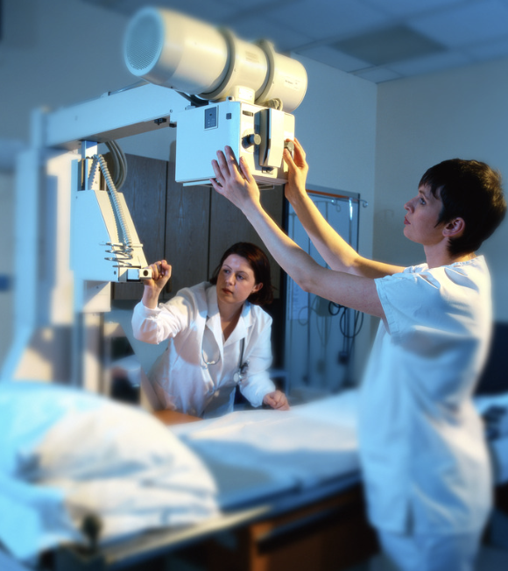
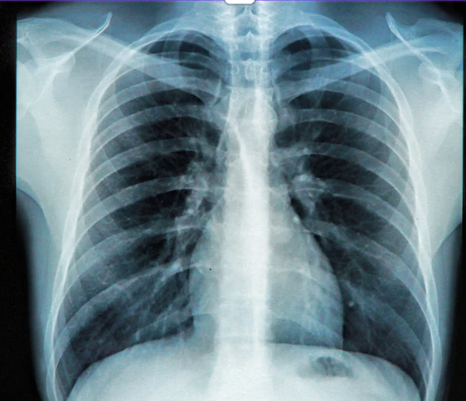
X-Rays are NOT an example of visible light
Notes:
X-rays are not visible light. You can not see the rays coming out of the x-ray machine, but you can see the image it produces through technology.
Feedback: Non-examples often need some explanation to make it clear to students the difference. Using clear and simple language can help with this.

Slide 31
Notes:
Let’s check-in for understanding.

Slide 32
What are examples of visible light?
Notes:
What are examples of visible light?
[fireworks, traffic lights, sunlight]

Slide 33
True/False: X-Rays are an example of visible light
Notes:
True/False: X-Rays are an example of visible light
[False]

Slide 34
True/False: X-Rays are an example of visible light
Notes:
False: X-Rays are NOT an example of visible light

Slide 35
Notes:
We will now complete this concept map, called a Frayer model, to summarize and further clarify what you have learned about the term visible light.

Slide 36
Definition
Picture
Visible Light
Example
How does visible light impact my life?
Notes:
To complete the Frayer model, we will choose from four choices the correct picture, definition, example, and response to the question, “How does visible light impact my life?” Select the best response for each question using the information you just learned. As we select responses, we will see how this model looks filled in for the term visible light.

Slide 37
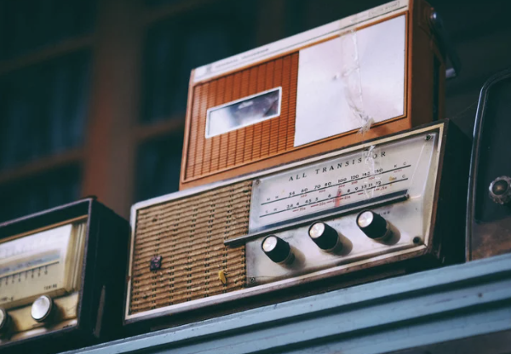
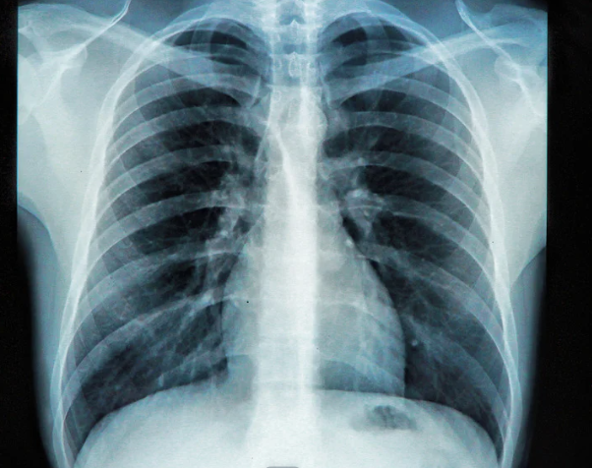
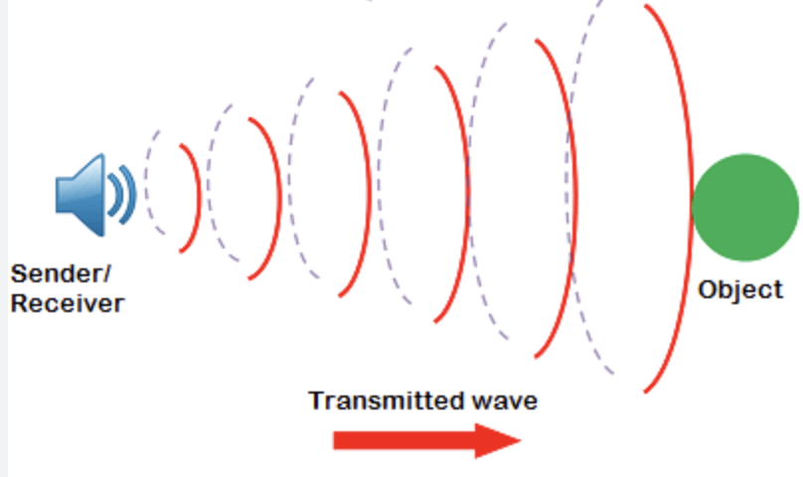
Directions: Choose the correct picture of visible light from the choices below.
A
B
C
D
Notes:
Choose the one correct picture of a visible light from these four choices.

Slide 38
Directions: Choose the correct picture of visible light from the choices below.
A
B
C
D
Notes:
The rainbow is the picture that shows visible light.

Slide 39
Definition
Picture
Visible Light
Example
How does visible light impact my life?
Notes:
Here is the Frayer model filled in with a picture of visible light.

Slide 40
Directions: Choose the correct definition of visible light from the choices below.
A
How fast an object is traveling
B
Wavelengths on the electromagnetic spectrum that people can see with their eyes
C
A repeating motion that carries energy from one place to another.
D
A material in which electrons can not move around easily
Notes:
Choose the one correct definition of visible light from these four choices.

Slide 41
Directions: Choose the correct definition of visible light from the choices below.
A
How fast an object is travelling
B
Wavelengths on the electromagnetic spectrum that people can see with their eyes
C
A repeating motion that carries energy from one place to another.
D
A material in which electrons can not move around easily
Notes:
“The part of the electromagnetic spectrum that can be seen by the human eye.
” is correct! This is the definition of visible light.

Slide 42
Definition
Picture
Wavelengths on the electromagnetic spectrum that people can see with their eyes
Visible Light
Example
How does visible light impact my life?
Notes:
Here is the Frayer Model with a picture and the definition filled in for visible light: Wavelengths on the electromagnetic spectrum that people can see with their eyes

Slide 43
Directions: Choose the correct example of a visible light from the choices below.
A
Fireworks in the sky
B
An apple hanging on a tree
C
A dog running after a ball
D
A ripple of water in a pond
Notes:
Choose the one correct example of visible light from these four choices.

Slide 44
Directions: Choose the correct example of a visible light from the choices below.
A
Fireworks in the sky
B
An apple hanging on a tree
C
A dog running after a ball
D
A ripple of water in a pond
Notes:
“a rainbow in the sky” is correct! This is an example of a visible light.

Slide 45
Definition
Picture
Wavelengths on the electromagnetic spectrum that people can see with their eyes
Visible Light
Fireworks in the sky
Example
How does visible light impact my life?
Notes:
Here is the Frayer Model with a picture, definition, and an example of visible light: Fireworks in the sky.

Slide 46
Directions: Choose the correct response for “how does visible light impact my life?” from the choices below.
A
Visible light is in the food we eat and give us the nutrition our bodies need to survive
B
Visible light helps me see the world around me
C
Visible light helps me hear the world around me
D
Visible light erodes the surface of rocks giving them their shape
Notes:
Choose the one correct response for “how does visible light impact my life?” from these four choices.

Slide 47
Directions: Choose the correct response for “how do waves impact my life?” from the choices below.
A
Visible light is in the food we eat and give us the nutrition our bodies need to survive
B
Visible light helps me see the world around me
C
Visible light helps me hear the world around me
D
Visible light erodes the surface of rocks giv
Notes:
“Visible light helps me see the world around me.” That is correct! This is an example of how visible light impacts your life.

Slide 48
Definition
Picture
Wavelengths on the electromagnetic spectrum that people can see with their eyes
Visible Light
Fireworks in the sky
Visible light helps me see the world around me
Example
How does visible light impact my life?
Notes:
Here is the Frayer Model with a picture, definition, example, and a correct response to “How does visible light impact my life?”: Visible light helps me see the world around me

Slide 49
Remember!!!
Notes:
So remember!
Feedback: A good general strategy for information retention is: 1) tell them what you're going to teach them, 2) teach them, and 3) tell them what you just taught them. Make sure to include the third and final step. While it is easy to think a quick review of what you just went over is unnecessary, it can be incredibly useful in helping the students remember the information over the long term.

Slide 50
Visible Light: wavelengths on the electromagnetic spectrum that people can see with their eyes
Notes:
Visible light is wavelengths on the electromagnetic spectrum that people can see with their eyes

Slide 51
Big Question: How does light make our day better and help us see and understand things around us?
Notes:
Let’s reflect once more on our big question. Our “big question” is: How does light make our day better and help us see and understand things around us?
Does anyone have any additional examples to share that haven’t been discussed yet?

Slide 52
Notes:
Thanks for watching, and please continue watching CAPs available from this website.

Slide 53
This Video Was Created With Resources From:
Questions or Comments
Michael Kennedy, Ph.D. MKennedy@Virginia.edu
Rachel L Kunemund, Ph.D. rk8vm@virginia.edu

