Slide 1
Intro
“Big Idea” Question
Review Concepts
Check-In Questions
Teacher Demo
Vocabulary
Student-Friendly Definition
Examples & Non-Examples
Morphological Word Parts
Simulation/Activity
Notes:
OK everyone, get ready for our next lesson. Just as a reminder, these are the different components that our lesson may include, and you’ll see these icons in the top left corner of each slide so that you can follow along more easily!

Slide 2
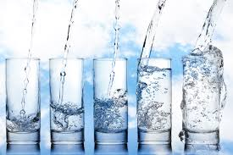
Water Quality
Intro
Notes:
Today we will learn about water quality.

Slide 3
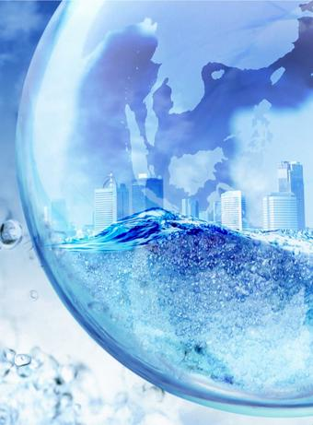
Big Question: How do factors interact and impact our water quality?
Notes:
Our “big question” is: How do factors interact and impact our water quality?
[Pause and illicit predictions from students.]
I love all these thoughtful scientific hypotheses! Be sure to keep this question and your predictions in mind as we move through these next few lessons, and we’ll continue to revisit it.
Feedback: Asking students to make predictions about how factors interact and impact our water quality is a great way to activate and elicit student ideas and prior knowledge. This type of activity is evidence of the teacher planning for students’ engagement with science ideas.

Slide 4
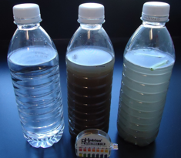
Demonstration
Collect water samples for different areas around the school, town, and your home. Bottle the water in different containers and set them in front of the classroom. Have students make observations about the different water samples. You can disclose where the water samples are from. Today we will be looking more at how to test water for its quality and health for living organisms.
Notes:
Collect water samples for different areas around the school, town, and your home. Bottle the water in different containers and set them in front of the classroom. Have students make observations about the different water samples. You can disclose where the water samples are from. Today we will be looking more at how to test water for its quality and health for living organisms.
Feedback: This demonstration offers opportunities for students to more closely engage in carrying out investigations. Throughout the demonstration, offer students opportunity to demonstrate their understanding by asking various types of questions (i.e., open-ended, probing). This is important to ensure that they are making sense of this new content!

Slide 5
Notes:
Before we move on to our new vocabulary term, let’s review some other words & concepts that you already learned and make sure you are firm in your understanding.

Slide 6
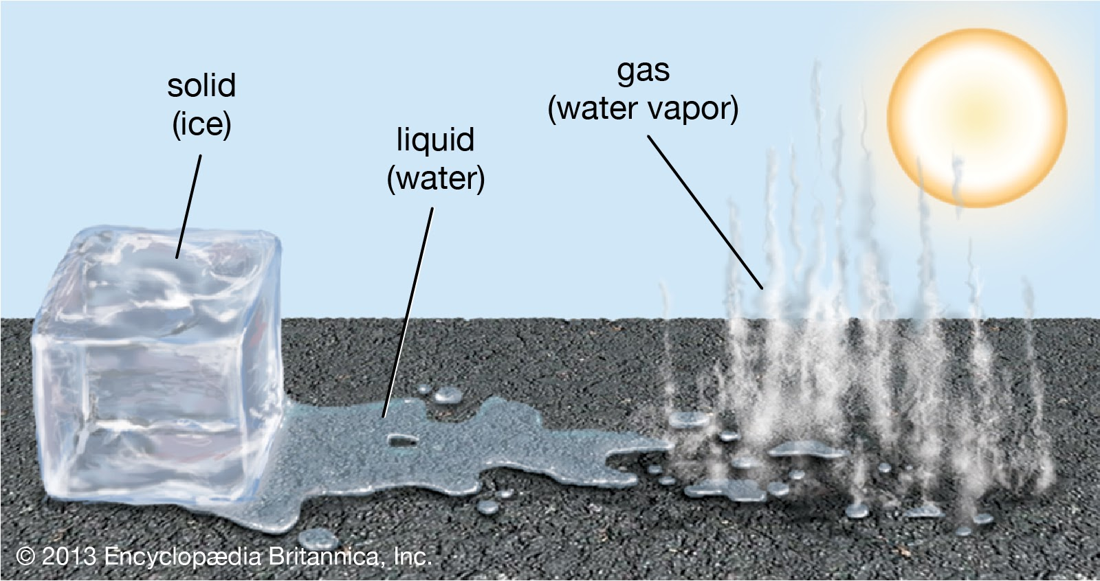
Water: a compound that exists in all three states of matter (solid, liquid, gas); necessary fluid for living things
Notes:
Water is a compound that exists in all three states of matter (solid, liquid, gas). It is a necessary fluid for living things.

Slide 7
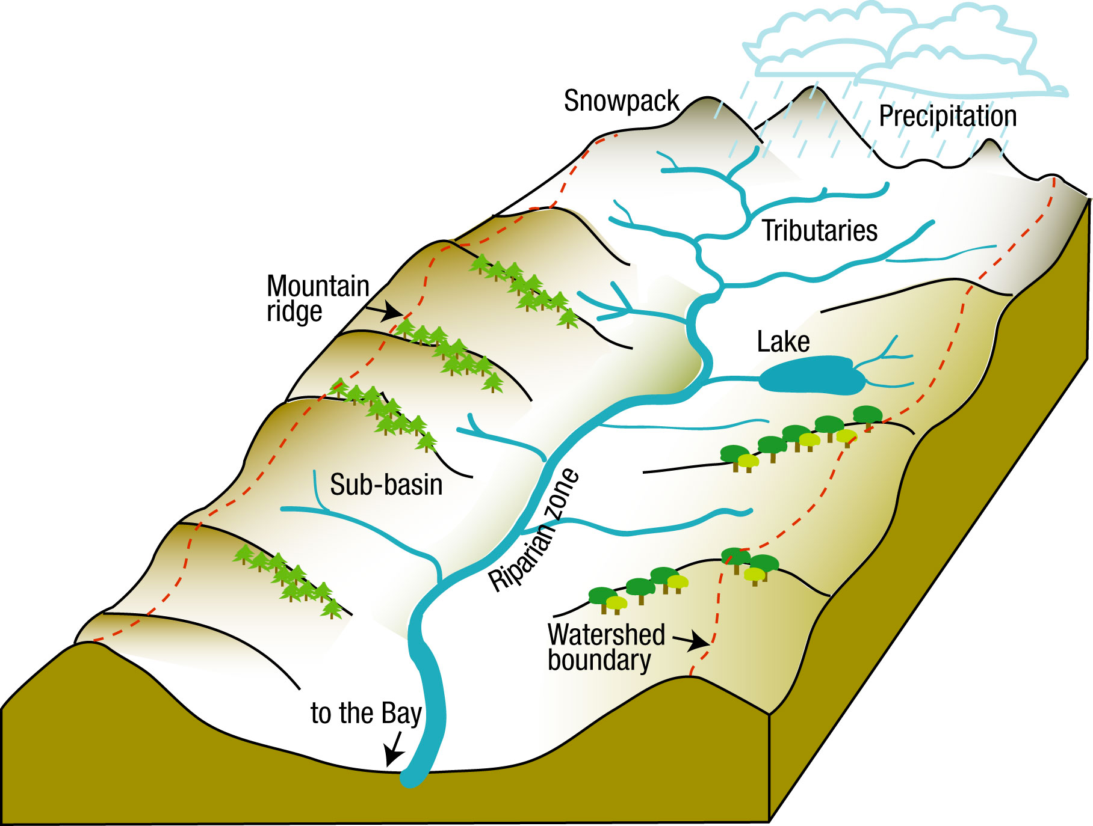
Watershed: the land that water flows across or through on its way to a stream, lake, wetland, or other body of water
Notes:
A watershed is the land that water flows across or through on its way to a stream, lake, wetland, or other body of water.

Slide 8
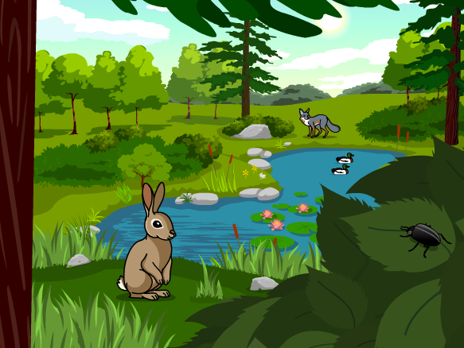
Ecosystem: a community of organisms that interact with each other and their environment
Notes:
An ecosystem is a community of organisms that interact with each other and their environment.

Slide 9
Notes:
Now let’s pause for a moment to check your understanding.

Slide 10
What is a watershed?
Notes:
What is a watershed?
[A watershed is the land that water flows across or through on its way to a stream, lake, wetland, or other body of water.]

Slide 11
What is an ecosystem?
Notes:
What is an ecosystem?
[An ecosystem is a community of living and non-living things interacting with each other in an environment.]

Slide 12
Water Quality
Notes:
Now that we’ve reviewed, let’s define our new term, water quality.
Feedback: Using cues, such as on this slide, helps prepare students for what is coming up next in the lesson. This is important especially for students who may struggle with new vocabulary instruction.

Slide 13
Water Quality: measures the condition of water and its suitability for living organisms
Notes:
Water quality measures the condition of water and its suitability for living organisms.

Slide 14
Notes:
Let’s check-in for understanding.

Slide 15
What is water quality?
Notes:
What is water quality?
[Water quality measures the condition of water and its suitability for living organisms.]

Slide 16
Notes:
That is the basic definition, but there is a bit more you need to know.

Slide 17
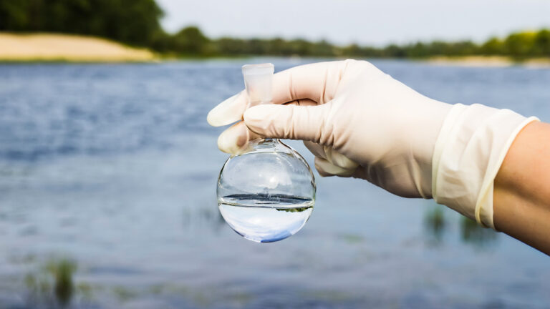
Water Quality Indicators and Testing
Notes:
There are many indicators we can use to tell us about the quality of water. These include: turbidity, ph, dissolved oxygen, temperature, nitrates, and bio-indicators. We will talk about each of these individually and how we can test these.

Slide 18
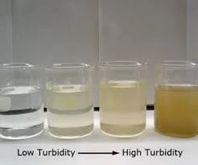
Turbidity: the cloudiness or clarity of water
Notes:
The first water quality indicator we are going to look at is turbidity. Turbidity is the cloudiness or clarity of water.
Feedback: Including visuals is a great way to help students build understanding of new vocabulary.

Slide 19
Notes:
When there are more sediments in the water, the water becomes more cloudy and less clear. The higher the turbidity, the lower the water quality. The lower the turbidity, the higher the water quality. High turbidity can reduce the amount of oxygen in the water for plants and animals. If the sediments are extremely high, it can kill fish directly. Additionally, if the water is too cloudy, animals might not be able to see where they are going.

Slide 20
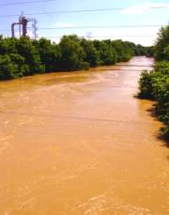
Notes:
The turbidity of water changes throughout the year. It can be increased through heavy rain, snowmelt, or windstorms. Additionally, it can be increased through human activity, polluting the water.

Slide 21
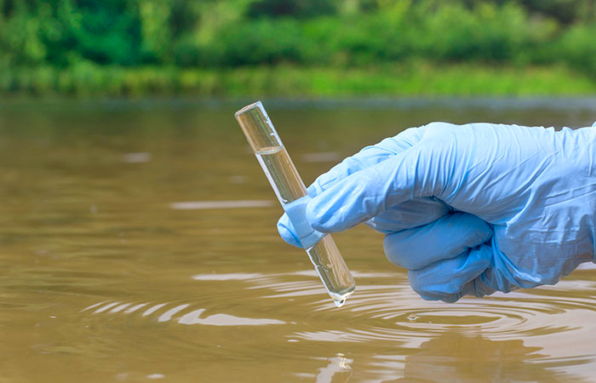
Testing
Notes:
Turbidity can be measured by shining a light through the water you are monitoring and seeing how the quickly the light is scattered by the particles.

Slide 22
Notes:
Let’s check-in for understanding.

Slide 23
What is turbidity?
Notes:
What is turbidity?
[Turbidity is the cloudiness or clarity of water.]

Slide 24
Why does turbidity matter?
Notes:
Why does turbidity matter?
[Increased turbidity can decrease the amount of oxygen in water which negatively impacts the plants and animals in the water. It can also kill fish directly or make it so that animals cannot see anything in the water.]

Slide 25
How can turbidity increase?
Notes:
How can turbidity increase?
[It can be increased through heavy rain, snowmelt, or windstorms. Additionally, it can be increased through human activity, polluting the water.]

Slide 26
How can we test the turbidity of water?
Notes:
How can we test the turbidity of water?
[Turbidity can be measured by shining a light through the water you are monitoring and seeing how the quickly the light is scattered by the particles.]

Slide 27
Notes:
Now, let’s talk about some examples of turbidity.

Slide 28
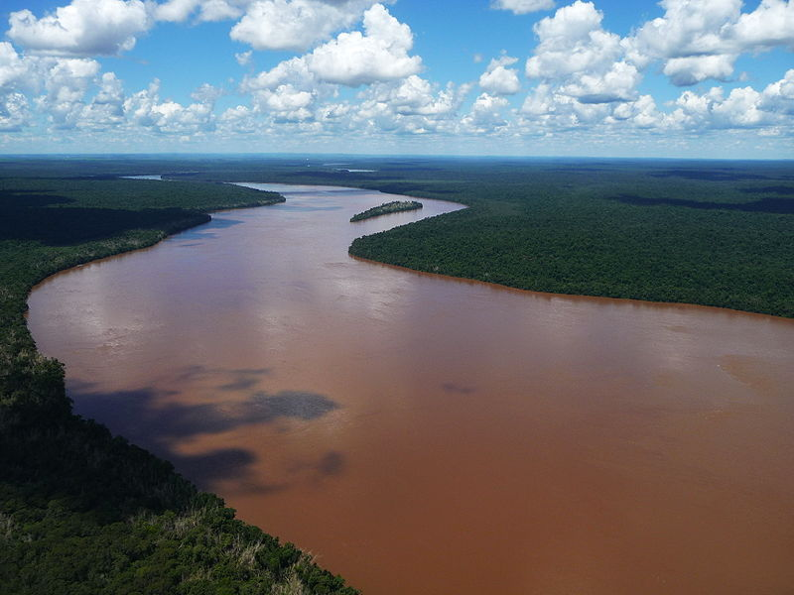
Notes:
This river is an example of water with high turbidity. The water is very cloudy and not clear at all.

Slide 29
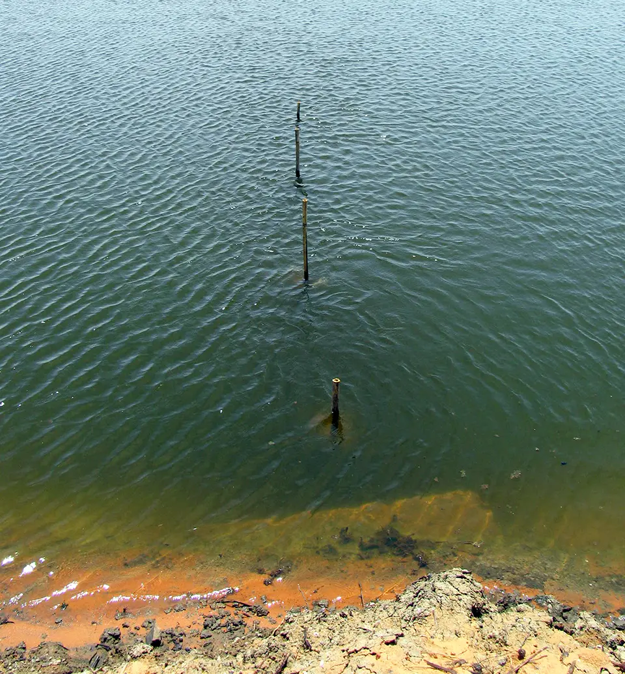
Notes:
This is an example of water with low turbidity. The water is very clear.

Slide 30
Notes:
Let’s check-in for understanding.

Slide 31
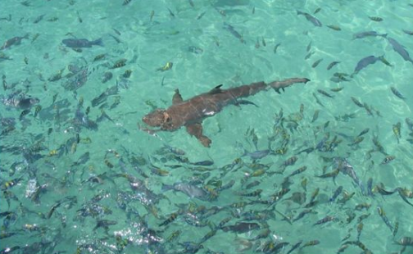
Does this body of water have high or low turbidity? How can you tell?
Notes:
Does this body of water have high or low turbidity? How can you tell?

Slide 32
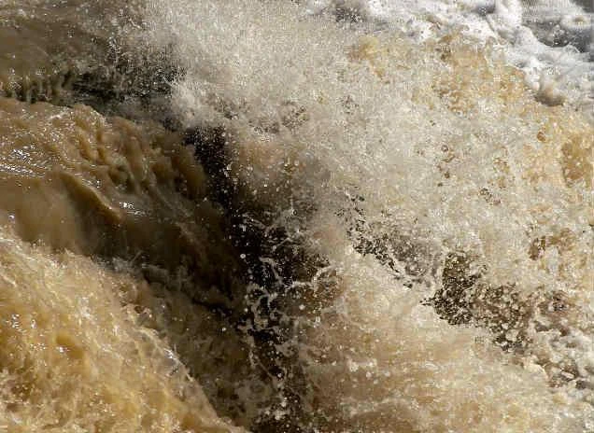
Does this body of water have high or low turbidity? How can you tell?
Notes:
Does this body of water have high or low turbidity? How can you tell?

Slide 33
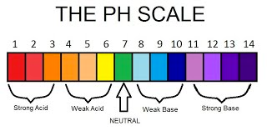
pH: the measure of how acidic or basic the water is; measured on a scale of 0 to 14
Notes:
The next water quality indicator we are going to look at is pH. pH is the measure of how acidic or basic the water is. It is measured on a scale of 0 to 14.

Slide 34
Notes:
Healthy pH levels for water are in the neutral area. If the pH of water is too acidic or too basic, it can have a very negative effect on the organisms living in the water. It can stress the animals and increase mortality rates. When pH levels are extreme, they can make it easier for organisms to absorb chemical toxins. Humans can also be irritated by drinking water with extreme pH levels.
Feedback: After providing a definition and explanation in clear, concise language, you may consider asking students for examples of liquids that would fall at different points on the PH scale. This can elicit prior knowledge, help build connections, and engage students. Be ready with some examples of your own too!

Slide 35
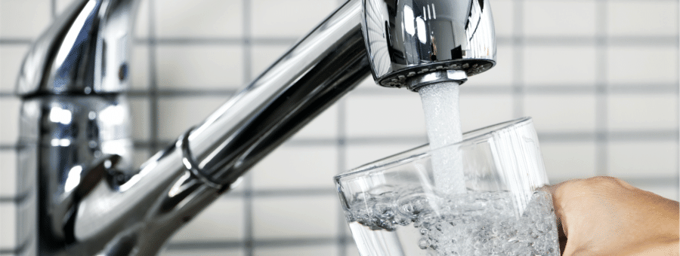
Notes:
The acidity of water can be impacted by many things. The most common natural cause is when rocks interact with other materials in the water. Precipitation and wastewater discharges can impact pH levels. These levels can also be impacted by carbon dioxide. Pollution caused by humans can also impact pH levels.

Slide 36
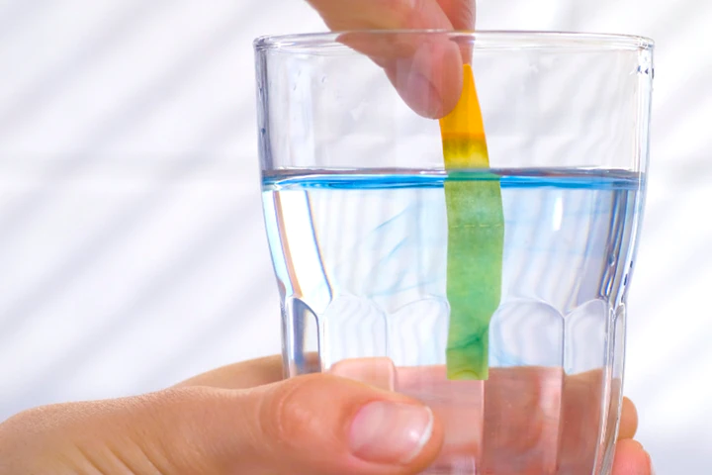
Testing
Notes:
One way to test pH levels is by using a pH meter. The meter is placed in a sample of water and it gives you the pH of the water.
Another way to test pH levels is by using litmus papers. The strip is placed in sample of water and then compare it to the color chart that came with the paper to get the pH of the water.

Slide 37
Notes:
Let’s check-in for understanding.

Slide 38
What is pH?
Notes:
What is pH?
[pH is the measure of how acidic or basic the water is. It is measured on a scale of 0 to 14.]

Slide 39
Why does pH matter?
Notes:
Why does pH matter?
[Healthy pH levels for water are in the neutral area. If the pH of water is too acidic or too basic, it can have a very negative effect on the organisms living in the water. It can stress the animals and increase mortality rates. When pH levels are extreme, they can make it easier for organisms to absorb chemical toxins. Humans can also be irritated by drinking water with extreme pH levels.]

Slide 40
How do pH levels change?
Notes:
How do pH levels change?
[The acidity of water can be impacted by many things. The most common natural cause is when rocks interact with other materials in the water. Precipitation and wastewater discharges can impact pH levels. These levels can also be impacted by carbon dioxide. Pollution caused by humans can also impact pH levels.]

Slide 41
How can we test the pH levels of water?
Notes:
How can we test the pH levels of water?
[One way to test pH levels is by using a pH meter. The meter is placed in a sample of water and it gives you the pH of the water.
Another way to test pH levels is by using litmus papers. The strip is placed in sample of water and then compare it to the color chart that came with the paper to get the pH of the water.]

Slide 42
Notes:
Now, let’s talk about some examples of pH levels.

Slide 43
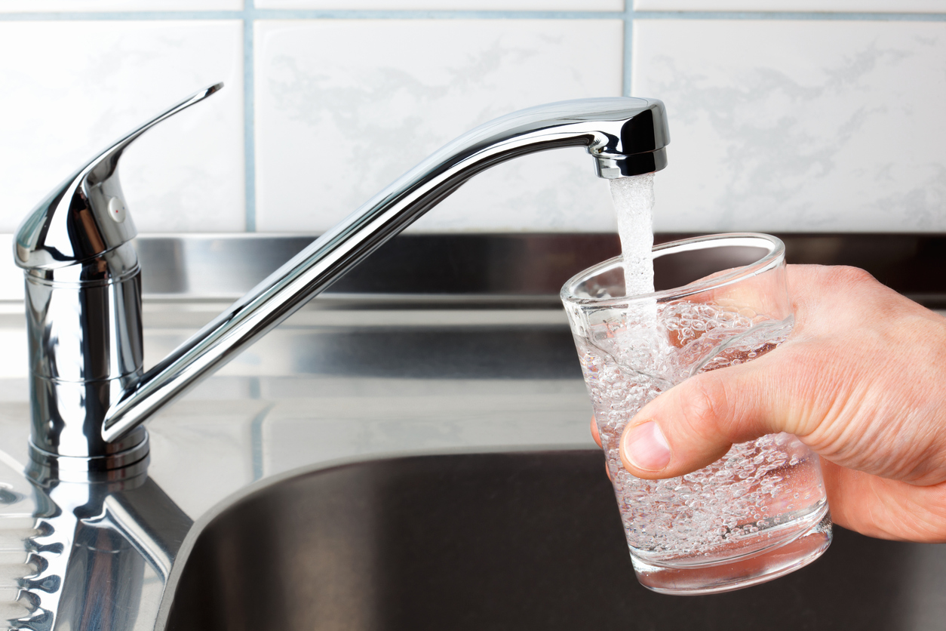
Notes:
The pH level of tap water varies but is typically about 7.5.

Slide 44
Notes:
The pH level of freshwater lakes, ponds, and streams is typically between 6-8.

Slide 45
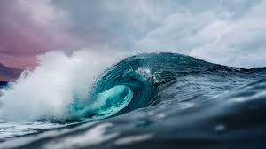
Notes:
The pH level of the surface of saltwater is typically about 8.1.

Slide 46
Notes:
Let’s check-in for understanding.

Slide 47
True/False: The pH levels of all water is the same.
Notes:
True/False: The pH levels of all water is the same.

Slide 48
True/False: The pH levels of all water is the same.
Notes:
True/False: The pH levels of all water is the same.
[False – the pH levels of water vary.]

Slide 49
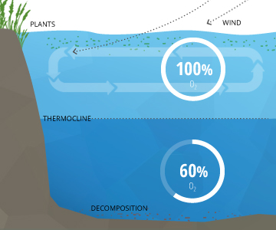
Dissolved Oxygen: the amount of oxygen present in water
Notes:
The next water quality indicator we are going to look at is dissolved oxygen. Dissolved oxygen is the amount of oxygen that is present in water.

Slide 50
Notes:
Oxygen is necessary for all life in water. Low oxygen levels create an unhealthy water habitats and high oxygen levels create a healthy water habitat.

Slide 51
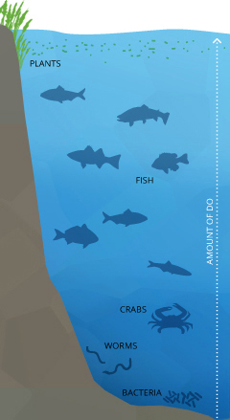
Notes:
Oxygen levels are impacted by temperature, salt levels, and temperature.
Colder water contains more dissolved oxygen than warmer water.
Dissolved oxygen levels decrease exponentially as salt levels increase. Therefore, freshwater contains more dissolved oxygen than saltwater.
Dissolved oxygen levels increase as pressure increases. Therefore, deeper water contains more dissolved oxygen than more shallow water.

Slide 52
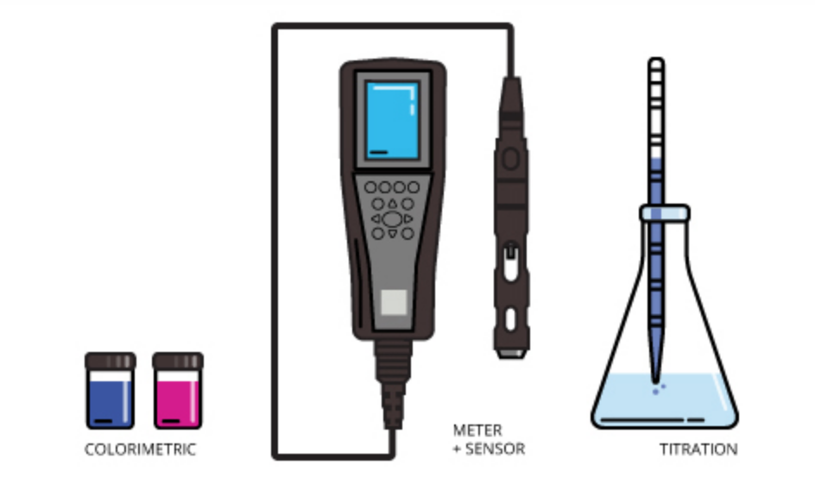
Testing
Notes:
There are three main methods for testing dissolved oxygen levels.
The first is by the colorimetric method. It compares the color of the water to a metric to understand the oxygen levels. This can be inaccurate as it is more subjective.
The second is through a sensor and is the most popular method.
The third is through the titration method. This method adds reagents to change the color of the water to measure the amount of oxygen. When done correctly, this can be the most accurate method.

Slide 53
Notes:
Let’s check-in for understanding.

Slide 54
What is dissolved oxygen?
Notes:
What is dissolved oxygen?
[Dissolved oxygen is the amount of oxygen that is present in water.]

Slide 55
Why does dissolved oxygen matter?
Notes:
Why does dissolved oxygen matter?
[Oxygen is necessary for all life in water. Low oxygen levels create an unhealthy water habitats and high oxygen levels create a healthy water habitat.]

Slide 56
When do dissolved oxygen levels change?
Notes:
When do dissolved oxygen levels change?
[Oxygen levels are impacted by temperature, salt levels, and temperature.
Colder water contains more dissolved oxygen than warmer water.
Dissolved oxygen levels decrease exponentially as salt levels increase. Therefore, freshwater contains more dissolved oxygen than saltwater.
Dissolved oxygen levels increase as pressure increases. Therefore, deeper water contains more dissolved oxygen than more shallow water.]

Slide 57
How can we test the dissolved oxygen levels of water?
Notes:
How can we test the dissolved oxygen levels of water?
[There are three main methods for testing dissolved oxygen levels.
The first is by the colorimetric method. It compares the color of the water to a metric to understand the oxygen levels. This can be inaccurate as it is more subjective.
The second is through a sensor and is the most popular method.
The third is through the titration method. This method adds reagents to change the color of the water to measure the amount of oxygen. When done correctly, this can be the most accurate method.]

Slide 58
Notes:
Now, let’s talk about some examples of dissolved oxygen levels.

Slide 59
Notes:
In this example of a deep lake, the levels dissolved oxygen are high. This is because fresh water, higher water pressure, and colder water (which water is colder as it gets deeper) contains higher levels of dissolved oxygen.

Slide 60
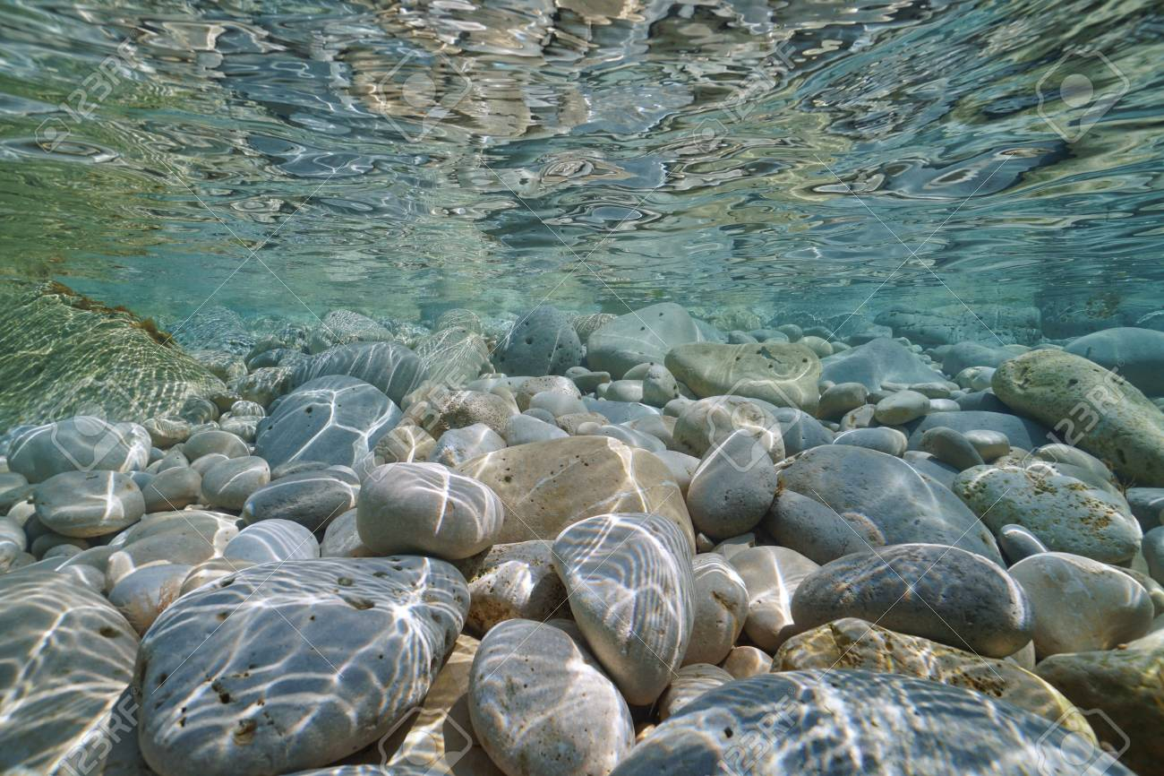
Notes:
In this example of the surface of saltwater, the levels dissolved oxygen are low. This is because saltwater, lower water pressure, and warmer water (closer to the surface and warmed by the sun) contains lower levels of dissolved oxygen.

Slide 61
Notes:
Let’s check-in for understanding.

Slide 62
What is the difference in dissolved oxygen levels between saltwater and freshwater?
Notes:
What is the difference in dissolved oxygen levels between saltwater and freshwater?

Slide 63
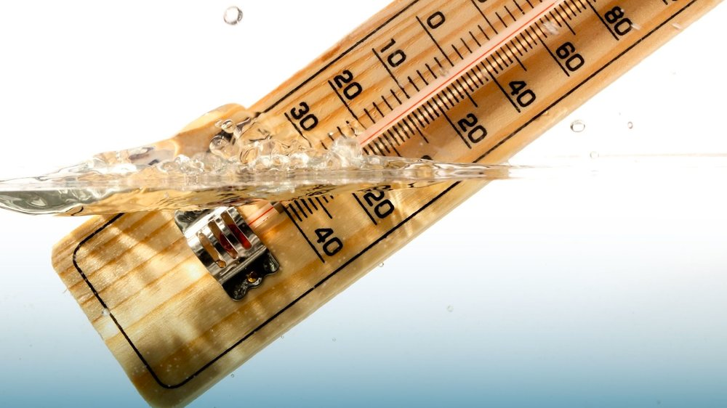
Temperature: how hot or cold something is
Notes:
The next water quality indicator we are going to look at is temperature. Temperature is how hot or cold something is.

Slide 64
Notes:
Water temperature is important because it impacts how much dissolved oxygen is in the water. Warm water has less dissolved oxygen than cold water. Some organisms need more oxygen than others so the temperature could impact their availability to survive in the water. It can impact almost every other indicator of water quality.

Slide 65
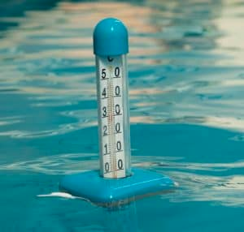
Notes:
Water temperature can be impacted by many things including: sunlight, heat transfer from the atmosphere, turbidity, and stream confluence.
Since sunlight is a form of thermal energy, it transfers energy in the form of heat to the water. This increases the temperature of the water.
Atmospheric transfer occurs when there is a difference in temperature between the atmosphere and the water. When the atmosphere is cooler, warm water will transfer energy to the air and cool off, and vice versa.
When there is high turbidity, the particles in the air absorb more sunlight/heat and warm up the water.
Confluence is when water from a stream changes the temperature of the body of water into which it is flowing (if it is cooler or warmer).

Slide 66
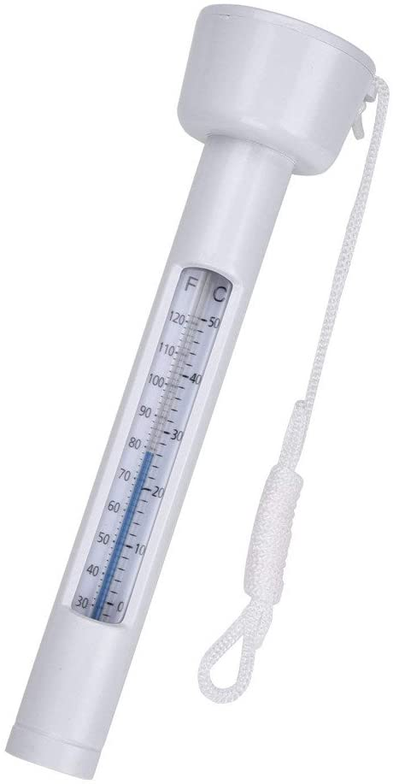
Testing
Notes:
We can measure the temperature of water by using a thermometer.

Slide 67
Notes:
Let’s check-in for understanding.

Slide 68
What is temperature?
Notes:
What is temperature?
[Temperature is how hot or cold something is.]

Slide 69
Why does temperature matter?
Notes:
Why does temperature matter?
[Water temperature is important because it impacts how much dissolved oxygen is in the water. Warm water has less dissolved oxygen than cold water. Some organisms need more oxygen than others so the temperature could impact their availability to survive in the water. It can impact almost every other indicator of water quality.]

Slide 70
How does water temperature change?
Notes:
How does water temperature change?
[Water temperature can be impacted by many things including: sunlight, heat transfer from the atmosphere, turbidity, and stream confluence.
Since sunlight is a form of thermal energy, it transfers energy in the form of heat to the water. This increases the temperature of the water.
Atmospheric transfer occurs when there is a difference in temperature between the atmosphere and the water. When the atmosphere is cooler, warm water will transfer energy to the air and cool off, and vice versa.
When there is high turbidity, the particles in the air absorb more sunlight/heat and warm up the water.
Confluence is when water from a stream changes the temperature of the body of water into which it is flowing (if it is cooler or warmer).]

Slide 71
How can we test the temperature of water?
Notes:
How can we test the temperature of water?
[Thermometer]

Slide 72
Notes:
Now, let’s talk about some examples of water temperature.

Slide 73
Notes:
The ocean in Florida is very warm water.

Slide 74
Notes:
In contrast, the ocean up by Maine is much colder.

Slide 75
Notes:
Now, let’s talk about a non-example of water temperature.
Feedback: It is important to provide non-examples for students, especially by clearly stating similarities and differences between examples and non-examples.

Slide 76
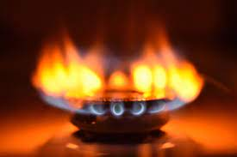
Notes:
A flame is an example of heat not temperature. However, you can measure the temperature of the flames.

Slide 77
Notes:
Let’s check-in for understanding.

Slide 78
How does water temperature change?
Notes:
How does water temperature change?
[Water temperature can be impacted by many things including: sunlight, heat transfer from the atmosphere, turbidity, and stream confluence.
Since sunlight is a form of thermal energy, it transfers energy in the form of heat to the water. This increases the temperature of the water.
Atmospheric transfer occurs when there is a difference in temperature between the atmosphere and the water. When the atmosphere is cooler, warm water will transfer energy to the air and cool off, and vice versa.
When there is high turbidity, the particles in the air absorb more sunlight/heat and warm up the water.
Confluence is when water from a stream changes the temperature of the body of water into which it is flowing (if it is cooler or warmer).]
Feedback: If you have additional time in your lesson, it might be helpful here to include a graphic of these changes in which students can fill in important information. This slide could also be broken into several slides to be more manageable for both the teacher and the students.

Slide 79
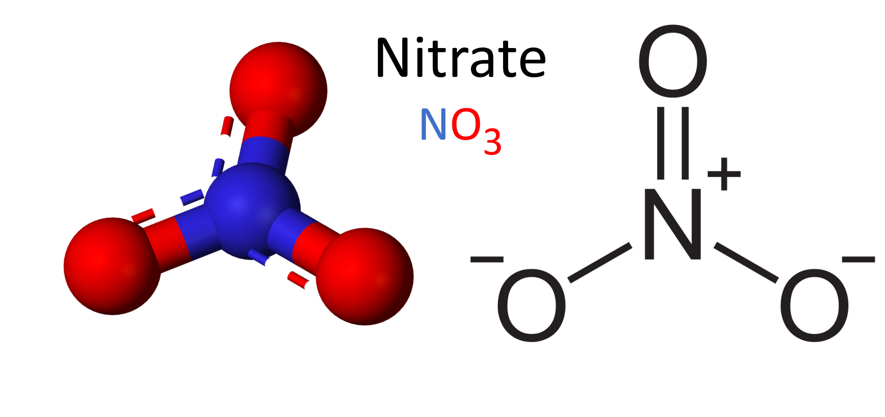
Nitrates: compounds made up of nitrogen and oxygen
Notes:
The next water quality indicator we are going to look at is nitrates. Nitrates are compounds made up of nitrogen and oxygen.

Slide 80
Notes:
Nitrates are a source of nutrients for plants and can be used as a fertilizer. This can be positive for plant growth and indicate good water quality. However, too much nitrate in water can be a problem for drinking water.

Slide 81
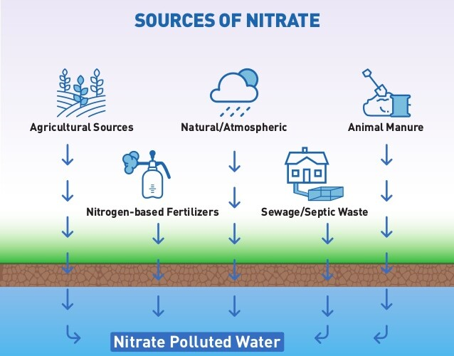
Notes:
There are many sources of nitrate. Most of these are due to human activity. These include:
Agricultural sources
Nitrogen-based fertilizers
Natural atmospheric (rain)
Sewage/septic waste
Animal manure

Slide 82
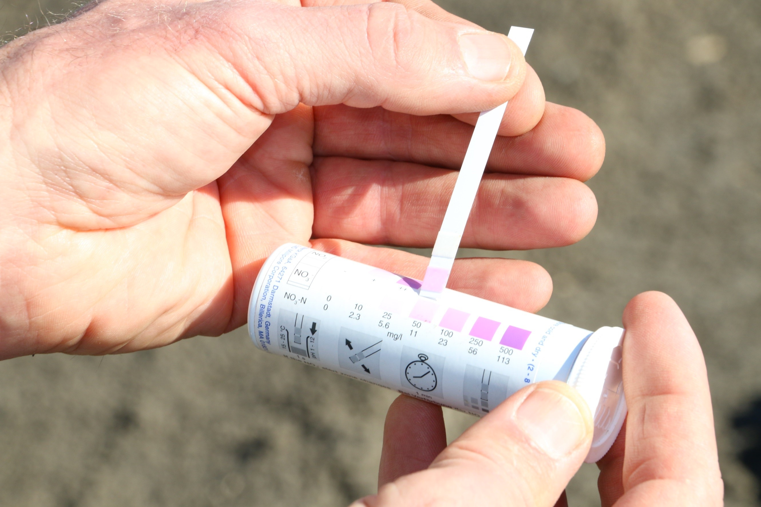
Testing
Notes:
To test for nitrates levels in water, we can use nitrate strips. After dipping the strip in the sample water, compare the color to see what the levels are.

Slide 83
Notes:
Let’s check-in for understanding.

Slide 84
What are nitrates?
Notes:
What are nitrates?
[Nitrates are compounds made up of nitrogen and oxygen.]

Slide 85
Why do nitrates matter?
Notes:
Why do nitrates matter?
[Nitrates are a source of nutrients for plants and can be used as a fertilizer. This can be positive for plant growth and indicate good water quality. However, too much nitrate in water can be a problem for drinking water.]

Slide 86
How do nitrate levels change?
Notes:
How do nitrate levels change?
[There are many sources of nitrate. Most of these are due to human activity. These include:
Agricultural sources
Nitrogen-based fertilizers
Natural atmospheric (rain)
Sewage/septic waste
Animal manure]

Slide 87
How can we test the nitrate levels in water?
Notes:
How can we test the nitrate levels in water?
[To test for nitrates levels in water, we can use nitrate strips. After dipping the strip in the sample water, compare the color to see what the levels are.]
Feedback: This is a great opportunity to bring in the demonstration from slide 117 to engage students and make the science concepts more visible for them!

Slide 88
Notes:
Let’s look at some examples of nitrates.

Slide 89
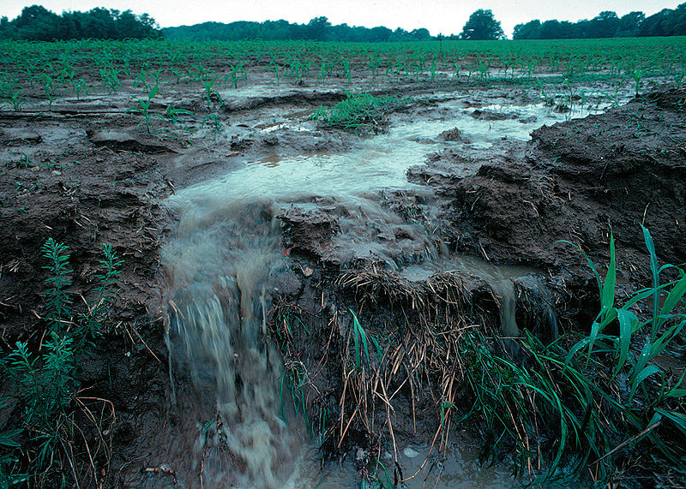
Notes:
Fertilizers and animal waste contain a lot of nitrates which runoff from the farm to the water.

Slide 90
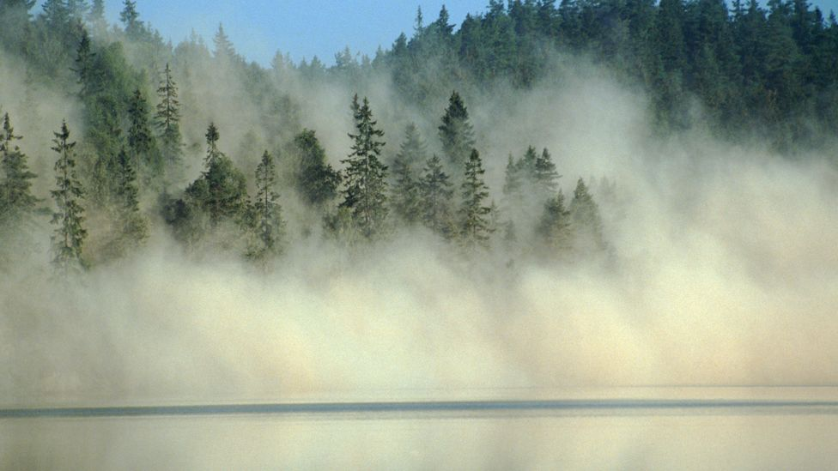
Notes:
Acid rain causes nitrates to build up in waterways.

Slide 91
Notes:
Let’s check-in for understanding.

Slide 92
What are some examples of how nitrate levels increase?
Notes:
What are some examples of nitrate levels increase?

Slide 93
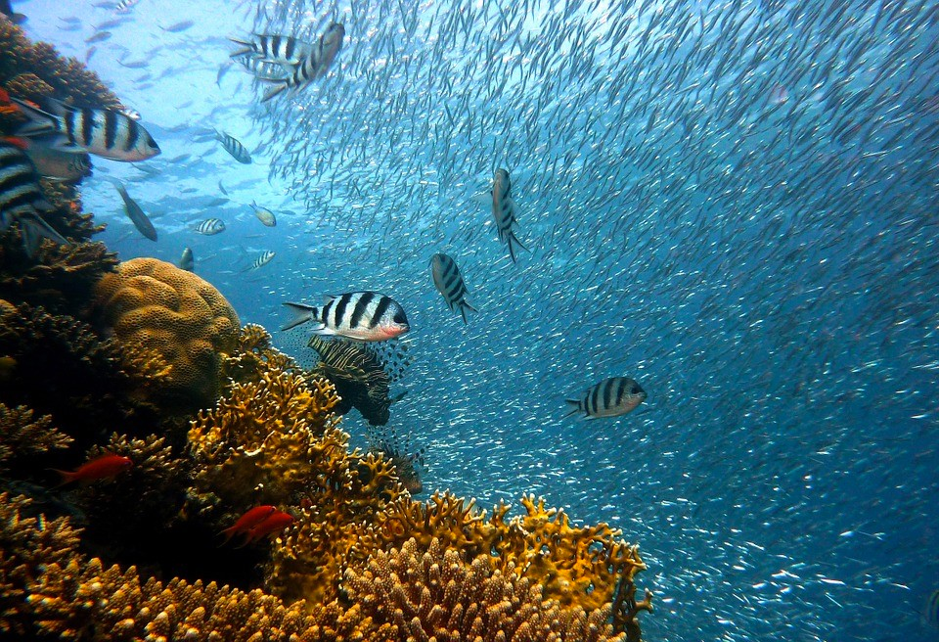
Bio-indicators: refer to the living organisms found in a body of water
Notes:
The final water quality indicator we are going to look at are bio-indicators. Bio-indicators refer to the living organisms found in a body of water.

Slide 94
Notes:
When bio-indicator levels are high, it usually means that the water quality is good. It means that many organisms can survive in the water and that the water is healthy. When bio-indicator levels are low, it usually means that the water quality is poor.

Slide 95
Notes:
The other indicators that we have already discussed can impact the level of bio-indicators because they impacts the living conditions of the organisms.

Slide 96
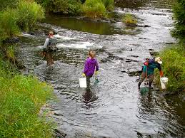
Notes:
Biomonitoring can help us understand the levels of bio-indicators in a body of water.

Slide 97
Notes:
Let’s check-in for understanding.

Slide 98
What are bio-indicators?
Notes:
What are bio-indicators?
[Bio-indicators refer to the living organisms found in a body of water.]

Slide 99
What do bio-indicators tell us about the quality of water?
Notes:
What do bio-indictors tell us about the quality of water?
[When bio-indicator levels are high, it usually means that the water quality is good. It means that many organisms can survive in the water and that the water is healthy. When bio-indicator levels are low, it usually means that the water quality is poor.]

Slide 100
How do the other water quality indicators impact bio-indicators?
Notes:
How do the other water quality indicators impact bio-indicators?
[The other indicators that we have already discussed can impact the level of bio-indicators because they impacts the living conditions of the organisms.]

Slide 101
Notes:
Let’s check-in for understanding.

Slide 102
What is water quality?
Notes:
What is water quality?
[Water quality measures the condition of water and its suitability for living organisms.]

Slide 103
What is an example of a water quality indicator and how we can test it?
Notes:
What is an example of a water quality indicator and how we can test it?

Slide 104
How are bio-indicators are related to the other water quality indicators?
Notes:
How are bio-indicators related to the other water quality indicators?

Slide 105
Why is water quality important?
Notes:
Why is water quality important?

Slide 106
Remember!!!
Notes:
So remember!

Slide 107
Water Quality: measures the condition of water and its suitability for living organisms
Notes:
Water quality measures the condition of water and its suitability for living organisms.

Slide 108
Turbidity: the cloudiness or clarity of water
Notes:
The first water quality indicator we are going to look at is turbidity. Turbidity is the cloudiness or clarity of water.

Slide 109
pH: the measure of how acidic or basic the water is; measured on a scale of 0 to 14
Notes:
The next water quality indicator we are going to look at is pH. pH is the measure of how acidic or basic the water is. It is measured on a scale of 0 to 14.

Slide 110
Dissolved Oxygen: the amount of oxygen present in water
Notes:
The next water quality indicator we are going to look at is dissolved oxygen. Dissolved oxygen is the amount of oxygen that is present in water.

Slide 111
Temperature: how hot or cold something is
Notes:
The next water quality indicator we are going to look at is temperature. Temperature is how hot or cold something is.

Slide 112
Nitrates: compounds made up of nitrogen and oxygen
Notes:
The next water quality indicator we are going to look at is nitrates. Nitrates are compounds made up of nitrogen and oxygen.

Slide 113
Bio-indicators: refer to the living organisms found in a body of water
Notes:
The final water quality indicator we are going to look at are bio-indicators. Bio-indicators refer to the living organisms found in a body of water.

Slide 114
Big Question: How do factors interact and impact water quality?
Notes:
Explicit cue to revisit the big question at the end of the lesson: Okay everyone. Now that we’ve learned the term, let’s reflect once more on our big question. Was there anything that we predicted earlier that was correct or incorrect? Do you have any new hypotheses to share?

Slide 115
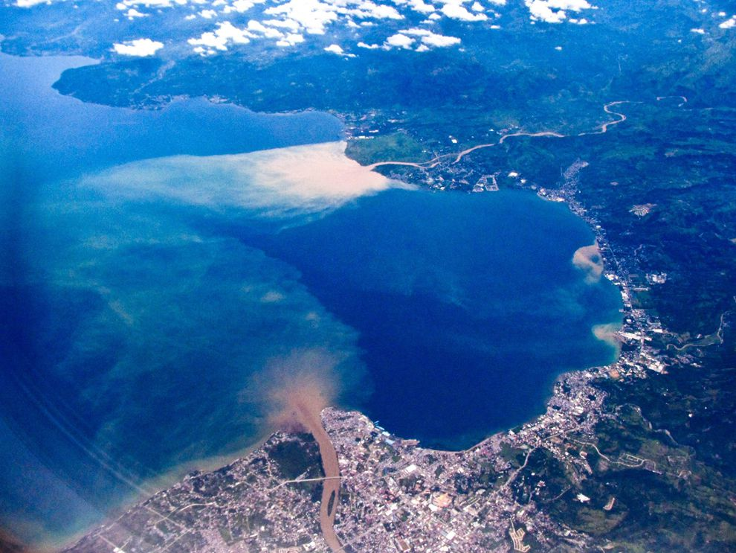
Simulation Activity
Water Quality Degradation in the Ocean
Click the link above to investigate causes of water quality degradation and analyze the relationship between harmful algal blooms, toxic algae, and dead zones.
Notes:
Feedback: Providing a simulation activity is a great way to make science thinking visible. In this simulation, students have the opportunity to make connections between causes and water quality degradation effects (i.e., harmful algal blooms, toxic algae, and dead zones).

Slide 116
Simulation Activity
Determining Water Quality
Click the link above to make observations and measurements of different water samples.
Adjust water samples based on important waterways near where you live.
Notes:
Feedback: Providing a simulation activity is a great way to make science thinking visible. In this simulation, students have the opportunity to make predictions and apply an idea to a new situation by changing the variables in the simulation (i.e., different waterways).

Slide 117
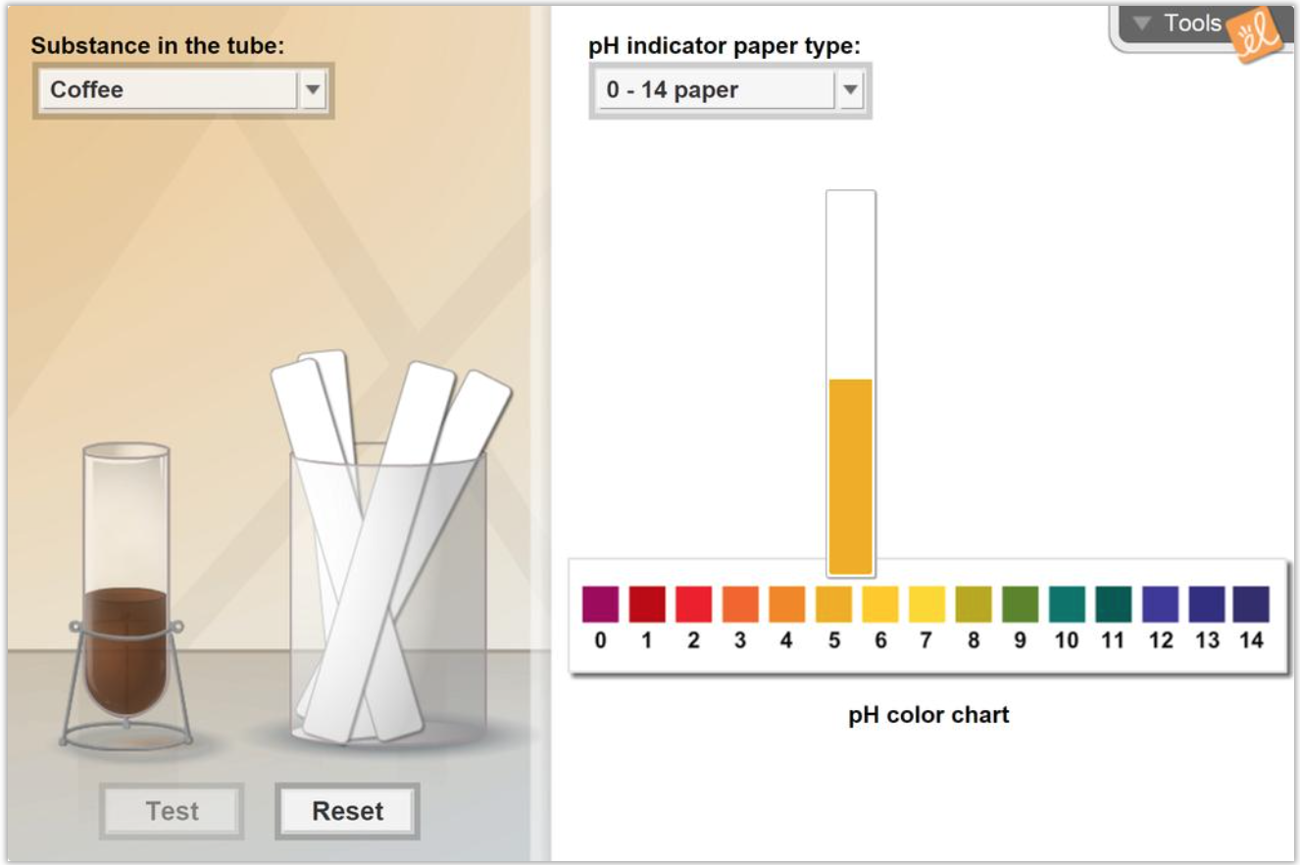
Simulation Activity
pH Analysis
Click the link above to test the acidity of common substances using pH paper.
Notes:
Feedback: This demonstration offers opportunities for students to more closely engage in carrying out investigations without needing all of the supplies of a hands-on experiment. Students could engage in this simulation on the slide that discusses pH analysis.

Slide 118
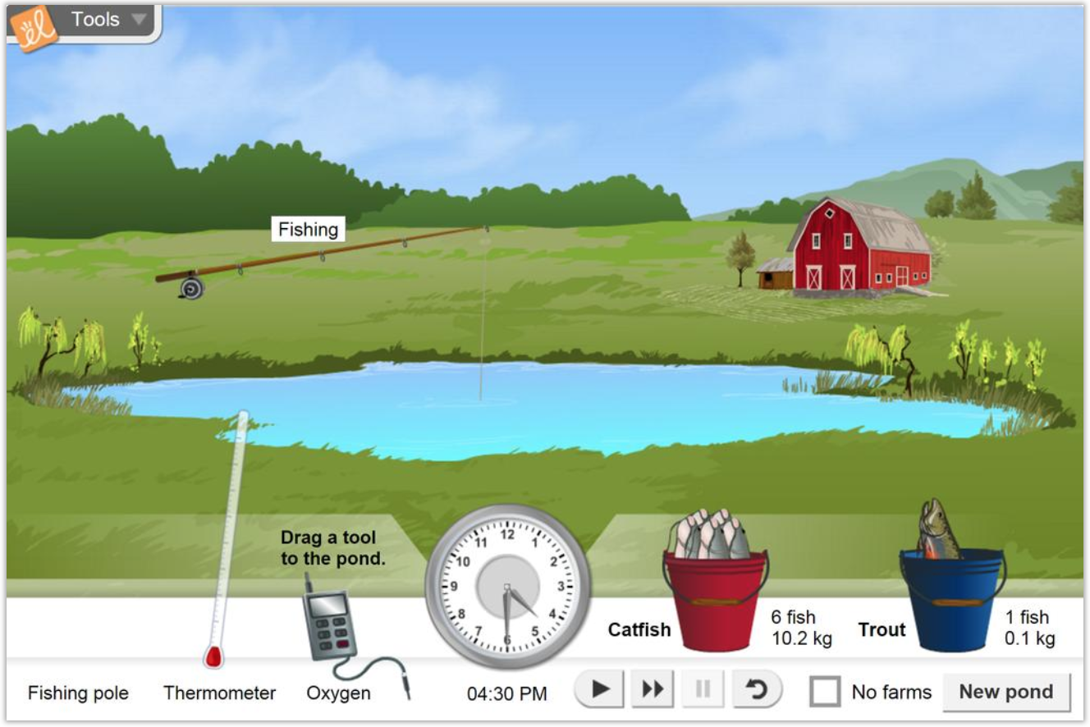
Simulation Activity
Pond Ecosystem
Click the link above to measure the temperature and oxygen content of a pond over the course of a day.
Notes:
Feedback: Providing a simulation activity is a great way to make science thinking visible. In this simulation, students have the opportunity to make predictions regarding temperature and oxygen content of a pond over the course of a day.

Slide 119
Notes:
Thanks for watching, and please continue watching CAPs available from this website.

Slide 120
This Video Was Created With Resources From:
Questions or Comments
Michael Kennedy, Ph.D. MKennedy@Virginia.edu
Rachel L Kunemund, Ph.D. rk8vm@virginia.edu

