Slide 1
“Big Idea” Question
Teacher Demo
Review Concepts
Check-In Questions
Vocabulary
Student-Friendly Definition
Examples & Non-Examples
Morphological Word Parts
Simulation/Activity
Notes:
OK everyone, get ready for our next lesson. Just as a reminder, these are the different components that our lesson may include, and you’ll see these icons in the top left corner of each slide so that you can follow along more easily!

Slide 2
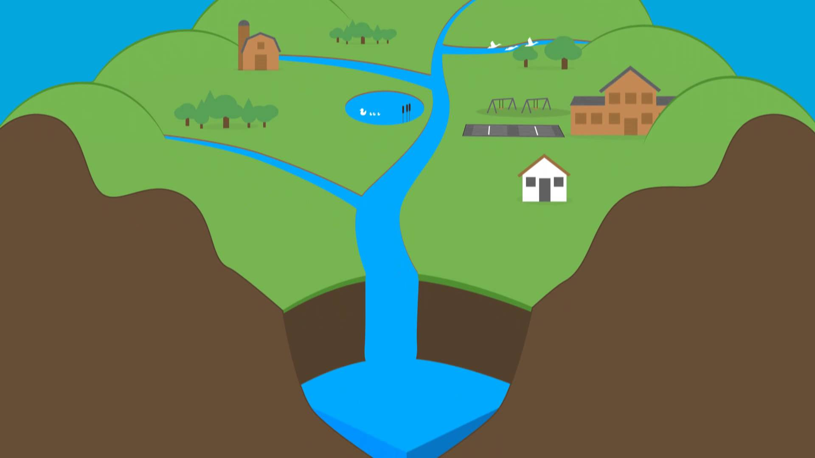
Intro
Watersheds
Notes:
Today we will learn the definition of watersheds.

Slide 3
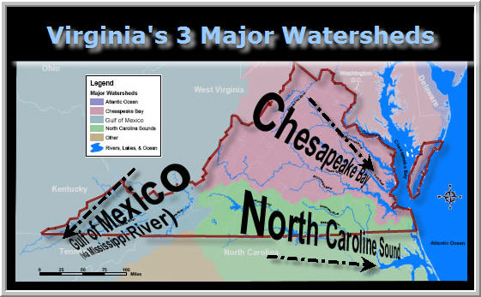
Big Question: What are watersheds and Why are Virginia’s watersheds important? Do you live in a watershed?
Notes:
Our “big question” is: What are watersheds and Why are Virginia’s watersheds important? Do you live in a watershed?
[Pause and illicit predictions from students.]
I love all these thoughtful scientific hypotheses! Be sure to keep this question and your predictions in mind as we move through these next few lessons, and we’ll continue to revisit it.
Feedback: Asking students to make predictions about the three major watersheds in Virginia helps students to place their ideas in a geographic context and is a great way to activate and elicit student ideas and prior knowledge. This type of activity is evidence of the teacher planning for students’ engagement with science ideas.

Slide 4
Demonstration
What is a Watershed?
TEACHER DIRECTIONS:
Before: Click on the video link above to show a video introducing watersheds. Before showing the video, ask students what they already know about watersheds.
During: While playing the video for your students, be sure to pause to check for understanding (What is a watershed?, What can be part of a watershed?, etc.)
After: Tell students that they will be learning more about Virginia watersheds and why they are important in this lesson.
Notes:
Let’s do a quick demonstration that will help get our brains ready to think about watersheds, and how they relate to our big question.
Feedback: This demonstration offers a clear and logical order of steps that help students make sense of the activity and stay engaged. Be sure to keep the students engaged throughout the demonstration, high levels of engagement are important for student understanding and participation.

Slide 5
Notes:
Now let’s pause for a moment to check your understanding.

Slide 6
What is a watershed?
Notes:
What is a watershed?
[A watershed is all of the land that drains into the same body of water.]
Feedback: Remember to use open-ended questions when discussing a term. This helps you check for understanding and gives students an opportunity to discuss the term and meaning in their own words.

Slide 7
True/False: Only bodies of water can be a part of a watershed.
Notes:
True or False: Only bodies of water can be a part of a watershed.
False: Any land, including parks, farms, forests, and schools are all part of the watershed. Even soil is part of a watershed.

Slide 8
True/False: Only bodies of water can be a part of a watershed.
Notes:
True/False: Only bodies of water can be a part of a watershed.
[False - Any land, including parks, farms, forests, and schools are all part of the watershed. Even soil is part of a watershed.]

Slide 9
True/False: Everyone in the world lives in a watershed.
Notes:
True/False: Everyone in the world lives in a watershed.
True.

Slide 10
True/False: Everyone in the world lives in a watershed.
Notes:
True/False: Everyone in the world lives in a watershed.
[True]

Slide 11
Notes:
Before we move on to our new vocabulary term, let’s review some other words & concepts that you already learned and make sure you are firm in your understanding.
Feedback: Providing cues for upcoming instruction is important to help students be prepared and ready to learn!

Slide 12
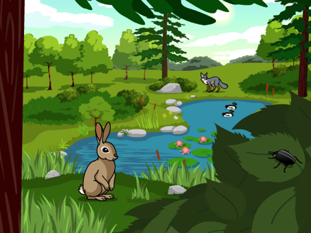
Ecosystem: a community of organisms that interact with each other and their environment
Notes:
An ecosystem is a community of organisms that interact with each other and their environment. Organisms can respond to change in the environment.

Slide 13
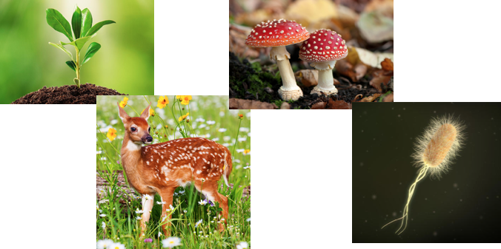
Biotic factors are the…
Ecosystem: a community of organisms that interact with each other and their environment
Notes:
These biotic factors are the organisms that interact with each other in an ecosystem…

Slide 14
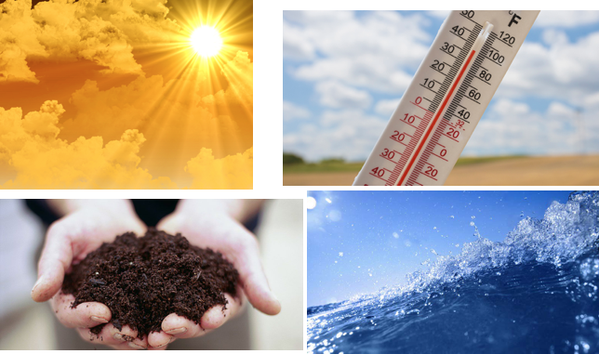
Abiotic factors are the…
Ecosystem: a community of organisms that interact with each other and their environment
Notes:
… While abiotic factors are the non-living things in an ecosystem’s environment that organisms interact with.

Slide 15
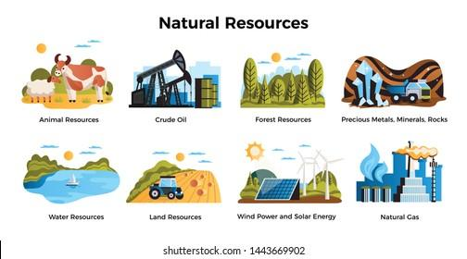
Natural Resource: something found in nature that can be used by people
Notes:
A natural resource is something found in nature that can be used by people.

Slide 16
Notes:
Now let’s pause for a moment to check your understanding.

Slide 17
What are ecosystems? Describe your own ecosystem.
Notes:
What are ecosystems? Describe your own ecosystem.
[An ecosystem is a community of organisms that interact with each other and their environment. Organisms can respond to change in the environment.]

Slide 18
Give an example of a natural resource that you use.
Notes:
Give an example of a natural resource that you use.
Feedback: The use of images in this slide when providing examples will help students to better grasp the content.

Slide 19
Watershed
Notes:
Now that we’ve reviewed, let’s define our new term, watershed.

Slide 20
Watershed: area of land that drains into the same body of water
Notes:
A watershed is an area of land that drains into the same body of water.
Feedback: Longer, more formal definitions are tricky. This definition uses clear language.

Slide 21
Notes:
Let’s check-in for understanding.

Slide 22
What is a watershed?
Notes:
What is a watershed?
[A watershed is an area of land that drains into the same body of water.]

Slide 23
Notes:
That is the basic definition, but there is a bit more you need to know.

Slide 24
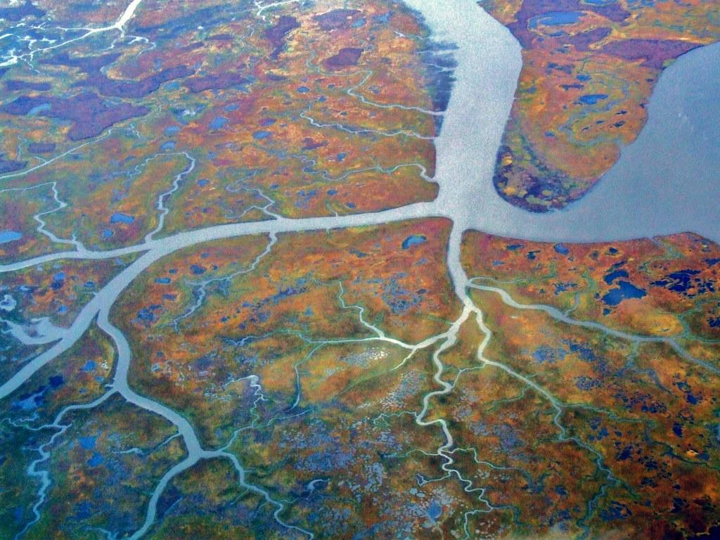
Watersheds are made up of tributaries.
Notes:
Watersheds are made up of tributaries. A tributary is a river or stream that runs into a larger river or lake. Tributaries DO NOT run directly into the ocean. Here we can see many different tributaries that run into a larger river or stream.

Slide 25
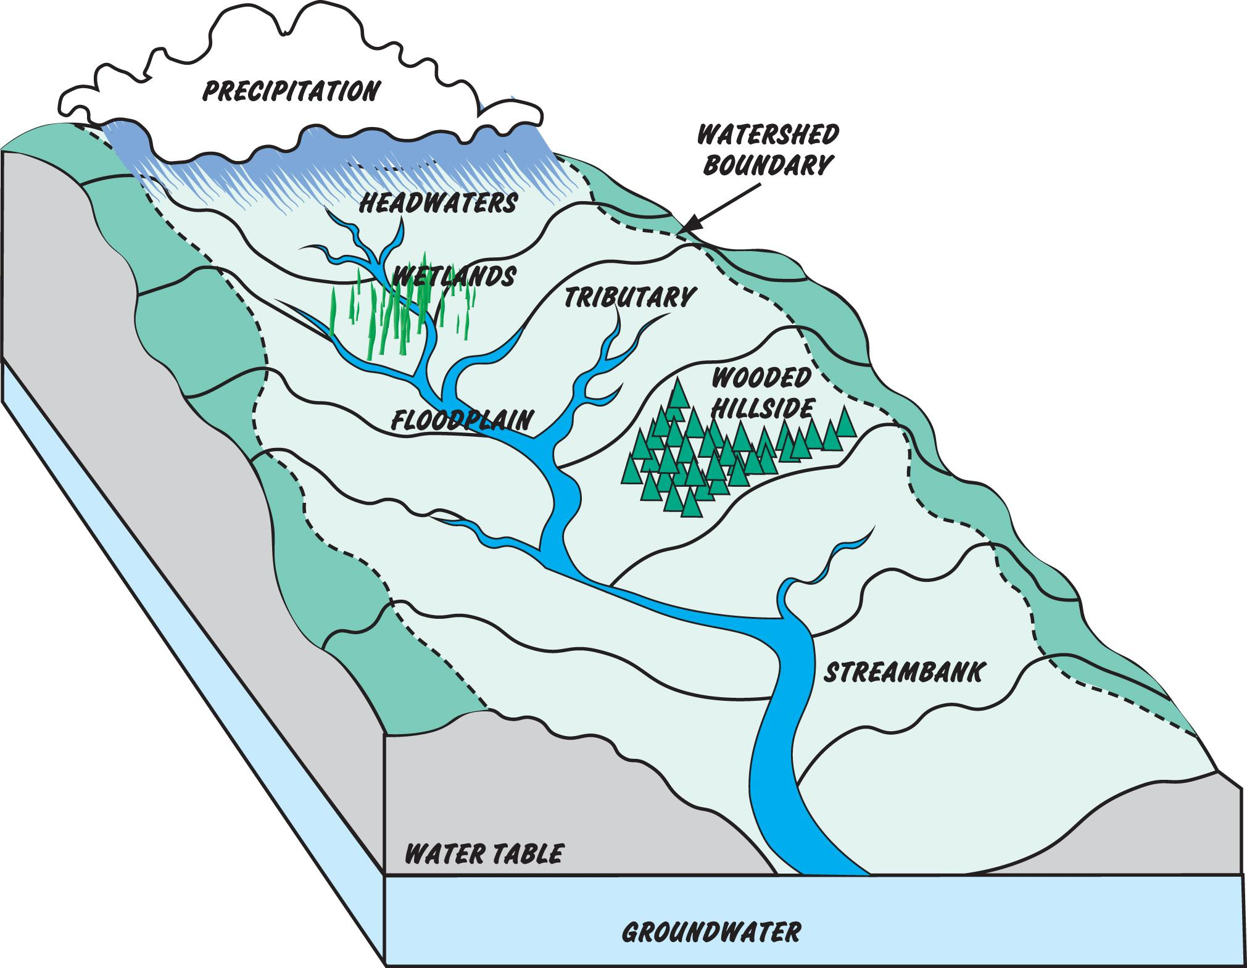
Notes:
While tributaries are one source of fresh water that makes up a watershed, there are different sources of fresh water that run into a watershed including: precipitation from the water cycle, water from the wetlands, floodplain, stream banks, etc.

Slide 26
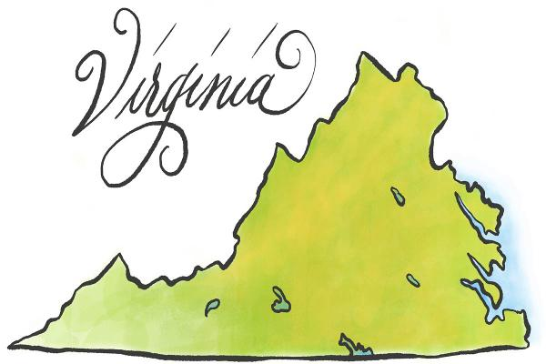
What about local watersheds?
Notes:
Let’s look at some local watersheds.

Slide 27
North Carolina Sounds
Chesapeake Bay
Gulf of Mexico
Major Watersheds in Virginia
Notes:
The three major watershed systems lead into the Chesapeake Bay, North Carolina Sounds, and the Gulf of Mexico.

Slide 28
Notes:
Here is a picture of the major watersheds.

Slide 29
Notes:
60% of Virginia is part of the Chesapeake Bay watershed. The Chesapeake Bay watershed spans more than 64,000 square miles. The Chesapeake Bay is the largest of any coastal water body in the world.
Feedback: Focusing on a watersheds in Virginia,in our geographical region, can help students make connections to real-life situations. You may invite students to discuss if they have visited this estuary before or have other experiences with these types of environments.

Slide 30
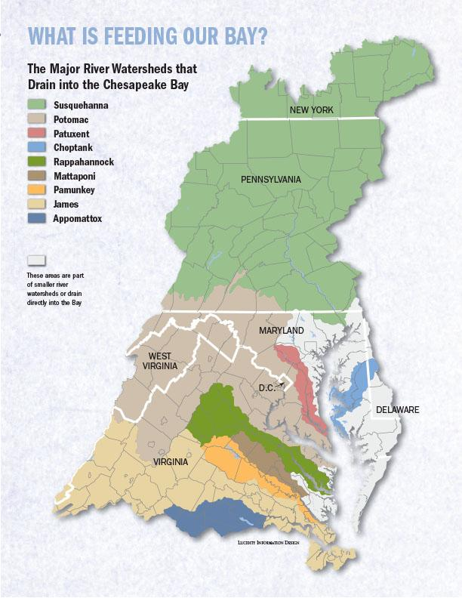
Notes:
Several smaller watersheds can make up a larger watershed. For example, these smaller watersheds are all included in the Chesapeake Bay watershed.

Slide 31
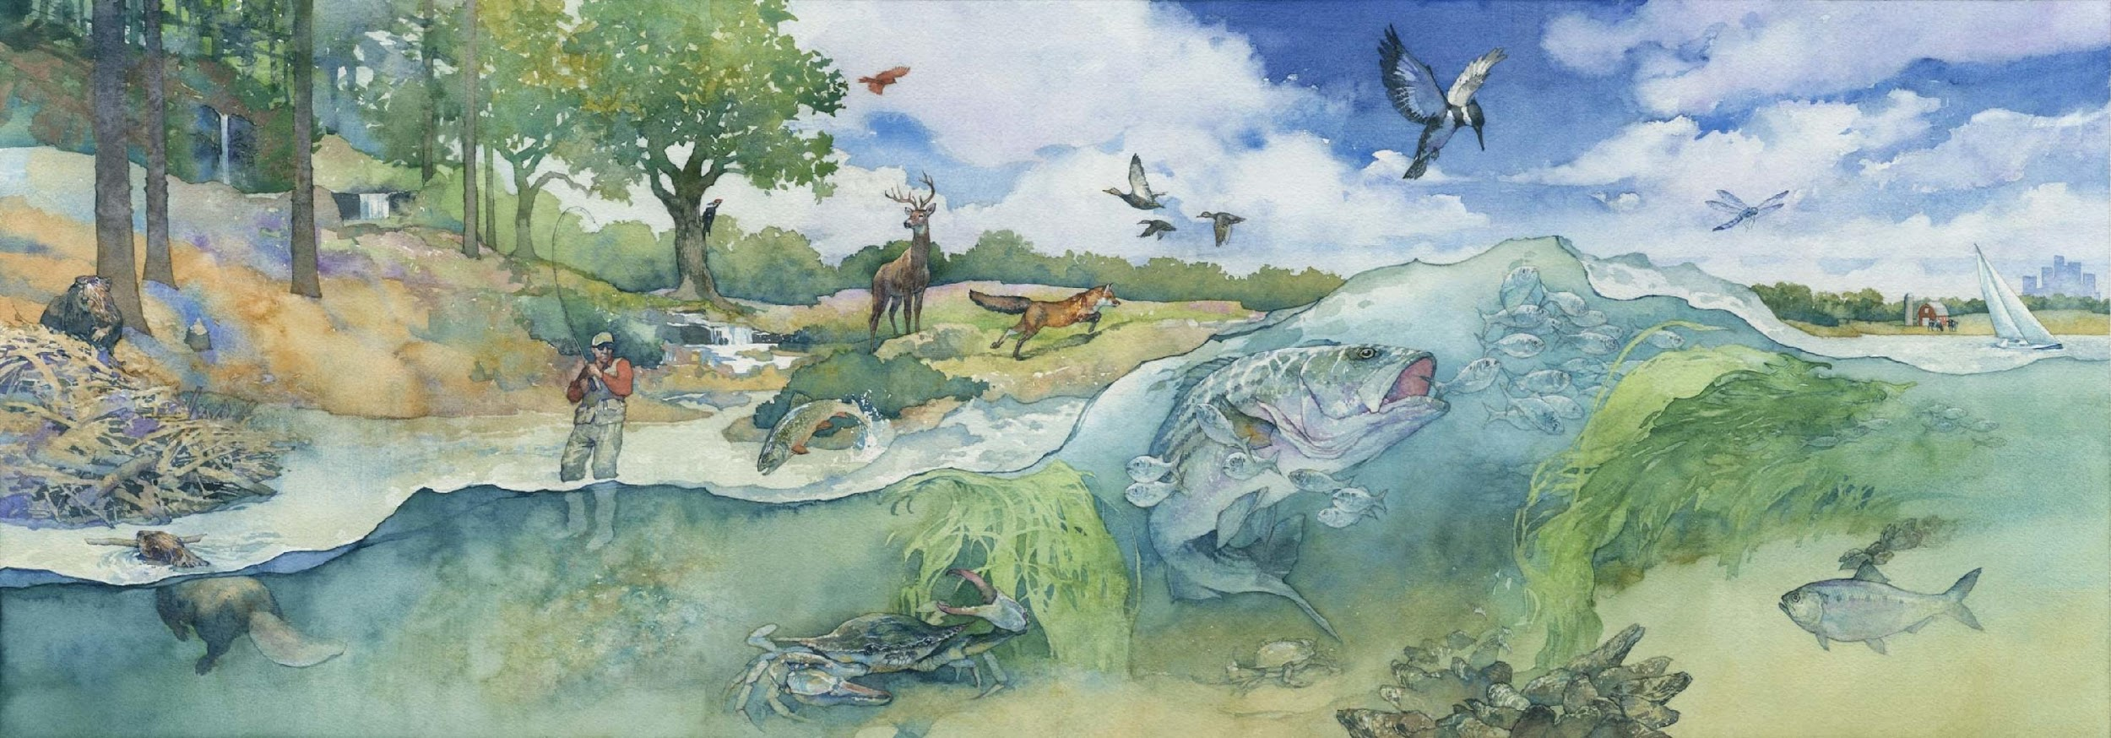
Virginia’s watersheds are important ecosystems
Notes:
All of Virginia’s watersheds are important ecosystems. Here is an image of what a Chesapeake bay watershed ecosystem could look like. What abiotic factors do you notice? What biotic factors do you notice? Ecosystems are important because they give us natural resources (like fish) that we need.

Slide 32
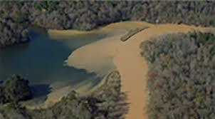
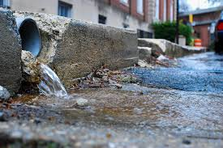
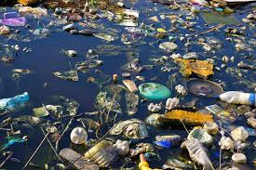
Watershed and Pollutants
Sediment
Stormwater runoff
Trash
Notes:
We have said our watersheds are important resources and ecosystems. But, our watersheds can become polluted or harmed by things that we do. One way rivers can become polluted is by having too much sediment (like rocks, soil, sand, etc.). When too much sediment is in a river, it can block sunlight and oxygen and harm the ecosystem causing plants and animals to die. Sediment pollution is often caused by construction or agriculture practices. The second type of pollution we see is from stormwater runoff. Our storm water travels through the watersheds, but picks up contaminants in the soil like with fertilizers or pesticides and those things can pollute water in the watershed. Finally our own trash pollutes water. When we throw plastic or other trash into rivers, it pollutes them and harms the ecosystem and our natural resources.

Slide 33
Notes:
So, how can we keep our watersheds safe?
Feedback: This would be a great opportunity to elicit students’ ideas and incorporate their ideas into the discussion.

Slide 34
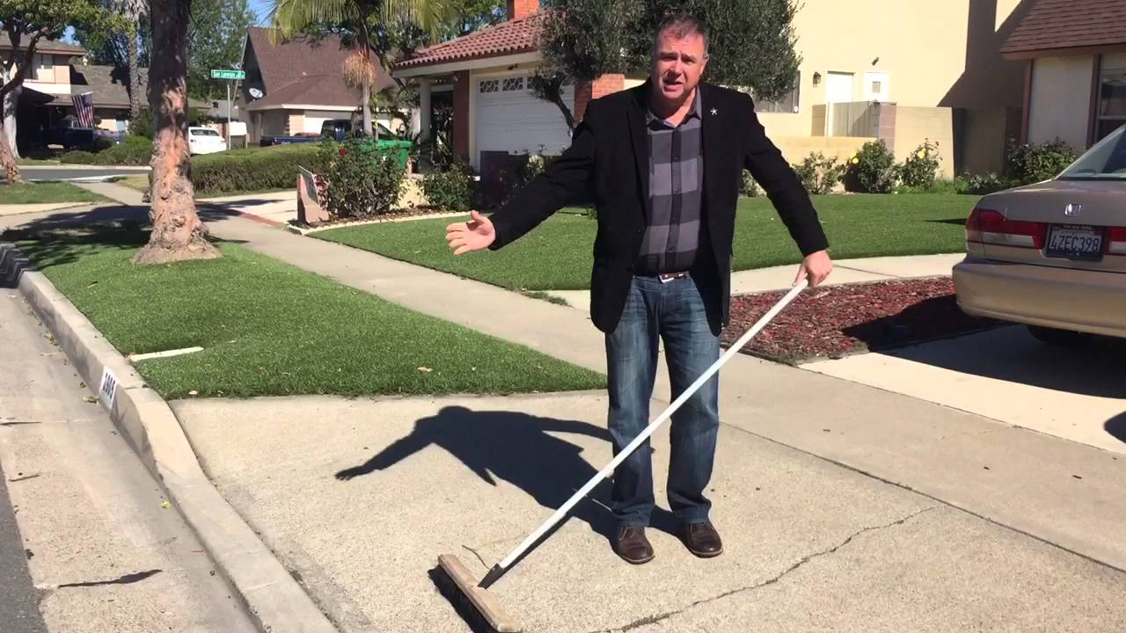
Notes:
One way we can help stop pollution is to sweep off our driveways instead of hosing them down. This way, we can prevent pollutants from our driveway from getting into our rivers/watershed.

Slide 35
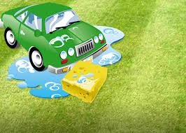
Notes:
You can also wash a car on the grass or somewhere where water would be absorbed instead of running into a fresh water source.

Slide 36
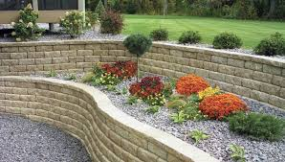
Notes:
You could also garden, to plant flowers or other types of plants to help prevent soil erosion that could run into rivers and would contribute to sediment pollution.

Slide 37
Notes:
Let’s check-in for understanding.

Slide 38
What are tributaries and how are they important to watersheds?
Notes:
What are tributaries and how are they important to watershed?
[Watersheds are made up of tributaries. A tributary is a river or stream that runs into a larger river or lake. Tributaries DO NOT run directly into the ocean. Here we can see many different tributaries that run into a larger river or stream.]

Slide 39
Give an example of another freshwater source that can make up a watershed.
Notes:
Give an example of another freshwater source that can make up a watershed.
[Stream, floodplain, wetland, etc.]

Slide 40
What are the three major watersheds in Virginia?
?
?
?
Major watersheds in Virginia
Notes:
What are the three major Virginia Watersheds?
[The three major watershed systems lead into the Chesapeake Bay, North Carolina Sounds, and the Gulf of Mexico.]

Slide 41
What is the largest watershed in Virginia?
Notes:
What is the largest watershed in Virginia?
[The Chesapeake Bay watershed because 60% of Virginia is part of this watershed.]

Slide 42
Explain what makes up a larger watershed.
Notes:
What makes up a larger watershed?
[Several smaller watersheds can make up a larger watershed. For example, these smaller watersheds are all included in the Chesapeake Bay watershed.]

Slide 43
Why are Virginia’s watersheds important?
Notes:
Why are Virginia’s watersheds important?
[All of Virginia’s watersheds are important ecosystems. Here is an image of what a Chesapeake bay watershed ecosystem could look like. What abiotic factors do you notice? What biotic factors do you notice? Ecosystems are important because they give us natural resources (like fish) that we need.]

Slide 44
Name and explain one way watersheds are polluted.
Notes:
Name and explain one way watersheds become polluted?
[We have said our watersheds are important resources and ecosystems. But, our watersheds can become polluted or harmed by things that we do. One way rivers can become polluted is by having too much sediment (like rocks, soil, sand, etc.). When too much sediment is in a river, it can block sunlight and oxygen and harm the ecosystem causing plants and animals to die. Sediment pollution is often caused by construction or agriculture practices. The second type of pollution we see is from stormwater runoff. Our storm water travels through the watersheds, but picks up contaminants in the soil like with fertilizers or pesticides and those things can pollute water in the watershed. Finally our own trash pollutes water. When we through plastic or other trash into rivers, it pollutes them and harms the ecosystem and our natural resources.]
Feedback: Guide the student discussion to meet the points above. You can do this by calling on different students, incorporating their thoughts into the discussion, and give specific feedback to guide students to any points that were not naturally brought up in discussion.

Slide 45
Name one thing you can do to help stop watershed pollution.
Notes:
Name one thing you can do to help stop watershed pollution.
[Sweeping driveway, washing car in the grass or somewhere water won’t runoff into freshwater, planting to prevent soil erosion.]

Slide 46
Notes:
Now, let’s talk about some examples of watersheds.

Slide 47
Notes:
Here we have an example of a watershed because water is drained into the same body of water. Water can drain into a lake, stream, or river.

Slide 48
Notes:
Here we have another example of a watershed. The area of land is draining into the same river.

Slide 49
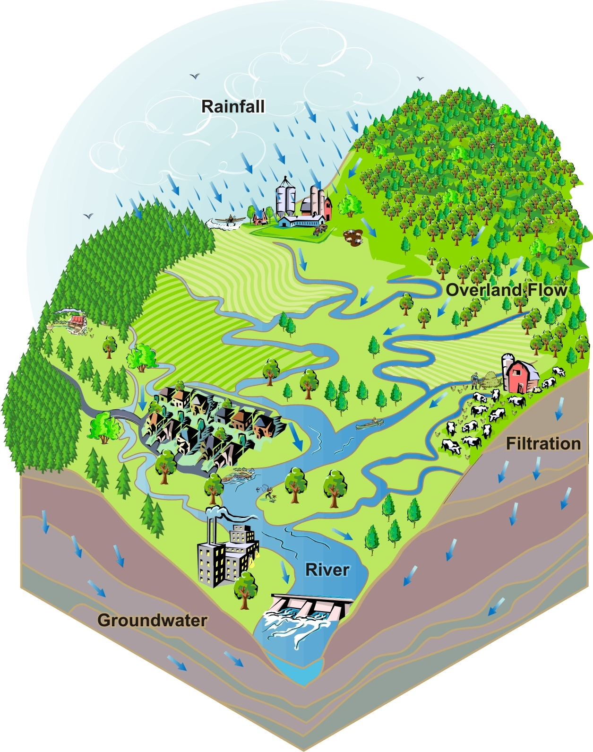
Notes:
Here we can see another example of a watershed. Notice how we can see the tributaries that make up this watershed. Remember a tributary is a river or stream that flows into a bigger lake or river.
Feedback: These slides introduce examples of the terms along with images. This helps students to make connections.

Slide 50
Notes:
Next, let’s talk about some a non-examples of watersheds.

Slide 51
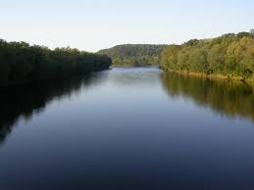
Notes:
A single river is not an example of a watershed. A river can be part of a watershed, but a river is not a watershed itself.
Feedback: One important component of using non-examples is clearly distinguishing similarities and differences to explain why it is a non-example. Including images as part of your non-example helps students to recognize these similarities and differences.

Slide 52
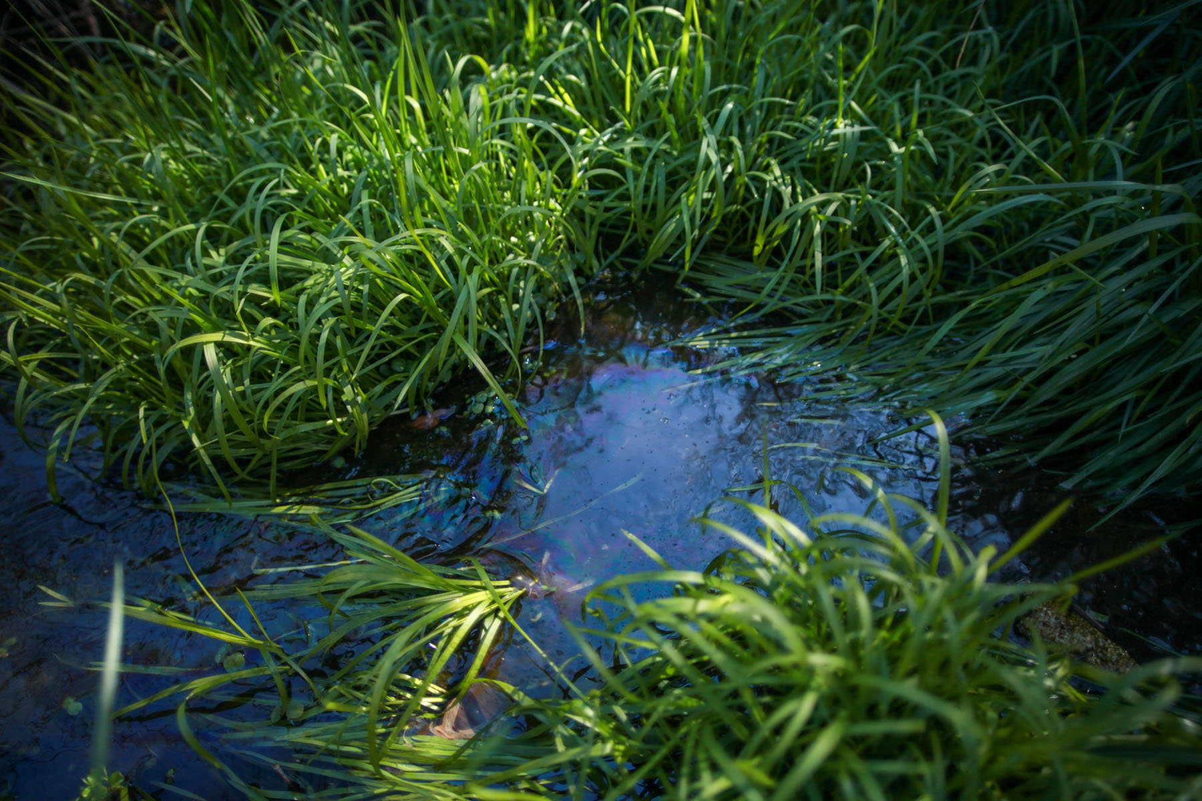
Notes:
Groundwater on it’s own is not an example of a watershed. Groundwater can be part of a watershed, but groundwater is not a watershed itself.

Slide 53
Notes:
Let’s check-in for understanding.

Slide 54
Is this an example of a watershed? Explain your answer.
Notes:
Is this an example of a watershed? Explain your answer.
[Yes. Here we have an example of a watershed because water is drained into the same body of water. Water can drain into a lake, stream, or river.]

Slide 55
Is this an example of a watershed? Explain your answer.
Notes:
Is this an example of a watershed? Explain your answer.
[No, A single river is not an example of a watershed. A river can be part of a watershed, but a river is not a watershed itself.]

Slide 56
Is this example of a watershed made up of any tributaries? Explain your answer.
Notes:
Is this example of a watershed made up of any tributaries? Explain your answer.
[Yes, there are tributaries because the tributaries are the smaller rivers that are flowing into the larger river (have students point out the tributaries in the picture).]

Slide 57
What are tributaries and how are they important to watersheds?
Notes:
What are tributaries and how are they important to watersheds?
[Watersheds are made up of tributaries. A tributary is a river or stream that runs into a larger river or lake. Tributaries DO NOT run directly into the ocean. Here we can see many different tributaries that run into a larger river or stream.]

Slide 58
What is a watershed?
Notes:
What is a watershed?
[A watershed is an area of land that drains into the same body of water.]

Slide 59
You live in a watershed, we all do! Give me some examples of what makes up your watershed at school or home.
Notes:
You live in a watershed, we all do! Give me some examples of what makes up your watershed at school or home.

Slide 60
What are the three major watersheds in Virginia?
?
?
?
Major watersheds in Virginia
Notes:
What are the three major watersheds in Virginia?
[The three major watershed systems lead into the Chesapeake Bay, North Carolina Sounds, and the Gulf of Mexico.]

Slide 61
What is the largest watershed in Virginia?
Notes:
Which Virginia Watershed is the largest?
[The Chesapeake Bay watershed because 60% of Virginia is part of this watershed.]

Slide 62
Is this an example of a watershed? Why or why not?
Notes:
Is this an example of a watershed? Why or why not?
[No, a single river is not an example of a watershed. A river can be part of a watershed, but a river is not a watershed itself.]

Slide 63
How are watersheds important to your everyday life?
Notes:
How are watersheds important to your everyday life?
[Allow students to brainstorm some personal examples.]

Slide 64
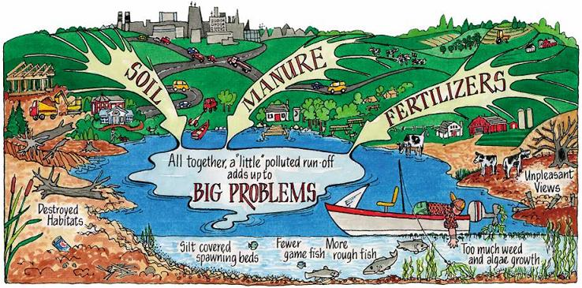
What type of pollution is shown in the picture below? Explain.
Notes:
What type of pollution is shown in the picture below? Explain.
[Stormwater runoff because it is showing what the water can pickup as it runs off into the main sources of water. Notice the problems it is causing as well: destroyed habitats, fewer fish, too much algae, etc.]

Slide 65
Name one thing you can do to help stop watershed pollution.
Notes:
Name one thing you can do to help stop watershed pollution.
[Sweeping driveway, washing car in the grass or somewhere water won’t runoff into fresh water, planting to prevent soil erosion]

Slide 66
Remember!!!
Notes:
So remember!

Slide 67
Watershed: area of land that drains into the same body of water
Notes:
A watershed is an area of land that drains into the same body of water.

Slide 68
Simulation Activity
Watershed Simulation
Click on the simulation above to learn more about watersheds.
Click on the different parts of a watershed to learn more about the different parts of watersheds. Can you find these parts of a watershed in the Virginia watersheds?
Notes:
Feedback: Here, this activity serves to review concepts about watersheds. This activity could also come earlier in this lesson to spark interest, build basic understanding of watersheds, and engage students.

Slide 69
Big Question: What are watersheds and Why are Virginia’s watersheds important? Do you live in a watershed?
Notes:
Explicit cue to revisit the big question at the end of the lesson: Okay everyone. Now that we’ve learned the term, let’s reflect once more on our big question. Was there anything that we predicted earlier that was correct or incorrect? Do you have any new hypotheses to share?
Feedback: Offering students an opportunity to evaluate their earlier hypotheses and make changes based on their new understandings is an important part of the iterative process in science. This is a great opportunity to help students build an epistemic understanding by explicitly stating how continuing to change and build on hypotheses as your knowledge grows is an important part of the discipline of science!

Slide 70
Notes:
Thanks for watching, and please continue watching CAPs available from this website.

Slide 71
This Video Was Created With Resources From:
Questions or Comments
Michael Kennedy, Ph.D. MKennedy@Virginia.edu
Rachel L Kunemund, Ph.D. rk8vm@virginia.edu

