Slide 1
Intro
“Big Idea” Question
Review Concepts
Check-In Questions
Teacher Engagement
Vocabulary
Student-Friendly Definition
Examples & Non-Examples
Morphological Word Parts
Frayer Model
Simulation/Activity
Notes:
OK everyone, get ready for our next lesson. Just as a reminder, these are the different components that our lesson may include, and you’ll see these icons in the top left corner of each slide so that you can follow along more easily!

Slide 2
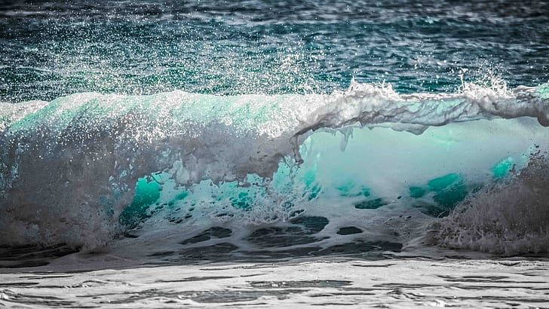
Intro
Wave
Notes:
Today, we’ll be learning about the word: Wave.

Slide 3
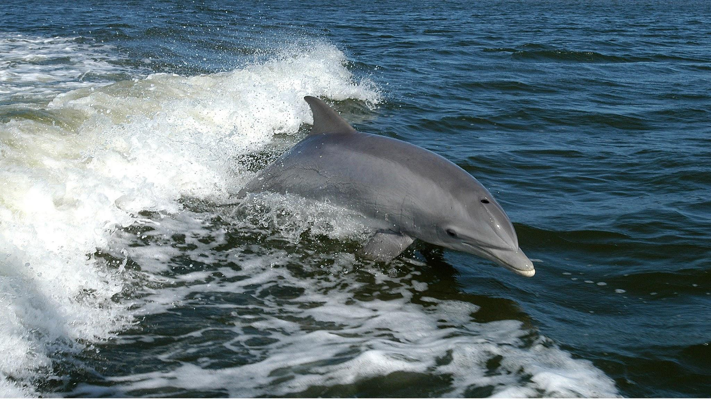
Big Question: How do ocean waves affect where sea animals live, impact the weather, and connect different parts of the Earth?
Notes:
Our “big question” is: How do ocean waves affect where sea animals live, impact the weather, and connect different parts of the Earth?
[Pause and illicit predictions from students.]
I love all these thoughtful scientific hypotheses! Be sure to keep this question and your predictions in mind as we move through these next few lessons, and we’ll continue to revisit it.

Slide 4
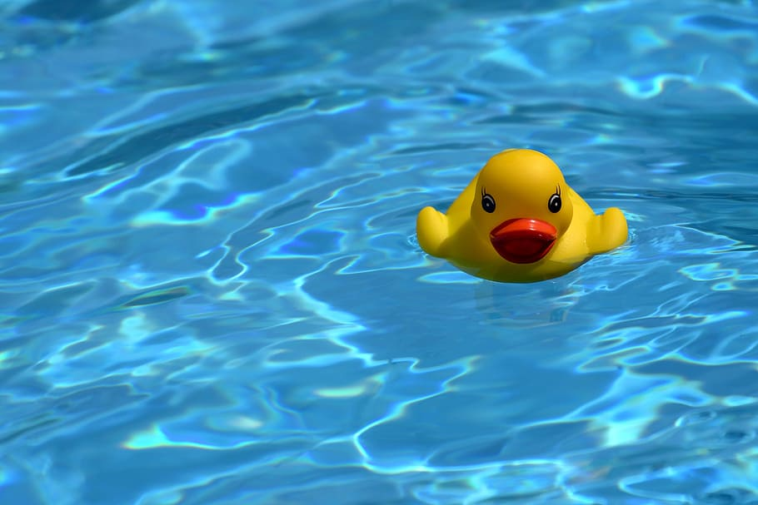
Exploring Water Waves
Materials needed:
A shallow tray or baking dish
Water
A small toy boat or plastic figurine
A straw
Instructions:
Fill the shallow tray or baking dish with water, making sure it's not too deep, just enough to cover the bottom.
Place the small toy boat or plastic figurine in the water. This represents something floating on the ocean, like a boat or a piece of driftwood.
Now, take the straw and gently blow air across the surface of the water, creating small waves. You can blow from different angles to see how it affects the movement of the water.
Observe how the waves move the toy boat or figurine. Notice how the waves cause the boat to bob up and down, and how they might push it towards the shore or away from it.
Discuss with the students what they observed. Talk about how waves in the ocean are like the waves we created in the tray. They move energy across the water's surface, which can affect objects floating on it.
Emphasize that waves in the ocean can be much bigger and more powerful, but they still work in a similar way, moving things around and shaping the coastline.

Slide 5
Notes:
Before we move on to our new topic, let’s review some other words & concepts that you already learned and make sure you are firm in your understanding.

Slide 6
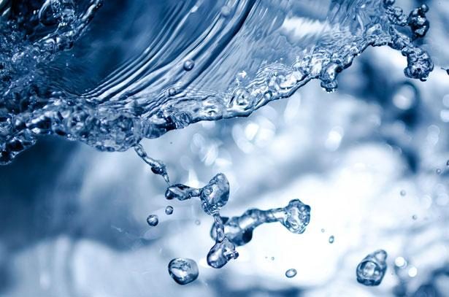
Water: The substance that covers most of the Earth's surface, found in oceans, rivers, lakes, and streams
Notes:
Water: The substance that covers most of the Earth's surface, found in oceans, rivers, lakes, and streams.

Slide 7
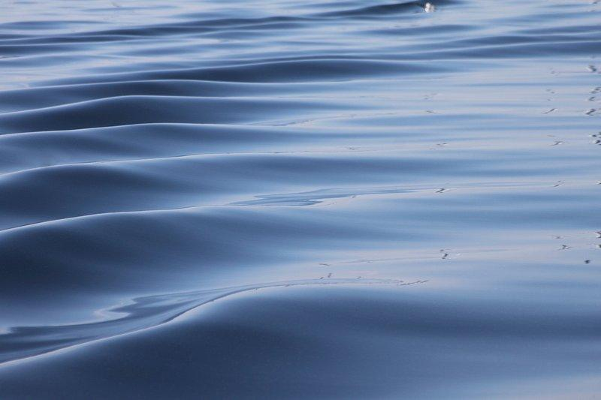
Surface: The top layer or outermost part of something
Notes:
Surface: The top layer or outermost part of something, in this case, the top layer of water in oceans, lakes, or rivers.

Slide 8
Motion: The act or process of moving or being moved
Notes:
Motion: The act or process of moving or being moved

Slide 9
Wind: Moving air, especially a natural flow of air parallel to or along the ground.
Notes:
Wind: Moving air, especially a natural flow of air parallel to or along the ground.

Slide 10
Notes:
Now let’s pause for a moment to review the information we have covered already.

Slide 11
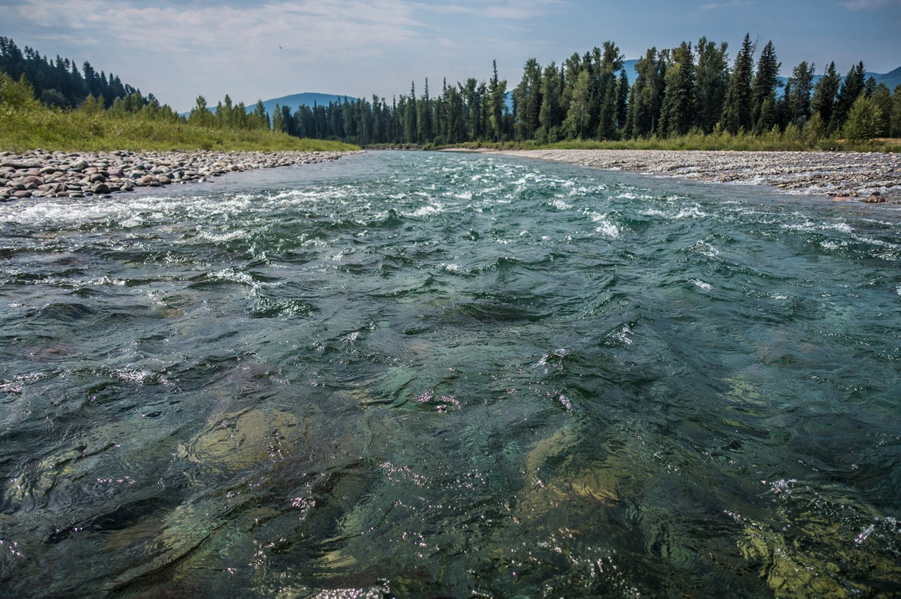
Water: The substance that covers most of the Earth's surface, found in ______
deserts and rocks
outer space
oceans, rives, lakes, and streams
Notes:
Water: The substance that covers most of the Earth's surface, found in ______
c. oceans, rives, lakes, and streams

Slide 12
Water: The substance that covers most of the Earth's surface, found in ______
deserts and rocks
outer space
oceans, rives, lakes, and streams
Notes:
Water: The substance that covers most of the Earth's surface, found in c. oceans, rives, lakes, and streams

Slide 13
What is the top layer or outermost part of something?
Notes:
What is the top layer or outermost part of something?
the surface

Slide 14
What is the top layer or outermost part of something?
The Surface
Notes:
What is the top layer or outermost part of something? The surface

Slide 15
The act or process of moving or being moved:
motion
lotion
potion
Notes:
The act or process of moving or being moved:
motion

Slide 16
The act or process of moving or being moved:
motion
lotion
potion
Notes:
The act or process of moving or being moved: a. motion

Slide 17
Wave
Notes:
Now that we’ve reviewed, let’s define the phrase wave.

Slide 18
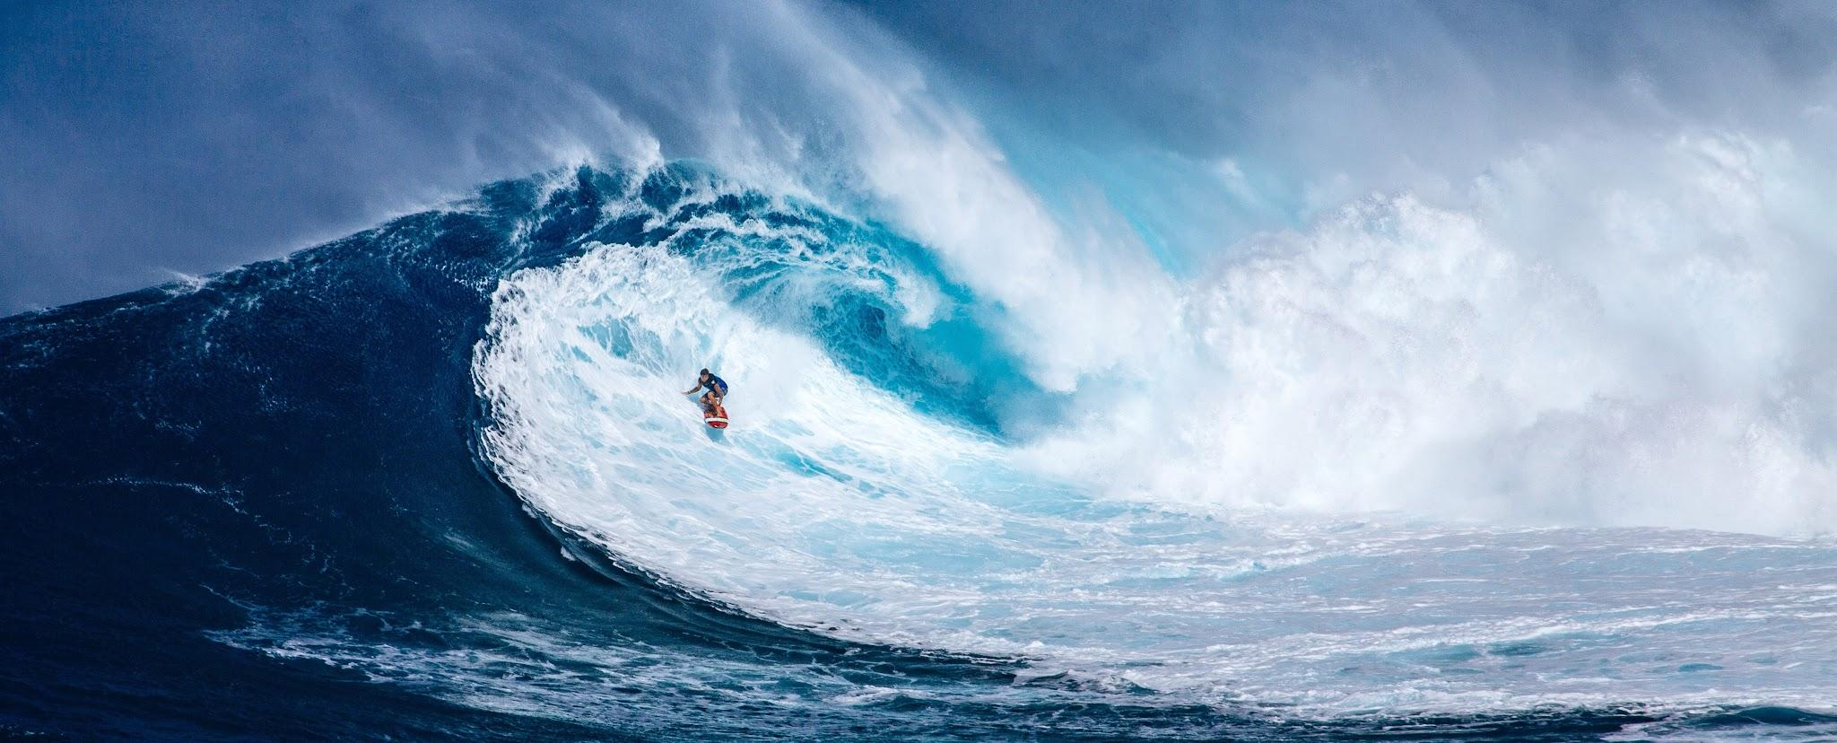
Wave: a moving up-and-down pattern in the water's surface caused by wind, earthquakes, or other disturbances.
Notes:
A wave is a moving up-and-down pattern in the water's surface caused by wind, earthquakes, or other disturbances.

Slide 19
Notes:
Let’s check-in for understanding.

Slide 20
What is a wave?
Notes:
What is a wave?
[A wave is a moving up-and-down pattern in the water's surface caused by wind, earthquakes, or other disturbances]

Slide 21
Notes:
That is the basic definition, but there is a bit more you need to know.

Slide 22
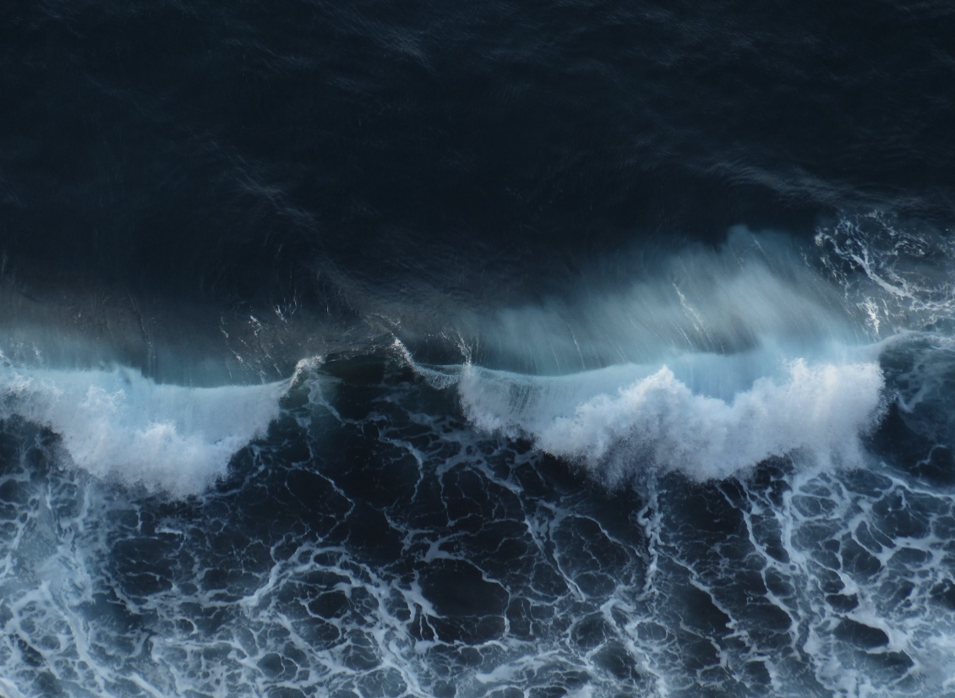
Waves are like nature's way of transmitting energy across the surface of the ocean. They form when the wind imparts its energy to the water, creating a consistent pattern of upward and downward movements.
Notes:
Waves are like nature's way of transmitting energy across the surface of the ocean. They form when the wind imparts its energy to the water, creating a consistent pattern of upward and downward movements.

Slide 23
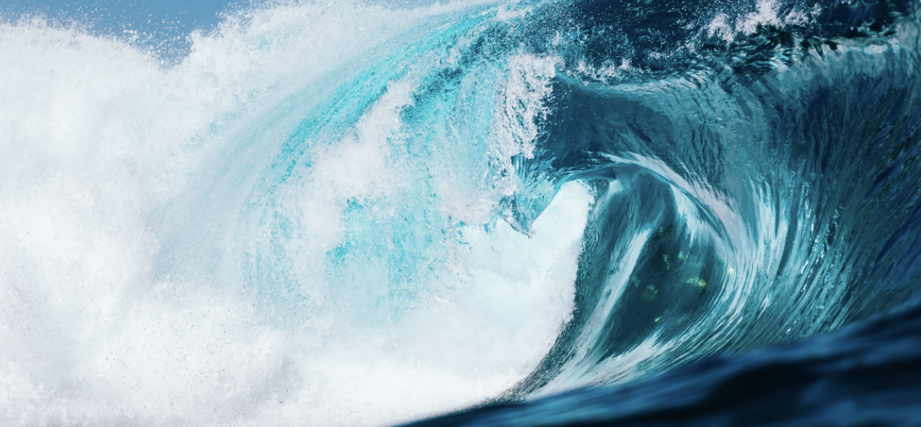
These patterns of rising and falling water have specific characteristics. The distance between the highest points of two waves is called the "wavelength," and the number of waves passing a particular point in one second is the "frequency." These properties determine the size and speed of a wave.
Notes:
These patterns of rising and falling water have specific characteristics. The distance between the highest points of two waves is called the "wavelength," and the number of waves passing a particular point in one second is the "frequency." These properties determine the size and speed of a wave.

Slide 24
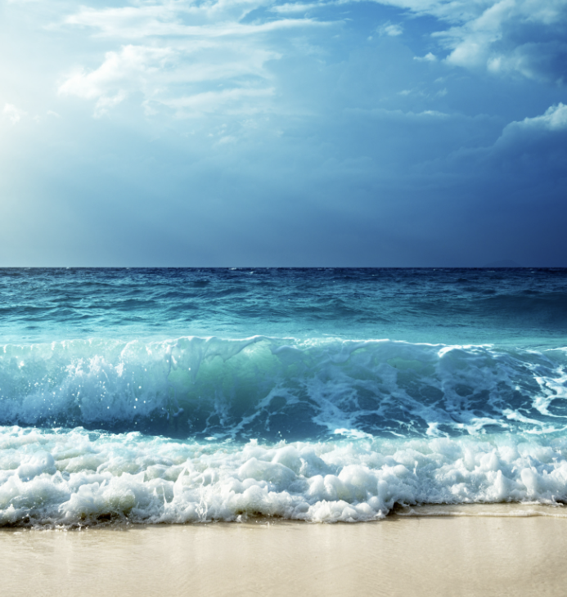
Observing waves at the beach, you'll notice varying intensities. Some waves are gentle, while others are more forceful, influenced by the energy of the wind and the distance it has traveled across the ocean.
Notes:
Observing waves at the beach, you'll notice varying intensities. Some waves are gentle, while others are more forceful, influenced by the energy of the wind and the distance it has traveled across the ocean.

Slide 25
Waves also play a role in shaping coastlines. As waves reach the shore, they transport and deposit sand, contributing to the formation of beaches and influencing the landscape.
Notes:
Waves also play a role in shaping coastlines. As waves reach the shore, they transport and deposit sand, contributing to the formation of beaches and influencing the landscape.

Slide 26
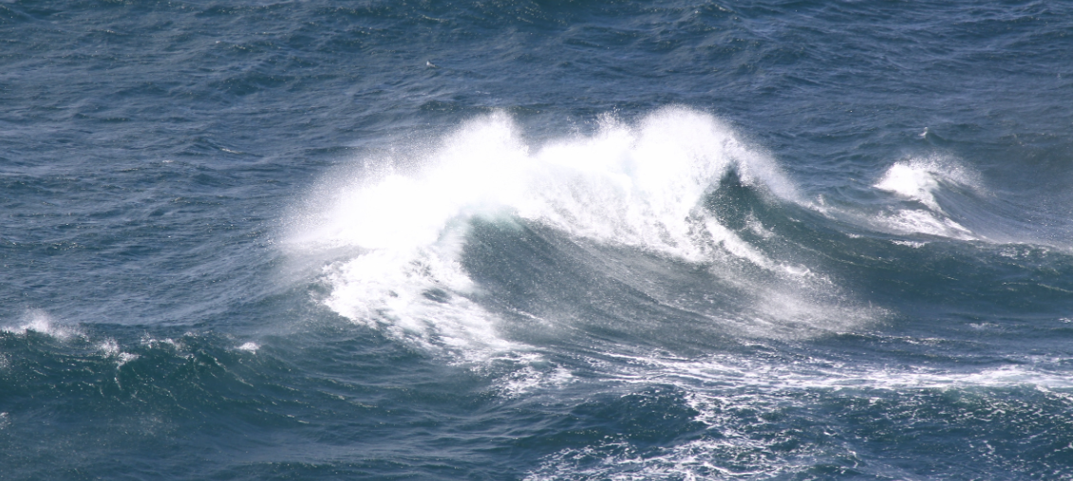
Waves are a constant presence, tirelessly carrying energy across the ocean. This continuous transfer of energy is essential for maintaining the movement of the ocean and connecting different parts of the sea. Waves, therefore, serve as a dynamic force shaping the surface of the water and impacting the world around them.
Notes:
Whether you're on land or at sea, waves are a constant presence, tirelessly carrying energy across the ocean. This continuous transfer of energy is essential for maintaining the movement of the ocean and connecting different parts of the sea. Waves, therefore, serve as a dynamic force shaping the surface of the water and impacting the world around them.

Slide 27
Notes:
Let’s check-in for understanding.

Slide 28
True or False: Waves transmit energy
Notes:
True or False: Waves transmit energy
[True]

Slide 29
True or False: Waves transmit energy
Notes:
True: Waves transmit energy

Slide 30
The distance between the highest points of two waves is called the ” .”
Notes:
The distance between the highest points of two waves is called the ” .”
[wavelength]

Slide 31
The distance between the highest points of two waves is called the ”wavelength.”
Notes:
The distance between the highest points of two waves is called the ”wavelength.”

Slide 32
True or False: All waves are gentle.
Notes:
True or False: All waves are gentle.
[False]

Slide 33
True or False: All waves are gentle.
Notes:
False: Some waves are gentle, while others are more forceful.

Slide 34
As waves reach the shore, they transport and deposit , contributing to the formation of beaches and influencing the landscape.
Lightning
Snow
Sand
Notes:
As waves reach the shore, they transport and deposit , contributing to the formation of beaches and influencing the landscape.
[sand]

Slide 35
As waves reach the shore, they transport and deposit , contributing to the formation of beaches and influencing the landscape.
Lightning
Snow
Sand
Notes:
As waves reach the shore, they transport and deposit sand, contributing to the formation of beaches and influencing the landscape.

Slide 36
Why are waves important?
Notes:
Waves are a constant presence, tirelessly carrying energy across the ocean. This continuous transfer of energy is essential for maintaining the movement of the ocean and connecting different parts of the sea. Waves, therefore, serve as a dynamic force shaping the surface of the water and impacting the world around them.

Slide 37
Notes:
Now, let’s talk about some examples of waves.

Slide 38
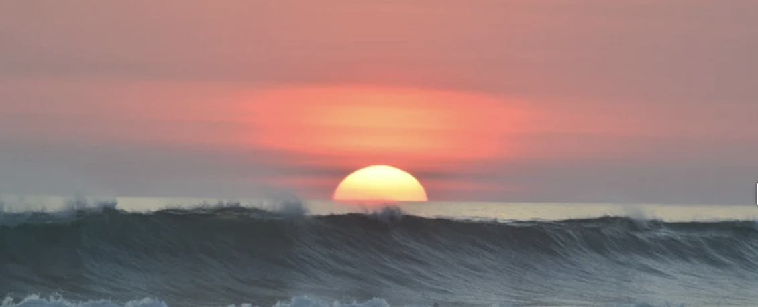
Ocean Waves are an example of waves. They mainly happen when the wind blows across the ocean's surface, making the water go up and down. These waves can be big or small, and they travel a long way, affecting coastlines and even the Earth's climate.
Notes:
Ocean Waves are an example of waves. They mainly happen when the wind blows across the ocean's surface, making the water go up and down. These waves can be big or small, and they travel a long way, affecting coastlines and even the Earth's climate.

Slide 39
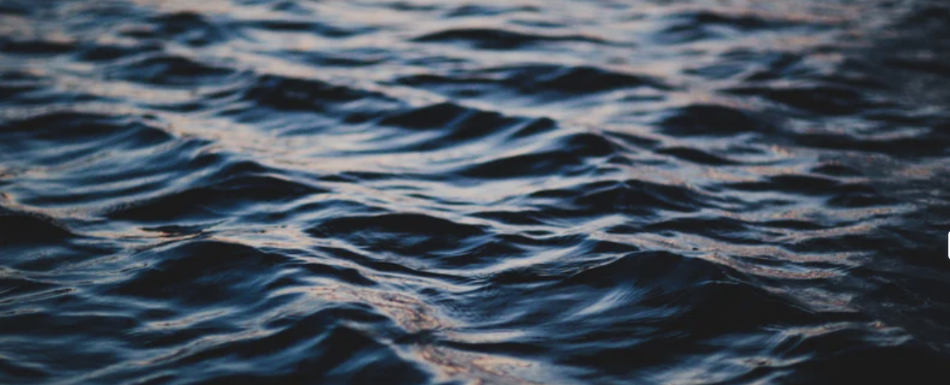
Ripple Waves are examples of waves. They occur on the surface of calm water, such as in a pond or lake. These waves are typically small and gentle, forming in response to a light breeze or disturbance on the water's surface. As the wind blows, it imparts energy to the water, causing it to ripple and creating a visible pattern of waves that move outward from the point of disturbance.
Notes:
Ripple Waves are examples of waves. They occur on the surface of calm water, such as in a pond or lake. These waves are typically small and gentle, forming in response to a light breeze or disturbance on the water's surface. As the wind blows, it imparts energy to the water, causing it to ripple and creating a visible pattern of waves that move outward from the point of disturbance.

Slide 40
Notes:
Now, let’s talk about some non-examples of waves.

Slide 41
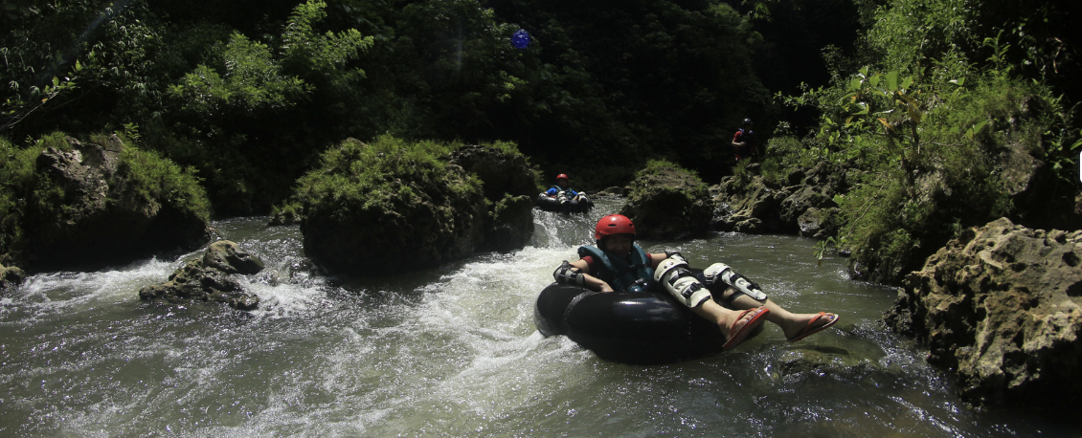
Water flow in a river is NOT an example of waves. While rivers involve the movement of water, the consistent downstream flow is not considered a wave, as it lacks the repetitive up-and-down pattern.
Notes:
Water flow in a river is NOT an example of waves. While rivers involve the movement of water, the consistent downstream flow is not considered a wave, as it lacks the repetitive up-and-down pattern.

Slide 42
Whirlpools are NOT an example of waves. They are circular currents in water caused by the movement of tides, underwater terrain, or draining water, but they don't exhibit the typical back-and-forth motion associated with waves.
Notes:
Whirlpools are NOT an example of waves. They are circular currents in water caused by the movement of tides, underwater terrain, or draining water, but they don't exhibit the typical back-and-forth motion associated with waves.

Slide 43
Notes:
Now let’s pause for a moment to check your understanding.

Slide 44
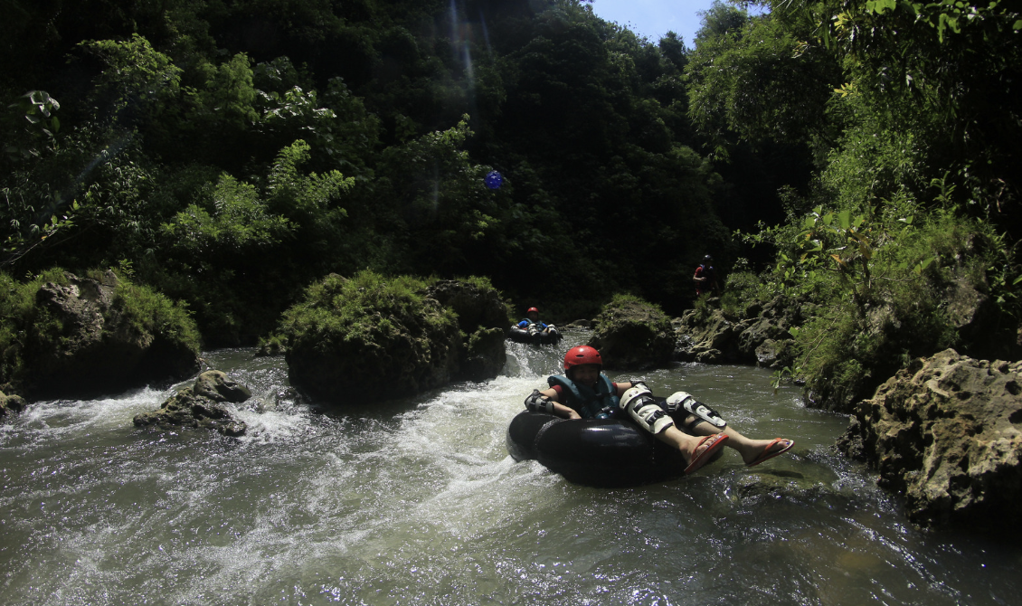
Why are a water flow and whirlpools NOT examples of waves?
Notes:
Why are a water flow and whirlpools NOT examples of waves?
[While rivers involve the movement of water, the consistent downstream flow is not considered a wave, as it lacks the repetitive up-and-down pattern and whirlpools are NOT an example of waves because they are circular currents in water caused by the movement of tides, underwater terrain, or draining water, but they don't exhibit the typical back-and-forth motion associated with waves.]

Slide 45
Remember!!!
Notes:
So remember!

Slide 46
Wave: a moving up-and-down pattern in the water's surface caused by wind, earthquakes, or other disturbances.
Notes:
A wave is a moving up-and-down pattern in the water's surface caused by wind, earthquakes, or other disturbances.

Slide 47
Notes:
We will now complete this concept map, called a Frayer model, to summarize and further clarify what you have learned about the term wave.

Slide 48
Definition
Picture
Wave
Example
How do waves impact my life?
Notes:
To complete the Frayer model, we will choose from four choices the correct picture, definition, example, and response to the question, “How do waves impact my life?” Select the best response for each question using the information you just learned. As we select responses, we will see how this model looks filled in for the term wave.

Slide 49
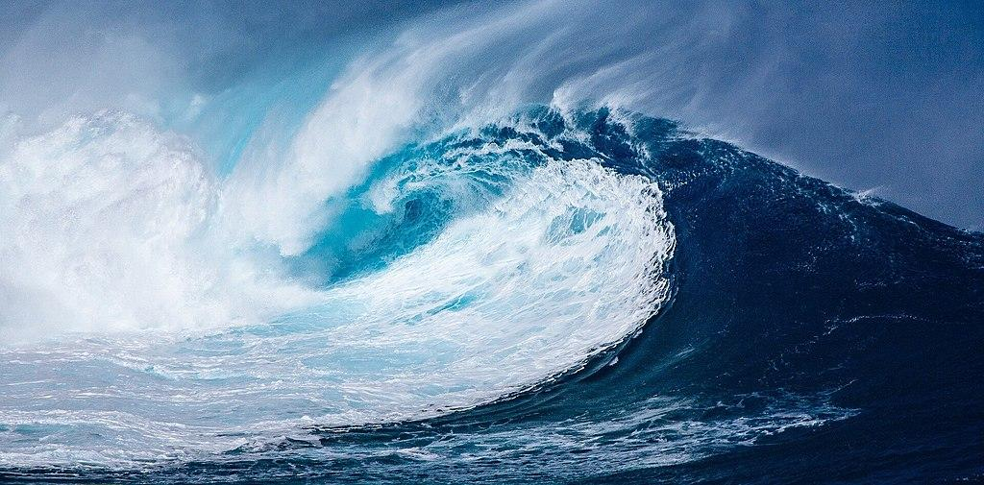
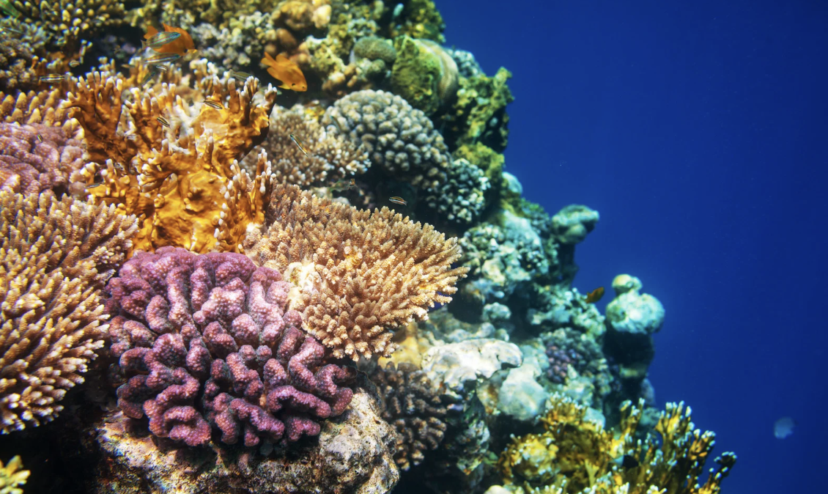
Directions: Choose the correct picture of a wave from the choices below.
A
B
C
D
Notes:
Choose the one correct picture of a wave from these four choices.

Slide 50
Directions: Choose the correct picture of a wave from the choices below.
A
B
C
D
Notes:
This is the picture that shows a wave.

Slide 51
Definition
Picture
Wave
Example
How do waves impact my life?
Notes:
Here is the Frayer model filled in with a picture of a wave.

Slide 52
Directions: Choose the correct definition of a wave from the choices below.
A
A solid collection of minerals
B
A moving up-and-down pattern in the water's surface caused by wind, earthquakes, or other disturbances.
C
The process of breaking down a rock over a long period of time
D
Sudden shaking of the ground caused by the movement of the Earth’s tectonic plates
Notes:
Choose the one correct definition of a wave from these four choices.

Slide 53
Directions: Choose the correct definition of a wave from the choices below.
A
A solid collection of minerals
B
A moving up-and-down pattern in the water's surface caused by wind, earthquakes, or other disturbances.
C
The process of breaking down a rock over a long period of time
D
Sudden shaking of the ground caused by the movement of the Earth’s tectonic plates
Notes:
“A moving up-and-down pattern in the water's surface caused by wind, earthquakes, or other disturbances” is correct! This is the definition of a wave.

Slide 54
Definition
Picture
A moving up-and-down pattern in the water's surface caused by wind, earthquakes, or other disturbances.
Wave
Example
How do waves impact my life?
Notes:
Here is the Frayer Model with a picture and the definition filled in for a wave: a moving up-and-down pattern in the water's surface caused by wind, earthquakes, or other disturbances.

Slide 55
Directions: Choose the correct example of a wave from the choices below.
A
Snow sliding down a plane
B
Shaking of the ground that tumbles buildings
C
Ripples
D
Dirt and other land mass falling into the ocean off a cliff
Notes:
Choose the one correct example of a wave from these four choices.

Slide 56
Directions: Choose the correct example of a wave from the choices below.
A
Snow sliding down a plane
B
Shaking of the ground that tumbles buildings
C
Ripples
D
Dirt and other land mass falling into the ocean off a cliff
Notes:
“Ripples” is correct! This is an example of a wave.

Slide 57
Definition
Picture
A moving up-and-down pattern in the water's surface caused by wind, earthquakes, or other disturbances.
Wave
Ripples
Example
How do waves impact my life?
Notes:
Here is the Frayer Model with a picture, definition, and an example of a wave: Ripples

Slide 58
Directions: Choose the correct response for “how do waves impact my life?” from the choices below.
Earthquakes can shake buildings, break roads, and sometimes cause power outages, making it important for us to be prepared and know how to stay safe during these shakes.
A
B
Waves shape coastlines and provide enjoyable moments at the beach, and even play a role in the weather. All of these things impact my life.
C
Earthquakes account for the amount of land we have on our planet versus ocean and tells us where to build habitats.
D
Earthquakes create different trenches and ranges in the ocean which influences weather patterns on Earth.
Notes:
Choose the one correct response for “how do waves impact my life?” from these four choices.

Slide 59
Directions: Choose the correct response for “how do waves impact my life?” from the choices below.
Earthquakes can shake buildings, break roads, and sometimes cause power outages, making it important for us to be prepared and know how to stay safe during these shakes.
A
B
Waves shape coastlines and provide enjoyable moments at the beach, and even play a role in the weather. All of these things impact my life.
C
Earthquakes account for the amount of land we have on our planet versus ocean and tells us where to build habitats.
D
Earthquakes create different trenches and ranges in the ocean which influences weather patterns on Earth.
Notes:
“Waves shape coastlines and provide enjoyable moments at the beach, and even play a role in the weather. All of these things impact my life.” That is correct! This is an example of how waves impacts your life.

Slide 60
Definition
Picture
A moving up-and-down pattern in the water's surface caused by wind, earthquakes, or other disturbances.
Wave
Waves shape coastlines and provide enjoyable moments at the beach, and even play a role in the weather. All of these things impact my life.
Ripples
Example
How do waves impact my life?
Notes:
Here is the Frayer Model with a picture, definition, example, and a correct response to “how do waves impact my life?”: Waves shape coastlines and provide enjoyable moments at the beach, and even play a role in the weather. All of these things impact my life.

Slide 61
Remember!!!
Notes:
So remember!

Slide 62
Wave: a moving up-and-down pattern in the water's surface caused by wind, earthquakes, or other disturbances.
Notes:
A wave is a moving up-and-down pattern in the water's surface caused by wind, earthquakes, or other disturbances.

Slide 63
Big Question: How do ocean waves affect where sea animals live, impact the weather, and connect different parts of the Earth?
Notes:
Let’s reflect once more on our big question. Our “big question” is: How do ocean waves affect where sea animals live, impact the weather, and connect different parts of the Earth?
Does anyone have any additional examples to share that haven’t been discussed yet?

Slide 64
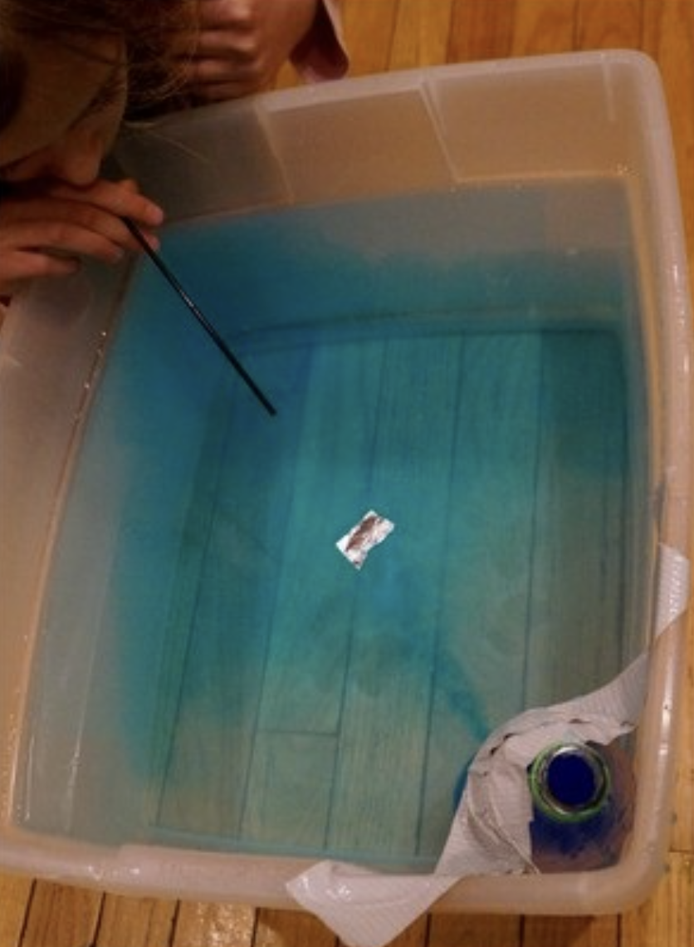
Demonstration
TEACHER DIRECTIONS:
Before viewing: Ask students what they already know about waves (water). Tell students today they will be learning about waves (water).
During: Discuss with students how the wind transfers its energy to the water, creating waves. Emphasize that waves are a way for energy to travel across the ocean. Explore the different characteristics of waves based on the strength of the "wind.” Discuss how waves can impact floating objects, showcasing their ability to move energy across the water's surface.
After: Tell students that today they will be learning more about waves (water).
Notes:
A feasible and effective classroom demonstration to teach about waves can involve the following simple activity:
Materials needed:
Large, shallow container (representing a portion of the ocean)
Water
Fan or hairdryer (representing wind)
Small toy boats or objects
Procedure:
Fill the large container with water to create a small "ocean."
Place the container on a stable surface.
Position the fan or hairdryer at one end of the container to represent the wind.
Turn on the fan or hairdryer to create a gentle breeze across the water surface.
Observe how the wind (fan or hairdryer) creates ripples and small waves on the water.
Introduce small toy boats or objects to demonstrate how waves can influence floating objects.
Discussion:
Discuss with students how the wind (represented by the fan or hairdryer) transfers its energy to the water, creating waves.
Emphasize that waves are a way for energy to travel across the ocean.
Explore the different characteristics of waves, such as their size and frequency, based on the strength of the "wind" (fan or hairdryer).
Discuss how waves can impact floating objects, showcasing their ability to move energy across the water's surface.
This hands-on demonstration helps students visually understand the connection between wind and wave formation in the ocean, making the concept more tangible and engaging.

Slide 65
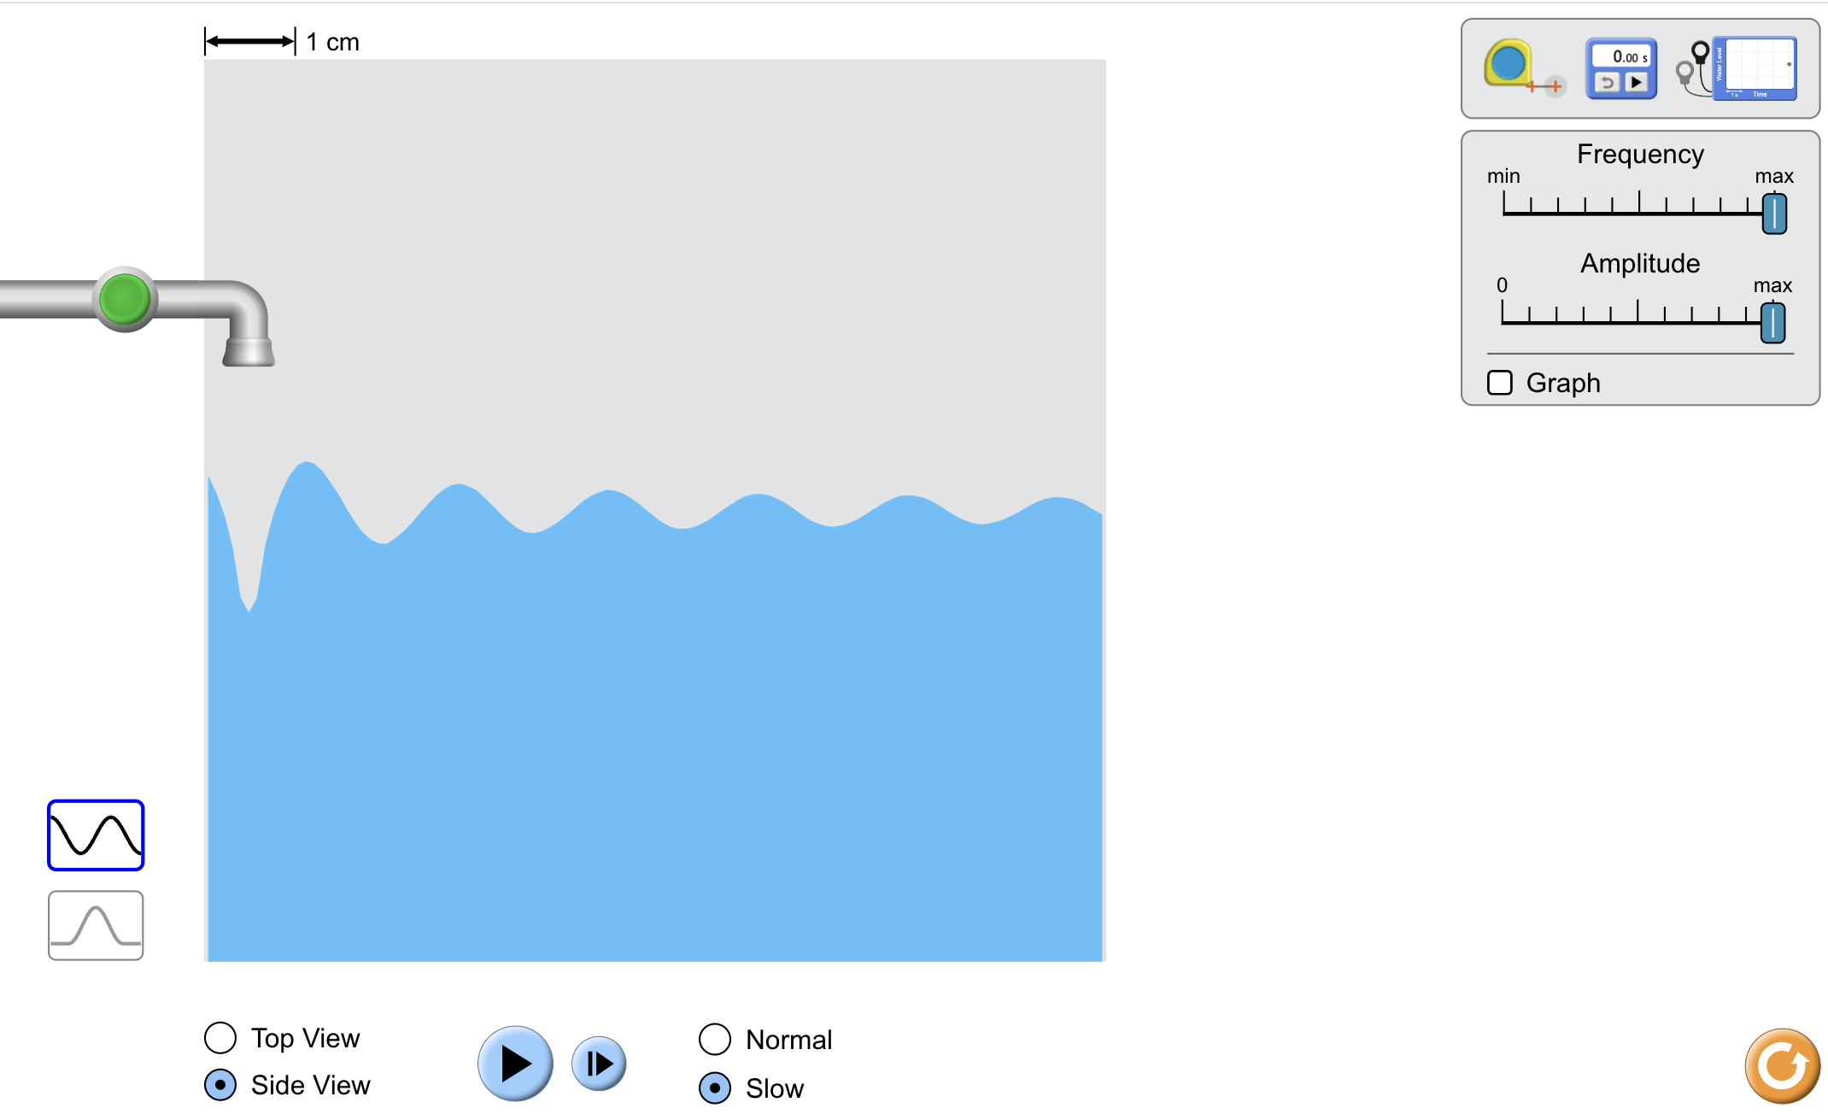
Simulation Activity
Water Waves Simulator
Click the link above for a simulation to deepen your knowledge of water waves.
Notes:
Click the link above for a simulation to deepen your understanding of earthquakes. In this simulation, you will adjust the frequency and amplitude of the waves. You can also view the waves from the top or from the side and in normal speed or slow it down.

Slide 66
Notes:
Thanks for watching, and please continue watching CAPs available from this website.

Slide 67
This Was Created With Resources From:
Questions or Comments
Michael Kennedy, Ph.D. MKennedy@Virginia.edu
Rachel L Kunemund, Ph.D. rk8vm@virginia.edu

