Slide 1
Intro
“Big Idea” Question
Review Concepts
Check-In Questions
Teacher Engagement
Vocabulary
Student-Friendly Definition
Examples & Non-Examples
Morphological Word Parts
Frayer Model
Simulation/Activity
Notes:
OK everyone, get ready for our next lesson. Just as a reminder, these are the different components that our lesson may include, and you’ll see these icons in the top left corner of each slide so that you can follow along more easily!

Slide 2
Wave
Intro
Notes:
Today, we’ll be learning about the word: Wave.
Feedback: Using clear and simple language when introducing content helps students understand what is expected.

Slide 3
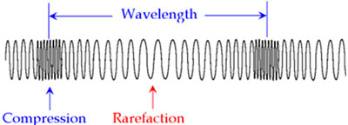
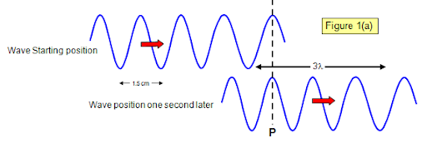
Big Question: What are the properties of waves and how are they related?
Notes:
Our “big question” is: What are the properties of waves and how are they related?
[Pause and illicit predictions from students.]
I love all these thoughtful scientific hypotheses! Be sure to keep this question and your predictions in mind as we move through these next few lessons, and we’ll continue to revisit it.

Slide 4
Notes:
Before we move on to our new topic, let’s review some other words & concepts that you already learned and make sure you are firm in your understanding.

Slide 5
Energy: ability to cause change
Notes:
Energy is the ability to cause change.

Slide 6
Notes:
Now let’s pause for a moment to review the information we have covered already.

Slide 7
Energy is the ability to cause __________.
Heat
Change
Life
Notes:
Energy is the ability to cause ______.
[b.change]

Slide 8
Energy is the ability to cause __________.
Heat
Change
Life
Notes:
Energy is the ability to cause ______. [b.change]

Slide 9
Wave
Notes:
Now that we’ve reviewed, let’s define the word wave.

Slide 10
Wave: repeating motion that carries energy from one place to another
Notes:
A wave is a repeating motion that carries energy from one place to another.

Slide 11
Notes:
Let’s check-in for understanding.

Slide 12
What is a wave?
Notes:
What is a wave?
[A repeating motion that carries energy from one place to another]

Slide 13
Notes:
That is the basic definition, but there is a bit more you need to know.

Slide 14
Notes:
Imagine a drop of water hitting a pond. This drop creates ripples of water moving up and down as they spread out from the center. Waves are like tiny ripples that move energy from one place to another.

Slide 15
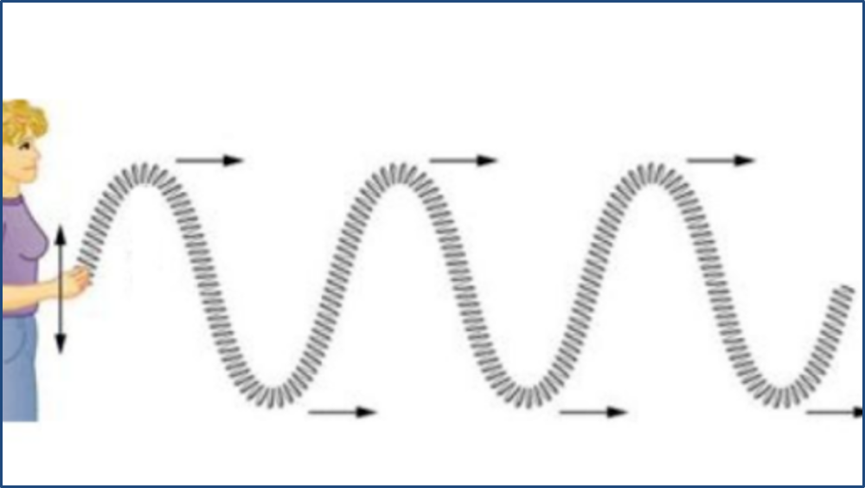
Notes:
Waves can move in two different ways. They can move up and down, like a string waving in the air.

Slide 16
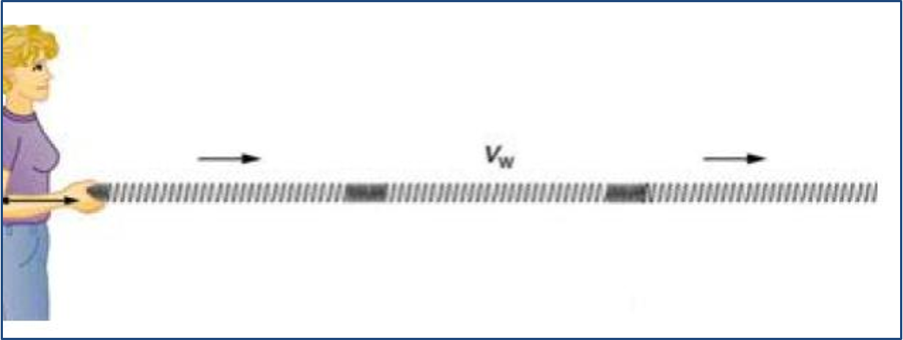
Notes:
Waves can also move slide to side, like a slinky.

Slide 17
Waves travel through a medium.
Notes:
Waves need some kind of matter, called a medium, to travel through. Waves can travel through any solid, liquid, or gas including air and water.

Slide 18
Notes:
Let’s check-in for understanding.

Slide 19
Notes:
What are the different ways that waves move?
[up and down/ side to side]

Slide 20
Waves travel through a _____________.
Medium
Mountain
Energy
Notes:
Waves travel through a _______________.
[medium]

Slide 21
Waves travel through a _____________.
Medium
Mountain
Energy
Notes:
Waves travel through a medium.

Slide 22
Notes:
Now, let’s talk about some examples of waves.

Slide 23
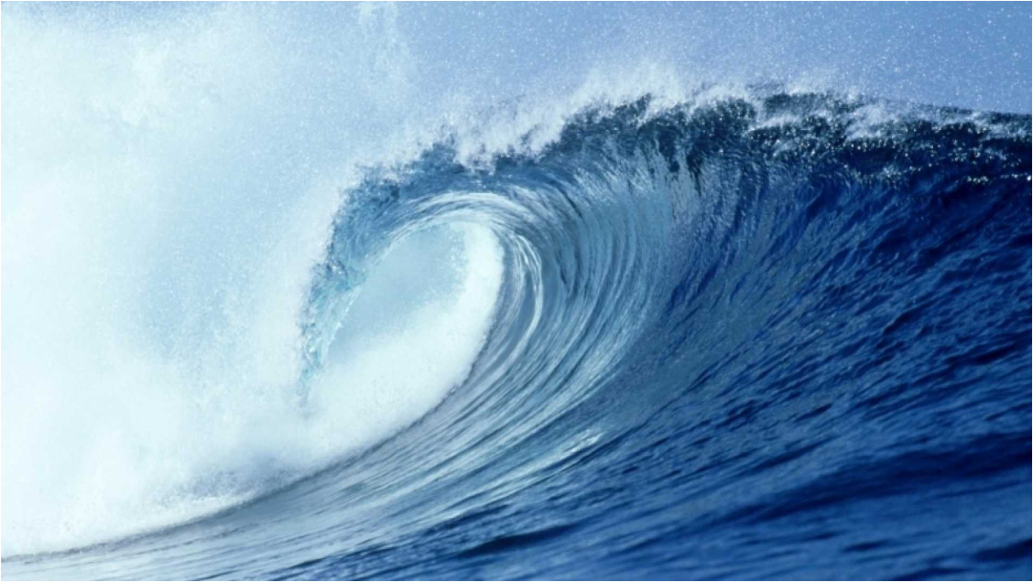
Waves in the ocean move energy from one place to another.
Notes:
Here is an example of a wave. Waves in the ocean move energy from one place to another.

Slide 24
All sounds travel as waves. They move sound energy from place to place.
Notes:
All sounds travel as waves. They move sound energy from place to place.

Slide 25
Light also travels as waves. It moves light energy from place to place.
Notes:
Light also travels as waves. It moves light energy from place to place.

Slide 26
Notes:
Let’s check-in for understanding.

Slide 27
True or False:
Sound travels in waves.
Notes:
True or False: Sounds travels in waves.
[True]

Slide 28
True:
Sound travels in waves.
Notes:
True: Sounds travels in waves.

Slide 29
Light waves are ________ moving from place to place.
Cells
Cold
Energy
Notes:
Light waves are ___________ moving from place to place.
[c. energy]

Slide 30
Light waves are ________ moving from place to place.
Cells
Cold
Energy
Notes:
Light waves are energy moving from place to place.

Slide 31
Notes:
Now, let’s talk about some non-examples of waves.

Slide 32
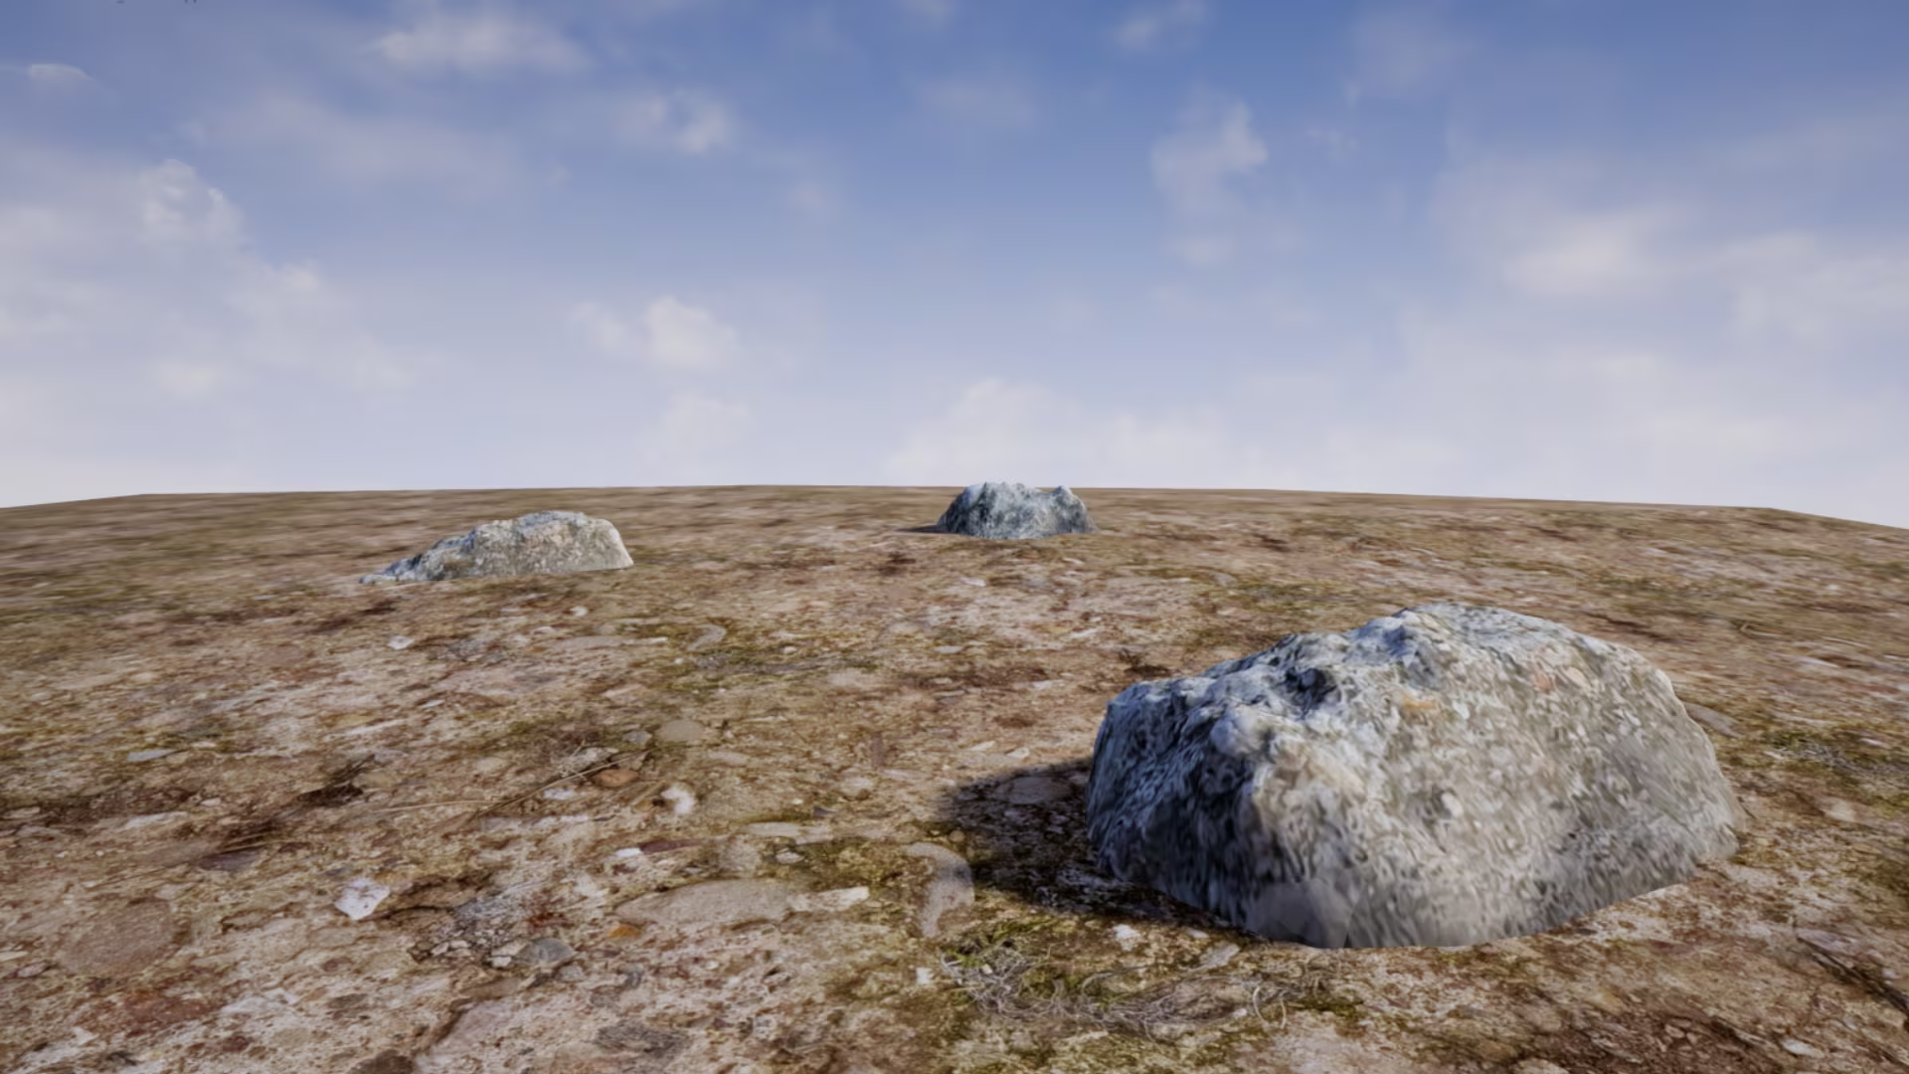
This rock is not moving, so it cannot create a repeated motion needed to make a wave.
Notes:
This rock is not an example of a wave. This rock is not moving, so it cannot create a repeated motion needed to make a wave.

Slide 33
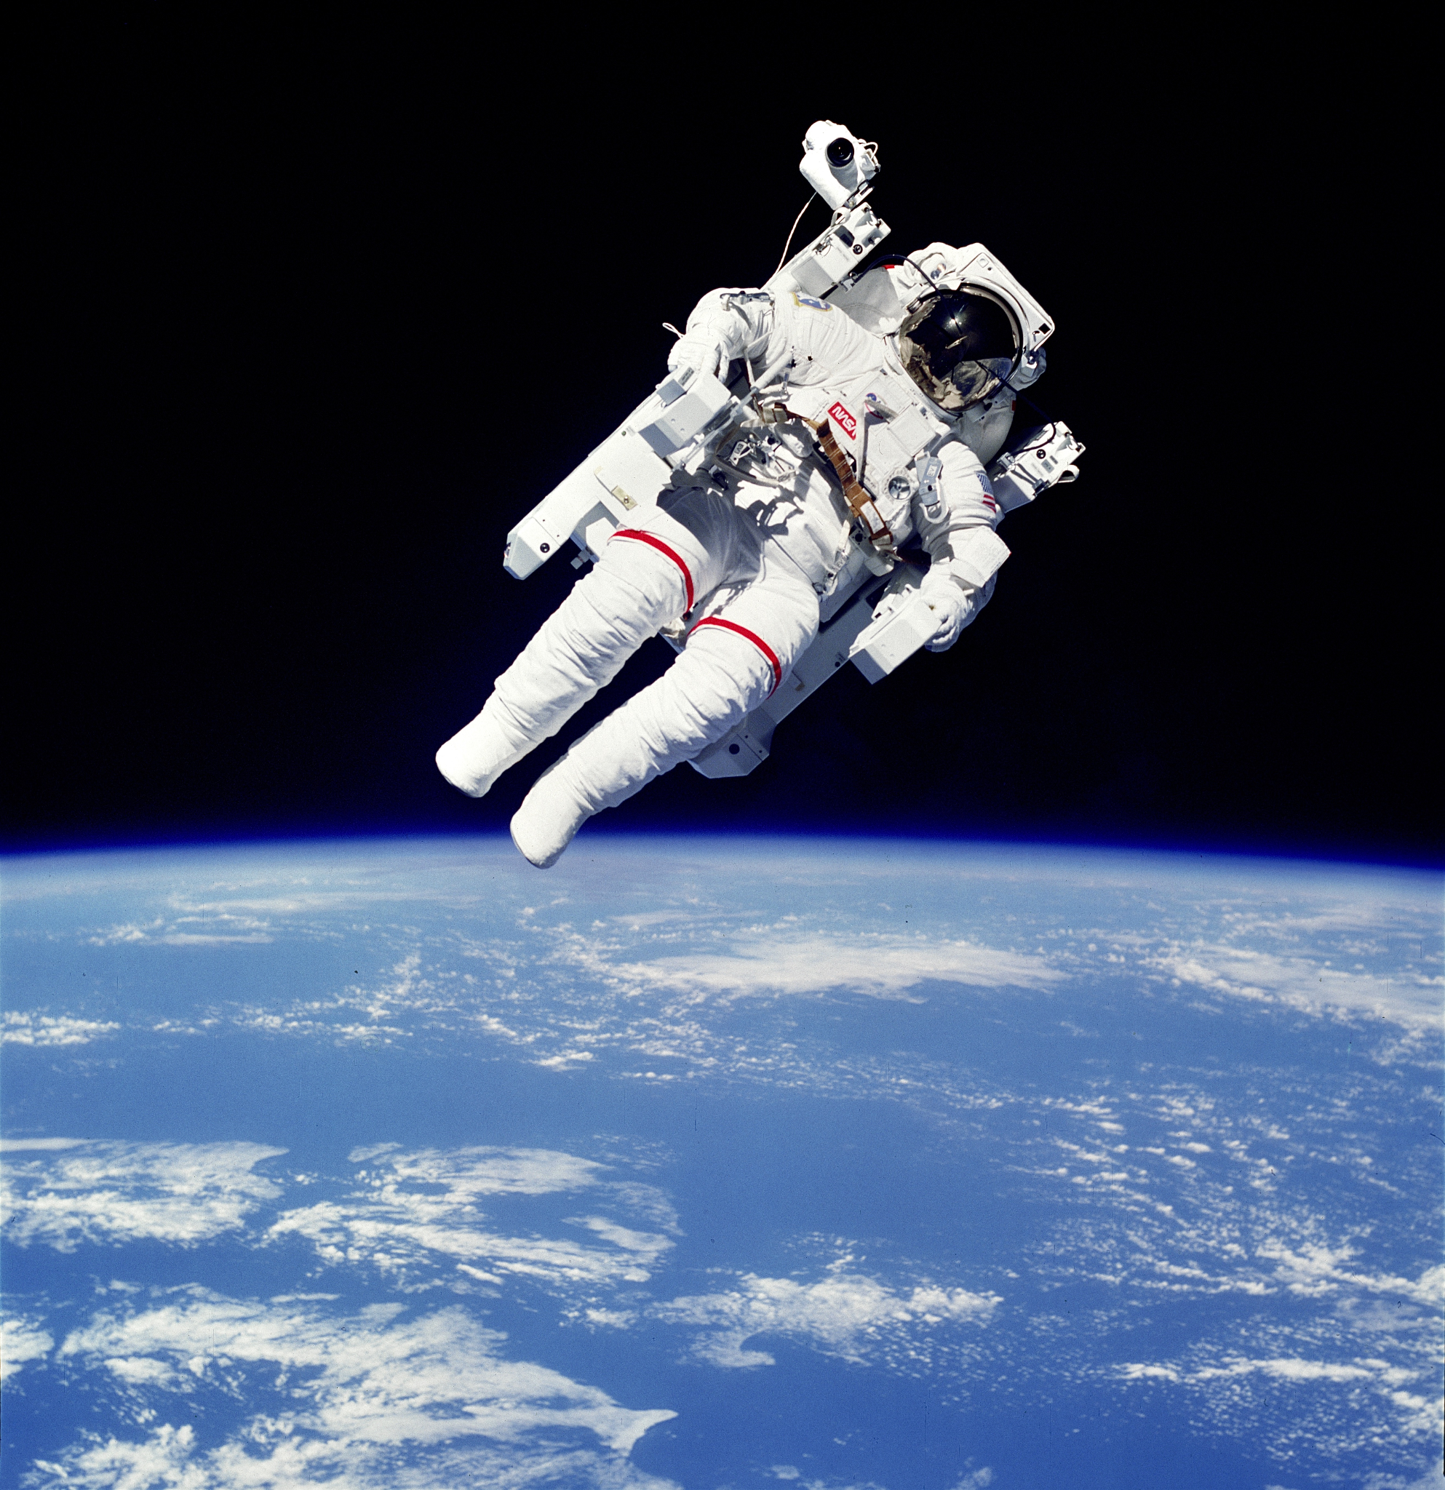
There is no air in space, so there is not medium for waves to travel through. That’s why there is no sound in space!
Notes:
This is also a non-example of a wave. There is no air in space, so there is not medium for waves to travel through. That’s why there is no sound in space!

Slide 34
Notes:
Now let’s pause for a moment to check your understanding.

Slide 35
Why can sound waves move on Earth but not in space?
Notes:
Why can sound waves move on Earth but not in space?

Slide 36
Remember!!!
Notes:
So remember!

Slide 37
Wave: repeating motion that carries energy from one place to another
Notes:
A wave is a repeating motion that carries energy from one place to another.

Slide 38
Notes:
We will now complete this concept map, called a Frayer model, to summarize and further clarify what you have learned about the term wave.

Slide 39
Definition
Picture
Wave
Example
How do waves impact my life?
Notes:
To complete the Frayer model, we will choose from four choices the correct picture, definition, example, and response to the question, “How do waves impact my life?” Select the best response for each question using the information you just learned. As we select responses, we will see how this model looks filled in for the term wave.

Slide 40
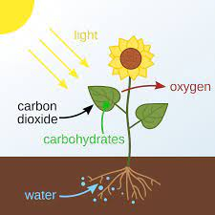
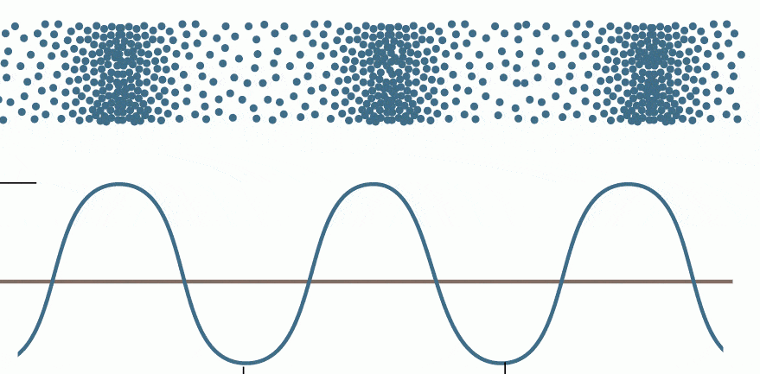
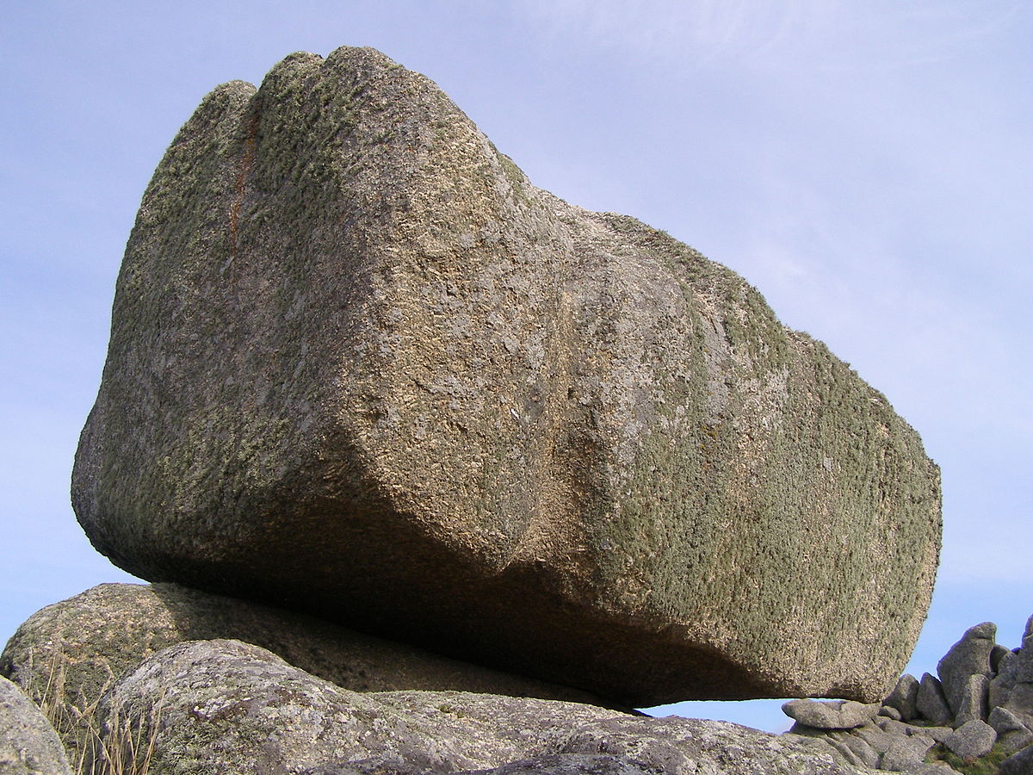
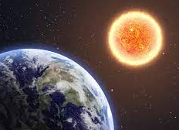
Directions: Choose the correct picture of a wave from the choices below.
A
B
C
D
Notes:
Choose the one correct picture of a wave from these four choices.

Slide 41
Directions: Choose the correct picture of a wave from the choices below.
A
B
C
D
Notes:
This is the picture that shows a wave.

Slide 42
Definition
Picture
Wave
Example
How do waves impact my life?
Notes:
Here is the Frayer model filled in with a picture of a wave.

Slide 43
Directions: Choose the correct definition of wave from the choices below.
A
Preserved remains of prehistoric life
B
A push or pull of an object
C
A repeating motion that carries energy from one place to another.
D
A material in which electrons can not move around easily
Notes:
Choose the one correct definition of wave from these four choices.

Slide 44
Directions: Choose the correct definition of wave from the choices below.
A
Preserved remains of prehistoric life
B
A push or pull of an object
C
A repeating motion that carries energy from one place to another.
D
A material in which electrons can not move around easily
Notes:
“A repeating motion that carries energy from one place to another” is correct! This is the definition of wave.

Slide 45
Definition
Picture
A repeating motion that carries energy from one place to another.
Wave
Example
How do waves impact my life?
Notes:
Here is the Frayer Model with a picture and the definition filled in for wave: a repeating motion that carries energy from one place to another.

Slide 46
Directions: Choose the correct example of a wave from the choices below.
A
A book sitting on a desk
B
An apple hanging on a tree
C
A bunny sleeping in a field
D
A ripple of water in a pond
Notes:
Choose the one correct example of a wave from these four choices.

Slide 47
Directions: Choose the correct example of a wave from the choices below.
A
A book sitting on a desk
B
An apple hanging on a tree
C
A bunny sleeping in a field
D
A ripple of water in a pond
Notes:
“a ripple of water in a pond” is correct! This is an example of a wave.

Slide 48
Definition
Picture
A repeating motion that carries energy from one place to another.
Wave
A ripple of water in a pond
Example
How do waves impact my life?
Notes:
Here is the Frayer Model with a picture, definition, and an example of a wave: a ripple of water in a pond.

Slide 49
Directions: Choose the correct response for “how do waves impact my life?” from the choices below.
A
Waves carry sound and light energy that help me to see and hear the world around me.
B
Waves are in the food we eat and give us the nutrition our bodies need to survive
C
Waves keep the Earth moving around the Sun so we experience four seasons.
Waves provide us shelter and protect us from extreme weather and temperatures
D
Notes:
Choose the one correct response for “how do waves impact my life?” from these four choices.

Slide 50
Directions: Choose the correct response for “how do waves impact my life?” from the choices below.
A
Waves carry sound and light energy that help me to see and hear the world around me.
B
Waves are in the food we eat and give us the nutrition our bodies need to survive
C
Waves keep the Earth moving around the Sun so we experience four seasons.
Waves provide us shelter and protect us from extreme weather and temperatures
D
Notes:
“Waves carry sound and light energy that help me to see and hear the world around me.” That is correct! This is an example of how waves impacts your life.

Slide 51
Definition
Picture
A repeating motion that carries energy from one place to another.
Wave
Waves carry sound and light energy that help me to see and hear the world around me.
A ripple of water in a pond
Example
How do waves impact my life?
Notes:
Here is the Frayer Model with a picture, definition, example, and a correct response to “how do waves impact my life?”: Waves carry sound and light energy that help me to see and hear the world around me.

Slide 52
Remember!!!
Notes:
So remember!

Slide 53
Wave: repeating motion that carries energy from one place to another
Notes:
A wave is a repeating motion that carries energy from one place to another.

Slide 54
Big Question: What are the properties of waves and how are they related?
Notes:
Let’s reflect again on our big question. Our “big question” is: What are the properties of waves and how are they related?
Does anyone have any additional examples to share that haven’t been discussed yet?
In our “big question,” there are two more vocabulary words we need to explore before we move onto our simulation activity.

Slide 55
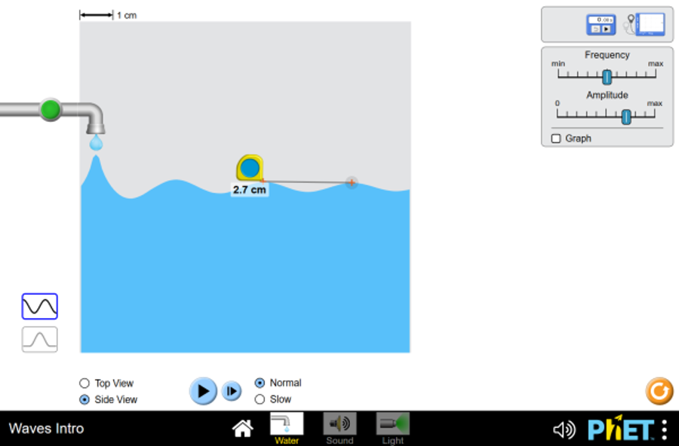
Simulation Activity
Intro to Waves
Notes:
Feedback: Giving students a chance to analyze and interpret data is a great way to help them to continue to independently problem solve.

Slide 56
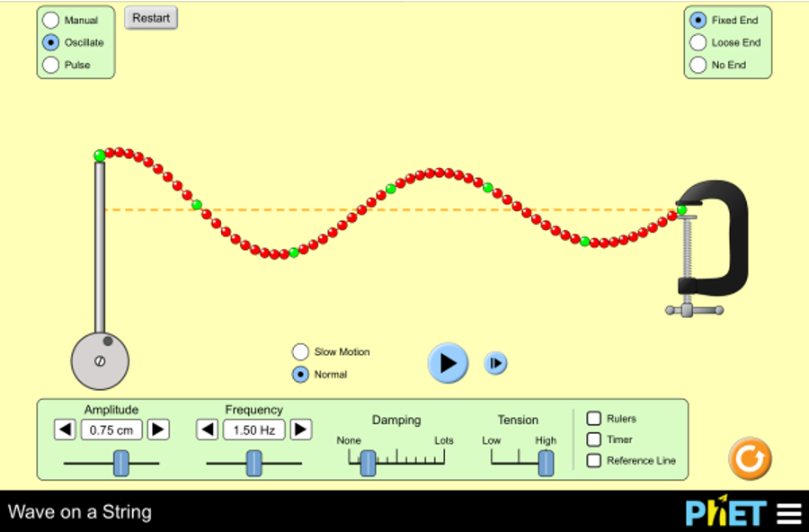
Simulation Activity
Wave on a String

Slide 57
Intro
“Big Idea” Question
Review Concepts
Check-In Questions
Teacher Engagement
Vocabulary
Student-Friendly Definition
Examples & Non-Examples
Morphological Word Parts
Frayer Model
Simulation/Activity
Notes:
OK everyone, get ready for our next lesson. Just as a reminder, these are the different components that our lesson may include, and you’ll see these icons in the top left corner of each slide so that you can follow along more easily!

Slide 58
Wavelength
Intro
Notes:
Today, we’ll be learning about the word: wavelength.
Feedback: Using clear and simple language when introducing content helps students understand what is expected.

Slide 59
Big Question: What are the properties of waves and how are they related?
Notes:
Our “big question” is: What are the properties of waves and how are they related?
[Pause and illicit predictions from students.]
I love all these thoughtful scientific hypotheses! Be sure to keep this question and your predictions in mind as we move through these next few lessons, and we’ll continue to revisit it.

Slide 60
Notes:
Before we move on to our new topic, let’s review some other words & concepts that you already learned and make sure you are firm in your understanding.

Slide 61
Wave: repeating motion that carries energy from one place to another
Notes:
A wave is a repeating motion that carries energy from one place to another.

Slide 62
Notes:
Now let’s pause for a moment to review the information we have covered already.

Slide 63
A wave is a repeating motion that carries ______________ from one place to another.
Notes:
A wave is a repeating motion that carries _______ from one place to another.
[energy]

Slide 64
A wave is a repeating motion that carries energy from one place to another.
Notes:
A wave is a repeating motion that carries energy from one place to another.

Slide 65
Wavelength
Notes:
Now that we’ve reviewed, let’s define the term wavelength.

Slide 66
Wavelength: the distance between two like points on a wave
Notes:
Wavelength is the distance between two like points on a wave.

Slide 67
Notes:
Let’s check-in for understanding.

Slide 68
What is wavelength?
Notes:
What is a wavelength?
[the distance between two like points on a wave]

Slide 69
Notes:
That is the basic definition, but there is a bit more you need to know.

Slide 70
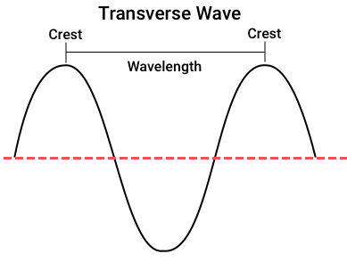
Notes:
Wavelength describes how long a wave is. You can measure a wave from the top of the wave, called a crest, to the next crest.

Slide 71
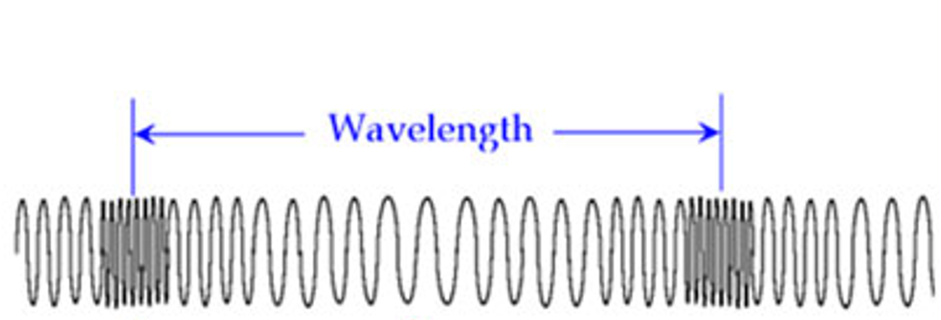
Notes:
Wavelength can also be measured from areas where particles are closely packed together, called a compression, to the next compression.

Slide 72
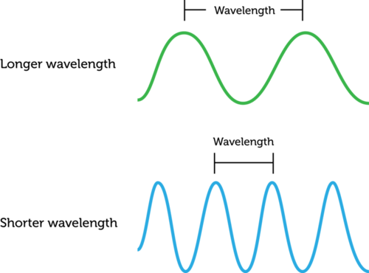
Notes:
Wavelengths can be long or short. The more waves there are, the shorter the wavelength is going to be.

Slide 73
Notes:
Let’s check-in for understanding.

Slide 74
True or False:
Wavelength describes how high or low a wave is.
Notes:
True or false: wavelength describes how high or low a wave is.

Slide 75
False
Wavelength describes how high or low a wave is.
Notes:
False

Slide 76
Notes:
Now, let’s talk about some examples of wavelength.

Slide 77
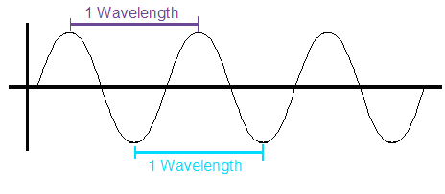
This is an example of wavelength because it shows the distance between two like points on a wave.
Notes:
This is an example of wavelength because it shows the distance between two like points on a wave. These points are farther apart so their wavelength would be larger than points that are closer together.
Feedback: Remember to try and use phrasing and language that is clear and easy for students to understand when going over examples of term meaning

Slide 78
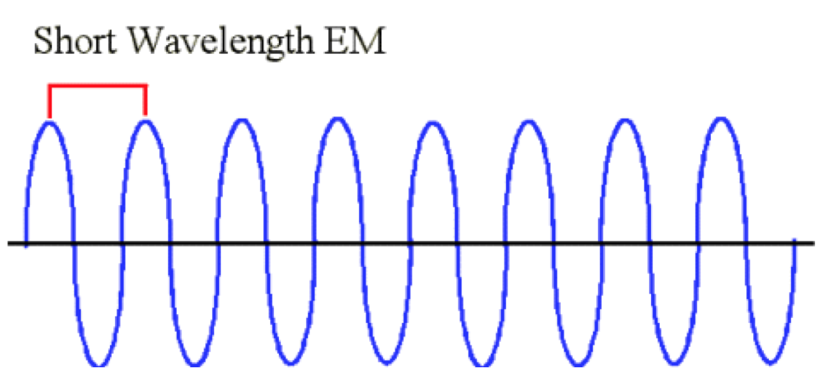
The distance between two like points on the wave are shorter, so the wavelength is shorter.
Notes:
Here is another example of wavelength. The distance between two like points on the wave are shorter, so the wavelength is shorter.

Slide 79
Notes:
Let’s check-in for understanding.

Slide 80
What is a wavelength?
Notes:
What is a wavelength?
[The distance between two like points on a wave]

Slide 81
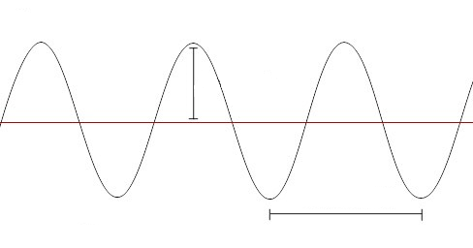
Does the arrow show a wavelength?
Notes:
Does the arrow show a measure of wavelength?
[Yes]

Slide 82
Notes:
Now, let’s talk about some non-examples of wavelength.

Slide 83
The height of a wave is not its wavelength. This is called a wave’s amplitude.
Notes:
The height of a wave is not its wavelength. This is called a wave’s amplitude. We’ll talk about this later.

Slide 84
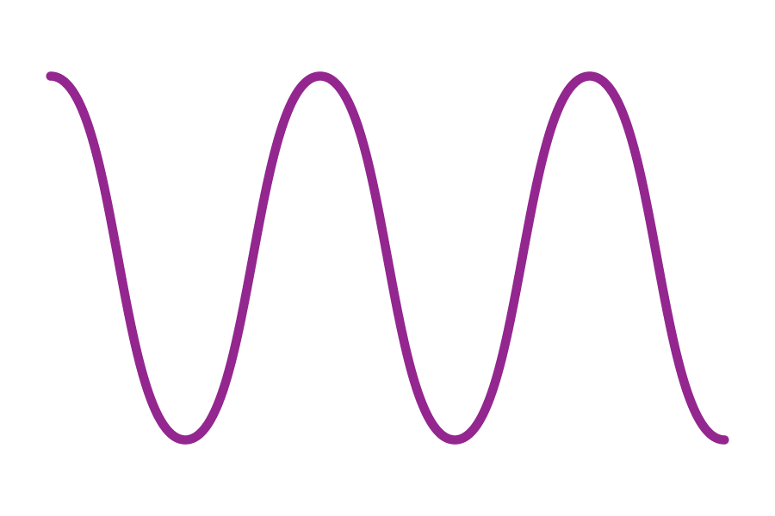
The tallest point of a wave is also not its wavelength. This point is called the wave’s crest.
Notes:
The tallest point of a wave is also not its wavelength. This point is called the wave’s crest. Wavelength is not one single point on a wave, but the distance between two similar points.

Slide 85
Notes:
Now let’s pause for a moment to check your understanding.

Slide 86
Which letter shows a wavelength?
A
C
B
Notes:
Which letter shows a wavelength?

Slide 87
Which letter shows a wavelength?
A
C
B
Notes:
Letter B shows a wavelength.

Slide 88
Notes:
We can also break down the term wavelength into different word parts to help us remember the meaning. Let’s take a look!

Slide 89
Wavelength
(word)
(word)
Notes:
Wavelength is a compound word. We can break it up into two individual words: wave and length.

Slide 90
Wavelength
repeating motions that carry energy from one place to another
Notes:
Remember that waves are repeating motions that carry energy from one place to another.

Slide 91
Wavelength
distance from one point to another
Notes:
And length is the distance from one point to another.

Slide 92
Wave + length
distance from one wave to another
Notes:
So wavelength is the distance from one wave to another.

Slide 93
Remember!!!
Notes:
So remember!

Slide 94
Wavelength: the distance between two like points on a wave
Notes:
Wavelength is the distance between two like points on a wave.

Slide 95
Notes:
We will now complete this concept map, called a Frayer model, to summarize and further clarify what you have learned about the term wavelength.

Slide 96
Definition
Picture
Wavelength
Example
How does wavelength impact my life?
Notes:
To complete the Frayer model, we will choose from four choices the correct picture, definition, example, and response to the question, “How does wavelength impact my life?” Select the best response for each question using the information you just learned. As we select responses, we will see how this model looks filled in for the term wavelength.

Slide 97
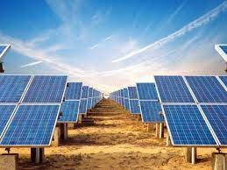
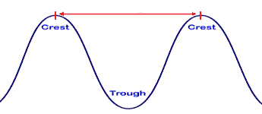
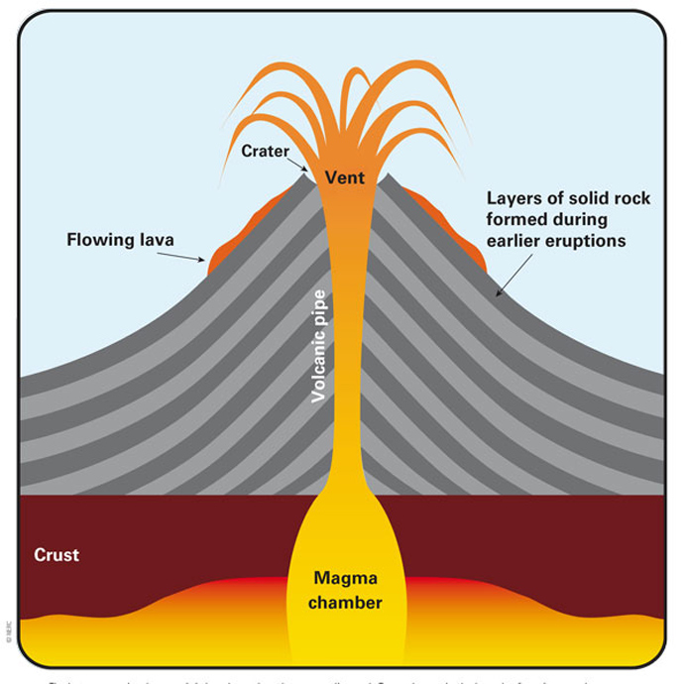
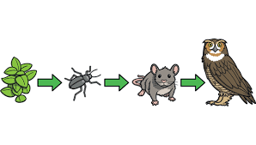
Directions: Choose the correct picture of wavelength from the choices below.
A
B
C
D
Notes:
Choose the one correct picture of wavelength from these four choices.

Slide 98
Directions: Choose the correct picture of wavelength from the choices below.
A
B
C
D
Notes:
This is the picture that shows wavelength.

Slide 99
Definition
Picture
Wavelength
Example
How does wavelength impact my life?
Notes:
Here is the Frayer model filled in with a picture of wavelength.

Slide 100
Directions: Choose the correct definition of wavelength from the choices below.
A
The ability to cause change
B
The distance between two like points on a wave
C
Earth materials, like rock and soil, are worn away and moved by wind and water
D
A force that resists the motion of two surfaces that are touching
Notes:
Choose the one correct definition of wavelength from these four choices.

Slide 101
Directions: Choose the correct definition of wavelength from the choices below.
A
The ability to cause change
B
The distance between two like points on a wave
C
Earth materials, like rock and soil, are worn away and moved by wind and water
D
A force that resists the motion of two surfaces that are touching
Notes:
“The distance between two like points on a wave” is correct! This is the definition of wavelength.

Slide 102
Definition
Picture
The distance between two like points on a wave
Wavelength
Example
How does wavelength impact my life?
Notes:
Here is the Frayer Model with a picture and the definition filled in for wavelength: the distance between two like points on a wave

Slide 103
Directions: Choose the correct example of wavelength from the choices below.
A
The number of candles on a birthday cake
B
The time is takes to get to school in the morning
C
The height of a roller coaster before it goes down the hill
D
The distance between the top of an ocean wave and the next ocean wave
Notes:
Choose the one correct example of wavelength from these four choices.

Slide 104
Directions: Choose the correct example of wavelength from the choices below.
A
The number of candles on a birthday cake
B
The time is takes to get to school in the morning
C
The height of a roller coaster before it goes down the hill
D
The distance between the top of an ocean wave and the next ocean wave
Notes:
“The distance between the top of an ocean wave and the next ocean wave” is correct! This is an example of wavelength.

Slide 105
Definition
Picture
The distance between two like points on a wave
Wavelength
The distance
between the top of an ocean wave and the next ocean wave
Example
How does wavelength impact my life?
Notes:
Here is the Frayer Model with a picture, definition, and an example of wavelength: The distance between the top of an ocean wave and the next ocean wave

Slide 106
Directions: Choose the correct response for “how does wavelength impact my life?” from the choices below.
A
Different wavelengths impact how we see light and hear sound in our environment
B
Wavelengths help us measure how far we need to travel to get to important places in our daily lives
C
Wavelengths impact how hot or cold the weather is and what we need to wear to stay comfortable
D
Different wavelengths are used by different animals to get nutrients they need to survive
Notes:
Choose the one correct response for “how does wavelength impact my life?” from these four choices.

Slide 107
Directions: Choose the correct response for “how does wavelength impact my life?” from the choices below.
A
Different wavelengths impact how we see light and hear sound in our environment
B
Wavelengths help us measure how far we need to travel to get to important places in our daily lives
C
Wavelengths impact how hot or cold the weather is and what we need to wear to stay comfortable
D
Different wavelengths are used by different animals to get nutrients they need to survive
Notes:
“Different wavelengths impact how we see light and hear sound in our environment.” That is correct! This is an example of how wavelength impacts your life.

Slide 108
Definition
Picture
The distance between two like points on a wave
Wavelength
The distance
between the top of an ocean wave and the next ocean wave
Different wavelengths impact how we see light and hear sound in our environment
Example
How does wavelength impact my life?
Notes:
Here is the Frayer Model with a picture, definition, example, and a correct response to “how do wavelength impact my life?”: Different wavelengths impact how we see light and hear sound in our environment.

Slide 109
Remember!!!
Notes:
So remember!

Slide 110
Wavelength: the distance between two like points on a wave
Notes:
Wavelength is the distance between two like points on a wave.

Slide 111
Big Question: What are the properties of waves and how are they related?
Notes:
Let’s reflect again on our big question. Our “big question” is: What are the properties of waves and how are they related?
Does anyone have any additional examples to share that haven’t been discussed yet?
In our “big question,” there are two more vocabulary words we need to explore before we move onto our simulation activity.

Slide 112
Intro
“Big Idea” Question
Review Concepts
Check-In Questions
Teacher Engagement
Vocabulary
Student-Friendly Definition
Examples & Non-Examples
Morphological Word Parts
Frayer Model
Simulation/Activity
Notes:
OK everyone, get ready for our next lesson. Just as a reminder, these are the different components that our lesson may include, and you’ll see these icons in the top left corner of each slide so that you can follow along more easily!

Slide 113
Compression Wave
Intro
Notes:
Today we will learn about compression waves.

Slide 114
Big Question: What are the properties of waves and how are they related?
Notes:
Our “big question” is: What are the properties of waves and how are they related?
[Pause and illicit predictions from students.]
I love all these thoughtful scientific hypotheses! Be sure to keep this question and your predictions in mind as we move through these next few lessons, and we’ll continue to revisit it.

Slide 115
Notes:
Before we move on to our new vocabulary term, let’s review some other words & concepts that you already learned and make sure you are firm in your understanding.
Feedback: Referring to prior topics that are relevant and on topic helps students make connections to the new content they will be learning and tie it to prior knowledge.

Slide 116
Wave: repeating motion that carries energy from one place to another
Notes:
A wave is a repeating motion that carries energy from one place to another.

Slide 117
Wavelength: the distance between two like points on a wave
Notes:
Wavelength is the distance between two like points on a wave.

Slide 118
Notes:
Now let’s pause for a moment to check your understanding.
Feedback: Remember to make adjustments to your lesson and content if you see some students not demonstrating understanding, this can help them make connections and prevent frustration.

Slide 119
A wave is a _______ _________ that carries energy from one place to another.
Notes:
A wave is a _________ ___________ that carries energy from one place to another.
[repeating motion]

Slide 120
A wave is a repeating motion that carries energy from one place to another.
Notes:
A wave is a repeating motion that carries energy from one place to another.

Slide 121
True or False:
Wavelength is the distance between two like points on a wave.
Notes:
True or False: Wavelength is the distance between two like points on a wave.

Slide 122
True :
Wavelength is the distance between two like points on a wave.
Notes:
True: Wavelength is the distance between two like points on a wave.

Slide 123
Compression Wave
Notes:
Now that we’ve reviewed, let’s define our new term, compression wave.

Slide 124
Compression Wave: a type of wave where the particles move back and forth in the same direction the wave is moving
Notes:
A compression wave is a type of wave where the particles move back and forth in the same direction the wave is moving.
Feedback: When providing more student-friendly definitions, it is helpful to provide students with cues so that they can be prepared and know what to expect and be ready to copy down the information.

Slide 125
Notes:
Now let’s pause for a moment to check your understanding.

Slide 126
A compression wave is a type of wave where the particles move back and forth in the _______ _________ the wave is moving
same direction
different direction
Notes:
A compression wave is a type of wave where the particles move back and forth in the _______ ________ the wave is moving.
[A. same direction]

Slide 127
A compression wave a type of wave where the particles move back and forth in the _______ _________ the wave is moving
same direction
different direction
Notes:
A compression wave is a type of wave where the particles move back and forth in the same direction the wave is moving.

Slide 128
Notes:
That is the basic definition, but there is a bit more you need to know.

Slide 129
Notes:
Compression waves move like a slinky. If you push one end of the slinky toward the other and then pull it back, you create sections of a slinky that are bunched up and others that are spread out. Like the slinky, the compression waves have sections where the particles of bunched together tightly and sections where they are spread out.

Slide 130
Compression waves have areas of compression.
Notes:
Compression waves have two sections. Compressions are areas where the particles are the closest together.

Slide 131
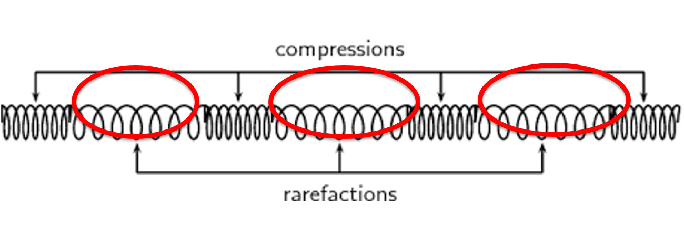
Compression waves also have areas of rarefactions
Notes:
Rarefactions are areas where the particles are most spread out.

Slide 132
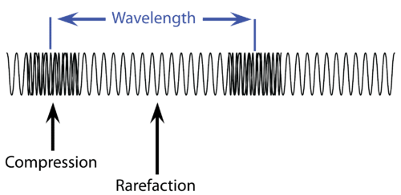
Notes:
A compression wave’s wavelength can be measured from one area of compression to the next, or one area of rarefaction to the next.

Slide 133
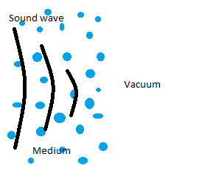
Notes:
Compression waves need some kind of matter, called a medium, to travel though. They can travel through solids, liquids, or gases - like air. Without a medium, there is nothing to move back and forth.

Slide 134
Notes:
Now let’s pause for a moment to check your understanding.

Slide 135
What part of a compression wave is this?
compression
rarefaction
Notes:
What part of a compression wave is this?
[A. compression]

Slide 136
What part of a compression wave is this?
compression
rarefaction
Notes:
What part of a compression wave is this?
[A. compression]

Slide 137
How do you measure wavelength for a compression wave?
Notes:
How do you measure wavelength for a compression wave?
[length from one area of compression or rarefaction to the next]

Slide 138
Compression waves move through a _____________.
medium
empty space
Notes:
Compression waves move through a _________
[a. medium]

Slide 139
Compression waves move through a _____________.
medium
empty space
Notes:
Compression waves move through a medium.

Slide 140
Notes:
Now, let’s talk about some examples of compression waves.

Slide 141
Sound waves are a kind of compression wave. When someone talks or claps their hands, they create vibrations in the air.
Direction of wave
Notes:
Sound waves are a kind of compression wave. When someone talks or claps their hands, they create vibrations in the air that moves toward our ears so we can hear the sound.

Slide 142
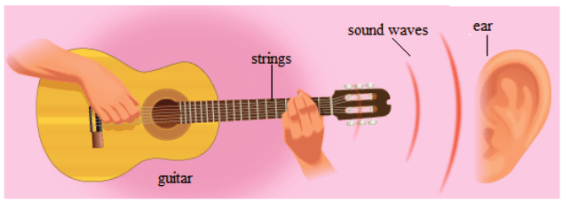
When you pluck the string on a guitar, the movement of the string back and forth creates a compression wave.
Notes:
This is how musical instruments make music. When you pluck the string on a guitar, the movement of the string back and forth creates a compression wave that moves from the guitar to your ear.

Slide 143
Notes:
Next, let’s talk about some non-examples of compression waves.
Feedback: One important component of using non-examples is by clearly distinguishing similarities and explaining why it is a non-example.

Slide 144
The particles are moving up and down instead of the same direction as the wave.
Direction of wave
Notes:
This is not an example of a compression wave. The particles are moving up and down instead of the same direction as the wave.

Slide 145
The particles are moving up and down instead of the same direction as the wave.
Notes:
Light waves are not a kind of compression wave. Light creates an up and down movement of particles when it moves through air. These are called transverse waves.

Slide 146
Notes:
Now let’s pause for a moment to check your understanding.

Slide 147
What is a compression wave?
Notes:
A compression wave is a type of wave where the particles move back and forth in the same direction the wave is moving.

Slide 148
Which one is an example of a compression wave?
Notes:
Which one is an example of a compression wave?
Feedback: It is important to take time throughout the close of the lesson to check for understanding one last time, this will help you know who may need more instruction or where further explanation is needed.

Slide 149
Which one is an example of a compression wave?
Notes:
Which one is an example of a compression wave?
Feedback: It is important to take time throughout the close of the lesson to check for understanding one last time, this will help you know who may need more instruction or where further explanation is needed.

Slide 150
How do musical instruments create sound?
Notes:
How do musical instruments create sound?
[the vibration of a string creates waves in the air that travel to our ears]
Feedback: It is important to take time throughout the close of the lesson to check for understanding one last time, this will help you know who may need more instruction or where further explanation is needed.

Slide 151
Remember!!!
Notes:
So remember!

Slide 152
Compression Wave: a type of wave where the particles move back and forth in the same direction the wave is moving
Notes:
A compression wave is a type of wave where the particles move back and forth in the same direction the wave is moving.

Slide 153
Notes:
We can also break down the term compression wave into different word parts to help us remember the meaning. Let’s take a look!

Slide 154
Compression Wave
(root)
(suffix)
Notes:
We can break up the term compression into two parts: root and suffix.

Slide 155
Compression Wave
Compress : to squeeze or press together
Notes:
Compress means to squeeze or press together.

Slide 156
Compression Wave
-ion: a process or result
Notes:
The suffix -ion means a process or result.

Slide 157
Compress + ion Wave
Compression
The process of being squeezed or pressed together
Notes:
So compression means the process of being squeezed or pressed together. A compression wave is a wave created by particles being pressed or squeezed together.

Slide 158
Remember!!!
Notes:
So remember!

Slide 159
Compression Wave: a type of wave where the particles move back and forth in the same direction the wave is moving
Notes:
A compression wave is a type of wave where the particles move back and forth in the same direction the wave is moving.

Slide 160
Notes:
We will now complete this concept map, called a Frayer model, to summarize and further clarify what you have learned about the term compression wave.

Slide 161
Definition
Picture
Compression Wave
How do compression waves
impact my life?
Example
Notes:
To complete the Frayer model, we will choose from four choices the correct picture, definition, example, and response to the question, “How does compression wave impact my life?” Select the best response for each question using the information you just learned. As we select responses, we will see how this model looks filled in for the term compression wave.

Slide 162
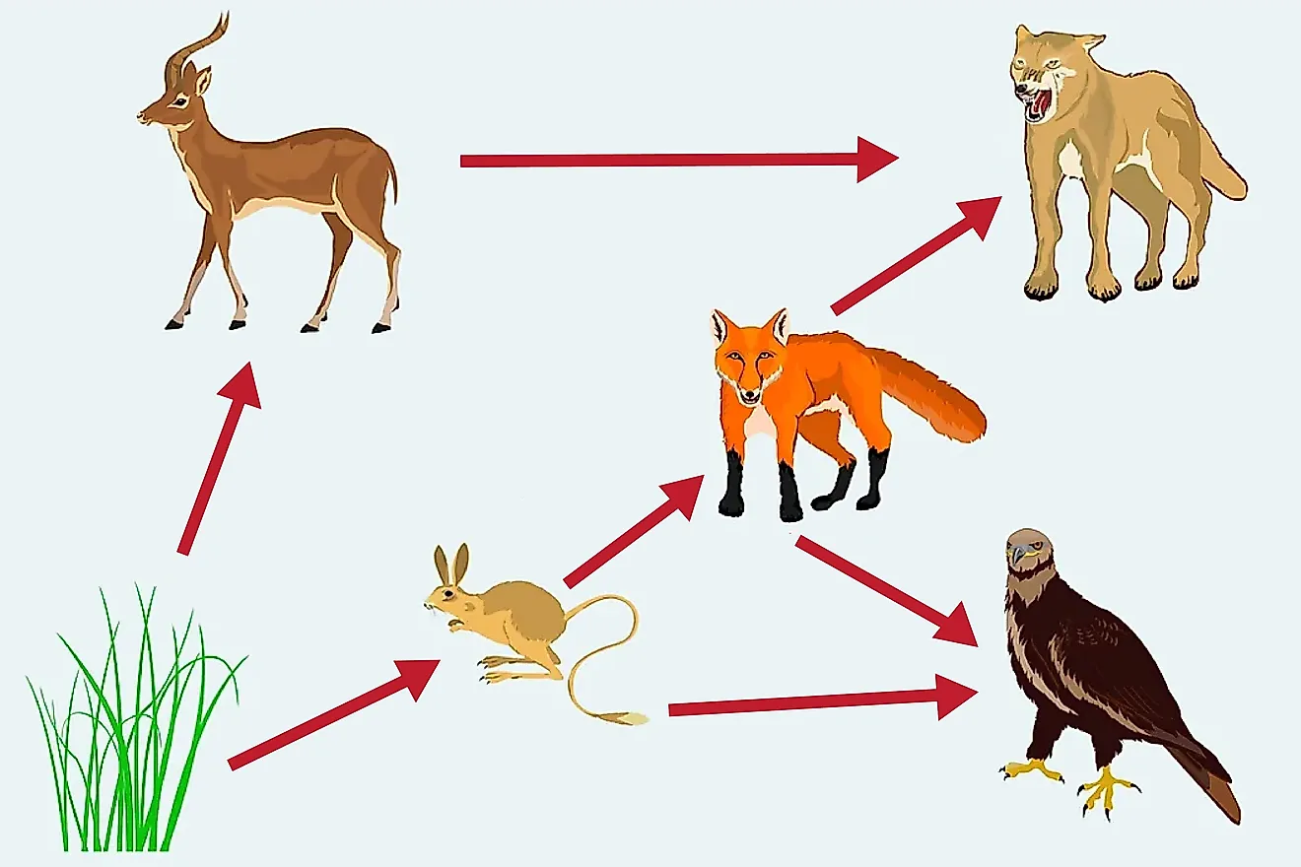
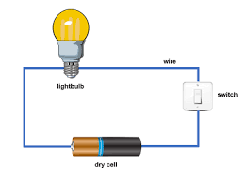
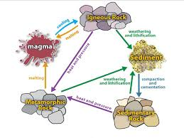
Directions: Choose the correct picture of a compression wave from the choices below.
A
B
C
D
Notes:
Choose the one correct picture of a compression wave from these four choices.

Slide 163
Directions: Choose the correct picture of a compression wave from the choices below.
A
B
C
D
Notes:
This is the picture that shows a compression wave.

Slide 164
Definition
Picture
Compression Wave
How do compression waves
impact my life?
Example
Notes:
Here is the Frayer model filled in with a picture of a compression wave.

Slide 165
Directions: Choose the correct definition of compression wave from the choices below.
A
Energy from heat
B
A type of wave where the particles move back and forth in the same direction the wave is moving
C
A force that surrounds all magnets, that moves electrically charged particles in a circular path​
D
The process of breaking down rock over long periods of time
Notes:
Choose the one correct definition of compression wave from these four choices.

Slide 166
Directions: Choose the correct definition of compression wave from the choices below.
A
Energy from heat
B
A type of wave where the particles move back and forth in the same direction the wave is moving
C
A force that surrounds all magnets, that moves electrically charged particles in a circular path​
D
The process of breaking down rock over long periods of time
Notes:
“A type of wave where the particles move back and forth in the same direction the wave is moving” is correct! This is the definition of compression wave.

Slide 167
Definition
Picture
A type of wave where the particles move back and forth in the same direction the wave is moving
Compression Wave
How do compression waves
impact my life?
Example
Notes:
Here is the Frayer Model with a picture and the definition filled in for compression wave: a type of wave where the particles move back and forth in the same direction the wave is moving.

Slide 168
Directions: Choose the correct example of compression wave from the choices below.
A
A bird protecting her eggs
B
A cake baking in the oven
C
A child practicing the piano
D
A tomato growing in the garden
Notes:
Choose the one correct example of compression wave from these four choices.

Slide 169
Directions: Choose the correct example of compression wave from the choices below.
A
A bird protecting her eggs
B
A cake baking in the oven
C
A child practicing the piano
D
A tomato growing in the garden
Notes:
“A child practicing the piano” is correct! This is an example of a compression wave.

Slide 170
Definition
Picture
A type of wave where the particles move back and forth in the same direction the wave is moving
Compression Wave
A child practicing the piano
How do compression waves
impact my life?
Example
Notes:
Here is the Frayer Model with a picture, definition, and an example of compression wave: a child practicing the piano.

Slide 171
Directions: Choose the correct response for “how do compression waves impact my life?” from the choices below.
A
Compression waves keep the air we breathe clean so we can stay healthy.
B
Compression waves helps us hear sounds so we can communicate and enjoy music.
C
Compression waves transmit heat so we can cook our food.
D
Compression waves keep our feet on the ground so we can move around our environment more easily.
Notes:
Choose the one correct response for “how do compression waves impact my life?” from these four choices.

Slide 172
Directions: Choose the correct response for “how do compression waves impact my life?” from the choices below.
A
Compression waves keep the air we breathe clean so we can stay healthy.
B
Compression waves helps us hear sounds so we can communicate and enjoy music.
C
Compression waves transmit heat so we can cook our food.
D
Compression waves keep our feet on the ground so we can move around our environment more easily.
Notes:
“Compression waves helps us hear sounds so we can communicate and enjoy music” That is correct! This is an example of how compression waves impacts your life.

Slide 173
Definition
Picture
A type of wave where the particles move back and forth in the same direction the wave is moving
Compression Wave
Compression waves
helps us hear sounds so we can communicate and enjoy music.
A child practicing the piano
How do compression waves
impact my life?
Example
Notes:
Here is the Frayer Model with a picture, definition, example, and a correct response to “how do compression waves impact my life?”: Compression waves helps us hear sounds so we can communicate and enjoy music.

Slide 174
Remember!!!
Notes:
So remember!

Slide 175
Compression Wave: a type of wave where the particles move back and forth in the same direction the wave is moving
Notes:
A compression wave is a type of wave where the particles move back and forth in the same direction the wave is moving.
Feedback: When providing more student-friendly definitions, it is helpful to provide students with cues so that they can be prepared and know what to expect and be ready to copy down the information.

Slide 176
Big Question: What are the properties of waves and how are they related?
Notes:
Let’s reflect once more on our big question. Our “big question” is: What are the properties of waves and how are they related?
Does anyone have any additional examples to share that haven’t been discussed yet?

Slide 177
Demonstration
Notes:
Let’s do a quick demonstration that will help get our brains ready to think about sound waves, and how it relates to our big question.

Slide 178
Notes:
Thanks for watching, and please continue watching CAPs available from this website.

Slide 179
This Was Created With Resources From:
Questions or Comments
Michael Kennedy, Ph.D. MKennedy@Virginia.edu
Rachel L Kunemund, Ph.D. rk8vm@virginia.edu

