Slide 1
Intro
“Big Idea” Question
Review Concepts
Check-In Questions
Teacher Demo
Vocabulary
Student-Friendly Definition
Examples & Non-Examples
Morphological Word Parts
Simulation/Activity
Notes:
OK everyone, get ready for our next lesson. Just as a reminder, these are the different components that our lesson may include, and you’ll see these icons in the top left corner of each slide so that you can follow along more easily!

Slide 2
Waves
Intro
Notes:
Today we will learn about waves.

Slide 3
Big Question: How is energy transported? What kind of energy is capable of being transported?
Notes:
Our “big question” is: How is energy transported? What kind of energy is capable of being transported?
[Pause and illicit predictions from students.]
I love all these thoughtful scientific hypotheses! Be sure to keep this question and your predictions in mind as we move through these next few lessons, and we’ll continue to revisit it.
Feedback: It is important to encourage students to make their own predictions about what will happen, this is an important step in helping them to understand the content.

Slide 4
Notes:
Before we move on to our new vocabulary term, let’s review some other words & concepts that you already learned and make sure you are firm in your understanding.

Slide 5
Energy: ability to cause change
Notes:
Energy is the ability to cause change.

Slide 6
Energy
Potential Energy
Kinetic Energy
Notes:
Energy can be classified into two different categories.

Slide 7
Potential energy: stored energy
Notes:
Potential energy is stored energy.

Slide 8
Kinetic Energy: energy of motion
Notes:
Kinetic energy is the energy of motion.

Slide 9
Notes:
Now let’s pause for a moment to check your understanding.
Feedback: It's really important to make sure that you're providing students with frequent opportunities to respond as you're activating prior knowledge – it will save so you so much time if you confirm understanding before asking them to try something independently.

Slide 10
What is energy?
Notes:
What is energy?
[Energy is the ability to cause change.]

Slide 11
What is the difference between kinetic energy and potential energy?
Notes:
What is the difference between kinetic energy and potential energy?
[- Kinetic energy is energy from motion.
- Potential energy is stored energy.]

Slide 12
Wave
Notes:
Now that we’ve reviewed, let’s define our new term, wave.

Slide 13
Wave: a disturbance that travels through a medium, moving energy from one place to another
Notes:
A wave is a disturbance that travels through a medium, moving energy from one place to another.
Feedback: Remember to use images with introducing new content such as student-friendly definitions it can help students remember key points and make sense of the new information.

Slide 14
Notes:
Let’s check-in for understanding.

Slide 15
What is a wave?
Notes:
What is a wave?
[A wave is a disturbance that travels through a medium, moving energy from one place to another.]
Feedback: When introducing new vocabularies, it is crucial to require the students to give out their own interpretation. I would strongly encourage you to ask students to explain the concept in their own words.

Slide 16
Notes:
That is the basic definition, but there is a bit more you need to know.

Slide 17
Notes:
Picture a raindrop hitting a still pond. As the raindrop hits the water, a wave is created. The raindrop is the disturbance. It is moving in the pond, which is the medium. The ripples show the water in the pond moving (kinetic energy) from where it was before the raindrop hit it to a new location after the raindrop hit it.

Slide 18
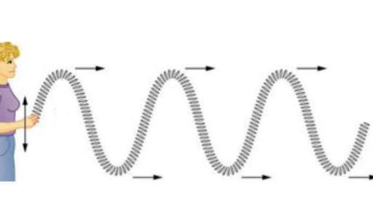
Notes:
Waves can move up and down, like a string. These are called transverse waves. We’ll learn more about these later.
Feedback: It is useful to offer a small preview of the next lesson. This not only offers the students a slight mental preparation for the next lesson but also helps the students see connections between the material.

Slide 19
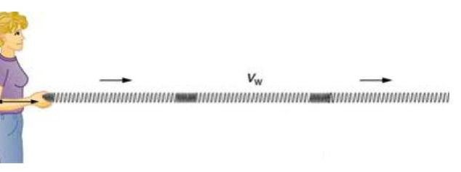
Notes:
Waves can also move side to side, like a slinky. These are called transverse waves. We’ll learn more about these later.

Slide 20
Notes:
Let’s check-in for understanding.

Slide 21
What are different ways that waves move?
Notes:
What are different ways that waves move?
[Up and down or side to side]

Slide 22
Notes:
Let’s look at some examples of waves.

Slide 23
Notes:
All sounds travel as waves. They move sound energy (which we will talk about later) from place to place.
Feedback: Remember to try and use phrasing and language that is clear and easy for students to understand when going over examples of term meaning.

Slide 24
Notes:
Light also travels as waves. It moves radiant energy (which we will talk about later) from place to place.

Slide 25
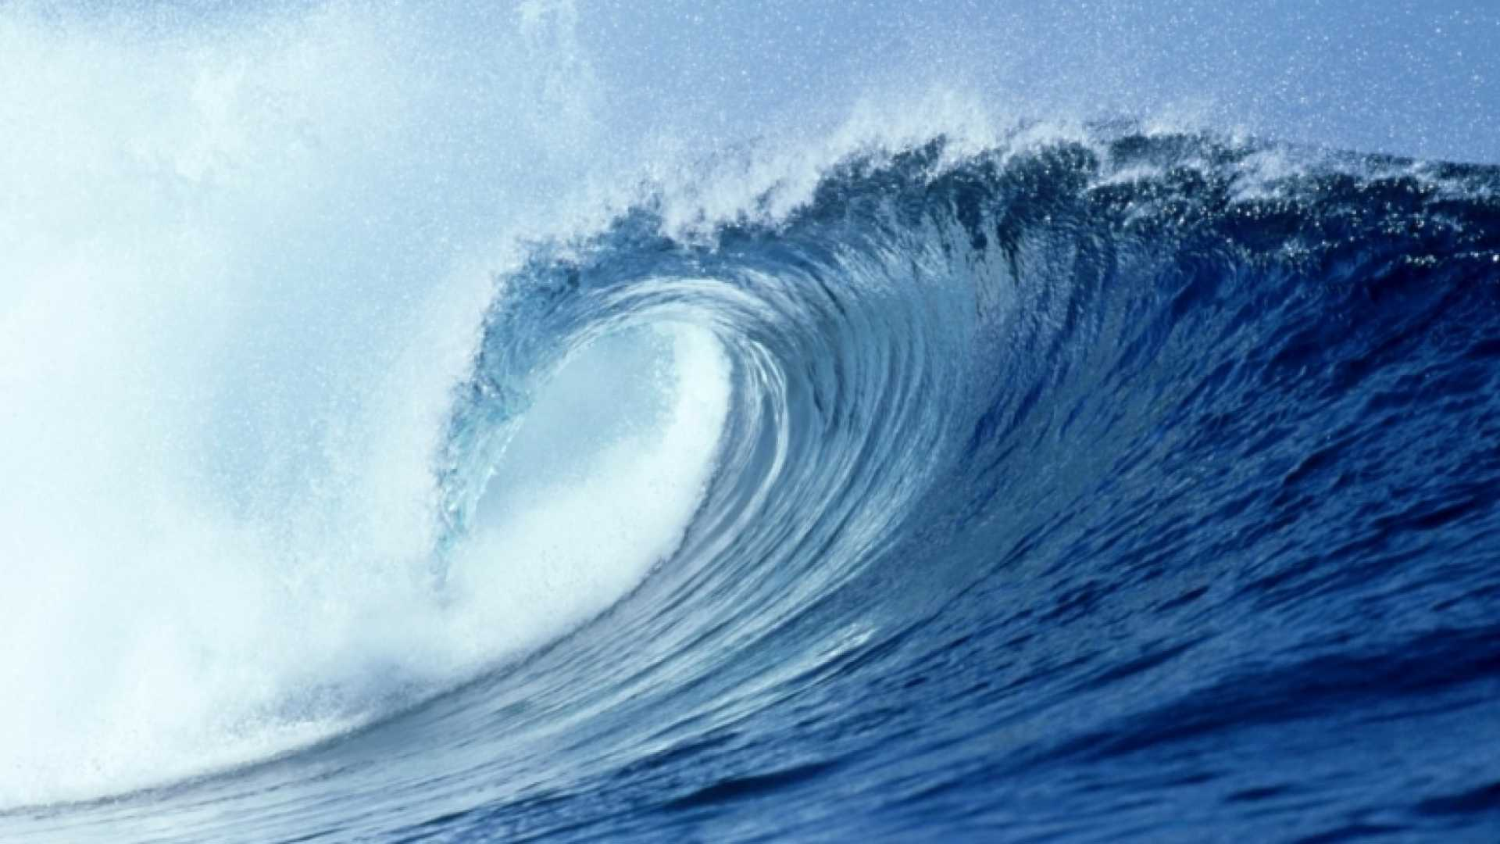
Notes:
Of course, you might also think of waves on the beach. These are also examples of waves, because they move energy from place to place.

Slide 26
Notes:
Let’s check-in for understanding.

Slide 27
What is a wave?
Notes:
What is a wave?
[A wave is a disturbance that travels through a medium, moving energy from one place to another.]

Slide 28
What are some examples of waves?
Notes:
What are some examples of waves?
[Sound waves, light waves, etc.]
Feedback: Having students generate their own examples increases retention and checks a higher level of understanding.

Slide 29
Notes:
That is the basic definition, but there is a bit more you need to know.

Slide 30
Energy Carried by Waves
Sound Energy
Radiant Energy
Notes:
Energy carried by waves is either sound energy or radiant energy.

Slide 31
Energy Carried by Waves
Sound Energy
Radiant Energy
Notes:
First, we’ll look at sound energy.

Slide 32
Sound Energy: energy that is carried by vibration of one or more objects or particles
Notes:
Sound energy is energy that is carried by vibration of one or more objects or particles.
Feedback: When providing more student-friendly definitions, it is helpful to provide students with cues so that they can be prepared and know what to expect and be ready to copy down the information.

Slide 33
Notes:
Sound energy is why we can hear things.

Slide 34
Notes:
When the raindrop hits water, it emits sound waves that travel to the ear and allows us to hear.

Slide 35
Notes:
Sound waves need to travel through matter. Sound waves cannot travel in space.

Slide 36
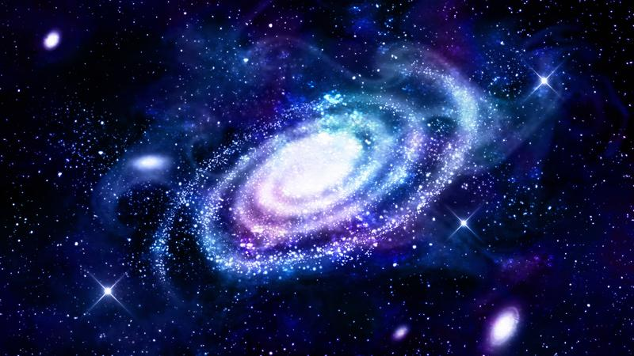
Notes:
This is why you cannot hear in space.

Slide 37
Notes:
Let’s look at some examples of sound energy.

Slide 38
Notes:
The sound coming from your headphones travels through sound energy.
Feedback: Using clear and concise language is a great way to ensure students are able to follow along and understand the content.

Slide 39
Notes:
Talking also requires sound energy. Your larynx vibrates which creates sound waves that carry sound energy.

Slide 40
Notes:
Let’s check-in for understanding.

Slide 41
What is sound energy?
Notes:
What is sound energy?
[Sound energy is energy that is carried by vibration of one or more objects or particles.]
Feedback: Remember the clarity of language is important when teaching vocabulary. Keep your questions simple when asking for students to state the definition.

Slide 42
Why can’t we hear in space?
Notes:
Why can’t we hear in space?
[Sound needs a medium to travel - that’s why we can’t hear in space.]

Slide 43
What are some examples of sound energy?
Notes:
What are some examples of sound energy?

Slide 44
Energy Carried by Waves
Sound Energy
Radiant Energy
Notes:
Next, we’ll look at radiant energy.

Slide 45
Radiant Energy: energy that is carried by electromagnetic radiation
Notes:
Radiant energy is energy that is carried by electromagnetic radiation.
Feedback: Longer more formal definitions are tricky so it is even more important to use clear language when providing the new definition.

Slide 46
Notes:
Radiant energy can travel in space. It does not need matter.

Slide 47
Notes:
Radiant energy can also be gamma rays, or x-rays. We can only see visible light.

Slide 48
Notes:
Let’s look at some examples of radiant energy.

Slide 49
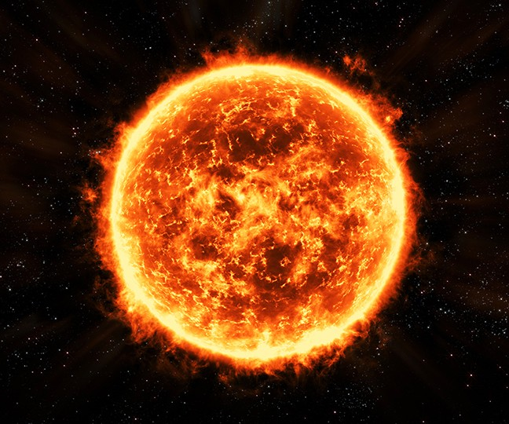
Notes:
The Sun (and all stars) emit radiant energy that travels as light.

Slide 50
Notes:
Light bulbs are a man-made device that also emit radiant energy.

Slide 51
Notes:
Let’s check-in for understanding.
Feedback: It's awesome to include many opportunities for students to demonstrate understanding, this can help you catch some confusion and get students back on track.

Slide 52
What is radiant energy?
Notes:
What is radiant energy?
[Radiant energy is energy that is carried by electromagnetic radiation.]

Slide 53
What are some other examples of radiant energy?
Notes:
What are some other examples of waves?
[X-rays, radiation, radio waves, etc.]

Slide 54
Remember!!!
Notes:
So remember!
Feedback: It is important to take time throughout the close of the lesson to check for understanding one last time, this will help you know who may need more instruction or where further explanation is needed.

Slide 55
Wave: a disturbance that travels through a medium, moving energy from one place to another
Notes:
A wave is a disturbance that travels through a medium, moving energy from one place to another.

Slide 56
Sound Energy: energy that is carried by vibration of one or more objects or particles
Notes:
Sound energy is energy that is carried by vibration of one or more objects or particles.

Slide 57
Radiant Energy: energy that is carried by electromagnetic radiation
Notes:
Radiant energy is energy that is carried by electromagnetic radiation.

Slide 58
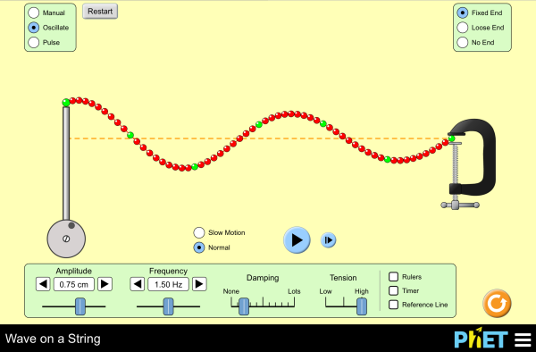
Simulation Activity
Wave on a String
Notes:
Feedback: Giving students a chance to analyze and interpret data is a great way to help them to continue to independently problem solve.

Slide 59
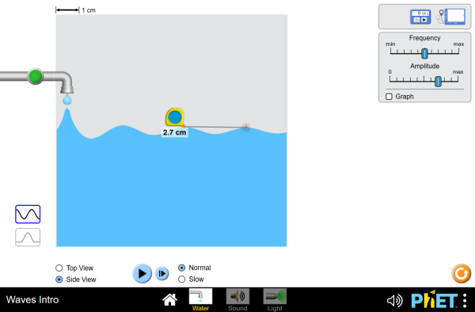
Simulation Activity
Intro to Waves

Slide 60
Big Question: How is energy transported? What kind of energy is capable of being transported?
Notes:
Explicit cue to revisit the big question at the end of the lesson: Okay everyone. Now that we’ve learned the term, let’s reflect once more on our big question. Was there anything that we predicted earlier that was correct or incorrect? Do you have any new hypotheses to share?
Feedback: As you are closing the lesson, keep in mind to monitor students' understanding so that you can determine if more instruction is needed or if there are any misunderstandings.

Slide 61
Notes:
Thanks for watching, and please continue watching CAPs available from this website.

Slide 62
This Video Created With Resources From:
Questions or Comments
Michael Kennedy, Ph.D. MKennedy@Virginia.edu
Rachel L Kunemund, Ph.D. rk8vm@virginia.edu

