Slide 1
“Big Idea” Question
Teacher Demo
Review Concepts
Check-In Questions
Vocabulary
Student-Friendly Definition
Examples & Non-Examples
Morphological Word Parts
Simulation/Activity
Notes:
OK everyone, get ready for our next lesson. Just as a reminder, these are the different components that our lesson may include, and you’ll see these icons in the top left corner of each slide so that you can follow along more easily!

Slide 2
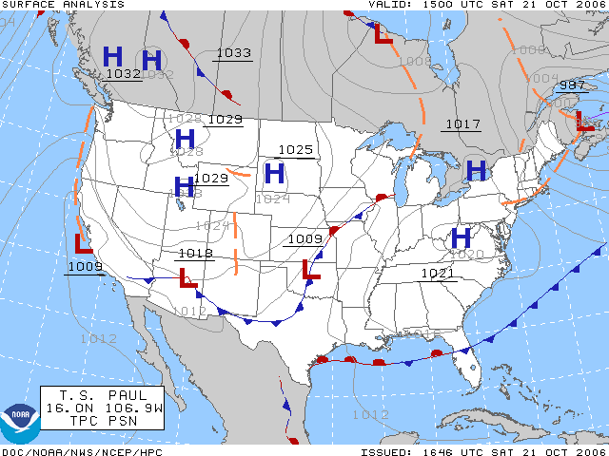
Weather Map
Intro
Notes:
Today we are going to learn about weather maps.

Slide 3
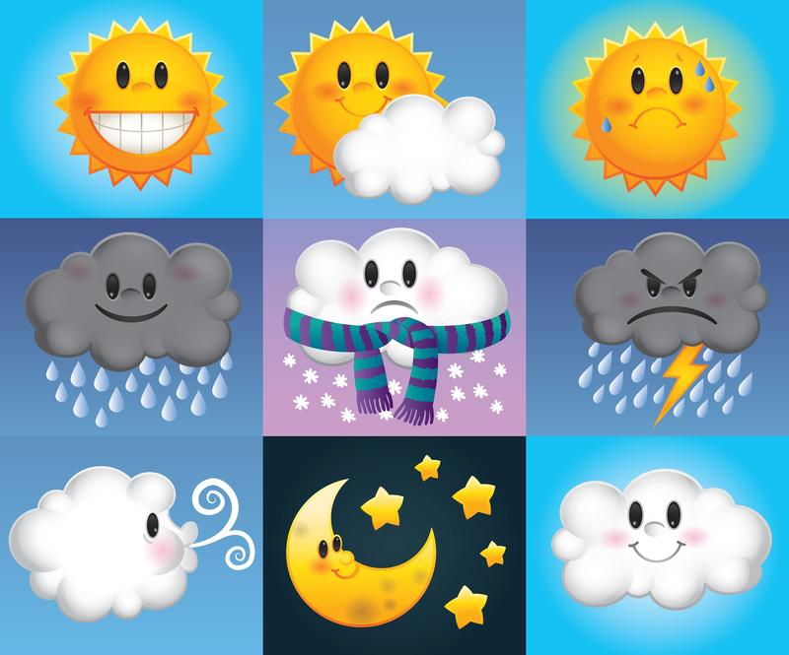
Big Question: Why are weather maps important, and what can they help us predict?
Notes:
Our “big question” is: Why are weather maps important and what can they help us predict? [Pause and illicit predictions from students.]
I love all these thoughtful scientific hypotheses! Be sure to keep this question and your predictions in mind as we move through these next few lessons, and we’ll continue to revisit it.
Feedback: Asking students to make predictions about why weather maps are important is a great way to activate and elicit student ideas and prior knowledge. This type of activity is evidence of the teacher planning for students’ engagement with science ideas.

Slide 4
Demonstration
Weather Maps
TEACHER DIRECTIONS:
Before: Click on the website above to have ready to go through with your students. Ask students what they know about weather/predicting weather. Tell students that today they will be learning about weather maps
During: Go through the website with your students. This will be a way to activate background knowledge by showing them what different symbols mean before hand. As you are going through the website make sure to ask students questions (Who do you think needs weather maps, why would you need a weather map, what does x symbol mean, etc.)
After: Tell students that now they are familiar with the symbols for weather maps, they will learn more about what weather maps are in this lesson.
Notes:
Let’s do a quick demonstration that will help get our brains ready to think about weather maps, and how it relates to our big question.
Feedback: Taking a moment to allow students to generate and share their predictions as to what will happen during a demonstration is a great way to allow them to problem solve and demonstrate their understanding.

Slide 5
Notes:
Now let’s pause for a moment to check your understanding.

Slide 6
What do different symbols tell us on a weather map?
Notes:
What do different symbols tell us on a weather map?
[They tell us something about the weather: sunny, fog, rain, mist, etc.]

Slide 7
Why is the UV Index Important?
Notes:
Why is the UV Index important?
[It tells us how dangerous it is to be outside because of the sun → when you need to wear sunscreen or if it is high when you need to stay inside to be safe.]

Slide 8
Who relies on the weather forecast?
Notes:
Who relies on the weather forecast?
[Everyone needs the weather forecast, but especially people whose jobs/hobbies need the weather like surfers, farmers, gardners, sailors, fishermen, pilots, and outdoor construction workers.]

Slide 9
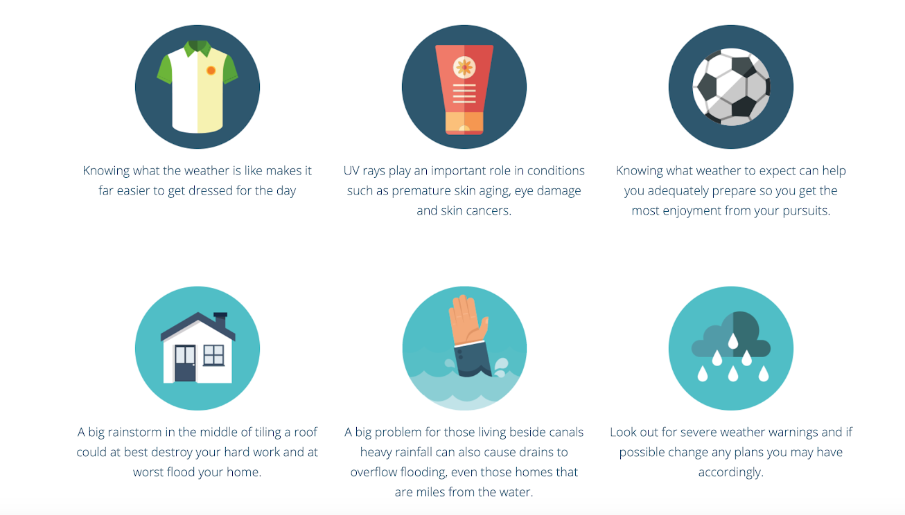
Why do you think a weather map can be useful for you?
Notes:
Why do you think a weather map can be useful for you?

Slide 10
Notes:
Before we move on to our new vocabulary term, let’s review some other words & concepts that you already learned and make sure you are firm in your understanding.
Feedback: This next part of the lesson refers to prior topics that were relevant and on topic. This helps students make connections to the new content they will be learning and tie it to prior knowledge.

Slide 11
Latitude: The distance north or south of the equator.
Notes:
Latitude lines run east to west but tell you directions north and south.

Slide 12
Equator: a latitude line that is equal distance from the north and south pole
Notes:
The equator is a latitude line that is equal distance from the north and south pole.

Slide 13
Weather: conditions of the atmosphere at a certain time and place
Notes:
Weather is the conditions of the atmosphere at a certain time and place.

Slide 14
Air Pressure: the amount of force being exerted on the earth
Notes:
Air pressure is the amount of force being exerted on the earth. This can affect the weather.

Slide 15
Air temperature: the degree of hotness or coldness in the air that can be measured by a thermometer
Notes:
The weather is affected by Air temperature. If it is below 32 it snows but above 32 we get rain!

Slide 16
Wind patterns: determine where hot and cold air blow
Notes:
Wind patterns affect the weather by determining where hot and cold air blow.

Slide 17
Notes:
Now let’s pause for a moment to check your understanding.
Feedback: Providing students with opportunities to respond is critical to this part of the lesson as it helps the teacher to determine whether students understand foundational vocabulary before introducing new terms.

Slide 18
What is the difference between lines of latitude and the equator?
Notes:
What is the difference between lines of latitude and the equator?
[Latitude is the distance north or south of the equator but the equator is a type of latitude line that is equal distance from the north and south pole.]

Slide 19
What is weather?
Notes:
What is weather?
[Weather is the conditions of the atmosphere at a certain time and place.]

Slide 20
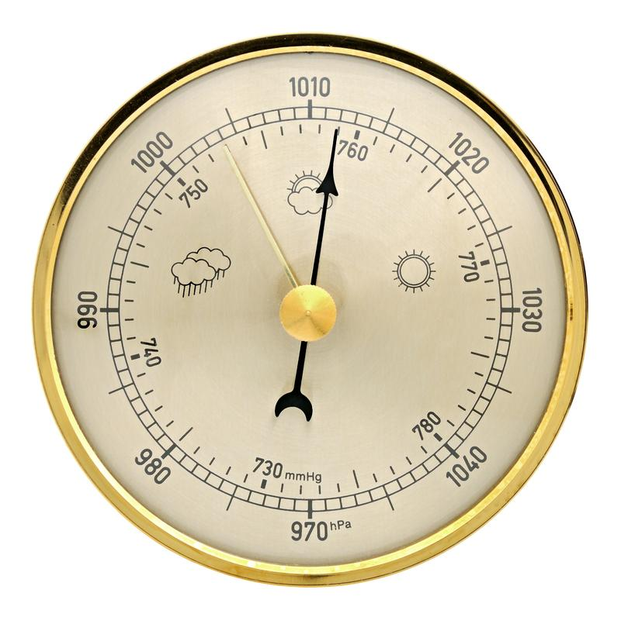
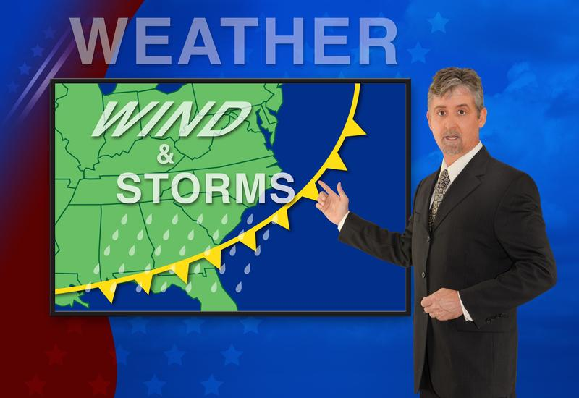
What are three things that can affect weather?
Notes:
What are three things that can affect the weather?
[Air pressure, temperature and weather patterns]

Slide 21
Weather Maps
Notes:
Now that we’ve reviewed, let’s define our new term, weather maps.
Feedback: This slide is an example of an explicit cue used at the beginning of a step to make it easy for students to follow along and be prepared to engage in the next part of the lesson.

Slide 22
Weather Map: shows current weather conditions for a wide geographic area
Notes:
A weather map is a map that shows current weather conditions for a wide geographic area. This information is collected from observations from specific locations within the area of the map.

Slide 23
Notes:
That is the basic definition, but there is a bit more you need to know

Slide 24
Notes:
Let’s take a closer look at this weather map and learn about what information it is telling you.

Slide 25
L = low pressure
H = high pressure
Notes:
The H’s are showing areas where there is high air pressure. The L’s are showing areas where there is lower air pressure.

Slide 26
Remember that air pressure is the amount of force being exerted on the earth
Notes:
Air pressure is the amount of force being exerted on the earth.

Slide 27
Low pressure
Notes:
A low air pressure usually means clouds and rain or other precipitation.

Slide 28
High pressure
Notes:
High pressure usually means good weather, fewer clouds and less precipitation.

Slide 29
L = low pressure
H = high pressure
Notes:
So by looking at high and low pressure on a weather map, we can predict the weather.
Feedback: This visual helps make science thinking visible through a scientific model as the teachers helps students to infer what is happening in a system based on data. This important to help support an ongoing change in student thinking as they understand what the model represents.

Slide 30
Notes:
Now let’s pause for a moment to check your understanding.

Slide 31
What does a weather map show us?
Notes:
What does a weather map show us?
[A weather map is a diagram that shows current weather conditions for a wide geographic area. This information is collected from observations from specific locations within the area of the map.]

Slide 32
What do the H and L stand for on a weather map?
Notes:
What do the H and the L stand for on a weather map?
[High air pressure and low air pressure]

Slide 33
What kind of weather can we predict there will be if there is low air pressure?
Notes:
What kind of weather can we predict there will be if there is low air pressure?
[A low air pressure usually means clouds and rain or other precipitation.]

Slide 34
What kind of weather can we predict if there is high air pressure?
Notes:
What kind of weather can we predict if there is high air pressure?
[High pressure usually means good weather, fewer clouds and less precipitation.]

Slide 35
How can we predict weather by looking at a weather map?
L = low pressure
H = high pressure
Notes:
How can we predict weather by looking at the weather map?
[We can predict weather by looking at the L and H (low and high air pressure)
In places where there are L’s (low air pressure) we can predict means clouds and rain or other precipitation.
In places where there are H’s (high air pressure) we can predict good weather, fewer clouds and less precipitation.]

Slide 36
Notes:
Now, let’s talk about some examples of weather maps.
Feedback: Again, here is an explicit cue to make it easier for students to follow along and be prepared to engage in the next part of the lesson.

Slide 37
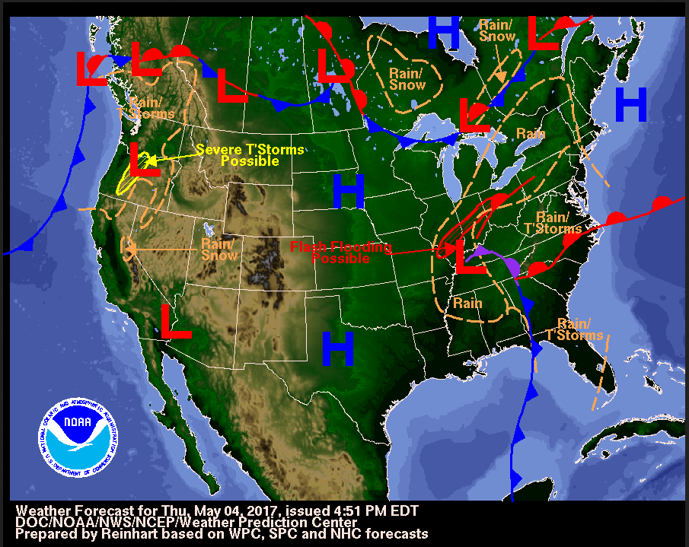
Notes:
This is an example of a weather map. It is more colorful than the first one we looked at, but it is still a weather map. We can see where the high pressure and low pressure is, so this is a weather map.

Slide 38
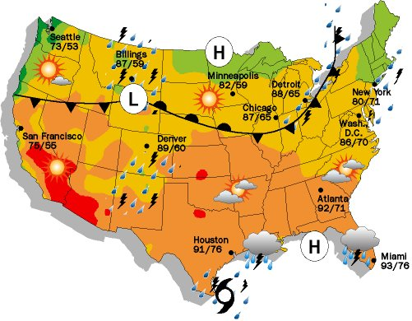
Notes:
This one looks a little different, but is it still a weather map? Yes! Why is it still a weather map? (Answer: It tells us where the high and low pressure is).

Slide 39
Notes:
Now let’s pause for a moment to check your understanding.

Slide 40
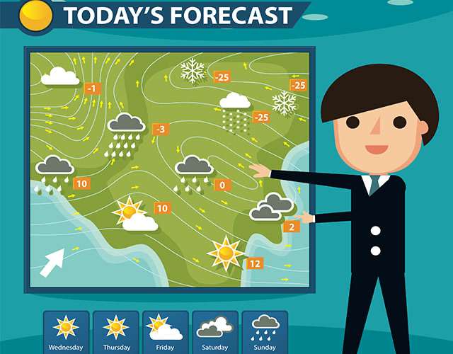
Is this an example of a weather map? Why or why not?
Notes:
Yes! It is a weather map. We can’t see where there is high and low pressure, but we can still use the images to tell us something about the weather on this map. We can see where there is rain, snow, clouds, sunshine, etc. This is just a more simple example of a weather map.

Slide 41
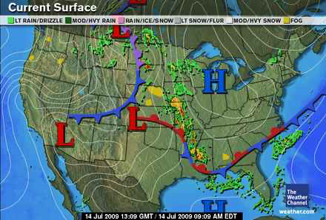
Why is this an example of a weather map?
Notes:
Because it tells us information about the weather. We can see where there is fog, rain, etc and where there is high and low pressure. We could use this weather map to predict information about the weather

Slide 42
What do the H and L on the weather map mean?
Notes:
It tells us where there is high pressure (H) and low pressure (L)
Feedback: The slides in this section were a great opportunity to press students for evidence-based explanations. Using scientific argument to make and justify claims based on the evidence presented in the model is a way for students to authentically engage in scientific practices while making sense of what a weather map is.

Slide 43
Notes:
Next, let’s talk about some non-examples of weather maps.

Slide 44
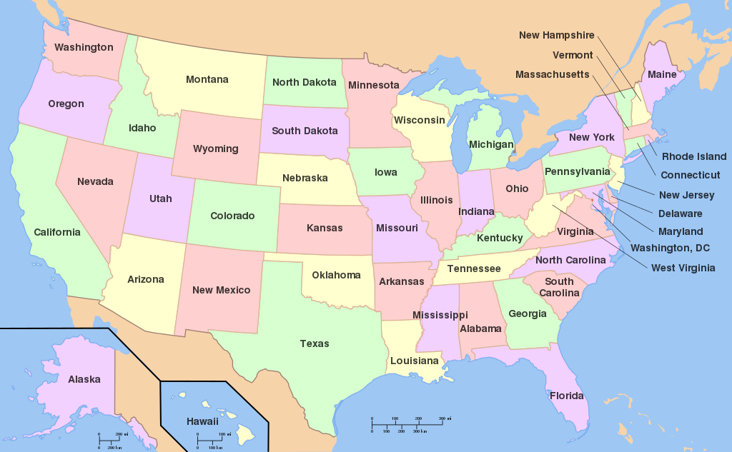
Notes:
Let’s look at this example. Is this an example of a weather map? No, because it does not tell us anything about the weather. It is just a regular map of the U.S.

Slide 45
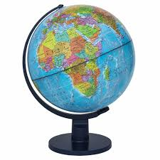
Notes:
Is this an example of a weather map? No, it is a globe, which is a 3D model of a map of the world. It doesn’t tell us anything about weather.

Slide 46
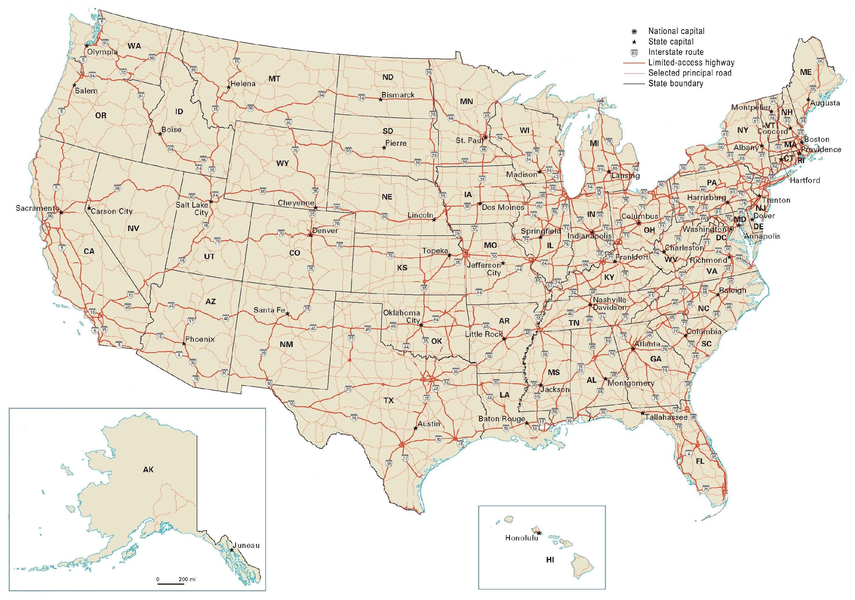
Notes:
Finally is this a weather map? No, it is a road map. It can tell you which roads to drive on but it can’t tell you anything about the weather.

Slide 47
Notes:
Let’s check-in for understanding.

Slide 48
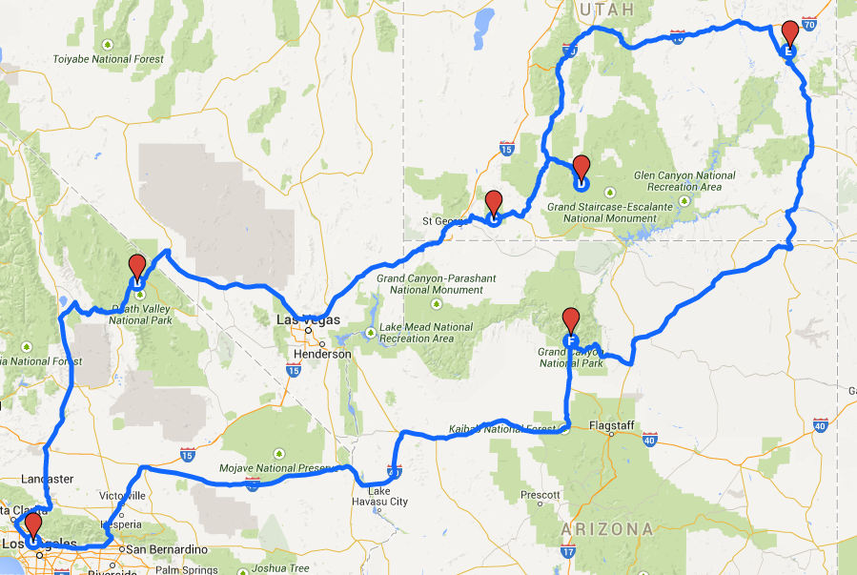
Why is this NOT an example weather map?
Notes:
Why is this not an example of a weather map?
[This is not a weather map because it does not tell us anything about the weather. We don’t know anything about low or high pressure, wind patterns, stormy/clear weather etc. This is still a map because we see an area of land represented, but this is actually a road map because it shows you where to go instead of the weather. ]

Slide 49
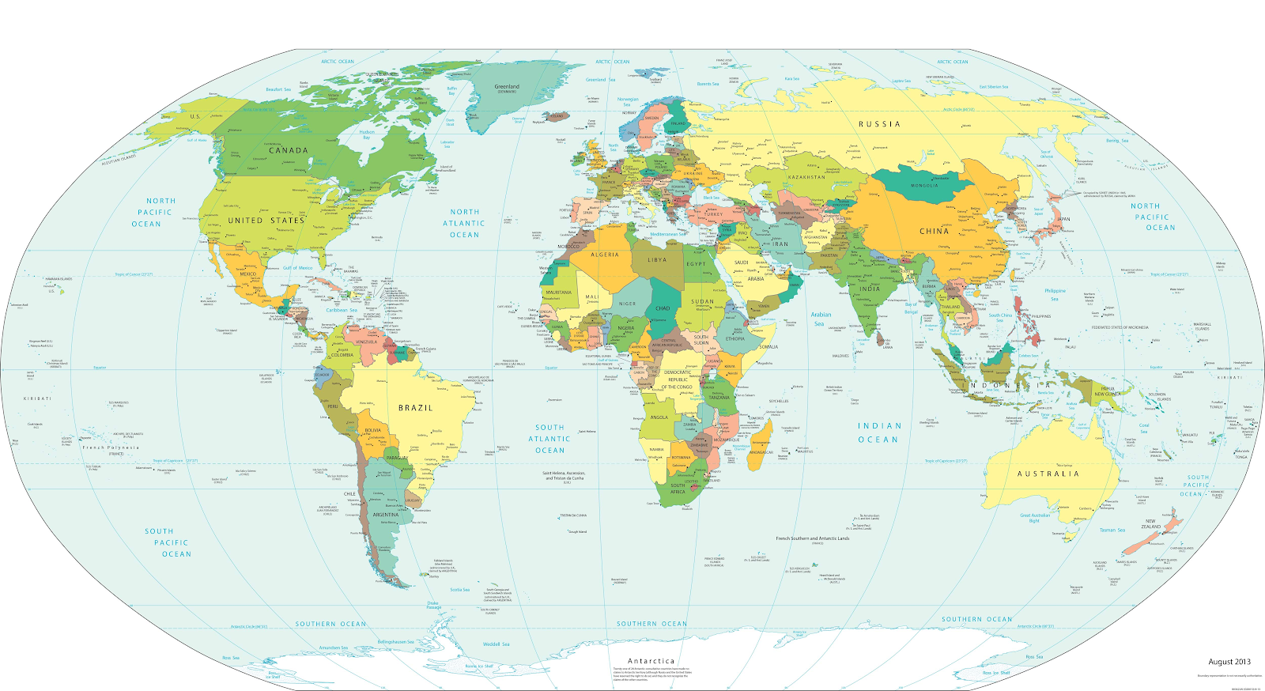
Is this a weather map? Why or why not?
Notes:
Is this a weather map? Why or why not?
[This is NOT a weather map because it does not tell us anything about the weather. This is simply a regular map.]

Slide 50
What are the differences between these two maps?
Notes:
What are the differences between these two maps? [The map on the left is a regular map of the U.S. The map on the right does show U.S. states, but it is a weather map because it shows the weather in different places, wind patterns, and high/low pressure areas, so this is how it is different from the regular map on the left.]

Slide 51
Notes:
Let’s break down the term weather map.

Slide 52
Weather Map
Conditions of the atmosphere at a certain time and place
Notes:
Let’s look at the meaning of our two words and then try to put them together. We know weather means the conditions of the atmosphere at a certain time and place.
Feedback: Using clear and concise language in this slide, and the following slides in this section, is a great way to ensure students are able to follow along and understand the content.

Slide 53
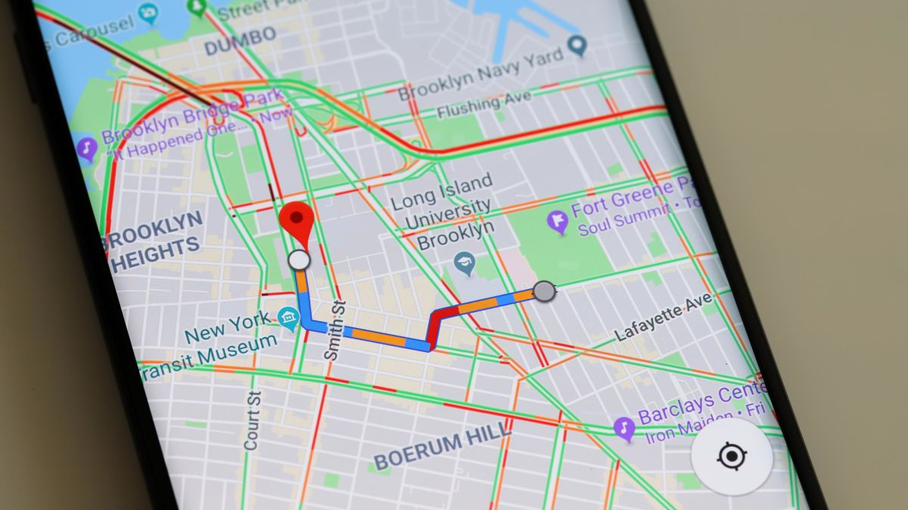
Weather Map
Diagram of a large area of land (geographical area)
Notes:
A map is a diagram of a large area of land (geographical area).

Slide 54
Weather Map
=
Conditions of the atmosphere at a certain time and place
Diagram of a large area of land (geographical area)
A diagram that shows current weather conditions for a wide geographic area
Notes:
So if we put these two words together, we know that a weather map is a diagram that shows the current weather conditions for a wide geographic area.

Slide 55
Notes:
Let’s check-in for understanding.

Slide 56
In the word Weather Map what does the word part Weather mean?
Notes:
In the word “weather map” what does the word part weather mean? [Conditions of the atmosphere at a certain time and place]

Slide 57
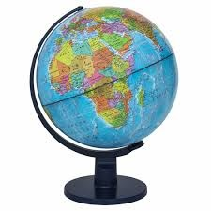
In the word Weather Map what does the word part Map mean?
Notes:
In the word “weather map” what does the word part map mean?
[Diagram of a large area of land (geographical area)]

Slide 58
Now we know what weather means and what map means. How does this help us remember what a weather map is?
+
Notes:
Now that we know what weather means and what map means, how does this help us remember what a weather map is?
[We know that weather is the conditions of the atmosphere at a certain time and place and map is a diagram of a large area of land (geographical area) so when you put it all together a weather map is a diagram that shows current weather conditions for a wide geographic area.]

Slide 59
What does a weather map show us?
Notes:
What does a weather map show us?
[A weather map is a diagram that shows current weather conditions for a wide geographic area. This information is collected from observations from specific locations within the area of the map.]

Slide 60
What kind of weather can we predict there will be if there is low air pressure?
Notes:
What kind of weather can we predict there will be if there is low pressure?
[A low air pressure usually means clouds and rain or other precipitation.]

Slide 61
What kind of weather can we predict if there is high air pressure?
Notes:
What kind of weather can we predict if there is high pressure?
[High pressure usually means good weather, fewer clouds and less precipitation.]

Slide 62
Take a look outside the window, or recall the weather when you were last outside. Based on the conditions do you think it was low or high pressure weather?
Notes:
Take a look outside the window, or recall the weather when you were last outside. Based on the conditions, do you think it was low or high pressure?

Slide 63
How can we predict weather by looking at a weather map?
L = low pressure
H = high pressure
Notes:
How can we predict the weather by looking at a weather map?
[We can predict weather by looking at the L and H (low and high air pressure)
In places where there are L’s (low air pressure) we can predict means clouds and rain or other precipitation.
In places where there are H’s (high air pressure) we can predict good weather, fewer clouds and less precipitation.]

Slide 64
Why is this an example of a weather map?
Notes:
Why is this an example of a weather map?
[Because it tells us information about the weather. We can see where there is fog, rain, etc and where there is high and low pressure. We could use this weather map to predict information about the weather.]

Slide 65
Is this an example of a weather map? How can you tell?
Notes:
Is this an example of a weather map? How can you tell?
[This is NOT a weather map because it does not tell us anything about the weather. This is simply a regular map.]

Slide 66
What does each word part of weather map mean?
+
Notes:
What do the word parts of weather map mean?
[We know that weather is the conditions of the atmosphere at a certain time and place and map is a diagram of a large area of land (geographical area) so when you put it all together a weather map is a diagram that shows current weather conditions for a wide geographic area.]

Slide 67
Remember!!!
Notes:
So remember!

Slide 68
Weather Map: shows current weather conditions for a wide geographic area
Notes:
A weather map is a map that shows current weather conditions for a wide geographic area. This information is collected from observations from specific locations within the area of the map.
Feedback: Throughout these slides, the teacher can not only introduce an example of a term but also show images to go along with it. This is a great way to help students to make connections.

Slide 69
Simulation Activity
Weather Maps Gizmo
(Explore Learning)
Click on the simulation above create your own weather map.
When creating your weather map, what are things you notice? What do you see when you show the grid? How can you telling something about the weather from your map?
Notes:
Feedback: This activity provides students with rich opportunities to create and use models to demonstrate their understanding of weather maps. Developing and using models through the gizmo simulation is a great way to allow students to apply their understanding of the model to a new situation by modifying the weather map based on new variables and information.

Slide 70
Big Question: Why are weather maps important, and what can they help us predict?
Notes:
Our “big question” is: Why are weather maps important, and what can they help us predict?
Let’s look at our big question again. Were our hypotheses correct? What did we learn/have to change about our hypotheses?

Slide 71
Notes:
Thanks for watching, and please continue watching CAPs available from this website.

Slide 72
This Video Was Created With Resources From:
Questions or Comments
Michael Kennedy, Ph.D. MKennedy@Virginia.edu
Rachel L Kunemund, Ph.D. rk8vm@virginia.edu

Slide 73
“Big Idea” Question
Teacher Demo
Review Concepts
Check-In Questions
Vocabulary
Student-Friendly Definition
Examples & Non-Examples
Morphological Word Parts
Simulation/Activity
Notes:
OK everyone, get ready for our next lesson. Just as a reminder, these are the different components that our lesson may include, and you’ll see these icons in the top left corner of each slide so that you can follow along more easily!

Slide 74
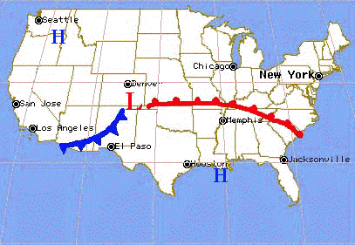
Intro
Front
Notes:
Today we are going to learn about Fronts.

Slide 75
Big Question: Why are weather maps important, and what can they help us predict?
Notes:
Our “big question” is: Why are weather maps important, and what can they help us predict?
What did we learn yesterday? What did we already know and what did we learn?
Feedback: These questions are used to activate students’ prior knowledge. This will help students make important connections to new content.

Slide 76
Demonstration
Weather Fronts
TEACHER DIRECTIONS:
Before: Ask students what they already know about weather fronts or if they have ever heard of a front before
During: You can play the video or recreate the experiment for students. Pause the video and ask the student what they observe happens with the water.
After: Ask students to predict what a front is after watching the video. Tell students in this lesson they will learn more about weather fronts.
Notes:
Let’s do a quick demonstration that will help get our brains ready to think about fronts, and how they relate to our big question. Use the questions on the following slides throughout the demonstration.
Feedback: This demonstration offers opportunities for students to more closely engage in carrying out investigations. Using the questions on the following slides throughout the demonstration offer students opportunity to demonstrate their understanding. This is important to ensure that they are making sense of this new content!

Slide 77
Notes:
Lets review everything we have reviewed so far!!

Slide 78
In this experiment what does the warm/cold water represent?
Notes:
In this experiment what does the warm and cold water represent?
Warm and cold fronts in the air
Feedback: Frequent questions is a great way of chunking information. Breaking down the information into manageable parts for the students to comprehend will help keep students engaged!

Slide 79
What did you predict would happen when the barrier between the warm and cold water was removed?
Notes:
What do you predict will happen when the barrier between the warm and cold water was removed?
Feedback: Providing students with opportunities to come up with their own predictions is a great way to get them thinking and generate their own hypotheses.

Slide 80
What does this experiment show about warm and cold fronts in the air?
Notes:
What does this experiment show about warm and cold fronts in the air?
[It shows us that there is a boundary between warm and cold air because the warm air is moving in one direction and cold is moving in another.]
Feedback: It is important to give multiple students an opportunity to respond. This helps with engagement and making sure that each student is grasping the content. Additionally, making and justifying claims in a science community (here, your classroom) through scientific argument (here, class discussion) is an important scientific practice!

Slide 81
Notes:
Before we move on to our new vocabulary term, let’s review some other words & concepts that you already learned and make sure you are firm in your understanding.
Feedback: This is a great opportunity to support ongoing change in student thinking before moving on.

Slide 82
Latitude: The distance north or south of the equator.
Notes:
Latitude lines run east to west but tell you directions north and south.

Slide 83
Equator: a latitude line that is equal distance from the north and south pole
Notes:
The equator is a latitude line that is equal distance from the north and south pole.

Slide 84
Weather: conditions of the atmosphere at a certain time and place
Notes:
Weather is the conditions of the atmosphere at a certain time and place.

Slide 85
Air Pressure: the amount of force being exerted on the earth
Notes:
Air pressure is the amount of force being exerted on the earth. This can affect the weather.

Slide 86
Air temperature: The degree of hotness or coldness in the air that can be measured by a thermometer
Notes:
The weather is affected by Air temperature. If it is below 32 it snows but above 32 we get rain!

Slide 87
Wind patterns: determine where hot and cold air blow
Notes:
Wind patterns affect the weather by determining where hot and cold air blow.

Slide 88
Weather Map: shows current weather conditions for a wide geographic area
Notes:
A weather map is a map that shows current weather conditions for a wide geographic area. This information is collected from observations from specific locations within the area of the map.

Slide 89
Notes:
Now let’s pause for a moment to check your understanding.

Slide 90
What is the difference between lines of latitude and the equator?
Notes:
What is the difference between lines of latitude and the equator?
[Latitude is the distance north or south of the equator but the equator is a type of latitude line that is equal distance from the north and south pole.]

Slide 91
What is weather?
Notes:
What is weather?
[Weather is the conditions of the atmosphere at a certain time and place.]

Slide 92
What are three things that can affect weather?
Notes:
What are three things that can affect the weather?
[Air pressure, Temperature and weather patterns]

Slide 93
What do weather maps show?
Notes:
What do weather maps show us?
[A weather map is a map that shows current weather conditions for a wide geographic area. This information is collected from observations from specific locations within the area of the map.]

Slide 94
Front
Notes:
Now that we’ve reviewed, let’s define our new term, Front.

Slide 95
Front: boundary between two different types of weather
Notes:
A front is a boundary between two different types of weather.
Feedback: This slide provides the student friendly message for fronts with a simple definition and a visual. This type of messaging is really important to provide students with language that they are comfortable with.

Slide 96
Notes:
That is the basic definition, but there is a bit more you need to know

Slide 97
Notes:
On this map, there are two fronts, or two different types of weather happening in different places. The red line is a warm front. The blue line is a cold front.
Feedback: Using clear and concise language is a great way to ensure students are able to follow along and understand the content.

Slide 98
Notes:
It is called a front, because it is the beginning of a new weather condition.

Slide 99
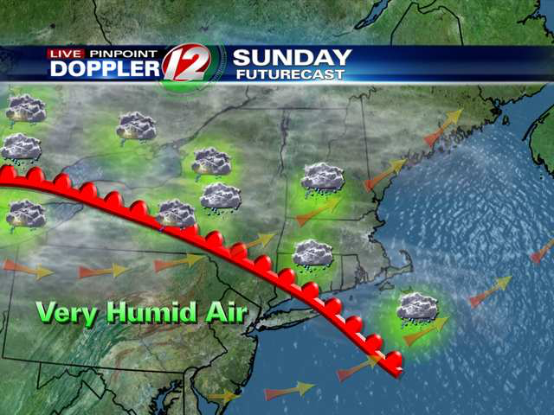
Warm front
Notes:
A warm front is when warm air moves. This is a red line with a red bump.
Feedback: Introducing images is a great way to help students to better grasp the content.

Slide 100
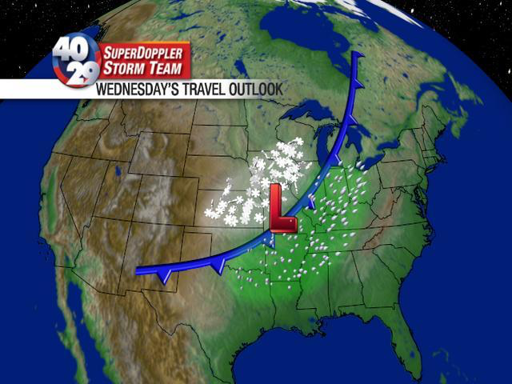
Cold front
Notes:
A cold front is when cold air moves and is shown by a blue line with blue triangles.

Slide 101
Notes:
Lets review everything we have reviewed so far!!

Slide 102
What is a front?
Notes:
What is a front?
[A front is a boundary between two different types of weather.]

Slide 103
Which type of front does this red line show?
Notes:
Which type of front does this red line show?
[A warm front]

Slide 104
What is a warm front?
Notes:
What is a warm front?
[A warm front is when warm air moves.]

Slide 105
What type of front does the blue line show?
Notes:
What type of front does this blue line show?
[A cold front]

Slide 106
What is a cold front?
Notes:
What is a cold front?
[A cold front is when cold air moves]

Slide 107
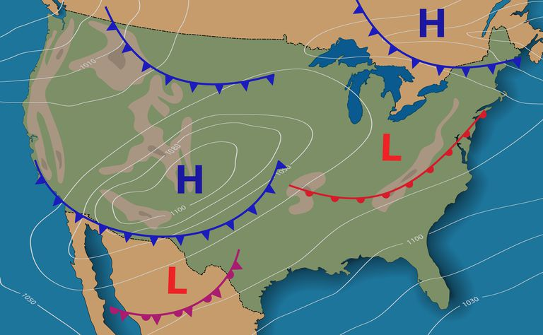
How does looking at different fronts on a weather map help predict the weather?
Notes:
How does looking at different fronts on a weather map help predict the weather?
[By looking at different fronts on a map, we know what type of weather can be happening in one place. When there is a warm front (very humid air) we might have thunderstorms, and when there is a cold front (very cold air) there might be snow storms.]
Feedback: Asking open-ended questions is a great way to gauge student understanding by requiring deeper thought than a rote opportunity to respond. Incorporating students’ own words back into the discussion will be a great way to help further their understanding and provide different ways of explaining the same content.

Slide 108
Notes:
Now, let’s talk about some examples of front.

Slide 109
Notes:
Does this map show cold or warm fronts?
[Right it shows both we see both the red lines and the blue lines that show two different fronts.]
Feedback: When reviewing examples of the new term, it is important to provide students with feedback that encourages them to continue to participate!

Slide 110
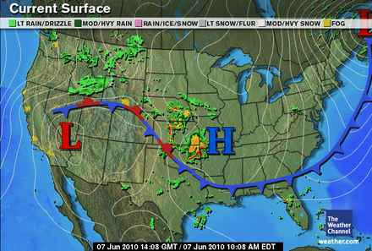
Notes:
Does this weather map show a warm or cold front?
[It shows a cold front with the blue line.]

Slide 111
Notes:
Next, let’s talk about some non-examples of front.

Slide 112
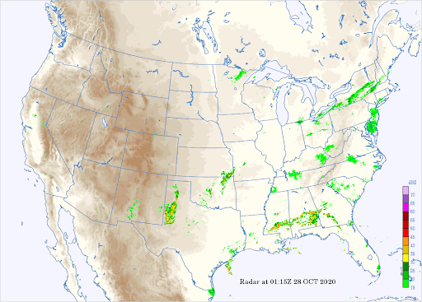
Notes:
Does this map show warm or cold fronts?
[No there are no lines that show us if there are any fronts.]

Slide 113
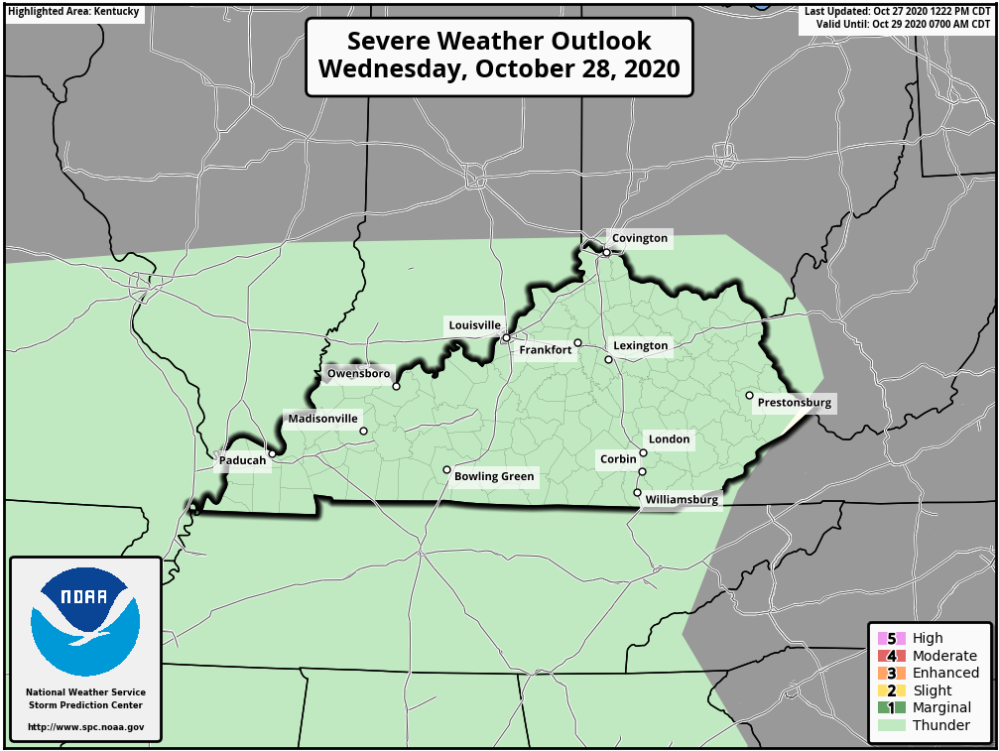
Notes:
Does this map show any fronts?
[Right! It doesn’t because there are no blue or red lines to show us about a front.]

Slide 114
Notes:
Let’s practice identifying warm and cold fronts.

Slide 115
What kind of front is shown on this map?
Notes:
What kind of front is shown on this map?
[Right! There is a warm front and cold front show by the red and blue lines. This is also considered a weather map because we could predict the weather by looking at the warm and cold fronts.]

Slide 116
Is there a warm or cold front shown on this map? Is this still a weather map?
Notes:
Is there a warm or cold front shown on this map? Is this still a weather map?
[We don’t see any fronts on this map because we don’t see the red or blue lines showing us the fronts….BUT this is still a weather map because it shows us something about the weather, we just don’t know anything about warm or cold fronts just by looking at this weather map.]

Slide 117
Is this a weather map? Do you see any fronts?
Notes:
Is this a weather map, do you see any fronts?
[Yes this is a weather map. We can see fronts by the red and blue lines and we can see where High and Low pressure is, so we can predict something about the weather, so this is a weather map.]

Slide 118
What is a front?
Notes:
What is a front?
[A front is a boundary between two different types of weather.]

Slide 119
What is a warm front?
Notes:
What is a warm front?
[A warm front is when warm air moves.]

Slide 120
What is a cold front?
Notes:
What is a cold front?
[A cold front is when cold air moves.]

Slide 121
How does looking at different fronts on a weather map help predict the weather?
Notes:
How does looking at different fronts help predict the weather?
[By looking at different fronts on a map, we know what type of weather can be happening in one place. When there is a warm front (very humid air) we might have thunderstorms, and when there is a cold front (very cold air) there might be snow storms.]

Slide 122
Are these maps weather maps? Do you see any fronts on these maps?
Notes:
Are these weather maps? Do you see any fronts on these maps?
[The map on the left is NOT a weather map. It is a map of the U.S. so it just shows a land area and there are no fronts on this map. The map on the right is a weather map. It shows where there will be snow, low pressure, and a cold front.]

Slide 123
Remember!!!
Notes:
So remember!

Slide 124
Front: boundary between two different types of weather
Notes:
A front is a boundary between two different types of weather.
Feedback: Slides like this help to provide a clear and explicit explanation that takes the guesswork out of it for students. Using explicit descriptions every once in a while makes it easier for students to grasp the content.

Slide 125
Simulation Activity
Weather Fronts
(learn weatherstem)
Click on the simulation above to interact with weather fronts.
Click and drag the front to see what happens? What do you notice when it mixes with a different front? Why do you predict this happens?
Notes:
Feedback: This simulation helps make science thinking visible through models as students are able to predict outcomes based on the model, infer what is happening in a system based on the model, and modify the model. The questions included in this slide help activitate and elicit students’ ideas about a science phenomenon by helping students make sense of new observations and information.

Slide 126
Big Question: Why are weather maps important, and what can they help us predict?
Notes:
Our “big question” is: Why are weather maps important and what can they help us predict?
Let’s look at our big question one last time. Based on what we have learned how do we answer our big question?

Slide 127
Notes:
Thanks for watching, and please continue watching CAPs available from this website.

Slide 128
This Video Was Created With Resources From:
Questions or Comments
Michael Kennedy, Ph.D. MKennedy@Virginia.edu
Rachel L Kunemund, Ph.D. rk8vm@virginia.edu

