Slide 1
Intro
“Big Idea” Question
Review Concepts
Check-In Questions
Teacher Demo
Vocabulary
Student-Friendly Definition
Examples & Non-Examples
Morphological Word Parts
Extension/Simulation Activity
Notes:
OK everyone, get ready for our next lesson. Just as a reminder, these are the different components that our lesson may include, and you’ll see these icons in the top left corner of each slide so that you can follow along more easily!

Slide 2
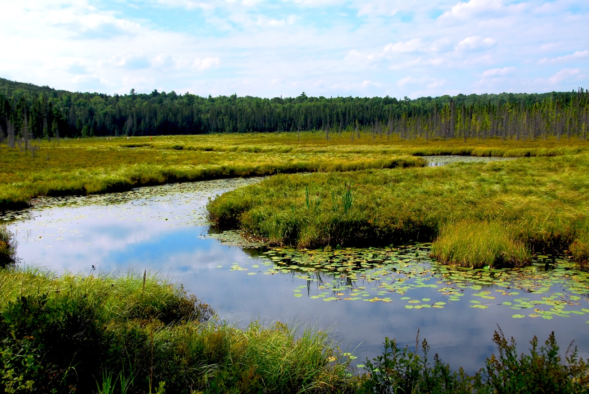
Wetlands
Intro
Notes:
Today we will discuss wetlands.

Slide 3
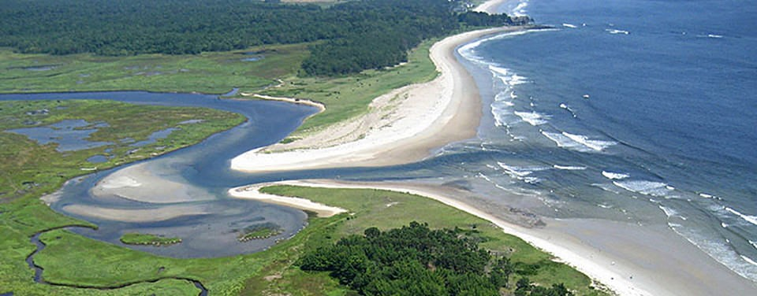
Big Questions: What features characterize different aquatic ecosystems and why are these ecosystems important to our environment?
Notes:
Our “big question” is: What features characterize different aquatic ecosystems and why are these ecosystems important to our environment?
[Pause and illicit predictions from students.]
I love all these thoughtful scientific hypotheses! Be sure to keep this question and your predictions in mind as we move through these next few lessons, and we’ll continue to revisit it.

Slide 4
Demonstration
Where does all the water go?
On the next slide is a picture of watersheds in the United States. Challenge students to consider that all water from our streams and rivers eventually makes its way to the ocean.
Questions:
What kind of habitat do you think is created when fresh water meets salt water?
What human activities upstream could affect these habitats in a negative way?
Notes:
Let’s do a quick demonstration that will help get our brains ready to think about wetlands, watersheds, estuaries, and how they relate to our big question.
Feedback: This demonstration is a great way to introduce students to the content. As suggested by the slide, beginning with open-ended questions, followed by providing explicit explanations, and then asking probing questions is a great way to engage students in a discussion while also providing clear explanations.

Slide 5
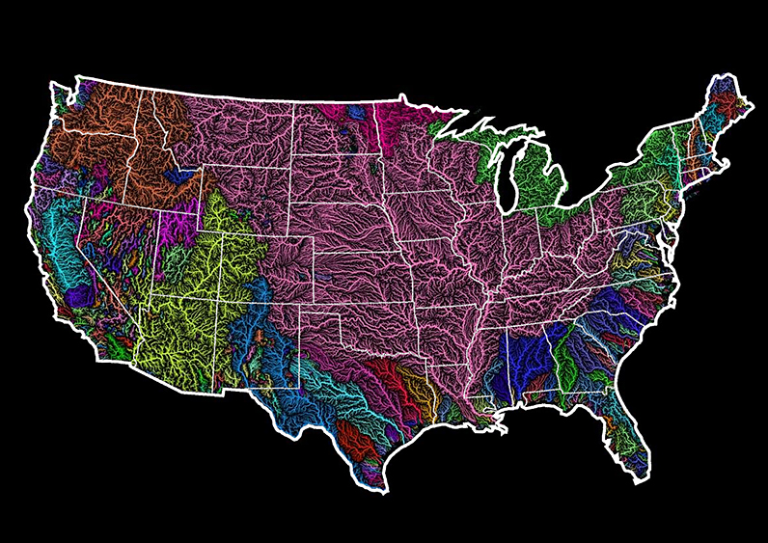
Notes:
Feedback: This demonstration is a great way to introduce students to the content. As suggested by the slide, beginning with open-ended questions, followed by providing explicit explanations, and then asking probing questions is a great way to engage students in a discussion while also providing clear explanations.

Slide 6
Notes:
Before we define the terms estuary, wetland, and watershed, let’s review some other words that you already learned, and make sure you are firm in your understanding.
Feedback: Cues are an important way to prepare students for what is coming next.

Slide 7
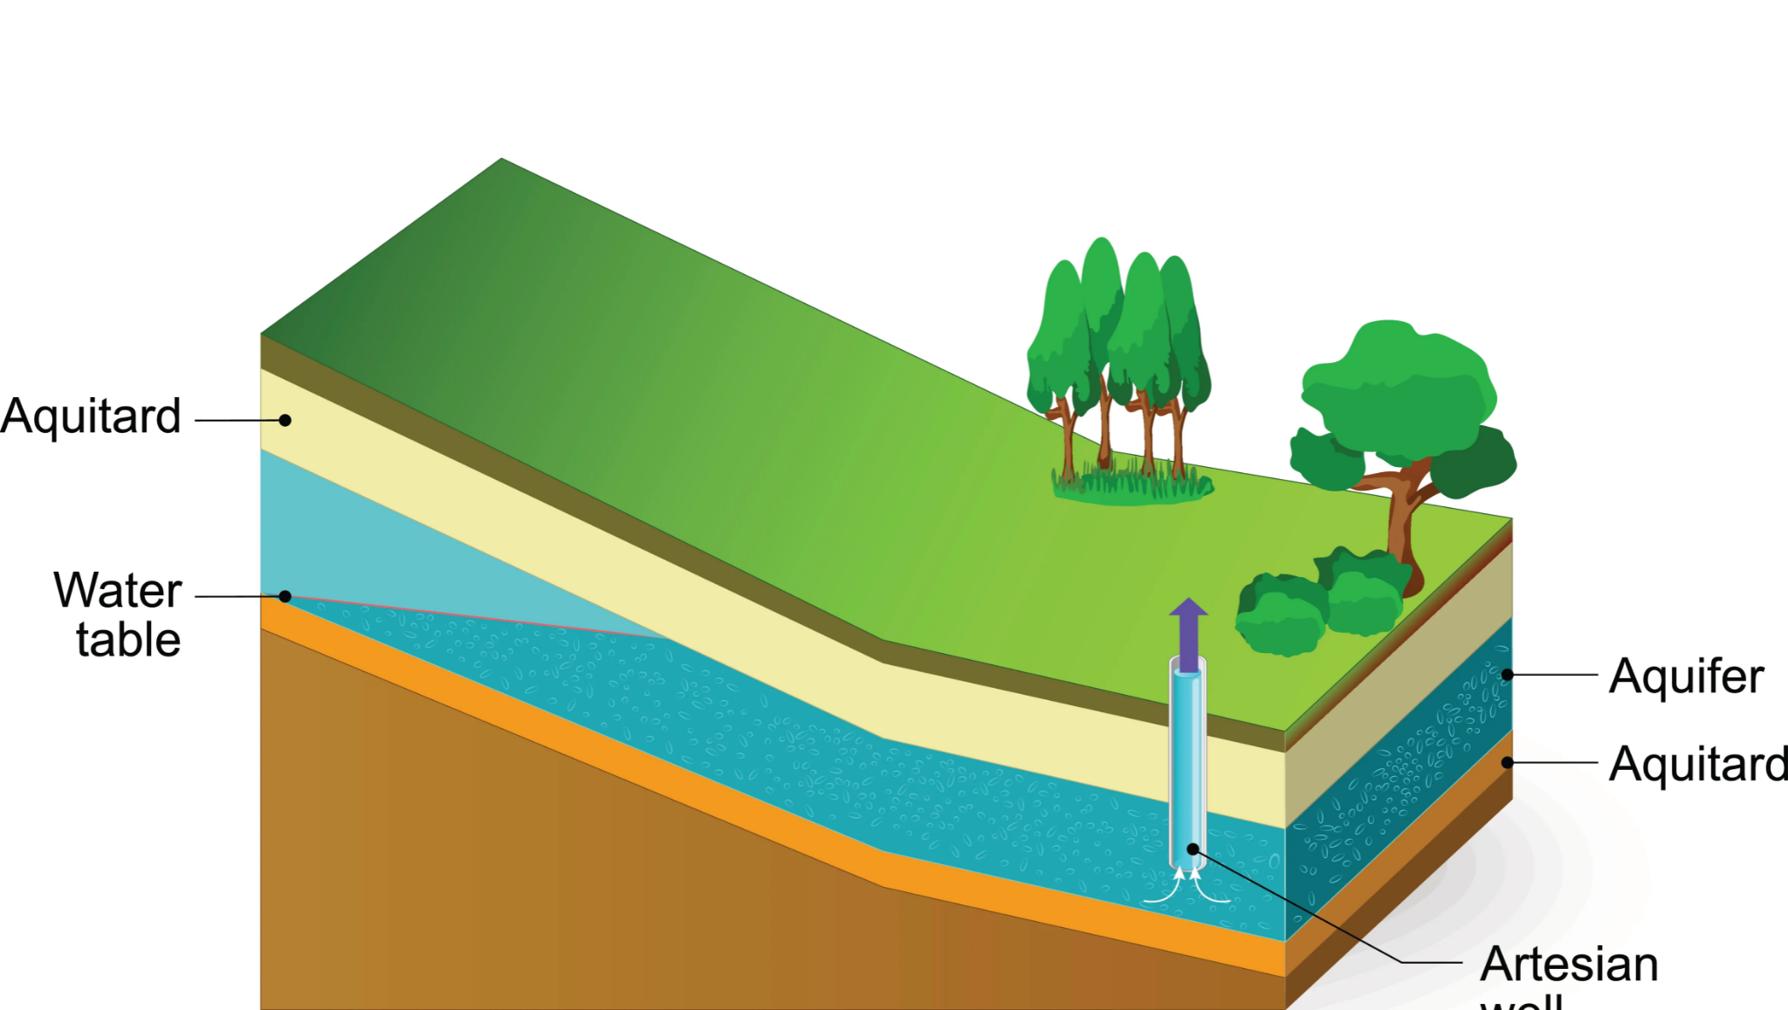
Aquifer: water stored under the ground
Notes:
An aquifer is water stored under the ground. We sometimes refer to aquifers as ground water.

Slide 8
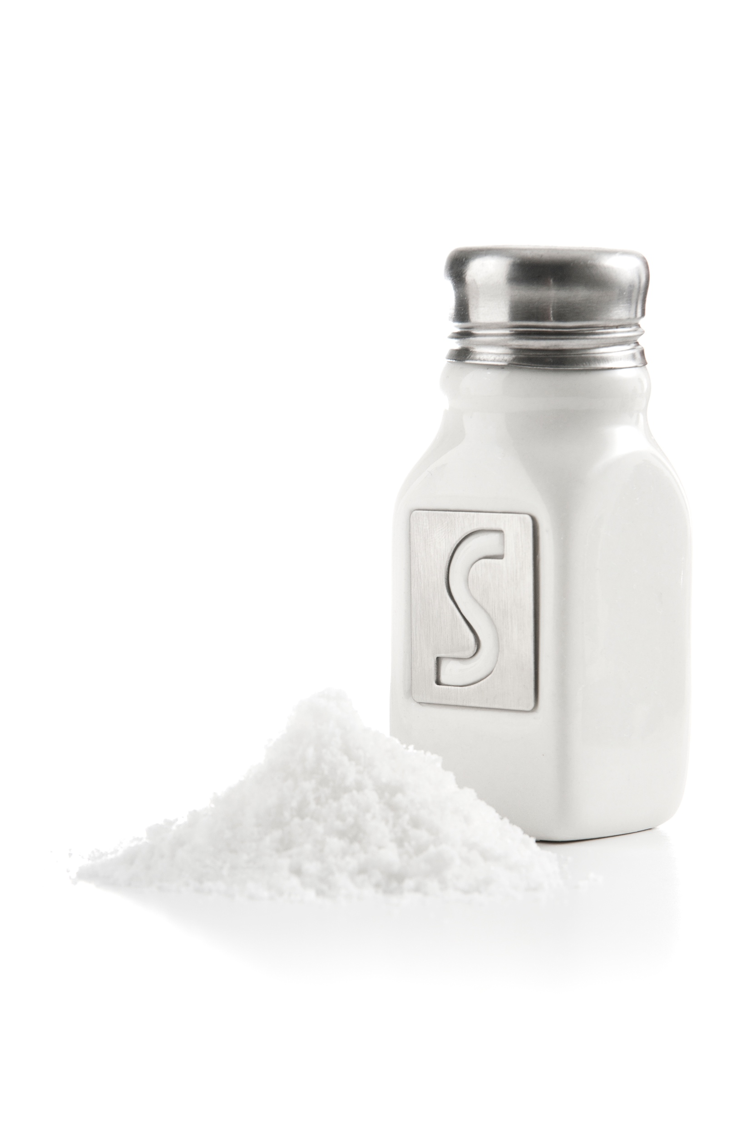
Salinity: the amount of salt in water
Notes:
Salinity is the amount of salt in the water.

Slide 9
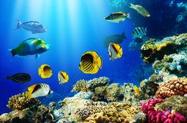
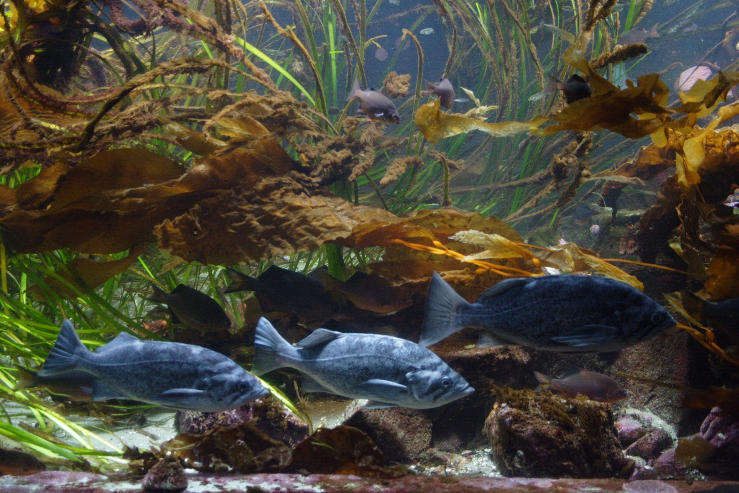
Ocean has Salt Water
Freshwater does NOT
contain salt
Notes:
Ocean water has salt in it while freshwater does NOT contain salt.

Slide 10
Notes:
Let’s check-in for understanding.

Slide 11
What is aquifer?
Notes:
What is aquifer?
[Aquifer is water stored under the ground.]

Slide 12
What is salinity?
Notes:
What is salinity?
[Salinity is the amount of salt in water.]

Slide 13
Wetland
Notes:
Now that we’ve reviewed, let’s define our new term, wetland.

Slide 14
Wetland: an area that is saturated with water for at least part of the year
Notes:
A wetland is an area that is saturated with water for at least part of the year.

Slide 15
Notes:
Let’s check-in for understanding.

Slide 16
What is a wetland?
Notes:
What is a wetland?
[A wetland is an area that is saturated with water for at least part of the year.]

Slide 17
Notes:
That is the basic definition, but there is a bit more you need to know.

Slide 18
Wetland: an area that is saturated with water for at least part of the year
Notes:
An area that is saturated is very wet or thoroughly soaked. So wetlands are soaked in water.

Slide 19
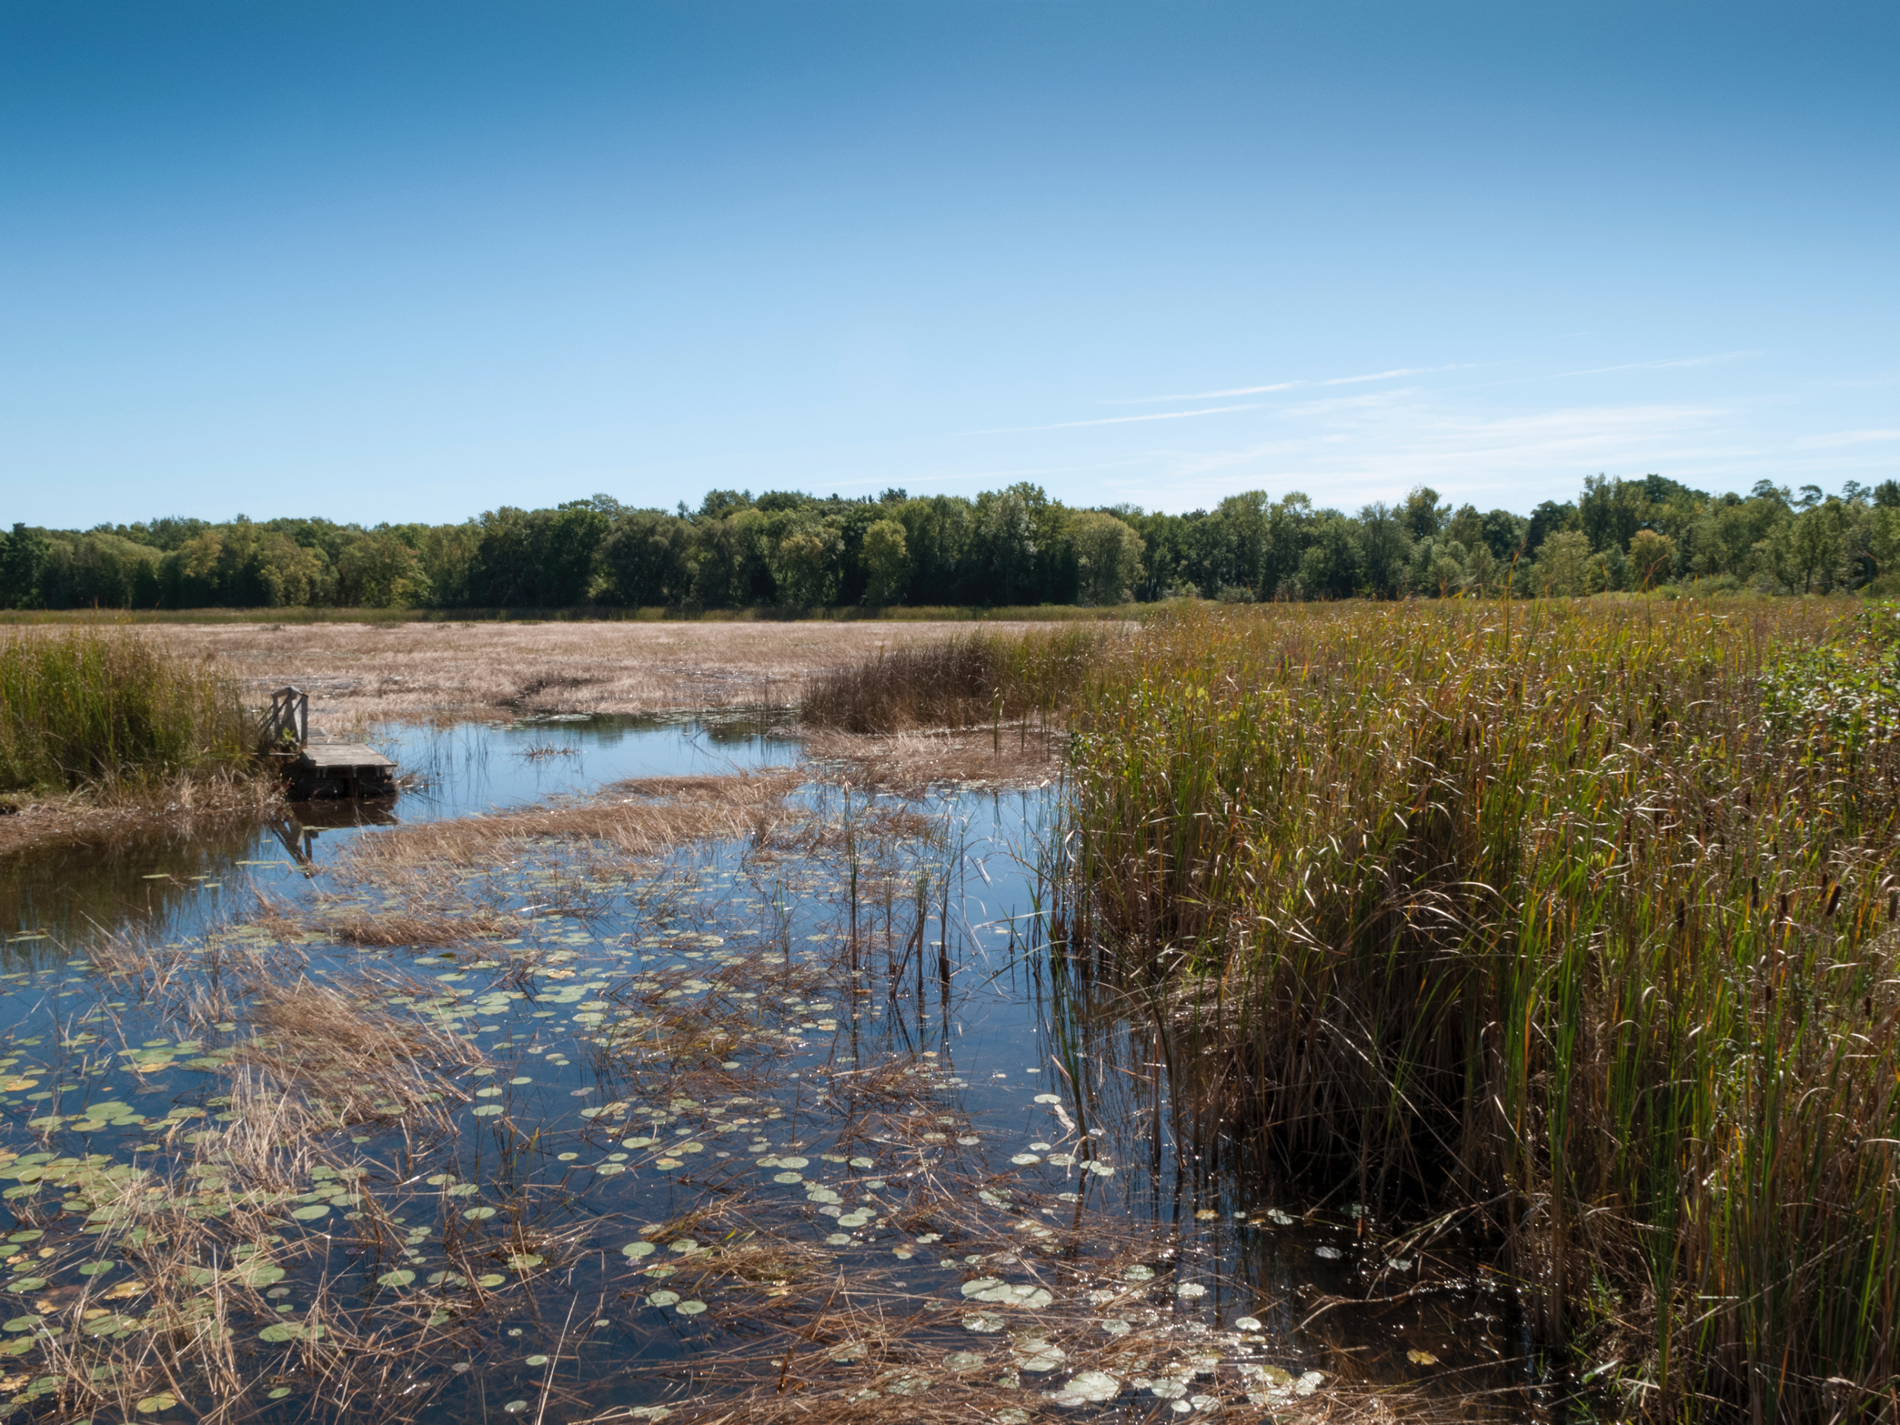
Wet
Land
Notes:
Basically, it is very wet land.

Slide 20
Types of wetlands:
Swamp
Bog
Marsh
Notes:
There are many different types of wetlands. The main ones are swamps, bogs, and marshes.

Slide 21
Notes:
Let’s check-in for understanding.

Slide 22
What does saturated mean?
Notes:
What does saturated mean?
[An area that is saturated is very wet or thoroughly soaked. So wetlands are soaked in water.]

Slide 23
Notes:
Now, let’s look at some examples of the main types of wetlands.

Slide 24
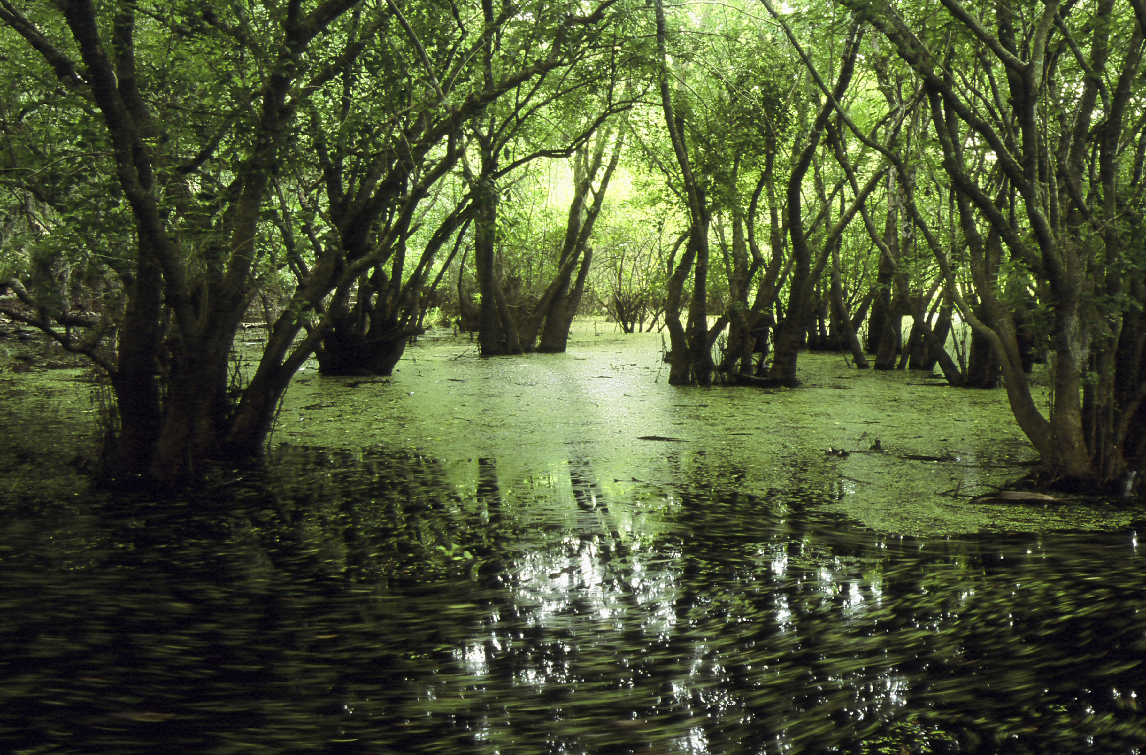
Swamp
Trees
Notes:
Swamps have lots of trees,

Slide 25
Swamp
Standing Water
Notes:
standing water,
(standing water moves very little if at all)

Slide 26
Swamp
Plants and Animals
Notes:
and lots of plants and animals.

Slide 27
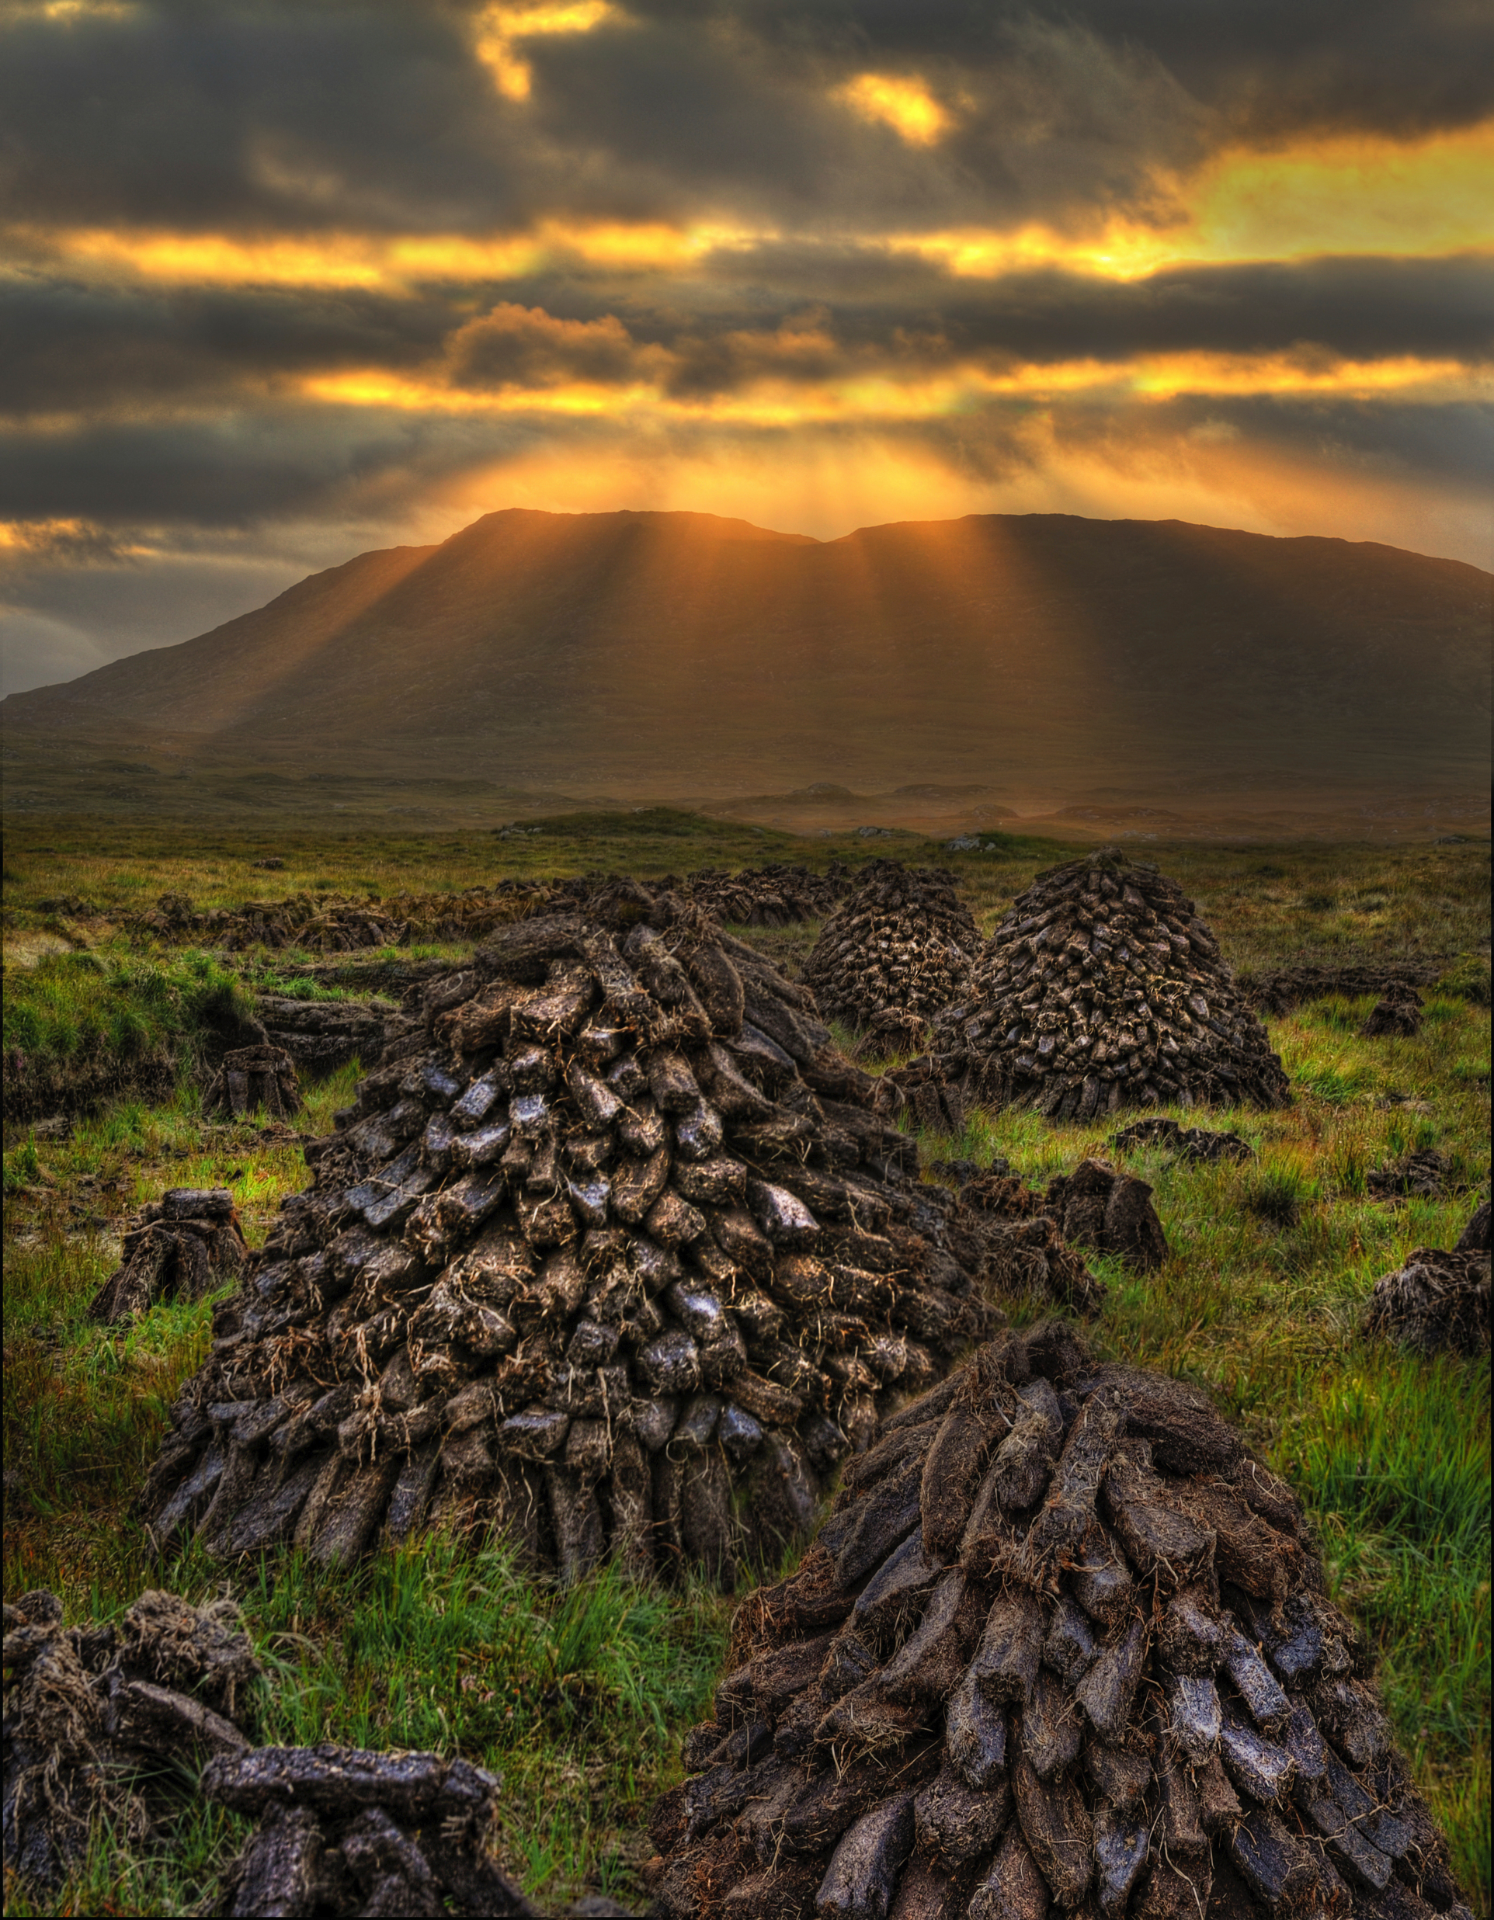
Bog
Peat
Notes:
Bogs have deep layers of rotting vegetation called peat,

Slide 28
Bog
Few trees
Notes:
few trees,

Slide 29
Bog
and many
plants and
animals
Notes:
and many plants and animals.

Slide 30
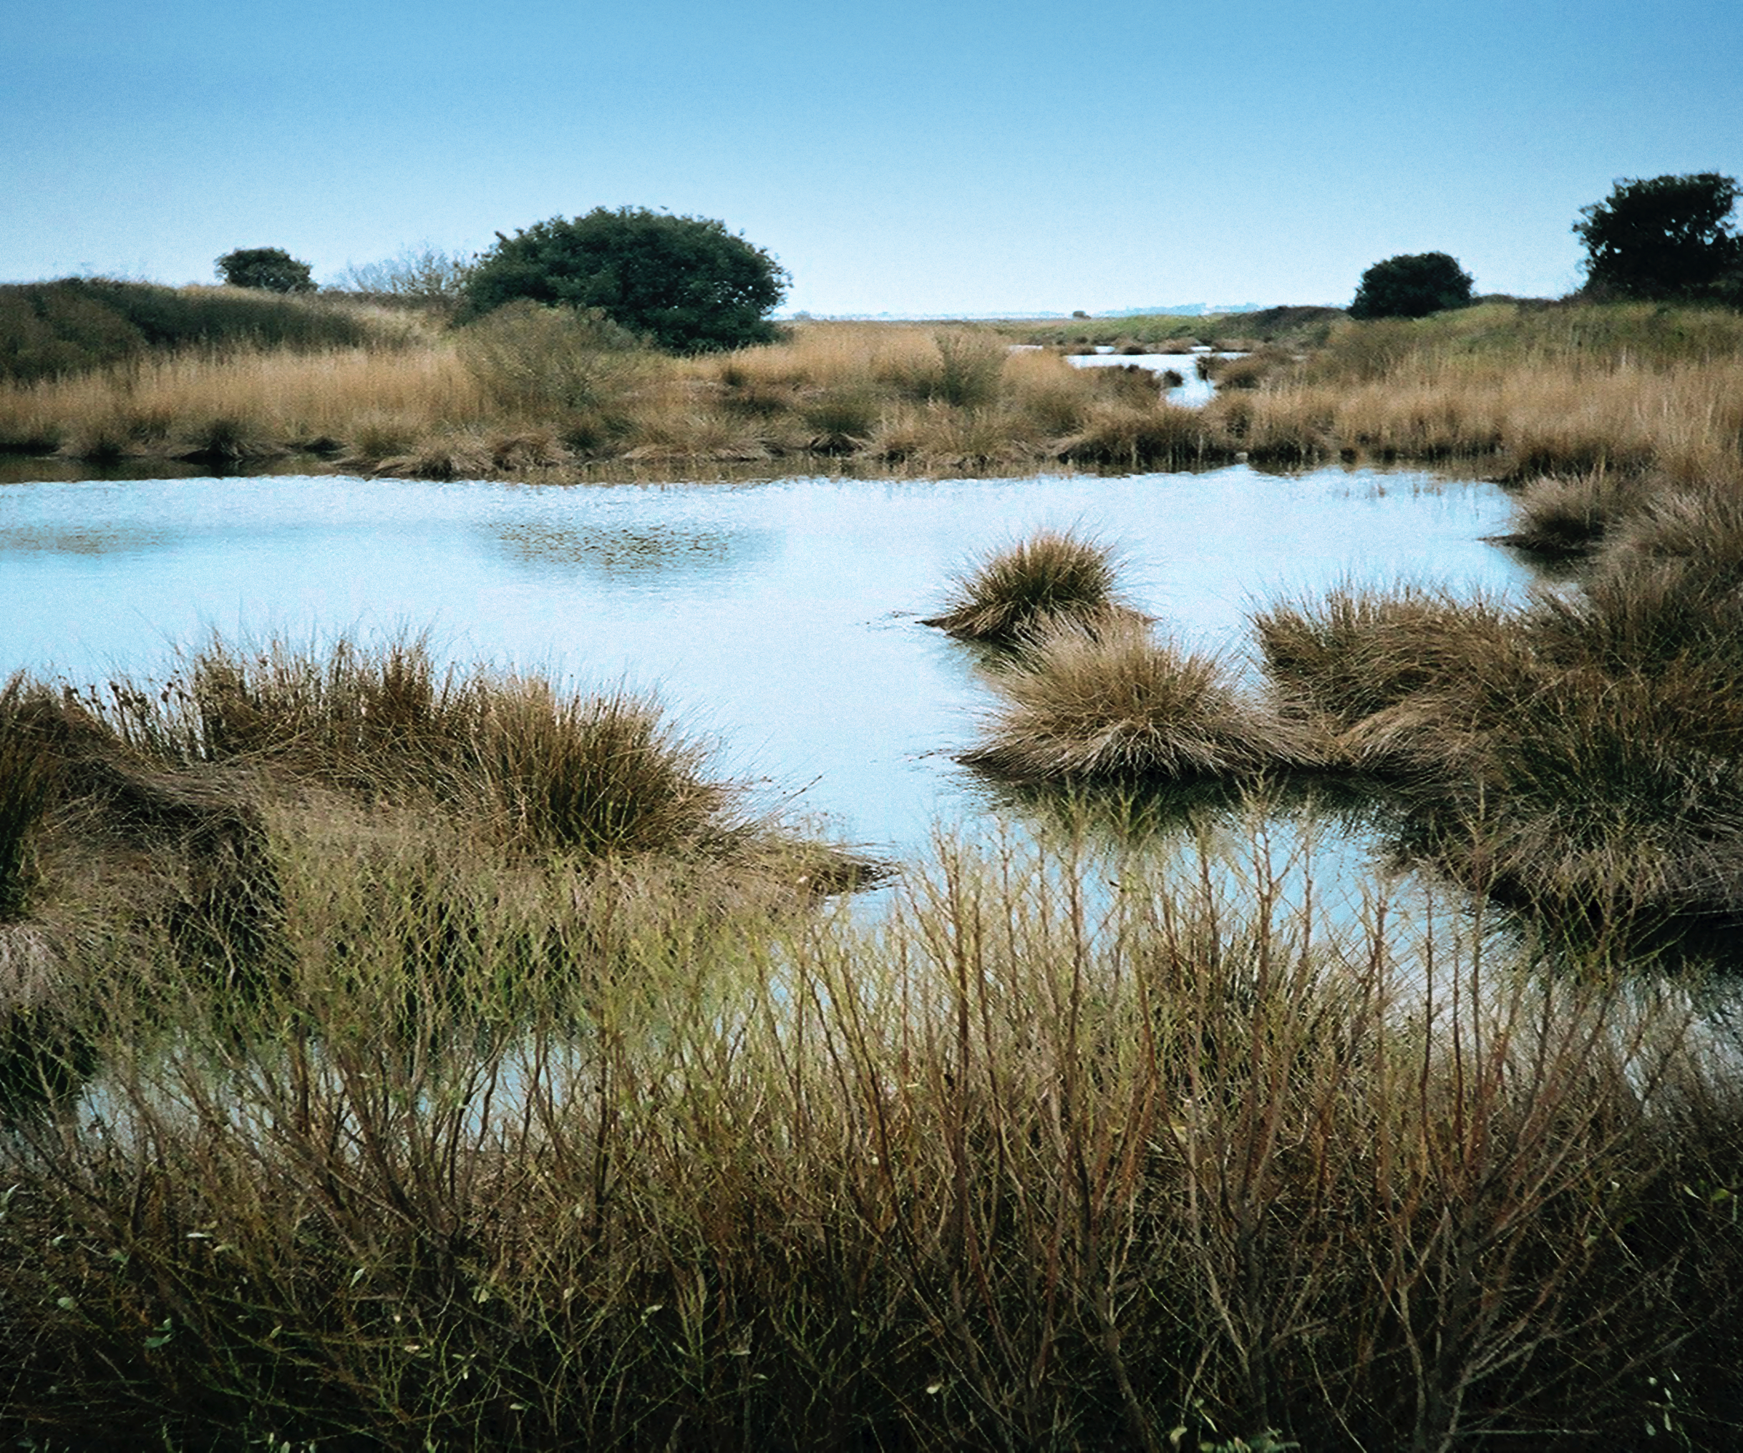
Marsh
Shallow Water
Notes:
Marshes have lots of shallow water,

Slide 31
Marsh
Few Trees
Grasses
Notes:
Lots of grasses with few trees,

Slide 32
Marsh
and many plants and animals
Notes:
and many plants and animals.

Slide 33
Notes:
Next, let’s look at a non-example of wetlands.

Slide 34
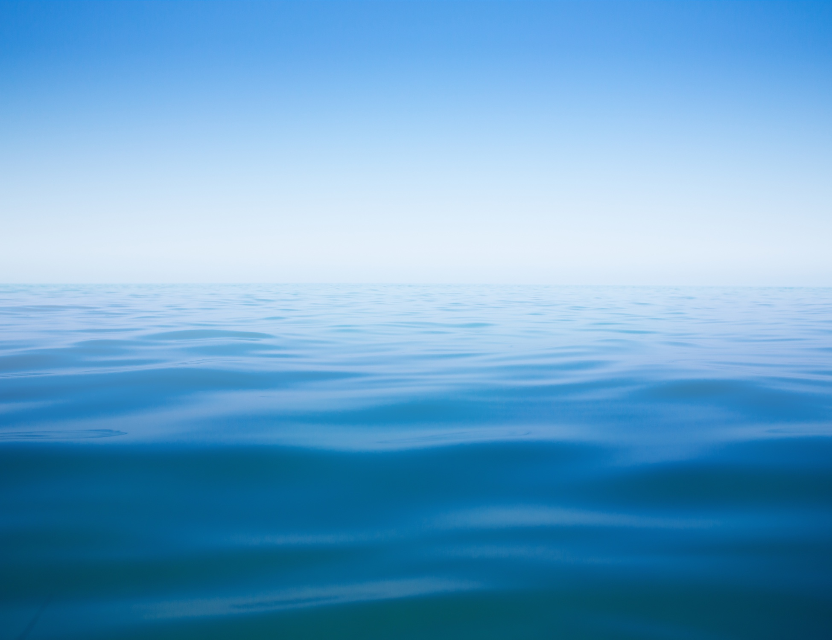
Notes:
Wetlands are areas of land, so oceans are not wetlands.

Slide 35
Notes:
Let’s check-in for understanding.

Slide 36
What are the three main types of wetlands?
Notes:
What are the three main types of wetlands?
[Swamps, bogs, and marshes]

Slide 37
Describe the similarities and differences between swamps, bogs, and marshes.
Notes:
Describe the characteristics of the main types of wetlands.
[Swamps have lots of trees, standing water (standing water moves very little if at all), and lots of plants and animals.
Bogs have deep layers of rotting vegetation called peat, few trees, and many plants and animals.
Marshes have lots of shallow water, lots of grasses with few trees, and many plants and animals.]

Slide 38
What is a wetland?
Notes:
What is a wetland?
[A wetland is an area that is saturated with water for at least part of the year.]

Slide 39
Remember!!!
Notes:
So remember!

Slide 40
Wetland: an area that is saturated with water for at least part of the year
Notes:
A wetland is an area that is saturated with water for at least part of the year.

Slide 41
Simulation Activity
Sensational Wetlands!
The resource linked above includes instructions for a teacher-led demonstration of wetland structure. Students will be able to differentiate wetlands from others habitats and list some plants and animals that live in wetlands. They will also learn about the different definitions that different groups of professionals use to describe wetlands.

Slide 42
Big Questions: What features characterize different aquatic ecosystems and why are these ecosystems important to our environment?
Notes:
Explicit cue to revisit the big question at the end of the lesson: Okay everyone. Now that we’ve learned about wetlands, let’s reflect once more on our big question. Was there anything that we predicted earlier that was correct or incorrect? Do you have any new hypotheses to share?
Feedback: Offering students an opportunity to evaluate their earlier hypotheses and make changes based on their new understandings is an important part of the iterative process in science. This is a great opportunity to help students build an epistemic understanding by explicitly stating how continuing to change and build on hypotheses as your knowledge grows is an important part of the discipline of science!

Slide 43
Notes:
Thanks for watching, and please continue watching CAPs available from this website.

Slide 44
This Video Was Created With Resources From:
Questions or Comments
Michael Kennedy, Ph.D. MKennedy@Virginia.edu
Rachel L Kunemund, Ph.D. rk8vm@virginia.edu

Slide 45
Intro
“Big Idea” Question
Review Concepts
Check-In Questions
Teacher Demo
Vocabulary
Student-Friendly Definition
Examples & Non-Examples
Morphological Word Parts
Extension/Simulation Activity
Notes:
OK everyone, get ready for our next lesson. Just as a reminder, these are the different components that our lesson may include, and you’ll see these icons in the top left corner of each slide so that you can follow along more easily!

Slide 46
Estuary
Intro
Notes:
Today we will discuss estuaries.

Slide 47
Big Questions: What features characterize different aquatic ecosystems and why are these ecosystems important to our environment?
Notes:
Our “big question” is: What features characterize different aquatic ecosystems and why are these ecosystems important to our environment?
[Pause and illicit predictions from students.]
I love all these thoughtful scientific hypotheses! Be sure to keep this question and your predictions in mind as we move through these next few lessons, and we’ll continue to revisit it.

Slide 48
Notes:
Before we define the terms estuary, wetland, and watershed, let’s review some other words that you already learned, and make sure you are firm in your understanding.
Feedback: Cues are an important way to prepare students for what is coming next.

Slide 49
Aquifer: water stored under the ground
Notes:
An aquifer is water stored under the ground. We sometimes refer to aquifers as ground water.

Slide 50
Salinity: the amount of salt in water
Notes:
Salinity is the amount of salt in the water.

Slide 51
Ocean has Salt Water
Freshwater does NOT
contain salt
Notes:
Ocean water has salt in it while freshwater does NOT contain salt.

Slide 52
Wetland: an area that is saturated with water for at least part of the year
Notes:
A wetland is an area that is saturated with water for at least part of the year. The main types of wetlands are swamps, bogs, and marshes.

Slide 53
Notes:
Let’s check-in for understanding.

Slide 54
What is aquifer?
Notes:
What is aquifer?
[Aquifer is water stored under the ground.]

Slide 55
What is salinity?
Notes:
What is salinity?
[Salinity is the amount of salt in water.]

Slide 56
What is a wetland?
Notes:
What is a wetland?
[A wetland is an area that is saturated with water for at least part of the year. The main types of wetlands are swamps, bogs, and marshes.]

Slide 57
Estuary
Notes:
Now that we’ve reviewed, let’s define our new term, estuary.

Slide 58
Estuary: partially enclosed body of water formed where a river flows into an ocean
Notes:
An estuary is a partially enclosed body of water formed where a river flows into an ocean.

Slide 59
Notes:
Let’s check-in for understanding.

Slide 60
What is an estuary?
Notes:
What is an estuary?
[An estuary is a partially enclosed body of water formed where a river flows into an ocean.]

Slide 61
Notes:
That is the basic definition, but there is a bit more you need to know.

Slide 62
Estuary: partially enclosed body of water formed where a river flows into an ocean
Notes:
Rivers are bodies of freshwater, whereas oceans are bodies of saltwater.

Slide 63
Estuary: partially enclosed body of water formed where a river flows into an ocean
Estuary
Notes:
The combination of fresh and saltwater creates a unique environment.

Slide 64
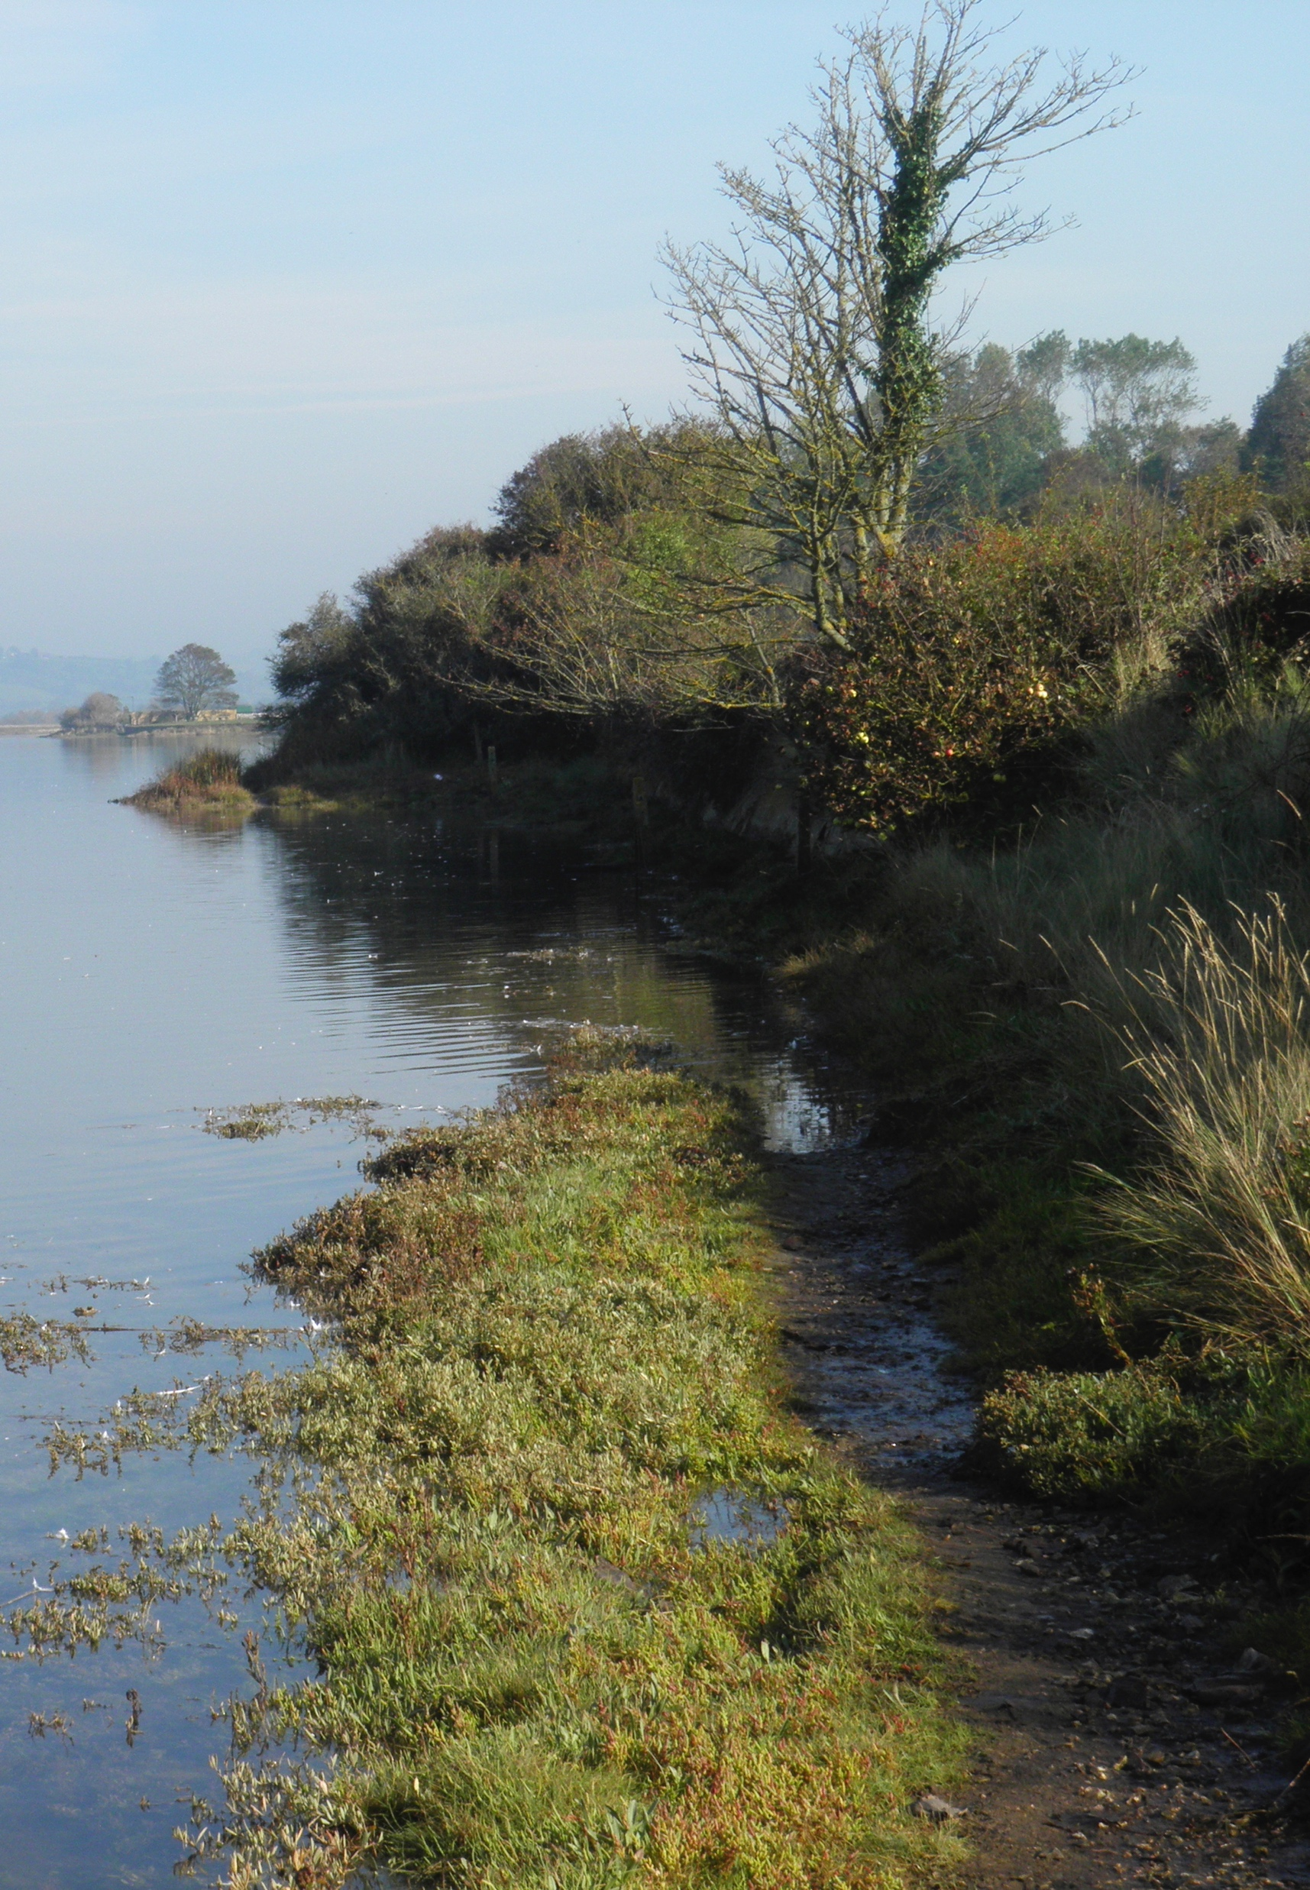
Photo # 497301675
Notes:
An estuary will often have wetland swamps and marshes along its edges.

Slide 65
Notes:
Estuaries have large aquifers underneath them where groundwater collects.

Slide 66
Photo # 503455659
Photo # 177390453 salt shaker
Mixture
Notes:
Estuaries have a mixture of freshwater and saltwater. Recall that salinity describes how salty the water is.

Slide 67
Fresh water from rivers
Gradient of salinity
Salt water from the ocean
Notes:
Estuaries have a gradient of salinity. This means that the amount of salt in the water changes as you travel through the estuary.

Slide 68
Fresh water from rivers
Very Little Salt
Gradient of salinity
Lots of Salt
Salt water from the ocean
Notes:
The fresh river water has very little salt. The amount of salt increases as you get closer to the ocean.

Slide 69
Notes:
Let’s check-in for understanding.

Slide 70
True/False: Estuaries often have wetland swamps and marshes along its edges.
Notes:
True/False: Estuaries often have wetland swamps and marshes along its edges.

Slide 71
True/False: Estuaries often have wetland swamps and marshes along its edges.
Notes:
True/False: Estuaries often have wetland swamps and marshes along its edges.

Slide 72
How does the salinity change in an estuary?
Fresh water from rivers
Salt water from the ocean
Notes:
How does the salinity change in an estuary?
[Estuaries have a gradient of salinity. This means that the amount of salt in the water changes as you travel through the estuary. The fresh river water has very little salt. The amount of salt increases as you get closer to the ocean.]

Slide 73
Notes:
Now, let’s talk about an important example of an estuary.

Slide 74
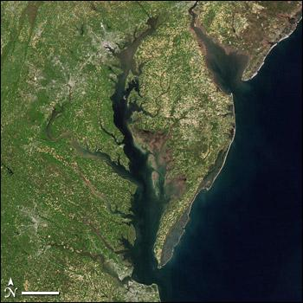
Chesapeake Bay
Estuary
Notes:
The largest estuary on the East Coast is the Chesapeake Bay.

Slide 75
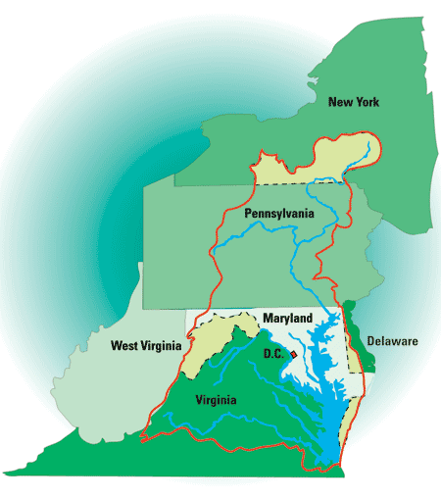
Chesapeake Bay
Watershed
Chesapeake Bay
Estuary
From: Fish and Wildlife Service website http://www.fws.gov
Notes:
The Chesapeake Bay estuary is part of the Chesapeake Bay watershed, which includes all the bodies of water the flow into the bay.

Slide 76
Notes:
So the freshwater runoff from the land outlined in red ends up in bodies of water that flow into the Chesapeake Bay estuary where it mixes with the salt water from the ocean.

Slide 77
Notes:
Let’s talk about some non-examples of estuaries. These are things that might seem similar but do not fit the definition of estuary.

Slide 78
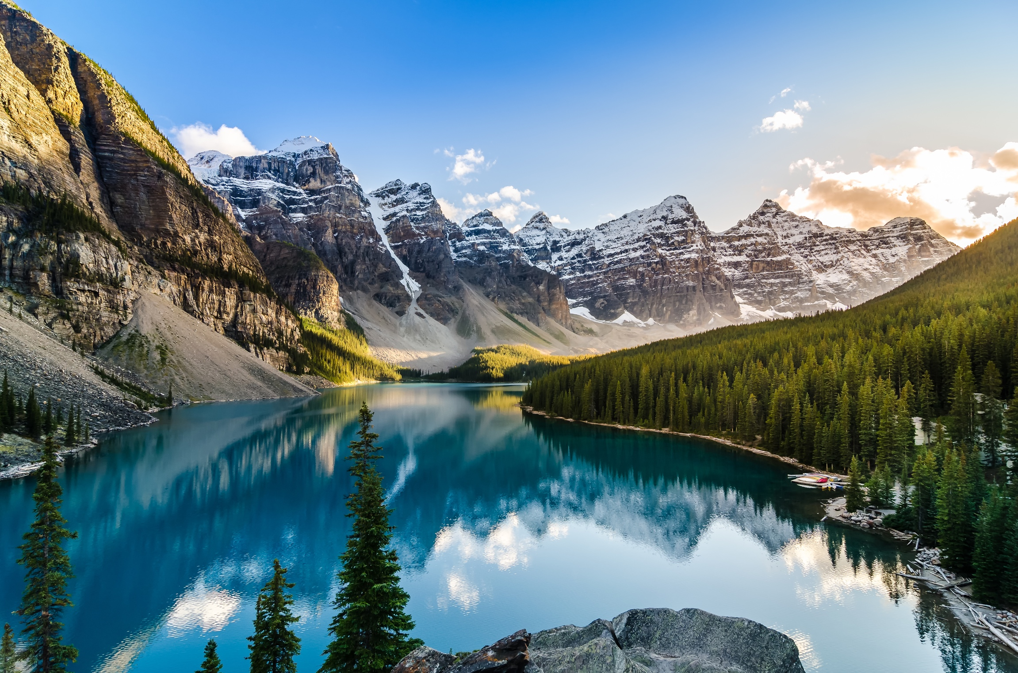
All freshwater
NOT an estuary
Notes:
A non-example is this mountain-top lake. There is NOT a mix of saltwater and freshwater here. It is all freshwater so it is NOT an estuary.

Slide 79
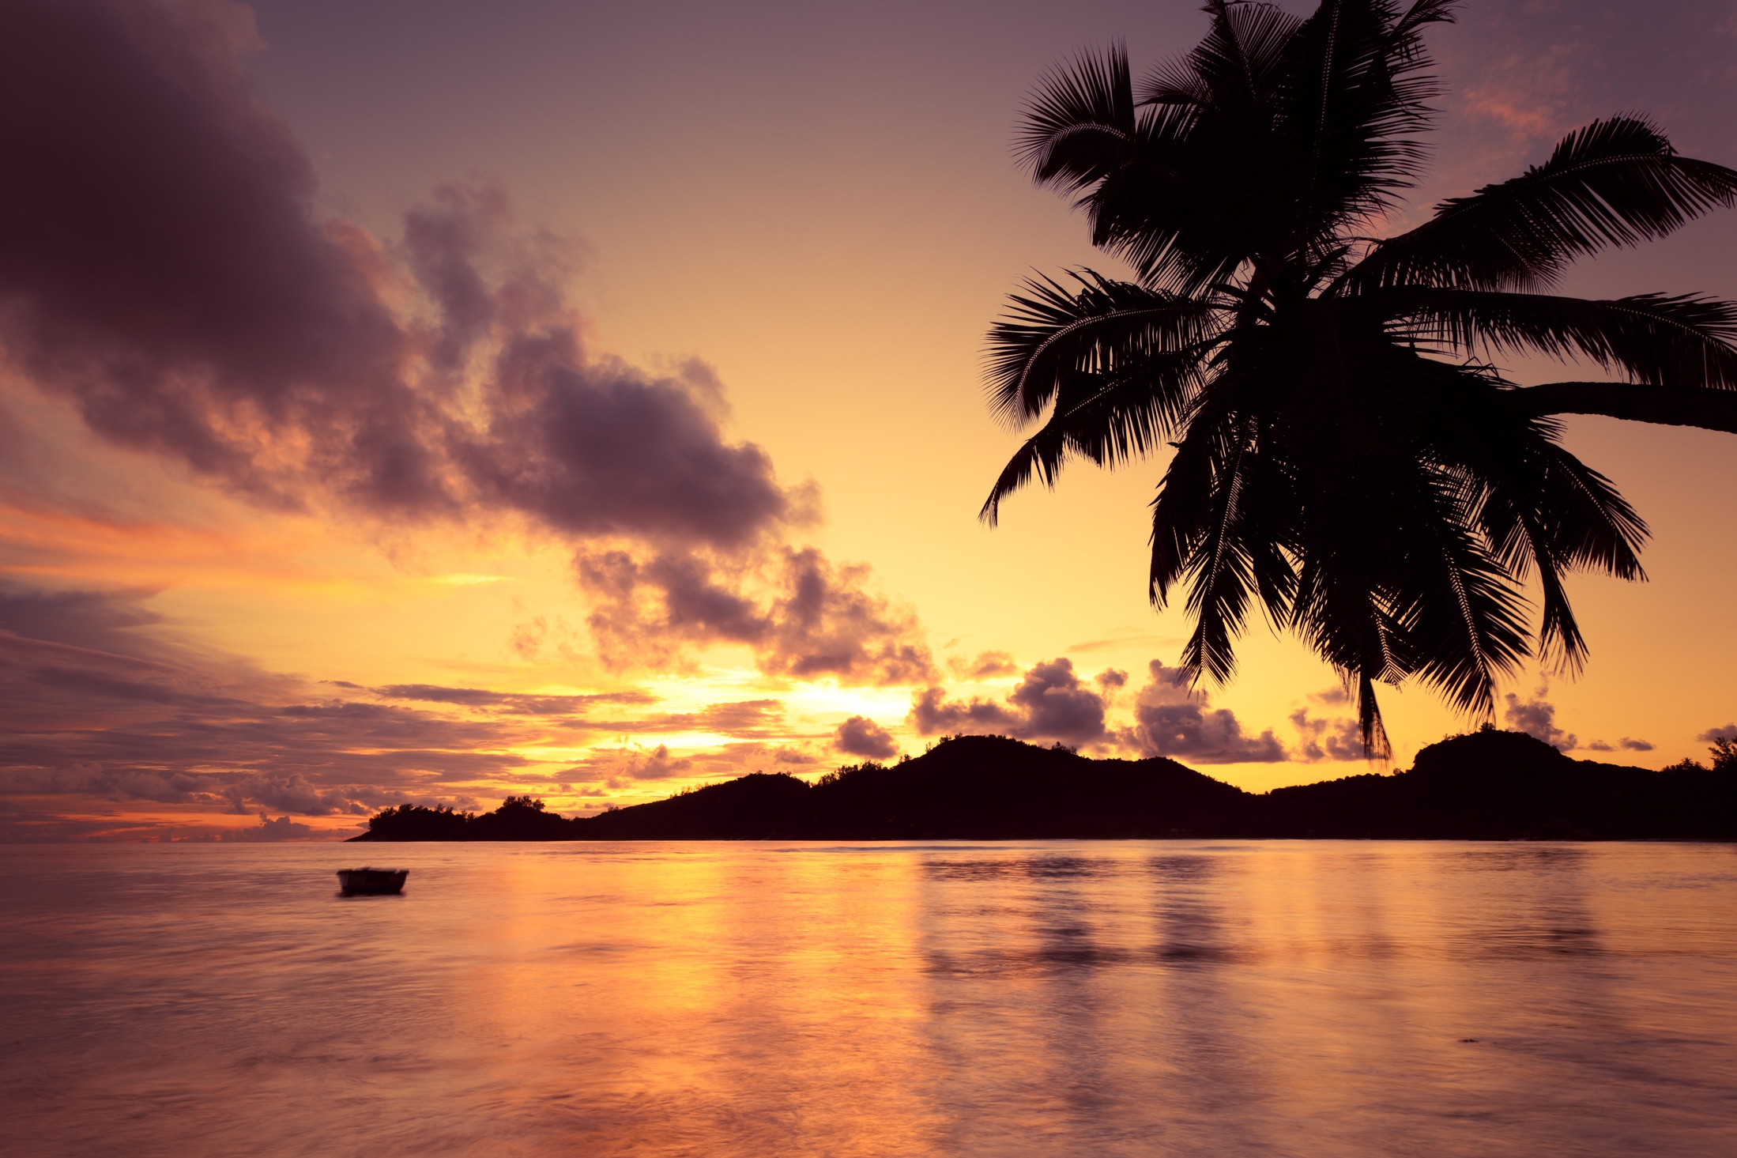
All salt water
NOT an estuary
Notes:
The ocean surrounding this island is NOT an example of an estuary.
It is ALL salt water so it is NOT an estuary.

Slide 80
Notes:
Let’s check-in for understanding.

Slide 81
How is the Chesapeake Bay an example of an estuary?
Notes:
How is the Chesapeake Bay an example of an estuary?
[So the freshwater runoff from the land outlined in red ends up in bodies of water that flow into the Chesapeake Bay estuary where it mixes with the salt water from the ocean.]

Slide 82
Why is this lake NOT an example of an estuary?
Notes:
Why is this lake NOT an example of an estuary?
[There is NOT a mix of saltwater and freshwater here. It is all freshwater so it is NOT an estuary.]

Slide 83
Estuaries are bodies of water where a(n) ________ flows into a(n) _________.
River; stream
Stream; ocean
Ocean; river
River; ocean
Pond; lake
Notes:
Estuaries are bodies of water where a(n) ________ flows into a(n) __________.

Slide 84
Estuaries are bodies of water where a(n) ________ flows into a(n) _________.
River; stream
Stream; ocean
Ocean; river
River; ocean
Pond; lake
Notes:
Estuaries are bodies of water where a(n) river flows into a(n) ocean.

Slide 85
Remember!!!
Notes:
So remember!

Slide 86
Estuary: partially enclosed body of water formed where a river flows into an ocean
Notes:
An estuary is a partially enclosed body of water formed where a river flows into an ocean.

Slide 87
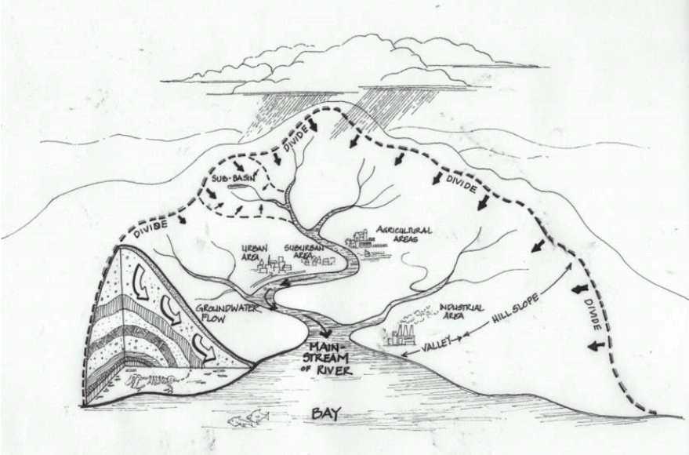
Extension Activity
Crumpled Paper Watershed
The activity linked above includes instructions for a student activity that will allow them to demonstrate their understanding of the term watershed and challenge them to extend their understanding of how pollution can get into waterways through runoff. The activity is geared for inhabitants of the Chesapeake Bay watershed but can easily be adapted for other regions.
Notes:
This resource can be used to provide students with the opportunity to demonstrate their understanding of watersheds.

Slide 88
Big Questions: What features characterize different aquatic ecosystems and why are these ecosystems important to our environment?
Notes:
Explicit cue to revisit the big question at the end of the lesson: Okay everyone. Now that we’ve learned about estuaries, let’s reflect once more on our big question. Was there anything that we predicted earlier that was correct or incorrect? Do you have any new hypotheses to share?
Feedback: Offering students an opportunity to evaluate their earlier hypotheses and make changes based on their new understandings is an important part of the iterative process in science. This is a great opportunity to help students build an epistemic understanding by explicitly stating how continuing to change and build on hypotheses as your knowledge grows is an important part of the discipline of science!

Slide 89
Notes:
Thanks for watching, and please continue watching CAPs available from this website.

Slide 90
This Video Was Created With Resources From:
Questions or Comments
Michael Kennedy, Ph.D. MKennedy@Virginia.edu
Rachel L Kunemund, Ph.D. rk8vm@virginia.edu

Slide 91
Intro
“Big Idea” Question
Review Concepts
Check-In Questions
Teacher Demo
Vocabulary
Student-Friendly Definition
Examples & Non-Examples
Morphological Word Parts
Extension/Simulation Activity
Notes:
OK everyone, get ready for our next lesson. Just as a reminder, these are the different components that our lesson may include, and you’ll see these icons in the top left corner of each slide so that you can follow along more easily!

Slide 92
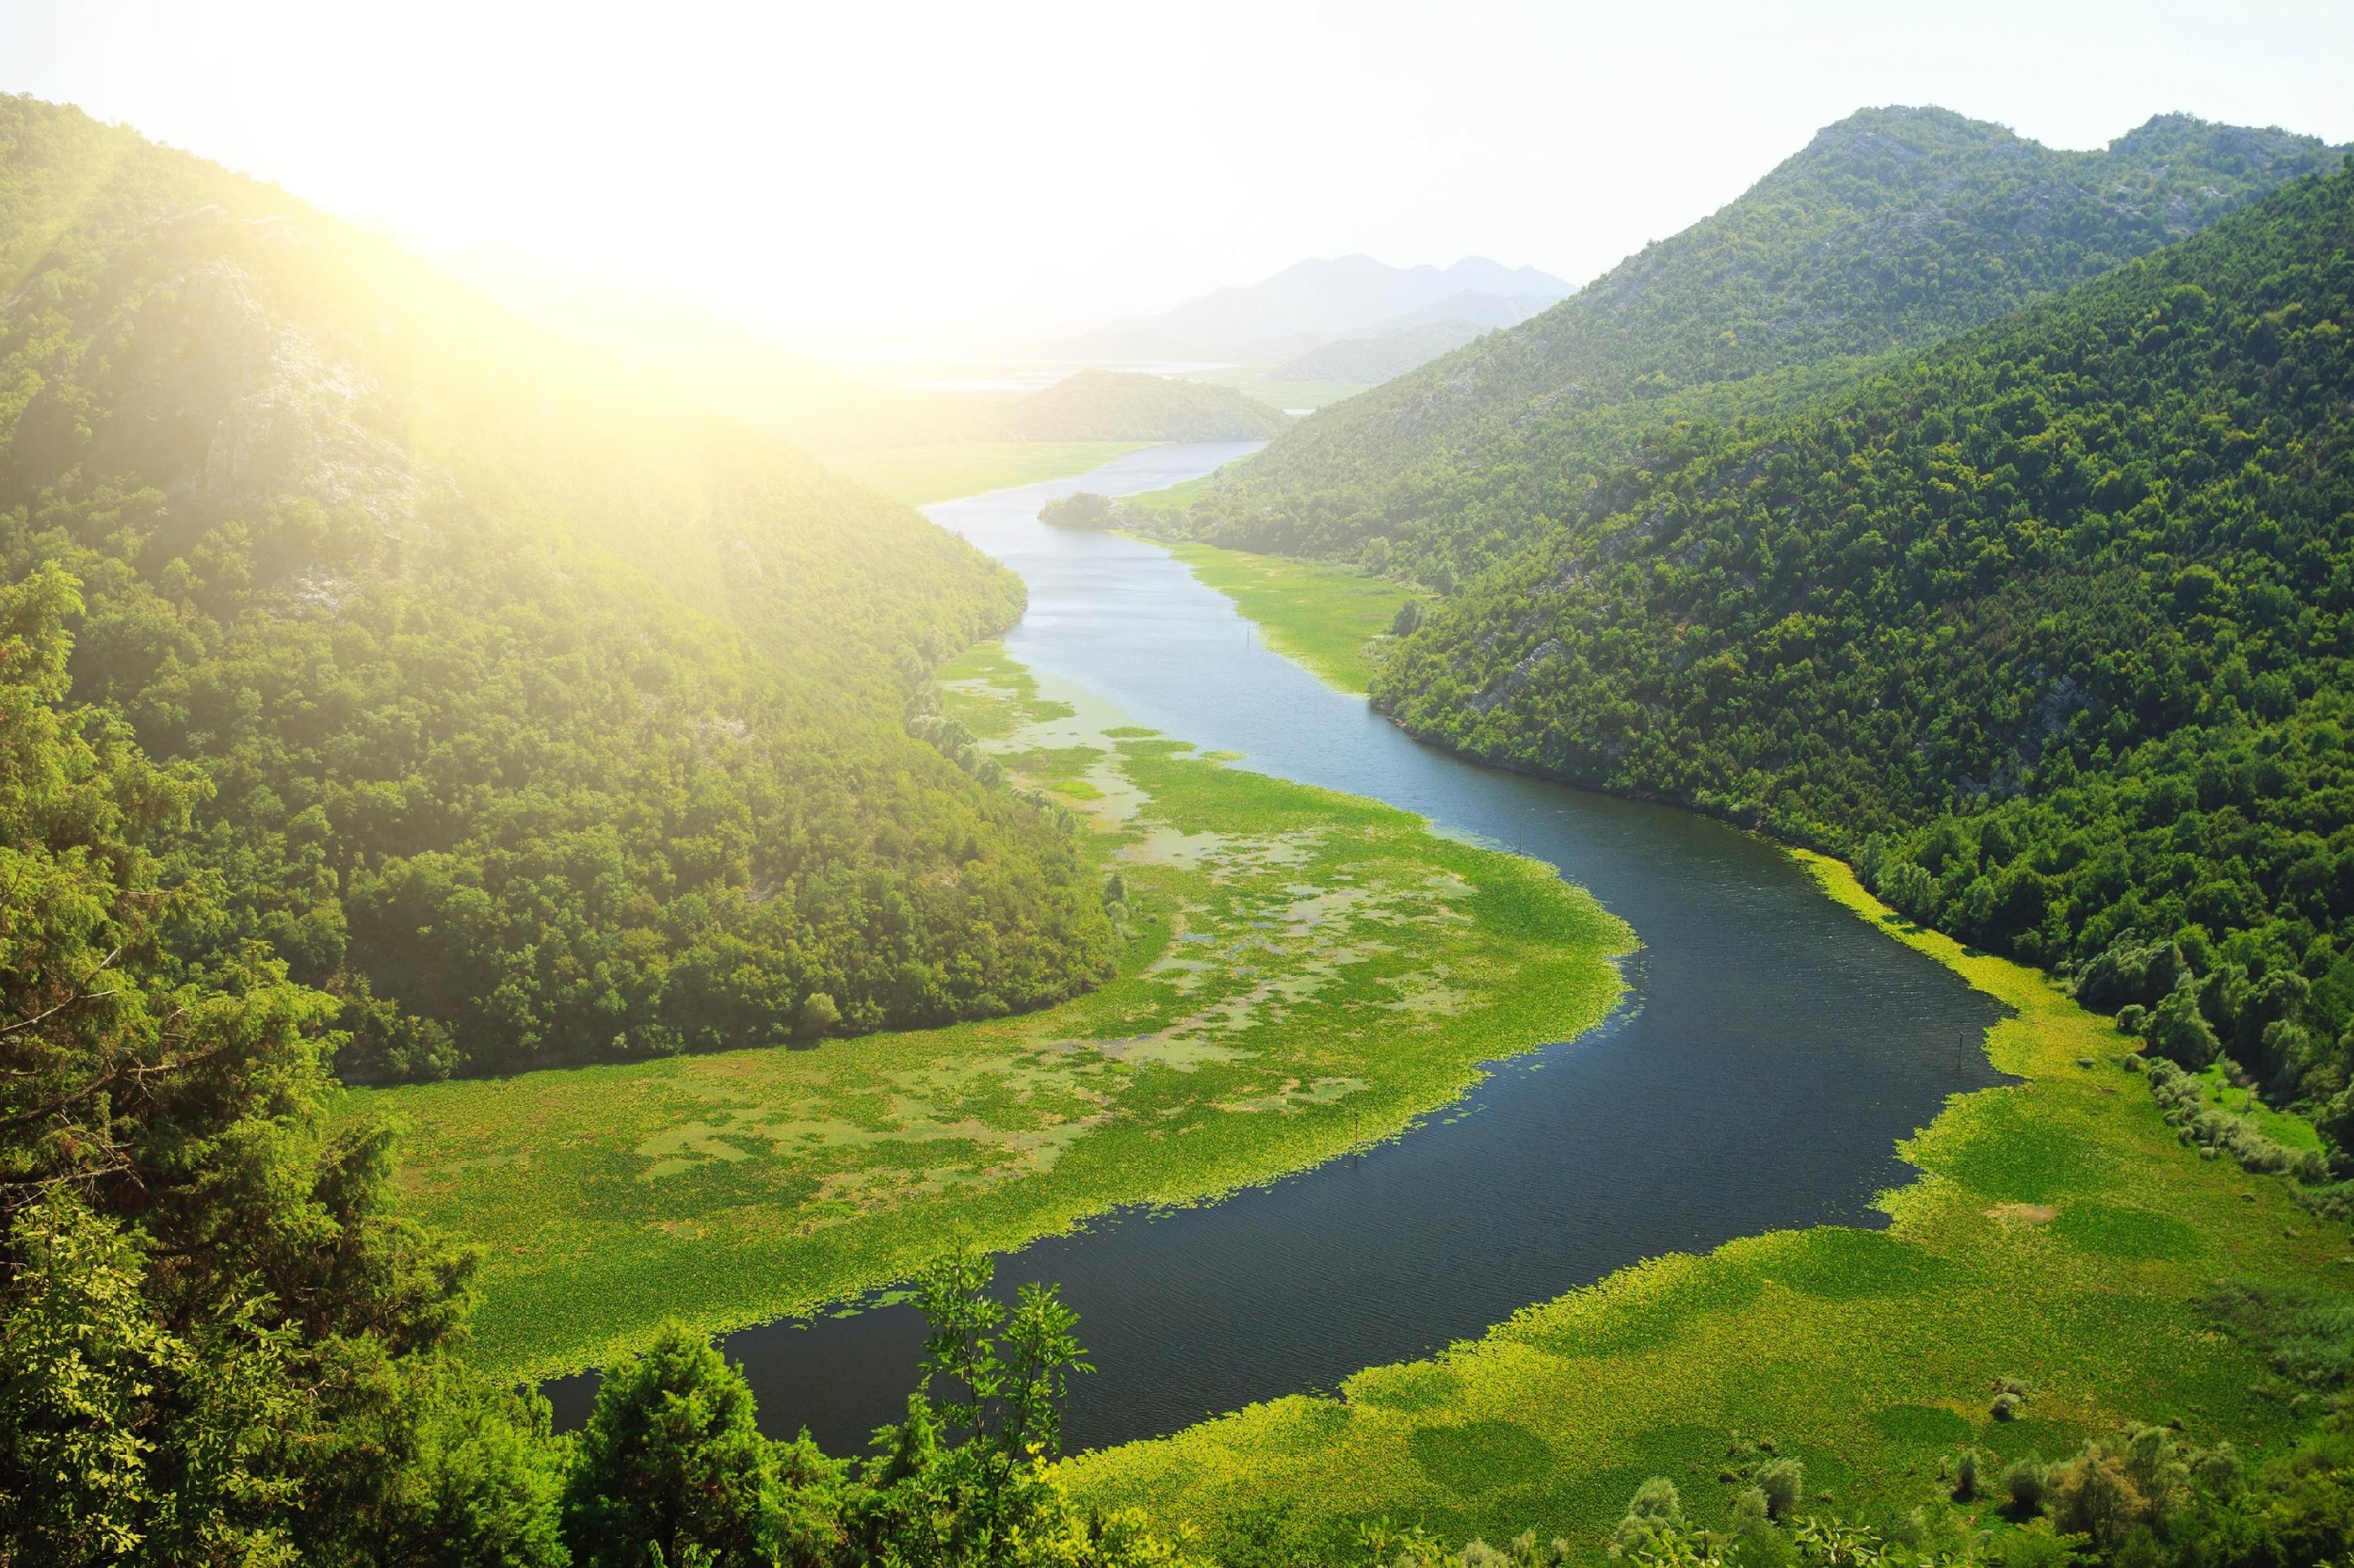
Watershed
Intro
Notes:
Today we will discuss watersheds.

Slide 93
Big Questions: What features characterize different aquatic ecosystems and why are these ecosystems important to our environment?
Notes:
Our “big question” is: What features characterize different aquatic ecosystems and why are these ecosystems important to our environment?
[Pause and illicit predictions from students.]
I love all these thoughtful scientific hypotheses! Be sure to keep this question and your predictions in mind as we move through these next few lessons, and we’ll continue to revisit it.

Slide 94
Notes:
Before we define the terms estuary, wetland, and watershed, let’s review some other words that you already learned, and make sure you are firm in your understanding.
Feedback: Cues are an important way to prepare students for what is coming next.

Slide 95
Aquifer: water stored under the ground
Notes:
An aquifer is water stored under the ground. We sometimes refer to aquifers as ground water.

Slide 96
Salinity: the amount of salt in water
Notes:
Salinity is the amount of salt in the water.

Slide 97
Ocean has Salt Water
Freshwater does NOT
contain salt
Notes:
Ocean water has salt in it while freshwater does NOT contain salt.

Slide 98
Wetland: an area that is saturated with water for at least part of the year
Notes:
A wetland is an area that is saturated with water for at least part of the year. The main types of wetlands are swamps, bogs, and marshes.

Slide 99
Estuary: partially enclosed body of water formed where a river flows into an ocean
Notes:
An estuary is a partially enclosed body of water formed where a river flows into an ocean.

Slide 100
Notes:
Let’s check-in for understanding.

Slide 101
What is aquifer?
Notes:
What is aquifer?
[Aquifer is water stored under the ground.]

Slide 102
What is salinity?
Notes:
What is salinity?
[Salinity is the amount of salt in water.]

Slide 103
What is a wetland?
Notes:
What is a wetland?
[A wetland is an area that is saturated with water for at least part of the year. The main types of wetlands are swamps, bogs, and marshes.]

Slide 104
What is an estuary?
Notes:
What is an estuary?
[An estuary is a partially enclosed body of water formed where a river flows into an ocean.]

Slide 105
Watershed
Notes:
Now that we’ve reviewed, let’s define our new term, watershed.

Slide 106
Watershed: an area of land where all of the runoff flows downhill into the same body of water
Notes:
A watershed is an area of land where all of the runoff flows downhill into the same body of water.

Slide 107
Notes:
Let’s check-in for understanding.

Slide 108
What is a watershed?
Notes:
What is a watershed?
[A watershed is an area of land where all the runoff flows downhill into the same body of water.]

Slide 109
Notes:
That is the basic definition, but there is a bit more you need to know.

Slide 110
An area of land
Land + Water = Watershed
All of the runoff flows downhill into the river.
Notes:
A watershed includes the water and the land that water flows over. It is not only the water.

Slide 111
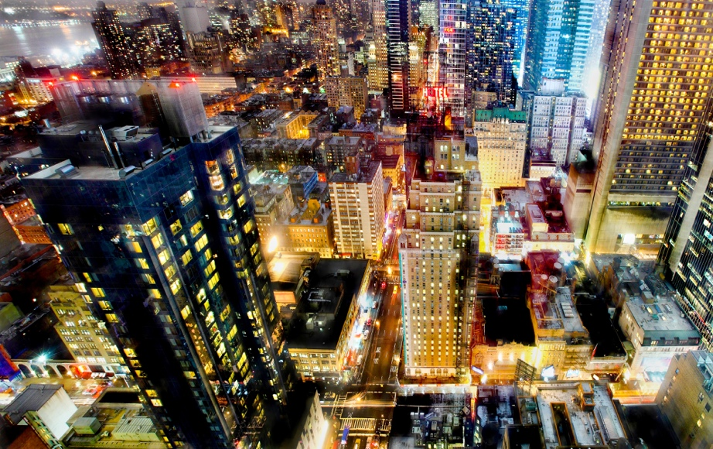
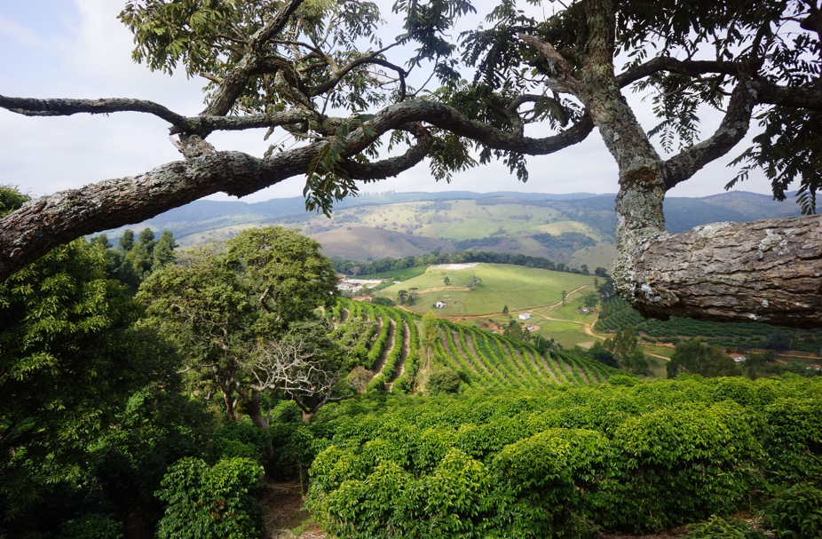
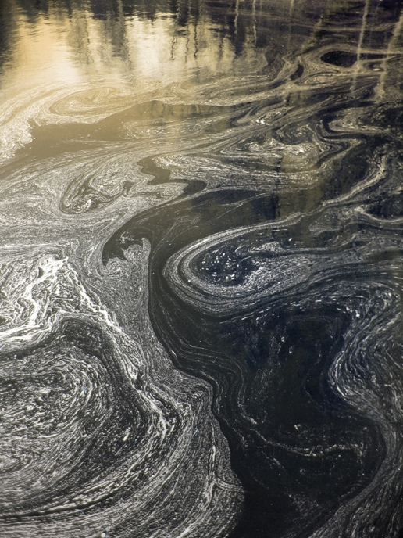
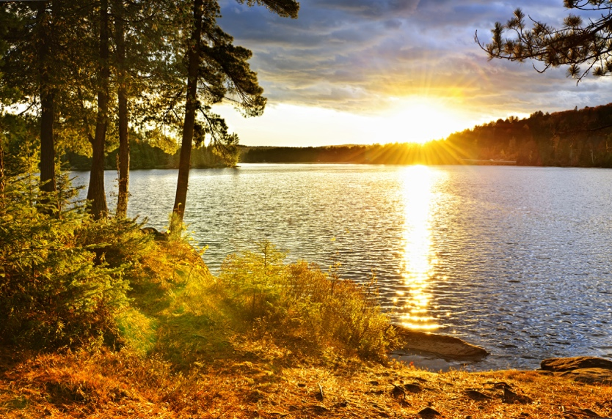
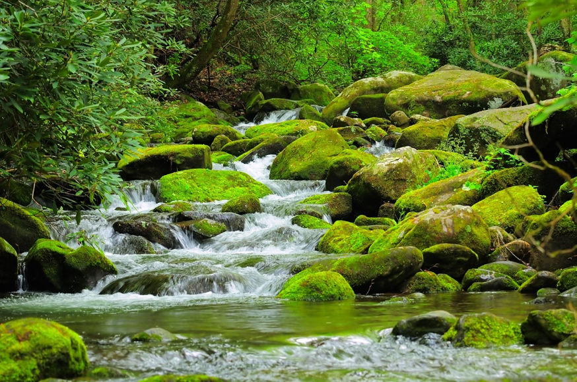
Watershed
Notes:
The watershed includes all sources of water, clean or polluted, and all the land that drain into a watershed.

Slide 112
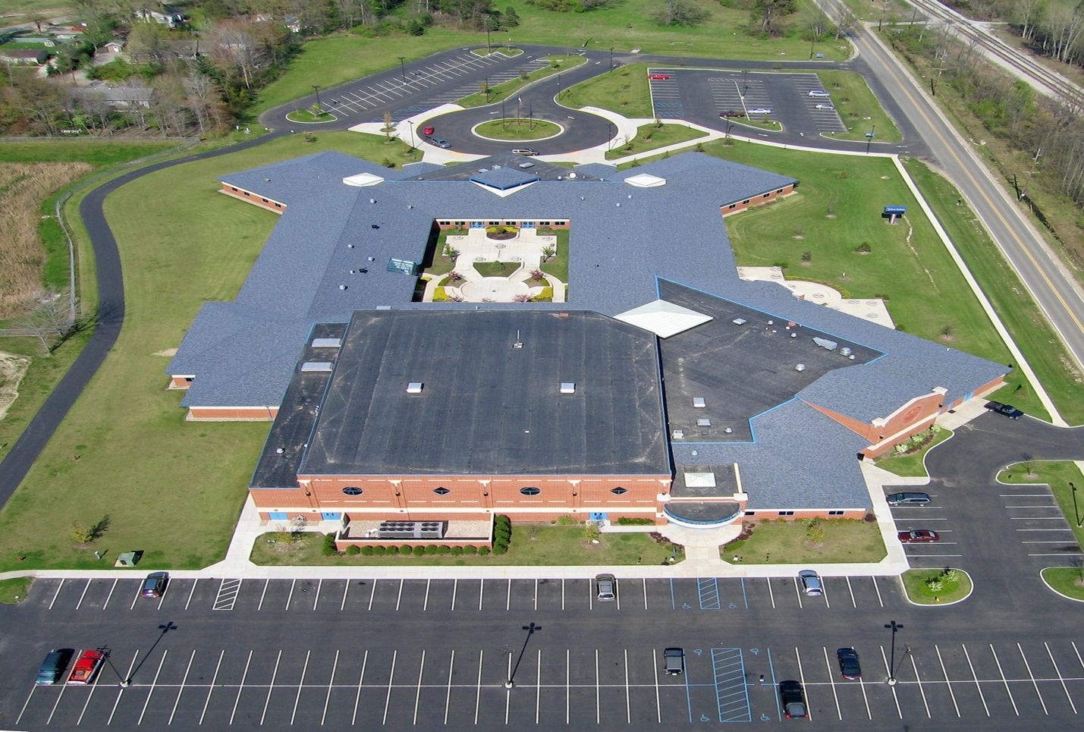
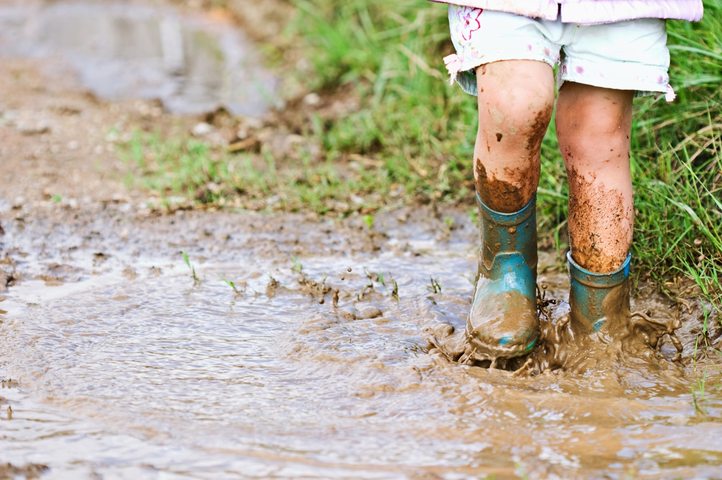
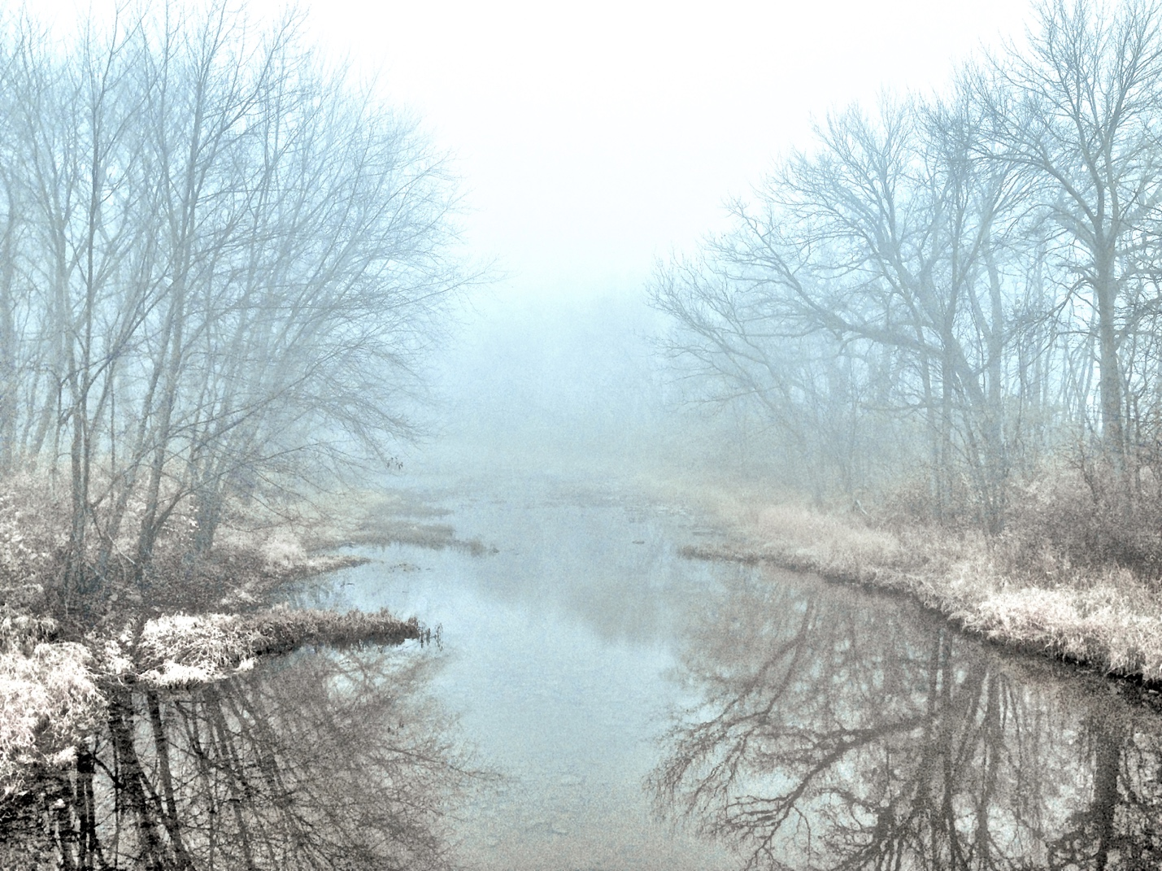
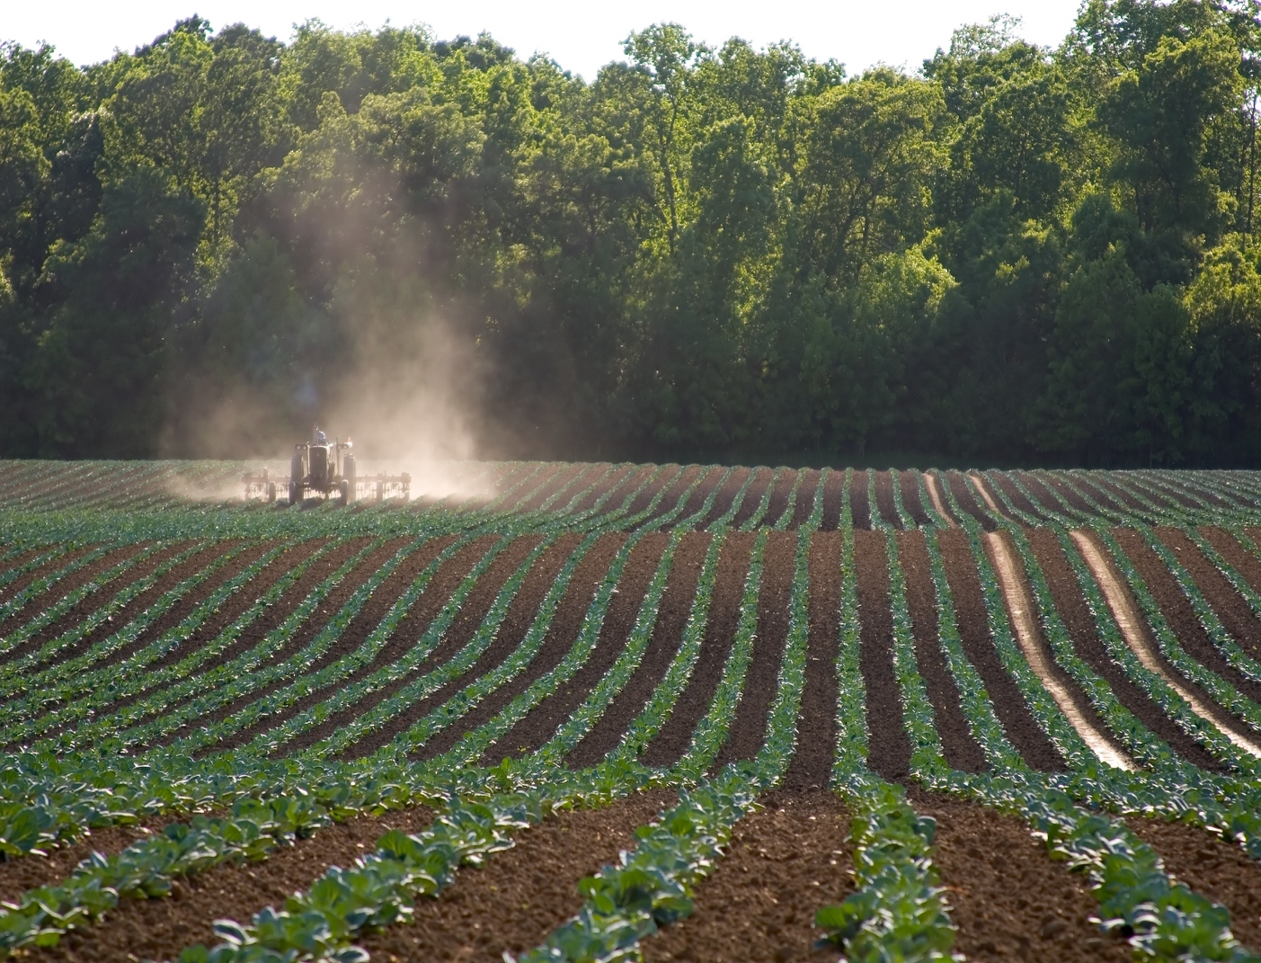
Notes:
So your school parking lot, this puddle, this creek, and this farm are all part of a watershed. All of these eventually drain into a single body of water.

Slide 113
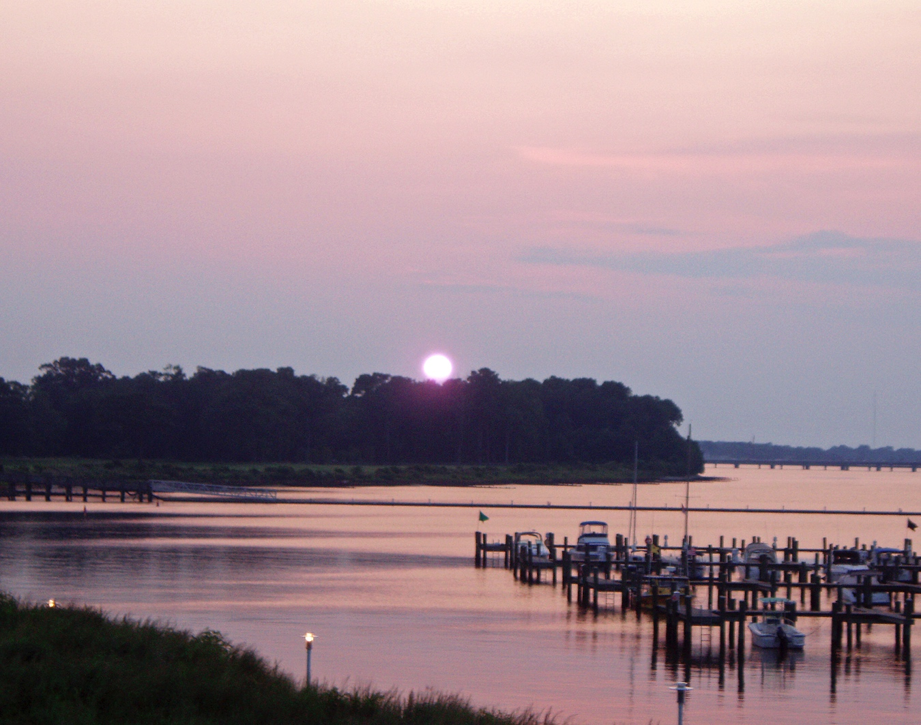
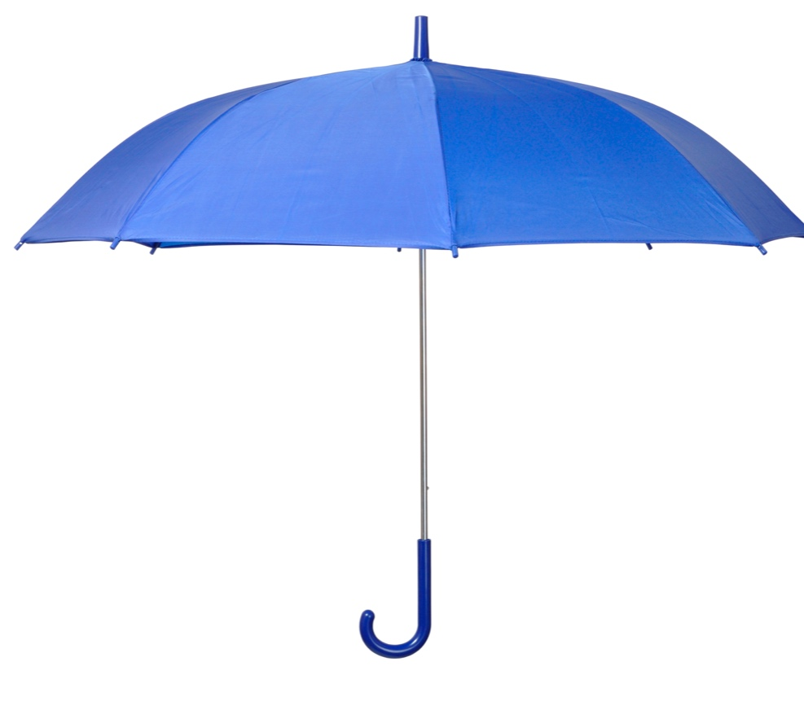
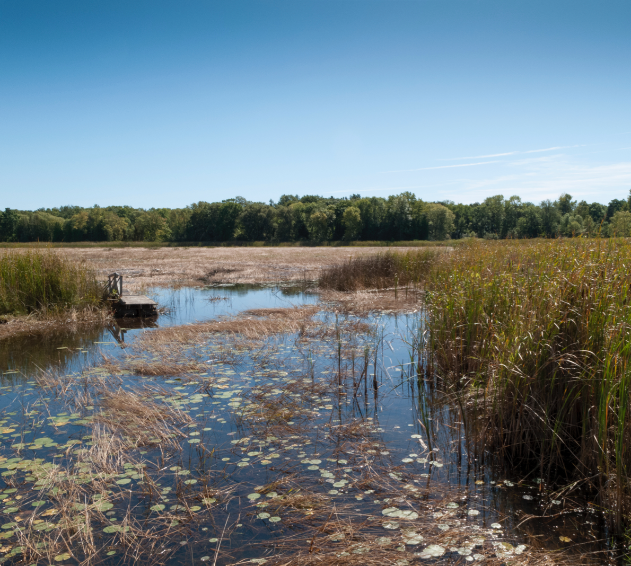
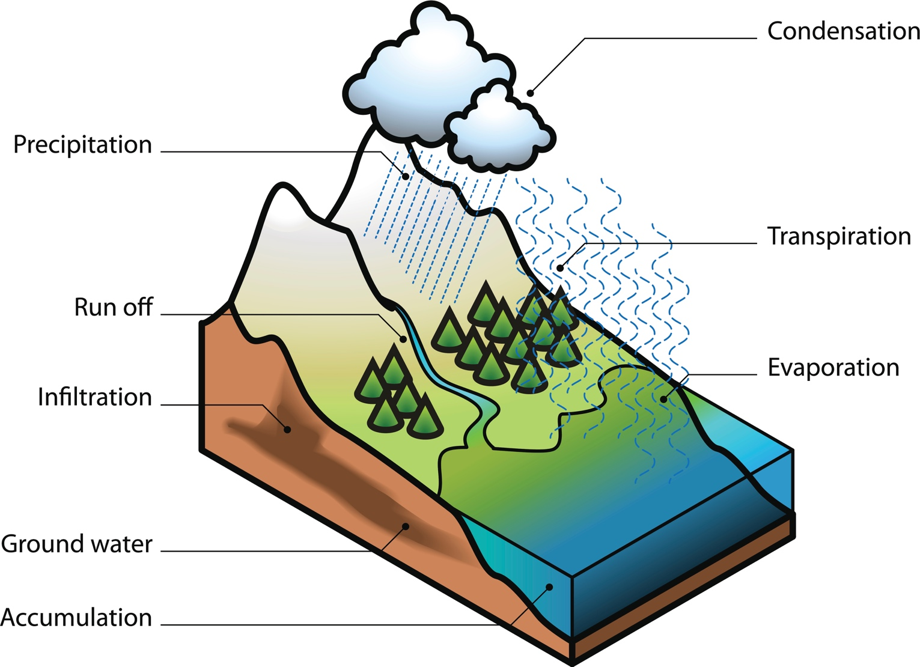
Estuary
Watershed
Wetland
Aquifer
Notes:
Wetlands and estuaries are parts found in many watersheds. Aquifers are found in the soil and rock below most watersheds.

Slide 114
Notes:
Let’s check-in for understanding.

Slide 115
What are parts that can be found in a watershed?
Notes:
What are parts that can be found in a watershed?
[A watershed is made up of both the land and water.]

Slide 116
Does it matter if the water is clean or polluted?
Notes:
Does it matter if the water is clean or polluted?
[No - all water sources, regardless of whether it is clean or polluted, flows into the watershed.]

Slide 117
True/False: Only estuaries can be found in watersheds.
Notes:
True/False: Only estuaries can be found in watersheds.

Slide 118
True/False: Only estuaries can be found in watersheds.
Notes:
True/False: Only estuaries can be found in watersheds.
[False - Estuaries, wetlands, and aquifers can all be found in watersheds.]

Slide 119
Notes:
Now, let’s look at some examples of watersheds.

Slide 120
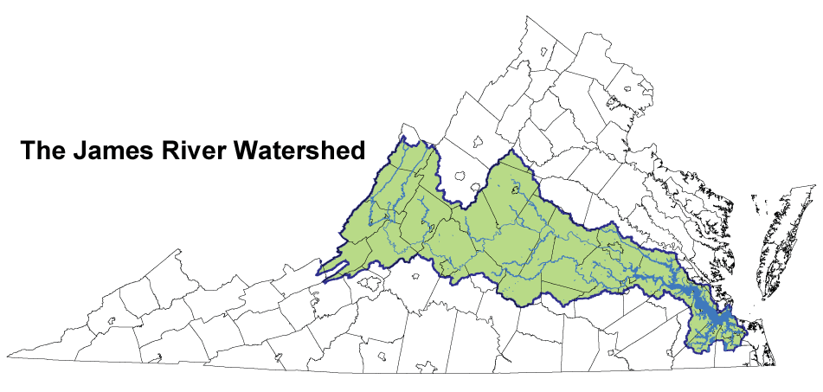
Notes:
An example of a watershed is the James River Watershed.
The watershed includes all the water AND land in that area.

Slide 121
Chesapeake Bay
Watershed
Notes:
Another example of a larger watershed is the Chesapeake Bay Watershed.
The watershed includes all the water AND land in that area.

Slide 122
James River
Watershed
Notes:
The James River watershed exists within the larger Chesapeake Bay watershed so that is included in BOTH watersheds.

Slide 123
Notes:
Let’s check-in for understanding.

Slide 124
What are some examples of watersheds?
Notes:
What are some examples of watersheds?

Slide 125
Notes:
Let’s break down the word “watershed” into parts to help us remember the definition of the term.

Slide 126
Watershed
Water shed
Notes:
We can break up the term into two parts: water and shed.

Slide 127
Watershed
Water shed
Flows through the watershed
Notes:
Water flows through the watershed.

Slide 128
Watershed
Water shed
To cast off or to let fall
Notes:
Shed can mean to cast off or to let fall.

Slide 129
Water shed
Watershed
Sheds the rainwater that falls on it
Notes:
A watershed sheds the rainwater that falls on it. This rainwater all collects in the same location.

Slide 130
Notes:
Let’s check-in for understanding.

Slide 131
How can we use the word parts of watershed to help us remember the definition of the term?
Watershed
Water shed
Notes:
How can we use the word parts of watershed to help us remember the definition of the term?
[We can break up the term into two parts: water and shed.
Water flows through the watershed.
Shed can mean to cast off or to let fall.
A watershed sheds the rainwater that falls on it. This rainwater all collects in the same location.]

Slide 132
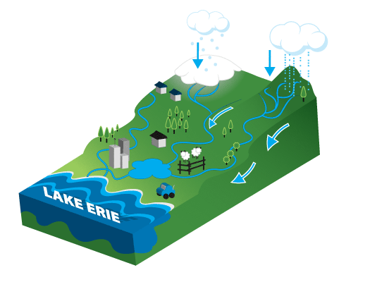
The picture below can be best described as a(n) --
Estuary
Pond
Wetland
Watershed
Notes:
The picture below can be described as a(n) --

Slide 133
The picture below can be best described as a(n) --
Estuary
Pond
Wetland
Watershed
Notes:
The picture below can be described as a(n) --
[Watershed]

Slide 134
Remember!!!
Notes:
So remember!

Slide 135
Watershed: an area of land where all of the runoff flows downhill into the same body of water
Notes:
A watershed is an area of land where all of the runoff flows downhill into the same body of water.

Slide 136
Body of water | What is it?
Estuary | Partially enclosed body of water formed where a river flows into an ocean
Wetland | An area that is saturated with water for at least part of the year
Watershed | An area of land where all of the runoff flows downhill into the same body of water
Notes:
Summary

Slide 137
Extension Activity
Crumpled Paper Watershed
The activity linked above includes instructions for a student activity that will allow them to demonstrate their understanding of the term watershed and challenge them to extend their understanding of how pollution can get into waterways through runoff. The activity is geared for inhabitants of the Chesapeake Bay watershed but can easily be adapted for other regions.
Notes:
This resource can be used to provide students with the opportunity to demonstrate their understanding of watersheds.

Slide 138
Big Questions: What features characterize different aquatic ecosystems and why are these ecosystems important to our environment?
Notes:
Explicit cue to revisit the big question at the end of the lesson: Okay everyone. Now that we’ve learned about watersheds, let’s reflect once more on our big question. Was there anything that we predicted earlier that was correct or incorrect? Do you have any new hypotheses to share?
Feedback: Offering students an opportunity to evaluate their earlier hypotheses and make changes based on their new understandings is an important part of the iterative process in science. This is a great opportunity to help students build an epistemic understanding by explicitly stating how continuing to change and build on hypotheses as your knowledge grows is an important part of the discipline of science!

Slide 139
Notes:
Thanks for watching, and please continue watching CAPs available from this website.

Slide 140
This Video Was Created With Resources From:
Questions or Comments
Michael Kennedy, Ph.D. MKennedy@Virginia.edu
Rachel L Kunemund, Ph.D. rk8vm@virginia.edu

