Slide 1
Intro
“Big Idea” Question
Review Concepts
Check-In Questions
Teacher Demo
Vocabulary
Student-Friendly Definition
Examples & Non-Examples
Morphological Word Parts
Simulation/Activity
Notes:
OK everyone, get ready for our next lesson. Just as a reminder, these are the different components that our lesson may include, and you’ll see these icons in the top left corner of each slide so that you can follow along more easily!
Feedback: Explicit cues used at the beginning of each step makes it easy for students to follow along and be prepared to engage in the next part of the lesson.

Slide 2
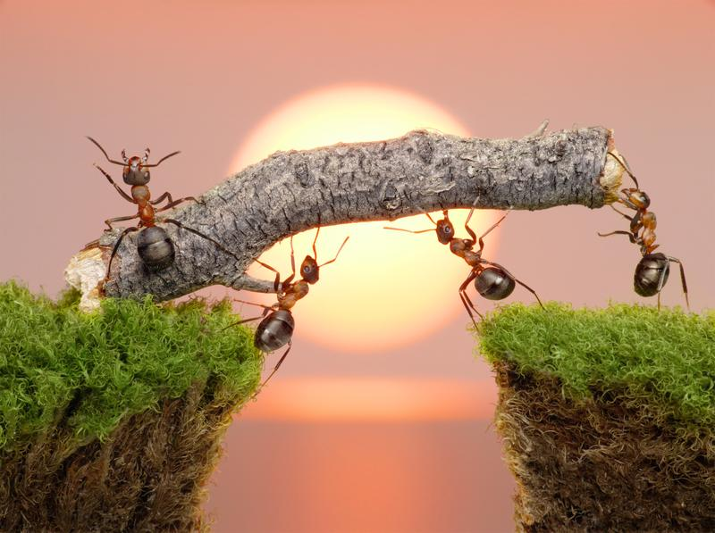
Intro
Work
Notes:
Today we will learn about work.

Slide 3
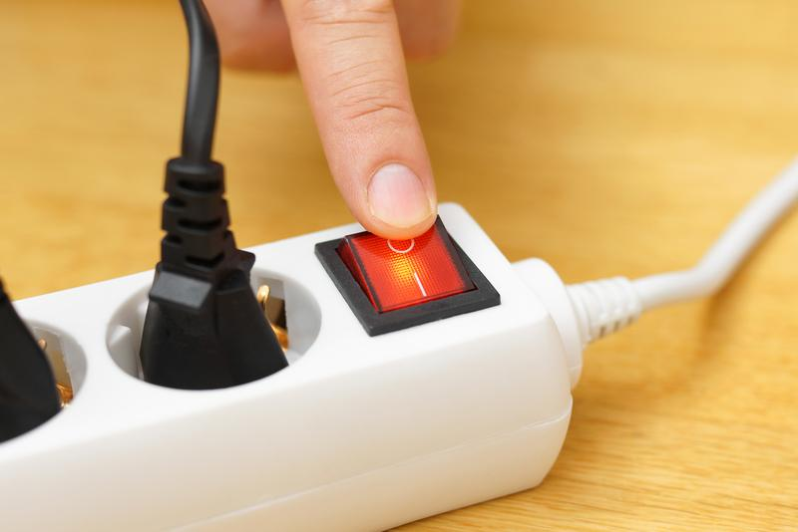
Big Question: What is the relationship between work and power?
Notes:
Our “big question” is: What is the relationship between work and power?
[Pause and illicit predictions from students.]
I love all these thoughtful scientific hypotheses! Be sure to keep this question and your predictions in mind as we move through these next few lessons, and we’ll continue to revisit it.

Slide 4
Notes:
Before we move on to our new vocabulary term, let’s review some other words & concepts that you already learned and make sure you are firm in your understanding.

Slide 5
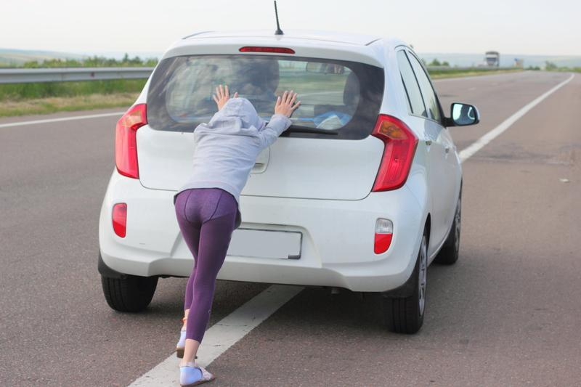
Force: push or pull on an object
Notes:
Force is a push or pull on an object.

Slide 6
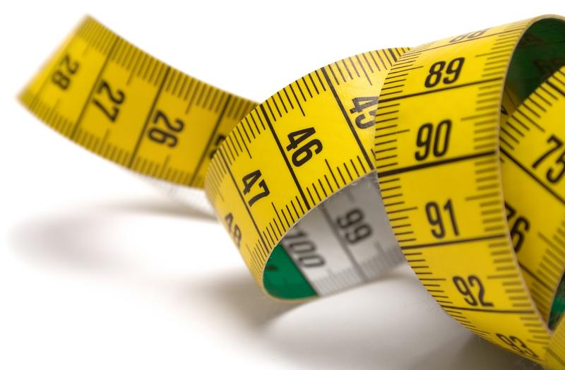
Newton (N): units of measurement used for force
Notes:
Newtons (N) are the units of measurement used for force.
Feedback: Referring to prior topics that are relevant and on topic helps students make connections to the new content they will be learning and tie it to prior knowledge.

Slide 7
Distance: how far an object travels
Notes:
Distance is how far an object travels.

Slide 8
Centimeters (cm): unit used to measure distance
Notes:
Centimeters (cm) are the unit used to measure distance. There are 100 centimeters in a meter.

Slide 9
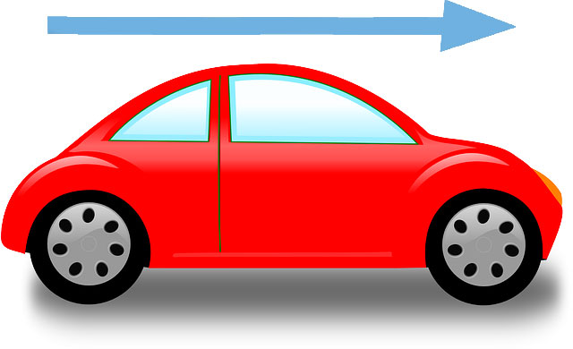
Velocity: The speed of an object in a given direction
Notes:
Velocity is the the speed of an object in a given direction

Slide 10
Acceleration: change in velocity over time
Notes:
Acceleration is the change in velocity over time.

Slide 11
Notes:
Now let’s pause for a moment to check your understanding.

Slide 12
What unit is force measured in?
Notes:
What unit is force measured in?
[Newtons (N)]

Slide 13
Force is a _____ or _____ on an object.
Notes:
Force is a ______ or ______ on an object.

Slide 14
Force is a push or pull on an object.
Notes:
Force is a push or pull on an object.
Feedback: Remember to make adjustments to your lesson and content if you see some students not demonstrating understanding, this can help them make connections and prevent frustration.

Slide 15
What quantity is defined as the change in velocity over time?
Mass
Acceleration
Speed
Velocity
Notes:
What quantity is defined as the change in velocity over time?

Slide 16
What quantity is defined as the change in velocity over time?
Mass
Acceleration
Speed
Velocity
Notes:
What quantity is defined as the change in velocity over time?
[Acceleration]

Slide 17
What is distance?
Notes:
What is distance?
[Distance is how far an object travels.]

Slide 18
Work
Notes:
Now that we’ve reviewed, let’s define our new term, work.

Slide 19
Work: forced applied over some distance
Notes:
Work is done when force is applied over some distance.

Slide 20
Notes:
Let’s check-in for understanding.

Slide 21
What is work?
Notes:
What is work?
[Work is done when an object is moved through a distance by an applied force.]
Feedback: Remember the clarity of language is important when teaching vocabulary. Keep your questions simple when asking for students to state the definition.

Slide 22
Notes:
Now, let’s talk about some examples of work.

Slide 23
Lifting Dumbells
Notes:
This is an example of work. The man is exerting a force on the dumbells to move them in the direction he wants. In this case, he is pulling them towards him.

Slide 24
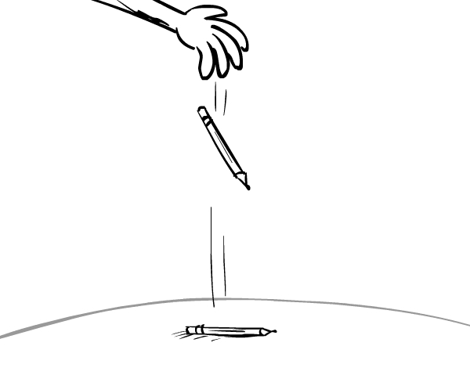
Pencil falling to the floor
Notes:
This pencil falling to the floor is an example of work. The force in this example is gravity, which is pulling the pencil to the ground. The pencil moves in the direction of the force, to the ground, meaning that work has occurred.

Slide 25
Notes:
Next, let’s talk about some non-examples of work.

Slide 26
Pushing a wall
Notes:
In this picture, the person is exerting a force on the wall by pushing it. However, the wall is not moving in the direction that the person is pushing the wall. So, even though there is a force, because the object has not moved in the direction of the force, no work has occurred.
Feedback: Remember to take a moment to explicitly distinguish between the similarities of the non-examples and the vocabulary term you were covering today. This helps students resolve any misconceptions they may have.

Slide 27
Notes:
Let’s check-in for understanding.

Slide 28
Name an example of work.
Notes:
Name an example of work.
[Lifting dumbbells, a pencil falling, etc.]

Slide 29
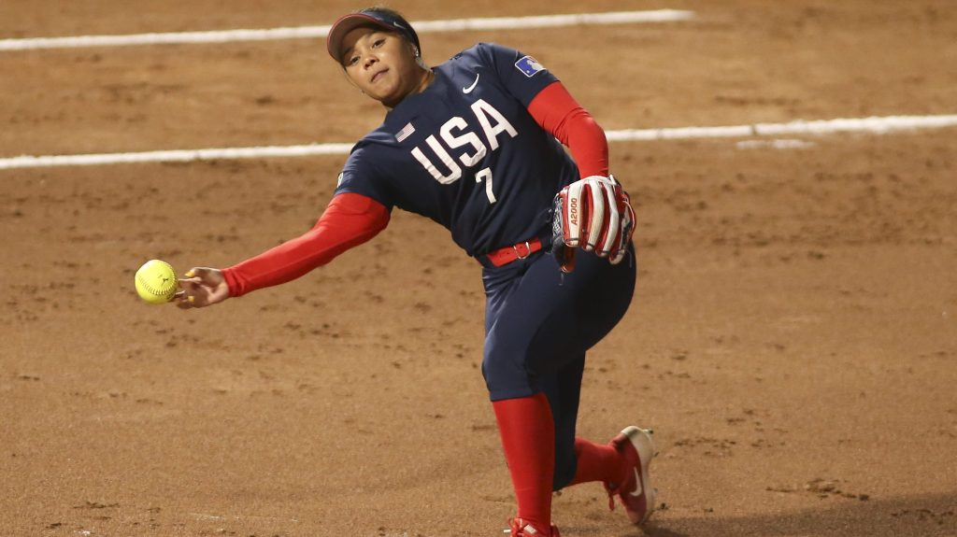
A softball player throws a ball towards home plate. Is this an example of work? Why or why not?
Notes:
A softball player throws a ball towards home plate. Is this an example of work? Why or why not?
[Yes – by throwing the ball, the softball player is exerting a force on it and it is moving in the direction of the force. Therefore, work has occurred.]

Slide 30
Notes:
That is the basic definition, but there is a bit more you need to know.

Slide 31
Work = Force x Distance
W = Fd
Notes:
This is the equation for calculating work. Let’s look at the units of measurements to calculate work.

Slide 32
Joules (J)
W = Fd
Notes:
Joules are the units for work.

Slide 33
Newtons (N)
W = Fd
Notes:
Force is measured in Newtons (N).

Slide 34
Meters (m)
W = Fd
Notes:
Distance is measured in meters (m).

Slide 35
Looking at Units
J = Nm
Work
Force
Distance
Notes:
So, if we look at the units, we can see that Joules = Newtons x meters.
Feedback: Explicitly modeling this skill (using the units to better understand a formula) for students provides them with visual of the strategy.

Slide 36
Notes:
Let’s check-in for understanding.

Slide 37
What is the equation for work?
Notes:
What is the equation for work?
[Work = force x distance]

Slide 38
What are the units for work?
Notes:
What are the units for work?
[Joules]

Slide 39
Notes:
Now, let’s solve a couple of examples of work together.

Slide 40
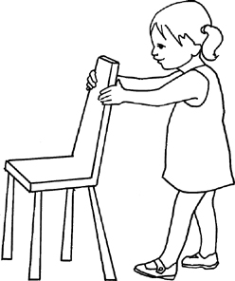
If you push a chair 3m across the classroom using a force of 30 N, how much work are you applying?
Notes:
If you push a chair 3m across the classroom using a force of 30 N, how much work are you applying?
Feedback: Remember, it is important to provide students with opportunities to ask questions themselves and work to define the problem. You can scaffold supports to help them along the way.

Slide 41
Work (J) = Force (N) x Distance (m)
W = F x D
W = 30 N x 3 m
Notes:
Since work equals force times distance, we know that in this example work equals 30 N x 3 m.

Slide 42
Work (J) = Force (N) x Distance (m)
W = F x D
W = 30 N x 3 m
W = 90 Nm
Notes:
When we multiply 30 N by 3 m we get that work equals 90 Nm.

Slide 43
Work (J) = Force (N) x Distance (m)
W = F x D
W = 30 N x 3 m
W = 90 Nm
W = 90 J
Notes:
When we simplify the units, we get that the work being applied on the chair is 90 J.

Slide 44
Notes:
A 10 kg object experiences a horizontal force. This causes it to accelerate at 5 m/s^2, moving it a distance of 20 m, horizontally. How much work is done by the force?
Feedback: Chunking the steps to the activity in a way that meets the students' level of understanding is important when explaining how to solve this problem.

Slide 45
Notes:
This problem is a little different than the one we just did. It does not give us the force, however, it does give us the information to find the force before we find the work. So this is a two-step problem.

Slide 46
Work (J) = Force (N) x Distance (m)
Notes:
Here is the equation for work, but our first step needs to be to find the force, which we can do by multiplying mass by acceleration. When we do this first step, we get that force equals 10 kg times 5 m/s^2

Slide 47
Work (J) = Force (N) x Distance (m)
Notes:
When we do this, we get that the force exerted on the object is 50 N. We are now ready to find the work.

Slide 48
Work (J) = Force (N) x Distance (m)
Notes:
To find the work, we multiply 50 N times 20 m.

Slide 49
Work (J) = Force (N) x Distance (m)
Notes:
When we multiply 50 N by 20 m we get that work equals 1000 Nm.

Slide 50
Work (J) = Force (N) x Distance (m)
Notes:
When we simplify the units, we get that the work being applied is 1000 J.

Slide 51
Notes:
Let’s check-in for understanding.

Slide 52
What are the units of work?
Notes:
What are the units of work?
[Joules]

Slide 53
What equation do we use to find work?
Notes:
What equation do we use to find work?
[Work (J) = Force (N) x Distance (m)]
Feedback: There are a lot of opportunities to respond throughout this portion of your lesson, which is so important for ensuring that your students are grasping this new skill.

Slide 54
If you throw a ball up in the air 2m at a force of 25 N, how much work did you apply on the ball?
Notes:
If you throw a ball up in the air 2m at a force of 25 N, how much work did you apply on the ball?

Slide 55
Answer
Work = Force x Distance
W = F x D
W = 25 N x 2 m
W = 50 Nm
W = 50 J
Notes:
If you throw a ball up in the air 2m at a force of 25 N, how much work did you apply on the ball?
[Since work equals force times distance, we know that in this example work equals 25 N x 2 m. When we multiply 25 N by 2 m we get that work equals 50 Nm. When we simplify the units, we get that the work being applied on the chair is 50 J.]

Slide 56
Notes:
Let’s keep diving deeper into work.

Slide 57
What factors affect work?
Notes:
So, what factors affect work?

Slide 58
Direction of Motion
Notes:
The first factor that affects work is the direction of the motion. Which way is the object being moved?

Slide 59
Direction of Motion
Notes:
In this picture, the object is moving to the left.

Slide 60
Applied Force
Notes:
The other factor that affects work is the force being applied. Here, the force is being applied upward.

Slide 61
Vertical Force
Notes:
This diagonal force has a vertical component,

Slide 62
Horizontal Force
Notes:
and the diagonal force has a horizontal component.

Slide 63
Only use force in the same direction
Notes:
When using the equation for work, we only use the horizontal force, since it is in the same direction as the movement.

Slide 64
Notes:
Let’s check-in for understanding.

Slide 65
What factors affect work?
Notes:
What factors affect work?
[Direction of the motion and the applied force;
Distance traveled]

Slide 66
Notes:
Now, let’s try to solve an example of this type of problem.
Feedback: It's good to pick a variety of examples to work through with your students. This prepares them for some types that might trip them up when they try it on their own.

Slide 67
If you pull a suitcase with a horizontal force of 16 N and a vertical force of 5 N for 10 m, how much work are you applying?
Notes:
If you pull a suitcase with a horizontal force of 16 N and a vertical force of 5 N for 10 m, how much work are you applying?

Slide 68
Work = Force x Distance
Notes:
For this problem, you would only use the horizontal force since we are pulling the suitcase in that direction.

Slide 69
Work (J) = Force (N) x Distance (m)
W = F x D
W = 16 N x 10 m
Notes:
Therefore, using the horizontal force, we would get that work equals 16 N times 10 m.

Slide 70
Work (J) = Force (N) x Distance (m)
W = F x D
W = 16 N x 10 m
W = 160 Nm
Notes:
When we multiply 16 N by 10 m we get that work equals 160 Nm.

Slide 71
Work (J) = Force (N) x Distance (m)
W = F x D
W = 16 N x 10 m
W = 160 Nm
W = 160 J
Notes:
When we simplify the units, we get that the work being applied on the suitcase is 160 J.

Slide 72
Demonstration
Notes:
Demonstration – Let’s see what work looks like in action!
For this demonstration, all I am going to use is this cardboard box.
I want to move this box across the room. When I push the box, I am exerting a force on it to make it move across the room.
Since work is done when an object is moved through a distance in the direction of the applied force, I am doing work. I am applying a force on the box, which is causing the box to move a distance in the direction that I am pushing the box.
Feedback: It's really important to make sure that you're providing students with frequent opportunities to respond as you're conducting a demonstration – it will save so you so much time if you monitor understanding before asking them to try something independently.

Slide 73
Notes:
Let’s check-in for understanding.

Slide 74
In this demonstration, what did you notice about work?
Notes:
In this demonstration, what did you notice about work?
[When the box is moved a distance due to the applied force, work is being done]

Slide 75
What are the factors that affect work?
Notes:
What are the factors that affect work?
[Direction, distance traveled, and applied force]

Slide 76
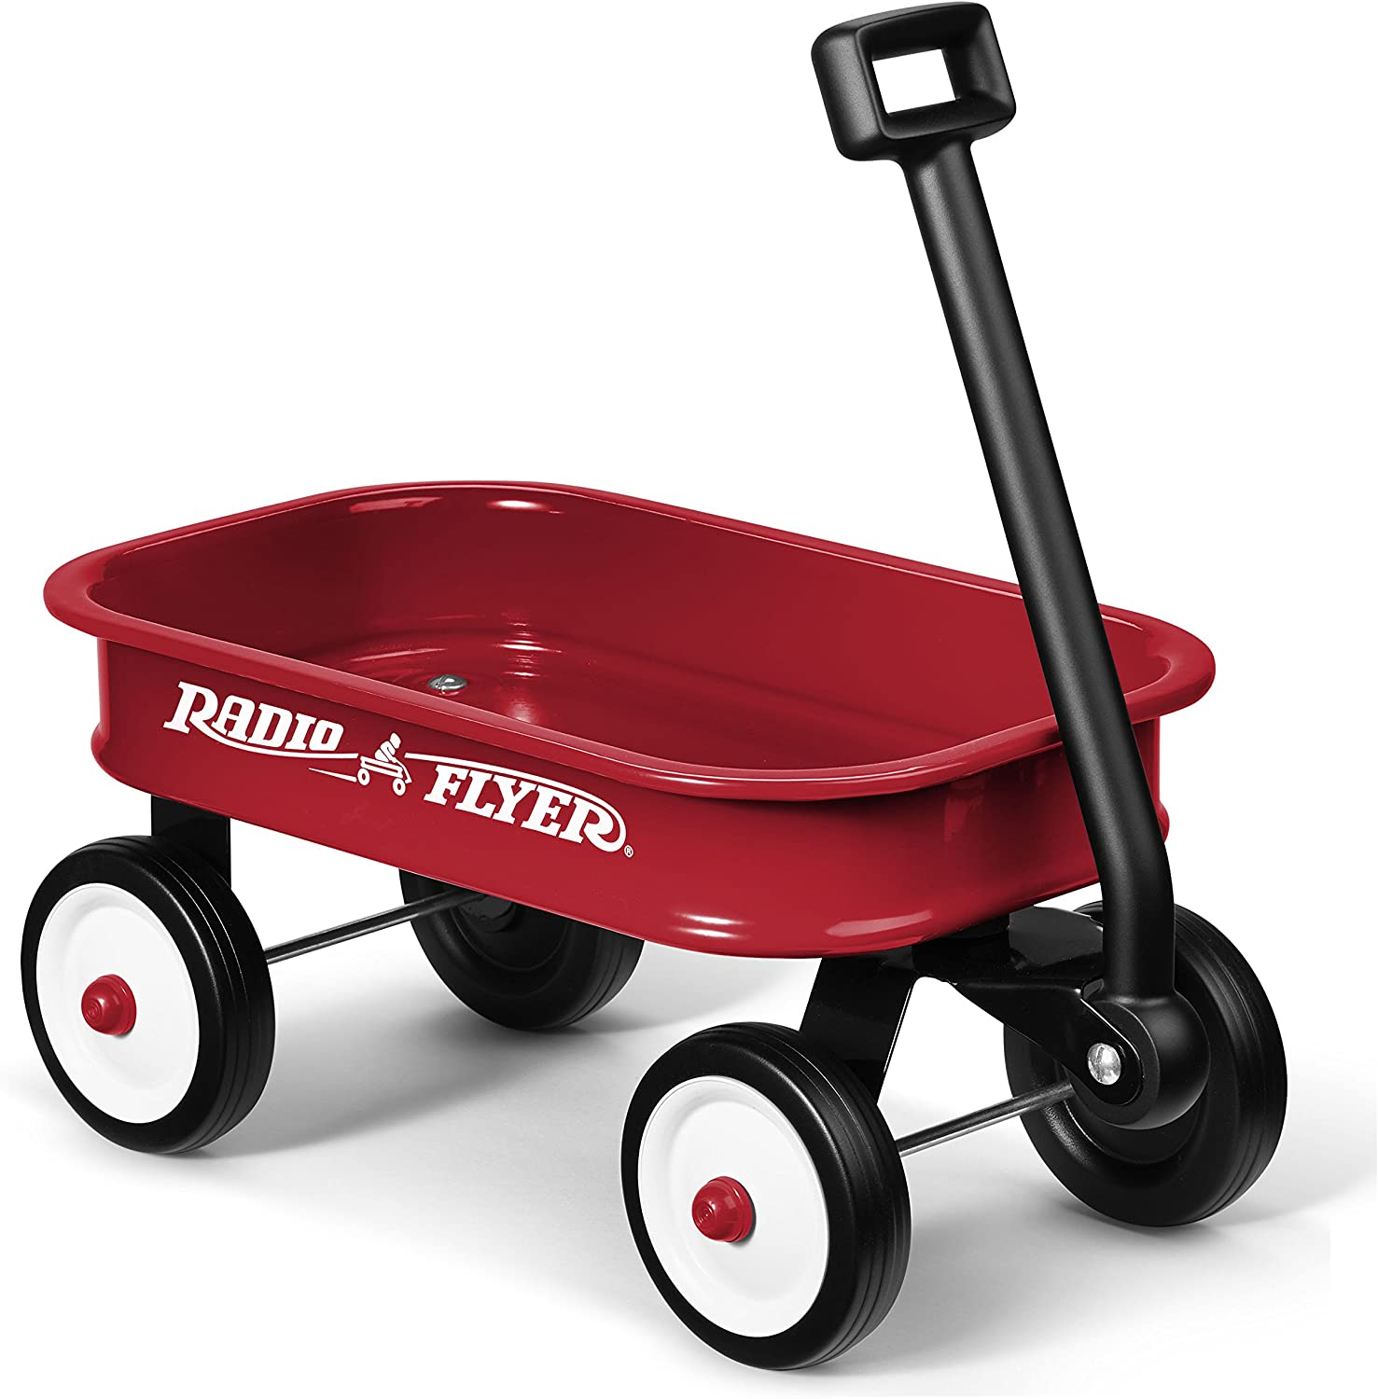
If you pull a wagon with a horizontal force of 12 N and a vertical force of 6 N for 20 m, how much work are you applying?
Notes:
If you pull a wagon with a horizontal force of 12 N and a vertical force of 6 N for 20 m, how much work are you applying?

Slide 77
Answer
W = F x D
W = 12 N x 20 m
W = 240 Nm
W = 240 J
Notes:
If you pull a wagon with a horizontal force of 12 N and a vertical force of 6 N for 20 m, how much work are you applying?
[For this problem, you would only use the horizontal force, since we are pulling the wagon in that direction.]
Feedback: It can take some getting used to but talking through your thoughts/process during the demonstration can be a great way to demonstrate to your students how to process the information and think it through.

Slide 78
Remember!!!
Notes:
So remember!

Slide 79
Work: when an object is moved through a distance in the direction of the applied force
Notes:
Work is done when an object is moved through a distance in the direction of the applied force.

Slide 80
Work = Force x Distance
W = Fd
Notes:
This is the equation for calculating work.

Slide 81
Looking at Units
J = Nm
Work
Force
Distance
Notes:
Joules = Newtons x meters.

Slide 82
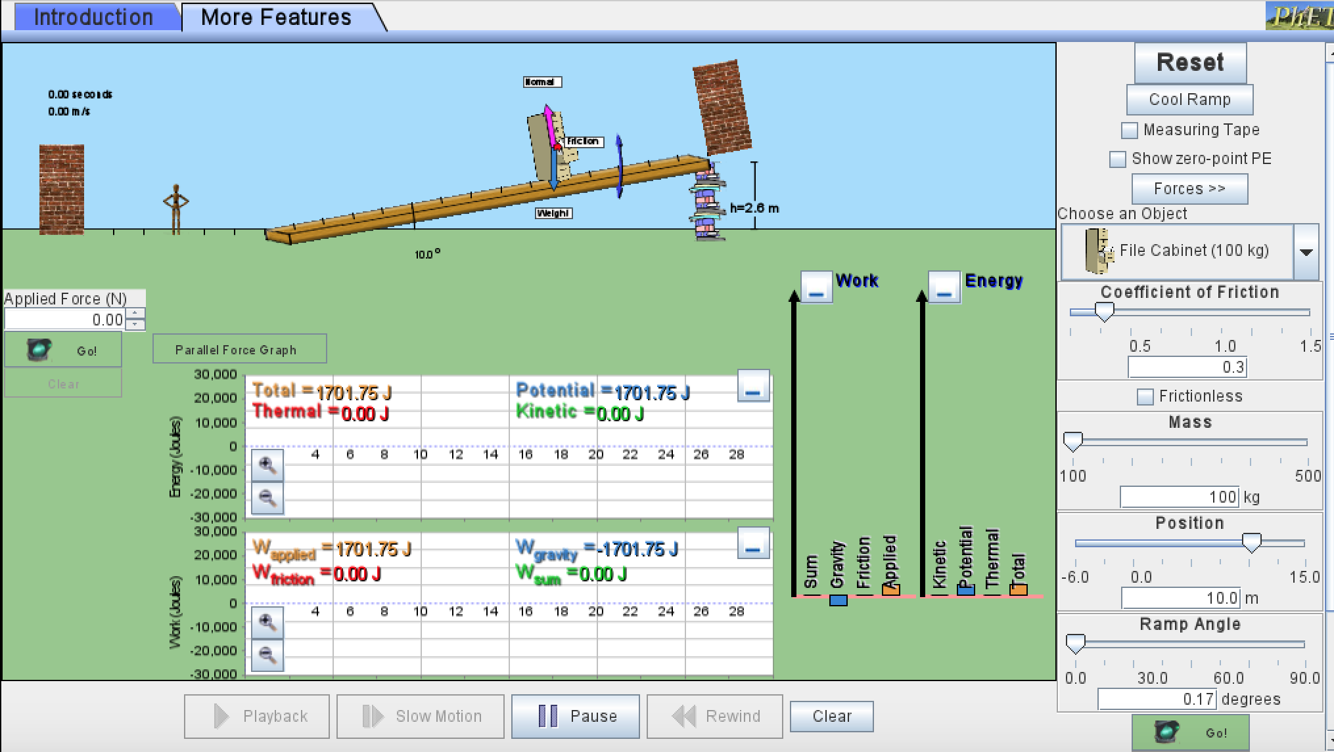
Simulation Activity
Work
(Phet)
Click the link above for a simulation to deepen your understanding of work.
Notes:
Feedback: Activities should have a nice balance between "attainable" and "challenging", supporting those high expectations for your students' success.

Slide 83
Big Question: What is the relationship between work and power?
Notes:
Explicit cue to revisit the big question at the end of the lesson: Okay everyone. Now that we’ve learned the term, work, let’s reflect once more on our big question. Was there anything that we predicted earlier that was correct or incorrect? Do you have any new hypotheses to share?

Slide 84
Notes:
Thanks for watching, and please continue watching CAPs available from this website.

Slide 85
This Video Was Created With Resources From:
Questions or Comments
Michael Kennedy, Ph.D. MKennedy@Virginia.edu
Rachel L Kunemund, Ph.D. rk8vm@virginia.edu

Slide 86
Intro
“Big Idea” Question
Review Concepts
Check-In Questions
Teacher Demo
Vocabulary
Student-Friendly Definition
Examples & Non-Examples
Morphological Word Parts
Simulation/Activity
Notes:
OK everyone, get ready for our next lesson. Just as a reminder, these are the different components that our lesson may include, and you’ll see these icons in the top left corner of each slide so that you can follow along more easily!

Slide 87
Intro
Power
Notes:
Today we’re going to learn about power.

Slide 88
Big Question: What is the relationship between work and power?
Notes:
Before we start, let’s think about our “big question”: What is the relationship between work and power? We recently learned about work, so what predictions do you have to share about the relationship between work and power?
[Pause and illicit predictions from students.]
I love all these thoughtful scientific hypotheses! Be sure to keep this question and your predictions in mind as we move through these next few lessons, and we’ll continue to revisit it.
Feedback: Providing students with the opportunity to make predictions about what will happen allows them to think critically about the content.

Slide 89
Notes:
Before we move on to our new vocabulary term, let’s review some other words & concepts that you already learned and make sure you are firm in your understanding.

Slide 90
Work: when an object is moved through a distance in the direction of the applied force
Notes:
Work is done when an object is moved through a distance in the direction of the applied force.

Slide 91
Work (J) = Force (N) x Distance (m)
W = Fd
Notes:
This is the equation for calculating work.

Slide 92
Notes:
Now let’s pause for a moment to check your understanding.

Slide 93
Which of these is the equation for work?
W = d / F
W = F x d
W = F / d
Notes:
Which of these is the equation for work?
Feedback: Providing your students with lots of opportunities to respond is critical to this part of your lesson as it helps you determine whether students understand the prior knowledge before you ask them to apply it.

Slide 94
Which of these is the equation for work?
W = d / F
W = F x d
W = F / d
Notes:
Which of these is the equation for work?
[W = F x d]

Slide 95
What is work?
Notes:
What is work?
[Work is done when an object is moved through a distance in the direction of the applied force.]

Slide 96
Power
Notes:
Now that we’ve reviewed, let’s define our new term, power.

Slide 97
Power: the rate at which work is done
Notes:
Power is the rate at which work is done.
Feedback: Remember to use images with introducing new content such as student-friendly definitions. This can help students remember key points and make sense of the new information.

Slide 98
Notes:
Let’s check-in for understanding.

Slide 99
What is power?
Notes:
What is power?
[Power is the rate at which work is done.]

Slide 100
Notes:
Now, let’s talk about some examples of power.
Feedback: Remember to provide students with instructional cues that give them a chance to prepare for what is coming up next in the lesson, this will help orient them and be better able to engage with the content.

Slide 101
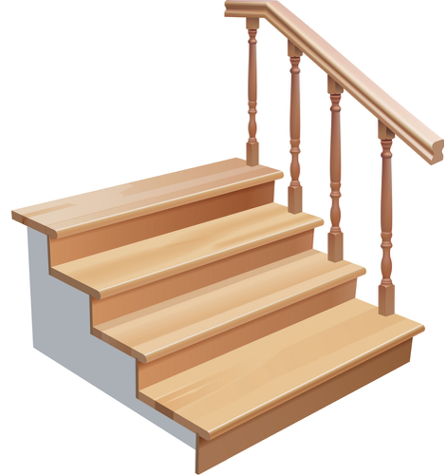
Walking vs. Running
Notes:
For example, when you walk up the stairs in 15 seconds compared to running up the stairs in 5 seconds, you are doing the same amount of work (getting up the stairs). However, you have greater power when you run up the stairs because you completed the task in a shorter amount of time.

Slide 102
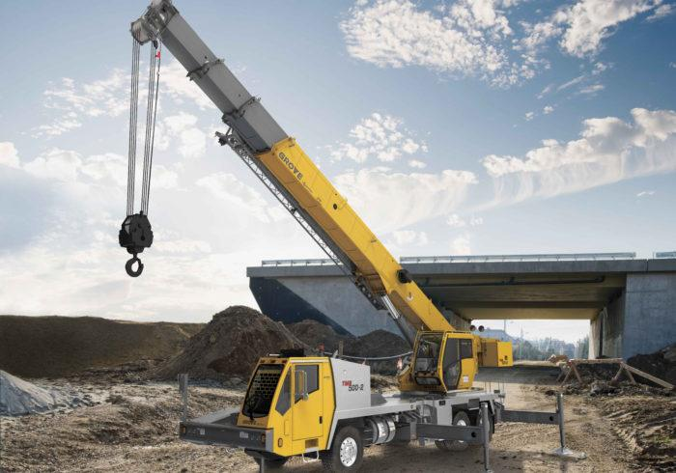
Crane Moving Objects
Notes:
In this example, one crane moves an object point A to point B in 20 seconds and another crane moves that same object from point A to point B in 30 seconds. Both of these cranes completed the same amount of work. However, since the first crane did that work in less time, it has greater power.

Slide 103
Notes:
Let’s check-in for understanding.

Slide 104
What is power?
Notes:
What is power?
[Power is the rate at which work is done.]

Slide 105
Notes:
That is the basic definition, but there is a bit more you need to know.
Feedback: Remember, it is important to have an organized and smooth transition to limit wasted time and reduce any disruptions. By having materials ready in advance and working on a routine with students you can easily get this done!

Slide 106
Power = Work / Time
P = W/t
Notes:
This is the equation for calculating power. Let’s look at the units of measurement to calculate work.

Slide 107
Power (W)
P = W/t
Notes:
Power is measured in watts.

Slide 108
Work (J)
P = W/t
Notes:
Work is measured in joules.

Slide 109
Time (s)
P = W/t
Notes:
Time is measured in seconds.

Slide 110
Looking at Units
W = J/s
Power
Work
Time
Notes:
So, if we look at the units, we can see that Watts = Joules / seconds.

Slide 111
Notes:
Let’s check-in for understanding.

Slide 112
What is the equation used to find power?
Notes:
What is the equation used to find power?
[Power = work/time]

Slide 113
What are the units for power?
Notes:
What are the units for power?
[Watts (J/s)]

Slide 114
Notes:
Now, let’s solve a couple of power problems together.
Feedback: Instruction in this area is important, equally as important is helping students determine when to use these new skills.

Slide 115
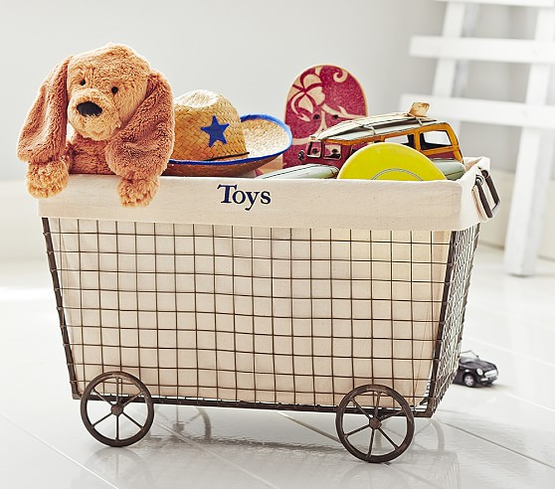
It took 150 J of work for Jenny to push a basket of toys in 100 seconds. How much power did she use?
Notes:
It took 150 J of work for Jenny to push a basket of toys in 100 seconds. How much power did she use?

Slide 116
Power (W) = Work (J) / Time (s)
Notes:
Since power equals work divided by time, we know that in this example power equals 150 J / 100 s.

Slide 117
Power (W) = Work (J) / Time (s)
Notes:
When we divide 150 J by 100 s, we get that power equals 1.5 W.

Slide 118
Find the power of a man who pushes a box 8m with a force of 15 N in 6 seconds.
Notes:
Let’s look at another example. Find the power of a man who pushes a box 8m with a force of 15 N in 6 seconds.
Feedback: Remember, it is important to include some computational or mathematics concepts in the science activity so that students can apply these concepts as part of the problem solving process.

Slide 119
Find the power of a man who pushes a box 8m with a force of 15N in 6 seconds.
Notes:
This problem is a little different than the on we just did. It does not give us the work, however, it does give us the information to find the work before we find the power. So, this is a two-step problem.

Slide 120
Power (W) = Work (J) / Time (s)
W = F x d
W = 15 N x 8 m
P = W/t
Notes:
Here is the equation for work, but our first step needs to be to find the work, which we can do by multiplying force by direction. When we do this first step, we get that work equals 15 N x 8 m.

Slide 121
Power (W) = Work (J) / Time (s)
W = F x d
W = 15 N x 8 m
W = 120 J
P = W/t
Notes:
When we do this, we get that the work is 120 J. We are now ready to find the power.

Slide 122
Power (W) = Work (J) / Time (s)
Notes:
To find the power, we divide 120 J by 6 s.

Slide 123
Power (W) = Work (J) / Time (s)
Notes:
When we divide 120 J by 6 s, we get that power equals 20 J/s.

Slide 124
Power (W) = Work (J) / Time (s)
Notes:
When we simplify the units, we get that the power is 20 W.

Slide 125
Demonstration
Notes:
Demonstration – Let’s see what power looks like in action!
Similarly to the work demonstration, all I am going to need is a cardboard box and a timer.
First, I am to get my timer ready so that I know exactly how long it takes me to push the box across the room.
Then, I am going to push the box across the room and write down how long it takes me. Remember, I need to make sure I press start and stop so I know exactly how long it takes me.
Next, I am going to push the box again, but this time I am going to do it faster. I will make sure to write down my time as well.
Now that I have both my times, I want to think about my power when pushing the box. Since power is the rate at which work is completed, I know that I had greater power the second time I pushed the box. I pushed the box, completed work, more quickly than I did the first time.
Feedback: Creating an organized demonstration that is clear and well structured is key to promoting student understanding.

Slide 126
Notes:
Let’s check-in for understanding.

Slide 127
In this demonstration, what did you notice about power?
Notes:
In this demonstration, what did you notice about power?
[When moving the same object the same distance faster, you are using more power]

Slide 128
Which is the equation to find power?
P = W / t
P = t / W
P = W x t
Notes:
Which is the equation to find power?
Feedback: It's really important to make sure that you're providing students with frequent opportunities to respond as you're closing the lesson – it will help you know if they understood and made sense of the activity and where you can provide further instruction.

Slide 129
Which is the equation to find power?
P = W / t
P = t / W
P = W x t
Notes:
Which is the equation to find power?
[P = W/t]

Slide 130
Find the power of a person who runs up the stairs 7 m high with a force of 500 N in 50 seconds.
Notes:
Find the power of a person who runs up the stairs 7 m high with a force of 500 N in 50 seconds.

Slide 131
Answer
Notes:
Find the power of a person who runs up the stairs 7 m high with a force of 500 N in 50 seconds.
[In this example, before finding the power, we need to find the work. Since we know that work equals force times distance, we know that in this example work equals 500 N x 7 m. When we do this, we get that the work is 3,500 J. Now we are ready to find the power. Since we know that power equals work divided by time, in this example work is 3,500 J divided by 50 s. When we do this, we get that power equals 70 W.]

Slide 132
Remember!!!
Notes:
So remember!

Slide 133
Power: the rate at which work is done
Notes:
Power is the rate at which work is done.

Slide 134
Power = Work / Time
P = W/t
Notes:
This is the equation for calculating power.

Slide 135
Looking at Units
W = J/s
Power
Work
Time
Notes:
The units of the equation for finding power are: Watts = Joules / seconds.

Slide 136
Big Question: What is the relationship between work and power?
Notes:
Explicit cue to revisit the big question at the end of the lesson: Okay everyone. Now that we’ve learned the term, power, let’s reflect once more on our big question. Was there anything that we predicted earlier that was correct or incorrect? Do you have any new hypotheses to share?
Feedback: It is important to relate the current topic to other strongly related content, this is critical in helping students build associations and relevance between terms.

Slide 137
Notes:
Thanks for watching, and please continue watching CAPs available from this website.

Slide 138
This Video Was Created With Resources From:
Questions or Comments
Michael Kennedy, Ph.D. MKennedy@Virginia.edu
Rachel L Kunemund, Ph.D. rk8vm@virginia.edu

