Slide 1
Intro
“Big Idea” Question
Review Concepts
Check-In Questions
Teacher Engagement
Vocabulary
Student-Friendly Definition
Examples & Non-Examples
Frayer Model
Simulation/Activity
Notes:
OK everyone, get ready for our next lesson. Just as a reminder, these are the different components that our lesson may include, and you’ll see these icons in the top left corner of each slide so that you can follow along more easily!

Slide 2
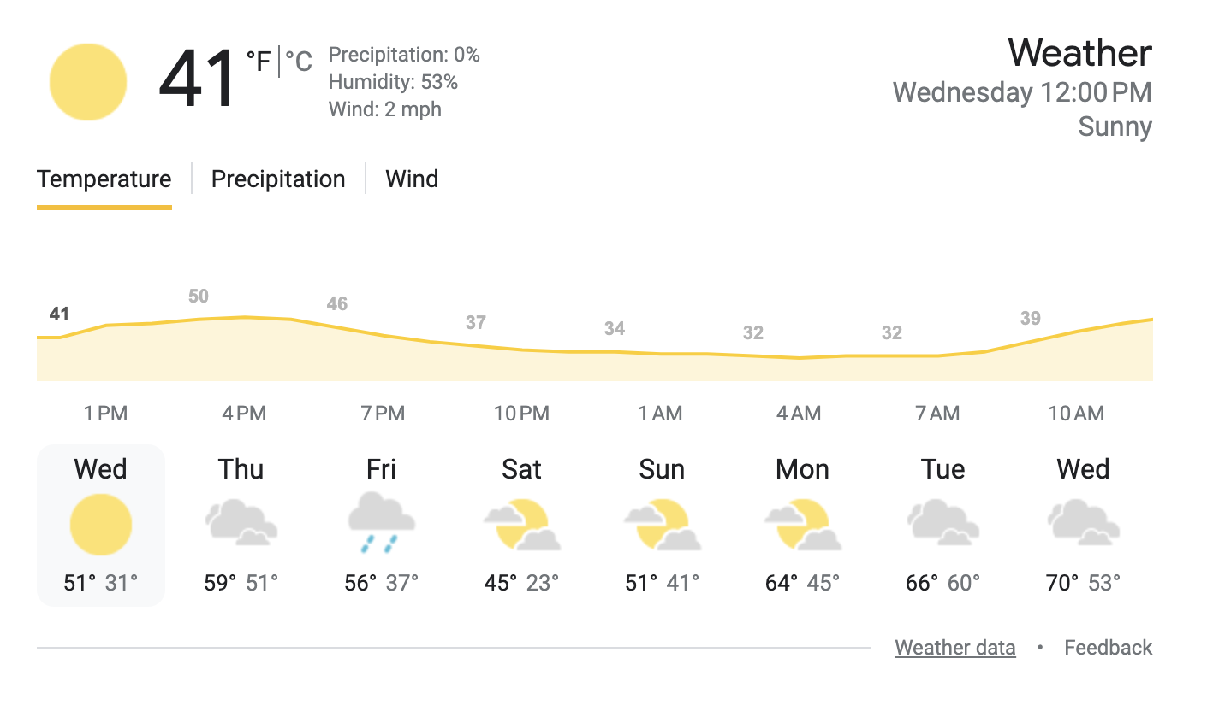
Forecast
Intro
Notes:
Today we will be learning about Forecast.

Slide 3
Big Question:
Why are forecasts important to know and how are they helpful for our daily lives?
Notes:
Our “big question” is: Why are weather forecasts important, and how are they helpful for our daily lives.
[Pause and illicit predictions from students.]
Be sure to keep this question and your predictions in mind as we move through this video and questions.

Slide 4
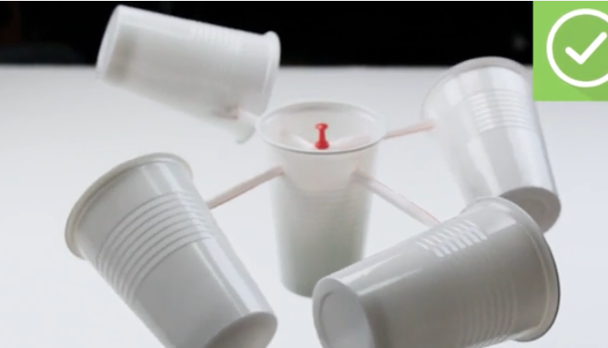
Demonstration
Materials Needed:
Five 3oz paper/plastic cups
Hole puncher
Pushpin
Pencil
2 Straws
Directions to make anemometer ahead of time in notes
Procedure
Once the anemometer is made show it to your students and ask what they think wind might tell them about the weather.
Take your class outside, or place the anemometer outside a window (you can do this indoors using a hair dryer). Ask students to make predictions.
Observe how quickly or slowly the cups spin. Discuss what the students observed, ask what might happen if the wind was stronger or weaker. Emphasize that this is just one of many ways to predict the weather
Notes:
A simple demonstration to illustrate using the wind to forecast or predict weather. Here are the instructions:
https://www.wikihow.com/Make-an-Anemometer
Materials needed:
A clear plastic cup
A glass of ice water
Room temperature water
Instructions:
Begin by filling the plastic cup about halfway with room temperature water.
Place the glass of ice water next to the plastic cup on a table or desk where all students can see.
Hold the plastic cup near the glass of ice water, but do not let them touch.
Ask the students to observe what happens to the outside of the glass of ice water.
Explain to the students that the water vapor in the air around us can condense into liquid water droplets when it comes into contact with a surface that is colder than the dew point temperature.
As the cold glass of ice water chills the air around it, the water vapor in that air condenses onto the surface of the glass, forming tiny water droplets that we see as condensation.
Emphasize that the temperature at which condensation occurs is known as the dew point temperature.
Discuss with the students how this concept is important for weather forecasting and understanding humidity levels.
Allow students to ask questions and discuss their observations.

Slide 5
Notes:
Before we move on to our new topic, let’s review some other words & concepts that you already learned and make sure you are firm in your understanding.

Slide 6
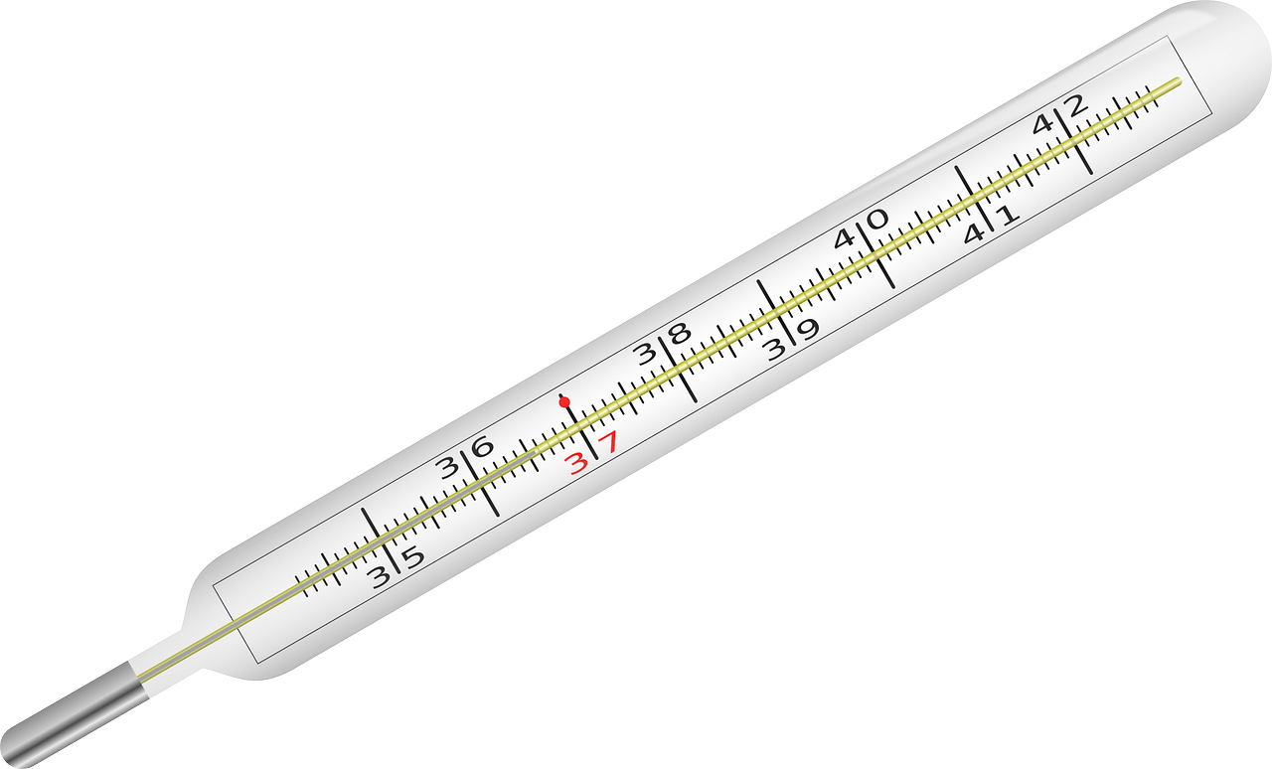
Temperature: how hot or cold something is
Notes:
Temperature is how hot or cold something is.

Slide 7
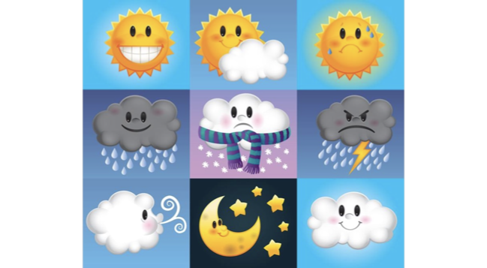
Weather: the state of the atmosphere around you. What is going on outside right now.
Notes:
Weather: the state of the atmosphere around you. What is going on outside right now.

Slide 8
Humidity: the amount of water vapor present in the air
Notes:
Humidity is the amount of water vapor present in the air.

Slide 9
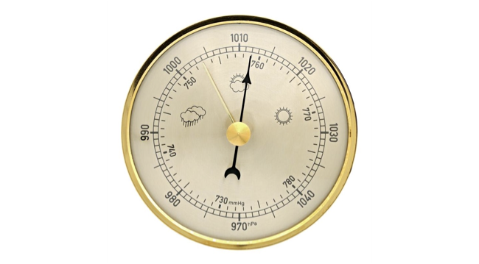
Air Pressure: the amount of force being exerted on the earth
Notes:
Air pressure is the amount of force being exerted on earth

Slide 10
Notes:
Now let’s pause for a moment to review the information we have covered already.

Slide 11
True or False : Temperature is how big or small something is
Notes:
True or False: temperature is how big or small something is
[Vapor]

Slide 12
False. Temperature is how HOT or COLD something is.
Notes:
False, temperature is how hot or cold something is.
[Vapor]

Slide 13
Humidity: the amount of water ____ present in the air
Notes:
Humidity: the amount of water ____ present in the air
[Vapor]

Slide 14
Humidity: the amount of water vapor present in the air
Notes:
Humidity: the amount of water ____ present in the air
[Vapor]

Slide 15
Weather: the state of the atmosphere. What is going on _______ right now.
Notes:
Humidity: the amount of water ____ present in the air
[Vapor]

Slide 16
Weather: the state of the atmosphere. What is going on outside right now.
Notes:
Weather: the state of the atmosphere. What is going on outside right now.
[Vapor]

Slide 17
Air pressure is the amount of ______ being exerted on earth
Time
Rain
Pressure
Candy
Notes:
Air pressure is the amount of ____ being exerted on earth

Slide 18
Air pressure is the amount of ______ being exerted on earth
Time
Rain
Pressure
Candy
Notes:
Air pressure is the amount of force being exerted on earth

Slide 19
Forecast
Notes:
Now that we’ve reviewed, let’s define our new term, Forecast.

Slide 20
Forecast: a prediction or guess of what the weather will be
Notes:
Forecast: a prediction or guess of what the weather will be

Slide 21
Notes:
Let’s check-in for understanding.

Slide 22
What is a forecast?
Notes:
What is a forecast?
[when water covers land that is usually dry, often happening because of heavy rain or a river overflowing.]

Slide 23
Notes:
That is the basic definition, but there is a bit more you need to know.

Slide 24
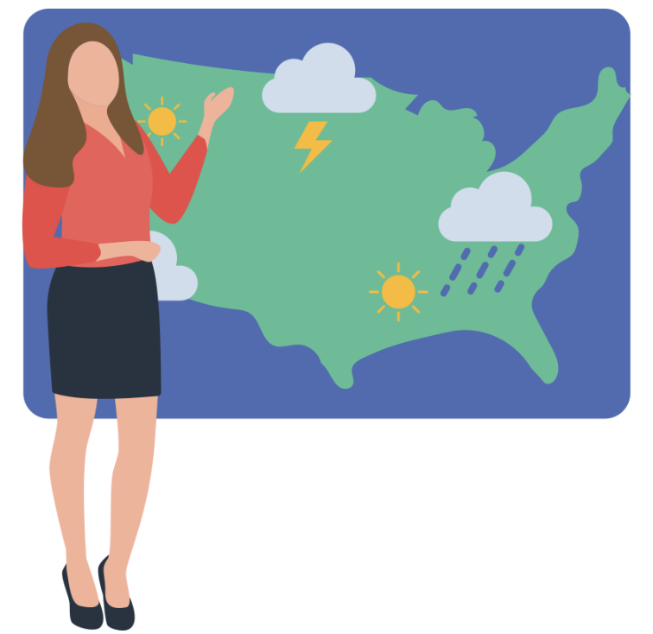
Who predicts the weather
We don’t just randomly guess the weather. Scientists called meteorologists use various tools to predict the weather. This helps you not get stuck outside in a rainstorm!
Notes:
Who predicts the weather: We don’t just randomly guess what the weather will be and hope we are right. Scientist called meteorologists use different tools to predict the weather. This helps you not get stuck outside in a rainstorm!

Slide 25
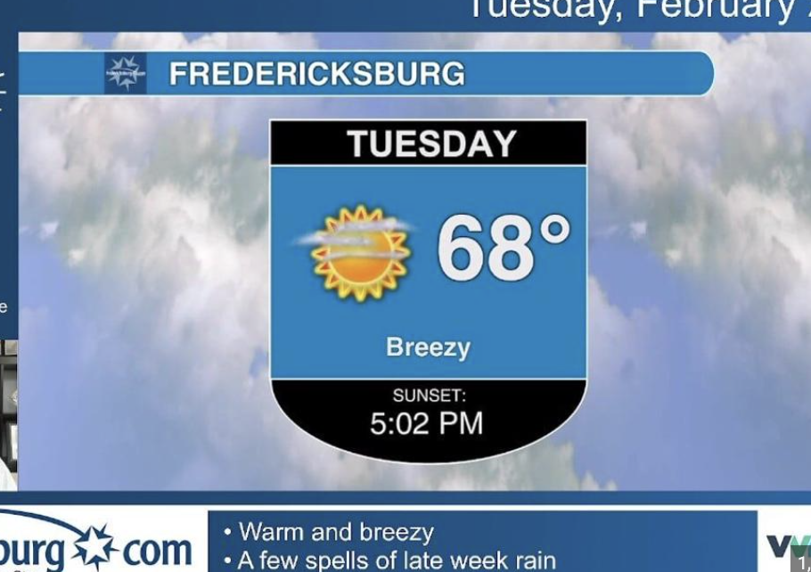
What we look for to predict the weather
Meteorologists look at different signs to predict what the weather will be in the next hour, day, or even week. They examine the temperature, wind speed, air pressure, and humidity
Notes:
What we look for to predict the weather: Ever notice how we see more dew on clear nights? That's because when the sky is clear, the Earth loses heat more quickly. When things cool down, they reach the dew point faster, so we see more dew in the morning.

Slide 26
Notes:
Now let’s pause for a moment to review the information we have covered already.

Slide 27
Scientists called _________ use different tools predict the weather.
Notes:
Scientists called _______ use different tools to predict the weather.

Slide 28
Scientists called meteorologists use different tools predict the weather.
Notes:
Scientists called meteorologists use different tools to predict the weather.

Slide 29
Which is NOT use to predict the weather?
Wind speed
Temperature
Humidity
Dog barking
Air pressure
Notes:
Which of the following is not used to predict the weather
[False]

Slide 30
Which is NOT use to predict the weather?
Wind speed
Temperature
Humidity
Dog barking
Air pressure
Notes:
Which of the following is not used to predict the weather. A dog barking.
[False]

Slide 31
Notes:
Now, let’s talk about some examples of dew point.

Slide 32
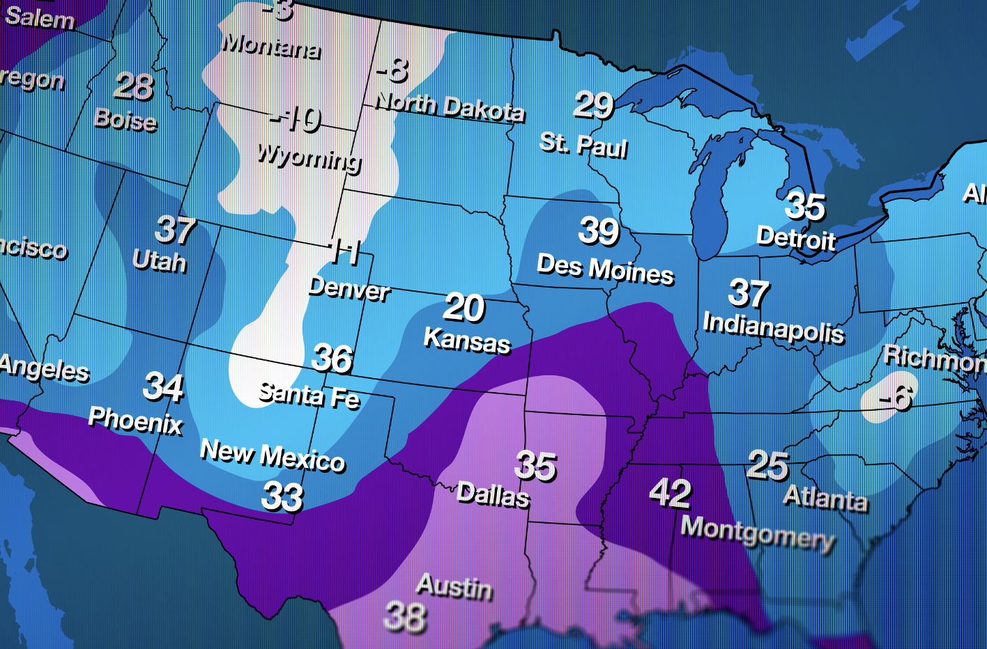
An example of a forecast is what how hot or cold it will be the next week. Meteorologists use thermometers to measure the current temperature and use other tools to make predictions about what the temperature will be in the next hour or days.
Notes:
An example of a forecast is what how hot or cold it will be the next week. Meteorologists use thermometers to measure the current temperature and use other tools to make predictions about what the temperature will be in the next hour or days.

Slide 33
Another example of a forecast is rain. Have you ever noticed how you can tell it might rain by looking up at the sky? What does it look like? Meteorologists use tools and maps to predict when it might rain the coming days.
Notes:
Another example of a forecast is rain. Have you ever noticed how you can tell it might rain by looking up at the sky? What does it look like? Meteorologists use tools and maps to predict when it might rain the coming days.

Slide 34
Notes:
Now, let’s talk about some non-examples of forecasts.

Slide 35
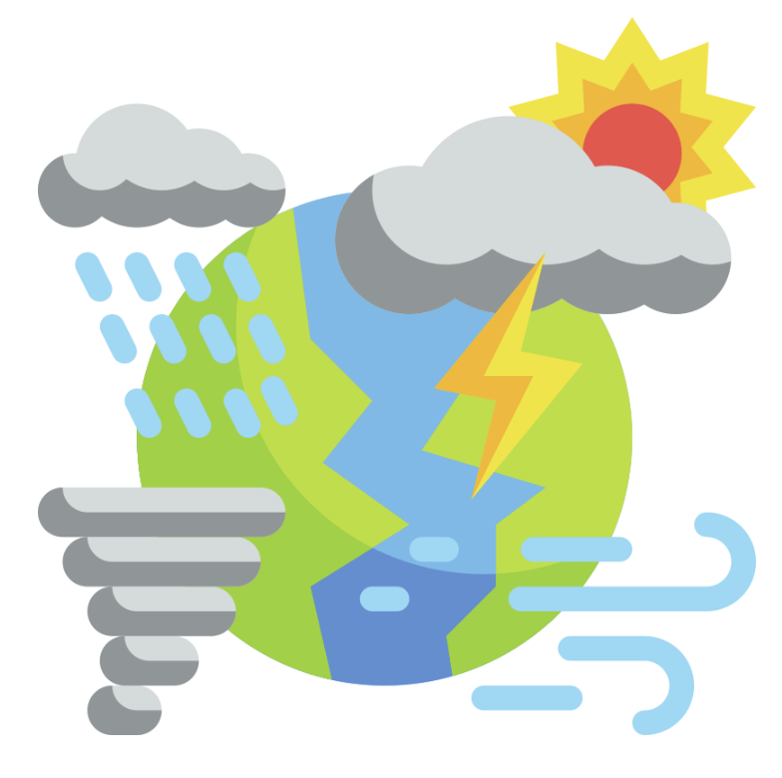
Discussing yesterday’s weather is not a forecast. It has already happened.
Notes:
While discussing past weather can be helpful in identifying patterns, this is not a forecast because you are not predicting future weather.

Slide 36
Notes:
Now let’s pause for a moment to check your understanding.

Slide 37
Why is yesterday’s weather not a forecast?
Notes:
Why is yesterday’s weather not a forecast
[Rain occurs when water droplets in clouds combine and become heavy enough to fall. Dew point is the temperature when the air is full of tiny water droplets]

Slide 38
Why is talking about yesterday’s weather not a forecast?
A forecast is a prediction of future weather, not weather that has already happened.
Notes:
Why is yesterday’s weather not a forecast
[Rain occurs when water droplets in clouds combine and become heavy enough to fall. Dew point is the temperature when the air is full of tiny water droplets]

Slide 39
Remember!!!
Notes:
So remember!

Slide 40
Forecast: a prediction or guess of what the weather will be
Notes:
Forecast: a prediction or guess of what the weather will be

Slide 41
Notes:
We will now complete this concept map, called a Frayer model, to summarize and further clarify what you have learned about the term dew point.

Slide 42
Definition
Picture
Forecast
Example
How does a forecast impact my life?
Notes:
To complete the Frayer model, we will choose from four choices the correct picture, definition, example, and response to the question, “How does a forecast impact my life?” Select the best response for each question using the information you just learned. As we select responses, we will see how this model looks filled in for the term forecast.

Slide 43
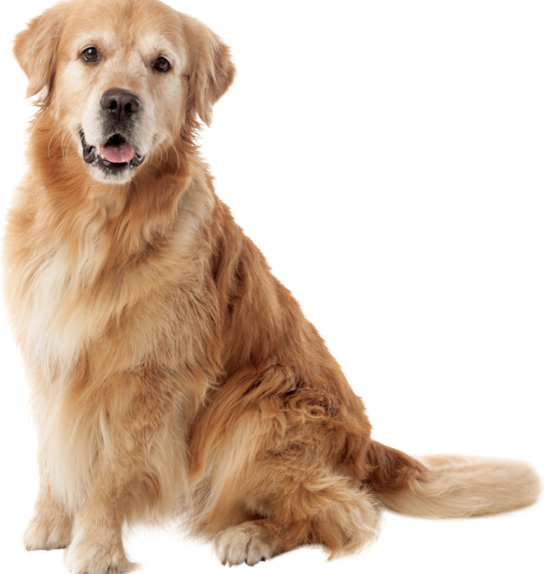
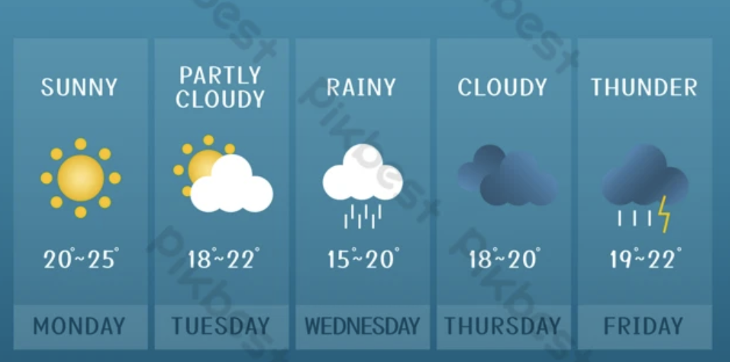
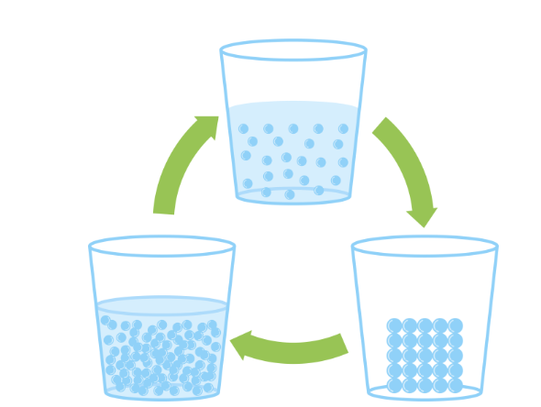
Directions: Choose the correct picture of a forecast from the choices below.
A
B
C
D
Notes:
Choose the one correct picture of forecast t from these four choices and drag and place it in the picture box below.

Slide 44
Directions: Choose the correct picture of a forecast from the choices below.
A
B
C
D
Notes:
You chose the picture that shows a forecast

Slide 45
Definition
Picture
Forecast
Example
How does a forecast t impact my life?
Notes:
Here is the Frayer Model filled in with a picture of forecast.

Slide 46
Directions: Choose the correct definition of forecast from the choices below.
A
Discussion of last week’s weather
B
How plants get energy from the sun
C
A prediction or guess of what the weather will be
D
The frost on the trees in the morning
Notes:
Choose the one correct definition of forecast from these four choices and drag and place it in the definition box below.

Slide 47
Directions: Choose the correct definition of forecast from the choices below.
A
Discussion of last week’s weather
B
How plants get energy from the sun
C
A prediction or guess of what the weather will be
D
The frost on the trees in the morning
Notes:
You chose “a prediction or guess of what the weather will be” This is correct! This is the definition of forecast.

Slide 48
Definition
Picture
A prediction or guess of what the weather will be
Forecast
Example
How does a forecast impact my life?
Notes:
Here is the Frayer Model with a picture and the definition filled in for forecast: a prediction or guess of what the weather will be

Slide 49
Directions: Choose the correct example of forecast from the choices below.
A
A meteorologist talking about today’s local parade
B
A meteorologist listing the yesterday’s top windspeed
C
The temperature at which dew forms on grass in the morning.
D
A meteorologist using humidity to predict tomorrow’s weather
Notes:
Choose the one correct example of forecast from these four choices and drag and place it in the example box below.

Slide 50
Directions: Choose the correct example of forecast from the choices below.
A
A meteorologist talking about today’s local parade
B
A meteorologist listing the yesterday’s top windspeed
C
The temperature at which dew forms on grass in the morning.
D
A meteorologist using humidity to predict tomorrow’s weather
Notes:
You chose: “a meteorologist using humidity to predict the tomorrow’s weather”. That is the correct example of forecast.

Slide 51
Definition
Picture
a prediction or guess of what the weather will be
Forecast
A meteorologist using humidity to predict tomorrow’s weather
Example
How does a forecast impact my life?
Notes:
Here is the Frayer Model with a picture, definition, and an example of dew point: The temperature at which dew forms on grass in the morning.

Slide 52
Directions: Choose the correct response for “how does a forecast impact my life?” from the choices below.
A
It helps me plan what type of clothes to wear and activities I can do tomorrow based on the weather
B
It helps predict who will win the basketball game
C
It influences how comfortable or sticky the air feels during hot weather.
D
It tells me how long it will take to drive home.
Notes:
Choose the one correct response for “how does a forecast impact my life?” from these four choices and drag and place it in the box below.

Slide 53
Directions: Choose the correct response for “how does a forecast impact my life?” from the choices below.
A
It helps me plan what type of clothes to wear and activities I can do tomorrow based on the weather
B
It helps predict who will win the basketball game
C
It influences how comfortable or sticky the air feels during hot weather.
D
It tells me how long it will take to drive home.
Notes:
You chose “It helps me plan what type of clothes to wear and activities I can do tomorrow based on the weather ” That is correct! This is an example of how a forecast impacts your life.

Slide 54
Definition
Picture
a prediction or guess of what the weather will be
Forecast
It helps me plan what types of clothes to wear and activities I can do tomorrow based on the weather.
A meteorologist using humidity to predict tomorrow’s weather
Example
How does a forecast impact my life?
Notes:
Here is the Frayer Model with a picture, definition, example, and a correct response to “how does a forecast impact my life?”: “It helps me plan what types of clothes to wear and activities I can do tomorrow based on the weather.”

Slide 55
Remember!!!
Notes:
So remember!

Slide 56
Forecast: a prediction or guess of what the weather will be
Notes:
Forecast: a prediction or guess of what the weather will be

Slide 57
Big Question:
Why are forecasts important to know and how are they helpful for our daily lives?
Notes:
Our “big question” is: Why are weather forecasts important, and how are they helpful for our daily lives.
[Pause and illicit predictions from students.]
Be sure to keep this question and your predictions in mind as we move through this video and questions.

Slide 58
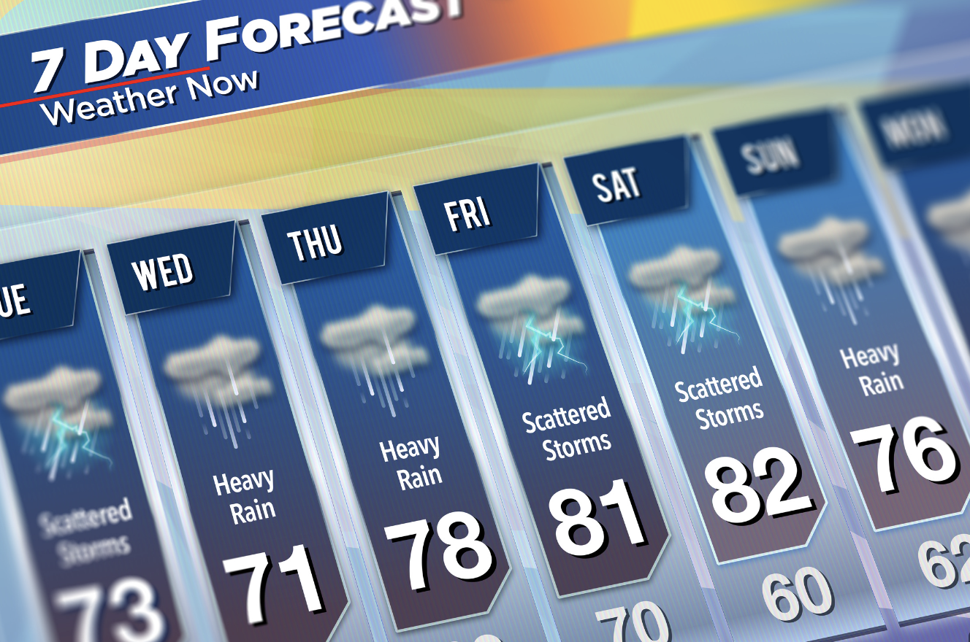
Simulation Activity
Forecast
(GIZMOS)
Click the link above for a simulation to explore weather forecasts..
Notes:
Click the link above for a simulation to deepen your understanding of a weather forecast
Feedback: Providing a simulation activity is a great way to make science thinking visible. In this simulation…
How do scientists measure and describe the weather? In this introductory lesson, students will practice using a thermometer, anemometer, rain gauge, and hygrometer to record weather conditions in a variety of locations and dates. This lesson uses U.S. customary units.
Launch Gizmo

Slide 59
Notes:
Thanks for watching, and please continue watching CAPs available from this website.

Slide 60
This Was Created With Resources From:
Questions or Comments
Michael Kennedy, Ph.D. MKennedy@Virginia.edu
Rachel L Kunemund, Ph.D. rk8vm@virginia.edu

