Slide 1
Intro
“Big Idea” Question
Review Concepts
Check-In Questions
Teacher Engagement
Vocabulary
Student-Friendly Definition
Examples & Non-Examples
Frayer Model
Simulation/Activity
Notes:
OK everyone, get ready for our next lesson. Just as a reminder, these are the different components that our lesson may include, and you’ll see these icons in the top left corner of each slide so that you can follow along more easily!

Slide 2
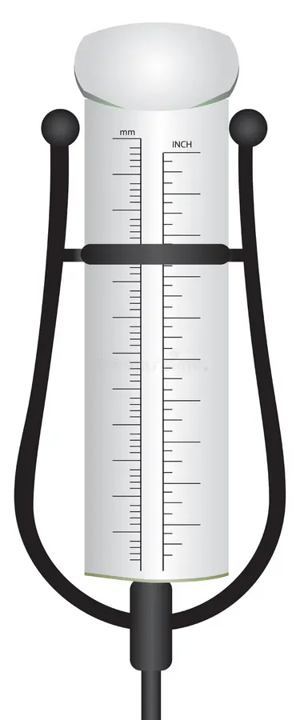
Rain Gauge
Intro
Notes:
Today we will be learning about a Rain Gauge.

Slide 3
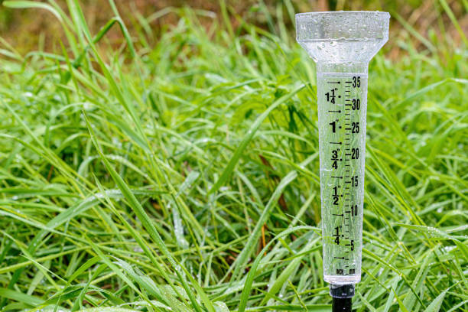
Big Question: Why is a rain gauge a valuable tool for scientists and meteorologists in understanding and predicting weather patterns?
Notes:
Our “big question” is: Why is a rain gauge a valuable tool for scientists and meteorologists in understanding and predicting weather patterns?
[Pause and illicit predictions from students.]
Be sure to keep this question and your predictions in mind as we move through this video and questions.

Slide 4
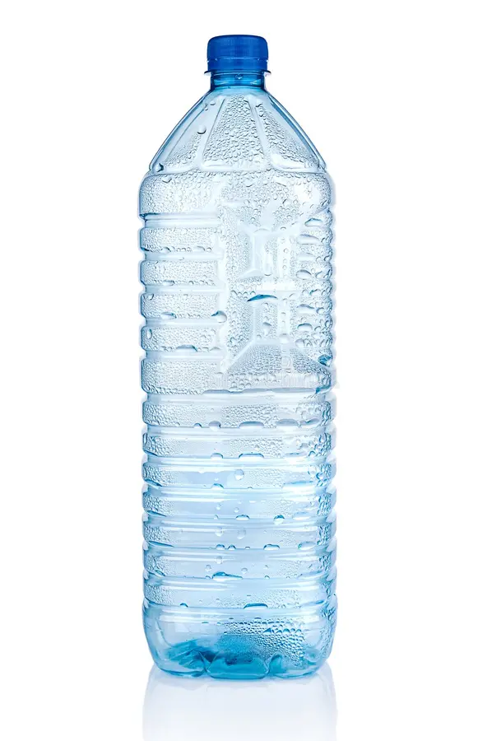
Demonstration
TEACHER DIRECTIONS:
Before viewing: Prepare materials and set up the demonstration stations around the classroom.
During: Guide students in making observations and recording the data.
After: Tell students that today they will be learning more about rain gauges.
Notes:
A feasible and effective classroom demonstration to teach about a rain gauge could involve the following steps:
Materials needed:
Clear plastic bottle or jar
Scissors
Ruler or measuring tape
Waterproof marker
Funnel (optional)
Water
Rain or water source (e.g., watering can, spray bottle)
Procedure:
Begin by explaining to the students what a rain gauge is and its purpose in measuring rainfall.
Prepare the rain gauge by cutting off the top portion of the plastic bottle or jar, leaving the bottom part intact. Ensure that the container has a wide opening to collect rainfall effectively.
Use the ruler or measuring tape to mark equal intervals along the side of the container, starting from the bottom. Each interval represents a measurement unit, such as inches or centimeters, to track the amount of rainfall.
If available, attach a funnel to the top of the rain gauge to help direct rainfall into the container more efficiently. This step is optional but can be helpful, especially if using a narrow-mouthed container.
Place the rain gauge in an open area outside, away from any obstructions like trees or buildings, where it can collect rainfall without interference.
Once the rain gauge is set up, instruct the students to observe and record the initial water level inside the container.
Use a watering can or spray bottle to simulate rainfall by pouring water into the rain gauge gradually. Encourage students to observe how the water level rises inside the container as "rainfall" is added.
After the demonstration, gather the students to discuss their observations. Ask questions such as:
What did you notice happening to the water level in the rain gauge when we added water?
How can we use the markings on the rain gauge to measure the amount of rainfall?
Why is it important to measure rainfall, and how does it help us understand the weather?
Conclude by reinforcing the concept that rain gauges are essential tools for measuring rainfall, which helps meteorologists track weather patterns, predict floods or droughts, and understand climate trends.
This hands-on demonstration allows students to actively engage with the concept of rain gauges and provides a tangible way for them to understand how these devices work to measure rainfall.

Slide 5
Notes:
Before we move on to our new topic, let’s review some other words & concepts that you already learned and make sure you are firm in your understanding.

Slide 6
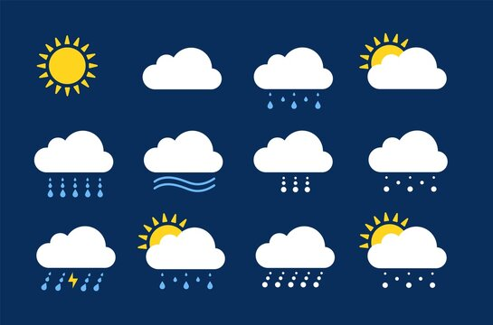
Precipitation: Forms of water falling from the sky.
Notes:
Precipitation is the form of water falling from the sky.

Slide 7
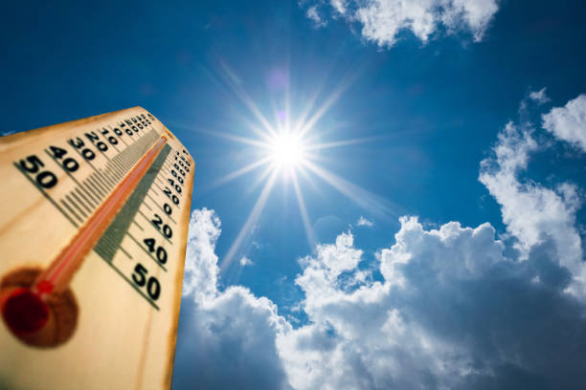
Weather: The condition of the atmosphere at a certain place and time
Notes:
Weather is the condition of the atmosphere at a certain place and time.

Slide 8
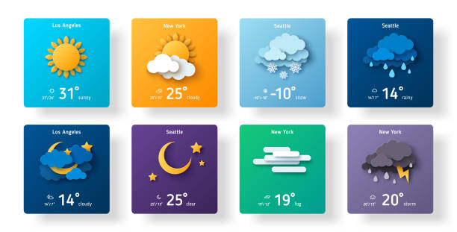
Forecast: A prediction of future weather conditions based on atmospheric patterns.
Notes:
Forecast is a prediction of future weather conditions based on atmospheric patterns.

Slide 9
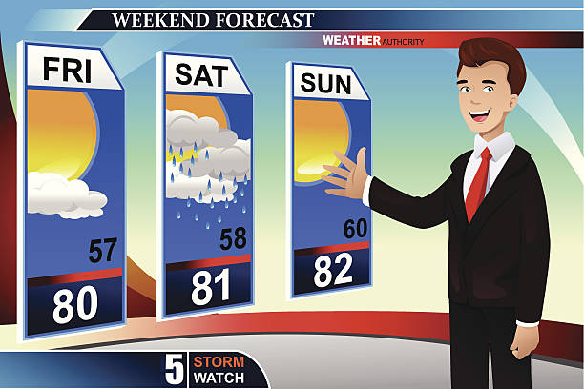
Meteorologist: A scientist who studies and predicts weather patterns.
Notes:
Meteorologist is a scientist who studies and predicts weather patterns.

Slide 10
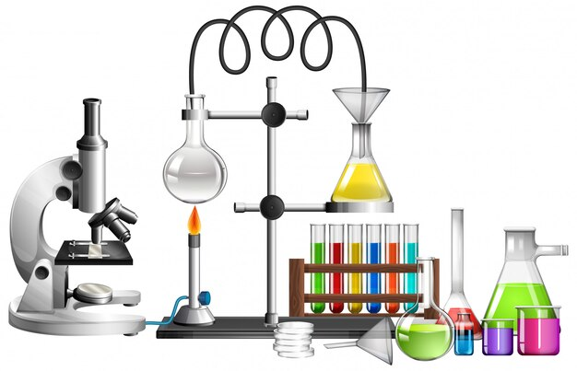
Instruments: Tools that scientists use to measure things.
Notes:
Instruments are tools that scientists use to measure things.

Slide 11
Notes:
Now let’s pause for a moment to review the information we have covered already.

Slide 12
True or False: A meteorologist studies and predicts weather patterns.
A. True
B. False
Notes:
True or false: A meteorologist studies and predicts weather patterns.
[True]

Slide 13
True or False: A meteorologist studies and predicts weather patterns.
A. True
B. False
Notes:
True or false: A meteorologist studies and predicts weather patterns.
[True]

Slide 14
A. Day
B. Season
C. Prediction
Forecast: A _________ of future weather conditions based on atmospheric patterns.
Notes:
Forecast: A _________ of future weather conditions based on atmospheric patterns.
[Prediction]

Slide 15
A. Day
B. Season
C. Prediction
Forecast: A _________ of future weather conditions based on atmospheric patterns.
Notes:
Forecast: A _________ of future weather conditions based on atmospheric patterns.
[Prediction]

Slide 16
What is the forms of water falling from the sky?
Precipitation
Condensation
Atmosphere
Temperature
Notes:
What is the forms of water falling from the sky?
[Precipitation]

Slide 17
What is the forms of water falling from the sky?
Precipitation
Condensation
Atmosphere
Temperature
Notes:
What is the forms of water falling from the sky?
[Precipitation]

Slide 18
True or False: Weather is the condition of the atmosphere at a certain place and time.
A. True
B. False
Notes:
True or False: Weather is the condition of the atmosphere at a certain place and time
[True]

Slide 19
True or False: Weather is the condition of the atmosphere at a certain place and time.
A. True
B. False
Notes:
True or False: Weather is the condition of the atmosphere at a certain place and time
[True]

Slide 20
True or False: Instruments are tools that scientists use to measure things
A. True
B. False
Notes:
True or False: Instruments are tools that scientists use to measure things
[True]

Slide 21
True or False: Instruments are tools that scientists use to measure things
A. True
B. False
Notes:
True or False: Instruments are tools that scientists use to measure things
[True]

Slide 22
Rain Gauge
Notes:
Now that we’ve reviewed, let’s define our new term, rain gauge.

Slide 23
Rain Gauge: a tool used to measure the amount of rainfall
Notes:
Rain Gauge: a tool used to measure the amount of rainfall

Slide 24
Notes:
Let’s check-in for understanding.

Slide 25
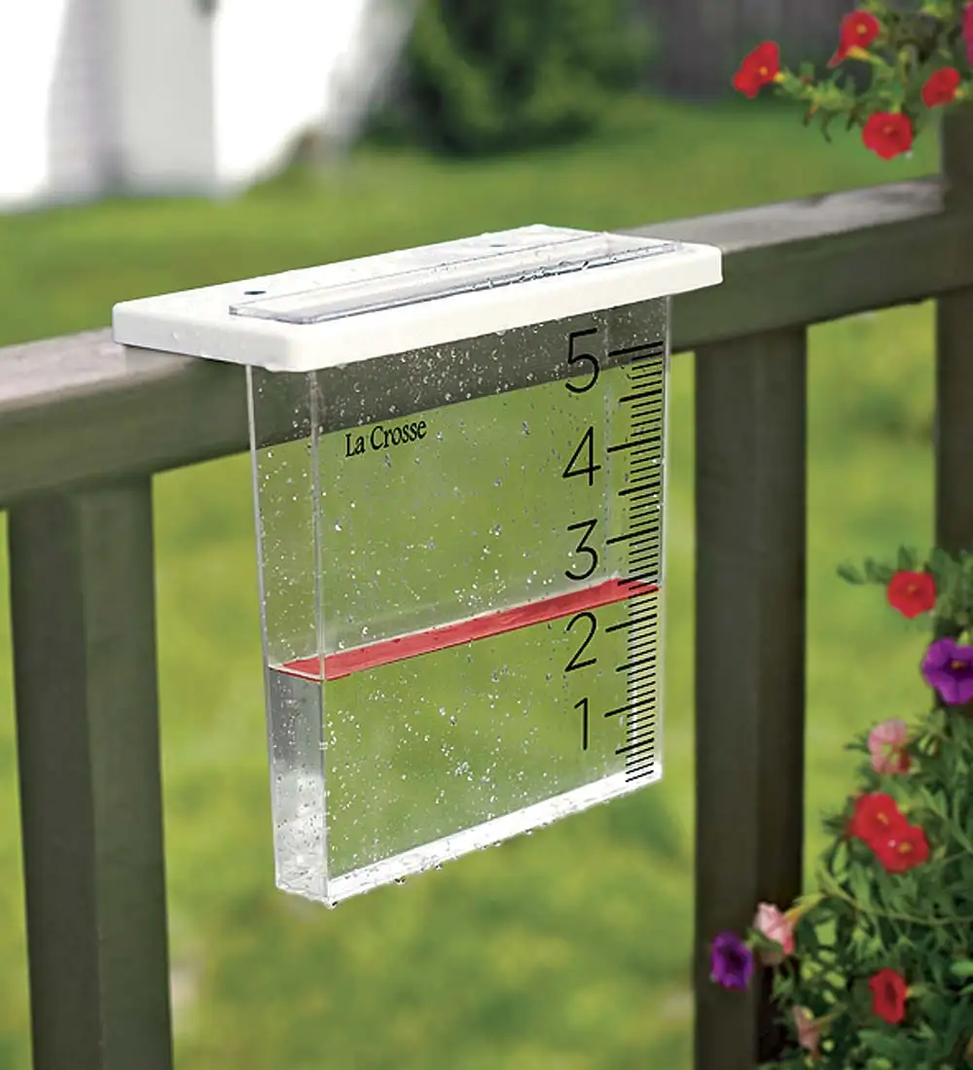
What is a rain gauge?
Notes:
What is a rain gauge?
[a tool used to measure the amount of rainfall.]

Slide 26
Notes:
That is the basic definition, but there is a bit more you need to know.

Slide 27
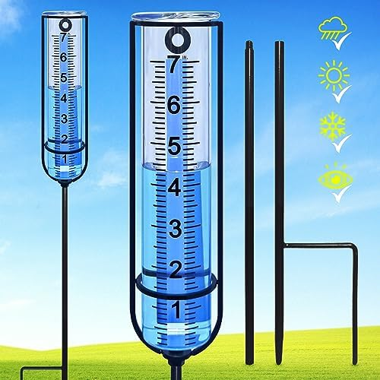
Reading a Rain Gauge:
It has a small container with markings on the side to show how many inches or centimeters of rain have collected inside. When it rains, water goes into the rain gauge and fills it up. We can then look at the markings on the side to see how much rain has fallen.
Notes:
Reading a Rain Gauge: It has a small container with markings on the side to show how many inches or centimeters of rain have collected inside. When it rains, water goes into the rain gauge and fills it up. We can then look at the markings on the side to see how much rain has fallen.

Slide 28
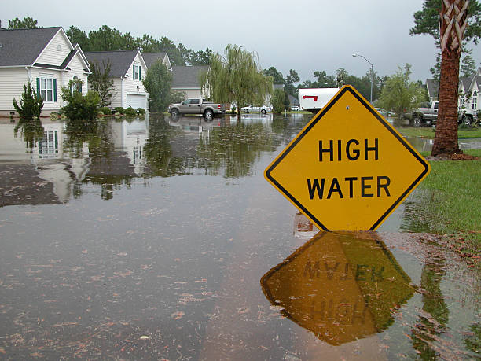
Why?:
Meteorologists use rain gauges to keep track of rainfall in different places over time. This helps them understand patterns in rainfall, predict floods or droughts, and plan for things like farming or water supply.
Notes:
Why?: Meteorologists use rain gauges to keep track of rainfall in different places over time. This helps them understand patterns in rainfall, predict floods or droughts, and plan for things like farming or water supply.

Slide 29
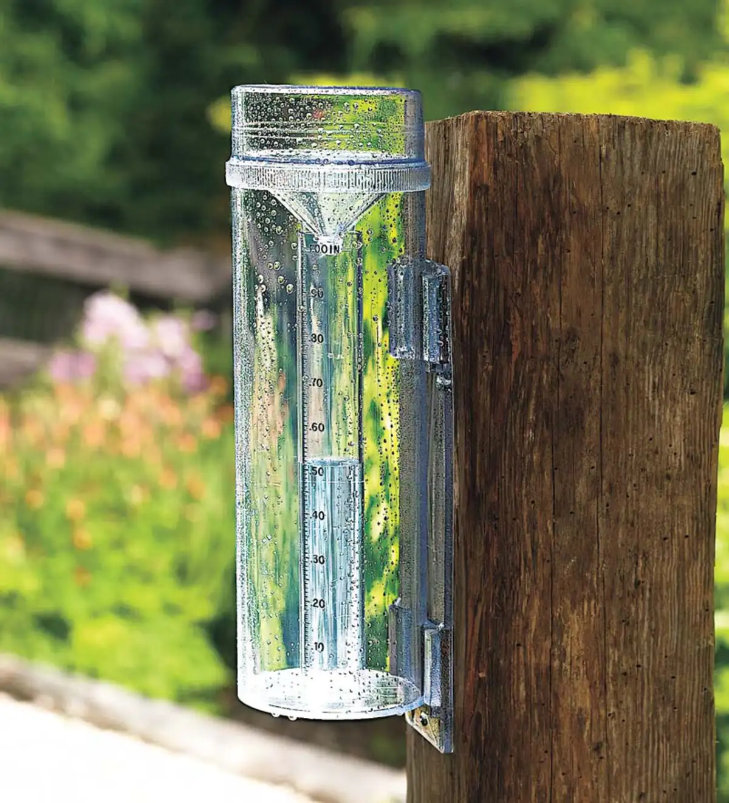
Types of Rain Gauges:
Rain gauges can be simple, like a plastic tube with measurements, or more advanced with electronic sensors. They're important tools for understanding and preparing for weather changes in our environment."
Notes:
Types of Rain Gauges: Rain gauges can be simple, like a plastic tube with measurements, or more advanced with electronic sensors. They're important tools for understanding and preparing for weather changes in our environment."

Slide 30
Notes:
Now let’s pause for a moment to review the information we have covered already.

Slide 31
True or False: There are markings on rain gauges on the side to show how much rainfall has occurred.
Notes:
True or False: There are markings on rain gauges on the side to show how much rainfall has occurred.
[True]

Slide 32
True or False: There are markings on rain gauges on the side to show how much rainfall has occurred.
Notes:
True or False: There are markings on rain gauges on the side to show how much rainfall has occurred.
[True]

Slide 33
Meteorologists use rain gauges to keep track of ______ in different places over time.
Notes:
Meteorologists use rain gauges to keep track of ______ in different places over time.
[Rainfall]

Slide 34
Meteorologists use rain gauges to keep track of rainfall in different places over time.
Notes:
Meteorologists use rain gauges to keep track of _________ in different places over time.
[Rainfall]

Slide 35
Notes:
Now, let’s talk about some examples of a rain gauge.

Slide 36
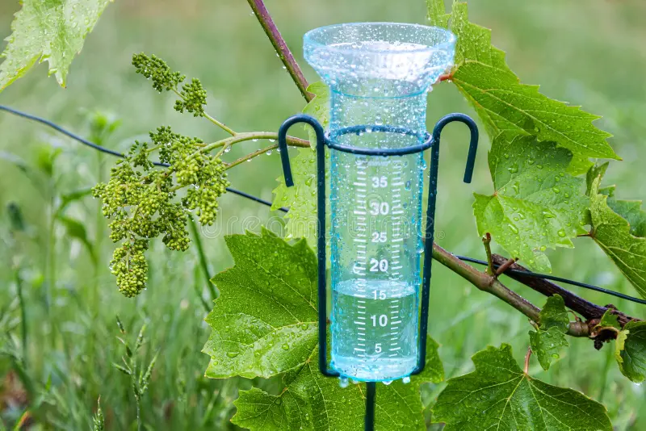
An example of a rain gauge is a cylinder rain gauge. It is a simple, clear plastic tube with measurement markings on the side, resembling a tall cup.
Notes:
An example of a rain gauge is a cylinder rain gauge. It is a simple, clear plastic tube with measurement markings on the side, resembling a tall cup.

Slide 37
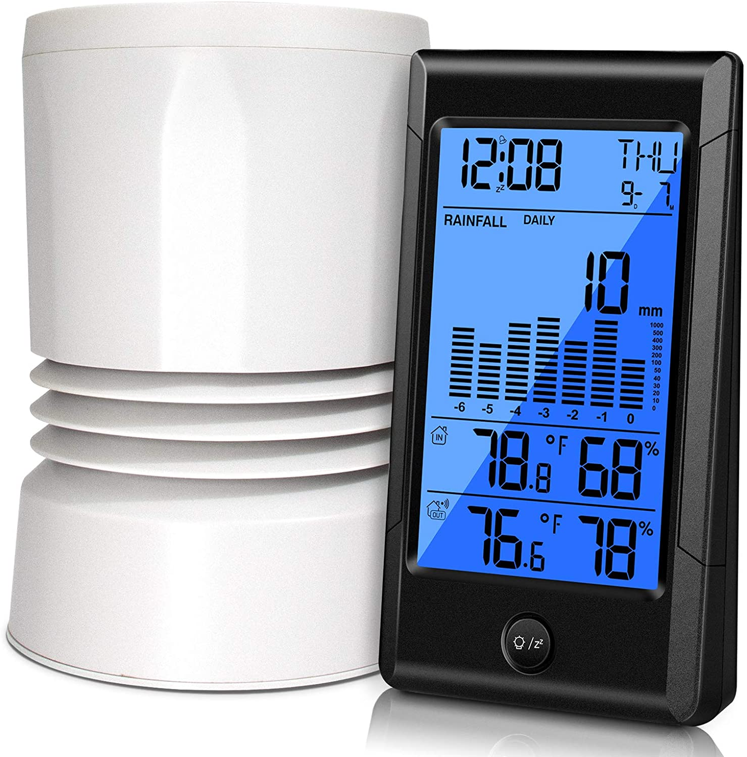
Another example of a rain gauge is an electronic rain gauge. It is a modern device equipped with sensors that automatically measure and record rainfall data digitally.
Notes:
Another example of a rain gauge is an electronic rain gauge. It is a modern device equipped with sensors that automatically measure and record rainfall data digitally.

Slide 38
Notes:
Now, let’s talk about some non-examples of a rain gauge.

Slide 39
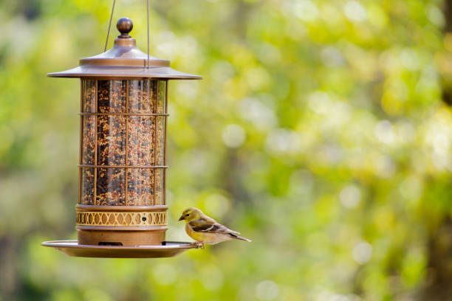
A bird feeder is NOT an example of a rain gauge. While a bird feeder provides food for birds, it does not measure rainfall.
Notes:
A bird feeder is NOT an example of a rain gauge. While a bird feeder provides food for birds, it does not measure rainfall.

Slide 40
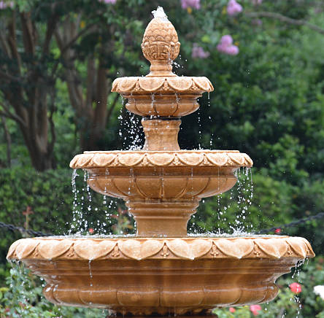
A fountain is NOT an example of a rain gauge. A fountain circulates water for decorative purposes, but it does not measure rainfall.
Notes:
A fountain is NOT an example of a rain gauge. A fountain circulates water for decorative purposes, but it does not measure rainfall.

Slide 41
Notes:
Now let’s pause for a moment to check your understanding.

Slide 42
How is a fountain different from a rain gauge?
Notes:
How is a fountain different from a rain gauge?
[A fountain circulates water for decorative purposes, but it does not measure rainfall.]

Slide 43
How is a fountain different from a rain gauge?
A fountain circulates water for decorative purposes, but it does not measure rainfall.
Notes:
How is a fountain different from a rain gauge?
[A fountain circulates water for decorative purposes, but it does not measure rainfall.]

Slide 44
Remember!!!
Notes:
So remember!

Slide 45
Rain Gauge: a tool used to measure the amount of rainfall
Notes:
Rain Gauge: a tool used to measure the amount of rainfall

Slide 46
Notes:
We will now complete this concept map, called a Frayer model, to summarize and further clarify what you have learned about the term rain gauge.

Slide 47
Definition
Picture
Rain Gauge
Example
How does a rain gauge impact my life?
Notes:
To complete the Frayer model, we will choose from four choices the correct picture, definition, example, and response to the question, “How does a rain gauge impact my life?” Select the best response for each question using the information you just learned. As we select responses, we will see how this model looks filled in for the term rain gauge.

Slide 48
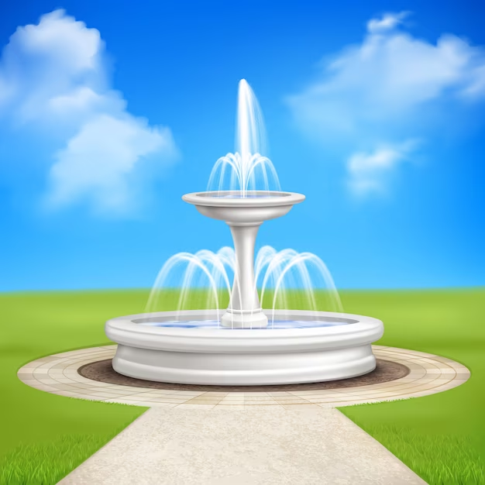
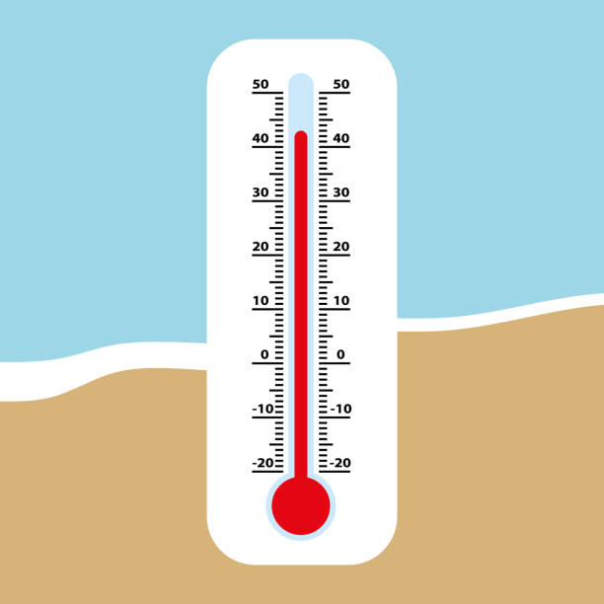
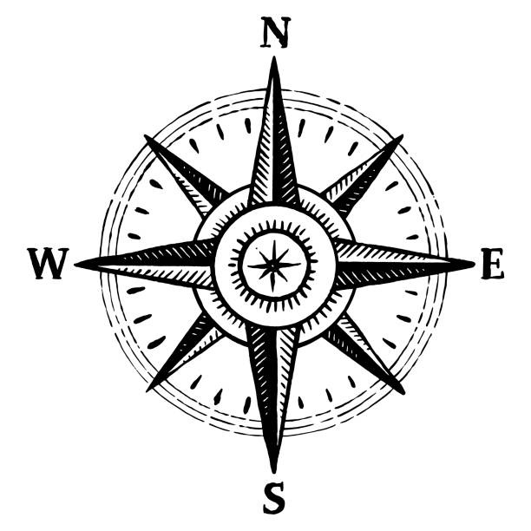
Directions: Choose the correct picture of a rain gauge from the choices below.
A
B
C
D
Notes:
Choose the one correct picture of a rain gauge from these four choices and drag and place it in the picture box below.

Slide 49
Directions: Choose the correct picture of a rain gauge from the choices below.
A
B
C
D
Notes:
You chose the picture that shows a rain gauge.

Slide 50
Definition
Picture
Rain Gauge
Example
How does a rain gauge impact my life?
Notes:
Here is the Frayer Model filled in with a picture of a rain gauge.

Slide 51
Directions: Choose the correct definition of a rain gauge from the choices below.
A
A device to measure the temperature of rainwater
B
A tool used to collect and measure the amount of rainfall
C
A decorative item that makes noise when rain falls on it
D
A container filled with water used for watering plants
Notes:
Choose the one correct definition of a rain gauge from these four choices and drag and place it in the definition box below.

Slide 52
Directions: Choose the correct definition of a rain gauge from the choices below.
A
A device to measure the temperature of rainwater
B
A tool used to collect and measure the amount of rainfall
C
A decorative item that makes noise when rain falls on it
D
A container filled with water used for watering plants
Notes:
You chose “a tool used to collect and measure the amount of rainfall” This is correct! This is the definition of a rain gauge.

Slide 53
Definition
Picture
A tool used to collect and measure the amount of rainfall.
Rain Gauge
Example
How does a rain gauge impact my life?
Notes:
Here is the Frayer Model with a picture and the definition filled in for a rain gauge: a tool used to collect and measure the amount of rainfall.

Slide 54
Directions: Choose the correct example of a rain gauge from the choices below.
A
A cylinder-shaped container with markings on the side
B
A fountain in the town
C
A bird feeder hung in the garden
D
A swimming pool in a backyard
Notes:
Choose the one correct example of a rain gauge from these four choices and drag and place it in the example box below.

Slide 55
Directions: Choose the correct example of a rain gauge from the choices below.
A
A cylinder-shaped container with markings on the side
B
A fountain in the town
C
A bird feeder hung in the garden
D
A swimming pool in a backyard
Notes:
You chose “a cylinder-shaped container with markings on the side” This is an example of a rain gauge!

Slide 56
Definition
Picture
A tool used to collect and measure the amount of rainfall.
Rain Gauge
A cylinder-shaped container with markings on the side.
Example
How does a rain gauge impact my life?
Notes:
Here is the Frayer Model with a picture, definition, and an example of a rain gauge: A cylinder-shaped container with markings on the side.

Slide 57
Directions: Choose the correct response for “how does a rain gauge impact my life?” from the choices below.
A
By playing music when it rains
B
By watering plants in the garden
C
By helping us understand weather patterns
D
By indicating the temperature of rainwater
Notes:
Choose the one correct response for “how does a rain gauge impact my life?” from these four choices and drag and place it in the box below.

Slide 58
Directions: Choose the correct response for “how does a rain gauge impact my life?” from the choices below.
A
By playing music when it rains
B
By watering plants in the garden
C
By helping us understand weather patterns
D
By indicating the temperature of rainwater
Notes:
You chose “By helping us understand weather patterns” That is correct! This is an example of how a rain gauge impacts your life.

Slide 59
Definition
Picture
A tool used to collect and measure the amount of rainfall.
Rain Gauge
A cylinder-shaped container with markings on the side.
By helping us understand weather patterns.
Example
How does a rain gauge impact my life?
Notes:
Here is the Frayer Model with a picture, definition, example, and a correct response to “how does a rain gauge impact my life?”: By helping us understand weather patterns.

Slide 60
Remember!!!
Notes:
So remember!

Slide 61
Rain Gauge: a tool used to measure the amount of rainfall
Notes:
Rain Gauge: a tool used to measure the amount of rainfall

Slide 62
Big Question: Why is a rain gauge a valuable tool for scientists and meteorologists in understanding and predicting weather patterns?
Notes:
Let’s reflect once more on our big question. Our “big question” is: Why is a rain gauge a valuable tool for scientists and meteorologists in understanding and predicting weather patterns?
Does anyone have any additional examples to share that haven’t been discussed yet?

Slide 63
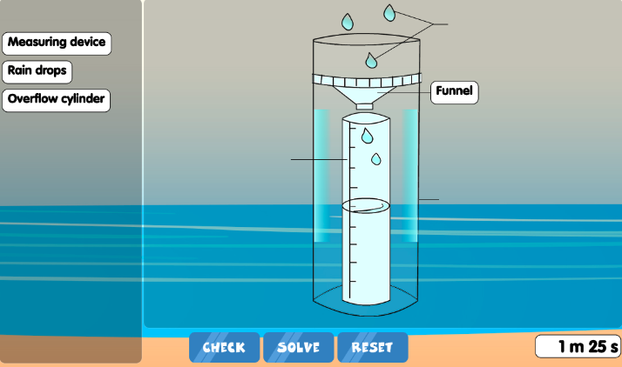
Simulation Activity
Diagram Game/Quiz
(Ecosystem for Kids)
Click the link above for a simulation to explore a rain gauge.
Notes:
Click the link above for a simulation to deepen your understanding of a rain gauge.
Feedback: Providing a simulation activity is a great way to make science thinking visible. In this simulation…
Identify parts of a rain gauge
Learn how a rain gauge measures amount of rainfall

Slide 64
Notes:
Thanks for watching, and please continue watching CAPs available from this website.

Slide 65
This Was Created With Resources From:
Questions or Comments
Michael Kennedy, Ph.D. MKennedy@Virginia.edu
Rachel L Kunemund, Ph.D. rk8vm@virginia.edu

