Slide 1
Intro
“Big Idea” Question
Review Concepts
Check-In Questions
Teacher Engagement
Vocabulary
Student-Friendly Definition
Examples & Non-Examples
Frayer Model
Simulation/Activity
Notes:
OK everyone, get ready for our next lesson. Just as a reminder, these are the different components that our lesson may include, and you’ll see these icons in the top left corner of each slide so that you can follow along more easily!

Slide 2
Energy
Intro
Notes:
Today we will be learning about Energy.

Slide 3
Big Question: How do forces, motion, and energy work together to affect the way objects move and interact with the world around us?
Notes:
Our “big question” is: How do forces, motion, and energy work together to affect the way objects move and interact with the world around us?
[Pause and illicit predictions from students.]
Be sure to keep this question and your predictions in mind as we move through this video and questions.

Slide 4
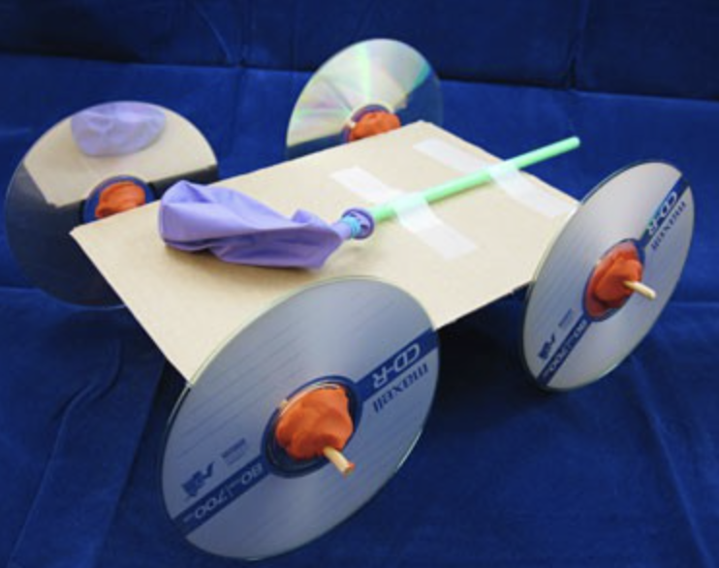
Demonstration
TEACHER DIRECTIONS:
Before viewing: Ask students to recall what they already know about energy.
During: Engage the students in a discussion about what they observed.
Discuss the concepts of potential energy, kinetic energy, and the conversion between the two.
After: Tell students that today they will be learning more about the term energy.
Notes:
To teach about motion in the context of sources of energy, you can conduct a simple and engaging classroom demonstration using a homemade balloon-powered car. This demonstration will help students understand the basics of motion and how energy can be transferred to create movement. Here's a step-by-step guide for the demonstration:
Materials needed:
Balloons
Drinking straws
Plastic bottle caps
Wheels (you can use CDs, bottle caps, or cardboard circles)
Rubber bands
Tape
Scissors
Markers or stickers for decorating (optional)
Procedure:
Prepare the Balloon-Powered Cars:
Distribute materials to each student or group of students.
Instruct students to design and create their own balloon-powered cars using the materials provided. They can cut the drinking straws to use as axles, attach wheels to the axles, and use a plastic bottle cap as the body of the car.
Attach the Balloon:
Once the basic car is assembled, show students how to attach a deflated balloon to the rear of the car using a rubber band. Make sure the balloon opening faces backward.
Decorate (Optional):
Allow students to decorate their balloon-powered cars using markers or stickers. Encourage creativity in designing the appearance of the cars.
Demonstrate and Discuss:
Demonstrate how to inflate the balloon and then release the air, letting the escaping air propel the car forward.
Discuss with the students the motion of the cars and how the energy from the inflated balloon is transferred to the wheels, causing the car to move.
Experiment and Observe:
Have students experiment with different sizes of balloons, amounts of air, or wheel configurations to see how these factors affect the motion of their cars.
Encourage them to make predictions and observe the outcomes.
Class Discussion:
Lead a class discussion about motion, emphasizing key concepts such as:
How does the inflated balloon store energy?
What happens when the balloon is released?
How does the transfer of energy result in motion?
Relate to Energy Sources:
Connect the demonstration to sources of energy by discussing how the balloon-powered car represents a basic form of energy transfer and motion, similar to how other vehicles are powered by different energy sources.
Extension Activity:
Challenge students to modify their designs to improve the speed or distance traveled by their balloon-powered cars.
This hands-on demonstration allows students to directly observe the principles of motion and energy transfer. It also provides an opportunity for creativity and problem-solving as students design and test their balloon-powered cars.
You
You are a 5th grade teacher teaching about sources of energy. What is a feasible and effective classroom demonstration to teach about energy?
ChatGPT
ChatGPT
A feasible and effective classroom demonstration to teach about energy can involve exploring potential and kinetic energy using a simple pendulum. This demonstration allows students to observe the conversion of energy between potential energy (at the highest point) and kinetic energy (at the lowest point) in a visually engaging way. Here's a step-by-step guide for the demonstration:
Materials needed:
String
A small weight (such as a metal washer or a small toy)
A ruler or meterstick
Stopwatch or timer
Tape
Procedure:
Setup:
Attach the string to the weight securely.
Use tape to attach the other end of the string to the top of the ruler or meterstick, creating a simple pendulum.
Measurement:
Measure and mark a starting point on the ruler where the pendulum will be released.
Measure and mark a point below the starting point (at least 20-30 cm down the ruler) to observe the pendulum's motion.
Potential Energy:
Hold the pendulum at the starting point, lifting it to the highest position.
Discuss with the students that, at this point, the weight has potential energy because it is higher above the ground.
Release and Observe:
Release the pendulum and let it swing freely.
As the weight descends, it converts potential energy into kinetic energy.
Measurement and Timing:
Use the stopwatch or timer to measure the time it takes for the pendulum to swing from the starting point to the lower point.
Observe and record the swinging motion.
Repeat and Experiment:
Repeat the process, changing variables like the starting height or the mass of the weight, and compare the results.
Discuss how these changes affect the conversion of potential to kinetic energy.
Class Discussion:
Engage the students in a discussion about what they observed.
Discuss the concepts of potential energy, kinetic energy, and the conversion between the two.
Relate to Energy Sources:
Connect the demonstration to sources of energy by explaining that different energy sources involve the conversion of energy from one form to another.
For example, discuss how a hydroelectric dam converts the potential energy of elevated water into kinetic energy and then into electricity.
Extension Activity:
Challenge students to design their own experiments by changing additional variables and observing the impact on energy conversion.
This demonstration provides a tangible way for students to understand the fundamental concepts of potential and kinetic energy and how energy can be transformed in various systems, connecting it to real-world examples of energy sources.

Slide 5
Notes:
Before we move on to our new topic, let’s review some other words & concepts that you already learned and make sure you are firm in your understanding.

Slide 6
Direction: where something moves or points
Notes:
Direction is where something moves or points

Slide 7
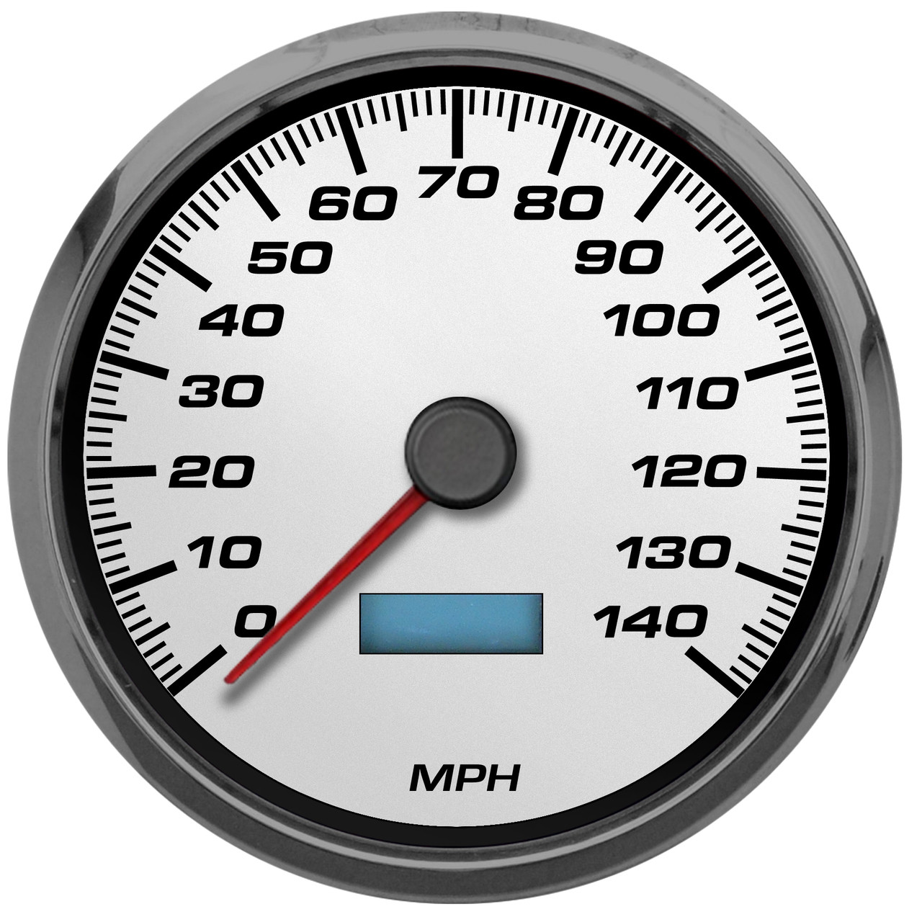
Speed: how fast an object moves
Notes:
Speed is how fast an object moves.

Slide 8
Motion: moving from one place to another
Notes:
Motion is moving from one place to another.

Slide 9
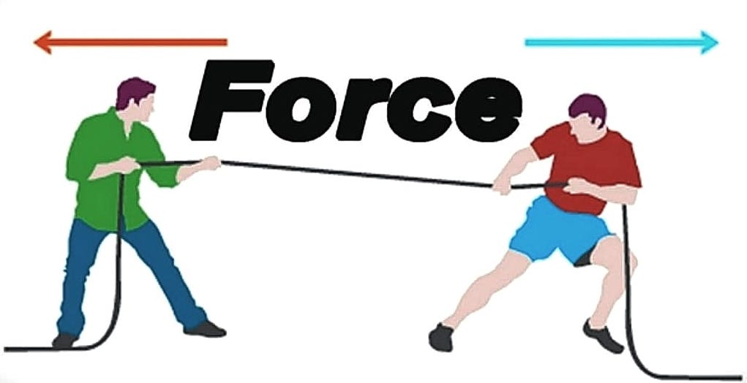
Force: a push or pull of an object
Notes:
Force is a push or pull of an object.

Slide 10
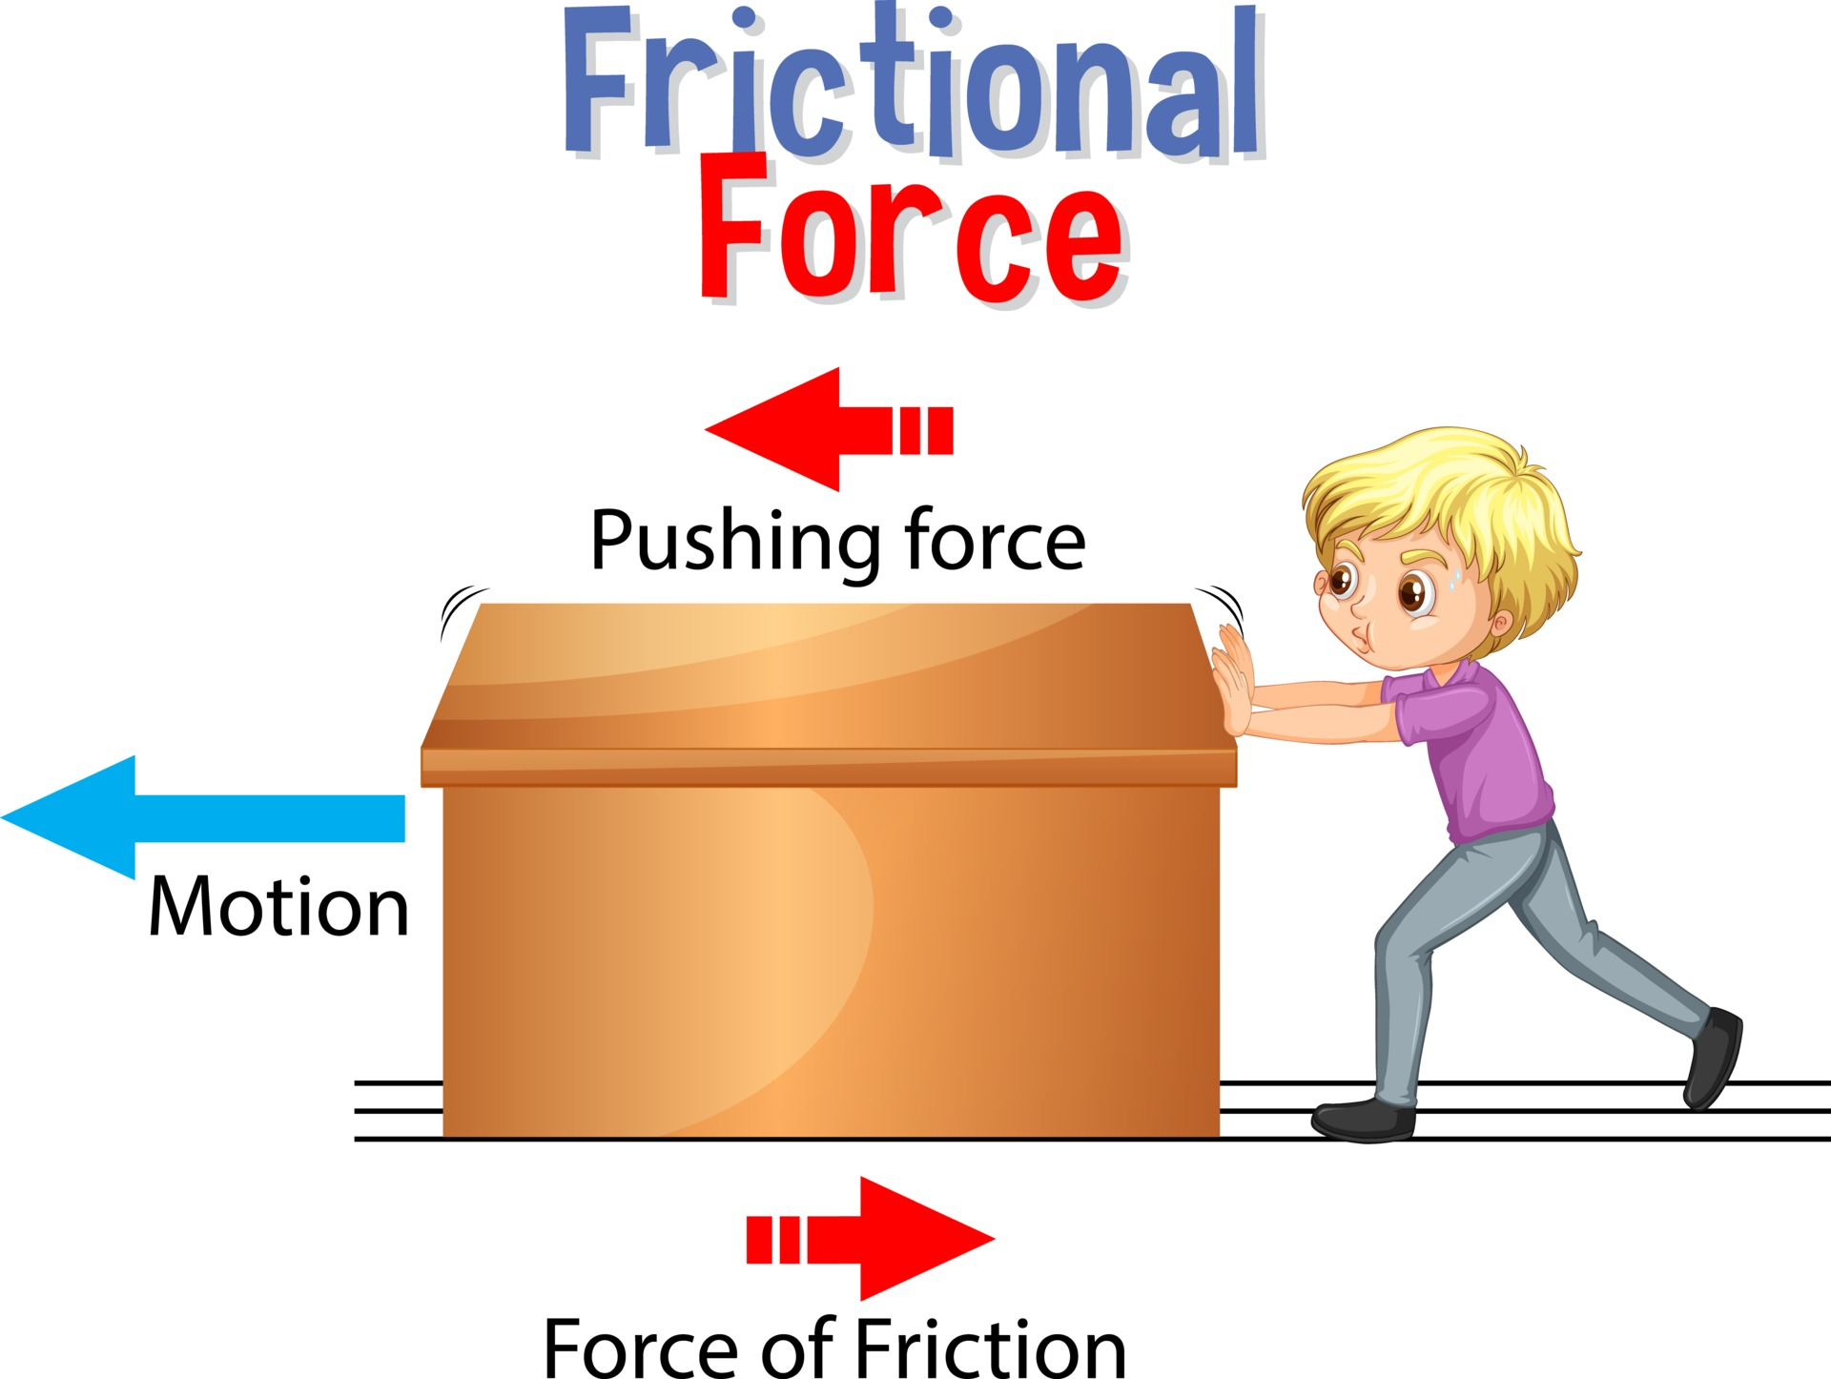
Friction: a force that resists the motion of two surfaces that are touching
Notes:
Friction is a force that resists the motion of two surface that are touching.

Slide 11
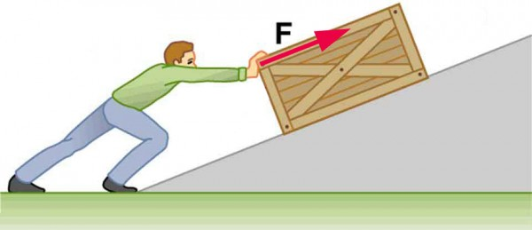
Work: a force acting upon an object causing the object to move in the direction of that force
Notes:
Work is a force acting upon an object causing the object to move in the direction of that force.

Slide 12
Notes:
Now let’s pause for a moment to review the information we have covered already.

Slide 13
True or False: Direction is where something moves or points.
A. True
B. False
Notes:
True or false: Direction is where something moves or points.
[True]

Slide 14
True or False: Direction is where something moves or points.
A. True
B. False
Notes:
True or false: Direction is where something moves or points.
[True]

Slide 15
A. Energy
B. Energy transformation
C. Speed
______ is how fast an object moves.
Notes:
_________ is how fast an object moves.
[Speed]

Slide 16
A. Energy
B. Energy transformation
C. Speed
______ is how fast an object moves.
Notes:
_________ is how fast an object moves.
[Speed]

Slide 17
True or False: Force is a push or pull of an object
Notes:
True or False: Force is a push or pull of an object
[True]

Slide 18
True or False: Force is a push or pull of an object
Notes:
True: Force is a push or pull of an object

Slide 19
Friction: a force that the motion of two surfaces that are touching
Notes:
Friction is a force that the motion of two surface that are touching.

Slide 20
Friction: a force that resists the motion of two surfaces that are touching
Notes:
Friction is a force that resists the motion of two surface that are touching.

Slide 21
Work: a acting upon an object causing the object to move in the of that force
friction, box
force, direction
Notes:
Work is a acting upon an object causing the object to move in the of that force.
[force, direction]

Slide 22
Work: a acting upon an object causing the object to move in the of that force
friction, box
force, direction
Notes:
Work is a force acting upon an object causing the object to move in the direction of that force.

Slide 23
Energy
Notes:
Now let’s define our new term, Energy.

Slide 24
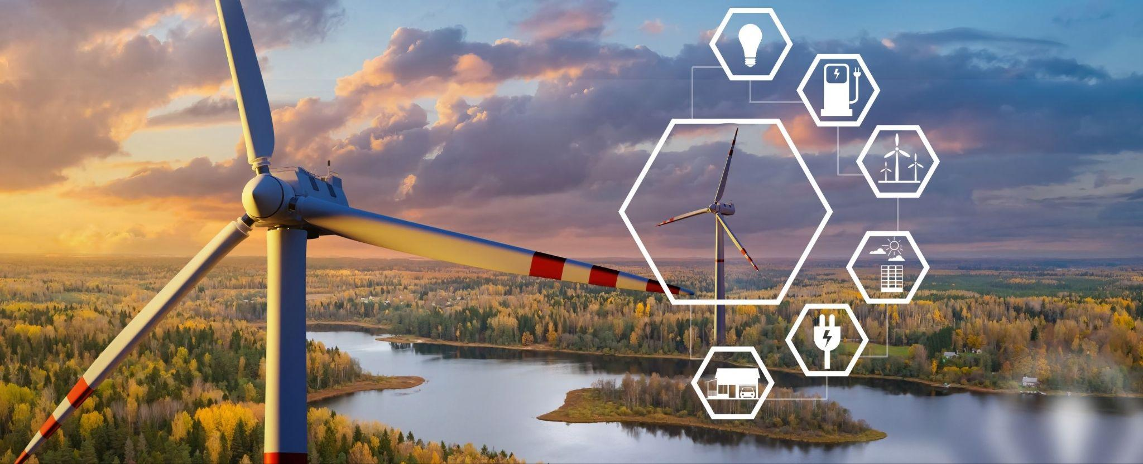
Energy: the ability to cause change
Notes:
Energy is the ability to cause change.

Slide 25
Notes:
Let’s check-in for understanding.

Slide 26
What is energy?
Notes:
What is energy?
[The ability to cause change]

Slide 27
Notes:
That is the basic definition, but there is a bit more you need to know.

Slide 28
Energy comes in different forms.
Some common forms of energy include:
Potential Energy: Stored energy. For example, a stretched rubber band or a raised book on a shelf has potential energy.
Kinetic Energy: Energy of mass in motion. Anything that is moving has kinetic energy, like a rolling ball or a running person.
Notes:
Energy comes in different forms. Some common forms of energy include:
Kinetic Energy: Energy of mass in motion. Anything that is moving has kinetic energy, like a rolling ball or a running person.
Potential Energy: Stored energy. For example, a stretched rubber band or a raised book on a shelf has potential energy.

Slide 29
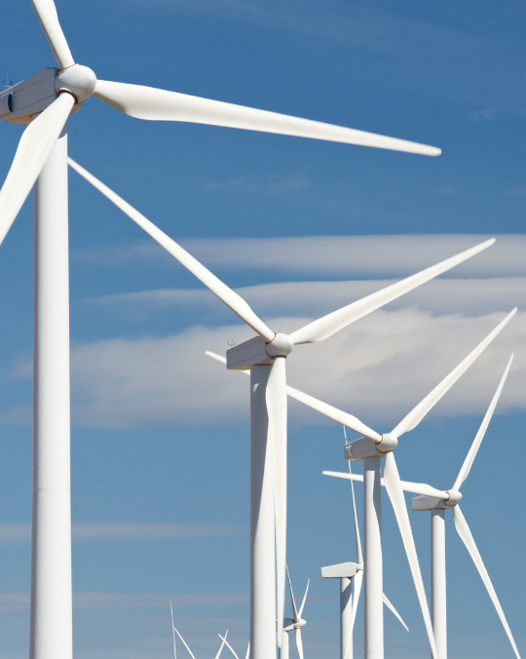
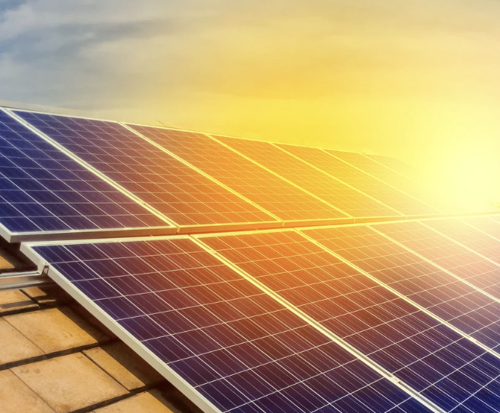
There are multiple sources of energy like the sun, which provides solar energy, or food, which gives our bodies the energy to move and function. Other sources include wind, water, and fuels like coal, oil, and natural gas.
Notes:
There are multiple sources of energy like the sun, which provides solar energy, or food, which gives our bodies the energy to move and function. Other sources include wind, water, and fuels like coal, oil, and natural gas.

Slide 30
Notes:
Now let’s pause for a moment to review the information we have covered already.

Slide 31
Name two forms of energy.
Notes:
Name two forms of energy.
[Kinetic Energy and Potential Energy]

Slide 32
There are multiple of energy like the sun, which provides solar energy.
Notes:
There are multiple of energy like the sun, which provides solar energy.
[sources]

Slide 33
There are multiple sources of energy like the sun, which provides solar energy.
Notes:
There are multiple sources of energy like the sun, which provides solar energy.

Slide 34
Notes:
Now, let’s talk about some examples of energy.

Slide 35
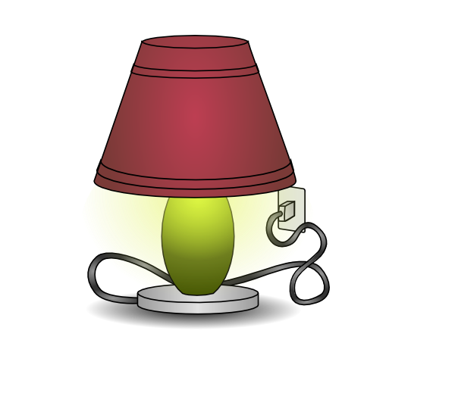
An example of energy is a lamp. A lamp does not have energy until it is plugged in. Once it is plugged into an electrical outlet, it receives energy from the outlet which causes it to display light when the lamp is turned on. Energy changes the lamp from being dark when turned off to having light when turned on.
Notes:
An example of energy is a lamp. A lamp does not have energy until it is plugged in. Once it is plugged into an electrical outlet, it receives energy from the outlet which causes it to display light when the lamp is turned on. Energy changes the lamp from being dark when turned off to having light when turned on.

Slide 36
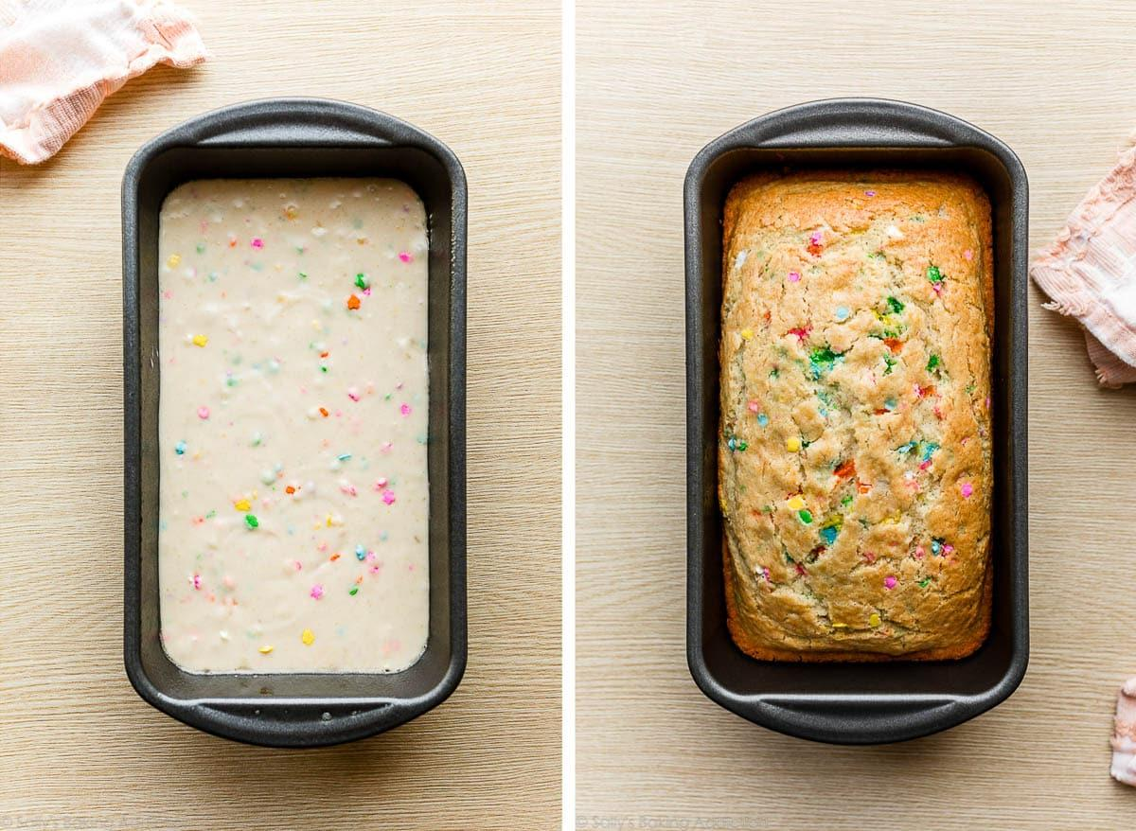
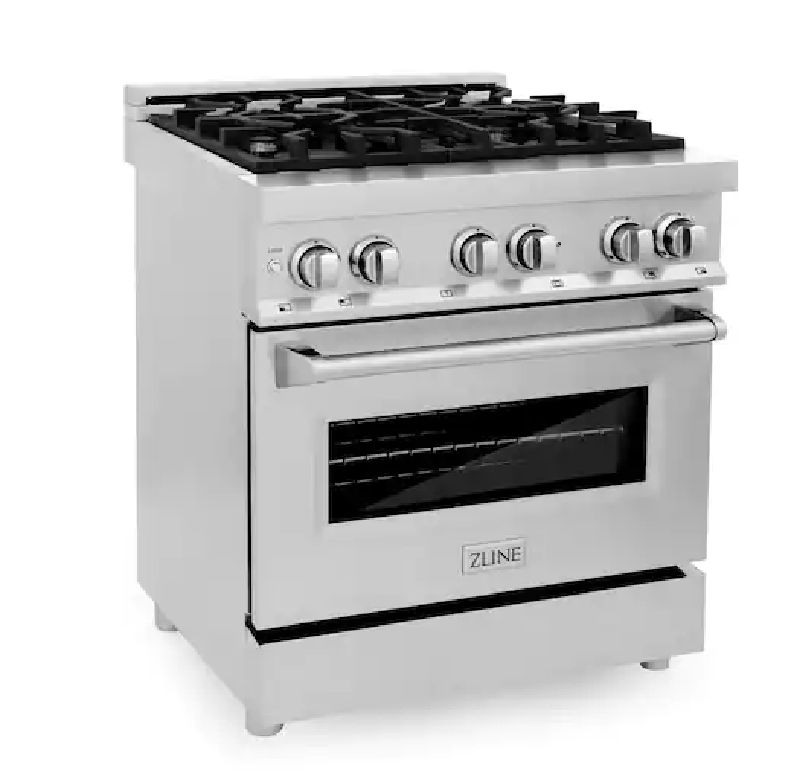
Another example of energy is cooking or baking food in an oven. The energy in an oven changes the food into being cooked or baked so we can eat it.
Before baking in oven
After baking in oven
Notes:
Another example of energy is cooking or baking food in an oven. The energy in an oven changes the food into being cooked or baked so we can eat it.

Slide 37
Notes:
Now, let’s talk about some non-examples of energy.

Slide 38
Electricity is NOT an example of energy. While electricity can be a carrier of energy, it is not energy itself. It is a form of energy transfer facilitated by the movement of electrons.
Notes:
Electricity is NOT an example of energy. While electricity can be a carrier of energy, it is not energy itself. It is a form of energy transfer facilitated by the movement of electrons.

Slide 39
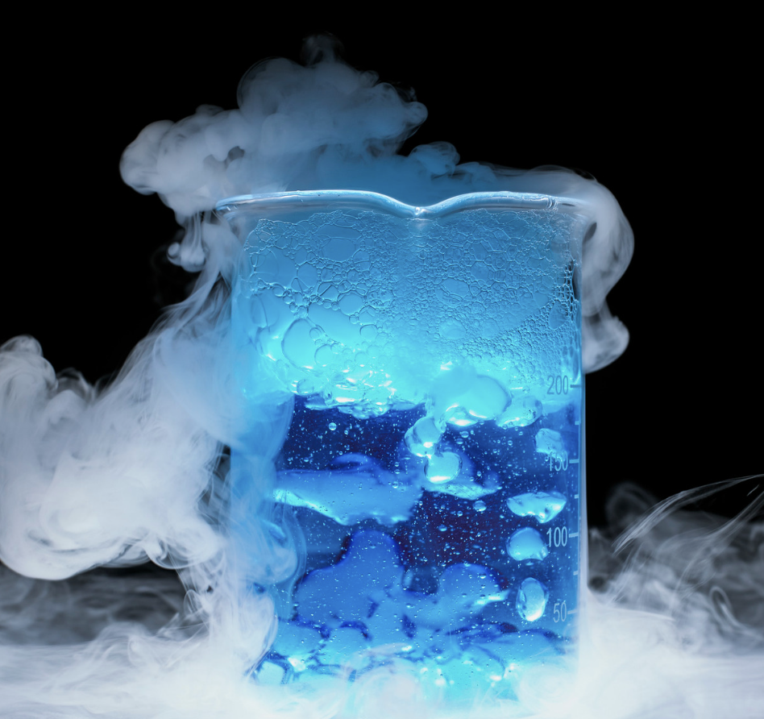
Matter, such as solids, liquids, and gases, is NOT energy. However, matter can contain and possess different forms of energy, like the potential and kinetic energy of an object.
Notes:
Matter, such as solids, liquids, and gases, is NOT energy. However, matter can contain and possess different forms of energy, like the potential and kinetic energy of an object.

Slide 40
Notes:
Now let’s pause for a moment to check your understanding.

Slide 41
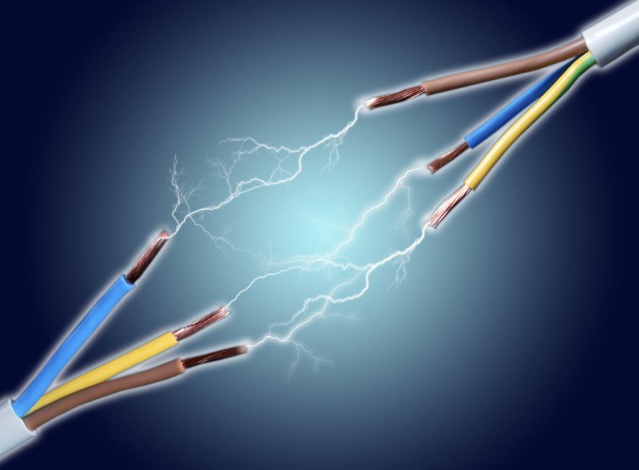
How is electricity different from energy?
Notes:
How is electricity different from energy?
[While electricity itself is not energy, it is a means by which energy is transmitted or delivered. Electricity can be harnessed and used to power various devices and perform work.]

Slide 42
Remember!!!
Notes:
So remember!

Slide 43
Energy: the ability to cause change
Notes:
Energy is the ability to cause change.

Slide 44
Notes:
We will now complete this concept map, called a Frayer model, to summarize and further clarify what you have learned about the term energy.

Slide 45
Definition
Picture
Energy
Example
How does energy impact my life?
Notes:
To complete the Frayer model, we will choose from four choices the correct picture, definition, example, and response to the question, “How does energy impact my life?” Select the best response for each question using the information you just learned. As we select responses, we will see how this model looks filled in for the term energy.

Slide 46
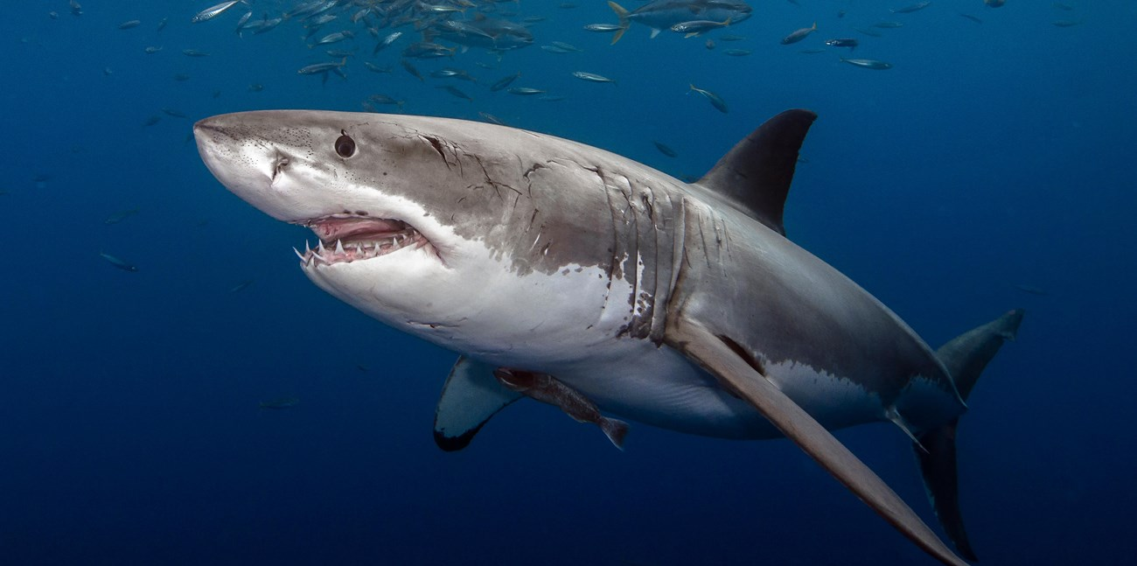
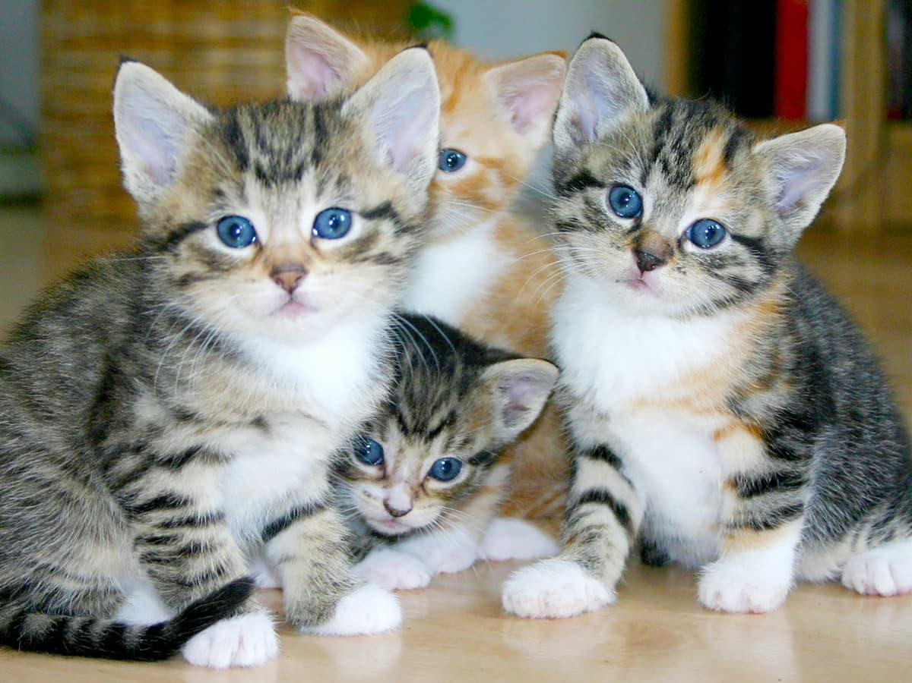
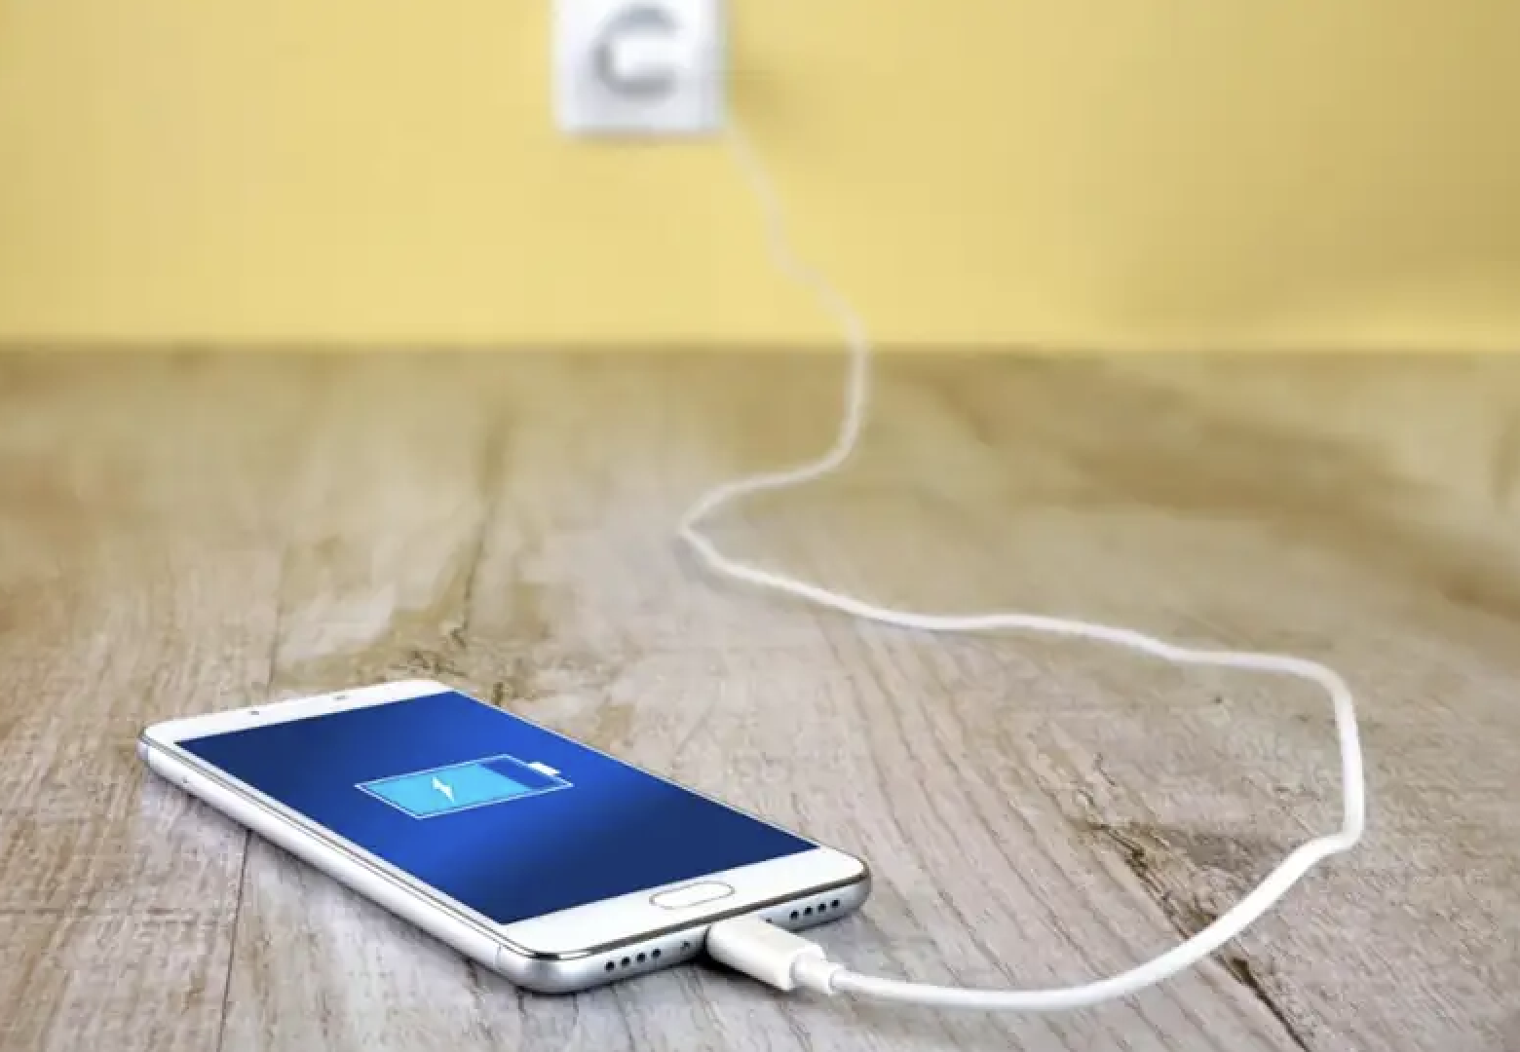
Directions: Choose the correct picture of Energy from the choices below.
A
B
C
D
Notes:
Choose the one correct picture of Energy from these four choices and drag and place it in the picture box below.

Slide 47
Directions: Choose the correct picture of Energy from the choices below.
A
B
C
D
Notes:
You chose the picture that shows Energy.

Slide 48
Definition
Picture
Energy
Example
How does energy impact my life?
Notes:
Here is the Frayer Model filled in with a picture of Energy.

Slide 49
Directions: Choose the correct definition of Energy from the choices below.
A
An animal that hunts and eats other animals
B
The ability to cause change
C
Energy of mass in motion
D
The powerhouse of the cell
Notes:
Choose the one correct definition of Energy from these four choices and drag and place it in the definition box below.

Slide 50
Directions: Choose the correct definition of Energy from the choices below.
A
An animal that hunts and eats other animals
B
The ability to cause change
C
Energy of mass in motion
D
The powerhouse of the cell
Notes:
You chose “The ability to cause change.” This is correct! This is the definition of Energy.

Slide 51
Definition
Picture
The ability to cause change
Energy
Example
How does energy impact my life?
Notes:
Here is the Frayer Model with a picture and the definition filled in for Energy: the ability to cause change.

Slide 52
Directions: Choose the correct example of Energy from the choices below.
A
A parked car
B
A couch
C
A cake baking in the oven
D
A cabin in the woods
Notes:
Choose the one correct example of Energy from these four choices and drag and place it in the example box below.

Slide 53
Directions: Choose the correct example of Energy from the choices below.
A
A parked car
B
A couch
C
A cake baking in the oven
D
A cabin in the woods
Notes:
You chose “A cake baking in the oven.” This is an example of Energy!

Slide 54
Definition
Picture
The ability to cause change
Energy
A cake baking in the oven
Example
How does energy impact my life?
Notes:
Here is the Frayer Model with a picture, definition, and an example of Energy: A cake baking in the oven

Slide 55
Directions: Choose the correct response for “how does energy impact my life?” from the choices below.
A
Energy impacts my life by cleaning our planet which helps keep us alive.
B
Energy impacts my life by powering our buildings and devices, helping us move from place to place, and overall helps us live.
C
Energy impacts my life by creating things like the air we breathe which is necessary for survival.
D
Energy impacts my life by growing fruits and vegetables that we can eat to be healthy and strong.
Notes:
Choose the one correct response for “how does energy impact my life?” from these four choices and drag and place it in the box below.

Slide 56
Directions: Choose the correct response for “how does energy impact my life?” from the choices below.
A
Energy impacts my life by cleaning our planet which helps keep us alive.
B
Energy impacts my life by powering our buildings and devices, helping us move from place to place, and overall helps us live.
C
Energy impacts my life by creating things like the air we breathe which is necessary for survival.
D
Energy impacts my life by growing fruits and vegetables that we can eat to be healthy and strong.
Notes:
You chose “Energy impacts my life by powering our buildings and devices, helping us move from place to place, and overall helps us live.” That is correct! This is an example of how energy impacts your life.

Slide 57
Definition
Picture
The ability to cause change
Energy
A cake baking in the oven
Energy impacts my life by powering our buildings and devices, helping us move from place to place, and overall helps us live.
Example
How does energy impact my life?
Notes:
Here is the Frayer Model with a picture, definition, example, and a correct response to “how does energy impact my life?”: Energy impacts my life by powering our buildings and devices, helping us move from place to place, and overall helps us live.

Slide 58
Remember!!!
Notes:
So remember!

Slide 59
Energy: the ability to cause change
Notes:
Energy is the ability to cause change.

Slide 60
Big Question: How do forces, motion, and energy work together to affect the way objects move and interact with the world around us?
Notes:
Let’s reflect once more on our big question. Our “big question” is: How do forces, motion, and energy work together to affect the way objects move and interact with the world around us?
Does anyone have any additional examples to share that haven’t been discussed yet?

Slide 61
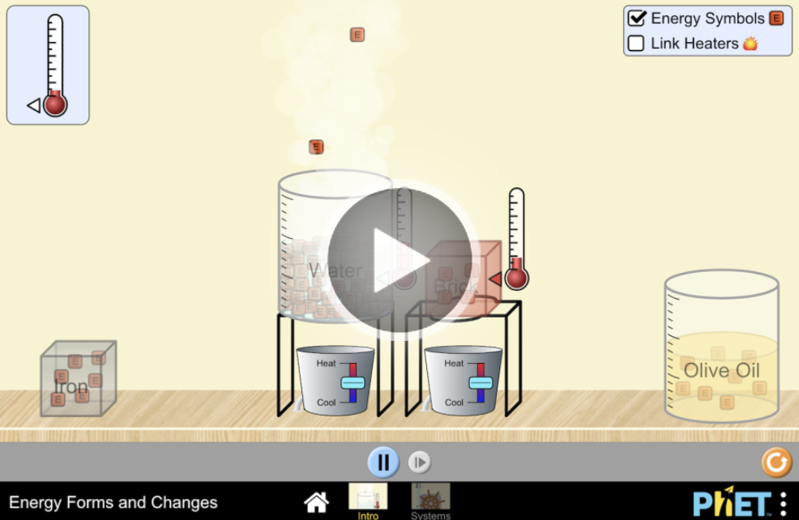
Simulation Activity
Energy
(PhET)
Click the link above for a simulation to explore energy.
Notes:
In this activity you will:
Predict how energy will flow when objects are heated or cooled, or for objects in contact that have different temperatures.
Describe the different types of energy and give examples from everyday life.
Describe how energy can change from one form of energy into another.
Explain conservation of energy in real-life systems.
Design a system with energy sources, changers, and users and describe how energy flows and changes one form of energy into another.
Feedback: Providing a rationale during this activity helps students make connections and promotes understanding of the content.

Slide 62
Notes:
Thanks for watching, and please continue watching CAPs available from this website.

Slide 63
This Was Created With Resources From:
Questions or Comments
Michael Kennedy, Ph.D. MKennedy@Virginia.edu
Rachel L Kunemund, Ph.D. rk8vm@virginia.edu

