Slide 1
Intro
“Big Idea” Question
Review Concepts
Check-In Questions
Teacher Engagement
Vocabulary
Student-Friendly Definition
Examples & Non-Examples
Frayer Model
Simulation/Activity
Notes:
OK everyone, get ready for our next lesson. Just as a reminder, these are the different components that our lesson may include, and you’ll see these icons in the top left corner of each slide so that you can follow along more easily!

Slide 2
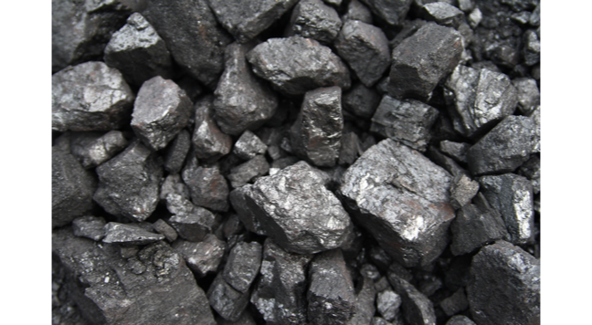
Intro
Fossil Fuels
Notes:
Today we are going to learn about fossil fuels,

Slide 3
Big Question: How do we use Earth’s resources to create energy?
Notes:
Our “big question” is: How do we use Earth’s resources to create energy?
[Pause and illicit predictions from students.]
I love all these thoughtful scientific hypotheses! Be sure to keep this question and your predictions in mind as we move through these next few lessons, and we’ll continue to revisit it.

Slide 4
Demonstration
Fossil Fuels: Chocolate Chip Mining
TEACHER DIRECTIONS:
Pass out the cookies, plates, and one Cookie Mining Worksheet for each student.
Students will sketch their cookie in two ways and answer the questions on the “Before Mining” side of their worksheet:
In the box on the left, students will make a sketch of their cookie.
In the box on the right, student will draw what fictional habitat is above ground on their cookie. Tell students to imagine that the cookie is actually the bedrock and dirt below ground – the second box is a bird’s eye view of that habitat on top. They should think of this as a fairly large area – the size of a city or national park. It can be a forest, desert, mountain, or any other ecosystem they like.
Pass out the toothpicks and explain that the students are actually coal miners. The chocolate chips in their cookies are the coal deposits underground, and they need to use their tools (toothpicks) to remove as much of that coal as possible. Give them about 5 minutes to “mine” for chocolate chips.
After mining, students will sketch their cookie in two ways and answer the questions again, this time on the “After Mining” section of their worksheet:
In the box on the left, they will make a sketch of their cookie.
In the box on the right, they will compare the damage to the cookie and the “before” image of the habitat to predict what their imaginary habitat looks like now. Encourage them to be specific when drawing and writing about what damage occurred.
Notes:
Let’s do a quick demonstration that will help get our brains ready to think about fossil fuels, and how it relates to our big question.
Feedback: Have students make predictions about the demonstration and make sure all students are actively participating in this portion of the lesson.

Slide 5
Notes:
Before we move on to our new vocabulary term, let’s review some other words & concepts that you already learned and make sure you are firm in your understanding.
Feedback: Reviewing key background knowledge helps lay the context and sets the students up to make sense of the new content you are introducing, it also reinforces previously learned material.

Slide 6
Element: a pure substance containing only one type of atom
Notes:
An element is a pure substance containing only one type of atom.

Slide 7
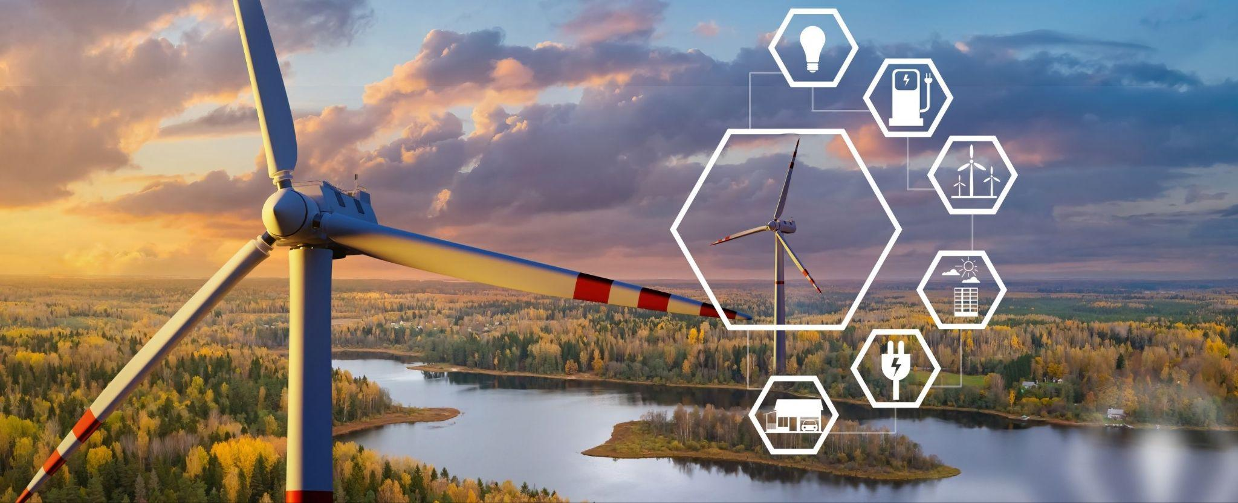
Energy: the ability to cause change
Notes:
Energy is the ability to cause change.

Slide 8
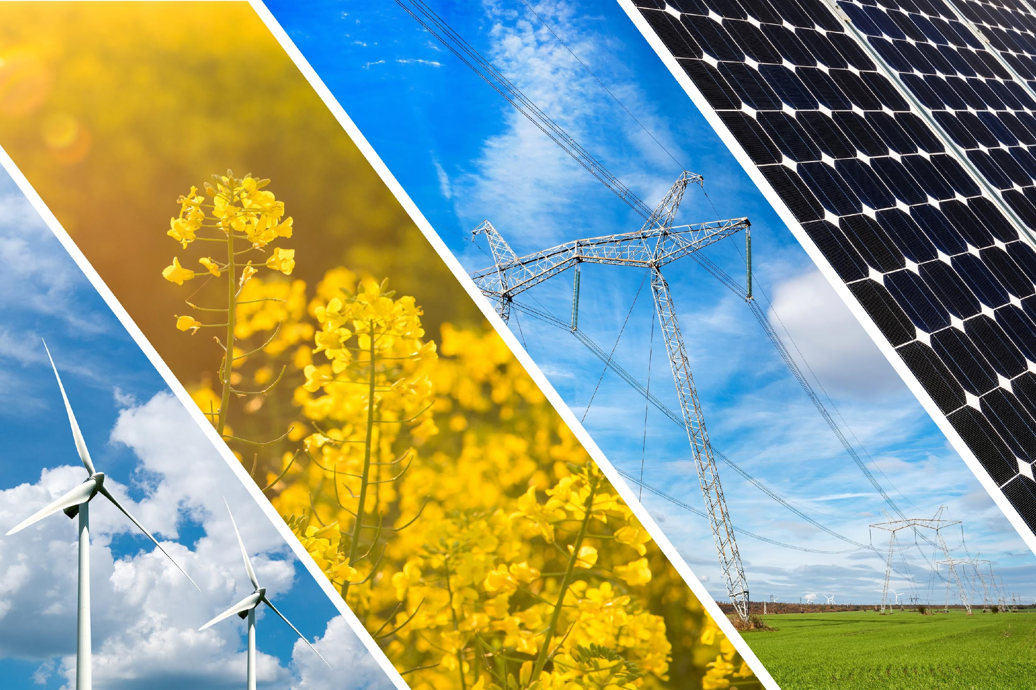
Renewable Resource: a resource that can be reused and replaced naturally
Notes:
A renewable resource is a resource that can be reused and replaced naturally.

Slide 9
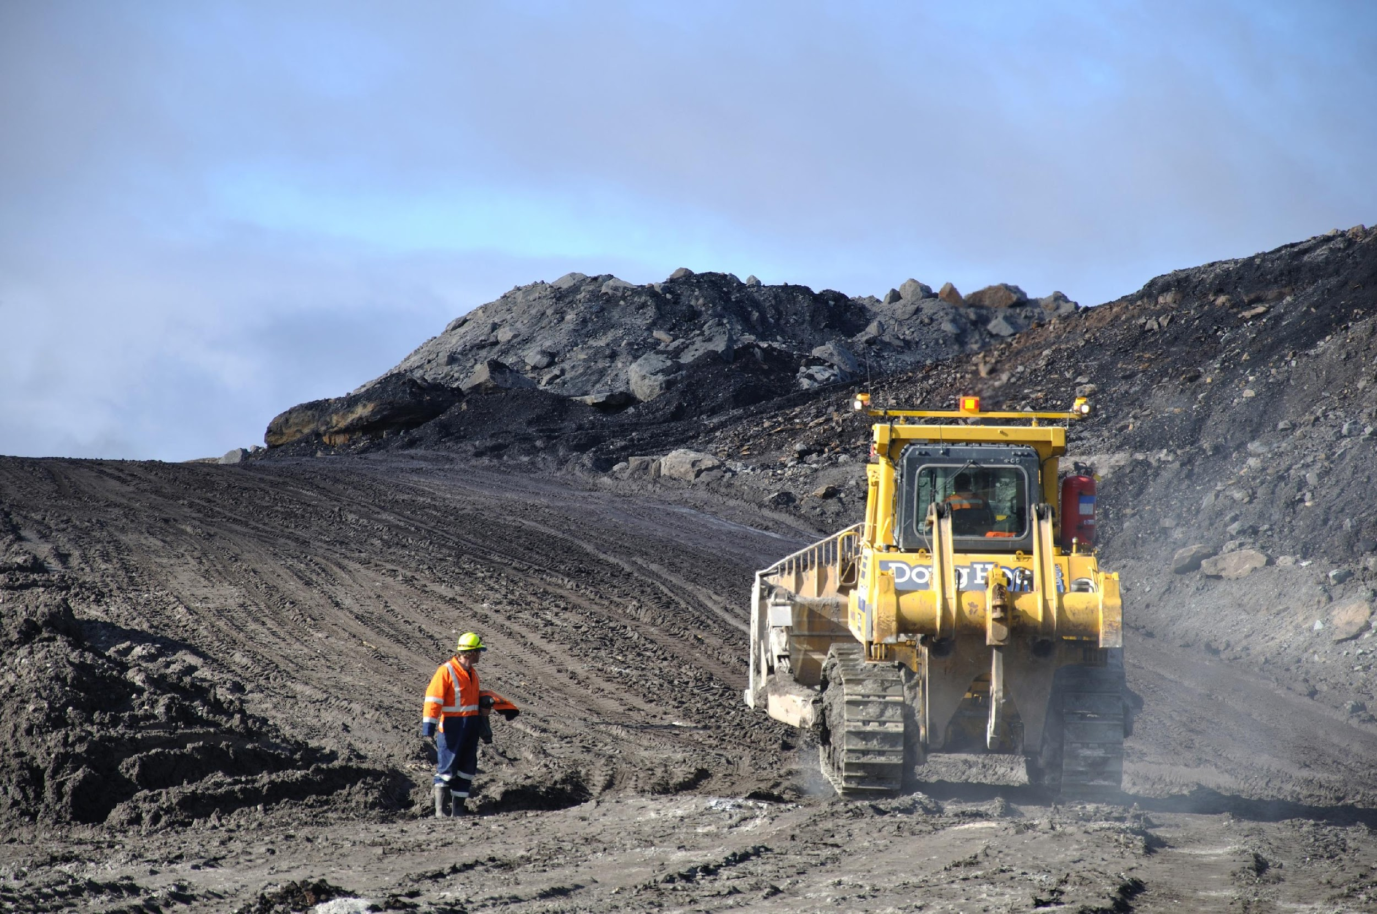
Non-Renewable Resource: a resource that is not replaced by nature quickly enough to match demand
Notes:
A non-renewable resource is a resource that is not replaced by nature quickly enough to match demand.

Slide 10
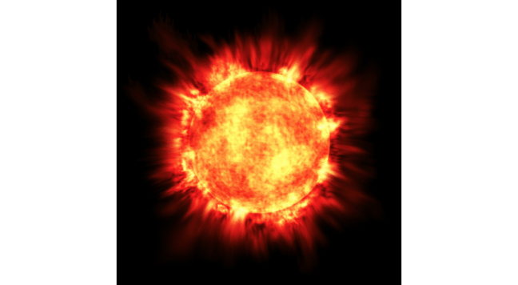
Solar Energy: energy from the sun.
Notes:
Solar energy is energy from the sun
Feedback: Clear and concise definitions are easier to understand for students.

Slide 11
Notes:
Now, let’s pause for a moment to check your understanding.
Feedback: It is important to monitor understanding during this portion of the lesson to make sure students have a strong foundation on previous terms that will help them better understand today’s new content.

Slide 12
What is an element?
Notes:
What is an element?
[An element is a pure substance containing only one type of atom.]

Slide 13
What is energy?
Notes:
What is energy?
[Energy is the ability to cause change.]

Slide 14
What is a the difference between a renewable and non-renewable resource?
Notes:
What is the difference between a renewable and non-renewable resource?
[A non-renewable resource is a resource that is not replaced by nature quickly enough to match demand (how much it is needed). A renewable resource is a resource that can be reused and replaced naturally.]

Slide 15
Solar Energy: energy from the .
Notes:
Solar energy is energy from the .
Feedback: Clear and concise definitions are easier to understand for students.

Slide 16
Solar Energy: energy from the sun.
Notes:
Solar energy is energy from the sun .
Feedback: Clear and concise definitions are easier to understand for students.

Slide 17
Fossil Fuels
Notes:
Now that we’ve reviewed, let’s define our new term, fossil fuels.

Slide 18
Fossil Fuels: energy that comes from the remains of plants and animals
Notes:
Fossil fuels are energy that comes from the remains of plants or animals.

Slide 19
Notes:
Let’s check-in for understanding.

Slide 20
What are fossil fuels?
Notes:
What are fossil fuels?
[Fossil fuels are energy that comes from the remains of plants or animals.]

Slide 21
Notes:
That’s the basic definition, but there’s more you need to know.

Slide 22
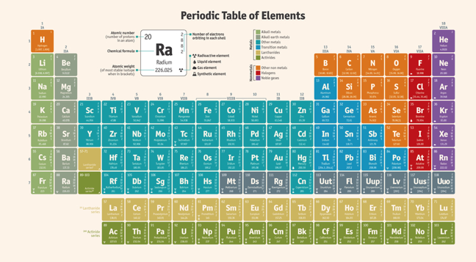
Fossil fuels are high in carbon and hydrogen. This is because they are made of plants and animals.
Notes:
Fossil fuels are high in carbon and hydrogen. This is because they are made of plants and animals.

Slide 23
These types of fuels are nonrenewable because they cannot be replaced in a short amount of time.
Notes:
These types of fuels are nonrenewable because they cannot be replaced in a short amount of time.

Slide 24
It takes millions of years to create fossil fuels.
Notes:
It takes millions of years to create fossil fuels.

Slide 25
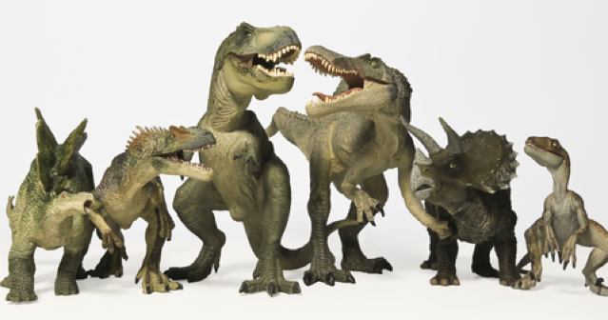
Fossil fuels formed before the dinosaurs!
Notes:
The fossil fuels we use today were formed BEFORE the dinosaurs!

Slide 26
This means they are not a safe or reliable option for energy!
Notes:
This means they are not a safe or reliable option for energy!

Slide 27
Notes:
Let’s check-in for understanding.

Slide 28
Which two elements are fossil fuels high in?
Hydrogen and nitrogen
Hydrogen and carbon
Hydrogen and oxygen
Notes:
Which two elements are fossil fuels high in?

Slide 29
Which two elements are fossil fuels high in?
Hydrogen and nitrogen
Hydrogen and carbon
Hydrogen and oxygen
Notes:
Which two elements are fossil fuels high in?
[Hydrogen and carbon]

Slide 30
Which energy source cannot be replaced in a short amount of time?
Water
Wind
Sun
Fossil fuels
Notes:
Which energy source cannot be replaced in a short amount of time?

Slide 31
Which energy source cannot be replaced in a short amount of time?
Water
Wind
Sun
Fossil fuels
Notes:
Which energy source cannot be replaced in a short amount of time?
[Fossil Fuels]

Slide 32
True/False: Fossil fuels are a source of renewable energy.
Notes:
True/False: Fossil fuels are a source of renewable energy.

Slide 33
True/False: Fossil fuels are a source of renewable energy.
Notes:
True/False: Fossil fuels are a source of renewable energy.
[False.]

Slide 34
Notes:
Now, let’s talk about some examples of fossil fuels.

Slide 35
Coal is made from million year old plants. This is an example of fossil fuels because it is the remains of all of those very plants.
Notes:
Coal is made from million year old plants. This is an example of fossil fuels because it is the remains of all of those very plants.

Slide 36
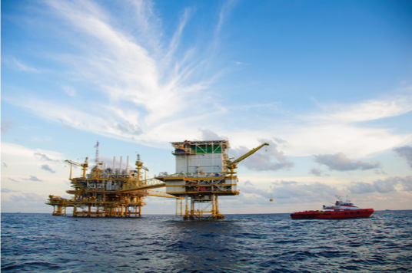
Oil is made from millions of years old plants and animals. Again, it is a fossil fuel because it is made up of the remains of plants and animals from millions of years ago.
Notes:
Oil is made from millions of years old plants and animals. Again, it is a fossil fuel because it is made up of the remains of plants and animals from millions of years ago.

Slide 37
Notes:
Next, let’s talk about some non-examples of fossil fuels.

Slide 38
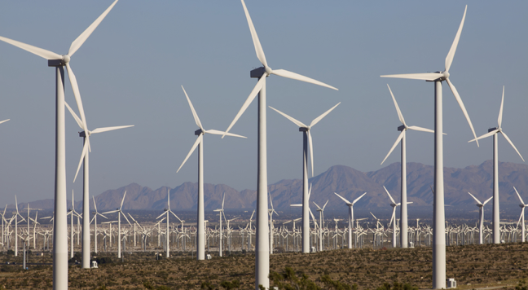
Renewable energy can be replaced in a short amount of time. Wind is renewable energy. You can replace it in a short amount of time. Renewable energy is the opposite of fuels.
Notes:
Renewable energy can be replaced in a short amount of time. Wind is renewable energy. You can replace it in a short amount of time. Renewable energy is the opposite of fuels.

Slide 39
The Sun produces renewable energy. This energy does not come from fossil fuels.
Notes:
The sun produces renewable energy. This energy does not come from fossil fuels.

Slide 40
Water is another source of renewable energy. This energy does not come from fossil fuels.
Notes:
Water is another source of renewable energy. This energy does not come from fossil fuels.

Slide 41
Notes:
Let’s check-in for understanding.

Slide 42
Provide one example of fossil fuel energy.
Notes:
Provide one example of fossil fuel energy.
[Coal, oil, natural gas]

Slide 43
Is water an example of fossil fuel energy? Explain your response.
Notes:
Is water an example of fossil fuel energy? Explain your response.
[Water is another source of renewable energy. This energy does not come from fossil fuels.]

Slide 44
What are fossil fuels?
Notes:
What are fossil fuels?
[Fossil fuels are energy that comes from the remains of plants or animals.]

Slide 45
Which two elements are fossil fuels high in?
Hydrogen and nitrogen
Hydrogen and carbon
Hydrogen and oxygen
Notes:
Which two elements are fossil fuels high in?

Slide 46
Which two elements are fossil fuels high in?
Hydrogen and nitrogen
Hydrogen and carbon
Hydrogen and oxygen
Notes:
Which two elements are fossil fuels high in?
[Hydrogen and carbon]

Slide 47
Which energy source cannot be replaced in a short amount of time?
Water
Wind
Sun
Fossil fuels
Notes:
Which energy source cannot be replaced in a short amount of time?

Slide 48
Which energy source cannot be replaced in a short amount of time?
Water
Wind
Sun
Fossil fuels
Notes:
Which energy source cannot be replaced in a short amount of time?
[Fossil Fuels]

Slide 49
True/False: Fossil fuels are a source of renewable energy.
Notes:
True/False: Fossil fuels are a source of renewable energy.

Slide 50
True/False: Fossil fuels are a source of renewable energy.
Notes:
True/False: Fossil fuels are a source of renewable energy.
[False.]

Slide 51
Remember!!!
Notes:
So remember!

Slide 52
Fossil Fuels: energy that comes from the remains of plants and animals
Notes:
Fossil fuels are energy that comes from the remains of plants or animals.

Slide 53
Notes:
We will now complete this concept map, called a Frayer model, to summarize and further clarify what you have learned about the term fossil fuels.

Slide 54
Definition
Picture
Fossil Fuels
Example
How do fossil fuels impact my life?
Notes:
To complete the Frayer model, we will choose from four choices the correct picture, definition, example, and response to the question, “How do fossil fuels impact my life?” Select the best response for each question using the information you just learned. As we select responses, we will see how this model looks filled in for the term fossil fuels.

Slide 55
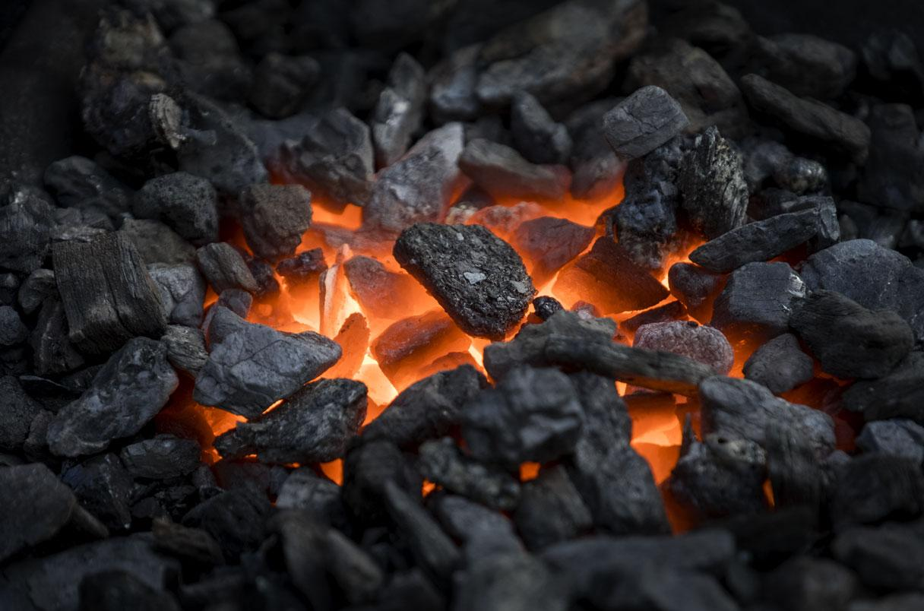
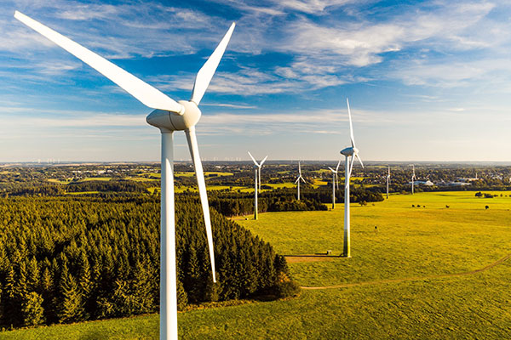
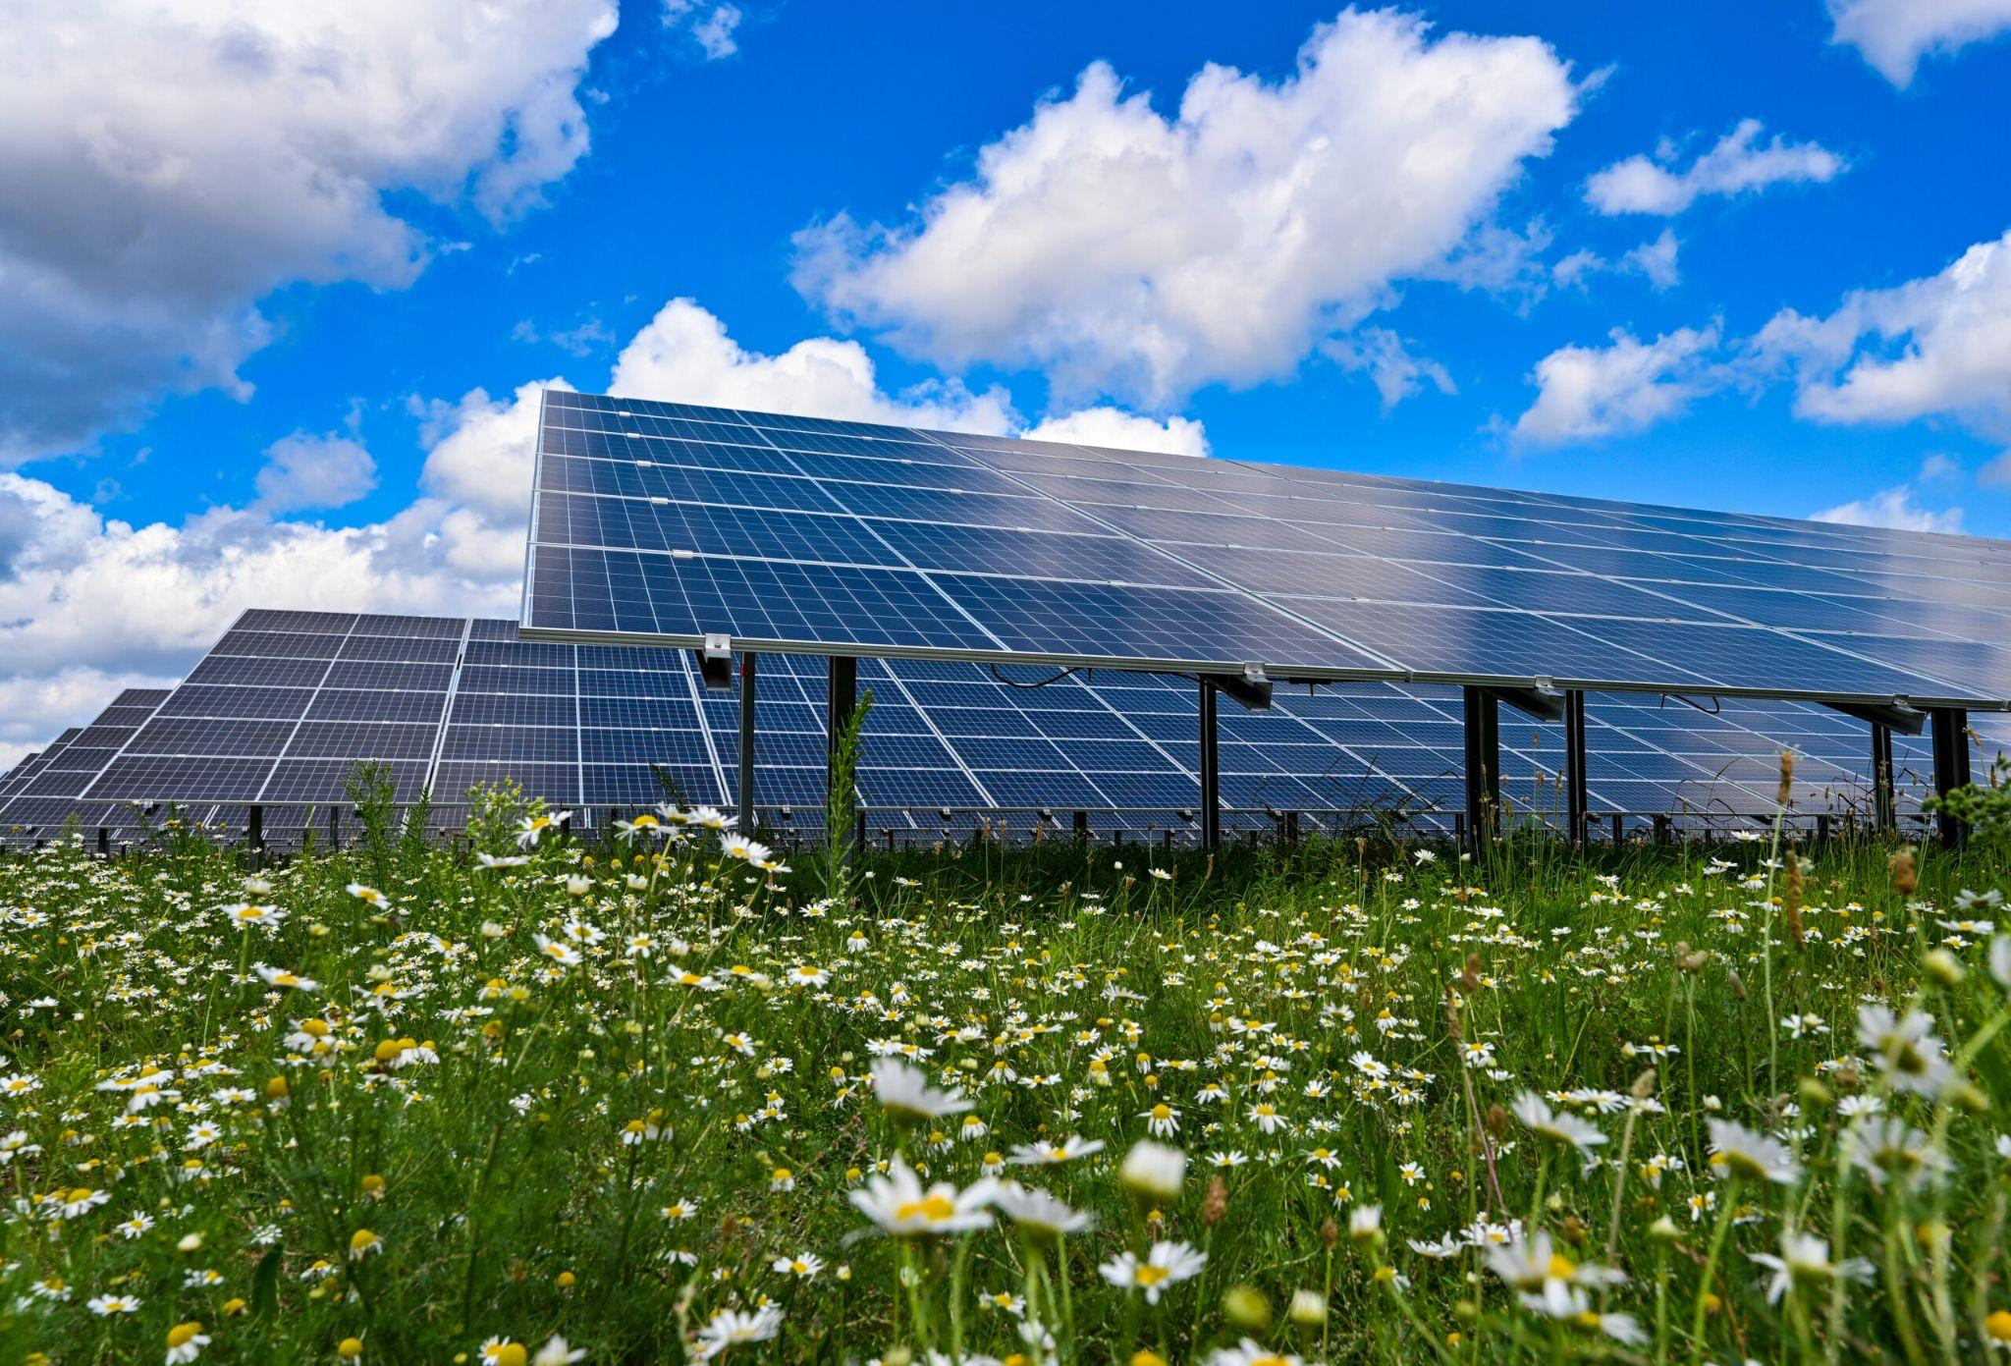
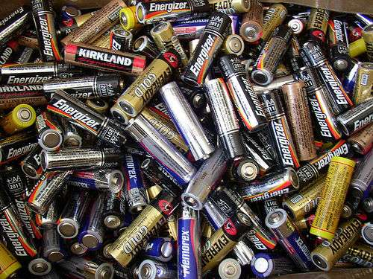
Directions: Choose the correct picture of fossil fuels from the choices below.
A
B
C
D
Notes:
Choose the one correct picture of fossil fuels from these four choices.

Slide 56
Directions: Choose the correct picture of fossil fuels from the choices below.
A
B
C
D
Notes:
This is the picture that shows fossil fuels.

Slide 57
Definition
Picture
Fossil Fuels
Example
How do fossil fuels impact my life?
Notes:
Here is the Frayer model filled in with a picture of fossil fuels.

Slide 58
Directions: Choose the correct definition of
fossil fuels from the choices below.
A
Energy that is carried by vibration of one or more objects or particles to our ears
B
Energy that comes from the remains of plants and animals
C
A resource that can be reused and replaced naturally
D
A substance containing only one type of atom
Notes:
Choose the one correct definition of fossil fuels from these four choices.

Slide 59
Directions: Choose the correct definition of
fossil fuels from the choices below.
A
Energy that is carried by vibration of one or more objects or particles to our ears
B
Energy that comes from the remains of plants and animals
C
A resource that can be reused and replaced naturally
D
A substance containing only one type of atom
Notes:
“Energy that comes from the remains of plants and animals” is correct! This is the definition of fossil fuels.

Slide 60
Definition
Picture
Energy that comes from the remains of plants and animals
Fossil Fuels
Example
How do fossil fuels impact my life?
Notes:
Here is the Frayer Model with a picture and the definition filled in for fossil fuels: Energy that comes from the remains of plants and animals

Slide 61
Directions: Choose the correct example of
fossil fuels from the choices below.
A
Windmill
B
A dam
C
Solar panel
D
Crude oil
Notes:
Choose the one correct example of fossil fuels from these four choices.

Slide 62
Directions: Choose the correct example of
fossil fuels from the choices below.
A
Windmill
B
A dam
C
Solar panel
D
Crude oil
Notes:
“Crude oil” is correct! This is an example of fossil fuels.

Slide 63
Definition
Picture
Energy that comes from the remains of plants and animals
Fossil Fuels
Crude oil
Example
How do fossil fuels impact my life?
Notes:
Here is the Frayer Model with a picture, definition, and an example of fossil fuels: Crude oil.

Slide 64
Directions: Choose the correct response for “how do fossil fuels impact my life?” from the choices below.
Fossil fuels, like oil, coal, and natural gas, give us energy for things like electricity, cars, and heating, but burning them also worsens the environment through air pollution and climate change.
A
B
Fossil fuels provide us energy sources that will never run out so that we can ensure our survival on the planet for forever.
C
Fossil fuels tell us about plants and animals that used to live on Earth so that we can better understand the different organisms on Earth today.
D
Fossil fuels explain the different parts of our solar system and how our planet was formed so that we can understand our environment.
Notes:
Choose the one correct response for “how do fossil fuels impact my life?” from these four choices.

Slide 65
Directions: Choose the correct response for “how do fossil fuels impact my life?” from the choices below.
Fossil fuels, like oil, coal, and natural gas, give us energy for things like electricity, cars, and heating, but burning them also worsens the environment through air pollution and climate change.
A
B
Fossil fuels provide us energy sources that will never run out so that we can ensure our survival on the planet for forever.
C
Fossil fuels tell us about plants and animals that used to live on Earth so that we can better understand the different organisms on Earth today.
D
Fossil fuels explain the different parts of our solar system and how our planet was formed so that we can understand our environment.
Notes:
“Fossil fuels, like oil, coal, and natural gas, give us energy for things like electricity, cars, and heating, but burning them also worsens the environment through air pollution and climate change.” That is correct! This is an example of how fossil fuels impact your life.

Slide 66
Definition
Picture
Energy that comes from the remains of plants and animals
Fossil Fuels
Fossil fuels, like oil, coal, and natural gas, give us energy for things like electricity, cars, and heating, but burning them also worsens the environment through air pollution and climate change.
Crude oil
Example
How do fossil fuels impact my life?
Notes:
Here is the Frayer Model with a picture, definition, example, and a correct response to “how do fossil fuels impact my life?”: Fossil fuels, like oil, coal, and natural gas, give us energy for things like electricity, cars, and heating, but burning them also worsens the environment through air pollution and climate change.

Slide 67
Remember!!!
Notes:
So remember!

Slide 68
Fossil Fuels: energy that comes from the remains of plants and animals
Notes:
Fossil fuels are energy that comes from the remains of plants or animals.

Slide 69
Big Question: How do we use Earth’s resources to create energy?
Notes:
Explicit cue to revisit the big question at the end of the lesson: Okay everyone. Now that we’ve learned the term, let’s reflect once more on our big question. Was there anything that we predicted earlier that was correct or incorrect? Do you have any new hypotheses to share?

Slide 70
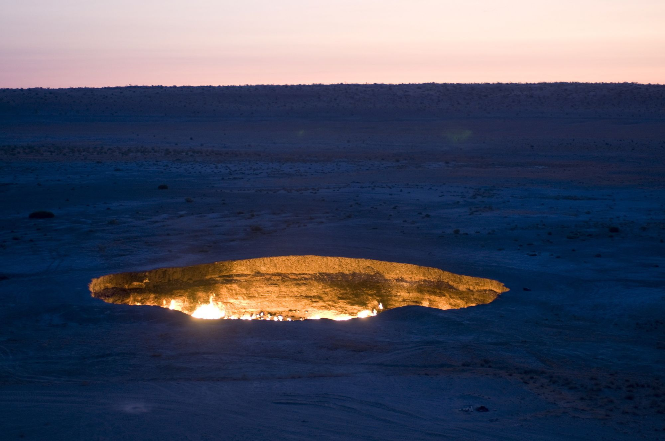
Simulation Activity
Putting the "Fossil" in Fossil Fuels
Students begin their exploration of fossil fuels by looking at video and photographs of the Darvaza gas crater in Turkmenistan and pondering what makes it burn. This is followed by an analysis of the Keeling Curve, a graph of global carbon dioxide levels in the atmosphere over time. Finally, in a class discussion prompted by a thought-provoking photograph, students complete a Know & Need to Know chart on fossil fuels.
Notes:
Students begin their exploration of fossil fuels by looking at video and photographs of the Darvaza gas crater in Turkmenistan and pondering what makes it burn. This is followed by an analysis of the Keeling Curve, a graph of global carbon dioxide levels in the atmosphere over time. Finally, in a class discussion prompted by a thought-provoking photograph, students complete a Know & Need to Know chart on fossil fuels.
Feedback: Have students analyze and interpret data to elevate their understanding of the content and strengthen their critical thinking skills.

Slide 71
Notes:
Thanks for watching, and please continue watching CAPs available from this website.

Slide 72
This Video Was Created With Resources From:
Questions or Comments
Michael Kennedy, Ph.D. MKennedy@Virginia.edu
Rachel L Kunemund, Ph.D. rk8vm@virginia.edu

