Slide 1
Intro
“Big Idea” Question
Review Concepts
Check-In Questions
Teacher Engagement
Vocabulary
Student-Friendly Definition
Examples & Non-Examples
Morphological Word Parts
Frayer Model
Simulation/Activity
Notes:
OK everyone, get ready for our next lesson. Just as a reminder, these are the different components that our lesson may include, and you’ll see these icons in the top left corner of each slide so that you can follow along more easily!

Slide 2
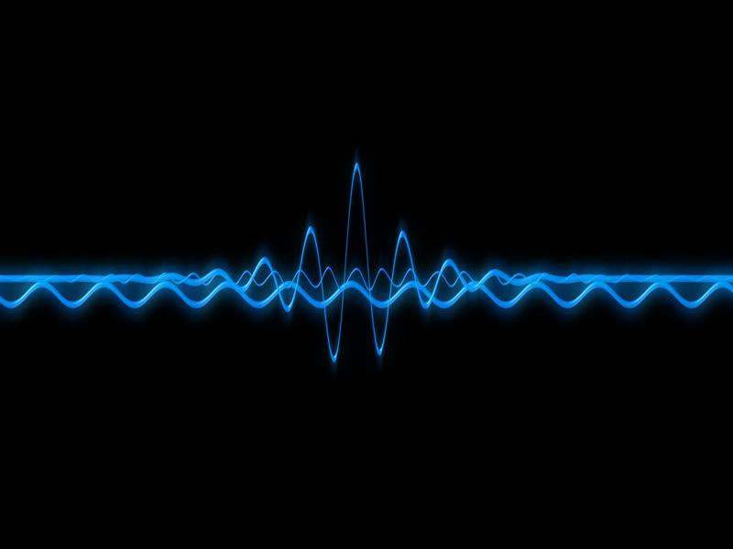
Frequency
Intro
Notes:
Today, we’ll be learning about the word: Frequency.
Feedback: Using clear and simple language when introducing content helps students understand what is expected.

Slide 3
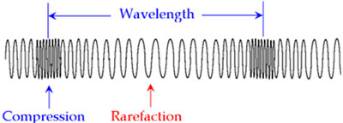
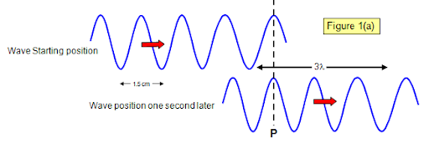
Big Question: What are the properties of waves and how are they related?
Notes:
Our “big question” is: What are the properties of waves and how are they related?
[Pause and illicit predictions from students.]
I love all these thoughtful scientific hypotheses! Be sure to keep this question and your predictions in mind as we move through these next few lessons, and we’ll continue to revisit it.

Slide 4
Notes:
Before we move on to our new topic, let’s review some other words & concepts that you already learned and make sure you are firm in your understanding.

Slide 5
Wavelength: the distance between two like points on a wave
Notes:
Wavelength is the distance between two like points on a wave.

Slide 6
Sound Waves: longitudinal waves that travel through mediums
Notes:
Sound waves are longitudinal waves that travel through mediums.

Slide 7
Compression: where particles are closely packed
Notes:
A sound wave is made of 2 main parts. Compressions where particles are closely packed,

Slide 8
Rarefaction: where particles are loosely packed
Notes:
And rarefaction where particles are loosely packed.

Slide 9
Notes:
Now let’s pause for a moment to review the information we have covered already.

Slide 10
A wavelength is the distance between two ______ points on a wave.
Like
Different
Notes:
A wavelength is the distance between two [like] points on a wave.

Slide 11
A wavelength is the distance between two ______ points on a wave.
Like
Different
Notes:
A wavelength is the distance between two ______ points on a wave.
[Like]

Slide 12
What are sound waves?
Notes:
What are sound waves?
[Sound waves are longitudinal waves that travel through mediums.]

Slide 13
What is the difference between compression and rarefaction?
Notes:
What is the difference between compression and rarefaction?
[A sound wave is made of 2 main parts. Compressions are where particles are closely packed and rarefactions are where particles are loosely packed.]

Slide 14
Frequency
Notes:
Now that we’ve reviewed, let’s define the phrase frequency.

Slide 15
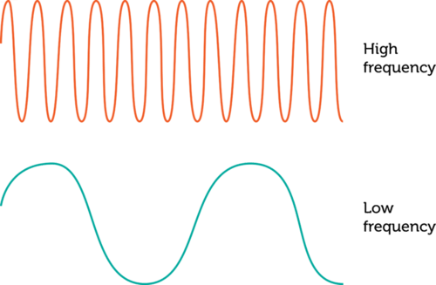
Frequency: the number of waves passing a set point in a specific amount of time
Notes:
Frequency is the number of waves passing a set point in a specific amount of time.

Slide 16
Notes:
Let’s check-in for understanding.

Slide 17
What is frequency?
Notes:
What is frequency?
[Frequency is the number of waves passing a set point in a specific amount of time.]

Slide 18
Notes:
That is the basic definition, but there is a bit more you need to know.

Slide 19
Frequency is like the of waves that pass by in a certain amount of time. Imagine you're at the beach, and you're watching the waves in the ocean. If you count how many waves go by in one minute, that's like measuring the frequency of the waves. If you see a lot of waves passing by quickly, it has a high frequency. If the waves are slower and fewer pass by in a minute, it has a lower frequency.
Notes:
Frequency is like the of waves that pass by in a certain amount of time. Imagine you're at the beach, and you're watching the waves in the ocean. If you count how many waves go by in one minute, that's like measuring the frequency of the waves. If you see a lot of waves passing by quickly, it has a high frequency. If the waves are slower and fewer pass by in a minute, it has a lower frequency.

Slide 20
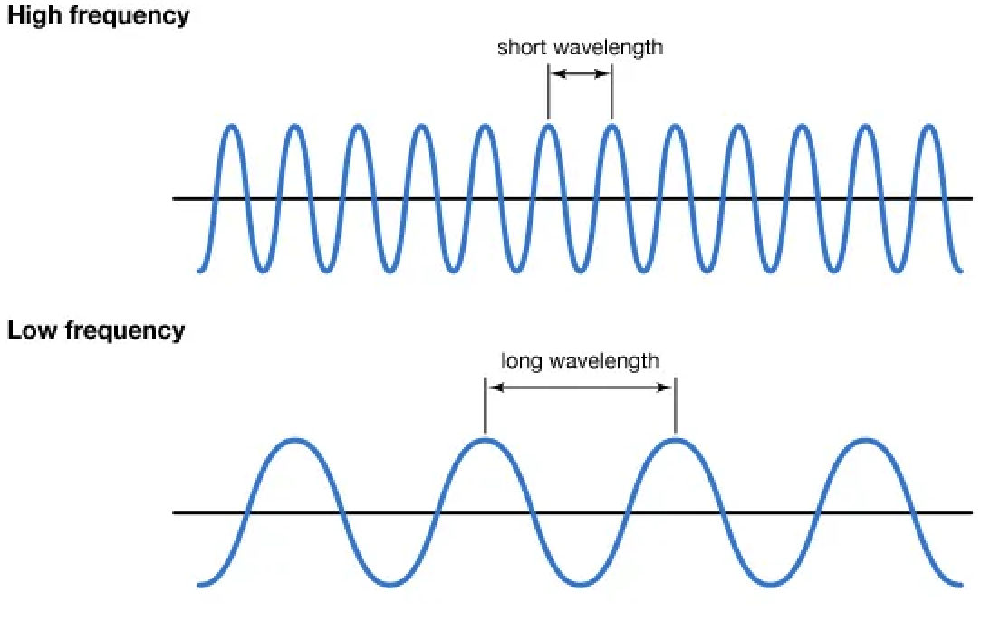
Frequency shows how much energy there is. The greater or higher the frequency, the greater the amount of energy. The lower the frequency, the lower the amount of energy. High frequency waves have shorter wavelengths, and low frequency waves have long wavelengths.
Notes:
Frequency shows how much energy there is. The greater or higher the frequency, the greater the amount of energy. The lower the frequency, the lower the amount of energy. High frequency waves have shorter wavelengths, and low frequency waves have long wavelengths.

Slide 21
Notes:
Let’s check-in for understanding.

Slide 22
True or False: Frequency shows how much energy there is. High frequency waves have more energy, low frequency have less energy.
True
False
Notes:
True or False: Frequency shows how much energy there is. High frequency waves have more energy, low frequency waves have less energy.
True
False

Slide 23
True or False: Frequency shows how much energy there is. High frequency waves have more energy, low frequency have less energy.
True
False
Notes:
True or False: Frequency shows how much energy there is. High frequency waves have more energy, low frequency waves have less energy.
[True]

Slide 24
Notes:
Now, let’s talk about some examples of frequency.

Slide 25
Examples of frequency can be seen in light waves. Different colors have waves with different frequencies. As we can see on this picture, blue light has a higher frequency than red light.
Notes:
Examples of frequency can be seen in light waves. Different colors have waves with different frequencies. As we can see on this picture, blue light has a higher frequency than red light.

Slide 26
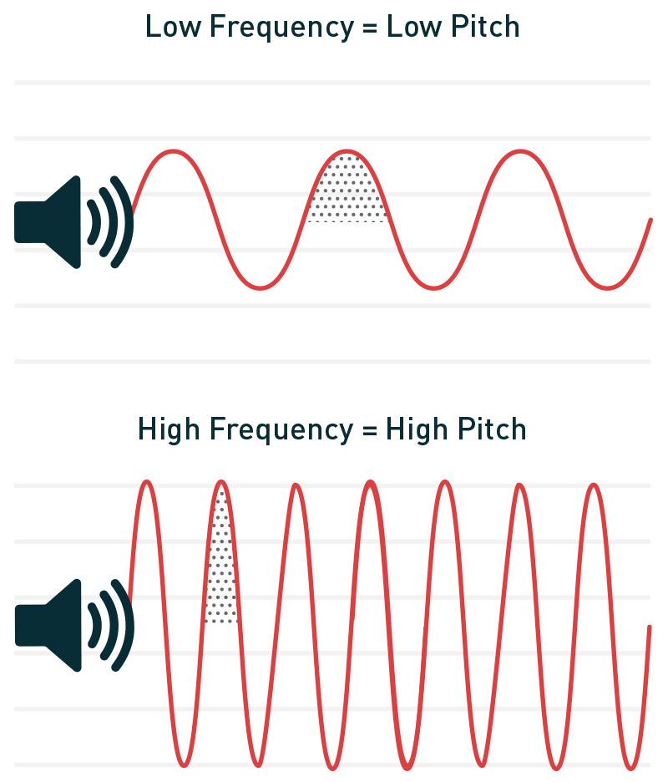
Another example of frequency are sound waves. Lower frequency waves have lower pitches and higher frequency waves have higher pitches. Someone with a deep voice has a voice with low frequency. Someone with a squeaky voice has a voice with a high frequency.
Notes:
Another example of frequency are sound waves. Lower frequency waves have lower pitches and higher frequency waves have higher pitches. Someone with a deep voice has a voice with low frequency. Someone with a squeaky voice has a voice with a high frequency.

Slide 27
Notes:
Let’s check-in for understanding.

Slide 28
What is frequency?
Notes:
What is frequency?
[Frequency is the number of waves passing a set point in a specific amount of time.]

Slide 29
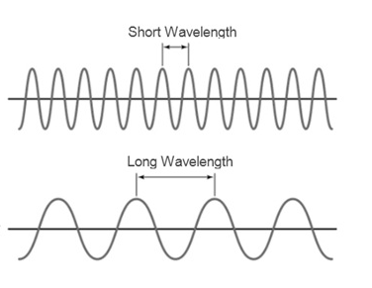
Which wave has a lower frequency?
Notes:
Which wave has a lower frequency?
[We know that the first wave has a lower frequency because the wavelength is shorter than the first wave
Shorter wavelength = larger frequency
Longer wavelength = smaller frequency]

Slide 30
Notes:
Now, let’s talk about some non-examples of frequency.

Slide 31
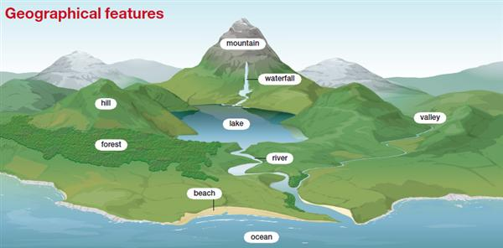
Geographic features, such as mountains and waterfalls, do not have frequency, They are features on the Earth’s surface.
Notes:
Geographic features, such as mountains and waterfalls, do not have frequency. They are features on the Earth’s surface.

Slide 32
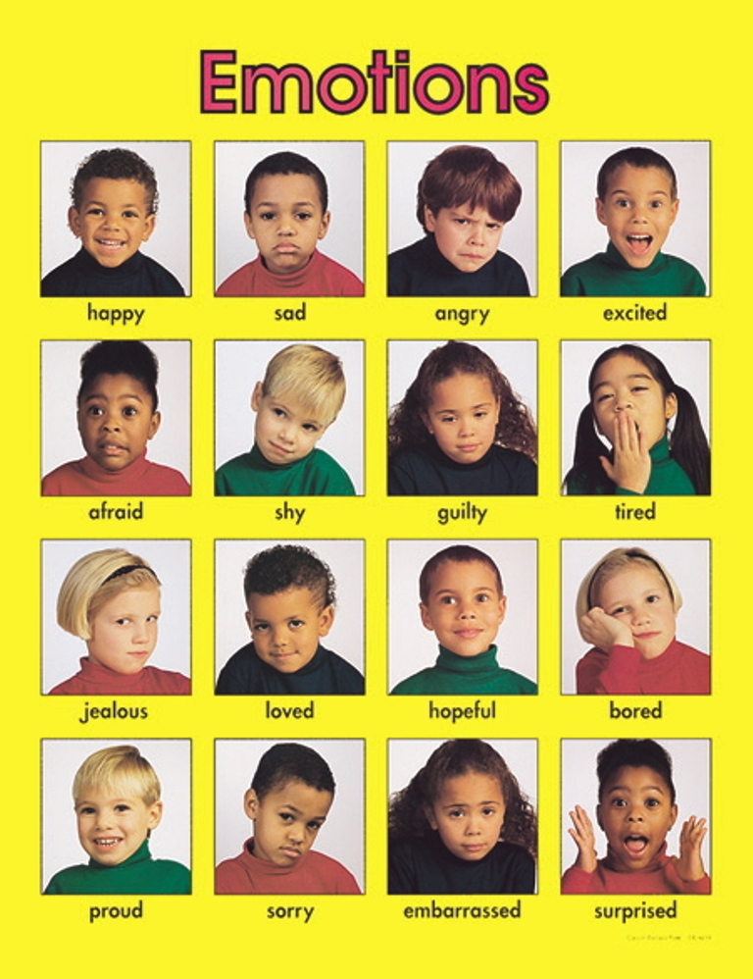
Emotions like happiness, sadness, or anger are not events that have a frequency. Emotions do not have frequency because they are thoughts and feelings humans and animals have in their minds.
Notes:
Emotions like happiness, sadness, or anger are not events that have a frequency. Emotions do not have frequency because they are thoughts and feelings humans and animals have in their minds.

Slide 33
Notes:
Now let’s pause for a moment to check your understanding.

Slide 34
Why do sound waves have frequency but emotions do not?
Notes:
Why do sound waves have frequency but emotions do not?
[Sound waves have frequency because frequency is the number of waves passing a set point in a specific amount of time. Emotions do not have frequency because they are thoughts and feelings humans and animals have in their minds.]

Slide 35
Remember!!!
Notes:
So remember!

Slide 36
What is frequency?
Notes:
What is frequency?
[Frequency is the number of waves passing a set point in a specific amount of time.]

Slide 37
Notes:
We will now complete this concept map, called a Frayer model, to summarize and further clarify what you have learned about the term frequency.

Slide 38
Definition
Picture
Frequency
Example
How does frequency impact my life?
Notes:
To complete the Frayer model, we will choose from four choices the correct picture, definition, example, and response to the question, “How does frequency impact my life?” Select the best response for each question using the information you just learned. As we select responses, we will see how this model looks filled in for the term frequency.

Slide 39
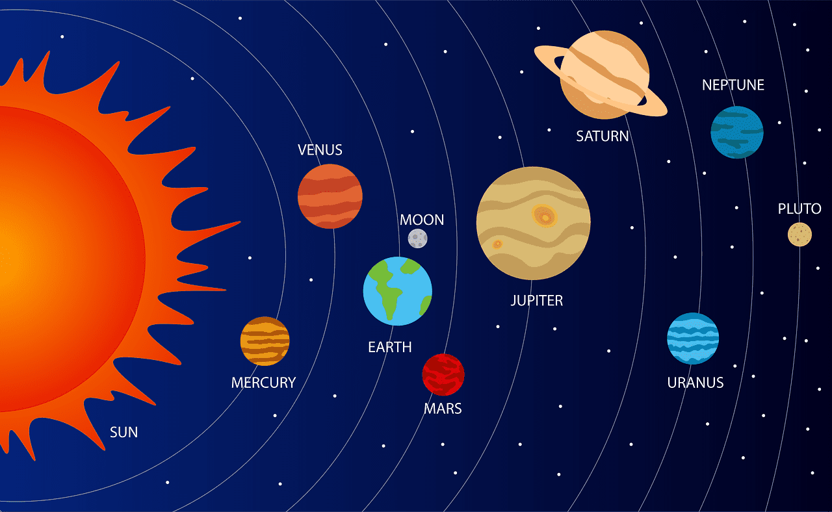
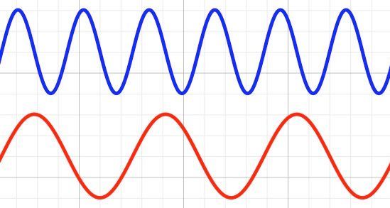
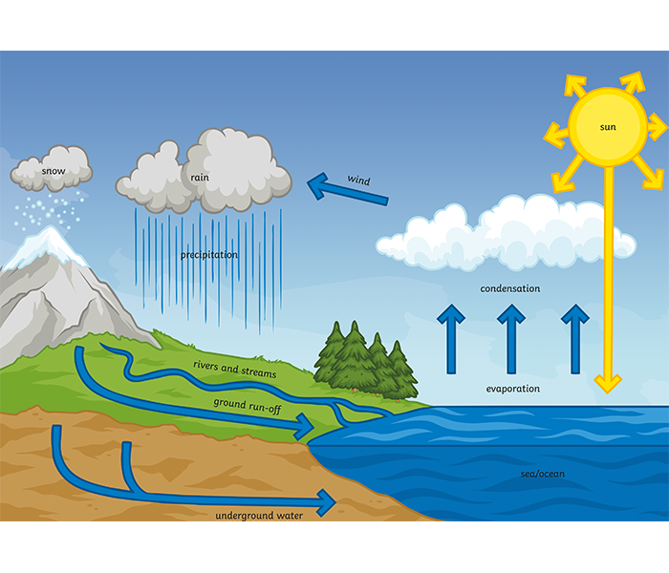
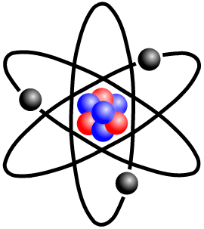
Directions: Choose the correct picture of frequency from the choices below.
A
B
C
D
Notes:
Choose the one correct picture of frequency from these four choices.

Slide 40
Directions: Choose the correct picture of frequency from the choices below.
A
B
C
D
Notes:
This is the picture that shows frequency.

Slide 41
Definition
Picture
Frequency
Example
How does frequency impact my life?
Notes:
Here is the Frayer model filled in with a picture of frequency.

Slide 42
Directions: Choose the correct definition of Frequency from the choices below.
A
The smallest unit of matter
B
When a wave “bounces” off of a surface
C
The number of waves passing a set point in a specific amount of time
D
The ability to cause change
Notes:
Choose the one correct definition of frequency from these four choices.

Slide 43
Directions: Choose the correct definition of Frequency from the choices below.
A
The smallest unit of matter
B
When a wave “bounces” off of a surface
C
The number of waves passing a set point in a specific amount of time
D
The ability to cause change
Notes:
“The amount of waves passing a set point in a specific amount of time” is correct! This is the definition of frequency.

Slide 44
Definition
Picture
The amount of waves passing a set point in a specific amount of time
Frequency
Example
How does frequency impact my life?
Notes:
Here is the Frayer Model with a picture and the definition filled in for frequency: The amount of waves passing a set point in a specific amount of time.

Slide 45
Directions: Choose the correct example of Frequency from the choices below.
A
An opera singer singing a high note
B
A plant growing in the ground
C
A cake baking in an oven
D
A cat taking a nap
Notes:
Choose the one correct example of frequency from these four choices.

Slide 46
Directions: Choose the correct example of Frequency from the choices below.
A
An opera singer singing a high note
B
A plant growing in the ground
C
A cake baking in an oven
D
A cat taking a nap
Notes:
“An opera singer singing a high note” is correct! This is an example of frequency.

Slide 47
Definition
Picture
The amount of waves passing a set point in a specific amount of time
Frequency
An opera singer singing a high note
Example
How does frequency impact my life?
Notes:
Here is the Frayer Model with a picture, definition, and an example of frequency: An opera singer singing a high note

Slide 48
Directions: Choose the correct response for “how does frequency impact my life?” from the choices below.
A
Frequency explains how animals and plants consume nutrients to survive.
B
Frequency determines things like the sound of music and the different colors of light depending on how high or low it is.
C
Frequency explains how farmers can grow many things at one time.
Frequency describes the types of energy we use in our homes, schools, and businesses.
D
Notes:
Choose the one correct response for “how does frequency impact my life?” from these four choices.

Slide 49
Directions: Choose the correct response for “how does frequency impact my life?” from the choices below.
A
Frequency explains how animals and plants consume nutrients to survive.
B
Frequency determines things like the sound of music and the different colors of light depending on how high or low it is.
C
Frequency explains how farmers can grow many things at one time.
Frequency describes the types of energy we use in our homes, schools, and businesses.
D
Notes:
“Frequency determines things like the sound of music the different colors of light depending on how high or low it is.” That is correct! This is an example of how frequency impacts your life.

Slide 50
Definition
Picture
The amount of waves passing a set point in a specific amount of time
Frequency
Frequency determines things like the sound of music the different colors of light depending on how high or low it is.
An opera singer singing a high note
Example
How does frequency impact my life?
Notes:
Here is the Frayer Model with a picture, definition, example, and a correct response to “how does frequency impact my life?”: Frequency determines things like the sound of music the different colors of light depending on how high or low it is.

Slide 51
Remember!!!
Notes:
So remember!

Slide 52
Frequency: the number of waves passing a set point in a specific amount of time
Notes:
Frequency is the number of waves passing a set point in a specific amount of time.

Slide 53
Big Question: What are the properties of waves and how are they related?
Notes:
Let’s reflect again on our big question. Our “big question” is: What are the properties of waves and how are they related?
Does anyone have any additional examples to share that haven’t been discussed yet?
In our “big question,” there are two more vocabulary words we need to explore before we move onto our simulation activity.

Slide 54
Simulation Activity
Waves Gizmo
(Explore Learning)
Click on the waves to create waves.
As you are changing different properties of the wave, take note of the frequency of the different waves. Are you creating waves, determine the frequency of the waves. Are they high or low frequency? How do you know if they are high or low frequency?
Notes:
Feedback: Remember, it is important to include some computational or mathematics concepts in the science activity so that students can apply these concepts as part of the problem solving process.

Slide 55
Notes:
Thanks for watching, and please continue watching CAPs available from this website.

Slide 56
This Was Created With Resources From:
Questions or Comments
Michael Kennedy, Ph.D. MKennedy@Virginia.edu
Rachel L Kunemund, Ph.D. rk8vm@virginia.edu

