Slide 1
Intro
“Big Idea” Question
Review Concepts
Check-In Questions
Teacher Engagement
Vocabulary
Student-Friendly Definition
Examples & Non-Examples
Frayer Model
Simulation/Activity
Notes:
OK everyone, get ready for our next lesson. Just as a reminder, these are the different components that our lesson may include, and you’ll see these icons in the top left corner of each slide so that you can follow along more easily!

Slide 2
Kinetic Energy
Intro
Notes:
Today we will be learning about Kinetic Energy.

Slide 3
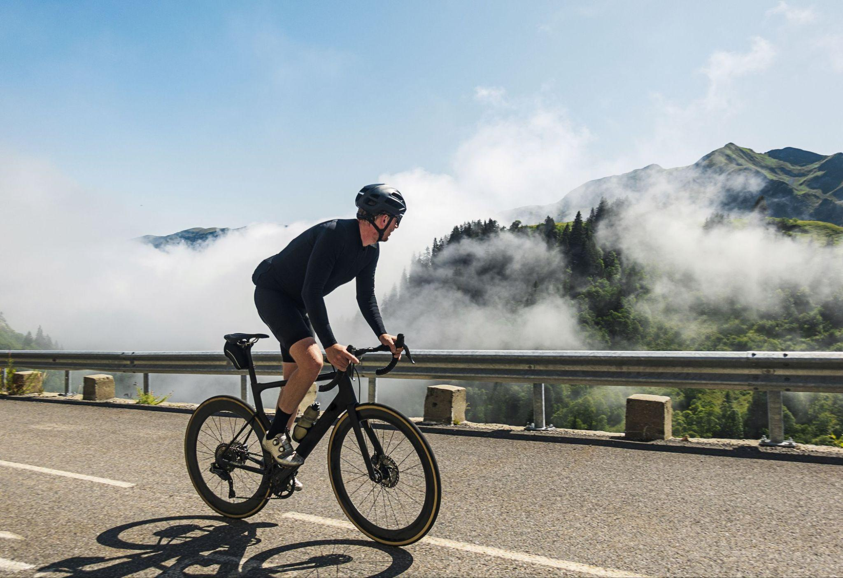
Big Question: How do forces, motion, and energy work together to affect the way objects move and interact with the world around us?
Notes:
Our “big question” is: How do forces, motion, and energy work together to affect the way objects move and interact with the world around us?
[Pause and illicit predictions from students.]
Be sure to keep this question and your predictions in mind as we move through this video and questions.

Slide 4
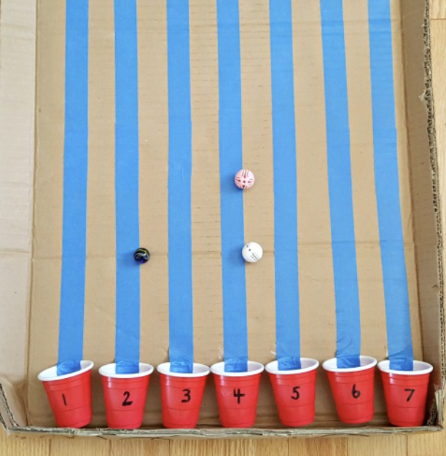
Demonstration
TEACHER DIRECTIONS:
Before viewing: Ask students to recall what they already know about energy.
During: Ask students to share observations, relating those observations back to what they know about energy. Tell students that the marble rolling down the inclined surface represents two different kinds of energy: potential and kinetic.
After: Tell students that today they will be learning more about the term kinetic energy.
Notes:
Let’s do a quick demonstration that will help get our brains ready to think about kinetic energy, and how it relates to our big question.
You can set up the materials – all you need is a marble an an inclined plane. Set up an inclined surface and roll the marble down the plan. *You can also change the size of the marble/the incline of the plane the marble rolls on to have students make observations about these changes (i.e. does the bigger marble go faster slower, etc.)
Feedback: This demonstration is a great way to introduce students to an investigation. In your classroom, you may encourage students to plan and conduct this investigation more independently since a large component of inquiry-based activities is encouraging student thinking and independence. As suggested by the slide, beginning with open-ended questions, followed by providing explicit explanations, and then asking probing questions is a great way to engage students in a discussion while also providing clear explanations.

Slide 5
Notes:
Before we move on to our new topic, let’s review some other words & concepts that you already learned and make sure you are firm in your understanding.

Slide 6
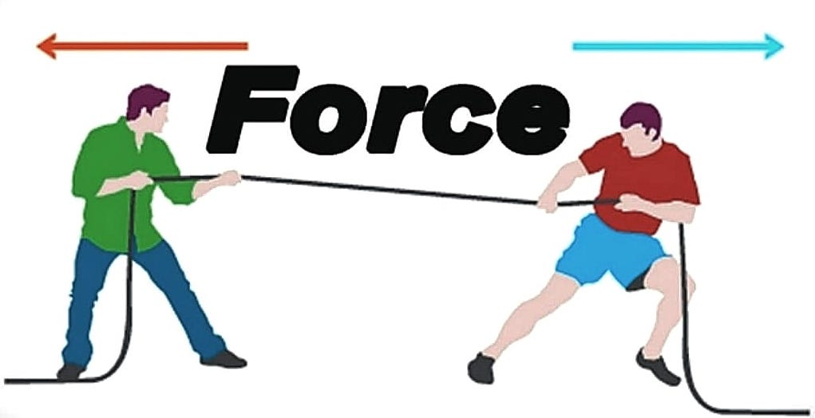
Force: a push or pull of an object
Notes:
Force is a push or pull of an object.

Slide 7
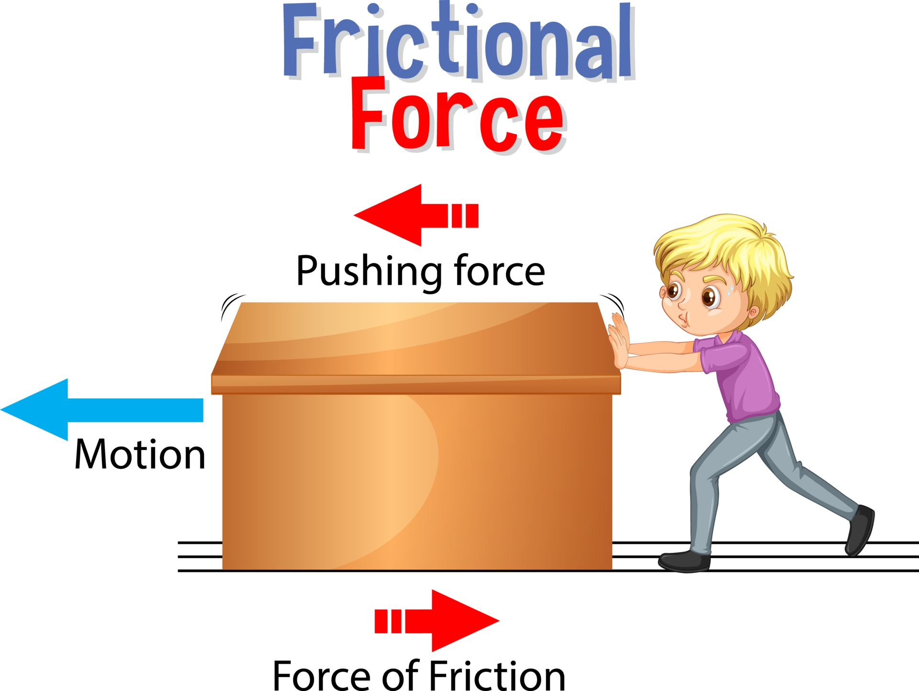
Friction: a force that resists the motion of two surfaces that are touching
Notes:
Friction is a force that resists the motion of two surface that are touching.

Slide 8
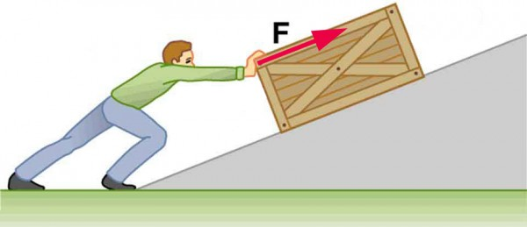
Work: a force acting upon an object causing the object to move in the direction of that force
Notes:
Work is a force acting upon an object causing the object to move in the direction of that force.

Slide 9
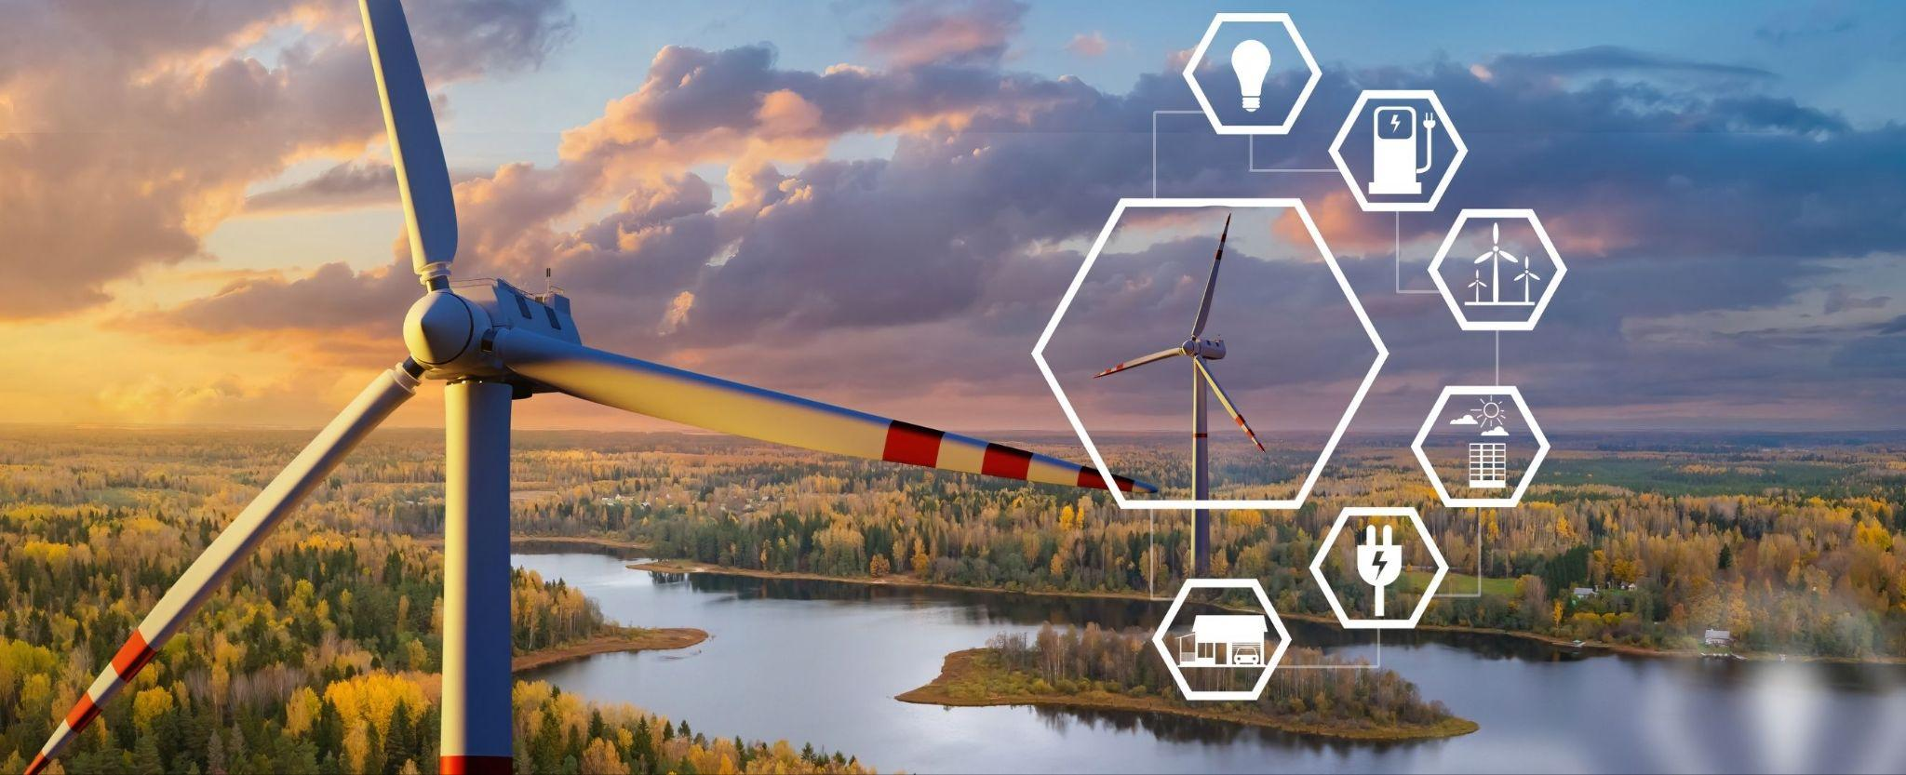
Energy: the ability to cause change
Notes:
Energy is the ability to cause change.

Slide 10
Notes:
Let’s check-in for understanding.

Slide 11
True or False: Force is a push or pull of an object
Notes:
True or False: Force is a push or pull of an object
[True]

Slide 12
True or False: Force is a push or pull of an object
Notes:
True: Force is a push or pull of an object

Slide 13
Friction: a force that the motion of two surfaces that are touching
Notes:
Friction is a force that the motion of two surface that are touching.

Slide 14
Friction: a force that resists the motion of two surfaces that are touching
Notes:
Friction is a force that resists the motion of two surface that are touching.

Slide 15
Work: a acting upon an object causing the object to move in the of that force
friction, box
force, direction
Notes:
Work is a acting upon an object causing the object to move in the of that force.
[force, direction]

Slide 16
Work: a acting upon an object causing the object to move in the of that force
friction, box
force, direction
Notes:
Work is a force acting upon an object causing the object to move in the direction of that force.

Slide 17
True or False: Energy is the ability to cause change
Notes:
True or False: Energy is the ability to cause change.
[True]

Slide 18
True or False: Energy is the ability to cause change
Notes:
True: Energy is the ability to cause change.

Slide 19
Kinetic Energy
Notes:
Now let’s define our new term, Kinetic Energy.

Slide 20
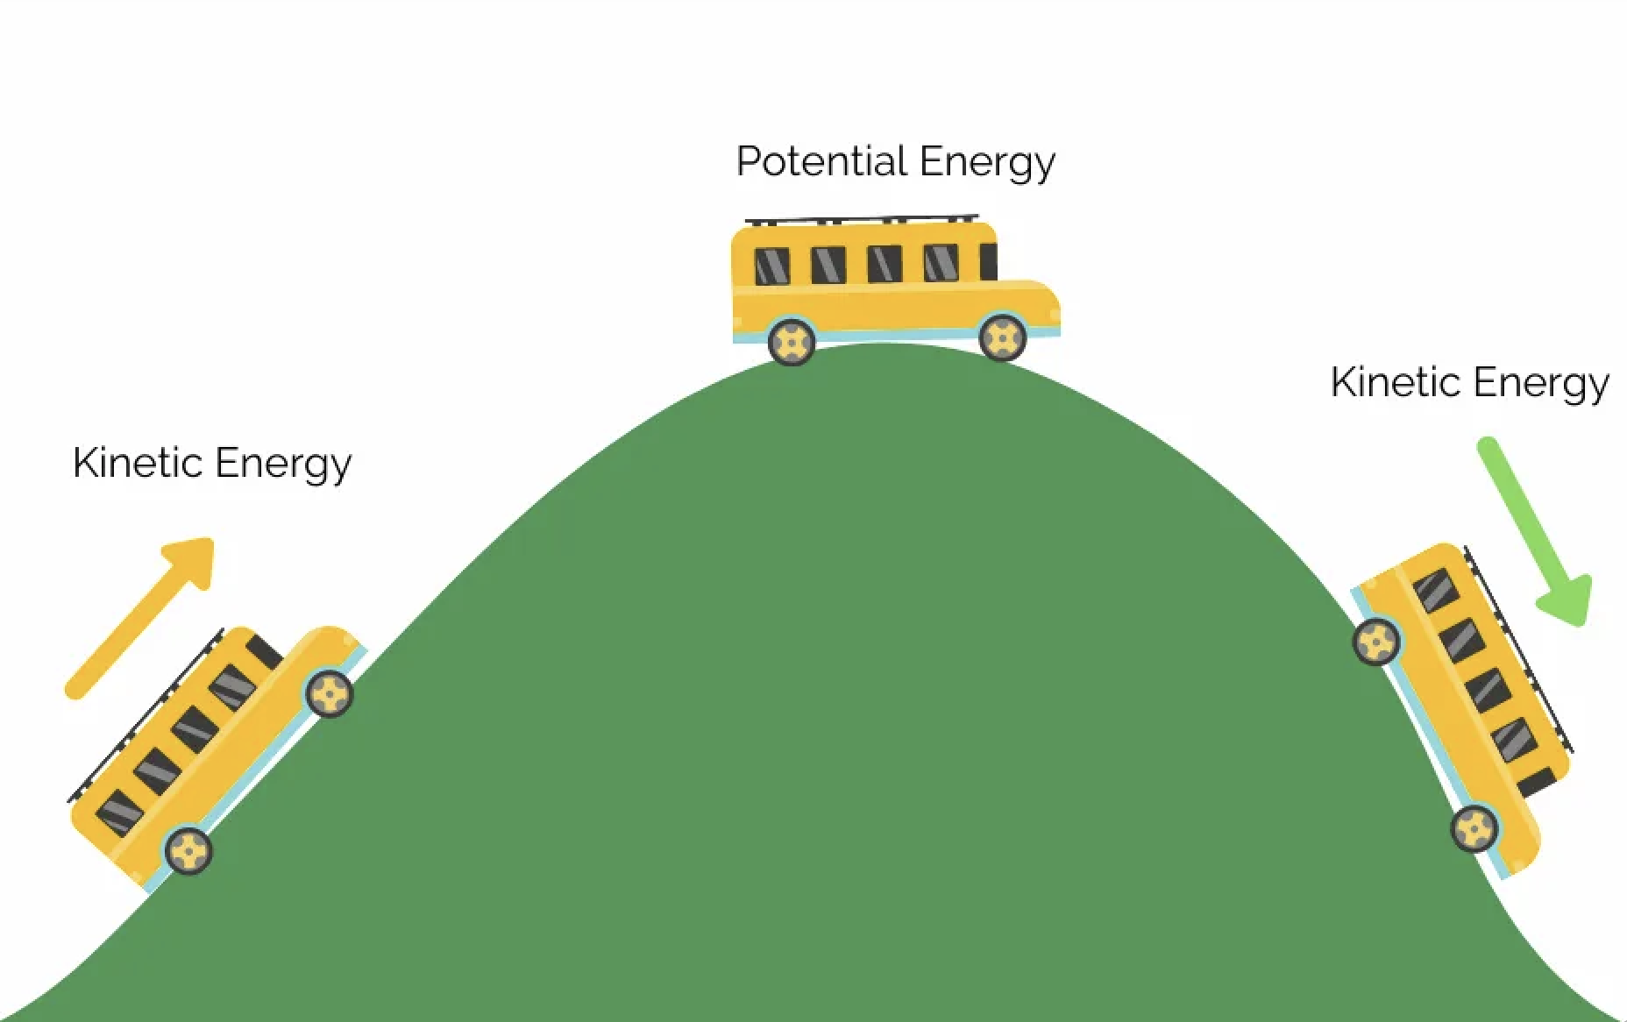
Kinetic Energy: energy of mass in motion
Notes:
Kinetic Energy is energy of mass in motion,.

Slide 21
Notes:
Let’s check-in for understanding.

Slide 22
What is kinetic energy?
Notes:
What is kinetic energy?
[Energy of mass in motion

Slide 23
Notes:
That is the basic definition, but there is a bit more you need to know.

Slide 24
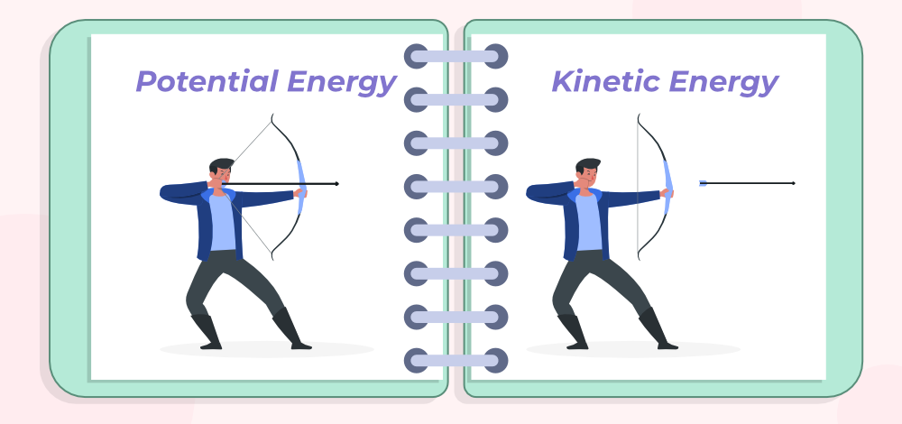
When you pull an arrow back in the bow, it has potential energy before you release it. When you release it and the arrow flies, the flying of the arrow is its kinetic energy.
Notes:
Kinetic Energy is the energy of an object in motion. It starts with something called potential energy. Potential energy is how much possible energy an object has before the energy is used or released. When you pull an arrow back in the bow, it has potential energy before you release it. When you release it and the arrow flies, the flying of the arrow is its kinetic energy.

Slide 25
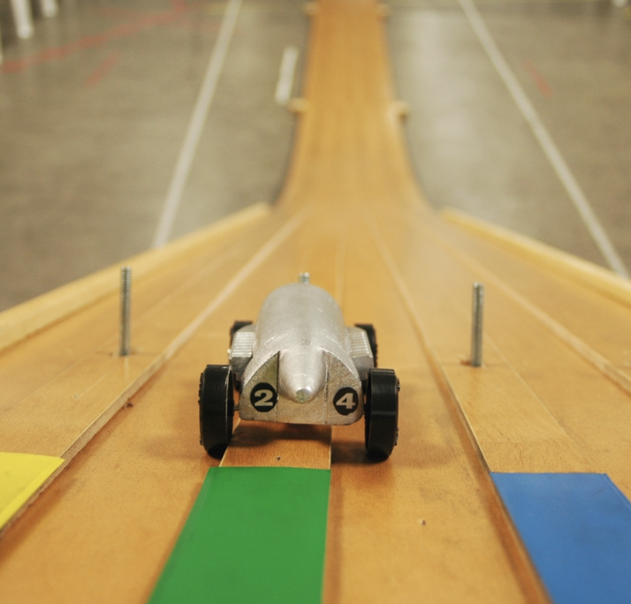
Speed matters! The faster an object is moving, the more kinetic energy it has. So, if our toy car is zooming down the ramp, it has more kinetic energy than if it's slowly rolling.
Notes:
The faster an object is moving, the more kinetic energy it has. So, if our toy car is zooming down the ramp, it has more kinetic energy than if it's slowly rolling.

Slide 26
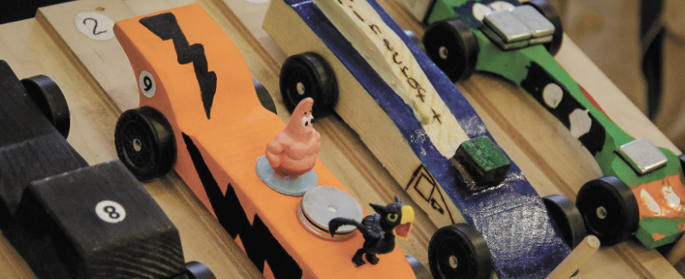
The amount of stuff (or mass) an object has also affects its kinetic energy. If you have two toy cars, and one is heavier than the other, the heavier one will have more kinetic energy when rolling at the same speed.
Notes:
The amount of stuff (or mass) an object has also affects its kinetic energy. If you have two toy cars, and one is heavier than the other, the heavier one will have more kinetic energy when rolling at the same speed.

Slide 27
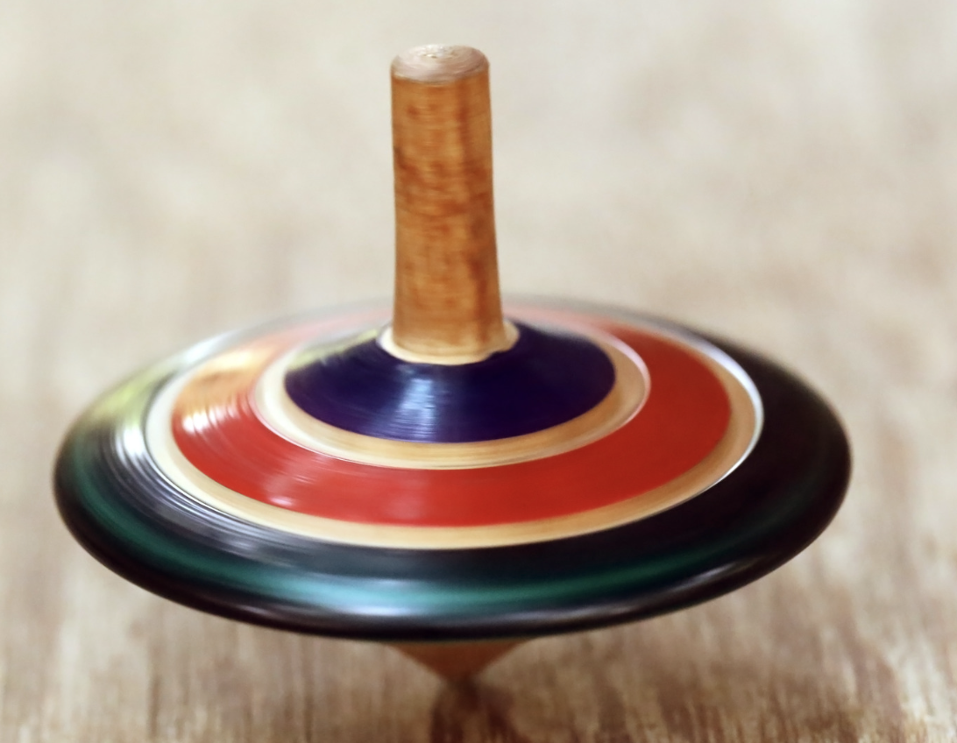
Objects can move in all sorts of ways. They can spin, slide, roll, or bounce. Each type of motion contributes to the object's kinetic energy. So, whether it's a spinning top or a rolling ball, there's kinetic energy involved.
Notes:
Objects can move in all sorts of ways. They can spin, slide, roll, or bounce. Each type of motion contributes to the object's kinetic energy. So, whether it's a spinning top or a rolling ball, there's kinetic energy involved.

Slide 28
Notes:
Let’s check-in for understanding.

Slide 29
True or False: The faster an object is moving makes no difference on the amount of kinetic energy it has.
Notes:
True or False: The faster an object is moving makes no difference on the amount of kinetic energy it has.
[False]

Slide 30
True or False: The faster an object is moving makes no difference on the amount of kinetic energy it has.
Notes:
False: The faster an object is moving, the more kinetic energy it has. So, if our toy car is zooming down the ramp, it has more kinetic energy than if it's slowly rolling.

Slide 31
The amount of stuff (or mass) an object has also affects its kinetic energy. If you have two toy cars, and one is heavier than the other, the heavier one will have kinetic energy when rolling at the same speed.
Notes:
The amount of stuff (or mass) an object has also affects its kinetic energy. If you have two toy cars, and one is heavier than the other, the heavier one will have kinetic energy when rolling at the same speed.

Slide 32
The amount of stuff (or mass) an object has also affects its kinetic energy. If you have two toy cars, and one is heavier than the other, the heavier one will have more kinetic energy when rolling at the same speed.
Notes:
The amount of stuff (or mass) an object has also affects its kinetic energy. If you have two toy cars, and one is heavier than the other, the heavier one will have more kinetic energy when rolling at the same speed.

Slide 33
Notes:
Now, let’s talk about some examples of kinetic energy.

Slide 34
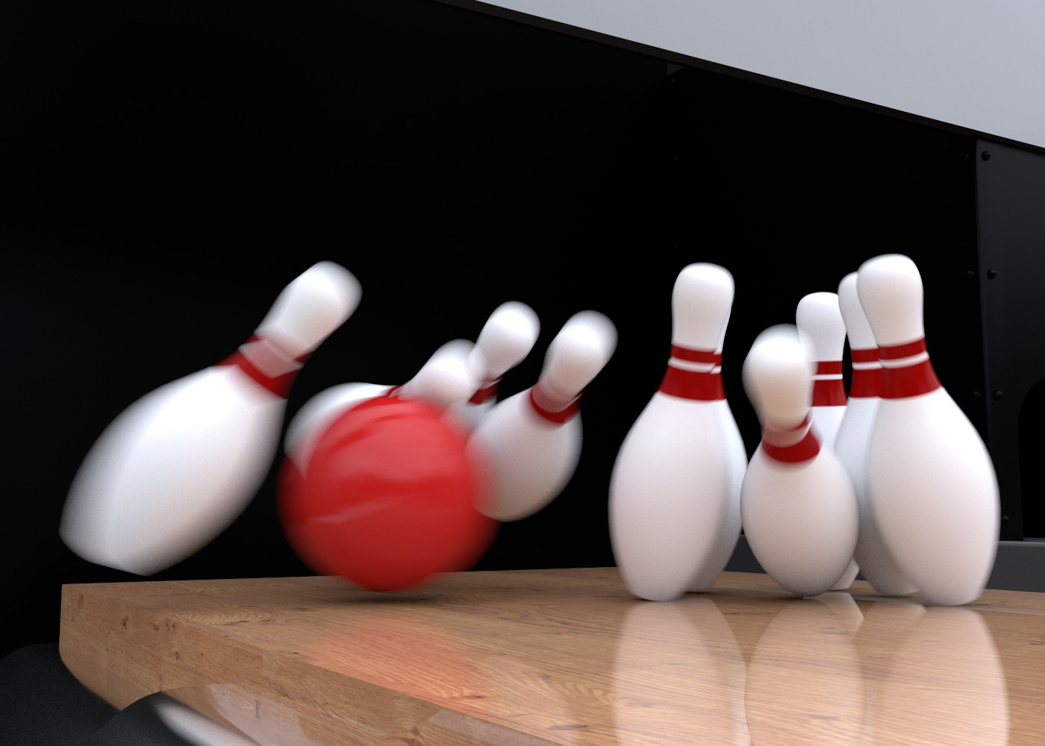
An example of kinetic energy is bowling. The movement of the bowling ball and any pins knocked over is kinetic energy.
Notes:
An example of kinetic energy is bowling. When you release the bowling ball down the alley lane, it moves towards the pins. If you’re lucky, a few of them will get knocked down! The movement of the bowling ball and any pins knocked over is kinetic energy.

Slide 35
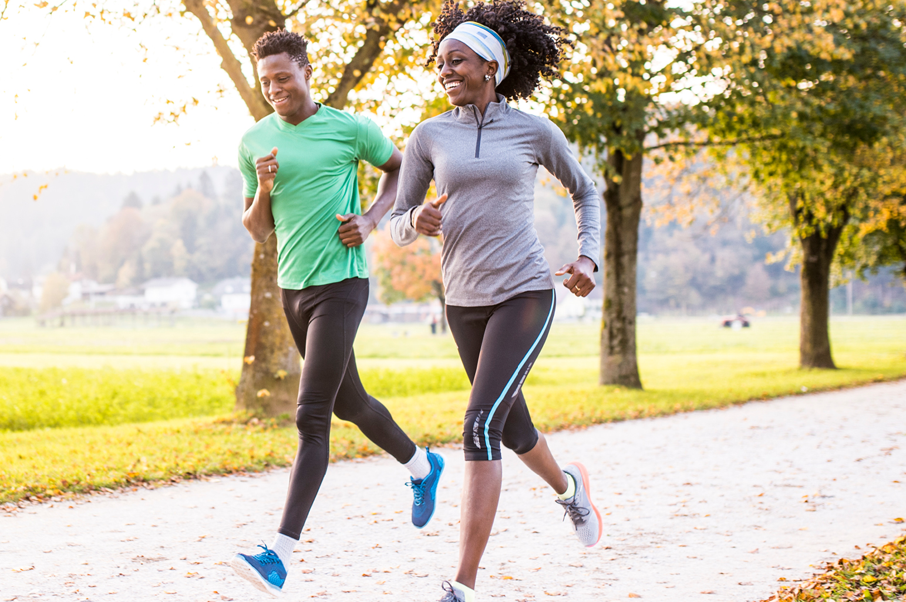
Another example of kinetic energy is running. As you move your legs forward and up and down quickly, you create the running motion. Your running movement is kinetic energy.
Notes:
Another example of kinetic energy is running. As you move your legs forward and up and down quickly, you create the running motion. Your running movement is kinetic energy.

Slide 36
Notes:
Now, let’s talk about some non-examples of Igneous Rocks.

Slide 37
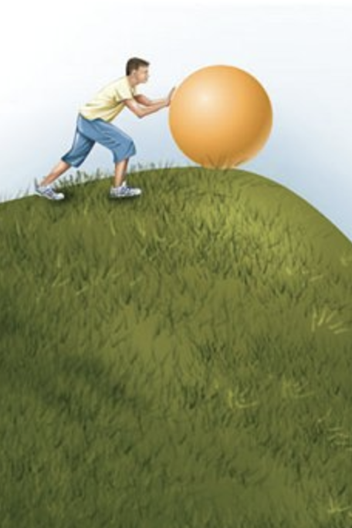
Potential energy is NOT an example of kinetic energy. Potential energy is the stored energy an object has based on its position or state, not its motion. For instance, a ball at the top of a hill has potential energy due to gravity, but it becomes kinetic energy as it rolls down.
Notes:
People might sometimes confuse potential energy with kinetic energy. Potential energy is the stored energy an object has based on its position or state, not its motion. For instance, a ball at the top of a hill has potential energy due to gravity, but it becomes kinetic energy as it rolls down.

Slide 38
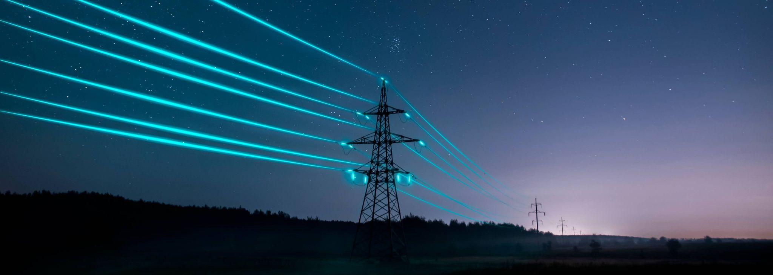
Electricity is NOT an example of kinetic energy. While the movement of electrons is an electric current and involves the motion of charged particles, it is not kinetic energy in the classical sense. Kinetic energy typically refers to the motion of larger objects.
Notes:
While the movement of electrons constitutes electric current and involves the motion of charged particles, it is not kinetic energy in the classical sense. Kinetic energy typically refers to the motion of larger objects.

Slide 39
Notes:
Let’s check-in for understanding.

Slide 40
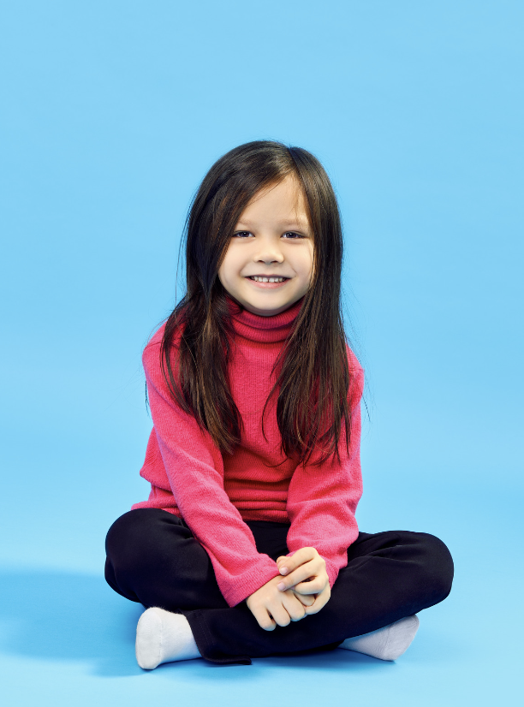
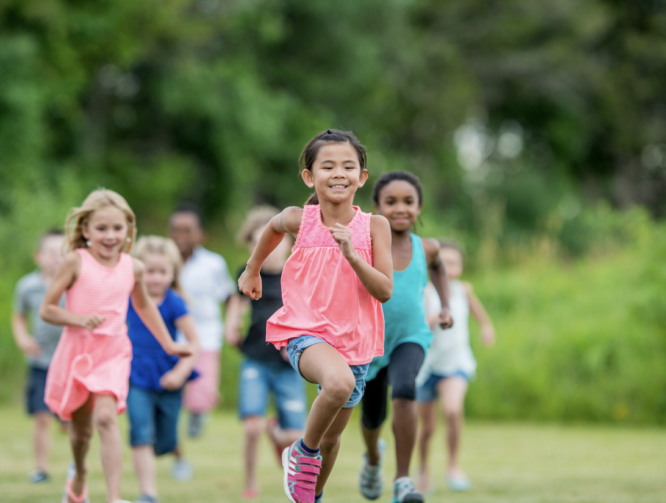
Which is an example of kinetic energy?
Notes:
Which is an example of kinetic energy?
[kids running]

Slide 41
Which is an example of kinetic energy?
Notes:
The kids running is an example of kinetic energy. They are in motion.

Slide 42
Remember!!!
Notes:
So remember!

Slide 43
Kinetic Energy: energy of mass in motion
Notes:
Kinetic Energy is energy of mass in motion,.

Slide 44
Notes:
We will now complete this concept map, called a Frayer model, to summarize and further clarify what you have learned about the term kinetic energy.

Slide 45
Definition
Picture
Kinetic Energy
Example
How does kinetic energy impact my life?
Notes:
To complete the Frayer model, we will choose from four choices the correct picture, definition, example, and response to the question, “How does kinetic energy impact my life?” Select the best response for each question using the information you just learned. As we select responses, we will see how this model looks filled in for the term kinetic energy.

Slide 46
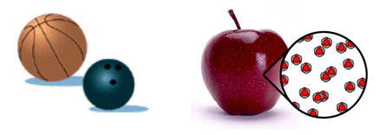
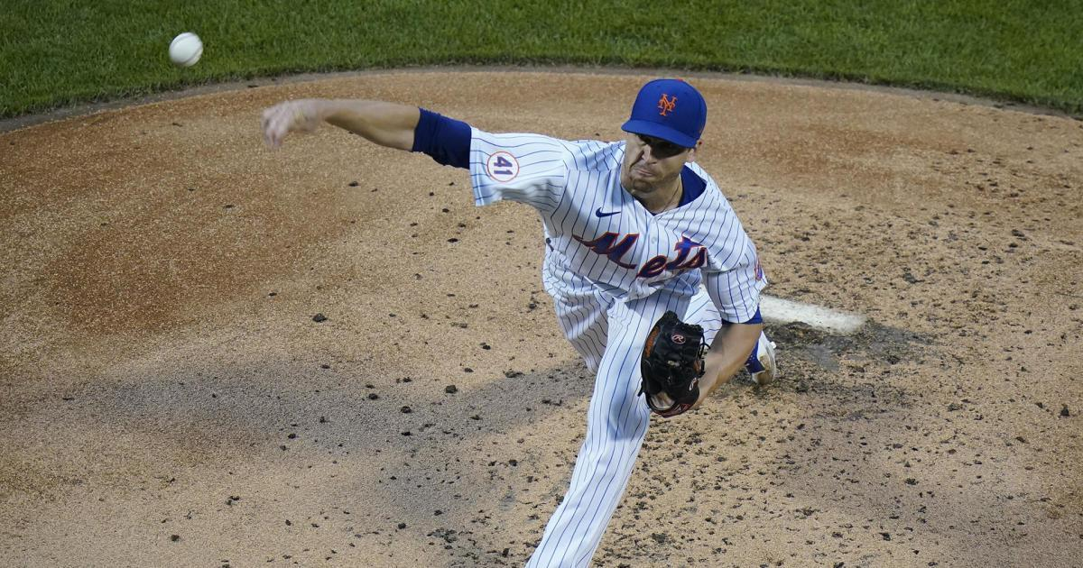
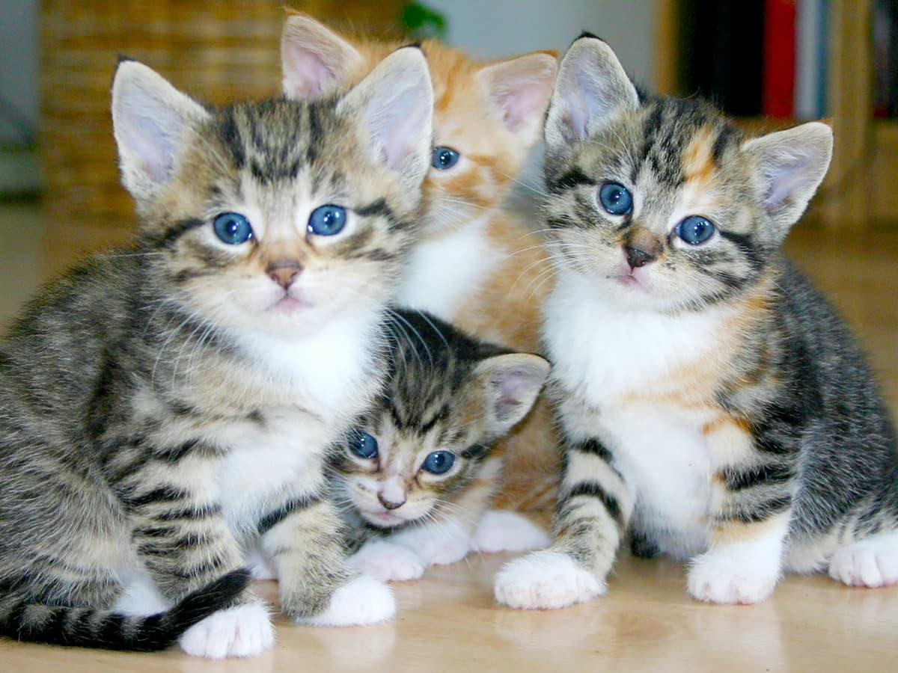
Directions: Choose the correct picture of Kinetic Energy from the choices below.
A
B
C
D
Notes:
Choose the one correct picture of Kinetic Energy from these four choices and drag and place it in the picture box below.

Slide 47
Directions: Choose the correct picture of Kinetic Energy from the choices below.
A
B
C
D
Notes:
You chose the picture that shows Kinetic Energy.

Slide 48
Definition
Picture
Kinetic Energy
Example
How does kinetic energy impact my life?
Notes:
Here is the Frayer Model filled in with a picture of Kinetic Energy.

Slide 49
Directions: Choose the correct definition of Kinetic Energy from the choices below.
A
An animal that hunts and eats other animals
B
The ability to cause change
C
Energy of mass in motion
D
The powerhouse of the cell
Notes:
Choose the one correct definition of Kinetic Energy from these four choices and drag and place it in the definition box below.

Slide 50
Directions: Choose the correct definition of Kinetic Energy from the choices below.
A
An animal that hunts and eats other animals
B
The ability to cause change
C
Energy of mass in motion
D
The powerhouse of the cell
Notes:
You chose “Energy of mass in motion.” This is correct! This is the definition of Kinetic Energy.

Slide 51
Definition
Picture
Energy of mass in motion
Kinetic Energy
Example
How does kinetic energy impact my life?
Notes:
Here is the Frayer Model with a picture and the definition filled in for Thermal Energy: Energy of mass in motion.

Slide 52
Directions: Choose the correct example of Kinetic Energy from the choices below.
A
A farm with lots of animals
B
Brownies baking in an oven
C
A baby sleeping
D
A basketball being dribbled by a basketball player
Notes:
Choose the one correct example of Kinetic Energy from these four choices and drag and place it in the example box below.

Slide 53
Directions: Choose the correct example of Kinetic Energy from the choices below.
A
A farm with lots of animals
B
Brownies baking in an oven
C
A baby sleeping
D
A basketball being dribbled by a basketball player
Notes:
You chose “A basketball being dribbled by a basketball player.” This is an example of Kinetic Energy!

Slide 54
Definition
Picture
Energy of mass in motion
Kinetic Energy
A basketball being dribbled by a basketball player
Example
How does kinetic energy impact my life?
Notes:
Here is the Frayer Model with a picture, definition, and an example of Kinetic Energy: A basketball being dribbled by a basketball player.

Slide 55
Directions: Choose the correct response for “how does kinetic energy impact my life?” from the choices below.
A
Kinetic energy impacts my life by cleaning our planet which helps keep us alive.
B
Kinetic energy impacts my life by allowing objects to move and helps power things like vehicles, both of which help us move in our environment.
C
Kinetic energy impacts my life by creating things like the air we breathe which is necessary for survival.
D
Kinetic energy impacts my life by growing fruits and vegetables that we can eat to be healthy and strong.
Notes:
Choose the one correct response for “how does kinetic energy impact my life?” from these four choices and drag and place it in the box below.

Slide 56
Directions: Choose the correct response for “how does kinetic energy impact my life?” from the choices below.
A
Kinetic energy impacts my life by cleaning our planet which helps keep us alive.
B
Kinetic energy impacts my life by allowing objects to move and helps power things like vehicles, both of which help us move in our environment.
C
Kinetic energy impacts my life by creating things like the air we breathe which is necessary for survival.
D
Kinetic energy impacts my life by growing fruits and vegetables that we can eat to be healthy and strong.
Notes:
You chose “Kinetic energy impacts my life by allowing objects to move and helps power things like vehicles, both of which helps move in our environment.” That is correct! This is an example of how kinetic energy impacts your life.

Slide 57
Definition
Picture
Energy of mass in motion
Kinetic Energy
Kinetic energy impacts my life by allowing objects to move and helps power things like vehicles, both of which helps move in our environment.
A basketball being dribbled by a basketball player
Example
How does kinetic energy impact my life?
Notes:
Here is the Frayer Model with a picture, definition, example, and a correct response to “how does kinetic energy impact my life?”: Kinetic energy impacts my life by allowing objects to move and helps power things like vehicles, both of which helps move in our environment.”

Slide 58
Remember!!!
Notes:
So remember!

Slide 59
Kinetic Energy: energy of mass in motion
Notes:
Kinetic Energy is energy of mass in motion,.

Slide 60
Big Question: How do forces, motion, and energy work together to affect the way objects move and interact with the world around us?
Notes:
Our “big question” is: How do forces, motion, and energy work together to affect the way objects move and interact with the world around us?
[Pause and illicit predictions from students.]
Be sure to keep this question and your predictions in mind as we move through this video and questions.

Slide 61
Simulation Activity
Roller Coaster Gizmo
Click the link above to explore more about kinetic energy.
In this simulation, you are changing the hills to make the car reach the egg without breaking it. How do we know this is kinetic energy? What are two important things you need to remember about kinetic energy?
Notes:
Feedback: Remind students that with kinetic energy, you have to pay attention to both speed and mass. You can also relate this back to potential energy. Ask students why they thing potential energy is also going to effect the car.

Slide 62
Notes:
Thanks, and please continue watching and using CAPs available from this website.

Slide 63
This Was Created With Resources From:
Questions or Comments
Michael Kennedy, Ph.D. MKennedy@Virginia.edu
Rachel L Kunemund, Ph.D. rk8vm@virginia.edu

