Slide 1
Intro
“Big Idea” Question
Review Concepts
Check-In Questions
Teacher Engagement
Vocabulary
Student-Friendly Definition
Examples & Non-Examples
Frayer Model
Simulation/Activity
Notes:
OK everyone, get ready for our next lesson. Just as a reminder, these are the different components that our lesson may include, and you’ll see these icons in the top left corner of each slide so that you can follow along more easily!

Slide 2
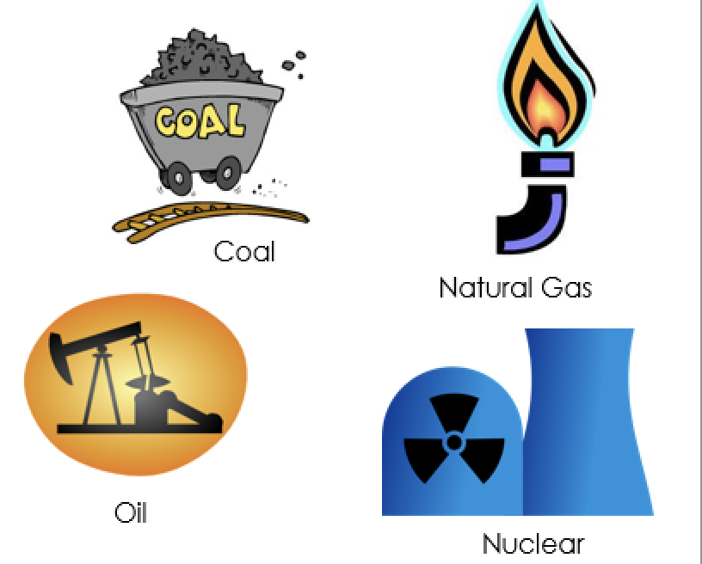
Non-Renewable Energy
Intro
Notes:
Today we will be learning about non-renewable energy

Slide 3
Big Question: How does the amount we use of different types of resources help us take care of our environment?
Notes:
Our “big question” is: How does the amount we use of different types of resources help us take care of our environment?
[Pause and illicit predictions from students.]
Be sure to keep this question and your predictions in mind as we move through this video and questions.

Slide 4
Notes:
Before we move on to our new vocabulary term, let’s review some other words & concepts that you already learned and make sure you are firm in your understanding.
Feedback: Reviewing key background knowledge helps lay the context and sets the students up to make sense of the new content you are introducing, it also reinforces previously learned material.

Slide 5
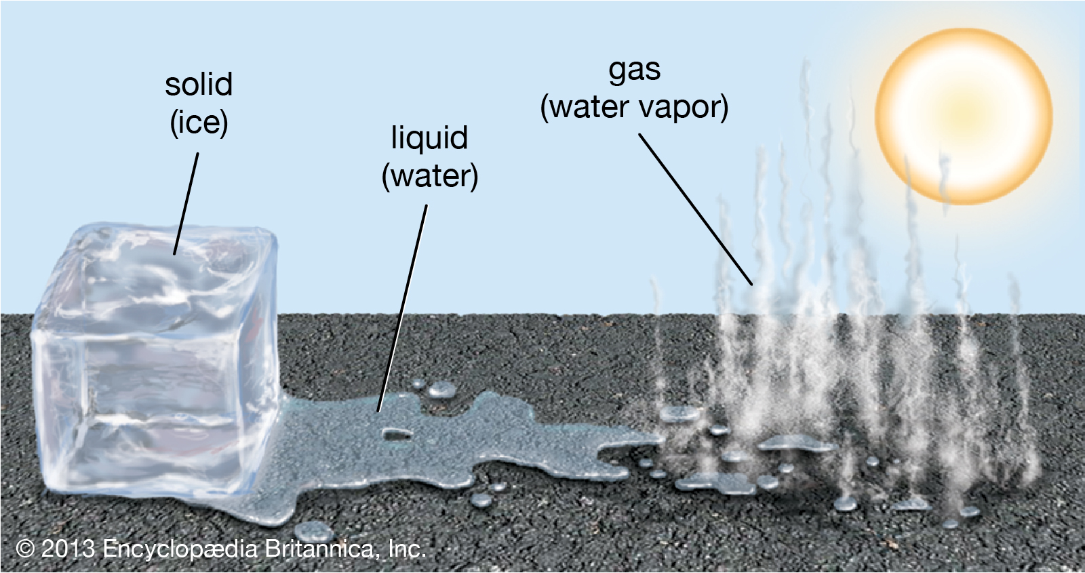
Water is the only compound that exists in all three states of matter: solid, liquid, and gas
Notes:
Water is the only compound that exists in all three states of matter: solid, liquid, and gas.

Slide 6
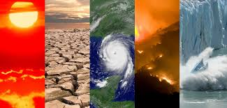
Climate: the average measurements of weather in a place over the course of years
Notes:
Climate is the average measurements of weather in a place over the course of years.

Slide 7
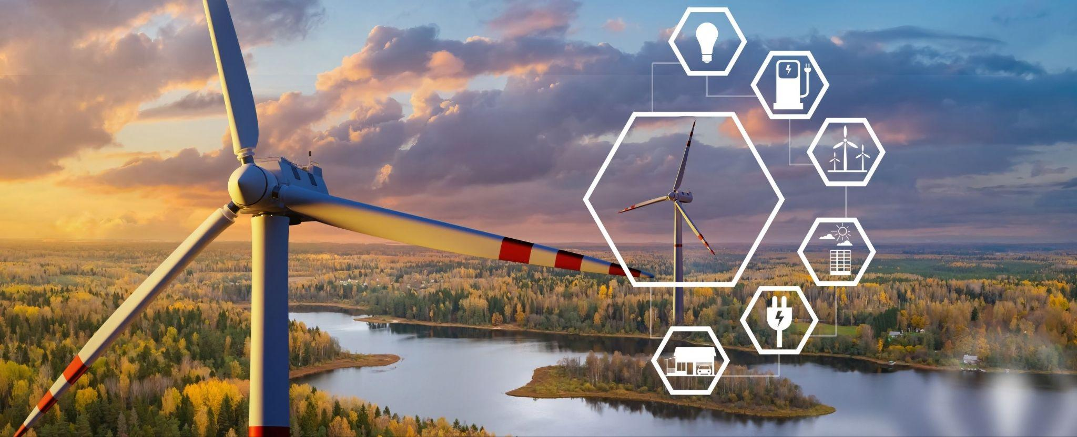
Energy: the ability to cause change
Notes:
Energy is the ability to cause change.

Slide 8
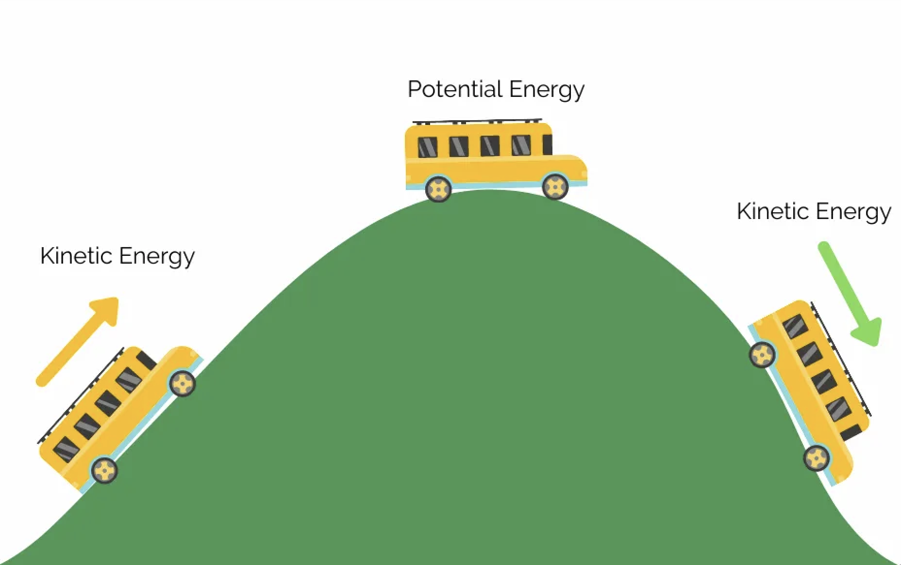
Kinetic Energy: energy of mass in motion
Notes:
Kinetic Energy is energy of mass in motion,.

Slide 9
Potential energy: stored energy
Notes:
Potential energy is stored energy.

Slide 10
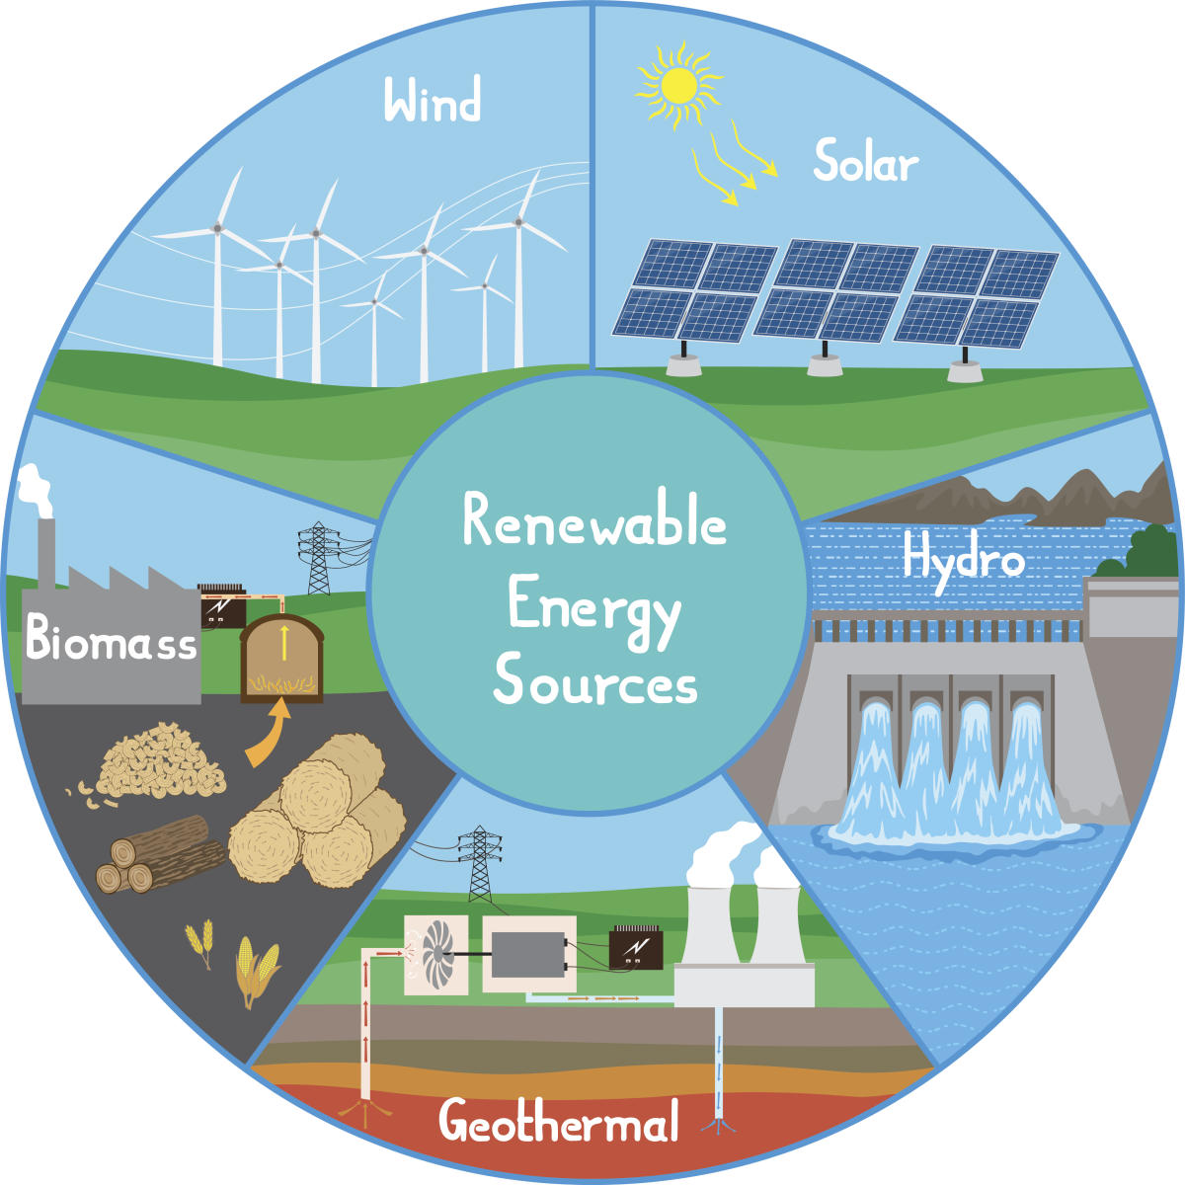
Renewable Energy: energy that comes from natural sources and will not run out
Notes:
Renewable Energy is energy that comes from natural sources and will not run out.

Slide 11
Notes:
Let’s check-in for understanding.

Slide 12
______ is the only compound that exists in all three states of matter: solid, liquid, and gas.
Notes:
______ is the only compound that exists in all three states of matter: solid, liquid, and gas.

Slide 13
Water is the only compound that exists in all three states of matter: solid, liquid, and gas.
Notes:
Water is the only compound that exists in all three states of matter: solid, liquid, and gas.

Slide 14
What is climate?
Notes:
What is climate?
[The average measurements of weather in a place over the course of years.]

Slide 15
True or False: Energy is the ability to cause change
Notes:
True or False: Energy is the ability to cause change.
[True]

Slide 16
True or False: Energy is the ability to cause change
Notes:
True: Energy is the ability to cause change.

Slide 17
Kinetic Energy: energy of in motion
Notes:
Kinetic Energy is energy of in motion.
[mass]

Slide 18
Kinetic Energy: energy of mass in motion
Notes:
Kinetic Energy is energy of in motion.
[mass]

Slide 19
True or False: Potential energy is stored energy
Notes:
True or False: Potential energy is stored energy.
[True]

Slide 20
True or False: Potential energy is stored energy
Notes:
True: Potential energy is stored energy.

Slide 21
Renewable Energy: energy that comes from natural sources and will run out
Notes:
Renewable Energy is energy that comes from natural sources and will run out.

Slide 22
Renewable Energy: energy that comes from natural sources and will not run out
Notes:
Renewable Energy is energy that comes from natural sources and will not run out.

Slide 23
Non-Renewable Energy
Notes:
Now let’s define our new term, Non-Renewable Energy.

Slide 24
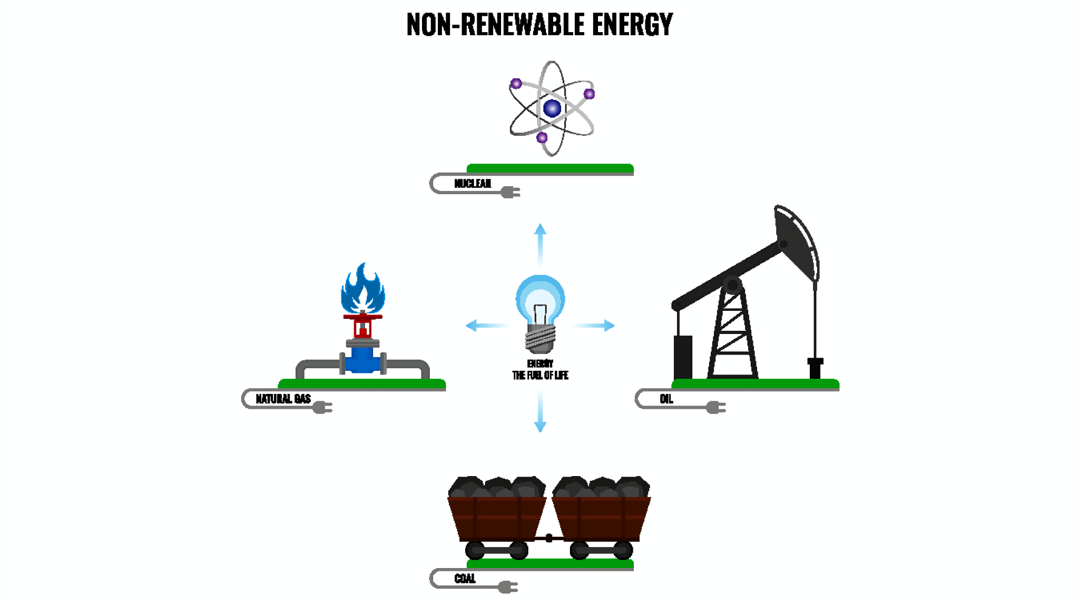
Non-Renewable Energy: energy that comes from sources that will eventually run out
Notes:
Non-Renewable Energy is energy that comes from sources that will eventually run out.

Slide 25
Notes:
Let’s check-in for understanding.

Slide 26
What is non-renewable energy?
Notes:
What is non-renewable energy?
[energy that comes from sources that will eventually run out]

Slide 27
Notes:
That is the basic definition, but there is a bit more you need to know.

Slide 28
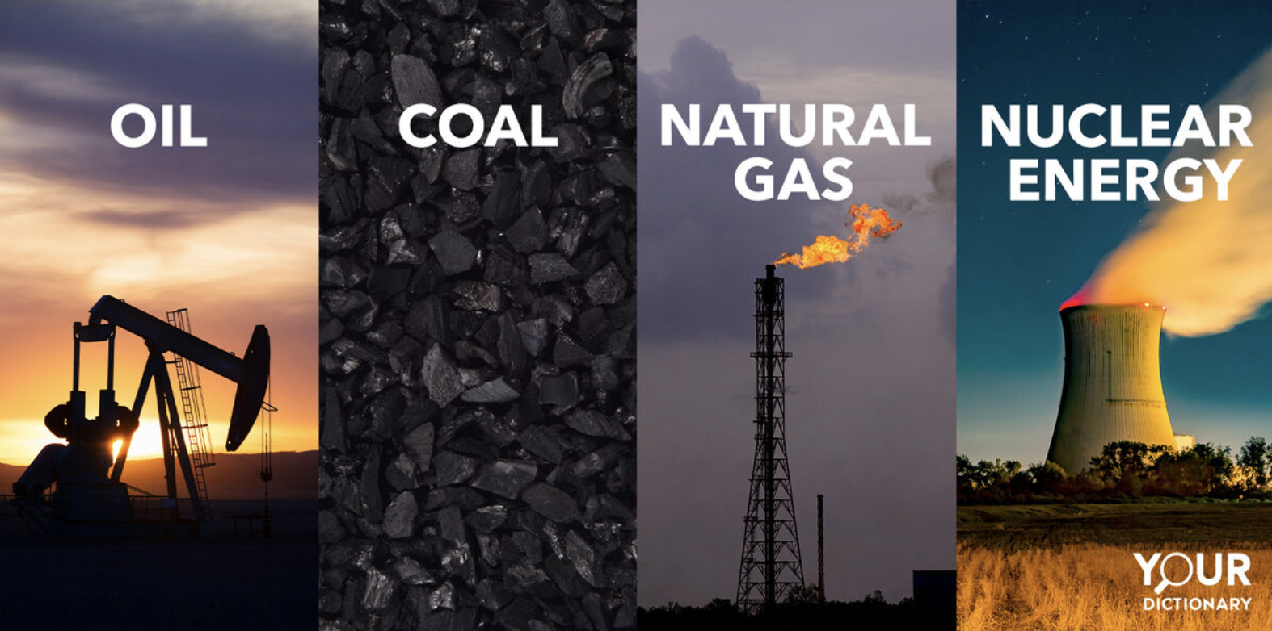
Non-renewable energy comes from sources that can run out over time.
Notes:
Non-renewable energy comes from sources that can run out over time. Fossil fuels like coal, oil, and natural gas are examples of non-renewable energy sources. They took millions of years to form, and once we use them up, they can't be easily replaced, so we need to find other ways to generate energy that won't run out.*

Slide 29
Fossil fuels like coal, oil, and natural gas are examples of non-renewable energy sources. They took millions of years to form, and once we use them up, they can't be easily replaced, so we need to find other ways to generate energy that won't run out.
Notes:
Fossil fuels like coal, oil, and natural gas are examples of non-renewable energy sources. They took millions of years to form, and once we use them up, they can't be easily replaced, so we need to find other ways to generate energy that won't run out.

Slide 30
Notes:
Let’s check-in for understanding.

Slide 31
What are different types of non-renewable energy resources?
Notes:
What are different types of non-renewable energy resources?
[Oil, Coal, Natural Gas, Nuclear Energy]

Slide 32
Notes:
Now, let’s talk about some examples of renewable energy.

Slide 33
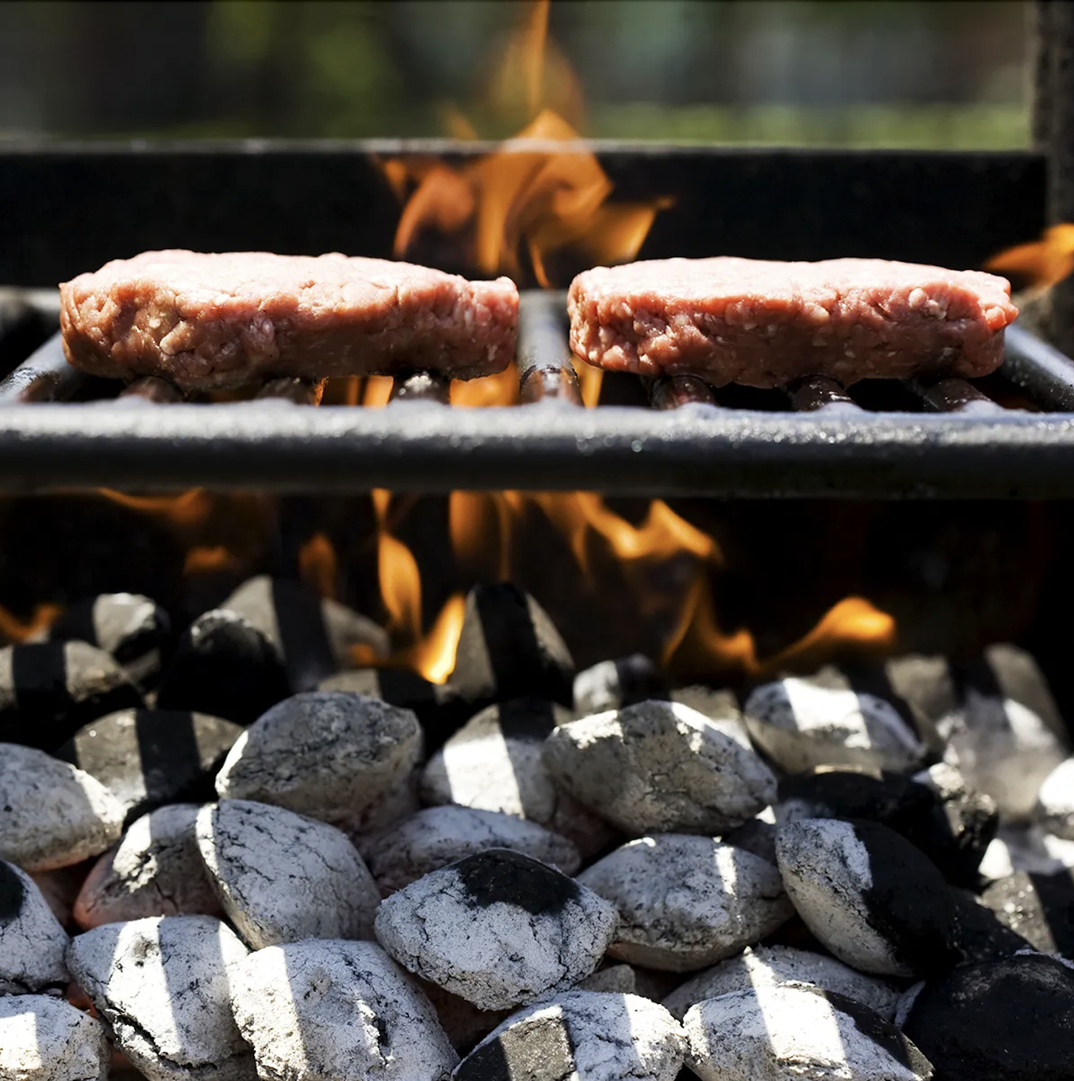
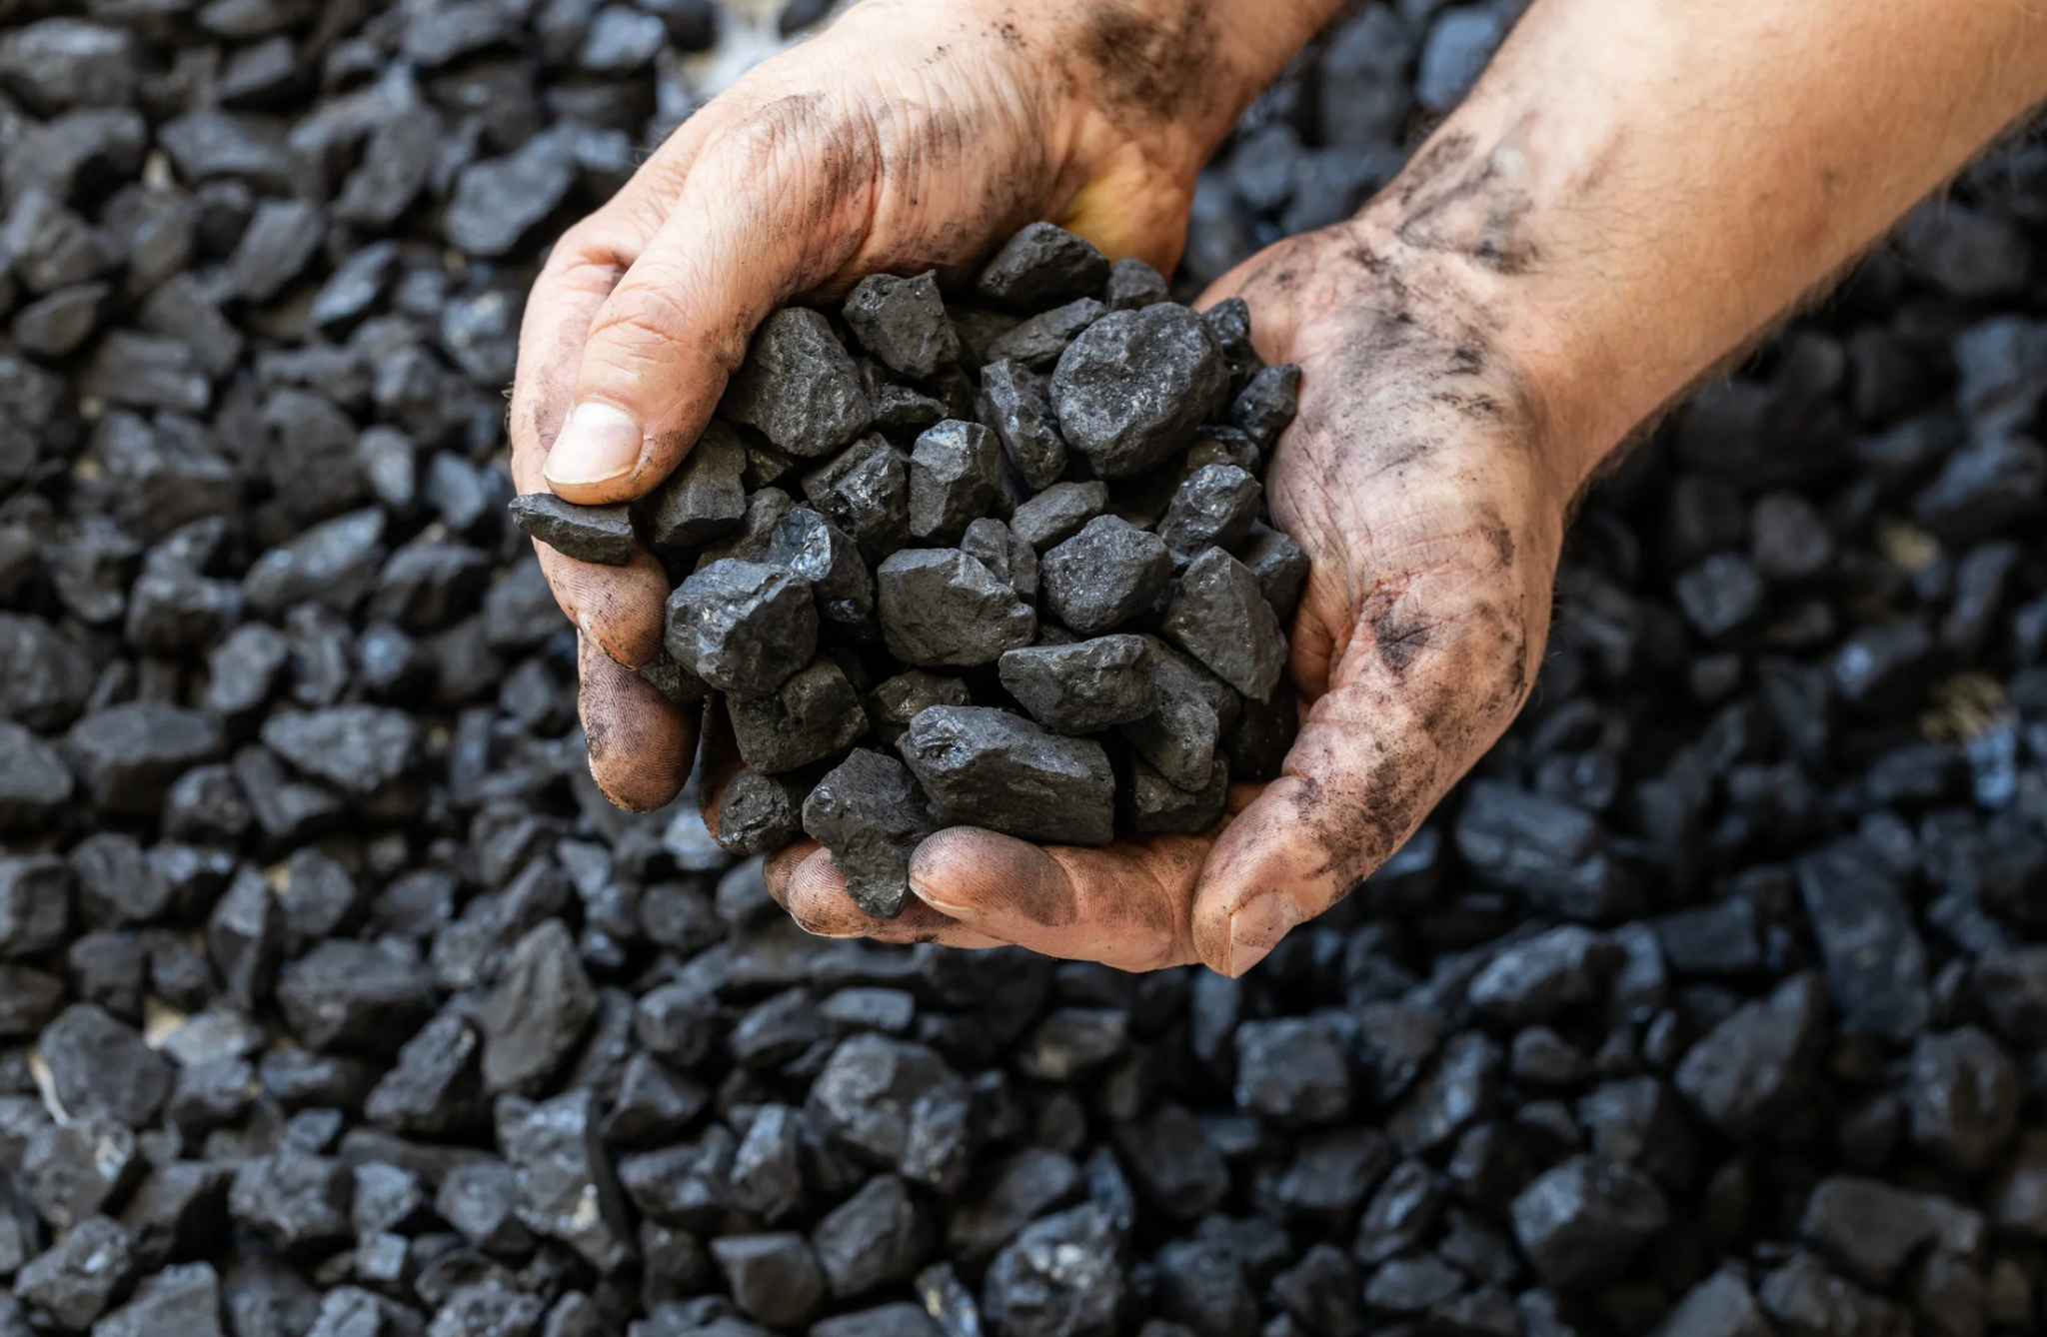
Coal is an example of a non-renewable energy. It is mined from underground, and there is a limited amount of it which will eventually run out. Coal is used for many things, such as creating electricity. It can even be used for cooking, such as using charcoal when grilling food.
Notes:
Coal is an example of a non-renewable energy. It is mined from underground, and there is a limited amount of it which will eventually run out. Coal is used for many things, such as creating electricity. It can even be used for cooking, such as using charcoal when grilling food.

Slide 34
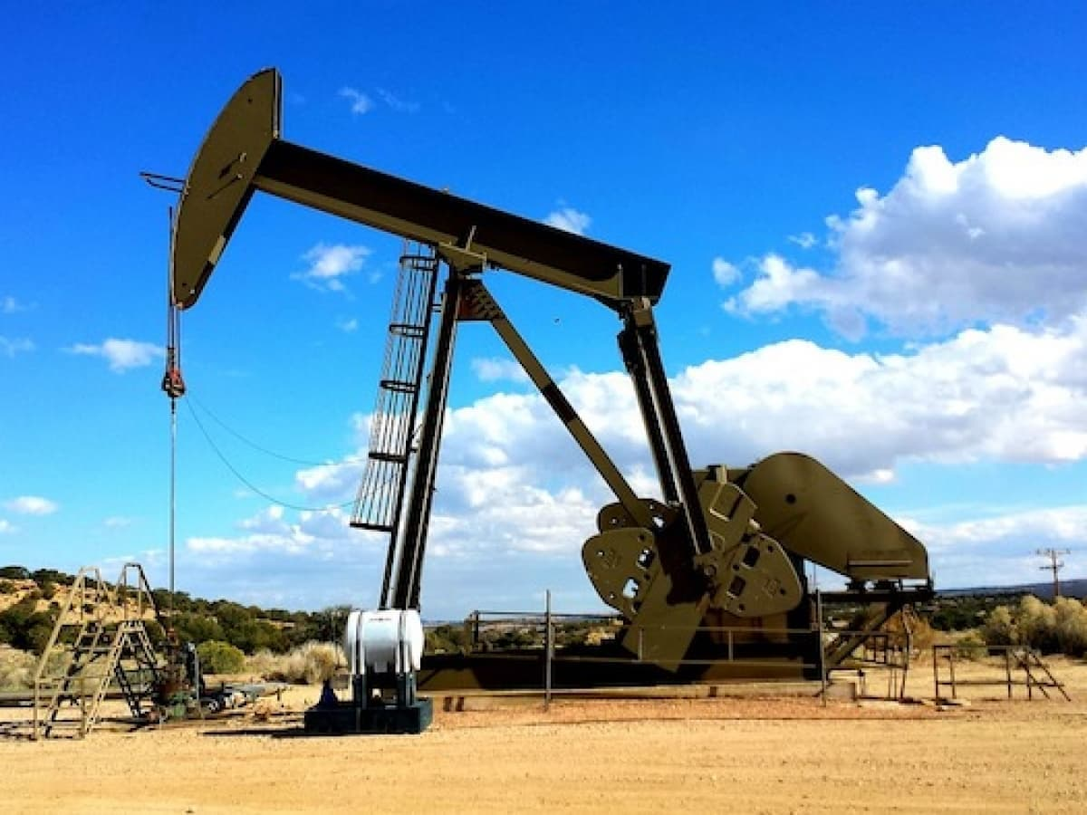
Oil is an example of non-renewable energy. It comes from fossil fuels, which will eventually run out since we have a limited amount of them on Earth. This comes out of the ground and is processed through a large oil pump. It can then be used to power machines, such as cars.
Notes:
Oil is an example of non-renewable energy. It comes from fossil fuels, which will eventually run out since we have a limited amount of them on Earth. This comes out of the ground and is processed through a large oil pump. It can then be used to power machines, such as cars.

Slide 35
Notes:
Now, let’s talk about some non-examples of renewable energy.

Slide 36
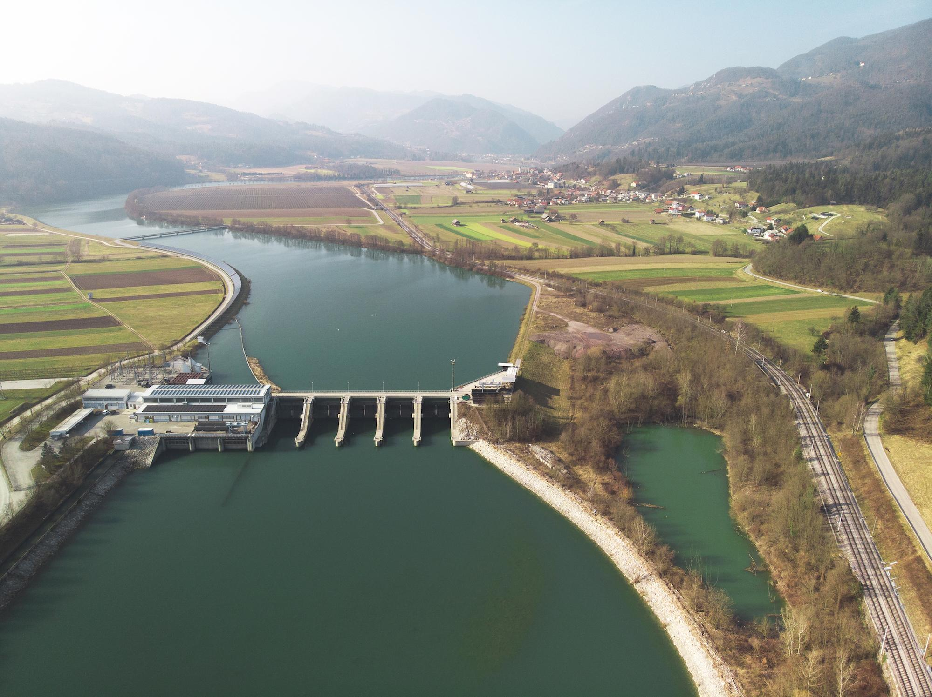
In this picture, we see a hydro power dam that creates energy from the movement of water. The energy from the dam helps power the nearby town. This is NOT an example of non-renewable energy.
Notes:
In this picture, we see a hydro power dam that creates energy from the movement of water. The energy from the dam helps power the nearby town. This is NOT an example of non-renewable energy

Slide 37
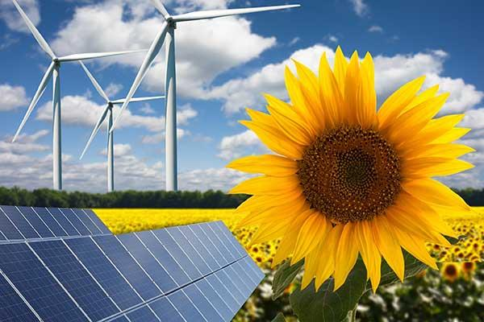
A farmer uses windmills and solar power to help power the farm that grows sunflowers. Windmills and solar power are renewable energy sources from wind and the Sun, which are energy sources that will never run out. These are NOT examples of non-renewable energy.
Notes:
A farmer uses windmills and solar power to help power the farm that grows sunflowers. Windmills and solar power are renewable energy sources from wind and the Sun, which are energy sources that will never run out. These are NOT examples of non-renewable energy.

Slide 38
Notes:
Now let’s pause for a moment to check your understanding.

Slide 39
Which one is an example of non-renewable energy?
Notes:
Which one is an example of non-renewable energy?

Slide 40
Which one is an example of non-renewable energy?
Notes:
Which one is an example of non-renewable energy?

Slide 41
Remember!!!
Notes:
So remember!

Slide 42
Non-Renewable Energy: energy that comes from sources that will eventually run out
Notes:
Non-Renewable Energy is energy that comes from sources that will eventually run out.

Slide 43
Notes:
We will now complete this concept map, called a Frayer model, to summarize and further clarify what you have learned about the term non-renewable energy.

Slide 44
Definition
Picture
Non-Renewable Energy
Example
How does non-renewable energy impact my life?
Notes:
To complete the Frayer model, we will choose from four choices the correct picture, definition, example, and response to the question, “How does non-renewable energy impact my life?” Select the best response for each question using the information you just learned. As we select responses, we will see how this model looks filled in for the term non-renewable energy.

Slide 45
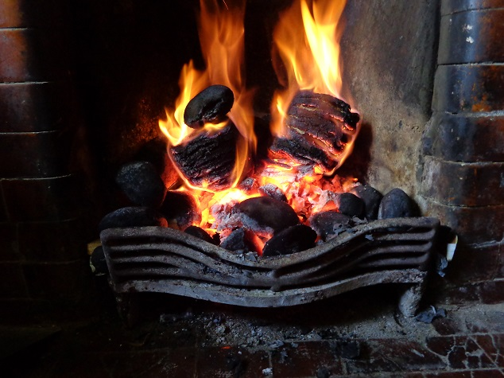
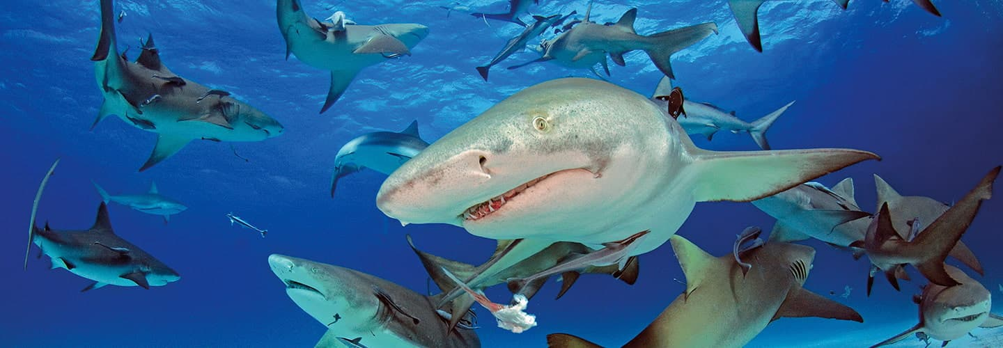
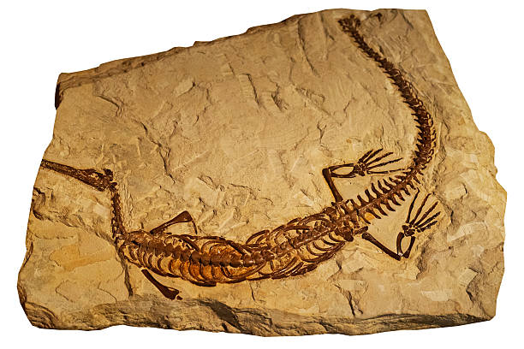
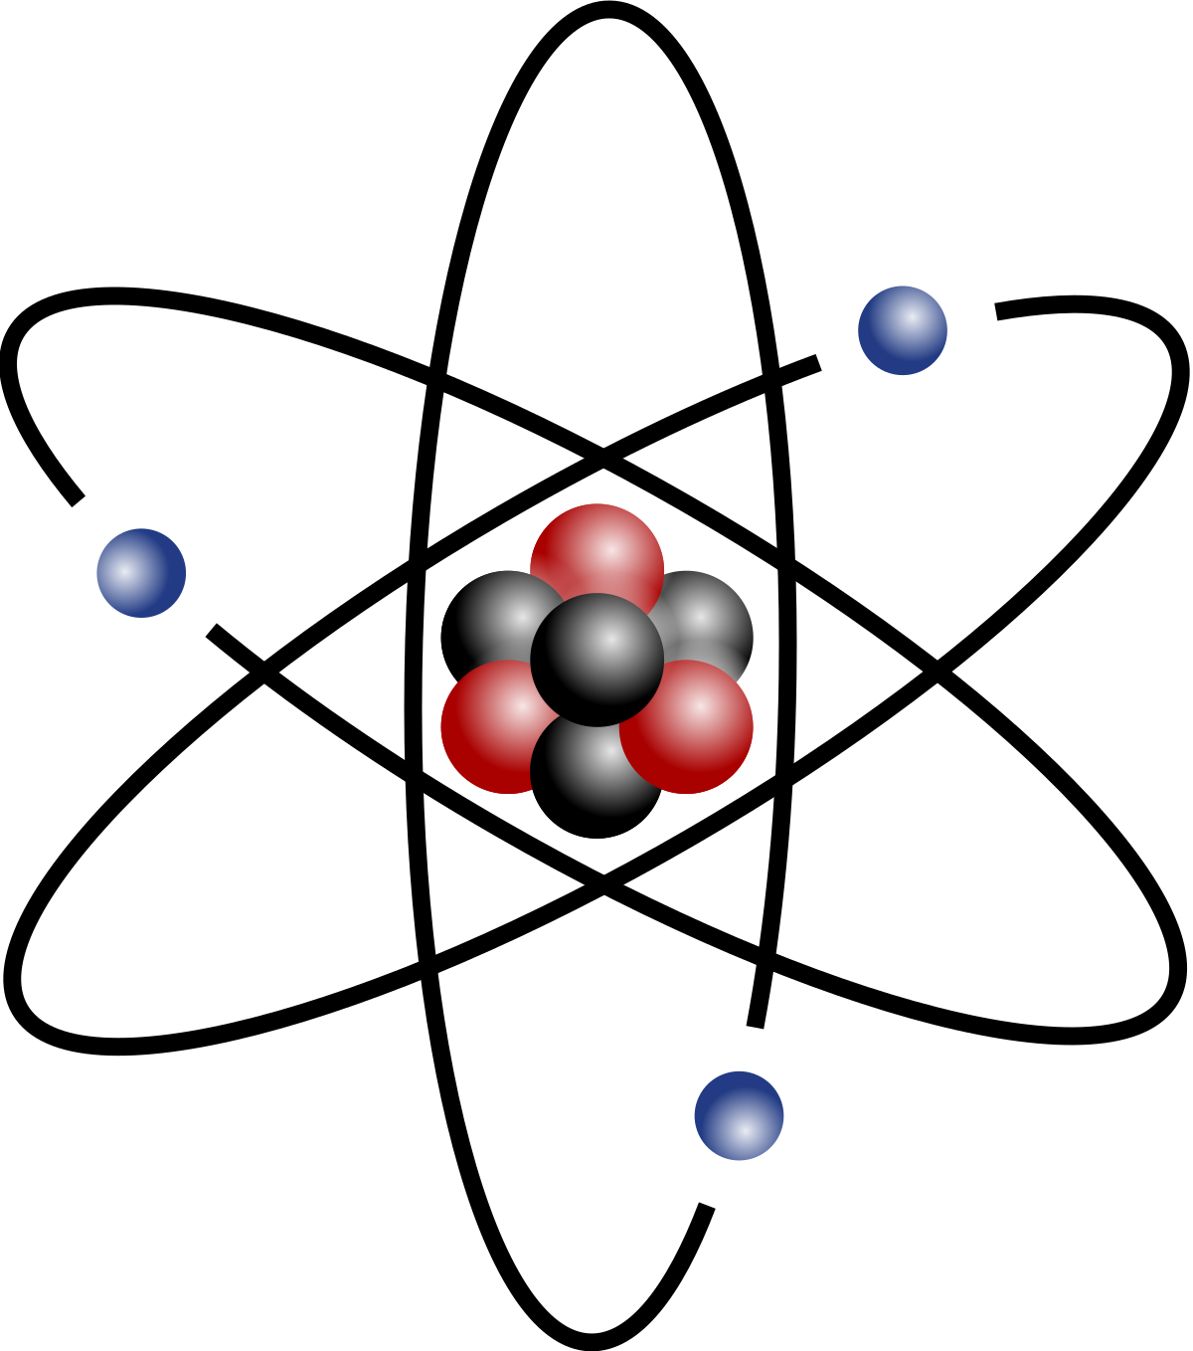
Directions: Choose the correct picture of Non-Renewable Energy from the choices below.
A
B
C
D
Notes:
Choose the one correct picture of Non-Renewable Energy from these four choices and drag and place it in the picture box below.

Slide 46
Directions: Choose the correct picture of Non-Renewable Energy from the choices below.
A
B
C
D
Notes:
You chose the picture that shows Non-Renewable Energy.

Slide 47
Picture
Definition
Picture
Non-Renewable Energy
Example
How does non-renewable energy impact my life?
Notes:
Here is the Frayer Model filled in with a picture of Non-Renewable Energy.

Slide 48
Directions: Choose the correct definition of Non-Renewable Energy from the choices below.
A
Dropping of sediment to a new location
B
Preserved remains of prehistoric life
C
The ability to cause change
D
Energy that comes from sources that will eventually run out
Notes:
Choose the one correct definition of Non-Renewable Energy from these four choices and drag and place it in the definition box below.

Slide 49
Directions: Choose the correct definition of Non-Renewable Energy from the choices below.
A
Dropping of sediment to a new location
B
Preserved remains of prehistoric life
C
The ability to cause change
D
Energy that comes from sources that will eventually run out
Notes:
You chose “Energy that comes from sources that will eventually run out.” This is correct! This is the definition of Non-Renewable Energy.

Slide 50
Picture
Definition
Picture
Energy that comes from sources that will eventually run out
Non-Renewable Energy
Example
How does non-renewable energy impact my life?
Notes:
Here is the Frayer Model with a picture and the definition filled in for Non-Renewable Energy: Energy that comes from sources that will eventually run out.

Slide 51
Directions: Choose the correct example of Non-Renewable Energy from the choices below.
A
A dinosaur preserved in stone
B
Animals and plants living together in one place
C
Using a natural gas stove to cook food
D
Eating a balanced diet including fruits and vegetables
Notes:
Choose the one correct example of Non-Renewable Energy from these four choices and drag and place it in the example box below.

Slide 52
Directions: Choose the correct example of Non-Renewable Energy from the choices below.
A
A dinosaur preserved in stone
B
Animals and plants living together in one place
C
Using a natural gas stove to cook food
D
Eating a balanced diet including fruits and vegetables
Notes:
You chose “Using a natural gas stove to cook food.” This is an example of Non-Renewable Energy!

Slide 53
Picture
Definition
Picture
Energy that comes from sources that will eventually run out
Non-Renewable Energy
Using a natural gas
stove to cook food
Example
How does non-renewable energy impact my life?
Notes:
Here is the Frayer Model with a picture, definition, and an example of Non-Renewable Energy: Using a natural gas stove to cook food.

Slide 54
Directions: Choose the correct response for “how does Non-Renewable Energy impact my life?” from the choices below.
A
Non-Renewable Energy impacts my life by showing me how to grow plants to use for food and medicine.
B
Non-Renewable Energy impacts my life by making sure I have healthy food to eat.
C
Non-Renewable Energy impacts my life by knowing what energy comes from sources that will run out, which can hurt the environment.
D
Non-Renewable Energy impacts my life by providing energy for me to live.
Notes:
Choose the one correct response for “how does TERM impact my life?” from these four choices and drag and place it in the box below.

Slide 55
Directions: Choose the correct response for “how does Non-Renewable Energy impact my life?” from the choices below.
A
Non-Renewable Energy impacts my life by showing me how to grow plants to use for food and medicine.
B
Non-Renewable Energy impacts my life by making sure I have healthy food to eat.
C
Non-Renewable Energy impacts my life by knowing what energy comes from sources that will run out, which can hurt the environment.
D
Non-Renewable Energy impacts my life by providing energy for me to live.
Notes:
You chose “Non-Renewable Energy impacts my life by knowing what energy comes from sources that will run out, which can hurt the environment.” That is correct! This is an example of how Non-Renewable Energy impacts your life.

Slide 56
Picture
Definition
Picture
Energy that comes from sources that will eventually run out
Non-Renewable Energy
Using a natural gas
stove to cook food
Non-Renewable Energy impacts my life by knowing what energy comes from sources will run out, which can hurt the environment.
Example
How does non-renewable energy impact my life?
Notes:
Here is the Frayer Model with a picture, definition, example, and a correct response to “how does Non-Renewable Energy impact my life?”: Non-Renewable Energy impacts my life by knowing what energy comes from sources that will run out, which can hurt the environment.

Slide 57
Remember!!!
Notes:
So remember!

Slide 58
Non-Renewable Energy: energy that comes from sources that will eventually run out
Notes:
Non-Renewable Energy is energy that comes from sources that will eventually run out.

Slide 59
Big Question: How does the amount we use of different types of resources help us take care of our environment?
Notes:
Let’s reflect once more on our big question. Our “big question” is: How does the amount we use of different types of resources help us take care of our environment?
Does anyone have any additional examples to share that haven’t been discussed yet?

Slide 60
Notes:
Thanks for watching, and please continue watching CAPs available from this website.

Slide 61
This Was Created With Resources From:
Questions or Comments
Michael Kennedy, Ph.D. MKennedy@Virginia.edu
Rachel L Kunemund, Ph.D. rk8vm@virginia.edu

