Slide 1
Intro
“Big Idea” Question
Review Concepts
Check-In Questions
Teacher Engagement
Vocabulary
Student-Friendly Definition
Examples & Non-Examples
Frayer Model
Simulation/Activity
Notes:
OK everyone, get ready for our next lesson. Just as a reminder, these are the different components that our lesson may include, and you’ll see these icons in the top left corner of each slide so that you can follow along more easily!

Slide 2
Intro
Nuclear Energy
Notes:
Today we will learn about nuclear energy.

Slide 3
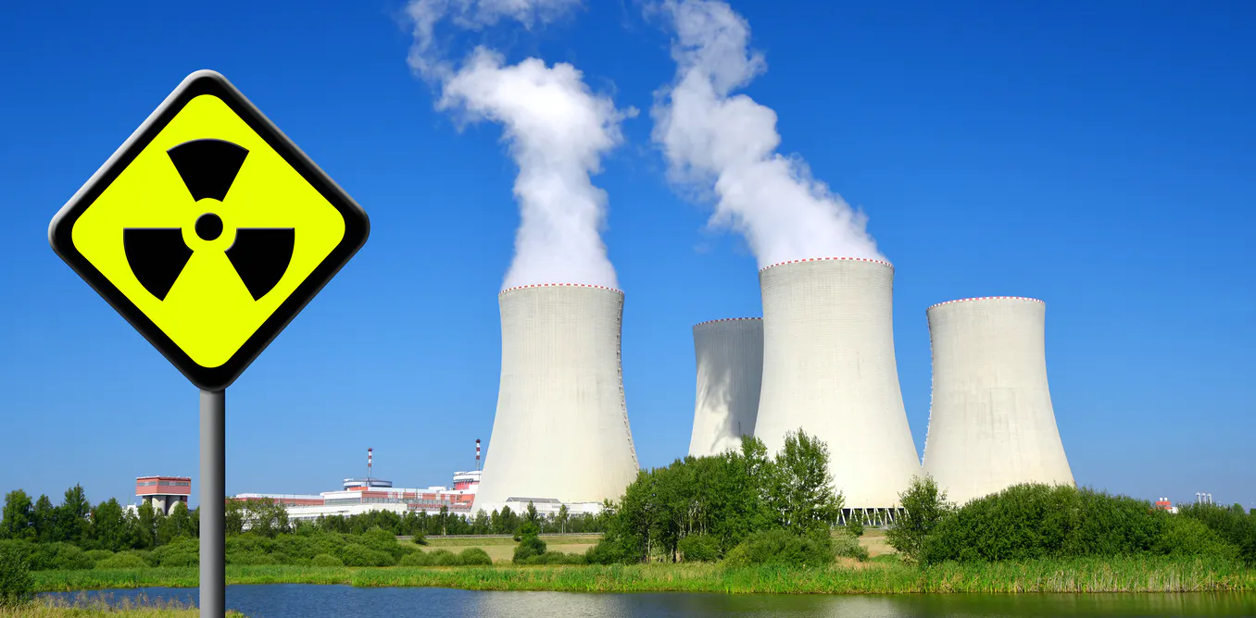
Big Question: How can nuclear energy be converted into other forms of energy?
Notes:
Our “big question” is: How can nuclear energy be converted into other forms of energy?
[Pause and illicit predictions from students.]
I love all these thoughtful scientific hypotheses! Be sure to keep this question and your predictions in mind as we move through these next few lessons, and we’ll continue to revisit it.

Slide 4
Notes:
Before we move on to our new vocabulary term, let’s review some other words & concepts that you already learned and make sure you are firm in your understanding.
Feedback: Reviewing key background knowledge helps lay the context and sets the students up to make sense of the new content you are introducing, it also reinforces previously learned material.

Slide 5
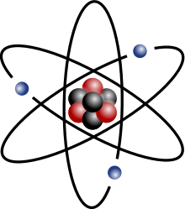
Atom: smallest whole unit of matter
Notes:
An atom is the smallest whole unit of matter.

Slide 6
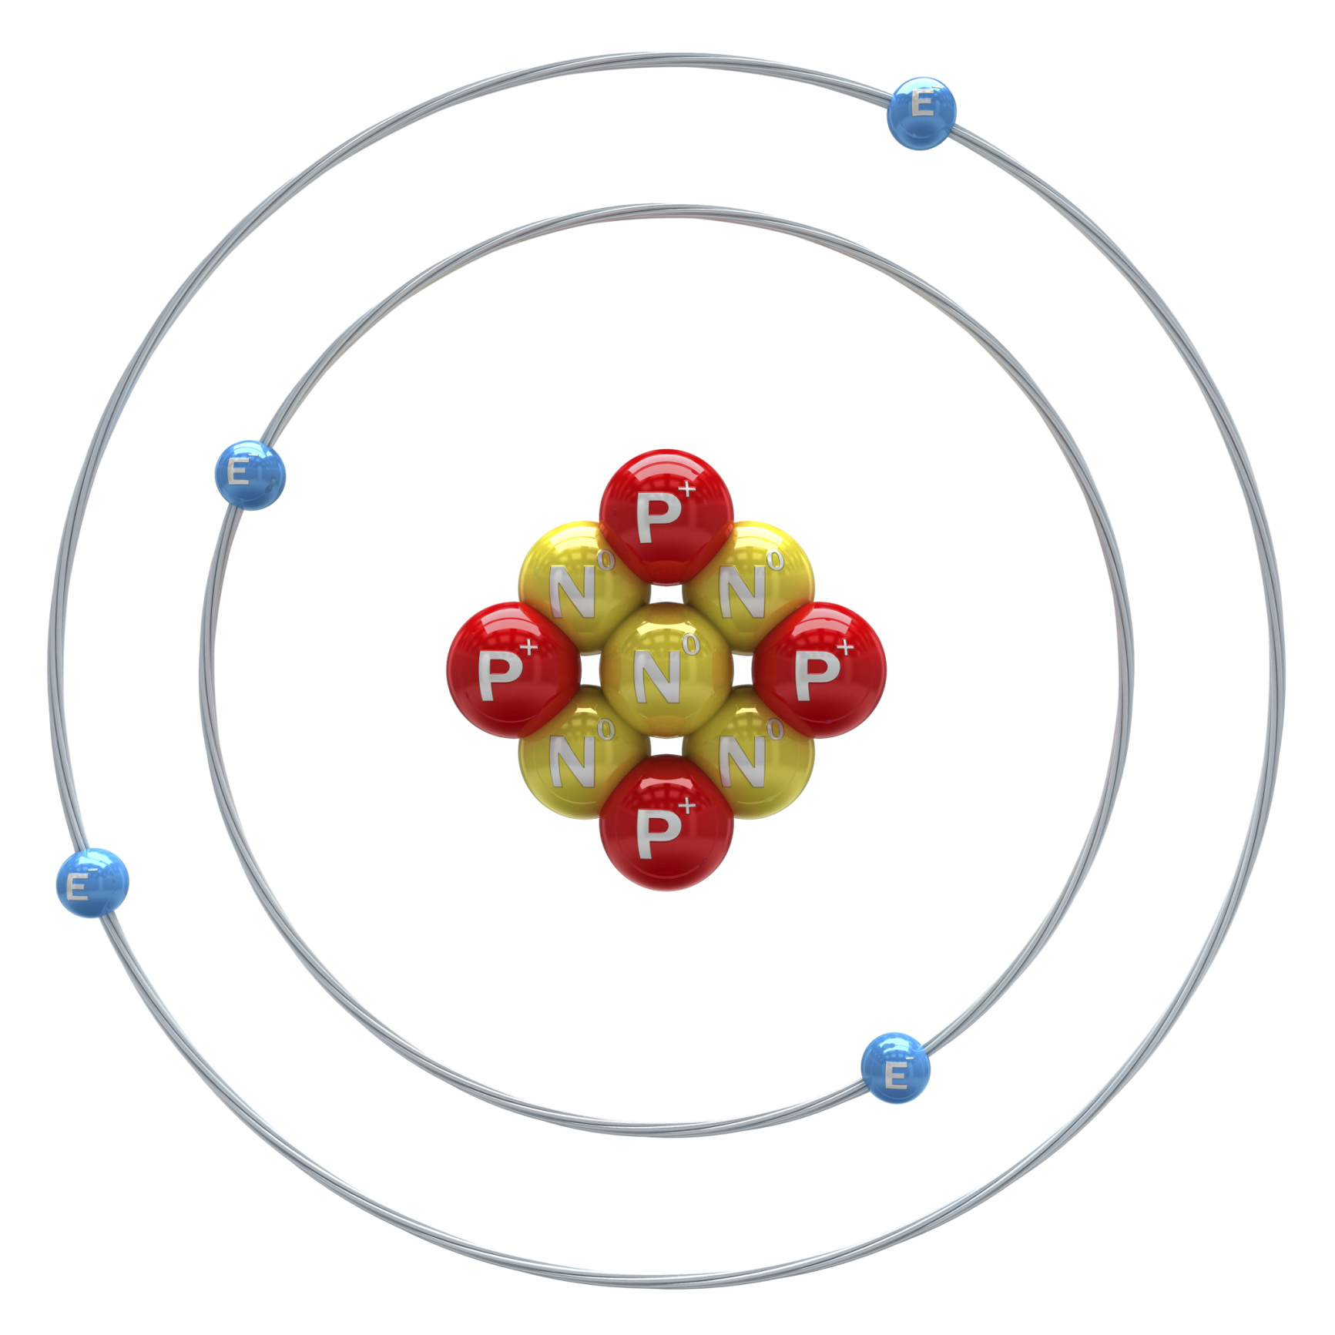
Atomic Nucleus: the center of the atom
Nucleus
Notes:
The atomic nucleus is the center of the atom.

Slide 7
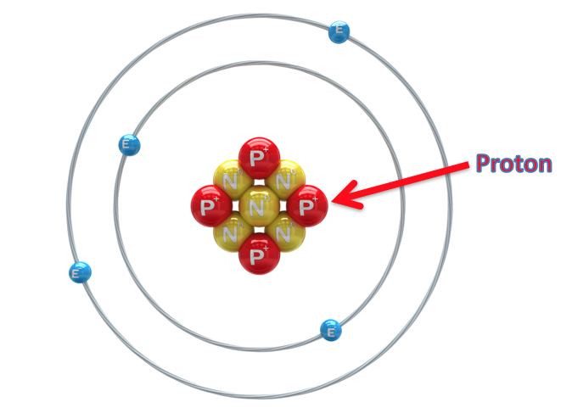
Proton: positively charged subatomic particle found in the nucleus of an atom
Notes:
A proton is a positively charged subatomic particle found in the nucleus of an atom.

Slide 8
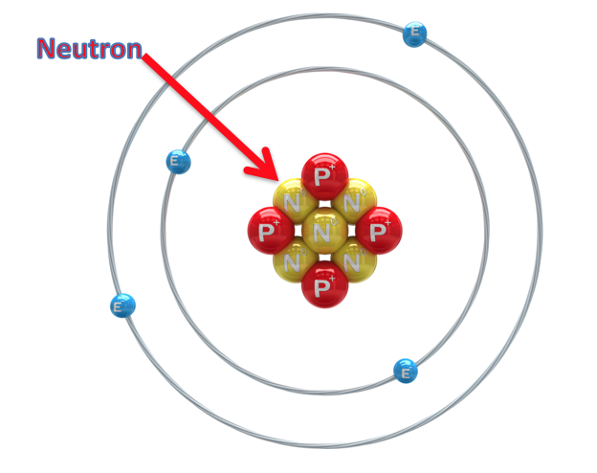
Neutron: subatomic particle with a neutral charge, found in the nucleus of an atom
Notes:
A neutron is a subatomic particle with a neutral charge, found in the nucleus of an atom.

Slide 9
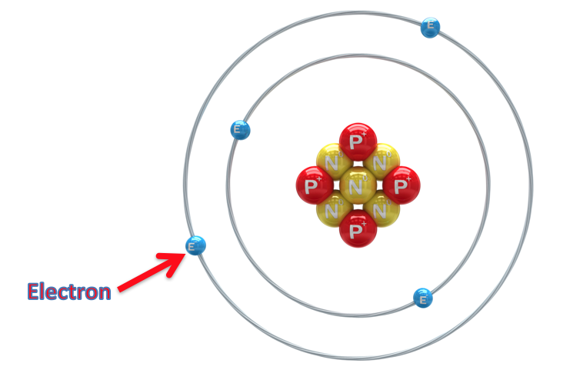
Electron: negatively charged particle that orbits the nucleus of an atom
Notes:
An electron is a negatively charged particle that orbits the nucleus.

Slide 10
Energy: the ability to cause change
Notes:
Energy is the ability to cause change.

Slide 11
Notes:
Now, let’s pause for a moment to check your understanding.
Feedback: Monitoring understanding during review is an important step before moving on to new material.

Slide 12
What is an atom?
Notes:
What is an atom?
[An atom is the smallest whole unit of matter.]

Slide 13
What is an atomic nucleus?
Nucleus
Notes:
What is an atomic nucleus?
[The atomic nucleus is the center of an atom.]

Slide 14
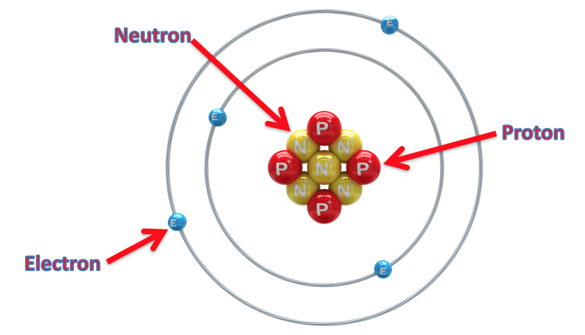
What are the 3 subatomic particles? Explain their similarities and differences.
Notes:
What are the 3 subatomic particles? Explain their similarities and differences.
[The 3 subatomic particles are protons, neutrons, and electrons. Neutrons and protons are both found in the nucleus, however, protons are positively charged and neutrons have a neutral charge. Electrons are negatively charged and orbit the nucleus.]

Slide 15
What is energy?
Notes:
What is energy?
[Energy is the ability to cause change.]

Slide 16
Nuclear Energy
Notes:
Now that we’ve reviewed, let’s define our new term, nuclear energy.

Slide 17
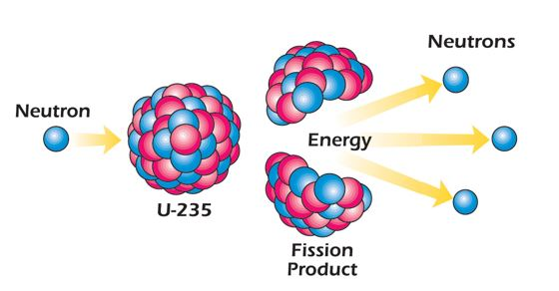
Nuclear Energy: energy stored in the nucleus of an atom
Notes:
Nuclear Energy is energy stored in the nucleus of an atom.

Slide 18
Notes:
Now, let’s pause for a moment to check your understanding.
Feedback: It is important to provide opportunities for students to demonstrate understanding, this help you catch some confusion early and get students back on track.

Slide 19
What is nuclear energy?
Notes:
What is nuclear energy?
[energy stored in the nucleus of an atom]

Slide 20
Notes:
That’s the basic definition, but there’s more you need to know.

Slide 21
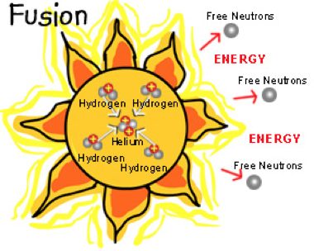
Nuclear energy can be natural or man-made. An example of natural nuclear energy is the heat and light produced by the sun. The sun is an example of nuclear fusion where two atoms are fused or joined together to become one atom.
Notes:
Nuclear energy can be natural or man-made. An example of natural nuclear energy is the heat and light produced by the sun. The sun is an example of nuclear fusion where two atoms are fused or joined together to become one atom.

Slide 22
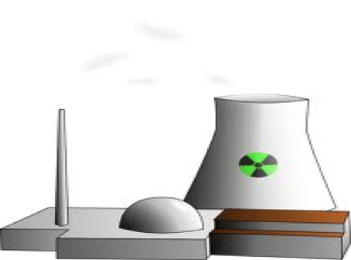
An example of man-made nuclear energy is the energy produced by a nuclear power plant reactor. Nuclear reactors use nuclear fission. One uranium atom is split to form two new atoms and release a huge amount of energy.
Notes:
An example of man-made nuclear energy is the energy produced by a nuclear power plant reactor. Nuclear reactors use nuclear fission. One uranium atom is split to form two new atoms and release a huge amount of energy.

Slide 23
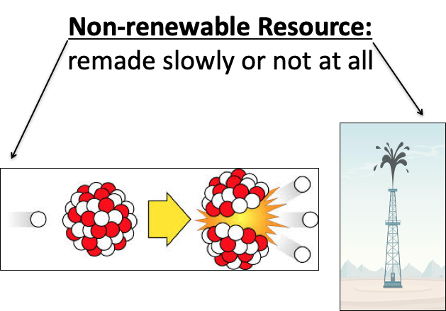
Nuclear energy is a non-renewable resource.
Notes:
Nuclear energy is a non-renewable resource.

Slide 24
Notes:
Now, let’s pause for a moment to check your understanding.

Slide 25
True/False: Nuclear energy can be natural or man-made.
Notes:
True/False: Nuclear energy can be natural or man-made.

Slide 26
True/False: Nuclear energy can be natural or man-made.
Notes:
True/False: Nuclear energy can be natural or man-made.
[True]

Slide 27
Is nuclear energy a renewable or non-renewable resource?
Notes:
Is nuclear energy a renewable or non-renewable resource?
[Nuclear energy is a non-renewable resource.]

Slide 28
Notes:
Now, let’s talk about some examples of nuclear energy.
Feedback: It is important to not only introduce an example of the term but also include images to go along with it, this is a great way to help students make connections.

Slide 29
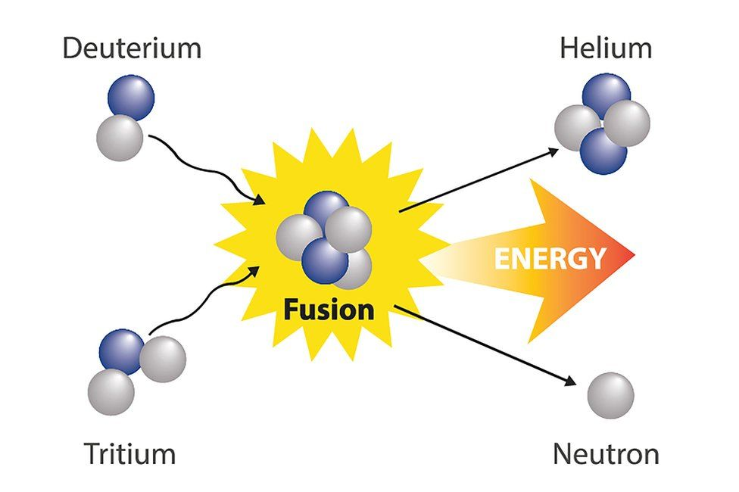
A fusion reaction is a type nuclear reaction in which two or more nuclei form one new nucleus.
Notes:
A fusion reaction is a type nuclear reaction in which two or more nuclei form one new nucleus.

Slide 30
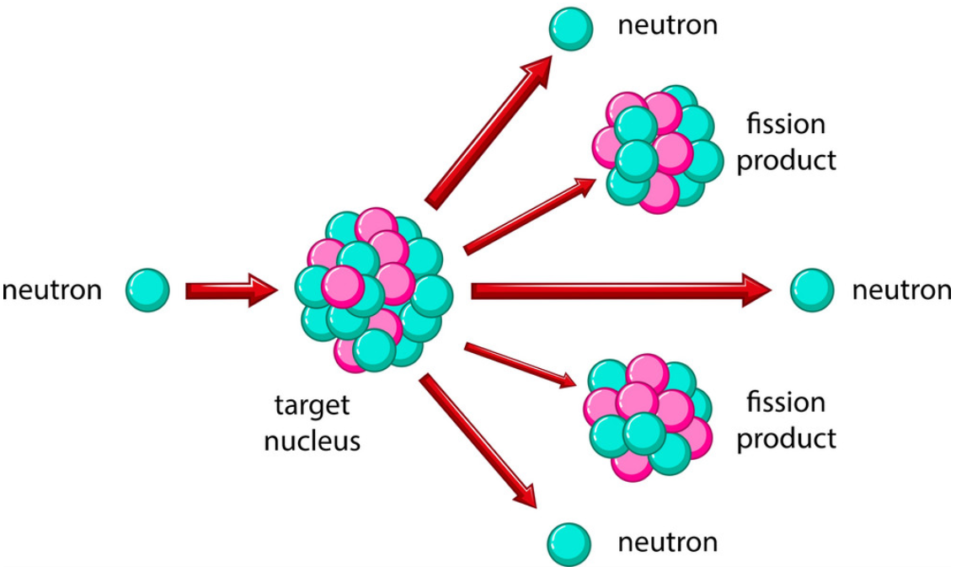
A fission reaction is a type nuclear reaction in which one nucleus is split into two or more nuclei.
Notes:
A fission reaction is a type nuclear reaction in which one nucleus is split into two or more nuclei.

Slide 31
Notes:
Next, let’s talk about some non-examples of nuclear energy.
Feedback: Take a moment to explicitly distinguish between the similarities of the non-examples and the vocabulary term. This helps students resolve any misconceptions they may have.

Slide 32
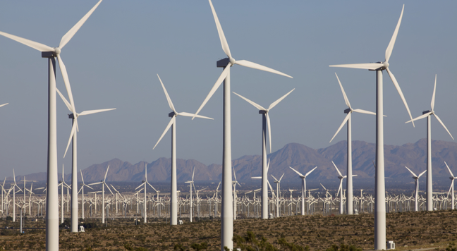
Renewable energy can be replaced in a short amount of time. Wind is renewable energy. You can replace it in a short amount of time. Renewable energy is NOT an example of nuclear energy.
Notes:
Renewable energy can be replaced in a short amount of time. Wind is renewable energy. You can replace it in a short amount of time. Renewable energy is not an example of nuclear energy.

Slide 33
Notes:
Let’s check-in for understanding.

Slide 34
What are two examples of nuclear reactions that produce energy?
Notes:
What are two examples of nuclear reactions that produce energy?
[Fusion and fission]

Slide 35
Is wind energy an example of nuclear energy?
Notes:
Is wind energy an example of nuclear energy?
[No, wind energy is a renewable energy source.]

Slide 36
Remember!!!
Notes:
So remember!
Feedback: Review the key term one last time before closing the lesson to lock in students’ understanding.

Slide 37
Nuclear Energy: energy stored in the nucleus of an atom
Notes:
Nuclear Energy is energy stored in the nucleus of an atom.

Slide 38
Notes:
We will now complete this concept map, called a Frayer model, to summarize and further clarify what you have learned about the term potential energy.

Slide 39
Definition
Picture
Nuclear Energy
Example
How does nuclear energy impact my life?
Notes:
To complete the Frayer model, we will choose from four choices the correct picture, definition, example, and response to the question, “How does nuclear energy impact my life?” Select the best response for each question using the information you just learned. As we select responses, we will see how this model looks filled in for the term nuclear energy.

Slide 40
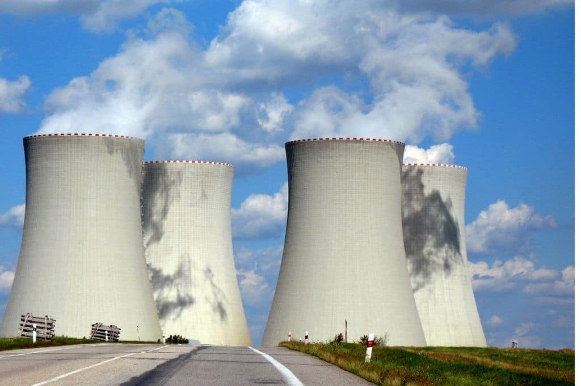
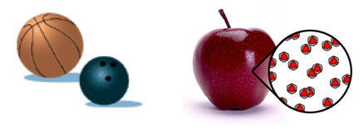
Directions: Choose the correct picture of Nuclear Energy from the choices below.
A
B
C
D
Notes:
Choose the one correct picture of Nuclear Energy from these four choices and drag and place it in the picture box below.

Slide 41
Directions: Choose the correct picture of Nuclear Energy from the choices below.
A
B
C
D
Notes:
You chose the picture that shows Nuclear Energy.

Slide 42
Definition
Picture
Nuclear Energy
Example
How does nuclear energy impact my life?
Notes:
Here is the Frayer Model filled in with a picture of Nuclear Energy.

Slide 43
Directions: Choose the correct definition of Nuclear Energy from the choices below.
A
The powerhouse of the cell
B
Energy stored in the nucleus of an atom
C
Prehistoric remains of plants and animals
D
A place where plants and animals live together
Notes:
Choose the one correct definition of Nuclear Energy from these four choices and drag and place it in the definition box below.

Slide 44
Directions: Choose the correct definition of Nuclear Energy from the choices below.
A
The powerhouse of the cell
B
Energy stored in the nucleus of an atom
C
Prehistoric remains of plants and animals
D
A place where plants and animals live together
Notes:
You chose “Energy stored in the nucleus of an atom.” This is correct! This is the definition of Nuclear Energy.

Slide 45
Definition
Picture
Energy stored in the nucleus of an atom
Nuclear Energy
Example
How does nuclear energy impact my life?
Notes:
Here is the Frayer Model with a picture and the definition filled in for Nuclear Energy: Energy stored in the nucleus of an atom.

Slide 46
Directions: Choose the correct example of
Nuclear Energy from the choices below.
A
A jungle
B
A plate of freshly baked cookies
C
The process of nuclear fusion that occurs in the sun
D
A fish swimming in the sea
Notes:
Choose the one correct example of Nuclear Energy from these four choices and drag and place it in the example box below.

Slide 47
Directions: Choose the correct example of
Nuclear Energy from the choices below.
A
A jungle
B
A plate of freshly baked cookies
C
The process of nuclear fusion that occurs in the sun
D
A fish swimming in the sea
Notes:
You chose “Light from the Sun helping a plant grow.” This is an example of Nuclear Energy!

Slide 48
Definition
Picture
Energy stored in the nucleus of an atom
Nuclear Energy
The process of nuclear fusion that occurs in the sun
Example
How does nuclear energy impact my life?
Notes:
Here is the Frayer Model with a picture, definition, and an example of Nuclear Energy: Light from the Sun helping a plant grow.

Slide 49
Directions: Choose the correct response for “how does nuclear energy impact my life?” from the choices below.
A
Nuclear energy impacts my life by creating things like the air we breathe which is necessary for survival.
B
Nuclear energy impacts my life by providing electricity and heat that powers our buildings, devices, and other things that help us survive.
Nuclear energy impacts my life by teaching us about plants and animals that lives a long time ago so we can better understand our world today.
C
D
Nuclear energy impacts my life by growing fruits and vegetables that we can eat to be healthy and strong.
Notes:
Choose the one correct response for “how does nuclear energy impact my life?” from these four choices and drag and place it in the box below.

Slide 50
Directions: Choose the correct response for “how does nuclear energy impact my life?” from the choices below.
A
Nuclear energy impacts my life by creating things like the air we breathe which is necessary for survival.
B
Nuclear energy impacts my life by providing electricity and heat that powers our buildings, devices, and other things that help us survive.
Nuclear energy impacts my life by teaching us about plants and animals that lives a long time ago so we can better understand our world today.
C
D
Nuclear energy impacts my life by growing fruits and vegetables that we can eat to be healthy and strong.
Notes:
You chose “Nuclear energy impacts my life by providing electricity and heat that powers our buildings, devices, and other things that help us survive.” That is correct! This is an example of how nuclear energy impacts your life.

Slide 51
Definition
Picture
Energy stored in the nucleus of an atom
Nuclear Energy
Light from the Sun helping a plant grow
Nuclear energy impacts my life by providing electricity and heat that powers our buildings, devices, and other things that help us survive.
Example
How does nuclear energy impact my life?
Notes:
Here is the Frayer Model with a picture, definition, example, and a correct response to “how does nuclear energy impact my life?”: Nuclear energy impacts my life by providing electricity and heat that powers our buildings, devices, and other things that help us survive.

Slide 52
Remember!!!
Notes:
So remember!
Feedback: Review the key term one last time before closing the lesson to lock in students’ understanding.

Slide 53
Nuclear Energy: energy stored in the nucleus of an atom
Notes:
Nuclear Energy is energy stored in the nucleus of an atom.

Slide 54
Big Question: How can nuclear energy be converted into other forms of energy?
Notes:
Okay everyone. Now that we’ve learned the term, let’s reflect once more on our big question: How can nuclear energy be converted into other forms of energy? Was there anything that we predicted earlier that was correct or incorrect?
Do you have any new hypotheses to share?

Slide 55
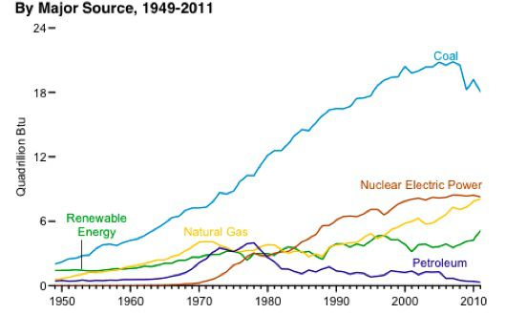
Simulation Activity
Evaluating Other Energy Sources
Students analyze various energy sources, comparing the costs and benefits of natural gas, coal, biomass, nuclear, wind, hydropower, and solar power for generating electricity. Students use real-world data to evaluate the relative costs and benefits of using different fuel sources to generate electricity.
Notes:
Students analyze various energy sources, comparing the costs and benefits of natural gas, coal, biomass, nuclear, wind, hydropower, and solar power for generating electricity. Students use real-world data to evaluate the relative costs and benefits of using different fuel sources to generate electricity.
Feedback: Have students analyze and interpret data, this is a great way to help them to continue to independently problem solve.

Slide 56
Notes:
Thanks for watching, and please continue watching CAPs available from this website.

Slide 57
This Video Was Created With Resources From:
Questions or Comments
Michael Kennedy, Ph.D. MKennedy@Virginia.edu
Rachel L Kunemund, Ph.D. rk8vm@virginia.edu

