Slide 1
Intro
“Big Idea” Question
Review Concepts
Check-In Questions
Teacher Engagement
Vocabulary
Student-Friendly Definition
Examples & Non-Examples
Frayer Model
Simulation/Activity
Notes:
OK everyone, get ready for our next lesson. Just as a reminder, these are the different components that our lesson may include, and you’ll see these icons in the top left corner of each slide so that you can follow along more easily!

Slide 2
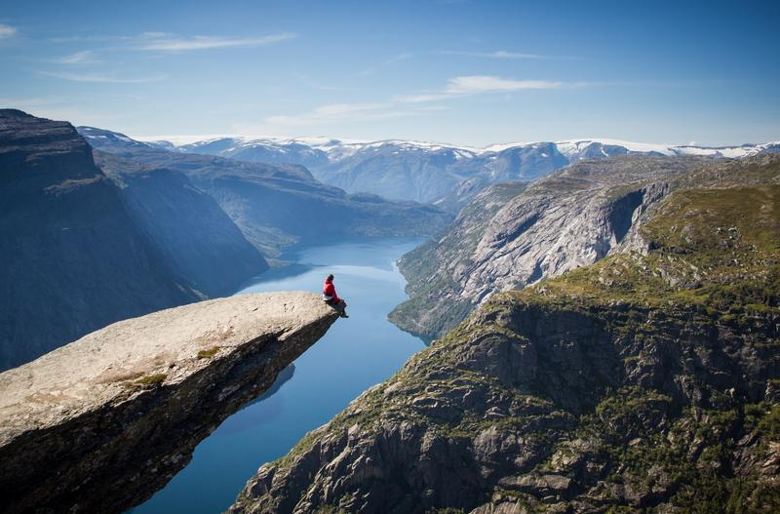
Intro
Potential Energy
Notes:
Today we will learn the definition of potential energy.

Slide 3
Big Question: How do forces, motion, and energy work together to affect the way objects move and interact with the world around us?
Notes:
Our “big question” is: How do forces, motion, and energy work together to affect the way objects move and interact with the world around us?
[Pause and illicit predictions from students.]
Be sure to keep this question and your predictions in mind as we move through this video and questions.

Slide 4
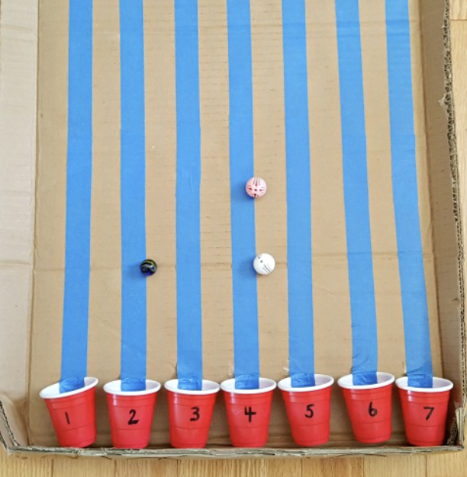
Demonstration
TEACHER DIRECTIONS:
Before viewing: Ask students to recall what they already know about potential energy.
During: Relate the activity to potential energy by discussing how the height of the starting point represents gravitational potential energy. Emphasize that as the cars move downhill, potential energy is converted into kinetic energy.
After: Tell students that today they will be learning more about the term potential energy.
Notes:
To demonstrate potential energy in a 5th-grade classroom, you can conduct a simple and engaging activity using everyday objects. The focus will be on gravitational potential energy. Here's a feasible and effective demonstration:
Activity: "Roller Coaster Potential Energy"
Materials needed:
Small toy cars or marbles
Cardboard or foam tubing (pool noodles can work well)
Ruler or measuring tape
Masking tape or adhesive putty
Small objects (e.g., lightweight plastic figures or erasers)
Scissors
Markers or crayons for decorating (optional)
Procedure:
Introduction:
Begin by discussing potential energy with the students, focusing on gravitational potential energy. Explain that potential energy is stored energy based on an object's position or height.
Designing the Roller Coaster:
Provide students with small toy cars or marbles and materials to create a simple roller coaster track. The tubing or pool noodles can be cut into sections to form curves, slopes, and loops.
Building the Roller Coaster:
In small groups or individually, have students design and build their roller coasters using the provided materials. Encourage creativity in constructing curves and slopes.
Adding Features:
Students can use masking tape or adhesive putty to secure their roller coaster tracks to desks, tables, or other surfaces. They can also add small objects like lightweight plastic figures or erasers as passengers in the toy cars.
Measurement:
Use a ruler or measuring tape to measure and record the height of the starting point of each roller coaster track. This will serve as the initial potential energy height.
Testing and Observations:
Allow students to release their toy cars at the top of the roller coaster tracks and observe the motion. Ask them to note how the potential energy at the starting point is converted into kinetic energy as the cars move down the track.
Class Discussion:
Engage in a class discussion about the observations. Ask questions such as:
How did the height of the starting point affect the motion of the toy cars?
Did the roller coasters with higher starting points have more potential energy?
How did the design of the track influence the movement of the toy cars?
Connect to Energy:
Relate the activity to potential energy by discussing how the height of the starting point represents gravitational potential energy. Emphasize that as the cars move downhill, potential energy is converted into kinetic energy.
Extension Activity:
Challenge students to modify their roller coasters to include different features and observe how these changes affect the potential and kinetic energy.
This hands-on roller coaster activity allows students to directly engage with the concept of potential energy, making it both fun and educational. It provides a tangible experience for students to understand how potential energy is associated with height and can be converted into kinetic energy in real-world scenarios.

Slide 5
Notes:
Before we move on to our new topic, let’s review some other words & concepts that you already learned and make sure you are firm in your understanding.

Slide 6
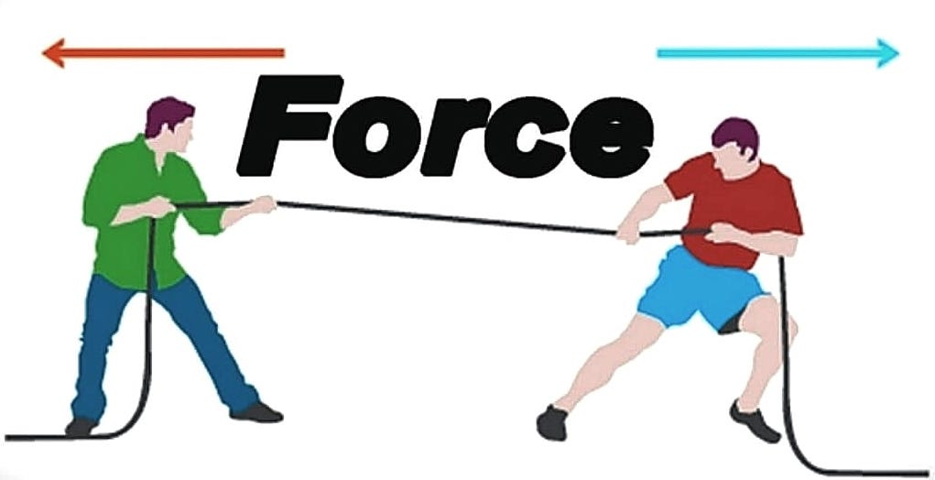
Force: a push or pull of an object
Notes:
Force is a push or pull of an object.

Slide 7
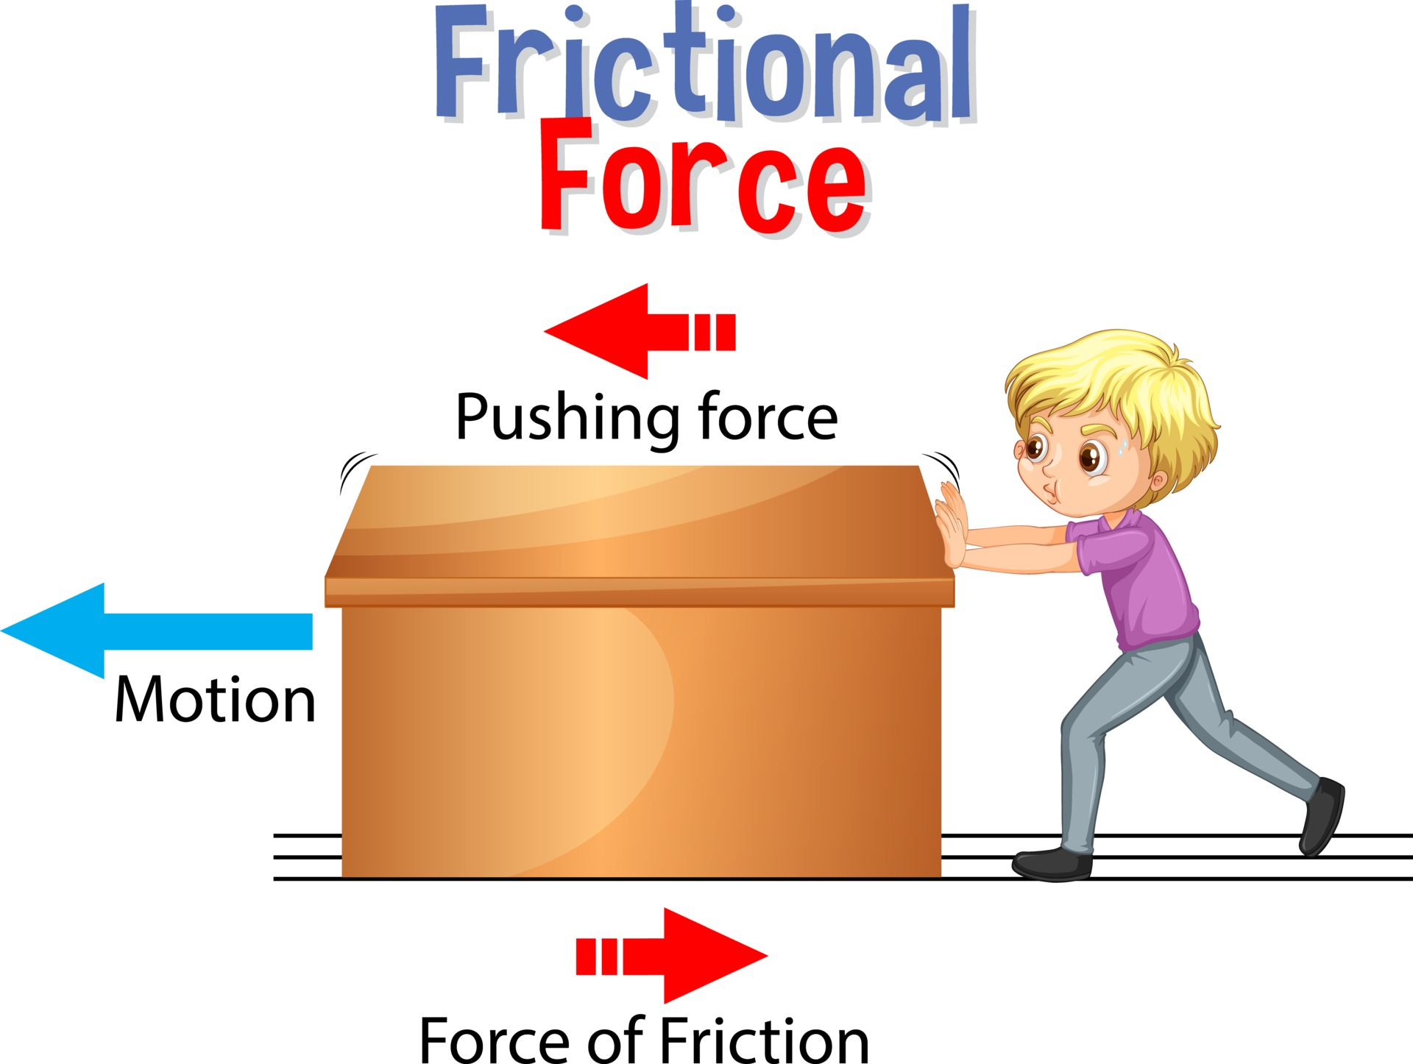
Friction: a force that resists the motion of two surfaces that are touching
Notes:
Friction is a force that resists the motion of two surface that are touching.

Slide 8
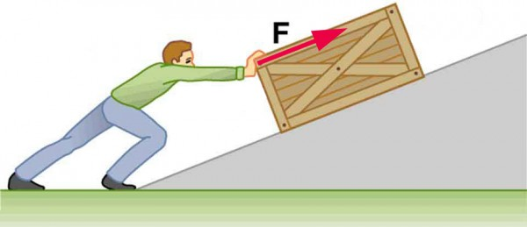
Work: a force acting upon an object causing the object to move in the direction of that force
Notes:
Work is a force acting upon an object causing the object to move in the direction of that force.

Slide 9
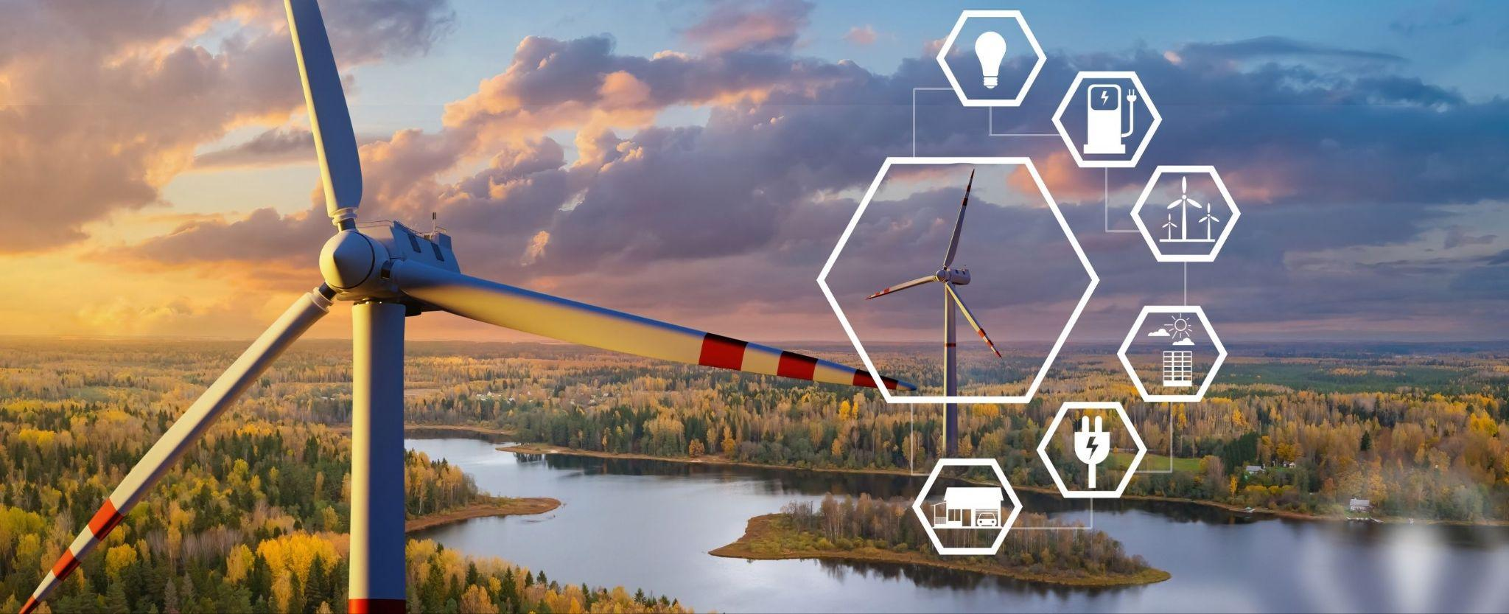
Energy: the ability to cause change
Notes:
Energy is the ability to cause change.

Slide 10
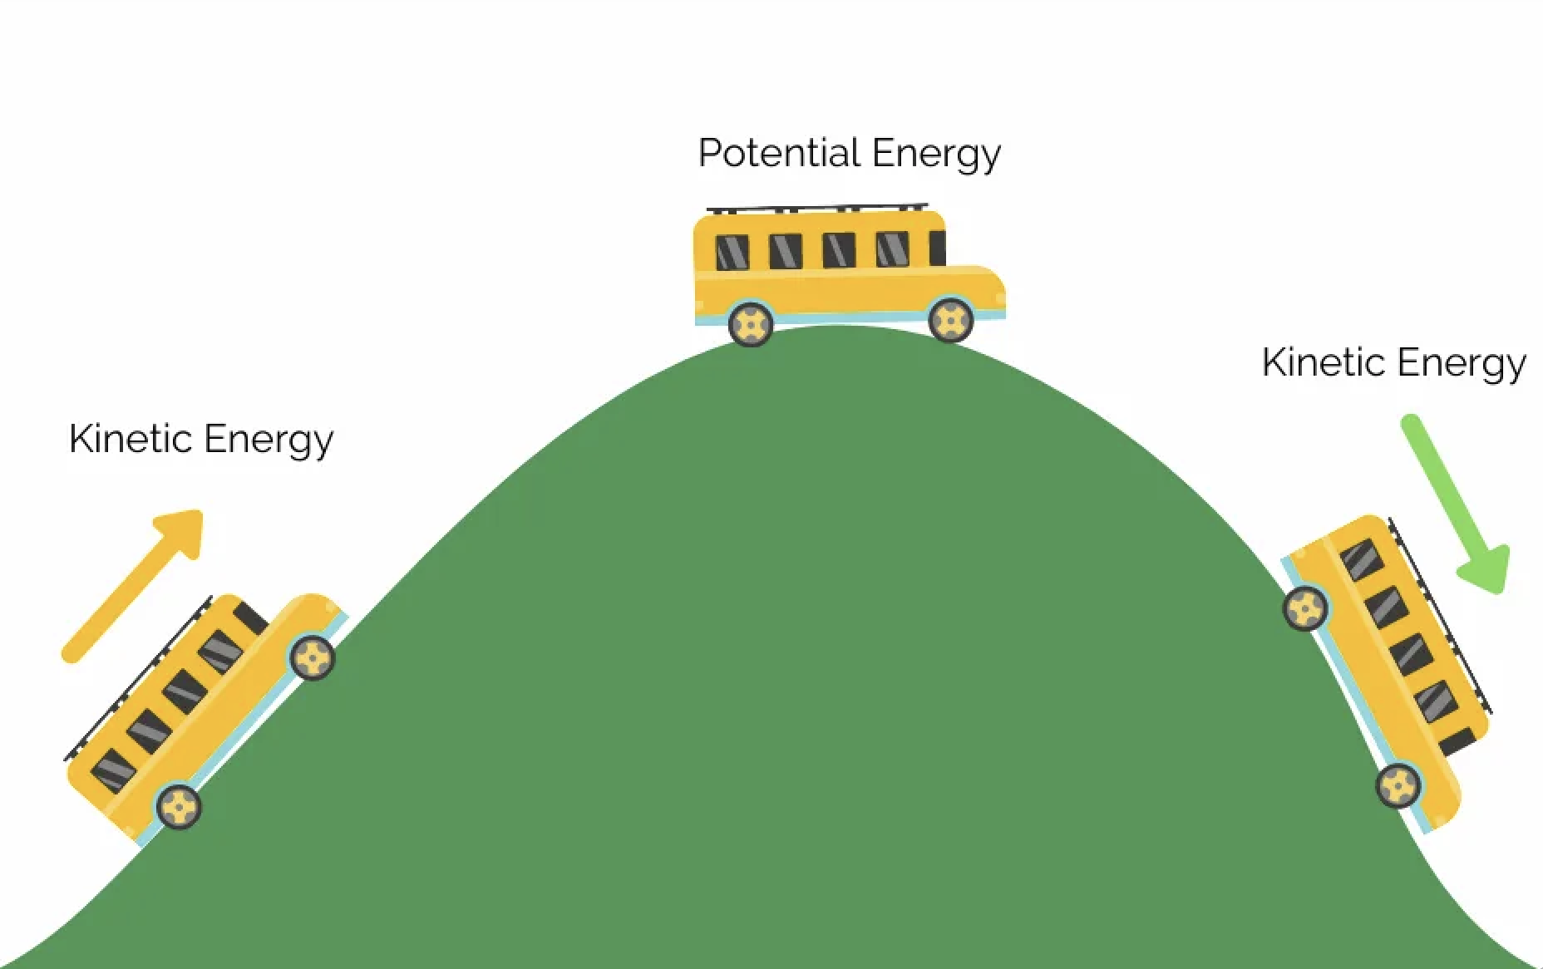
Kinetic Energy: energy of mass in motion
Notes:
Kinetic Energy is energy of mass in motion,.

Slide 11
Notes:
Let’s check-in for understanding.

Slide 12
True or False: Force is a push or pull of an object
Notes:
True or False: Force is a push or pull of an object
[True]

Slide 13
True or False: Force is a push or pull of an object
Notes:
True: Force is a push or pull of an object

Slide 14
Friction: a force that the motion of two surfaces that are touching
Notes:
Friction is a force that the motion of two surface that are touching.

Slide 15
Friction: a force that resists the motion of two surfaces that are touching
Notes:
Friction is a force that resists the motion of two surface that are touching.

Slide 16
Work: a acting upon an object causing the object to move in the of that force
friction, box
force, direction
Notes:
Work is a acting upon an object causing the object to move in the of that force.
[force, direction]

Slide 17
Work: a acting upon an object causing the object to move in the of that force
friction, box
force, direction
Notes:
Work is a force acting upon an object causing the object to move in the direction of that force.

Slide 18
True or False: Energy is the ability to cause change
Notes:
True or False: Energy is the ability to cause change.
[True]

Slide 19
True or False: Energy is the ability to cause change
Notes:
True: Energy is the ability to cause change.

Slide 20
Kinetic Energy: energy of in motion
Notes:
Kinetic Energy is energy of in motion.
[mass]

Slide 21
Kinetic Energy: energy of mass in motion
Notes:
Kinetic Energy is energy of in motion.
[mass]

Slide 22
Potential Energy
Notes:
Now let’s define our new term, Kinetic Energy.

Slide 23
Potential energy: stored energy
Notes:
Potential energy is stored energy.

Slide 24
Notes:
Let’s check-in for understanding.

Slide 25
What is potential energy?
Notes:
What is potential energy?
[stored energy]

Slide 26
Notes:
That is the basic definition, but there is a bit more you need to know.

Slide 27
Let’s Think About an Analogy

Slide 28
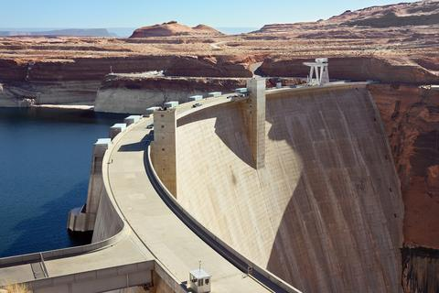
INCREASED PRESSURE
Potential energy, or stored energy, is like water behind a dam. Imagine all of that water building. As more and more water builds up, the pressure on the dam increases.
Notes:
Potential energy, or stored energy, is like water behind a dam. Imagine all of that water building. As more and more water builds up, the pressure on the dam increases.

Slide 29
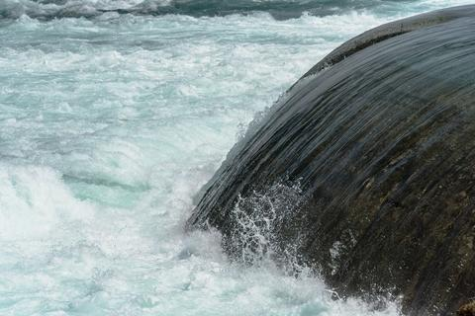
If the dam were to break, all of that water would be released. Think of the energy those rushing waves would have! The energy would no longer be stored.
Potential
Energy
Notes:
If the dam were to break, all of that water would be released. Think of the energy those rushing waves would have! The energy would no longer be stored.

Slide 30
Energy
Potential Energy
Chemical
Energy
Nuclear
Energy
Gravitational Potential
Energy
Notes:
There are three types of potential energy, so we are going to look at each type of potential or stored energy. First, we are going to look at gravitational potential energy.

Slide 31
Gravitational Potential Energy: energy stored because of an object’s position or height above Earth’s surface
Notes:
Gravitational potential energy is energy stored because of an object’s position or height above earth’s surface.

Slide 32
Notes:
Let’s check-in for understanding.

Slide 33
Energy
Potential Energy
Chemical
Energy
Nuclear
Energy
, Potential
Energy
Notes:
[Gravitational]

Slide 34
Energy
Potential Energy
Chemical
Energy
Nuclear
Energy
Gravitational Potential
Energy
Notes:
[Gravitational]

Slide 35
Notes:
Now, let’s talk about some examples of kinetic energy.

Slide 36
An example of potential energy is a stretched rubber band.
Notes:
An example of potential energy is a stretched rubber band.

Slide 37
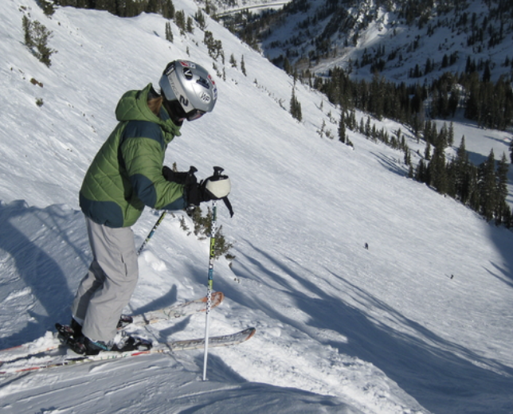
Another example of potential energy is a skier at the top of a hill.
Notes:
Another example of potential energy is a skier at the top of a hill.
A skier gains gravitational potential energy when positioned at the top of a slope. As the skier descends, the potential energy is transformed into kinetic energy.

Slide 38
Notes:
Now, let’s talk about some non-examples of Igneous Rocks.

Slide 39
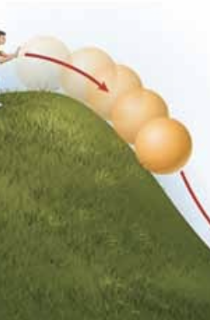
Kinetic energy is NOT an example of potential energy. Kinetic energy is the energy of mass in motion. For instance, a ball rolling down a hill has kinetic energy as it rolls down.
Notes:
Kinetic energy is NOT an example of potential energy. Kinetic energy is the energy of mass in motion. For instance, a ball rolling down a hill has kinetic energy as it rolls down.

Slide 40
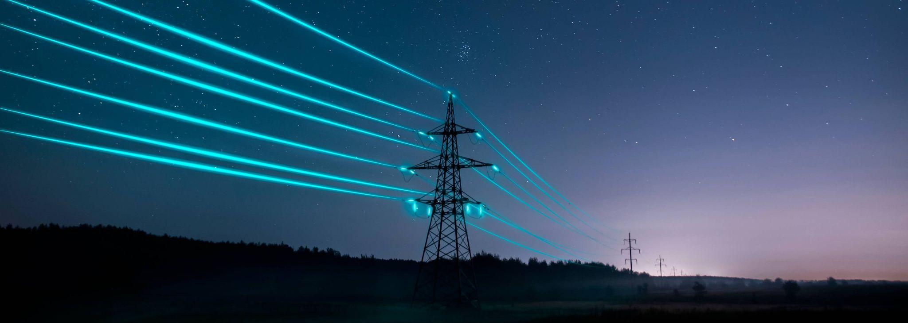
Electricity is NOT an example of potential energy. The movement of electrons is an electric current and involves the motion of charged particles.
Notes:
Electricity is NOT an example of potential energy. The movement of electrons is an electric current and involves the motion of charged particles.

Slide 41
Notes:
Let’s check-in for understanding.

Slide 42
Which is an example of potential energy?
Notes:
Which is an example of potential energy?
[kid sitting]

Slide 43
Which is an example of potential energy?
Notes:
The kid sitting is an example of potential energy.

Slide 44
Remember!!!
Notes:
So remember!

Slide 45
Potential energy: stored energy
Notes:
Potential energy is stored energy.

Slide 46
Notes:
We will now complete this concept map, called a Frayer model, to summarize and further clarify what you have learned about the term potential energy.

Slide 47
Definition
Picture
Potential Energy
Example
How does potential energy impact my life?
Notes:
To complete the Frayer model, we will choose from four choices the correct picture, definition, example, and response to the question, “How does potential energy impact my life?” Select the best response for each question using the information you just learned. As we select responses, we will see how this model looks filled in for the term potential energy.

Slide 48
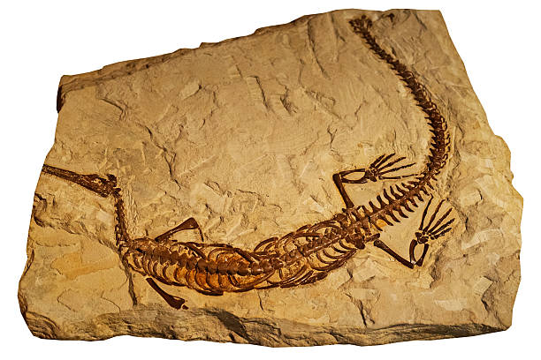
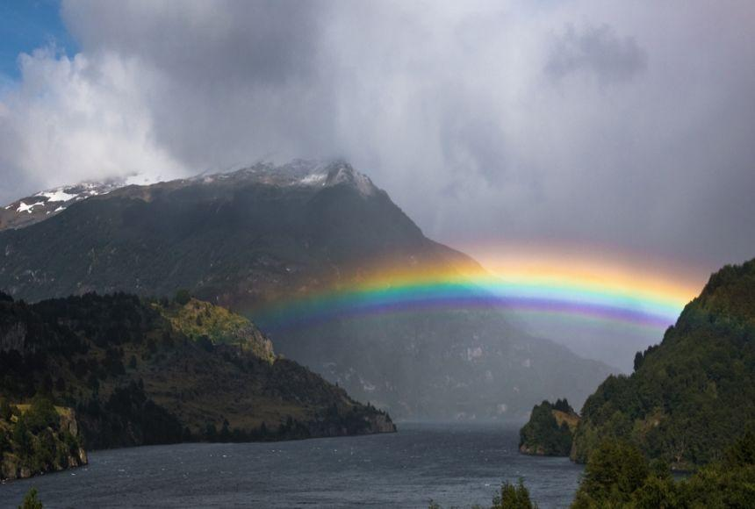
Directions: Choose the correct picture of Potential Energy from the choices below.
A
B
C
D
Notes:
Choose the one correct picture of Potential Energy from these four choices and drag and place it in the picture box below.

Slide 49
Directions: Choose the correct picture of Potential Energy from the choices below.
A
B
C
D
Notes:
You chose the picture that shows Potential Energy.

Slide 50
Definition
Picture
Potential Energy
Example
How does potential energy impact my life?
Notes:
Here is the Frayer Model filled in with a picture of Potential Energy.

Slide 51
Directions: Choose the correct definition of
Potential Energy from the choices below.
A
A place where animals and plants live together
B
The process by which a plant grows
C
The powerhouse of the cell
D
Stored energy (energy that is possible)
Notes:
Choose the one correct definition of Potential Energy from these four choices and drag and place it in the definition box below.

Slide 52
Directions: Choose the correct definition of
Potential Energy from the choices below.
A
A place where animals and plants live together
B
The process by which a plant grows
C
The powerhouse of the cell
D
Stored energy (energy that is possible)
Notes:
You chose “Stored energy (energy that is possible).” This is correct! This is the definition of Potential Energy.

Slide 53
Definition
Picture
Stored energy (energy that is possible)
Potential Energy
Example
How does potential energy impact my life?
Notes:
Here is the Frayer Model with a picture and the definition filled in for Mechanical Energy: The total potential and kinetic energy in a system.

Slide 54
Directions: Choose the correct example of
Potential Energy from the choices below.
A
A roller coaster waiting to go down its track
B
A cake baking in the oven
C
A train riding on its tracks
D
A shark swimming in the ocean
Notes:
Choose the one correct example of Potential Energy from these four choices and drag and place it in the example box below.

Slide 55
Directions: Choose the correct example of
Potential Energy from the choices below.
A
A roller coaster waiting to go down its track
B
A cake baking in the oven
C
A train riding on its tracks
D
A shark swimming in the ocean
Notes:
You chose “A roller coaster waiting to go down its track.” This is an example of Potential Energy!

Slide 56
Definition
Picture
Stored energy (energy that is possible)
Potential Energy
A roller coaster waiting to go down its track
Example
How does potential energy impact my life?
Notes:
Here is the Frayer Model with a picture, definition, and an example of Potential Energy: A roller coaster waiting to go down its track.

Slide 57
Directions: Choose the correct response for “how does
potential energy impact my life?” from the choices below.
A
Potential energy impacts my life by helping us understand how animals and plants live together which keeps our planet alive.
B
Potential energy impacts my life by storing energy that we can use to operate machines, move through the world, and do many other things.
C
Potential energy impacts my life by growing fruits and vegetables that we can eat to be healthy and strong.
D
Potential energy impacts my life by teaching us about animals and plants that lived on our planet many years ago.
Notes:
Choose the one correct response for “how does potential energy impact my life?” from these four choices and drag and place it in the box below.

Slide 58
Directions: Choose the correct response for “how does
potential energy impact my life?” from the choices below.
A
Potential energy impacts my life by helping us understand how animals and plants live together which keeps our planet alive.
B
Potential energy impacts my life by storing energy that we can use to operate machines, move through the world, and do many other things.
C
Potential energy impacts my life by growing fruits and vegetables that we can eat to be healthy and strong.
D
Potential energy impacts my life by teaching us about animals and plants that lived on our planet many years ago.
Notes:
You chose “Potential energy impacts my life by storing energy that we can use to operate machines, move through the world, and do many other things.” That is correct! This is an example of how potential energy impacts your life.

Slide 59
Definition
Picture
Stored energy (energy that is possible)
Potential Energy
Potential energy impacts my life by storing energy that we can use to operate machines, move through the world, and do many other things.
A roller coaster waiting to go down its track
Example
How does potential energy impact my life?
Notes:
Here is the Frayer Model with a picture, definition, example, and a correct response to “how does potential energy impact my life?”: Potential energy impacts my life by storing energy that we can use to operate machines, move through the world, and do many other things.

Slide 60
Remember!!!
Notes:
So remember!

Slide 61
Potential energy: stored energy
Notes:
Potential energy is stored energy.

Slide 62
Big Question: How do forces, motion, and energy work together to affect the way objects move and interact with the world around us?
Notes:
Let’s reflect again on our big question. Our “big question” is: How do forces, motion, and energy work together to affect the way objects move and interact with the world around us?

Slide 63
Simulation Activity
Potential Energy Gizmo
Click the link above to explore more about potential energy.
In this simulation activity, you’ll use the bar chart to observe how the potential energy of different objects changes as you move them. Think about, for example, what causes the ball to have higher potential energy than the paper clips, even when the paperclips are higher.
Notes:
Feedback: Providing a simulation activity is a great way to make science thinking visible. In this simulation, students have the opportunity to make predictions and apply an idea to a new situation by changing the variables in the simulation (i.e., potential energy levels).

Slide 64
Notes:
Thanks, and please continue watching and using CAPs available from this website.

Slide 65
This Was Created With Resources From:
Questions or Comments
Michael Kennedy, Ph.D. MKennedy@Virginia.edu
Rachel L Kunemund, Ph.D. rk8vm@virginia.edu

