Slide 1
Intro
“Big Idea” Question
Review Concepts
Check-In Questions
Teacher Engagement
Vocabulary
Student-Friendly Definition
Examples & Non-Examples
Morphological Word Parts
Frayer Model
Simulation/Activity
Notes:
OK everyone, get ready for our next lesson. Just as a reminder, these are the different components that our lesson may include, and you’ll see these icons in the top left corner of each slide so that you can follow along more easily!

Slide 2
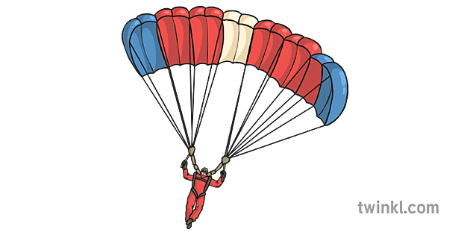
Resistance
Intro
resistance
gravity
Notes:
Today, we’ll be learning about the word: Resistance.

Slide 3
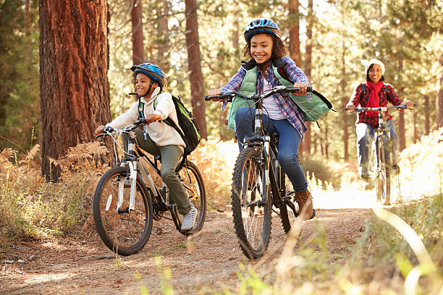
Big Question: How do friction and resistance impact the way objects move through the world?
Notes:
Our “big question” is: How do friction and resistance impact the way objects move through the world?
[Pause and illicit predictions from students.]
I love all these thoughtful scientific hypotheses! Be sure to keep this question and your predictions in mind as we move through these next few lessons, and we’ll continue to revisit it.

Slide 4
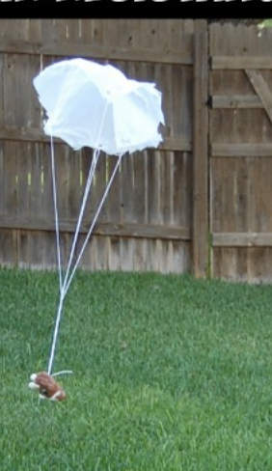
Demonstration
TEACHER DIRECTIONS:
Before viewing: Ask students to recall what they already know about resistance.
During: Engage in a discussion about air resistance. Ask questions such as:
How did the size of the parachute affect its descent? Which parachute experienced more air resistance? How did air resistance impact the fall of the objects?
After: Tell students that today they will be learning more about the term resistance.
Notes:
To teach about resistance in the context of sources of energy, specifically in the context of air resistance, you can conduct a simple and engaging classroom demonstration using paper and different-sized parachutes. This demonstration will help students understand how air resistance opposes the force of gravity. Here's a step-by-step guide for the demonstration:
Materials needed:
Sheets of paper
String or yarn
Small objects (e.g., paperclips, small toys)
Tape
Scissors
Markers or crayons for decorating (optional)
Procedure:
Create Parachutes:
Distribute sheets of paper to students and instruct them to cut out large circles. These circles will serve as the parachutes.
Optionally, students can decorate their parachutes with markers or crayons.
Attach Strings:
Cut equal lengths of string or yarn for each parachute. Attach one end of the string to the center of each parachute using tape.
Attach Objects:
Have students attach small objects (e.g., paperclips or small toys) to the free end of the string. This will act as the payload for the parachute.
Predictions:
Ask students to make predictions about what will happen when they drop their parachute with the attached object.
Experiment:
Invite students to stand on a chair or elevated surface and drop their parachutes. Observe how each parachute behaves as it falls.
Observations:
Discuss the observations as a class. Note the differences in descent speed and behavior among the various parachutes.
Class Discussion:
Engage in a discussion about air resistance. Ask questions such as:
How did the size of the parachute affect its descent?
Which parachute experienced more air resistance?
How did air resistance impact the fall of the objects?
Connect to Energy:
Relate the concept of resistance to energy by discussing how air resistance opposes the force of gravity. Emphasize that when parachutes open up, they catch more air, creating greater resistance.
Extension Activity:
Challenge students to design and create parachutes with different shapes and sizes. Encourage them to explore how altering the design influences air resistance.
This hands-on demonstration provides a tangible and visual way for students to understand the concept of resistance, specifically in the context of air resistance. It connects the idea of resistance to energy by illustrating how forces like air resistance can influence the motion of objects.

Slide 5
Notes:
Before we move on to our new topic, let’s review some other words & concepts that you already learned and make sure you are firm in your understanding.

Slide 6
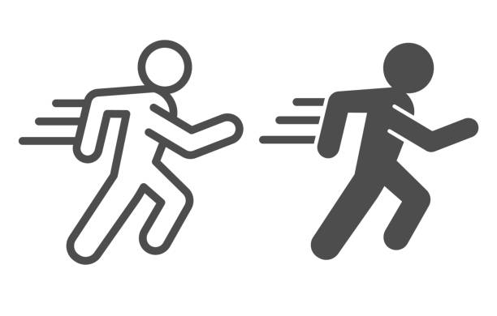
Motion: an object’s direction and speed
Notes:
Motion is an object’s direction and speed.

Slide 7
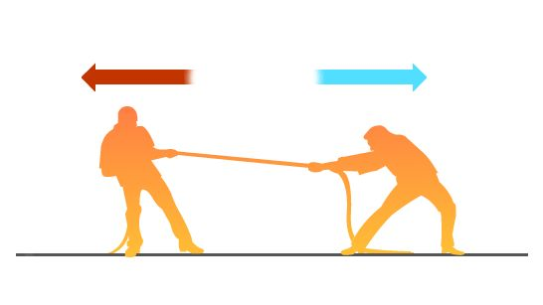
Force: any push or pull that causes an object to move, stop, or change direction.
Notes:
A force is any push or pull that causes an object to move, stop, or change direction.

Slide 8
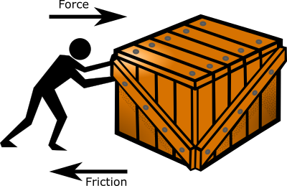
Friction: a force that opposes the motion of an object.
Notes:
Friction is a force that opposes the motion of an object.

Slide 9
Notes:
Now let’s pause for a moment to review the information we have covered already.

Slide 10
___________ is an object’s direction and speed.
Notes:
__________ is an object’s direction and speed.
[Motion]

Slide 11
Motion is an object’s direction and speed.
Notes:
Motion is an object’s direction and speed.

Slide 12
Force is any ______ or _______ that causes an object to move, stop, or change direction.
Notes:
Force is any ______ or _____ that causes an object to move, stop, or change direction.

Slide 13
Force is any push or pull that causes an object to move, stop, or change direction.
Notes:
Force is any push or pull that causes an object to move, stop, or change direction.

Slide 14
What is a force that opposes the motion of an object?
Work
Energy
Friction
Notes:
What is a force that opposes the motion of an object?
[C. Friction]

Slide 15
What is a force that opposes the motion of an object?
Work
Energy
Friction
Notes:
What is a force that opposes the motion of an object?
[C. Friction]

Slide 16
Resistance
Notes:
Now that we’ve reviewed, let’s define the phrase resistance.

Slide 17
Resistance: the force that tries to stop or slow down the movement of an object.
resistance
gravity
Notes:
Resistance is the force that tried to stop or slow down the movement of an object.

Slide 18
Notes:
Let’s check-in for understanding.

Slide 19
What is resistance?
resistance
gravity
Notes:
What is resistance?
[the force that tried to stop or slow down the movement of an object]

Slide 20
Notes:
That is the basic definition, but there is a bit more you need to know.

Slide 21
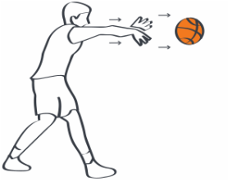
Resistance happens when any object is in motion. If an object is thrown, like this basketball, resistance pushes against the object in the opposite direction. This causes the ball to eventually slow down and stop. Without resistance, the ball would continue on forever!
Notes:
Resistance happens when any object is in motion. If an object is thrown, like this basketball, resistance pushes against the object in the opposite direction. This causes the ball to eventually slow down and stop. Without resistance, the ball would continue on forever!

Slide 22
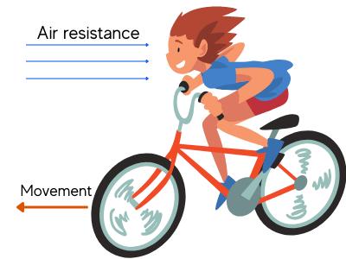
Resistance is a special kind of friction. Remember, friction is a force that opposes the motion of the object when two surfaces are rubbing together. In resistance, the object is in contact with either air or water that causes it to slow down or stop.
Notes:
Resistance is a special kind of friction. Remember, friction is a force that opposes the motion of the object when two surfaces are rubbing together. In resistance, the object is in contact with either air or water that causes it to slow down or stop.

Slide 23
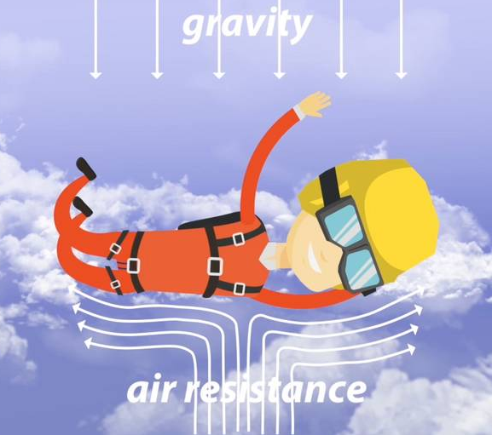
Air resistance happens whenever an object is in motion through the air. As the force of gravity pulls the sky diver to the ground, air resistance pushes up against the sky diver to slow them down.
Notes:
Air resistance happens whenever an object is in motion through the air. As the force of gravity pulls the sky diver to the ground, air resistance pushes up against the sky diver to slow them down.

Slide 24
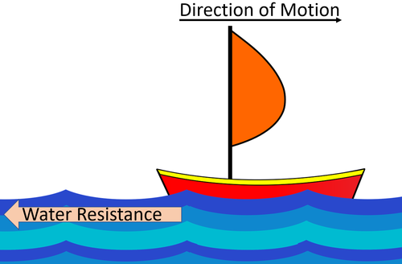
Water resistance is another kind of resistance. As the sailboat moves through the water, the water pushes back against the boat. The wind in the sail helps keep the boat in motion. Without the wind, water resistance will eventually stop the boat.
Notes:
Water resistance is another kind of resistance. As the sail boat moves through the water, the water pushes back against the boat. The wind in the sail helps keep the boat in motion. Without the wind, water resistance will eventually stop the boat.

Slide 25
Notes:
Let’s check-in for understanding.

Slide 26
Resistance pushes in the opposite direction of an object’s motion.
True
False
Notes:
True or False: Resistance pushes in the opposite direction of an object’s motion.
[True]

Slide 27
Resistance pushes in the opposite direction of an object’s motion.
True
False
Notes:
Resistance pushes in the opposite direction of an object’s motion. True

Slide 28
Resistance is a special kind of ______________.
Friction
Energy
Work
Notes:
Resistance is a special kind of ___________.
[friction]

Slide 29
Resistance is a special kind of ______________.
Friction
Energy
Work
Notes:
Resistance is a special kind of ___________. A. Friction

Slide 30
How does air resistance help a sky diver slow down?
Notes:
How does air resistance help a sky diver slow down?
[It pushes up against gravity and that causes them to slow down]

Slide 31
Notes:
Now, let’s talk about some examples of resistance.

Slide 32
Here is an example of resistance. As an airplane flies through the air, air resistance pushes against the airplane. The airplane uses its engines to keep the airplane in motion.
Resistance
Notes:
Here is an example of resistance. As an airplane flies through the air, air resistance pushes against the airplane. The airplane uses its engines to keep the airplane in motion.

Slide 33
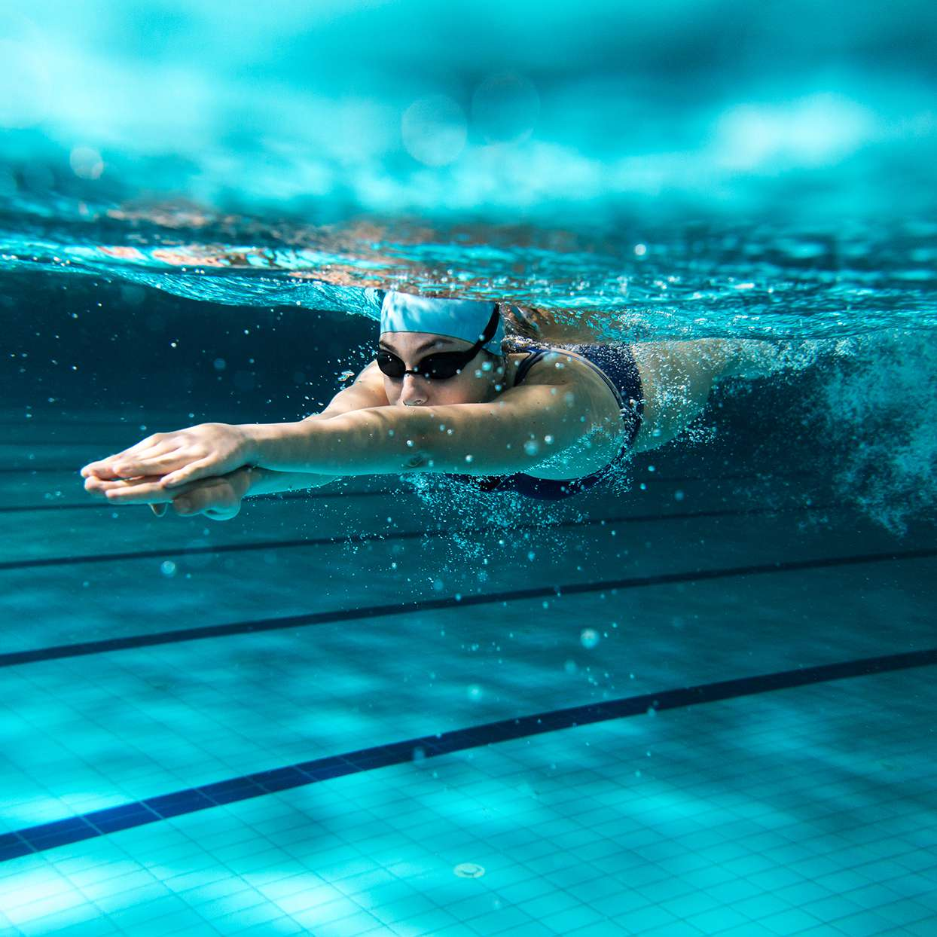
Here is another example of resistance. When we move through water, the particles in water are pushing against us. Our leg and arm muscles have to work hard to keep our motion going, otherwise the resistance would eventually make us stop.
Notes:
Here is another example of resistance. When we move through water, the particles in water are pushing against us. Our leg and arm muscles have to work hard to keep our motion going, otherwise the resistance would eventually make us stop.

Slide 34
Notes:
Now, let’s talk about some non-examples of resistance.

Slide 35
The mug sitting on the table is at rest and is NOT an example of resistance. Because the mug is not in motion, there is no resistance.
Notes:
Here is a non-example of resistance. The mug sitting on the table is at rest. Because the mug is not in motion, there is no resistance.

Slide 36
Watching TV is also NOT an example of resistance. The images on the screen are not in motion through air or space, so they do not experience resistance.
Notes:
Watching TV is another non-example of resistance. The images on the screen are not in motion through air or space, so they do not experience resistance.

Slide 37
Notes:
Now let’s pause for a moment to check your understanding.

Slide 38
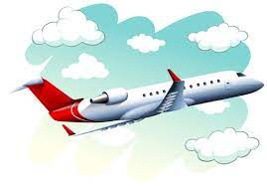
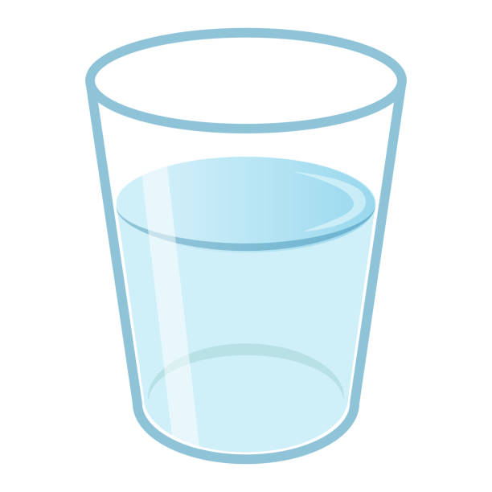
Find an example of resistance
Airplane flying
Glass of water
Book on a table
Notes:
Find an example of resistance.
[airplane flying]

Slide 39
Find an example of resistance
Airplane flying
Glass of water
Book on a table
Notes:
Find an example of resistance. Airplane flying.

Slide 40
Remember!!!
Notes:
So remember!

Slide 41
Resistance: the force that tries to stop or slow down the movement of an object.
resistance
gravity
Notes:
Resistance is the force that tried to stop or slow down the movement of an object.

Slide 42
Notes:
We will now complete this concept map, called a Frayer model, to summarize and further clarify what you have learned about the term resistance.

Slide 43
Definition
Picture
Resistance
Example
How does resistance impact my life?
Notes:
To complete the Frayer model, we will choose from four choices the correct picture, definition, example, and response to the question, “How does resistance impact my life?” Select the best response for each question using the information you just learned. As we select responses, we will see how this model looks filled in for the term resistance.

Slide 44
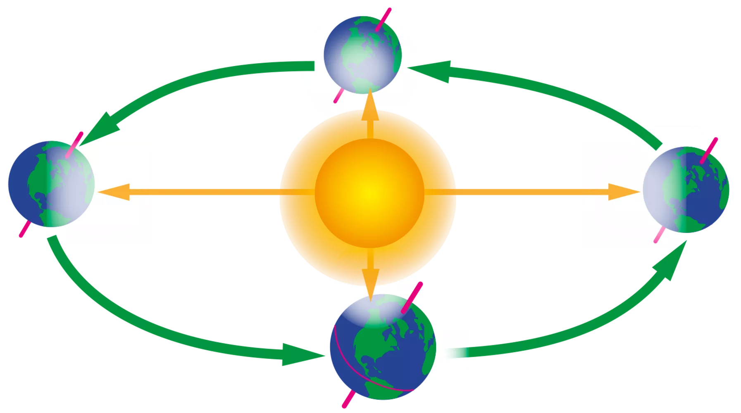
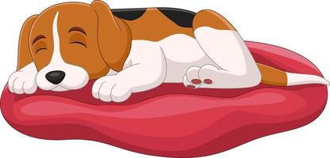
Directions: Choose the correct picture of resistance from the choices below.
A
B
C
D
Notes:
Choose the one correct picture of resistance from these four choices.

Slide 45
Directions: Choose the correct picture of resistance from the choices below.
A
B
C
D
Notes:
This is the picture that shows resistance.

Slide 46
Definition
Picture
Resistance
Example
How does resistance impact my life?
Notes:
Here is the Frayer model filled in with a picture of resistance.

Slide 47
Directions: Choose the correct definition of resistance from the choices below.
A
smallest whole unit of matter
B
energy that is carried by vibration of one or more objects or particles
C
energy in an electric current
D
the force that tries to stop or slow down the movement of an object.
Notes:
Choose the one correct definition of resistance from these four choices.

Slide 48
Directions: Choose the correct definition of resistance from the choices below.
A
smallest whole unit of matter
B
energy that is carried by vibration of one or more objects or particles
C
energy in an electric current
D
the force that tries to stop or slow down the movement of an object.
Notes:
“The force that tries to stop or slow down the movement of an object” is correct! This is the definition of resistance.

Slide 49
Definition
Picture
the force that tries to stop or slow down the movement of an object.
Resistance
Example
How does resistance impact my life?
Notes:
Here is the Frayer Model with a picture and the definition filled in for resistance: the force that tries to stop or slow down the movement of an object.

Slide 50
Directions: Choose the correct example of resistance from the choices below.
A
A sailboat moving through the water
B
A lamp resting on a table
C
A flower growing in a garden
D
Soundwaves vibrating our eardrums
Notes:
Choose the one correct example of resistance from these four choices.

Slide 51
Directions: Choose the correct example of resistance from the choices below.
A
A sailboat moving through the water
B
A lamp resting on a table
C
A flower growing in a garden
D
Soundwaves vibrating our eardrums
Notes:
“A sailboat moving through the water” is correct! This is an example of resistance.

Slide 52
Definition
Picture
the force that tries to stop or slow down the movement of an object.
Resistance
A sailboat moving through the water
Example
How does resistance impact my life?
Notes:
Here is the Frayer Model with a picture, definition, and an example of resistance: a sailboat moving through the water.

Slide 53
Directions: Choose the correct response for “how does resistance impact my life?” from the choices below.
A
Resistance is the smallest building block to life, including our own bodies.
B
Resistance creates a protective layer around the Earth so we don’t get too much light or heat from the Sun.
C
Resistance affects how people and things move through our world. It helps us slow down and stay safe.
Resistance give plants the light energy they need to make food. This energy then helps power our own bodies.
D
Notes:
Choose the one correct response for “how does resistance impact my life?” from these four choices.

Slide 54
Directions: Choose the correct response for “how does resistance impact my life?” from the choices below.
A
Resistance is the smallest building block to life, including our own bodies.
B
Resistance creates a protective layer around the Earth so we don’t get too much light or heat from the Sun.
C
Resistance affects how people and things move through our world. It helps us slow down and stay safe.
Resistance give plants the light energy they need to make food. This energy then helps power our own bodies.
D
Notes:
“ Resistance affects how people and things move through our world. It helps us slow down and stay safe.” That is correct! This is an example of how resistance impacts your life.

Slide 55
Definition
Picture
the force that tries to stop or slow down the movement of an object.
Resistance
Resistance affects how people and things move through our world. It helps us slow down and stay safe.
A sailboat moving through the water
Example
How does resistance impact my life?
Notes:
Here is the Frayer Model with a picture, definition, example, and a correct response to “how does resistance impact my life?”: Resistance affects how people and things move through our world. It helps us slow down and stay safe.

Slide 56
Remember!!!
Notes:
So remember!

Slide 57
Resistance: the force that tries to stop or slow down the movement of an object.
resistance
gravity
Notes:
Resistance is the force that tried to stop or slow down the movement of an object.

Slide 58
Big Question: How do friction and resistance impact the way objects move through the world?
Notes:
Let’s reflect again on our big question. Our “big question” is: How do friction and resistance impact the way objects move through the world?

Slide 59
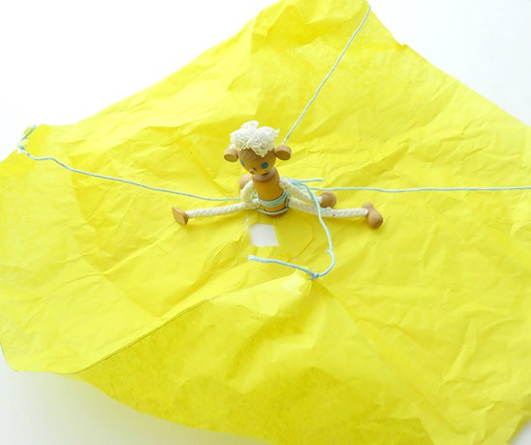
Demonstration Activity
Make a Parachute
In this demonstration, you will build your own parachute.
How does the parachute use air resistance to help the figure land safely?

Slide 60
Notes:
Thanks for watching, and please continue watching CAPs available from this website.

Slide 61
This Was Created With Resources From:
Questions or Comments
Michael Kennedy, Ph.D. MKennedy@Virginia.edu
Rachel L Kunemund, Ph.D. rk8vm@virginia.edu

