Slide 1
Intro
“Big Idea” Question
Review Concepts
Check-In Questions
Teacher Engagement
Vocabulary
Student-Friendly Definition
Examples & Non-Examples
Morphological Word Parts
Frayer Model
Simulation/Activity
Notes:
OK everyone, get ready for our next lesson. Just as a reminder, these are the different components that our lesson may include, and you’ll see these icons in the top left corner of each slide so that you can follow along more easily!

Slide 2
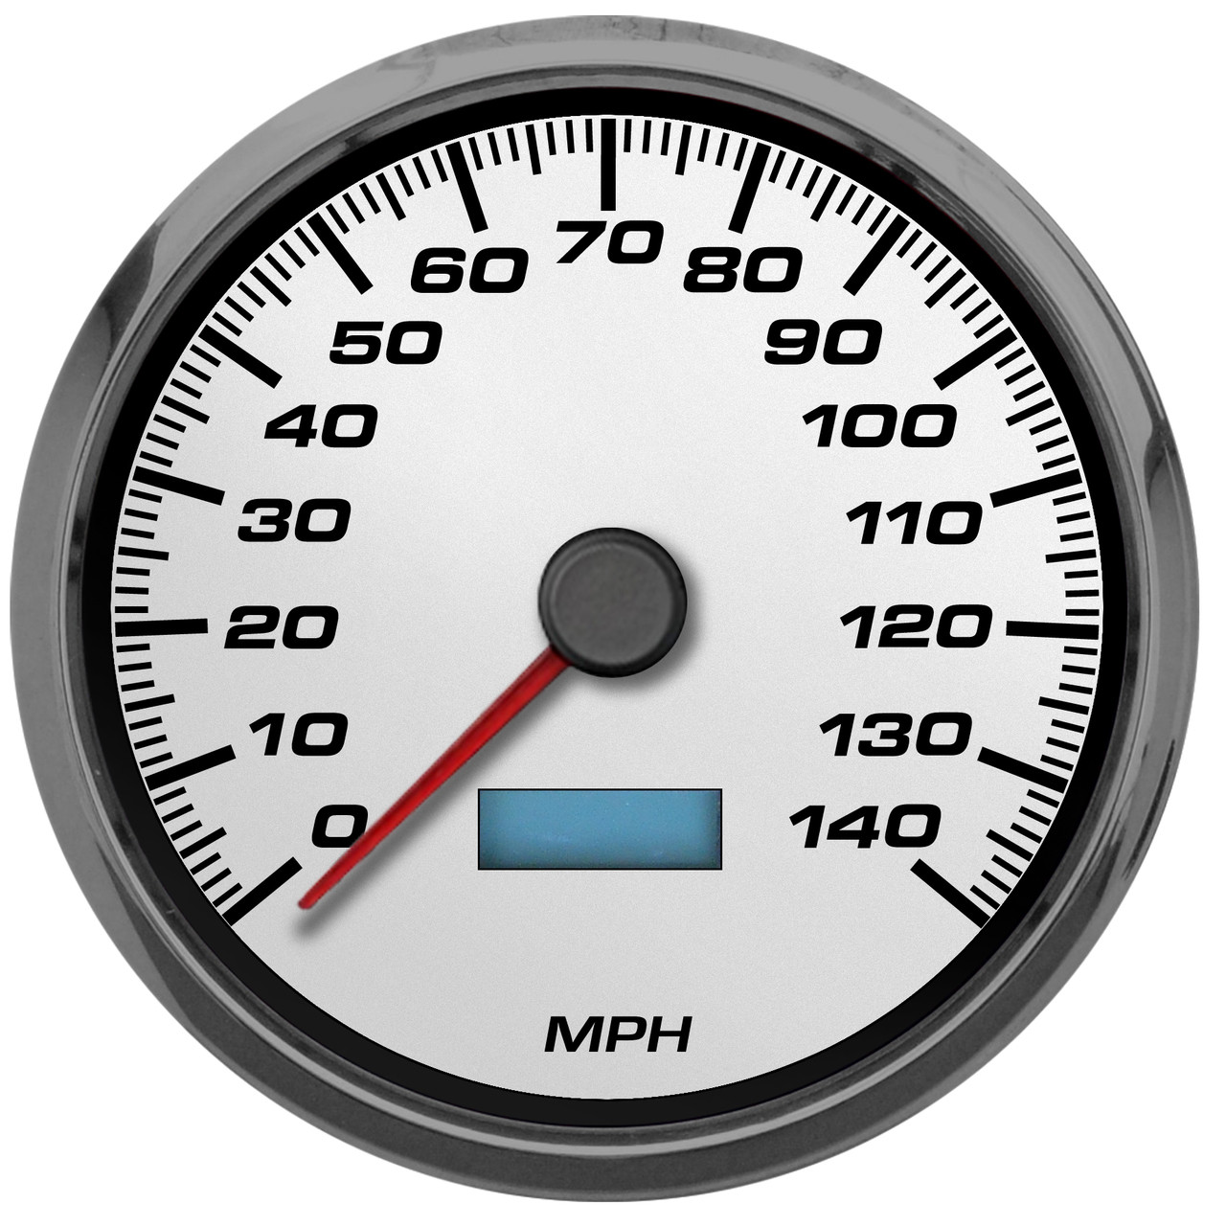
Speed
Intro
Notes:
Next, we’ll be learning about the word: Speed.

Slide 3
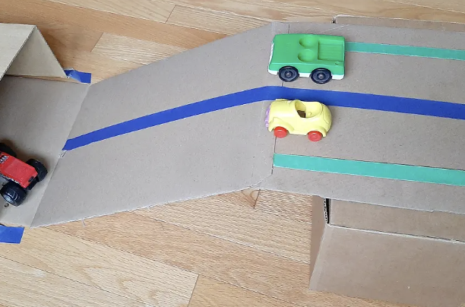
Demonstration
TEACHER DIRECTIONS:
Before viewing: Ask students to recall what they already know about speed.
During: Have students observe the speed of the cars. Discuss which car was the fastest and why. Ask the students if the size and weight of the cars affected their speed.
After: Tell students that today they will be learning more about the term speed.
Notes:
To teach about speed in the context of sources of energy, you can conduct a simple and engaging classroom demonstration using toy cars and ramps. This demonstration will help students understand the relationship between speed and energy. Here's a step-by-step guide for the demonstration:
Materials needed:
Toy cars (of different sizes and weights)
Ramps (you can use cardboard ramps or inclined surfaces)
Stopwatch or timer
Measuring tape or meterstick
Markers or chalk to mark the starting and ending points
Procedure:
Set Up the Ramps:
Place the ramps at an inclined angle, ensuring a smooth surface for the toy cars to roll down.
Mark Starting and Ending Points:
Use markers or chalk to mark a starting point at the top of the ramp and an ending point at the bottom.
Select Toy Cars:
Choose toy cars of different sizes and weights. You can discuss with the students how the mass of an object can affect its speed.
Release and Time:
Place a toy car at the starting point, let it go, and time how long it takes to reach the bottom using a stopwatch or timer.
Repeat and Compare:
Repeat the process with different toy cars. Encourage students to predict which car will be the fastest based on their observations of size and weight.
Measure and Record:
Use a measuring tape or meterstick to measure the distance each car traveled from the starting point to the ending point.
Record the time it took for each car to complete the descent.
Calculate Speed:
Guide students in calculating the speed of each toy car using the formula: Speed = Distance / Time.
Class Discussion:
Discuss the results as a class. Ask questions such as:
Which car was the fastest? Why?
How did the size and weight of the cars affect their speed?
What role did the ramp angle play in the cars' speed?
Relate to Energy:
Connect the concept of speed to energy by explaining that faster-moving objects often have more energy. Relate this to the idea that energy is involved in the motion of the cars as they roll down the ramp.
Extension Activity:
Challenge students to design and create their own ramps to test how different inclines affect the speed of toy cars.
This demonstration not only teaches students about speed but also allows them to observe and analyze the factors influencing the speed of objects. It provides a hands-on experience that reinforces the connection between motion, speed, and energy.

Slide 4
Notes:
Before we move on to our new topic, let’s review some other words & concepts that you already learned and make sure you are firm in your understanding.

Slide 5
Direction: where something moves or points
Notes:
Direction is where something moves or points

Slide 6
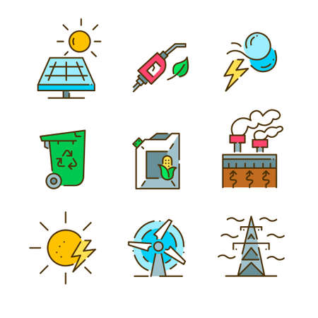
Energy: the ability to cause change
Notes:
Energy is the ability to cause change.

Slide 7
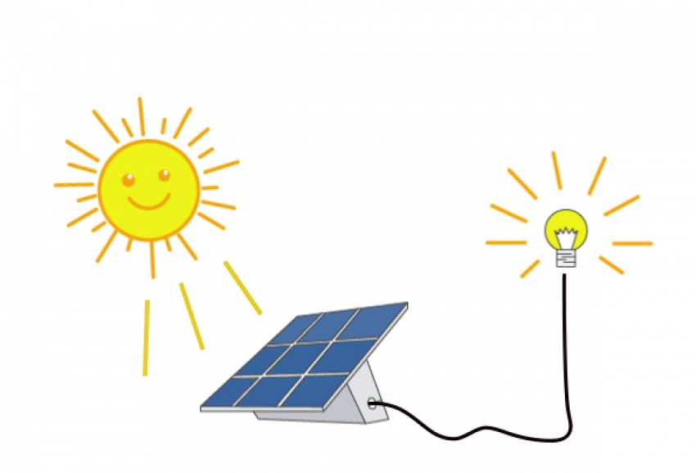
Energy transformation: changing energy from one form to another
Notes:
Energy transformation is when energy changes from one form to another.

Slide 8
Notes:
Now let’s pause for a moment to review the information we have covered already.

Slide 9
Energy is the ability to cause _______.
Similarities
Change
Emotions
Notes:
Energy is the ability to cause ________.
[Change]

Slide 10
Energy is the ability to cause _______.
Similarities
Change
Emotions
Notes:
Energy is the ability to cause ________.
[Change]

Slide 11
Energy transformation is keeping the form of energy the same.
True
False
Notes:
Energy transformation is keeping the form of energy the same.
[False]

Slide 12
Energy transformation is keeping the form of energy the same.
True
False
Notes:
False: Energy transformation is changing energy from one form to another.

Slide 13
Direction is where something ______ or ______.
Notes:
Direction is where something ______ or ______.
[moves, points]

Slide 14
Direction is where something moves or points.
Notes:
Direction is where something ______ or ______.
[moves, points]

Slide 15
Speed
Notes:
Now that we’ve reviewed, let’s define the phrase speed.

Slide 16
Speed: how fast an object moves
Notes:
Speed is how fast an object moves.

Slide 17
Notes:
Let’s check-in for understanding.

Slide 18
What is speed?
Notes:
What is speed?
[Speed is how fast an object moves.]

Slide 19
Notes:
That is the basic definition, but there is a bit more you need to know.

Slide 20
Speed is a measurement that describes a relationship between how far you go and how long it takes you to get there.
Notes:
Speed is a measurement that describes a relationship between how far you go and how long it takes you to get there.

Slide 21
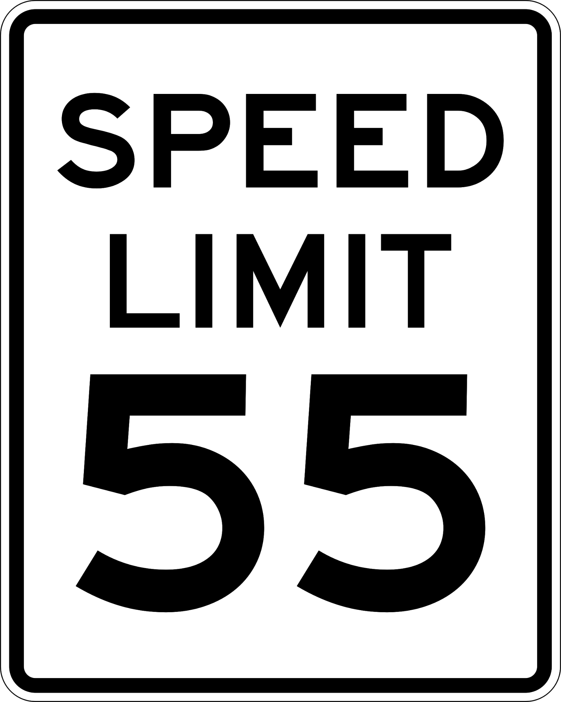
You might see the word speed all around you. For example, signs like this tell drivers they need to drive a speed of 55 miles per hour.
Notes:
You might see the word speed all around you. For example, signs like this tell drivers they need to drive a speed of 55 miles per hour.

Slide 22
The speed of an object can be described as increasing, decreasing, or remaining the same.
Notes:
The speed of an object can be described as increasing, decreasing, or remaining the same. For example, runners have an increasing speed when they run a race. Cars have decreasing speed when they use their brakes. If you take a nap, your speed is remaining the same - you aren’t moving!

Slide 23
Notes:
Let’s check-in for understanding.

Slide 24
Speed is a ___________ that describes a relationship between how far you go and how long it takes you to get there.
Clock
Measurement
Ruler
Notes:
Speed is a ___________ that describes a relationship between how far you go and how long it takes you to get there.
[Measurement]

Slide 25
Speed is a ___________ that describes a relationship between how far you go and how long it takes you to get there.
Clock
Measurement
Ruler
Notes:
Speed is a [measurement[ that describes a relationship between how far you go and how long it takes you to get there.
[Measurement]

Slide 26
True or False: The speed of an object can be described as increasing, decreasing, or remaining the same.
True
False
Notes:
True or False: The speed of an object can be described as increasing, decreasing, or remaining the same.

Slide 27
True or False: The speed of an object can be described as increasing, decreasing, or remaining the same.
True
False
Notes:
True: The speed of an object can be described as increasing, decreasing, or remaining the same.

Slide 28
Notes:
Now, let’s talk about some examples of speed.

Slide 29
Airplanes are objects that move. When airplanes are way up in the sky, they can be traveling at a speed of almost 550 miles per hour!
Notes:
Airplanes are objects that move. When airplanes are way up in the sky, they can be traveling at a speed of almost 550 miles per hour!

Slide 30
Cheetahs are objects that move. Cheetahs are the fastest land animal and can run at a speed of about 70 miles per hour!
Notes:
Cheetahs are objects that move. Cheetahs are the fastest land animal and can run at a speed of about 70 miles per hour!

Slide 31
Notes:
Let’s check-in for understanding.

Slide 32
What is speed?
Notes:
What is speed?
[Speed is how fast an object moves.]

Slide 33
Notes:
Now, let’s talk about some non-examples of speed.

Slide 34
Measuring the weight of an object is NOT an example of speed. Measuring weight does not tell you how fast it goes, so weight is not a measurement of speed.
Notes:
Measuring the weight of an object does not tell you how fast it goes, so weight is not a measurement of speed.

Slide 35
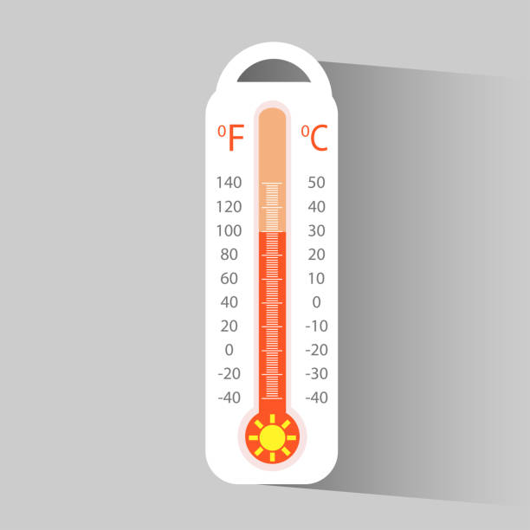
Measuring how hot it is outside does NOT tell you how fast an object moves, so temperature is not a measurement of speed.
Notes:
Measuring how hot it is outside does not tell you how fast an object moves, so temperature is not a measurement of speed.

Slide 36
Notes:
Now let’s pause for a moment to check your understanding.

Slide 37
Why does the cheetah show speed, but the thermometer does not?
Notes:
Why does the cheetah show speed, but the thermometer does not?
[Because the cheetah is an object moving. The thermometer is showing temperature]

Slide 38
Remember!!!
Notes:
So remember!

Slide 39
Speed: how fast an object moves
Notes:
Speed is how fast an object moves.

Slide 40
Notes:
We will now complete this concept map, called a Frayer model, to summarize and further clarify what you have learned about the term speed.

Slide 41
Definition
Picture
Speed
Example
How does speed impact my life?
Notes:
To complete the Frayer model, we will choose from four choices the correct picture, definition, example, and response to the question, “How does speed impact my life?” Select the best response for each question using the information you just learned. As we select responses, we will see how this model looks filled in for the term speed.

Slide 42
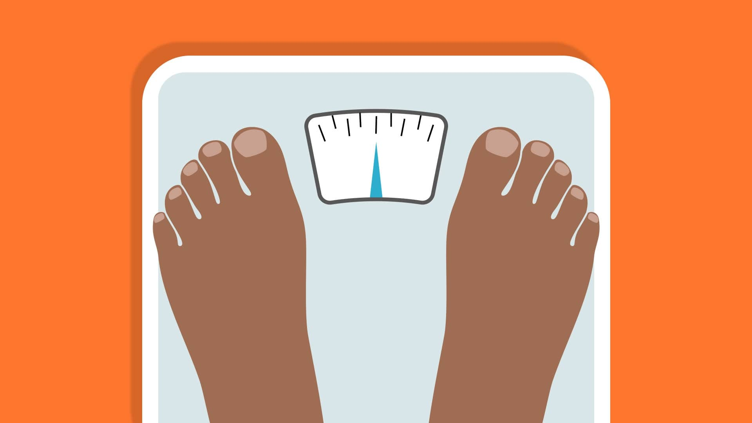
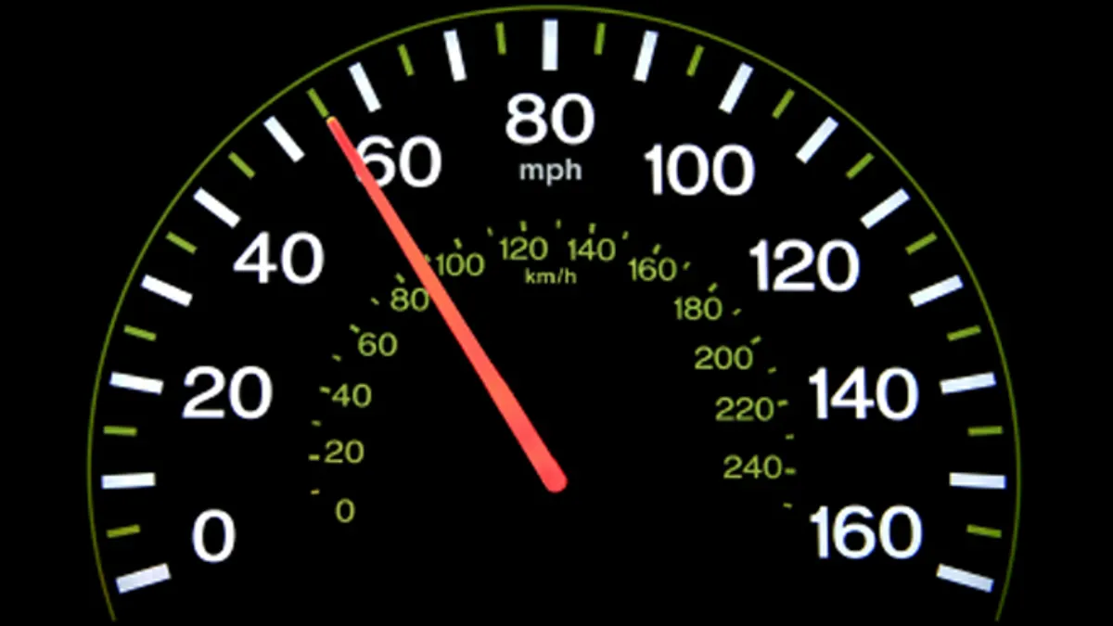
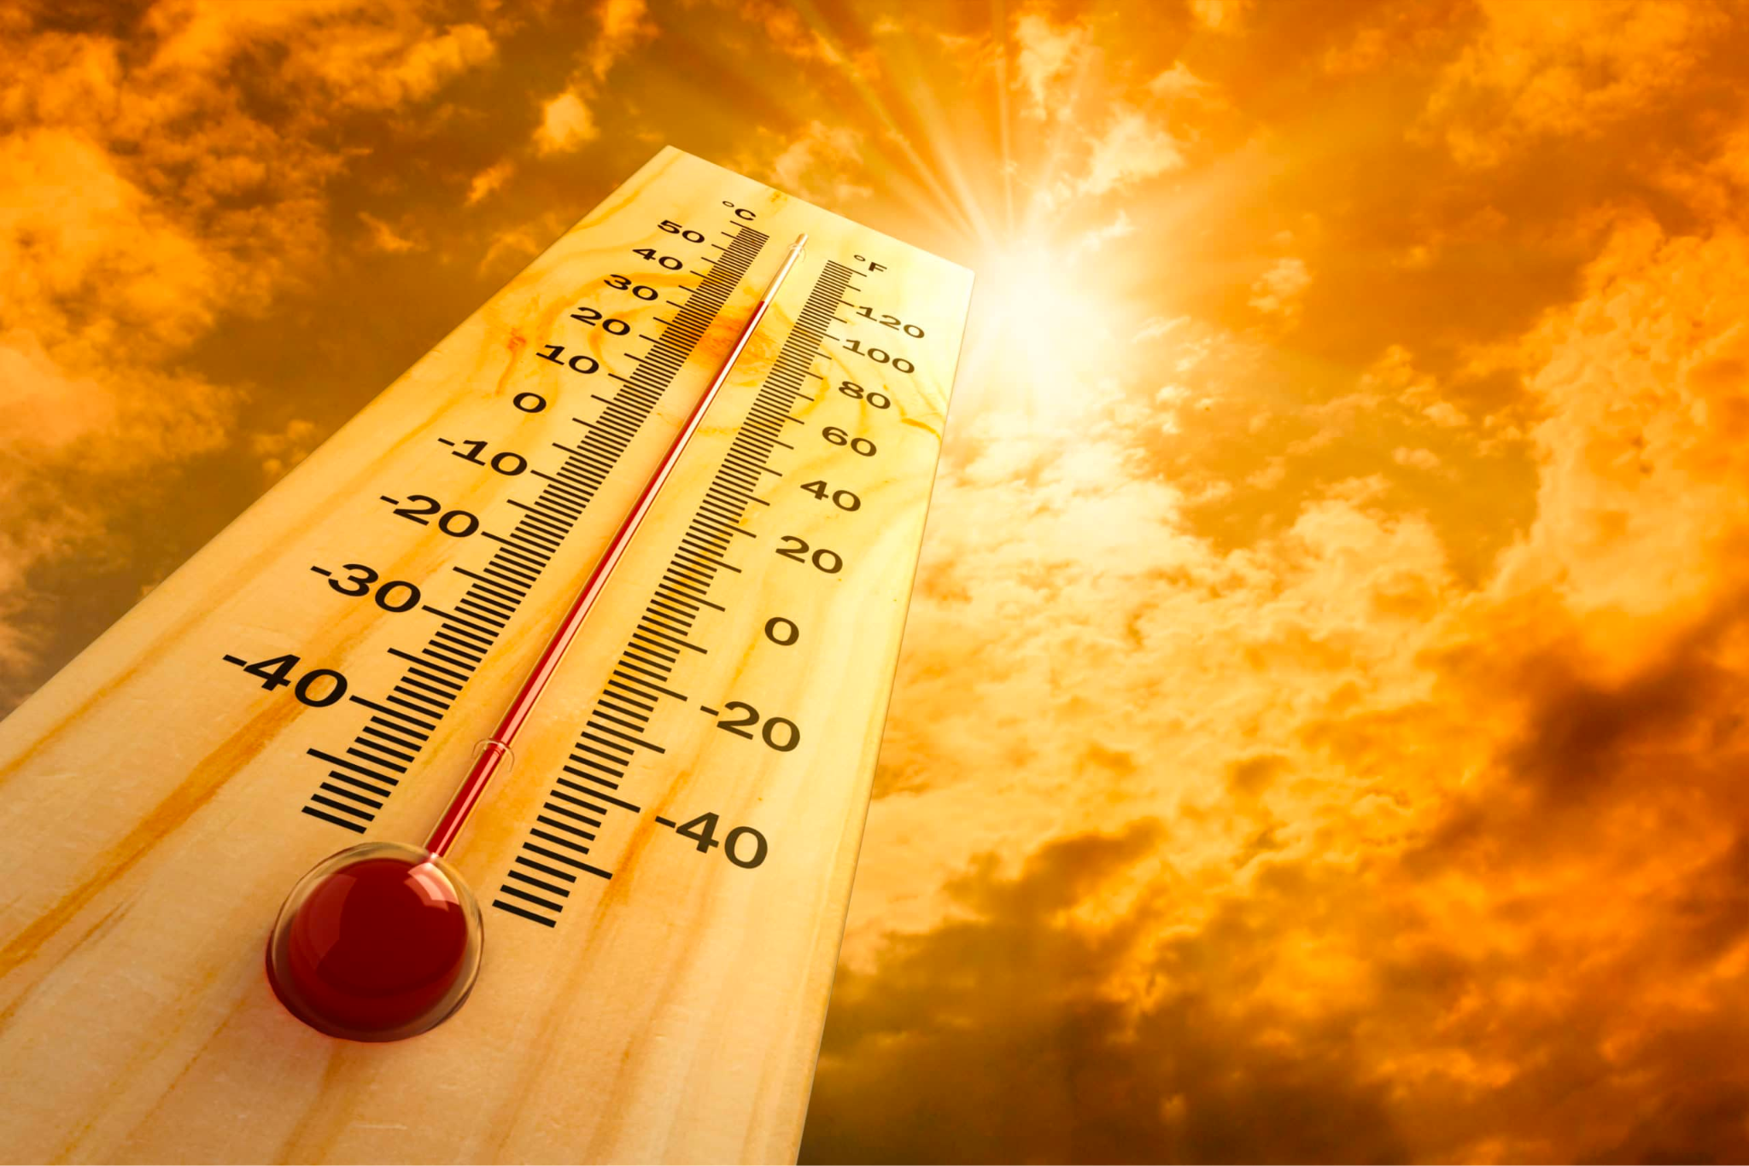
Directions: Choose the correct picture of speed from the choices below.
A
B
C
D
Notes:
Choose the one correct picture of speed from these four choices.

Slide 43
Directions: Choose the correct picture of speed from the choices below.
A
B
C
D
Notes:
This is the picture that shows speed.

Slide 44
Definition
Picture
Speed
Example
How does speed impact my life?
Notes:
Here is the Frayer model filled in with a picture of speed.

Slide 45
Directions: Choose the correct definition of Speed from the choices below.
A
How noisy an object is
B
How hot an object is
C
How heavy an object is
D
How fast an object moves
Notes:
Choose the one correct definition of speed from these four choices.

Slide 46
Directions: Choose the correct definition of Speed from the choices below.
A
How noisy an object is
B
How hot an object is
C
How heavy an object is
D
How fast an object moves
Notes:
“How fast an object moves” is correct! This is the definition of speed.

Slide 47
Definition
Picture
How fast an object moves
Speed
Example
How does speed impact my life?
Notes:
Here is the Frayer Model with a picture and the definition filled in for speed: how fast an object moves.

Slide 48
Directions: Choose the correct example of Speed from the choices below.
A
A train moving at 50 miles per hour
B
A cup of lemonade that tastes sweet
C
A singer singing a song
D
A bag of french fries that weighs 3 pounds
Notes:
Choose the one correct example of speed from these four choices.

Slide 49
Directions: Choose the correct example of Speed from the choices below.
A
A train moving at 50 miles per hour
B
A cup of lemonade that tastes sweet
C
A singer singing a song
D
A bag of french fries that weighs 3 pounds
Notes:
“A train moving at 50 miles per hour” is correct! This is an example of speed.

Slide 50
Definition
Picture
How fast an object moves
Speed
A train moving at 50 miles per hour
Example
How does speed impact my life?
Notes:
Here is the Frayer Model with a picture, definition, and an example of speed: A train moving at 50 miles per hour.

Slide 51
Directions: Choose the correct response for “how does speed impact my life?” from the choices below.
A
Speed helps us determine how much an object weighs
B
Speed describes how fast a vehicle gets us to school
C
Speed shows us how cold it is outside
Speed gives us a way to describe the taste of food
D
Notes:
Choose the one correct response for “how does speed impact my life?” from these four choices.

Slide 52
Directions: Choose the correct response for “how does speed impact my life?” from the choices below.
A
Speed helps us determine how much an object weighs
B
Speed describes how fast a vehicle gets us to school
C
Speed shows us how cold it is outside
Speed gives us a way to describe the taste of food
D
Notes:
“Speed describes how fast a vehicle gets us to school.” That is correct! This is an example of how speed impacts your life.

Slide 53
Definition
Picture
How fast an object moves
Speed
A train moving at 50 miles per hour
Speed describes how fast a vehicle gets us to school
Example
How does speed impact my life?
Notes:
Here is the Frayer Model with a picture, definition, example, and a correct response to “how does speed impact my life?”: Speed describes how fast a vehicle gets us to school.

Slide 54
Remember!!!
Notes:
So remember!

Slide 55
Speed: how fast an object moves
Notes:
Speed is how fast an object moves.

Slide 56
Big Question: How do direction and speed impact the motion of objects in the world around us?
Notes:
Let’s reflect again on our big question. Our “big question” is: How do direction and speed impact the motion of objects in the world around us?
Does anyone have any additional examples to share that haven’t been discussed yet?
In our “big question,” there is one more vocabulary word we need to explore.

Slide 57
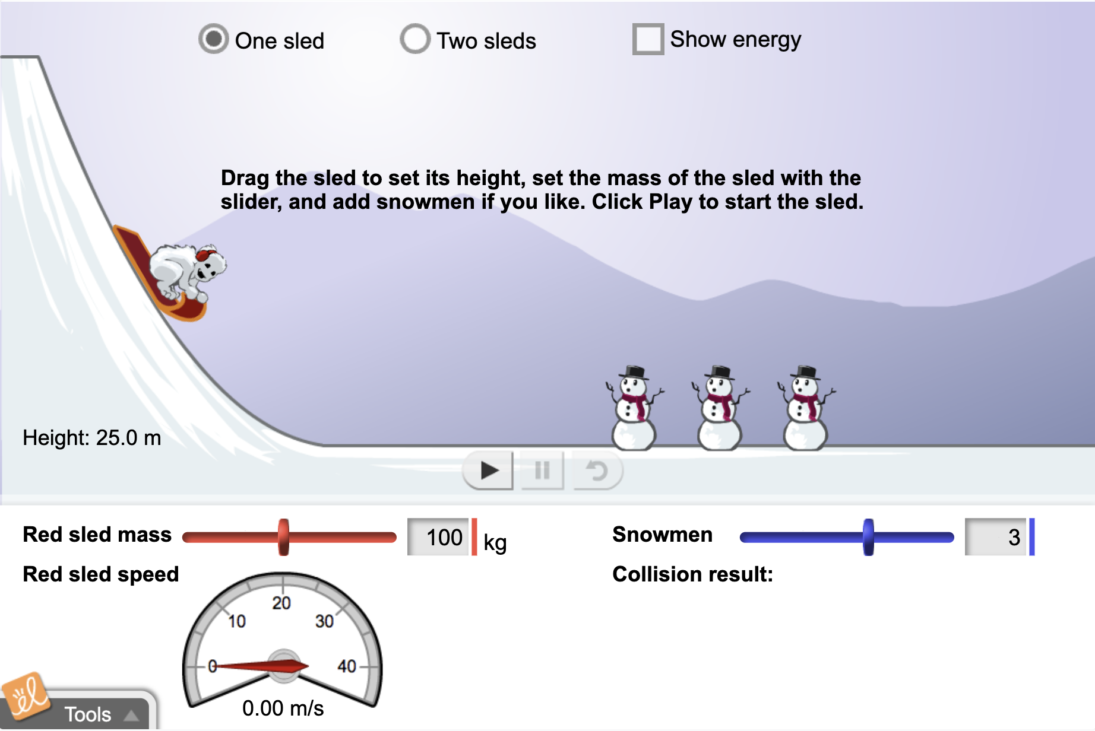
Simulation Activity
Speed
(Gizmos)
Click the link above for a simulation to explore speed.
In this activity, you will explore how changing certain variables can impact the speed of sleds.
Notes:
*This is the simulation for speed. Feel free to explore changing the height of the sled and the mass of the sled to see how those changes impact the speed of the sled. Also, try selecting “Two sleds” to have students compare speeds.

Slide 58
Notes:
Thanks for watching, and please continue watching CAPs available from this website.

Slide 59
This Was Created With Resources From:
Questions or Comments
Michael Kennedy, Ph.D. MKennedy@Virginia.edu
Rachel L Kunemund, Ph.D. rk8vm@virginia.edu

