Slide 1
Intro
“Big Idea” Question
Review Concepts
Check-In Questions
Teacher Engagement
Vocabulary
Student-Friendly Definition
Examples & Non-Examples
Morphological Word Parts
Frayer Model
Simulation/Activity
Notes:
OK everyone, get ready for our next lesson. Just as a reminder, these are the different components that our lesson may include, and you’ll see these icons in the top left corner of each slide so that you can follow along more easily!

Slide 2
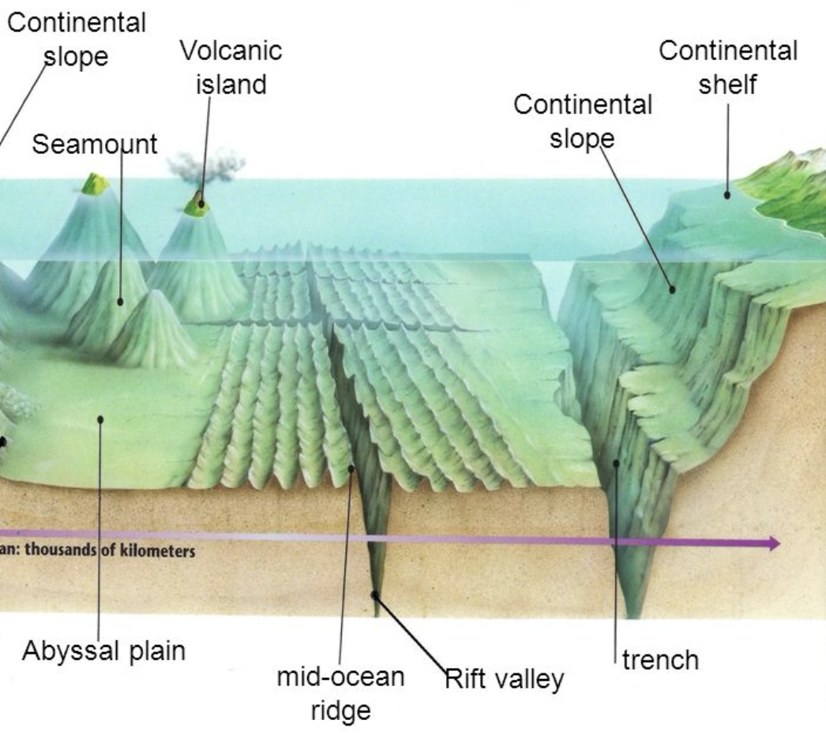
Intro
Abyssal Plain
Notes:
Today, we’ll be learning about the word: Abyssal Plain.

Slide 3
Big Question: How does the abyssal plain influence the balance of marine life and the overall health of the ocean environment?
Notes:
Our “big question” is: How does the abyssal plain influence the balance of marine life and the overall health of the ocean environment?
[Pause and illicit predictions from students.]
I love all these thoughtful scientific hypotheses! Be sure to keep this question and your predictions in mind as we move through these next few lessons, and we’ll continue to revisit it.

Slide 4
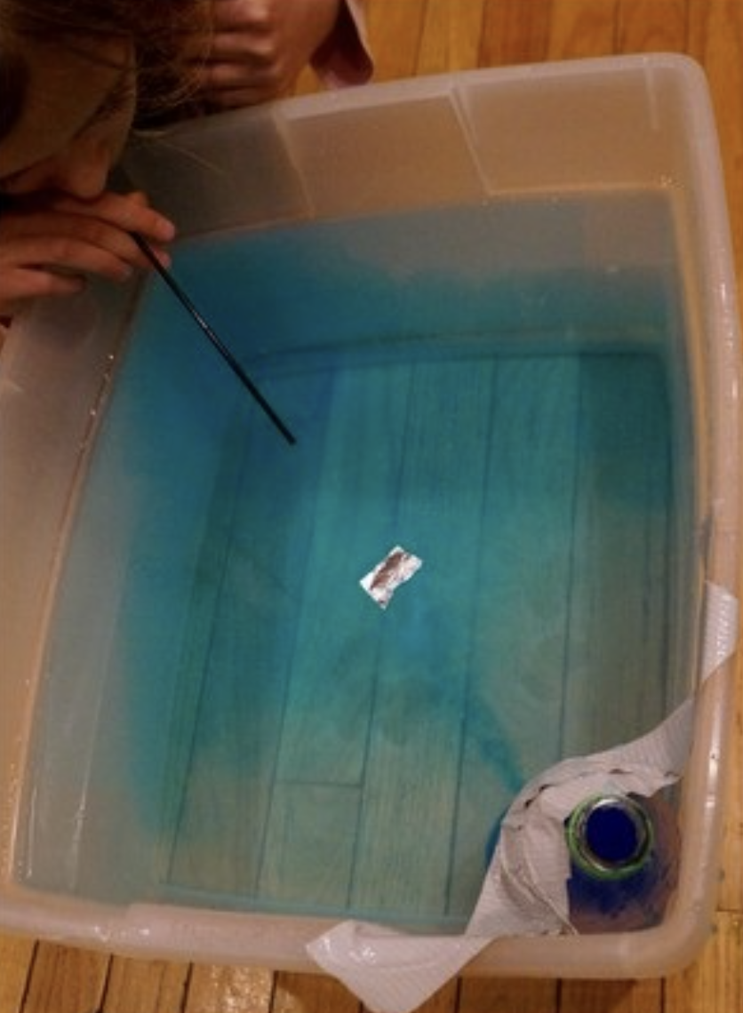
Demonstration
TEACHER DIRECTIONS:
Before viewing: Ask students what they already know about abyssal plains. Tell students today they will be learning about abyssal plains.
During: Discuss how abyssal plains can have some variations but are generally flat compared to other parts of the ocean floor.
After: Tell students that today they will be learning more about abyssal plains.
Notes:
A feasible and effective classroom demonstration to teach about the abyssal plain could involve creating a simple model using materials readily available in the classroom. Here's a step-by-step demonstration:
Materials:
Large, shallow container (like a tray or a baking sheet)
Playdough or modeling clay
Blue food coloring
Small plastic marine animal figurines or cutouts
Craft sticks or plastic utensils
Procedure:
Set up the Abyssal Plain:
Fill the large container with a layer of playdough or modeling clay, smoothing it out to create a flat surface. This represents the abyssal plain.
Add Ocean Water:
Fill a small container with water and add a few drops of blue food coloring to represent the ocean water. Pour this colored water into the large container, covering the playdough surface.
Introduce Marine Life:
Place plastic marine animal figurines or cutouts onto the abyssal plain. Discuss with the students how the flatness of the playdough represents the vast and level abyssal plain.
Discuss Features:
Use craft sticks or plastic utensils to create trenches or other features on the playdough surface. Discuss how abyssal plains can have some variations but are generally flat compared to other parts of the ocean floor.
Talk about Nutrient Absorption:
Explain that the abyssal plain can absorb nutrients from the water above, just like the playdough can absorb the colored water. Discuss how this process supports marine life in the deep ocean.
Explore Marine Life Adaptations:
Discuss how marine life in the abyssal plain has adapted to the unique conditions, such as low light and high pressure. Encourage students to think about the types of animals that might inhabit this environment.
Class Discussion:
Conclude with a class discussion about the importance of abyssal plains in the ocean system and their role in supporting marine life.

Slide 5
Notes:
Before we move on to our new topic, let’s review some other words & concepts that you already learned and make sure you are firm in your understanding.

Slide 6
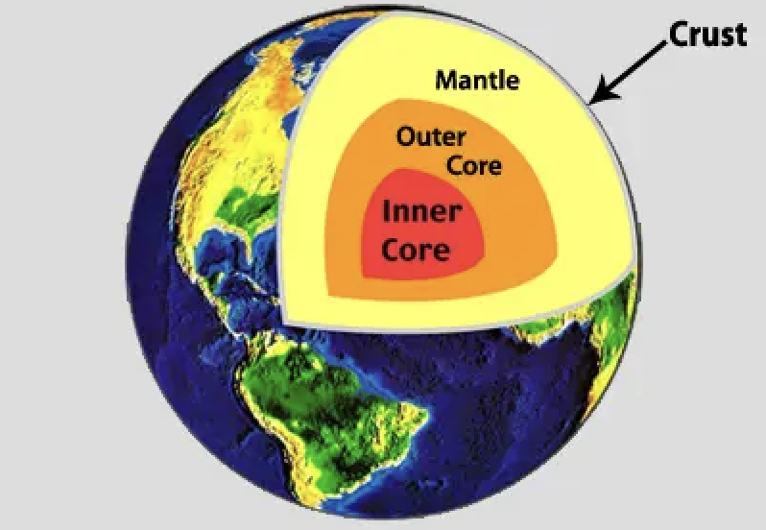
Crust: The outermost shell of the Earth
Notes:
Crust is the outermost shell of the Earth

Slide 7
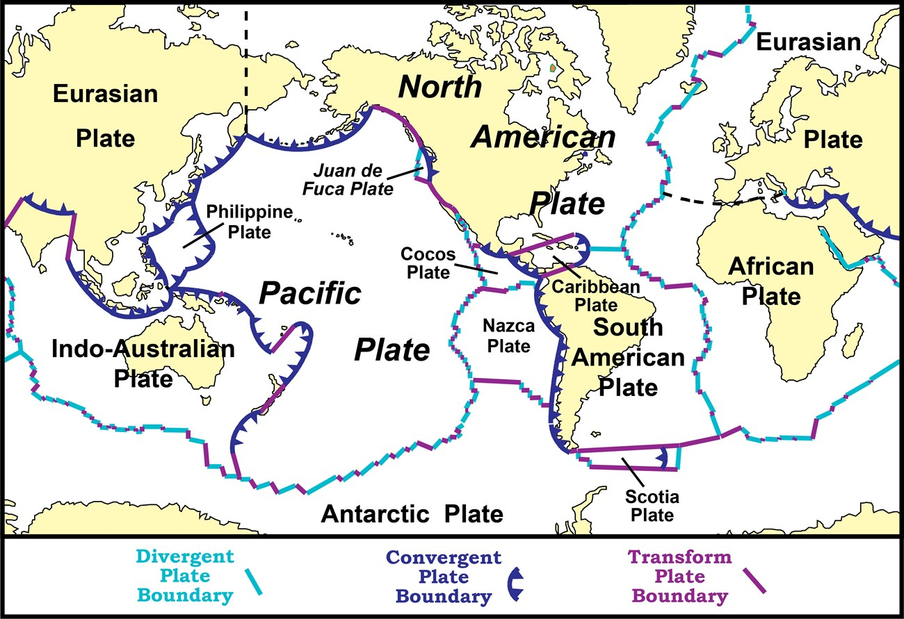
Tectonic Plates: Huge pieces of the Earth's surface that fit together like a puzzle and move very slowly over time
Notes:
Tectonic plates are huge pieces of the Earth’s surface that fit together like a puzzle an d move very slowly over time.

Slide 8
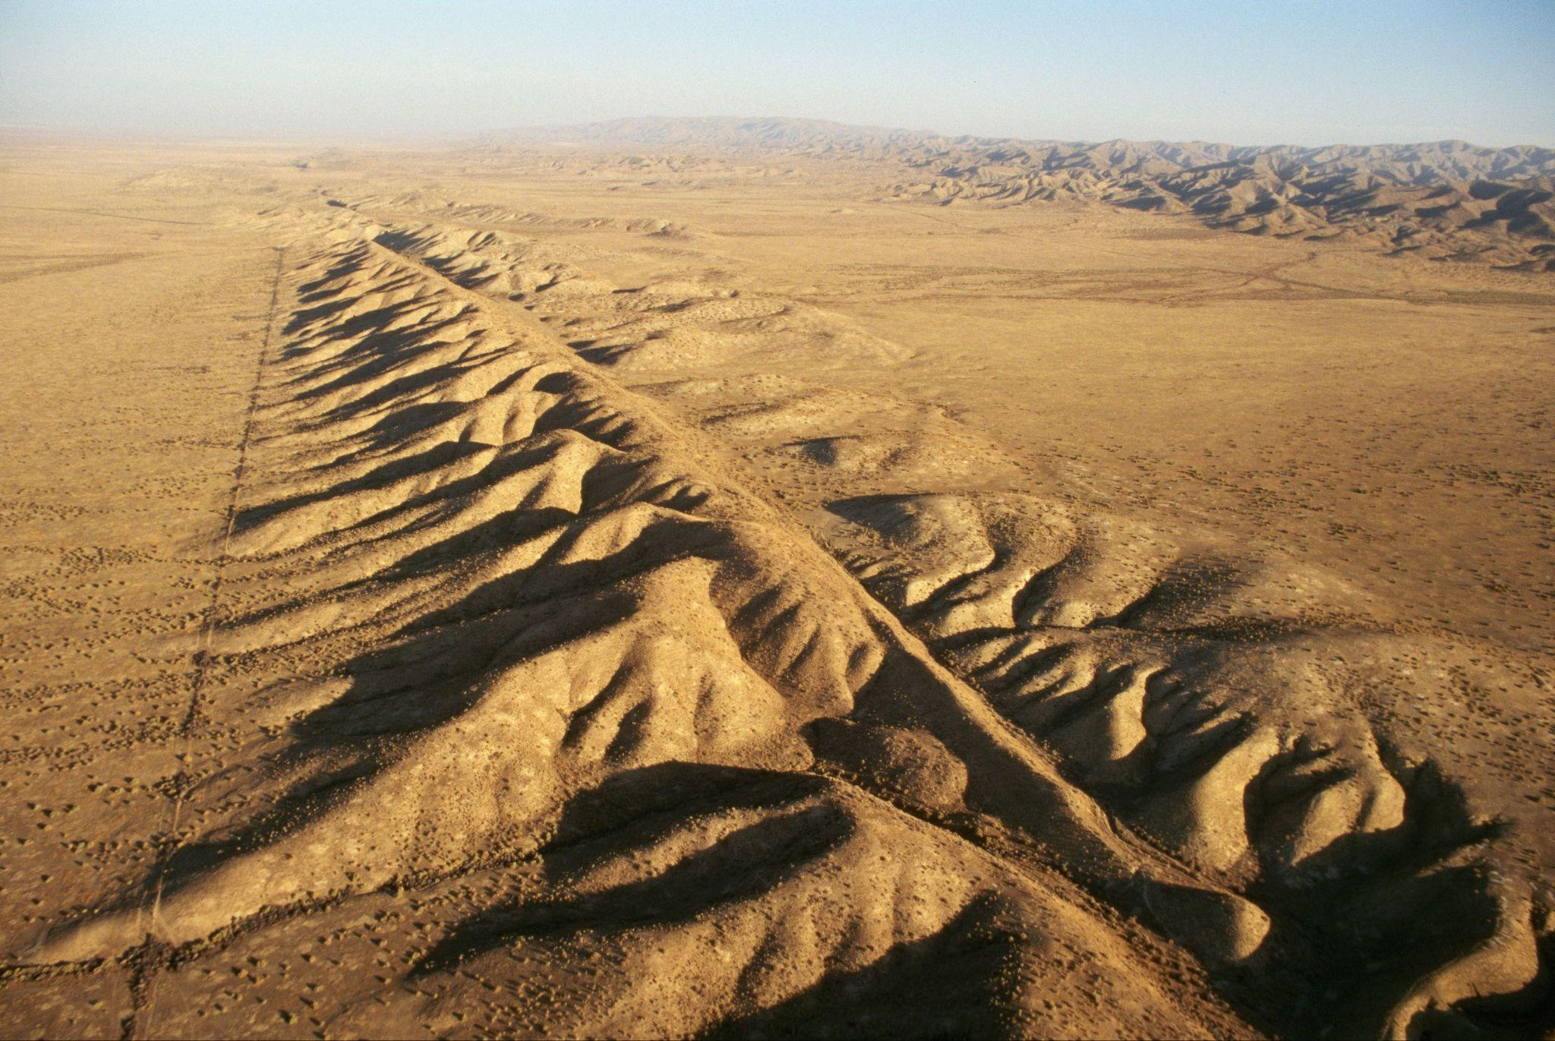
Fault: Long crack in the surface of the Earth
Notes:
A fault is a long crack in the surface of the Earth.

Slide 9
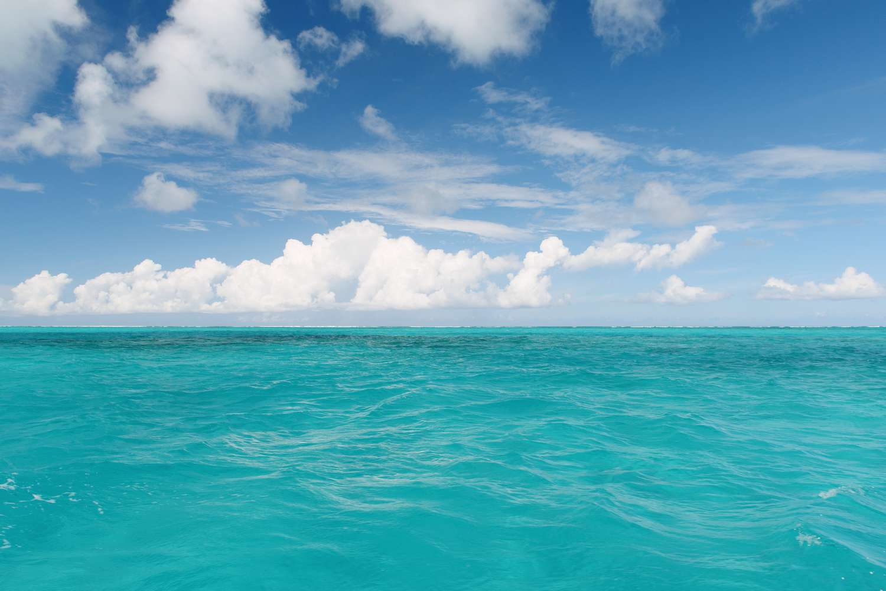
Ocean: A giant body of saltwater.
Notes:
An ocean is a giant body of saltwater.

Slide 10
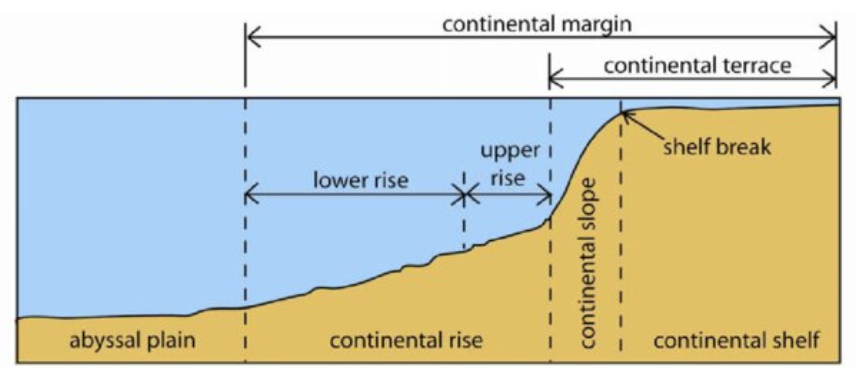
Woo (2005)
Continental Rise: a gentle slope at the ocean's bottom where sand and mud collect
Notes:
A continental rise is a gentle slope at the ocean's bottom where sand and mud collect, linking the steeper continental slope to the flat ocean floor
Image source: Woo, L. M. (2005). Summer circulation and water masses along the West Australian coast (Doctoral dissertation, University of Western Australia).
Chicago

Slide 11
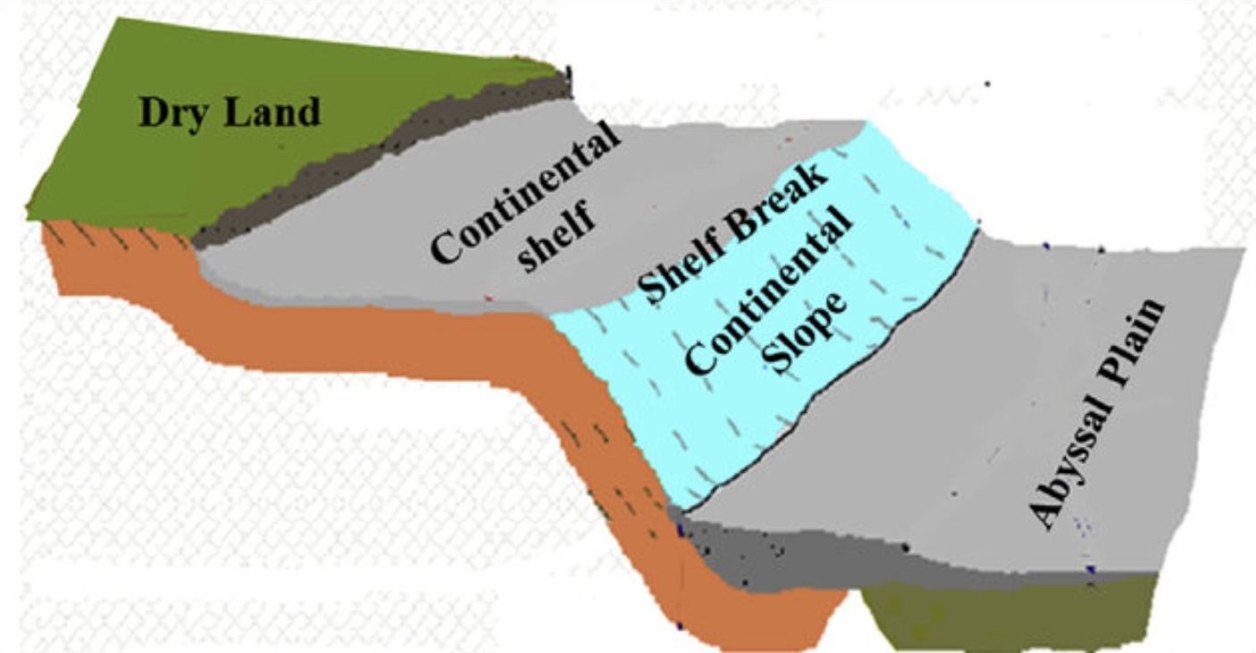
Solangi et al. (2018)
Continental Slope: a steep underwater hill that goes down from the edge of the continent into the deeper parts of the ocean
Notes:
A continental slope is a steep underwater hill that goes down from the edge of the continent into the deeper parts of the ocean
Image source: Solangi, S. H., Nazeer, A., Abbasi, S., & Zulkifil, M. M. (2019). Morphological features of continental shelf margin: Examples from the Pakistan Offshore. Geodesy and Geodynamics, 10(1), 77-91.

Slide 12
Notes:
Now let’s pause for a moment to review the information we have covered already.

Slide 13
The outermost shell of the Earth is called the…
Crust
Core
Notes:
The outermost shell of the Earth is called the…
[Crust]

Slide 14
The outermost shell of the Earth is called the…
Crust
Core
Notes:
The outermost shell of the Earth is called the…
[Crust]

Slide 15
True or False: Tectonic plates are huge pieces of the Earth's surface that fit together like a puzzle and move very slowly over time.
Notes:
True or False: Huge pieces of the Earth's surface that fit together like a puzzle and move very slowly over time.
[True]

Slide 16
True or False: Tectonic plates are huge pieces of the Earth's surface that fit together like a puzzle and move very slowly over time.
Notes:
True or False: Huge pieces of the Earth's surface that fit together like a puzzle and move very slowly over time.
[True]

Slide 17
A _____ is a long _____ in the surface of the Earth.
fault, crack
crack, fault
Notes:
A _____ is a long _____ in the surface of the Earth.
[fault, crack]

Slide 18
A _____ is a long _____ in the surface of the Earth.
fault, crack
crack, fault
Notes:
A _____ is a long _____ in the surface of the Earth.
[fault, crack]

Slide 19
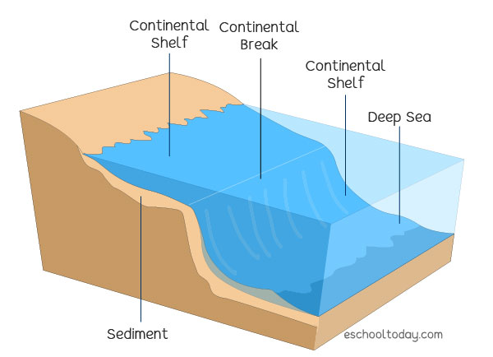
Continental Shelf: The edge of a continent that is underwater
Notes:
A continental shelf is the edge of a continent that is underwater

Slide 20
Woo (2005)
Continental Rise: a gentle slope at the ocean's bottom where and collect
Notes:
A continental rise is a gentle slope at the ocean's bottom where and collect, linking the steeper continental slope to the flat ocean floor
[sand, mud]
Image source: Woo, L. M. (2005). Summer circulation and water masses along the West Australian coast (Doctoral dissertation, University of Western Australia).
Chicago

Slide 21
Woo (2005)
Continental Rise: a gentle slope at the ocean's bottom where sand and mud collect
Notes:
A continental rise is a gentle slope at the ocean's bottom where sand and mud collect, linking the steeper continental slope to the flat ocean floor
Image source: Woo, L. M. (2005). Summer circulation and water masses along the West Australian coast (Doctoral dissertation, University of Western Australia).
Chicago

Slide 22
Solangi et al. (2018)
True or False: A continental slope is an above water hill that people roll down to get into the ocean.
Notes:
True or False: A continental slope is an above water hill that people roll down to get into the ocean.
[False]
Image source: Solangi, S. H., Nazeer, A., Abbasi, S., & Zulkifil, M. M. (2019). Morphological features of continental shelf margin: Examples from the Pakistan Offshore. Geodesy and Geodynamics, 10(1), 77-91.

Slide 23
Solangi et al. (2018)
True or False: A continental slope is an above water hill that people roll down to get into the ocean.
Notes:
False: A continental slope is a steep underwater hill that goes down from the edge of the continent into the deeper parts of the ocean
Image source: Solangi, S. H., Nazeer, A., Abbasi, S., & Zulkifil, M. M. (2019). Morphological features of continental shelf margin: Examples from the Pakistan Offshore. Geodesy and Geodynamics, 10(1), 77-91.

Slide 24
Continental Shelf: The of a continent that is underwater
Notes:
A continental shelf is the of a continent that is underwater
[edge]

Slide 25
Continental Shelf: The edge of a continent that is underwater
Notes:
A continental shelf is the edge of a continent that is underwater

Slide 26
Abyssal Plain
Notes:
Now that we’ve reviewed, let’s define the phrase abyssal plain.

Slide 27
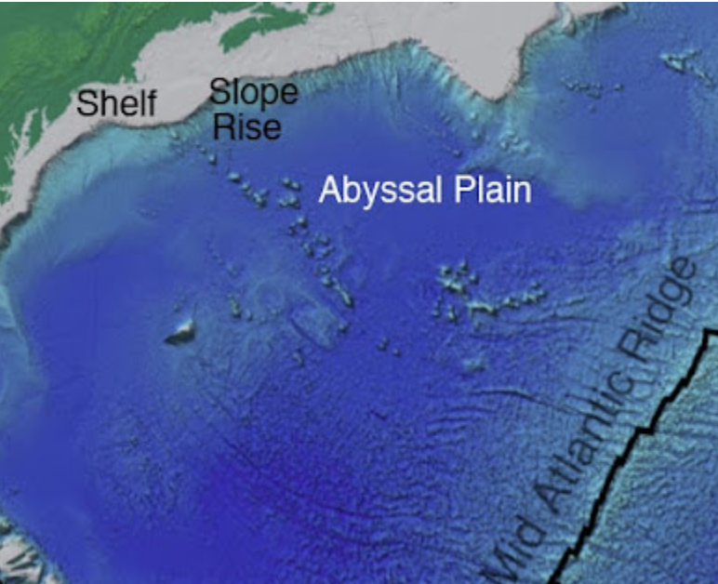
Abyssal Plain: A large flat surface on the ocean floor
Notes:
An abyssal plain is a large flat surface on the ocean floor
Image source: https://geologylearn.blogspot.com/2015/09/abyssal-plain.html

Slide 28
Notes:
Let’s check-in for understanding.

Slide 29
What is an abyssal plain?
Notes:
What is an abyssal plain?
[a large flat surface on the ocean floor]

Slide 30
Notes:
That is the basic definition, but there is a bit more you need to know.

Slide 31
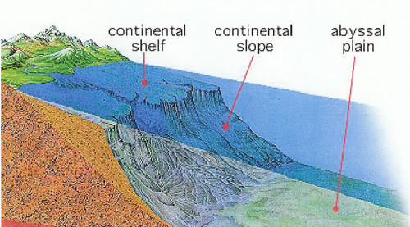
An abyssal plain is a large and level area on the ocean floor, much like a huge underwater field. These plains are found in the deepest parts of the ocean, thousands of feet below the surface.
Notes:
An abyssal plain is a large and level area on the ocean floor, much like a huge underwater field. These plains are found in the deepest parts of the ocean, thousands of feet below the surface.

Slide 32
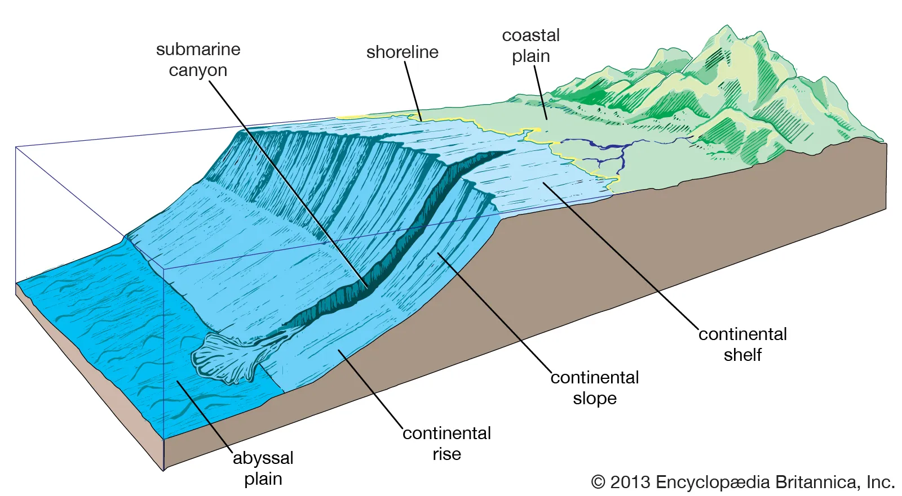
The abyssal plain is not only flat but also covered with fine mud and sediment that has settled over a very long time.
Notes:
The abyssal plain is not only flat but also covered with fine mud and sediment that has settled over a very long time.

Slide 33
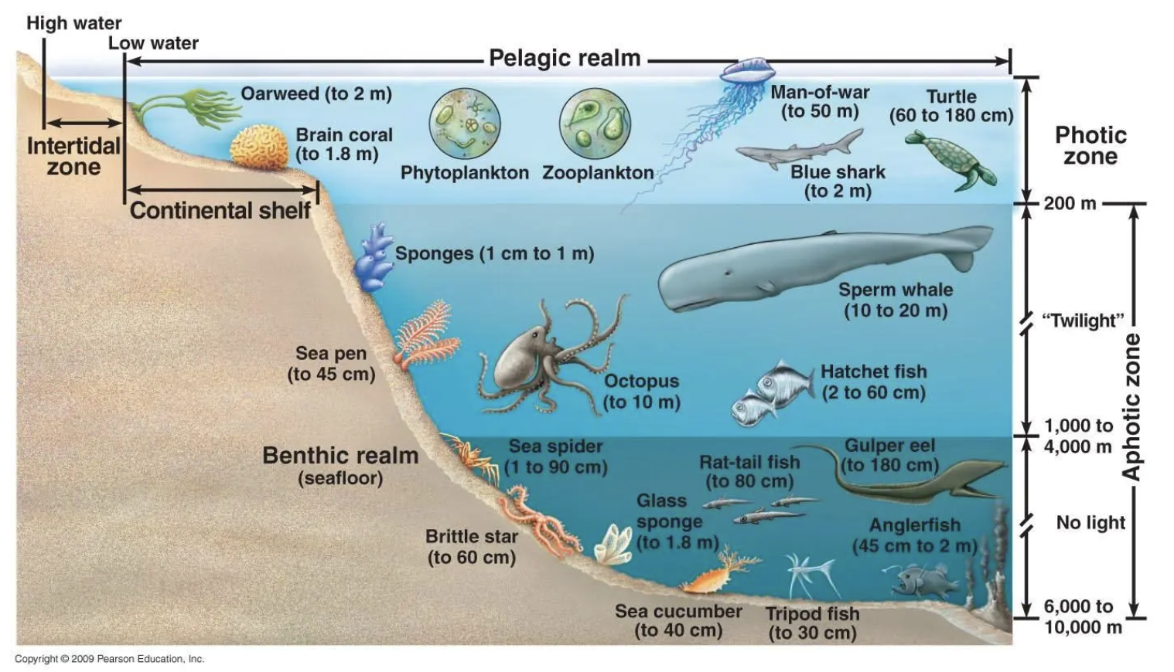
The mud on the abyssal plain acts like a giant sponge, soaking up nutrients and tiny particles from the water above. This process creates a kind of nutrient-rich environment that can support unique and mysterious forms of life, from tiny organisms to larger creatures.
Notes:
The mud on the abyssal plain acts like a giant sponge, soaking up nutrients and tiny particles from the water above. This process creates a kind of nutrient-rich environment that can support unique and mysterious forms of life, from tiny organisms to larger creatures.

Slide 34
Notes:
Let’s check-in for understanding.

Slide 35
An abyssal plain is a and level area on the ocean floor, much like a huge underwater field. These plains are found in the deepest parts of the ocean, thousands of feet below the surface.
Notes:
An abyssal plain is a and level area on the ocean floor, much like a huge underwater field. These plains are found in the deepest parts of the ocean, thousands of feet below the surface.
[large]

Slide 36
An abyssal plain is a large and level area on the ocean floor, much like a huge underwater field. These plains are found in the deepest parts of the ocean, thousands of feet below the surface.
Notes:
An abyssal plain is a large and level area on the ocean floor, much like a huge underwater field. These plains are found in the deepest parts of the ocean, thousands of feet below the surface.

Slide 37
True or False: The abyssal plain is flat
Notes:
True or False: The abyssal plain is flat
[True]

Slide 38
True or False: The abyssal plain is flat
Notes:
True: The abyssal plain is flat

Slide 39
Notes:
Now, let’s talk about some examples of abyssal plains.

Slide 40
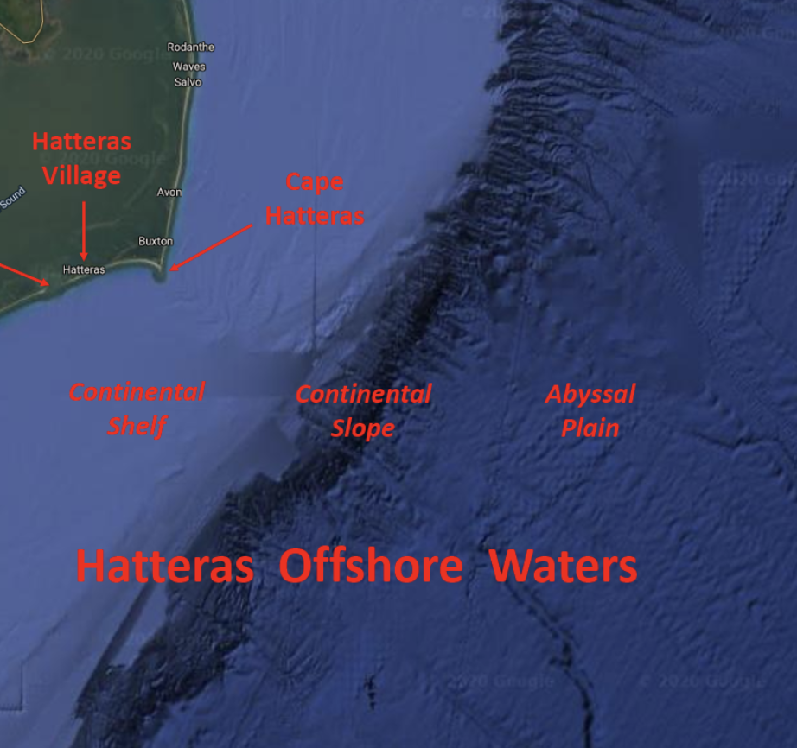
Hatteras Abyssal Plain is an example of an abyssal plain. It is located on the ocean floor between Bermuda and the southern United States.
Notes:
Hatteras Abyssal Plain is an example of an abyssal plain. It is located on the ocean floor between Bermuda and the southern United States.
Image Source: https://birdfinding.info/north-carolina-hatteras-offshore/;

Slide 41
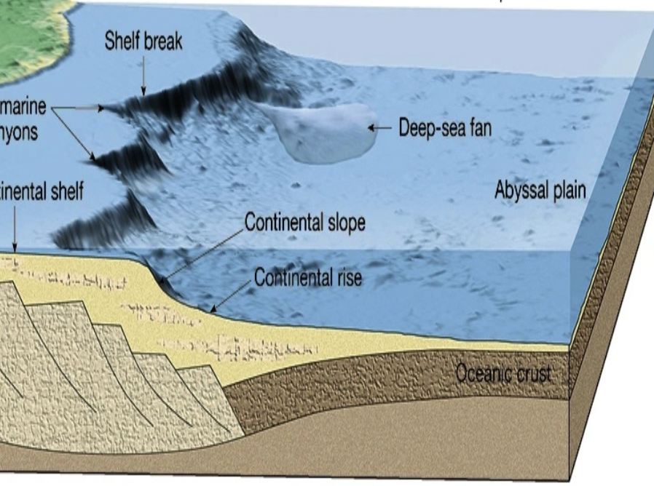
Another example of an abyssal plain is the Southwest Pacific Abyssal Plain.
Photo: Georgia Coast Atlas
Notes:
Another example of an abyssal plain is the Southwest Pacific Abyssal Plain.
Image Source: https://allgeographynow.wordpress.com/2016/02/21/abyssal-plain/

Slide 42
Notes:
Now, let’s talk about some non-examples of continental shelf.

Slide 43
A fault is NOT an example of an abyssal plain. A fault is a long crack in the surface of the Earth
Notes:
A fault is NOT an example of an abyssal plain. A fault is a long crack in the surface of the Earth

Slide 44
Solangi et al. (2018)
A continental slope is NOT an example of an abyssal plain. A continental slope is a steep underwater hill that goes down from the edge of the continent into the deeper parts of the ocean.
Notes:
A continental slope is NOT an example of an abyssal plain. A continental slope is a steep underwater hill that goes down from the edge of the continent into the deeper parts of the ocean.
Image source: Solangi, S. H., Nazeer, A., Abbasi, S., & Zulkifil, M. M. (2019). Morphological features of continental shelf margin: Examples from the Pakistan Offshore. Geodesy and Geodynamics, 10(1), 77-91.

Slide 45
Notes:
Now let’s pause for a moment to check your understanding.

Slide 46
Why are faults and continental slopes NOT examples of an abyssal plain?
Notes:
Why are faults and continental slopes NOT examples of an abyssal plain?
[Faults are long cracks in the surface of the Earth and continental slopes are steep underwater hills that go down from the edge of the continent into the deeper parts of the ocean. While abyssal plains are large flat surfaces on the ocean floor.]

Slide 47
Remember!!!
Notes:
So remember!

Slide 48
Abyssal Plain: A large flat surface on the ocean floor
Notes:
An abyssal plain is a large flat surface on the ocean floor
Image source: https://geologylearn.blogspot.com/2015/09/abyssal-plain.html

Slide 49
Notes:
We will now complete this concept map, called a Frayer model, to summarize and further clarify what you have learned about the term abyssal plain.

Slide 50
Definition
Picture
Abyssal Plain
Example
How do abyssal plains impact my life?
Notes:
To complete the Frayer model, we will choose from four choices the correct picture, definition, example, and response to the question, “How do abyssal plains impact my life?” Select the best response for each question using the information you just learned. As we select responses, we will see how this model looks filled in for the term abyssal plain.

Slide 51
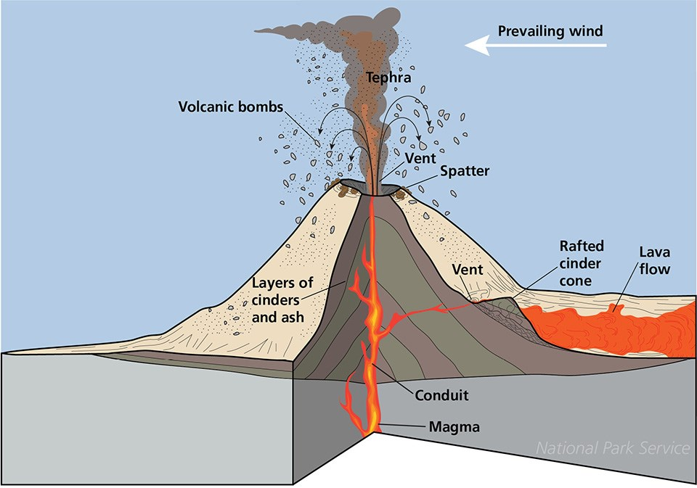
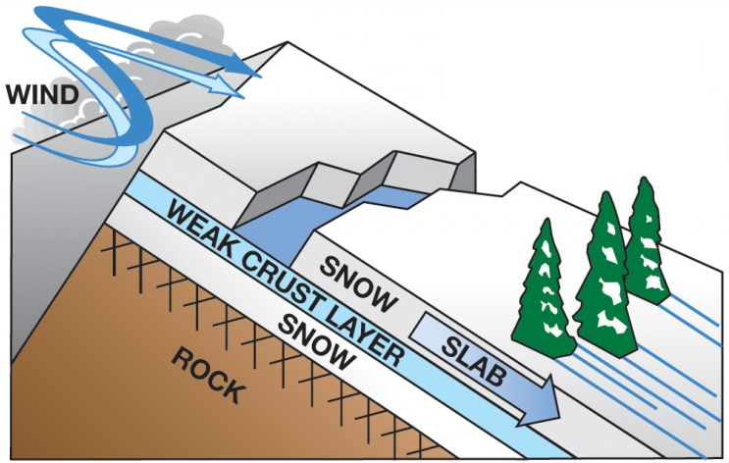
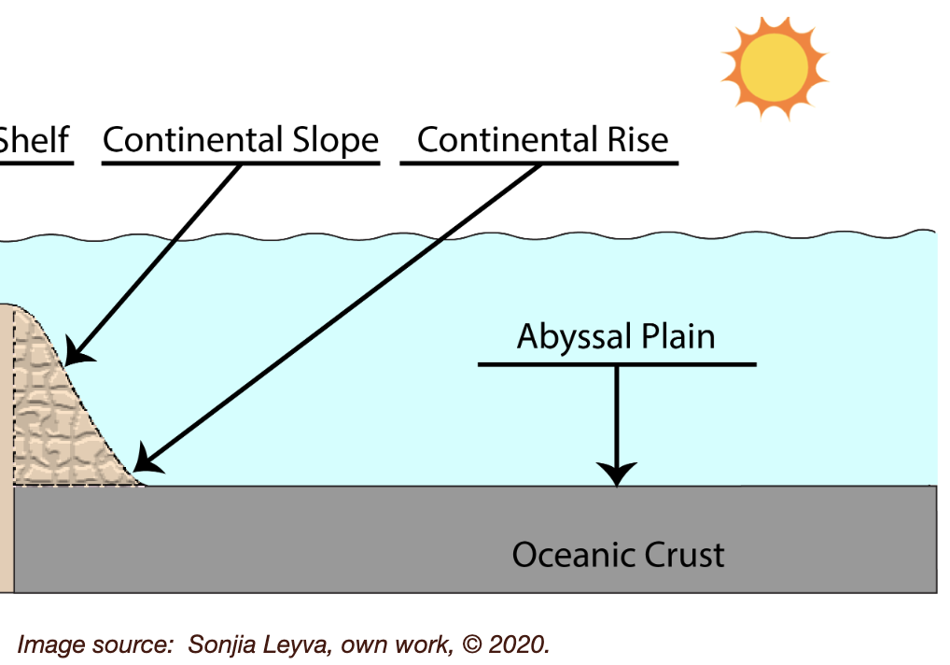
Directions: Choose the correct picture of an abyssal plain from the choices below.
A
B
C
D
Notes:
Choose the one correct picture of an abyssal plain from these four choices.

Slide 52
Directions: Choose the correct picture of an abyssal plain from the choices below.
A
B
C
D
Notes:
This is the picture that shows an abyssal plain.

Slide 53
Definition
Picture
Abyssal Plain
Example
How do abyssal plains impact my life?
Notes:
Here is the Frayer model filled in with a picture of an abyssal plain.

Slide 54
Directions: Choose the correct definition of an abyssal plain from the choices below.
A
A large flat surface on the ocean floor
B
The edge of a continent that is underwater
C
Underwater ecosystem made up of coral polyps
D
Deep, steep-sided valleys carved into the seafloor by erosion.
Notes:
Choose the correct definition of an abyssal plain from the choices below.

Slide 55
Directions: Choose the correct definition of an abyssal plain from the choices below.
A
A large flat surface on the ocean floor
B
The edge of a continent that is underwater
C
Underwater ecosystem made up of coral polyps
D
Deep, steep-sided valleys carved into the seafloor by erosion.
Notes:
“A large flat surface on the ocean floor” is correct! This is the definition of an abyssal plain.

Slide 56
Definition
Picture
A large flat surface on the ocean floor
Abyssal Plain
Example
How do abyssal plains impact my life?
Notes:
Here is the Frayer Model with a picture and the definition filled in for an abyssal plain: A large flat surface on the ocean floor

Slide 57
Directions: Choose the correct example of an abyssal plain from the choices below.
A
Snow sliding down a plane
B
North Sea Continental Shelf
C
Strong winds that tear down trees
D
Southwest Pacific Abyssal Plain
Notes:
Choose the correct example of an abyssal plain from the choices below.

Slide 58
Directions: Choose the correct example of an abyssal plain from the choices below.
A
Snow sliding down a plane
B
North Sea Continental Shelf
C
Strong winds that tear down trees
D
Southwest Pacific Abyssal Plain
Notes:
“Southwest Pacific Abyssal Plain” is correct! This is an example of an abyssal plain.

Slide 59
Definition
Picture
A large flat surface on the ocean floor
Abyssal Plain
Southwest Pacific Abyssal Plain
Example
How do abyssal plains impact my life?
Notes:
Here is the Frayer Model with a picture and the definition filled in for an abyssal plain: A large flat surface on the ocean floor

Slide 60
Directions: Choose the correct response for “How do abyssal plains impact my life?” from the choices below.
A
Abyssal plains help protect the coast from big waves, making beaches safer for activities like swimming and playing.
B
Abyssal plains explain how movement of animals on our planet impacts food and crops we have available to us.
Abyssal plains absorb nutrients in the deep ocean, supporting unique marine life, and contributing to the health of the entire ocean ecosystem, which in turn affects the balance of life on Earth.
C
D
Abyssal plains create different trenches and ranges in the ocean which influences weather patterns on Earth.
Notes:
Choose the one correct response for “how do abyssal plains impact my life?” from these four choices.

Slide 61
Directions: Choose the correct response for “How do abyssal plains impact my life?” from the choices below.
A
Abyssal plains help protect the coast from big waves, making beaches safer for activities like swimming and playing.
B
Abyssal plains explain how movement of animals on our planet impacts food and crops we have available to us.
Abyssal plains absorb nutrients in the deep ocean, supporting unique marine life, and contributing to the health of the entire ocean ecosystem, which in turn affects the balance of life on Earth.
C
D
Abyssal plains create different trenches and ranges in the ocean which influences weather patterns on Earth.
Notes:
“Abyssal plains absorb nutrients in the deep ocean, supporting unique marine life, and contributing to the health of the entire ocean ecosystem, which in turn affects the balance of life on Earth.” That is correct! This is an example of how abyssal plains impact your life.

Slide 62
Definition
Picture
A large flat surface on the ocean floor
Abyssal Plain
Abyssal plains absorb nutrients in the deep ocean, supporting unique marine life, and contributing to the health of the entire ocean ecosystem, which in turn affects the balance of life on Earth.
Southwest Pacific Abyssal Plain
Example
How do abyssal plains impact my life?
Notes:
Here is the Frayer Model with a picture, definition, example, and a correct response to “how do abyssal plains impact my life?”: Abyssal plains absorb nutrients in the deep ocean, supporting unique marine life, and contributing to the health of the entire ocean ecosystem, which in turn affects the balance of life on Earth.

Slide 63
Remember!!!
Notes:
So remember!

Slide 64
Abyssal Plain: A large flat surface on the ocean floor
Notes:
An abyssal plain is a large flat surface on the ocean floor
Image source: https://geologylearn.blogspot.com/2015/09/abyssal-plain.html

Slide 65
Big Question: How does the abyssal plain influence the balance of marine life and the overall health of the ocean environment?
Notes:
Let’s reflect once more on our big question. Our “big question” is: How does the abyssal plain influence the balance of marine life and the overall health of the ocean environment?
Does anyone have any additional examples to share that haven’t been discussed yet?
I love all these thoughtful scientific hypotheses! Be sure to keep this question and your predictions in mind as we move through these next few lessons, and we’ll continue to revisit it.

Slide 66
Notes:
Thanks for watching, and please continue watching CAPs available from this website.

Slide 67
This Was Created With Resources From:
Questions or Comments
Michael Kennedy, Ph.D. MKennedy@Virginia.edu
Rachel L Kunemund, Ph.D. rk8vm@virginia.edu

