Slide 1
“Big Idea” Question
Teacher Demo
Review Concepts
Check-In Questions
Vocabulary
Student-Friendly Definition
Examples & Non-Examples
Morphological Word Parts
Simulation/Activity
Notes:
OK everyone, get ready for our next lesson. Just as a reminder, these are the different components that our lesson may include, and you’ll see these icons in the top left corner of each slide so that you can follow along more easily!

Slide 2
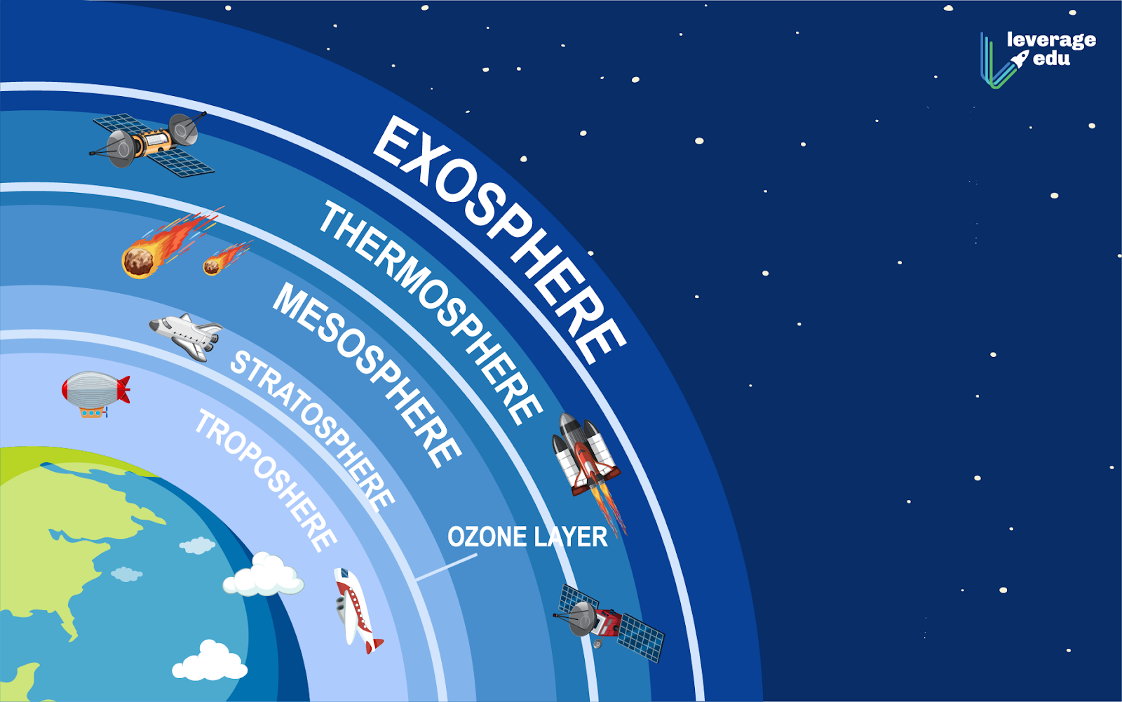
Atmosphere
Intro
Notes:
Today we are going to learn about the layers of earth’s atmosphere

Slide 3
Big Question: How are all the layers of the earth’s atmosphere different and how are they related? How might we be impacted by the earth’s atmospheric layers?
Notes:
Our “big question” is: How are all the layers of the earth’s atmosphere different and how are they related? How might we be impacted by the earth’s atmospheric layers?
[Pause and illicit predictions from students.]
I love all these thoughtful scientific hypotheses! Be sure to keep this question and your predictions in mind as we move through these next few lessons, and we’ll continue to revisit it.

Slide 4
Notes:
Before we move on to our new topic, let’s review some other words & concepts that you already learned and make sure you are firm in your understanding.

Slide 5
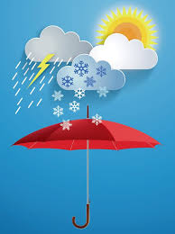
Weather: the conditions of the atmosphere at a certain time and place
Notes:
Weather is the conditions of the atmosphere at a certain time and place.

Slide 6
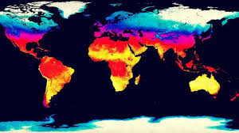
Climate: the pattern of weather over time in a specific location
Notes:
Climate is the pattern of weather over time in a specific location.

Slide 7
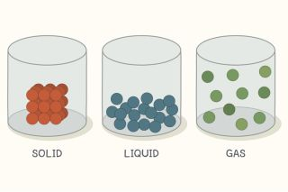
Gas: a state of matter; gas particles move very fast
Notes:
Gas is a state of matter. Gas particles move very fast.

Slide 8
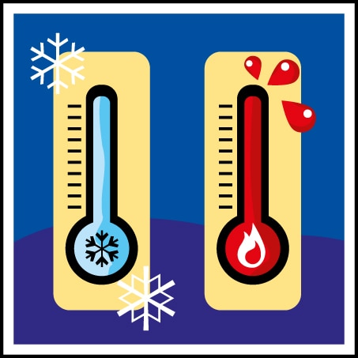
Temperature: how hot or cold something is
Notes:
Temperature is how hot or cold something is.

Slide 9
Notes:
Now let’s pause for a moment to review the information we have covered already.
Feedback: Monitoring understanding during review is an important step before moving on to new material.

Slide 10
Which state of matter has particles that move around very quickly?
Solid
Liquid
Gas
Plasma
Notes:
Which state of matter has particles that move around very quickly?

Slide 11
Which state of matter has particles that move around very quickly?
Solid
Liquid
Gas
Plasma
Notes:
Which state of matter has particles that move around very quickly?
[Gas]

Slide 12
What is the difference between climate and weather?
Notes:
What is the difference between climate and weather?
[Weather is the conditions of the atmosphere at a certain time and place. While climate is the pattern of weather over time in a specific location.]

Slide 13
Temperature is how or _____ something is.
Notes:
Temperature is how _______ or _______ something is.

Slide 14
Temperature is how hot or cold something is.
Notes:
Temperature is how hot or cold something is.

Slide 15
Atmosphere
Notes:
Now that we’ve reviewed, let’s define atmosphere.

Slide 16
Atmosphere: the layers of gas surrounding the surface of a planet
Notes:
The atmosphere is the layers of gas surrounding the surface of a planet. Sometimes the atmosphere is called a “blanket” of gases.
Feedback: Using clear language can take make formal more complicated definitions a little easier for students to understand.

Slide 17
Notes:
Let’s check-in for understanding.

Slide 18
What is atmosphere?
Notes:
What is atmosphere?
Atmosphere is the layers of gas surrounding the surface of a planet. Sometimes the atmosphere is called a “blanket” of gases.

Slide 19
Notes:
That is the basic definition, but there is a bit more you need to know.

Slide 20
Nitrogen
Notes:
Nitrogen gas makes up most of our atmosphere. 78% of earth’s atmosphere is nitrogen.

Slide 21
Oxygen
Notes:
Oxygen makes up another 21% of our atmosphere.

Slide 22
Other Gases
Notes:
Other gases include: water vapor, argon, and carbon dioxide.

Slide 23
Notes:
Our atmosphere is made up of several layers. We will learn about each these layers next.
Feedback: You were so thoughtful in using clear and simple language when introducing today's content, this helps students understand what is expected.

Slide 24
Notes:
Now let’s pause for a moment to check your understanding.

Slide 25
What gases make up most of the Earth’s atmosphere?
Notes:
What gases make up most of the Earth’s atmosphere?
Nitrogen and oxygen. Other gases include: water vapor, argon, and carbon dioxide.

Slide 26
Notes:
Now, let’s talk about some examples of the earth’s atmosphere.
Feedback: It is important to introduce an example of the term but also included images to go along with it, this is a great way to help students make connections.

Slide 27
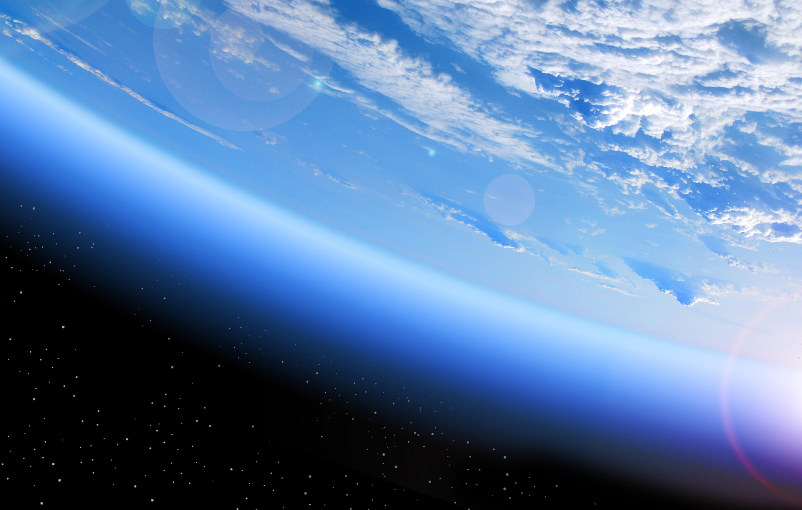
Notes:
This is an example of the earth’s atmosphere, the gaseous layers surrounding the earth

Slide 28
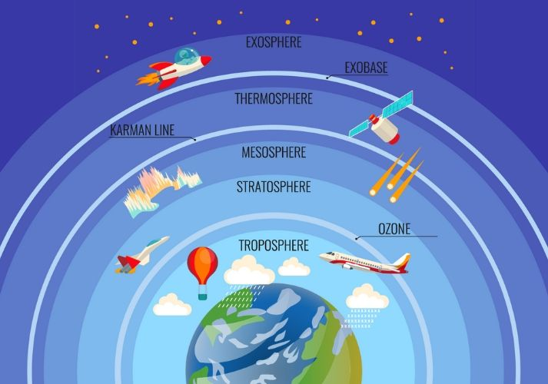
Notes:
This image is an example that shows the individual layers of the atmosphere, we will cover each of these coming up.

Slide 29
Notes:
Now let’s pause for a moment to check your understanding.

Slide 30
How many layers can you spot in this example of the earth’s atmosphere?
Notes:
How many layers can you spot in this example of the earth’s atmosphere?
[5]

Slide 31
Notes:
Now, let’s talk about some non-examples of the earth’s atmosphere.
Feedback: One important component of using non-examples is by clearly distinguishing similarities and explaining why it is a non-example.

Slide 32
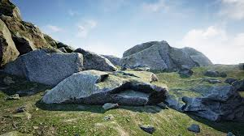
Notes:
Rocks are part of the earth, not it’s atmosphere; they are on the ground.

Slide 33
Notes:
This beach is part of the earth; it is not part of the earth’s atmosphere.

Slide 34
Notes:
Now let’s pause for a moment to check your understanding.

Slide 35
Why is this not an example of the earth’s atmosphere?
Notes:
Why is this not example of the earth’s atmosphere?
[It is part of the earth, not the gaseous layers surrounding earth.]

Slide 36
Notes:
We can also break down the term atmosphere into different word parts to help us remember the meaning. Let’s take a look!
Feedback: I love how you broke down the vocabulary term into word parts and defined each part, this is essential in building student understanding of the word parts.

Slide 37
Atmosphere
(prefix)
(suffix)
Notes:
We can break up the term atmosphere into two parts: prefix and suffix.

Slide 38
Atmosphere
Atmo = air
Notes:
First, we have the prefix atmo which means air.

Slide 39
Atmosphere
Sphere meaning the around = such as around a planet
Notes:
Sphere is a suffix meaning around, like around a planet…now let’s put it all together.

Slide 40
Atmo sphere
Atmosphere
The air around a planet (like earth!)
Notes:
So when we put it all together. Atmosphere means the air around a planet.
Feedback: Reuniting the word parts is a crucial step in helping students understand the whole picture when reviewing morphological word parts.

Slide 41
Notes:
Let’s check-in for understanding.

Slide 42
How can we use the word parts of atmosphere to help us remember the definition of the term?
Atmosphere
(prefix)
(suffix)
Notes:
How can we use the word parts of the atmosphere to help us remember the definition of the term?
[The prefix atmo which means air.
Sphere is a suffix meaning around, like around a planet.
So when we put it all together. Atmosphere means the air around a planet.]
Feedback: It is important to create opportunities during this portion of the lesson to monitor understanding. This is a key strategy to ensure everyone is on track with morphological word parts and putting it all together.

Slide 43
What is the atmosphere made up of?
Notes:
What is the atmosphere made up of?
[Gas]

Slide 44
Which gas makes up most of the earth’s atmosphere?
carbon
nitrogen
oxygen
water
Notes:
Which gas makes up most of the earth’s atmosphere?

Slide 45
Which gas makes up most of the earth’s atmosphere?
carbon
nitrogen
oxygen
water
Notes:
Which gas makes up most of the earth’s atmosphere?
[Nitrogen]
Feedback: It is crucial to include all of the opportunities for students to demonstrate understanding, this help you catch some confusion early and get students back on track.

Slide 46
Remember!!!
Notes:
So remember!

Slide 47
Atmosphere: the layers of gas surrounding the surface of a planet
Notes:
The atmosphere is the layers of gas surrounding the surface of a planet. Sometimes the atmosphere is called a “blanket” of gases.

Slide 48
Big Question: How are all the layers of the earth’s atmosphere different and how are they related?
Notes:
Let’s revisit our “big question” is: How are all the layers of the earth’s atmosphere different and how are they related?
Keep this question
I love all these thoughtful scientific hypotheses! Be sure to keep this question and your predictions in mind as we move through these next few lessons, and we’ll continue to revisit it.

Slide 49
Notes:
Thanks for watching, and please continue watching CAPs available from this website.

Slide 50
This Video Was Created With Resources From:
Questions or Comments
Michael Kennedy, Ph.D. MKennedy@Virginia.edu
Rachel L Kunemund, Ph.D. rk8vm@virginia.edu

Slide 51
Intro
“Big Idea” Question
Review Concepts
Check-In Questions
Teacher Demo
Vocabulary
Student-Friendly Definition
Examples & Non-Examples
Morphological Word Parts
Simulation/Activity
Notes:
OK everyone, get ready for our next lesson. Just as a reminder, these are the different components that our lesson may include, and you’ll see these icons in the top left corner of each slide so that you can follow along more easily!

Slide 52
Layers of the Atmosphere
Intro
Notes:
Today we are going to learn about the different layers of the earth’s atmosphere.

Slide 53
Big Question: How are all the layers of the earth’s atmosphere different and how are they related?
Notes:
Let’s revisit our “big question” is: How are all the layers of the earth’s atmosphere different and how are they related?
Keep this question
I love all these thoughtful scientific hypotheses! Be sure to keep this question and your predictions in mind as we move through these next few lessons, and we’ll continue to revisit it.

Slide 54
Notes:
Before we move on to our new topic, let’s review some other words and concepts that you already learned and make sure you are firm in your understanding.
Feedback: You referred to prior topics that were relevant and on topic, this helps students make connections to the new content they will be learning and tie it to prior knowledge.

Slide 55
Weather: the conditions of the atmosphere at a certain place and time
Notes:
Weather is the conditions of the atmosphere at a certain time and place.

Slide 56
Climate: the pattern of weather over time in a specific location
Notes:
Climate is the pattern of weather over time in a specific location.

Slide 57
Gas: a state of matter; gas particles move very fast
Notes:
Gas is a state of matter. Gas particles move very fast.

Slide 58
Temperature: how hot or cold something is
Notes:
Temperature is how hot or cold something is.

Slide 59
Atmosphere: the layers of gas surrounding the surface of a planet
Notes:
The atmosphere is the layers of gas surrounding the surface of a planet. Sometimes the atmosphere is called a “blanket” of gases.

Slide 60
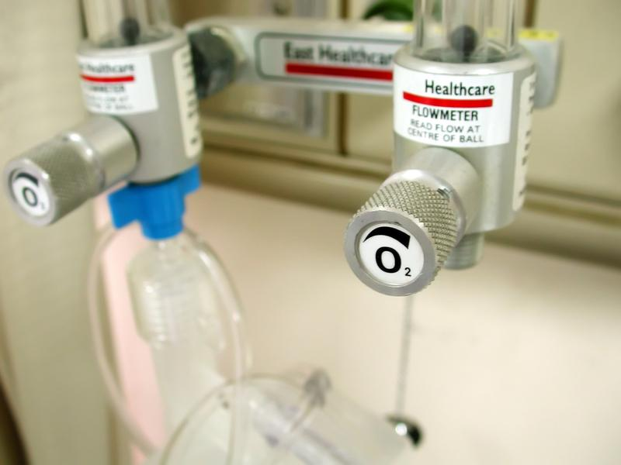
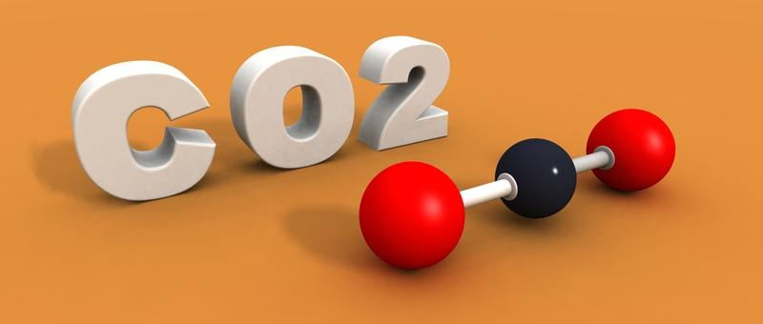
Nitrogen
The atmosphere is made up of many gases.
Oxygen
Other Gases
Notes:
Nitrogen gas makes up most of our atmosphere. 78% of earth’s atmosphere is nitrogen. Oxygen makes up another 21% of our atmosphere. Other gases include: water vapor, argon, and carbon dioxide.

Slide 61
Notes:
Now let’s pause for a moment to review the information we have covered already.
Feedback: You provide a lot of opportunities to respond throughout this portion of your lesson, which is so important for ensuring that your students understand this previous content.

Slide 62
Which state of matter has particles that move around very quickly?
solid
liquid
gas
plasma
Notes:
Which state of matter has particles that move around very quickly?

Slide 63
Which state of matter has particles that move around very quickly?
solid
liquid
gas
plasma
Notes:
Which state of matter has particles that move around very quickly?
[Gas]

Slide 64
What is the difference between climate and weather?
Notes:
What is the difference between climate and weather?
[Weather is the conditions of the atmosphere at a certain time and place. While climate is the pattern of weather over time in a specific location.]

Slide 65
What is temperature?
Notes:
What is temperature?
[How hot or cold something is.]

Slide 66
What is the atmosphere made up of?
Notes:
What is the atmosphere made up of?
Gas

Slide 67
Which gas makes up most of the earth’s atmosphere?
carbon
nitrogen
oxygen
water
Notes:
Which gas makes up most of the earth’s atmosphere?

Slide 68
Which gas makes up most of the earth’s atmosphere?
carbon
nitrogen
oxygen
water
Notes:
Which gas makes up most of the earth’s atmosphere?
[Nitrogen]

Slide 69
Troposphere
Notes:
Now that we’ve reviewed, let’s define troposphere.

Slide 70
Earth’s Atmosphere

Slide 71
Troposphere: the lowest and densest layer in the atmosphere.
Notes:
The troposphere is the lowest and densest layer in the atmosphere.
Feedback: It's challenging to explain long and complicated definitions to the students. Your clear language helps students to understand the new definition quickly.

Slide 72
Notes:
Now let’s pause for a moment to review the information we have covered already.

Slide 73
What is the troposphere?
Notes:
What is the troposphere?
[The troposphere is the lowest and densest layer in the atmosphere.]

Slide 74
Notes:
That is the basic definition, but there is a bit more you need to know.

Slide 75
A
L
T
I
TUDE
TEMPERATURE
Notes:
In the troposphere, temperatures decreases as altitude increases.

Slide 76
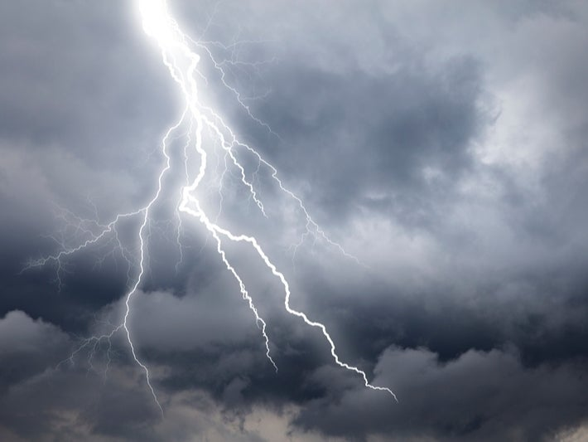
Weather occurs in the troposphere.
Notes:
Weather, like thunderstorms, occurs in the troposphere. Clouds can ALSO form in the troposphere.

Slide 77
Notes:
Now let’s pause for a moment to review the information we have covered already.

Slide 78
In the troposphere, what happens to the temperature as the altitude increases?
Notes:
In the troposphere, what happens to the temperature as the altitude increases?
[As the altitude increases, temperature decreases.]

Slide 79
Notes:
We can also break down the term troposphere into different word parts to help us remember the meaning. Let’s take a look!
Feedback: It is important to break down the vocabulary term into word parts and defined each part, this is essential in building student understanding of the word parts.

Slide 80
Troposphere
[prefix)
[suffix)
Notes:
We can break up the word troposphere into two parts: prefix and suffix.

Slide 81
Troposphere
Tropo = change
Notes:
The prefix tropo which means change-because the weather and gases are always changing.

Slide 82
Troposphere
Sphere meaning the around, such as around earth
Notes:
Sphere is a suffix meaning around, like around the earth…now let’s put it all together

Slide 83
Tropo sphere
Troposphere
Changing around the earth
Notes:
So when we put it all together, troposphere means the layer that is changing (such as the weather) around earth.
Feedback: Once you had broken down the word parts it was great to see you put it all back together again and review one more time for the students.

Slide 84
Notes:
Now let’s pause for a moment to review the information we have covered already.

Slide 85
How can we use the word parts of troposphere to help us remember the definition of the term?
Troposphere
[prefix)
[suffix)
Notes:
How can we use the word parts of troposphere to help us remember the definition of the term?
[The prefix tropo which means change-because the weather and gases are always changing.
Sphere is a suffix meaning around, like around the earth.
So when we put it all together, troposphere means the layer that is changing (such as the weather) around earth.]
Feedback: It is important to create opportunities during this portion of the lesson monitor understanding. This is a key strategy to ensure everyone is on track with morphological word parts and putting it all together.

Slide 86
True/False: Weather occurs in the troposphere.
Notes:
True/False: Weather occurs in the troposphere.

Slide 87
True/False: Weather occurs in the troposphere.
Notes:
True/False: Weather occurs in the troposphere.
[True]

Slide 88
What is the troposphere?
Notes:
What is the troposphere?
[The troposphere is the lowest and densest layer in the atmosphere.]

Slide 89
Stratosphere
Notes:
Next, let’s define what stratosphere means.

Slide 90
Earth’s Atmosphere

Slide 91
Stratosphere: layer above the troposphere mostly made up of ozone gas.
Notes:
The stratosphere is the layer just above the troposphere, made mostly of ozone gas. This is also called the ozone layer.

Slide 92
Notes:
Now let’s pause for a moment to review the information we have covered already.

Slide 93
What is the stratosphere?
Notes:
What is the stratosphere?
[The stratosphere is the layer above the troposphere, mostly made up of ozone gas. This is also called the ozone layer.]

Slide 94
Notes:
That is the basic definition, but there is a bit more you need to know.

Slide 95
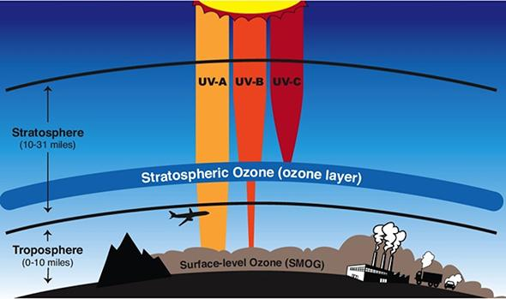
O₃
Notes:
The stratosphere is a very thin layer. Ozone is a form of oxygen gas, abbreviated O₃. The ozone layer filters and protects the earth from ultraviolet radiation from the sun.

Slide 96
Notes:
Now let’s pause for a moment to review the information we have covered already.

Slide 97
How does ozone protect us?
Notes:
How does ozone protect us?
[The ozone layer filters and protects the earth from ultraviolet radiation from the sun.]

Slide 98
Notes:
We can also break down the term stratosphere into different word parts to help us remember the meaning. Let’s take a look!

Slide 99
Stratosphere
(prefix)
(suffix)
Notes:
We can break up the term stratosphere into two parts: prefix and suffix.

Slide 100
Stratosphere
Strata = layer
Notes:
The prefix strata which means layer-stratosphere has several layers (ozone layer).

Slide 101
Stratosphere
Sphere meaning the around, such as around earth
Notes:
Sphere is a suffix meaning around, like around the earth…now let’s put it all together

Slide 102
Strato sphere
Atmosphere
The layers around earth
Notes:
So when we put it all together, stratosphere means the layers around earth.

Slide 103
Notes:
Now let’s pause for a moment to review the information we have covered already.

Slide 104
How can we use the word parts of stratosphere to help us remember the definition of the term?
Stratosphere
(prefix)
(suffix)
Notes:
How can we use the word parts of stratosphere to help us remember the definition of the term?
[The prefix strata which means layer-stratosphere has several layers (ozone layer).
Sphere is a suffix meaning around, like around the earth…now let’s put it all together
So when we put it all together, stratosphere means the layers around earth.]

Slide 105
What is the stratosphere?
Notes:
What is the stratosphere?
[The stratosphere is the layer above the troposphere, mostly made up of ozone gas. This is also called the ozone layer.]

Slide 106
Mesosphere
Notes:
Next, let’s define what mesosphere means.

Slide 107
Earth’s Atmosphere

Slide 108
Mesosphere: the third layer of the atmosphere, above the stratosphere
Notes:
The mesosphere is the third layer of the atmosphere, above the stratosphere.

Slide 109
Notes:
Now let’s pause for a moment to review the information we have covered already.

Slide 110
What is the mesosphere?
Notes:
What is the mesosphere?
[The mesosphere is the third layer of the atmosphere, above the stratosphere.]

Slide 111
Notes:
That is the basic definition, but there is a bit more you need to know.

Slide 112
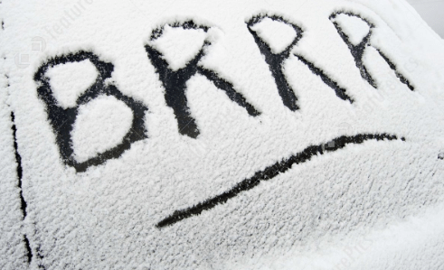
Notes:
The mesosphere is the coldest layer in the atmosphere. In the mesosphere, temperatures decrease rapidly as altitude increases.

Slide 113
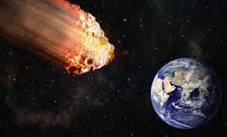
The mesosphere protects the earth from meteors.
Notes:
The mesosphere protects the earth from meteors. In this layer, meteors burn up. When we see them, these meteors are sometimes called shooting stars.

Slide 114
Notes:
Now let’s pause for a moment to review the information we have covered already.

Slide 115
In the mesosphere, what happens to the temperature as the altitude increases?
Notes:
In the mesosphere, what happens to the temperature as the altitude increases?
[As the altitude increases, temperature rapidly decreases. It is the coldest layer of the atmosphere.]

Slide 116
What does the mesosphere protect us from?
Notes:
What does the mesosphere protect us from?
[The mesosphere protects the earth from meteors. In this layer, meteors burn up. When we see them, these meteors are sometimes called shooting stars.]

Slide 117
Notes:
We can also break down the term mesosphere into different word parts to help us remember the meaning. Let’s take a look!

Slide 118
Mesosphere
(prefix)
(suffix)
Notes:
We can break up the term mesosphere into two parts: prefix and suffix.

Slide 119
Mesosphere
Meso = middle
Notes:
The prefix meso means middle.

Slide 120
Mesosphere
Sphere meaning the around- such as around earth
Notes:
Sphere is a suffix meaning around, like around the earth…now let’s put it all together.

Slide 121
Meso sphere
Mesosphere
The middle layer around earth
Notes:
So when we put it all together. Mesosphere means the middle layer around earth.

Slide 122
Notes:
Now let’s pause for a moment to review the information we have covered already.

Slide 123
How can we use the word parts of mesosphere to help us remember the definition of the term?
Mesosphere
(prefix)
(suffix)
Notes:
How can we use the word parts of mesosphere to help us remember the definition of the term?
[The prefix meso means middle.
Sphere is a suffix meaning around, like around the earth.
So when we put it all together. Mesosphere means the middle layer around earth.]

Slide 124
What is the mesosphere?
Notes:
What is the mesosphere?
[The mesosphere is the third layer of the atmosphere, above the stratosphere.]

Slide 125
Thermosphere
Notes:
Next, let’s define what thermosphere means.

Slide 126
Earth’s Atmosphere

Slide 127
Thermosphere: the fourth layer of the atmosphere, above the mesosphere.
Notes:
The thermosphere is the fourth layer of the atmosphere, above the mesosphere.

Slide 128
Notes:
Now let’s pause for a moment to review the information we have covered already.

Slide 129
What is the thermosphere?
Notes:
What is the thermosphere?
[The thermosphere is the fourth layer of the atmosphere, above the mesosphere.]

Slide 130
Notes:
That is the basic definition, but there is a bit more you need to know.

Slide 131
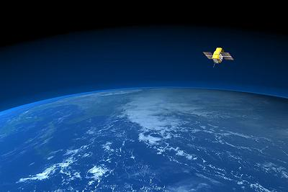
The thermosphere has the hottest temperatures in the atmosphere.
ALTITUDE
TEMPERATURE
Notes:
The thermosphere has the hottest temperatures in the atmosphere. Here, unlike the other layers of the atmosphere, temperature increases as a higher altitude is reached.

Slide 132
Notes:
The thermosphere absorbs most of the ultraviolet radiation from the sun.

Slide 133
Notes:
Now let’s pause for a moment to review the information we have covered already.

Slide 134
What happens to the temperature in the thermosphere as altitude increases?
Notes:
What happens to the temperature in the thermosphere as altitude increases?
[The thermosphere has the hottest temperatures in the atmosphere. Here, unlike the other layers of the atmosphere, temperature increases as a higher altitude is reached.]

Slide 135
Notes:
We can also break down the term thermosphere into different word parts to help us remember the meaning. Let’s take a look!

Slide 136
Thermosphere
(prefix)
(suffix)
Notes:
The term thermosphere can be broken up into two parts: prefix and suffix.

Slide 137
Thermosphere
Thermo = heat
Notes:
The prefix thermo means heat.

Slide 138
Thermosphere
Sphere meaning the around, such as around earth
Notes:
Sphere is a suffix meaning around, like around the earth…now let’s put it all together

Slide 139
Thermo sphere
Thermosphere
The hottest layer around the earth
Notes:
So when we put it all together, thermosphere means the hottest layer around earth.

Slide 140
Notes:
Now let’s pause for a moment to review the information we have covered already.

Slide 141
How can we use the word parts of thermosphere to help us remember the definition of the term?
Thermosphere
(prefix)
(suffix)
Notes:
How can we use the word parts of thermosphere to help us remember the definition of the term?
[The prefix thermo means heat.
Sphere is a suffix meaning around, like around the earth.
So when we put it all together, thermosphere means the hottest layer around earth.]

Slide 142
What is the thermosphere?
Notes:
What is the thermosphere?
[The thermosphere is the fourth layer of the atmosphere, above the mesosphere.]

Slide 143
Exosphere
Notes:
Next, let’s define what exosphere means.

Slide 144
Earth’s Atmosphere

Slide 145
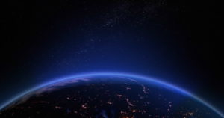
Exosphere: the outermost layer of the earth’s atmosphere.
Notes:
The exosphere is the fifth and outermost layer of the atmosphere, above the mesosphere.

Slide 146
Notes:
Now let’s pause for a moment to review the information we have covered already.

Slide 147
What is the exosphere?
Notes:
What is the exosphere?
[The exosphere is the fifth and outermost layer of the atmosphere, above the mesosphere.]

Slide 148
Notes:
That is the basic definition, but there is a bit more you need to know.

Slide 149
Notes:
The exosphere is the last layer, it separates the atmosphere and earth from outer space. The exosphere layer is almost as large as the earth!

Slide 150
Notes:
Now let’s pause for a moment to review the information we have covered already.

Slide 151
About how large is the exosphere?
Notes:
About how large is the exosphere?
[It is almost as large as the Earth.]

Slide 152
Notes:
We can also break down the term exosphere into different word parts to help us remember the meaning. Let’s take a look!

Slide 153
Exosphere
(prefix)
(suffix)
Notes:
We can break up the term exosphere into two parts: prefix and suffix.

Slide 154
Exosphere
Exo = outer/outside
Notes:
The prefix exo means outer or outside.

Slide 155
Exosphere
Sphere meaning the around- such as around earth
Notes:
Sphere is a suffix meaning around, like around the earth…now let’s put it all together

Slide 156
Exo sphere
Exosphere
The outside or outer layer around earth
Notes:
So when we put it all together, exosphere means the outside or outer most layer around earth.

Slide 157
Notes:
Now let’s pause for a moment to review the information we have covered already.

Slide 158
How can we use the word parts of exosphere to help us remember the definition of the term?
Exosphere
(prefix)
(suffix)
Notes:
How can we use the word parts of exosphere to help us remember the definition of the term?
[The prefix exo means outer or outside.
Sphere is a suffix meaning around, like around the earth.
So when we put it all together, exosphere means the outside or outer most layer around earth.]

Slide 159
What is the exosphere?
Notes:
What is the exosphere?
[The exosphere is the fifth and outermost layer of the atmosphere, above the mesosphere.]

Slide 160
Notes:
Now, let’s talk about some examples of the earth’s atmospheric layers.
Feedback: It is important to not only introduce an example of the term but also included images to go along with it, this is a great way to help students make connections.

Slide 161
Notes:
Is this picture of the sky an example of part of the atmosphere?
Yes this looks like the troposphere where clouds are formed.

Slide 162
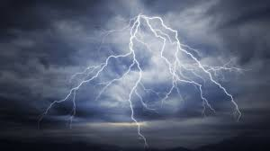
Notes:
Is this picture of lightning an example of part of the atmosphere?
Yes this looks like the troposphere which is where weather occurs.

Slide 163
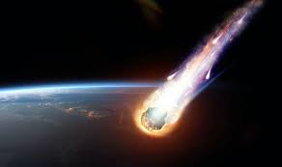
Notes:
Is this picture of a meteor an example of part of the atmosphere?
This is the mesosphere which can help protect the earth from meteors.

Slide 164
Notes:
Now let’s pause for a moment to check your understanding.

Slide 165
Is this an example of the earth’s atmosphere? Can you figure out which layer this might be?
Notes:
Is this an example of the earth’s atmosphere? Can you figure out which layer this might be?
[Yes this looks like the troposphere where clouds are formed.]

Slide 166
Notes:
Now, let’s talk about some non-examples of the earth’s atmospheric layers.
Feedback: Non-examples often need some explanation to make it clear to students the difference.

Slide 167
Notes:
This beach is part of the earth; it is not part of the earth’s atmosphere.

Slide 168
Notes:
Now let’s pause for a moment to check your understanding.

Slide 169
Are rocks a part of the earth’s atmosphere? Why or why not?
Notes:
Are these rocks a part of the earth’s atmosphere?
[No – rocks are part of the earth; they are on the ground.]

Slide 170
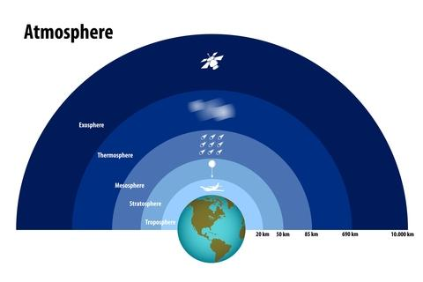
What is the atmosphere made up of?
Notes:
What is the atmosphere made up of?
[Gas]

Slide 171
Which gas makes up most of the earth’s atmosphere?
carbon
nitrogen
oxygen
water
Notes:
Which gas makes up most of the earth’s atmosphere?

Slide 172
Which gas makes up most of the earth’s atmosphere?
carbon
nitrogen
oxygen
water
Notes:
Which gas makes up most of the earth’s atmosphere?
[Nitrogen]

Slide 173
Which is the coldest layer of the atmosphere?
stratosphere
mesosphere
thermosphere
troposphere
Notes:
Which is the coldest layer of the atmosphere?

Slide 174
Which is the coldest layer of the atmosphere?
stratosphere
mesosphere
thermosphere
troposphere
Notes:
Which is the coldest layer of the atmosphere?
[Mesosphere]

Slide 175
How does the stratosphere protect the earth from the sun?
Notes:
How does the stratosphere protect the earth from the sun?
[Ozone is a form of oxygen gas, abbreviated O₃. The ozone layer filters and protects the earth from ultraviolet radiation from the sun.]

Slide 176
In the mesosphere, temperature _________ as altitude increases.
decreases
increases
stays constant
Notes:
In the mesosphere, temperature _________ as altitude increases.

Slide 177
In the mesosphere, temperature _________ as altitude increases.
decreases
increases
stays constant
Notes:
In the mesosphere, temperature _________ as altitude increases.
[Decreases]

Slide 178
What is the outermost layer of the atmosphere? What can you tell me about it?
Notes:
What is the outermost layer of the atmosphere? What can you tell me about it?
[The outermost layer, known as the exosphere separates earth from outer space.]

Slide 179
In the thermosphere, temperature _________ as altitude increases.
decreases
increases
stays constant
Notes:
In the thermosphere, temperature _________ as altitude increases.

Slide 180
In the thermosphere, temperature _________ as altitude increases.
decreases
increases
stays constant
Notes:
In the thermosphere, temperature _________ as altitude increases.
[Increases]

Slide 181
Name the five layers of the earth’s atmosphere.
Notes:
Name the five layers of the earth’s atmosphere.
[Troposphere
Stratosphere
Mesosphere
Thermosphere
Exosphere]

Slide 182
Remember!!!
Notes:
So remember!
Feedback: I appreciated how you consistently used images in your lesson, this helps students make connections to the words in the definition.

Slide 183
Troposphere: the lowest and densest layer in the atmosphere.
Notes:
The troposphere is the lowest and densest layer in the atmosphere.

Slide 184
Stratosphere: layer above the troposphere mostly made up of ozone gas.
Notes:
The stratosphere is the layer just above the troposphere, made mostly of ozone gas. This is also called the ozone layer.

Slide 185
Mesosphere: the third layer of the atmosphere, above the stratosphere
Notes:
The mesosphere is the third layer of the atmosphere, above the stratosphere.

Slide 186
Thermosphere: the fourth layer of the atmosphere, above the mesosphere.
Notes:
The thermosphere is the fourth layer of the atmosphere, above the mesosphere.

Slide 187
Exosphere: the outermost layer of the earth’s atmosphere.
Notes:
The exosphere is the fifth and outermost layer of the atmosphere, above the mesosphere.

Slide 188
Simulation Activity
Layers of the Atmosphere
Identify the many layers of the earth’s atmosphere and their characteristics.
Notes:
Review Video: https://www.youtube.com/watch?v=5sg9sCOXFIk
Feedback: This activity meets students at an appropriate level. Students can be adequately challenged and still able to complete the activity and understand the content.

Slide 189
Big Question: How are all the layers of the earth’s atmosphere different and how are they related? How might we be impacted by the earth’s atmospheric layers?
Notes:
Our “big question” is: How are all the layers of the earth’s atmosphere different and how are they related? How might we be impacted by the earth’s atmospheric layers?
[Pause and illicit predictions from students.]
I love all these thoughtful scientific hypotheses! Be sure to keep this question and your predictions in mind as we move through these next few lessons, and we’ll continue to revisit it.

Slide 190
Notes:
Thanks for watching, and please continue watching CAPs available from this website.

Slide 191
This Video Was Created With Resources From:
Questions or Comments
Michael Kennedy, Ph.D. MKennedy@Virginia.edu
Rachel L Kunemund, Ph.D. rk8vm@virginia.edu

