Slide 1
Intro
“Big Idea” Question
Review Concepts
Check-In Questions
Teacher Engagement
Vocabulary
Student-Friendly Definition
Examples & Non-Examples
Morphological Word Parts
Frayer Model
Simulation/Activity
Notes:
OK everyone, get ready for our next lesson. Just as a reminder, these are the different components that our lesson may include, and you’ll see these icons in the top left corner of each slide so that you can follow along more easily!

Slide 2
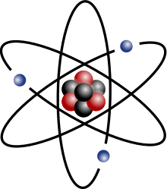
Atom
Intro
Notes:
Today, we’ll be learning about the word: atom.

Slide 3
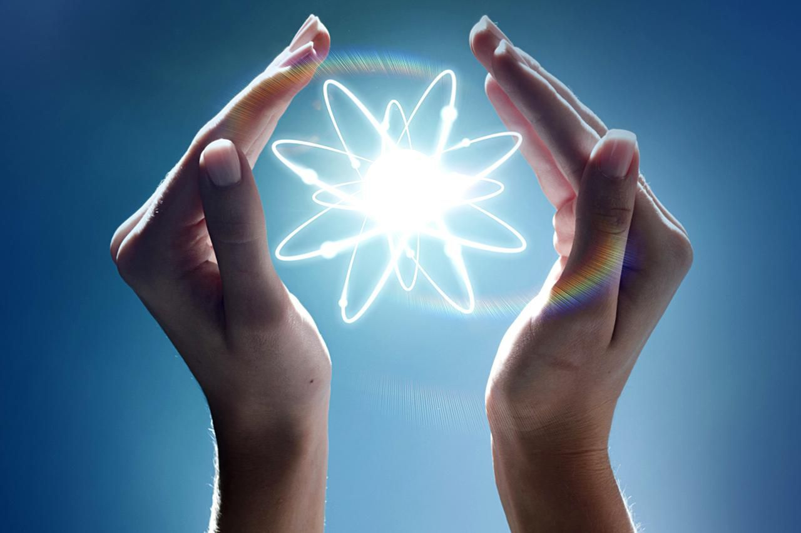
Big Question: What are atoms, and how do they come together to create everything around us?
Notes:
Our “big question” is: What are atoms, and how do they come together to create everything around us?
[Pause and illicit predictions from students.]
I love all these thoughtful guesses! Be sure to keep this question and your predictions in mind as we move through these next few lessons, and we’ll continue to revisit it.

Slide 4
Notes:
Before we move on to our new topic, let’s review some other words & concepts that you already learned and make sure you are firm in your understanding.

Slide 5
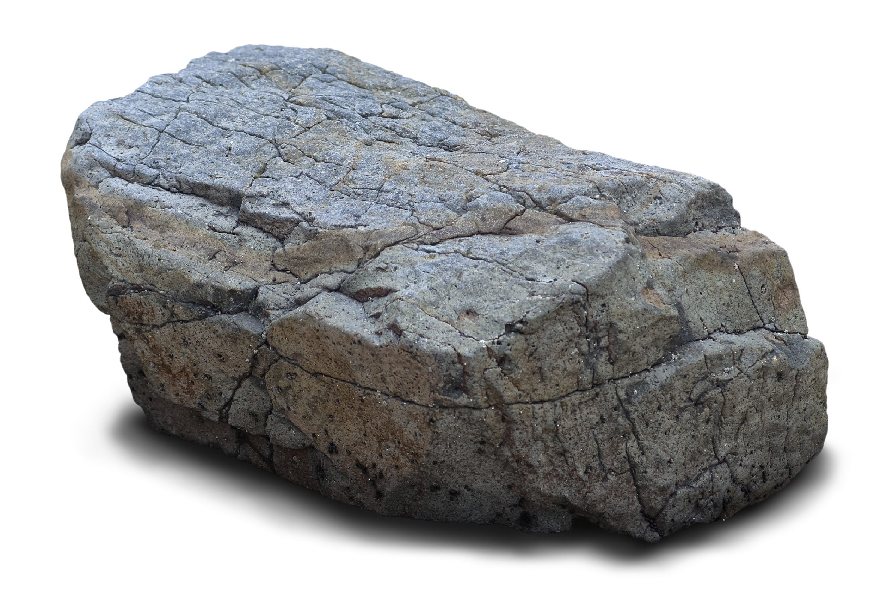
Matter: anything that has mass and take up space
Notes:
Matter is anything that has mass and takes up space.

Slide 6
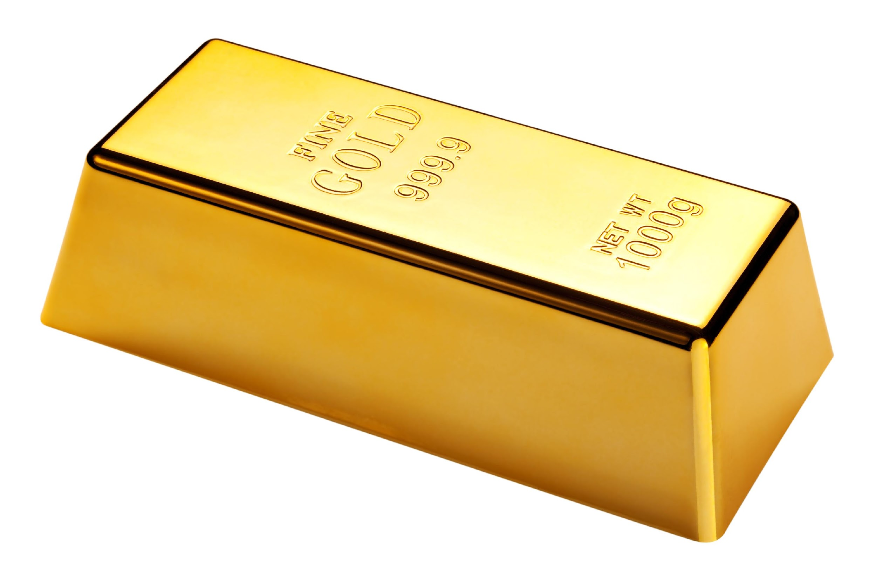
Element: a pure substance containing only one type of atom
Notes:
An element is a pure substance containing only one type of atom.

Slide 7
Elements are an example of matter.
Notes:
Elements are an example of matter.

Slide 8
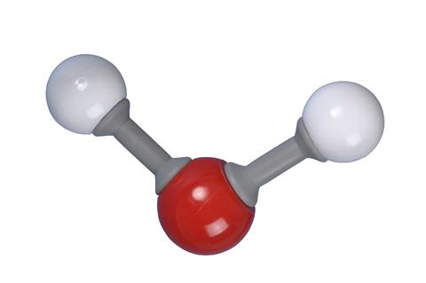
Molecule: a particle containing 2 or more atoms of the same OR different elements
Notes:
A molecule is a particle containing 2 or more atoms of the same OR different elements. Molecules are the smallest pieces of compounds.

Slide 9
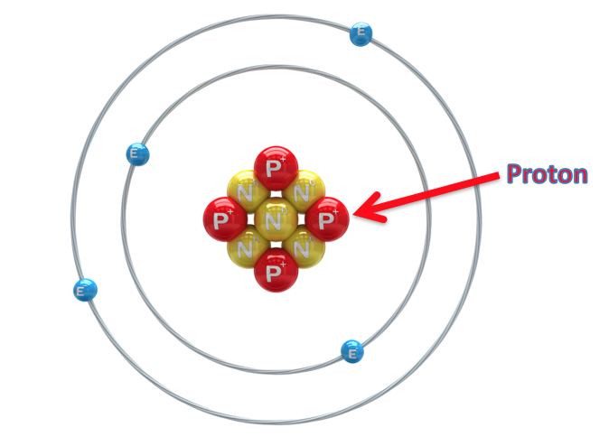
Proton: positively charged subatomic particle found in the nucleus of an atom
Notes:
A proton is a positively charged subatomic particle found in the nucleus of an atom.

Slide 10
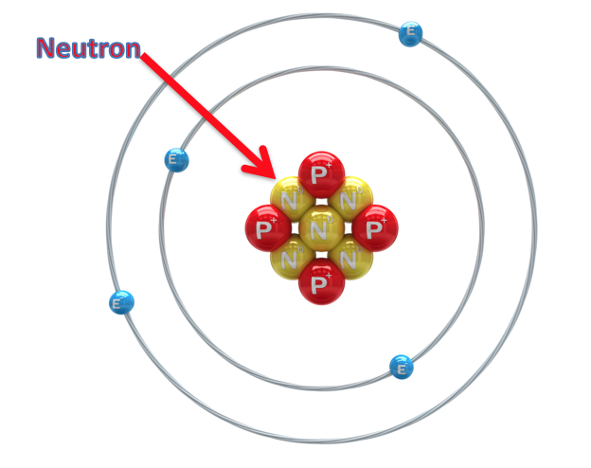
Neutron: subatomic particle with a neutral charge, found in the nucleus of an atom
Notes:
A neutron is a subatomic particle with a neutral charge, found in the nucleus of an atom.

Slide 11
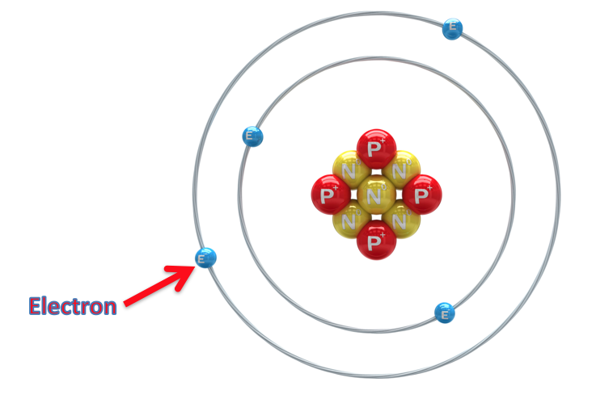
Electron: negatively charged particle that orbits the nucleus of an atom
Notes:
An electron is a negatively charged particle that orbits the nucleus.

Slide 12
Notes:
Now let’s pause for a moment to review the information we have covered already.

Slide 13
A pure substance containing one type of atom is…
Matter
An element
Notes:
A pure substance containing one type of atom is…

Slide 14
A pure substance containing one type of atom is…
Matter
An element
Notes:
A pure substance containing one type of atom is…
[An element]

Slide 15
Elements are an example of ________.
Notes:
Elements are an example of ________.
[Matter]

Slide 16
Elements are an example of matter.
Notes:
Elements are an example of matter.

Slide 17
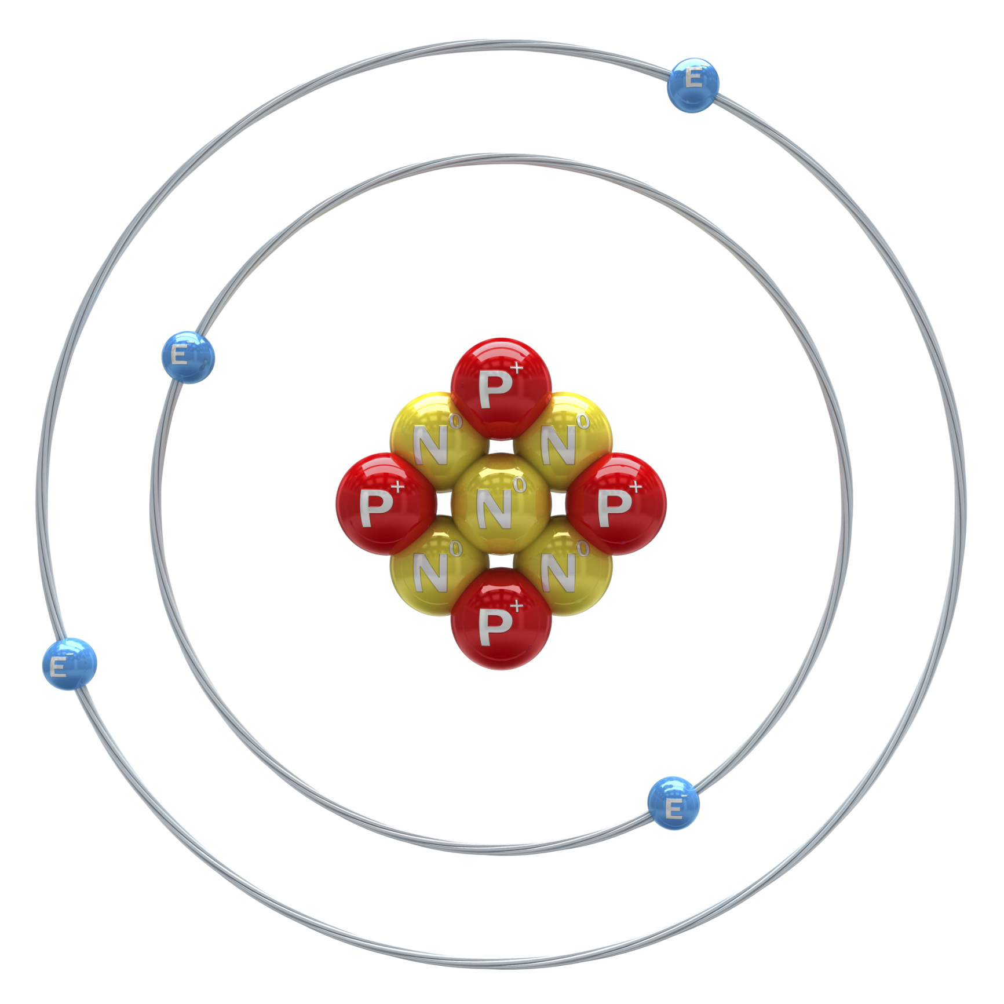
________, ________, and _______ are the three particles that make up an atom.
Notes:
_______, _______, and ________ are the three particles that make up an atom.

Slide 18
Protons, neutrons, and electrons are the three particles that make up an atom.
Notes:
[Protons, neutrons, and electrons are the three particles that make up an atom.]

Slide 19
Atom
Notes:
Now that we’ve reviewed, let’s define the phrase atom.

Slide 20
Atom: smallest whole unit of matter
Notes:
An atom is the smallest whole unit of matter.

Slide 21
Notes:
Let’s check-in for understanding.

Slide 22
What is an atom?
Notes:
What is an atom?
[An atom is the smallest whole unit of matter. ]

Slide 23
Atoms are made up of the three particles…
Notes:
Atoms are made up of the three particles…
[Protons, neutrons, and electrons.]

Slide 24
Notes:
That is the basic definition, but there is a bit more you need to know.

Slide 25
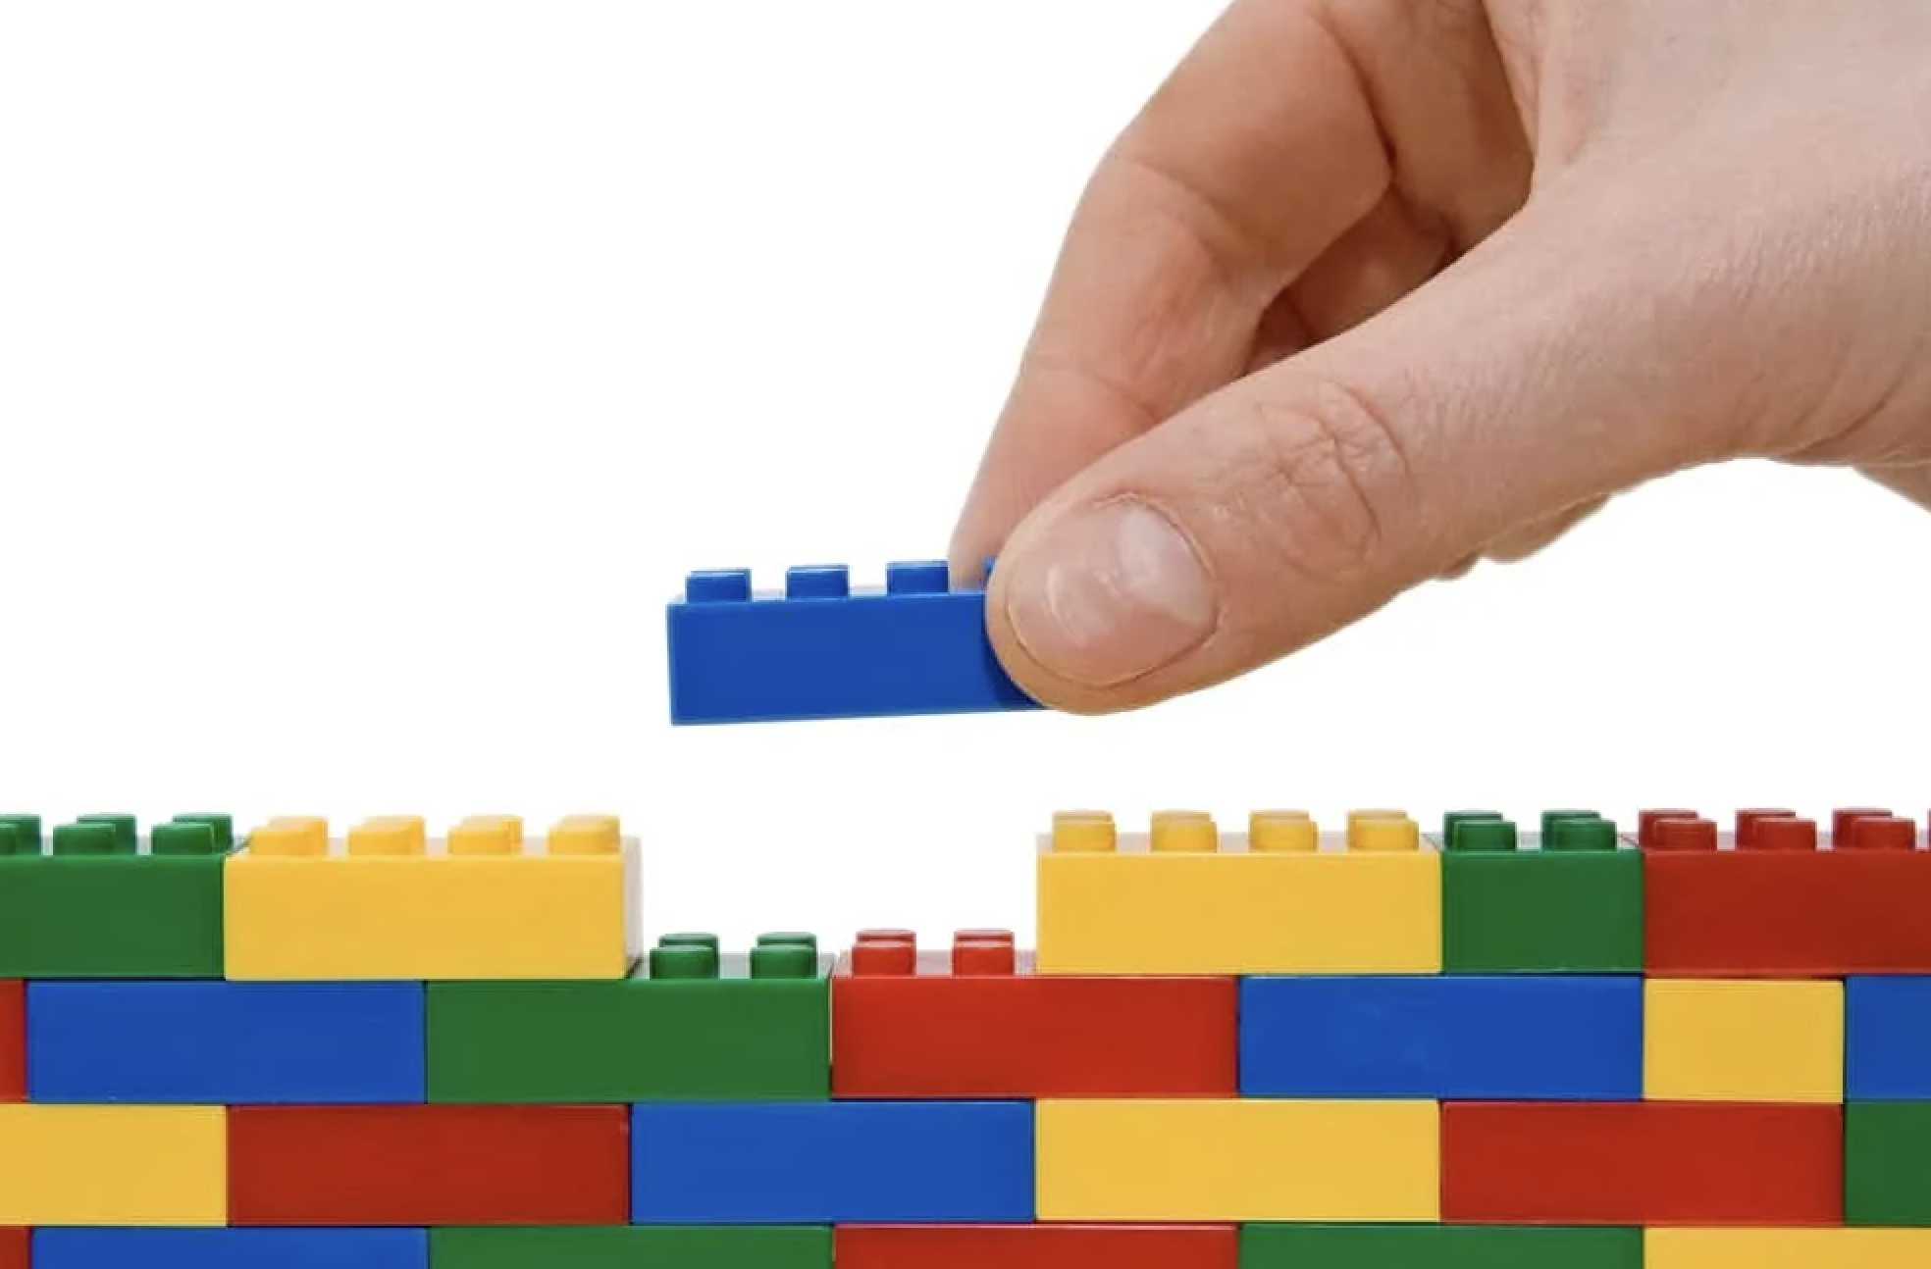
Atoms are like tiny building blocks that make up everything around us.
Notes:
Imagine atoms as tiny building blocks, like Lego pieces, that make up everything around us. Every element and type of matter, from the air we breathe to the water we drink, is made up of these atoms.

Slide 26
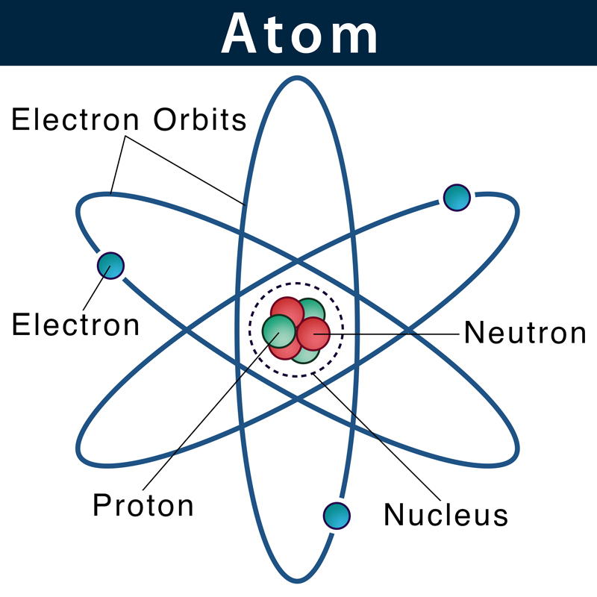
Atoms are very small and have even smaller particles known as protons, neutrons, and electrons.
Notes:
Atoms are incredibly small, so small that you can't see them with your eyes. They have a center called the nucleus, which is like the core of the atom. Even smaller parts, or particles, known as protons, neutrons, and electrons are a part of the atom.

Slide 27
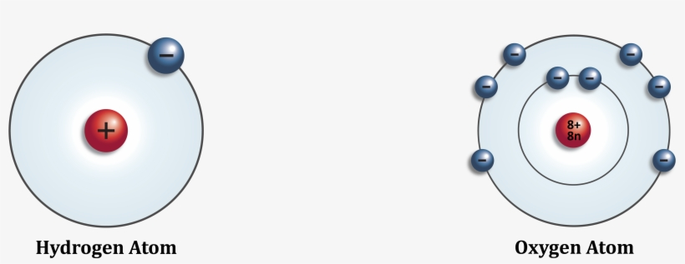
Different elements are made up of specific types of atoms.
Notes:
Different elements, like oxygen, hydrogen, and carbon, are made up of specific types of atoms. For example, oxygen atoms join together to make the air we breathe, and hydrogen atoms combine to make water.

Slide 28
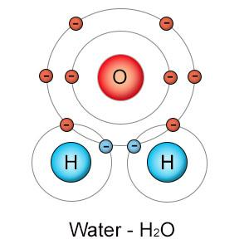
When atoms of different elements connect, they create molecules.
Notes:
When atoms of different elements get together and connect in specific ways, they create molecules, which are like groups of Legos stuck together to build something more complex. These molecules can be simple, like a molecule of water (H2O), or complex, like the molecules that make up your body.

Slide 29
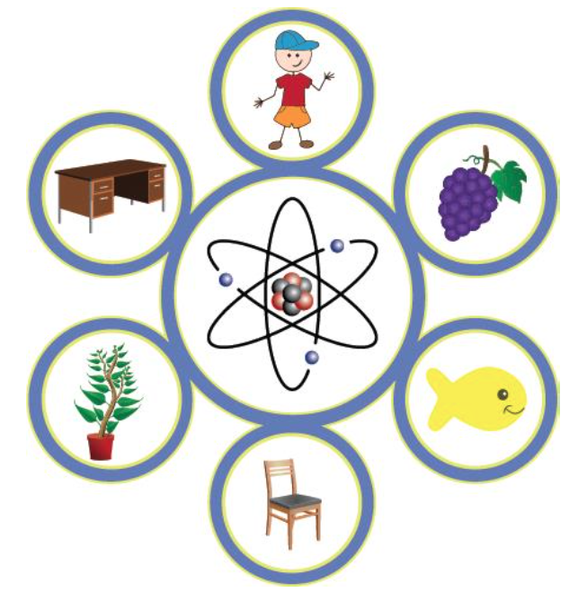
Everything around us is made up of atoms.
Notes:
So, everything around us, whether it's a rock, a plant, or a person, is made up of these tiny building blocks called atoms. It's like nature's way of putting together all the different things we see and experience!

Slide 30
Notes:
Let’s check-in for understanding.

Slide 31
True or false: Atoms are so small we cannot see them with our eyes.
True
False
Notes:
True or false: Atoms are so small we cannot see them with our eyes.

Slide 32
True or false: Atoms are so small we cannot see them with our eyes.
True
False
Notes:
True or false: Atoms are so small we cannot see them with our eyes.
[True]

Slide 33
Which of the following is NOT a particle that makes up an atom?
Protons
Freons
Neutrons
Electrons
Notes:
Which of the following is NOT a particle that makes up an atom?

Slide 34
Which of the following is NOT a particle that makes up an atom?
Protons
Freons
Neutrons
Electrons
Notes:
Which of the following is NOT a particle that makes up an atom?
[B. Freons]

Slide 35
Different _____ are made up of specific types of atoms.
Notes:
Different ______ are made up of specific types of atoms.

Slide 36
Different elements are made up of specific types of atoms.
Notes:
[Different elements are made up of specific types of atoms.]

Slide 37
When atoms of different elements connect, they create _______.
Notes:
When atoms of different connect, they create ________.

Slide 38
When atoms of different elements connect, they create molecules.
Notes:
[When atoms of different connect, they create molecules.]

Slide 39
Notes:
Now, let’s talk about some examples of atoms

Slide 40
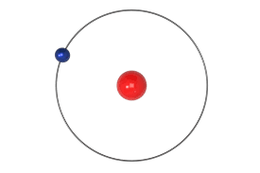
Notes:
This is an example of a hydrogen atom. Hydrogen is the smallest, lightest atom. It has one proton in its nucleus and a single electron. Hydrogen is the most abundant element in our universe, and combines with many other atoms to create substances like water and sugar.

Slide 41
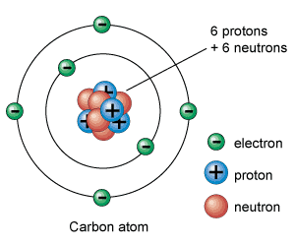
Notes:
Another example of an atom is this carbon atom. The carbon atom has six protons and neutrons with six electrons orbiting the nucleus. Most carbon atoms are found in Earth’s rocks and sediment. Carbon atoms also combine with oxygen atoms to make carbon dioxide in our atmosphere.

Slide 42
Notes:
Let’s check-in for understanding.

Slide 43
Atoms are the __________ whole unit of matter, and _______ are made up of only one type of atom.
Notes:
Atoms are the ________ whole unit of matter, and ________ are made up of only one type of atom.
[smallest, elements]

Slide 44
Atoms are the smallest whole unit of matter, and elements are made up of only one type of atom.
Notes:
[Atoms are the smallest whole unit of matter, and elements are made up of only one type of atom.]

Slide 45
Notes:
Now, let’s talk about some non-examples of an atom.

Slide 46
Notes:
Toys are not an example of an atom. While toys are made up of molecules containing atoms, you can see them with your own eyes. You cannot see atoms with your eyes.

Slide 47
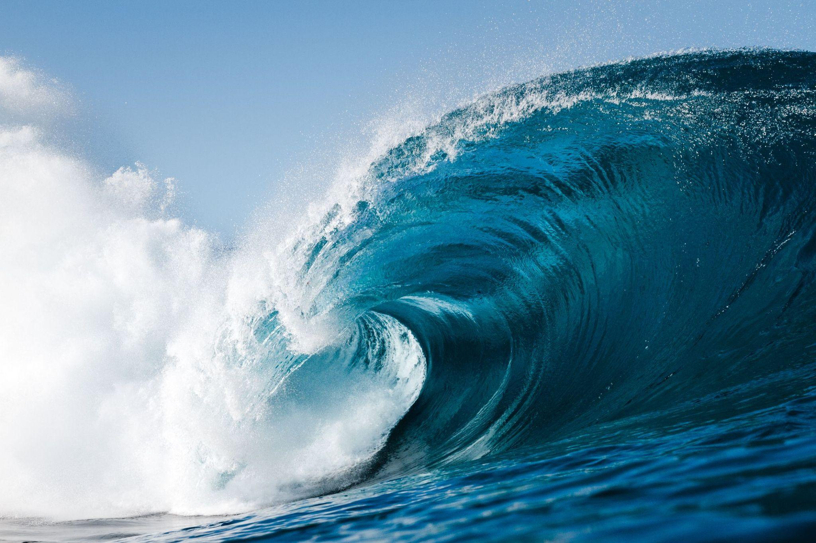
Notes:
The ocean is not an example of an atom. The ocean contains many different organisms like fish and plants.

Slide 48
Notes:
Now let’s pause for a moment to check your understanding.

Slide 49
Why is this not an example of an atom?
Notes:
Why is this not an example of an atom?
[Since the ocean is many different things, it is not an atom. Atoms are very small and the building blocks of all things.]

Slide 50
Remember!!!
Notes:
So remember!

Slide 51
Atom: smallest whole unit of matter
Notes:
An atom is the smallest whole unit of matter.

Slide 52
Notes:
We will now complete this concept map, called a Frayer model, to summarize and further clarify what you have learned about the term atom.

Slide 53
Definition
Picture
Atom
Example
How do atoms impact my life?
Notes:
To complete the Frayer model, we will choose from four choices the correct picture, definition, example, and response to the question, “How do atoms impact my life?” Select the best response for each question using the information you just learned. As we select responses, we will see how this model looks filled in for the term atoms.

Slide 54
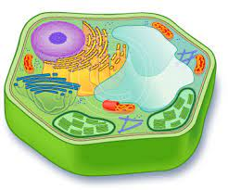
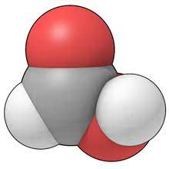
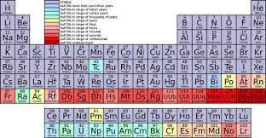
Directions: Choose the correct picture of an atom from the choices below.
A
B
C
D
Notes:
Choose the one correct picture of atom from these four choices.

Slide 55
Directions: Choose the correct picture of an atom from the choices below.
A
B
C
D
Notes:
This is the picture that shows atom.

Slide 56
Definition
Picture
Atom
Example
How do atoms impact my life?
Notes:
Here is the Frayer model filled in with a picture of atom.

Slide 57
Directions: Choose the correct definition of atom from the choices below.
A
Sources of wealth such as land, water, and forests
B
The amount of matter in an object
C
Smallest whole unit of matter
D
A mixture in which the components can be seen separately
Notes:
Choose the one correct definition of atom from these four choices.

Slide 58
Directions: Choose the correct definition of atom from the choices below.
A
Sources of wealth such as land, water, and forests
B
The amount of matter in an object
C
Smallest whole unit of matter
D
A mixture in which the components can be seen separately
Notes:
“Smallest whole unit of matter” is correct! This is the definition of atom.

Slide 59
Definition
Picture
Smallest whole unit of matter
Atom
Example
How do atoms impact my life?
Notes:
Here is the Frayer Model with a picture and the definition filled in for atom: Smallest whole unit of matter.

Slide 60
Directions: Choose the correct example of an atom from the choices below.
A
Hydrogen
B
Neutron
C
Sugar
D
Baking soda
Notes:
Choose the one correct example of atom from these four choices.

Slide 61
Directions: Choose the correct example of an atom from the choices below.
A
Hydrogen
B
Neutron
C
Sugar
D
Baking soda
Notes:
“Hydrogen” is correct! This is an example of atom.

Slide 62
Definition
Picture
Smallest whole unit of matter
Atom
Hydrogen
Example
How do atoms impact my life?
Notes:
Here is the Frayer Model with a picture, definition, and an example of atom: hydrogen.

Slide 63
Directions: Choose the correct response for “how do atoms impact my life?” from the choices below.
A
Atoms make up everything in our universe including our environment and our bodies.
B
Atoms produce energy that fuels my cells so I can perform daily activities.
C
Atoms protect me from harmful bacteria and viruses to keep me healthy.
D
Atoms produce heat that helps regulate our body temperature.
Notes:
Choose the one correct response for “how do atoms impact my life?” from these four choices.

Slide 64
Directions: Choose the correct response for “how do atoms impact my life?” from the choices below.
A
Atoms make up everything in our universe including our environment and our bodies.
B
Atoms produce energy that fuels my cells so I can perform daily activities.
C
Atoms protect me from harmful bacteria and viruses to keep me healthy.
D
Atoms produce heat that helps regulate our body temperature.
Notes:
“Atoms make up everything in our universe including our environment and our bodies.” That is correct! This is an example of how atoms impact your life.

Slide 65
Definition
Picture
Smallest whole unit of matter
Atom
Atoms make up everything in our universe including our environment and our bodies.
Hydrogen
Example
How do atoms impact my life?
Notes:
Here is the Frayer Model with a picture, definition, example, and a correct response to “how do atoms impact my life?”: Atoms make up everything in our universe including our environment and our bodies.

Slide 66
Remember!!!
Notes:
So remember!

Slide 67
Atom: smallest whole unit of matter
Notes:
An atom is the smallest whole unit of matter.

Slide 68
Big Question: What are atoms, and how do they come together to create everything around us?
Notes:
Let’s reflect once more on our big question. Our “big question” is: What are atoms, and how do they come together to create everything around us?
Does anyone have any additional examples to share that haven’t been discussed yet?
[Pause and illicit predictions from students.]

Slide 69
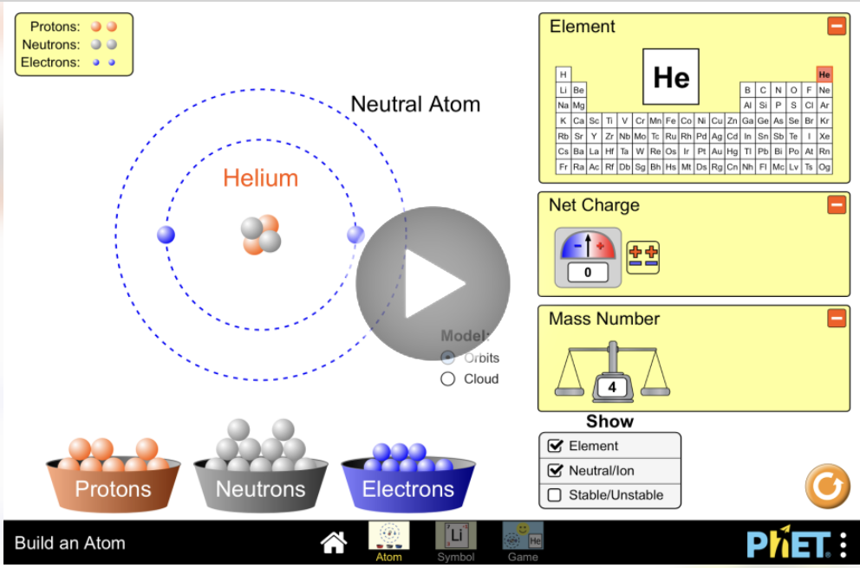
Simulation
Materials Needed:
Computer or tablet that can access this website: https://phet.colorado.edu/en/simulations/build-an-atom/activities
Procedure:
Click the play button, then click on the “Atom” square to access the simulation.
Using the website, drag different amounts of protons, neutrons, and electrons on to the atom. As you build different types of atoms, make note of which ones you create as show in the Periodic Table diagram.
Notes:
We’ll now do a simulation. On your devices, go to the website I have linked on the slide. Click the play button, then click on the “Atom” square to access the simulation. Using the website, drag different amounts of protons, neutrons, and electrons on to the atom. As you build different types of atoms, make note of which ones you create as show in the Periodic Table diagram.

Slide 70
Reflection Activity
What atoms did you build?
Did you recognize any of the substances of elements you made atoms of?
Name some places or things you can think of that contain the elements you’ve built atoms of that our in our everyday lives.
Notes:
Have students discuss these questions with a partner or with their table before calling on groups to share one of their responses with the class.

Slide 71
Notes:
Thanks for watching, and please continue watching CAPs available from this website.

Slide 72
This Was Created With Resources From:
Questions or Comments
Michael Kennedy, Ph.D. MKennedy@Virginia.edu
Rachel L Kunemund, Ph.D. rk8vm@virginia.edu

