Slide 1
Intro
“Big Idea” Question
Review Concepts
Check-In Questions
Teacher Demo
Vocabulary
Student-Friendly Definition
Examples & Non-Examples
Morphological Word Parts
Simulation/Activity
Notes:
OK everyone, get ready for our next lesson. Just as a reminder, these are the different components that our lesson may include, and you’ll see these icons in the top left corner of each slide so that you can follow along more easily!

Slide 2
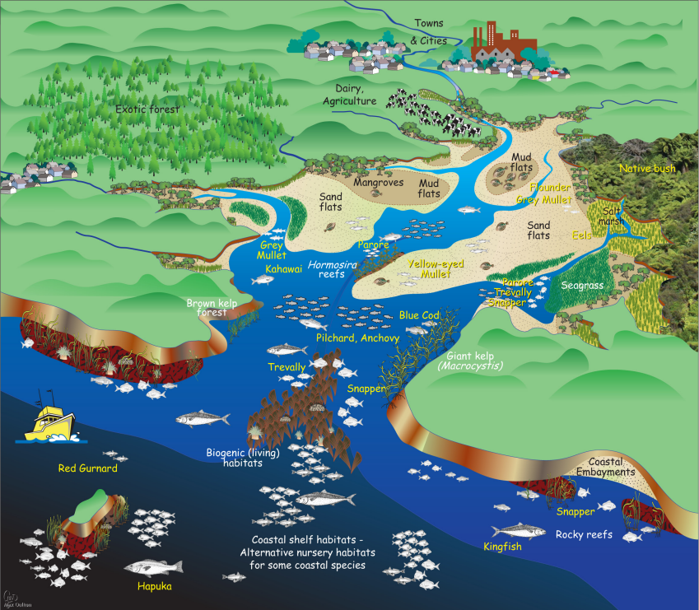
Intro
Estuary
Notes:
Today we will learn the definition of an estuary.
Feedback: Giving students the specific goal of the lesson helps to cue them for what they will be asked to do and sets them up for success!

Slide 3
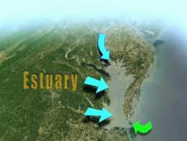
Big Question: What are estuaries, and what is the most important estuary in Virginia?
Notes:
Our “big question” is: What are estuaries, and what is the most important estuary in Virginia?
[Pause and illicit predictions from students.]
I love all these thoughtful scientific hypotheses! Be sure to keep this question and your predictions in mind as we move through these next few lessons, and we’ll continue to revisit it.
Feedback: Asking students to make predictions about the most important estuary in Virginia helps students to place their ideas in a geographic context and is a great way to activate and elicit student ideas and prior knowledge. This type of activity is evidence of the teacher planning for students’ engagement with science ideas.

Slide 4
Notes:
Before we move on to our new vocabulary term, let’s review some other words & concepts that you already learned and make sure you are firm in your understanding.
Feedback: When reviewing previously learned material, monitoring understanding is an important step before moving on to new material. Explicitly cueing students that this what you are doing is an important way to prepare students for what is next and set them up for success.

Slide 5
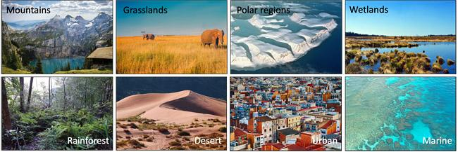
Habitat: home of an animal or plant
Notes:
A habitat is a home of an animal or plant. Most habitats include food, shelter, and water.

Slide 6
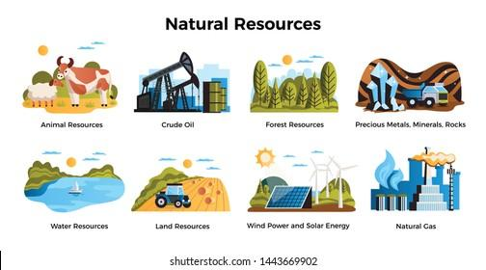
Natural resource: something found in nature that can be used by people
Notes:
A natural resource is something found in nature that can be used by people.
Feedback: Having the definition written on the slide along with pictures could be a great way to help students make connections as they hear, see, and read aspects of definitions.

Slide 7
Notes:
Now let’s pause for a moment to check your understanding.

Slide 8
What is a habitat?
Notes:
What is a habitat?
[A habitat is a home of an animal or plant. Most habitats include food, shelter, and water.]

Slide 9
True/False: A natural resource is something people make.
Notes:
True/False: A natural resource is something people make.
Feedback: Offering these questions is a quick way to monitor students understanding before continuing to build definitions.

Slide 10
True/False: A natural resource is something people make.
Notes:
True/False: A natural resource something people make.
[False: A natural resource is something found in nature that can be used by people.]

Slide 11
Estuary
Notes:
Now that we’ve reviewed, let’s define our new term, estuary

Slide 12
Estuary: area where fresh water from rivers and streams mixes with salt water from the ocean
Notes:
An estuary is an area where fresh water from rivers and streams mixes with salt water from the ocean.

Slide 13
Notes:
Now let’s pause for a moment to check your understanding.

Slide 14
What is an estuary?
Notes:
What is an estuary?
[An estuary is an area where fresh water from rivers and streams mix with salt water from the ocean.]

Slide 15
Notes:
That is the basic definition, but there is a bit more you need to know.

Slide 16
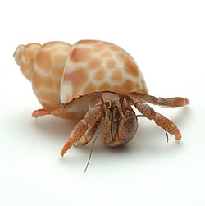
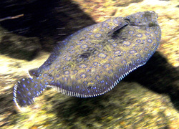
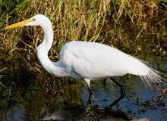
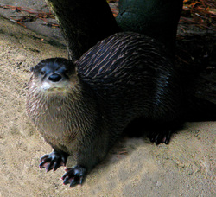
Estuaries are habitats for many animals
Notes:
Estuaries are habitats for many different animals. Animals use habitats as nurseries to protect their young, for food and water, and for shelter. Some animals you might find in some estuaries would be crabs, fish, otters, and birds.
Feedback: Offering specific examples of animals found in estuaries can help students to visualize what an estuary is and build understanding around this new definition.

Slide 17
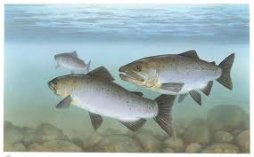
We need natural resources from estuaries.
Notes:
We get natural resources from estuaries. A major natural resource that we get from estuaries is fish. People fish in estuaries to catch fish for food.

Slide 18
Estuaries filter out pollutants
Notes:
Pollutants drain into the estuary, but estuaries filter out those pollutants, to keep water clean, which helps people, plants, and animals.

Slide 19
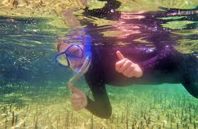
We use estuaries for fun!
Notes:
We also use estuaries to do fun things like swimming or boating.

Slide 20
Notes:
Now let’s pause for a moment to check your understanding.

Slide 21
Estuaries are _______ for many animals.
Notes:
Estuaries are _________ for many different animals. Animals use habitats as nurseries to protect their young, for food and water, and for shelter. Some animals you might find in some estuaries would be crabs, fish, otters, and birds.

Slide 22
Estuaries are habitats for many animals.
Notes:
Estuaries are habitats for many different animals. Animals use habitats as nurseries to protect their young, for food and water, and for shelter. Some animals you might find in some estuaries would be crabs, fish, otters, and birds.

Slide 23
True/False: We cannot get natural resources from estuaries.
Notes:
True/False: We cannot get natural resources from estuaries.

Slide 24
True/False: We cannot get natural resources from estuaries.
Notes:
True/False: We cannot get natural resources from estuaries.
[False: We get natural resources from estuaries. A major natural resource that we get from estuaries is fish. People fish in estuaries to catch fish for food.]

Slide 25
How do estuaries help keep water clean?
Notes:
How do estuaries help keep water clean?
[Pollutants drain into the estuary, but estuaries filter out those pollutants, to keep water clean, which helps people, plants, and animals.]

Slide 26
Name something else we use estuaries for.
Notes:
Name something else we use estuaries for.
[We also use estuaries to do fun things like swimming or boating.]

Slide 27
Notes:
Now, let’s look at examples of estuaries.

Slide 28
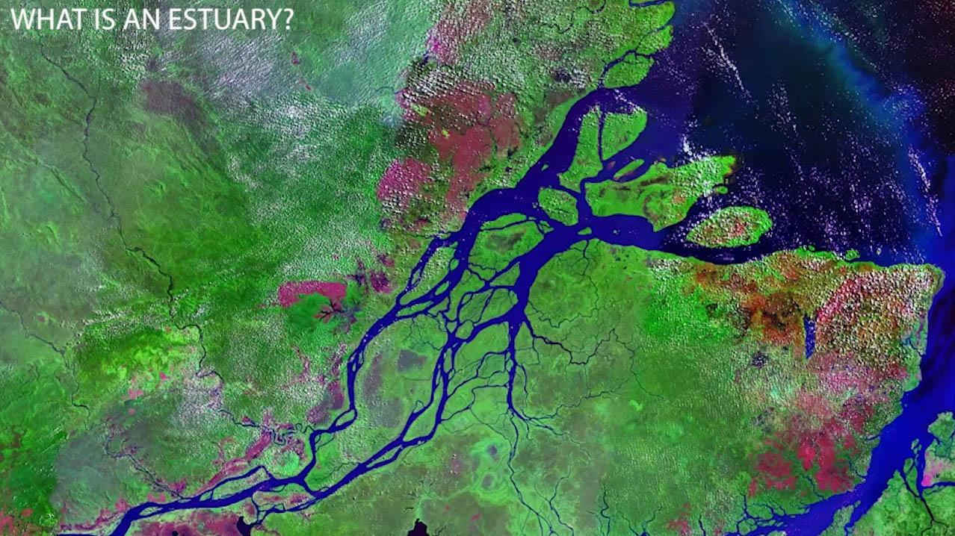
Notes:
Here we have an example of an estuary. The arrows are point at a river. The river flows into the ocean, so where the fresh water from the river meets the salt water from the ocean, is the estuary.

Slide 29
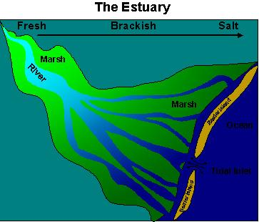
Notes:
Here we have another picture of an estuary. The river runs into the ocean. Remember the estuary is where the fresh water from the river mixes with the salt water from the ocean.

Slide 30
Notes:
Next, let’s talk about some a non-examples of estuaries.

Slide 31
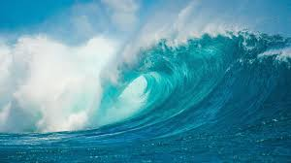
Notes:
Remember the ocean is NOT an estuary. Salt water from the ocean has to mix with fresh water from the river for an estuary to form.
Feedback: One important component of using non-examples is clearly distinguishing similarities and differences to explain why it is a non-example. Including images as part of your non-example helps students to recognize these similarities and differences.

Slide 32
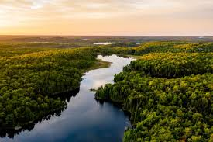
Notes:
A river by itself is also not an estuary because the fresh water from the river would have to mix with salt water from the ocean. So, by itself a river is not an estuary.

Slide 33
Notes:
Now let’s pause for a moment to check your understanding.

Slide 34
Is this an example of an estuary? Explain your answer.
Notes:
Is this an example of an estuary? Explain your answer.
[Yes because the river mixes with the ocean creating an estuary.]

Slide 35
Is the ocean an estuary? Explain your answer.
Notes:
Is the ocean an estuary? Explain your answer.
[Remember the ocean is NOT an estuary. Salt water from the ocean has to mix with fresh water from the river for an estuary to form.]

Slide 36
Why is a river NOT an estuary?
Notes:
Why is a river NOT an estuary?
[A river by itself is also not an estuary because the fresh water from the river would have to mix with salt water from the ocean. So, by itself a river is not an estuary.]

Slide 37
Why is this an example of an estuary?
Notes:
Why is this an example of an estuary?
[Here we have another picture of an estuary. The river runs into the ocean. Remember the estuary is where the fresh water from the river mixes with the salt water from the ocean.]

Slide 38
What is an estuary?
Notes:
What is an estuary?
[An estuary is an area where fresh water from rivers and streams mix with salt water from the ocean.]

Slide 39
Estuaries are _______ for many animals.
Notes:
Estuaries are ________ for many different animals. Animals use habitats as nurseries to protect their young, for food and water, and for shelter. Some animals you might find in some estuaries would be crabs, fish, otters, and birds.

Slide 40
Estuaries are habitat for many animals.
Notes:
Estuaries are habitats for many different animals. Animals use habitats as nurseries to protect their young, for food and water, and for shelter. Some animals you might find in some estuaries would be crabs, fish, otters, and birds.

Slide 41
True/False: We cannot get natural resources from estuaries.
Notes:
True/False: We cannot get natural resources from estuaries.
False: We get natural resources from estuaries. A major natural resource that we get from estuaries is fish. People fish in estuaries to catch fish for food.

Slide 42
True/False: We cannot get natural resources from estuaries.
Notes:
True/False: We cannot get natural resources from estuaries.
[False: We get natural resources from estuaries. A major natural resource that we get from estuaries is fish. People fish in estuaries to catch fish for food.]

Slide 43
How do estuaries help keep water clean?
Notes:
How do estuaries help keep water clean?
[Pollutants drain into the estuary, but estuaries filter out those pollutants, to keep water clean, which helps people, plants, and animals.]

Slide 44
Name something else we use estuaries for.
Notes:
Name something else we use estuaries for.
[We also use estuaries to do fun things like swimming or boating.]

Slide 45
Is this an example of an estuary? Explain your answer.
Notes:
Is this an example of an estuary? Explain your answer.
[Yes because the river mixes with the ocean creating an estuary.]

Slide 46
Is the ocean an estuary? Explain your answer.
Notes:
Is the ocean an estuary? Explain your answer.
[Remember the ocean is NOT an estuary. Salt water from the ocean has to mix with fresh water from the river for an estuary to form.]

Slide 47
Why is a river NOT an estuary?
Notes:
Why is a river NOT an estuary?
[A river by itself is also not an estuary because the fresh water from the river would have to mix with salt water from the ocean. So, by itself a river is not an estuary.]

Slide 48
Why is this an example of an estuary?
Notes:
Why is this an example of an estuary?
[Here we have another picture of an estuary. The river runs into the ocean. Remember the estuary is where the fresh water from the river mixes with the salt water from the ocean.]

Slide 49
Remember!!!
Notes:
So remember!

Slide 50
Estuary: area where fresh water from rivers and streams mixes with salt water from the ocean
Notes:
An estuary is an area where fresh water from rivers and streams mixes with salt water from the ocean.

Slide 51
Simulation Activity
Estuaries: Nature’s Water Filters
(Digital Coast)
Click through the simulation to learn about how estuaries filter water.
As you are reading through how estuaries filter water, make sure to pay attention to how this helps the environment/other reasons it is important that estuaries filter water.
Notes:
Feedback: Simulations are an important part of making science thinking visible for students. You may incorporate specific questions into the simulation activity to help cue students to when the simulation offers information about how estuaries help the environment.

Slide 52
Big Question: What are estuaries, and what is the most important estuary in Virginia?
Notes:
Our “big question” is: What are estuaries, and what is the most important estuary in Virginia?
Explicit cue to revisit the big question at the end of the lesson: Okay everyone. Now that we’ve learned the term, potential energy let’s reflect once more on our big question. Was there anything that we predicted earlier that was correct or incorrect? Do you have any new hypotheses to share?
Feedback: Feedback: Offering students an opportunity to evaluate their earlier hypotheses and make changes based on their new understandings is an important part of the iterative process in science. This is a great opportunity to help students build an epistemic understanding by explicitly stating how continuing to change and build on hypotheses as your knowledge grows is an important part of the discipline of science!

Slide 53
Notes:
Thanks for watching, and please continue watching CAPs available from this website.

Slide 54
This Video Was Created With Resources From:
Questions or Comments
Michael Kennedy, Ph.D. MKennedy@Virginia.edu
Rachel L Kunemund, Ph.D. rk8vm@virginia.edu

Slide 55
Intro
“Big Idea” Question
Review Concepts
Check-In Questions
Teacher Demo
Vocabulary
Student-Friendly Definition
Examples & Non-Examples
Morphological Word Parts
Simulation/Activity
Notes:
OK everyone, get ready for our next lesson. Just as a reminder, these are the different components that our lesson may include, and you’ll see these icons in the top left corner of each slide so that you can follow along more easily!

Slide 56
Intro
Chesapeake Bay Estuary
Notes:
Today we will learn about the Chesapeake Bay Estuary

Slide 57
Big Question: What are estuaries, and what is the most important estuary in Virginia?
Notes:
Our “big question” is: What are estuaries, and what is the most important estuary in Virginia?
[Pause and illicit predictions from students.]
I love all these thoughtful scientific hypotheses! Be sure to keep this question and your predictions in mind as we move through these next few lessons, and we’ll continue to revisit it.

Slide 58
Notes:
Before we move on to our new vocabulary term, let’s review some other words & concepts that you already learned and make sure you are firm in your understanding.

Slide 59
Habitat: home of an animal or plant
Notes:
A habitat is a home of an animal or plant. Most habitats include food, shelter, and water.

Slide 60
Natural Resource: something found in nature that can be used by people
Notes:
A natural resource is something found in nature that can be used by people.

Slide 61
Estuary: area where fresh water from rivers and streams mixes with salt water from the ocean
Notes:
An estuary is an area where fresh water from rivers and streams mixes with salt water from the ocean.

Slide 62
Notes:
Now let’s pause for a moment to check your understanding.

Slide 63
What is a habitat?
Notes:
A habitat is a home of an animal or plant. Most habitats include food, shelter, and water.

Slide 64
True/False: A natural resource is something people make.
Notes:
True/False: A natural resource is something people make.

Slide 65
True/False: A natural resource is something people make.
Notes:
True/False: A natural resource is something people make.
[False: A natural resource is something found in nature that can be used by people.]

Slide 66
What is an estuary?
Notes:
What is an estuary?
[An estuary is an area where fresh water from rivers and streams mixes with salt water from the ocean.]

Slide 67
Chesapeake Bay Estuary
Notes:
Now that we’ve reviewed, let’s define our new term, Chesapeake Bay Estuary.

Slide 68
Chesapeake Bay Estuary: estuary that stretches from Maryland to Virginia Beach, Virginia.
Notes:
The Chesapeake Bay Estuary is an estuary that stretches from Maryland to Virginia Beach, Virginia.

Slide 69
Notes:
Now let’s pause for a moment to check your understanding.

Slide 70
What is the Chesapeake Bay Estuary?
Notes:
What is the Chesapeake Bay Estuary?
[The Chesapeake Bay Estuary is an estuary that stretches from Maryland to Virginia Beach, Virginia.]

Slide 71
Notes:
That is the basic definition, but there is a bit more you need to know.

Slide 72
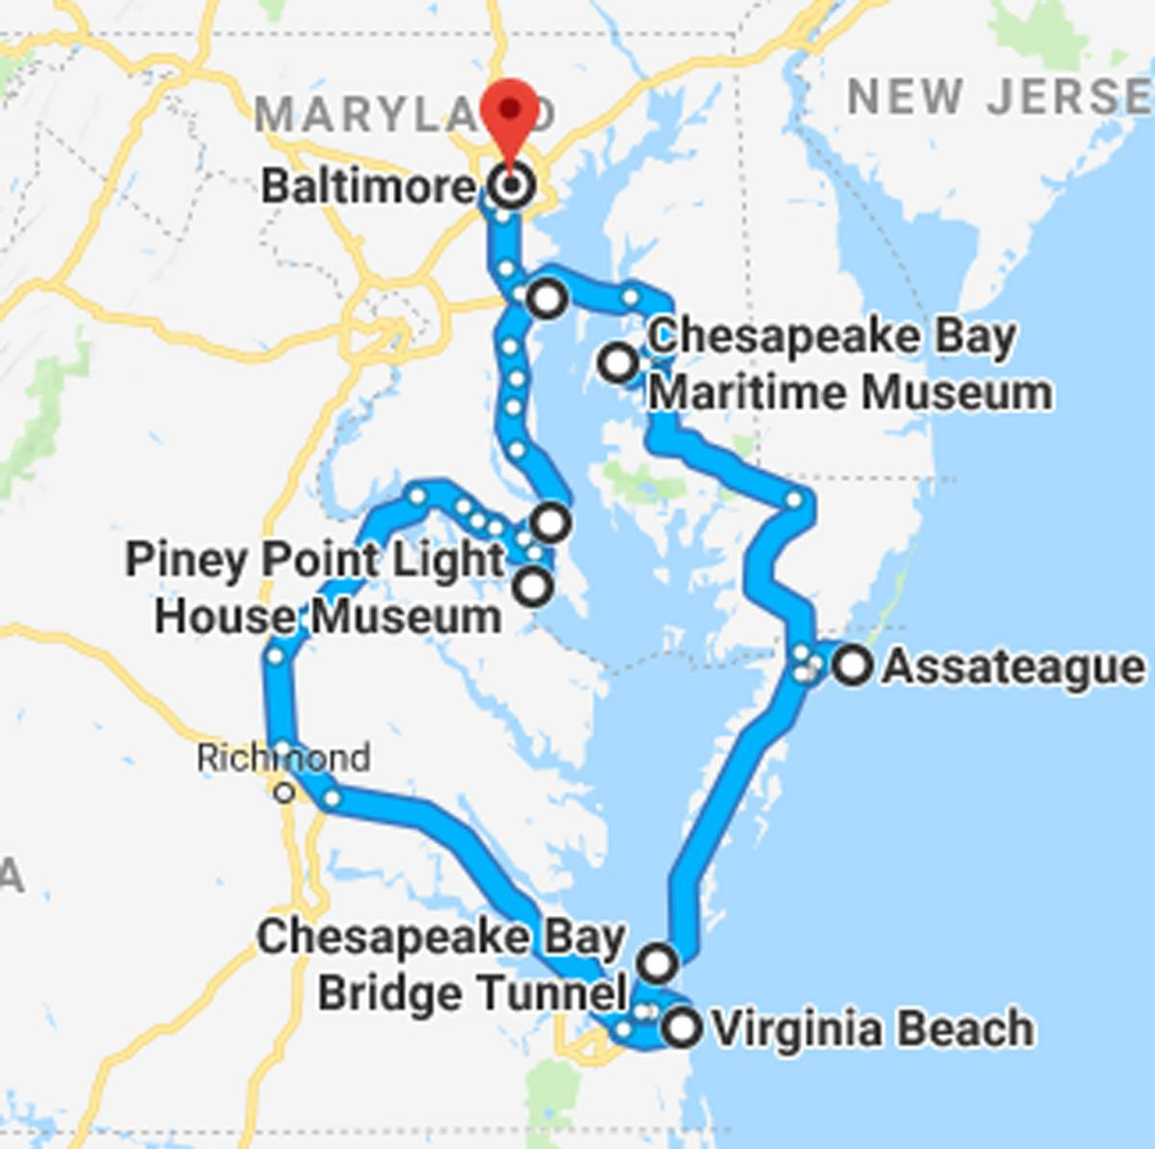
Notes:
Here is the area of the Chesapeake Bay. It is the largest and most productive estuary in the United States. Remember it goes all the way from Virginia to Maryland!

Slide 73
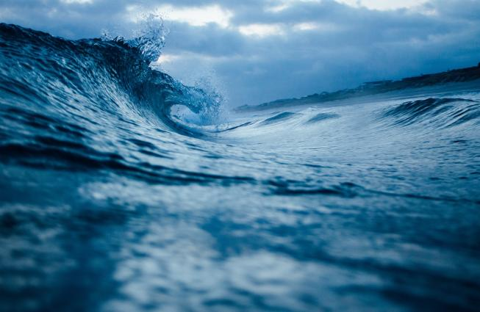
The water in the Chesapeake Bay Estuary is mixed by tides.
Notes:
The water in the Chesapeake Bay Estuary is mixed by tides. Tides push seawater into the estuary and allow water to come back into the ocean.

Slide 74
Notes:
Just like other estuaries, the Chesapeake Bay Estuary is a habitat for many different plants and animals, it filters pollutants out of the waters, once of the most productive places for fishing (to get our natural resource: fish), and where we do a lot of fun activities, like swimming!

Slide 75
Notes:
Now let’s pause for a moment to check your understanding.

Slide 76
True/False: The Chesapeake Bay Estuary is the smallest and least productive in the United States.
Notes:
True/False: The Chesapeake Bay Estuary is the smallest and least productive in the United States.

Slide 77
True/False: The Chesapeake Bay Estuary is the smallest and least productive in the United States.
Notes:
True/False: The Chesapeake Bay Estuary is the smallest and least productive in the United States.
[False: It is the largest and most productive estuary in the United States. Remember it goes all the way from Virginia to Maryland!]

Slide 78
How is the freshwater and saltwater mixed in the Chesapeake Bay Estuary?
Notes:
How is the freshwater and saltwater mixed in the Chesapeake Bay Estuary?
[The water in the Chesapeake Bay Estuary is mixed by tides. Tides push seawater into the estuary and allow water to come back into the ocean.]

Slide 79
Name one important thing the Chesapeake Bay Estuary does.
Notes:
Name one important thing the Chesapeake Bay Estuary does.
[Call on multiple students for this question: Just like other estuaries, the Chesapeake Bay Estuary is a habitat for many different plants and animals, it filters pollutants out of the waters, once of the most productive places for fishing (to get our natural resource: fish), and where we do a lot of fun activities, like swimming!]

Slide 80
Notes:
Now, let’s look at examples of the Chesapeake Bay Estuary.

Slide 81
Notes:
Here we have an example of the Chesapeake Bay Estuary on a Map. We know it is an estuary because we can see where the rivers meet with the ocean on the map. We know it is the Chesapeake Bay Estuary because we can see that it goes from Virginia To Maryland.
Feedback: Focusing on an estuary in our geographical region can help students make connections to real-life situations. You may invite students to discuss if they have visited this estuary before or have other experiences with these types of environments.

Slide 82
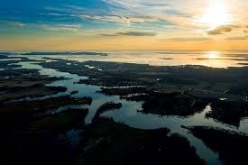
Notes:
Here is a close up picture of part of the Chesapeake Bay Estuary. We can actually see here how some rivers/streams are running into the ocean.

Slide 83
Notes:
Next, let’s talk about some a non-examples of the Chesapeake Bay Estuary.

Slide 84
Notes:
Remember the ocean is NOT an estuary. Salt water from the ocean has to mix with fresh water from the river for an estuary to form.

Slide 85
Notes:
A river by itself is also not an estuary because the fresh water from the river would have to mix with salt water from the ocean. So, by itself a river is not an estuary.

Slide 86
Notes:
Now let’s pause for a moment to check your understanding.

Slide 87
How do you know this is the Chesapeake Bay Estuary?
Notes:
How do you know this is the Chesapeake Bay Estuary?
[Here we have an example of the Chesapeake Bay Estuary on a Map. We know it is an estuary because we can see where the rivers meet with the ocean on the map. We know it is the Chesapeake Bay Estuary because we can see that it goes from Virginia To Maryland.]

Slide 88
What is the Chesapeake Bay Estuary?
Notes:
What is the Chesapeake Bay Estuary?
[Estuary that stretches from Maryland to Virginia Beach, Virginia.]

Slide 89
True/False: The Chesapeake Bay Estuary is the smallest and least productive in the United States.
Notes:
True/False: The Chesapeake Bay Estuary is the smallest and least productive in the United States.

Slide 90
True/False: The Chesapeake Bay Estuary is the smallest and least productive in the United States.
Notes:
True/False: The Chesapeake Bay Estuary is the smallest and least productive in the United States.
[False: It is the largest and most productive estuary in the United States. Remember it goes all the way from Virginia to Maryland!]

Slide 91
How is the freshwater and saltwater mixed in the Chesapeake Bay Estuary?
Notes:
How is the freshwater and saltwater mixed in the Chesapeake Bay Estuary?
[The water in the Chesapeake Bay Estuary is mixed by tides. Tides push seawater into the estuary and allow water to come back into the ocean.]

Slide 92
Name one important thing the Chesapeake Bay Estuary does.
Notes:
Name one important thing the Chesapeake Bay Estuary does.
[Call on multiple students for this question: Just like other estuaries, the Chesapeake Bay Estuary is a habitat for many different plants and animals, it filters pollutants out of the waters, once of the most productive places for fishing (to get our natural resource: fish), and where we do a lot of fun activities, like swimming!]

Slide 93
How do you know this is the Chesapeake Bay Estuary?
Notes:
How do you know this is the Chesapeake Bay Estuary?
[Here we have an example of the Chesapeake Bay Estuary on a Map. We know it is an estuary because we can see where the rivers meet with the ocean on the map. We know it is the Chesapeake Bay Estuary because we can see that it goes from Virginia To Maryland.]

Slide 94
Remember!!!
Notes:
So remember!

Slide 95
Chesapeake Bay Estuary: estuary that stretches from Maryland to Virginia Beach, Virginia.
Notes:
The Chesapeake Bay Estuary is an estuary that stretches from Maryland to Virginia Beach, Virginia.

Slide 96
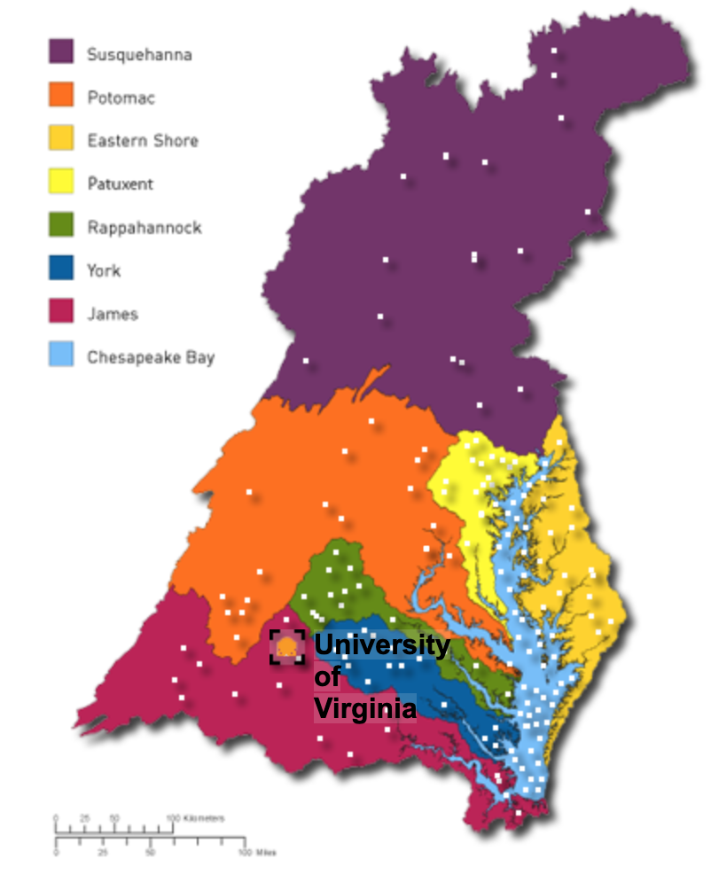
Simulation Activity
UVA Bay Game
Click the link above to explore an interactive map of the Chesapeake Bay.

Slide 97
Big Question: What are estuaries, and what is the most important estuary in Virginia?
Notes:
Explicit cue to revisit the big question at the end of the lesson: Okay everyone. Now that we’ve learned the term, potential energy let’s reflect once more on our big question. Was there anything that we predicted earlier that was correct or incorrect? Do you have any new hypotheses to share?

Slide 98
Notes:
Thanks for watching, and please continue watching CAPs available from this website.

Slide 99
This Video Was Created With Resources From:
Questions or Comments
Michael Kennedy, Ph.D. MKennedy@Virginia.edu
Rachel L Kunemund, Ph.D. rk8vm@virginia.edu

