Slide 1
Intro
“Big Idea” Question
Review Concepts
Check-In Questions
Teacher Engagement
Vocabulary
Student-Friendly Definition
Examples & Non-Examples
Morphological Word Parts
Frayer Model
Simulation/Activity
Notes:
OK everyone, get ready for our next lesson. Just as a reminder, these are the different components that our lesson may include, and you’ll see these icons in the top left corner of each slide so that you can follow along more easily!

Slide 2
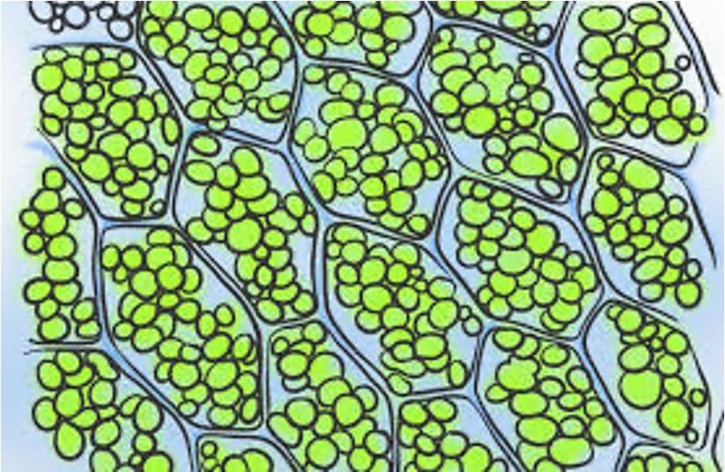
Intro
Chlorophyll
Notes:
Today, we’ll be learning about the word: Chlorophyll.

Slide 3
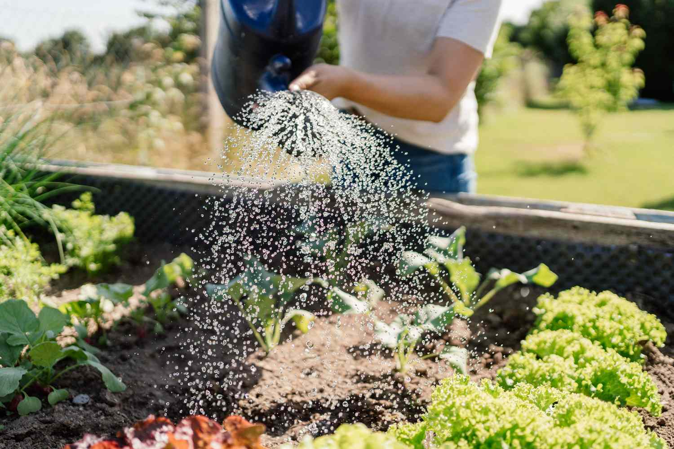
Big Question: What do plants need to survive?
Notes:
Our “big question” is: What do plants need to survive?
[Pause and illicit predictions from students.]
I love all these thoughtful scientific hypotheses! Be sure to keep this question and your predictions in mind as we move through these next few lessons, and we’ll continue to revisit it.

Slide 4
Notes:
Before we move on to our new topic, let’s review some other words & concepts that you already learned and make sure you are firm in your understanding.

Slide 5
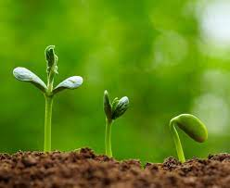
Living Thing: organisms that move, grow, change, and respond to its environment
Notes:
Living things are organisms that grow, change, and respond to its environment.

Slide 6
Energy: the ability to cause change
Notes:
Energy is the ability to cause change.

Slide 7
Notes:
Now let’s pause for a moment to review the information we have covered already.

Slide 8
All living things grow and change.
True
False
Notes:
All living things grow and change.
[True]

Slide 9
All living things grow and change.
True
False
Notes:
All living things grow and change. [True]

Slide 10
What is the ability to cause change?
Heat
Energy
Growth
Notes:
What is the ability to cause change?
[B. Energy]

Slide 11
What is the ability to cause change?
Heat
Energy
Growth
Notes:
What is the ability to cause change? B. Energy

Slide 12
Chlorophyll
Notes:
Now that we’ve reviewed, let’s define the phrase chlorophyll.

Slide 13
Chlorophyll: green pigment found in plants
Notes:
Chlorophyll is a green pigment found in plants

Slide 14
Notes:
Let’s check-in for understanding.

Slide 15
What is chlorophyll?
Notes:
What is chlorophyll?
[A green pigment found in plants]

Slide 16
Notes:
That is the basic definition, but there is a bit more you need to know.

Slide 17
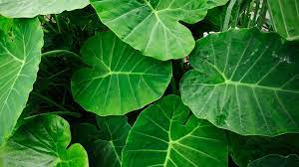
Chlorophyll is most often found in leaves.
Notes:
Chlorophyll is what gives plants their green color. It is most often found in the plant’s leaves.

Slide 18
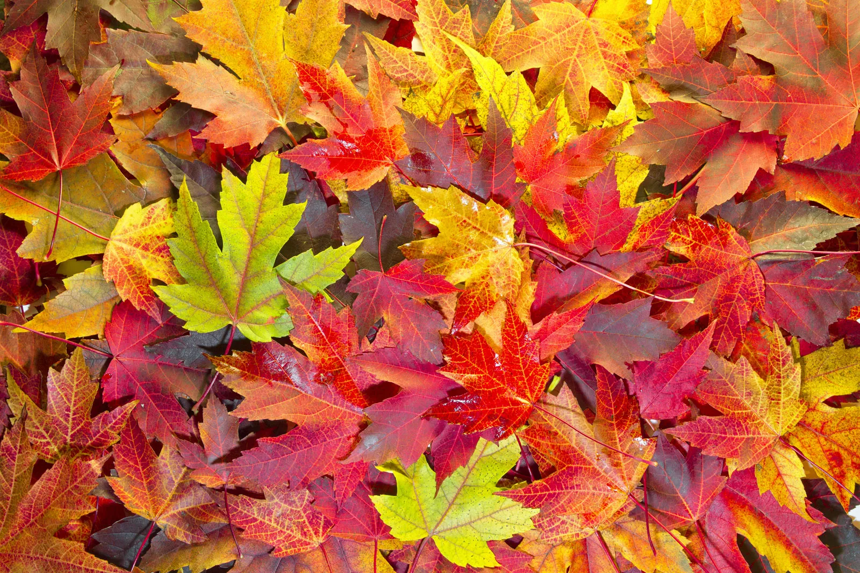
We see a changing leaf colors when chlorophyll breaks down in fall.
Notes:
Each fall, chlorophyll begins to break down because there is less sunlight. As the chlorophyll breaks down, we start to see other pigment colors in the leaves. This is why we see the leaves change colors in the fall.

Slide 19
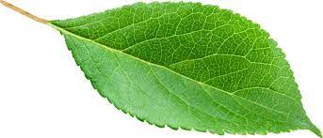
Licensable
It helps the plant absorb light energy from the Sun.
Notes:
Chlorophyll plays an important role in a plant’s survival. It captures the sun’s light energy so it can be used to make a food for the plant. This process is called photosynthesis, we’ll talk about that a bit later.

Slide 20
Notes:
Let’s check-in for understanding.

Slide 21
Where is chlorophyll usually found?
Leaves
Flowers
Roots
Notes:
Where is chlorophyll usually found?
[A. Leaves]

Slide 22
Where is chlorophyll usually found?
Leaves
Flowers
Roots
Notes:
Where is chlorophyll usually found? A. Leaves

Slide 23
Why do the color of the leaves change during fall?
Notes:
Why do the color of the leaves change during fall?
[Chlorophyll breaks down so we can see the other pigments in the leaves]

Slide 24
Chlorophyll helps the plant absorb _______ ________ from the Sun.
Notes:
Chlorophyll helps the plant absorb _______ ______ from the Sun.
[Light energy]

Slide 25
Chlorophyll helps the plant absorb light energy from the Sun.
Notes:
Chlorophyll helps the plant absorb light energy from the Sun.

Slide 26
Notes:
Now, let’s talk about some examples of chlorophyll

Slide 27
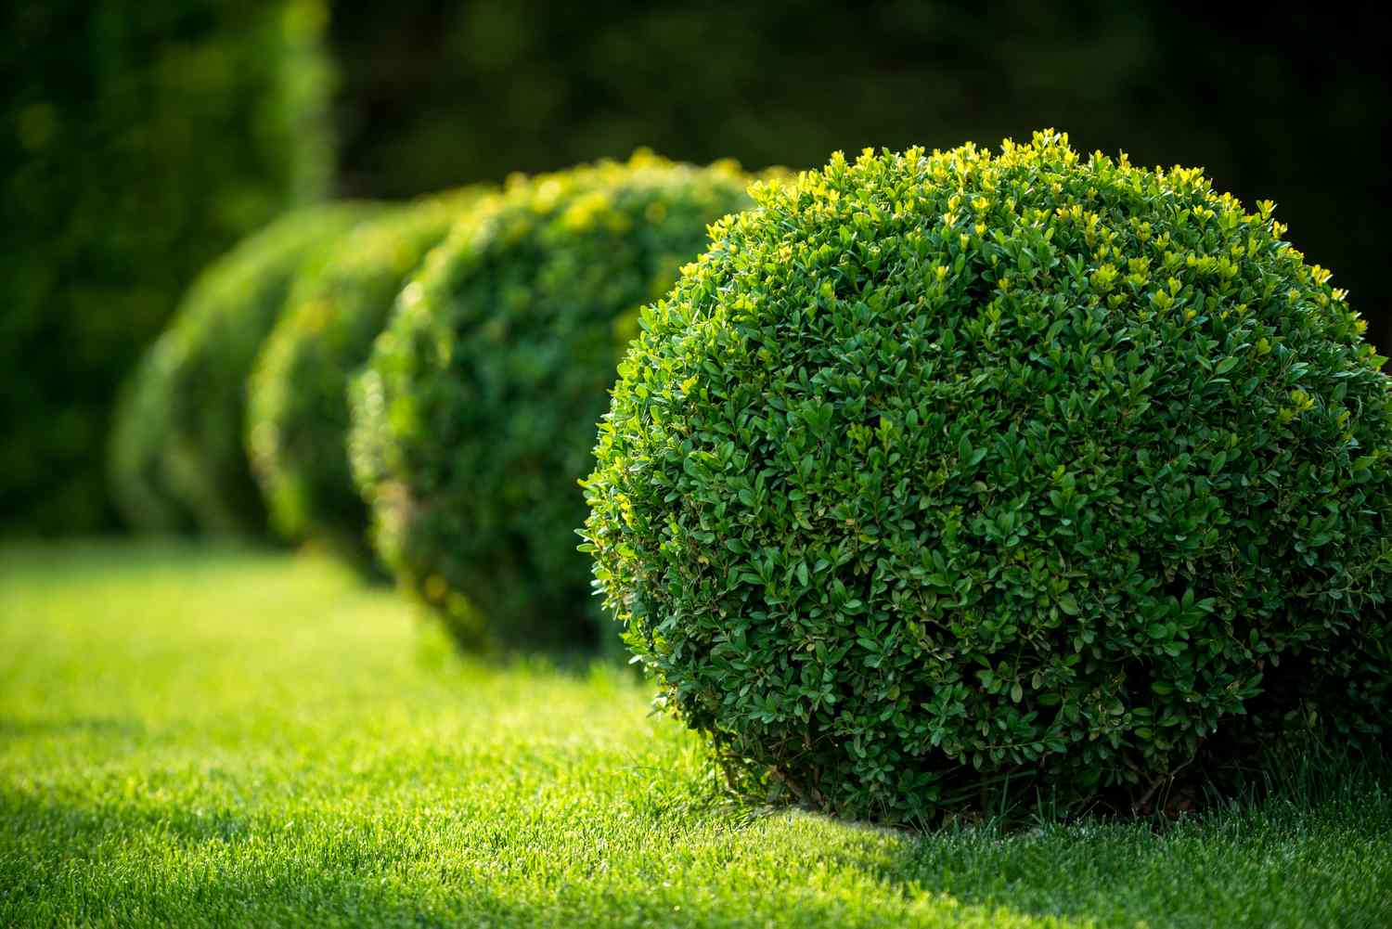
These bushes have chlorophyll in their leaves. The chlorophyll in each leaf capture sunlight to help the bush make its own food.
Notes:
These bushes have chlorophyll in their leaves. The chlorophyll in each leaf capture sunlight to help the bush make its own food.

Slide 28
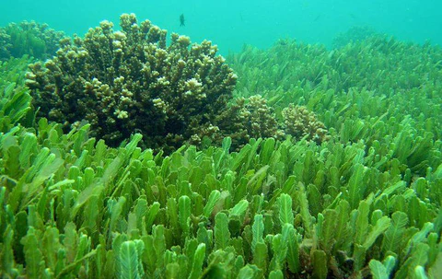
Here is another example of chlorophyll. Algae and other underwater plants still need chlorophyll to capture sunlight to make food. Without the chlorophyll, the plant would not survive.
Notes:
Here is another example of chlorophyll. Algae and other underwater plants still need chlorophyll to capture sunlight to make food. Without the chlorophyll, the plant would not survive.

Slide 29
Notes:
Now, let’s talk about some non-examples of chlorophyll.

Slide 30
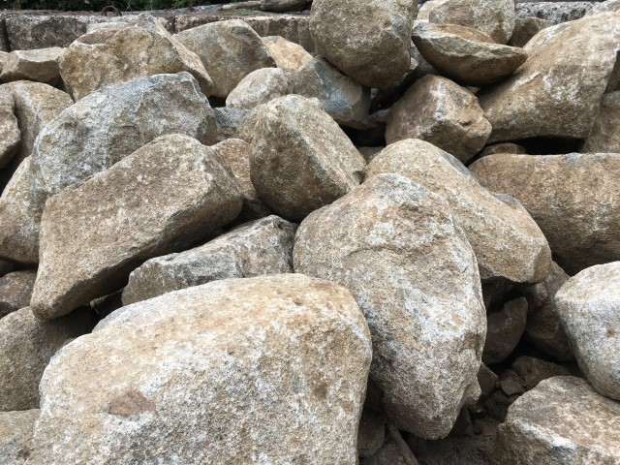
This is NOT an example of chlorophyll. Rocks are not living things, so they do not have chlorophyll.
Notes:
This is not an example of chlorophyll. Rocks are not living things, so they do not have chlorophyll.

Slide 31
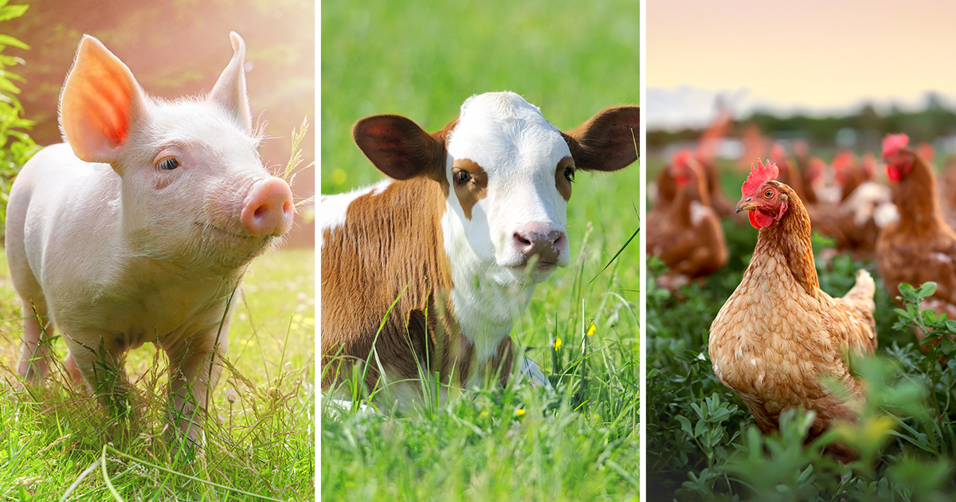
This is also NOT an example of chlorophyll. Animals gets their energy from eating plants and animals, so they do not have chlorophyll in their cells.
Notes:
This is also not an example of chlorophyll. Animals gets their energy from eating plants and animals, so they do not have chlorophyll in their cells.

Slide 32
Notes:
Now let’s pause for a moment to check your understanding.

Slide 33
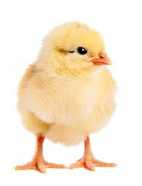
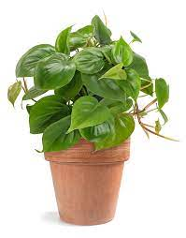
Why do plants need chlorophyll and animals do not?
Notes:
Why do plants need chlorophyll and animals do not?
[Plants get energy from the sun. Animals get energy from other plants and animals]

Slide 34
Notes:
We can also break down the term chlorophyll into different word parts to help us remember the meaning. Let’s take a look!

Slide 35
Chlorophyll
(root)
(suffix)
Notes:
We can break up the term chlorophyll: a root and a suffix

Slide 36
Chlorophyll
green
Notes:
“Chloro” is the root word. It mean “green”.

Slide 37
Chlorophyll
Leaf
Notes:
“-phyll” is the suffix. It means leaf.

Slide 38
Chloro + phyll
green leaf
Notes:
Together, chlorophyll means “green leaf”. This can remind us that chlorophyll is the pigment that makes the leaves look green.

Slide 39
Remember!!!
Notes:
So remember!

Slide 40
Chlorophyll: green pigment found in plants
Notes:
Chlorophyll is a green pigment found in plants

Slide 41
Notes:
We will now complete this concept map, called a Frayer model, to summarize and further clarify what you have learned about the term chlorophyll.

Slide 42
Definition
Picture
Chlorophyll
Example
How does chlorophyll impact my life?
Notes:
To complete the Frayer model, we will choose from four choices the correct picture, definition, example, and response to the question, “How does chlorophyll impact my life?” Select the best response for each question using the information you just learned. As we select responses, we will see how this model looks filled in for the term chlorophyll.

Slide 43
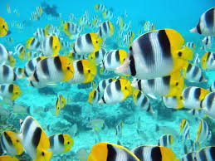
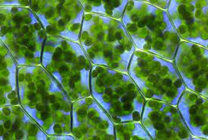
Directions: Choose the correct picture of chlorophyll from the choices below.
A
B
C
D
Notes:
Choose the one correct picture of chlorophyll from these four choices.

Slide 44
Directions: Choose the correct picture of chlorophyll from the choices below.
A
B
C
D
Notes:
This is the picture that shows chlorophyll.

Slide 45
Definition
Picture
Chlorophyll
Example
How does chlorophyll impact my life?
Notes:
Here is the Frayer model filled in with a picture of chlorophyll.

Slide 46
Directions: Choose the correct definition of chlorophyll from the choices below.
A
A type of measurement that tells us how much matter is in an object​
B
Energy from heat
C
Green pigment found in plants
D
Smallest whole unit of matter
Notes:
Choose the one correct definition of chlorophyll from these four choices.

Slide 47
Directions: Choose the correct definition of chlorophyll from the choices below.
A
A type of measurement that tells us how much matter is in an object​
B
Energy from heat
C
Green pigment found in plants
D
Smallest whole unit of matter
Notes:
“Green pigment found in plants” is correct! This is the definition of chlorophyll.

Slide 48
Definition
Picture
Green pigment found in plants
Chlorophyll
Example
How does chlorophyll impact my life?
Notes:
Here is the Frayer Model with a picture and the definition filled in for chlorophyll: green pigment found in plants

Slide 49
Directions: Choose the correct example of chlorophyll from the choices below.
A
The grass in your school’s field
B
A bird and the eggs in her nest
C
A cheetah running after an antelope
D
A rock resting near a river
Notes:
Choose the one correct example of chlorophyll from these four choices.

Slide 50
Directions: Choose the correct example of chlorophyll from the choices below.
A
The grass in your school’s field
B
A bird and the eggs in her nest
C
A cheetah running after an antelope
D
A rock resting near a river
Notes:
“The grass in your school’s field” is correct! This is an example of chlorophyll.

Slide 51
Definition
Picture
Green pigment found in plants
Chlorophyll
The grass in your school’s field
Example
How does chlorophyll impact my life?
Notes:
Here is the Frayer Model with a picture, definition, and an example of chlorophyll: The grass in your school’s field

Slide 52
Directions: Choose the correct response for “how does chlorophyll impact my life?” from the choices below.
A
Chlorophyll keeps our feet on the ground so we don’t float away
B
Chlorophyll creates the tides in the ocean and helps keep living things in the ocean healthy
C
Chlorophyll protects the Earth from harmful rays from the Sun that could make the earth too hot
Chlorophyll helps keep plants alive so they can provide us with food to eat and oxygen to breath.
D
Notes:
Choose the one correct response for “how does chlorophyll impact my life?” from these four choices.

Slide 53
Directions: Choose the correct response for “how does chlorophyll impact my life?” from the choices below.
A
Chlorophyll keeps our feet on the ground so we don’t float away
B
Chlorophyll creates the tides in the ocean and helps keep living things in the ocean healthy
C
Chlorophyll protects the Earth from harmful rays from the Sun that could make the earth too hot
C
Chlorophyll helps keep plants alive so they can provide us with food to eat and oxygen to breath.
D
D
Notes:
“Chlorophyll helps keep plant alive so they can provide us with food to eat and oxygen to breathe” That is correct! This is an example of how chlorophyll impacts your life.

Slide 54
Definition
Picture
Green pigment found in plants
Chlorophyll
Chlorophyll helps keep
plants alive so they can provide us with food to eat and oxygen to breath.
The grass in your school’s field
Example
How does chlorophyll impact my life?
Notes:
Here is the Frayer Model with a picture, definition, example, and a correct response to “how does chlorophyll impact my life?”: Chlorophyll helps keep plants alive so they can provide us with food to eat and oxygen to breathe.”

Slide 55
Remember!!!
Notes:
So remember!

Slide 56
Chlorophyll: green pigment found in plants
Notes:
Chlorophyll is green pigment found in plants.

Slide 57
Big Question: What do plants need to survive?
Notes:
Let’s reflect once more on our big question. Our “big question” is: What do plants need to survive?
Does anyone have any additional examples to share that haven’t been discussed yet?

Slide 58
Notes:
Thanks for watching, and please continue watching CAPs available from this website.

Slide 59
This Was Created With Resources From:
Questions or Comments
Michael Kennedy, Ph.D. MKennedy@Virginia.edu
Rachel L Kunemund, Ph.D. rk8vm@virginia.edu

