Slide 1
Intro
“Big Idea” Question
Review Concepts
Check-In Questions
Teacher Demo
Vocabulary
Student-Friendly Definition
Examples & Non-Examples
Morphological Word Parts
Simulation/Activity
Notes:
OK everyone, get ready for our next lesson. Just as a reminder, these are the different components that our lesson may include, and you’ll see these icons in the top left corner of each slide so that you can follow along more easily!

Slide 2
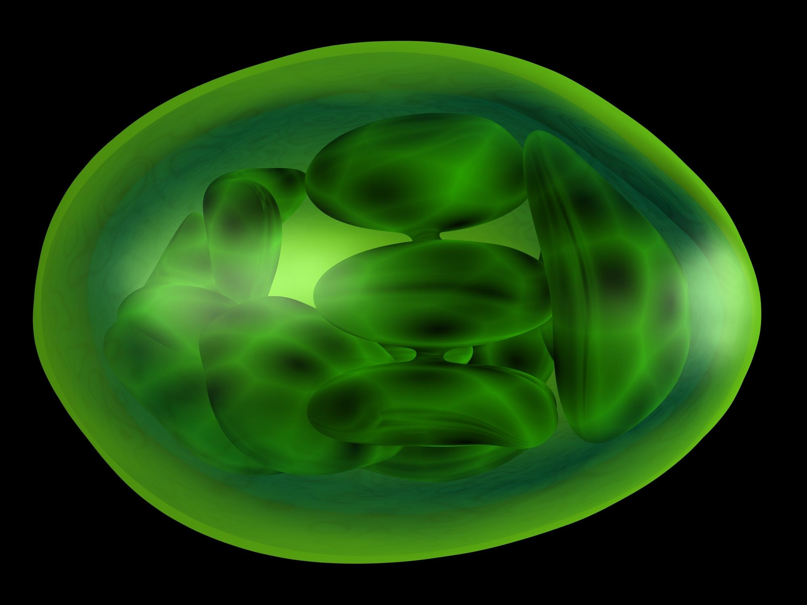
Chloroplast
Intro
Notes:
Today we are learning about chloroplast.

Slide 3
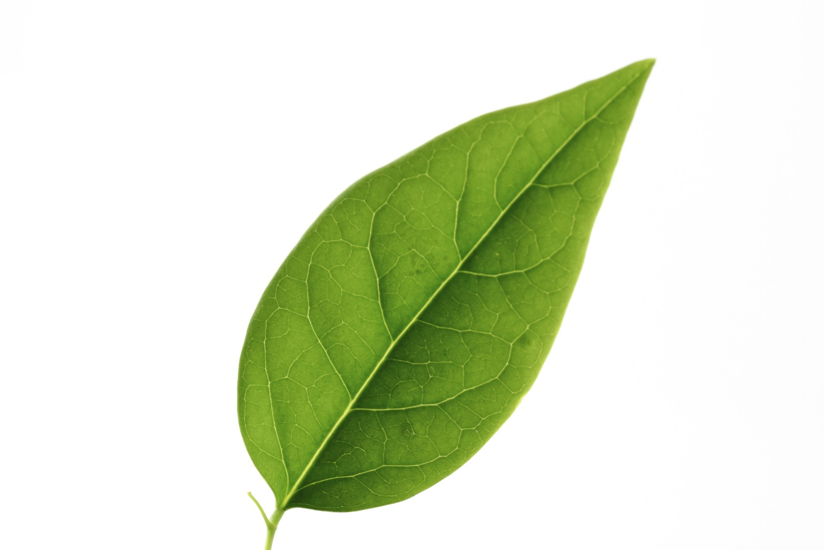
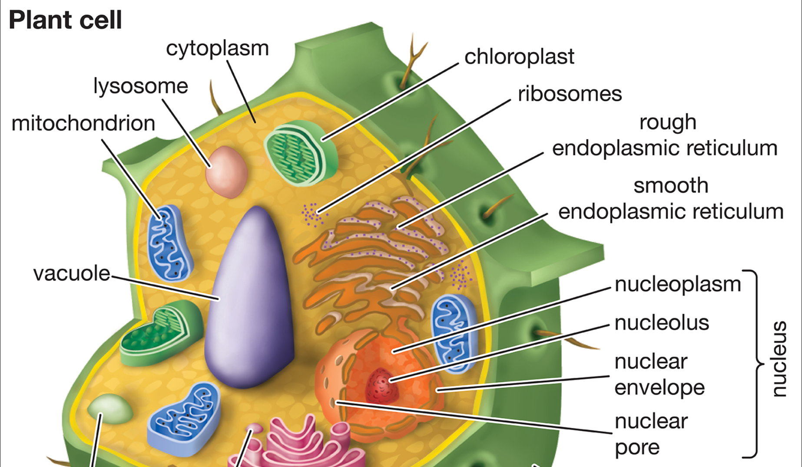
Big Question: What is the function of chloroplast and chlorophyll and how are they the same or different in plant and animal cells?
Chlorophyll
Notes:
Our “big question” is: What is the function of chloroplast and chlorophyll and how are they the same or different in plant and animal cells?
[Pause and illicit predictions from students.]
I love all these thoughtful scientific hypotheses! Be sure to keep this question and your predictions in mind as we move through these next few lessons, and we’ll continue to revisit it.

Slide 4
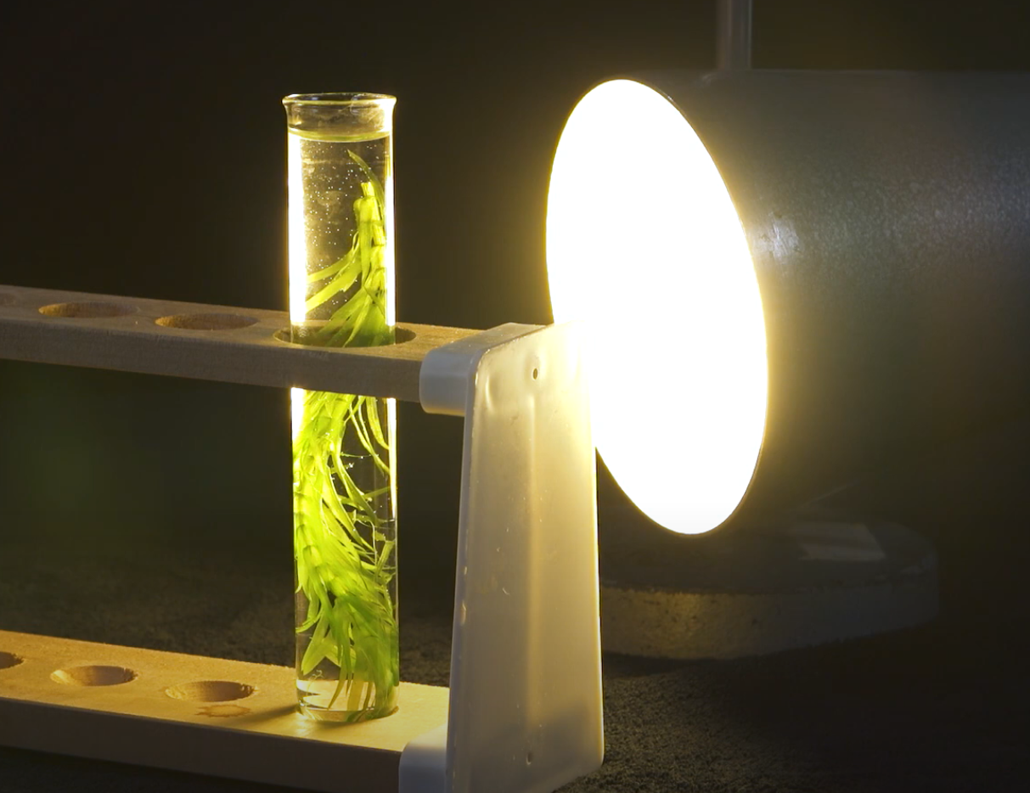
How does pondweed respond to the presence or absence of light?
Demonstration
Notes:
Let’s make some hypotheses about whether the presence of light will increase or decrease the number of bubbles produced by this pondweed within a 3 minute time period. You might think back to what you already know about the process of photosynthesis. Allow students to make predictions before proceeding to demonstrate an increase of bubbles with the presence of light.]
The increased bubbles indicates that the rate of photosynthesis is increasing. Today we are going to look at the organelles inside of plant cells that are important in making sure photosynthesis is carried out. We will also review why photosynthesis is important for the survival of the plant!
Feedback: This activity represents an optional demonstration that can be made more simple or complex depending on the needs of your classroom. There are many different types of pondweed that can be found or ordered for the the activity, and more details about setup can be found here. Notice also that this demonstration is a live example of the simulation activity included at the end of the lesson.

Slide 5
Notes:
Answer the following questions as you go through the demonstration with the students.

Slide 6
Will the process of photosynthesis increase (causing more bubbles to form) or decrease when the amount of light increases?
Notes:
Will the process of photosynthesis increase (causing more bubbles to form) or decrease when the amount of light increases?

Slide 7
Why is the plant green? Which parts of the plant cells contribute to green coloration, and what role do they play in photosynthesis?
Notes:
Why is the plant green? Which parts of the plant cell contribute to green coloration, and what role do they play in photosynthesis?

Slide 8
Notes:
Before we move on to our new vocabulary term, let’s review some other words & concepts that you already learned and make sure you are firm in your understanding.

Slide 9
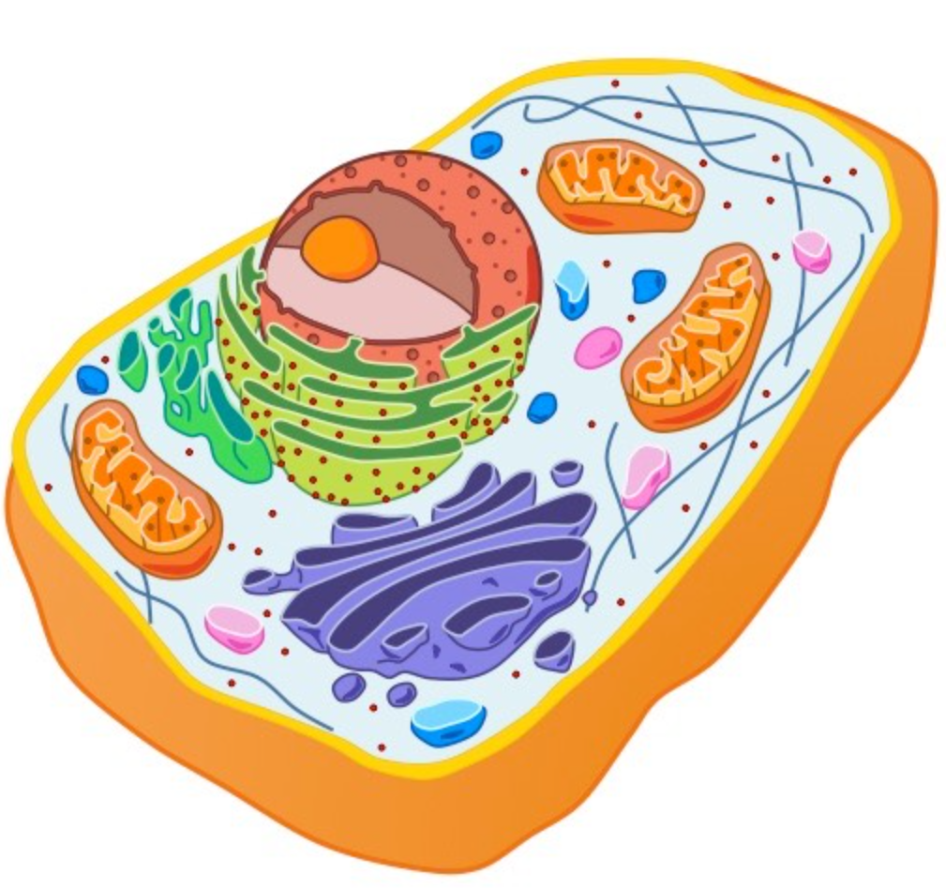
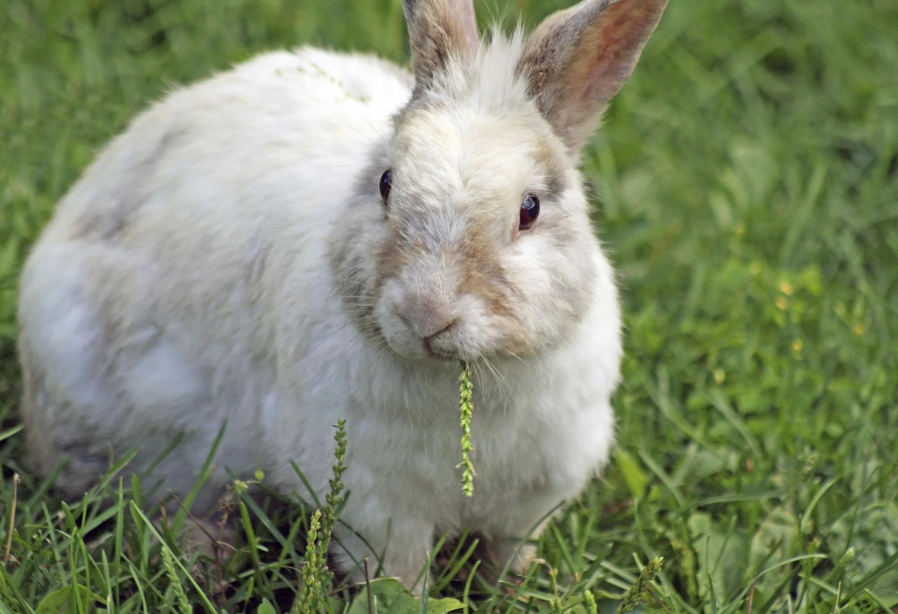
Notes:
Remember all living things are a made of one or more cells.

Slide 10
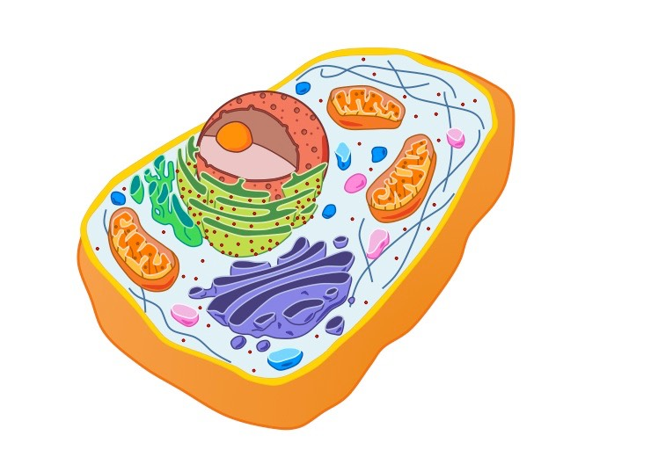
Cell: Smallest unit of life
Notes:
A cell is the smallest unit of life. In living things one cell or many cells are responsible for carrying out all of the processes an organism needs to do in order to stay alive.

Slide 11
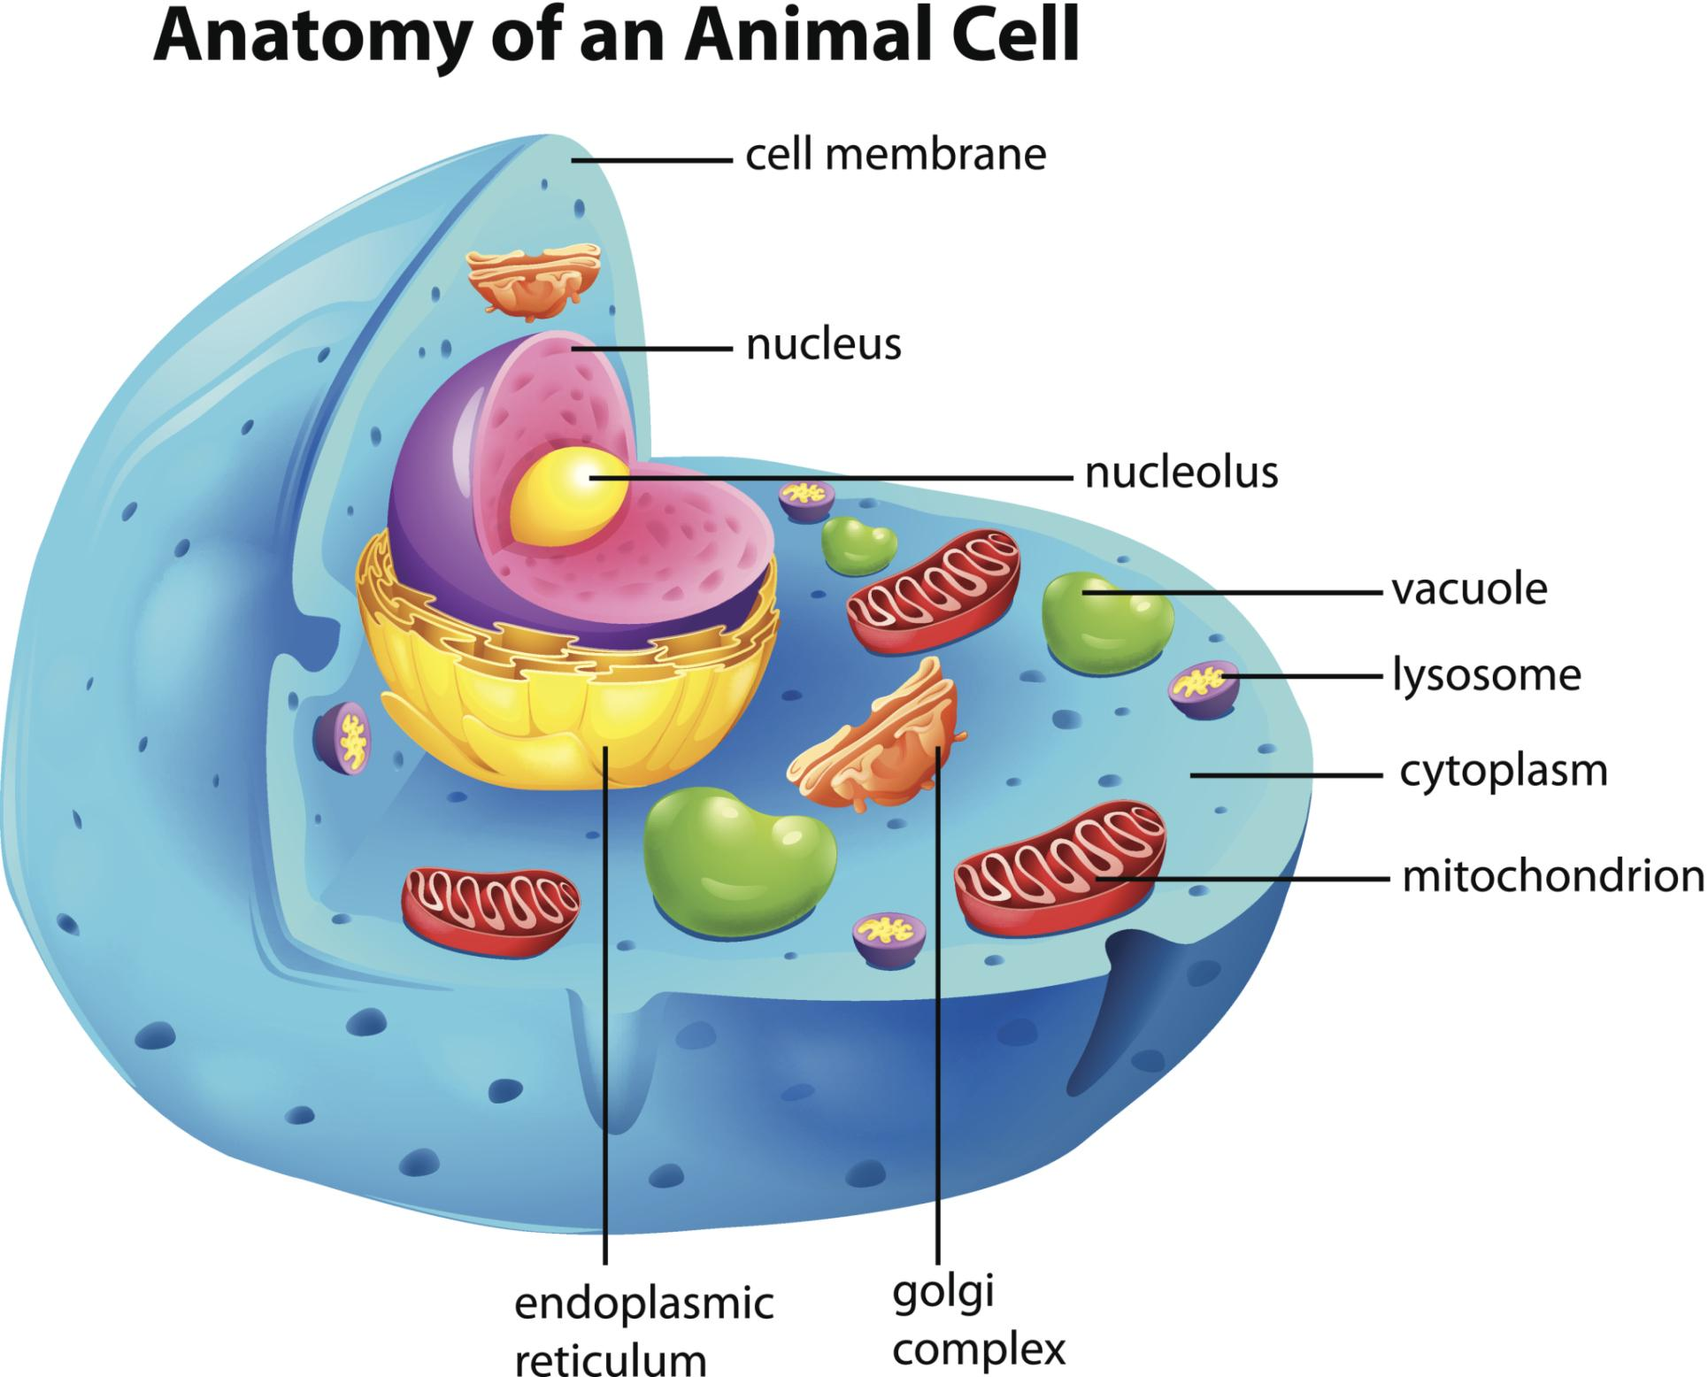
Organelles: Smaller parts of the cell that does one or more specific jobs in the cell
Notes:
Organelles are the smaller parts of the cell that does one or more specific jobs in the cell.
Feedback: Using clear, concise language is important when discussing terminology.

Slide 12
Photosynthesis: process of turning carbon dioxide and water into oxygen and glucose using light energy
Notes:
Photosynthesis is the process of turning carbon dioxide and water into oxygen and glucose using light energy.

Slide 13
organelle
chloroplast
nucleus
parts of a cell
vacuole
membrane
cytoplasm
endoplasmic reticulum
Notes:
Inside a cell, its different parts have different jobs that help the cell carry out those processes.

Slide 14
organelle
chloroplast
nucleus
parts of a cell
vacuole
membrane
cytoplasm
endoplasmic reticulum
Notes:
Today, we discuss chloroplasts.

Slide 15
Notes:
Now let’s pause for a moment to check your understanding.

Slide 16
What are all living things made up of?
Notes:
What are living things made up of?
[All living things are a made of one or more cells.]

Slide 17
What is a cell?
Notes:
What is a cell?
[A cell is the smallest unit of life. In living things one cell or many cells are responsible for carrying out all of the processes an organism needs to do in order to stay alive.]

Slide 18
What is the function of organelles?
Notes:
What is the function of organelles?
[Organelles are the smaller parts of the cell that do one or more specific jobs in the cell.]

Slide 19
Describe the process of photosynthesis.
Notes:
Describe the process of photosynthesis.
[Photosynthesis is the process of turning carbon dioxide and water into oxygen and glucose using light energy.]

Slide 20
Chloroplast
Notes:
Now that we’ve reviewed, let’s define our new term, chloroplast.
Feedback: Giving students cues is an important way to help prepare them for what comes next.

Slide 21
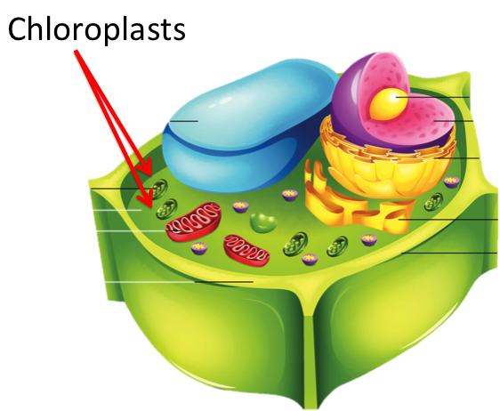
Chloroplast: an organelle in a plant cell where photosynthesis takes place
Notes:
A chloroplast is an organelle in a plant cell where photosynthesis takes place.

Slide 22
Notes:
Now let’s pause for a moment to check your understanding.

Slide 23
What is a chloroplast?
Notes:
What is a chloroplast?
[A chloroplast is an organelle in a plant cell where photosynthesis takes place.]

Slide 24
Notes:
That is the basic definition, but there is a bit more you need to know.

Slide 25
Chlorophyll
Notes:
Chloroplasts contain chlorophyll. Chlorophyll is a green pigment present in all green plants.

Slide 26
Only in Plant Cells
Notes:
Plant cells are the only type of cells that have chloroplasts. Bacteria cells and animal cells do not have chloroplasts.
Feedback: If time allows, this is a great opportunity to bring up the more open-ended question of why other types of cells do not have chloroplasts. Students can give evidence to support their arguments based on their everyday experiences / interactions / understanding of the concepts. This is a way of activating and eliciting ideas about a science phenomenon.

Slide 27
Notes:
Now let’s pause for a moment to check your understanding.

Slide 28
What is a chloroplast?
Notes:
What is a chloroplast?
[A chloroplast is an organelle in a plant cell where photosynthesis takes place.]

Slide 29
What do chloroplasts contain?
?
Notes:
What do chloroplasts contain?
[Chloroplasts contain chlorophyll.]

Slide 30
What is chlorophyll?
Chlorophyll
Notes:
What is chlorophyll?
[Chlorophyll is a green pigment present in all green plants.]

Slide 31
Where are chloroplasts found?
Notes:
Where are chloroplasts found?
[Plant cells are the only type of cells that have chloroplasts. Bacteria cells and animal cells do not have chloroplasts.]

Slide 32
Notes:
Now, let’s talk about some examples of chloroplast .

Slide 33
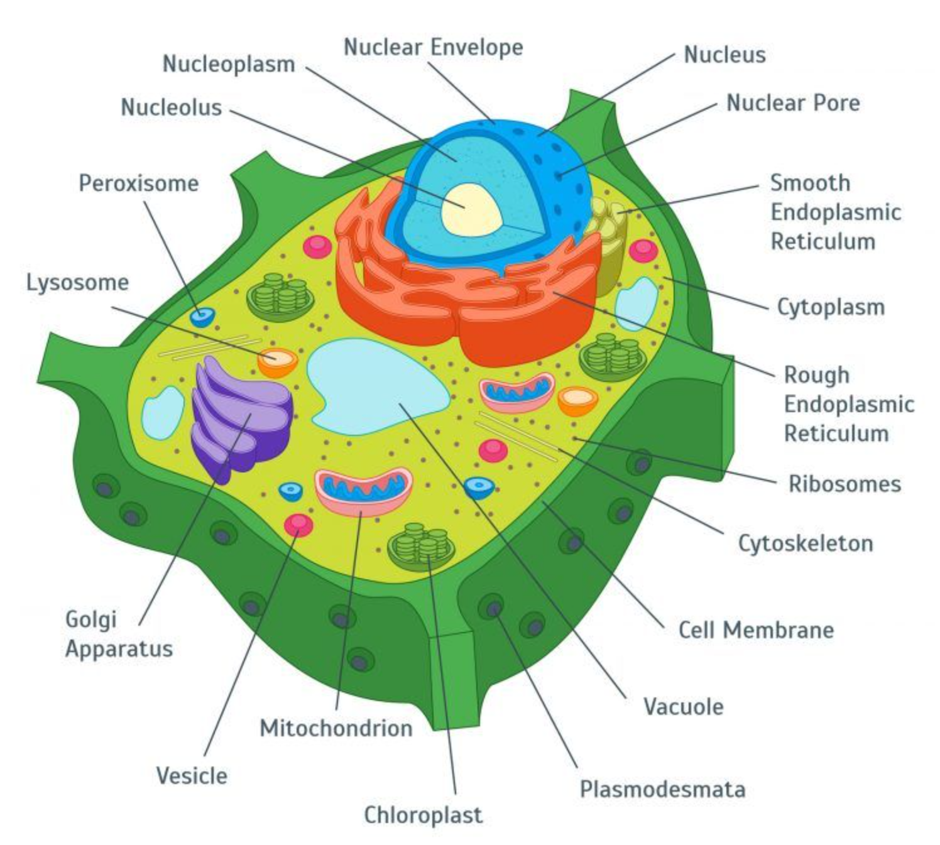
Notes:
This is what the chloroplast looks like inside of a plant cell. Remember this is where photosynthesis takes place.

Slide 34
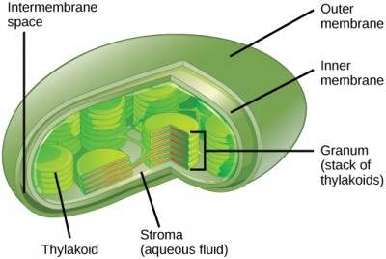
Notes:
Here is another example of the chloroplast in a plant cell. The picture on the right show the chloroplast in a plant cell and the picture on the right shows what the chloroplast looks like more closely.

Slide 35
Notes:
Next, let’s talk about some non-examples of chloroplast.

Slide 36
Notes:
In the animal cell, there is no chloroplast, Remember, chloroplast are only found in plant cells.

Slide 37
Notes:
Now let’s pause for a moment to check your understanding.

Slide 38
What is a chloroplast?
Notes:
What is a chloroplast?
[A chloroplast is an organelle in a plant cell where photosynthesis takes place.]

Slide 39
What is the function of a chloroplast in a plant cell?
Notes:
What is the function of a chloroplast in a plant cell?
[This is what the chloroplast looks like inside of a plant cell. Remember this is where photosynthesis takes place.]

Slide 40
Is this an example of a chloroplast?
Notes:
Is this an example of a chloroplast?
[Yes, it is found in the plant cell.]

Slide 41
Can a chloroplast be found in an animal cell?
Notes:
Can a chloroplast be found in an animal cell?
[In the animal cell, there is no chloroplast, Remember, chloroplast are only found in plant cells.]

Slide 42
Notes:
Let’s break down chloroplast, to help us remember what it means.

Slide 43
Chloroplast
Chloro
plast
Green
Notes:
The word chloro means green.
Feedback: When breaking words down into morphological parts, the use of clear language is essential.

Slide 44
Chloroplast
Chloro
plast
Form or shape
Notes:
Plast means form or shape.

Slide 45
Chloro Plast
Chloroplast
Green form
Notes:
So, chloroplast means “green form”. This can help you remember that chloroplasts are green, because they contain chlorophyll, and only plant cells contain chloroplasts and chlorophyll.
Feedback: Reuniting the word parts is a crucial step in helping students understand the whole picture when reviewing morphological word parts.

Slide 46
Chlorophyll
Chloroplast
Notes:
Chlorophyll is what is inside a chloroplast. They both have the word part CHLORO that means green.

Slide 47
Notes:
Let’s check-in for understanding.

Slide 48
What does Chloro mean in the word chloroplast?
Chloroplast
Chloro
Notes:
What does Chloro mean in the word chloroplast?
[The word chloro means green.]

Slide 49
What does plast mean in the word chloroplast?
Chloroplast
plast
Notes:
What does plast mean in the word chloroplast?
[It means form or shape.]

Slide 50
When we put chloro and plast together, how can we remember what a chloroplast is?
Chloro Plast
Chloroplast
Green form
Notes:
When we put chloro and plast together, how can we remember what a chloroplast is?
[So, chloroplast means “green form”. This can help you remember that chloroplasts are green, because they contain chlorophyll, and only plant cells contain chloroplasts and chlorophyll.]

Slide 51
What is a chloroplast?
Notes:
What is a chloroplast?
[A chloroplast is an organelle in a plant cell where photosynthesis takes place.]

Slide 52
What do chloroplasts contain?
?
Notes:
What do chloroplasts contain?
[Chloroplasts contain chlorophyll.]

Slide 53
What is chlorophyll?
Chlorophyll
Notes:
What is chlorophyll?
[Chlorophyll is a green pigment present in all green plants.]

Slide 54
Where are chloroplasts found?
Notes:
Where are chloroplasts found?
[Plant cells are the only type of cells that have chloroplasts. Bacteria cells and animal cells do not have chloroplasts.]

Slide 55
What is the function of a chloroplast in a plant cell?
Notes:
What is the function of a chloroplast in a plant
[This is what the chloroplast looks like inside of a plant cell. Remember this is where photosynthesis takes place.]

Slide 56
Remember!!!
Notes:
So remember!

Slide 57
Chloroplast: an organelle in a plant cell where photosynthesis takes place
Notes:
A chloroplast is an organelle in a plant cell where photosynthesis takes place.

Slide 58
Simulation Activity
Photosynthesis Lab Gizmo
(Explore Learning)
Click on the Link above to see how different changes can effect photosynthesis in a plant.
When doing this simulation, think about why these changes might effect the photosynthesis of a plant? Do you think the changes are affecting the chloroplast? Why or why not?
Notes:
Feedback: Providing a simulation activity is a great way to make science thinking visible. In this simulation, students have the opportunity to make predictions and apply an idea to a new situation by changing the variables in the simulation (i.e., light intensity, light wavelength). Pending student needs, it may be helpful to include opportunities for students to share their considerations of the questions in the slide either in small group or whole class discussion. This offers opportunities for you to gauge student understanding and for them to make connections between the simulation and the content.

Slide 59
Big Question: What is the function of chloroplast and chlorophyll and how are they the same or different in plant and animal cells?
Chlorophyll
Notes:
Our “big question” is: What is the function of chloroplast and chlorophyll and how are they the same or different in plant and animal cells?
Let’s look at our big question again. Were our hypotheses correct? What did we learn/have to change about our hypotheses?
Feedback: Offering students an opportunity to evaluate their earlier hypotheses and make changes based on their new understandings is an important part of the iterative process in science. This is a great opportunity to help students build an epistemic understanding by explicitly stating how continuing to change and build on hypotheses as your knowledge grows is an important part of the discipline of science!

Slide 60
Notes:
Thanks for watching, and please continue watching CAPs available from this website.

Slide 61
This Video Was Created With Resources From:
Questions or Comments
Michael Kennedy, Ph.D. MKennedy@Virginia.edu
Rachel L Kunemund, Ph.D. rk8vm@virginia.edu

