Slide 1
Intro
“Big Idea” Question
Review Concepts
Check-In Questions
Teacher Engagement
Vocabulary
Student-Friendly Definition
Examples & Non-Examples
Frayer Model
Simulation/Activity
Notes:
OK everyone, get ready for our next lesson. Just as a reminder, these are the different components that our lesson may include, and you’ll see these icons in the top left corner of each slide so that you can follow along more easily!

Slide 2
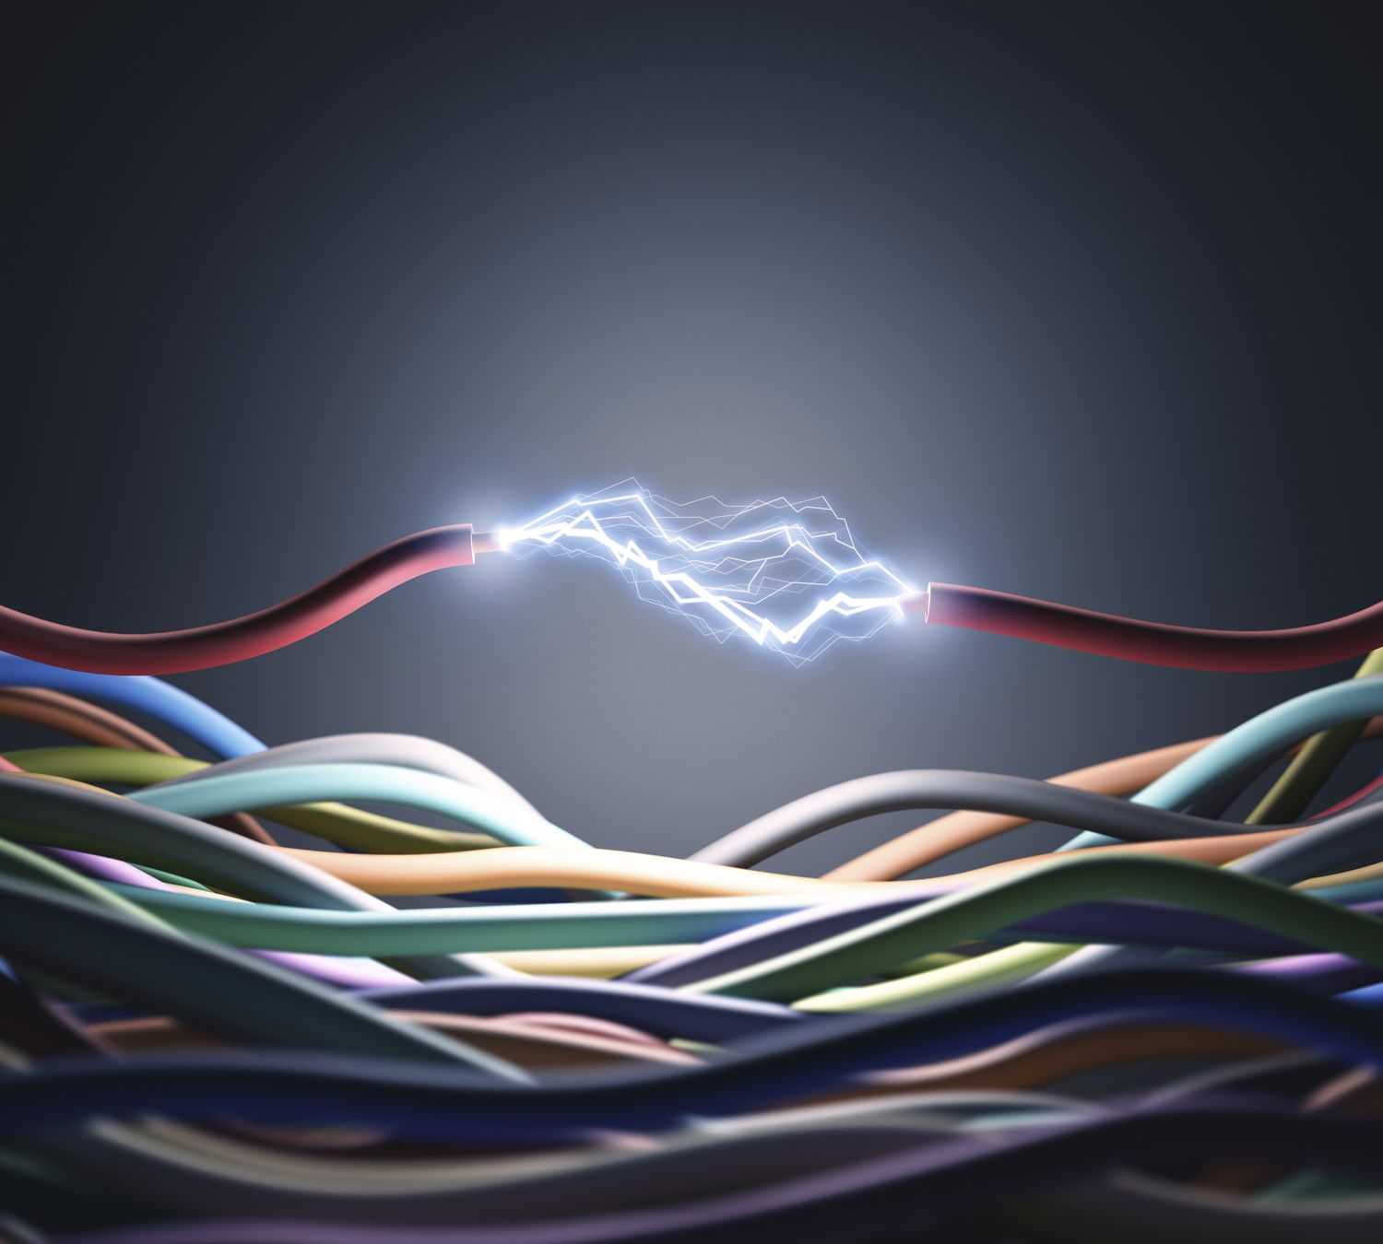
Intro
Conductor
Notes:
Today, we’ll be learning about the word: Conductor.

Slide 3
Big Question: How do conductors help us use electricity in our daily lives?
Notes:
Our “big question” is: How do conductors help us use electricity in our daily lives?
[Pause and illicit predictions from students.]
I love all these thoughtful scientific hypotheses! Be sure to keep this question and your predictions in mind as we move through these next few lessons, and we’ll continue to revisit it.

Slide 4
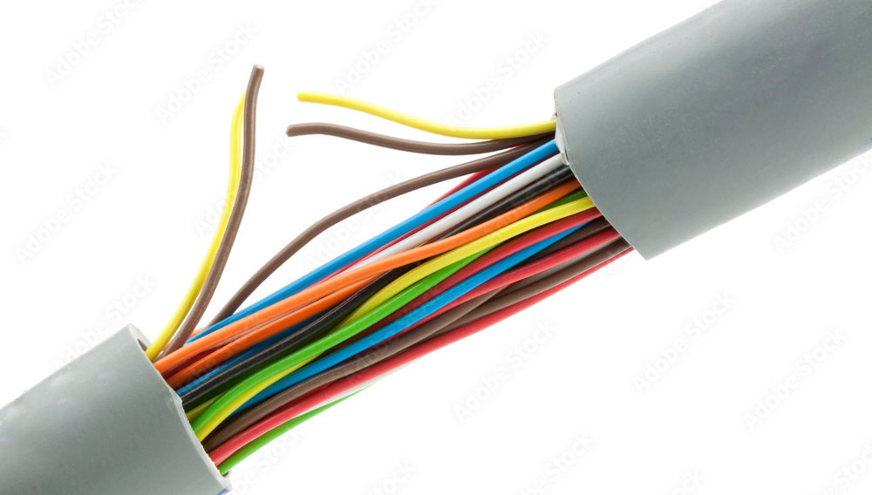
Demonstration
How do I charge?
Bring in a broken electronic wire (e.g., a charging cable). Explain how the charger is used to charge phones by transferring electricity from a power source (wall) to the phone. Pass the wire around and have students observe the different parts of the broken wire while you explain how the wire material affect the charging (transferring electricity).
Notes:
Bring in a broken electronic wire (e.g., a charging cable). Explain how the charger is used to charge phones by transferring electricity from a power source (wall) to the phone. Pass the wire around and have students observe the different parts of the broken wire while you explain how the wire material affect the charging (transferring electricity).

Slide 5
Notes:
Before we move on to our new topic, let’s review some other words & concepts that you already learned and make sure you are firm in your understanding.

Slide 6
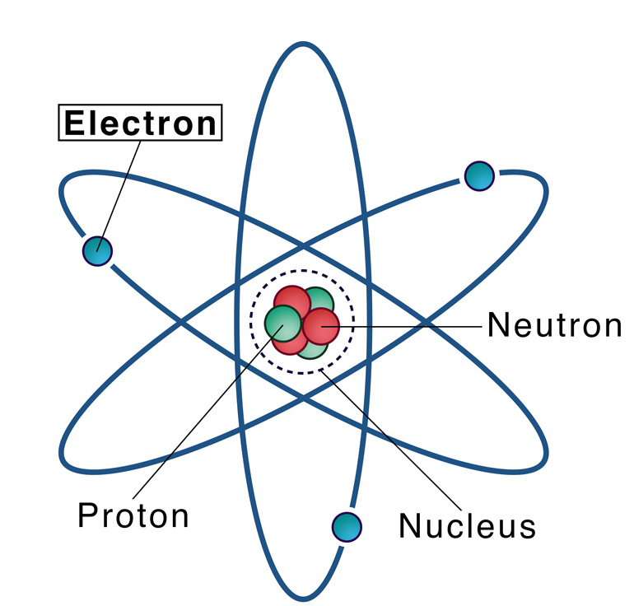
Electron: negatively charged particle that orbits the nucleus of an atom
Notes:
An electron is a negatively charged particle that orbits the nucleus of an atom

Slide 7
Electricity: electrical energy transformed into different forms of energy to meet needs
Notes:
Electricity is electrical energy transformed into different forms of energy to meet needs.

Slide 8
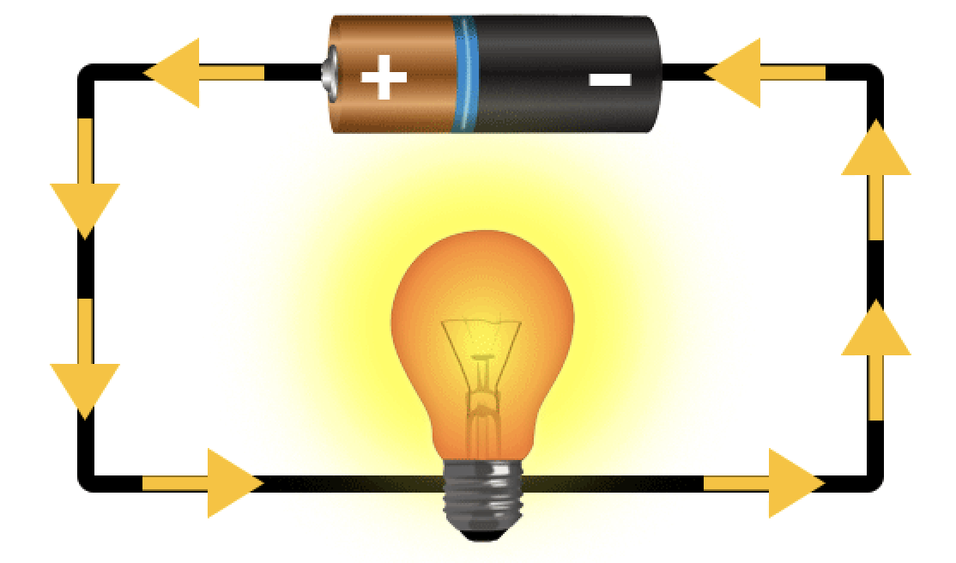
Current: an electrical charge in motion
Notes:
A current is an electrical charge in motion.

Slide 9
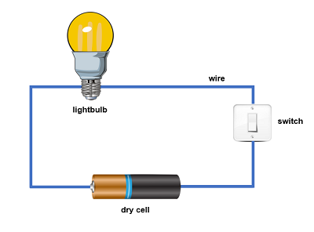
Circuit: the path electricity travels on
Notes:
A circuit is the path electricity travels on.

Slide 10
Notes:
Now let’s pause for a moment to review the information we have covered already.

Slide 11
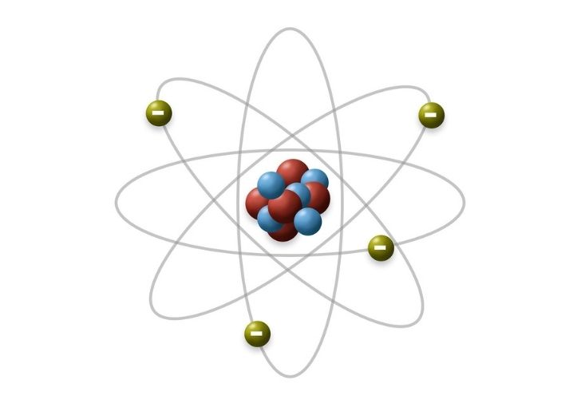
What charge does an electron have?
Positive charge
Negative charge
Notes:
What charge does an electron have? [A. Negative charge]

Slide 12
What charge does an electron have?
Positive charge
Negative charge
Notes:
What charge does an electron have? [A. Negative charge]

Slide 13
Current: an charge in motion
Notes:
A current is an charge in motion.
[electrical]

Slide 14
Current: an electrical charge in motion
Notes:
A current is an electrical charge in motion.

Slide 15
Conductor
Notes:
Now that we’ve reviewed, let’s define the phrase Conductor.

Slide 16
Conductor: a material that electricity can flow through
Notes:
Conductors are materials that electricity can flow through.

Slide 17
Notes:
Let’s check-in for understanding.

Slide 18
What does conductor mean?
Notes:
What does conductor mean?
[a material that electricity can flow through]

Slide 19
Notes:
That is the basic definition, but there is a bit more you need to know.

Slide 20
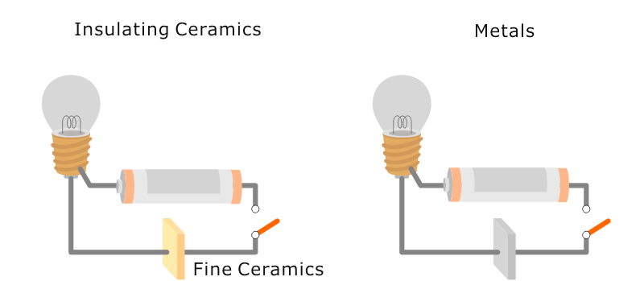
Licensable
Circuits need conductors to move electric charges.
Notes:
Circuits need conductors to move electric charges.

Slide 21
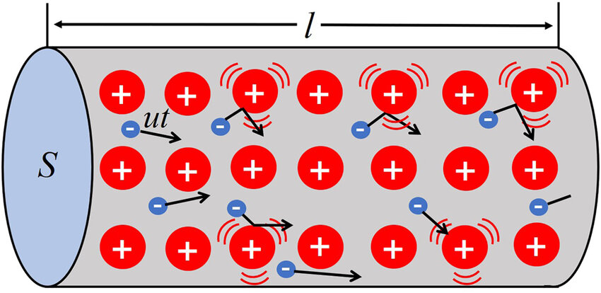
Licensable
Conductors have electrons that are not tightly packed so electricity can more easily flow through them.
Notes:
Look at how much space the electrons have for moving around.

Slide 22
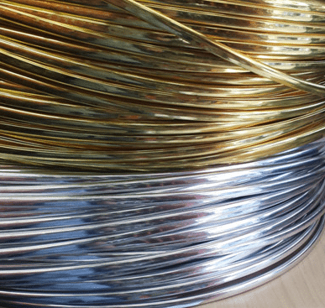
Licensable
Metals are good conductors.
Notes:
Metals are good conductors.
How much space the electrons have for moving around in metals?
A lot or a little?

Slide 23
Licensable
Some materials make it difficult for electricity to pass through.
Notes:
Some materials make it difficult for electricity to pass through.

Slide 24
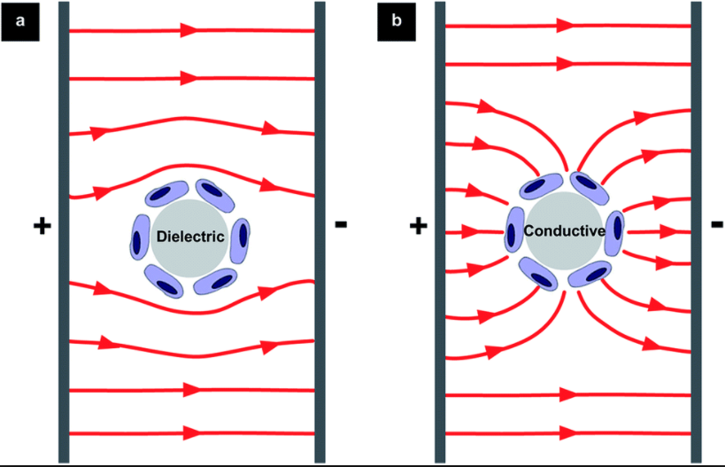
Licensable
This is because their electrons are tightly bound so electricity cannot easily flow past them.
Notes:
This is because their electrons are tightly bound so electricity cannot easily flow past them.
Insulator
Conductor
Notice how the electricity can pass through the conductor but not the insulator.
Dielectric = no conductive properties

Slide 25
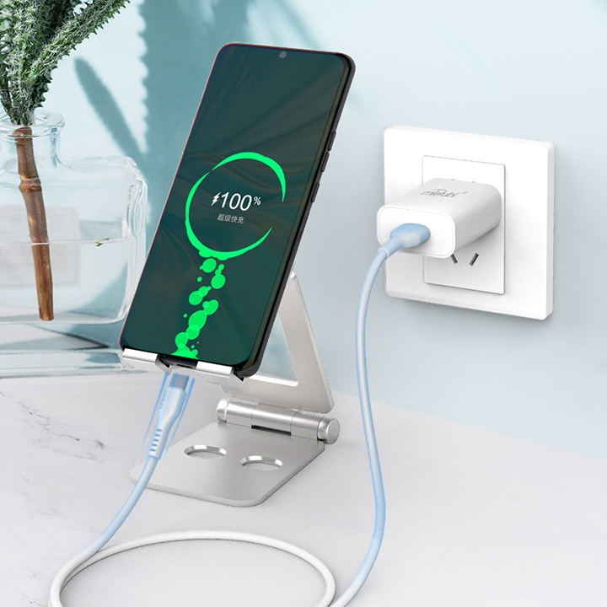
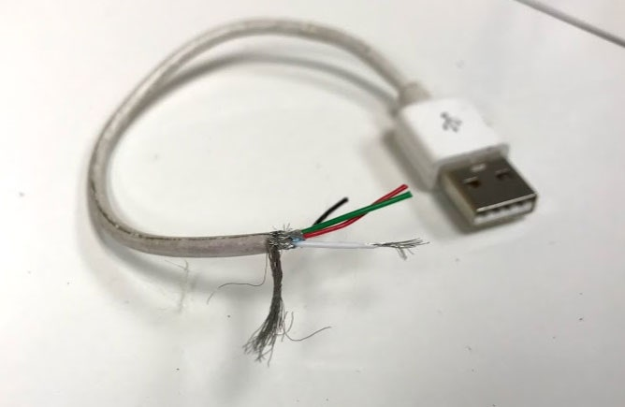
Licensable
Conductors allow us to transfer electricity.
Notes:
Conductors allow us to transfer energy from the wall outlet to our electronic device via a charging cable.

Slide 26
Notes:
Let’s check-in for understanding.

Slide 27
Which is true about conductors?
Every metal has the same conductivity.
Conductors have tightly packed electrons.
Electricity moves faster in conductors.
Conductors have a positive charge.
Notes:
[C] Electricity moves faster in conductors is true.

Slide 28
Which is true about conductors?
Every metal has the same conductivity.
Conductors have tightly packed electrons.
Electricity moves faster in conductors.
Conductors have a positive charge.
Notes:
[C] Electricity moves faster in conductors is true.

Slide 29
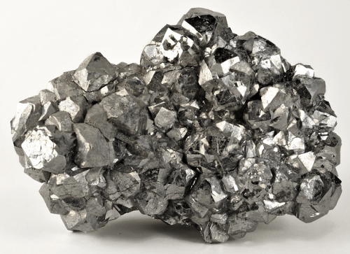
Which material is more likely to be used as a conductor?
Wood
Silver
Notes:
Which material is more likely to be used as a conductor?
Silver because it is a metal.

Slide 30
Which material is more likely to be used as a conductor?
Wood
Silver
Notes:
Which material is more likely to be used as a conductor?
Silver because it is a metal.

Slide 31
Notes:
Now, let’s talk about some examples of Conductor.

Slide 32
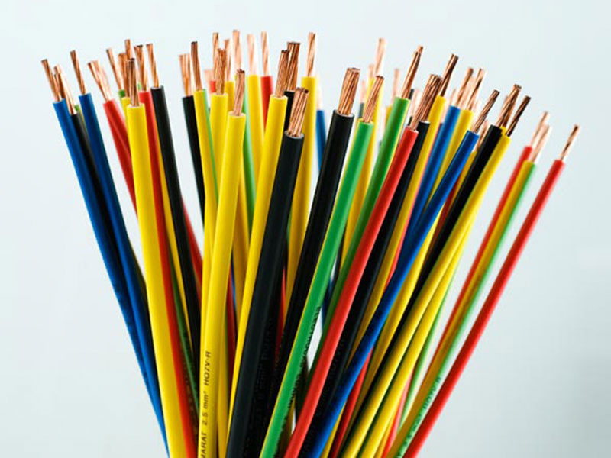
Copper is an example of a conductor
Notes:
Copper is an example of a conductor. It is one of the most popular materials used for conductors.

Slide 33
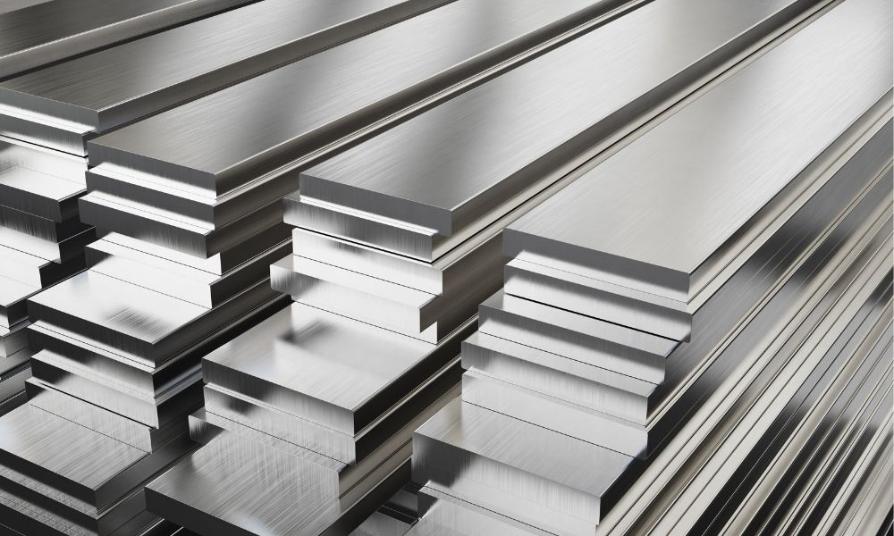
Steel is also is an example of a conductor
Notes:
Steel is another example of a conductor.
However, it isn’t as widely used since it’s not as flexible as copper or aluminum but is expensive.

Slide 34
Notes:
Now, let’s talk about some non-examples of Conductor.

Slide 35
Paper is NOT an example of a conductor
Notes:
Paper isn’t a conductor because it doesn’t allow electricity to easily flow through it.

Slide 36
Glass is also NOT an example of a conductor
Notes:
Glass isn’t a good conductor because it is difficult for electricity to flow through it.

Slide 37
Notes:
Now let’s pause for a moment to check your understanding.

Slide 38
Which one is NOT an example of a conductor:
Glass
Steel
Copper
Notes:
Which one is NOT an example of a conductor:
Glass
Steel
Copper
[Glass]

Slide 39
Which one is NOT an example of a conductor:
Glass
Steel
Copper
Notes:
Which one is NOT an example of a conductor:
Glass
Steel
Copper

Slide 40
Remember!!!
Notes:
So remember!

Slide 41
Conductor: a material that electricity can flow through
Notes:
Conductors are materials that electricity can flow through.

Slide 42
Notes:
We will now complete this concept map, called a Frayer model, to summarize and further clarify what you have learned about the term conductors.

Slide 43
Definition
Picture
Conductor
Example
How do conductors impact my life?
Notes:
To complete the Frayer model, we will choose from four choices the correct picture, definition, example, and response to the question, “How do Conductors impact my life?” Select the best response for each question using the information you just learned. As we select responses, we will see how this model looks filled in for the term Conductor.

Slide 44
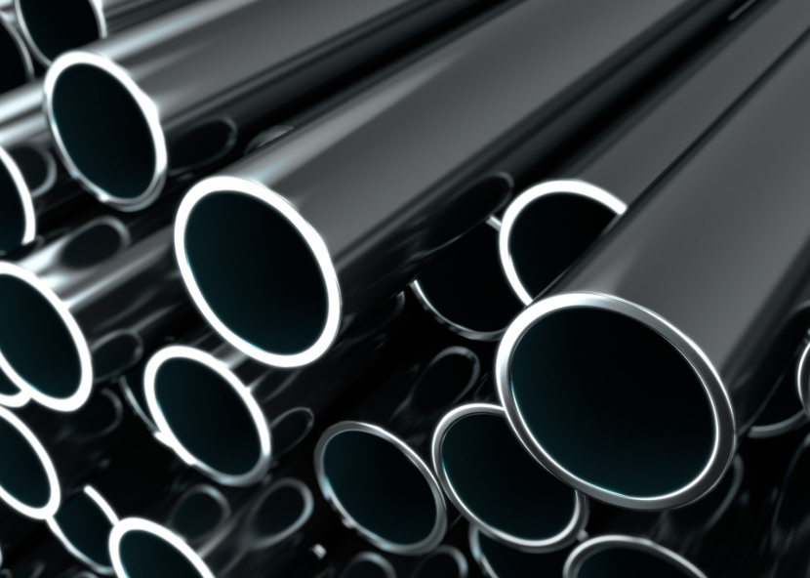
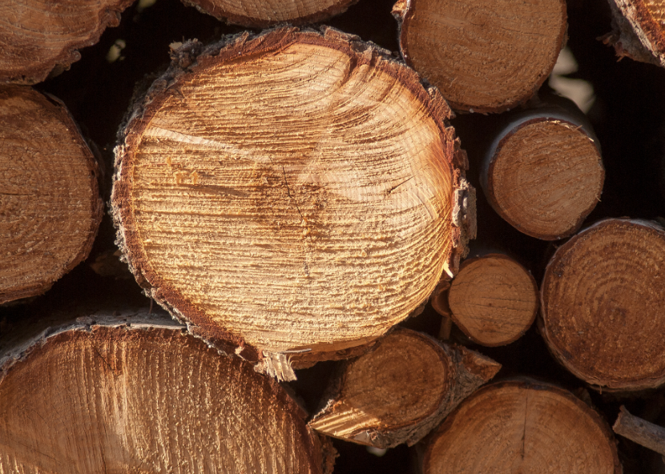
Directions: Choose the correct picture of a conductor from the choices below.
A
B
C
D
Notes:
This is the picture that shows a conductor.

Slide 45
Directions: Choose the correct picture of a conductor from the choices below.
A
B
C
D
Notes:
This is the picture that shows conductors.
Steel is a correct picture of conductors.

Slide 46
Definition
Picture
Conductor
Example
How do conductors impact my life?
Notes:
Here is the Frayer model filled in with a picture of conductors.

Slide 47
Directions: Choose the correct definition of conductor from the choices below.
A
An electrical charge in motion
B
When two objects rub together, and one takes electrons from the other
C
A material that electricity can flow through
D
The electric charge of an atom
Notes:
Choose the one correct definition of Conductors from these four choices.
[C] A material that electricity can flow through

Slide 48
Directions: Choose the correct definition of conductor from the choices below.
A
An electrical charge in motion
B
When two objects rub together, and one takes electrons from the other
C
A material that electricity can flow through
D
The electric charge of an atom
Notes:
“a material that electricity can flow through” is correct! This is the definition of conductors.

Slide 49
Definition
Picture
a material that electricity can flow through
Conductor
Example
How do conductors impact my life?
Notes:
Here is the Frayer model filled in with the definition of Conductor.

Slide 50
Directions: Choose the correct example of a conductor from the choices below.
A
A wall outlet
B
TV screens
C
A phone
D
The copper wires in a charger
Notes:
Choose the one correct example of a conductor from these four choices.
The copper wires in a charger

Slide 51
Directions: Choose the correct example of a conductor from the choices below.
A
A wall outlet
B
TV screens
C
A phone
D
The copper wires in a charger
Notes:
“The copper wires in a charger” is correct! This is an example of a conductor.

Slide 52
Definition
Picture
a material that electricity can flow through
Conductor
The copper wires in a charger
Example
How do conductor impact my life?
Notes:
Here is the Frayer Model with a picture, definition, and an example of a conductor: The copper wires in a charger

Slide 53
Directions: Choose the correct response for “how do conductors impact my life?” from the choices below.
A
Conductors make our leaves fall.
B
Conductors help plants grow.
C
Conductors transfer electricity, allowing lights to turn on.
D
Conductors create rainbows in the sky.
Notes:
Choose the one correct response for “how do conductors impact my life?” from these four choices.
Conductors transfer electricity, allowing lights to turn on.

Slide 54
Directions: Choose the correct response for “how do conductors impact my life?” from the choices below.
A
Conductors make leaves fall.
B
Conductors help plants grow.
C
Conductors transfer electricity, allowing lights to turn on.
D
Conductors create rainbows in the sky.
Notes:
“Conductors transfer electricity, allowing lights to turn on.” That is correct! This is an example of how conductors impacts our lives.

Slide 55
Definition
Picture
a material that electricity can flow through
Conductor
Conductors transfer electricity, allowing lights to turn on.
The copper wires in a charger
Example
How do conductors impact my life?
Notes:
Here is the Frayer Model with a picture, definition, example, and a correct response to “how do conductors impact my life?”: Conductors transfer electricity, allowing lights to turn on.

Slide 56
Remember!!!
Notes:
So remember!

Slide 57
Conductor: a material that electricity can flow through
Notes:
Conductors are materials that electricity can flow through.

Slide 58
Big Question: How do conductors help us use electricity in our daily lives?
Notes:
Let’s reflect on our “big question”: How do conductors help us use electricity in our daily lives?
Does anyone have any additional examples to share that haven’t been discussed yet?

Slide 59
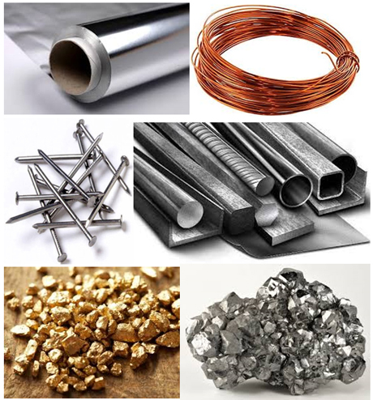
Simulation
Provide students a list of conductors e.g., phone charger wires, batteries, lightbulb filament.
Have students look at what the materials are for the conductors and the most common materials for conductors.
Notes:
Provide students a list of conductors e.g., phone charger wires, batteries, lightbulb filament.
Have students look at what the materials are for the conductors and the most common materials for conductors.

Slide 60
Notes:
Thanks for watching, and please continue watching CAPs available from this website.

Slide 61
This Was Created With Resources From:
Questions or Comments
Michael Kennedy, Ph.D. MKennedy@Virginia.edu
Rachel L Kunemund, Ph.D. rk8vm@virginia.edu

