Slide 1
Intro
“Big Idea” Question
Review Concepts
Check-In Questions
Teacher Engagement
Vocabulary
Student-Friendly Definition
Examples & Non-Examples
Morphological Word Parts
Frayer Model
Simulation/Activity
Notes:
OK everyone, get ready for our next lesson. Just as a reminder, these are the different components that our lesson may include, and you’ll see these icons in the top left corner of each slide so that you can follow along more easily!

Slide 2
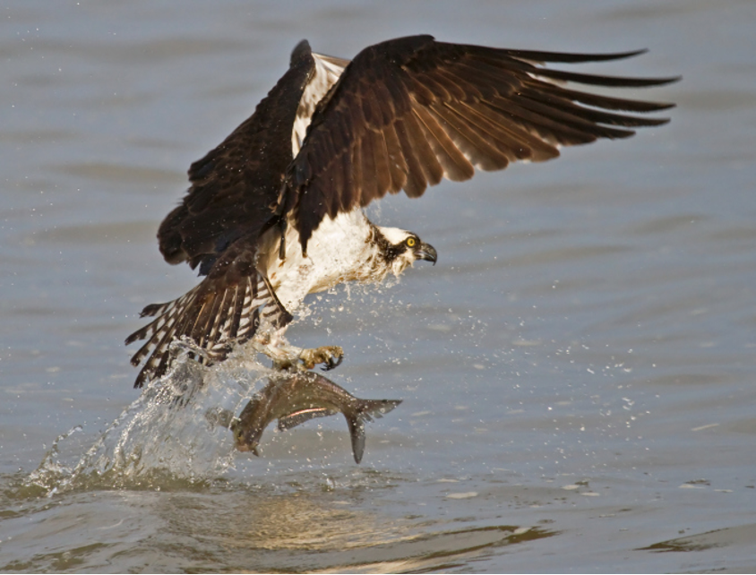
Intro
Consumer
Notes:
Today, we’ll be learning about the word: Consumer.

Slide 3
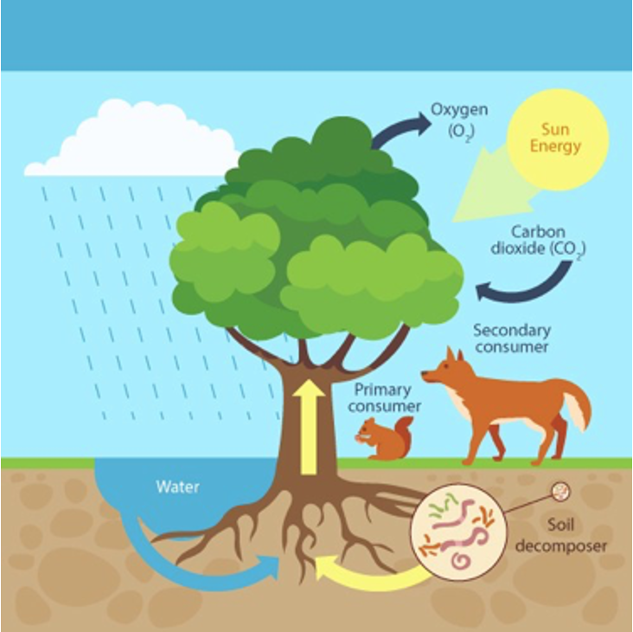
Big Question: How do consumers interact with other plants and animals?
Notes:
Our “big question” is: How do consumers interact with other plants and animals?
[Pause and illicit predictions from students.]
I love all these thoughtful scientific hypotheses! Be sure to keep this question and your predictions in mind as we move through these next few lessons, and we’ll continue to revisit it.

Slide 4
Notes:
Before we move on to our new topic, let’s review some other words & concepts that you already learned and make sure you are firm in your understanding.

Slide 5
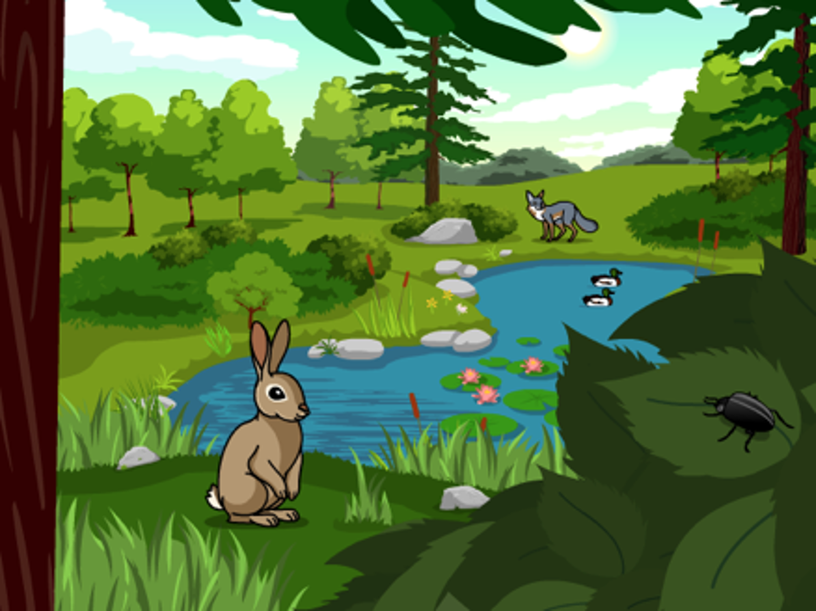
Ecosystem: an area where living and nonliving things interact
Notes:
An ecosystem is an area where living and nonliving things interact.

Slide 6
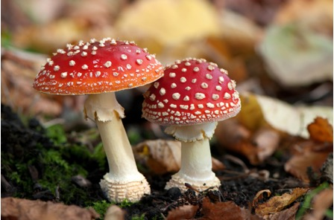
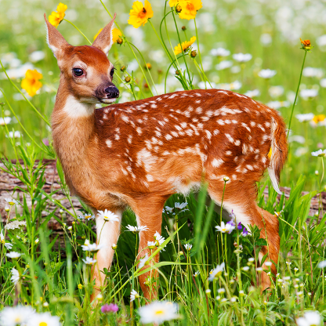
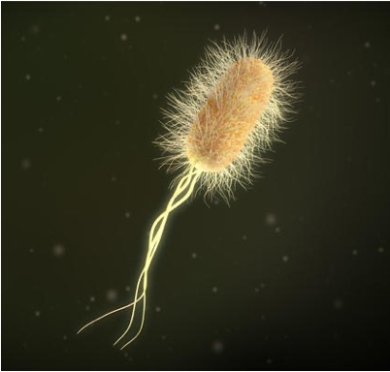
Biotic Factor: living things in an ecosystem
Notes:
Biotic factors are the living things in an ecosystem.

Slide 7
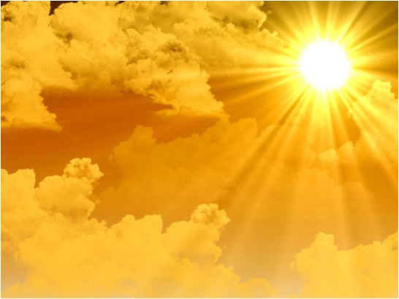
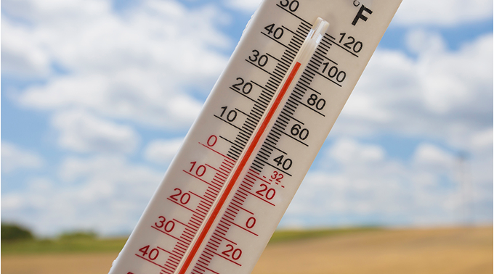
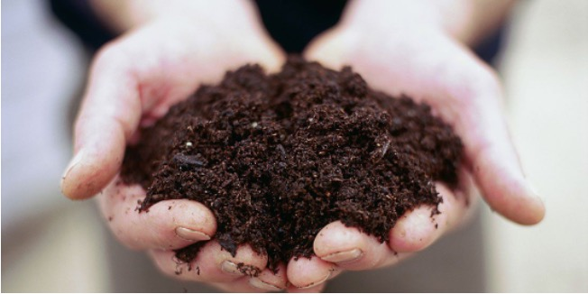
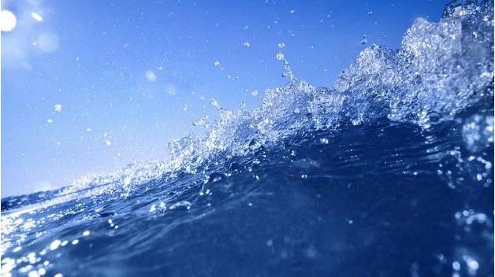
Abiotic Factor: nonliving things in an ecosystem
Notes:
Abiotic factors are nonliving things in an ecosystem.

Slide 8
Producer: organisms that use energy from the sun to make their own food
Notes:
Producers are organisms that use energy from the sun to make their own food.

Slide 9
Notes:
Now let’s pause for a moment to review the information we have covered already.

Slide 10
What is an ecosystem?
Notes:
What is an ecosystem?
[an area where living and nonliving things interact]

Slide 11
What is an example of an abiotic factor?
Trees
Squirrels
Soil
Notes:
What is an example of an abiotic factor?
[C. Soil]

Slide 12
What is an example of an abiotic factor?
Trees
Squirrels
Soil
Notes:
What is an example of an abiotic factor? C. Soil

Slide 13
Producers can make their own food.
True
False
Notes:
Producers can make their own food.
[A. True]

Slide 14
Producers can make their own food.
True
False
Notes:
Producers can make their own food. A. True

Slide 15
Consumer
Notes:
Now that we’ve reviewed, let’s define the phrase consumer.

Slide 16
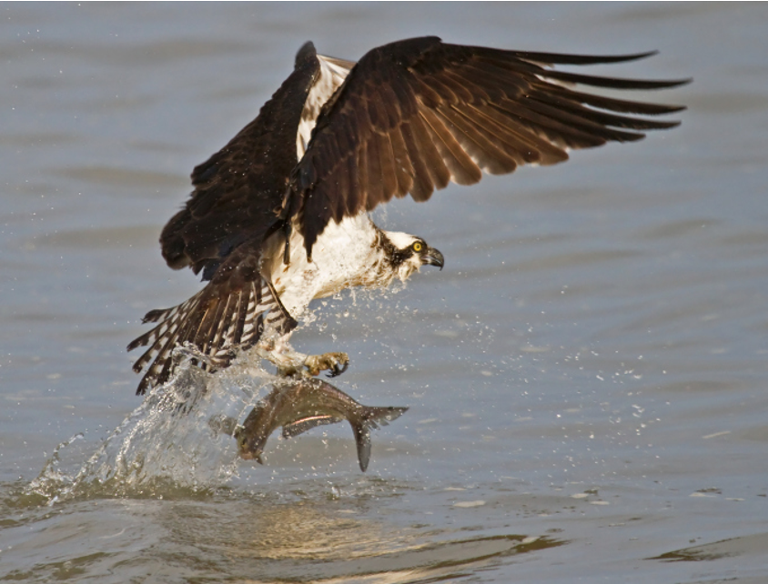
Consumer: organisms that eat other organisms for energy
Notes:
A consumer is an organism that eats other organisms for energy.

Slide 17
Notes:
Let’s check-in for understanding.

Slide 18
What is a consumer?
Notes:
What is a consumer?
[Organisms that eat other organisms for energy]

Slide 19
Notes:
That is the basic definition, but there is a bit more you need to know.

Slide 20
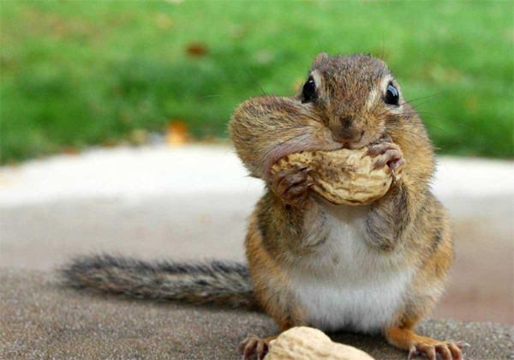
Consumers may eat plants, animals, or both plants and animals.
Notes:
Unlike producers, consumers cannot create their own food for energy. Instead, consumers may eat plants, animals, or both plants and animals to get energy.

Slide 21
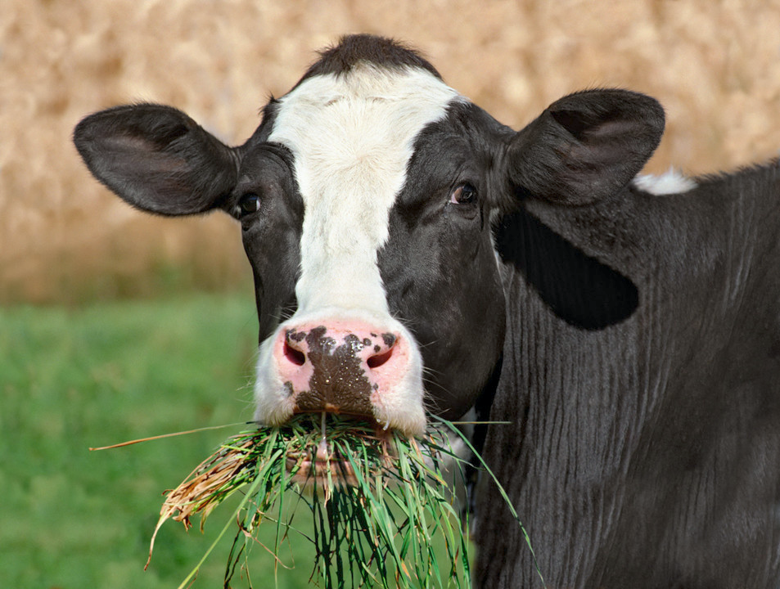
Herbivores are consumers that eat only plants.
Notes:
Herbivores, like this cow, eat only plants to get their energy.

Slide 22
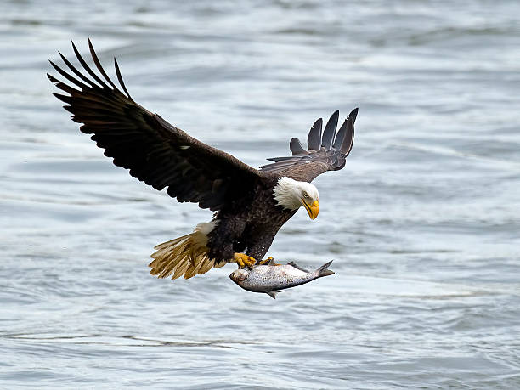
Carnivores are consumers that eat only other animals.
Notes:
Carnivores eat only other animals to get energy. For example, eagles have to hunt animals like fish and snakes to eat.

Slide 23
Omnivores are consumers that eat both plants and animals
Notes:
Omnivores eat both plants and animals. People are a kind of omnivores because we eat meat (like chicken or fish) as well as fruits and vegetables.

Slide 24
Notes:
Let’s check-in for understanding.

Slide 25
Where do consumers get their energy?
Plants
Animals
C. Plants and Animals
D. All of the above
Notes:
Where do consumers get their energy?
[D. All of the above]

Slide 26
Where do consumers get their energy?
Plants
Animals
C. Plants and Animals
D. All of the above
Notes:
Where do consumers get their energy? D. All of the above

Slide 27
What kind of consumers are humans?
Herbivore
Carnivore
Omnivore
Notes:
What kind of consumers are humans?
[C. Omnivore]

Slide 28
What kind of consumers are humans?
Herbivore
Carnivore
Omnivore
Notes:
What kind of consumers are humans? C. Omnivore

Slide 29
Notes:
Now, let’s talk about some examples of consumers.

Slide 30
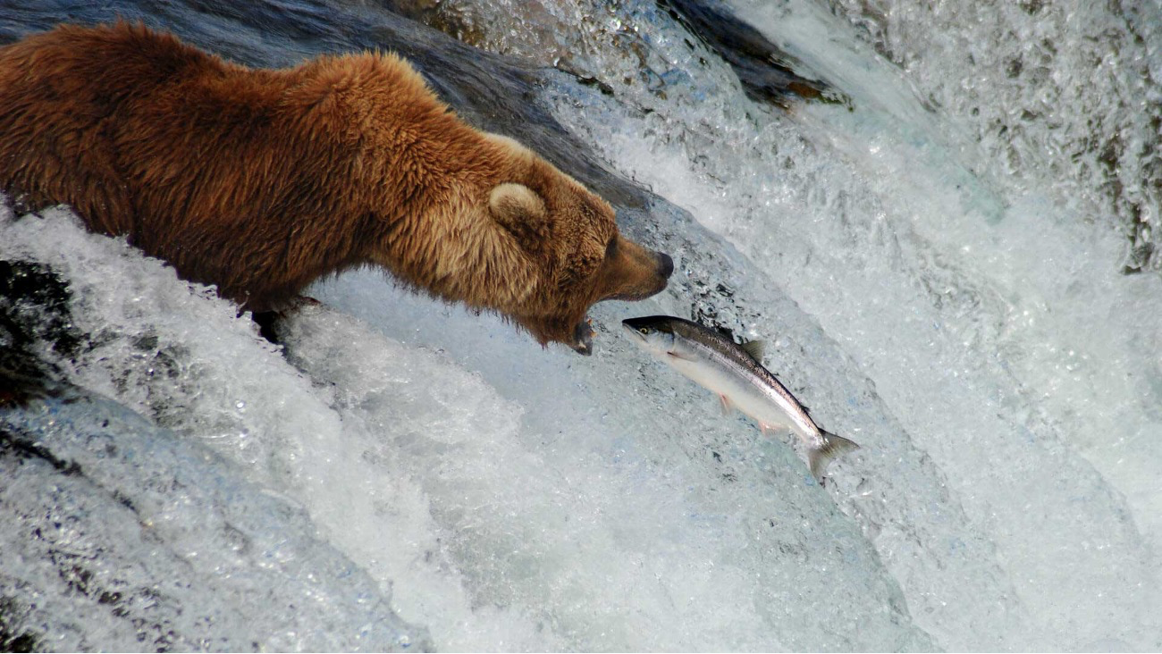
Notes:
Bears are consumers because they eat other organisms (including salmon and even berries from plants).

Slide 31
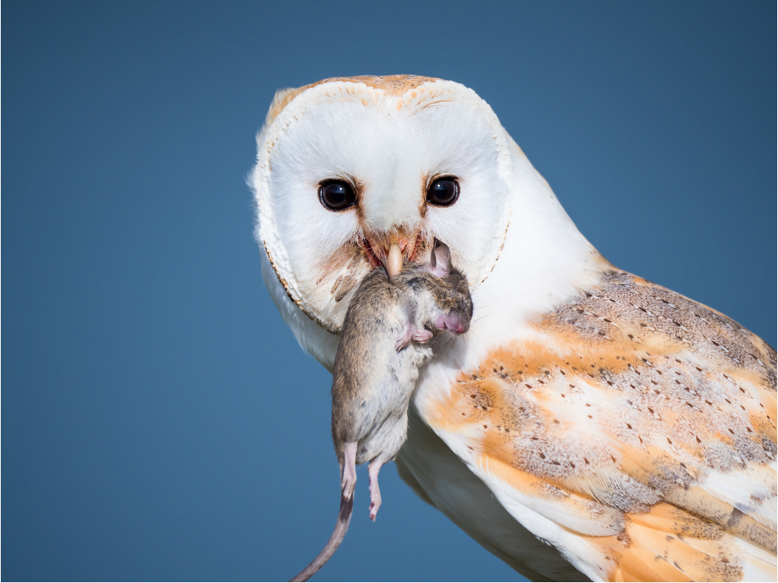
Notes:
Owls also consume other organisms – mostly rodents such as mice.

Slide 32
Notes:
Now, let’s talk about some non-examples of consumers.

Slide 33
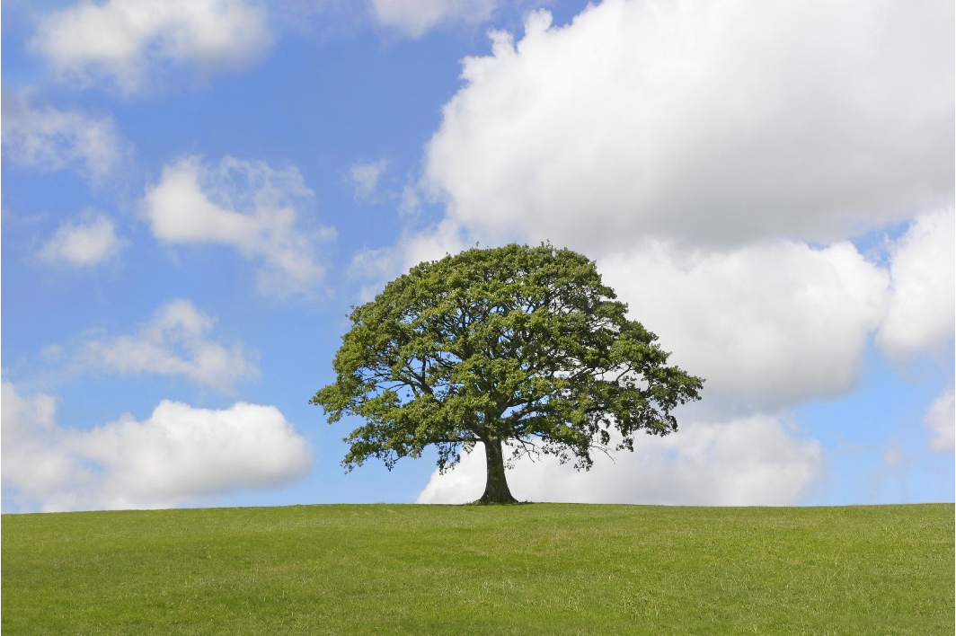
Notes:
A tree is a producer – it performs photosynthesis and uses energy from the sun to make its own food.

Slide 34
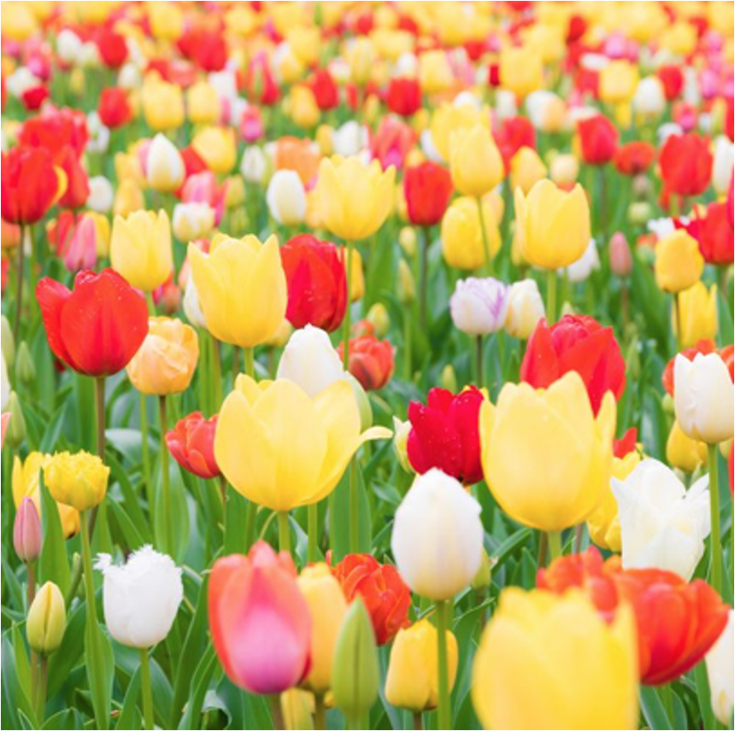
Notes:
Flowers are not consumers, they are producers.

Slide 35
Notes:
Now let’s pause for a moment to check your understanding.

Slide 36
What is an example of a consumer?
Notes:
What is an example of a consumer?
[Answers may vary]

Slide 37
How are producers and consumers different?
Notes:
How are producers and consumers different?
[Producers make their own food for energy, and consumers eat other organisms for energy]

Slide 38
Notes:
We can also break down the term consumer into different word parts to help us remember the meaning. Let’s take a look!

Slide 39
Consumer
(root)
(suffix)
Notes:
We can break up the term consumer into two parts: a root and a suffix.

Slide 40
Consumer
to eat or drink
Notes:
First, the root word “consume” means to eat or drink

Slide 41
Consumer
something that performs an action
Notes:
The suffix -er means something that performs an action.

Slide 42
Consum + er
something that eats or drinks
Notes:
So, when you add the suffix, -er to the root word produce, this means someone or something that eats or drinks.

Slide 43
So, when we use the term consumers, we are referring to organisms that eat other organisms.
Notes:
When we talk about consumers in science class, we are referring to organisms that eat other organisms.

Slide 44
Remember!!!
Notes:
So remember!

Slide 45
Consumer: organisms that eat other organisms for energy
Notes:
Consumers are organisms that eat other organisms for energy.

Slide 46
Notes:
We will now complete this concept map, called a Frayer model, to summarize and further clarify what you have learned about the term consumer.

Slide 47
Definition
Picture
Consumer
Example
How do consumers impact my life?
Notes:
To complete the Frayer model, we will choose from four choices the correct picture, definition, example, and response to the question, “How do consumers impact my life?” Select the best response for each question using the information you just learned. As we select responses, we will see how this model looks filled in for the term consumer.

Slide 48
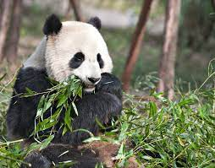
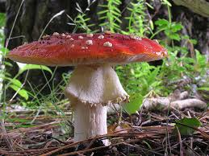
Directions: Choose the correct picture of a consumer from the choices below.
A
B
C
D
Notes:
Choose the one correct picture of a consumer from these four choices

Slide 49
Directions: Choose the correct picture of a consumer from the choices below.
A
B
C
D
Notes:
You are correct! This is a picture of a consumer.

Slide 50
Definition
Picture
Consumers
Example
How do consumers impact my life?
Notes:
Here is the Frayer model filled in with a picture of a consumer.

Slide 51
Directions: Choose the correct definition of Consumers from the choices below.
A
Organisms that use energy to make their own food
B
Organisms that can fly
C
Organisms that are inactive during the winter months
D
Organisms that eat other organisms for energy
Notes:
Choose the one correct definition of consumers from these four choices

Slide 52
Directions: Choose the correct definition of Consumers from the choices below.
A
Organisms that use energy to make their own food
B
Organisms that can fly
C
Organisms that break down the remains of other organisms
s
D
Organisms that eat other organisms for energy.
Notes:
You are correct! Consumers are organisms that eat other organisms for energy.

Slide 53
Definition
Picture
organisms that eat other organisms for energy
Consumers
Example
How do consumers impact my life?
Notes:
Here is the Frayer model filled in with a picture of and the definition filled in for consumers: organisms that eat other organisms for energy.

Slide 54
Directions: Choose the correct example of a Consumer from the choices below.
A
tomatoes growing on the vine
B
pine tree in the forest
C
bear eating a fish
D
flowers in the garden
Notes:
Choose the one correct example of a consumer from these four choices

Slide 55
Directions: Choose the correct example of a Consumer from the choices below.
A
tomatoes growing on the vine
B
pine tree in the forest
C
bear eating a fish
D
flowers in the garden
Notes:
You are correct! An example of a consumer is a bear eating a fish

Slide 56
Definition
Picture
organisms which eat other organisms for energy
Consumers
bear eating a fish
Example
How do consumers impact my life?
Notes:
Here is the Frayer model with a picture, definition, and an example of a consumer: a bear eating a fish.

Slide 57
Directions: Choose the correct response for “how do consumers impact my life?” from the choices below.
A
They produce energy that keep me warm
B
I am a consumer. I can eat plants and animals for energy
C
They help keep the air clean so I can breathe
D
They help me digest the food I eat
Notes:
Choose the one correct response for “how do consumers impact my life?” from these four choices.

Slide 58
Directions: Choose the correct response for “how do consumers impact my life?” from the choices below.
A
They produce energy that keep me warm
B
I am a consumer. I can eat plants and animals for energy.
C
They help keep the air clean so I can breathe
D
They help me digest the food I eat
Notes:
You are correct! We are consumers. We eat plants and animals for energy.

Slide 59
Definition
Picture
organisms which eat other organisms for energy
Consumers
bear eating a fish
I am a consumer. I can eat
plants and animals for
energy.
Example
How do consumers impact my life?
Notes:
Here is the Frayer model with a picture, definition, example, and a correct response to “how do consumers impact my life?”: I am a consumer. I can eat plants and animals for energy.

Slide 60
Remember!!!
Notes:
So remember!

Slide 61
Consumer: organisms that eat other organisms for energy
Notes:
Consumers are organisms that eat other organisms for energy.

Slide 62
Big Question: How do consumers interact with other plants and animals?
Notes:
Our “big question” is: How do consumers interact with other plants and animals?
[Pause and illicit predictions from students.]

Slide 63
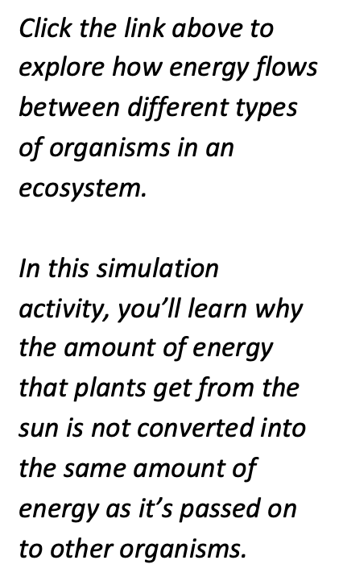
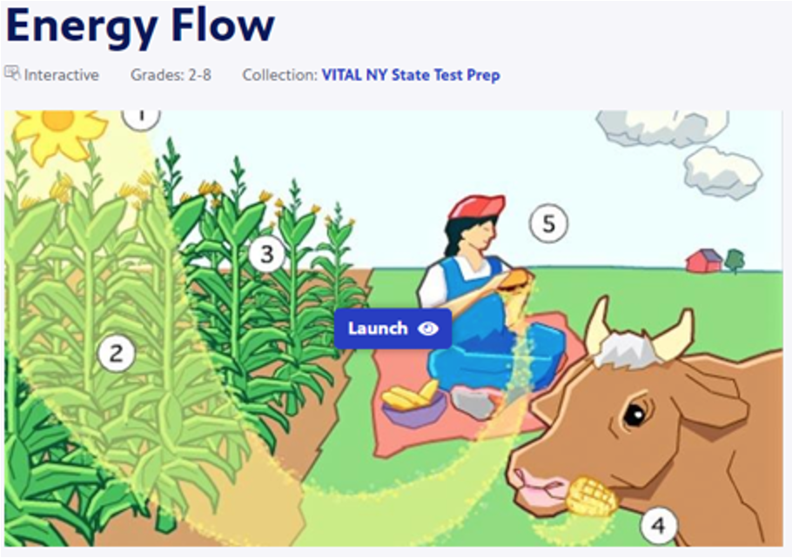
Simulation Activity
Energy Flow Interactive
(PBS Learning Media)
Notes:
Click the link above to explore how energy flows between different types of organisms in an ecosystem.
Feedback: Providing a rationale during this activity helps students make connections and promotes understanding of the content.

Slide 64
Notes:
Thanks for watching, and please continue watching CAPs available from this website.

Slide 65
This Was Created With Resources From:
Questions or Comments
Michael Kennedy, Ph.D. MKennedy@Virginia.edu
Rachel L Kunemund, Ph.D. rk8vm@virginia.edu

