Slide 1
Intro
“Big Idea” Question
Review Concepts
Check-In Questions
Teacher Engagement
Vocabulary
Student-Friendly Definition
Examples & Non-Examples
Morphological Word Parts
Frayer Model
Simulation/Activity
Notes:
OK everyone, get ready for our next lesson. Just as a reminder, these are the different components that our lesson may include, and you’ll see these icons in the top left corner of each slide so that you can follow along more easily!

Slide 2
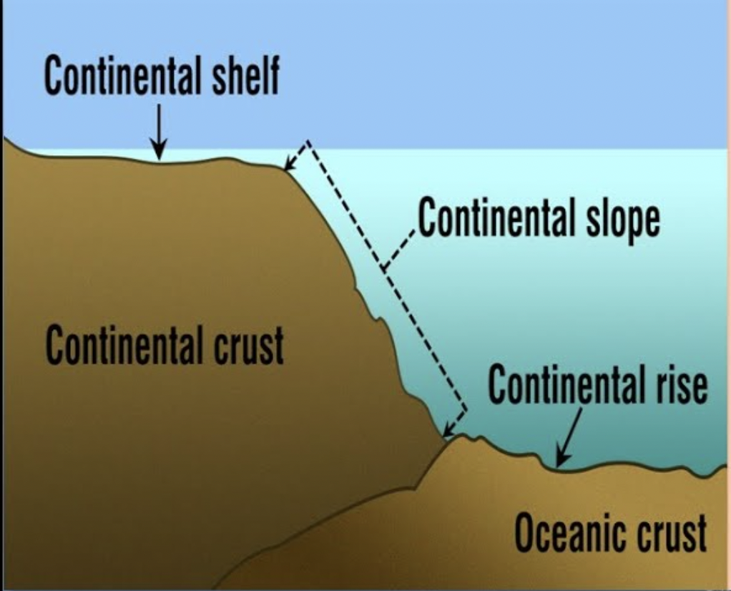
Intro
Continental Shelf
Notes:
Today, we’ll be learning about the word: Continental Shelf.

Slide 3
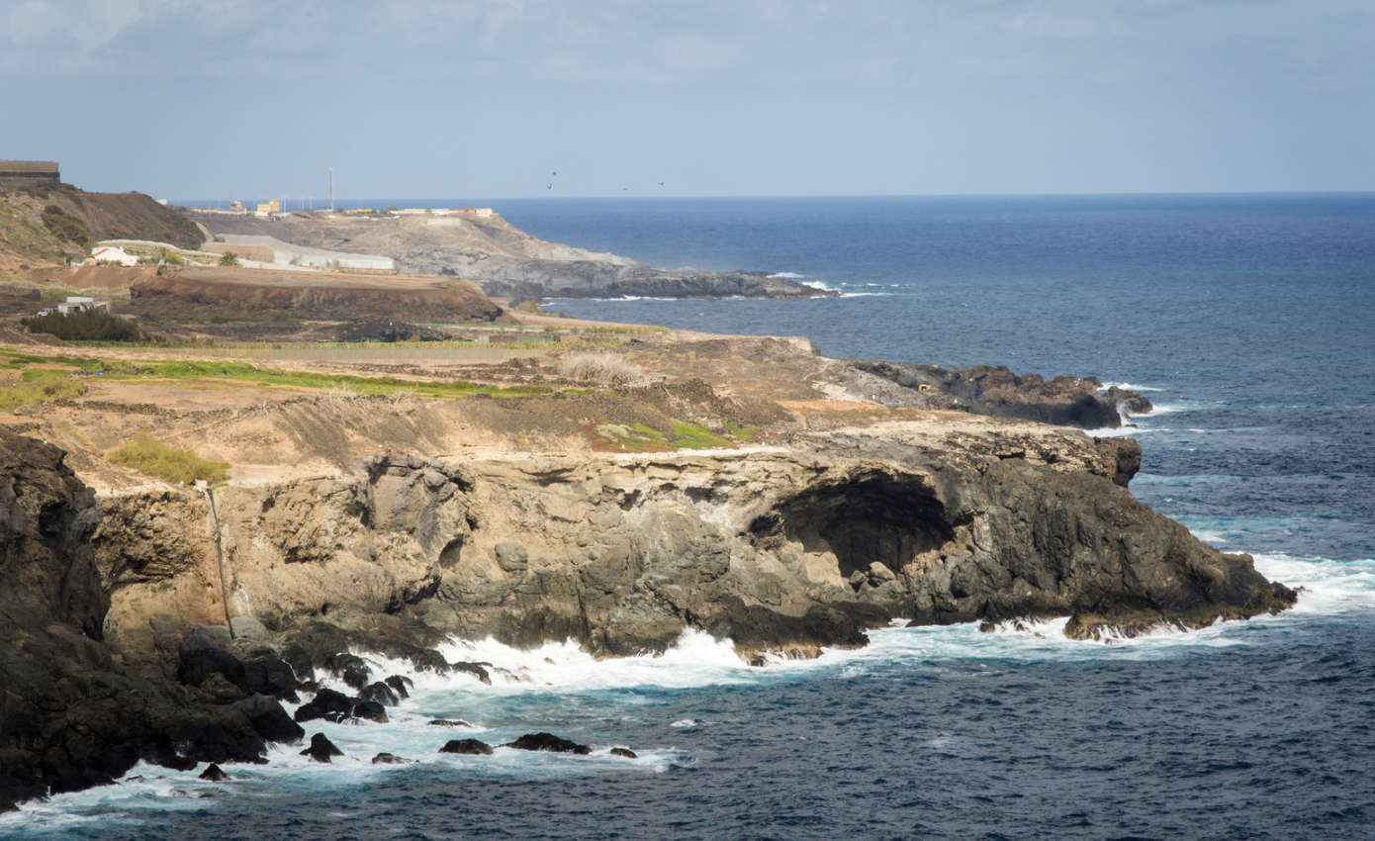
Big Question: How do continental shelves shape our coasts and influence the habitats of plants and animals in the ocean?
Notes:
Our “big question” is: How do continental shelves shape our coasts and influence the habitats of plants and animals in the ocean?
[Pause and illicit predictions from students.]
I love all these thoughtful scientific hypotheses! Be sure to keep this question and your predictions in mind as we move through these next few lessons, and we’ll continue to revisit it.

Slide 4
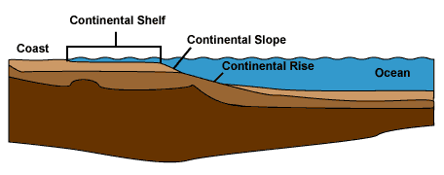
Demonstration
Using a large tub or container, filled it with water until it is halfway full, adding sand, and various objects representing different features of the continental shelf. During the demonstration, discuss the significance of continental shelves, such as their role in supporting marine life, their importance for fishing and resource extraction, and their influence on ocean currents and weather patterns.
Notes:
Set up the large tub or container in a visible area of the classroom where all students can see.
Fill the tub with water until it's about halfway full.
Sprinkle sand or soil evenly along the bottom of the tub to represent the ocean floor.
Place small rocks, shells, and other objects on top of the sand to represent different features of the continental shelf such as ridges, valleys, and canyons.
Gradually slope the sand upward from the edge of the tub to represent the continental slope.
Measure and mark the depth of the water at different points in the tub using the ruler or measuring tape.
Explain to the students that the tub represents a portion of the ocean with its continental shelf, slope, and deep ocean floor.
Discuss the various features of the continental shelf, such as its shallow depth, gradual slope, and rich biodiversity.
Optionally, add plastic figurines representing marine life onto the continental shelf and slope to illustrate how different organisms inhabit different parts of the ocean.
Encourage students to observe and ask questions about the demonstration.

Slide 5
Notes:
Before we move on to our new topic, let’s review some other words & concepts that you already learned and make sure you are firm in your understanding.

Slide 6
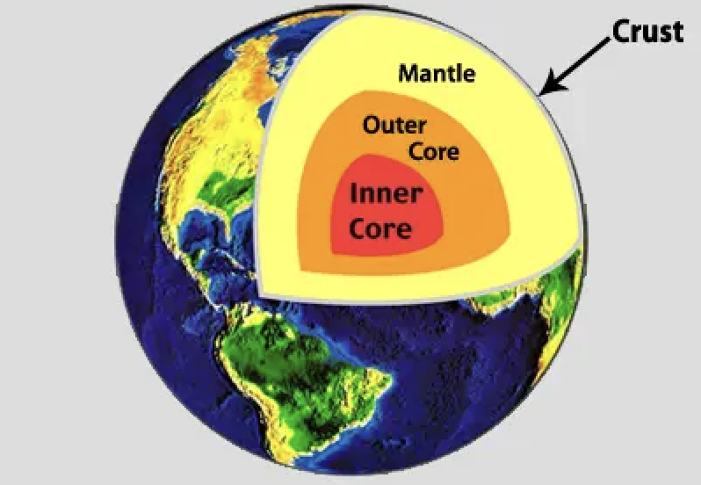
Crust: The outermost shell of the Earth
Notes:
Crust is the outermost shell of the Earth

Slide 7
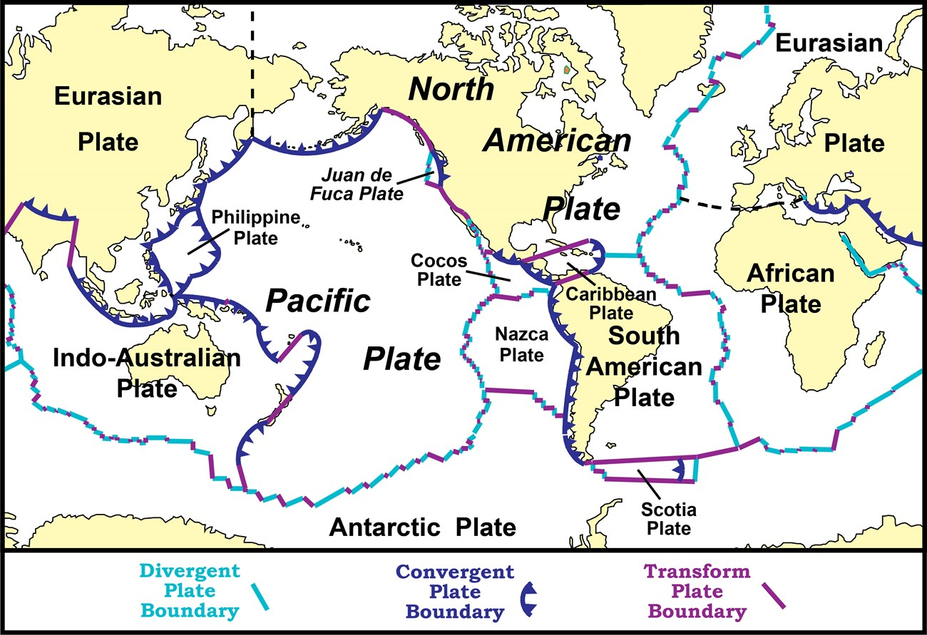
Tectonic Plates: Huge pieces of the Earth's surface that fit together like a puzzle and move very slowly over time
Notes:
Tectonic plates are huge pieces of the Earth’s surface that fit together like a puzzle an d move very slowly over time.

Slide 8
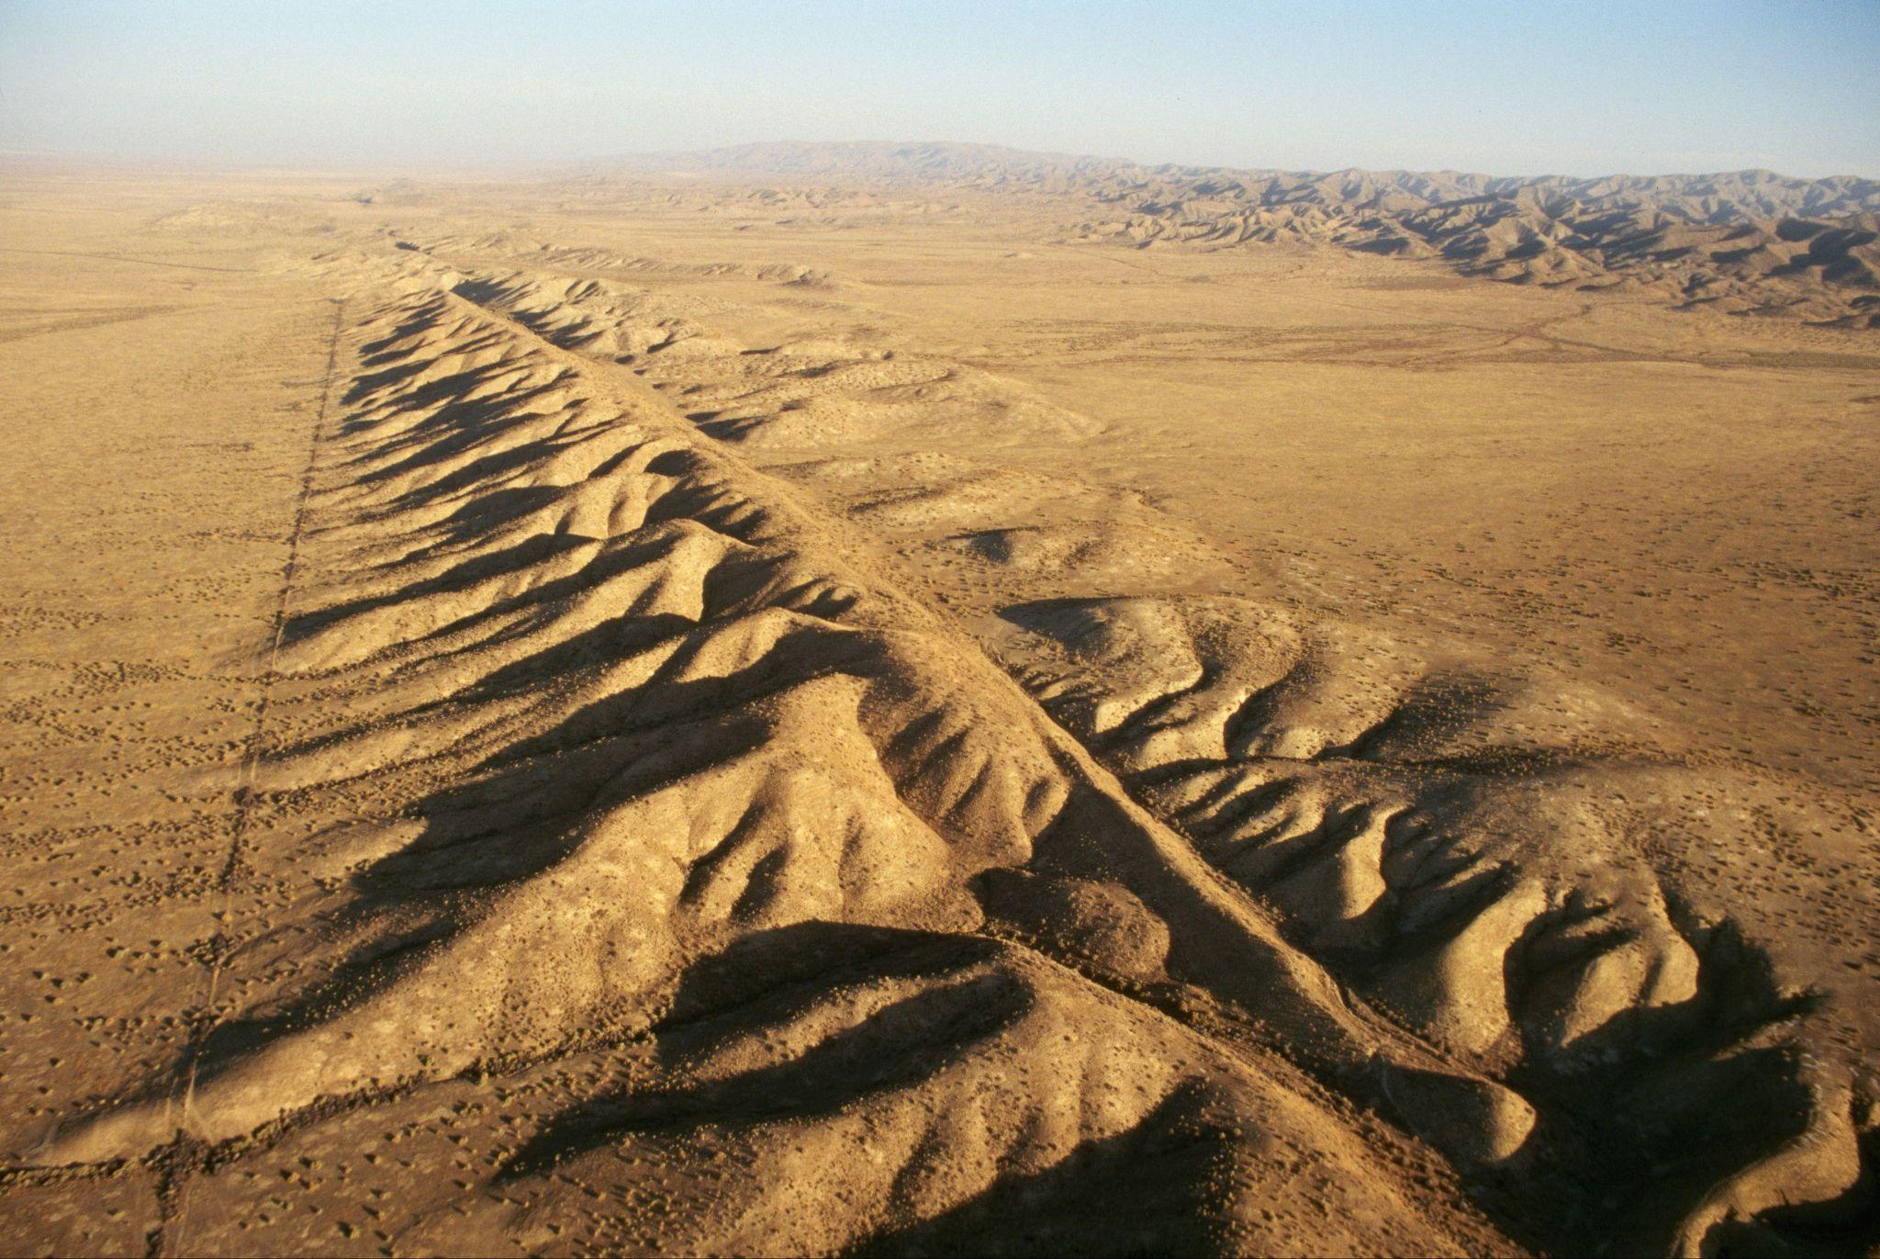
Fault: Long crack in the surface of the Earth
Notes:
A fault is a long crack in the surface of the Earth.

Slide 9
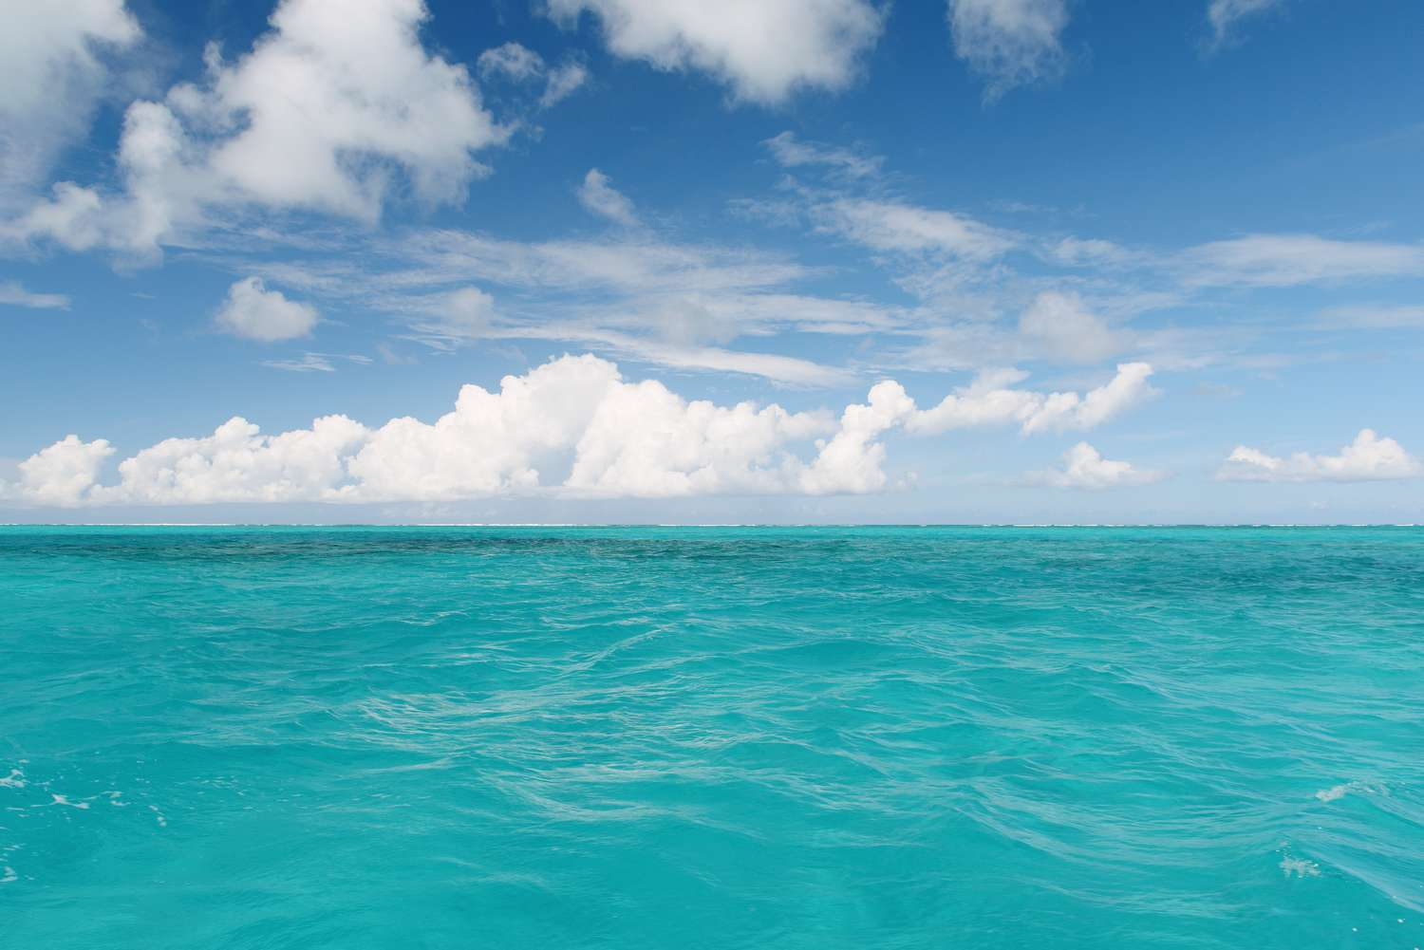
Ocean: A giant body of saltwater.
Notes:
An ocean is a giant body of saltwater.

Slide 10
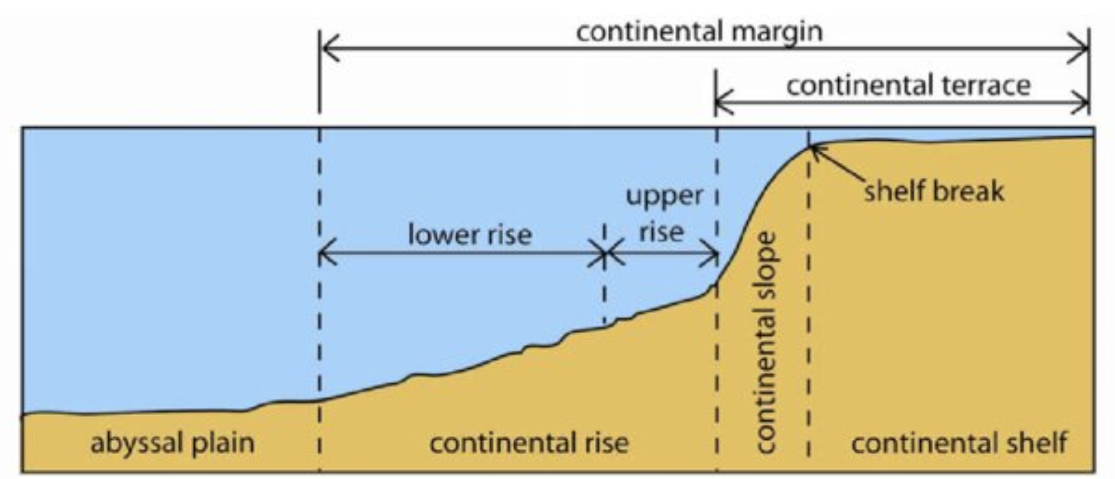
Woo (2005)
Continental Rise: a gentle slope at the ocean's bottom where sand and mud collect
Notes:
A continental rise is a gentle slope at the ocean's bottom where sand and mud collect, linking the steeper continental slope to the flat ocean floor
Image source: Woo, L. M. (2005). Summer circulation and water masses along the West Australian coast (Doctoral dissertation, University of Western Australia).
Chicago

Slide 11
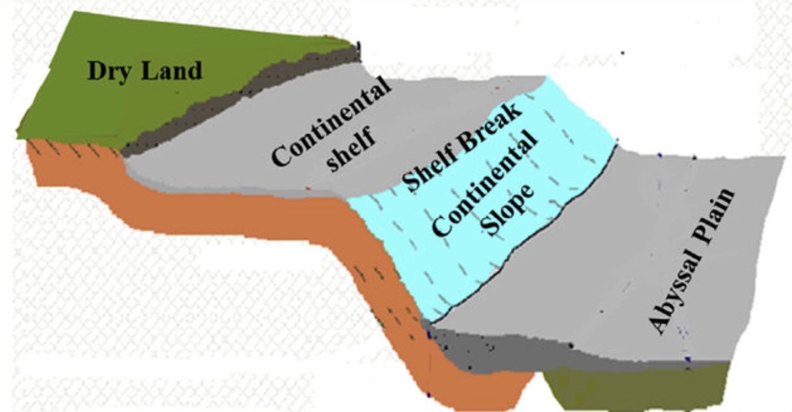
Solangi et al. (2018)
Continental Slope: a steep underwater hill that goes down from the edge of the continent into the deeper parts of the ocean
Notes:
A continental slope is a steep underwater hill that goes down from the edge of the continent into the deeper parts of the ocean
Image source: Solangi, S. H., Nazeer, A., Abbasi, S., & Zulkifil, M. M. (2019). Morphological features of continental shelf margin: Examples from the Pakistan Offshore. Geodesy and Geodynamics, 10(1), 77-91.

Slide 12
Notes:
Now let’s pause for a moment to review the information we have covered already.

Slide 13
The outermost shell of the Earth is called the…
Crust
Core
Notes:
The outermost shell of the Earth is called the…
[Crust]

Slide 14
The outermost shell of the Earth is called the…
Crust
Core
Notes:
The outermost shell of the Earth is called the…
[Crust]

Slide 15
True or False: Tectonic plates are huge pieces of the Earth's surface that fit together like a puzzle and move very slowly over time.
Notes:
True or False: Huge pieces of the Earth's surface that fit together like a puzzle and move very slowly over time.
[True]

Slide 16
True or False: Tectonic plates are huge pieces of the Earth's surface that fit together like a puzzle and move very slowly over time.
Notes:
True or False: Huge pieces of the Earth's surface that fit together like a puzzle and move very slowly over time.
[True]

Slide 17
A _____ is a long _____ in the surface of the Earth.
fault, crack
crack, fault
Notes:
A _____ is a long _____ in the surface of the Earth.
[fault, crack]

Slide 18
A _____ is a long _____ in the surface of the Earth.
fault, crack
crack, fault
Notes:
A _____ is a long _____ in the surface of the Earth.
[fault, crack]

Slide 19
Woo (2005)
Continental Rise: a gentle slope at the ocean's bottom where and collect
Notes:
A continental rise is a gentle slope at the ocean's bottom where and collect, linking the steeper continental slope to the flat ocean floor
[sand, mud]
Image source: Woo, L. M. (2005). Summer circulation and water masses along the West Australian coast (Doctoral dissertation, University of Western Australia).
Chicago

Slide 20
Woo (2005)
Continental Rise: a gentle slope at the ocean's bottom where sand and mud collect
Notes:
A continental rise is a gentle slope at the ocean's bottom where sand and mud collect, linking the steeper continental slope to the flat ocean floor
Image source: Woo, L. M. (2005). Summer circulation and water masses along the West Australian coast (Doctoral dissertation, University of Western Australia).
Chicago

Slide 21
Solangi et al. (2018)
True or False: A continental slope is an above water hill that people roll down to get into the ocean.
Notes:
True or False: A continental slope is an above water hill that people roll down to get into the ocean.
[False]
Image source: Solangi, S. H., Nazeer, A., Abbasi, S., & Zulkifil, M. M. (2019). Morphological features of continental shelf margin: Examples from the Pakistan Offshore. Geodesy and Geodynamics, 10(1), 77-91.

Slide 22
Solangi et al. (2018)
True or False: A continental slope is an above water hill that people roll down to get into the ocean.
Notes:
False: A continental slope is a steep underwater hill that goes down from the edge of the continent into the deeper parts of the ocean
Image source: Solangi, S. H., Nazeer, A., Abbasi, S., & Zulkifil, M. M. (2019). Morphological features of continental shelf margin: Examples from the Pakistan Offshore. Geodesy and Geodynamics, 10(1), 77-91.

Slide 23
Continental Shelf
Notes:
Now that we’ve reviewed, let’s define the phrase continental shelf.

Slide 24
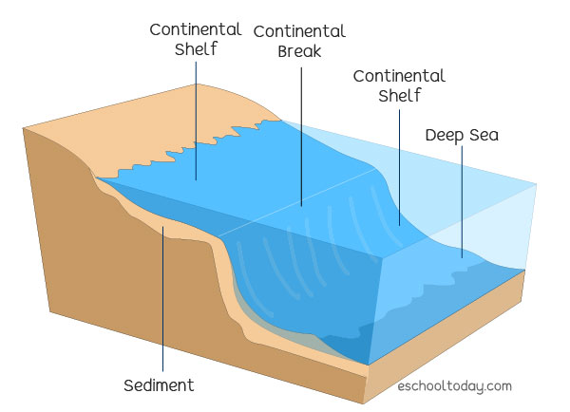
Continental Shelf: The edge of a continent that is underwater
Notes:
A continental shelf is the edge of a continent that is underwater

Slide 25
Notes:
Let’s check-in for understanding.

Slide 26
What is a continental shelf?
Notes:
What is a continental shelf?
[The edge of a continent that is underwater]

Slide 27
Notes:
That is the basic definition, but there is a bit more you need to know.

Slide 28
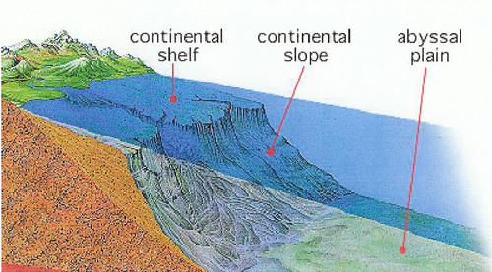
The continental shelf is where the land meets the sea, it's like the edge of a giant underwater plateau, stretching from the shore out into the ocean.
Notes:
The continental shelf is where the land meets the sea, it's like the edge of a giant underwater plateau, stretching from the shore out into the ocean.

Slide 29
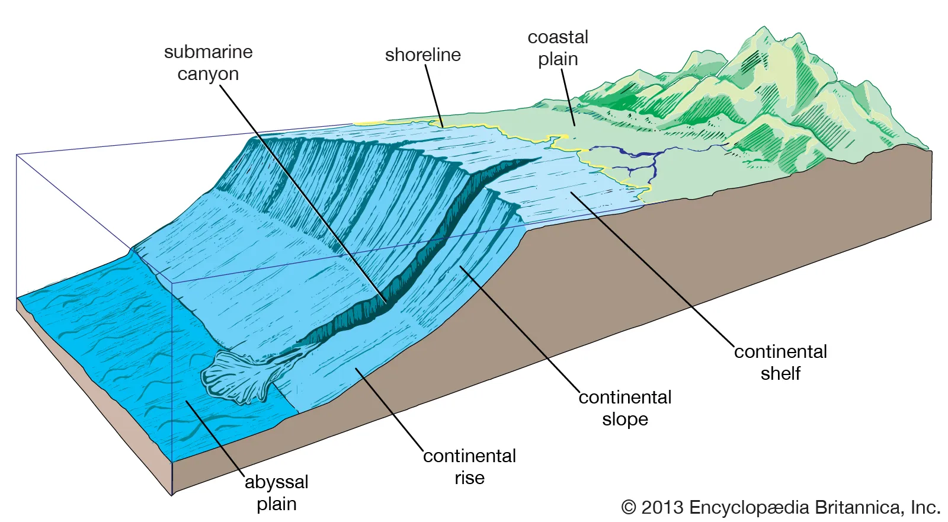
The continental shelf helps protect the land from big waves because it's like a barrier between the deep ocean and the coast.
Notes:
The continental shelf helps protect the land from big waves because it's like a barrier between the deep ocean and the coast.

Slide 30
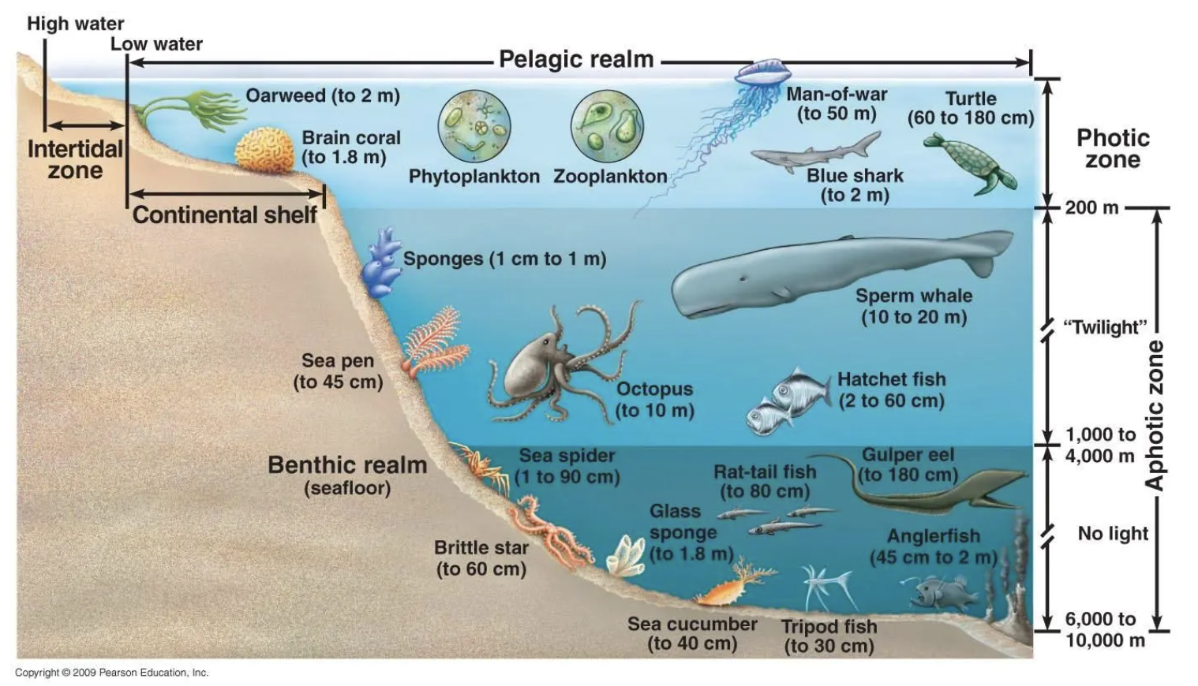
The continental shelf isn't very deep, which is perfect for sea creatures and plants to live and grow. It's like a big underwater playground for fish, crabs, and other ocean animals.
Notes:
The continental shelf isn't very deep, which is perfect for sea creatures and plants to live and grow. It's like a big underwater playground for fish, crabs, and other ocean animals.

Slide 31
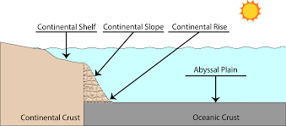
Sometimes, the continental shelf is shallow enough that sunlight can reach all the way down, helping plants to make food through a process called photosynthesis.
Notes:
Sometimes, the continental shelf is so shallow that sunlight can reach all the way down, helping plants to make food through a process called photosynthesis.

Slide 32
Notes:
Let’s check-in for understanding.

Slide 33
The Continental Shelf is where the lands meets the ______, it’s like the edge of a giant underwater plateau, stretching from the shore out into the ocean.
Notes:
The continental shelf is where the land meets the _____, it's like the edge of a giant underwater plateau, stretching from the shore out into the ocean.
[sea]

Slide 34
The Continental Shelf is where the lands meets the sea, it’s like the edge of a giant underwater plateau, stretching from the shore out into the ocean.
Notes:
The continental shelf is where the land meets the sea, it's like the edge of a giant underwater plateau, stretching from the shore out into the ocean.

Slide 35
True or False: The continental shelf helps protect the land from big waves because it's like a barrier between the deep ocean and the coast.
Notes:
True or False: The continental shelf helps protect the land from big waves because it's like a barrier between the deep ocean and the coast.
[True]

Slide 36
True or False: The continental shelf helps protect the land from big waves because it's like a barrier between the deep ocean and the coast.
Notes:
True: The continental shelf helps protect the land from big waves because it's like a barrier between the deep ocean and the coast.

Slide 37
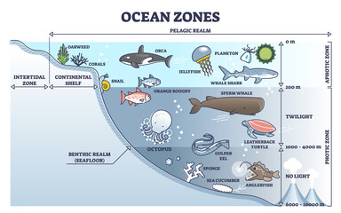
The Continental Shelf is like a big underwater playground for_____, _____, and other ______.
dogs, cats, hamsters
dogs, fish, whales
fish, crabs, ocean animals
Notes:
The continental shelf is like a big underwater playground for _____, ______, and other _________.
dogs, cats, hamsters
dogs, fish, whales
fish, crabs, ocean animals
[fish, crabs, ocean animals]

Slide 38
The Continental Shelf is like a big underwater playground for_____, _____, and other ______.
dogs, cats, hamsters
dogs, fish, whales
fish, crabs, ocean animals
Notes:
The continental shelf is like a big underwater playground for _____, ______, and other _________.
dogs, cats, hamsters
dogs, fish, whales
fish, crabs, ocean animals

Slide 39
Notes:
Now, let’s talk about some examples of a continental shelf.

Slide 40
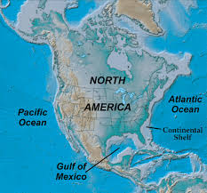
An example of a continental shelf can be found on the map below. If we look at the map, we can see that the continental shelf goes along the coastlines of North America. It is like the border between the continent and the deep ocean.
Picture: The Geology of our National Parks, Monuments and Seashores,” by Robert J. Lillie, New York, W. W. Norton and Company, 298 pp., 200
Notes:
An example of a continental shelf can be found on the map below. If we look at the map, we can see that the continental shelf goes along the coastlines of North America. It is like the border between the continent and the deep ocean.

Slide 41
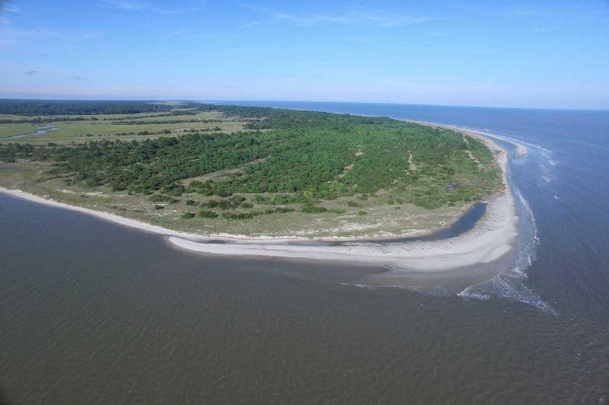
Another example of a continental shelf can be found in the state of Georgia. This continental shelf is more than 80 miles wide, called the Georgia Continental Shelf.
Photo: Georgia Coast Atlas
Notes:
Another example of a continental shelf can be found in the state of Georgia. This continental shelf is more than 80 miles wide, called the Georgia Continental Shelf.
Source: https://storymaps.arcgis.com/stories/d84231afdad14b97a2eacc191eac5b2a

Slide 42
Notes:
Now, let’s talk about some non-examples of continental shelf.

Slide 43
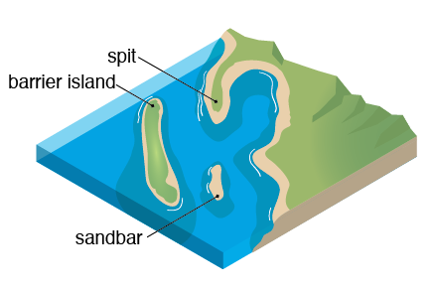
A sandbar is NOT an example of a continental shelf. Sandbars are shallow underwater formations found near shorelines. They are often temporary and can shift with tides and currents, whereas continental shelves are more stable and extend for greater distances from the coastline.
Notes:
A sandbar is not an example of a continental shelf. Sandbars are often temporary and can shift with tides and currents, whereas continental shelves are more stable and extend for greater distances from the coastline.

Slide 44
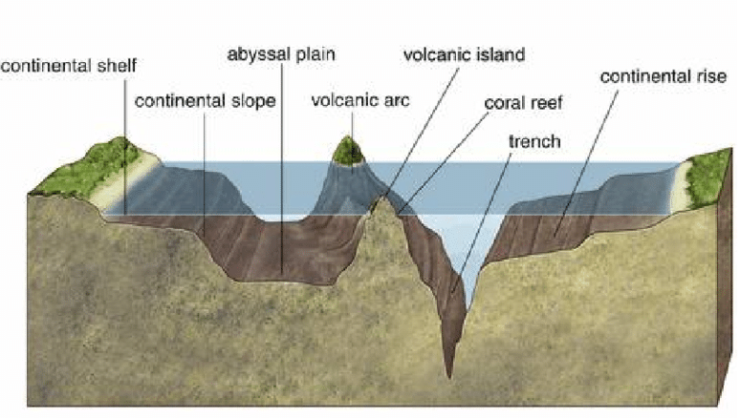
A coral reef is NOT an example of a continental shelf. Coral reefs are diverse underwater ecosystems made up of coral polyps and other marine organisms. While they can be found on the continental shelf, they are not the same as the continental shelf itself. Coral reefs grow on rocky or sandy substrates on the continental shelf but are distinct features within the marine environment.
Notes:
A coral reef is NOT an example of a continental shelf. Coral reefs are diverse underwater ecosystems made up of coral polyps and other marine organisms. While they can be found on the continental shelf, they are not the same as the continental shelf itself. Coral reefs grow on rocky or sandy substrates on the continental shelf but are distinct features within the marine environment.

Slide 45
Notes:
Now let’s pause for a moment to check your understanding.

Slide 46
Why are sandbars and coral reefs not examples of a continental shelf?
Notes:
Why are sandbars and coral reefs not examples of a continental shelf?
[Coral reefs are underwater ecosystems composed of living coral polyps and the structures they create over time and Sandbars are underwater or partially exposed ridges of sand that may be found near coastlines, in estuaries, or along the ocean floor, while a continental shelf the edge of a continent that is underwater]

Slide 47
Remember!!!
Notes:
So remember!

Slide 48
Continental Shelf: The edge of a continent that is underwater
Notes:
A continental shelf is the edge of a continent that is underwater.

Slide 49
Notes:
We will now complete this concept map, called a Frayer model, to summarize and further clarify what you have learned about the term continental shelf.

Slide 50
Definition
Picture
Continental Shelf
Example
How do continental shelves impact my life?
Notes:
To complete the Frayer model, we will choose from four choices the correct picture, definition, example, and response to the question, “How do continental shelves impact my life?” Select the best response for each question using the information you just learned. As we select responses, we will see how this model looks filled in for the term continental shelf.

Slide 51
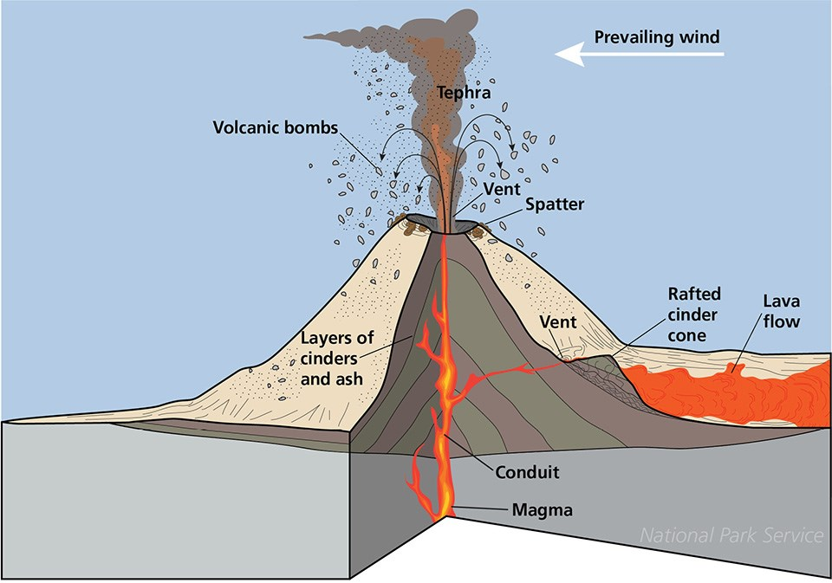
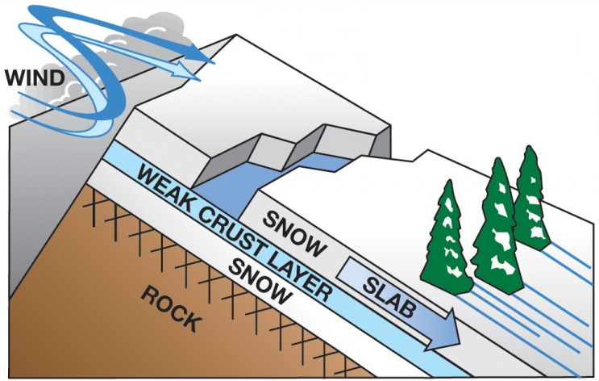
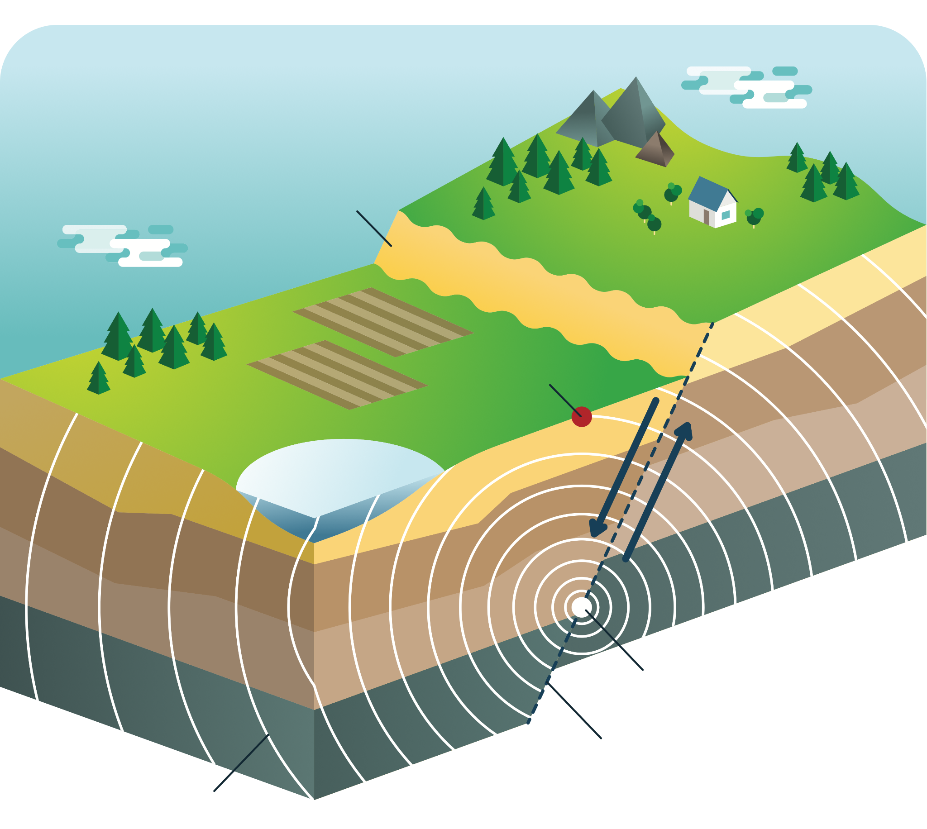
Directions: Choose the correct picture of a continental shelf from the choices below.
A
B
C
D
Notes:
Choose the one correct picture of a continental shelf from these four choices.

Slide 52
Directions: Choose the correct picture of a continental shelf from the choices below.
A
B
C
D
Notes:
This is the picture that shows a continental shelf.

Slide 53
Definition
Picture
Continental Shelf
Example
How do continental shelves impact my life?
Notes:
Here is the Frayer model filled in with a picture of an continental shelf.

Slide 54
Directions: Choose the correct definition of a continental shelf from the choices below.
A
A solid collection of minerals
B
The edge of a continent that is underwater
C
Underwater ecosystem made up of coral polyps
D
Deep, steep-sided valleys carved into the seafloor by erosion.
Notes:
Choose the correct definition of a continental shelf from the choices below.

Slide 55
Directions: Choose the correct definition of a continental shelf from the choices below.
A
A solid collection of minerals
B
The edge of a continent that is underwater
C
Underwater ecosystem made up of coral polyps
D
Deep, steep-sided valleys carved into the seafloor by erosion.
Notes:
“The edge of a continent that is underwater” is correct! This is the definition of a continental shelf.

Slide 56
Definition
Picture
The edge of a continent that is underwater
Continental Shelf
Example
How do continental shelves impact my life?
Notes:
Here is the Frayer Model with a picture and the definition filled in for a continental shelf: The edge of a continent that is underwater.

Slide 57
Directions: Choose the correct example of a continental shelf from the choices below.
A
Snow sliding down a plane
B
North Sea Continental Shelf
C
Strong winds that tear down trees
D
Dirt and other land mass falling into the ocean off a cliff
Notes:
Choose the correct example of a continental shelf from the choices below.

Slide 58
Directions: Choose the correct example of a continental shelf from the choices below.
A
Snow sliding down a plane
B
North Sea Continental Shelf
C
Strong winds that tear down trees
D
Dirt and other land mass falling into the ocean off a cliff
Notes:
“North Sea continental shelf” is correct! This is an example of a continental shelf.

Slide 59
Definition
Picture
The edge of a continent that is underwater
Continental Shelf
North Sea Continental Shelf
Example
How do continental shelves impact my life?
Notes:
Here is the Frayer Model with a picture, definition, and an example of a continental shelf: North Sea Continental Shelf

Slide 60
Directions: Choose the correct response for “How do continental shelves impact my life?” from the choices below.
A
Continental shelves help protect the coast from big waves, making beaches safer for activities like swimming and playing.
B
Continental shelves explain how movement of animals on our planet impacts food and crops we have available to us.
C
Continental shelves account for the amount of land we have on our planet versus ocean, and tells us where to build habitats.
Continental shelves create different trenches and ranges in the ocean which influences weather patterns on Earth.
D
Notes:
Choose the one correct response for “how do continental shelves impact my life?” from these four choices.

Slide 61
Directions: Choose the correct response for “How do continental shelves impact my life?” from the choices below.
A
Continental shelves help protect the coast from big waves, making beaches safer for activities like swimming and playing.
B
Continental shelves explain how movement of animals on our planet impacts food and crops we have available to us.
C
Continental shelves account for the amount of land we have on our planet versus ocean, and tells us where to build habitats.
Continental shelves create different trenches and ranges in the ocean which influences weather patterns on Earth.
D
Notes:
“Continental Shelves help protect the coast from big waves, making beaches safer for activities like swimming and playing.” That is correct! This is an example of how continental shelves impacts your life.

Slide 62
Definition
Picture
Sudden shaking of the ground caused by the movement of the Earth’s tectonic plates
Continental Shelf
Shaking of the ground that tumbles buildings
Continental Shelves help protect the coast from big waves, making beaches safer for activities like swimming and playing.
Example
How do continental shelves impact my life?
Notes:
Here is the Frayer Model with a picture, definition, example, and a correct response to “how do continental shelves impact my life?”: Continental Shelves help protect the coast from big waves, making beaches safer for activities like swimming and playing.

Slide 63
Remember!!!
Notes:
So remember!

Slide 64
Continental Shelf: The edge of a continent that is underwater
Notes:
A continental shelf is the edge of a continent that is underwater.

Slide 65
Big Question: How do continental shelves shape our coasts and influence the habitats of plants and animals in the ocean?
Notes:
Let’s reflect once more on our big question. Our “big question” is: How do continental shelves shape our coasts and influence the habitats of plants and animals in the ocean?
Does anyone have any additional examples to share that haven’t been discussed yet?
I love all these thoughtful scientific hypotheses! Be sure to keep this question and your predictions in mind as we move through these next few lessons, and we’ll continue to revisit it.

Slide 66
Activity
Continental Shelf Activity
Click the link above for an activity to deepen your knowledge of continental shelves.
Notes:
Click the link above for an activity to deepen your knowledge of continental shelves.

Slide 67
Notes:
Thanks for watching, and please continue watching CAPs available from this website.

Slide 68
This Was Created With Resources From:
Questions or Comments
Michael Kennedy, Ph.D. MKennedy@Virginia.edu
Rachel L Kunemund, Ph.D. rk8vm@virginia.edu

