Slide 1
Intro
“Big Idea” Question
Review Concepts
Check-In Questions
Teacher Engagement
Vocabulary
Student-Friendly Definition
Examples & Non-Examples
Morphological Word Parts
Frayer Model
Simulation/Activity
Notes:
OK everyone, get ready for our next lesson. Just as a reminder, these are the different components that our lesson may include, and you’ll see these icons in the top left corner of each slide so that you can follow along more easily!

Slide 2
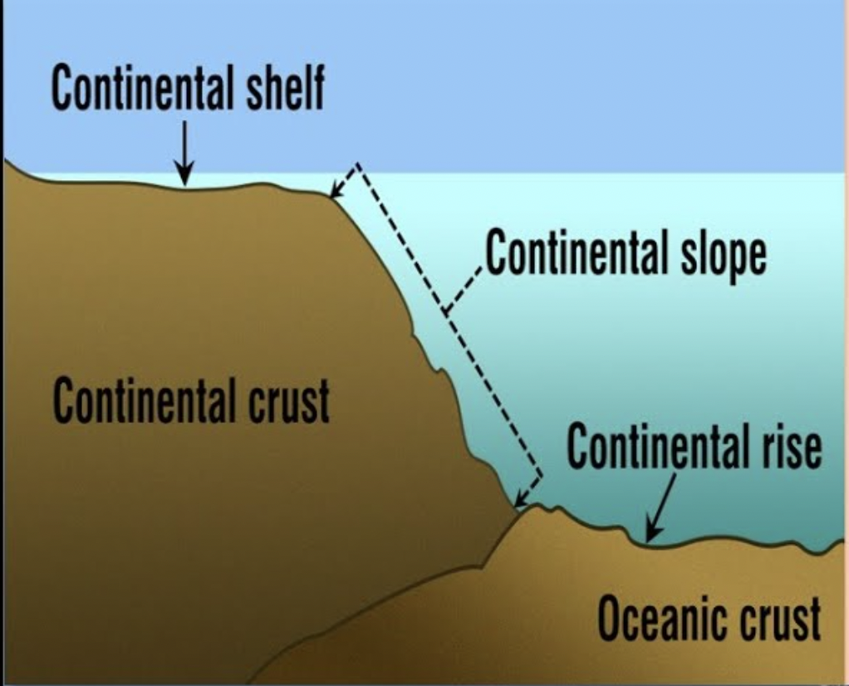
Intro
Continental Slope
Notes:
Today, we’ll be learning about the word: Continental Slope.

Slide 3
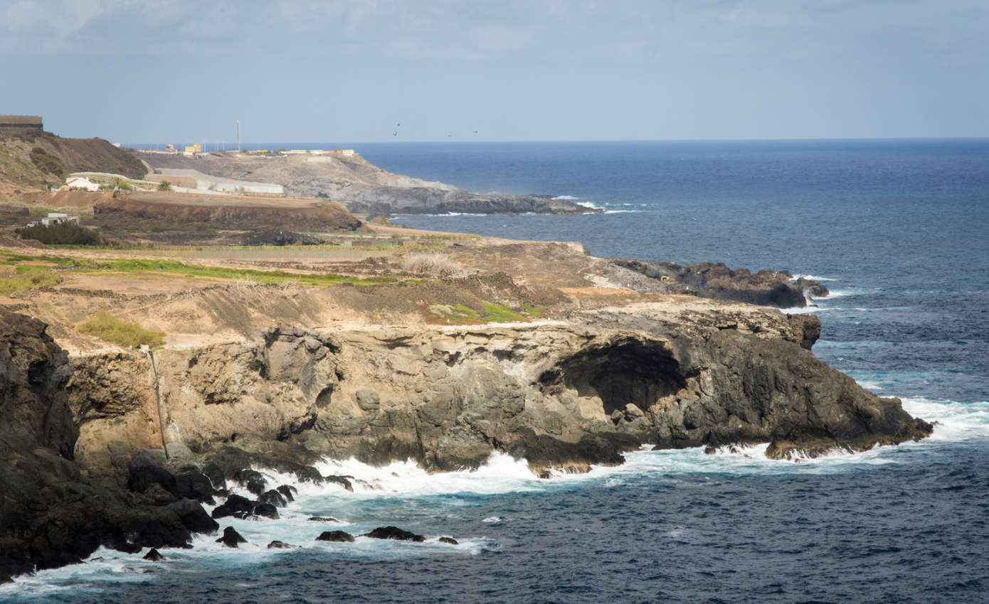
Big Question: How does the continental slope in the ocean affect the animals and resources we rely on every day?
Notes:
Our “big question” is: How does the continental slope in the ocean affect the animals and resources we rely on every day?
[Pause and illicit predictions from students.]
I love all these thoughtful scientific hypotheses! Be sure to keep this question and your predictions in mind as we move through these next few lessons, and we’ll continue to revisit it.

Slide 4
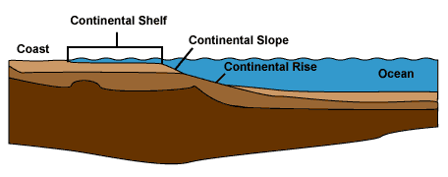
Demonstration
TEACHER DIRECTIONS:
Before viewing: Ask students what they already know about continental slopes. Tell students today they will be learning about continental slopes.
During: Discuss with students how the steep slope influences the underwater landscape and provides habitats for marine life.
After: Tell students that today they will be learning more about continental slopes.
Notes:
Materials needed:
Large, shallow container (representing the ocean floor)
Sand or soil
Water
Small toy figures or marine animal toys
Procedure:
Fill the large container with water to create an "ocean floor."
Gradually build up one side of the container with sand or soil, creating a slope to represent the continental slope.
Introduce small toy figures or marine animal toys on the slope to represent ocean creatures.
Pour water gently down the slope, simulating ocean currents and emphasizing how water moves along the continental slope.
Discuss with students how the steep slope influences the underwater landscape and provides habitats for marine life.
This hands-on demonstration helps students visualize the continental slope, understand its significance for ocean currents and marine habitats, and allows for interactive discussions in the classroom.

Slide 5
Notes:
Before we move on to our new topic, let’s review some other words & concepts that you already learned and make sure you are firm in your understanding.

Slide 6
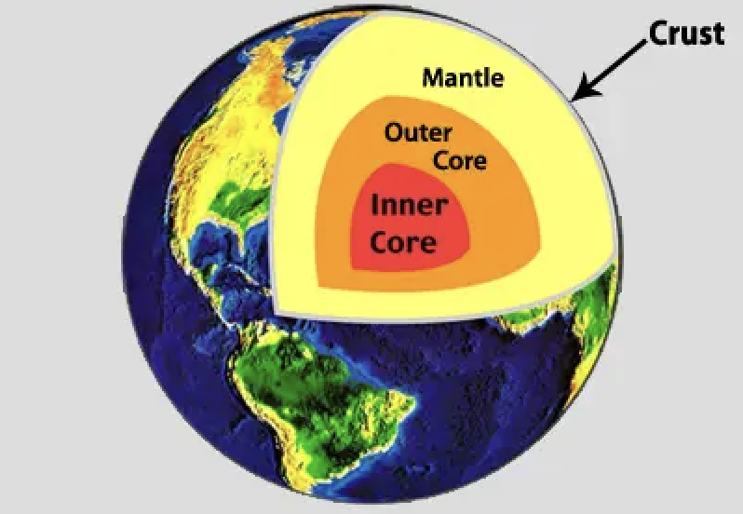
Crust: The outermost shell of the Earth
Notes:
Crust is the outermost shell of the Earth

Slide 7
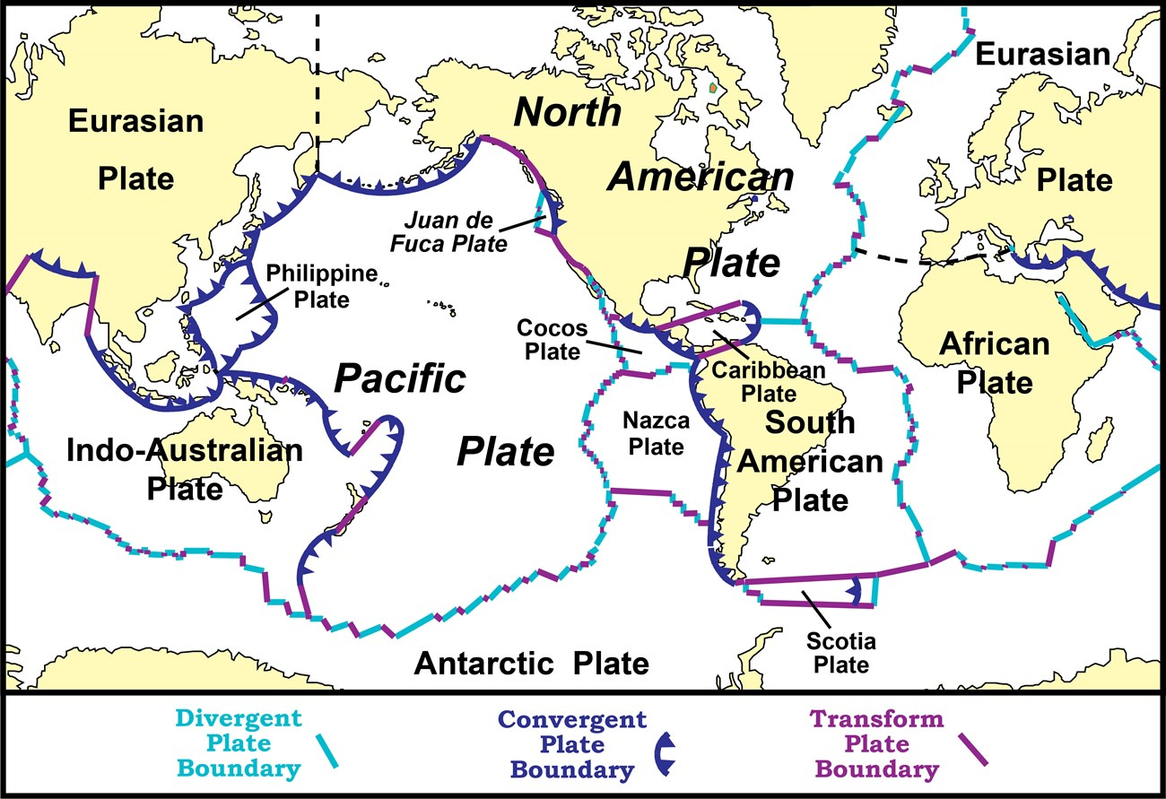
Tectonic Plates: Huge pieces of the Earth's surface that fit together like a puzzle and move very slowly over time
Notes:
Tectonic plates are huge pieces of the Earth’s surface that fit together like a puzzle an d move very slowly over time.

Slide 8
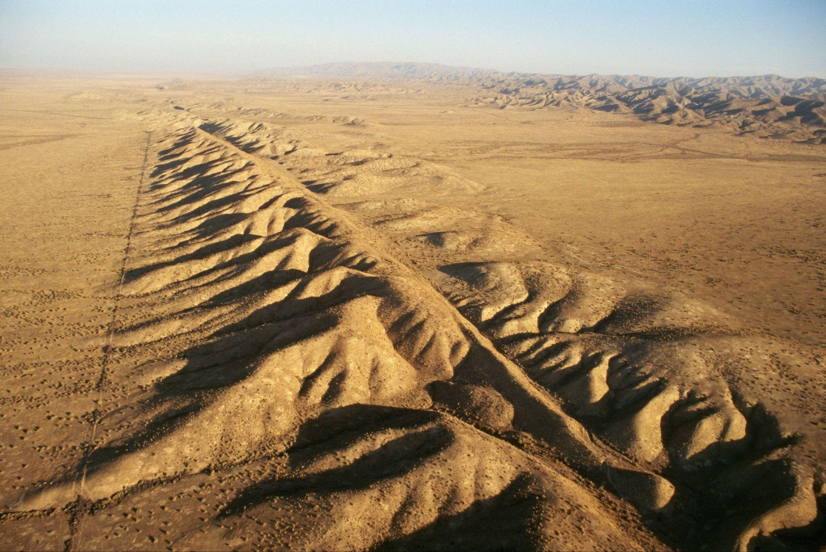
Fault: Long crack in the surface of the Earth
Notes:
A fault is a long crack in the surface of the Earth.

Slide 9
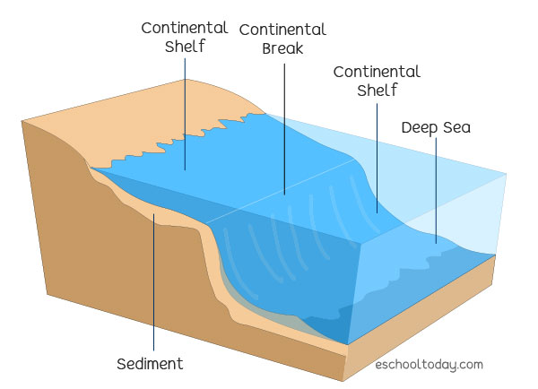
Continental Shelf: The edge of a continent that is underwater
Notes:
A continental shelf is the edge of a continent that is underwater

Slide 10
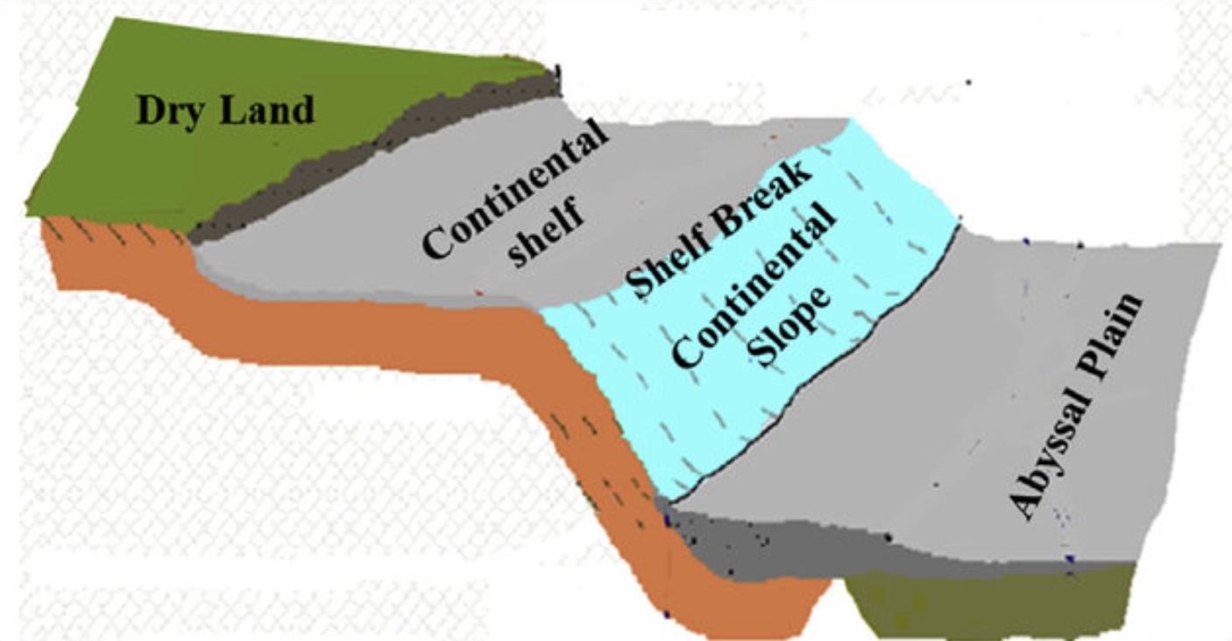
Solangi et al. (2018)
Continental Slope: a steep underwater hill that goes down from the edge of the continent into the deeper parts of the ocean
Notes:
A continental slope is a steep underwater hill that goes down from the edge of the continent into the deeper parts of the ocean
Image source: Solangi, S. H., Nazeer, A., Abbasi, S., & Zulkifil, M. M. (2019). Morphological features of continental shelf margin: Examples from the Pakistan Offshore. Geodesy and Geodynamics, 10(1), 77-91.

Slide 11
Notes:
Now let’s pause for a moment to review the information we have covered already.

Slide 12
The outermost shell of the Earth is called the…
Crust
Core
Notes:
The outermost shell of the Earth is called the…
[Crust]

Slide 13
The outermost shell of the Earth is called the…
Crust
Core
Notes:
The outermost shell of the Earth is called the…
[Crust]

Slide 14
True or False: Tectonic plates are huge pieces of the Earth's surface that fit together like a puzzle and move very slowly over time.
Notes:
True or False: Huge pieces of the Earth's surface that fit together like a puzzle and move very slowly over time.
[True]

Slide 15
True or False: Tectonic plates are huge pieces of the Earth's surface that fit together like a puzzle and move very slowly over time.
Notes:
True or False: Huge pieces of the Earth's surface that fit together like a puzzle and move very slowly over time.
[True]

Slide 16
A _____ is a long _____ in the surface of the Earth.
fault, crack
crack, fault
Notes:
A _____ is a long _____ in the surface of the Earth.
[fault, crack]

Slide 17
A _____ is a long _____ in the surface of the Earth.
fault, crack
crack, fault
Notes:
A _____ is a long _____ in the surface of the Earth.
[fault, crack]

Slide 18
Continental Shelf: The of a continent that is underwater
Notes:
A continental shelf is the of a continent that is underwater
[edge]

Slide 19
Continental Shelf: The edge of a continent that is underwater
Notes:
A continental shelf is the edge of a continent that is underwater

Slide 20
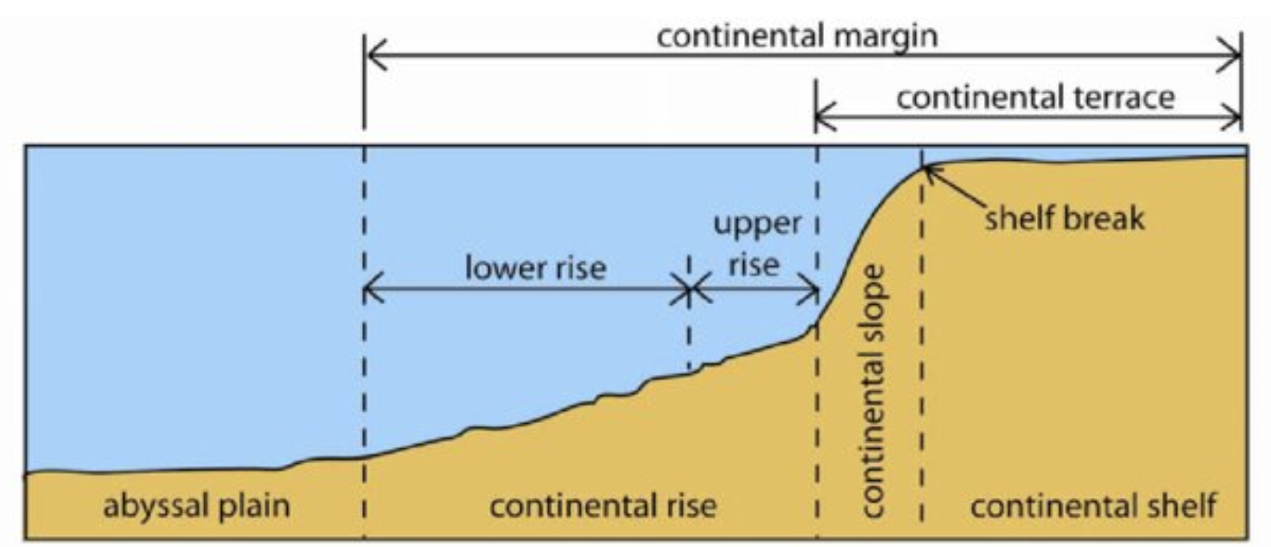
Woo (2005)
Continental Rise: a gentle slope at the ocean's bottom where and collect
Notes:
A continental rise is a gentle slope at the ocean's bottom where and collect, linking the steeper continental slope to the flat ocean floor
[sand, mud]
Image source: Woo, L. M. (2005). Summer circulation and water masses along the West Australian coast (Doctoral dissertation, University of Western Australia).
Chicago

Slide 21
Woo (2005)
Continental Rise: a gentle slope at the ocean's bottom where sand and mud collect
Notes:
A continental rise is a gentle slope at the ocean's bottom where sand and mud collect, linking the steeper continental slope to the flat ocean floor
Image source: Woo, L. M. (2005). Summer circulation and water masses along the West Australian coast (Doctoral dissertation, University of Western Australia).
Chicago

Slide 22
Continental Slope
Notes:
Now that we’ve reviewed, let’s define the phrase continental slope.

Slide 23
Solangi et al. (2018)
Continental Slope: a steep underwater hill that goes down from the edge of the continent into the deeper parts of the ocean
Notes:
A continental slope is a steep underwater hill that goes down from the edge of the continent into the deeper parts of the ocean
Image source: Solangi, S. H., Nazeer, A., Abbasi, S., & Zulkifil, M. M. (2019). Morphological features of continental shelf margin: Examples from the Pakistan Offshore. Geodesy and Geodynamics, 10(1), 77-91.

Slide 24
Notes:
Let’s check-in for understanding.

Slide 25
Solangi et al. (2018)
What is a continental slope?
Notes:
A continental slope is a steep underwater hill that goes down from the edge of the continent into the deeper parts of the ocean
Image source: Solangi, S. H., Nazeer, A., Abbasi, S., & Zulkifil, M. M. (2019). Morphological features of continental shelf margin: Examples from the Pakistan Offshore. Geodesy and Geodynamics, 10(1), 77-91.

Slide 26
Notes:
That is the basic definition, but there is a bit more you need to know.

Slide 27
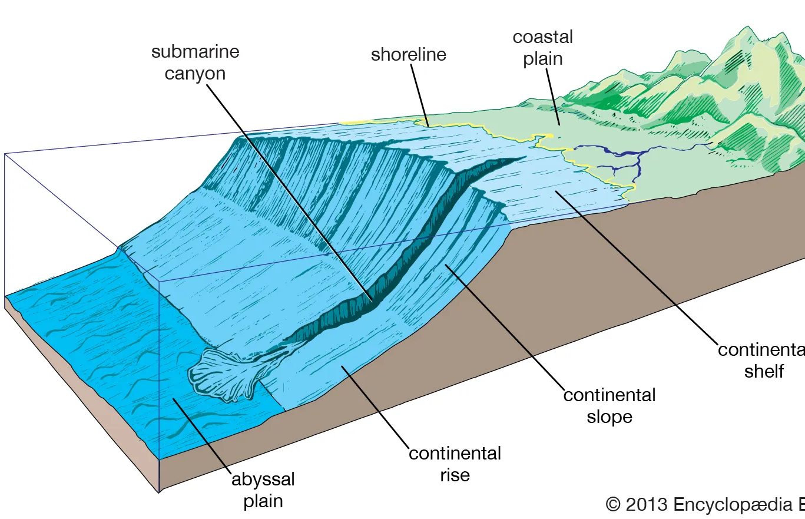
The continental slope marks the boundary between the shallow waters near the shore and the much deeper ocean floor.
Notes:
The continental slope marks the boundary between the shallow waters near the shore and the much deeper ocean floor.

Slide 28
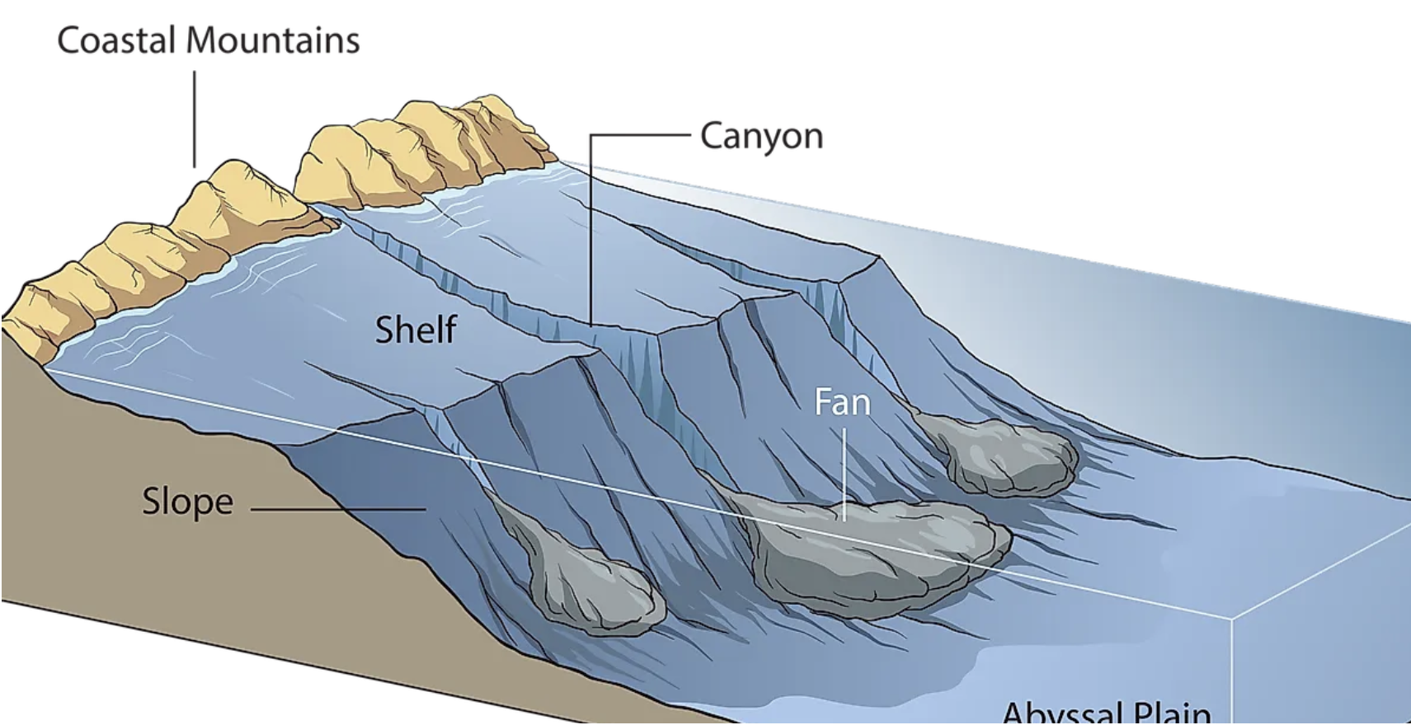
As you descend down this underwater hill, the ocean gets darker, and the pressure increases. The continental slope isn't just steep; it's a transition zone where the ocean floor drops off dramatically, revealing the hidden wonders below.
Notes:
As you descend down this underwater hill, the ocean gets darker, and the pressure increases. The continental slope isn't just steep; it's a transition zone where the ocean floor drops off dramatically, revealing the hidden wonders below.
Image Source: https://www.worldatlas.com/oceans/what-are-continental-shelves.html

Slide 29
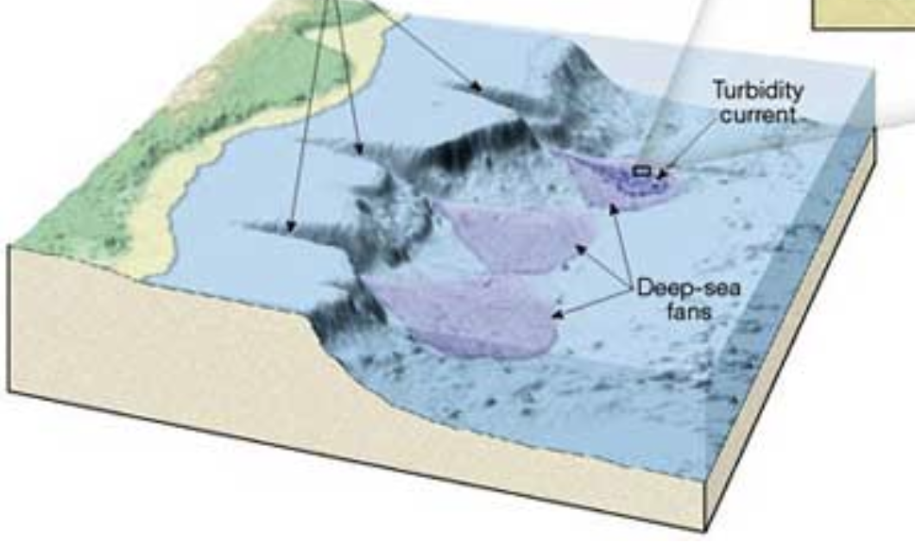
This area is also a busy highway for ocean currents, as water moves from the shallower coastal regions to the deeper ocean. These currents are like underwater rivers that flow along the slope, connecting different parts of the ocean. It's a superhighway for water, transporting warmth and nutrients to various regions.
Notes:
This area is also a busy highway for ocean currents, as water moves from the shallower coastal regions to the deeper ocean. These currents are like underwater rivers that flow along the slope, connecting different parts of the ocean. It's a superhighway for water, transporting warmth and nutrients to various regions.
Image Source: https://geographyoftheoceanfloor.weebly.com/continental-slope.html

Slide 30
Notes:
Let’s check-in for understanding.

Slide 31
True or False: The continental slope marks the boundary between the shallow waters near the shore and the much deeper ocean floor.
Notes:
True or False: The continental slope marks the boundary between the shallow waters near the shore and the much deeper ocean floor.
[True]

Slide 32
True or False: The continental slope marks the boundary between the shallow waters near the shore and the much deeper ocean floor.
Notes:
True: The continental slope marks the boundary between the shallow waters near the shore and the much deeper ocean floor.

Slide 33
The continental slope is a transition zone where the ocean floor off dramatically, revealing the hidden wonders below.
Notes:
As you descend down this underwater hill, the ocean gets darker, and the pressure increases. The continental slope isn't just steep; it's a transition zone where the ocean floor off dramatically, revealing the hidden wonders below.
[drops]
Image Source: https://www.worldatlas.com/oceans/what-are-continental-shelves.html

Slide 34
The continental slope is a transition zone where the ocean floor drops off dramatically, revealing the hidden wonders below.
Notes:
As you descend down this underwater hill, the ocean gets darker, and the pressure increases. The continental slope isn't just steep; it's a transition zone where the ocean floor drops off dramatically, revealing the hidden wonders below.
Image Source: https://www.worldatlas.com/oceans/what-are-continental-shelves.html

Slide 35
Notes:
Now, let’s talk about some examples of a continental shelf.

Slide 36
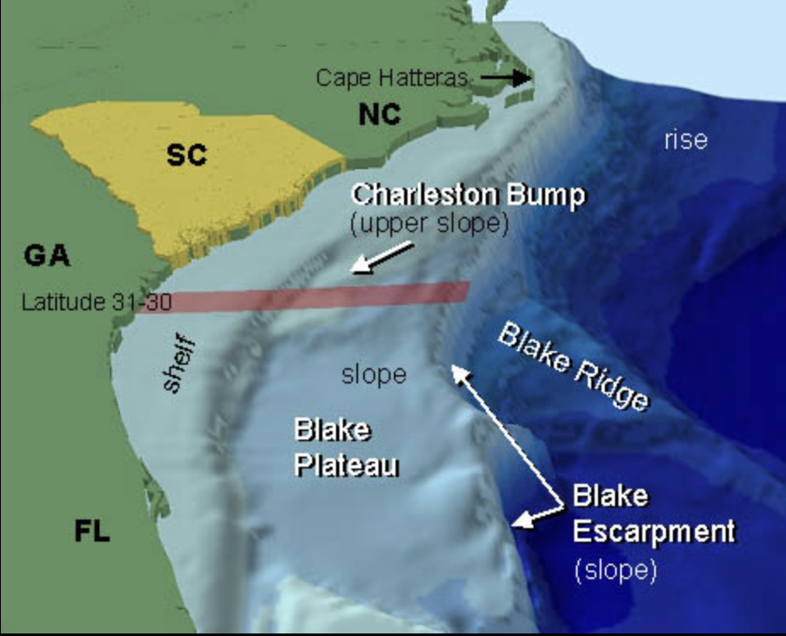
The Blake Plateau is an example of a continental slope. It is located off the southeastern United States.
Notes:
The Blake Plateau is an example of a continental slope. It is located off the southeastern United States.
Image Source: National Oceanic and Atmospheric Administration (NOAA)

Slide 37
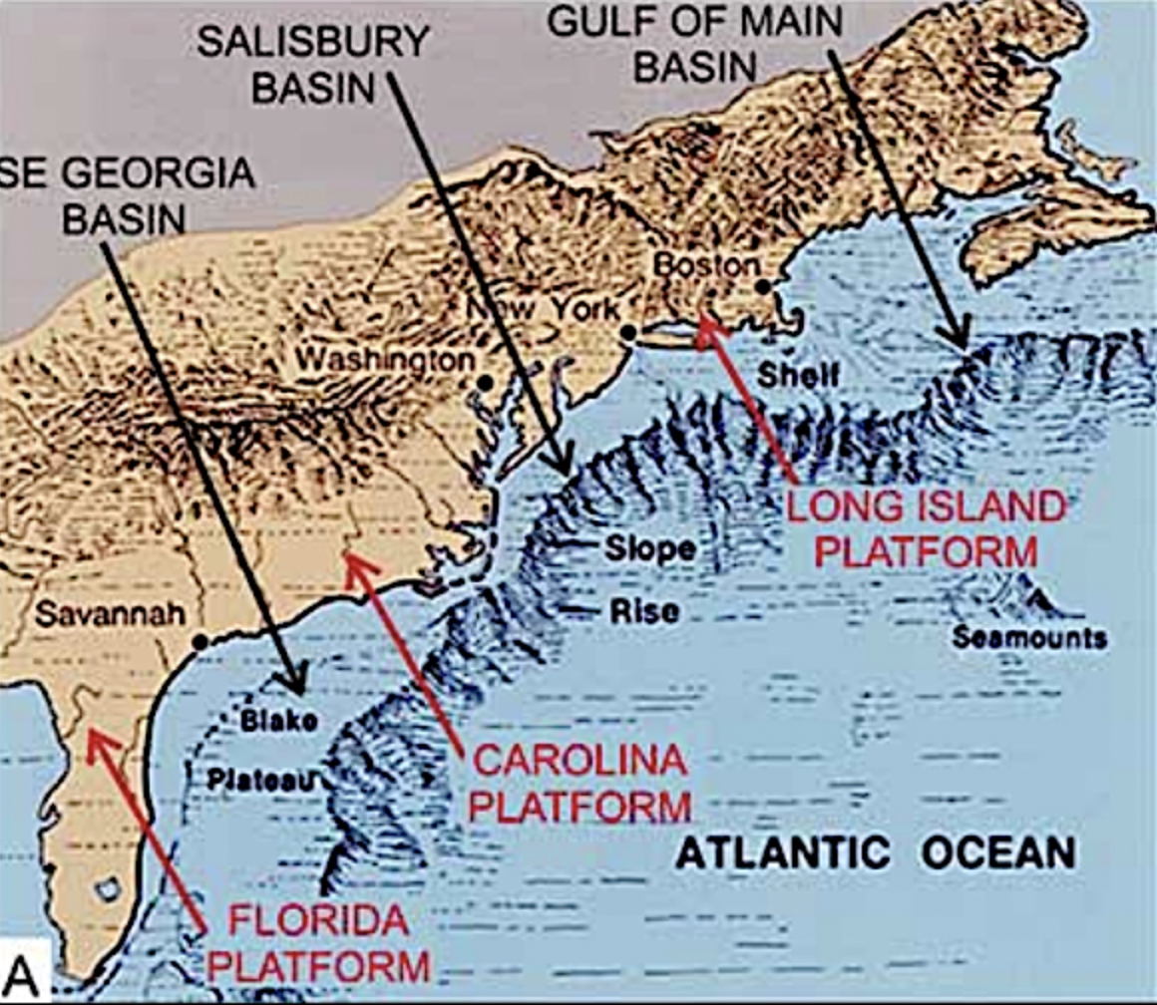
Another example is the continental slope in the Atlantic Ocean. This is the largest continental slope among all the world’s oceans.
Notes:
Another example is the continental slope in the Atlantic Ocean. This is the largest continental slope among all the world’s oceans.
Image Source: http://www.virginiaplaces.org/boundaries/ocs.html

Slide 38
Notes:
Now, let’s talk about some non-examples of continental shelf.

Slide 39
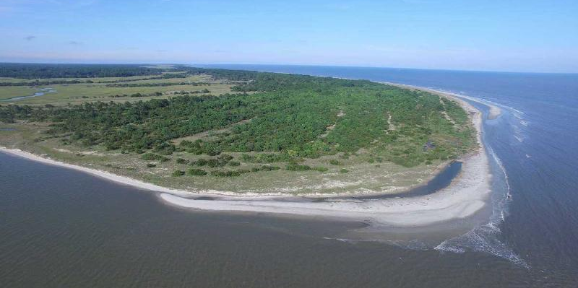
The Georgia Continental Shelf is NOT an example of a continental slope. It is a continental shelf which is the edge of a continent that is underwater.
Notes:
The Georgia Continental Shelf is NOT an example of a continental slope. It is a continental shelf which is the edge of a continent that is underwater.

Slide 40
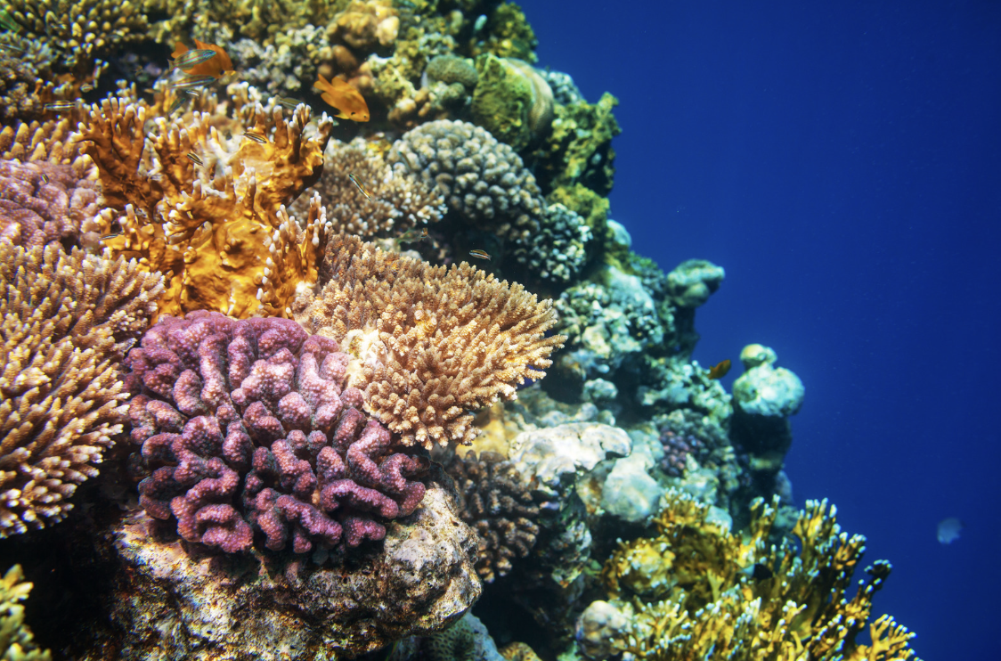
A coral reef is NOT an example of a continental slope. Coral reefs are diverse underwater ecosystems made up of coral polyps and other marine organisms. Coral reefs grow on rocky or sandy substrates on the continental shelf but are distinct features within the marine environment.
Notes:
A coral reef is NOT an example of a continental slope. Coral reefs are diverse underwater ecosystems made up of coral polyps and other marine organisms. Coral reefs grow on rocky or sandy substrates on the continental shelf but are distinct features within the marine environment.

Slide 41
Notes:
Now let’s pause for a moment to check your understanding.

Slide 42
Why are coral reefs and the Georgia Continental Shelf not examples of a continental rise?
Notes:
Why are coral reefs and the Georgia Continental Shelf not examples of a continental rise?
[Coral reefs are underwater ecosystems composed of living coral polyps and the structures they create over time and the Georgia Continental Shelf is a continental shelf which is the edge of a continent that is underwater. While a continental slope a steep underwater hill that goes down from the edge of the continent into the deeper parts of the ocean]

Slide 43
Remember!!!
Notes:
So remember!

Slide 44
Solangi et al. (2018)
Continental Slope: a steep underwater hill that goes down from the edge of the continent into the deeper parts of the ocean
Notes:
A continental slope is a steep underwater hill that goes down from the edge of the continent into the deeper parts of the ocean
Image source: Solangi, S. H., Nazeer, A., Abbasi, S., & Zulkifil, M. M. (2019). Morphological features of continental shelf margin: Examples from the Pakistan Offshore. Geodesy and Geodynamics, 10(1), 77-91.

Slide 45
Notes:
We will now complete this concept map, called a Frayer model, to summarize and further clarify what you have learned about the term continental rise.

Slide 46
Definition
Picture
Continental Slope
Example
How do continental slopes impact my life?
Notes:
To complete the Frayer model, we will choose from four choices the correct picture, definition, example, and response to the question, “How do continental slopes impact my life?” Select the best response for each question using the information you just learned. As we select responses, we will see how this model looks filled in for the term continental slope.

Slide 47
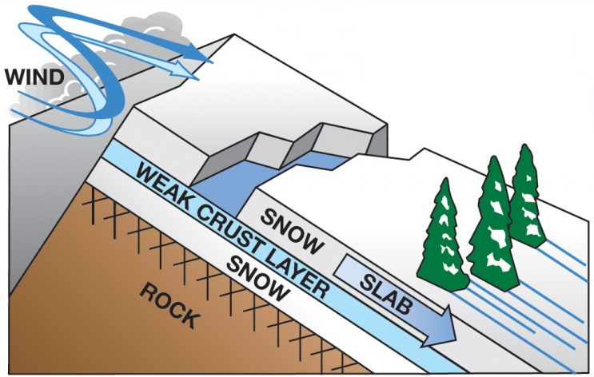
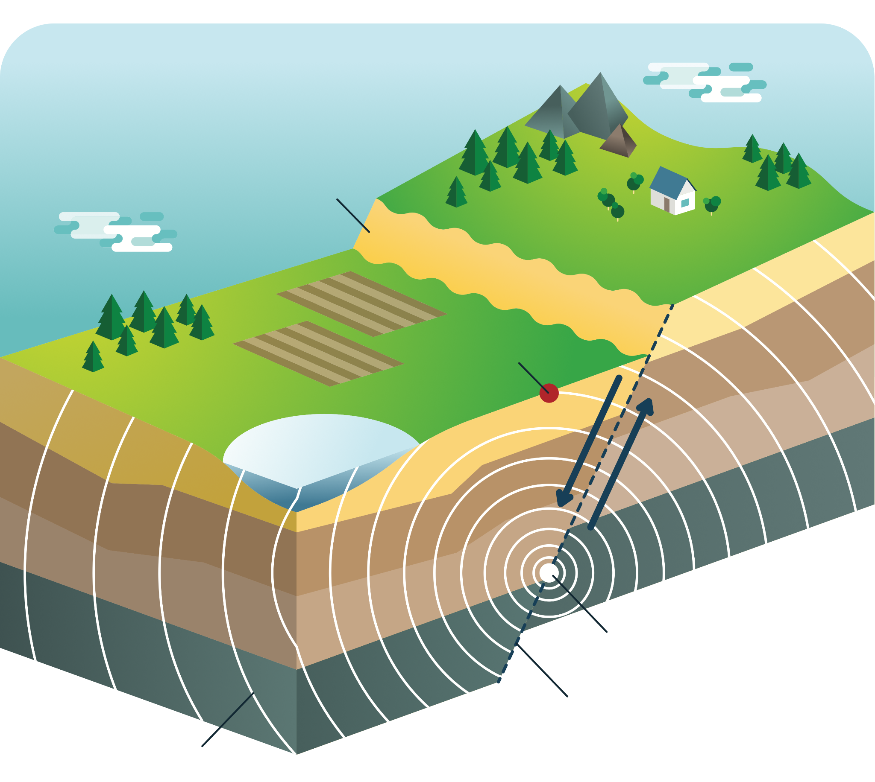
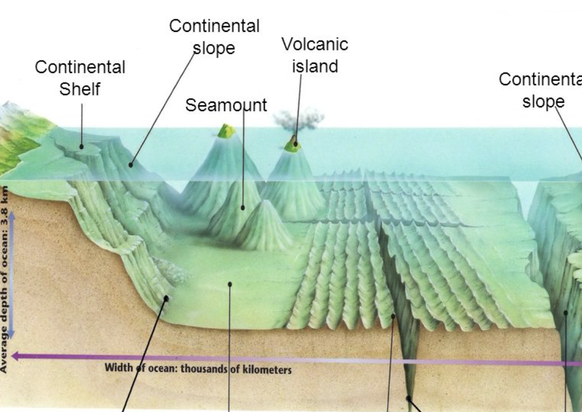
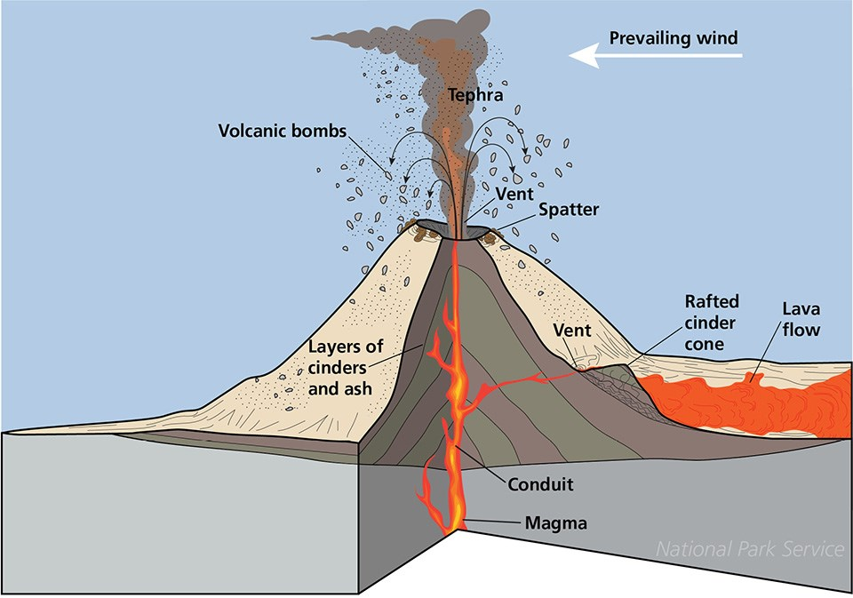
Directions: Choose the correct picture of an continental slope from the choices below.
A
B
C
D
Notes:
Choose the one correct picture of a continental slope from these four choices.

Slide 48
Directions: Choose the correct picture of an continental slope from the choices below.
A
B
C
D
Notes:
This is the picture that shows a continental slope.

Slide 49
Definition
Picture
Continental Slope
Example
How do continental slopes impact my life?
Notes:
Here is the Frayer model filled in with a picture of a continental slope.

Slide 50
Directions: Choose the correct definition of a continental slope from the choices below.
A
A steep underwater hill that goes down from the edge of the continent into the deeper parts of the ocean
B
The edge of a continent that is underwater
C
A gentle slope at the ocean's bottom where sand and mud collect
D
Deep, steep-sided valleys carved into the seafloor by erosion.
Notes:
Choose the correct definition of a continental slope from the choices below.

Slide 51
Directions: Choose the correct definition of a continental slope from the choices below.
A
A steep underwater hill that goes down from the edge of the continent into the deeper parts of the ocean
B
The edge of a continent that is underwater
C
A gentle slope at the ocean's bottom where sand and mud collect
D
Deep, steep-sided valleys carved into the seafloor by erosion.
Notes:
“A steep underwater hill that goes down from the edge of the continent into the deeper parts of the oceant” is correct! This is the definition of a continental slope.

Slide 52
Definition
Picture
A steep underwater hill that goes down from the edge of the continent into the deeper parts of the ocean
Continental Slope
Example
How do continental slopes impact my life?
Notes:
Here is the Frayer Model with a picture and the definition filled in for a continental slope: A steep underwater hill that goes down from the edge of the continent into the deeper parts of the ocean.

Slide 53
Directions: Choose the correct example of a continental slope from the choices below.
A
Snow sliding down a plane
B
North Sea Continental Shelf
C
The Blake Plateau
D
The Amazon Cone
Notes:
Choose the correct example of a continental slope from the choices below.

Slide 54
Directions: Choose the correct example of a continental slope from the choices below.
A
Snow sliding down a plane
B
North Sea Continental Shelf
C
The Blake Plateau
D
The Amazon Cone
Notes:
“The Blake Plateau” is correct! This is an example of a continental slope.

Slide 55
Definition
Picture
A steep underwater hill that goes down from the edge of the continent into the deeper parts of the ocean
Continental Slope
The Blake Plateau
Example
How do continental slopes impact my life?
Notes:
Here is the Frayer Model with a picture, definition, and an example of a continental slope: The Blake Plateau

Slide 56
Directions: Choose the correct response for “How do continental slopes impact my life?” from the choices below.
A
Continental slopes help protect the coast from big waves, making beaches safer for activities like swimming and playing.
B
Continental slopes play a big role in ocean currents and create homes for many sea creatures, which impacts the seafood we have and keeps the ocean healthy.
C
Continental slopes explain how movement of animals on our planet impacts food and crops we have available to us.
Continental rises create different trenches and ranges in the ocean which influences weather patterns on Earth.
D
Notes:
Choose the one correct response for “how do continental slopes impact my life?” from these four choices.

Slide 57
Directions: Choose the correct response for “How do continental slopes impact my life?” from the choices below.
A
Continental slopes help protect the coast from big waves, making beaches safer for activities like swimming and playing.
B
Continental slopes play a big role in ocean currents and create homes for many sea creatures, which impacts the seafood we have and keeps the ocean healthy.
C
Continental slopes explain how movement of animals on our planet impacts food and crops we have available to us.
Continental rises create different trenches and ranges in the ocean which influences weather patterns on Earth.
D
Notes:
“Continental slopes play a big role in ocean currents and create homes for many sea creatures, which impacts the seafood we have and keeps the ocean healthy.” That is correct! This is an example of how continental slopes impacts your life.

Slide 58
Definition
Picture
A steep underwater hill that goes down from the edge of the continent into the deeper parts of the ocean
Continental Slope
Continental slopes play a big role in ocean currents and create homes for many sea creatures, which impacts the seafood we have and keeps the ocean healthy.
The Blake Plateau
Example
How do continental slopes impact my life?
Notes:
Here is the Frayer Model with a picture, definition, example, and a correct response to “how do continental slopes impact my life?”: Continental slopes play a big role in ocean currents and create homes for many sea creatures, which impacts the seafood we have and keeps the ocean healthy.

Slide 59
Remember!!!
Notes:
So remember!

Slide 60
Solangi et al. (2018)
Continental Slope: a steep underwater hill that goes down from the edge of the continent into the deeper parts of the ocean
Notes:
A continental slope is a steep underwater hill that goes down from the edge of the continent into the deeper parts of the ocean
Image source: Solangi, S. H., Nazeer, A., Abbasi, S., & Zulkifil, M. M. (2019). Morphological features of continental shelf margin: Examples from the Pakistan Offshore. Geodesy and Geodynamics, 10(1), 77-91.

Slide 61
Big Question: How does the continental slope in the ocean affect the animals and resources we rely on every day?
Notes:
Let’s reflect once more on our big question. Our “big question” is: How does the continental slope in the ocean affect the animals and resources we rely on every day?
Does anyone have any additional examples to share that haven’t been discussed yet?
I love all these thoughtful scientific hypotheses! Be sure to keep this question and your predictions in mind as we move through these next few lessons, and we’ll continue to revisit it.

Slide 62
Notes:
Thanks for watching, and please continue watching CAPs available from this website.

Slide 63
This Was Created With Resources From:
Questions or Comments
Michael Kennedy, Ph.D. MKennedy@Virginia.edu
Rachel L Kunemund, Ph.D. rk8vm@virginia.edu

