Slide 1
Intro
“Big Idea” Question
Review Concepts
Check-In Questions
Teacher Engagement
Vocabulary
Student-Friendly Definition
Examples & Non-Examples
Morphological Word Parts
Frayer Model
Simulation/Activity
Notes:
OK everyone, get ready for our next lesson. Just as a reminder, these are the different components that our lesson may include, and you’ll see these icons in the top left corner of each slide so that you can follow along more easily!

Slide 2
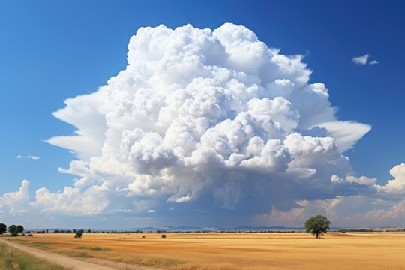
Intro
Cumulonimbus clouds
Notes:
Today, we’ll be learning about the phrase: Cumulonimbus clouds.

Slide 3
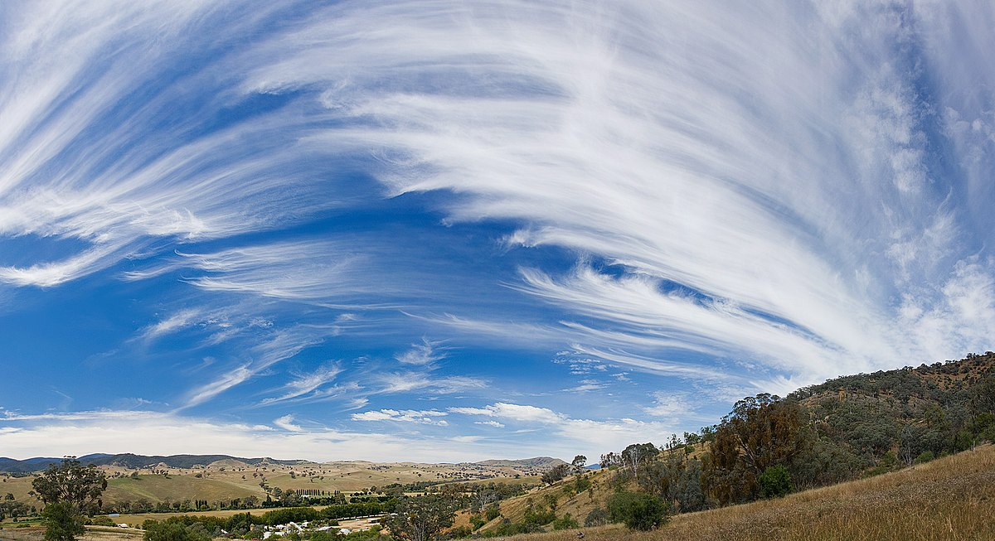
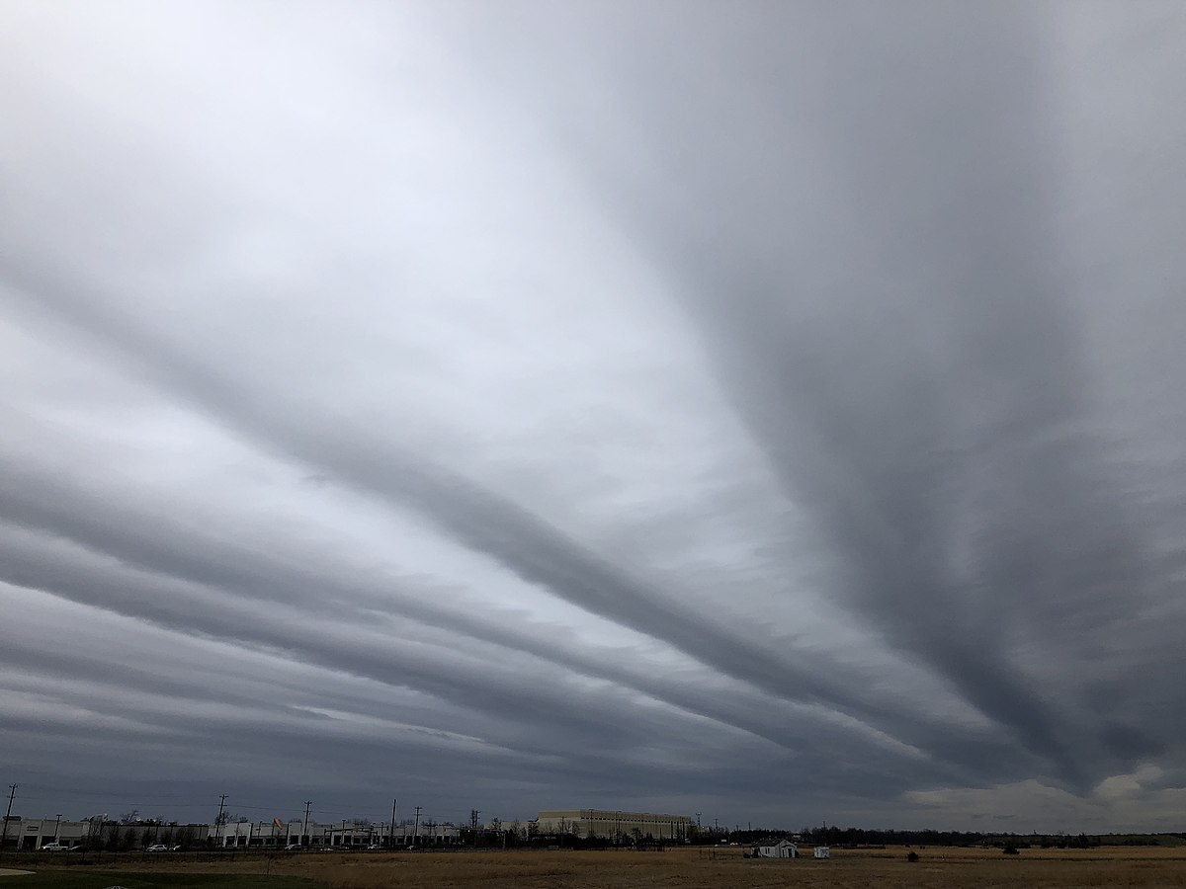
Big Question: How can I predict weather events by tracking weather conditions?
Notes:
Our “big question” is: How can I predict weather events by tracking weather conditions?
[Pause and illicit predictions from students.]
I love all these thoughtful scientific hypotheses! Be sure to keep this question and your predictions in mind as we move through these next few lessons, and we’ll continue to revisit it.

Slide 4
Notes:
Before we move on to our new topic, let’s review some other words & concepts that you already learned and make sure you are firm in your understanding.

Slide 5
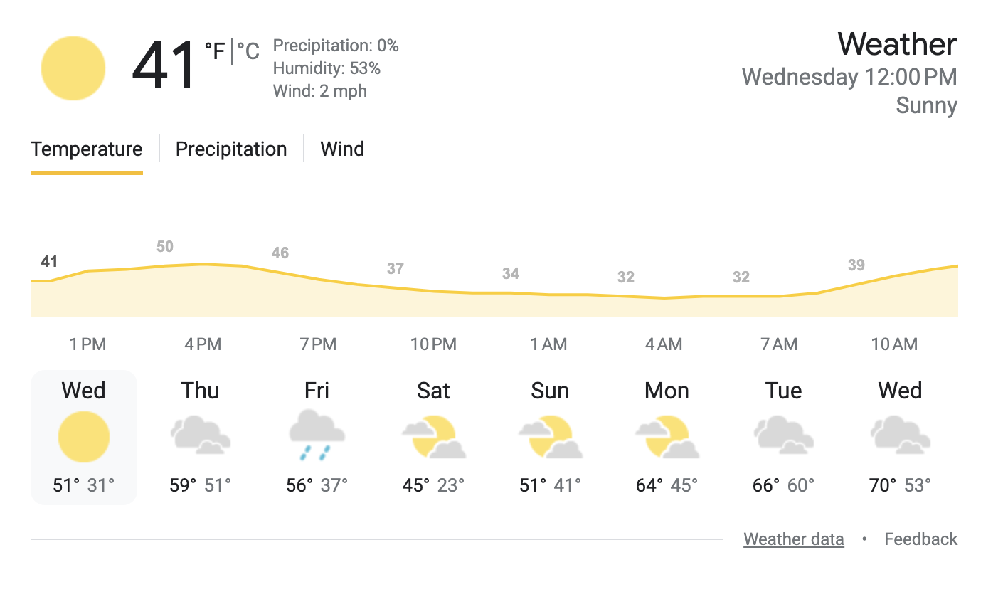
Forecast: A prediction or guess of what the weather will be
Notes:
Forecast is a prediction or guess of what the weather will be.

Slide 6
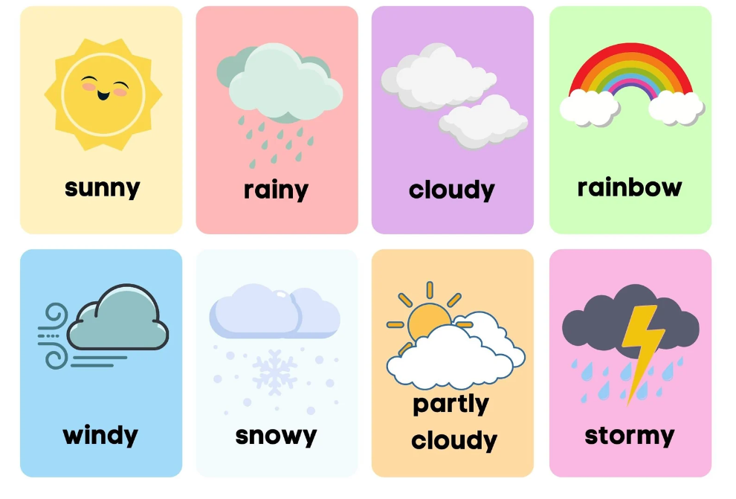
Weather: What is happening in the air outside
Notes:
Weather is what is happening in the air outside

Slide 7
Climate: The weather of a given area averaged over an extended period of time (years)
Notes:
Climate is the weather of a given area averaged over an extended period of time (years).

Slide 8
Cumulus clouds: fluffy, white clouds with flat bottoms
Notes:
Cumulus clouds are fluffy, white clouds with flat bottoms.

Slide 9
Notes:
Now let’s pause for a moment to review the information we have covered already.

Slide 10
A forecast is a _______ or guess of what the weather will be.
prediction
fact
Notes:
A forecast is a ________ or guess of what the weather will be.
[A. prediction]

Slide 11
A forecast is a _______ or guess of what the weather will be.
prediction
fact
Notes:
A forecast is a ________ or guess of what the weather will be.
[A. prediction]

Slide 12
Weather is what is happening in the air outside. What words describe the weather in the boxes below?
Notes:
Weather is what is happening in the air outside. What words describe the weather in the boxes below?
[sunny, rainy, cloudy, stormy, snowy, windy]

Slide 13
Weather is what is happening in the air outside. What words describe the weather in the boxes below?
Notes:
Weather is what is happening in the air outside. What words describe the weather in the boxes below?
[sunny, rainy, cloudy, stormy, snowy, windy]

Slide 14
True or false: Climate is the weather of a given area averaged over an extended period of time.
True
False
Notes:
True or false: Climate is the weather of a given area averaged over an extended period of time.
[True]

Slide 15
True or false: Climate is the weather of a given area averaged over an extended period of time.
True
False
Notes:
True or false: Climate is the weather of a given area averaged over an extended period of time.
[True]

Slide 16
Cumulus clouds are ______, white clouds with flat bottoms.
fluffy
wispy
Notes:
Cumulus clouds are ______, white clouds with flat bottoms.
[A. fluffy]

Slide 17
Cumulus clouds are ______, white clouds with flat bottoms.
fluffy
wispy
Notes:
Cumulus clouds are ______, white clouds with flat bottoms.
[A. fluffy]

Slide 18
Cumulonimbus clouds
Notes:
Now that we’ve reviewed, let’s define the phrase cumulonimbus clouds.

Slide 19
Cumulonimbus clouds: large, tall clouds with dark bottoms
Notes:
Cumulonimbus clouds are large, tall clouds with dark bottoms.

Slide 20
Notes:
Let’s check-in for understanding.

Slide 21
What are cumulonimbus clouds?
Notes:
What are cumulonimbus clouds?
[Large, tall clouds with dark bottoms.]

Slide 22
Notes:
That is the basic definition, but there is a bit more you need to know.

Slide 23
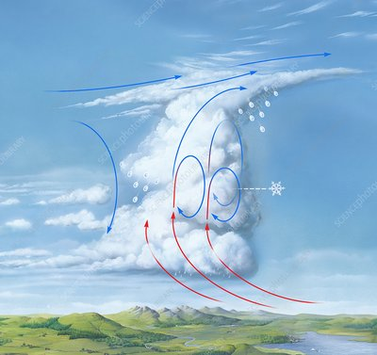
Cumulonimbus clouds form when warm, moist air rises rapidly into the atmosphere.
warm, moist air
Notes:
Cumulonimbus clouds form when warm, moist air rises rapidly into the atmosphere.

Slide 24
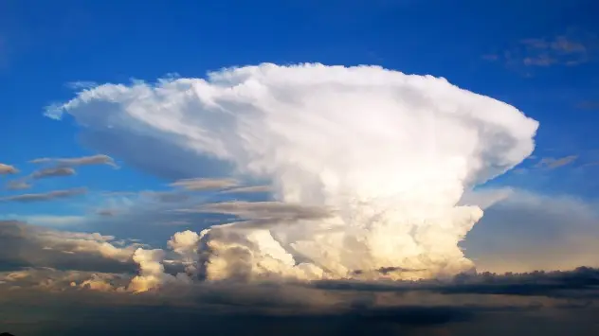
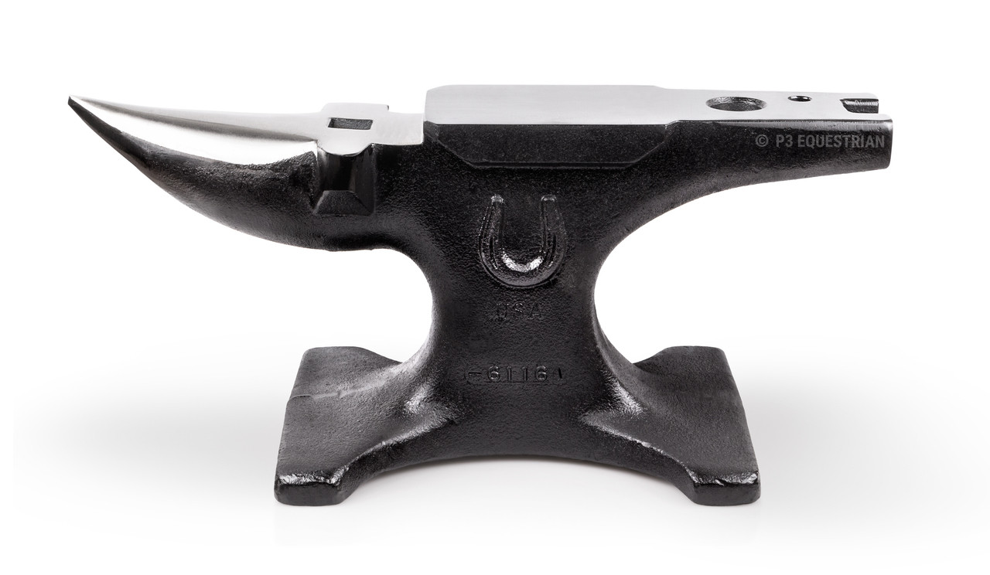
Cumulonimbus clouds often have anvil-shaped tops that form when the upper part of the cloud spreads out horizontally.
anvil-shaped top
Notes:
Cumulonimbus clouds often have anvil-shaped tops that form when the upper part of the cloud spreads out horizontally.

Slide 25
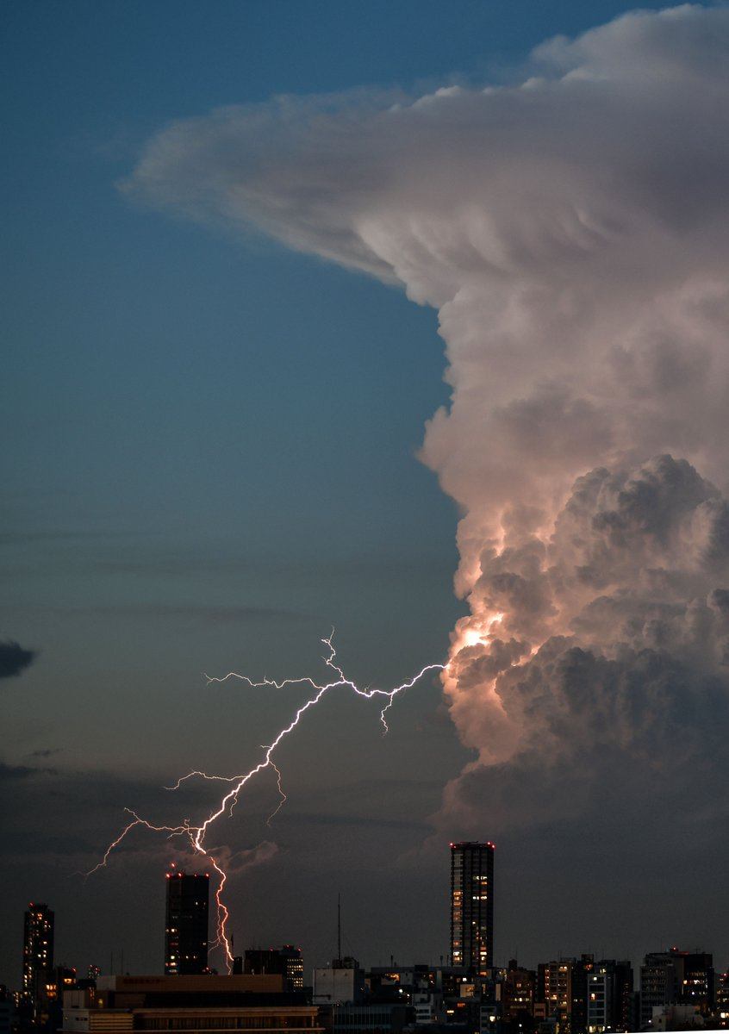
Cumulonimbus clouds usually indicate stormy weather. These storms could be severe.
Notes:
Cumulonimbus clouds usually indicate stormy weather. These storms could be severe.

Slide 26
Notes:
Let’s check-in for understanding.

Slide 27
Cumulonimbus clouds form when _______ air rises rapidly into the atmosphere.
cool, dry
warm, moist
Notes:
Cumulonimbus clouds form when _______ air rises rapidly into the atmosphere.
[B. warm, moist]

Slide 28
Cumulonimbus clouds form when _______ air rises rapidly into the atmosphere.
cool, dry
warm, moist
warm, moist
Notes:
Cumulonimbus clouds form when _______ air rises rapidly into the atmosphere.
[B. warm, moist]

Slide 29
True or false: Cumulonimbus clouds often have anvil-shaped tops that form when the upper part of the cloud spreads out horizontally.
True
False
Notes:
True or false: Cumulonimbus clouds often have anvil-shaped tops that form when the upper part of the cloud spreads out horizontally.
[A. True]

Slide 30
True or false: Cumulonimbus clouds often have anvil-shaped tops that form when the upper part of the cloud spreads out horizontally.
True
False
anvil-shaped top
Notes:
True or false: Cumulonimbus clouds often have anvil-shaped tops that form when the upper part of the cloud spreads out horizontally.
[A. True]

Slide 31
True or false: Cumulonimbus clouds usually indicate nice weather.
True
False
Notes:
True or false: Cumulonimbus clouds usually indicate nice weather.
[B. False]

Slide 32
True or false: Cumulonimbus clouds usually indicate stormy weather.
True
False
Notes:
True or false: Cumulonimbus clouds usually indicate nice weather.
[B. False]

Slide 33
Notes:
Now, let’s talk about some examples of cumulonimbus clouds.

Slide 34
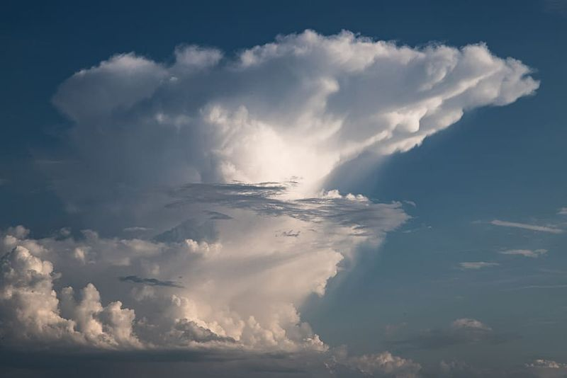
This is an example of a cumulonimbus cloud. It is a large, tall cloud with a dark bottom.
Notes:
This is an example of a cumulonimbus cloud. It is a large, tall cloud with a dark bottom.

Slide 35
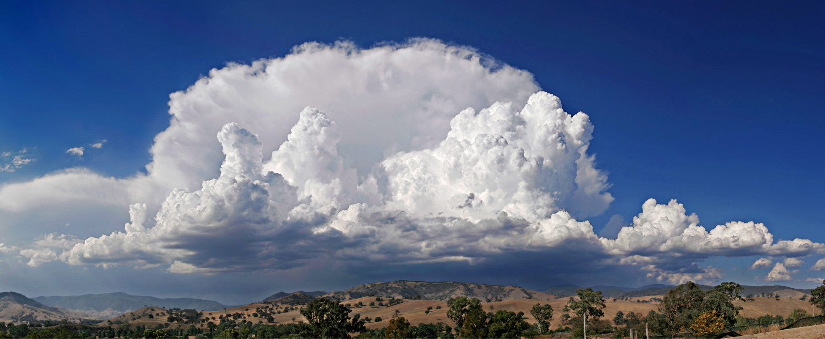
This is also an example of a cumulonimbus cloud. It is a large, tall cloud with a dark bottom.
Notes:
This is also an example of a cumulonimbus cloud. It is a large, tall cloud with a dark bottom.

Slide 36
Notes:
Now, let’s talk about some non-examples of cumulonimbus clouds.

Slide 37
These are not cumulonimbus clouds. They are not large, tall clouds with a dark bottom.
Notes:
These are not cumulonimbus clouds. They are not large, tall clouds with a dark bottom.

Slide 38
These are also not cumulonimbus clouds. They are not large, tall clouds with a dark bottom.
Notes:
These are also not cumulonimbus clouds. They are not large, tall clouds with a dark bottom.

Slide 39
Notes:
Now let’s pause for a moment to check your understanding.

Slide 40
Which picture shows cumulonimbus clouds?
Notes:
Which picture shows cumulonimbus clouds?
[The right picture.]

Slide 41
Which picture shows cumulonimbus clouds?
Notes:
Which picture shows cumulonimbus clouds?
[The right picture.]

Slide 42
Notes:
We can also break down the term cumulonimbus into different word parts to help us remember the meaning. Let’s take a look!

Slide 43
Cumulonimbus
(prefix)
(suffix)
Notes:
We can break up the term cumulonimbus into two parts: a prefix and a suffix.

Slide 44
Cumulonimbus
Cumulo nimbus
mass
Notes:
The prefix, cumulo, means mass.

Slide 45
Cumulonimbus
Cumulo nimbus
rain
Notes:
The suffix, nimbus, means rain.

Slide 46
Cumulo nimbus
Cumulonimbus
Mass of rain
Notes:
Cumulonimbus means a mass of rain.

Slide 47
Notes:
Let’s check-in for understanding.

Slide 48
How can we use the word parts of cumulonimbus to help us remember the definition of the term?
Cumulonimbus
Cumulo nimbus
Notes:
How can we use the word parts of cumulonimbus to help us remember the definition of the term?
[Cumulo = mass
Nimbus = rain
Cumulonimbus means a mass of rain.]

Slide 49
Remember!!!
Notes:
So remember!

Slide 50
Cumulonimbus clouds: large, tall clouds with dark bottoms
Cumulonimbus clouds: large, tall clouds with dark bottoms
Notes:
Cumulonimbus clouds are large, tall clouds with dark bottoms.

Slide 51
Notes:
We will now complete this concept map, called a Frayer model, to summarize and further clarify what you have learned about the term cumulonimbus clouds.

Slide 52
Definition
Picture
Cumulonimbus
clouds
How do cumulonimbus
clouds impact my life?
Example
Notes:
To complete the Frayer model, we will choose from four choices the correct picture, definition, example, and response to the question, “How do cumulonimbus clouds impact my life?” Select the best response for each question using the information you just learned. As we select responses, we will see how this model looks filled in for the term cumulonimbus clouds.

Slide 53
Directions: Choose the correct picture of cumulonimbus clouds from the choices below.
A
B
C
D
Notes:
Choose the correct picture of cumulonimbus clouds from the choices below.

Slide 54
Directions: Choose the correct picture of cumulonimbus clouds from the choices below.
A
B
C
D
Notes:
Choose the correct picture of cumulonimbus clouds from the choices below.

Slide 55
Definition
Picture
Cumulonimbus
clouds
How do cumulonimbus
clouds impact my life?
Example
Notes:
Here is the Frayer model filled in with a picture of cumulonimbus clouds.

Slide 56
Directions: Choose the correct definition of cumulonimbus clouds from the choices below.
A
Large, tall clouds with dark bottoms
B
High, feathery clouds
C
Fluffy, white clouds with flat bottoms
D
Smooth, gray clouds that cover the whole sky
Notes:
Choose the correct definition of cumulonimbus clouds from the choices below.

Slide 57
Directions: Choose the correct definition of cumulonimbus clouds from the choices below.
A
Large, tall clouds with dark bottoms
B
High, feathery clouds
C
Fluffy, white clouds with flat bottoms
D
Smooth, gray clouds that cover the whole sky
Notes:
Choose the correct definition of cumulonimbus clouds from the choices below.
[A. Large, tall clouds with dark bottoms.]

Slide 58
Definition
Picture
Large, tall clouds with dark bottoms
Cumulonimbus
clouds
How do cumulonimbus
clouds impact my life?
Example
Notes:
Here is the Frayer Model with a picture and the definition filled in for cumulonimbus clouds: Large, tall clouds with dark bottoms.

Slide 59
Directions: Choose the correct example of cumulonimbus clouds from the choices below.
A
Small clouds that look like cotton balls
B
Large clouds that look stormy
C
Clouds high in the sky that look wispy
D
Clouds that looks like a big gray blanket across the sky
Notes:
Choose the correct example of cumulonimbus clouds from the choices below.

Slide 60
Directions: Choose the correct example of cumulonimbus clouds from the choices below.
A
Small clouds that look like cotton balls
B
Large clouds that look stormy
C
Clouds high in the sky that look wispy
D
Clouds that looks like a big gray blanket across the sky
Notes:
“Large clouds that look stormy” is correct! This is an example of cumulonimbus clouds.

Slide 61
Definition
Picture
Large, tall clouds with dark bottoms
Cumulonimbus
clouds
Large clouds that look stormy
How do cumulonimbus
clouds impact my life?
Example
Notes:
Here is the Frayer Model with a picture, definition, and an example of cumulonimbus clouds: Large clouds that look stormy.

Slide 62
Directions: Choose the correct response for “How do cumulonimbus clouds impact my life?” from the choices below.
A
Cumulonimbus clouds tell me to look out for a severe storm.
B
Cumulonimbus clouds tell me to expect some snow.
C
Cumulonimbus clouds tell me that I might not see the sun today.
D
Cumulonimbus clouds tell me that it is going to be nice outside.
Notes:
Choose the one correct response for “how do cumulonimbus clouds impact my life?” from these four choices.

Slide 63
Directions: Choose the correct response for “How do cumulonimbus clouds impact my life?” from the choices below.
A
Cumulonimbus clouds tell me to look out for a severe storm.
B
Cumulonimbus clouds tell me to expect some snow.
C
Cumulonimbus clouds tell me that I might not see the sun today.
D
Cumulonimbus clouds tell me that it is going to be nice outside.
Notes:
“Cumulonimbus clouds tell me to look out for a severe storm.” That is correct! This is an example of how cumulonimbus clouds impact your life.

Slide 64
Definition
Picture
Large, tall clouds with dark bottoms
Cumulonimbus
clouds
Large clouds that look stormy
Cumulonimbus clouds tell me to look out for a severe storm.
How do cumulonimbus
clouds impact my life?
Example
Notes:
Here is the Frayer Model with a picture, definition, example, and a correct response to “how do cumulonimbus clouds impact my life?”: Cumulonimbus clouds tell me to look out for a severe storm.

Slide 65
Remember!!!
Notes:
So remember!

Slide 66
Cumulonimbus clouds: large, tall clouds with dark bottoms
Notes:
Cumulonimbus clouds are large, tall clouds with dark bottoms.

Slide 67
Big Question: How can I predict weather events by tracking weather conditions?
Notes:
Our “big question” is: How can I predict weather events by tracking weather conditions?
Does anyone have any additional examples to share that haven’t been discussed yet?
I love all these thoughtful scientific hypotheses! Be sure to keep this question and your predictions in mind as we move through these next few lessons, and we’ll continue to revisit it.

Slide 68
Extension Activity
Cumulonimbus Cloud Formation Video
Click the link above for a timelapse video showing a cumulonimbus cloud forming.
Try to create a flowchart for how cumulonimbus clouds form (maybe with pictures).
Discuss them as a class.
Notes:
Click the link above for a timelapse video showing a cumulonimbus cloud forming. Try to create a flowchart for how cumulonimbus clouds form (maybe with pictures). Discuss them as a class.

Slide 69
Notes:
Thanks for watching, and please continue watching CAPs available from this website.

Slide 70
This Was Created With Resources From:
Questions or Comments
Michael Kennedy, Ph.D. MKennedy@Virginia.edu
Rachel L Kunemund, Ph.D. rk8vm@virginia.edu

