Slide 1
“Big Idea” Question
Teacher Demo
Review Concepts
Check-In Questions
Vocabulary
Student-Friendly Definition
Examples & Non-Examples
Morphological Word Parts
Simulation/Activity
Notes:
OK everyone, get ready for our next lesson. Just as a reminder, these are the different components that our lesson may include, and you’ll see these icons in the top left corner of each slide so that you can follow along more easily!

Slide 2
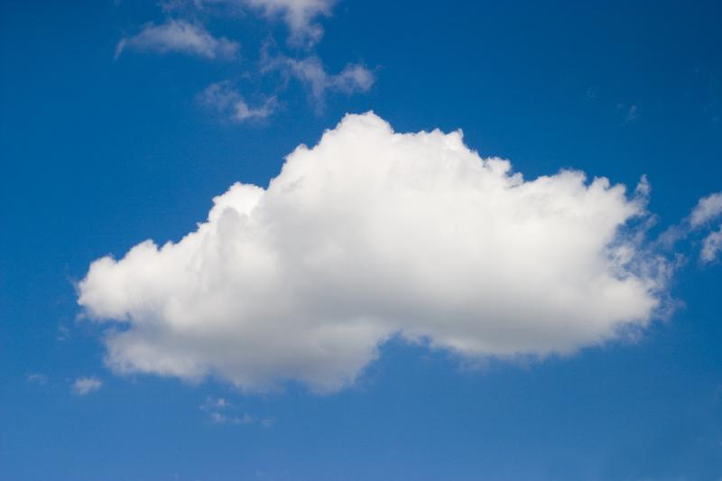
Intro
Cumulus Clouds
Notes:
Today we will learn about cumulus clouds.

Slide 3
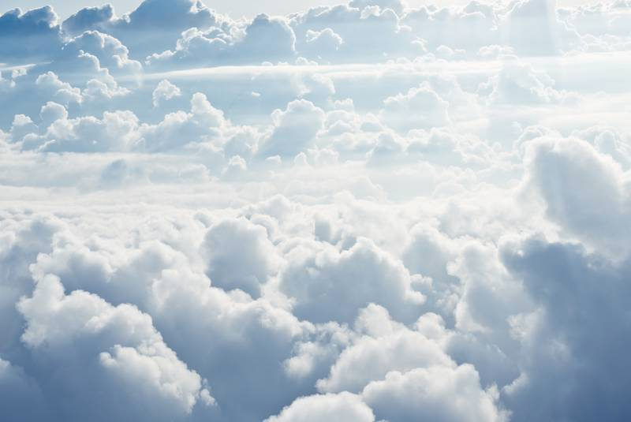
Big Question: Why do we see different types of clouds? How are they different?
Notes:
Our “big question” is: Why do we see different types of clouds? How are they different?
[Pause and illicit predictions from students.]
I love all these thoughtful scientific hypotheses! Be sure to keep this question and your predictions in mind as we move through this lesson, and we’ll revisit it.

Slide 4
Demonstration
What are clouds?
TEACHER DIRECTIONS:
Before: Open the link above and have it ready to play.
During: Play the video. Pause the video throughout and ask students to reflect on the questions in the following slides.
After: Ask students why clouds are important for life. Tell students in this lesson they will learn more about cumulus clouds.
Notes:
Before we begin, let’s watch a video to introduce us to clouds.
Alternate video: https://vpm.pbslearningmedia.org/resource/nvcl.sci.earth.types/why-so-many-cloud-types/
Feedback: Creating an organized demonstration that is clear and well structured is key to promoting student understanding.

Slide 5
Notes:
Let’s review our demonstration.

Slide 6
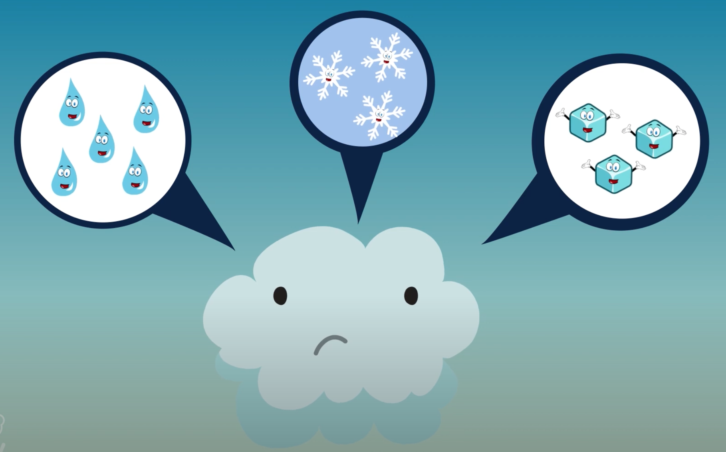
What are clouds made up of?
Notes:
What are clouds made up of?
[Tiny drops of water, snowflakes, or ice crystals]

Slide 7
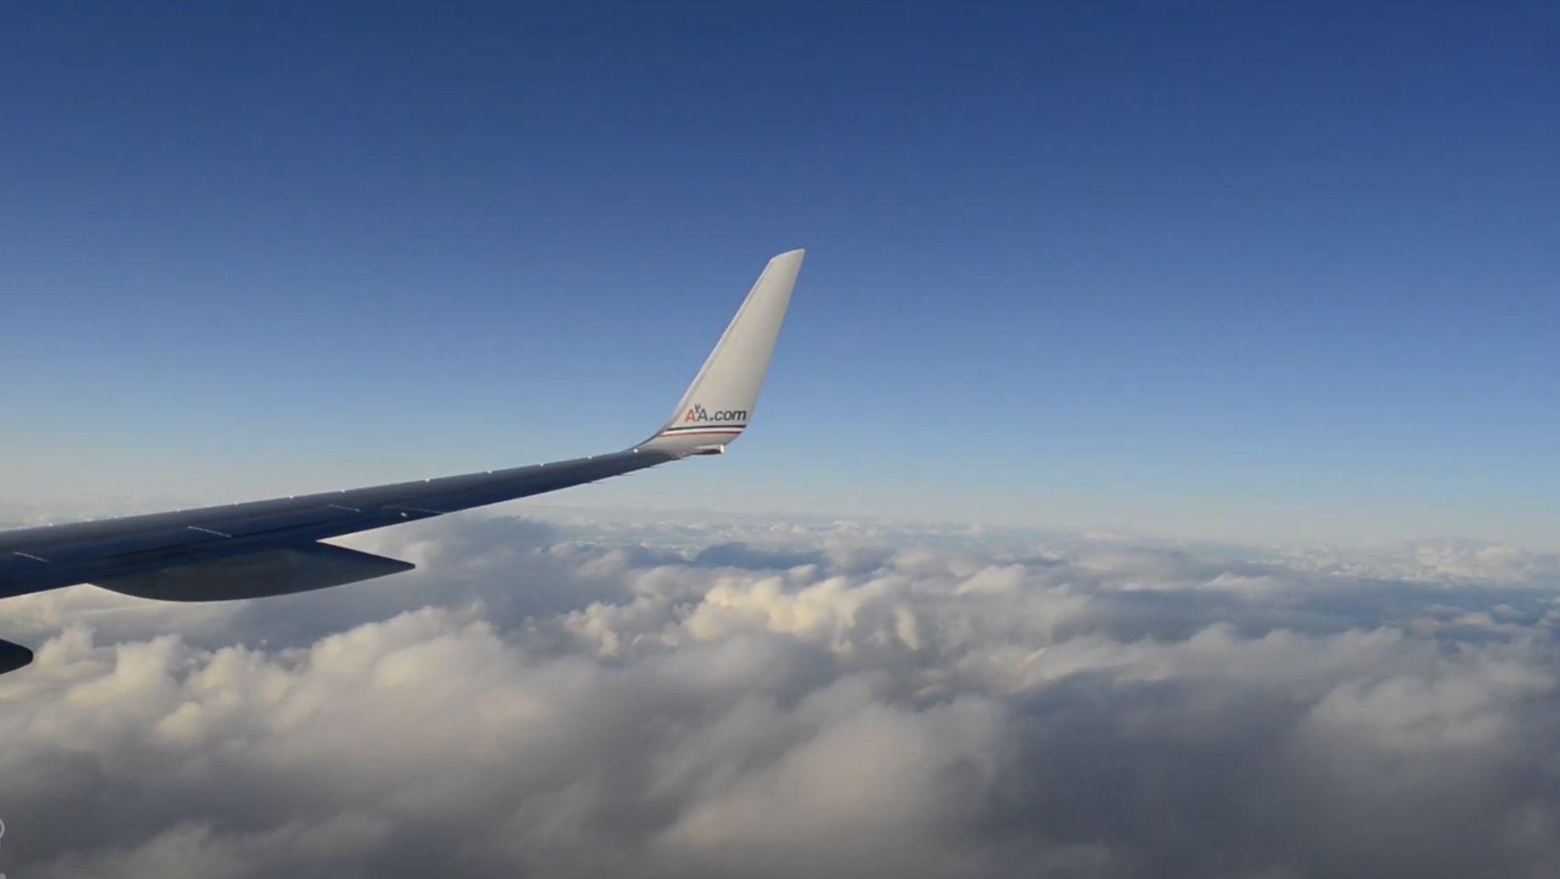
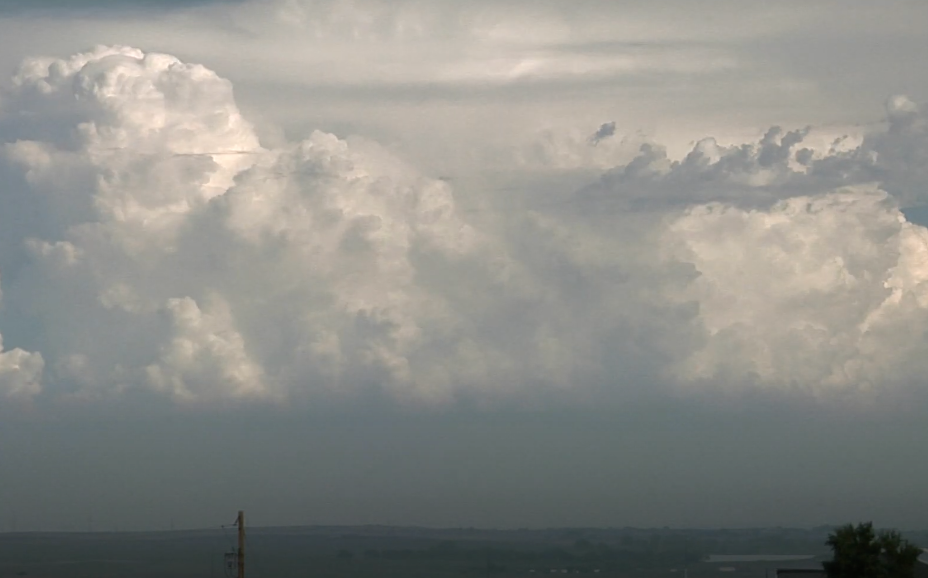
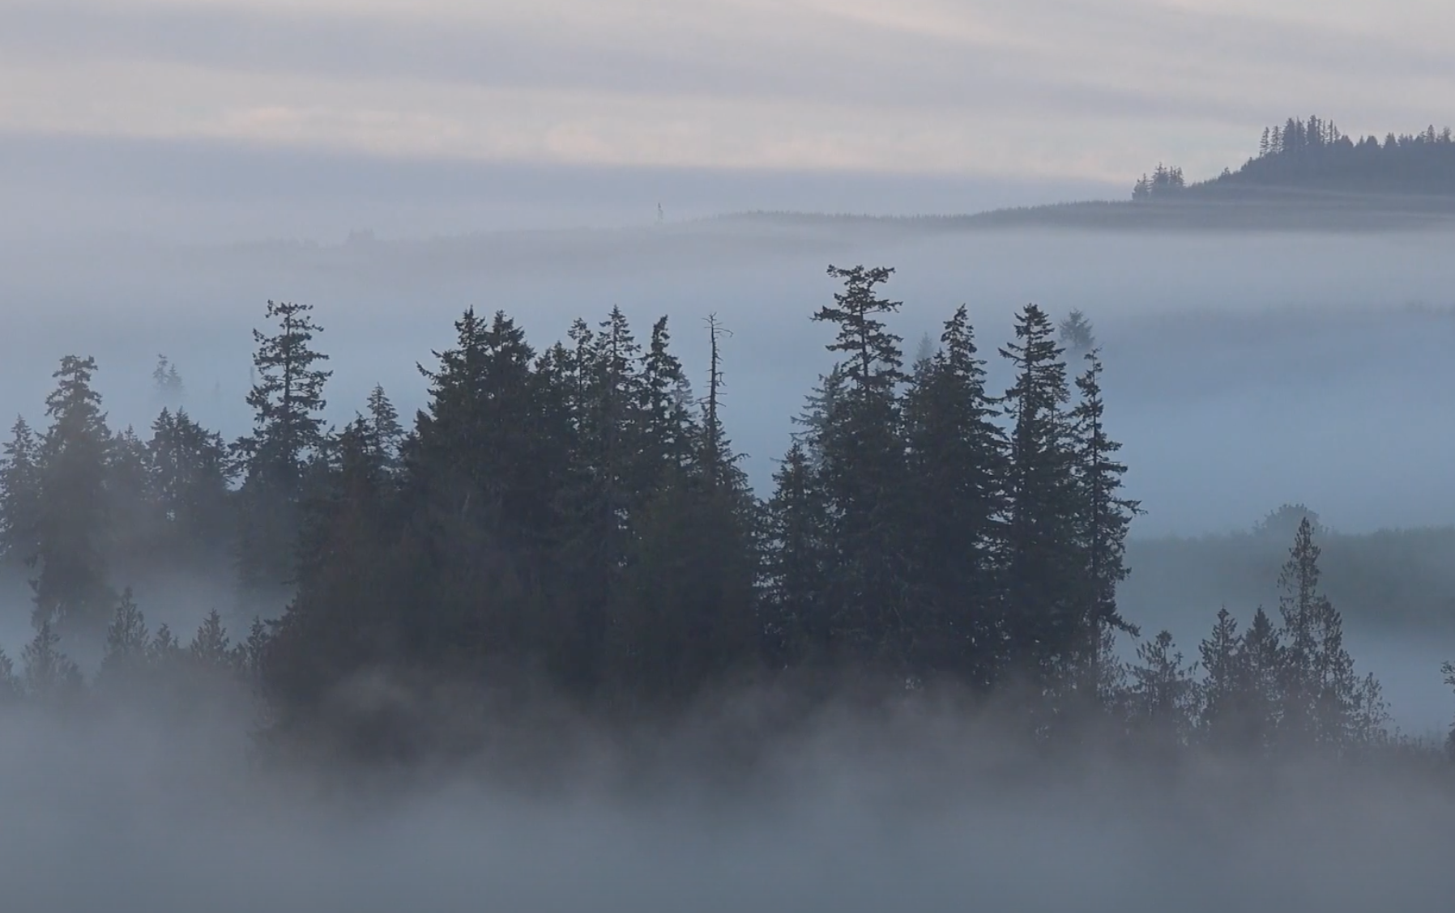
How are clouds different from one another?
Notes:
How are clouds different from one another?
[Shape, color, size, and altitude]

Slide 8
What do cumulus clouds look like?
Notes:
What do cumulus clouds look like?
[Cumulus clouds look like they are swollen and made of cotton]

Slide 9
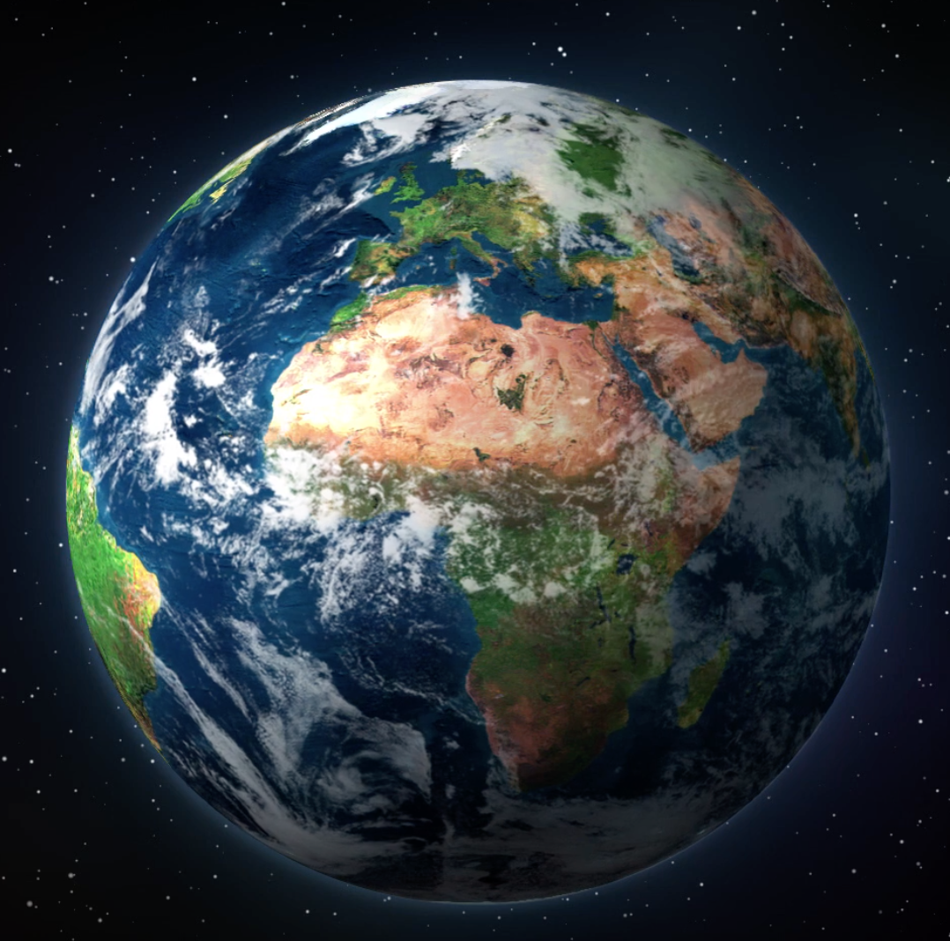
Why are clouds important for life?
Notes:
Why are clouds important for life?
[Clouds are essential for rain and snowfall and regulating the temperature on earth.]
Feedback: By providing a lot of opportunities to respond throughout demonstration you helped ensured that your students are grasping this new content.

Slide 10
Notes:
Before we move on to our new vocabulary term, let’s review some other words & concepts that you already learned and make sure you are firm in your understanding.
Feedback: You used relevant topics and content to activate prior knowledge, this sets the students up to make important connections to new content.

Slide 11
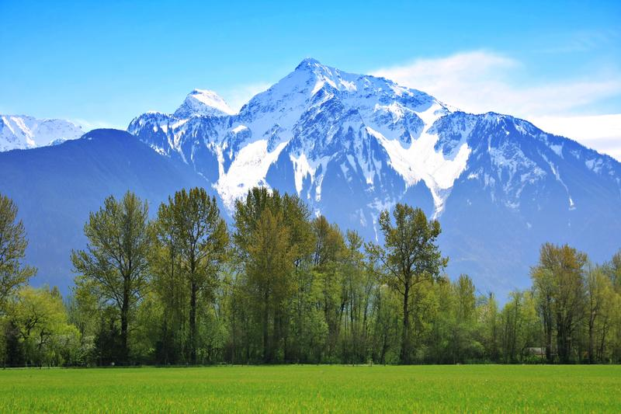
Altitude: how high you are above sea level
Notes:
Altitude is how high you are above sea level. The Rocky Mountain tops have snow because their altitude is much higher than the plains below.

Slide 12
Notes:
As altitude increase, the temperature decreases. This is why there is always snow on Mt. Everest. This changes the properties of the environment.

Slide 13
Atmosphere: the layers of gas, that have distinct characteristics, surrounding the earth’s surface
Notes:
The atmosphere is the layers of gas, that have distinct characteristics, surrounding the earth’s surface. Sometimes the atmosphere is called a “blanket” of gases.

Slide 14
Troposphere: the lowest and densest layer in the atmosphere
Notes:
The troposphere is the lowest and densest layer in the atmosphere. Clouds form here.

Slide 15
Notes:
Now let’s pause for a moment to check your understanding.
Feedback: Monitoring understanding during review is an important step before moving on to new material.

Slide 16
What is the atmosphere?
Notes:
What is the atmosphere?
[The atmosphere is the layers of gas, that have distinct characteristics, surrounding the earth’s surface. Sometimes, the atmosphere is called a “blanket” of gases.]

Slide 17
What part of the atmosphere do clouds form in?
Notes:
What part of the atmosphere do clouds form in?
[Troposphere]

Slide 18
What is altitude?
Notes:
What is altitude?
[Altitude is the distance above sea level.]

Slide 19
Cumulus Clouds
Notes:
Now that we’ve reviewed, let’s define our new term, cumulus clouds.

Slide 20
Cumulus Cloud: a type of cloud that has a flat base and is white and puffy
Notes:
A cumulus cloud is a type of cloud that has a flat base and is white and puffy.
Feedback: Using clear language can take make formal more complicated definitions a little easier for students to understand.

Slide 21
Notes:
Let’s check-in for understanding.

Slide 22
What is a cumulus cloud?
Notes:
What is a cumulus cloud?
[A cumulus cloud is a type of cloud that has a flat base and is white and puffy.]

Slide 23
Notes:
That is the basic definition, but there is a bit more you need to know.

Slide 24
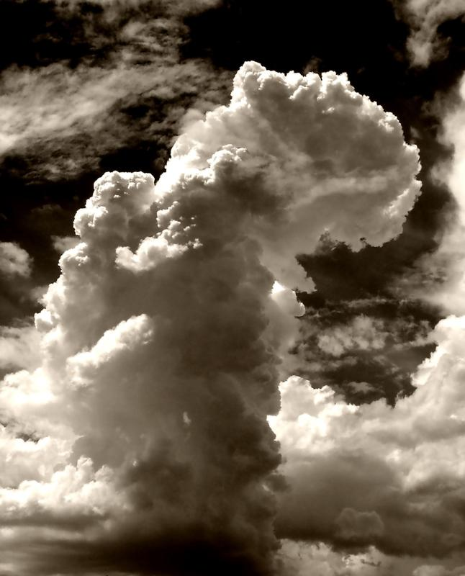
Notes:
Their main feature is how puffy they are.

Slide 25
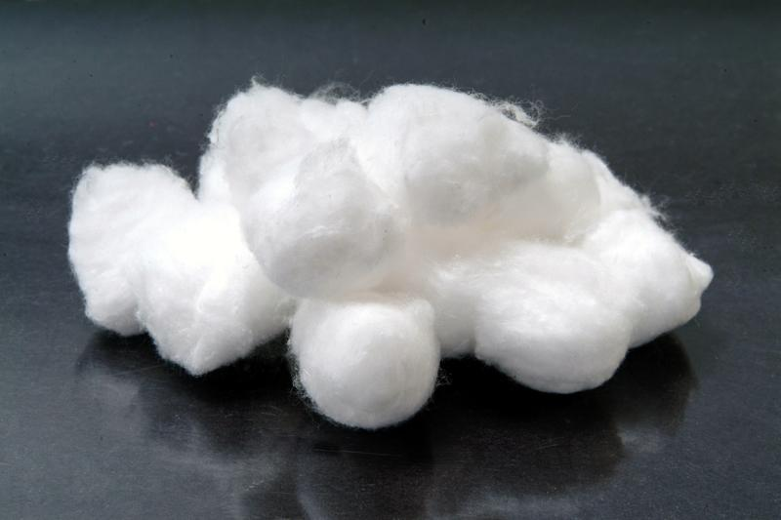
Notes:
They look like cotton balls!

Slide 26
Notes:
Cumulus clouds hold liquid water.

Slide 27
Cirrus
Cumulus
Altitude
Stratus
Earth
Notes:
They develop in the middle of the troposphere.

Slide 28
Notes:
Let’s check-in for understanding.

Slide 29
What are characteristics of cumulus clouds?
Notes:
What are characteristics of cumulus clouds?
[Flat base, white, puffy]

Slide 30
Where do they develop?
Notes:
Where do they develop?
[Troposphere]

Slide 31
Notes:
Now, let’s look at some examples of cumulus clouds.
Feedback: It is important to not only introduce an example of the term but also included images to go along with it, this is a great way to help students make connections.

Slide 32
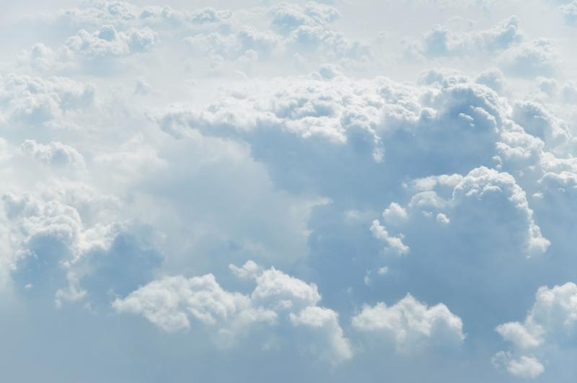
Notes:
This is an example of a cumulus cloud. What do you notice about it?

Slide 33
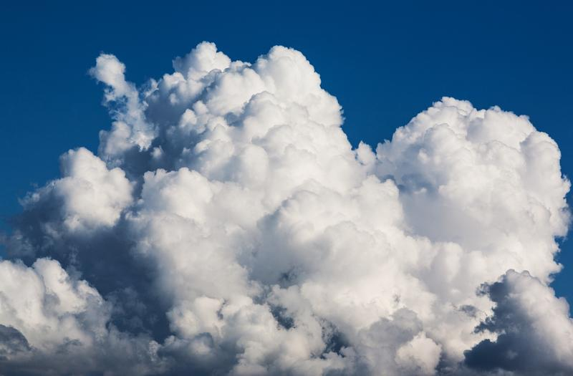
Notes:
This is another example of a cumulus cloud. What do you notice about it?

Slide 34
Notes:
Let’s check-in for understanding.

Slide 35
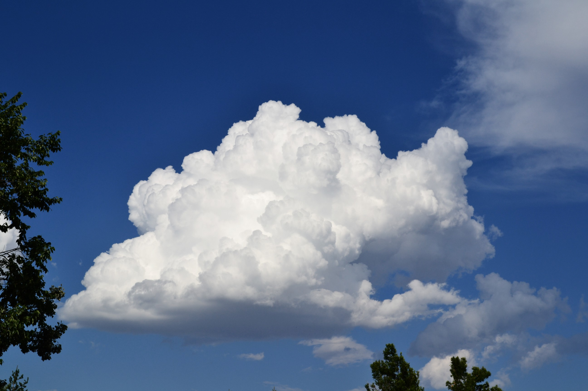
Is this an example of a cumulus cloud? How can you tell?
Notes:
Is this an example of a cumulus cloud? How can you tell?
[Yes, given the characteristics (flat base, white, puffy).]

Slide 36
Notes:
Now let’s look at a couple of non-examples of cumulus clouds.
Feedback: One important component of using non-examples is by clearly distinguishing similarities and explaining why it is a non-example.

Slide 37
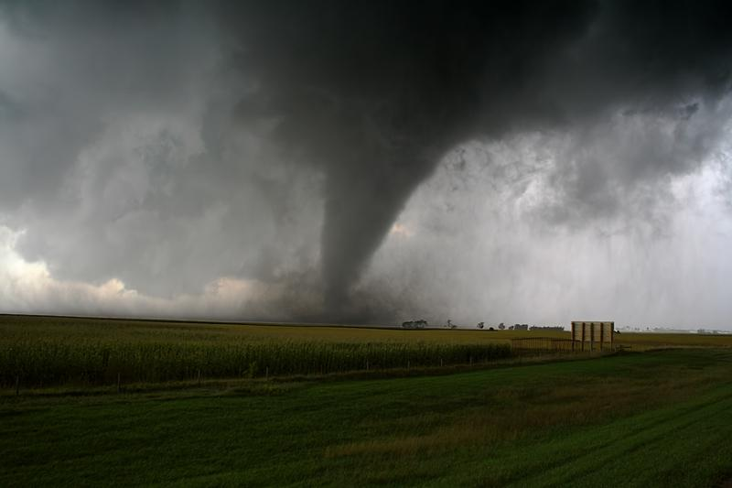
Notes:
This is not a cumulus cloud. This is a tornado.

Slide 38
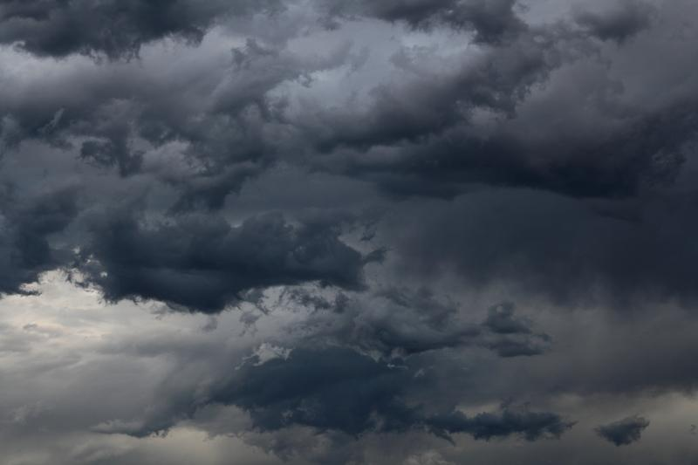
Notes:
This is not a cumulus cloud. This is a stratus cloud.

Slide 39
Notes:
Let’s check-in for understanding.

Slide 40
What is a cumulus cloud?
Notes:
What is a cumulus cloud?
[A cumulus cloud is a type of cloud that has a flat base and is white and puffy.]

Slide 41
Where do cumulus clouds form?
Notes:
Where do cumulus clouds form?
[In the middle of the troposphere]

Slide 42
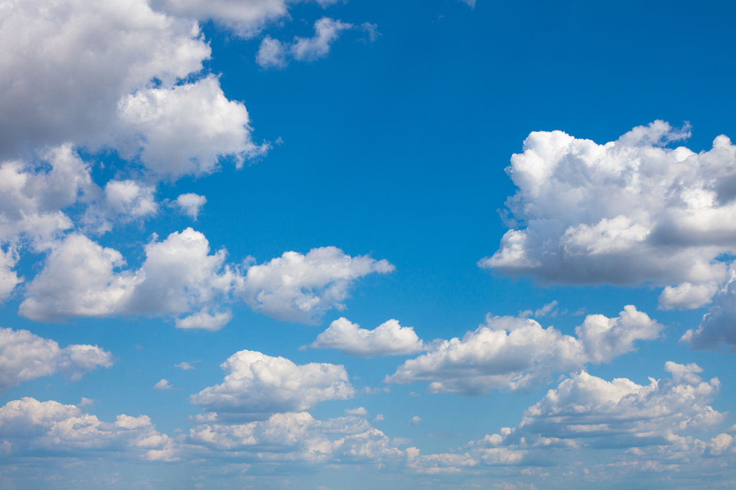
Do these clouds hold liquid? If so what kind?
Notes:
Do these clouds hold liquid? If so what kind?
[Yes, they hold liquid water.]

Slide 43
Remember!!!
Notes:
So remember!
Feedback: Reviewing new content is an important step at the end of a lesson.

Slide 44
Cumulus Cloud: a type of cloud that is white and puffy
Notes:
A cumulus cloud is a type of cloud that has a flat base and is white and puffy.

Slide 45
Big Question: Why do we see different types of clouds? How are they different?
Notes:
Our “big question” is: Why do we see different types of clouds? How are they different?
[Pause and illicit predictions from students.]
I love all these thoughtful scientific hypotheses! Be sure to keep this question and your predictions in mind as we move through this lesson, and we’ll revisit it.

Slide 46
Notes:
Thanks for watching, and please continue watching CAPs available from this website.

Slide 47
This Video Was Created With Resources From:
Questions or Comments
Michael Kennedy, Ph.D. MKennedy@Virginia.edu
Rachel L Kunemund, Ph.D. rk8vm@virginia.edu

Slide 48
“Big Idea” Question
Teacher Demo
Review Concepts
Check-In Questions
Vocabulary
Student-Friendly Definition
Examples & Non-Examples
Morphological Word Parts
Simulation/Activity
Notes:
OK everyone, get ready for our next lesson. Just as a reminder, these are the different components that our lesson may include, and you’ll see these icons in the top left corner of each slide so that you can follow along more easily!

Slide 49
Intro
Stratus Clouds
Notes:
Today we will learn about stratus clouds.

Slide 50
Big Question: Why do we see different types of clouds? How are they different?
Notes:
Our “big question” is: Why do we see different types of clouds? How are they different?
[Pause and illicit predictions from students.]
I love all these thoughtful scientific hypotheses! Be sure to keep this question and your predictions in mind as we move through this lesson, and we’ll revisit it.

Slide 51
Demonstration
Cloud in a bottle
TEACHER DIRECTIONS:
Before: Gather all the materials for the demonstration and set up as much as you can ahead of time. Tell students that today they will be learning about a type of cloud that often produces rain.
During: Perform the demonstration. Tell students to write down their observations from the demonstration.
After: Prompt students to make inferences about the demonstration. Tell students that today they will learn more about a stratus clouds.
Notes:
Perform this quick demonstration of a cloud in a bottle to get students engaged in the lesson or watch a demonstration of the activity in this video.
Teacher directions: https://kids.nationalgeographic.com/science/article/make-clouds-in-a-bottle
Materials:
two-liter soda bottle
rubbing alcohol
bicycle pump with needle
cork
skewer
optional: duct tape
Feedback: Creating an organized demonstration that is clear and well structured is key to promoting student understanding.

Slide 52
Notes:
Let’s review our demonstration.
Feedback: By providing a lot of opportunities to respond throughout demonstration you helped ensured that your students are grasping this new content.

Slide 53
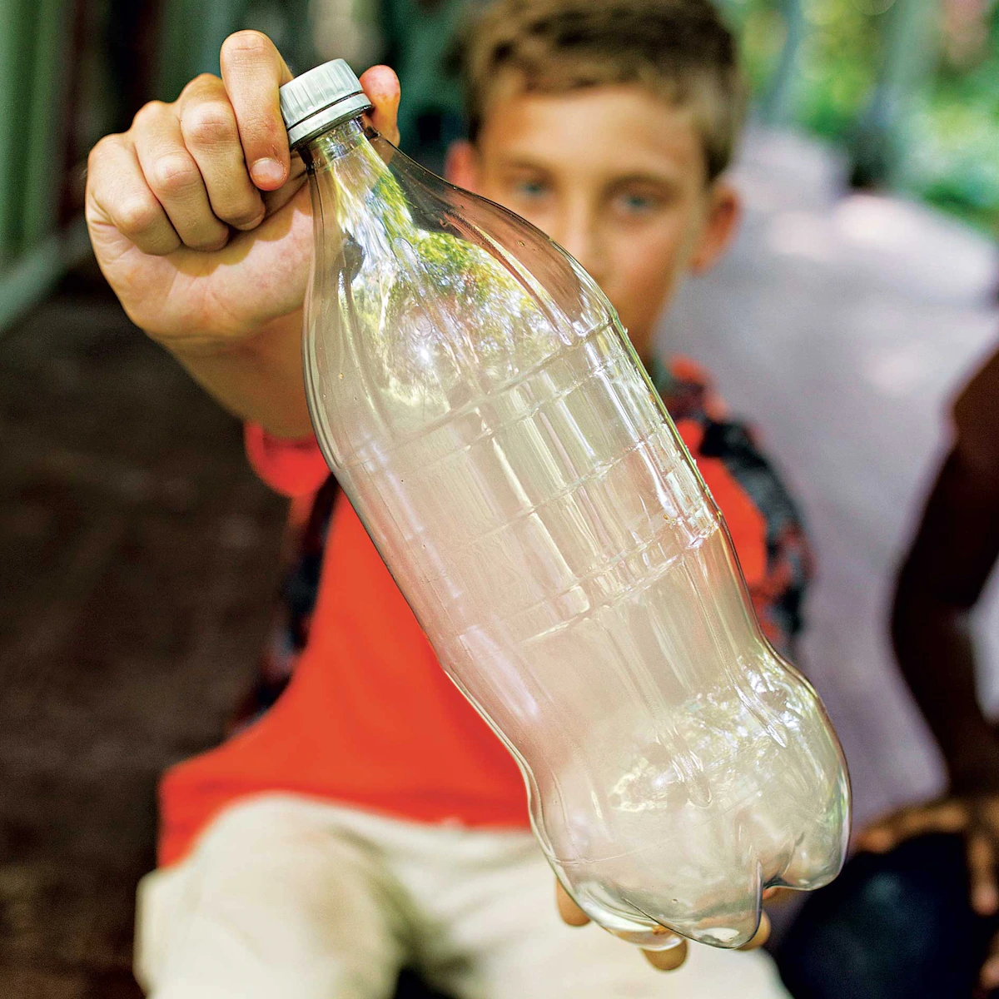
What was put inside of the bottle?
Notes:
What was put inside of the bottle?

Slide 54
What happened once the cork was removed from the bottle?
Notes:
What happened once the cork was removed from the bottle?

Slide 55
How do clouds form?
Notes:
How do clouds form?
Feedback: Providing students with the opportunity to make predictions about what will happen allows them to think critically about the content.

Slide 56
Notes:
Before we move on to our new vocabulary term, let’s review some other words & concepts that you already learned and make sure you are firm in your understanding.
Feedback: You used relevant topics and content to activate prior knowledge, this sets the students up to make important connections to new content.

Slide 57
Altitude: how high you are above sea level
Notes:
Altitude is how high you are above sea level. The Rocky Mountain tops have snow because their altitude is much higher than the plains below.

Slide 58
Notes:
As altitude increase, the temperature decreases. This is why there is always snow on Mt. Everest. This changes the properties of the environment.

Slide 59
Atmosphere: the layers of gas, that have distinct characteristics, surrounding the earth’s surface
Notes:
The atmosphere is the layers of gas, that have distinct characteristics, surrounding the earth’s surface. Sometimes the atmosphere is called a “blanket” of gases.

Slide 60
Troposphere: the lowest and densest layer in the atmosphere
Notes:
The troposphere is the lowest and densest layer in the atmosphere. Clouds form here.

Slide 61
Cumulus Cloud: a type of cloud that has a flat base and is white and puffy
Notes:
A cumulus cloud is a type of cloud that has a flat base and is white and puffy.

Slide 62
Notes:
Now let’s pause for a moment to check your understanding.
Feedback: Monitoring understanding during review is an important step before moving on to new material.

Slide 63
What is the atmosphere?
Notes:
What is the atmosphere?
[The atmosphere is the layers of gas, that have distinct characteristics, surrounding the earth’s surface. Sometimes, the atmosphere is called a “blanket” of gases.]

Slide 64
What part of the atmosphere do clouds form in?
Notes:
What part of the atmosphere do clouds form in?
[Troposphere]

Slide 65
What is altitude?
Notes:
What is altitude?
[Altitude is the distance above sea level.]

Slide 66
What is a cumulus cloud?
Notes:
What is a cumulus cloud?
[A cumulus cloud is a type of cloud that has a flat base and is white and puffy.]

Slide 67
Stratus Clouds
Notes:
Now that we’ve reviewed, let’s define our new term, stratus clouds.

Slide 68
Stratus Cloud: a type of cloud that is gray and forms horizontally
Notes:
A stratus cloud is a type of cloud that is gray and forms horizontally.

Slide 69
Notes:
Let’s check-in for understanding.

Slide 70
What are the characteristics of a stratus cloud? How is it different than a cumulus?
Notes:
What are the characteristics of a stratus cloud? How is it different than a cumulus?
[A stratus cloud is a type of cloud that is gray and forms horizontally. Cumulus are white and puffy.]

Slide 71
Notes:
That is the basic definition, but there is a bit more you need to know.

Slide 72
Notes:
Stratus clouds often produce precipitation such as rain or snow.

Slide 73
Cirrus
Cumulus
Altitude
Stratus
Earth
Notes:
They develop at the bottom of the troposphere, closest to the earth.

Slide 74
Notes:
Let’s check-in for understanding.

Slide 75
Where do stratus clouds develop?
Notes:
Where do stratus clouds develop?
[The bottom of the troposphere]

Slide 76
What do stratus clouds produce?
Notes:
What do stratus clouds produce?
[Precipitation (rain or snow)]

Slide 77
Notes:
Now, let’s look at an example of stratus clouds.

Slide 78
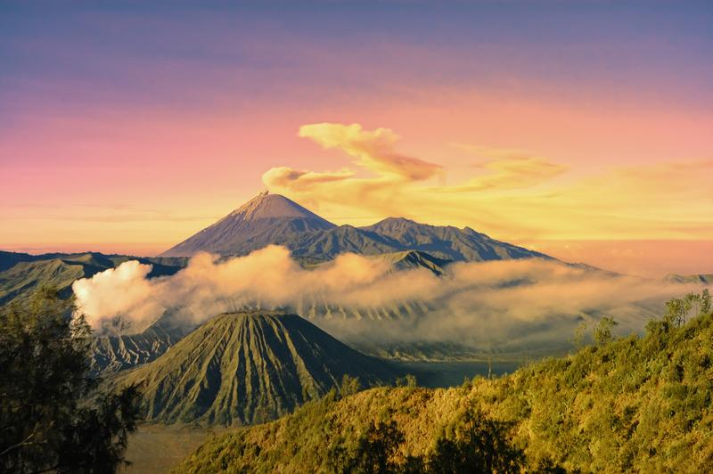
Notes:
These are stratus clouds.

Slide 79
Notes:
Let’s check-in for understanding.

Slide 80
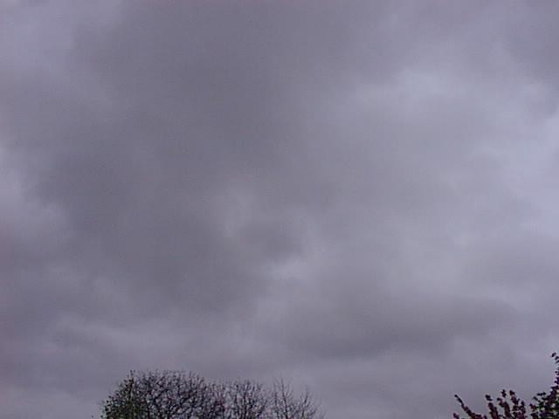
Is this an example of a stratus cloud? Why or why not?
Notes:
Is this an example of a stratus cloud?
[Yes]

Slide 81
Notes:
Now let’s look at a non-examples of stratus clouds.

Slide 82
Notes:
These are not stratus clouds.

Slide 83
Notes:
Let’s check-in for understanding.

Slide 84
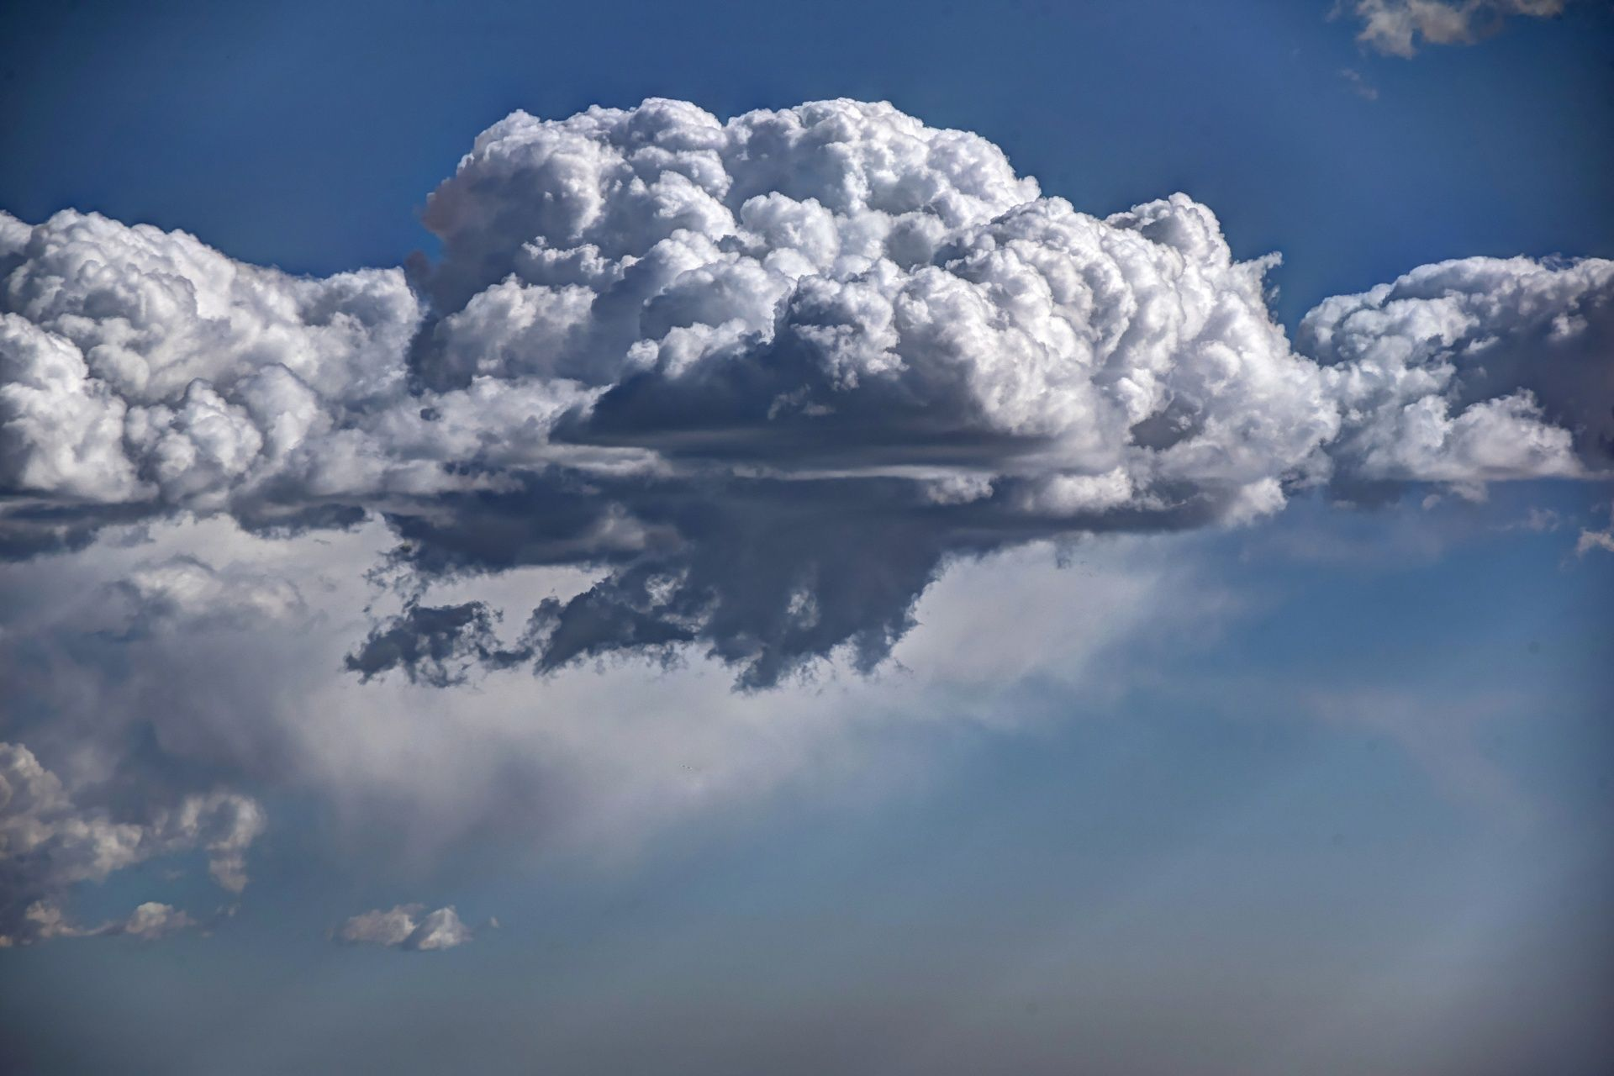
Is this an example of a stratus cloud? Why or why not?
Notes:
Is this an example of a stratus cloud? Why or why not?
[No - this is a cumulus cloud.]

Slide 85
What are the differences between examples of stratus and cumulus clouds?
Notes:
What are the differences between examples of stratus and cumulus clouds?

Slide 86
What is a stratus cloud?
Notes:
What is a stratus cloud?
[A stratus cloud is a type of cloud that is gray and forms horizontally.]

Slide 87
Where do stratus clouds form?
Notes:
Where do stratus clouds form?
[At the bottom of the troposphere]
Feedback: You consistently used images in your lesson, this helps students make connections to the words in the definition.

Slide 88
Remember!!!
Notes:
So remember!

Slide 89
Stratus Cloud: a type of cloud that is gray and forms horizontally
Notes:
A stratus cloud is a type of cloud that is gray and forms horizontally.

Slide 90
Big Question: Why do we see different types of clouds? How are they different?
Notes:
Our “big question” is: Why do we see different types of clouds? How are they different?
[Pause and illicit predictions from students.]
I love all these thoughtful scientific hypotheses! Be sure to keep this question and your predictions in mind as we move through this lesson, and we’ll revisit it.

Slide 91
Notes:
Thanks for watching, and please continue watching CAPs available from this website!

Slide 92
This Video Was Created With Resources From:
Questions or Comments
Michael Kennedy, Ph.D. MKennedy@Virginia.edu
Rachel L Kunemund, Ph.D. rk8vm@virginia.edu

Slide 93
Intro
“Big Idea” Question
Review Concepts
Check-In Questions
Teacher Demo
Vocabulary
Student-Friendly Definition
Examples & Non-Examples
Morphological Word Parts
Simulation/Activity
Notes:
OK everyone, get ready for our next lesson. Just as a reminder, these are the different components that our lesson may include, and you’ll see these icons in the top left corner of each slide so that you can follow along more easily!

Slide 94
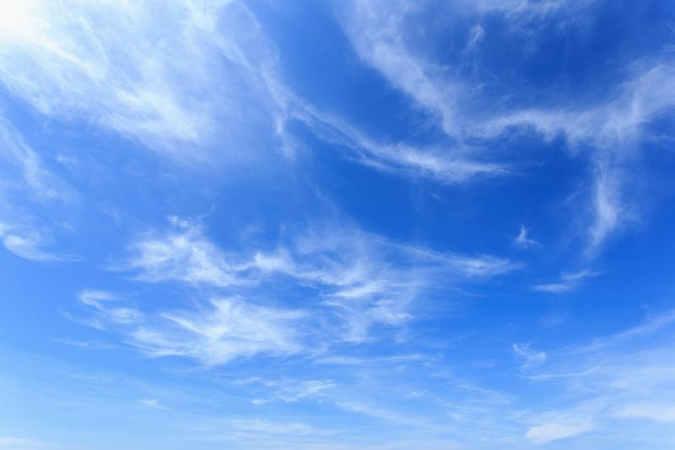
Intro
Cirrus Clouds
Notes:
Today we will learn about cirrus clouds.

Slide 95
Big Question: Why do we see different types of clouds? How are they different?
Notes:
Our “big question” is: Why do we see different types of clouds? How are they different?
[Pause and illicit predictions from students.]
I love all these thoughtful scientific hypotheses! Be sure to keep this question and your predictions in mind as we move through this lesson, and we’ll revisit it.

Slide 96
Notes:
Before we move on to our new vocabulary term, let’s review some other words & concepts that you already learned and make sure you are firm in your understanding.

Slide 97
Altitude: how high you are above sea level
Notes:
Altitude is how high you are above sea level. The Rocky Mountain tops have snow because their altitude is much higher than the plains below.

Slide 98
Notes:
As altitude increase, the temperature decreases. This is why there is always snow on Mt. Everest. This changes the properties of the environment.

Slide 99
Atmosphere: the layers of gas, that have distinct characteristics, surrounding the earth’s surface
Notes:
The atmosphere is the layers of gas, that have distinct characteristics, surrounding the earth’s surface. Sometimes the atmosphere is called a “blanket” of gases.

Slide 100
Troposphere: the lowest and densest layer in the atmosphere
Notes:
The troposphere is the lowest and densest layer in the atmosphere. Clouds form here.

Slide 101
Cumulus Cloud: a type of cloud that has a flat base and is white and puffy
Notes:
A cumulus cloud is a type of cloud that has a flat base and is white and puffy.

Slide 102
Stratus Cloud: a type of cloud that is gray and forms horizontally
Notes:
A stratus cloud is a type of cloud that is gray and forms horizontally.

Slide 103
Notes:
Now let’s pause for a moment to check your understanding.

Slide 104
What is the atmosphere?
Notes:
What is the atmosphere?
[The atmosphere is the layers of gas, that have distinct characteristics, surrounding the earth’s surface. Sometimes, the atmosphere is called a “blanket” of gases.]

Slide 105
What part of the atmosphere do clouds form in?
Notes:
What part of the atmosphere do clouds form in?
[Troposphere]

Slide 106
What is altitude?
Notes:
What is altitude?
[Altitude is the distance above sea level.]

Slide 107
What is the difference between cumulus and stratus clouds?
Notes:
What is the difference between cumulus and stratus clouds?
[A cumulus cloud is a type of cloud that has a flat base and is white and puffy.
A stratus cloud is a type of cloud that is gray and forms horizontally.]

Slide 108
Cirrus Clouds
Notes:
Now that we’ve reviewed, let’s define our new term, cirrus clouds.

Slide 109
Cirrus Cloud: a type of cloud that is thin, white, and wispy
Notes:
A cirrus cloud is a type of cloud that is thin, white, and wispy.

Slide 110
Notes:
Let’s check-in for understanding.

Slide 111
What is a cirrus cloud?
Notes:
What is a cirrus cloud?
[A cirrus cloud is a type of cloud that is thin, white, and wispy.]

Slide 112
Notes:
That is the basic definition, but there is a bit more you need to know.

Slide 113
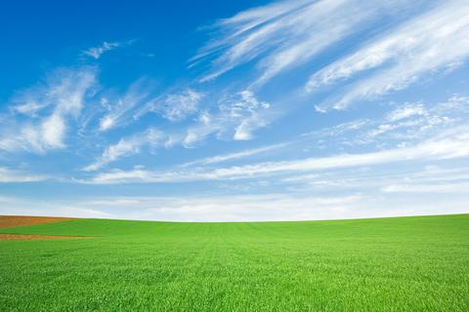
Notes:
Their main attribute is how thin they are.

Slide 114
Cirrus
Cumulus
Altitude
Stratus
Earth
Notes:
Cirrus clouds develop at the top of the troposphere.

Slide 115
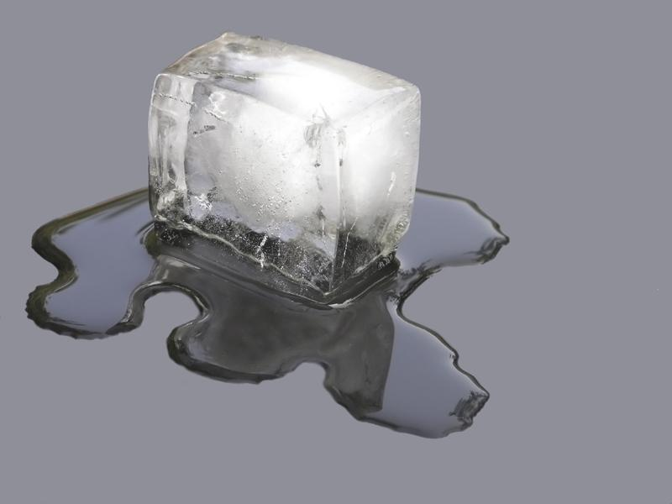
Notes:
They are made of ice!

Slide 116
Notes:
Let’s check-in for understanding.

Slide 117
Where do cirrus clouds form?
Notes:
Where do cirrus clouds form?
[The top of the troposphere]

Slide 118
What are cirrus clouds made of?
Notes:
What are cirrus clouds made of?
[Ice]

Slide 119
Notes:
Now, let’s look at a couple of examples of cirrus clouds.

Slide 120
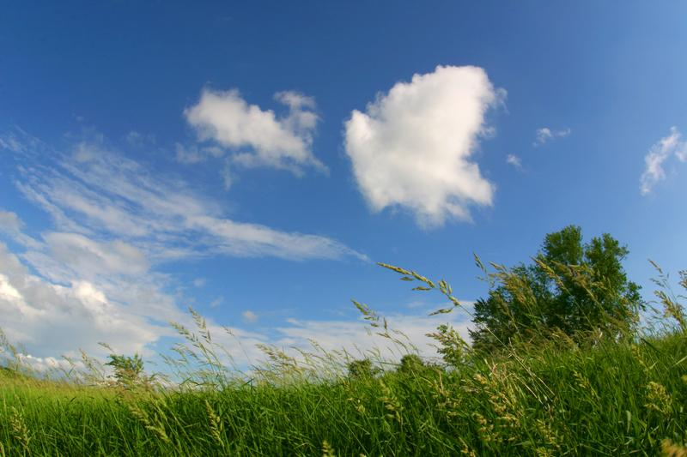
Notes:
These are cirrus clouds.

Slide 121
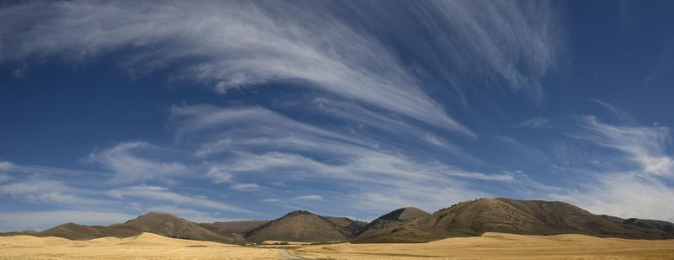
Notes:
These are also cirrus clouds.

Slide 122
Notes:
Let’s check-in for understanding.

Slide 123
Which of these is a cirrus cloud? How can you tell?
Notes:
What of these is a cirrus cloud? How can you tell?
[The clouds on the left are cirrus clouds. They are thin and wispy.]

Slide 124
Notes:
Now let’s look at a non-examples of stratus clouds.

Slide 125
Notes:
The clouds circled are not cirrus clouds. These are cumulus clouds.

Slide 126
Notes:
Let’s check-in for understanding.

Slide 127
What is a cirrus cloud?
Notes:
What is a cirrus cloud?
[A cirrus cloud is a type of cloud that is thin, white, and wispy.]

Slide 128
Where do cirrus clouds form?
Notes:
Where do cirrus clouds form?
[At the top of the troposphere]

Slide 129
Remember!!!
Notes:
So remember!

Slide 130
Cirrus Cloud: a type of cloud that is thin, white, and wispy
Notes:
A cirrus cloud is a type of cloud that is thin, white, and wispy.

Slide 131
Big Question: Why do we see different types of clouds? How are they different?
Notes:
Our “big question” is: Why do we see different types of clouds? How are they different?
[Pause and illicit predictions from students.]
I love all these thoughtful scientific hypotheses! Be sure to keep this question and your predictions in mind as we move through this lesson, and we’ll revisit it.

Slide 132
Notes:
Thanks for watching, and please continue watching CAPs available from this website.

Slide 133
This Video Was Created With Resources From:
Questions or Comments
Michael Kennedy, Ph.D. MKennedy@Virginia.edu
Rachel L Kunemund, Ph.D. rk8vm@virginia.edu

