Slide 1
Intro
“Big Idea” Question
Review Concepts
Check-In Questions
Teacher Engagement
Vocabulary
Student-Friendly Definition
Examples & Non-Examples
Frayer Model
Simulation/Activity
Notes:
OK everyone, get ready for our next lesson. Just as a reminder, these are the different components that our lesson may include, and you’ll see these icons in the top left corner of each slide so that you can follow along more easily!

Slide 2
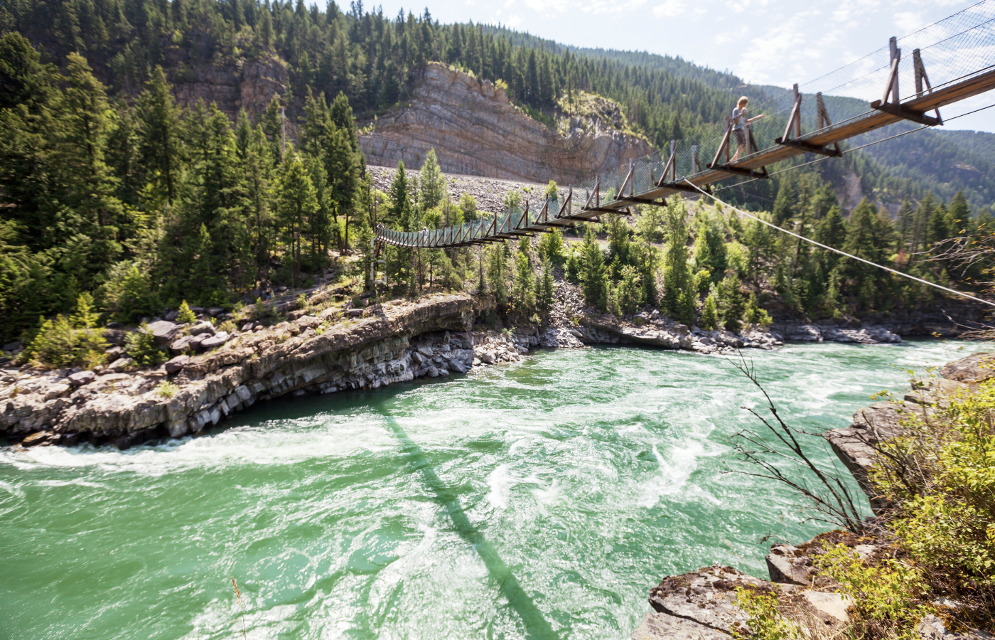
Current
Intro
Notes:
Today we are going to learn about the term current as it relates to water,

Slide 3
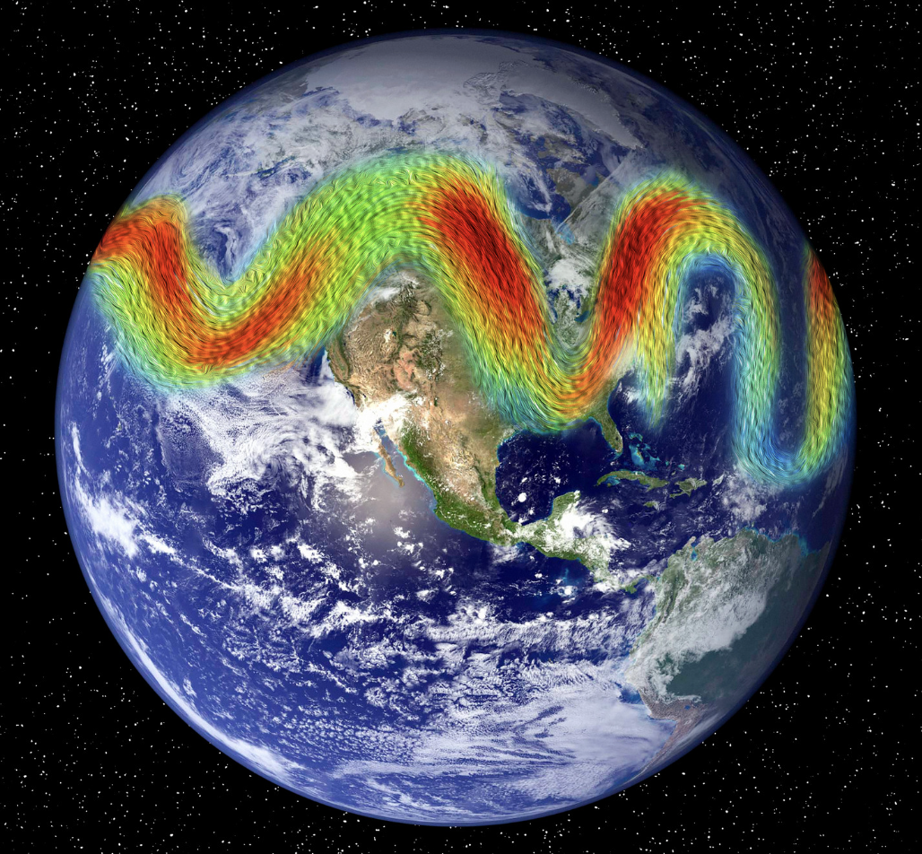
Big Question: How do ocean currents connect different parts of the world, and in what ways do they influence weather patterns?
Notes:
Our “big question” is: How do ocean currents connect different parts of the world, and in what ways do they influence weather patterns?
[Pause and illicit predictions from students.]
I love all these thoughtful scientific hypotheses! Be sure to keep this question and your predictions in mind as we move through these next few lessons, and we’ll continue to revisit it.

Slide 4
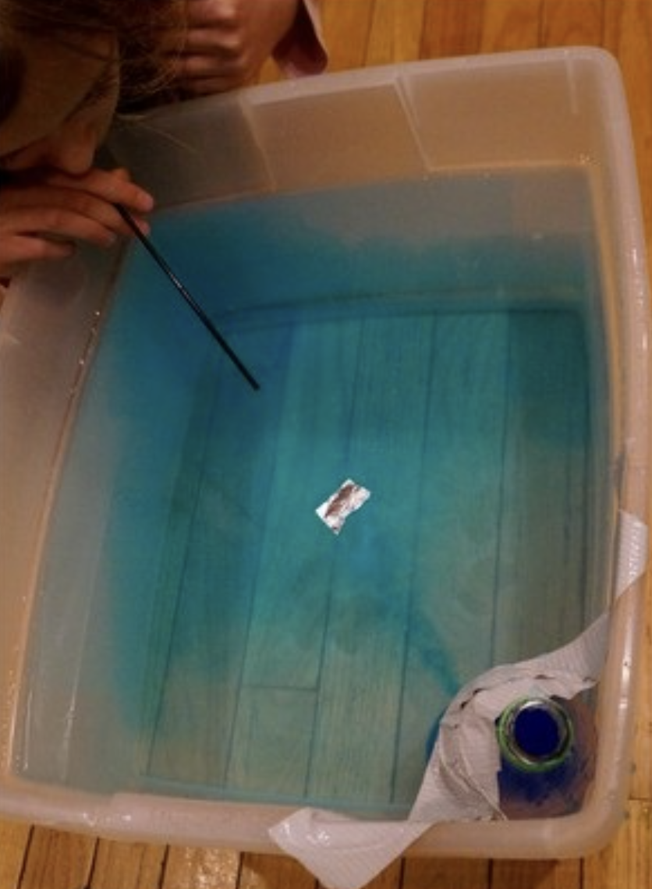
Demonstration
TEACHER DIRECTIONS:
Before viewing: Ask students what they already know about water currents. Tell students today they will be learning about currents.
During: Ask students what they think might happen when you create movement in the water. Encourage students to observe how the floating objects move in response to the currents you've created. Discuss the direction in which the objects are carried.
After: Tell students that today they will be learning more about the term current.
Notes:
Let’s do a quick demonstration that will help get our brains ready to think about fossil fuels, and how it relates to our big question.
Materials:
Large basin or tub
Water
Food coloring (optional)
Small floating objects (e.g., plastic toys, leaves, small pieces of cork)
A straw or small stick
Procedure:
Fill the basin with water, leaving enough space for the water to move freely.
Optionally, add a few drops of food coloring to the water to make the currents more visible.
Place the small floating objects on the surface of the water.
Discuss with the students what they think might happen when you create movement in the water.
Use the straw or small stick to gently blow or stir the water in one corner of the basin. This represents the introduction of energy, similar to the wind creating currents in the ocean.
Observe how the floating objects move in response to the currents you've created. Discuss the direction in which the objects are carried.
Experiment with creating different types of currents by blowing or stirring the water in various directions.
Discuss with the students how this simple model reflects the movement of ocean currents in the real world.
Teaching Points:
Emphasize that currents are like rivers in the ocean, constantly moving water around the globe.
Relate the experiment to real-world examples of currents and their impact on marine life and weather patterns.
Discuss how currents can influence transportation and trade routes.
This hands-on demonstration allows students to visualize and understand the concept of currents in a simple and engaging way, making the learning experience more memorable.

Slide 5
Notes:
Before we move on to our new vocabulary term, let’s review some other words & concepts that you already learned and make sure you are firm in your understanding.
Feedback: Reviewing key background knowledge helps lay the context and sets the students up to make sense of the new content you are introducing, it also reinforces previously learned material.

Slide 6
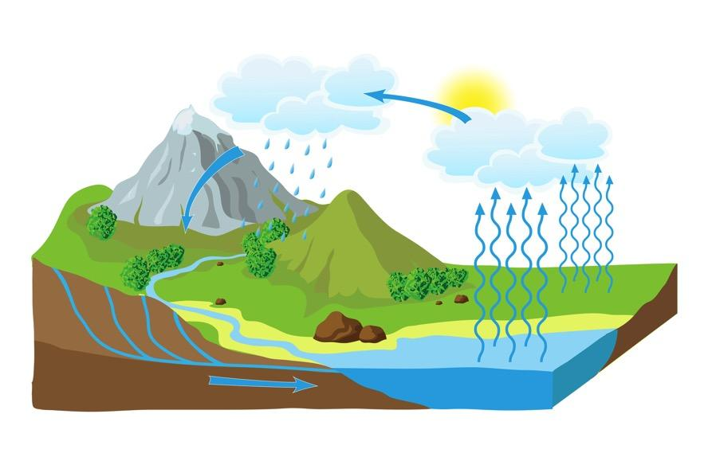
Water Cycle: the process through which water moves from Earth through the atmosphere and returns to Earth
Notes:
The Water Cycle is the process through which water moves from Earth through the atmosphere and returns to Earth.

Slide 7
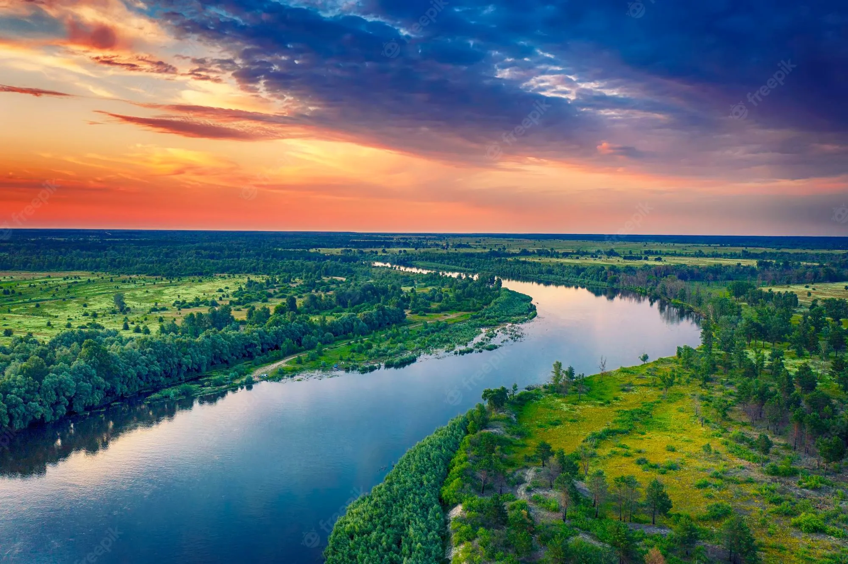
River: A long, winding stream of water that constantly moves.
Notes:
A river is a long, winding stream of water that constantly moves.

Slide 8
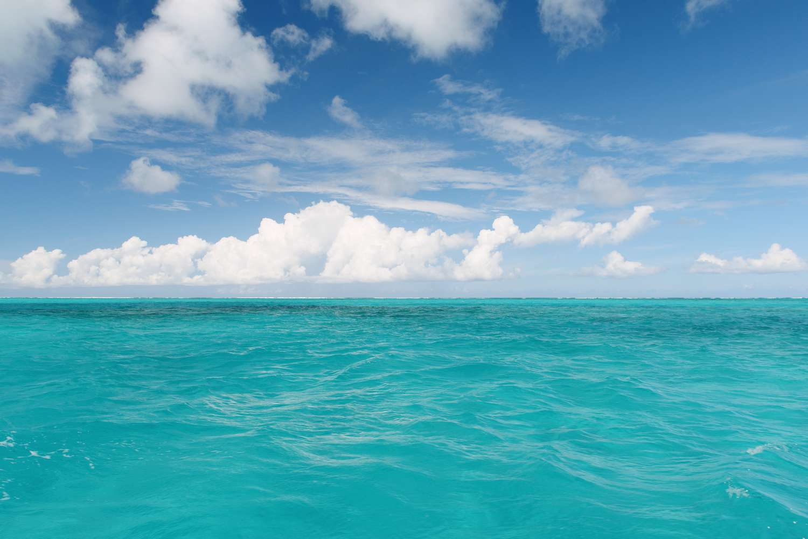
Ocean: A giant body of saltwater.
Notes:
An ocean is a giant body of saltwater.

Slide 9
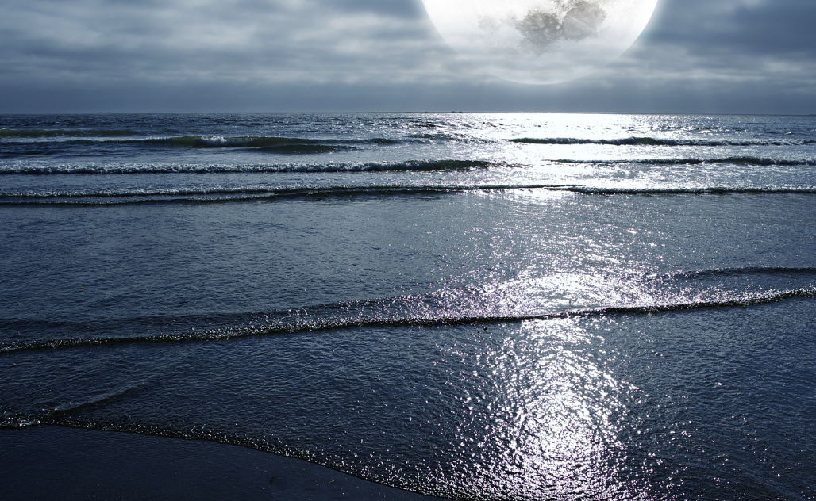
Tide: the regular rising and falling of the sea level caused by the moon and the sun's gravitational pull
Notes:
A tide is the regular rising and falling of the sea level caused by the moon and the sun's gravitational pull

Slide 10
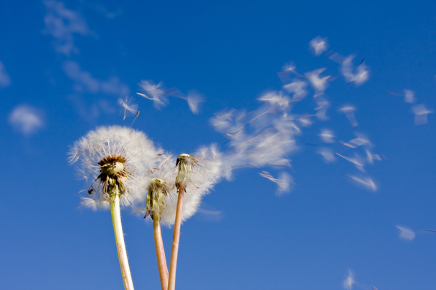
Wind: Moving air, especially a natural flow of air parallel to or along the ground.
Notes:
Wind: Moving air, especially a natural flow of air parallel to or along the ground.

Slide 11
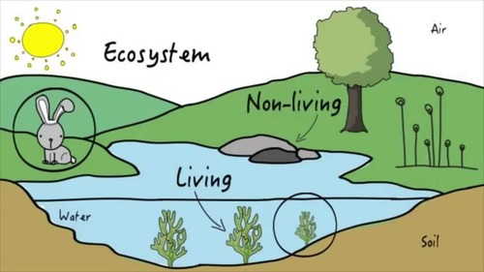
Ecosystem: an area where living and nonliving things interact
Notes:
An ecosystem is the area where living and nonliving things interact.

Slide 12
Notes:
Now, let’s pause for a moment to check your understanding.
Feedback: It is important to monitor understanding during this portion of the lesson to make sure students have a strong foundation on previous terms that will help them better understand today’s new content.

Slide 13
Tide: the regular and of the sea level caused by the moon and the sun's gravitational pull
Notes:
A tide is the regular and of the sea level caused by the moon and the sun's gravitational pull
[rising, falling]

Slide 14
Tide: the regular rising and falling of the sea level caused by the moon and the sun's gravitational pull
Notes:
A tide is the regular and of the sea level caused by the moon and the sun's gravitational pull
[rising, falling]

Slide 15
True/False: An ecosystem is an area where living and nonliving things interact
Notes:
True/False: An ecosystem is the area where living and nonliving things interact.
[True]

Slide 16
True/False: An ecosystem is an area where living and nonliving things interact
Notes:
True: An ecosystem is the area where living and nonliving things interact.

Slide 17
Current
Notes:
Now that we’ve reviewed, let’s define our new term, current.

Slide 18
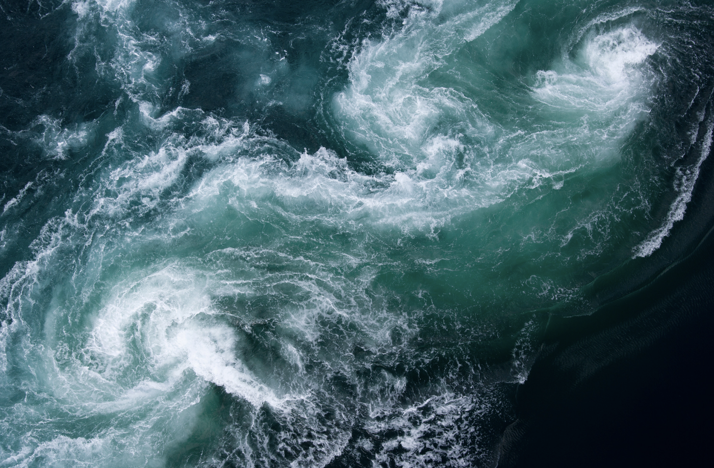
Current: The steady flow of water in a specific direction within a body of water
Notes:
A current is the steady flow of water in a specific direction within a body of water, like a river or an ocean.

Slide 19
Notes:
Let’s check-in for understanding.

Slide 20
What is a current?
Notes:
What is a current?
[The steady flow of water in a specific direction within a body of water]

Slide 21
Notes:
That’s the basic definition, but there’s more you need to know.

Slide 22
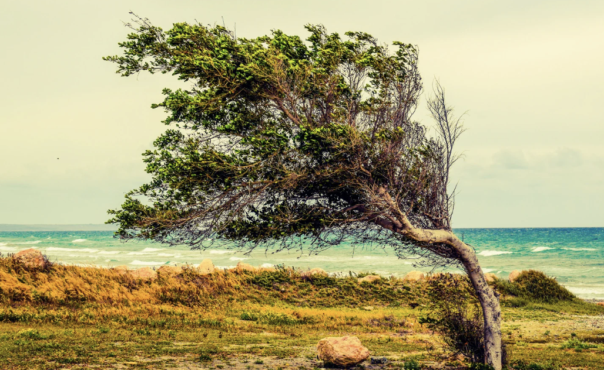
What makes currents happen? One big helper is the wind. Imagine the wind blowing across the surface of the ocean - it can push the water, creating currents.
Notes:
What makes currents happen? One big helper is the wind. Imagine the wind blowing across the surface of the ocean - it can actually push the water, creating currents.

Slide 23
Another key player is the temperature. Think about how some parts of the ocean are warmer than others. Warm water is like a fast runner, so it moves quicker than cold water. This temperature difference can also set currents in motion. It's like a dance between the wind and the temperature, making the water move around in these steady flows.
Notes:
Another key player is the temperature. Think about how some parts of the ocean are warmer than others. Warm water is like a fast runner, so it moves quicker than cold water. This temperature difference can also set currents in motion. It's like a dance between the wind and the temperature, making the water move around in these steady flows.
Now, currents aren't just random. They have important jobs! They help distribute heat around the Earth, kind of like nature's way of sharing warmth. They also carry nutrients and tiny living things, like plankton, to different places. So, currents are like the movers and shakers of the ocean, making sure things are flowing smoothly and helping life under the sea!

Slide 24
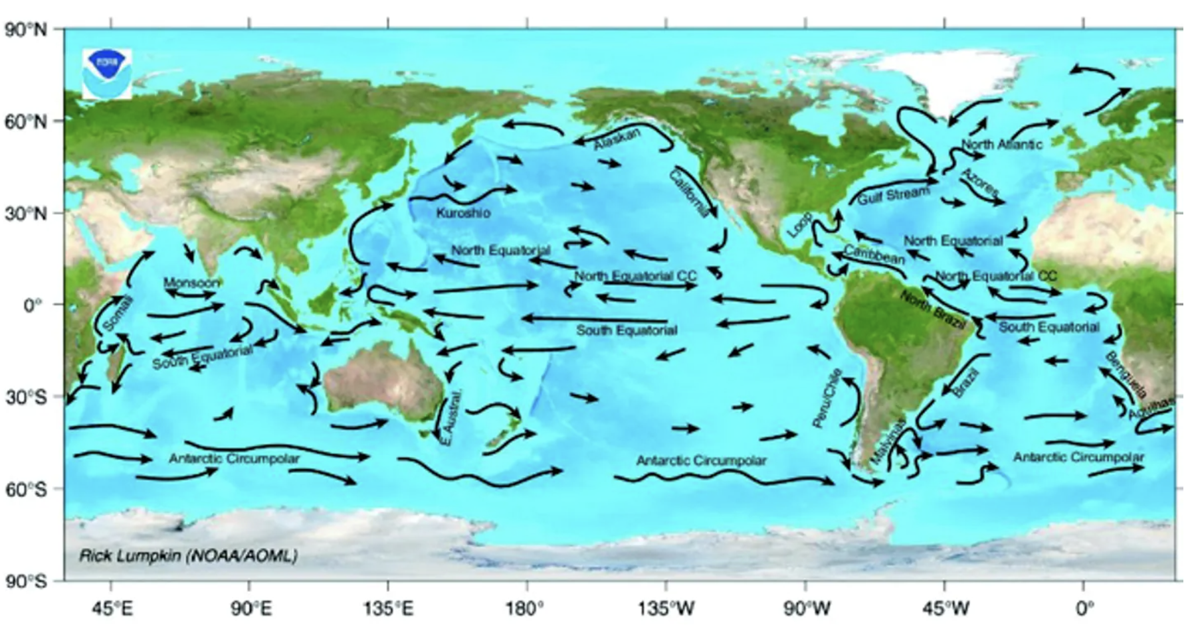
Currents have important jobs! They help spread heat around the Earth, kind of like nature's way of sharing warmth. They also carry nutrients and tiny living things, like plankton, to different places. So, currents are like the movers and shakers of the ocean, making sure things are flowing smoothly and helping life under the sea!
Notes:
Currents have important jobs! They help spread heat around the Earth, kind of like nature's way of sharing warmth. They also carry nutrients and tiny living things, like plankton, to different places. So,
currents are like the movers and shakers of the ocean, making sure things are flowing smoothly and helping life under the sea!

Slide 25
Notes:
Let’s check-in for understanding.

Slide 26
Which is NOT a key helper in making currents happen?
Wind
Temperature
Trees
Notes:
Which is NOT a key helper in making currents happen?
[Trees]

Slide 27
Which is NOT a key helper in making currents happen?
Wind
Temperature
Trees
Notes:
Which is NOT a key helper in making currents happen?
[Trees]

Slide 28
Currents help heat around the Earth.
Notes:
Currents help spread heat around the Earth.

Slide 29
Currents help spread heat around the Earth.
Notes:
Currents help heat around the Earth.
[heat]

Slide 30
Notes:
Now, let’s talk about some examples of fossil fuels.

Slide 31
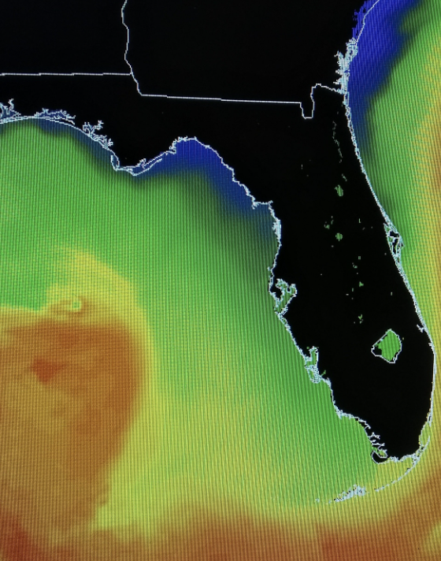
The Gulf Stream is an example of a major ocean current. The Gulf Stream is a warm, wind-driven surface current located in the Gulf of Mexico, which is part of the Atlantic Ocean.
Notes:
The Gulf Stream is an example of a major ocean current. The Gulf Stream is a warm, wind-driven surface current located in the Gulf of Mexico, which is part of the Atlantic Ocean.

Slide 32
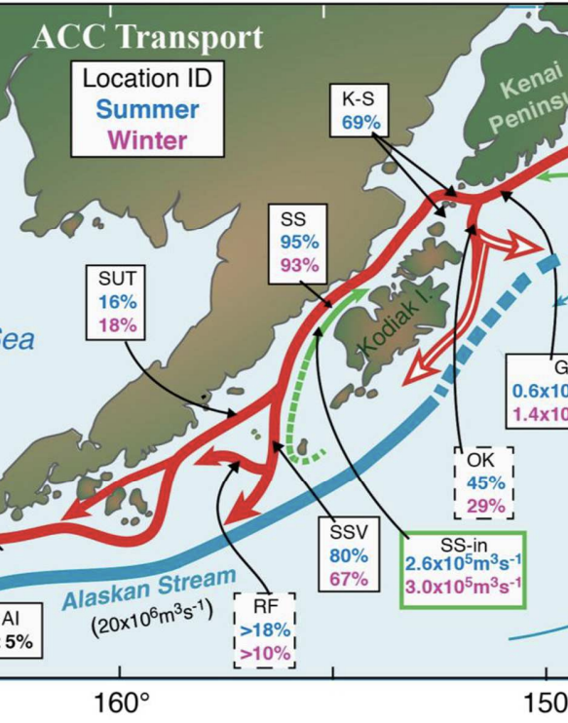
The Alaska Current is also an example of an ocean current. It is a warm current off the southwest coast of Alaska and the west coast of Canada.
Stabeno et al. (2016)
Notes:
The Alaska Current is also an example of an ocean current. It is a warm current off the southwest coast of Alaska and the west coast of Canada.
Iimage from: Stabeno, P. J., Bell, S., Cheng, W., Danielson, S., Kachel, N. B., & Mordy, C. W. (2016). Long-term observations of Alaska Coastal Current in the northern Gulf of Alaska. Deep Sea Research Part II: Topical Studies in Oceanography, 132, 24-40.

Slide 33
Notes:
Next, let’s talk about some non-examples of fossil fuels.

Slide 34
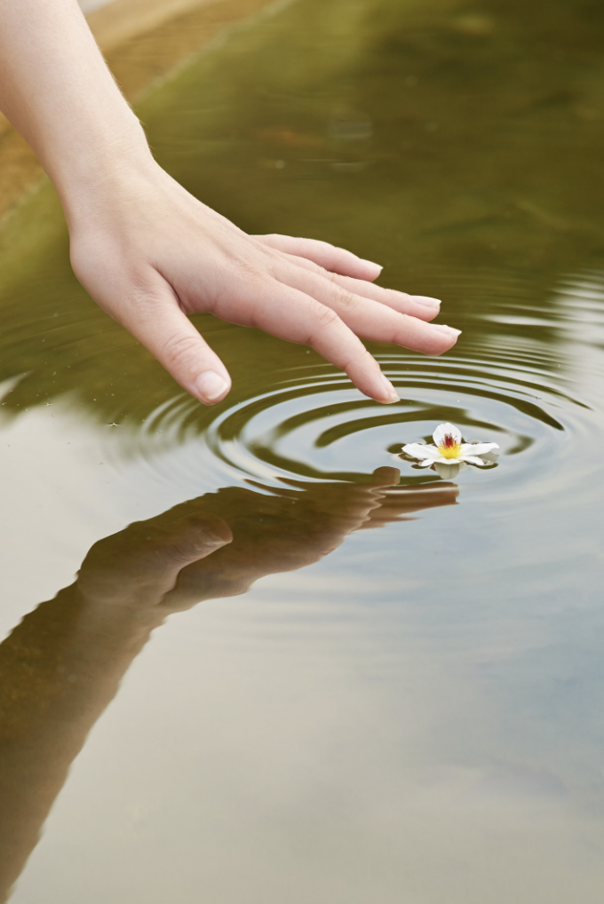
Ripples in the water are NOT an example of currents. While ripples on the surface of the water might look like a current, they are usually caused by a disturbance or wind and do not represent a continuous, steady flow.
Notes:
Ripples in the water are NOT an example of currents. While ripples on the surface of the water might look like a current, they are usually caused by a disturbance or wind and do not represent a continuous, steady flow.

Slide 35
Waterfalls are NOT an example of currents. Though waterfalls involve the movement of water, the downward flow is not a current in the same way river or ocean currents are. Waterfalls are more about the force of gravity pulling water downward.
Notes:
Waterfalls are NOT an example of currents. Though waterfalls involve the movement of water, the downward flow is not a current in the same way river or ocean currents are. Waterfalls are more about the force of gravity pulling water downward.

Slide 36
Notes:
Let’s check-in for understanding.

Slide 37
Why are water ripples and waterfalls NOT examples of currents?
Notes:
Why are water ripples and waterfalls NOT examples of currents?
[Water ripples do not have a continuous and steady flow of water and waterfalls water flow is related to gravity pulling the water down.]

Slide 38
Remember!!!
Notes:
So remember!

Slide 39
Current: The steady flow of water in a specific direction within a body of water
Notes:
A current is the steady flow of water in a specific direction within a body of water, like a river or an ocean.

Slide 40
Notes:
We will now complete this concept map, called a Frayer model, to summarize and further clarify what you have learned about the term fossil fuels.

Slide 41
Definition
Picture
Current
Example
How do currents impact my life?
Notes:
To complete the Frayer model, we will choose from four choices the correct picture, definition, example, and response to the question, “How do currents impact my life?” Select the best response for each question using the information you just learned. As we select responses, we will see how this model looks filled in for the term current.

Slide 42
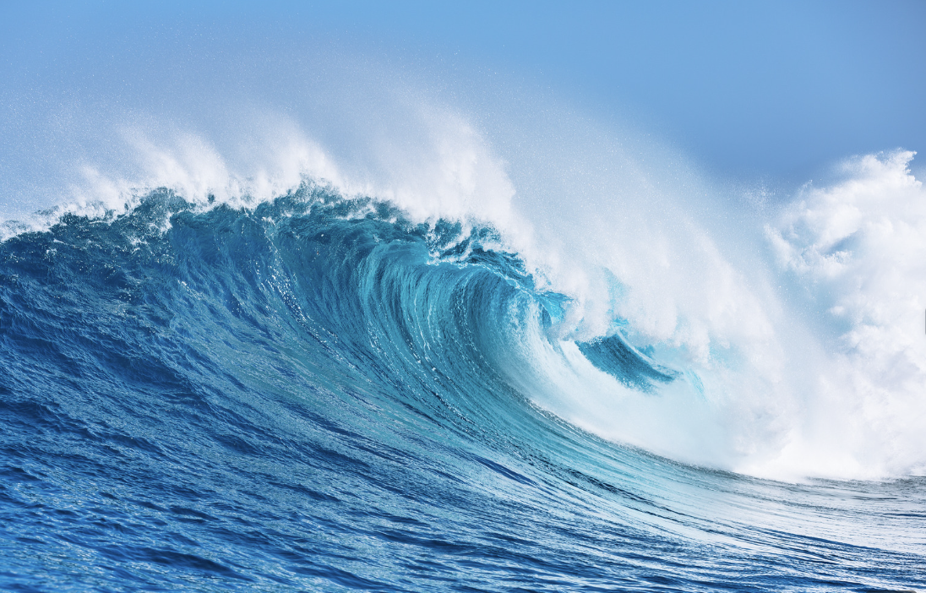
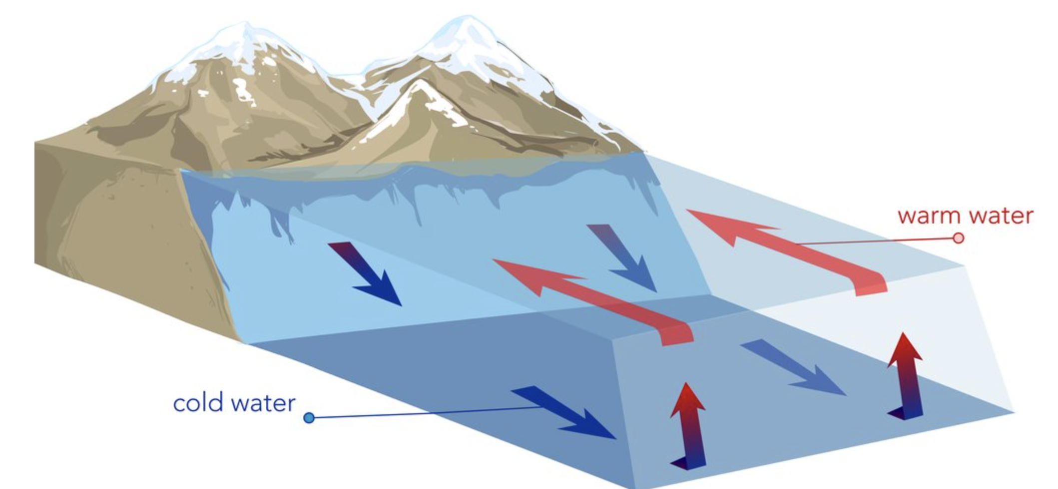
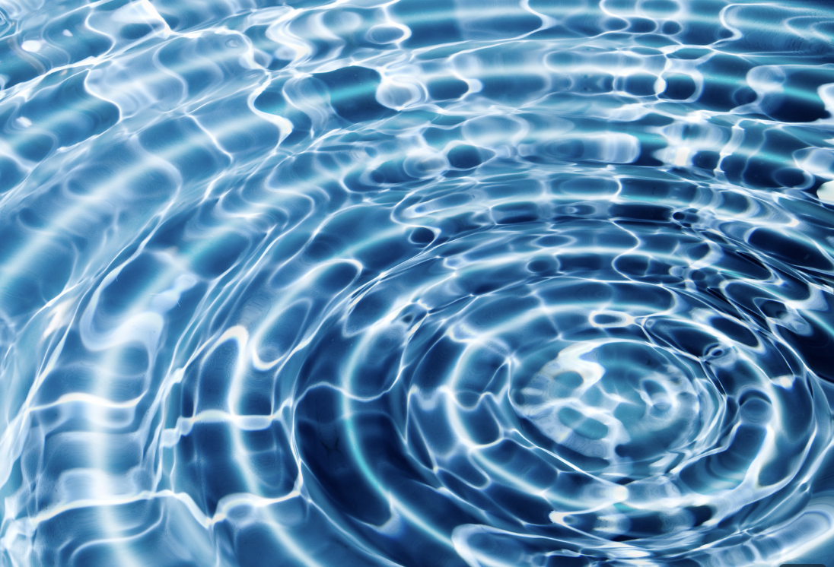
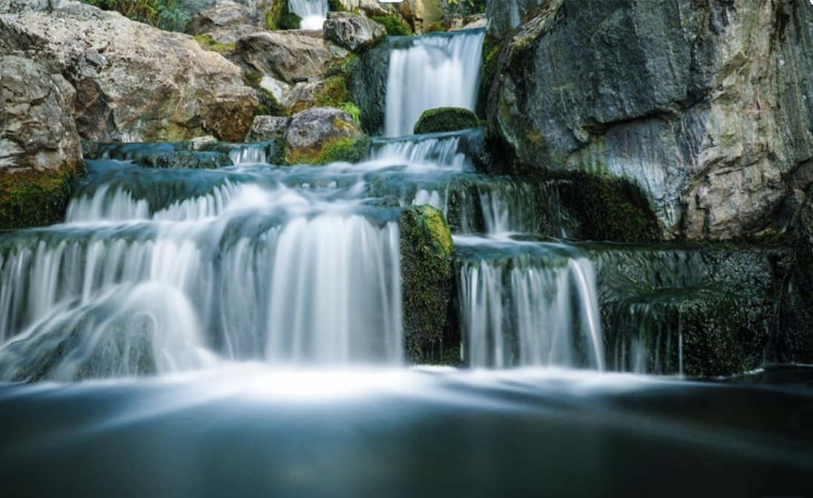
Directions: Choose the correct picture of a current from the choices below.
B
A
C
D
Notes:
Choose the one correct picture of a current from these four choices.

Slide 43
Directions: Choose the correct picture of a current from the choices below.
B
A
C
D
Notes:
This is the picture that shows a current.

Slide 44
Definition
Picture
Current
Example
How do currents impact my life?
Notes:
Here is the Frayer model filled in with a picture of a current.

Slide 45
Directions: Choose the correct definition of
current from the choices below.
A
The steady flow of water in a specific direction within a body of water
B
The steady flow of water from a faucet
C
The steady flow of water downward from a gravitational pull.
D
A substance containing only one type of atom
Notes:
Choose the one correct definition of a current from these four choices.

Slide 46
Directions: Choose the correct definition of
current from the choices below.
A
The steady flow of water in a specific direction within a body of water
B
The steady flow of water from a faucet
C
The steady flow of water downward from a gravitational pull.
D
A substance containing only one type of atom
Notes:
“The steady flow of water in a specific direction within a body of water” is correct! This is the definition of a current.

Slide 47
Definition
Picture
The steady flow of water in a specific direction within a body of water
Current
Example
How do currents impact my life?
Notes:
Here is the Frayer Model with a picture and the definition filled in for current: The steady flow of water in a specific direction within a body of water

Slide 48
Directions: Choose the correct example of a
current from the choices below.
A
The Ring of Fire
B
The Atlantic Ocean
C
The Indian Ocean
D
The Gulf Stream
Notes:
Choose the one correct example of a current from these four choices.

Slide 49
Directions: Choose the correct example of a
current from the choices below.
A
The Ring of Fire
B
The Atlantic Ocean
C
The Indian Ocean
D
The Gulf Stream
Notes:
“The Gulf Stream” is correct! This is an example of an ocean current.

Slide 50
Definition
Picture
The steady flow of water in a specific direction within a body of water
Current
The Gulf Stream
Example
How do currents impact my life?
Notes:
Here is the Frayer Model with a picture, definition, and an example of an ocean current: The Gulf Stream.

Slide 51
Directions: Choose the correct response for “how do currents impact my life?” from the choices below.
Currents, like oil, coal, and natural gas, give us energy for things like electricity, cars, and heating, but burning them also worsens the environment through air pollution and climate change.
A
B
Currents provide us energy sources that will never run out so that we can ensure our survival on the planet for forever.
Currents tell us about plants and animals that used to live on Earth so that we can better understand the different organisms on Earth today.
C
Currents impact my life by influencing the weather, helping ships travel more efficiently, and even impacting the habitats (homes) of marine animals.
D
Notes:
Choose the one correct response for “how do currents impact my life?” from these four choices.

Slide 52
Directions: Choose the correct response for “how do currents impact my life?” from the choices below.
Currents, like oil, coal, and natural gas, give us energy for things like electricity, cars, and heating, but burning them also worsens the environment through air pollution and climate change.
A
B
Currents provide us energy sources that will never run out so that we can ensure our survival on the planet for forever.
Currents tell us about plants and animals that used to live on Earth so that we can better understand the different organisms on Earth today.
C
Currents impact my life by influencing the weather, helping ships travel more efficiently, and even impacting the habitats (homes) of marine animals.
D
Notes:
“Currents impact my life by influencing the weather, helping ships travel more efficiently, and even impacting the habitats (homes) of marine animals.” That is correct! This is an example of how currents impact your life.

Slide 53
Definition
Picture
The steady flow of water in a specific direction within a body of water
Current
Currents impact my life by influencing the weather, helping ships travel more efficiently, and even impacting the habitats (homes) of marine animals.
The Gulf Stream
Example
How do currents impact my life?
Notes:
Here is the Frayer Model with a picture, definition, example, and a correct response to “how do currents impact my life?”: Currents impact my life by influencing the weather, helping ships travel more efficiently, and even impacting the habitats (homes) of marine animals.

Slide 54
Remember!!!
Notes:
So remember!

Slide 55
Current: The steady flow of water in a specific direction within a body of water
Notes:
A current is the steady flow of water in a specific direction within a body of water, like a river or an ocean.

Slide 56
Big Question: How do ocean currents connect different parts of the world, and in what ways do they influence weather patterns?
Notes:
Explicit cue to revisit the big question at the end of the lesson: Okay everyone. Now that we’ve learned the term, let’s reflect once more on our big question: How do ocean currents connect different parts of the world, and in what ways do they influence weather patterns?
Was there anything that we predicted earlier that was correct or incorrect? Do you have any new hypotheses to share?

Slide 57
Simulation Activity
Ocean Currents Game
Notes:
Play Go With the Flow to learn about ocean currents—and to unlock the hidden treasure!
In this game, you are in a submarine and you need to fix the currents to take you where you want to go. Where do you want to go? You want to get the key to the treasure chest full of gold!
Feedback: Have students analyze and interpret data to elevate their understanding of the content and strengthen their critical thinking skills.

Slide 58
Notes:
Thanks for watching, and please continue watching CAPs available from this website.

Slide 59
This Video Was Created With Resources From:
Questions or Comments
Michael Kennedy, Ph.D. MKennedy@Virginia.edu
Rachel L Kunemund, Ph.D. rk8vm@virginia.edu

