Slide 1
Intro
“Big Idea” Question
Review Concepts
Check-In Questions
Teacher Engagement
Vocabulary
Student-Friendly Definition
Examples & Non-Examples
Frayer Model
Simulation/Activity
Notes:
OK everyone, get ready for our next lesson. Just as a reminder, these are the different components that our lesson may include, and you’ll see these icons in the top left corner of each slide so that you can follow along more easily!

Slide 2
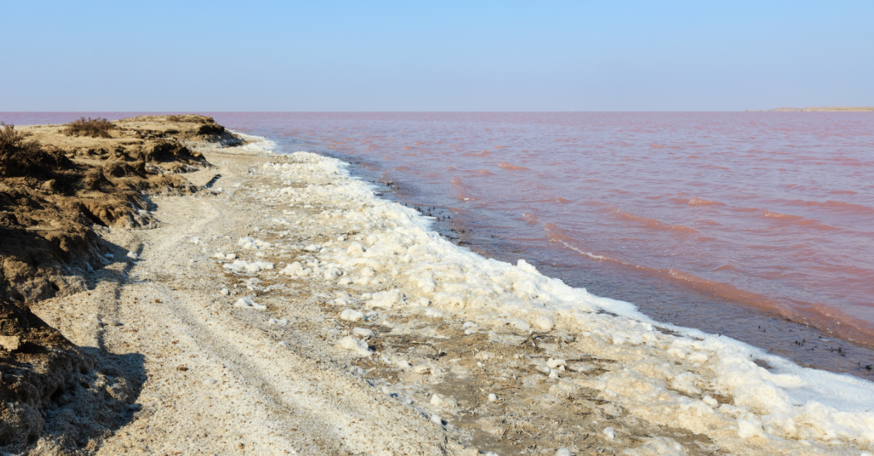
Intro
Deposition
Notes:
Today, we’ll be learning about the word: Deposition.

Slide 3
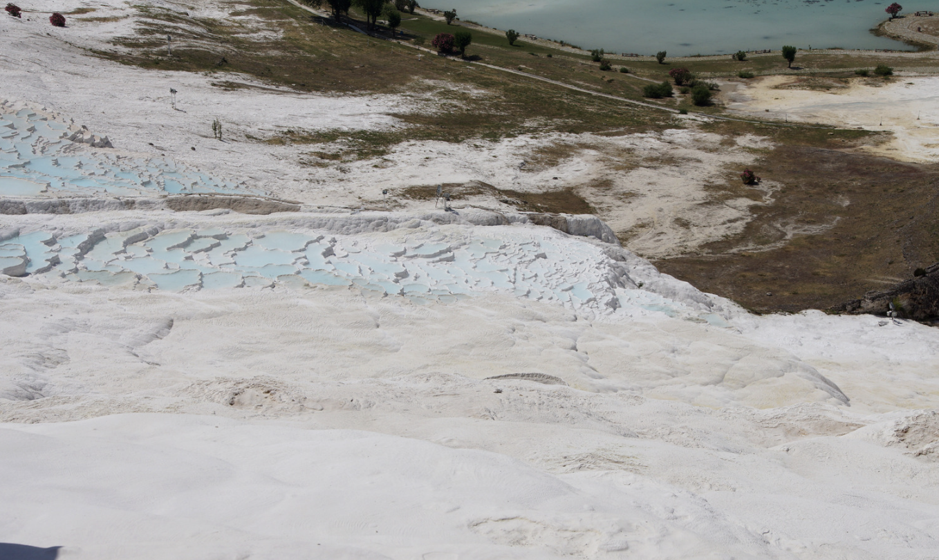
Big Question: How does deposition change the landscape of our beaches, rivers, and parks, and what effects does that have on our environment and the activities we enjoy in these places?
Notes:
Our “big question” is: How does deposition change the landscape of our beaches, rivers, and parks, and what effects does that have on our environment and the activities we enjoy in these places?
I love all these thoughtful scientific hypotheses! Be sure to keep this question and your predictions in mind as we move through these next few lessons, and we’ll continue to revisit it.

Slide 4
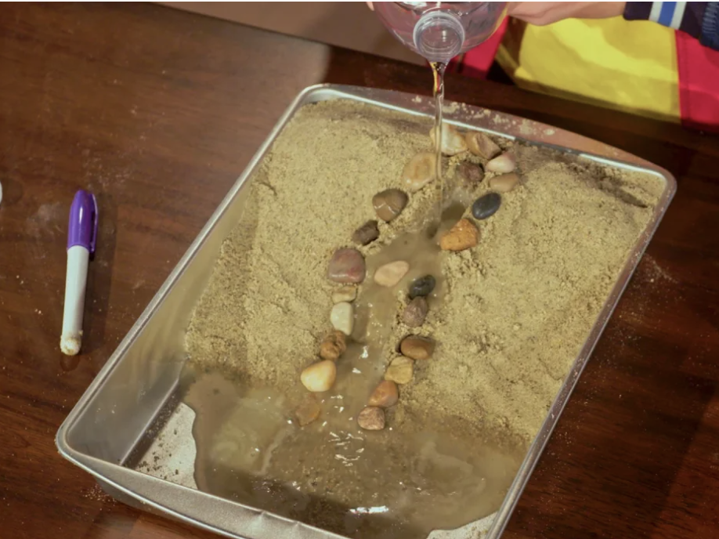
Demonstration
TEACHER DIRECTIONS:
Before viewing: Ask students what they already know about epicenters. Tell students today they will be learning about the term deposition.
During: Encourage students to discuss how this simple model represents natural processes like the formation of river deltas or sandbanks. Ask students to think about how deposition changes the landscape over time, such as creating new landforms or fertile soil for plants.
After: Tell students that today they will be learning more about the term deposition.
Notes:
An effective and feasible classroom demonstration to teach 5th graders about deposition involves a simple experiment using sand, water, and a container:
Materials Needed:
A clear plastic container or a large glass jar.
Sand (a couple of cups should be enough).
Water.
A spoon or stick for stirring.
Steps:
Prepare the Container: Fill the container about halfway with water.
Add Sand: Slowly pour sand into the water while stirring gently with the spoon or stick. This simulates materials like sand and soil being carried by moving water.
Observe Deposition: Let the container stand still after stirring. Watch as the sand settles at the bottom of the container. This settling process is an example of deposition, where materials being carried by water are laid down.
Discussion: Discuss how this simple model represents natural processes like the formation of river deltas or sandbanks. Ask students to think about how deposition changes the landscape over time, such as creating new landforms or fertile soil for plants.
Extension: To make the demonstration more complex, you can add different materials like small pebbles or organic matter (like leaves) to see how different materials deposit at different rates.
This demonstration is effective because it visually shows the process of deposition in an easily understandable way. It also provides a hands-on learning experience, which can be more engaging for young students.

Slide 5
Notes:
Before we move on to our new topic, let’s review some other words & concepts that you already learned and make sure you are firm in your understanding.

Slide 6
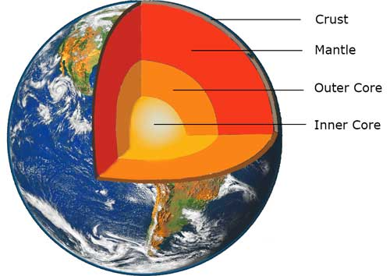
The Layers of the Earth
Notes:
Review the layers of the Earth.

Slide 7
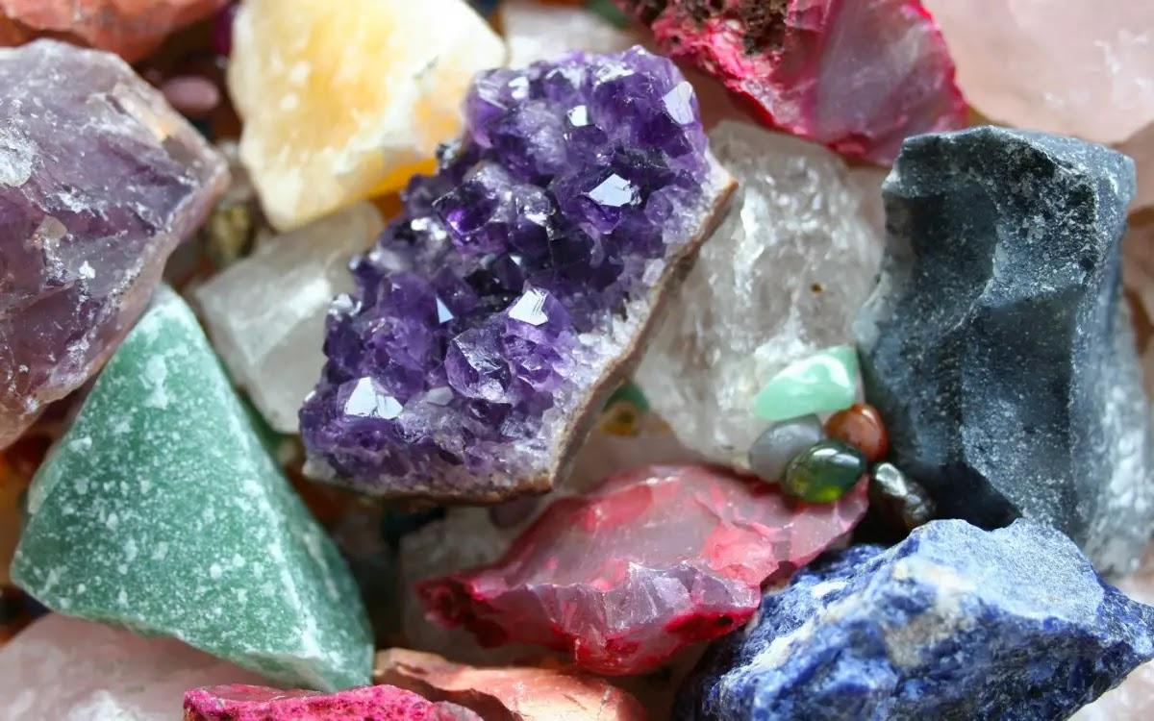
Mineral: Substances that do not come from an animal or plant, the building blocks that make up rocks
Notes:
Mineral: Substances that do not come from an animal or plant, the building blocks that make up rocks

Slide 8
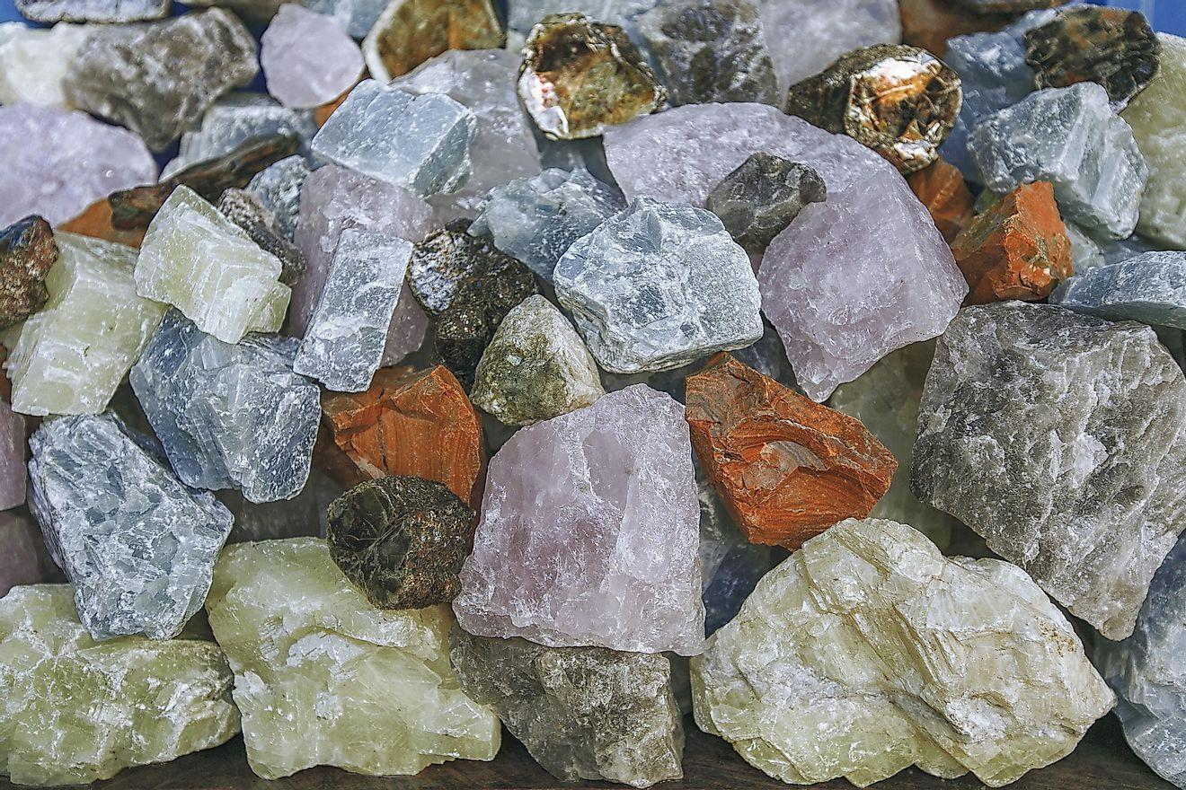
Rock: A solid collection of minerals.
Notes:
Rock: A solid collection of minerals.

Slide 9
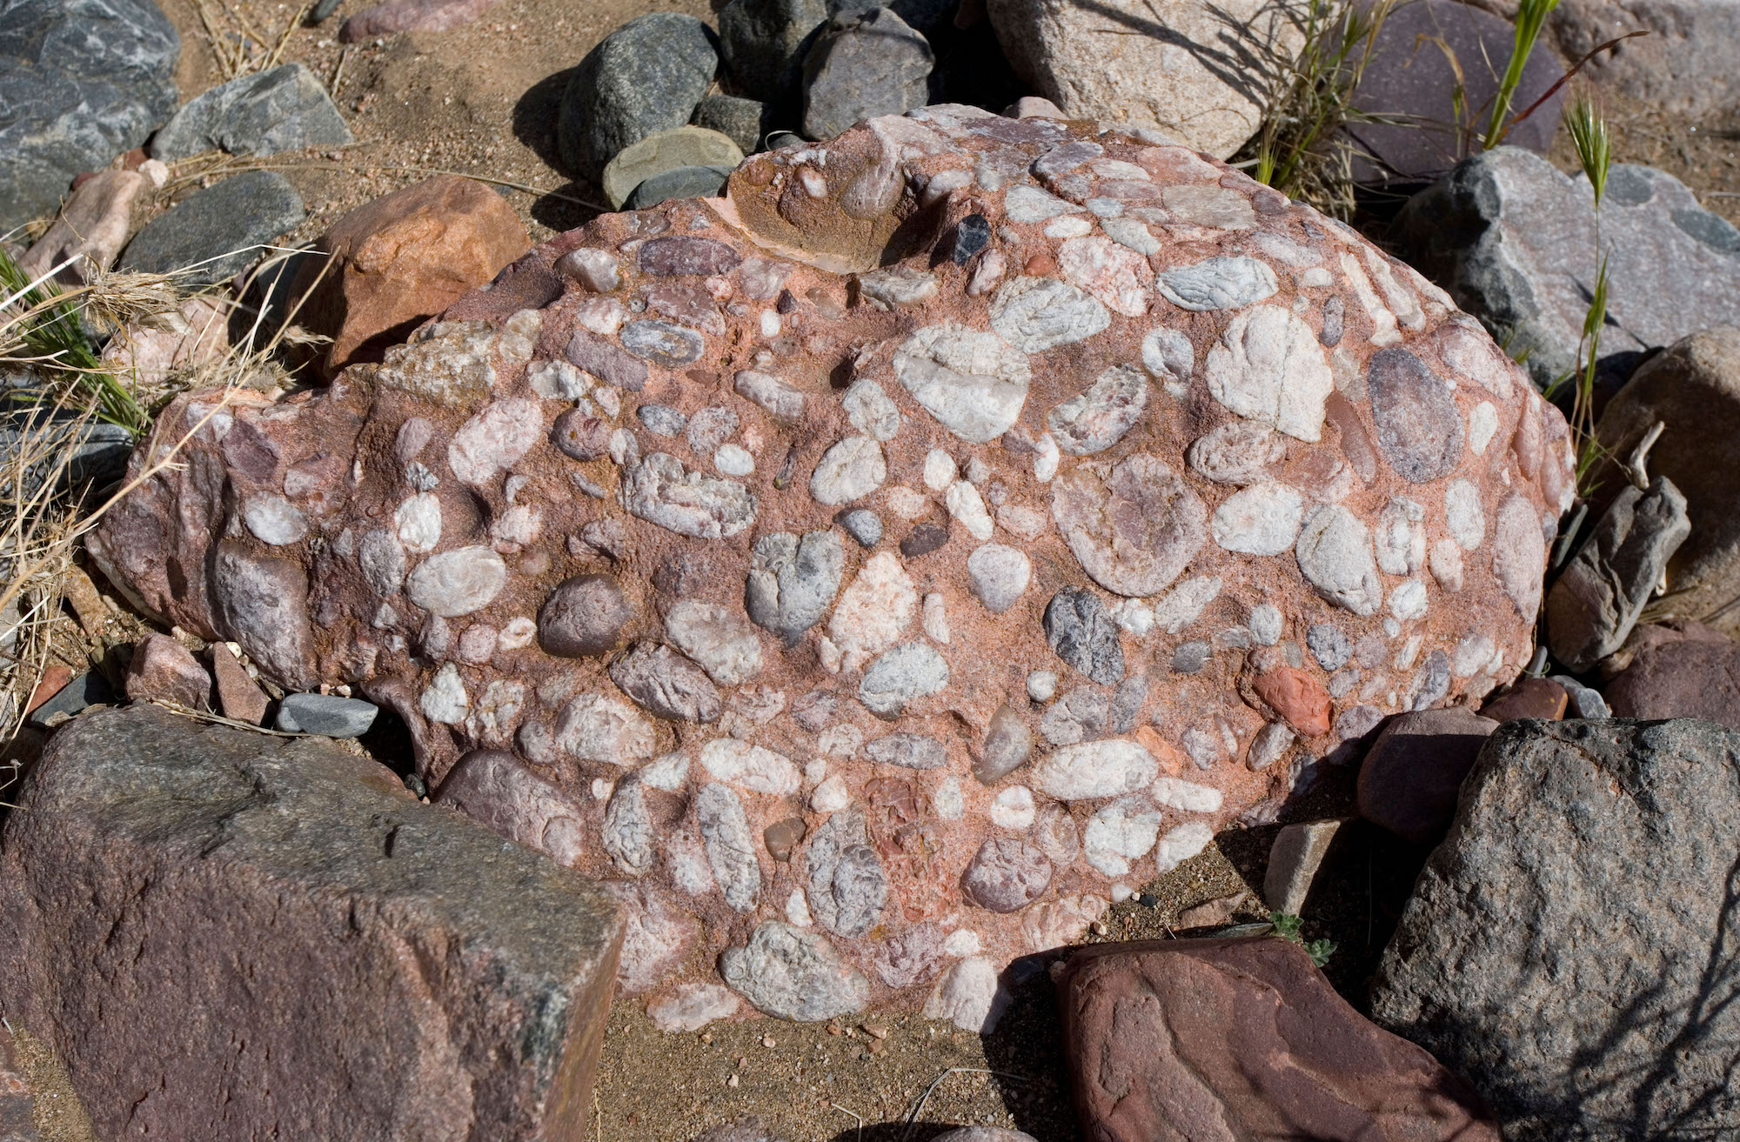
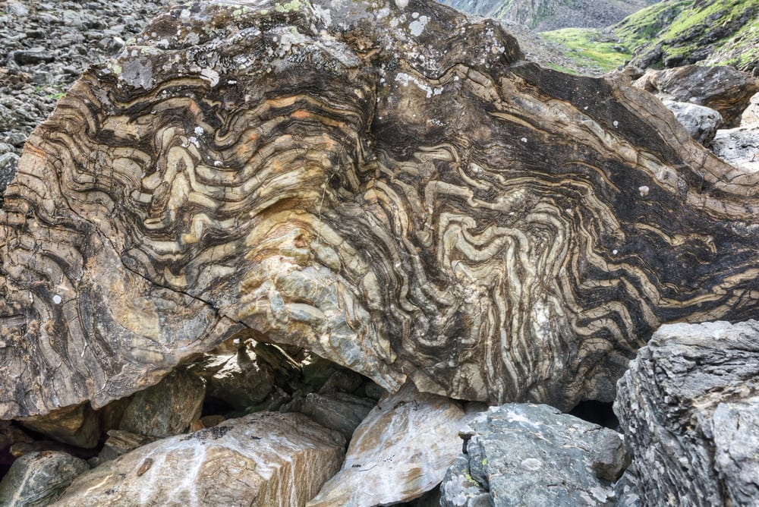
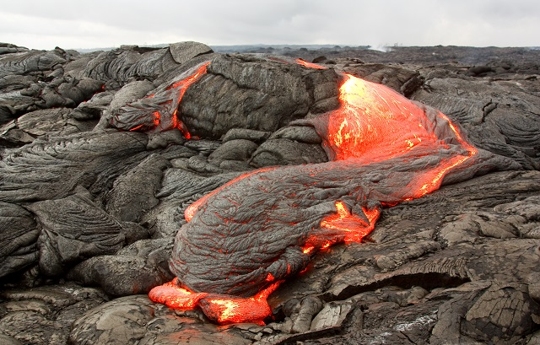
There are three types of rocks. Each type forms differently.
Igneous – when lava cools down and solidifies
Sedimentary – when small particles e.g., minerals, organic materials, sand, stick together over time
Metamorphic – when existing rocks undergo temperature, pressure, or chemical change
Notes:
There are three types of rocks. Each type of rock forms differently.

Slide 10
Notes:
Now let’s pause for a moment to review the information we have covered already.

Slide 11
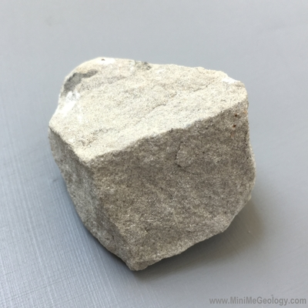
What is the relationship between rocks and minerals?
Rocks are created when minerals go through changes in temperature and pressure.
Rocks are tiny pieces of minerals that stick together over time.
Rocks are made up of one or more mineral.
Notes:
What is the relationship between rocks and minerals?
[C] Rocks are made up of one or more mineral.

Slide 12
What is the relationship between rocks and minerals?
Rocks are created when minerals go through changes in temperature and pressure.
Rocks are tiny pieces of minerals that stick together over time.
Rocks are made up of one or more mineral.
Notes:
What is the relationship between rocks and minerals? Rocks are made up of one or more mineral.
[C] Rocks are made up of one or more mineral.

Slide 13
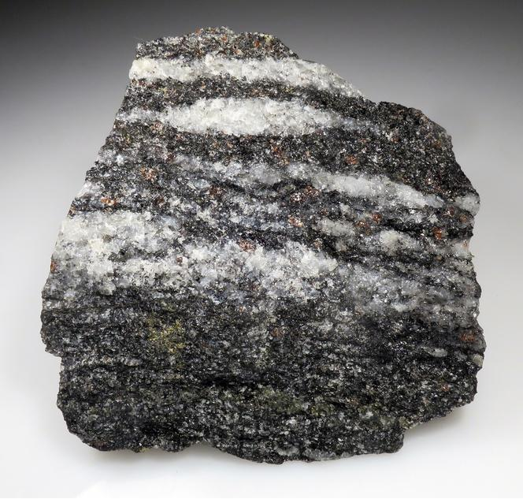
Which of the following materials can rocks not be made of?
Sand particles
Minerals
Former living things
Fossils
Notes:
Which of the following materials can rocks not be made of?
[D] Fossils

Slide 14
Which of the following materials can rocks not be made of?
Sand particles
Minerals
Former living things
Fossils
Notes:
Which of the following materials can rocks not be made of?
[D] Fossils

Slide 15
Deposition
Notes:
Now that we’ve reviewed, let’s define the phrase Deposition

Slide 16
Deposition: dropping of sediment to a new location
Notes:
Deposition is the dropping of sediment to a new location

Slide 17
Notes:
Let’s check-in for understanding.

Slide 18
What is deposition?
Notes:
What is deposition?
[Dropping of sediment to a new location.]

Slide 19
Notes:
That is the basic definition, but there is a bit more you need to know.

Slide 20
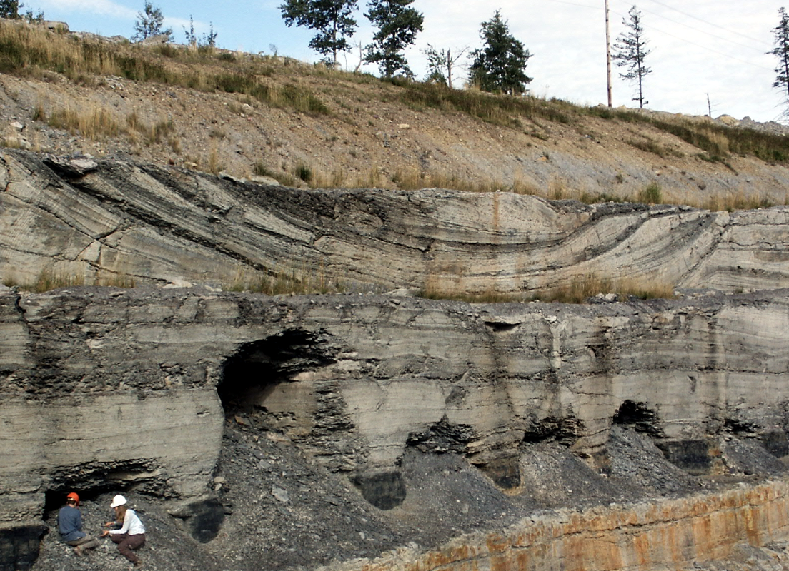
Sediment can include particles like sand, silt, and rocks. When these particles are transported by wind, water, or ice, they eventually settle or drop to the ground, a process known as deposition.
Notes:
Sediment can include particles like sand, silt, and rocks. When these particles are transported by wind, water, or ice, they eventually settle or drop to the ground, a process known as deposition.

Slide 21
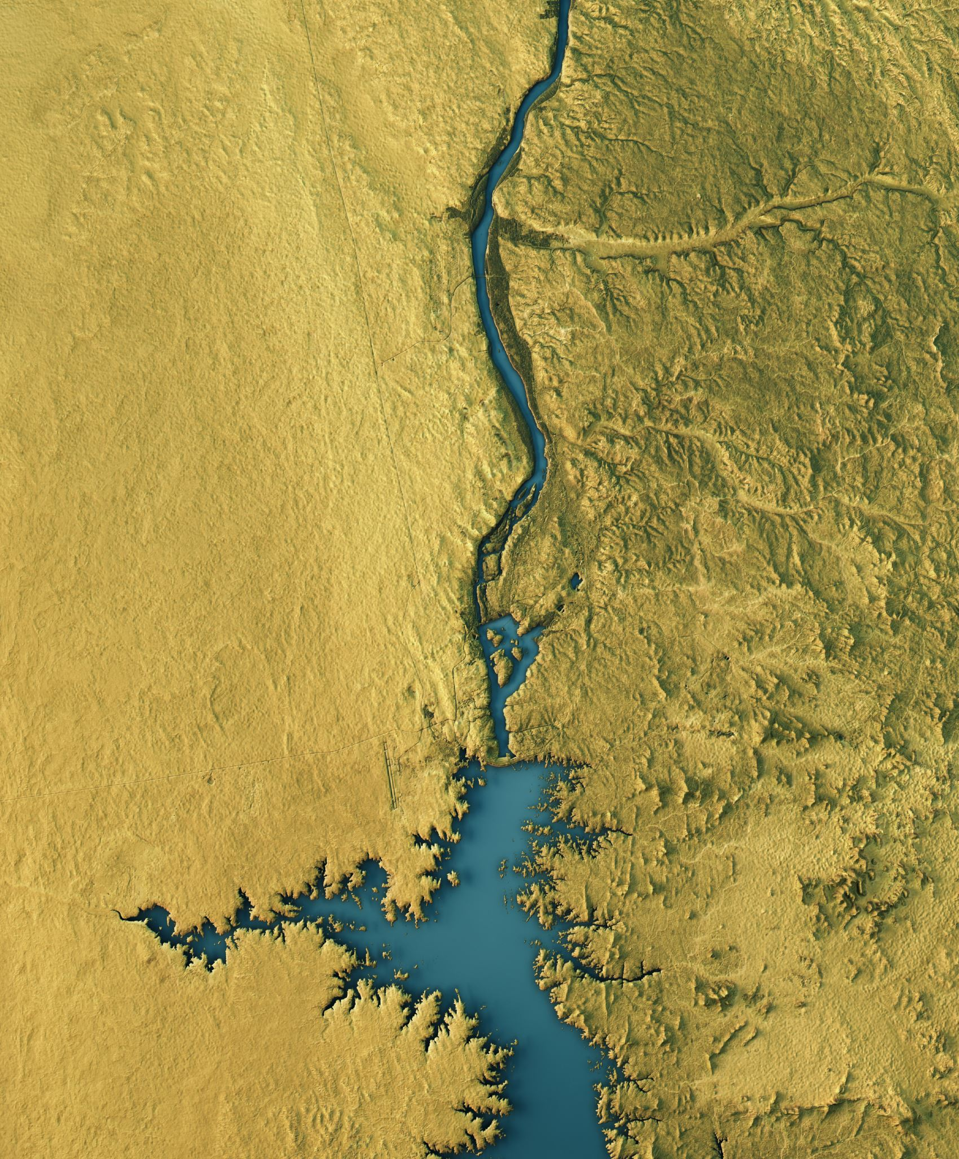
The are different things that cause deposition such as water. Rivers, streams, and ocean currents transport sediment and deposit it when the water slows down.
Notes:
The are different things that cause deposition such as water. Rivers, streams, and ocean currents transport sediment and deposit it when the water slows down.

Slide 22
Wind is also a cause of deposition. Wind can carry smaller particles like sand and deposit them when the wind speed decreases.
Notes:
Wind is also a cause of deposition. Wind can carry smaller particles like sand and deposit them when the wind speed decreases.

Slide 23
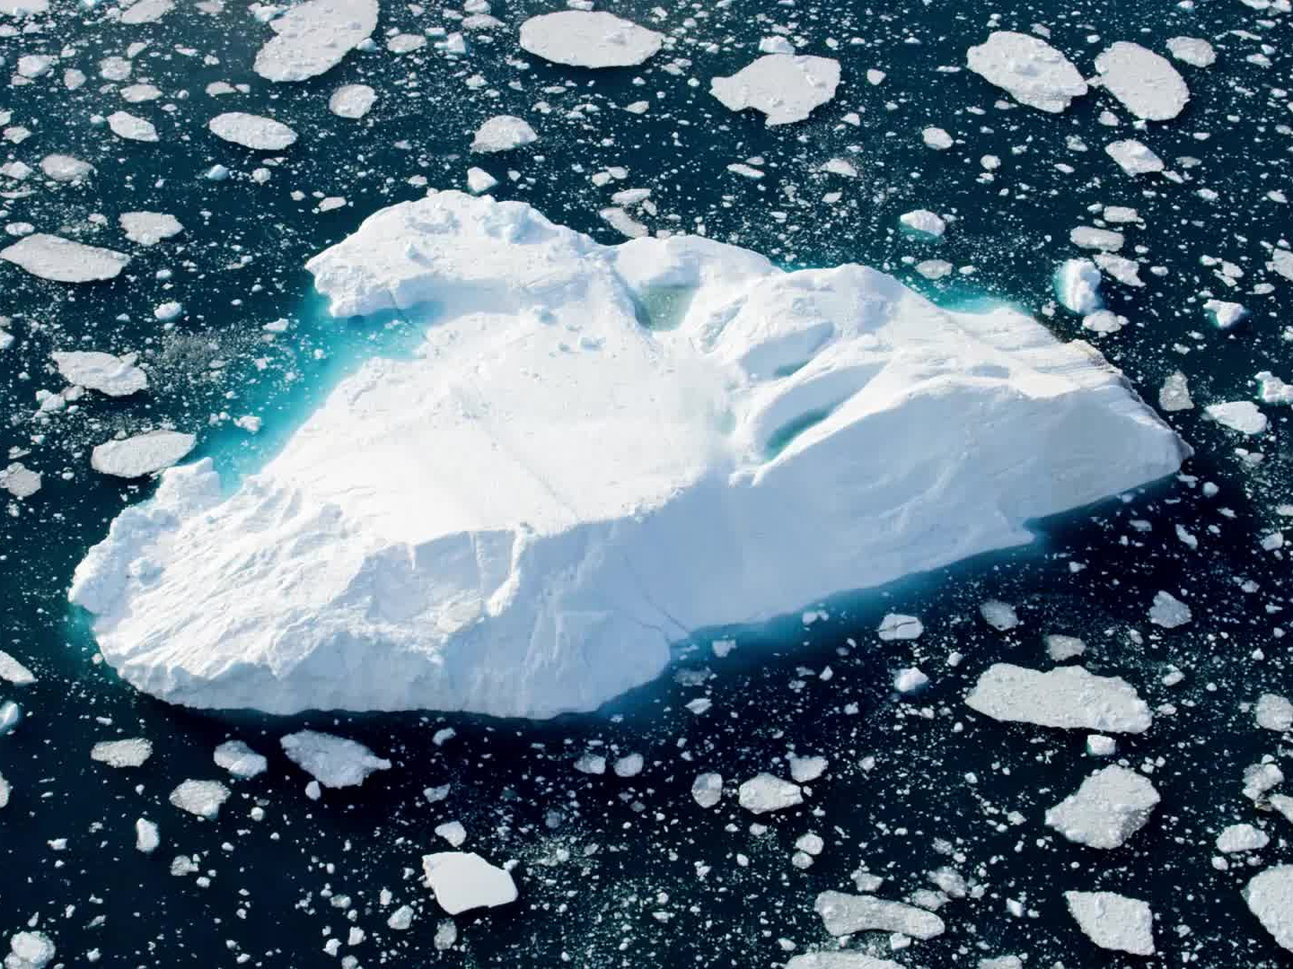
Ice is another cause of deposition. Glaciers transport and deposit large amounts of sediment as they move.
Notes:
Ice is another cause of deposition. Glaciers transport and deposit large amounts of sediment as they move.

Slide 24
Deposition contributes to the formation of various landforms such as beaches, sand dunes, riverbanks, and deltas. These landforms result from the accumulation of deposited sediment.
Notes:
Deposition contributes to the formation of various landforms such as beaches, sand dunes, riverbanks, and deltas. These landforms result from the accumulation of deposited sediment.

Slide 25
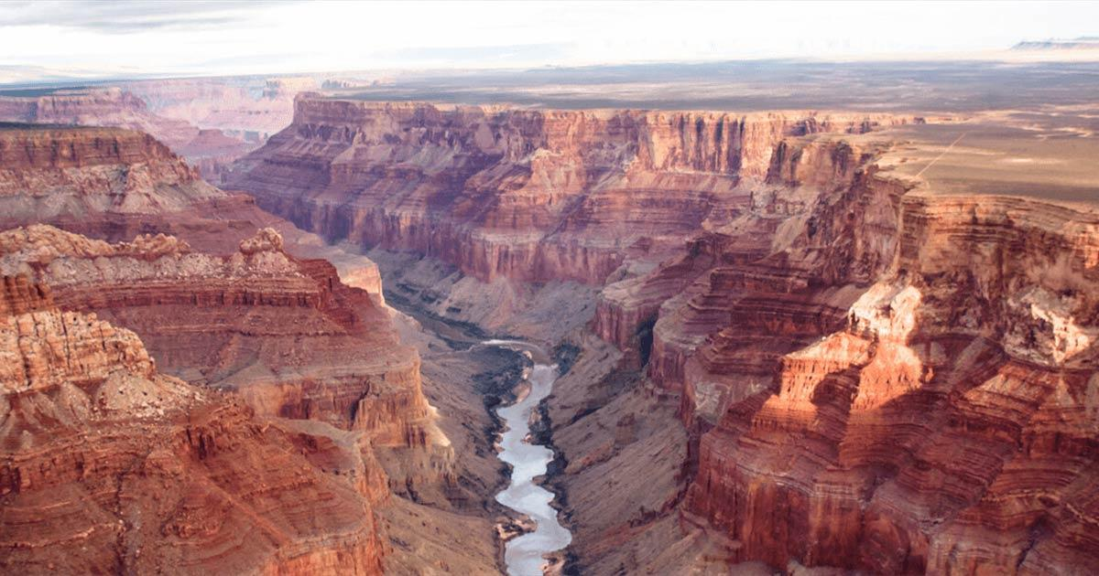
Deposition is a gradual process that occurs over time. Sediment may collect layer by layer, eventually forming thick deposits.
Notes:
Deposition is a gradual process that occurs over time. Sediment may collect layer by layer, eventually forming thick deposits.

Slide 26
Notes:
Let’s check-in for understanding.

Slide 27
True or False: Wind is one cause of deposition.
Notes:
True or False: Wind is one cause of deposition.
[True]

Slide 28
True or False: Wind is one cause of deposition.
Notes:
True: Wind is one cause of deposition.

Slide 29
Deposition is a gradual process that occurs over time. Sediment may collect
by , eventually forming thick deposits.
Notes:
Deposition is a gradual process that occurs over time. Sediment may collect by , eventually forming thick deposits.
[layer, layer]

Slide 30
Deposition is a gradual process that occurs over time. Sediment may collect
layer by layer, eventually forming thick deposits.
Notes:
Deposition is a gradual process that occurs over time. Sediment may collect layer by layer, eventually forming thick deposits.

Slide 31
Notes:
Now, let’s talk about some examples of deposition.

Slide 32
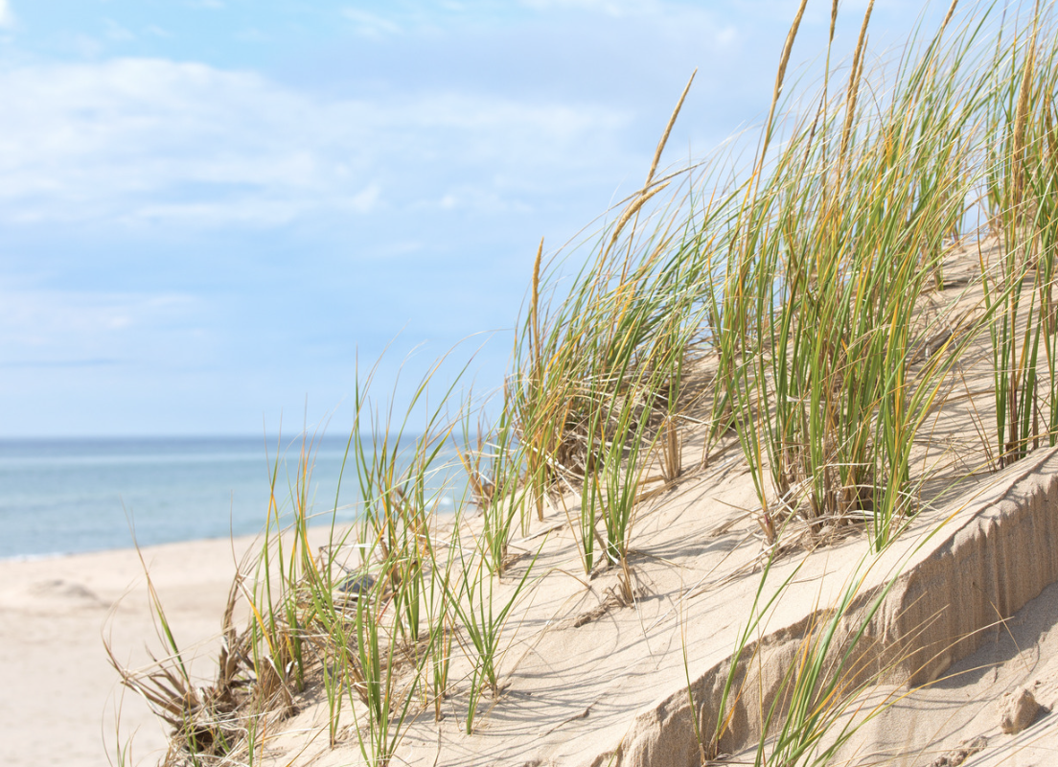
Beach Sand Dunes are an example of deposition. The wind blows sand along the beach, and over time, this sand gets deposited in piles, creating dunes. This is a clear example of deposition by wind.
Notes:
Beach Sand Dunes are an example of deposition. The wind blows sand along the beach, and over time, this sand gets deposited in piles, creating dunes. This is a clear example of deposition by wind.

Slide 33
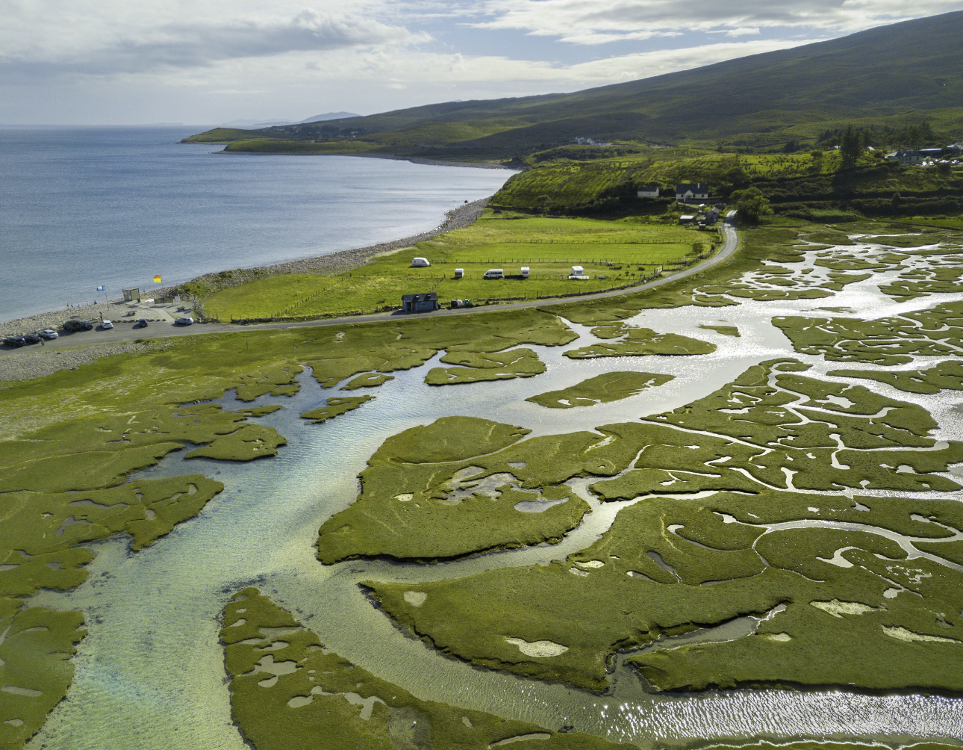
River Deltas are another example of deposition. They are formed when a river slows down and enters slow or stagnant water and drops off, or deposits, the soil and sediment it’s carrying, forming new land over time.
Notes:
River Deltas are another example of deposition. They are formed when a river slows down and enters slow or stagnant water and drops off, or deposits, the soil and sediment it’s carrying, forming new
land over time.

Slide 34
Notes:
Now, let’s talk about some non-examples of deposition.

Slide 35
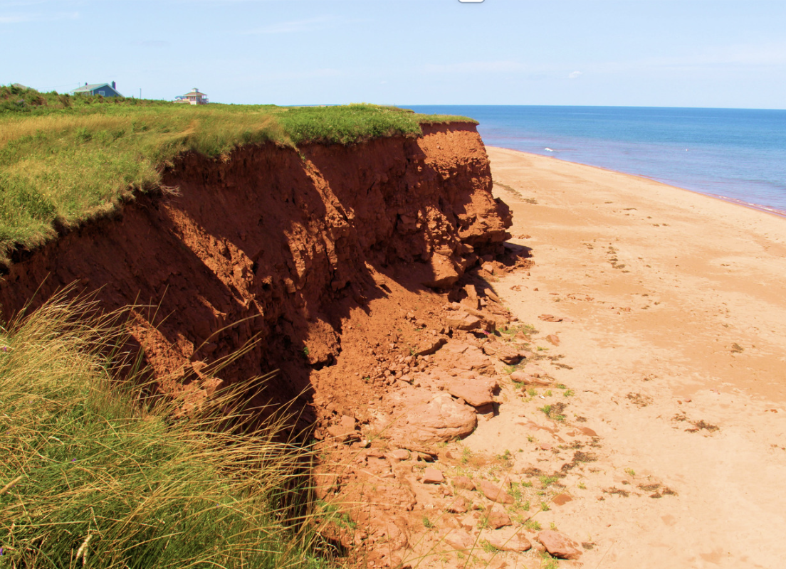
Erosion is NOT an example of deposition. While deposition involves the laying down or building up of material, erosion is the wearing away and removal of soil, rock, or sediment.
Notes:
Erosion is NOT an example of deposition. While deposition involves the laying down or building up of material, erosion is the wearing away and removal of soil, rock, or sediment.

Slide 36
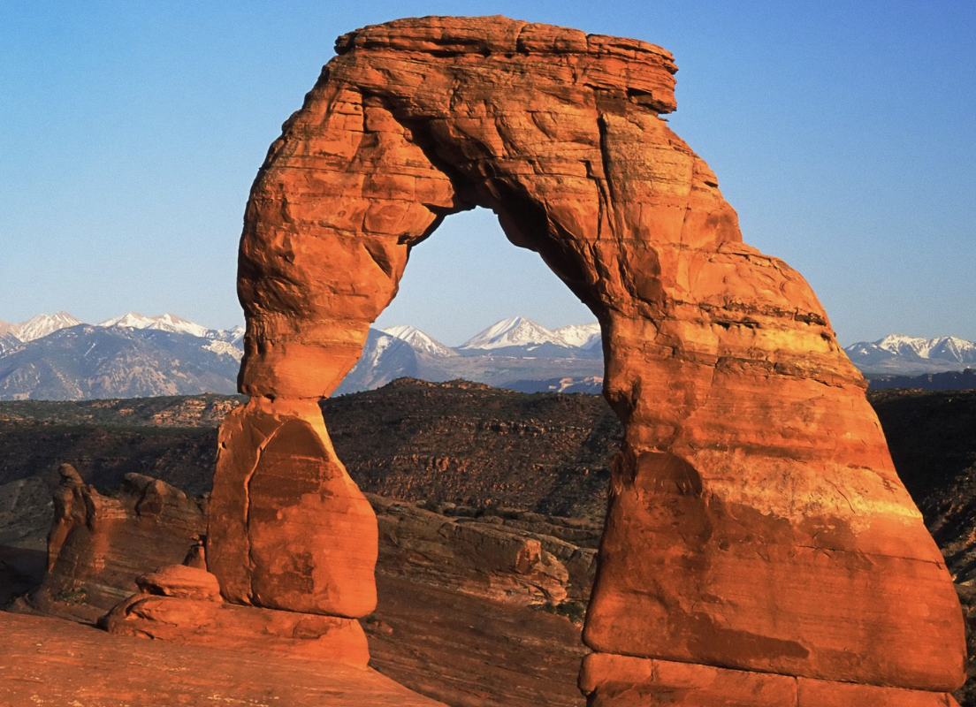
Weathering is NOT an example of deposition. Weathering is the breaking down of rocks, soil, and minerals through contact with the Earth's atmosphere, such as wind or water.
Notes:
Weathering is NOT an example of deposition. Weathering is the breaking down of rocks, soil, and minerals through contact with the Earth's atmosphere, such as wind or water.

Slide 37
Notes:
Now let’s pause for a moment to check your understanding.

Slide 38
Why are erosion and weathering not examples of deposition?
Notes:
Why are erosion and weathering not examples of deposition?
[Erosion is NOT an example of deposition because erosion is the wearing away and removal of soil, rock, or sediment. Weathering is NOT an example of deposition because weathering is the breaking down of rocks, soil, and minerals through contact with the Earth's atmosphere, such as wind or water.]

Slide 39
Remember!!!
Notes:
So remember!

Slide 40
Deposition: dropping of sediment to a new location
Notes:
Deposition is the dropping of sediment to a new location

Slide 41
Notes:
We will now complete this concept map, called a Frayer model, to summarize and further clarify what you have learned about the term deposition.

Slide 42
Definition
Picture
Deposition
How does deposition impact my life?
Example
Notes:
To complete the Frayer model, we will choose from four choices the correct picture, definition, example, and response to the question, “How does deposition impact my life?” Select the best response for each question using the information you just learned. As we select responses, we will see how this model looks filled in for the term deposition.

Slide 43
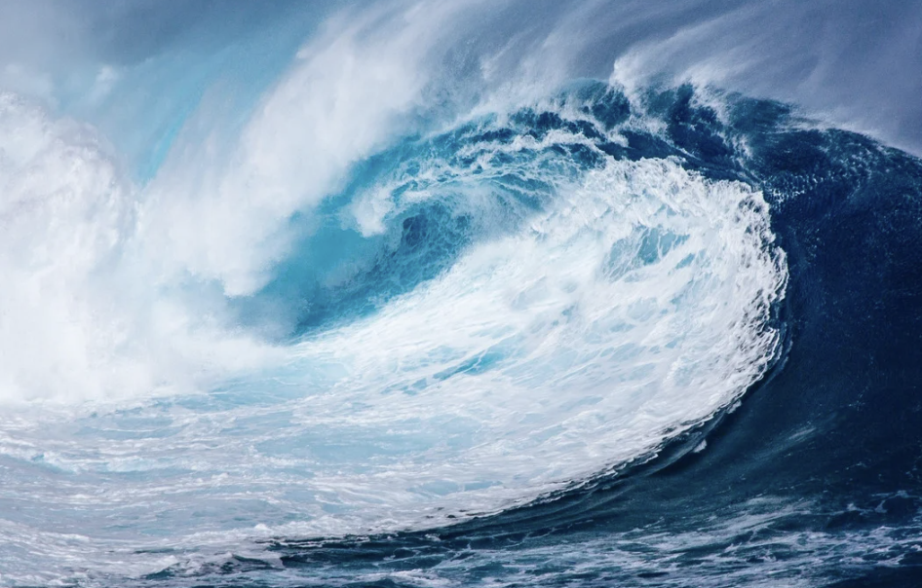
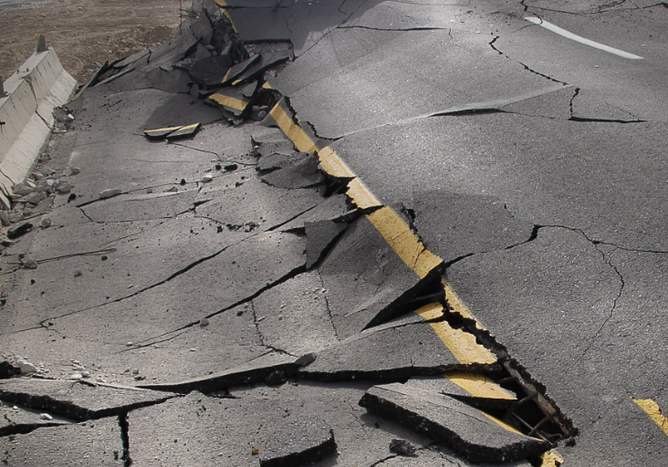
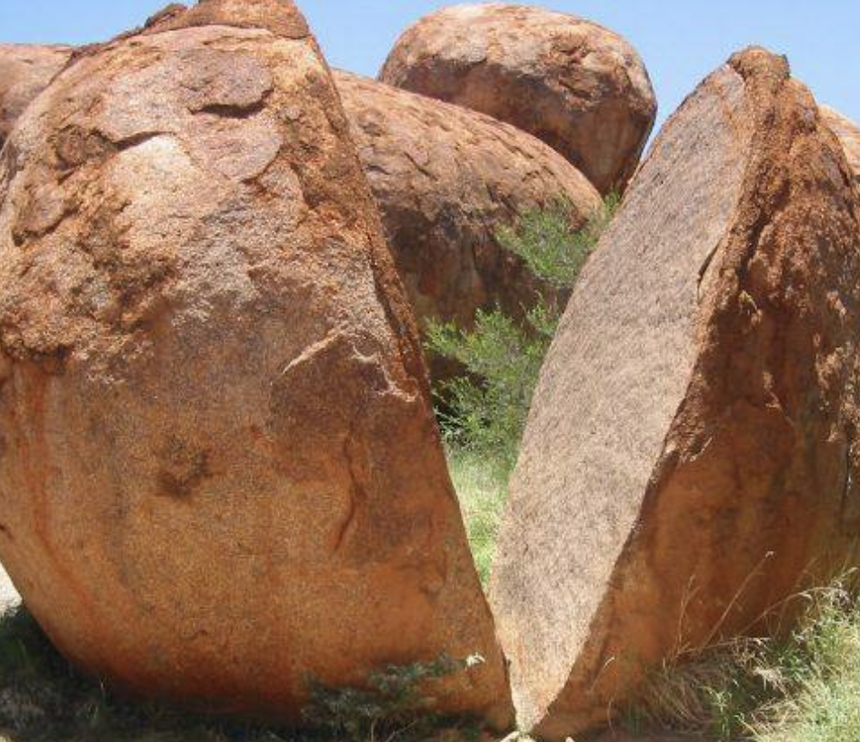
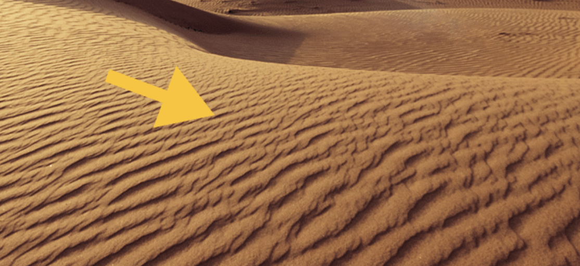
Directions: Choose the correct picture of deposition from the choices below.
A
B
C
D
Notes:
Choose the correct picture of deposition from the choices below.

Slide 44
Directions: Choose the correct picture of deposition from the choices below.
A
B
C
D
Notes:
This is the picture that shows deposition.

Slide 45
Definition
Picture
Deposition
How does deposition impact my life?
Example
Notes:
Here is the Frayer model filled in with a picture of deposition.

Slide 46
Directions: Choose the correct definition of deposition from the choices below.
A
Substances that do not come from an animal or plant, the building blocks that make up rocks
B
A solid collection of crystals
C
The process of breaking down rock over long periods of time
D
The dropping of sediment to a new location
Notes:
Choose the one correct definition of deposition from these four choices.

Slide 47
Directions: Choose the correct definition of deposition from the choices below.
A
Substances that do not come from an animal or plant, the building blocks that make up rocks
B
A solid collection of crystals
C
The process of breaking down rock over long periods of time
D
The dropping of sediment to a new location
Notes:
“The dropping of sediment to a new location” is correct! This is the definition of rock.

Slide 48
Definition
Picture
The dropping of sediment to a new location
Deposition
How does deposition impact my life?
Example
Notes:
Here is the Frayer Model with a picture and the definition filled in for deposition: The dropping of sediment to a new location

Slide 49
Directions: Choose the correct example of deposition from the choices below.
A
River Deltas
B
Volcanic Eruption
C
Landslides cause by earthquakes
D
Weathering
Notes:
Choose the one correct example of deposition from these four choices.

Slide 50
Directions: Choose the correct example of deposition from the choices below.
A
River Deltas
B
Volcanic Eruption
C
Landslides cause by earthquakes
D
Weathering
Notes:
“River Deltas” is correct! These are examples of deposition.

Slide 51
Definition
Picture
The dropping of sediment to a new location
Deposition
River Deltas
How does deposition impact my life?
Example
Notes:
Here is the Frayer Model with a picture, definition, and an example of deposition: River Deltas.

Slide 52
Directions: Choose the correct response for “how does deposition impact my life?” from the choices below.
A
Deposition contributes to our production of renewable energy sources like wind and solar power.
B
Deposition influences our climate.
Deposition shapes the land where we play and live, like forming beaches where we can build sandcastles or creating fertile soil in gardens where our food grows.
C
C
D
D
Deposition wears down rocks and mountains to form new shapes that are fun to look at.
Notes:
Choose the one correct response for “how does deposition impact my life?” from these four choices.

Slide 53
Directions: Choose the correct response for “how does deposition impact my life?” from the choices below.
A
Deposition contributes to our production of renewable energy sources like wind and solar power.
B
Deposition influences our climate.
Deposition shapes the land where we play and live, like forming beaches where we can build sandcastles or creating fertile soil in gardens where our food grows.
C
C
D
D
Deposition wears down rocks and mountains to form new shapes that are fun to look at.
Notes:
“Deposition shapes the land where we play and live, like forming beaches where we can build sandcastles or creating fertile soil in gardens where our food grows..” That is correct! This is an example of how deposition impacts our lives.

Slide 54
Definition
Picture
The dropping of sediment to a new location
Deposition
Deposition shapes the land where we play and live, like forming beaches where we can build sandcastles or creating fertile soil in gardens where our food grows.
River Deltas
Example
How does deposition impact my life?
Notes:
Here is the Frayer Model with a picture, definition, example, and a correct response to “how does deposition impact my life?”: Deposition shapes the land where we play and live, like forming beaches where we can build sandcastles or creating fertile soil in gardens where our food grows.

Slide 55
Remember!!!
Notes:
So remember!

Slide 56
Deposition: dropping of sediment to a new location
Notes:
Deposition is the dropping of sediment to a new location

Slide 57
Big Question: How does deposition change the landscape of our beaches, rivers, and parks, and what effects does that have on our environment and the activities we enjoy in these places?
Notes:
Our “big question” is: : How does deposition change the landscape of our beaches, rivers, and parks, and what effects does that have on our environment and the activities we enjoy in these places?
I love all these thoughtful scientific hypotheses! Be sure to keep this question and your predictions in mind as we move through these next few lessons, and we’ll continue to revisit it.

Slide 58
Notes:
Thanks for watching, and please continue watching CAPs available from this website.

Slide 59
This Was Created With Resources From:
Questions or Comments
Michael Kennedy, Ph.D. MKennedy@Virginia.edu
Rachel L Kunemund, Ph.D. rk8vm@virginia.edu

