Slide 1
Intro
“Big Idea” Question
Review Concepts
Check-In Questions
Teacher Engagement
Vocabulary
Student-Friendly Definition
Examples & Non-Examples
Frayer Model
Simulation/Activity
Notes:
OK everyone, get ready for our next lesson. Just as a reminder, these are the different components that our lesson may include, and you’ll see these icons in the top left corner of each slide so that you can follow along more easily!

Slide 2
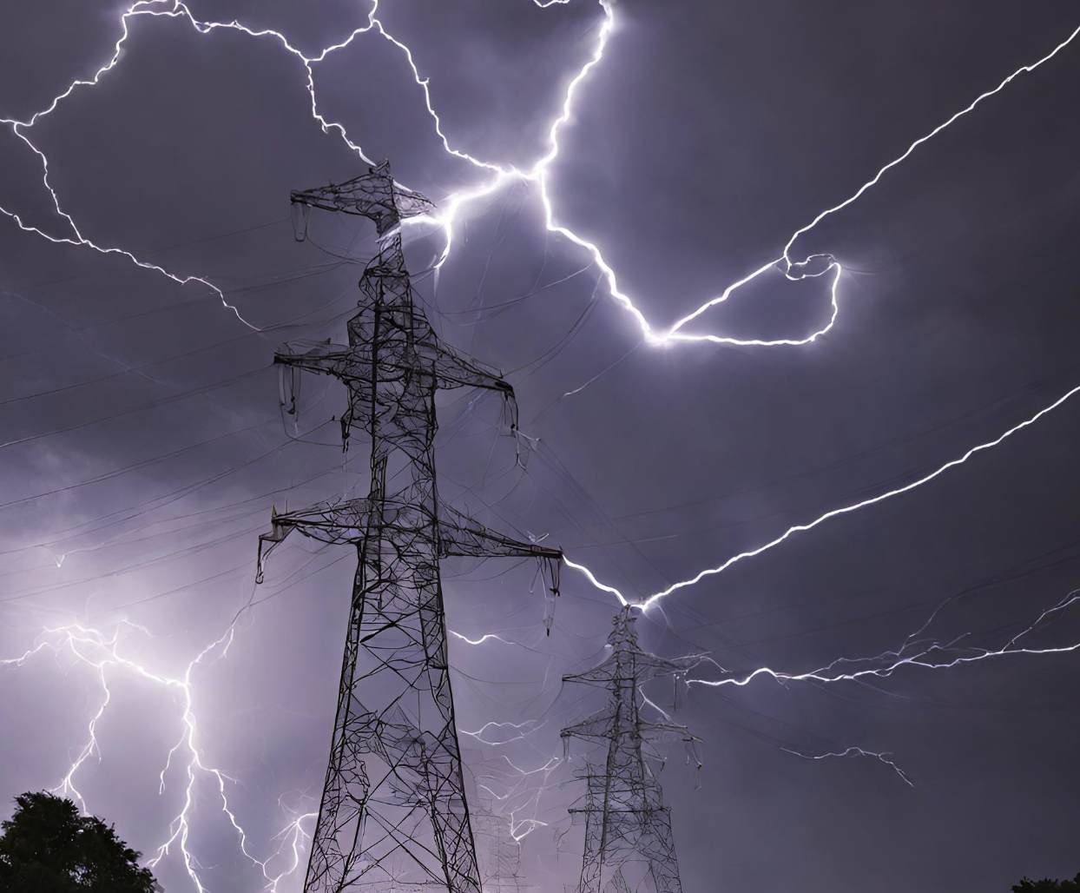
Intro
Electricity
Notes:
Today, we’ll be learning about the word: Resistance.

Slide 3
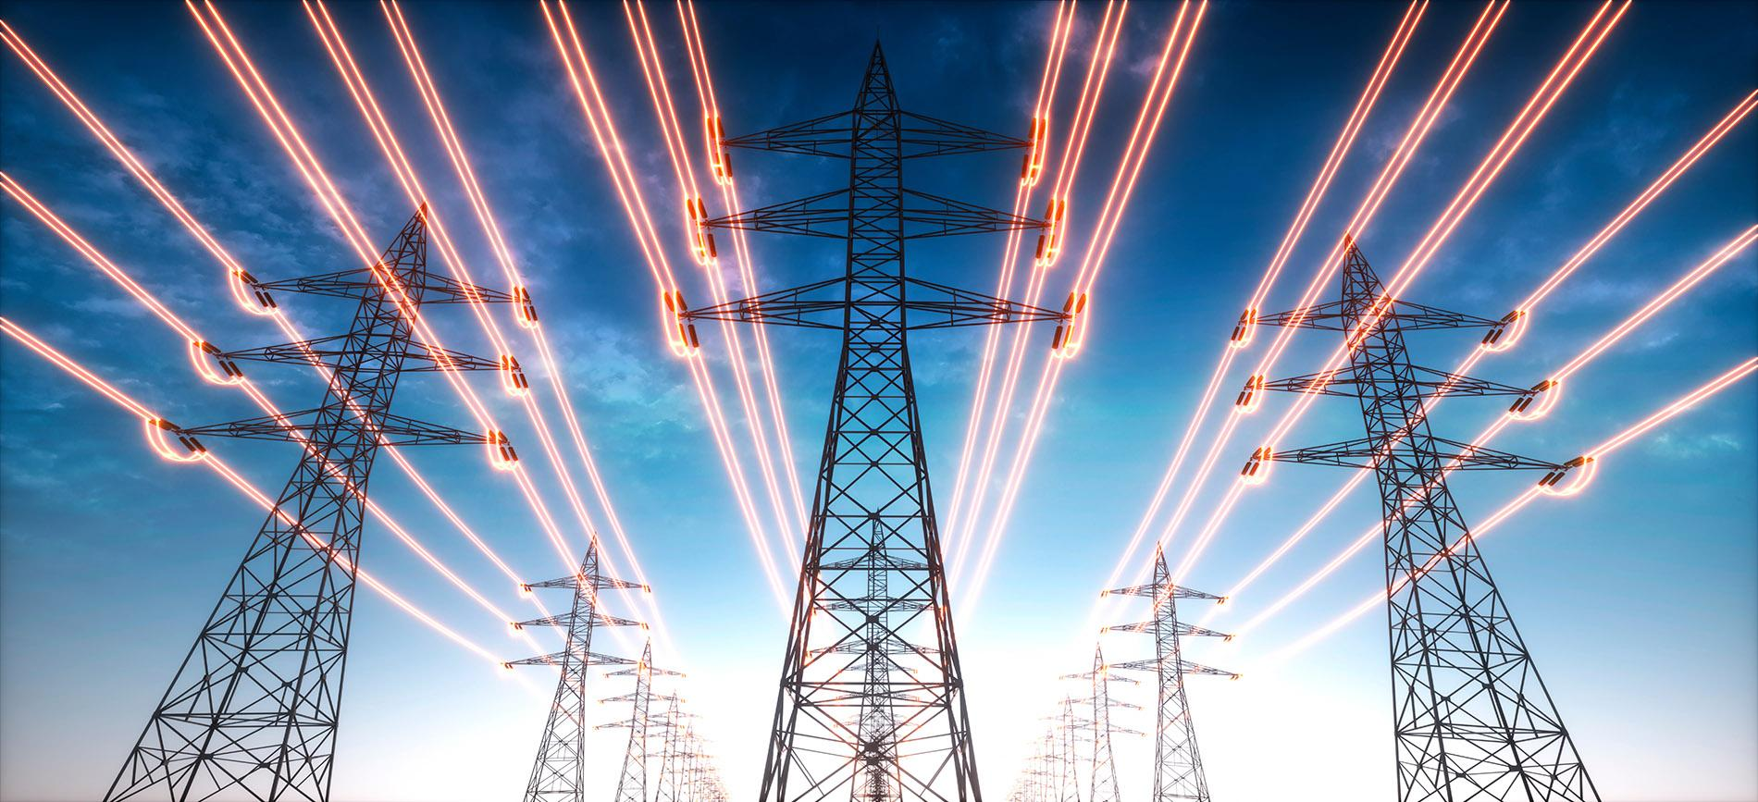
Big Question: How is electricity transmitted and used in daily life?
Notes:
Our “big question” is: How is electricity transmitted and used in daily life?
[Pause and illicit predictions from students.]
I love all these thoughtful scientific hypotheses! Be sure to keep this question and your predictions in mind as we move through these next few lessons, and we’ll continue to revisit it.

Slide 4
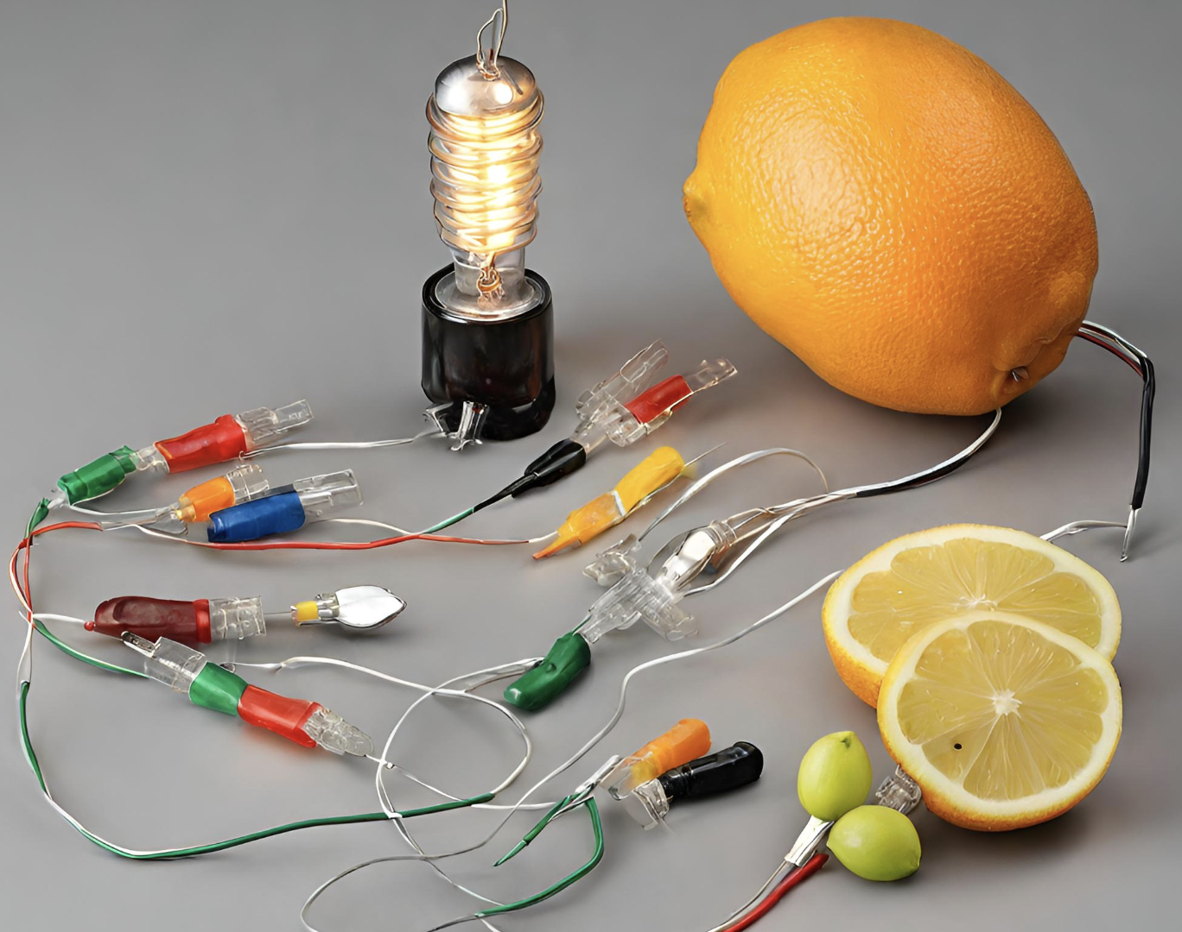
Demonstration
TEACHER DIRECTIONS:
Before viewing: Ask students what they already know about electricity. Tell students today they will be learning about electricity.
During: Ask students to think about what is happening and what the fruit battery is producing (electricity) and how.
Encourage students to come up with questions they might have about electricity based on the experiment.
After: Tell students that today they will be learning more about the term electricity.
Notes:
Materials:
Various fruits (e.g., lemons, oranges, or potatoes)
Galvanized nails (available at hardware stores)
Copper wire
LED bulbs
Alligator clips
Knife (for adult use)
Safety goggles
Procedure:
Safety First: Begin by emphasizing safety. Wear safety goggles and remind students to handle materials carefully.
Prepare the Fruits: Cut the fruits in half. For example, if using lemons, cut them into halves.
Insert the Electrodes: Insert a galvanized nail into one half of the fruit and a piece of copper wire into the other half. Make sure they are not touching inside the fruit.
Connect the Circuit: Use alligator clips to connect the copper wire from one fruit to the galvanized nail of the next fruit. Continue this chain until you have several fruits connected.
Add the LED Bulb: Connect the last fruit to an LED bulb using alligator clips. The bulb should light up if the circuit is complete.
Explanation: This demonstration illustrates the basic principles of an electrical circuit. The fruits act as chemical cells, generating a small amount of electricity. When connected in a series, they create a circuit that allows the flow of electricity, lighting up the LED bulb.
This activity not only showcases the generation of electricity but also introduces students to the concept of circuits and conductivity. It's a hands-on and engaging way to explore the basics of electrical circuits in a classroom setting.

Slide 5
Notes:
Before we move on to our new topic, let’s review some other words & concepts that you already learned and make sure you are firm in your understanding.

Slide 6
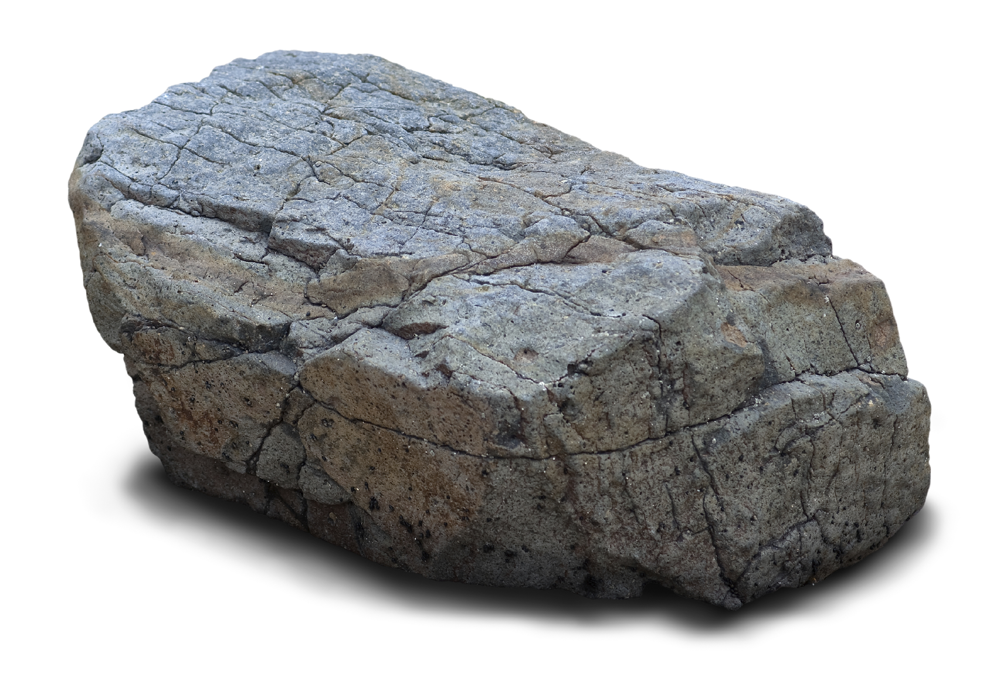
Matter: has mass and takes up space
Notes:
Matter is anything that has mass and takes up space.

Slide 7
Atom: smallest whole unit of matter
Atom
Atom
Atom
Atom
Atom
Notes:
An atom is the smallest whole unit of matter.

Slide 8
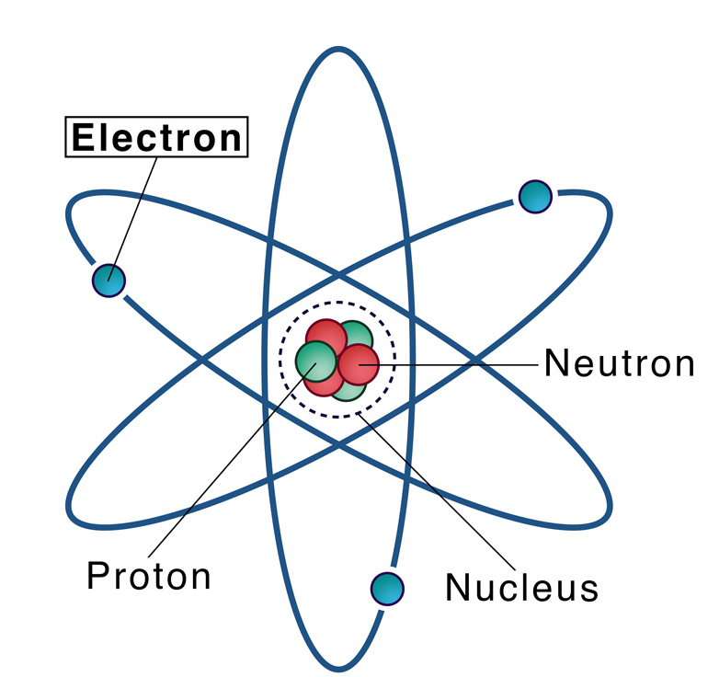
Electron: negatively charged particle that orbits the nucleus of an atom
Notes:
An electron is a negatively charged particle that orbits the nucleus of an atom

Slide 9
Notes:
Now let’s pause for a moment to review the information we have covered already.

Slide 10
What are the two qualities of matter?
Notes:
What are the two qualities of matter?
[Matter has mass and takes up space]

Slide 11
What is an atom?
Notes:
What is an atom?
[An atom is the smallest whole unit of matter.]

Slide 12
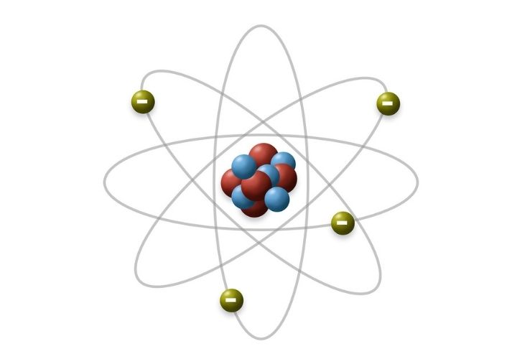
What charge does an electron have?
Positive charge
Negative charge
Notes:
What charge does an electron have? [A. Negative charge]

Slide 13
What charge does an electron have?
Positive charge
Negative charge
Notes:
What charge does an electron have? [A. Negative charge]

Slide 14
Electricity
Notes:
Now that we’ve reviewed, let’s define the phrase Resistance.

Slide 15
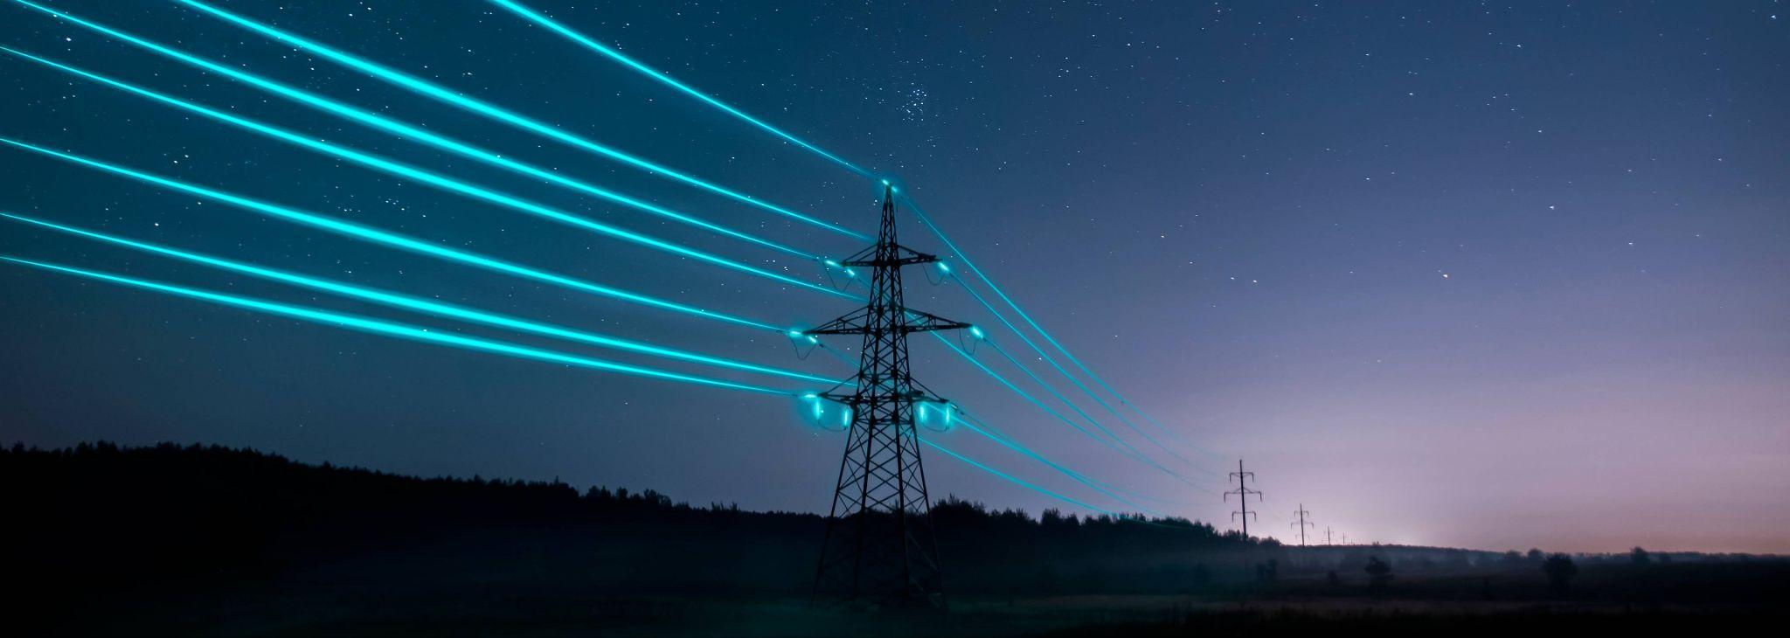
Electricity: the movement of electrons between atoms
Notes:
Electricity is the movement of electrons between atoms

Slide 16
Notes:
Let’s check-in for understanding.

Slide 17
What is electricity?
Notes:
Electricity is the movement of electrons between atoms

Slide 18
Notes:
That is the basic definition, but there is a bit more you need to know.

Slide 19
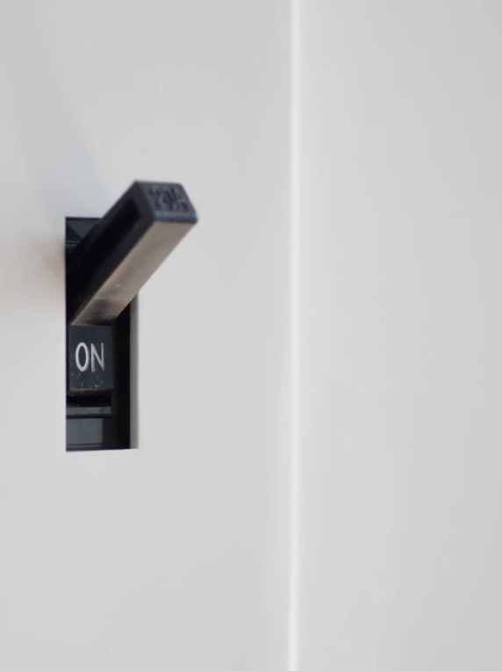
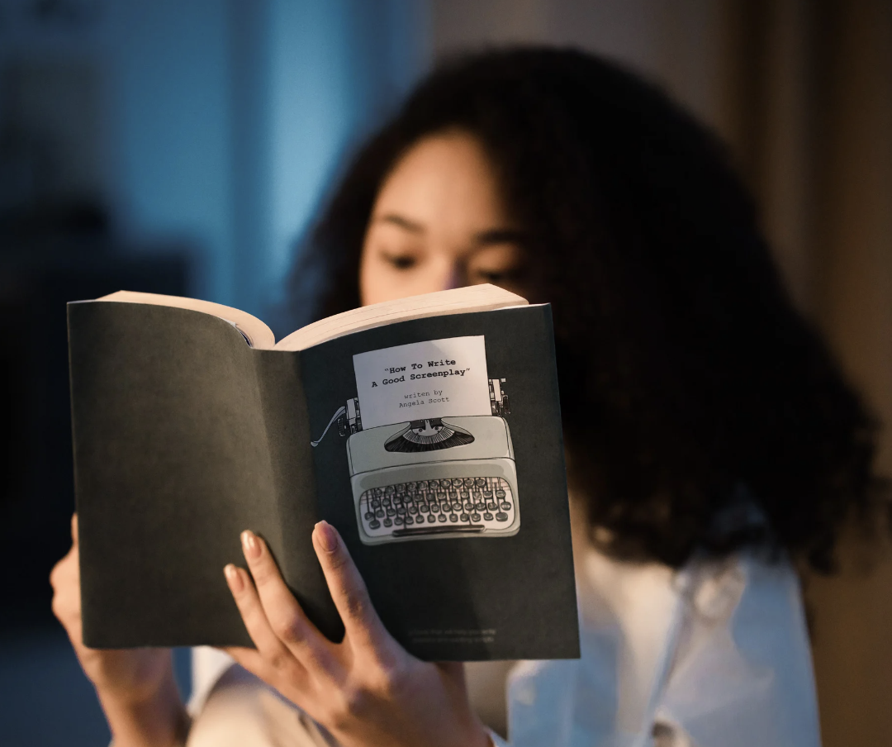
When you flip a switch, electricity is the invisible force that turns on the lights, allowing you to read your favorite books or play games after sunset.
Notes:
When you flip a switch, it's the invisible force that turns on the lights, allowing you to read your favorite books or play games after sunset. It's the reason your computer screen lights up with information and
your refrigerator keeps your snacks cool.

Slide 20
Electricity is what makes your doorbell ring, your phone buzz with messages, and your TV screen come to life with shows and movies.
Notes:
Electricity is also a master communicator. It's what makes your doorbell ring, your phone buzz with messages, and your TV screen come to life with
shows and movies. It's the force behind the scenes that keeps us in touch with friends and family, even when they're far away.

Slide 21
Notes:
Let’s check-in for understanding.

Slide 22
Name two examples of how electricity helps us in our daily lives.
Notes:
Name two examples of how electricity helps us in our daily lives.

Slide 23
Notes:
Now, let’s talk about some examples of resistance.

Slide 24
When it is turned on, a lightbulb is an example of electricity flowing to it to produce light
Notes:
When it is turned on, a lightbulb is an example of electricity flowing to it to produce light

Slide 25
Computers and laptops are examples of things that run on electricity.
Notes:
Computers and laptops run on electricity. When you press the power button, electricity flows through circuits, allowing you to browse the internet, play games, and do schoolwork.

Slide 26
Notes:
Now, let’s talk about some non-examples of resistance.

Slide 27
Using a bicycle is NOT an example of electricity
Notes:
Using a bicycle is NOT an example of electricity. A bicycle uses mechanical energy to move, it doesn't operate using electricity.

Slide 28
A basketball is NOT an example of electricity
Notes:
A basketball is NOT an example of electricity. A basketball is made of materials like rubber and leather, which do not involve electricity in their basic properties. Bouncing a basketball doesn't generate an electric charge.

Slide 29
Notes:
Now let’s pause for a moment to check your understanding.

Slide 30
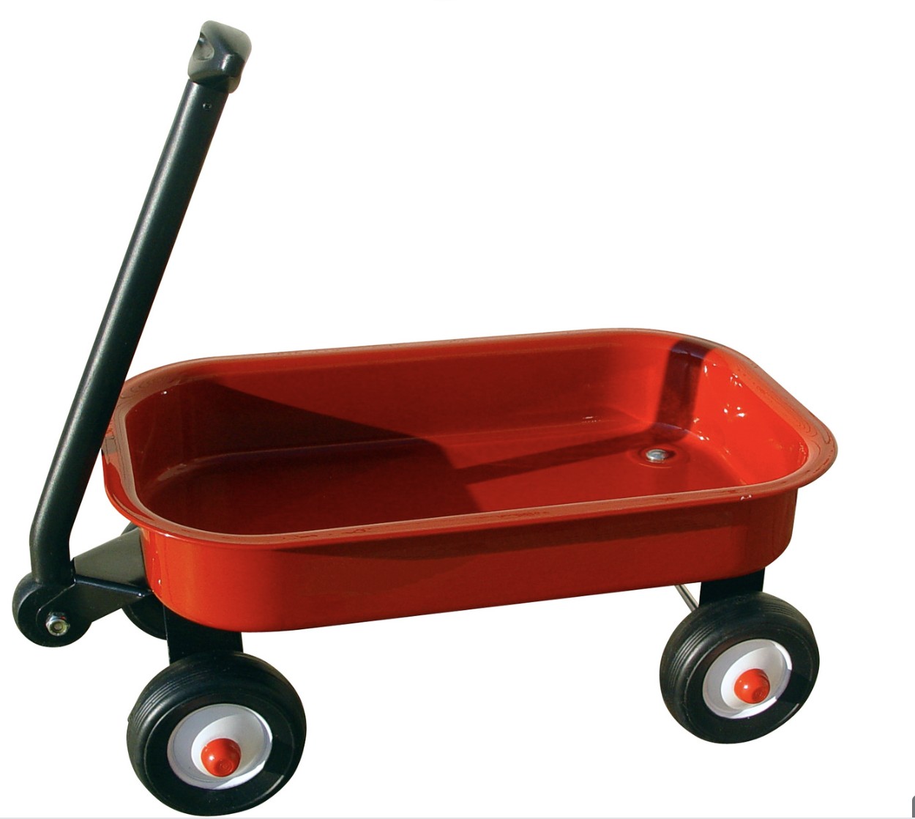
Which is an example of something that uses electricity?
Notes:
Which is an example of something that uses electricity?
[Light bulb]

Slide 31
Which is an example of something that uses electricity?
Notes:
Which is an example of something that uses electricity?
[Light bulb]

Slide 32
Remember!!!
Notes:
So remember!

Slide 33
Electricity: the movement of electrons between atoms
Notes:
Electricity is the movement of electrons between atoms

Slide 34
Notes:
We will now complete this concept map, called a Frayer model, to summarize and further clarify what you have learned about the term electricity.

Slide 35
Definition
Picture
Electricity
Example
How does electricity impact my life?
Notes:
To complete the Frayer model, we will choose from four choices the correct picture, definition, example, and response to the question, “How does electricity impact my life?” Select the best response for each question using the information you just learned. As we select responses, we will see how this model looks filled in for the term electricity.

Slide 36
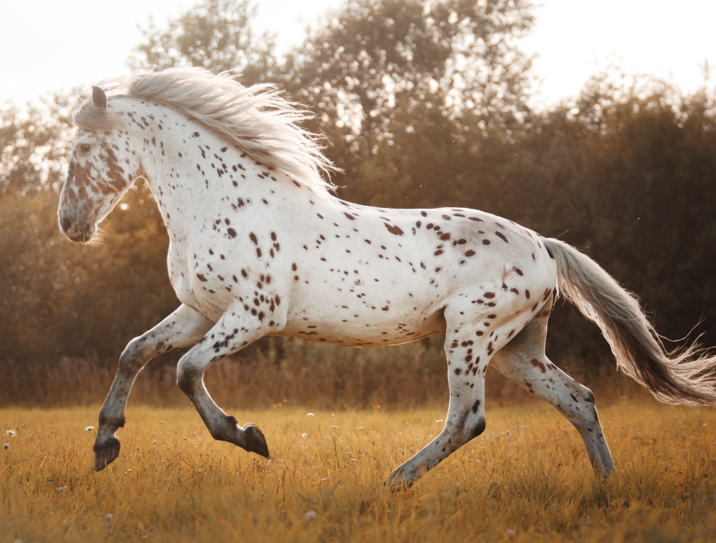
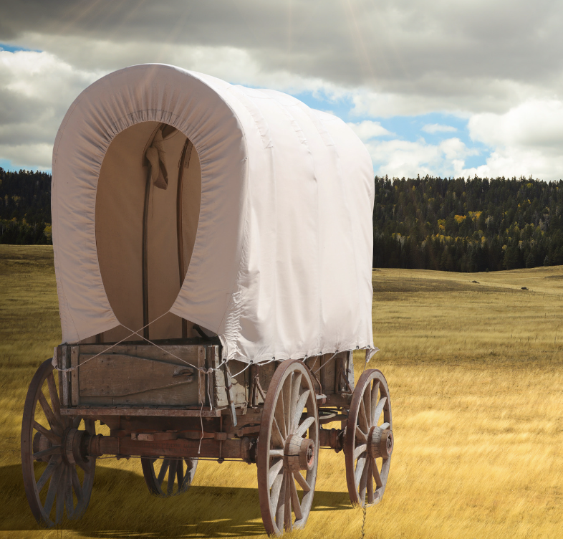
Directions: Choose the correct picture of electricity from the choices below.
A
B
C
D
Notes:
Choose the one correct picture of electricity from these four choices.

Slide 37
Directions: Choose the correct picture of electricity from the choices below.
A
B
C
D
Notes:
This is the picture that shows electricity being used.

Slide 38
Definition
Picture
Electricity
Example
How does electricity impact my life?
Notes:
Here is the Frayer model filled in with a picture of electricity.

Slide 39
Directions: Choose the correct definition of electricity from the choices below.
A
The measure of how easy it is to grow a plant
B
The smallest whole unit of matter
C
The movement of electrons between atoms
D
The measure of how difficult it is for an electric current to flow in a material
Notes:
Choose the one correct definition of electricity from these four choices.

Slide 40
Directions: Choose the correct definition of electricity from the choices below.
A
The measure of how easy it is to grow a plant
B
The smallest whole unit of matter
C
The movement of electrons between atoms
D
The measure of how difficult it is for an electric current to flow in a material
Notes:
“The movement of electrons between atoms” is correct! This is the definition of electricity.

Slide 41
Definition
Picture
The movement of electrons between atoms
Electricity
Example
How does electricity impact my life?
Notes:
Here is the Frayer Model with a picture and the definition filled in for electricity: The movement of electrons between atoms.

Slide 42
Directions: Choose the correct example of electricity from the choices below.
A
A flame burning
B
A television that is turned on
C
Riding a bicycle
D
Roller skating
Notes:
Choose the one correct example of electricity from these four choices.

Slide 43
Directions: Choose the correct example of electricity from the choices below.
A
A flame burning
B
A television that is turned on
C
Riding a bicycle
D
Roller skating
Notes:
“A television that is turned on” is correct! This is an example of electricity.

Slide 44
Definition
Picture
The movement of electrons between atoms
Electricity
A television that is turned on
Example
How does electricity impact my life?
Notes:
Here is the Frayer Model with a picture, definition, and an example of electricity: A television that is turned on.

Slide 45
Directions: Choose the correct response for “how does electricity impact my life?” from the choices below.
A
Electricity makes my house dark which helps me to sleep better.
B
Electricity is the energy that causes the tides in the oceans. This impacts the weather and how we dress for the day.
C
Electricity is the power that we use to pull a wagon or run up a hill. Making us sweat from the energy we exert.
D
Electricity makes our lights shine, our computers work, and our food stays cool in the fridge, making everything easier and more fun every day.
Notes:
Choose the one correct response for “how does electricity impact my life?” from these four choices.

Slide 46
Directions: Choose the correct response for “how does electricity impact my life?” from the choices below.
A
Electricity makes my house dark which helps me to sleep better.
B
Electricity is the energy that causes the tides in the oceans. This impacts the weather and how we dress for the day.
C
Electricity is the power that we use to pull a wagon or run up a hill. Making us sweat from the energy we exert.
D
Electricity makes our lights shine, our computers work, and our food stays cool in the fridge, making everything easier and more fun every day.
Notes:
“Electricity makes our lights shine, our computers work, and our food stays cool in the fridge, making everything easier and more fun every day.” That is correct! This is an example of how electricity impacts your life.

Slide 47
Definition
Picture
The movement of electrons between atoms
Electricity
Electricity makes our lights shine, our computers work, and our food stays cool in the fridge, making everything easier and more fun every day.
A television that is turned on
Example
How does electricity impact my life?
Notes:
Here is the Frayer Model with a picture, definition, example, and a correct response to “how does electricity impact my life?”: Electricity makes our lights shine, our computers work, and our food stays cool in the fridge, making everything easier and more fun every day.

Slide 48
Remember!!!
Notes:
So remember!

Slide 49
Electricity: the movement of electrons between atoms
Notes:
Electricity is the movement of electrons between atoms

Slide 50
Big Question: How is electricity transmitted and used in daily life?
Notes:
Let’s reflect once more on our big question. Our “big question” is: How is electricity transmitted and used in daily life?
Does anyone have any additional examples to share that haven’t been discussed yet?

Slide 51
Simulation Activity
Static Electricity
Click the link above for a simulation to deepen your understanding of electricity.

Slide 52
Notes:
Thanks, and please continue watching and using CAPs available from this website.

Slide 53
This Was Created With Resources From:
Questions or Comments
Michael Kennedy, Ph.D. MKennedy@Virginia.edu
Rachel L Kunemund, Ph.D. rk8vm@virginia.edu

