Slide 1
Intro
“Big Idea” Question
Review Concepts
Check-In Questions
Teacher Engagement
Vocabulary
Student-Friendly Definition
Examples & Non-Examples
Morphological Word Parts
Frayer Model
Simulation/Activity
Notes:
OK everyone, get ready for our next lesson. Just as a reminder, these are the different components that our lesson may include, and you’ll see these icons in the top left corner of each slide so that you can follow along more easily!

Slide 2
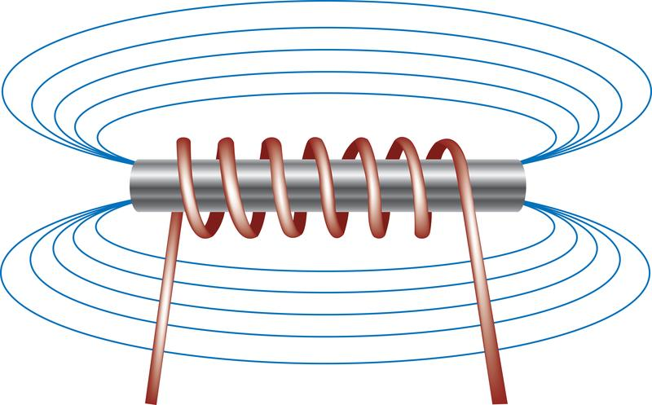
Intro
Electromagnet
Notes:
Today, we’ll be learning about the word: Electromagnet.

Slide 3
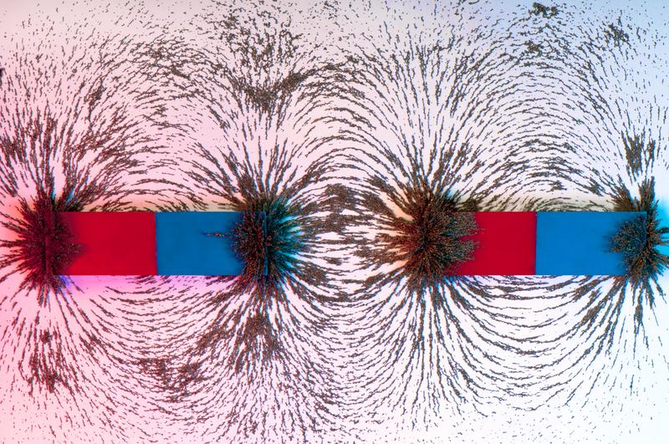
Big Question: What is the relationship between magnetic fields and electromagnets?
Notes:
Our “big question” is: What is the relationship between magnetic fields and electromagnets?
[Pause and illicit predictions from students.]
I love all these thoughtful scientific hypotheses! Be sure to keep this question and your predictions in mind as we move through these next few lessons, and we’ll continue to revisit it.

Slide 4
Notes:
Before we move on to our new topic, let’s review some other words & concepts that you already learned and make sure you are firm in your understanding.

Slide 5
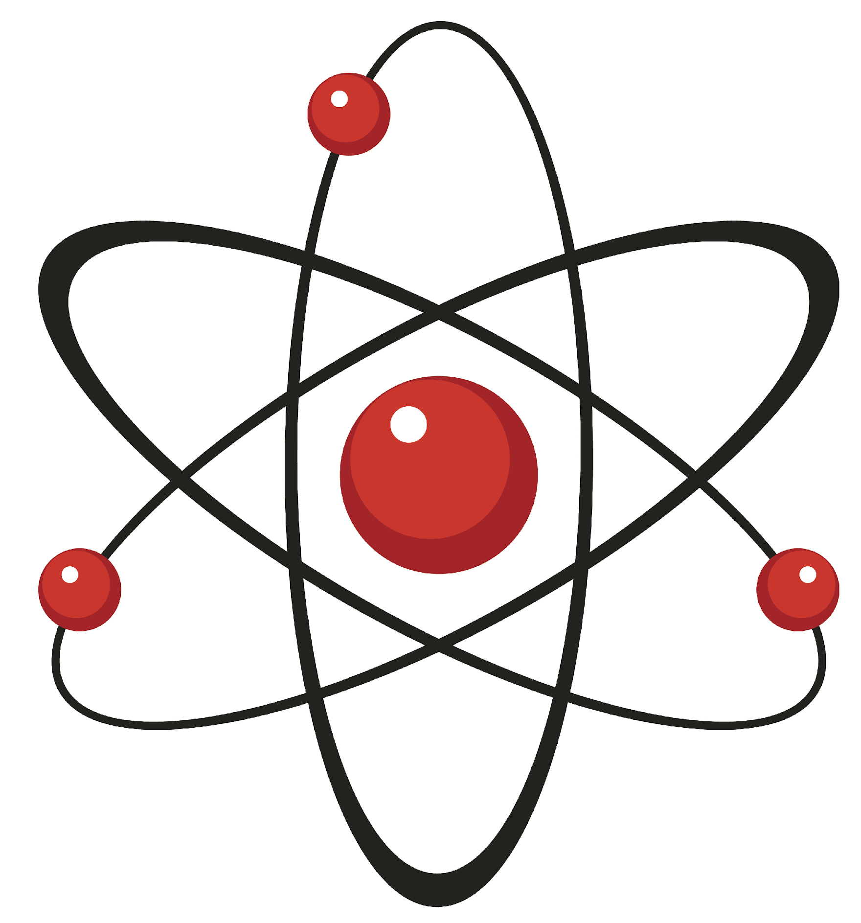
Atom: smallest whole unit of matter
Atom
Atom
Atom
Atom
Atom
Notes:
An atom is the smallest whole unit of matter.

Slide 6
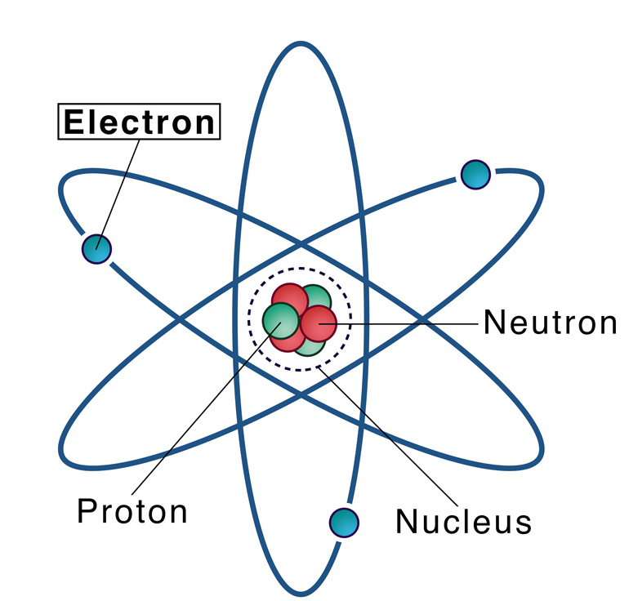
Electron: negatively charged particle that orbits the nucleus of an atom
Notes:
An electron is a negatively charged particle that orbits the nucleus of an atom

Slide 7
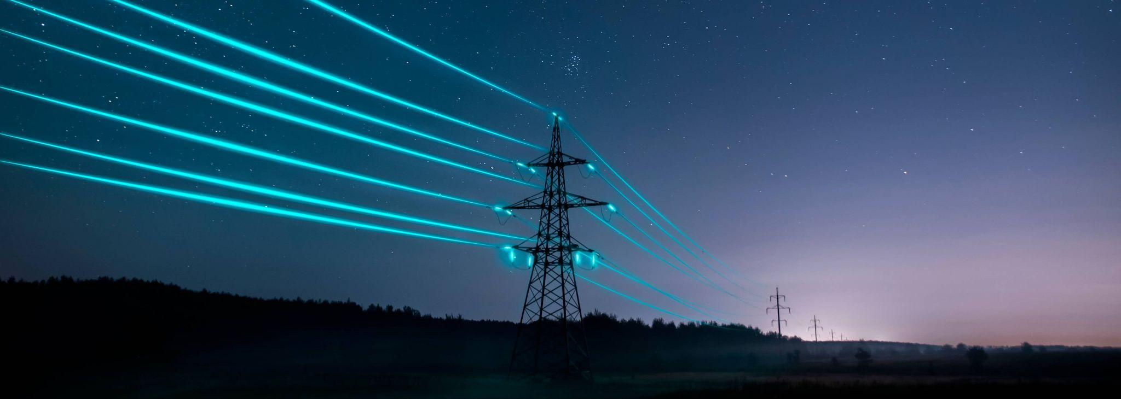
Electricity: the movement of electrons between atoms
Notes:
Electricity is the movement of electrons between atoms

Slide 8
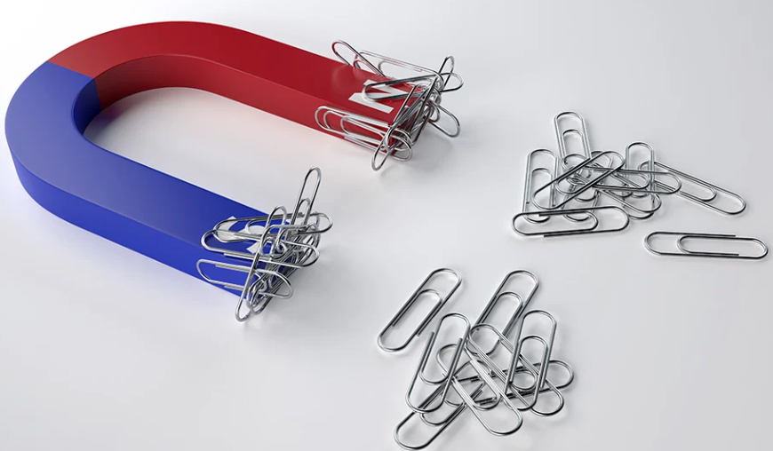
Magnet: a material or object that can attract certain metals
Notes:
Magnet: a material or object that can attract certain metals

Slide 9
Magnetic Field: a force that surrounds all magnets, that moves electrically charged particles in a circular path
Notes:
A magnetic field is a force that surrounds all magnets, that moves electrically charged particles in a circular path.

Slide 10
Notes:
Now let’s pause for a moment to review the information we have covered already.

Slide 11
Electricity: the movement of
between atoms
Notes:
Electricity is the movement of between atoms
[electrons]

Slide 12
Electricity: the movement of
electrons between atoms
Notes:
Electricity is the movement of electrons between atoms
[electrons]

Slide 13
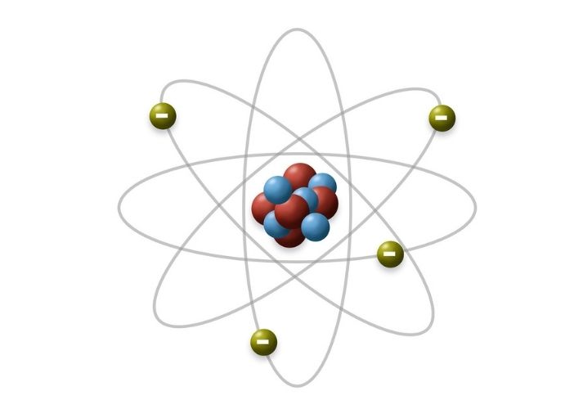
What charge does an electron have?
Positive charge
Negative charge
Notes:
What charge does an electron have? [A. Negative charge]

Slide 14
What charge does an electron have?
Positive charge
Negative charge
Notes:
What charge does an electron have? [A. Negative charge]

Slide 15
What is a magnet?
Notes:
What is a magnet?
[a material or object that can attract certain metals]

Slide 16
What is a magnetic field?
Notes:
What is a magnetic field?
[A magnetic field is a force that surrounds all magnets, that moves electrically charged particles in a circular path.]

Slide 17
Electromagnet
Notes:
Now that we’ve reviewed, let’s define the phrase Electromagnet.

Slide 18
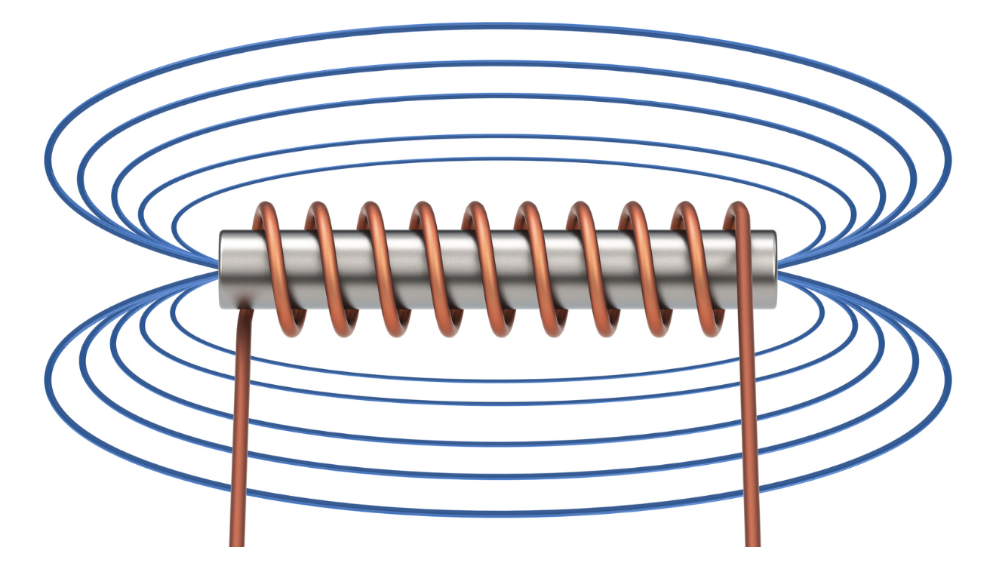
Electromagnet: a type of magnet where the magnetic field is produced by an electric current
Notes:
An electromagnet is a type of magnet where the magnetic field is produced by an electric current.

Slide 19
Notes:
Let’s check-in for understanding.

Slide 20
What is an electromagnet?
Notes:
What is an electromagnet?
[An electromagnet is a type of magnet in which the magnetic field is produced by an electric field is produced by an electric current.]

Slide 21
Notes:
That is the basic definition, but there is a bit more you need to know.

Slide 22
To build an electromagnet, you need four parts. First, you need a battery - this provides a power source.
Notes:
To build an electromagnet, you need four parts. First, you need a battery - this provides a power source.

Slide 23
The second part is an iron core. A nail is often used as an iron core.
Notes:
The second part is an iron core. A nail is often used as an iron core.

Slide 24
The third part is wire. The wire conducts electricity from the battery.
Notes:
The third part is wire. The wire conducts electricity from the battery.

Slide 25
The fourth part is a coiled wire around the iron nail. This provides strength to the electromagnet - the more coils, the stronger the magnet!
Notes:
The fourth part is a coiled wire around the iron nail. This provides strength to the electromagnet - the more coils, the stronger the magnet!

Slide 26
Notes:
Let’s check-in for understanding.

Slide 27
What are the four parts to an electromagnet?
B________
I_____ C_____
W_____
C_____ W____
Notes:
What are the four parts to an electromagnet?
[Battery, iron core [nail], wire, coiled wire]

Slide 28
What are the four parts to an electromagnet?
Battery
Iron Core
Wire
Coiled Wire
Notes:
What are the four parts to an electromagnet?
[Battery, iron core [nail], wire, coiled wire]

Slide 29
True or false: The more coils in the wire, the weaker the electromagnet.
True
False
Notes:
True or false: The more coils in the wire, the weaker the electromagnet.
[B. False]

Slide 30
True or false: The more coils in the wire, the weaker the electromagnet.
True
False
Notes:
True or false: The more coils in the wire, the weaker the electromagnet. False. The more coils in the wire, the stronger the electromagnet.
[B. False]

Slide 31
Notes:
Now, let’s talk about some examples of electromagnet.

Slide 32
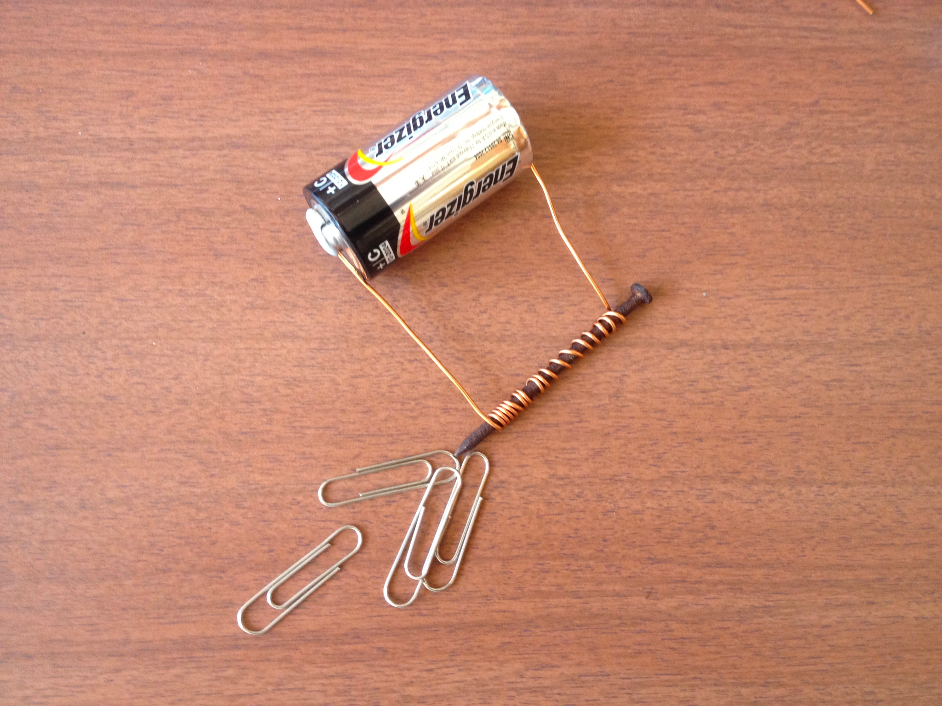
This is an example of an electromagnet - it has all four parts.
Notes:
This is an example of an electromagnet - it has all 4 parts.

Slide 33
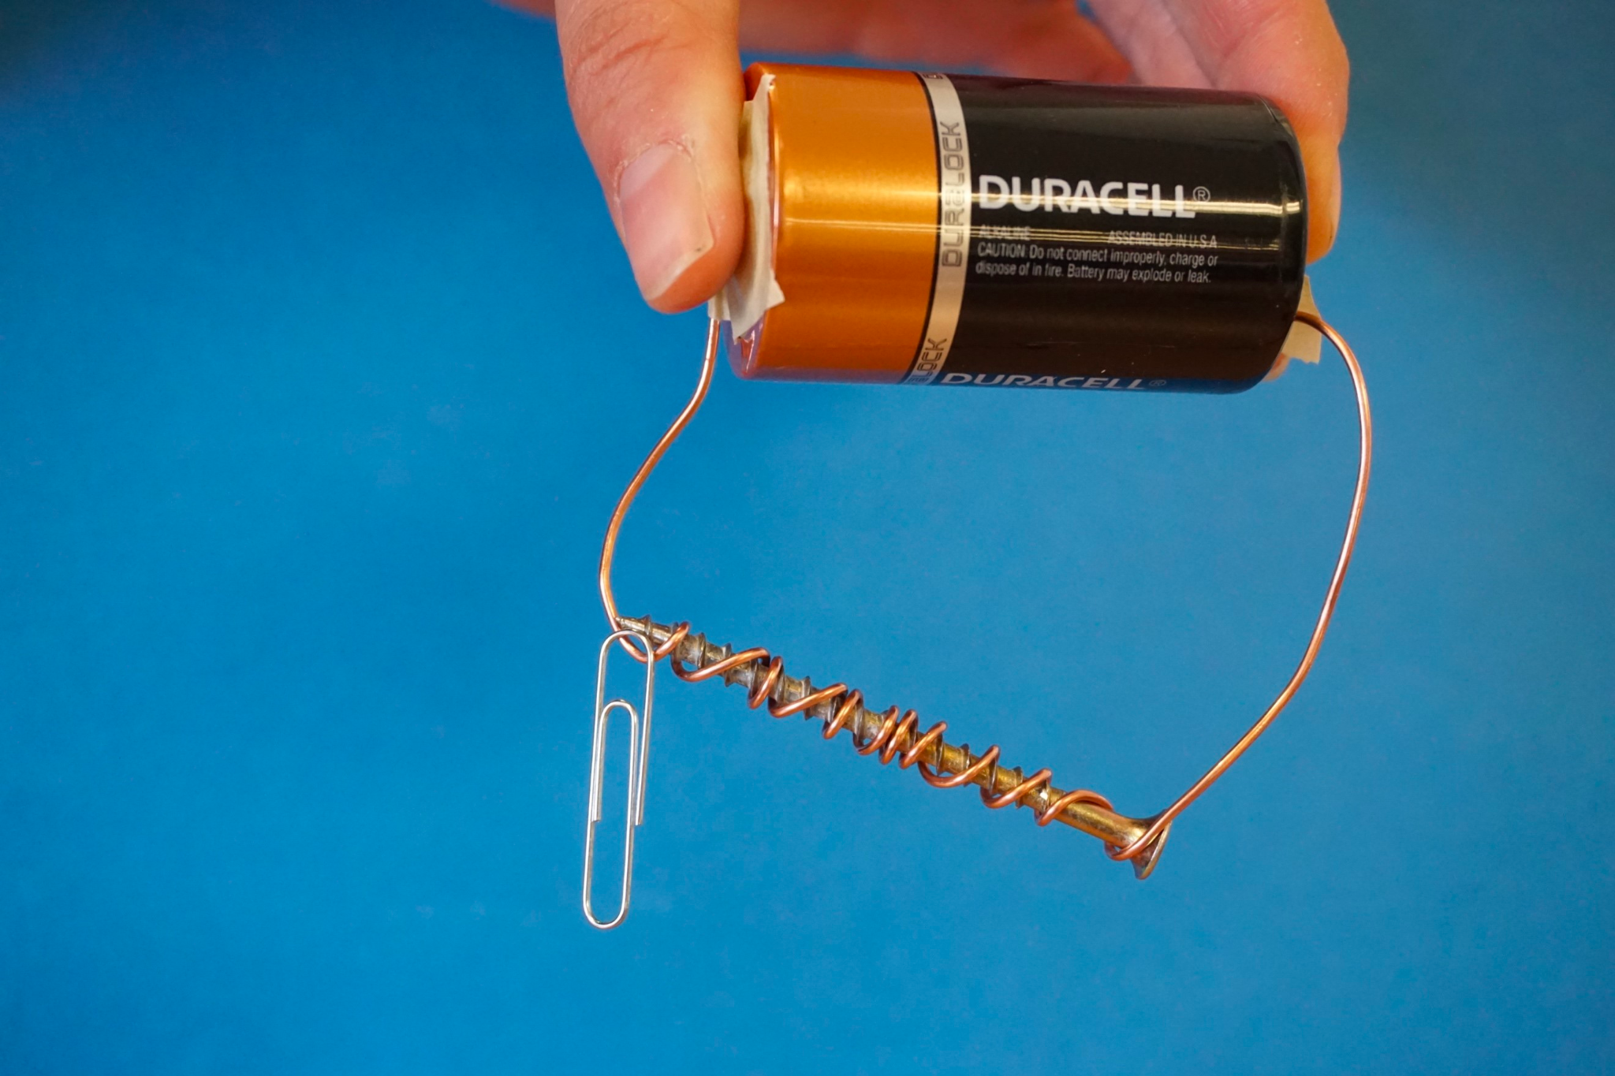
This is also an example of an electromagnet - it has all four parts.
Notes:
This is also an example of an electromagnet - it has all four parts.

Slide 34
Notes:
Now, let’s talk about some non-examples of electromagnet.

Slide 35
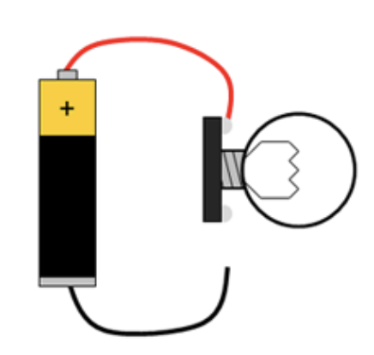
This is NOT an example of an electromagnet.
This is an open circuit.
Notes:
This is a non-example of an electromagnet. This is an open circuit.

Slide 36
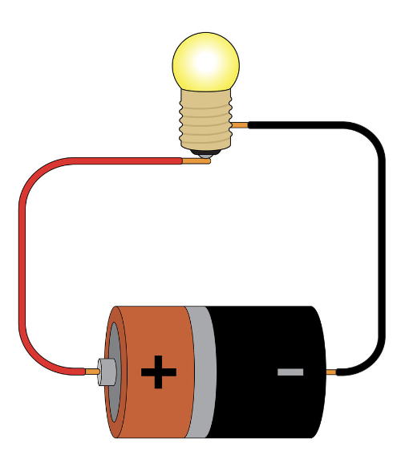
This is also NOT an example of an electromagnet. Though there is a closed circuit, there is no iron core or coils.
Notes:
This is also a non-example of an electromagnet. Though there is a closed circuit, there is no iron core or coils.

Slide 37
Notes:
Now let’s pause for a moment to check your understanding.

Slide 38
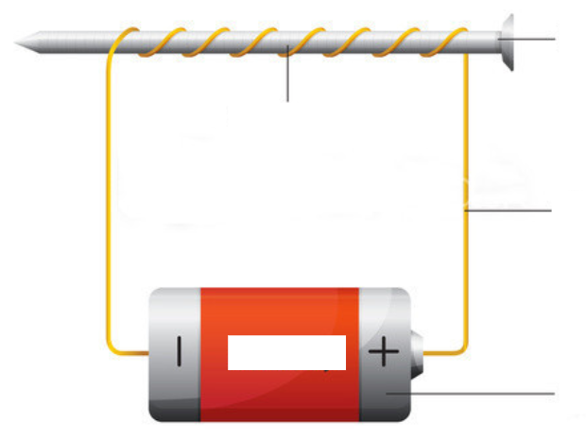
Which is an example of an electromagnet?
Notes:
Which is an example of an electromagnet?
[Right picture]

Slide 39
Which is an example of an electromagnet?
Notes:
Which is an example of an electromagnet?
[Right picture]

Slide 40
Remember!!!
Notes:
So remember!

Slide 41
Electromagnet: a type of magnet where the magnetic field is produced by an electric current
Notes:
An electromagnet is a type of magnet where the magnetic field is produced by an electric current.

Slide 42
Notes:
We will now complete this concept map, called a Frayer model, to summarize and further clarify what you have learned about the term electromagnet.

Slide 43
Definition
Picture
Electromagnet
Example
How do electromagnets impact my life?
Notes:
To complete the Frayer model, we will choose from four choices the correct picture, definition, example, and response to the question, “How do electromagnets impact my life?” Select the best response for each question using the information you just learned. As we select responses, we will see how this model looks filled in for the term electromagnet.

Slide 44
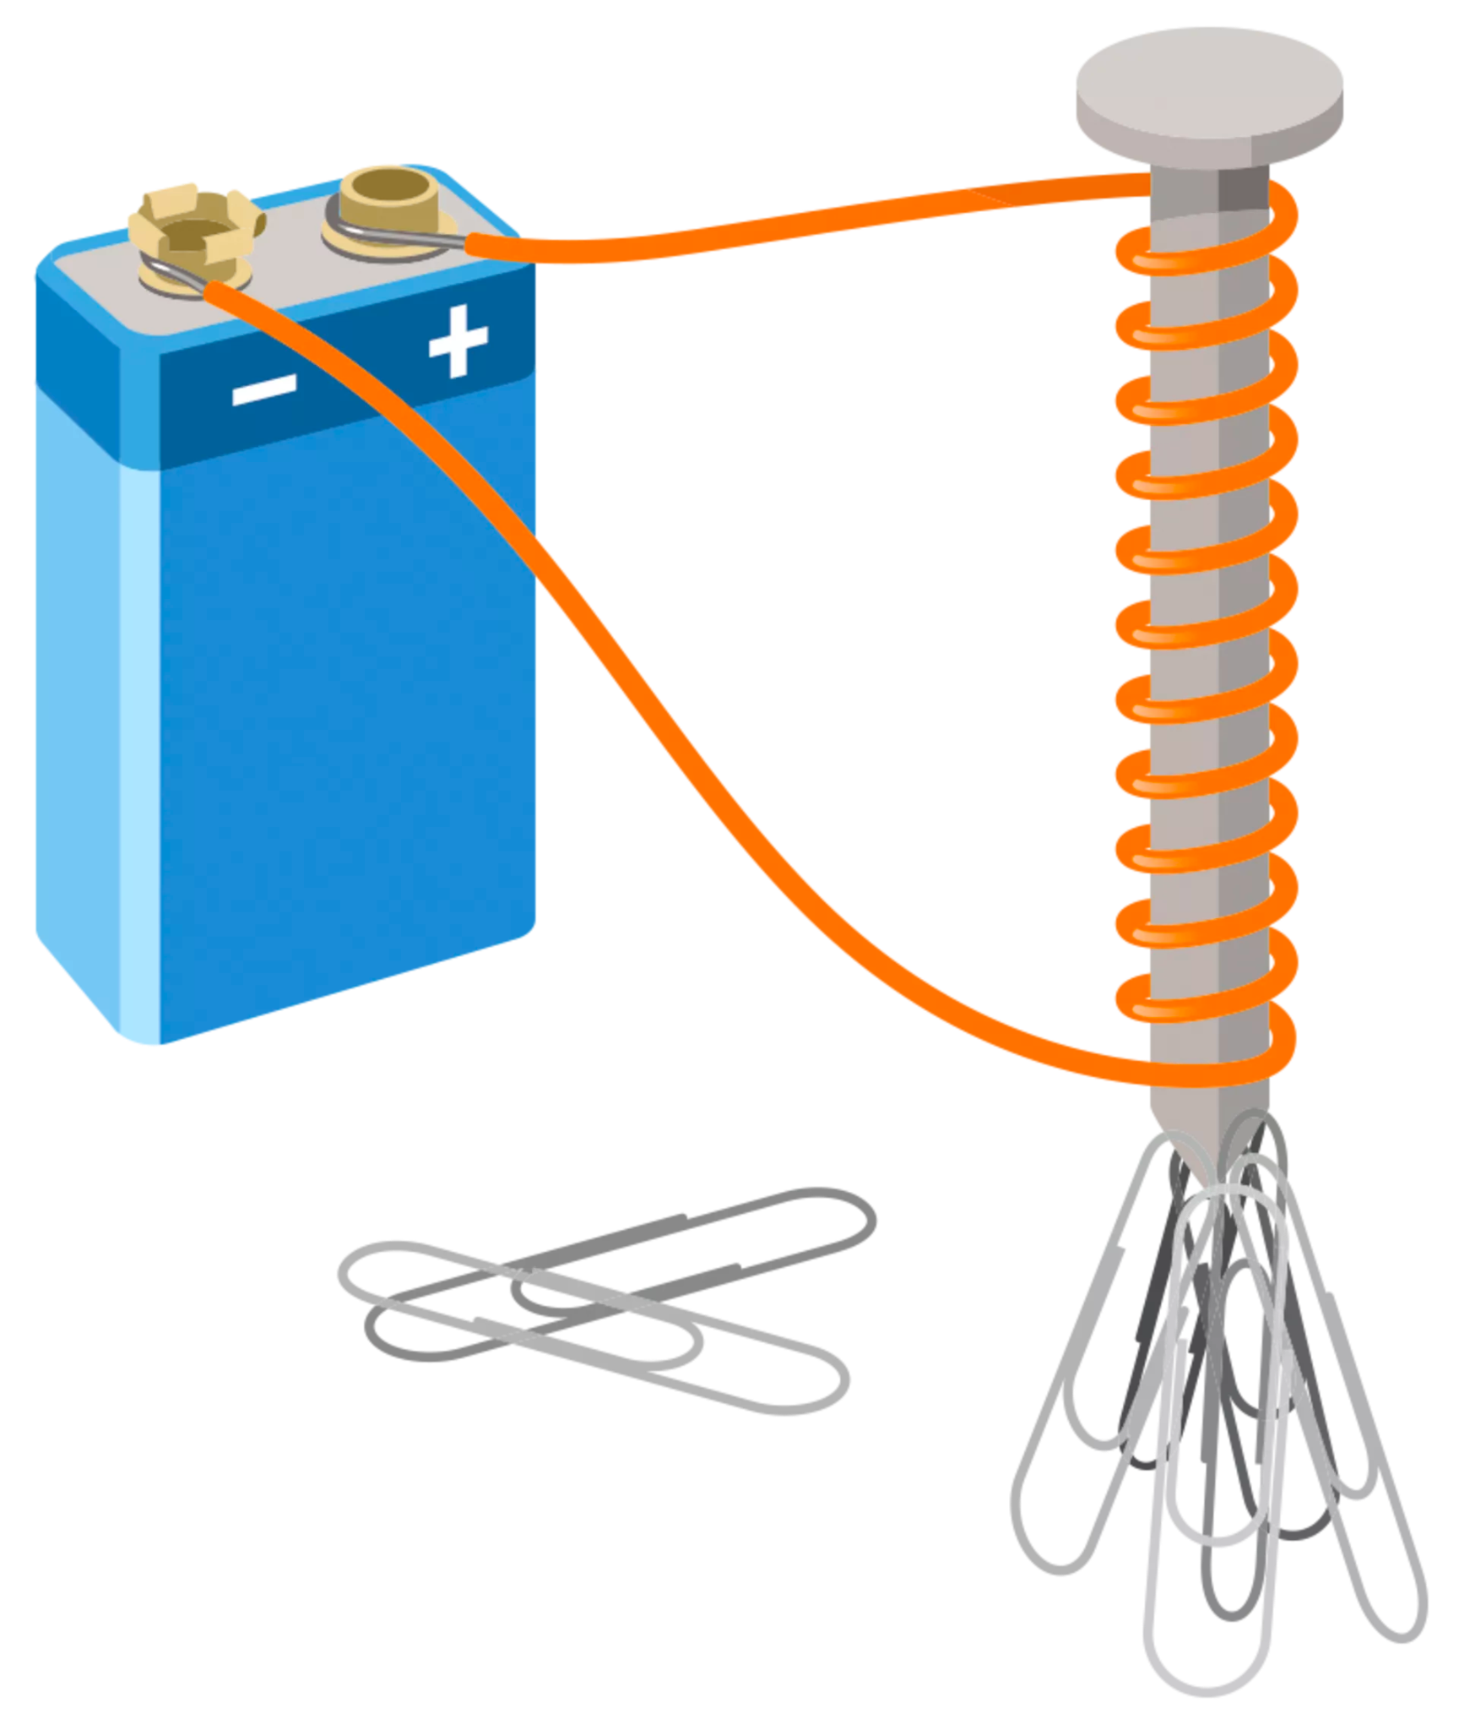
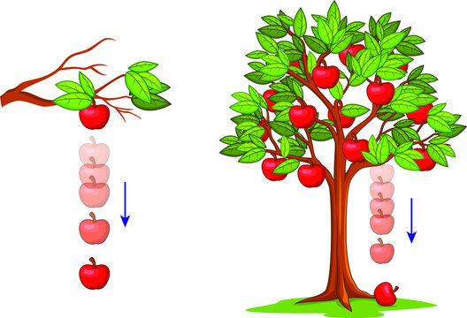
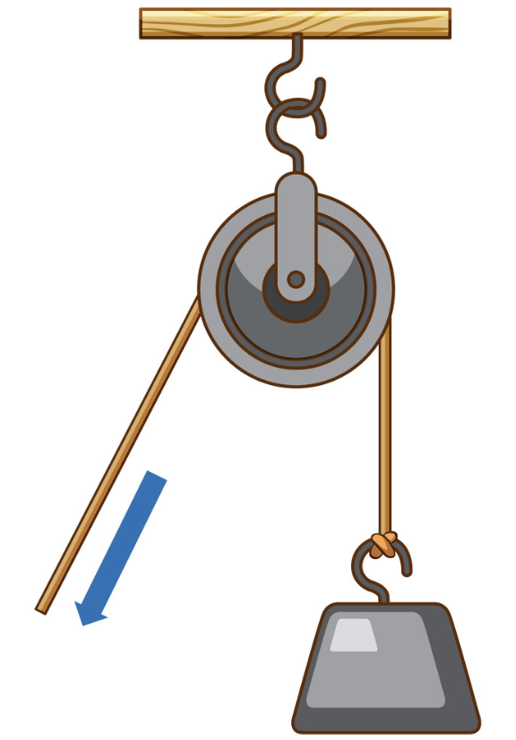
Directions: Choose the correct picture of electromagnet from the choices below.
A
B
C
D
Notes:
Choose the one correct picture of electromagnet from these four choices.

Slide 45
Directions: Choose the correct picture of electromagnet from the choices below.
A
B
C
D
Notes:
This is the picture that shows an electromagnet.

Slide 46
Definition
Picture
Electromagnet
Example
How do electromagnets impact my life?
Notes:
Here is the Frayer model filled in with a picture of electromagnet.

Slide 47
Directions: Choose the correct definition of electromagnet from the choices below.
A
A type of magnet where the magnetic field is produced by wind
B
A type of magnet where the magnetic field is produced by heat
C
A type of magnet where the magnetic field is produced by an electric current
D
A type of magnet where the magnetic field is produced by water
Notes:
Choose the one correct definition of electromagnet from these four choices.

Slide 48
Directions: Choose the correct definition of electromagnet from the choices below.
A
A type of magnet where the magnetic field is produced by wind
B
A type of magnet where the magnetic field is produced by heat
C
A type of magnet where the magnetic field is produced by an electric current
D
A type of magnet where the magnetic field is produced by water
Notes:
“A type of magnet where the magnetic field is produced by an electric current” is correct! This is the definition of electromagnet.

Slide 49
Definition
Picture
A type of magnet where the magnetic field is produced by an electric current
Electromagnet
Example
How do electromagnets impact my life?
Notes:
Here is the Frayer Model with a picture and the definition filled in for electromagnet: A type of magnet where the magnetic field is produced by an electric current.

Slide 50
Directions: Choose the correct example of electromagnet from the choices below.
A
An open circuit with a battery
B
A closed circuit with a silver core
C
An open circuit with a battery and iron core
D
A closed circuit with a battery, iron core, and coiled wire
Notes:
Choose the one correct example of electromagnet from these four choices.

Slide 51
Directions: Choose the correct example of electromagnet from the choices below.
A
An open circuit with a battery
B
A closed circuit with a silver core
C
An open circuit with a battery and iron core
D
A closed circuit with a battery, iron core, and coiled wire
Notes:
“A closed circuit with a battery, iron core, and coiled wire” is correct! This is an example of electromagnet.

Slide 52
Definition
Picture
A type of magnet where the magnetic field is produced by an electric current
Electromagnet
A closed circuit with a battery, iron core, and coiled wire
Example
How do electromagnets impact my life?
Notes:
Here is the Frayer Model with a picture, definition, and an example of electromagnet: A closed circuit with a battery, iron core, and coiled wire.

Slide 53
Directions: Choose the correct response for “how do electromagnets impact my life?” from the choices below.
A
Electromagnets allow candles to burn.
B
Electromagnets help electronics to function properly
C
Electromagnets help plants to produce food.
D
Electromagnets help balloons to float.
Notes:
Choose the one correct response for “how do electromagnets impact my life?” from these four choices.

Slide 54
Directions: Choose the correct response for “how do electromagnets impact my life?” from the choices below.
A
Electromagnets allow candles to burn.
B
Electromagnets help electronics to function properly
C
Electromagnets help plants to produce food.
D
Electromagnets help balloons to float.
Notes:
You chose “Electromagnets help electronics to function properly.” That is correct! This is an example of how electromagnets impacts your life.

Slide 55
Definition
Picture
A type of magnet where the magnetic field is produced by an electric current
Electromagnet
A closed circuit with a battery, iron core, and coiled wire
Electromagnets help electronics to function properly
Example
How do electromagnets impact my life?
Notes:
Here is the Frayer Model with a picture, definition, example, and a correct response to “how do electromagnets impact my life?”: Electromagnets help electronic to function properly.

Slide 56
Remember!!!
Notes:
So remember!

Slide 57
Electromagnet: a type of magnet where the magnetic field is produced by an electric current
Notes:
An electromagnet is a type of magnet where the magnetic field is produced by an electric current.

Slide 58
Big Question: What is the relationship between magnetic fields and electromagnets?
Notes:
Our “big question” is: What is the relationship between magnetic fields and electromagnets?
Does anyone have any additional examples to share that haven’t been discussed yet?

Slide 59
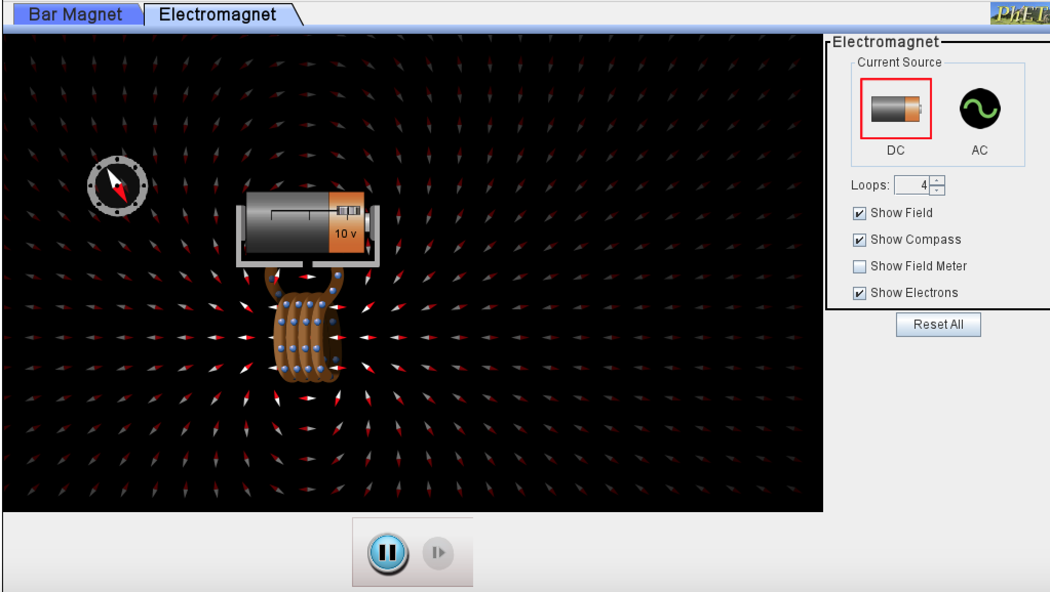
Simulation Activity
Electromagnets
(Phet)
Click the link above for a simulation to deepen your understanding of electromagnets.
Notes:
Feedback: Providing a simulation activity is a great way to make science thinking visible.

Slide 60
Notes:
Thanks, and please continue watching and using CAPs available from this website.

Slide 61
This Was Created With Resources From:
Questions or Comments
Michael Kennedy, Ph.D. MKennedy@Virginia.edu
Rachel L Kunemund, Ph.D. rk8vm@virginia.edu

