Slide 1
Intro
“Big Idea” Question
Review Concepts
Check-In Questions
Teacher Engagement
Vocabulary
Student-Friendly Definition
Examples & Non-Examples
Frayer Model
Simulation/Activity
Notes:
OK everyone, get ready for our next lesson. Just as a reminder, these are the different components that our lesson may include, and you’ll see these icons in the top left corner of each slide so that you can follow along more easily!

Slide 2
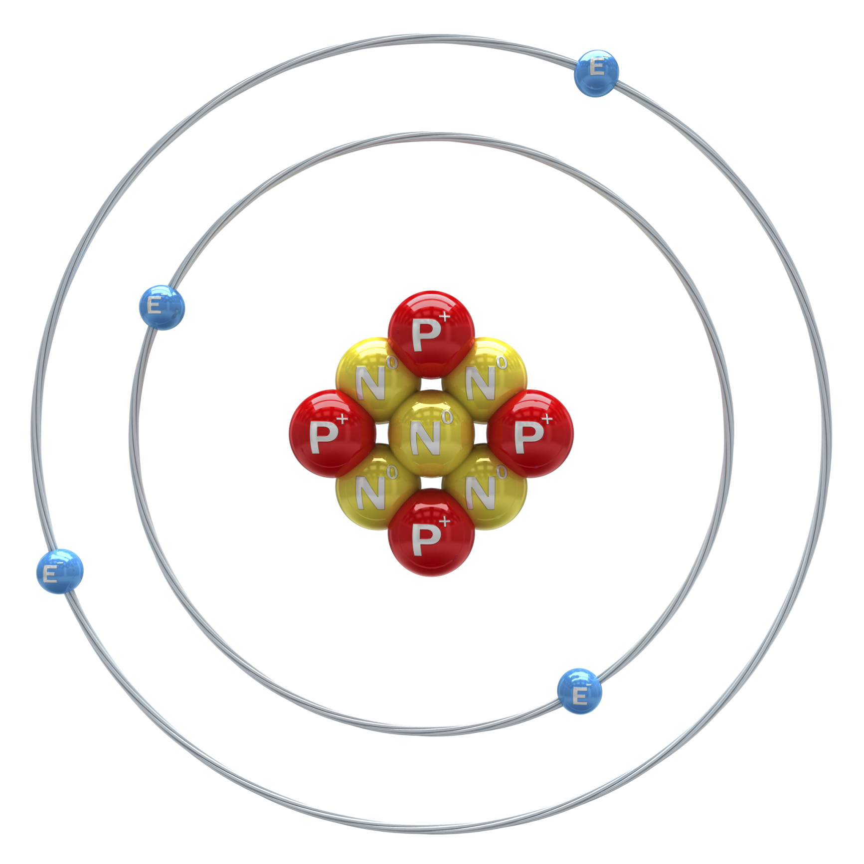
Electron
Intro
Electron
Notes:
Today we are going to learn about electrons.
Feedback: Using clear and consistent language when introducing today's content helps students understand what is expected.

Slide 3
Big Question: How do electrons affect our use of technology, power our homes, and add to our daily conveniences?
Notes:
Our “big question” is: How do electrons affect our use of technology, power our homes, and add to our daily conveniences?
[Pause and illicit predictions from students.]
Be sure to keep this question and your predictions in mind as we move through this video and questions.

Slide 4
Notes:
Before we move on to our new vocabulary term, let’s review some other words & concepts that you already learned and make sure you are firm in your understanding.

Slide 5
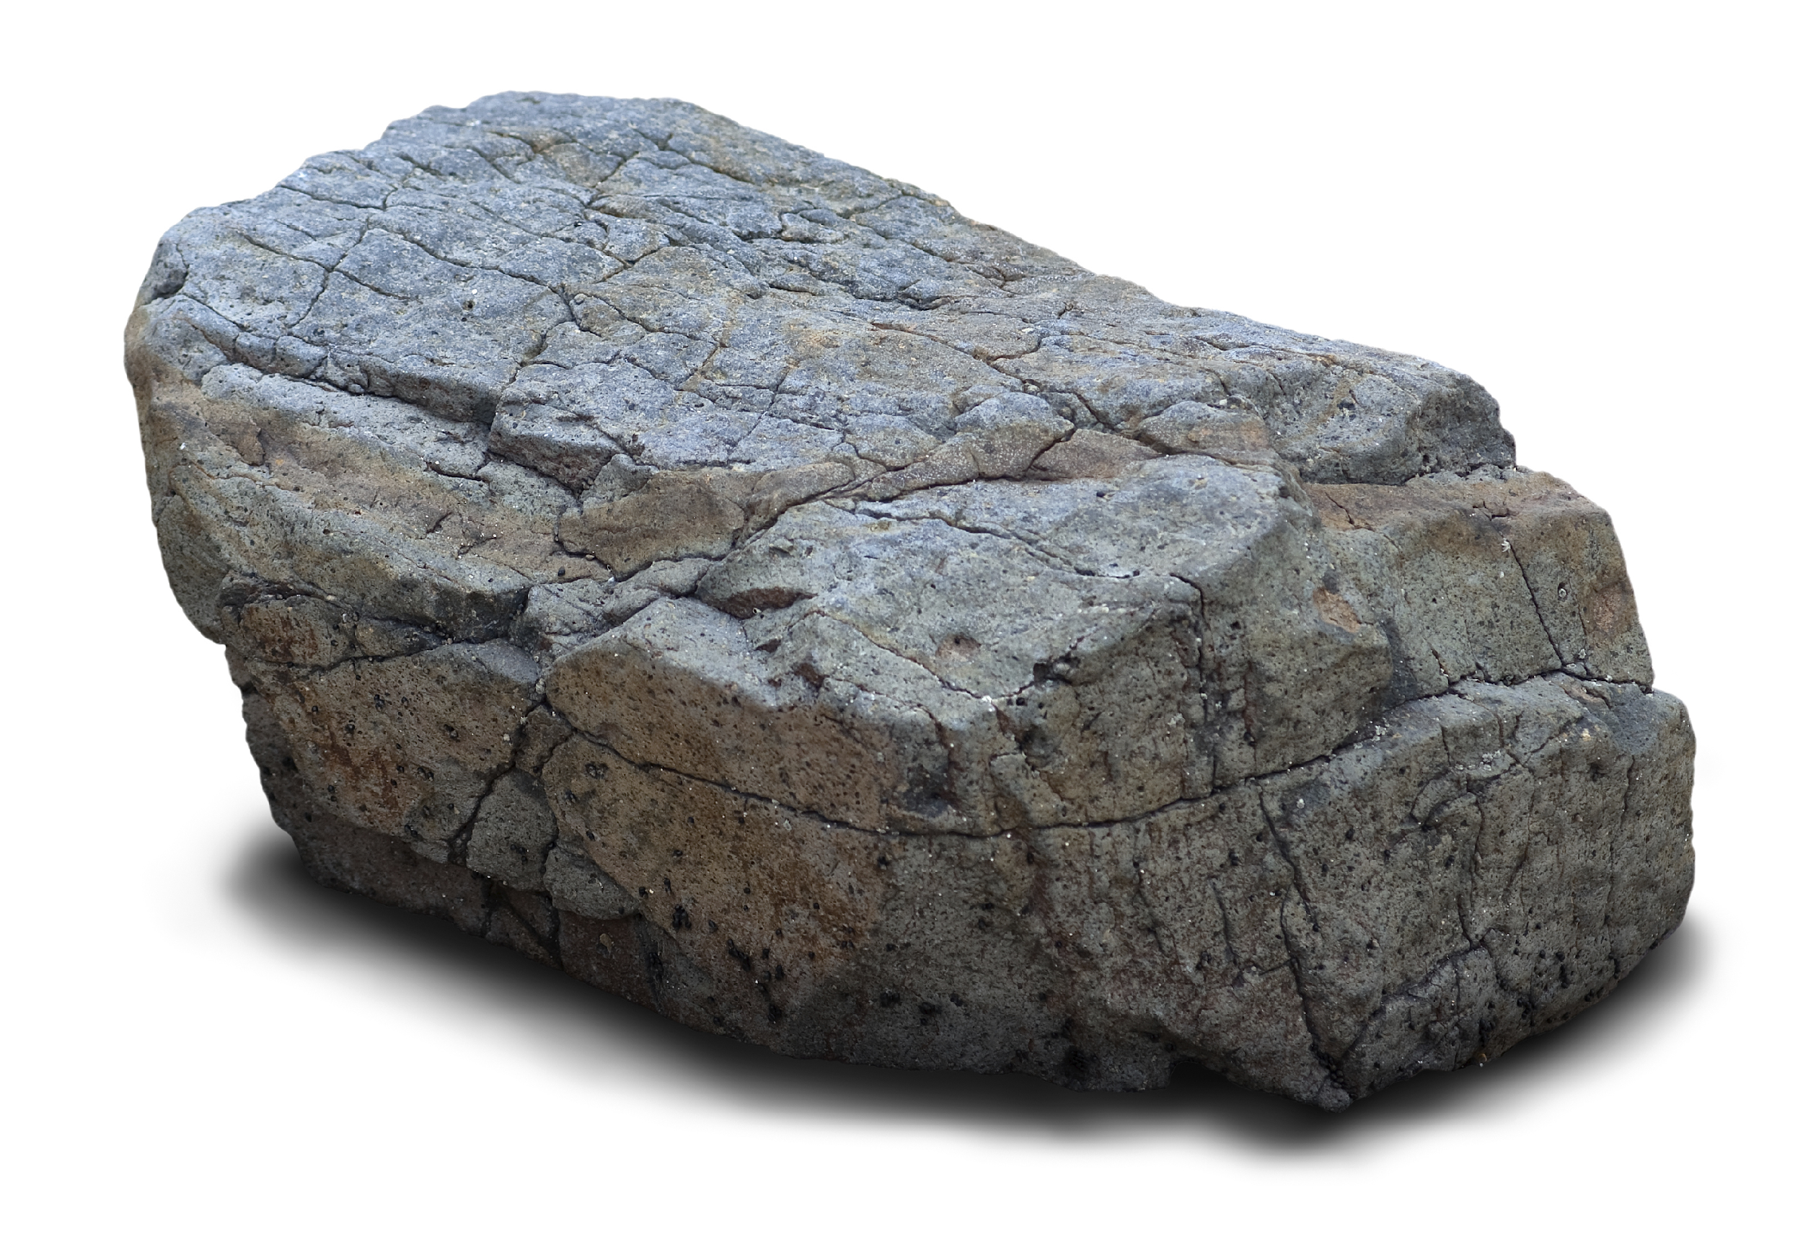
Matter: has mass and takes up space
Notes:
Matter is anything that has mass and takes up space.

Slide 6
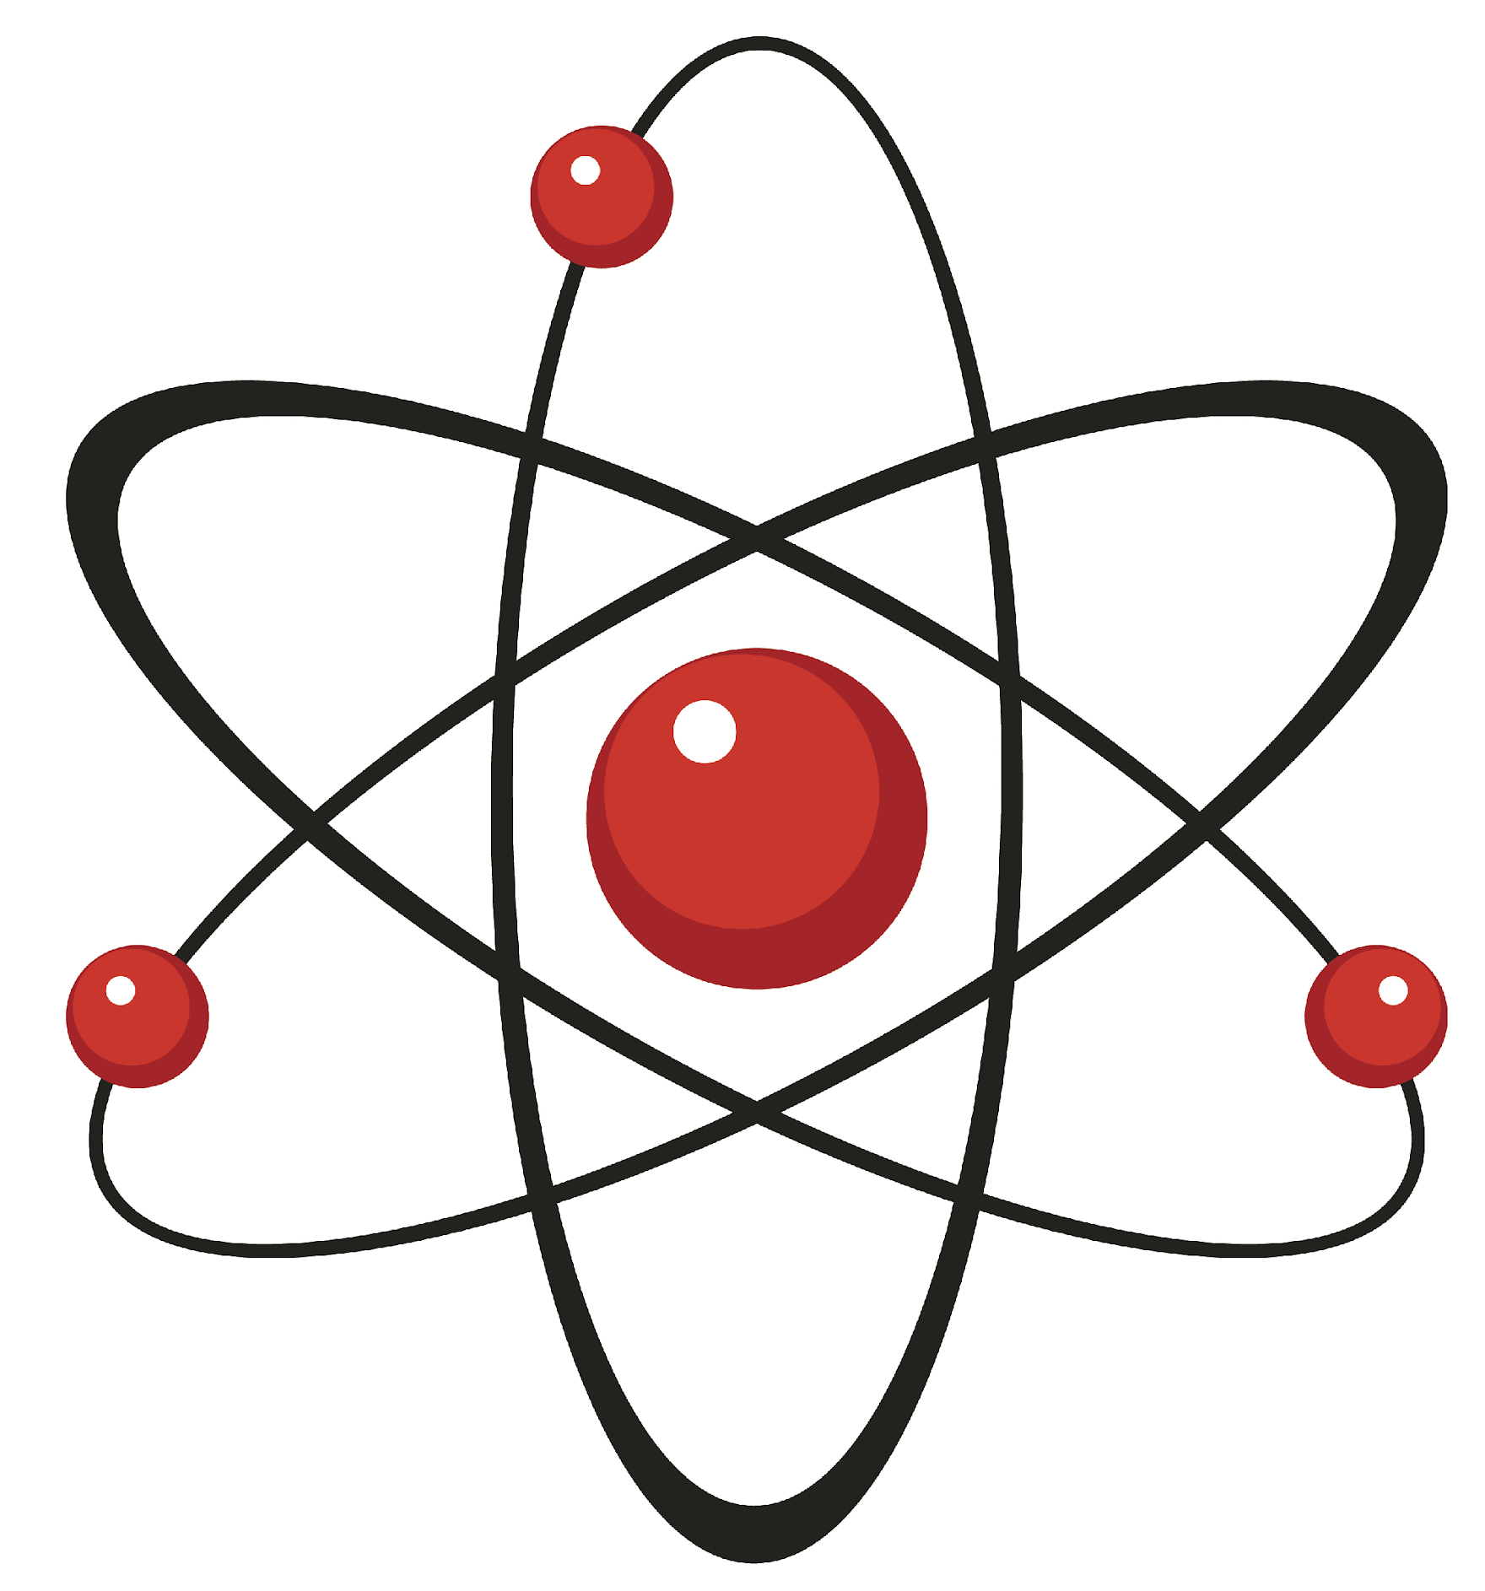
Atom: smallest whole unit of matter
Atom
Atom
Atom
Atom
Atom
Notes:
An atom is the smallest whole unit of matter.

Slide 7
Nucleus: the center of the atom that is made up of protons and neutrons
Notes:
The nucleus is the center of the atom that is made of protons and neutrons.
Feedback: It is important to give some background information or a related natural phenomena related to the topic of the lesson. This helps students make connections.

Slide 8
Protons: a positively charged particle that orbits the nucleus of an atom
Proton
Nucleus
Notes:
A proton is a positively charged particle that orbits the nucleus of an atom

Slide 9
Neutrons: a particle with no charge (neutral charge) that orbits the nucleus of an atom.
Neutron
Nucleus
Notes:
A neutron is a particle with no charge (neutral charge) that orbits the nucleus of an atom.

Slide 10
Notes:
Now let’s pause for a moment to check your understanding.
Feedback: Remember to make adjustments to your lesson and content if you see some students not demonstrating understanding, this can help them make connections and prevent frustration.

Slide 11
What are the two qualities of matter?
Notes:
What are the two qualities of matter?
[Matter has mass and takes up space]

Slide 12
What is an atom?
Notes:
What is an atom?
[An atom is the smallest whole unit of matter.]

Slide 13
What is the relationship between atoms and matter?
Notes:
What is the relationship between atoms and matter?
[Matter is made up of atoms.]

Slide 14
What is a nucleus?
Notes:
What is a nucleus?
[The nucleus is the center of the atom that is made of protons and neutrons.]
Feedback: You might need to move slower and more intentionally through the review of the previous day’s material. Use these checks for understanding to determine how well the students are doing with the content.

Slide 15
What is the difference between protons and neutrons?
Proton
Neutron
Notes:
What is the difference between protons and neutrons?
[Protons and neutrons are both particles found in the nucleus of an atom. However, protons have a positive charge and neutrons have no charge (neutral).]

Slide 16
Electron
Notes:
Now that we’ve reviewed, let’s define our new term, electron.

Slide 17
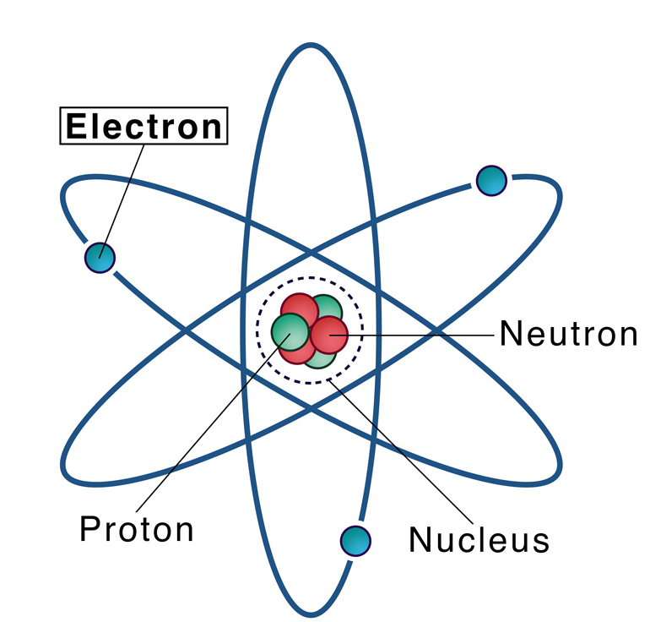
Electron: negatively charged particle that orbits the nucleus of an atom
Notes:
An electron is a negatively charged particle that orbits the nucleus of an atom

Slide 18
Notes:
Now let’s pause for a moment to check your understanding.

Slide 19
What are electrons?
Electron
Notes:
What are electrons?
[Electrons are negatively charged subatomic particles orbiting the nucleus.]
Feedback: Remember, students might look like they are understanding the definition but it is important that you check for understanding yourself by asking questions or providing them with other opportunities to respond.

Slide 20
Notes:
That is the basic definition, but there is a bit more you need to know.

Slide 21
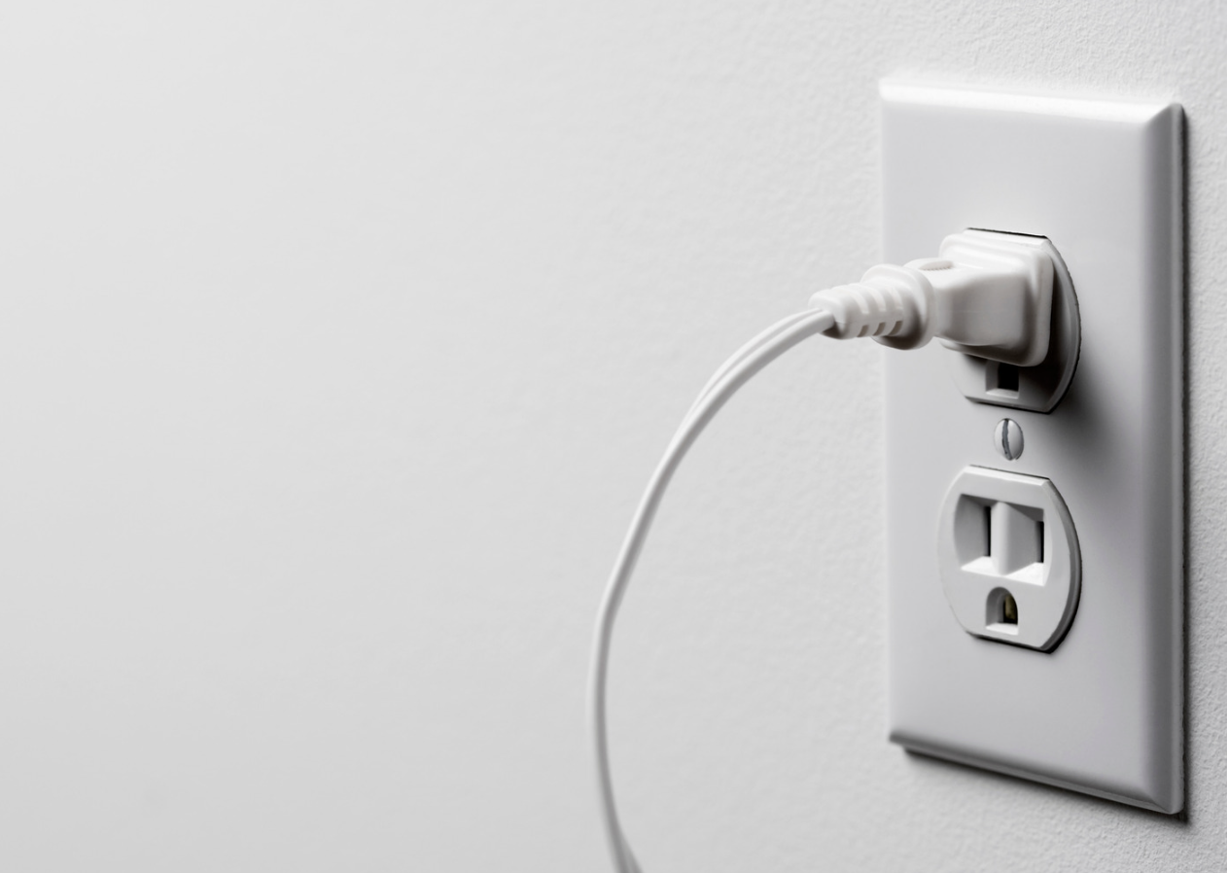
Electrons are the carriers of electric charge.
Notes:
Electrons are the carriers of electric charge. They have a negative charge, and it's their movement that creates the flow of electricity.

Slide 22
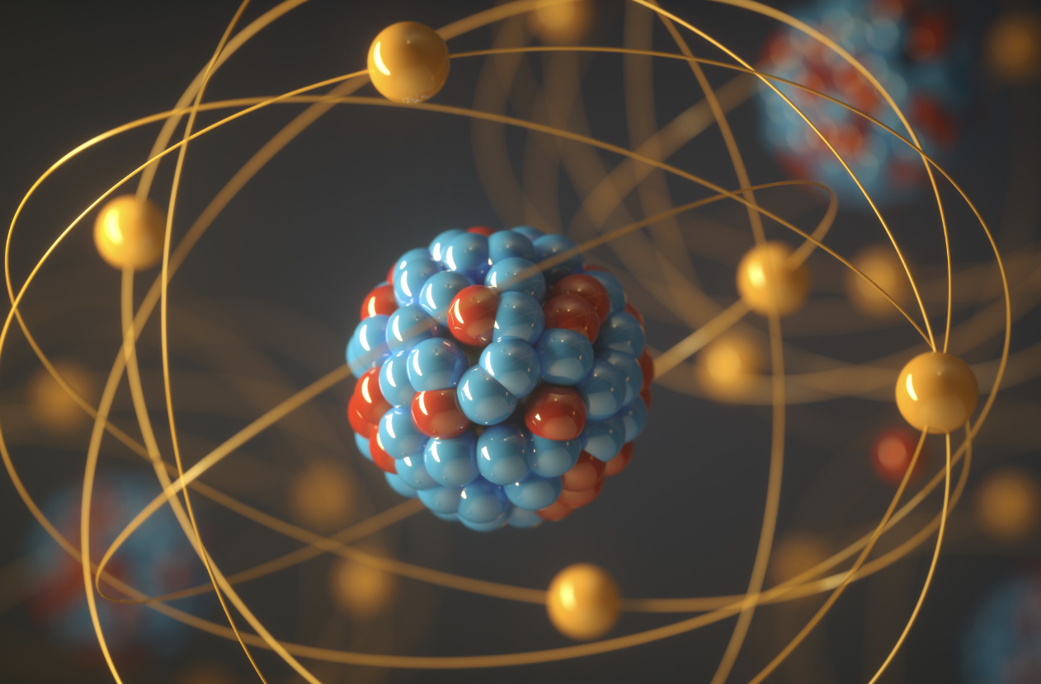
Electrons are part of atoms, which are the building blocks of everything around us.
Notes:
Electrons are part of atoms, which are the building blocks of everything around us. They orbit the nucleus of an atom, much like planets orbit the sun.

Slide 23
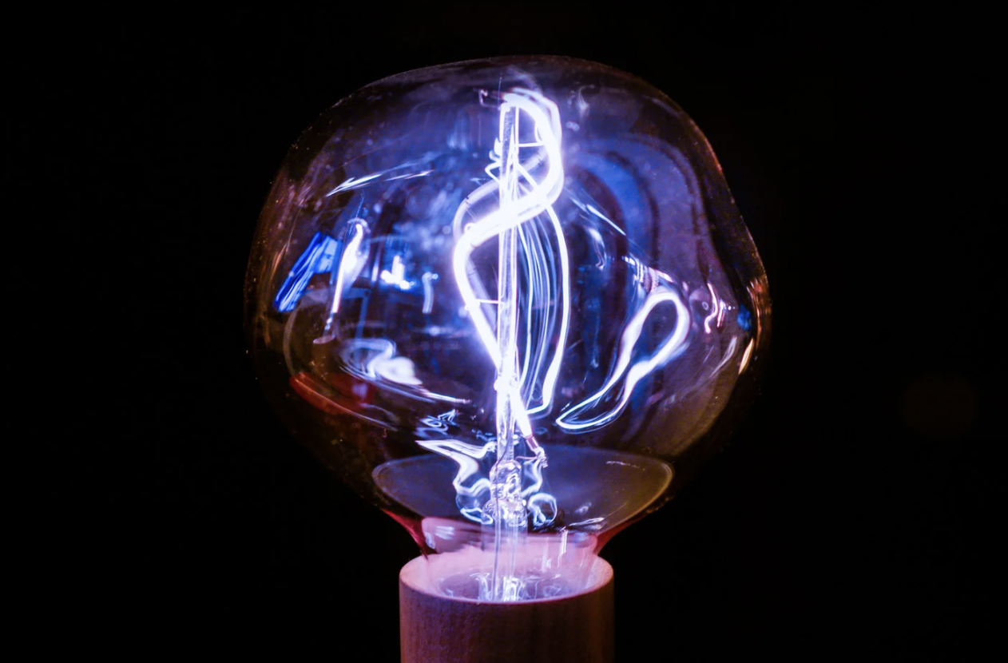
When we talk about electricity, we're talking about the movement of electrons.
Notes:
When we talk about electricity, we're talking about the movement of electrons. They leap from atom to atom, creating a chain reaction that powers our devices.

Slide 24
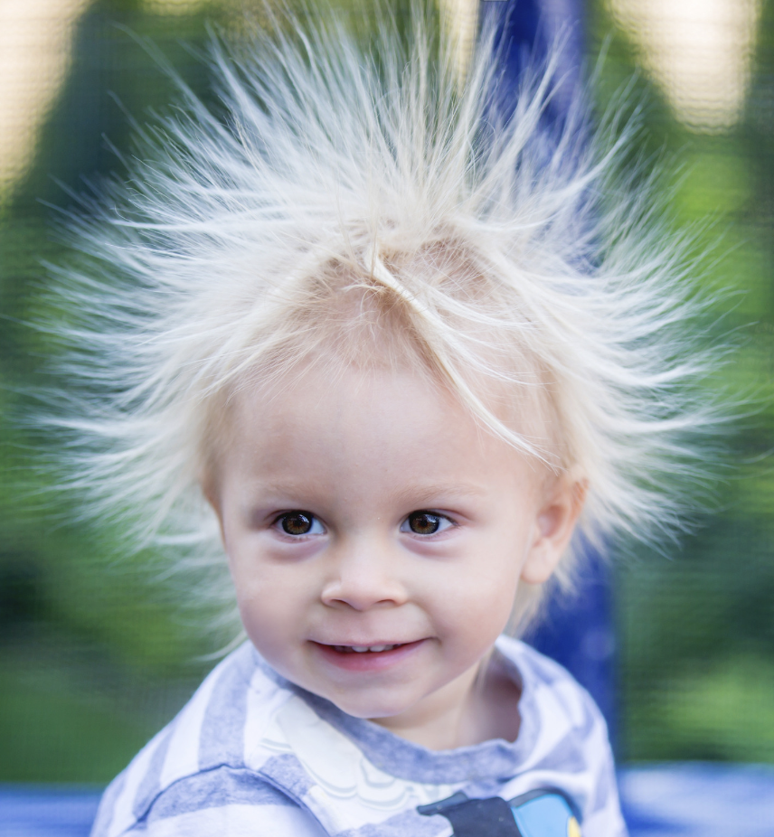
Ever rubbed a balloon on your hair and watched it stick?
That's electrons jumping from your hair to the balloon, creating static electricity.
Notes:
Ever rubbed a balloon on your hair and watched it stick? That's electrons jumping from your hair to the balloon, creating static electricity.

Slide 25
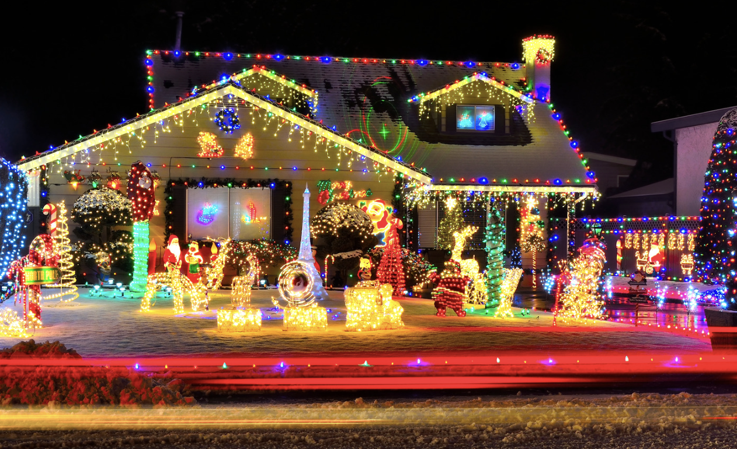
Electrons are too small to see with our eyes, but their effects are mighty.
Notes:
Electrons are too small to see with our eyes, but their effects are mighty. They're responsible for the lights in our homes, the buzzing of electronics, and so much more.

Slide 26
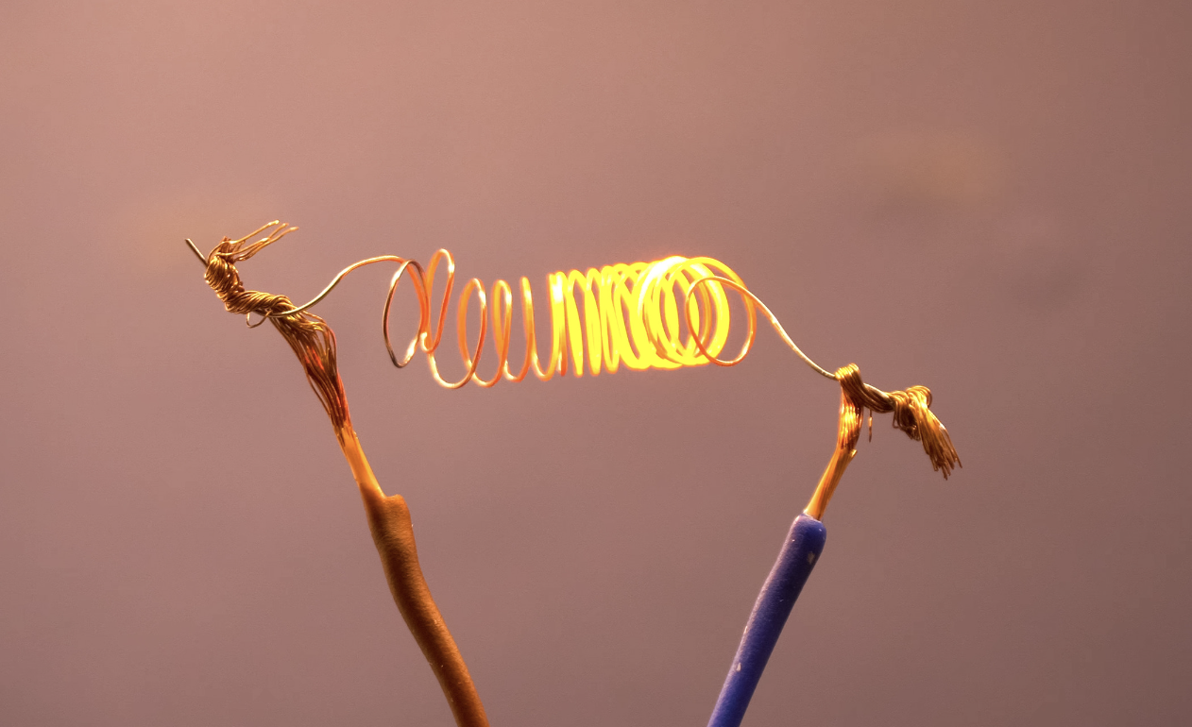
In electrical circuits, electrons form a current.
Notes:
In electrical circuits, electrons form a current. They flow through wires, powering up gadgets, and making sure our devices work when we flip the switch.

Slide 27
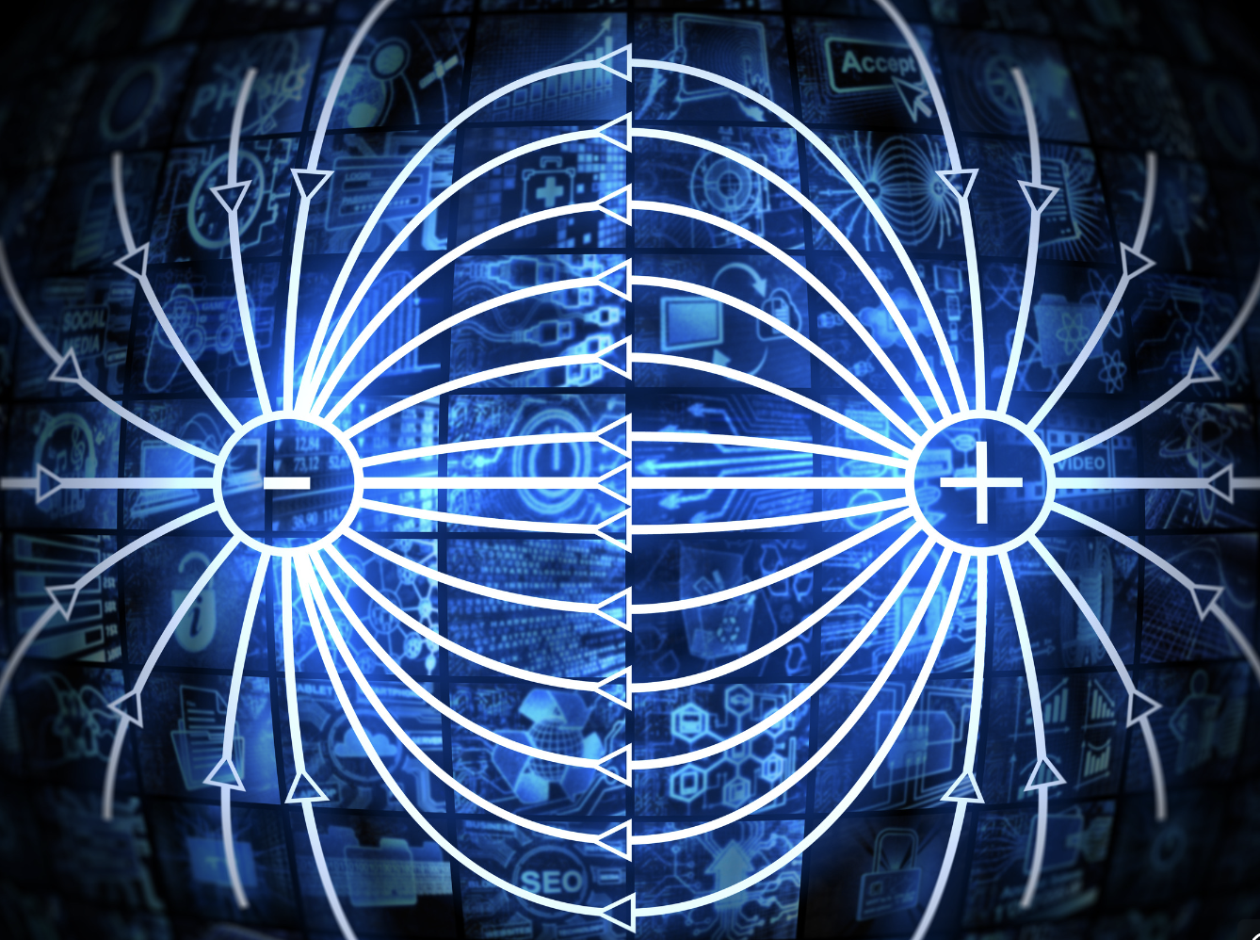
Moving electrons create a magnetic field.
Notes:
Moving electrons create a magnetic field. This connection between electricity and magnetism is the basis of many technologies, from doorbells to MRI machines.

Slide 28
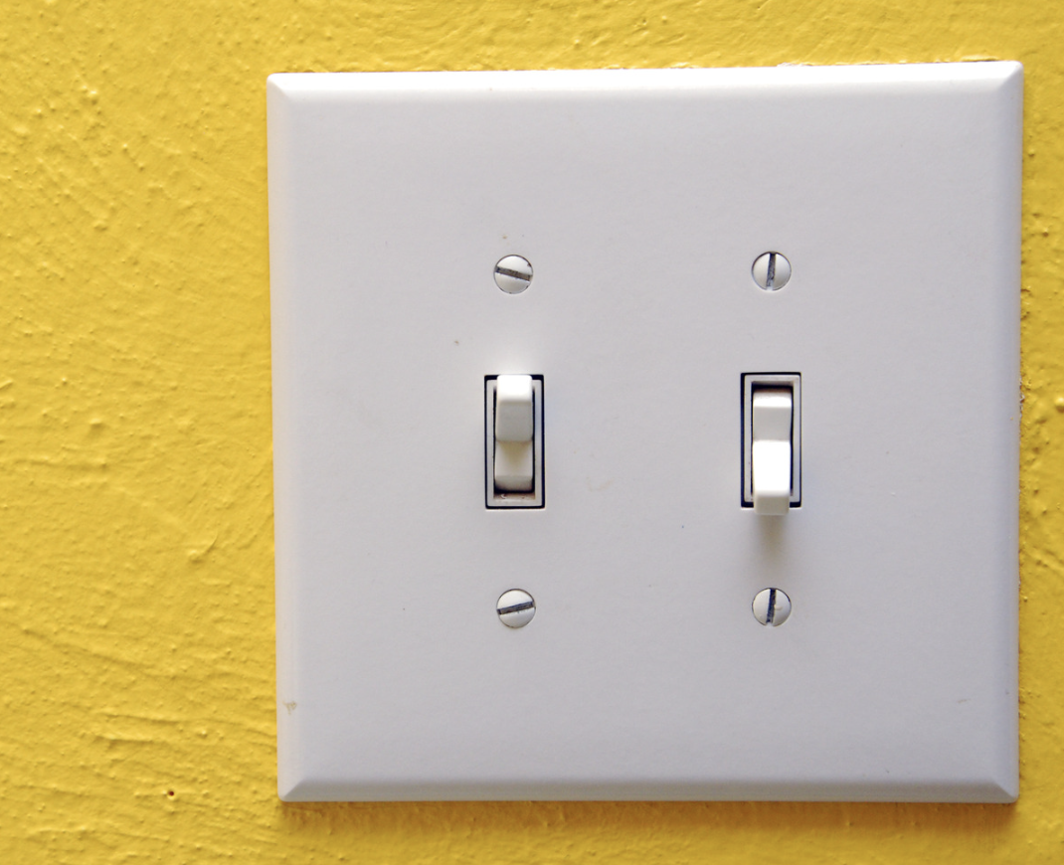
The flow of electrons can be controlled, like turning on and off a tap.
Notes:
The flow of electrons can be controlled, like turning on and off a tap. This control is what allows us to use electricity when and where we need it. Think of light switches.

Slide 29
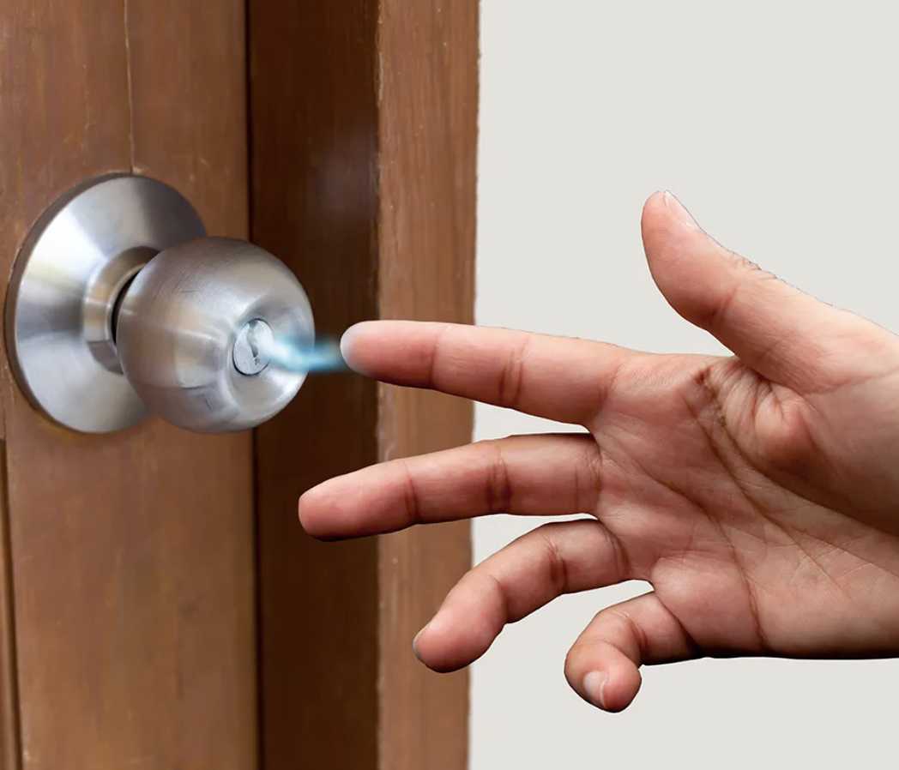
Have you ever touched a doorknob and felt a little shock?
That's electrons moving between you and the doorknob, equalizing the charge.
Notes:
Have you ever touched a doorknob and felt a little shock? That's electrons moving between you and the doorknob, equalizing the charge.

Slide 30
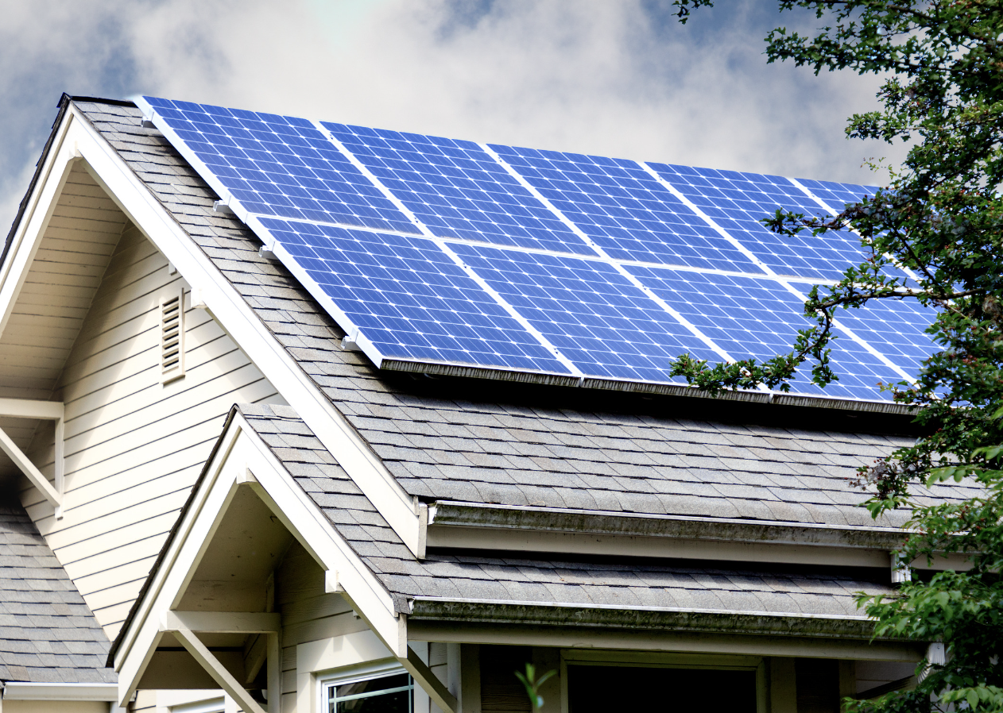
Electrons also play a role in renewable energy.
Notes:
Electrons also play a role in renewable energy. In solar panels, sunlight knocks electrons loose, creating an electric current that we can use for power.

Slide 31
Notes:
Now let’s pause for a moment to check your understanding.

Slide 32
Electrons are part of , which are the building blocks of everything around us.
Notes:
Electrons are part of , which are the building blocks of everything around us.
[atoms]

Slide 33
Electrons are part of atoms, which are the building blocks of everything around us.
Notes:
Electrons are part of atoms, which are the building blocks of everything around us.
[atoms]

Slide 34
True/False: In electrical circuits, electrons form a current.
Notes:
True/False: In electrical circuits, electrons form a current..
[True]

Slide 35
True/False: In electrical circuits, electrons form a current.
Notes:
True: In electrical circuits, electrons form a current..

Slide 36
Notes:
Now, let’s talk about some examples of electrons.
Feedback: Remember, it is important to have an organized and smooth transition to limit wasted time and reduce any disruptions. By having materials ready in advance and working on a routine with students you can easily get this done!

Slide 37
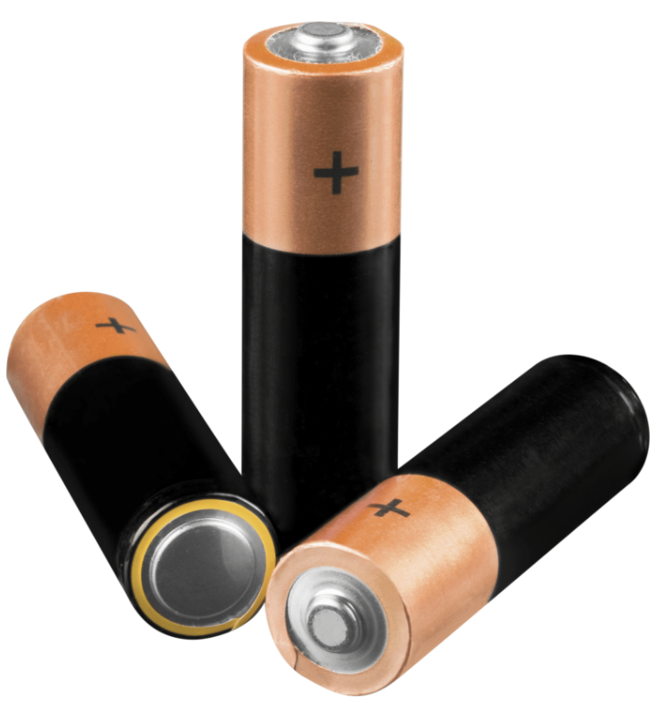
Electrons are inside batteries.
Notes:
Electrons are inside batteries. This is an example of how electrons are used. When you put a battery in a toy, the electrons start moving, creating an electric current that makes the toy work.

Slide 38
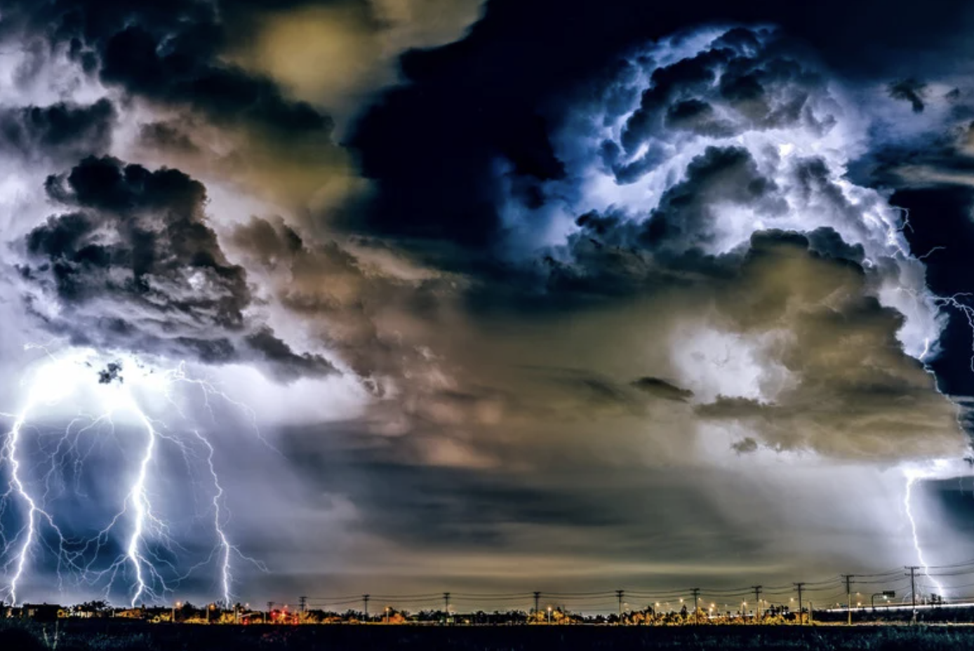
During a thunderstorm, electrons move between clouds and the ground.
Notes:
During a thunderstorm, electrons move between clouds and the ground. This movement creates lightning, a powerful example of electrons in action.

Slide 39
Notes:
Now, let’s talk about some non-examples of an organism.

Slide 40
A proton is NOT an example of an electron.
Proton
Nucleus
Notes:
A proton is NOT an example of an electron. A proton is a positively charged particle that orbits the nucleus of an atom

Slide 41
A neutron is NOT an example of an electron.
Neutron
Nucleus
Notes:
A nucleus is NOT an example of an electron. A neutron is a particle with no charge (neutral charge) that orbits the nucleus of an atom.

Slide 42
Notes:
Now let’s pause for a moment to check your understanding.

Slide 43
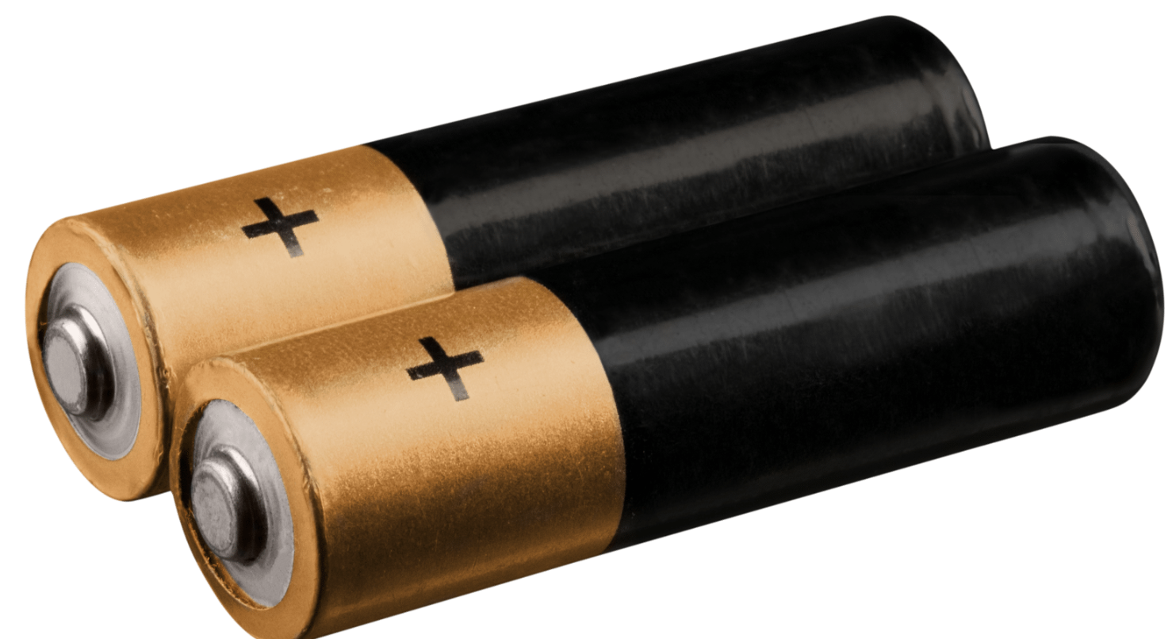
True/False: Electrons are NOT inside of batteries
Notes:
True/False: Electrons are NOT inside of batteries
[False]

Slide 44
True/False: Electrons are NOT inside of batteries
Notes:
False: Electrons ARE inside of batteries. When batteries are in use, electrons are moving around creating an electric current to power whatever the batteries are being used in.

Slide 45
During a thunderstorm, move between clouds and the ground.
Notes:
During a thunderstorm, move between clouds and the ground.
[electrons]

Slide 46
During a thunderstorm, electrons move between clouds and the ground.
Notes:
During a thunderstorm, electrons move between clouds and the ground.

Slide 47
Remember!!!
Notes:
So remember!

Slide 48
Electron: negatively charged particle that orbits the nucleus of an atom
Notes:
An electron is a negatively charged particle that orbits the nucleus of an atom

Slide 49
Notes:
We will now complete this concept map, called a Frayer model, to summarize and further clarify what you have learned about the term electron.

Slide 50
Definition
Picture
Electron
Example
How do electrons impact my life?
Notes:
To complete the Frayer model, we will choose from four choices the correct picture, definition, example, and response to the question, “How do electrons impact my life?” Select the best response for each question using the information you just learned. As we select responses, we will see how this model looks filled in for the term electron.

Slide 51
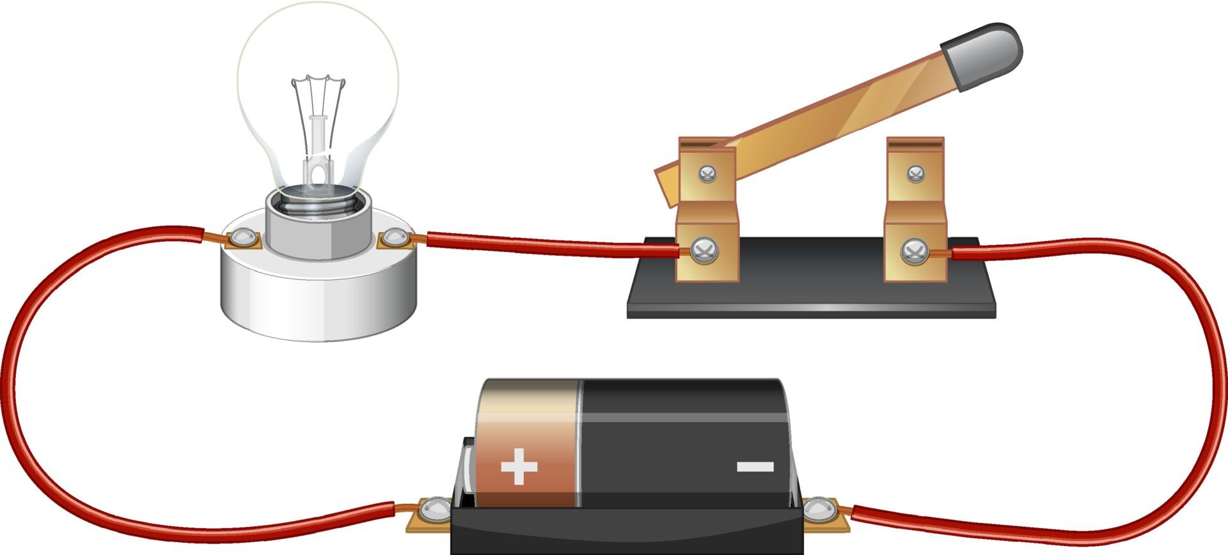
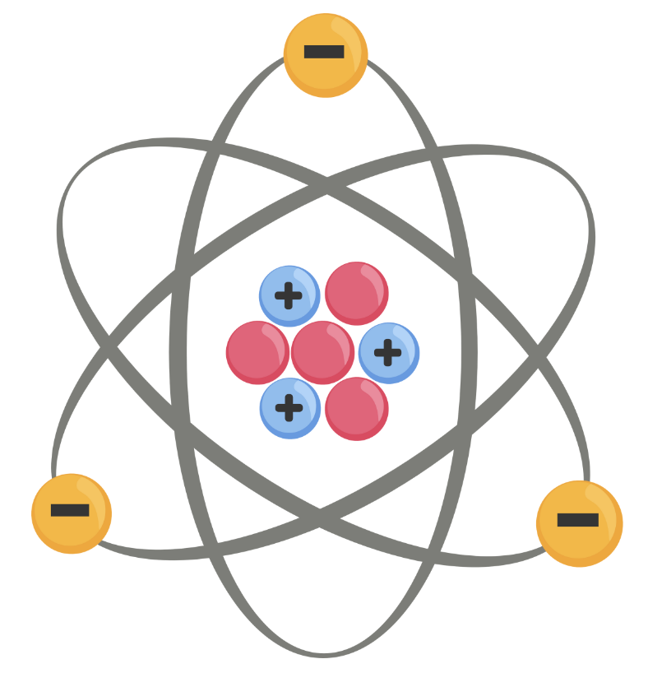
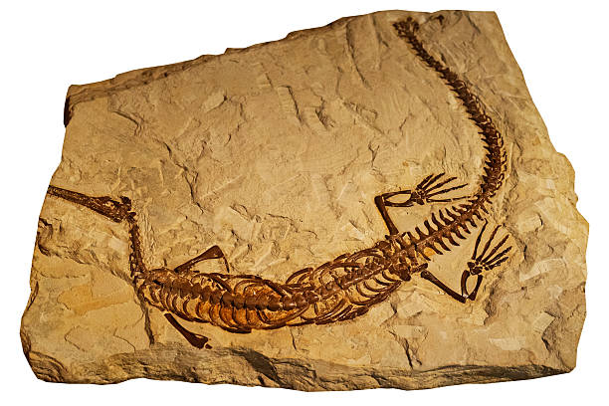
Directions: Choose the correct picture of an electron from the choices below.
A
B
C
D
Notes:
Choose the one correct picture of an electron from these four choices.

Slide 52
Directions: Choose the correct picture of an electron from the choices below.
A
B
C
D
Notes:
This is the picture that shows an electron.

Slide 53
Definition
Picture
Electron
Example of electrons moving
How do electrons impact my life?
Notes:
Here is the Frayer model filled in with a picture of an electron.

Slide 54
Directions: Choose the correct definition of an
electron from the choices below.
A
The center of the atom that is made up of protons and neutrons
B
The path electricity travels on
C
A negatively charged particle that orbits the nucleus of an atom
D
An animal that hunts and eats another animal
Notes:
Choose the one correct definition of an electron from these four choices.

Slide 55
Directions: Choose the correct definition of an
electron from the choices below.
A
The center of the atom that is made up of protons and neutrons
B
The path electricity travels on
C
A negatively charged particle that orbits the nucleus of an atom
D
An animal that hunts and eats another animal
Notes:
“A negatively charged particle that orbits the nucleus of an atom” is correct! This is the definition of an electron.

Slide 56
Definition
Picture
A negatively charged particle that orbits the nucleus of an atom
Electron
Example of electrons moving
How do electrons impact my life?
Notes:
Here is the Frayer Model with a picture and the definition filled in for electron: A negatively charged particle that orbits the nucleus of an atom

Slide 57
Directions: Choose the correct example of
electrons moving from the choices below.
A
A fish swimming in the sea
B
A thunderstorm
C
A book sitting on a shelf
D
A baby crawling on the ground
Notes:
Choose the one correct example of an electrons moving from these four choices.

Slide 58
Directions: Choose the correct example of
electrons moving from the choices below.
A
A fish swimming in the sea
B
A thunderstorm
C
A book sitting on a shelf
D
A baby crawling on the ground
Notes:
“A thunderstorm” is correct! This is an example of electrons moving.

Slide 59
Definition
Picture
A negatively charged particle that orbits the nucleus of an atom
Electron
A thunderstorm
Example of electrons moving
How do electrons impact my life?
Notes:
Here is the Frayer Model with a picture, definition, and an example of electrons moving: A thunderstorm

Slide 60
Directions: Choose the correct response for “how do electrons impact my life?” from the choices below.
A
Electrons make things work. When we turn on the lights, play with toys, or watch TV, electrons are moving and creating electricity.
B
Electrons show how people used to live thousands of years ago so we can learn from it to help us survive.
C
Electrons show us how animals and plants work and live together in one spot.
D
Electrons teach us how weather works so we can build environments to protect ourselves and live life in.
Notes:
Choose the one correct response for “how do electrons impact my life?” from these four choices.

Slide 61
Directions: Choose the correct response for “how do electrons impact my life?” from the choices below.
A
Electrons make things work. When we turn on the lights, play with toys, or watch TV, electrons are moving and creating electricity.
B
Electrons show how people used to live thousands of years ago so we can learn from it to help us survive.
C
Electrons show us how animals and plants work and live together in one spot.
D
Electrons teach us how weather works so we can build environments to protect ourselves and live life in.
Notes:
“Electrons make things work. When we turn on the lights, play with toys, or watch TV, electrons are moving and creating electricity.” That is correct! This is an example of how electrons impact your life.

Slide 62
Definition
Picture
A negatively charged particle that orbits the nucleus of an atom
Electron
Electrons make things work. When we turn on the lights, play with toys, or watch TV, electrons are moving and creating electricity.
A thunderstorm
Example of electrons moving
How do electrons impact my life?
Notes:
Here is the Frayer Model with a picture, definition, example, and a correct response to “how do electrons impact my life?”: Electrons make things work. When we turn on the lights, play with toys, or watch TV, electrons are moving and creating electricity

Slide 63
Remember!!!
Notes:
So remember!

Slide 64
Electron: negatively charged particle that orbits the nucleus of an atom
Notes:
An electron is a negatively charged particle that orbits the nucleus of an atom

Slide 65
Big Question: How do electrons affect our use of technology, power our homes, and add to our daily conveniences?
Notes:
Let’s reflect once more on our big question. Our “big question” is: How do electrons affect our use of technology, power our homes, and add to our daily conveniences?
Does anyone have any additional examples to share that haven’t been discussed yet?

Slide 66
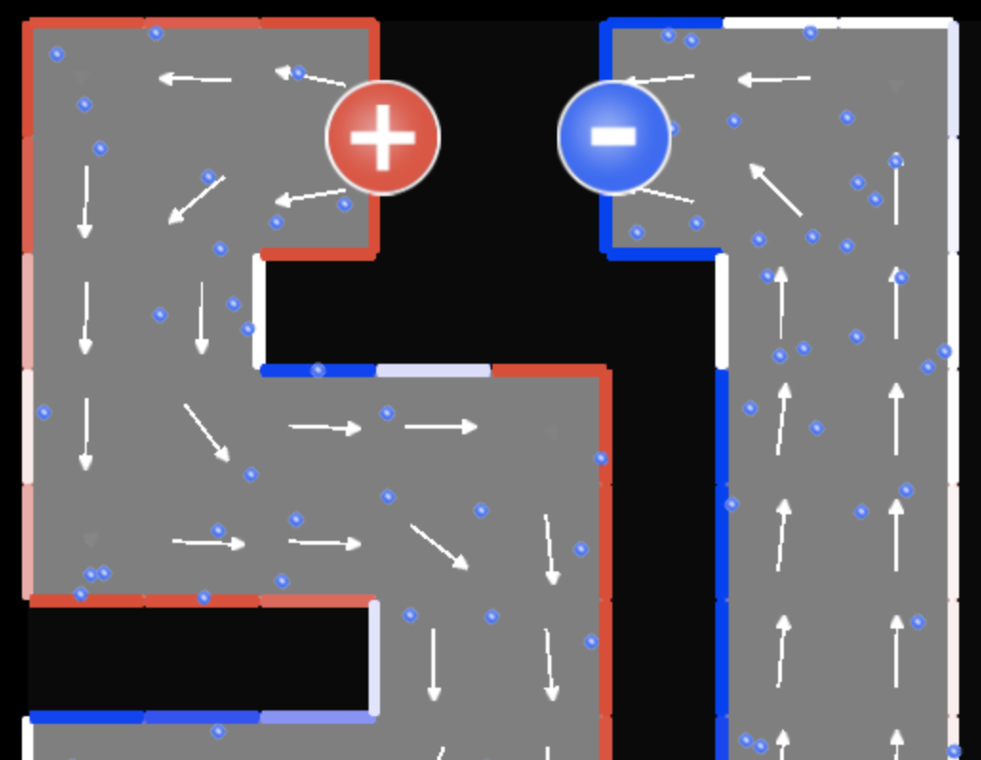
Simulation Activity
Electron Flow
Click on the link above to simulate the flow of electrons through a wire caused by electric fields created by surface charges.
Notes:
“Circuit Electron Flow” simulates the flow of electrons through a wire caused by electric fields created by surface charges. Four different situations are presented, in order of increasing complexity:
Electron flow through a straight wire
Electron flow through a wire with a 90 degree bend
Electron flow through a simple circuit
Electron flow through a “snaky” circuit
In the simulation and the corresponding worksheet (included below), students are encouraged to explore how the accumulation of electrons on the surface of a wire affects the surface charge, which in turn
alters the electric fields throughout the circuit.
Go to website for simulations and worksheets: https://www.simbucket.com/simulation/circuit-electron-flow/

Slide 67
Notes:
Thanks for watching, and please continue watching CAPs available from this website.

Slide 68
This Video Was Created With Resources From:
Questions or Comments
Michael Kennedy, Ph.D. MKennedy@Virginia.edu
Rachel L Kunemund, Ph.D. rk8vm@virginia.edu

