Slide 1
Intro
“Big Idea” Question
Review Concepts
Check-In Questions
Teacher Engagement
Vocabulary
Student-Friendly Definition
Examples & Non-Examples
Frayer Model
Simulation/Activity
Notes:
OK everyone, get ready for our next lesson. Just as a reminder, these are the different components that our lesson may include, and you’ll see these icons in the top left corner of each slide so that you can follow along more easily!

Slide 2
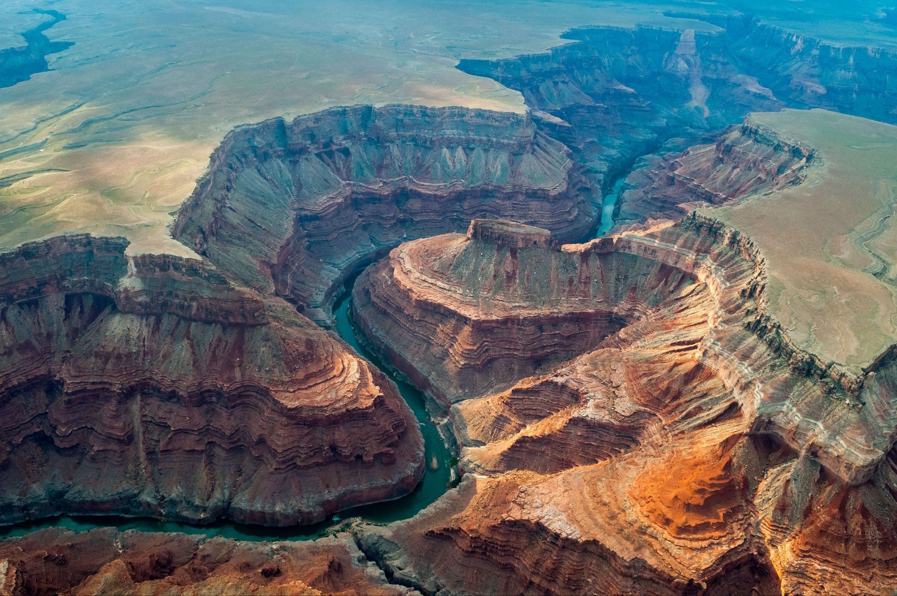
Intro
Erosion
Notes:
Today, we’ll be learning about the word: Erosion.

Slide 3
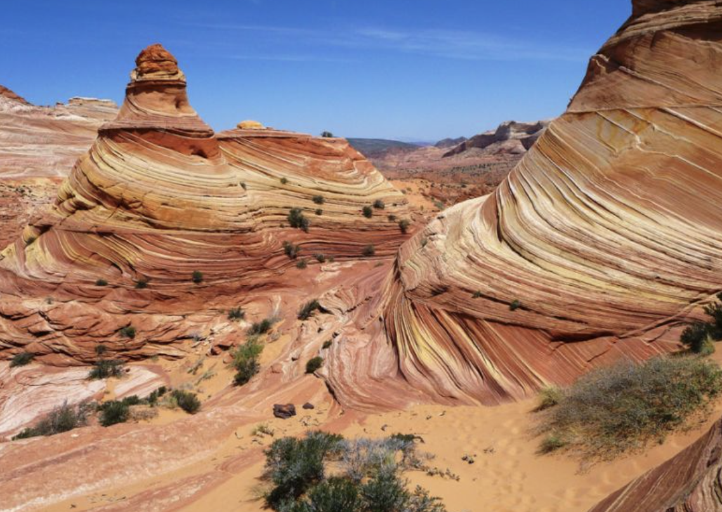
Big Question: How does erosion shape the land around us and impact our environment?
Notes:
Our “big question” is: How does erosion shape the land around us and impact our environment?
I love all these thoughtful scientific hypotheses! Be sure to keep this question and your predictions in mind as we move through these next few lessons, and we’ll continue to revisit it.

Slide 4
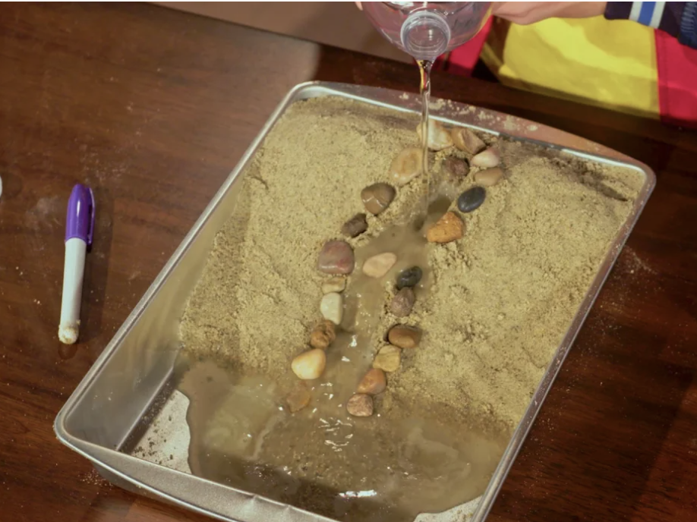
Demonstration
TEACHER DIRECTIONS:
Before viewing: Ask students what they already know about erosion. Tell students today they will be learning about the term erosion.
During: Discuss with the students what happens as the water flows over the landscape. Encourage them to observe how it carries away soil, creates channels, and may form features like valleys.
After: Tell students that today they will be learning more about the term erosion.
Notes:
Here are detailed steps for the erosion demonstration:
Materials needed:
A large tray or shallow container
Sand
Soil
Small rocks or pebbles
Watering can or a container with a spout
Plastic wrap (optional)
Small toy figures or objects (optional)
Steps:
Prepare the tray: Fill the tray with a layer of sand to represent the Earth's surface. Add some soil on top to simulate the topsoil layer.
Create features: Arrange small rocks or pebbles on the sand to represent mountains or hills. You can also add small toy figures to represent trees or houses.
Stabilize the landscape: If desired, cover the landscape with plastic wrap and press it gently to stabilize the features. This step represents how vegetation can help prevent erosion by holding the soil in place.
Introduce water: Hold the watering can or container with a spout above the tray. Simulate rainfall by gently pouring water onto the landscape. Observe how the water interacts with the land.
Observe and discuss: Discuss with students what happens as the water flows over the landscape. Observe how it carries away soil, creates channels, and may form features like valleys.
Repeat: You can repeat the process with variations, such as adjusting the angle of the tray or experimenting with different amounts of water.
Discuss outcomes: After the demonstration, have a class discussion about what the students observed. Talk about how erosion can change the shape of the land over time and discuss the importance of soil conservation practices.
This hands-on activity allows students to actively engage with the concept of erosion and provides a visual representation of the Earth's surface changes over time.

Slide 5
Notes:
Before we move on to our new topic, let’s review some other words & concepts that you already learned and make sure you are firm in your understanding.

Slide 6
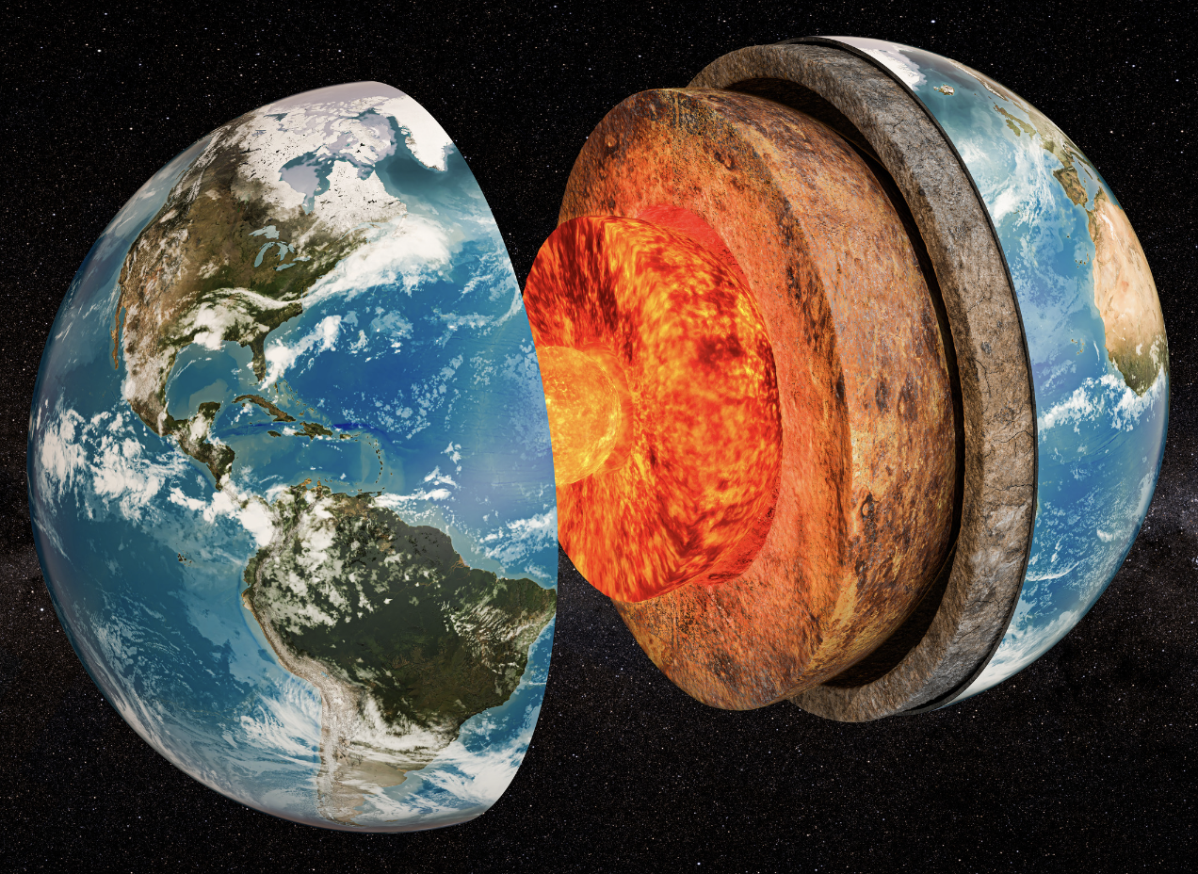
The Earth’s System: The interconnected components that work together to form the Earth.
Notes:
The Earth’s System: The interconnected components that work together to form the Earth.

Slide 7
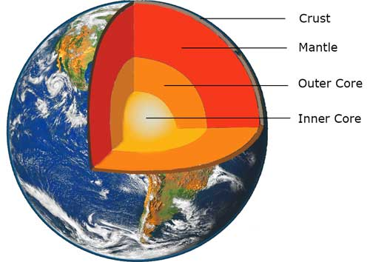
The Layers of the Earth
Notes:
Review the layers of the Earth. Crust, Mantle, Outer Core, and Inner Core

Slide 8
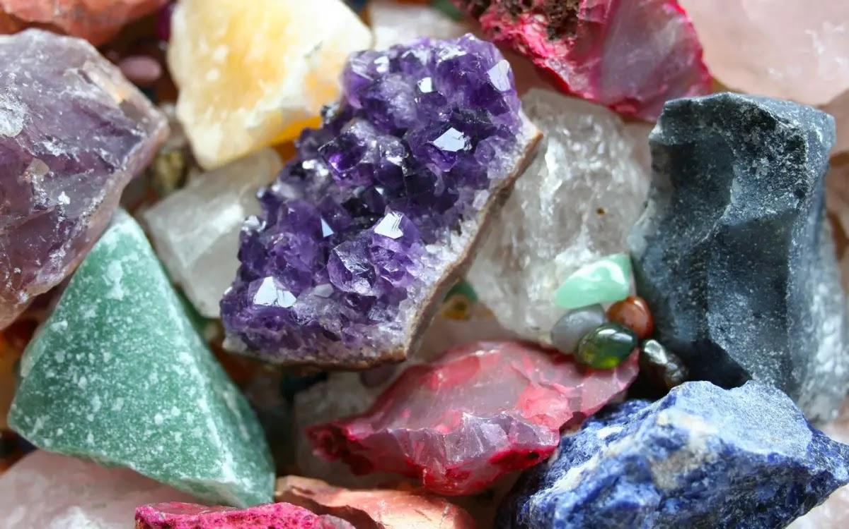
Mineral: Substances that do not come from an animal or plant, the building blocks that make up rocks
Notes:
Mineral: Substances that do not come from an animal or plant, the building blocks that make up rocks

Slide 9
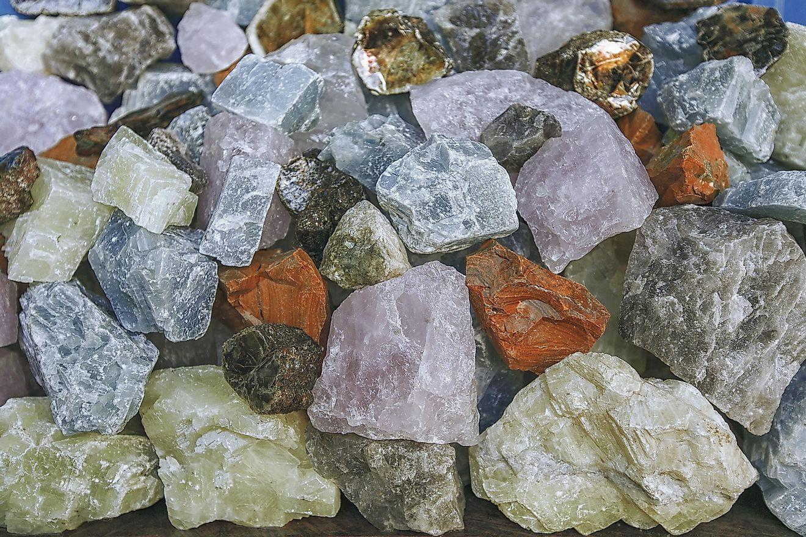
Rock: A solid collection of minerals.
Notes:
Rock: A solid collection of minerals.

Slide 10
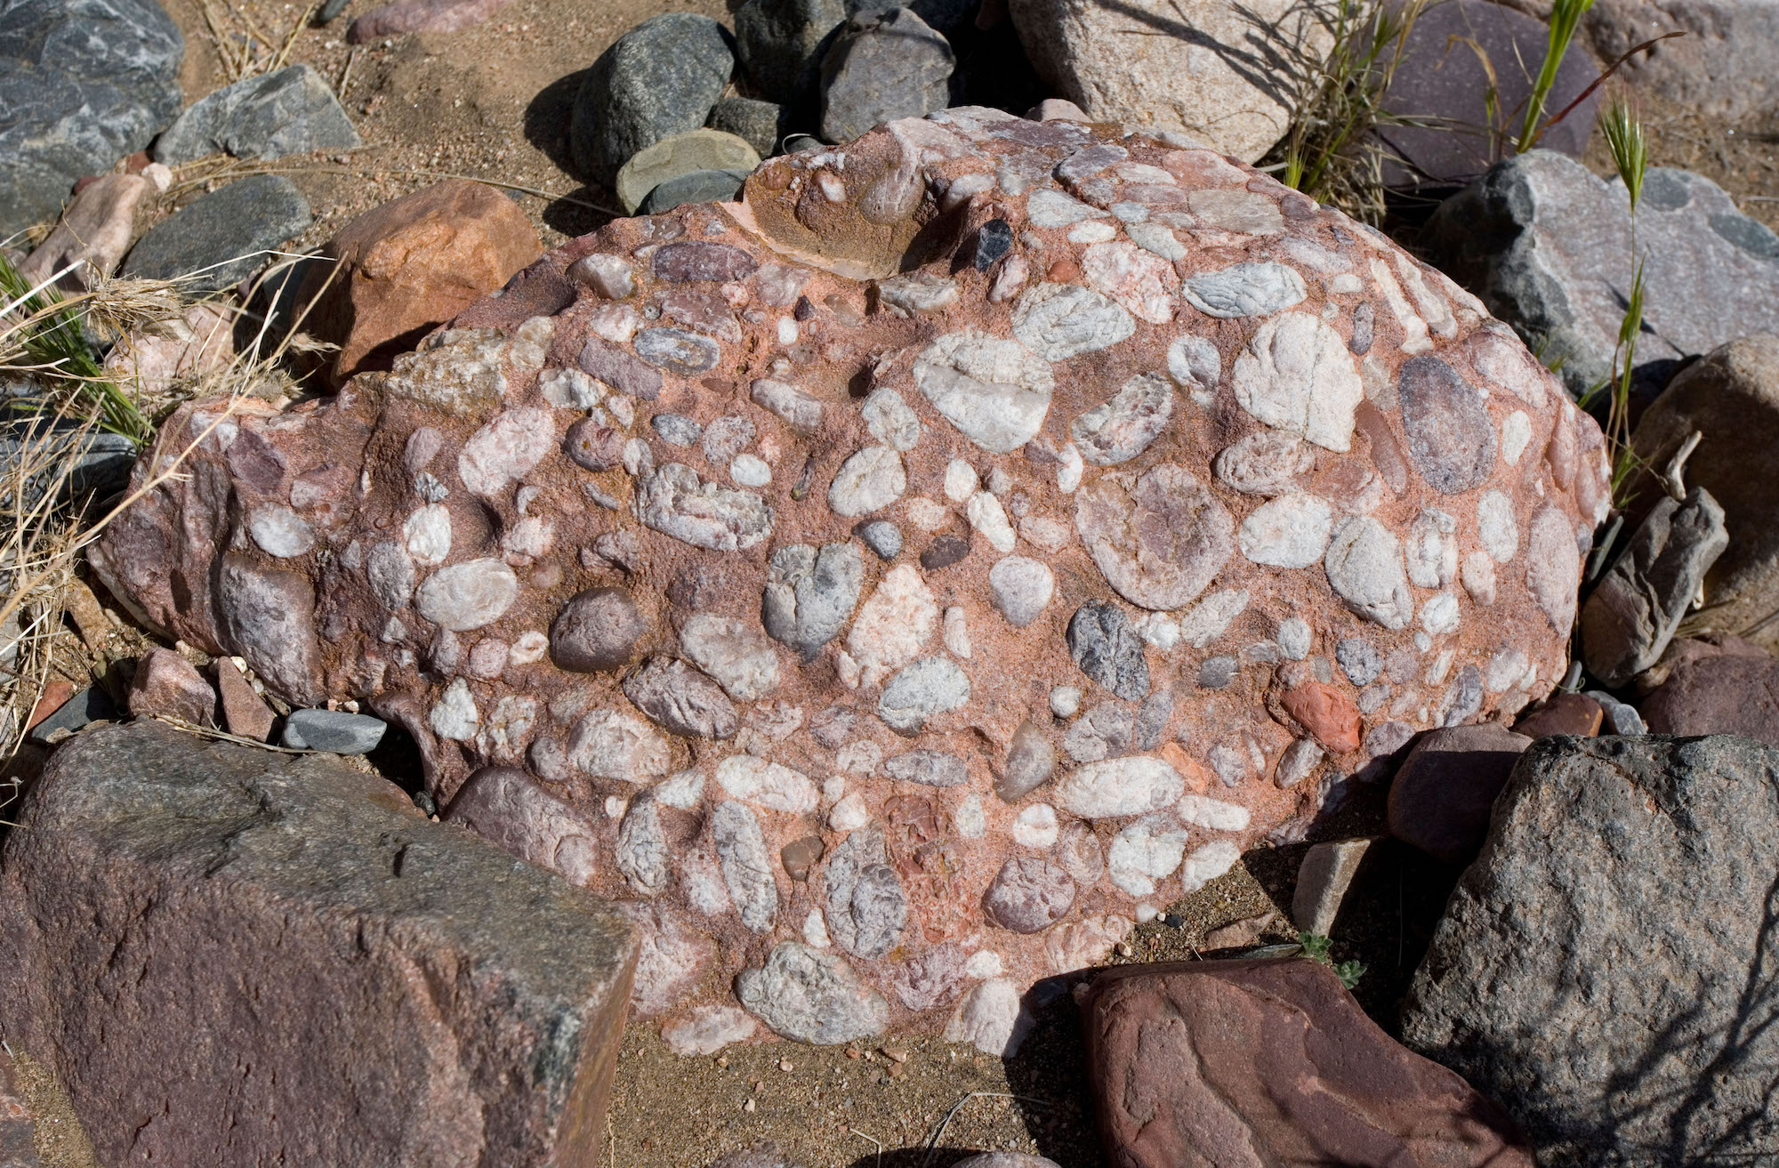
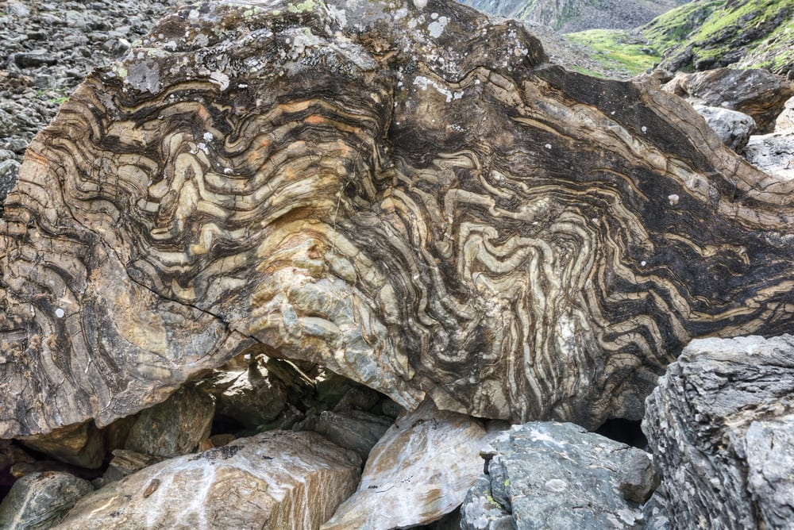
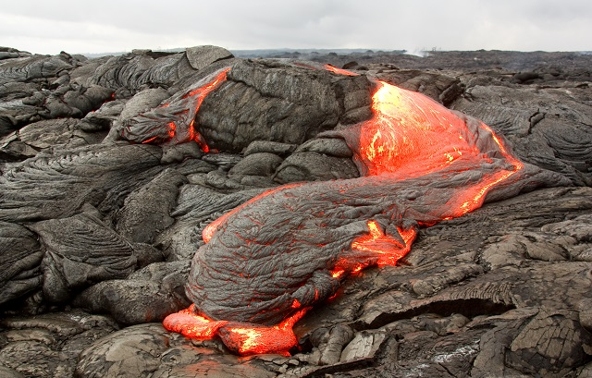
There are three types of rocks. Each type forms differently.
Igneous – when lava cools down and solidifies
Sedimentary – when small particles e.g., minerals, organic materials, sand, stick together over time
Metamorphic – when existing rocks undergo temperature, pressure, or chemical change
Notes:
There are three types of rocks. Each type of rock forms differently.
Today, we will be learning about sedimentary rocks.

Slide 11
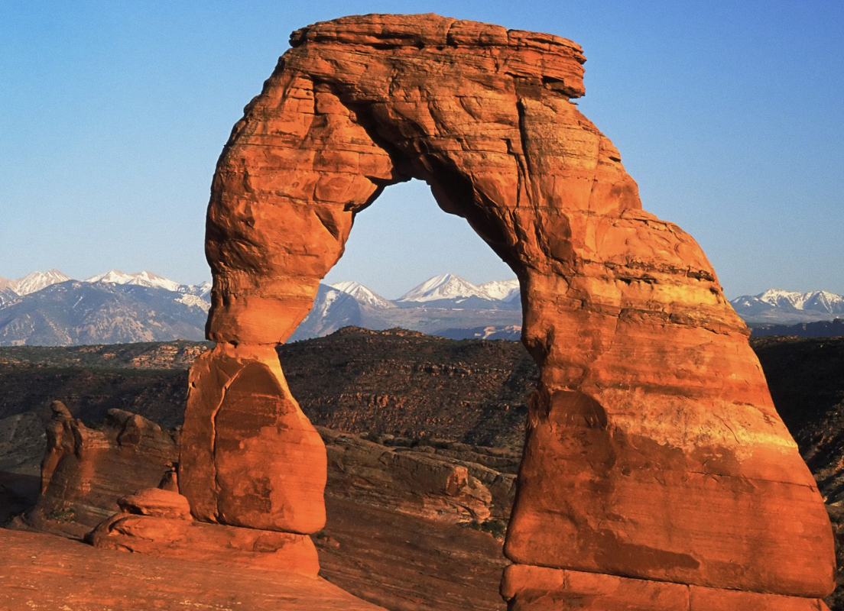
Weathering: the process of breaking down rock over long periods of time
Notes:
Weathering: the process of breaking down rock over long periods of time

Slide 12
Deposition: dropping of sediment to a new location
Notes:
Deposition is the dropping of sediment to a new location

Slide 13
Notes:
Now let’s pause for a moment to review the information we have covered already.

Slide 14
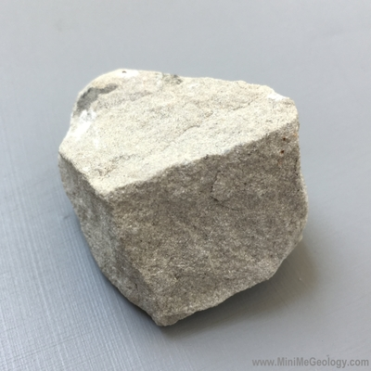
What is the relationship between rocks and minerals?
Rocks are created when minerals go through changes in temperature and pressure.
Rocks are tiny pieces of minerals that stick together over time.
Rocks are made up of one or more mineral.
Notes:
What is the relationship between rocks and minerals?
[C] Rocks are made up of one or more mineral.

Slide 15
What is the relationship between rocks and minerals?
Rocks are created when minerals go through changes in temperature and pressure.
Rocks are tiny pieces of minerals that stick together over time.
Rocks are made up of one or more mineral.
Notes:
What is the relationship between rocks and minerals? Rocks are made up of one or more mineral.
[C] Rocks are made up of one or more mineral.

Slide 16
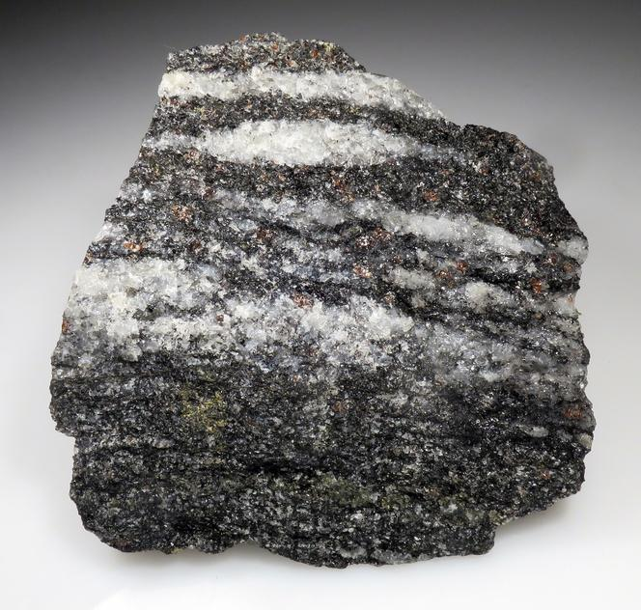
Which of the following materials can rocks not be made of?
Sand particles
Minerals
Former living things
Fossils
Notes:
Which of the following materials can rocks not be made of?
[D] Fossils

Slide 17
Which of the following materials can rocks not be made of?
Sand particles
Minerals
Former living things
Fossils
Notes:
Which of the following materials can rocks not be made of?
[D] Fossils

Slide 18
Weathering: the process of breaking down rock over periods of time
Notes:
Weathering: the process of breaking down rock over periods of time
[long]

Slide 19
Weathering: the process of breaking down rock over long periods of time
Notes:
Weathering: the process of breaking down rock over long periods of time

Slide 20
True or False: Deposition is the dropping of sediment to a new location
Notes:
True or False: Deposition is the dropping of sediment to a new location
[True]

Slide 21
True or False: Deposition is the dropping of sediment to a new location
Notes:
True : Deposition is the dropping of sediment to a new location

Slide 22
Erosion
Notes:
Now that we’ve reviewed, let’s define the phrase Erosion

Slide 23
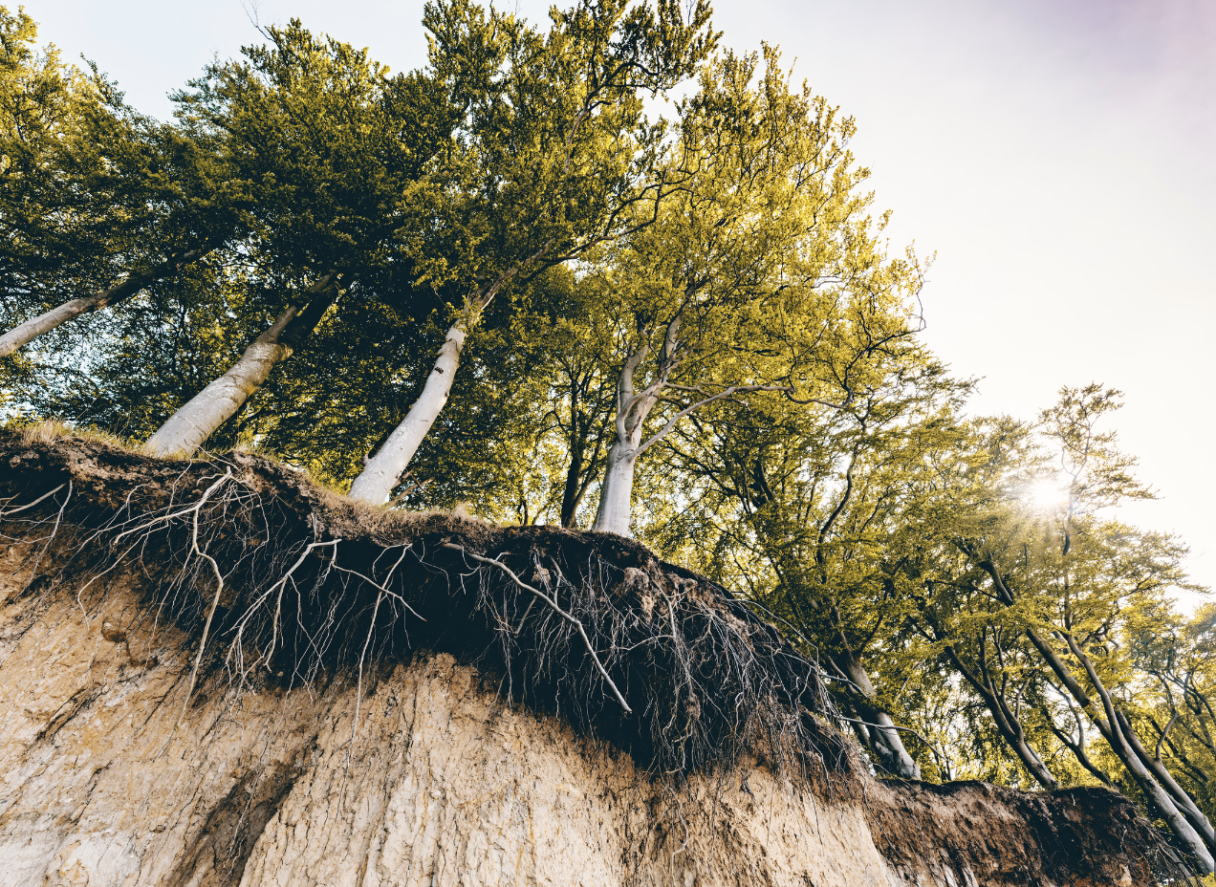
Erosion: Earth materials (rock, soil) are worn away and moved by wind and water
Notes:
Erosion: Earth materials (rock, soil) are worn away and moved by wind and water

Slide 24
Notes:
Let’s check-in for understanding.

Slide 25
What is erosion?
Notes:
What is erosion?
[Earth materials (rock, soil) are worn away and moved by wind and water]

Slide 26
Notes:
That is the basic definition, but there is a bit more you need to know.

Slide 27
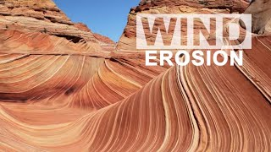
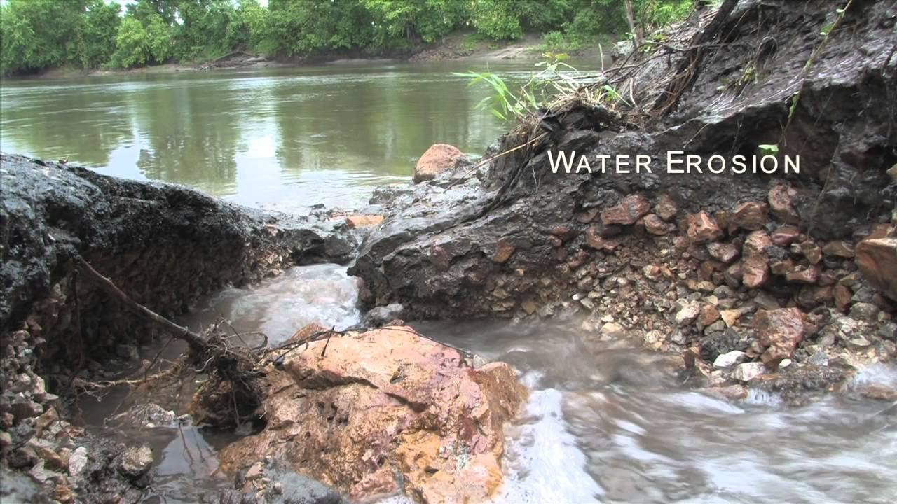
Erosion is a reshaping of the Earth’s surface. This is because when water flows over the surface of our planet, or when wind blows, either water or wind can move tiny particles of soil which makes the land look different.
Notes:
Erosion is a reshaping of the Earth’s surface. This is because when water flows over the surface of our planet, or when wind blows, either water or wind can move tiny particles of soil which makes the land look different.

Slide 28
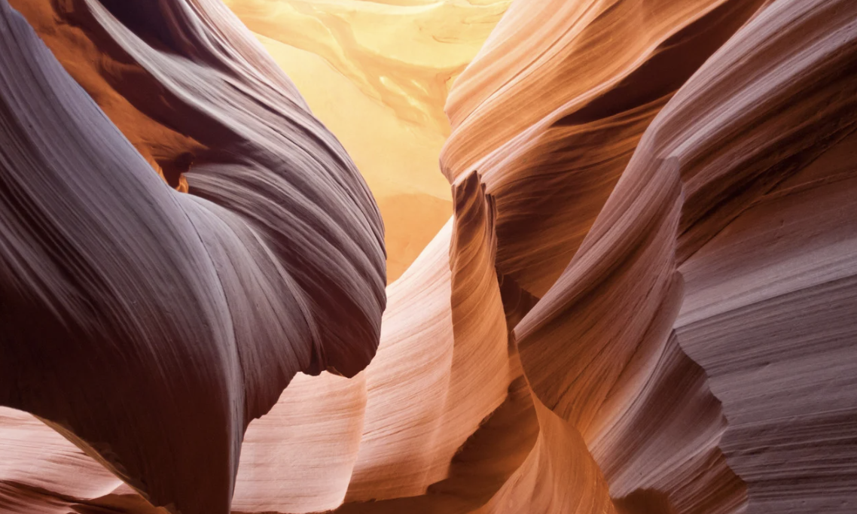
Erosion happens over a long period of time and results in landscapes such as beaches, canyons, and valleys.
Notes:
Erosion happens over a long period of time and results in landscapes such as beaches, canyons, and valleys.

Slide 29
Notes:
Let’s check-in for understanding.

Slide 30
True or False: Erosion is does not change the surface of the Earth
Notes:
True or False: Erosion is does not change the surface of the Earth
[False]

Slide 31
True or False: Erosion is does not change the surface of the Earth
Notes:
False: Erosion is changes and reshapes the surface of the Earth

Slide 32
Notes:
Now, let’s talk about some examples of rocks.

Slide 33
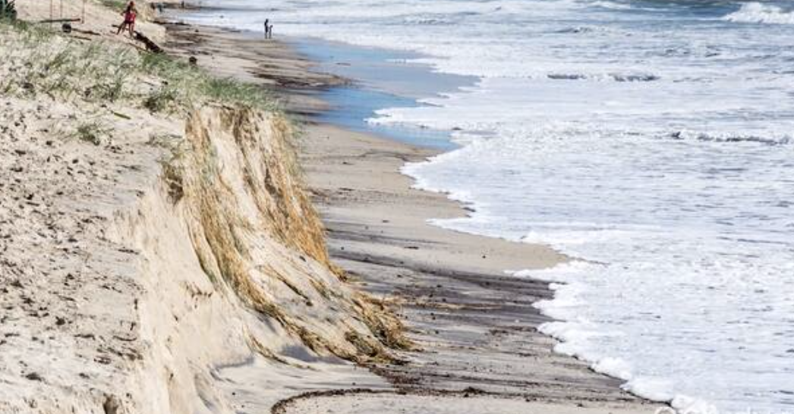
Beach erosion is an example of erosion. It is the gradual wearing away of coastal land, particularly sandy shorelines, by natural forces such as waves, currents, tides, and wind.
Notes:
Beach erosion is an example of erosion. It is the gradual wearing away of coastal land, particularly sandy shorelines, by natural forces such as waves, currents, tides, and wind. It is a natural process influenced by various factors, including weather patterns, sea level changes, and human activities.

Slide 34
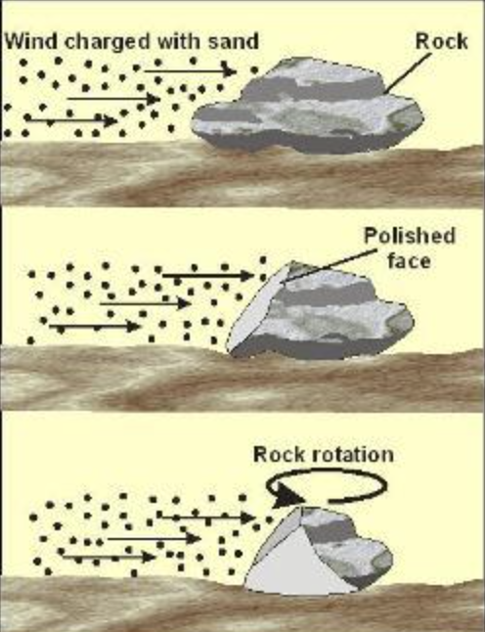
Wind erosion is also an example of erosion. It is the process by which soil and other loose materials are lifted and carried away by the force of the wind.
Notes:
Wind erosion is also an example of erosion. It is the process by which soil and other loose materials are lifted and carried away by the force of the wind. This natural phenomenon occurs when wind blows over bare or loosely covered soil, picking up particles and transporting them to other locations.

Slide 35
Notes:
Now, let’s talk about some non-examples of sedimentary rocks.

Slide 36
Melting ice is NOT an example of erosion. Melting ice is a physical change caused by an increase in temperature, and it doesn't involve rocks being worn away.
Notes:
Melting ice is NOT an example of erosion. Melting ice is a physical change caused by an increase in temperature, and it doesn't involve rocks being worn away.

Slide 37
Chemical Weathering is NOT an example of erosion. Chemical weathering is when acids in rainwater can react with minerals in rocks, changing what they are made of.
Notes:
Chemical Weathering is NOT an example of erosion. Chemical weathering is when acids in rainwater can react with minerals in rocks, changing what they are made of.

Slide 38
Notes:
Now let’s pause for a moment to check your understanding.

Slide 39
Why are melting ice and chemical weathering not examples of erosion?
Notes:
Why are melting ice and chemical weathering not examples of erosion?
[Melting ice is not an example of erosion because it is a physical change caused by an increase in temperature, and it doesn't involve rocks being worn down. Chemical weathering is not an example of erosion because it is is when acids in rainwater can react with minerals in rocks, changing what they are made of.]

Slide 40
Remember!!!
Notes:
So remember!

Slide 41
Erosion: Earth materials (rock, soil) are worn away and moved by wind and water
Notes:
Erosion: Earth materials (rock, soil) are worn away and moved by wind and water

Slide 42
Notes:
We will now complete this concept map, called a Frayer model, to summarize and further clarify what you have learned about the term erosion.

Slide 43
Definition
Picture
Erosion
Example
How does erosion impact my life?
Notes:
To complete the Frayer model, we will choose from four choices the correct picture, definition, example, and response to the question, “How does erosion impact my life?” Select the best response for each question using the information you just learned. As we select responses, we will see how this model looks filled in for the term erosion.

Slide 44
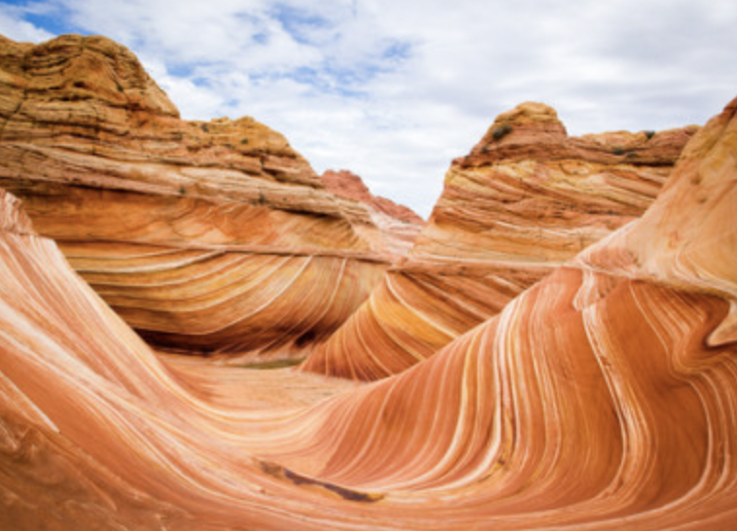
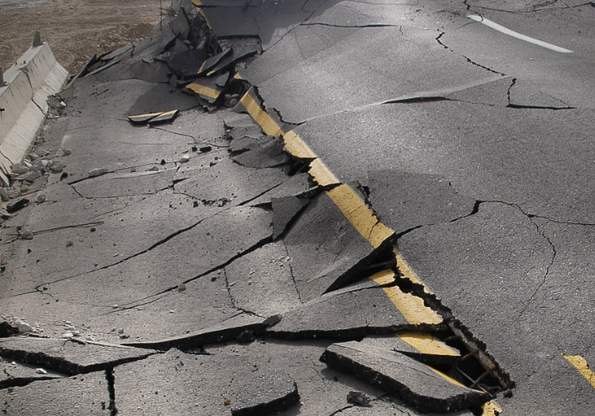
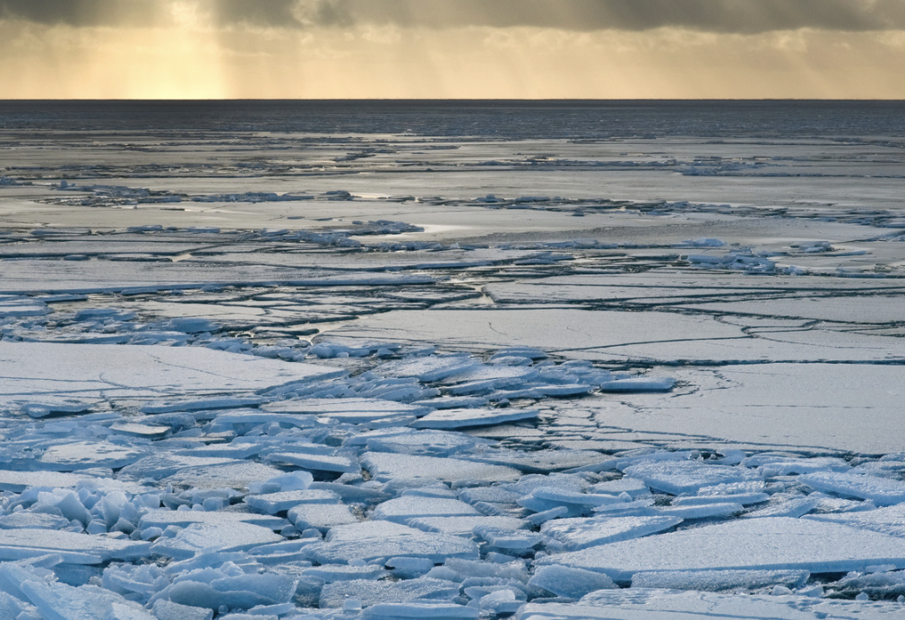
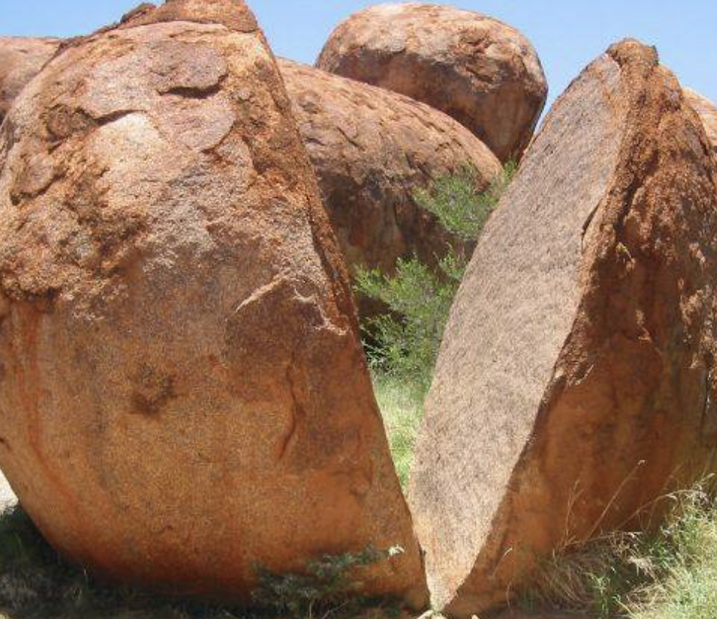
Directions: Choose the correct picture of erosion from the choices below.
A
B
C
D
Notes:
Choose the correct picture of erosion from these four choices.

Slide 45
Directions: Choose the correct picture of erosion from the choices below.
A
B
C
D
Notes:
This is the picture that shows erosion.

Slide 46
Definition
Picture
Erosion
Example
How does erosion impact my life?
Notes:
Here is the Frayer model filled in with a picture of erosion.

Slide 47
Directions: Choose the correct definition of erosion from the choices below.
A
Substances that do not come from an animal or plant, the building blocks that make up rocks
B
Earth materials (rock, soil) are worn away and moved by wind and water
C
The process of breaking down rock over long periods of time
D
The dropping of sediment to a new location
Notes:
Choose the one correct definition of erosion from these four choices.

Slide 48
Directions: Choose the correct definition of erosion from the choices below.
A
Substances that do not come from an animal or plant, the building blocks that make up rocks
B
Earth materials (rock, soil) are worn away and moved by wind and water
C
The process of breaking down rock over long periods of time
D
The dropping of sediment to a new location
Notes:
“Earth materials (rock, soil) are worn away and moved by wind and water” is correct! This is the definition of erosion.

Slide 49
Definition
Picture
Earth materials (rock, soil) are worn away and moved by wind and water
Erosion
Example
How does erosion impact my life?
Notes:
Here is the Frayer Model with a picture and the definition filled in for erosion: Earth materials (rock, soil) are worn away and moved by wind and water

Slide 50
Directions: Choose the correct example of erosion from the choices below.
A
Volcanic Eruption
B
Acids in rainwater changing what rocks are made of
C
Landslides cause by earthquakes
D
Gradual wearing away of coastal land by natural forces
Notes:
Choose the one correct example of erosion from these four choices.

Slide 51
Directions: Choose the correct example of erosion from the choices below.
A
Volcanic Eruption
B
Acids in rainwater changing what rocks are made of
C
Landslides cause by earthquakes
D
Gradual wearing away of coastal land by natural forces
Notes:
“Gradual wearing away of coastal land by natural forces” is correct! These are examples of erosion.

Slide 52
Definition
Picture
Earth materials (rock, soil) are worn away and moved by wind and water
Erosion
Gradual wearing away of coastal land by natural forces
Example
How does erosion impact my life?
Notes:
Here is the Frayer Model with a picture, definition, and an example of erosion: Gradual wearing away of coastal land by natural forces

Slide 53
Directions: Choose the correct response for “how does erosion impact my life?” from the choices below.
A
Erosion contributes to our production of renewable energy sources like wind and solar power.
B
Erosion influences our climate.
C
Erosion makes rocks change and shapes the land around us over time. It makes the world look different!
C
D
D
Erosion is glass breaking. This is used to create different art pieces that we can look at and enjoy.
Notes:
Choose the one correct response for “how does erosion impact my life?” from these four choices.

Slide 54
Directions: Choose the correct response for “how does erosion impact my life?” from the choices below.
A
Erosion contributes to our production of renewable energy sources like wind and solar power.
B
Erosion influences our climate.
C
Erosion makes rocks change and shapes the land around us over time. It makes the world look different!
C
D
D
Erosion is glass breaking. This is used to create different art pieces that we can look at and enjoy.
Notes:
“Erosion makes rocks change and shapes the land around us over time. It makes the world look different!” That is correct! This is an example of how erosoin impacts our lives.

Slide 55
Definition
Picture
Earth materials (rock, soil) are worn away and moved by wind and water
Erosion
Gradual wearing away of coastal land by natural forces
Erosion makes rocks change and shapes the land around us over time. It makes the world look different!
Example
How does erosion impact my life?
Notes:
Here is the Frayer Model with a picture, definition, example, and a correct response to “how does deposition impact my life?”: Erosion makes rocks change and shapes the land around us over time. It makes the world look different!

Slide 56
Remember!!!
Notes:
So remember!

Slide 57
Erosion: Earth materials (rock, soil) are worn away and moved by wind and water
Notes:
Erosion: Earth materials (rock, soil) are worn away and moved by wind and water

Slide 58
Big Question: How does erosion shape the land around us and impact our environment?
Notes:
Let’s reflect once more on our big question. Our “big question” is: How does erosion shape the land around us and impact our environment?
Does anyone have any additional examples to share that haven’t been discussed yet?

Slide 59
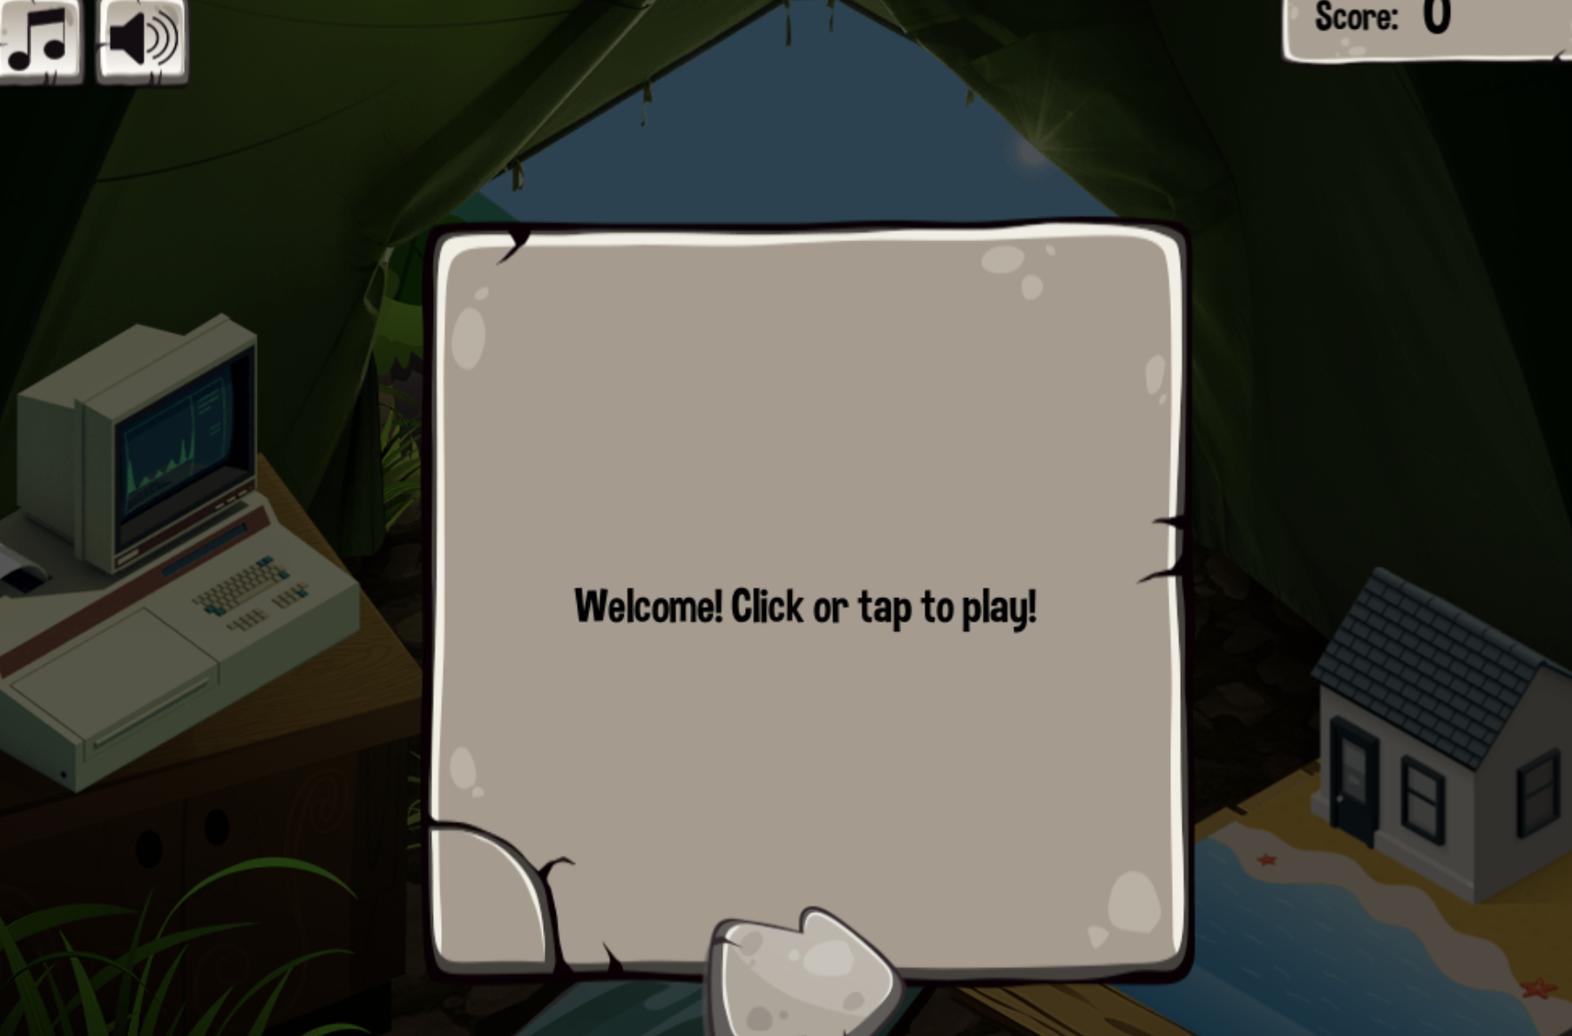
Simulation Activity
Weathering and Erosion Simulator
Click the link above for a simulation to deepen your knowledge of erosion.
Notes:
Click the link above for a simulation to deepen your understanding of weathering. In this simulation, you will meet Walter, a friendly animal who will guide you on your quest for knowledge about erosion and weathering. You will begin your journey by doing different activities to that will simulate weathering and erosion. The game continues with a variety of activities and information. At the end, you will play a bonus arcade game to award you for your good work.

Slide 60
Notes:
Thanks for watching, and please continue watching CAPs available from this website.

Slide 61
This Was Created With Resources From:
Questions or Comments
Michael Kennedy, Ph.D. MKennedy@Virginia.edu
Rachel L Kunemund, Ph.D. rk8vm@virginia.edu

