Slide 1
Intro
“Big Idea” Question
Review Concepts
Check-In Questions
Teacher Engagement
Vocabulary
Student-Friendly Definition
Examples & Non-Examples
Morphological Word Parts
Frayer Model
Simulation/Activity
Notes:
OK everyone, get ready for our next lesson. Just as a reminder, these are the different components that our lesson may include, and you’ll see these icons in the top left corner of each slide so that you can follow along more easily!

Slide 2
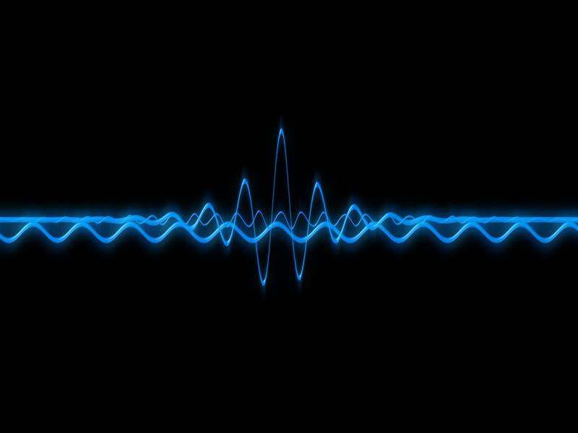
Frequency
Intro
Notes:
Today, we’ll be learning about the word: Frequency.
Feedback: Using clear and simple language when introducing content helps students understand what is expected.

Slide 3
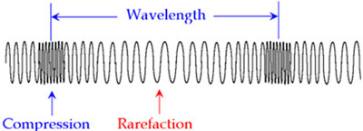
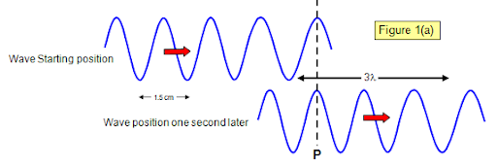
Big Question: What are the properties of waves and how are they related?
Notes:
Our “big question” is: What are the properties of waves and how are they related?
[Pause and illicit predictions from students.]
I love all these thoughtful scientific hypotheses! Be sure to keep this question and your predictions in mind as we move through these next few lessons, and we’ll continue to revisit it.

Slide 4
Notes:
Before we move on to our new topic, let’s review some other words & concepts that you already learned and make sure you are firm in your understanding.

Slide 5
Wavelength: the distance between two like points on a wave
Notes:
Wavelength is the distance between two like points on a wave.

Slide 6
Sound Waves: longitudinal waves that travel through mediums
Notes:
Sound waves are longitudinal waves that travel through mediums.

Slide 7
Compression: where particles are closely packed
Notes:
A sound wave is made of 2 main parts. Compressions where particles are closely packed,

Slide 8
Rarefaction: where particles are loosely packed
Notes:
And rarefaction where particles are loosely packed.

Slide 9
Notes:
Now let’s pause for a moment to review the information we have covered already.

Slide 10
A wavelength is the distance between two ______ points on a wave.
Like
Different
Notes:
A wavelength is the distance between two [like] points on a wave.

Slide 11
A wavelength is the distance between two ______ points on a wave.
Like
Different
Notes:
A wavelength is the distance between two ______ points on a wave.
[Like]

Slide 12
What are sound waves?
Notes:
What are sound waves?
[Sound waves are longitudinal waves that travel through mediums.]

Slide 13
What is the difference between compression and rarefaction?
Notes:
What is the difference between compression and rarefaction?
[A sound wave is made of 2 main parts. Compressions are where particles are closely packed and rarefactions are where particles are loosely packed.]

Slide 14
Frequency
Notes:
Now that we’ve reviewed, let’s define the phrase frequency.

Slide 15
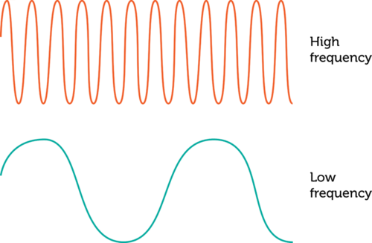
Frequency: the number of waves passing a set point in a specific amount of time
Notes:
Frequency is the number of waves passing a set point in a specific amount of time.

Slide 16
Notes:
Let’s check-in for understanding.

Slide 17
What is frequency?
Notes:
What is frequency?
[Frequency is the number of waves passing a set point in a specific amount of time.]

Slide 18
Notes:
That is the basic definition, but there is a bit more you need to know.

Slide 19
Notes:
Frequency is like the of waves that pass by in a certain amount of time. Imagine you're at the beach, and you're watching the waves in the ocean. If you count how many waves go by in one minute, that's like measuring the frequency of the waves. If you see a lot of waves passing by quickly, it has a high frequency. If the waves are slower and fewer pass by in a minute, it has a lower frequency.

Slide 20
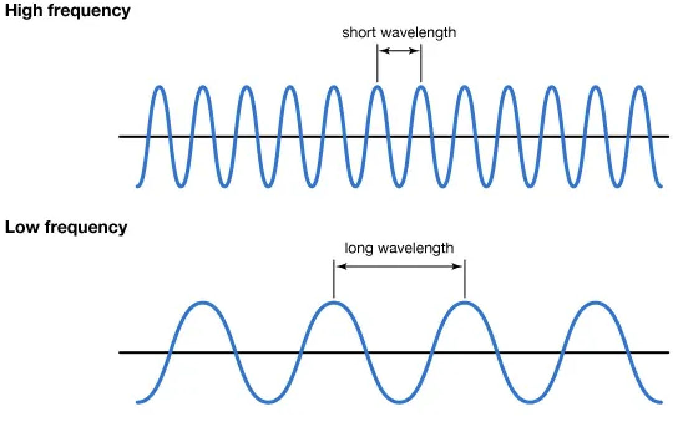
Notes:
Frequency shows how much energy there is. The greater or higher the frequency, the greater the amount of energy. The lower the frequency, the lower the amount of energy. High frequency waves have shorter wavelengths, and low frequency waves have long wavelengths.

Slide 21
Notes:
Let’s check-in for understanding.

Slide 22
True or False: Frequency shows how much energy there is. High frequency waves have more energy, low frequency have less energy.
True
False
Notes:
True or False: Frequency shows how much energy there is. High frequency waves have more energy, low frequency waves have less energy.
True
False

Slide 23
True or False: Frequency shows how much energy there is. High frequency waves have more energy, low frequency have less energy.
True
False
Notes:
True or False: Frequency shows how much energy there is. High frequency waves have more energy, low frequency waves have less energy.
[True]

Slide 24
Notes:
Now, let’s talk about some examples of frequency.

Slide 25
Different colors have waves with different frequencies
Notes:
Examples of frequency can be seen in light waves. Different colors have waves with different frequencies. As we can see on this picture, blue light has a higher frequency than red light.

Slide 26
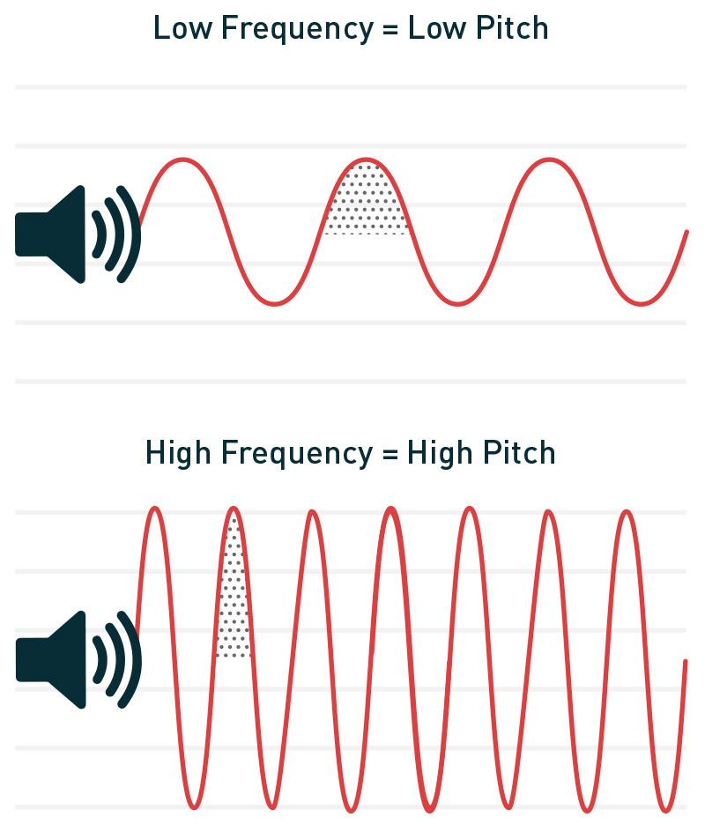
Lower frequency waves have lower pitches and higher frequency waves have higher pitches.
Notes:
Another example of frequency are sound waves. Lower frequency waves have lower pitches and higher frequency waves have higher pitches. Someone with a deep voice has a voice with low frequency. Someone with a squeaky voice has a voice with a high frequency.

Slide 27
Notes:
Let’s check-in for understanding.

Slide 28
What is frequency?
Notes:
What is frequency?
[Frequency is the number of waves passing a set point in a specific amount of time.]

Slide 29
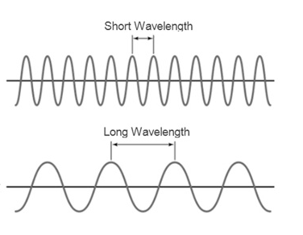
Which wave has a lower frequency?
Notes:
Which wave has a lower frequency?
[We know that the first wave has a lower frequency because the wavelength is shorter than the first wave
Shorter wavelength = larger frequency
Longer wavelength = smaller frequency]

Slide 30
Notes:
Now, let’s talk about some non-examples of frequency.

Slide 31
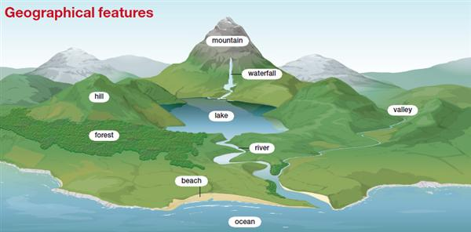
Geographic features, such as mountains and waterfalls, do not have frequency
Notes:
Geographic features, such as mountains and waterfalls, do not have frequency. They are features on the Earth’s surface.

Slide 32
Emotions like happiness, sadness, or anger are not events that have a frequency.
Notes:
Emotions like happiness, sadness, or anger are not events that have a frequency. Emotions do not have frequency because they are thoughts and feelings humans and animals have in their minds.

Slide 33
Notes:
Now let’s pause for a moment to check your understanding.

Slide 34
Why do sound waves have frequency but emotions do not?
Notes:
Why do sound waves have frequency but emotions do not?
[Sound waves have frequency because frequency is the number of waves passing a set point in a specific amount of time. Emotions do not have frequency because they are thoughts and feelings humans and animals have in their minds.]

Slide 35
Remember!!!
Notes:
So remember!

Slide 36
What is frequency?
Notes:
What is frequency?
[Frequency is the number of waves passing a set point in a specific amount of time.]

Slide 37
Notes:
We will now complete this concept map, called a Frayer model, to summarize and further clarify what you have learned about the term frequency.

Slide 38
Definition
Picture
Frequency
Example
How does frequency impact my life?
Notes:
To complete the Frayer model, we will choose from four choices the correct picture, definition, example, and response to the question, “How does frequency impact my life?” Select the best response for each question using the information you just learned. As we select responses, we will see how this model looks filled in for the term frequency.

Slide 39
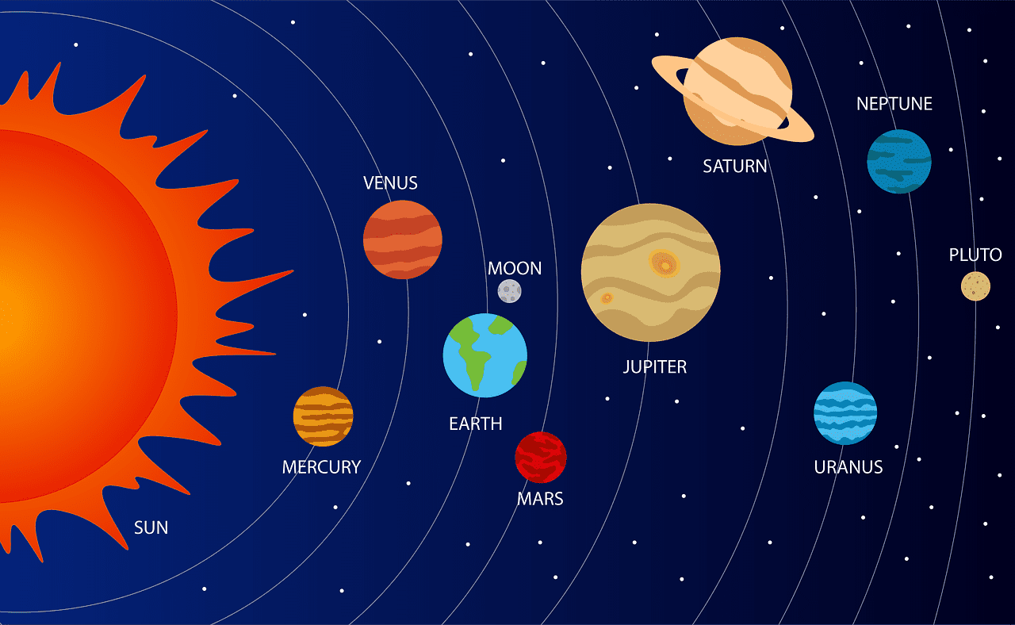
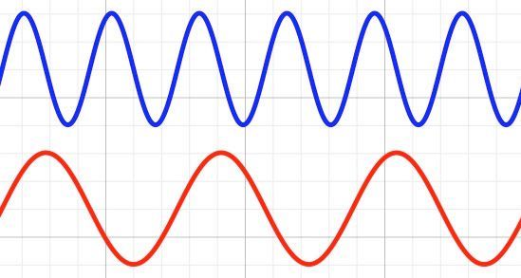
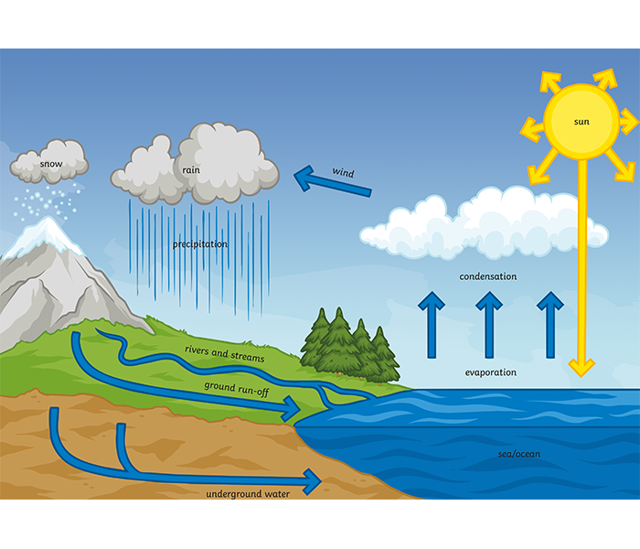
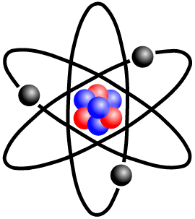
Directions: Choose the correct picture of frequency from the choices below.
A
B
C
D
Notes:
Choose the one correct picture of frequency from these four choices.

Slide 40
Directions: Choose the correct picture of frequency from the choices below.
A
B
C
D
Notes:
This is the picture that shows frequency.

Slide 41
Definition
Picture
Frequency
Example
How does frequency impact my life?
Notes:
Here is the Frayer model filled in with a picture of frequency.

Slide 42
Directions: Choose the correct definition of Frequency from the choices below.
A
The smallest unit of matter
B
When a wave “bounces” off of a surface
C
The number of waves passing a set point in a specific amount of time
D
The ability to cause change
Notes:
Choose the one correct definition of frequency from these four choices.

Slide 43
Directions: Choose the correct definition of Frequency from the choices below.
A
The smallest unit of matter
B
When a wave “bounces” off of a surface
C
The number of waves passing a set point in a specific amount of time
D
The ability to cause change
Notes:
“The amount of waves passing a set point in a specific amount of time” is correct! This is the definition of frequency.

Slide 44
Definition
Picture
The amount of waves passing a set point in a specific amount of time
Frequency
Example
How does frequency impact my life?
Notes:
Here is the Frayer Model with a picture and the definition filled in for frequency: The amount of waves passing a set point in a specific amount of time.

Slide 45
Directions: Choose the correct example of Frequency from the choices below.
A
An opera singer singing a high note
B
A plant growing in the ground
C
A cake baking in an oven
D
A cat taking a nap
Notes:
Choose the one correct example of frequency from these four choices.

Slide 46
Directions: Choose the correct example of Frequency from the choices below.
A
An opera singer singing a high note
B
A plant growing in the ground
C
A cake baking in an oven
D
A cat taking a nap
Notes:
“An opera singer singing a high note” is correct! This is an example of frequency.

Slide 47
Definition
Picture
The amount of waves passing a set point in a specific amount of time
Frequency
An opera singer singing a high note
Example
How does frequency impact my life?
Notes:
Here is the Frayer Model with a picture, definition, and an example of frequency: An opera singer singing a high note

Slide 48
Directions: Choose the correct response for “how does frequency impact my life?” from the choices below.
A
Frequency explains how animals and plants consume nutrients to survive.
B
Frequency determines things like the sound of music and the different colors of light depending on how high or low it is.
C
Frequency explains how farmers can grow many things at one time.
Frequency describes the types of energy we use in our homes, schools, and businesses.
D
Notes:
Choose the one correct response for “how does frequency impact my life?” from these four choices.

Slide 49
Directions: Choose the correct response for “how does frequency impact my life?” from the choices below.
A
Frequency explains how animals and plants consume nutrients to survive.
B
Frequency determines things like the sound of music and the different colors of light depending on how high or low it is.
C
Frequency explains how farmers can grow many things at one time.
Frequency describes the types of energy we use in our homes, schools, and businesses.
D
Notes:
“Frequency determines things like the sound of music the different colors of light depending on how high or low it is.” That is correct! This is an example of how frequency impacts your life.

Slide 50
Definition
Picture
The amount of waves passing a set point in a specific amount of time
Frequency
Frequency determines things like the sound of music the different colors of light depending on how high or low it is.
An opera singer singing a high note
Example
How does frequency impact my life?
Notes:
Here is the Frayer Model with a picture, definition, example, and a correct response to “how does frequency impact my life?”: Frequency determines things like the sound of music the different colors of light depending on how high or low it is.

Slide 51
Remember!!!
Notes:
So remember!

Slide 52
Frequency: the number of waves passing a set point in a specific amount of time
Notes:
Frequency is the number of waves passing a set point in a specific amount of time.

Slide 53
Big Question: What are the properties of waves and how are they related?
Notes:
Let’s reflect again on our big question. Our “big question” is: What are the properties of waves and how are they related?
Does anyone have any additional examples to share that haven’t been discussed yet?
In our “big question,” there are two more vocabulary words we need to explore before we move onto our simulation activity.

Slide 54
Simulation Activity
Waves Gizmo
(Explore Learning)
Click on the waves to create waves.
As you are changing different properties of the wave, take note of the frequency of the different waves. Are you creating waves, determine the frequency of the waves. Are they high or low frequency? How do you know if they are high or low frequency?
Notes:
Feedback: Remember, it is important to include some computational or mathematics concepts in the science activity so that students can apply these concepts as part of the problem solving process.

Slide 55
Intro
“Big Idea” Question
Review Concepts
Check-In Questions
Teacher Engagement
Vocabulary
Student-Friendly Definition
Examples & Non-Examples
Morphological Word Parts
Frayer Model
Simulation/Activity
Notes:
OK everyone, get ready for our next lesson. Just as a reminder, these are the different components that our lesson may include, and you’ll see these icons in the top left corner of each slide so that you can follow along more easily!

Slide 56
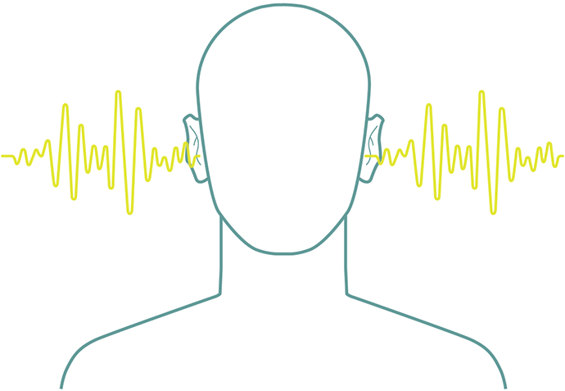
Pitch
Intro
Notes:
Today, we’ll be learning about the word: Pitch.
Feedback: Using clear and simple language when introducing content helps students understand what is expected.

Slide 57
Big Question: What are the properties of waves and how are they related?
Notes:
Our “big question” is: What are the properties of waves and how are they related?
[Pause and illicit predictions from students.]
I love all these thoughtful scientific hypotheses! Be sure to keep this question and your predictions in mind as we move through these next few lessons, and we’ll continue to revisit it.

Slide 58
Notes:
Before we move on to our new topic, let’s review some other words & concepts that you already learned and make sure you are firm in your understanding.

Slide 59
Wavelength: the distance between two like points on a wave
Notes:
Wavelength is the distance between two like points on a wave.

Slide 60
Sound Waves: longitudinal waves that travel through mediums
Notes:
Sound waves are longitudinal waves that travel through mediums.

Slide 61
Compression: where particles are closely packed
Notes:
A sound wave is made of 2 main parts. Compressions where particles are closely packed,

Slide 62
Rarefaction: where particles are loosely packed
Notes:
And rarefaction where particles are loosely packed.

Slide 63
Frequency: the number of waves passing a set point in a specific amount of time
Notes:
Frequency is the number of waves passing a set point in a specific amount of time.

Slide 64
Vibration: Movement of particles that occurs in solids, liquids, or gases.
Notes:
Vibration is the movement of particles that occurs in solids, liquids, or gases.

Slide 65
Notes:
Now let’s pause for a moment to review the information we have covered already.

Slide 66
What are sound waves?
Notes:
What are sound waves?
[Sound waves are longitudinal waves that travel through mediums.]

Slide 67
Frequency is the _______ of waves passing a set point in a specific amount of _______.
number, time
time, number
Notes:
Frequency is the ______ of waves passing a set point in a specific amount of ______.
[number, time]

Slide 68
Frequency is the _______ of waves passing a set point in a specific amount of _______.
number, time
time, number
Notes:
Frequency is the [number] of waves passing a set point in a specific amount of [time].

Slide 69
True or False: Vibration is the movement of particles that occurs in solids, liquids, or gases.
Notes:
True or False: Vibration is the movement of particles that occurs in solids, liquids, or gases.
[True]

Slide 70
True or False: Vibration is the movement of particles that occurs in solids, liquids, or gases.
Notes:
True: Vibration is the movement of particles that occurs in solids, liquids, or gases.

Slide 71
Pitch
Notes:
Now that we’ve reviewed, let’s define the phrase pitch.

Slide 72
Pitch: how high or low a sound is
Notes:
Pitch is how high or low a sound is.

Slide 73
Notes:
Let’s check-in for understanding.

Slide 74
What is pitch?
Notes:
What is pitch?
[How high or low a sound is.]

Slide 75
Notes:
That is the basic definition, but there is a bit more you need to know.

Slide 76
Pitch is determined by how fast something is vibrating to make a sound.
Notes:
Pitch is how we describe whether a sound is high or low. Pitch is determined by how fast something is vibrating, or moving, to make a sound.

Slide 77
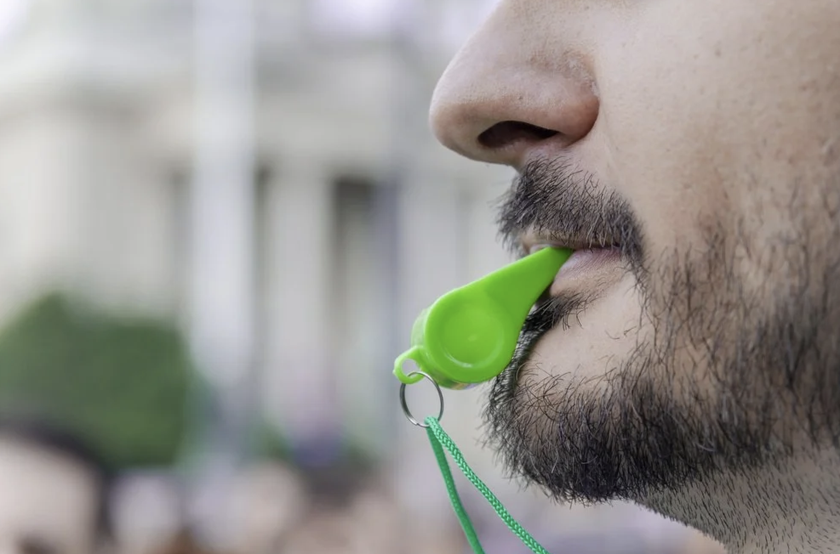
If something vibrates really quickly, it makes a high-pitched sound.
Notes:
If something vibrates really quickly, it makes a high-pitched sound. When a person blows a whistle, it makes a high-pitched sound meaning it vibrates quickly.

Slide 78
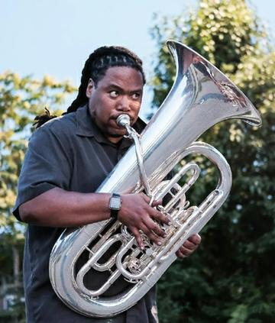
If something vibrates more slowly, it makes a low-pitched sound.
Notes:
If something vibrates more slowly, it makes a low-pitched sound. A tuba makes a low-pitched sound, which means it vibrates slowly.

Slide 79
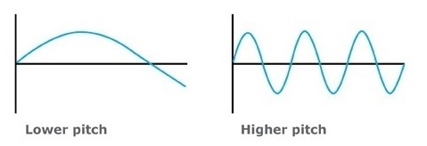
Sounds with lower pitch have bigger wavelengths, sounds with higher pitch have smaller wavelengths.
Notes:
Sounds with lower pitch have bigger wavelengths, sounds with higher pitch have smaller wavelengths.

Slide 80
Notes:
Let’s check-in for understanding.

Slide 81
Pitch is determined by how _____ something is vibrating to make a sound.
Fast
Much
High
Notes:
Pitch is determined by how _____ something is vibrating, or moving, to make a sound.
[Fast]

Slide 82
Pitch is determined by how _____ something is vibrating to make a sound.
Fast
Much
High
Notes:
Pitch is determined by how [fast] something is vibrating, or moving, to make a sound.

Slide 83
True or False: If something vibrates really quickly, it makes a high-pitched sound. If something vibrates more slowly, it makes a low-pitched sound.
True
False
Notes:
True or False: If something vibrates really quickly, it makes a high-pitched sound. If something vibrates more slowly, it makes a low-pitched sound.
[True]

Slide 84
True or False: If something vibrates really quickly, it makes a high-pitched sound. If something vibrates more slowly, it makes a low-pitched sound.
True
False
Notes:
True or False: If something vibrates really quickly, it makes a high-pitched sound. If something vibrates more slowly, it makes a low-pitched sound.
[True]

Slide 85
Notes:
Now, let’s talk about some examples of pitch.

Slide 86
Car engines make deep, low sounds.
Notes:
An example of a low pitch is a car engine. Car engines make deep, low sounds.

Slide 87
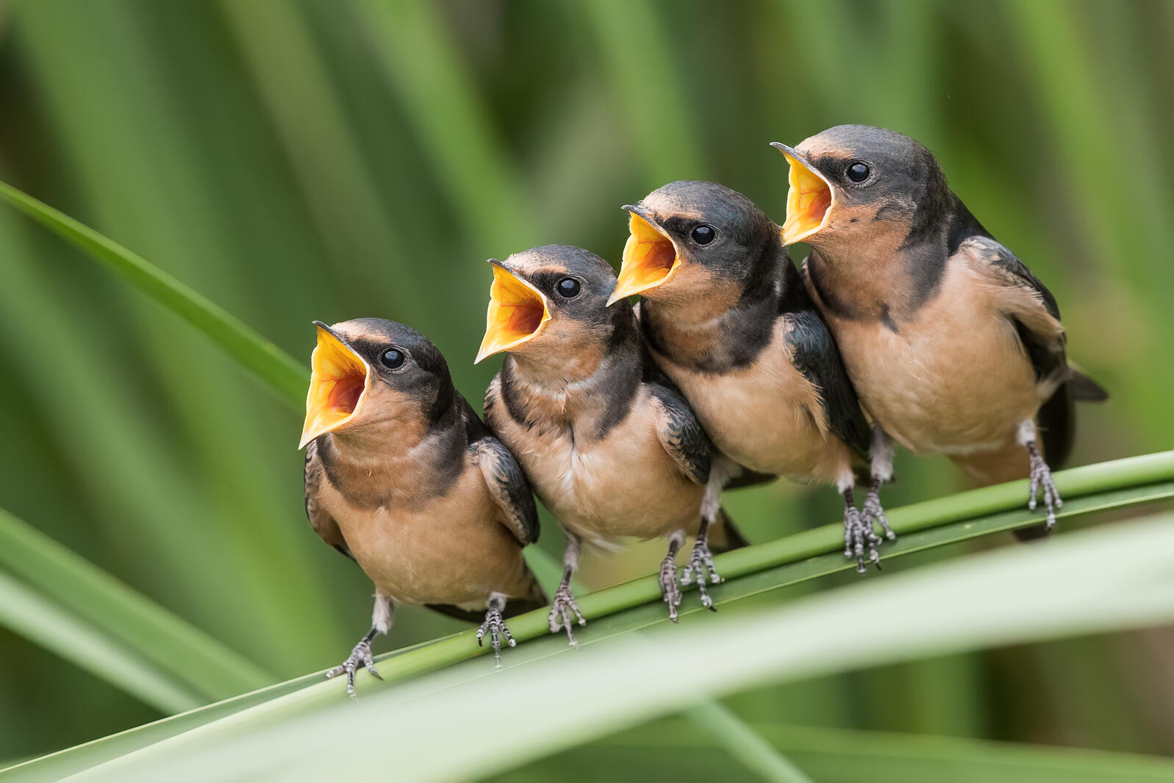
An example of a high pitch are birds chirping.
Notes:
An example of a high pitch are birds chirping.

Slide 88
Notes:
Let’s check-in for understanding.

Slide 89
What is pitch?
Notes:
What is pitch?
[How high or low a sound is.]

Slide 90
Notes:
Now, let’s talk about some non-examples of pitch.

Slide 91
Color is a property of light, not sound, so it doesn’t have a pitch.
Notes:
Color is not an example of pitch. It is a property of light, not sound, so it doesn’t have a pitch.

Slide 92
Length is not an example of pitch. It is a measure of size or distance.
Notes:
Length is not an example of pitch. It is a measure of size or distance.

Slide 93
Notes:
Now let’s pause for a moment to check your understanding.

Slide 94
Why do bird chirps have pitch and color does not?
Notes:
Why do bird chirps have pitch and color does not?
[The bird chirps are sounds. Color is not a sound.]

Slide 95
Remember!!!
Notes:
So remember!

Slide 96
What is pitch?
Notes:
What is pitch?
[How high or low a sound is.]

Slide 97
Notes:
We will now complete this concept map, called a Frayer model, to summarize and further clarify what you have learned about the term pitch.

Slide 98
Definition
Picture
Pitch
Example
How does pitch impact my life?
Notes:
To complete the Frayer model, we will choose from four choices the correct picture, definition, example, and response to the question, “How does pitch impact my life?” Select the best response for each question using the information you just learned. As we select responses, we will see how this model looks filled in for the term pitch.

Slide 99
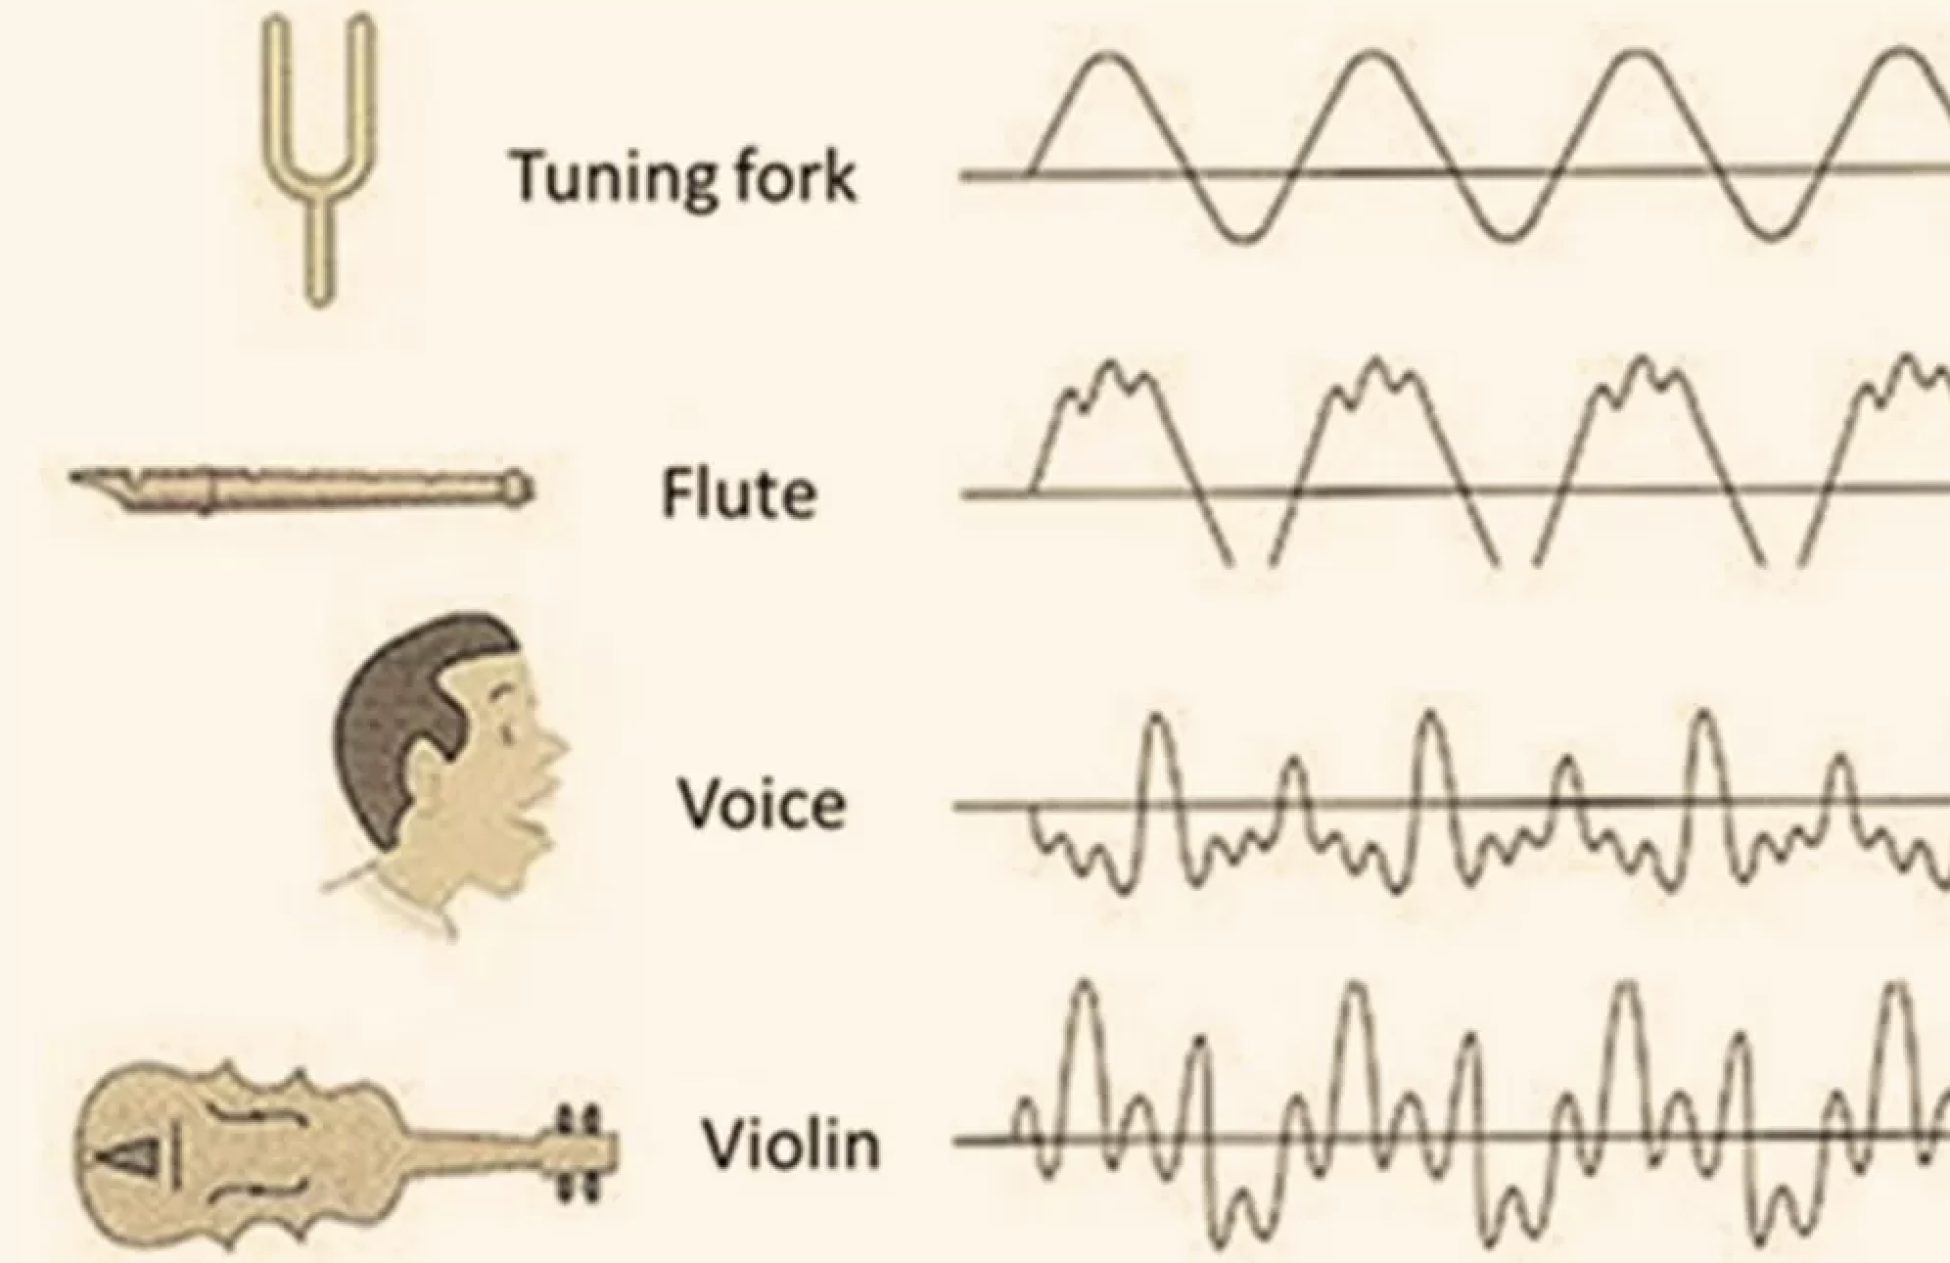
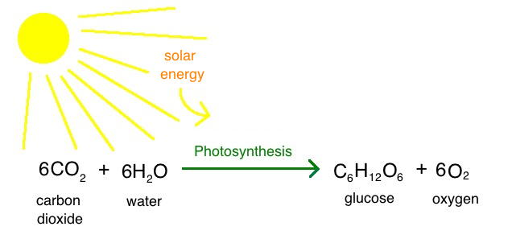
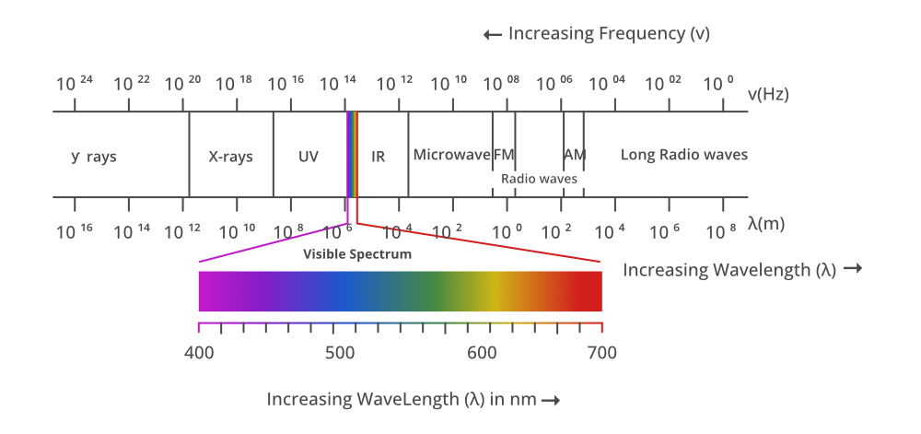
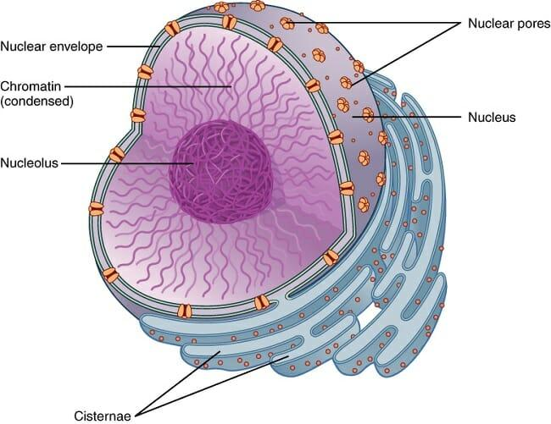
Directions: Choose the correct picture of pitch from the choices below.
A
B
C
D
Notes:
Choose the one correct picture of pitch from these four choices.

Slide 100
Directions: Choose the correct picture of pitch from the choices below.
A
B
C
D
Notes:
This is the picture that shows pitch.

Slide 101
Definition
Picture
Pitch
Example
How does pitch impact my life?
Notes:
Here is the Frayer model filled in with a picture of pitch.

Slide 102
Directions: Choose the correct definition of Pitch from the choices below.
A
How fast or slow an object is moving
B
How high or low a sound is
C
How heavy or light an object is
D
How hot or cold something is
Notes:
Choose the one correct definition of pitch from these four choices.

Slide 103
Directions: Choose the correct definition of Pitch from the choices below.
A
How fast or slow an object is moving
B
How high or low a sound is
C
How heavy or light an object is
D
How hot or cold something is
Notes:
“How high or low a sound is” is correct! This is the definition of pitch.

Slide 104
Definition
Picture
How high or low a sound is
Pitch
Example
How does pitch impact my life?
Notes:
Here is the Frayer Model with a picture and the definition filled in for pitch: how high or low a sound is.

Slide 105
Directions: Choose the correct example of Pitch from the choices below.
A
A cell phone ringing with a high sound
B
A cup of lemonade that tastes sweet
C
A sunset over the ocean
D
A baby crawling on the ground
Notes:
Choose the one correct example of pitch from these four choices.

Slide 106
Directions: Choose the correct example of Pitch from the choices below.
A
A cell phone ringing with a high sound
B
A cup of lemonade that tastes sweet
C
A sunset over the ocean
D
A baby crawling on the ground
Notes:
“A cell phone ringing with a high sound” is correct! This is an example of pitch.

Slide 107
Definition
Picture
How high or low a sound is
Pitch
A cell phone ringing with a high sound
Example
How does pitch impact my life?
Notes:
Here is the Frayer Model with a picture, definition, and an example of pitch: A cell phone ringing with a high sound

Slide 108
Directions: Choose the correct response for “how does pitch impact my life?” from the choices below.
A
Pitch helps us distinguish between different sounds in our lives.
B
Pitch explains how objects move on the surface of the planet.
C
Pitch determines how hot or cold it is outside.
D
Pitch helps us explain our thoughts and feelings.
Notes:
Choose the one correct response for “how does pitch impact my life?” from these four choices.

Slide 109
Directions: Choose the correct response for “how does pitch impact my life?” from the choices below.
A
Pitch helps us distinguish between different sounds in our lives.
B
Pitch explains how objects move on the surface of the planet.
C
Pitch determines how hot or cold it is outside.
D
Pitch helps us explain our thoughts and feelings.
Notes:
“Pitch helps us distinguish between different sounds in our lives.” That is correct! This is an example of how pitch impacts your life.

Slide 110
Definition
Picture
How high or low a sound is
Pitch
Pitch helps us distinguish between different sounds in our lives.
A cell phone ringing with a high sound
Example
How does pitch impact my life?
Notes:
Here is the Frayer Model with a picture, definition, example, and a correct response to “how does pitch impact my life?”: Pitch helps us distinguish between different sounds in our lives.

Slide 111
Remember!!!
Notes:
So remember!

Slide 112
What is pitch?
Notes:
What is pitch?
[How high or low a sound is.]

Slide 113
Big Question: What are the properties of waves and how are they related?
Notes:
Let’s reflect again on our big question. Our “big question” is: What are the properties of waves and how are they related?
Does anyone have any additional examples to share that haven’t been discussed yet?
In our “big question,” there are two more vocabulary words we need to explore before we move onto our simulation activity.

Slide 114
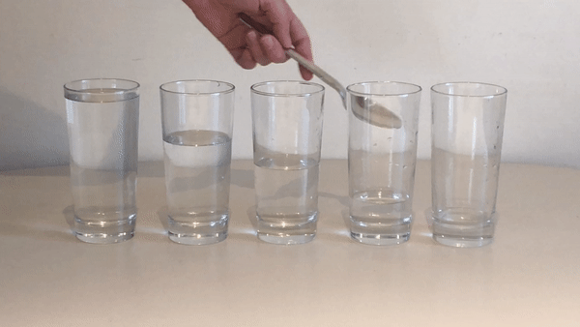
Demonstration
Materials Needed:
Glasses filled with different amounts of water, a metal utensil
Procedure:
Fill glasses with different amounts of water. Then hit each glass lightly with a metal utensil. Take note of the different pitches each glass makes.
Notes:
Now that we’ve learned about pitch, let’s do a demonstration.
On your tables, you have glasses filled with different amounts of water and a metal utensil. Fill glasses with different amounts of water. Then hit each glass lightly with a metal utensil. Take note of the different pitches each glass makes.
We will reflect on this activity on the next slide.

Slide 115
Reflection Activity
Ask yourselves…
Which glasses made the highest and lowest pitches?
Why might the pitch change depending on how much water is in the glass?
Notes:
Have students discuss these questions with a partner or with their table before calling on groups to share one of their responses with the class.
Ask yourselves…
Which glasses made the highest and lowest pitches?
Why might the pitch change depending on how much water is in the glass?

Slide 116
Intro
“Big Idea” Question
Review Concepts
Check-In Questions
Teacher Engagement
Vocabulary
Student-Friendly Definition
Examples & Non-Examples
Morphological Word Parts
Frayer Model
Simulation/Activity
Notes:
OK everyone, get ready for our next lesson. Just as a reminder, these are the different components that our lesson may include, and you’ll see these icons in the top left corner of each slide so that you can follow along more easily!

Slide 117
Amplitude
Intro
Notes:
Today we will learn about amplitude.

Slide 118
Big Question: What are the properties of waves and how are they related?
Notes:
Our “big question” is: What are the properties of waves and how are they related?
[Pause and illicit predictions from students.]
I love all these thoughtful scientific hypotheses! Be sure to keep this question and your predictions in mind as we move through these next few lessons, and we’ll continue to revisit it.

Slide 119
Demonstration
Wavelength and Amplitude
TEACHER DIRECTIONS:
Before: Click on the video above and show a video about wavelength and amplitude. Make sure to pause the video to check for understanding. Before beginning the video, ask students what they know about waves and what they predict some properties of waves might be.
During: During the video, make sure to pause and ask students what they think the amplitude of a wave is. Ask students what they observe in the video.
After: Tell students that in today’s lesson they will learn more about amplitude. They will also learn about wavelength, but that will be a little bit later.
Notes:
Let’s do a quick demonstration that will help get our brains ready to think about amplitude, and how it relates to our big question.
Feedback: Remember to plan out the demonstration so that you are able to follow a logical order. This will help students make sense of the activity and not become lost.

Slide 120
Notes:
Now let’s pause for a moment to check your understanding.

Slide 121
The ball didn’t move with the wave. Why did it just bob up and down?
Notes:
The ball didn’t move with the wave? Why did it just bob up and down?
[Matter can’t move through waves, only energy does.]
Feedback: Remember, we want students to gather information and then be able to not only evaluate but also effectively communicate what they have learned from this activity.

Slide 122
What is amplitude?
Notes:
What is amplitude?
[Amplitude is how tall a wave is]

Slide 123
How do you measure amplitude?
Notes:
How do you measure amplitude?
[Measure from the wave’s peak to its resting point (or resting point to peak)]

Slide 124
Notes:
Before we move on to our new vocabulary term, let’s review some other words & concepts that you already learned and make sure you are firm in your understanding.
Feedback: Referring to prior topics that are relevant and on topic helps students make connections to the new content they will be learning and tie it to prior knowledge.

Slide 125
Wavelength: the distance between two like points on a wave
Notes:
Wavelength is the distance between two like points on a wave.

Slide 126
Sound Waves: longitudinal waves that travel through mediums
Notes:
Sound waves are longitudinal waves that travel through mediums.

Slide 127
Compression: where particles are closely packed
Notes:
A sound wave is made of 2 main parts. Compressions where particles are closely packed...

Slide 128
Rarefaction: where particles are loosely packed
Notes:
...and rarefaction where particles are loosely packed.

Slide 129
Vibration: Movement of particles that occurs in solids, liquids, or gases.
Notes:
Vibration is the movement of particles that occurs in solids, liquids, or gases.

Slide 130
Pitch: how high or low a sound is
Notes:
Pitch is how high or low a sound is.

Slide 131
Notes:
Now let’s pause for a moment to check your understanding.
Feedback: Remember to make adjustments to your lesson and content if you see some students not demonstrating understanding, this can help them make connections and prevent frustration.

Slide 132
Vibration is the _________ that occurs in solids, liquids, or gases.
Notes:
Vibration is the ______________ that occurs in solids, liquids, or gases.

Slide 133
Vibration is the movement of particles that occurs in solids, liquids, or gases.
Notes:
Vibration is the movement of particles that occurs in solids, liquids, or gases.

Slide 134
What are sound waves?
Notes:
What are sound waves?
[Sound waves are longitudinal waves that travel through mediums.]

Slide 135
What is the difference between compression and rarefaction?
Notes:
What is the difference between compression and rarefaction?
[A sound wave is made of 2 main parts. Compressions are where particles are closely packed and rarefactions are where particles are loosely packed.]

Slide 136
Amplitude
Notes:
Now that we’ve reviewed, let’s define our new term, amplitude.

Slide 137
Amplitude: is the maximum distance a particle travels from rest
Notes:
Amplitude is the maximum distance that a particle travels from rest.
Feedback: When providing more student-friendly definitions, it is helpful to provide students with cues so that they can be prepared and know what to expect and be ready to copy down the information.

Slide 138
Notes:
Now let’s pause for a moment to check your understanding.

Slide 139
What is amplitude?
Notes:
What is amplitude?
[Amplitude is the maximum distance that a particle travels from rest.]

Slide 140
Notes:
That is the basic definition, but there is a bit more you need to know.

Slide 141
Notes:
Here, the top particle has a higher amplitude than the bottom particle.

Slide 142
Notes:
The larger the amplitude a particle has, the higher its energy.

Slide 143
Notes:
Here, the top particles also has more energy than the bottom particle since its amplitude is larger.

Slide 144
Notes:
Now let’s pause for a moment to check your understanding.

Slide 145
What is amplitude?
Notes:
What is amplitude?
[Amplitude is the maximum distance that a particle travels from rest.]
Feedback: Provide clear and straightforward directions when asking students to explain the definitions. This helps to avoid confusion!

Slide 146
Which particle has a larger amplitude?
Notes:
Which particle has a larger amplitude?
[The top particle]

Slide 147
The larger the amplitude a particle has, the higher the _________.
Notes:
The larger the amplitude a particle has, the higher the __________.
[energy]

Slide 148
The larger the amplitude a particle has, the higher the energy.
Notes:
The larger the amplitude a particle has, the higher the energy.

Slide 149
Why does the top particle have more energy than the bottom particle?
Notes:
Why does the top particle have more energy than the bottom particle?
[It’s amplitude is larger, so it has more energy.]

Slide 150
Notes:
Now, let’s talk about some examples of amplitude.

Slide 151
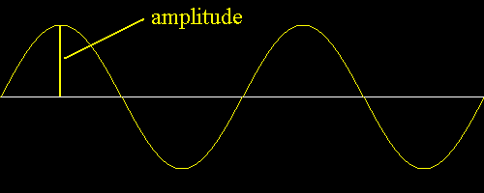
All waves will have amplitude since amplitude is the property of waves.
Notes:
Here we can see amplitude in this wave. Remember, all waves will have amplitude since amplitude is the property of waves.
Feedback: It's great practice to introduce an example of the term WITH images to go along with it, this is a great way to help students make connections.

Slide 152
Notes:
This wave also has amplitude. Again we see it is the measure from the point of rest to the particle in the wave.

Slide 153
Notes:
Next, let’s talk about some non-examples of amplitude.
Feedback: One important component of using non-examples is by clearly distinguishing similarities and explaining why it is a non-example.

Slide 154
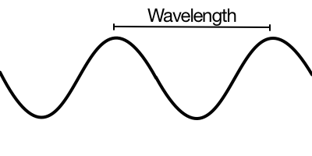
The distance between two like points on on a wave is called wavelength. This is not the same thing as amplitude.
Notes:
The distance between two like points on on a wave is called wavelength. This is not the same thing as amplitude. We will learn more about wavelength later.

Slide 155
Notes:
Now let’s pause for a moment to check your understanding.

Slide 156
Is the distance between the two points on the wave below an example of amplitude?
Notes:
Is the distance between the two points on the wave below an example of amplitude?
[No, it would be wavelength]

Slide 157
Is the measure of the wave (shown by the arrows) an example of amplitude?
Notes:
Is the measure of the wave (shown by arrows) an example of amplitude?
[Yes it is an example of amplitude because it shows the maximum distance a particle travels from rest.]

Slide 158
Why is the measurement shown below an example of amplitude?
Notes:
Why is the measurement shown below an example of amplitude?
[It shows the maximum distance a particle travels from rest.]
Feedback: It is important to take time throughout the close of the lesson to check for understanding one last time, this will help you know who may need more instruction or where further explanation is needed.

Slide 159
What is amplitude?
Notes:
What is amplitude?
[Amplitude is the maximum distance that a particle travels from rest.]

Slide 160
Why does the top particle have more ENERGY than the bottom particle?
Notes:
Why does the top particle have more ENERGY than the bottom particle?
[It’s amplitude is larger, so it has more energy.]

Slide 161
Remember!!!
Notes:
So remember!

Slide 162
Amplitude: is the maximum distance a particle travels from rest.
Notes:
Amplitude is the maximum distance that a particle travels from rest.

Slide 163
Notes:
We can also break down the term amplitude into different word parts to help us remember the meaning. Let’s take a look!

Slide 164
Amplitude
(root)
(suffix)
Notes:
We can break up the term amplitude into two parts: root and suffix.

Slide 165
Amplitude
Ampli = greatness or magnitude
Notes:
First, we have the root “ampli” which means greatness or magnitude. In the word amplitude, it indicates how great or how much energy a particle has.

Slide 166
Amplitude
-tude describes conditions, states, or qualities of things
Notes:
-tude is the suffix. The “-tude” suffix describes conditions, states, or qualities of things. Now let’s put it all together.

Slide 167
Ampli tude
Amplitude
How great something is
Notes:
So when we put it all together, amplitude means how great something is.

Slide 168
Notes:
Let’s check-in for understanding.

Slide 169
How can we use the word parts of amplitude to help us remember the definition of the term?
Amplitude
(root)
(suffix)
Notes:
How can we use the word parts of amplitude to help us remember the definition of the term?
[The root ampli means greatness or magnitude.
-tude is the suffix that describes conditions, states, or qualities of things.
So when we put it all together, amplitude is how great something is. In this case, the distance and power involving particles.]

Slide 170
Remember!!!
Notes:
So remember!

Slide 171
Amplitude: is the maximum distance a particle travels from rest.
Notes:
Amplitude is the maximum distance that a particle travels from rest.

Slide 172
Notes:
We will now complete this concept map, called a Frayer model, to summarize and further clarify what you have learned about the term amplitude.

Slide 173
Definition
Picture
Amplitude
Example
How does amplitude impact my life?
Notes:
To complete the Frayer model, we will choose from four choices the correct picture, definition, example, and response to the question, “How does amplitude impact my life?” Select the best response for each question using the information you just learned. As we select responses, we will see how this model looks filled in for the term amplitude.

Slide 174
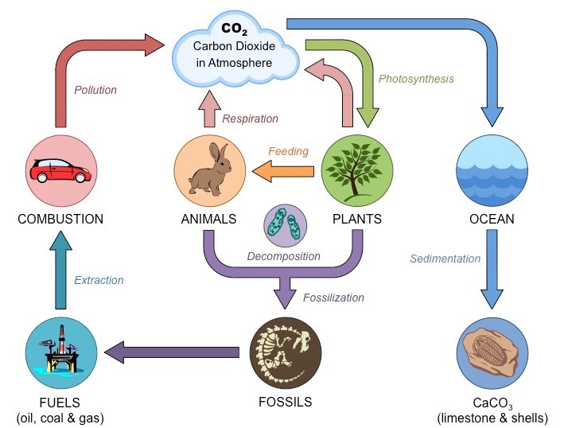
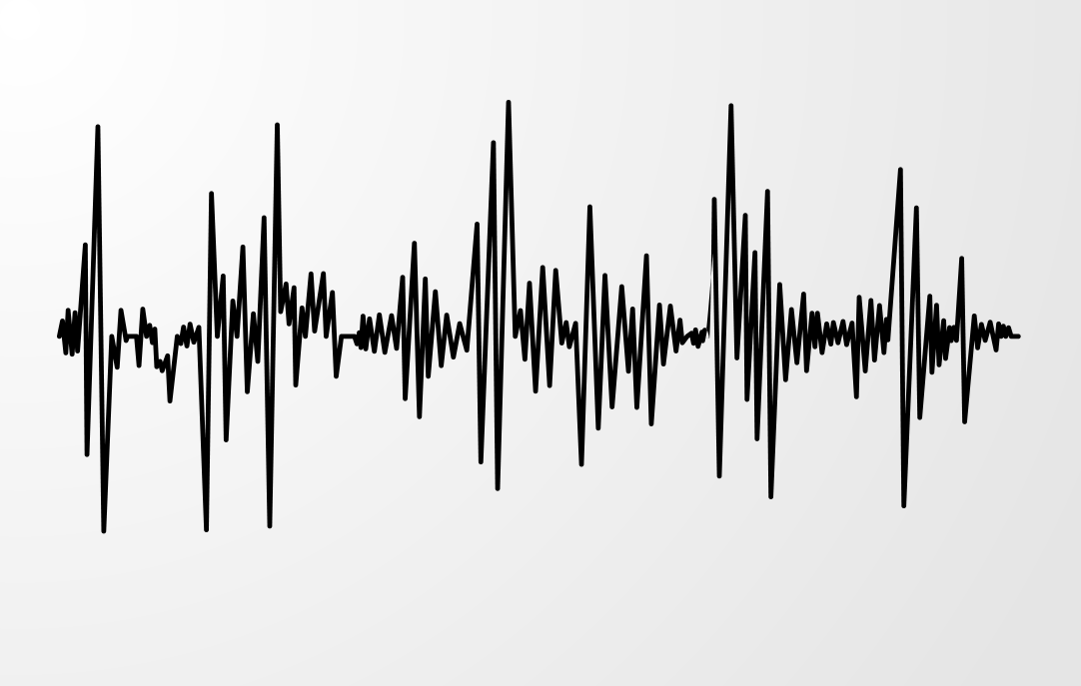
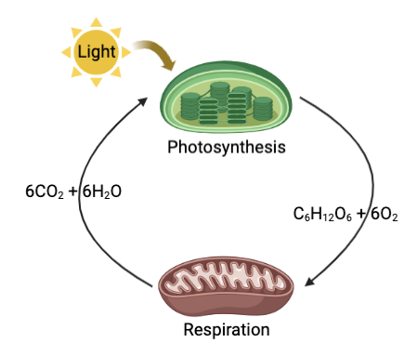
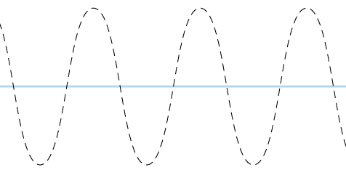
Directions: Choose the correct picture of amplitude from the choices below.
A
B
C
D
Notes:
Choose the one correct picture of amplitude from these four choices.

Slide 175
Directions: Choose the correct picture of amplitude from the choices below.
A
B
C
D
Notes:
This is the picture that shows amplitude.

Slide 176
Definition
Picture
Amplitude
Example
How does amplitude impact my life?
Notes:
Here is the Frayer model filled in with a picture of amplitude.

Slide 177
Directions: Choose the correct definition of Amplitude from the choices below.
A
A place where animals and plants live together
B
The maximum distance a particle travels from rest
C
Solid, liquid, and gas
D
The process by which oxygen is converted into carbon dioxide
Notes:
Choose the one correct definition of amplitude from these four choices.

Slide 178
Directions: Choose the correct definition of Amplitude from the choices below.
A
A place where animals and plants live together
B
The maximum distance a particle travels from rest
C
Solid, liquid, and gas
D
The process by which oxygen is converted into carbon dioxide
Notes:
“The maximum distance a particle travels from rest” is correct! This is the definition of amplitude.

Slide 179
Definition
Picture
The maximum distance a particle travels from rest
Amplitude
Example
How does amplitude impact my life?
Notes:
Here is the Frayer Model with a picture and the definition filled in for amplitude: The maximum distance a particle travels from rest

Slide 180
Directions: Choose the correct example of Amplitude from the choices below.
A
A loud sound has a high wave
B
Asteroids and comets moving in our solar system
C
A plant absorbing sunlight and water to create food
D
Brownie batter heating up and turning into brownies as it bakes in the oven
Notes:
Choose the one correct example of amplitude from these four choices.

Slide 181
Directions: Choose the correct example of Amplitude from the choices below.
A
A loud sound has a high wave
B
Asteroids and comets moving in our solar system
C
A plant absorbing sunlight and water to create food
D
Brownie batter heating up and turning into brownies as it bakes in the oven
Notes:
“A loud sound has a high wave” is correct! This is an example of amplitude.

Slide 182
Definition
Picture
The maximum distance a particle travels from rest
Amplitude
A loud sound has a high wave
Example
How does amplitude impact my life?
Notes:
Here is the Frayer Model with a picture, definition, and an example of amplitude: A loud sound has a high wave.

Slide 183
Directions: Choose the correct response for “how does amplitude impact my life?” from the choices below.
A
Amplitude explains how water changes into ice.
B
Amplitude makes sounds louder or softer.
C
Amplitude keeps the Earth not too hot or cold.
D
Amplitude helps us breathe oxygen.
Notes:
Choose the one correct response for “how does amplitude impact my life?” from these four choices.

Slide 184
Directions: Choose the correct response for “how does amplitude impact my life?” from the choices below.
A
Amplitude explains how water changes into ice.
B
Amplitude makes sounds louder or softer.
C
Amplitude keeps the Earth not too hot or cold.
D
Amplitude helps us breathe oxygen.
Notes:
“Amplitude makes sounds louder or softer.” That is correct! This is an example of how amplitude impacts your life.

Slide 185
Definition
Picture
The maximum distance a particle travels from rest
Amplitude
A loud sound has a high wave
Amplitude makes sounds louder or softer.
Example
How does amplitude impact my life?
Notes:
Here is the Frayer Model with a picture, definition, example, and a correct response to “how does amplitude impact my life?”: Amplitude makes sounds louder or softer.

Slide 186
Remember!!!
Notes:
So remember!

Slide 187
Amplitude: is the maximum distance a particle travels from rest.
Notes:
Amplitude is the maximum distance that a particle travels from rest.

Slide 188
Big Question: What are the properties of waves and how are they related?
Notes:
Let’s reflect once more on our big question. Our “big question” is: What are the properties of waves and how are they related?
Does anyone have any additional examples to share that haven’t been discussed yet?

Slide 189
Simulation Activity
Waves Gizmo
(Explore Learning)
Click on the simulation above to interact with waves.
While interacting with the waves, only change the amplitude. Predict what you think will happen when you increase or decrease the amplitude of a wave. Once you have made your predictions, change the amplitude of the wave and then click on play, so see if your prediction was correct.
Notes:
Feedback: Giving students a chance to analyze and interpret data is a great way to help them to continue to independently problem solve.

Slide 190
Notes:
Thanks for watching, and please continue watching CAPs available from this website.

Slide 191
This Was Created With Resources From:
Questions or Comments
Michael Kennedy, Ph.D. MKennedy@Virginia.edu
Rachel L Kunemund, Ph.D. rk8vm@virginia.edu

