Slide 1
Intro
“Big Idea” Question
Review Concepts
Check-In Questions
Teacher Engagement
Vocabulary
Student-Friendly Definition
Examples & Non-Examples
Morphological Word Parts
Frayer Model
Simulation/Activity
Notes:
OK everyone, get ready for our next lesson. Just as a reminder, these are the different components that our lesson may include, and you’ll see these icons in the top left corner of each slide so that you can follow along more easily!

Slide 2
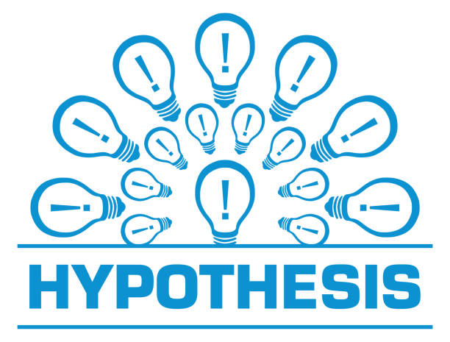
Intro
Notes:
Today, we’ll be learning about the word: hypothesis.

Slide 3
Big Question: What is a hypothesis and how does it help scientists learn and discover new things?
Notes:
Our “big question” is: What is a hypothesis and how does it help scientists learn and discover new things?
[Pause and illicit predictions from students.]
I love all these thoughtful guesses! Be sure to keep this question and your predictions in mind as we move through these next few lessons, and we’ll continue to revisit it.

Slide 4
Demonstration
Materials Needed:
Document camera, 2 styrofoam cups, two different food dyes, hot and cold water
Procedure:
Explain that you have a cup of hot and cold water. You will be putting one drop of food coloring into each at the same time. Have students predict which temperature of water will cause the color to spread out into the water faster with a Think-Pair-Share. You can record responses as tallies on the boards and make it a competition! Add a drop of food coloring to each and allow students to observe via projection of the document camera footage.
Notes:
Before we jump in, let’s look at a short demonstration related to making a hypothesis. Which temperature of water do you think will cause the color to spread out within the liquid faster?
Let’s observe and see if our guess was correct… Notice that the hot water caused the color to move much faster through the liquid. What we call “heat” really has to do with how fast molecules are moving - that movement of the water molecules causes the food dye to move as well.
This small and simple experiment demonstrates a few of the principles of the process by which we do science. Science gives us insight into the natural world. Science is based upon data, which we collected through simple observation. These observations are important because they help us see if our guesses were correct or incorrect. We are going to learn more today about how guesses fit into the scientific process.

Slide 5
Notes:
Before we move on to our new topic, let’s review some other words & concepts that you already learned and make sure you are firm in your understanding.

Slide 6
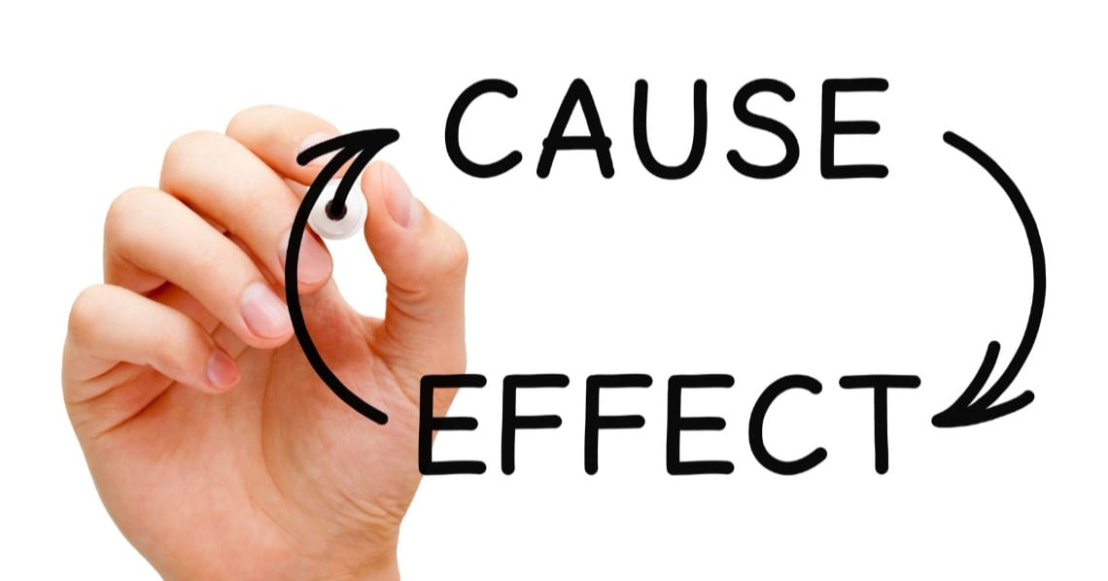
Notes:
"Cause-and-effect" is a way to understand how one thing leads to another. It's like figuring out why something happens. The "cause" is the reason, action, or event that makes something else happen, which we call the "effect." Understanding cause-and-effect helps us learn how things are connected and why certain things happen in the world around us.

Slide 7
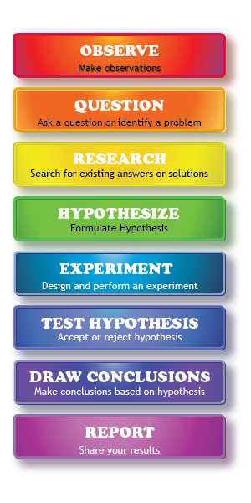
Scientific Method: steps that investigators follow to answer questions about the natural world
Notes:
One term that you’ve likely heard year after year in science class is the scientific method. The scientific method is a series of steps that investigators follow to answer questions about the natural world. By following the same steps, investigators are able to copy and check the work that is done by others. Let’s do a quick review of some of these steps.

Slide 8
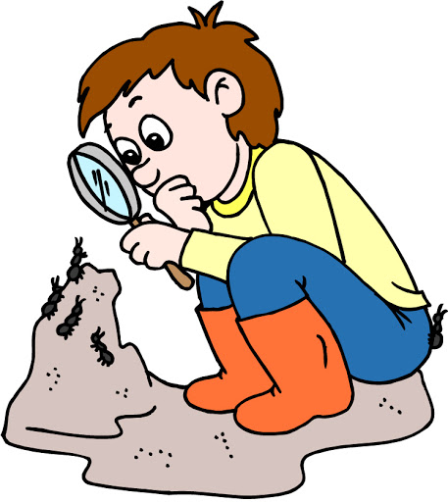
Observation
Notes:
The first step of the scientific method always begins with making an observation, or noticing something interesting that you’d like to explore further.

Slide 9
Question
Notes:
As you observe interesting things, you may find yourself asking some questions about what you saw, or you may even notice a problem that needs to be fixed.

Slide 10
Research
Notes:
This leads you to doing some research into different answers and solutions that may already exist about that topic and helps you to further develop your own ideas.

Slide 11
Notes:
Now let’s pause for a moment to review the information we have covered already.

Slide 12
What is the “cause” part of a cause and effect relationship?
A reason, action, or event
Questions or problems
Notes:
What is the “cause” part of a cause and effect relationship?

Slide 13
What is the “cause” part of a cause and effect relationship?
A reason, action, or event
Questions or problems
Notes:
What is the “cause” part of a cause and effect relationship?
[A reason, action, or event]

Slide 14
What are the steps that investigators follow to answer questions about the natural world called?
Questions or Problems
Scientific Method
Notes:
What are the steps that investigators follow to answer questions about the natural world called?

Slide 15
What are the steps that investigators follow to answer questions about the natural world called?
Questions or Problems
Scientific Method
Notes:
What are the steps that investigators follow to answer questions about the natural world called?
[Scientific Method]

Slide 16
As you observe interesting things using the Scientific Method, you may find yourself asking some ______ about what you saw, or you may even notice a _____ that needs to be fixed.
questions, problem
problem, questions
Notes:
As you observe interesting things, you may find yourself asking some ___________ about what you saw, or you may even notice a problem that needs to be fixed.

Slide 17
As you observe interesting things using the Scientific Method, you may find yourself asking some ______ about what you saw, or you may even notice a _____ that needs to be fixed.
questions, problem
problem, questions
Notes:
As you observe interesting things, you may find yourself asking some ___________ about what you saw, or you may even notice a problem that needs to be fixed.
[question, problem]

Slide 18
Hypothesis
Notes:
Now that we’ve reviewed, let’s define the phrase hypothesis.

Slide 19
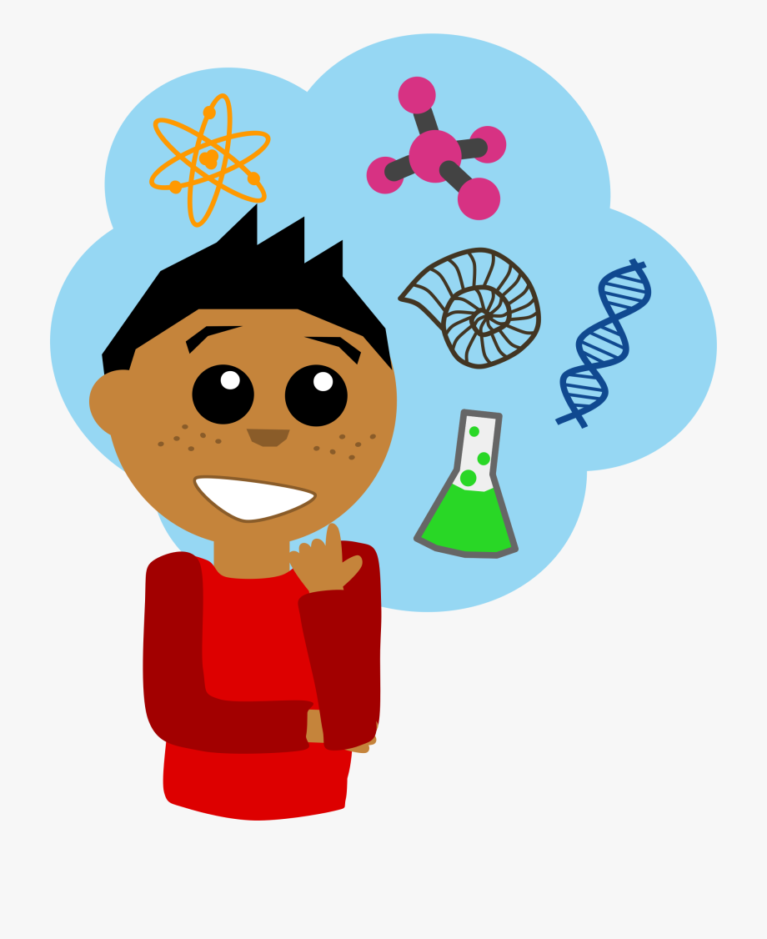
Hypothesis: A suggested explanation or idea that can be tested through an experiment
Notes:
A hypothesis is a suggested explanation or idea that can be tested through an experiment. It’s super important to note that a hypothesis must be able to be tested! The hypothesis predicts what will happen and why.

Slide 20
Notes:
Let’s check-in for understanding.

Slide 21
What is a hypothesis?
Notes:
What is a hypothesis?
[tA hypothesis is a suggested explanation or idea that can be tested through an experiment. ]

Slide 22
A hypothesis must be...
Notes:
A hypothesis must be...
[testable / able to be tested through an experiment]

Slide 23
Notes:
That is the basic definition, but there is a bit more you need to know.

Slide 24
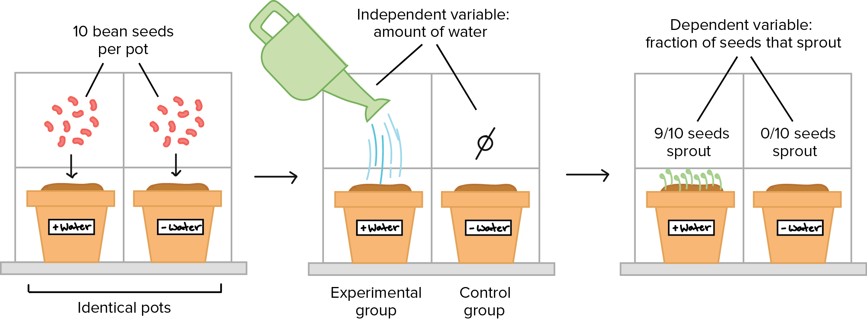
Science is based on evidence –
both observational and experimental.
Notes:
Everything in science begins with an observation that makes us curious about something. Then we gather more evidence through experiments and more observations to determine answers to the questions or problems that we were curious about.

Slide 25
A hypothesis is a smart guess based on what you have observed.
Notes:
A hypothesis is like a smart guess that you make based on what you already know or what you've observed. It's an idea that you think might be true, and you want to test it to find out if you're right.

Slide 26
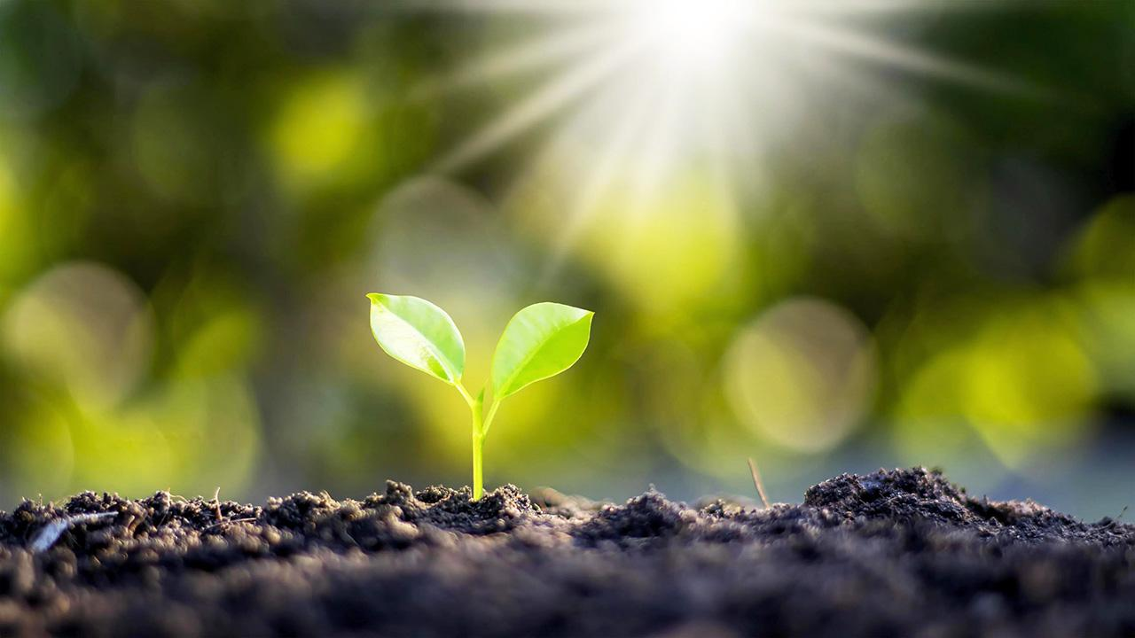
We test a hypothesis by doing an experiment.
Notes:
For example, let's say you see that plants grow better when they get more sunlight. Your hypothesis could be, "If I give this plant more sunlight, it will grow taller." Then, you would do an experiment to test your hypothesis by placing one plant in the sun and another in the shade to see if your guess is correct.

Slide 27
Hypotheses help us discover new things.
Notes:
In science, hypotheses help us investigate and understand things better. They're like the starting point for experiments and observations, and they let us explore and discover new things!

Slide 28
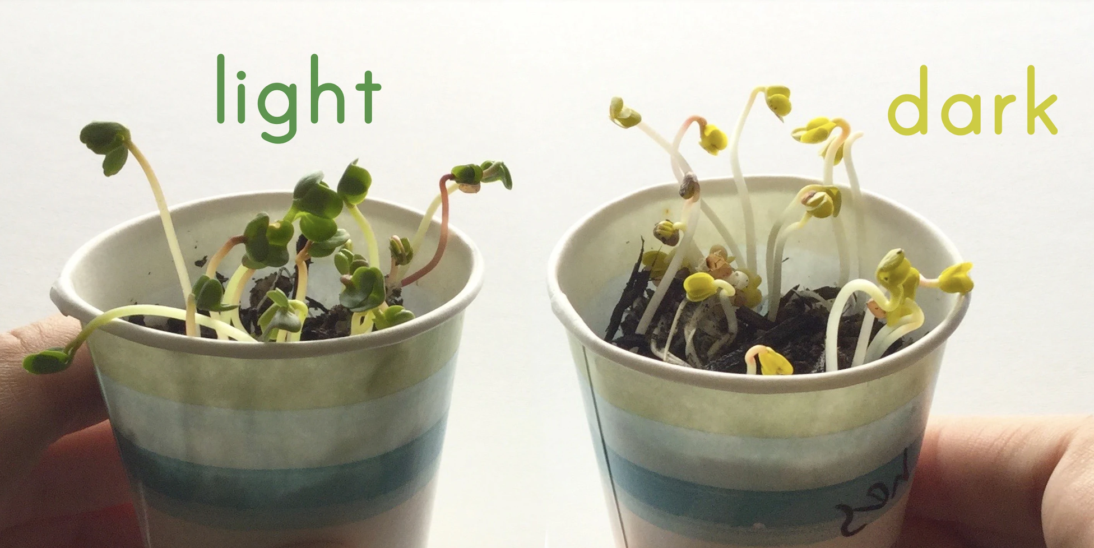
Hypotheses can show cause-and-effect relationships.
Notes:
Hypotheses can show cause-and-effect relationships. Going back to our plant example, we may learn than sunlight helps cause a plant to grow in a green, healthy way whereas a plant that is grown in the shade or in the dark may be more yellow than green and not as healthy. This means the cause, sunlight, effects the way the plant grows.

Slide 29
Notes:
Let’s check-in for understanding.

Slide 30
Which of the following is NOT true about a hypothesis?
It’s a smart guess based on what has been observed.
It is tested by doing an experiment.
It can show a cause-and-effect relationship.
It tells you everything you need to know about the Scientific Method.
Notes:
Which of the following is NOT true about a hypothesis?

Slide 31
Which of the following is NOT true about a hypothesis?
It’s a smart guess based on what has been observed.
It is tested by doing an experiment.
It can show a cause-and-effect relationship.
It tells you everything you need to know about the Scientific Method.
Notes:
Which of the following is NOT true about a hypothesis?
[It tells you everything you need to know about the Scientific Method.]

Slide 32
Notes:
Now, let’s talk about some examples of a hypothesis.

Slide 33
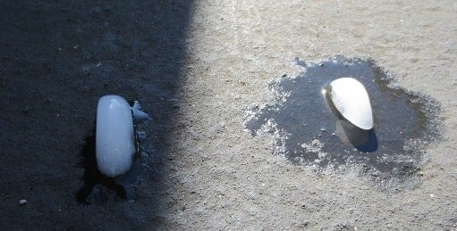
If I place an ice cube in a sunny spot, then it will melt faster than if I put it in a shaded area.
Notes:
An example of a hypothesis is: “If I place an ice cube in a sunny spot, then it will melt faster than if I put it in a shaded area.” You can test this by doing an experiment with one ice cube in the shade and one ice cube in a sunny spot at the same time, then timing to see which ice cube melts the fastest. In this experiment, you are seeing what effect the cause of the sun has on how quickly an ice cube melts.

Slide 34
If I drop a ball from a higher height, it will bounce higher than if I drop the ball from a lower height.
Notes:
Another example of a hypothesis is: “If I drop a ball from a higher height, it will bounce higher than if I drop the ball from a lower height.” You can test this by doing an experiment dropping balls from both high and low heights and record how high or low they bounce. In this experiment, you are seeing what effect the cause of how high you drop the ball has on the effect of how high the ball bounces.

Slide 35
Notes:
Let’s check-in for understanding.

Slide 36
A hypothesis can be _______, and may show a _____ and ____ relationship.
Notes:
A hypothesis can be __________, and may show a _____ and _____ relationship.
[tested, cause, effect]

Slide 37
A hypothesis can be tested, and may
show a cause and effect relationship.
Notes:
A hypothesis can be tested, and may show a cause and effect relationship.

Slide 38
Notes:
Now, let’s talk about some non-examples of a hypothesis.

Slide 39
Ice cream is the best food.
Notes:
“Ice cream is the best food.” While you may agree with this statement, it cannot be tested and does not show a cause and effect relationship. Therefore, this is an opinion. This is not a hypothesis.

Slide 40
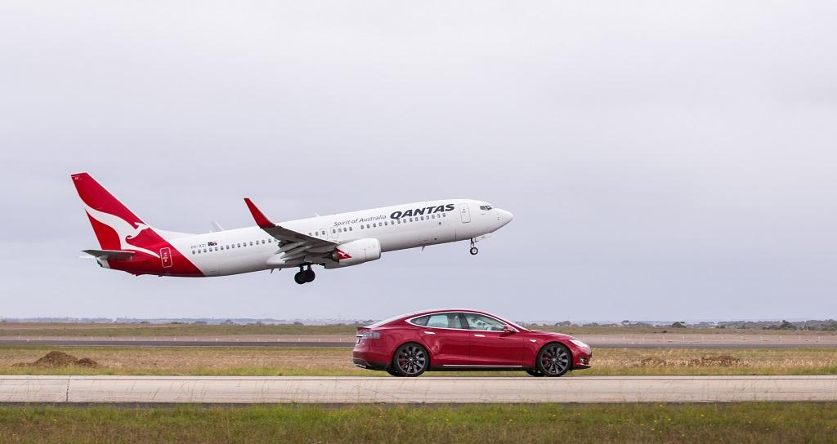
An airplane is faster than a car.
Notes:
“An airplane is faster than a car.” This is a statement based on something we already have tested and know. Therefore, this is a fact. It is not a hypothesis.

Slide 41
Notes:
Now let’s pause for a moment to check your understanding.

Slide 42
Why is this not an example of a hypothesis?
Notes:
Why is this not an example of a hypothesis?
[This is not a hypothesis because we know that airplanes move much faster than cars because we have tested this many times before, so we do not need to test this (at least until cars get faster). There is also not a cause and effect relationship since the speed of a plane does not have an effect on the speed of a car, or vice versa.]

Slide 43
Notes:
We can also break down the term hypothesis into different word parts to help us remember the meaning. Let’s take a look!

Slide 44
Hypothesis
(prefix)
(root)
Notes:
We can break up the term hypothesis into two parts: prefix and root.

Slide 45
Hypothesis
Hypo = under investigation
Notes:
First, we have the prefix “hypo” which means means "under" or "less than." In this word, it indicates that a hypothesis is something that is "under" or "less than" a proven theory and is still being tested. Think of it as something as “under” investigation.

Slide 46
Hypothesis
Thesis = Something that is being considered or thought about
Notes:
Thesis is the root. The root "thesis" carries the basic meaning of "a proposition" or "a statement that is put forward for consideration." Think of it as something that is being considered or thought about. Now let’s put it all together.

Slide 47
Hypo thesis
Hypothesis
A thought under investigation
Notes:
So when we put it all together, hypothesis means a thought under investigation. We investigate it by testing it!

Slide 48
Notes:
Let’s check-in for understanding.

Slide 49
How can we use the word parts of hypothesis to help us remember the definition of the term?
Hypothesis
(prefix)
(root)
Notes:
How can we use the word parts of the hypothesis to help us remember the definition of the term?
[The prefix hypo means under investigation.
Thesis is the root meaning a thought or consideration.
So when we put it all together, hypothesis means a thought under investigation.]

Slide 50
Remember!!!
Notes:
So remember!

Slide 51
Hypothesis: A suggested explanation or idea that can be tested through an experiment
Notes:
A hypothesis is a suggested explanation or idea that can be tested through an experiment. It’s super important to note that a hypothesis must be able to be tested! The hypothesis predicts what will happen and why.

Slide 52
Notes:
We will now complete this concept map, called a Frayer model, to summarize and further clarify what you have learned about the term hypothesis.

Slide 53
Definition
Picture
Hypothesis
Example
How do hypotheses impact my life?
Notes:
To complete the Frayer model, we will choose from four choices the correct picture, definition, example, and response to the question, “How do hypotheses impact my life?” Select the best response for each question using the information you just learned. As we select responses, we will see how this model looks filled in for the term hypothesis.

Slide 54
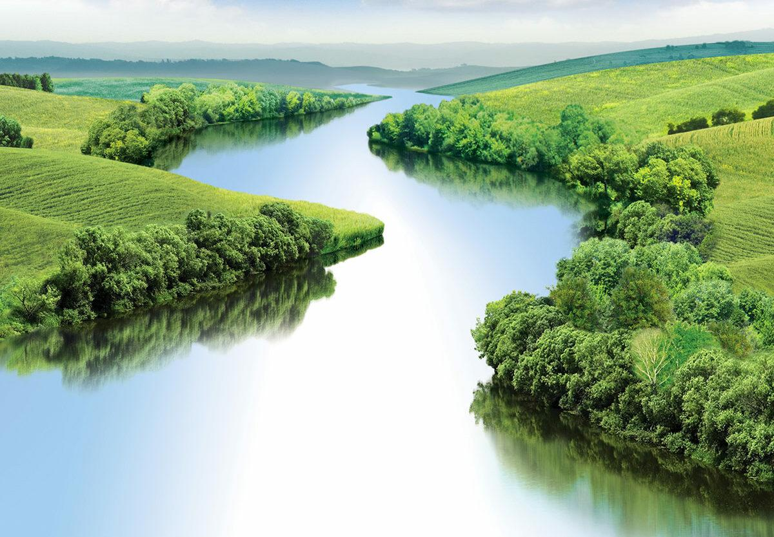
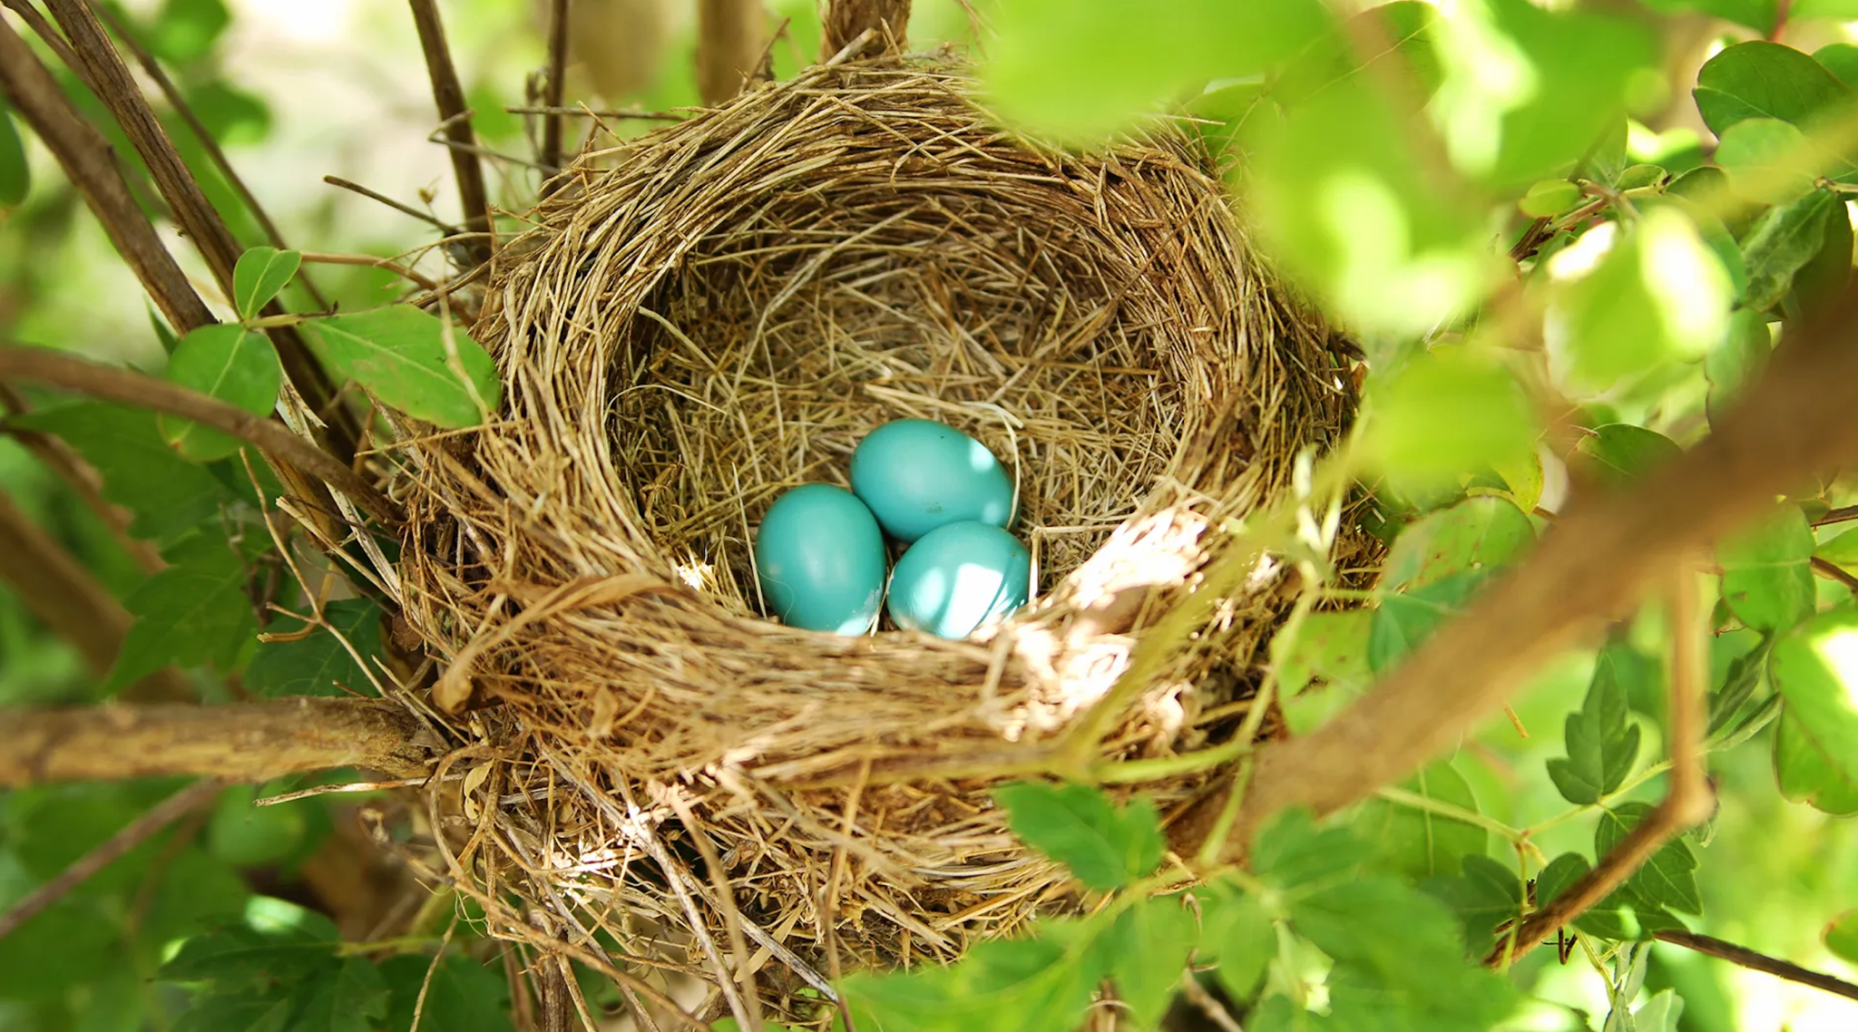
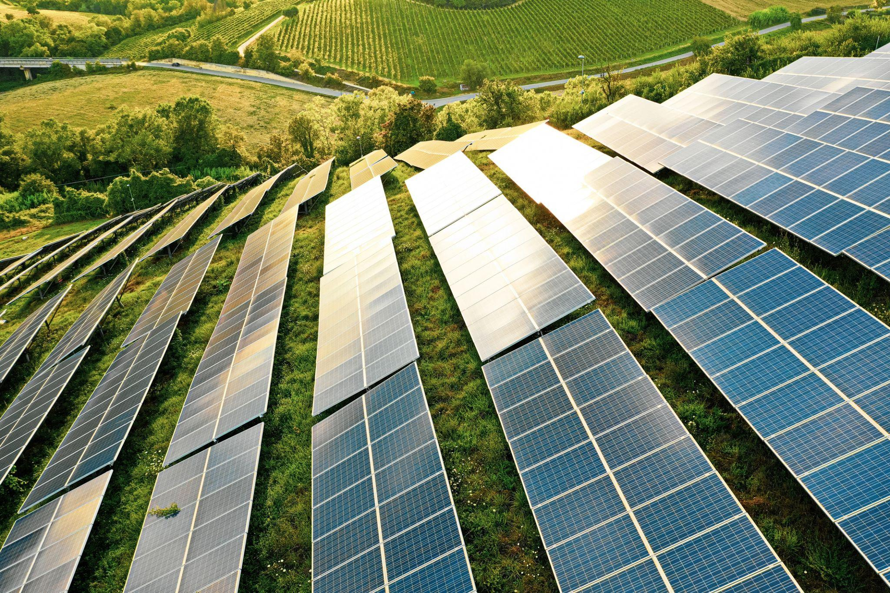
Directions: Choose the correct picture of a
Hypothesis from the choices below.
A
B
C
D
Notes:
Choose the one correct picture of hypothesis from these four choices.

Slide 55
Directions: Choose the correct picture of a
Hypothesis from the choices below.
A
B
C
D
Notes:
This is the picture that shows hypothesis.

Slide 56
Definition
Picture
Hypothesis
Example
How do hypotheses impact my life?
Notes:
Here is the Frayer model filled in with a picture of hypothesis.

Slide 57
Directions: Choose the correct definition of
Hypothesis from the choices below.
A
How hot or cold something is
B
The smallest unit of matter
C
A suggested explanation or idea that can be tested through an experiment
D
The energy of mass in motion
Notes:
Choose the one correct definition of hypothesis from these four choices.

Slide 58
Directions: Choose the correct definition of
Hypothesis from the choices below.
A
How hot or cold something is
B
The smallest unit of matter
C
A suggested explanation or idea that can be tested through an experiment
D
The energy of mass in motion
Notes:
“A suggested explanation or idea that can be tested through an experiment” is correct! This is the definition of hypothesis.

Slide 59
Definition
Picture
A suggested explanation or idea that can be tested through an experiment
Hypothesis
Example
How do hypotheses impact my life?
Notes:
Here is the Frayer Model with a picture and the definition filled in for hypothesis: A suggested explanation or idea that can be tested through an experiment.

Slide 60
Directions: Choose the correct example of
Hypothesis from the choices below.
A
Bouncing a ball
B
Testing whether a plant grows better with or without fertilizer
C
Watching grass grow
D
Writing a paragraph in a short story
Notes:
Choose the one correct example of hypothesis from these four choices.

Slide 61
Directions: Choose the correct example of
Hypothesis from the choices below.
A
Bouncing a ball
B
Testing whether a plant grows better with or without fertilizer
C
Watching grass grow
D
Writing a paragraph in a short story
Notes:
“Testing whether a plant grows better with or without fertilizer” is correct! This is an example of hypothesis.

Slide 62
Definition
Picture
A suggested explanation or idea that can be tested through an experiment
Hypothesis
Testing whether a plant grows better with or without fertilizer
Example
How do hypotheses impact my life?
Notes:
Here is the Frayer Model with a picture, definition, and an example of hypothesis: Testing whether a plant grows better with or without fertilizer.

Slide 63
Directions: Choose the correct response for “how do hypotheses impact my life?” from the choices below.
A
Hypotheses help us discover cause and effect relationships or other new knowledge.
B
Hypotheses explain how electricity works.
C
Hypotheses show how objects move in our environment.
D
Hypotheses teach us about the history of our planet.
Notes:
Choose the one correct response for “how do hypotheses impact my life?” from these four choices.

Slide 64
Directions: Choose the correct response for “how do hypotheses impact my life?” from the choices below.
A
Hypotheses help us discover cause and effect relationships or other new knowledge.
B
Hypotheses explain how electricity works.
C
Hypotheses show how objects move in our environment.
D
Hypotheses teach us about the history of our planet.
Notes:
“Hypotheses help us discover cause and effect relationships or other new knowledge.” That is correct! This is an example of how hypotheses impact your life.

Slide 65
Definition
Picture
A suggested explanation or idea that can be tested through an experiment
Hypothesis
Testing whether a plant grows better with or without fertilizer
Hypotheses help us discover cause and effect relationships or other new knowledge.
Example
How do hypotheses impact my life?
Notes:
Here is the Frayer Model with a picture, definition, example, and a correct response to “how do hypotheses impact my life?”: Hypotheses help us discover cause and effect relationships or other new knowledge.

Slide 66
Remember!!!
Notes:
So remember!

Slide 67
Hypothesis: A suggested explanation or idea that can be tested through an experiment
Notes:
A hypothesis is a suggested explanation or idea that can be tested through an experiment. It’s super important to note that a hypothesis must be able to be tested! The hypothesis predicts what will happen and why.

Slide 68
Big Question: What is a hypothesis and how does it help scientists learn and discover new things?
Notes:
Let’s reflect once more on our big question. Our “big question” is: What is a hypothesis and how does it help scientists learn and discover new things?
Does anyone have any additional examples to share that haven’t been discussed yet?
[Pause and illicit predictions from students.]

Slide 69
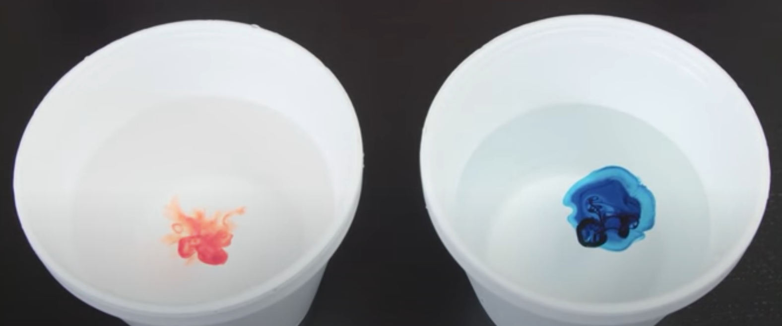
Reflection Activity
Why did you make the guess that you made at the beginning of class? Do you think your guess would have been different if you knew more about what a hypothesis beforehand?
Knowing what you do now about hypotheses, how does that impact your guess or decision making skills for future scientific inquiries and experiments?
Notes:
Have students discuss these questions with a partner or with their table before calling on groups to share one of their responses with the class.

Slide 70
Notes:
Thanks for watching, and please continue watching CAPs available from this website.

Slide 71
This Was Created With Resources From:
Questions or Comments
Michael Kennedy, Ph.D. MKennedy@Virginia.edu
Rachel L Kunemund, Ph.D. rk8vm@virginia.edu

