Slide 1
Intro
“Big Idea” Question
Review Concepts
Check-In Questions
Teacher Engagement
Vocabulary
Student-Friendly Definition
Examples & Non-Examples
Frayer Model
Simulation/Activity
Notes:
OK everyone, get ready for our next lesson. Just as a reminder, these are the different components that our lesson may include, and you’ll see these icons in the top left corner of each slide so that you can follow along more easily!

Slide 2
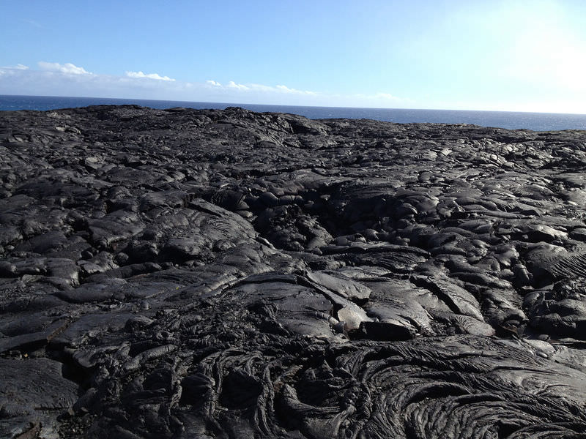
Intro
Igneous Rock
Notes:
Today, we’ll be learning about the word: Igneous Rock.

Slide 3
Big Question: What do igneous rocks tell us about what's under the Earth's surface?
Notes:
Our “big question” is: What do igneous rocks tell us about what's under the Earth's surface? [Pause and illicit predictions from students.]
I love all these thoughtful scientific hypotheses! Be sure to keep this question and your predictions in mind as we move through these next few lessons, and we’ll continue to revisit it.

Slide 4
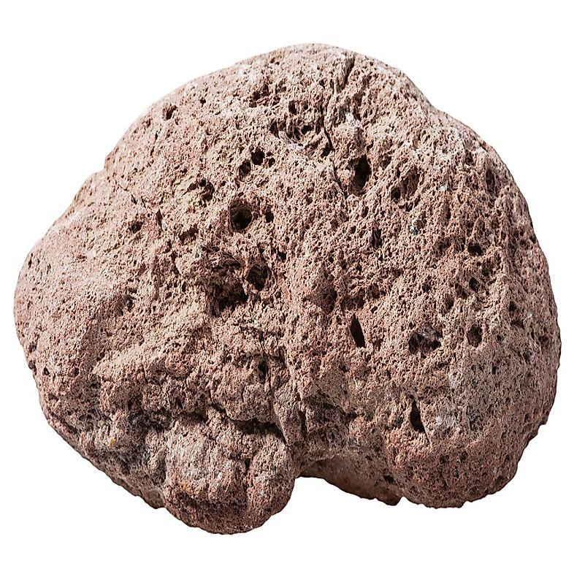
Demonstration
Igneous Rocks
Provide a few igneous rock samples and have students contrast igneous rock features to other rocks e.g., sedimentary rocks.
Notes:
Igneous Rocks
Provide a few igneous rock samples and have students contrast igneous rock features to other rocks e.g., sedimentary rocks.

Slide 5
Notes:
Before we move on to our new topic, let’s review some other words & concepts that you already learned and make sure you are firm in your understanding.

Slide 6
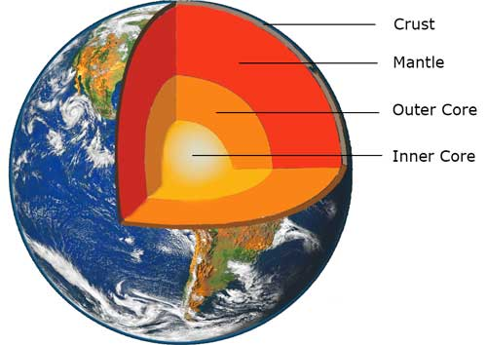
The Layers of the Earth
Notes:
Review the layers of the Earth.

Slide 7
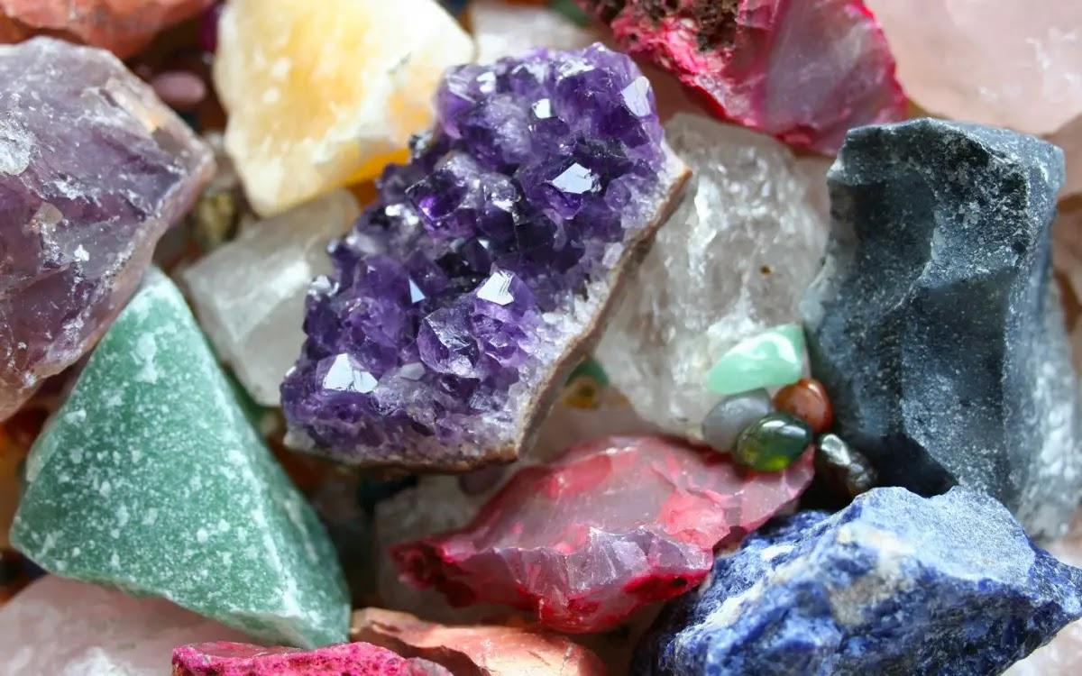
Mineral: Substances that do not come from an animal or plant, the building blocks that make up rocks
Notes:
Mineral: Substances that do not come from an animal or plant, the building blocks that make up rocks

Slide 8
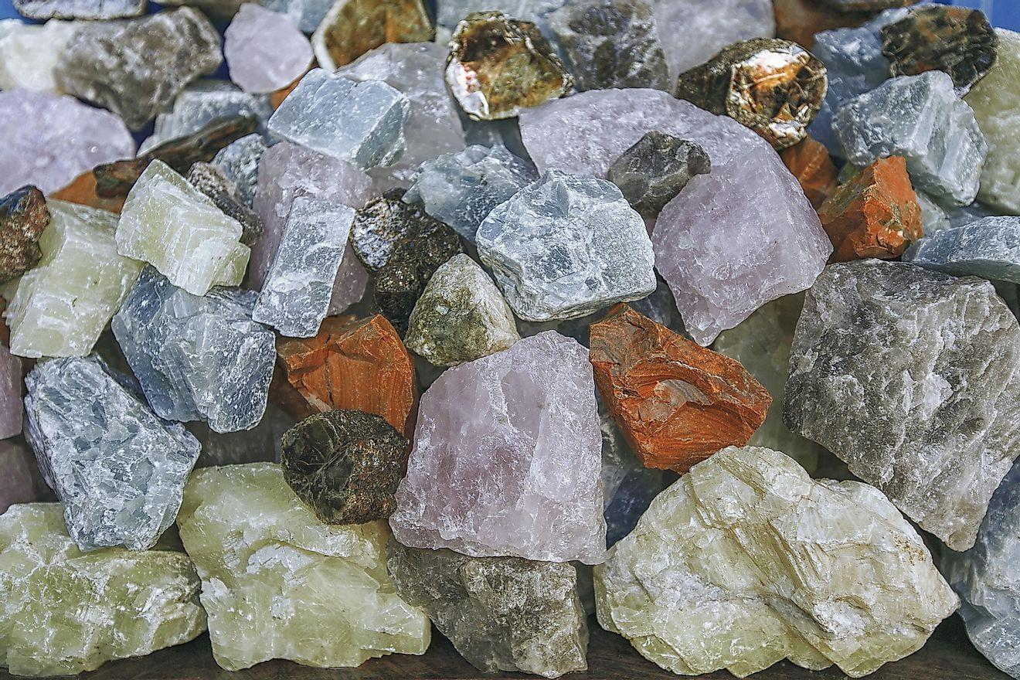
Rock: A solid collection of minerals.
Notes:
Rock: A solid collection of minerals.

Slide 9
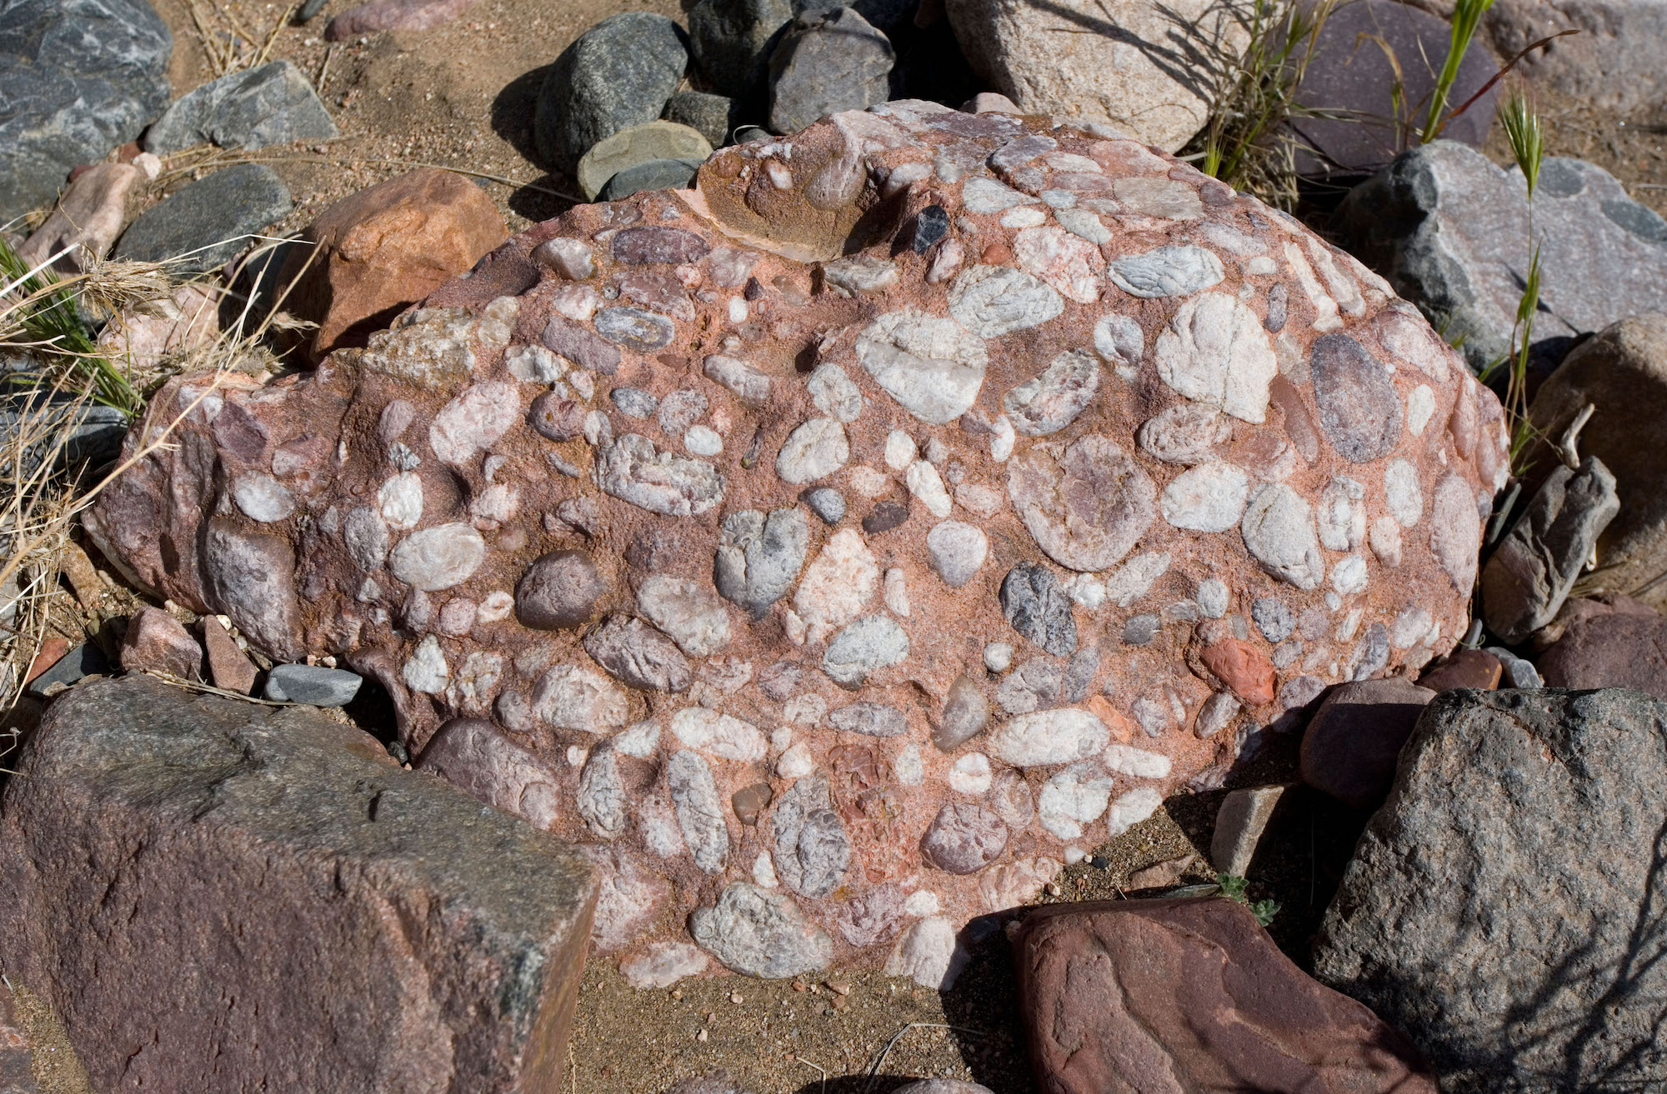
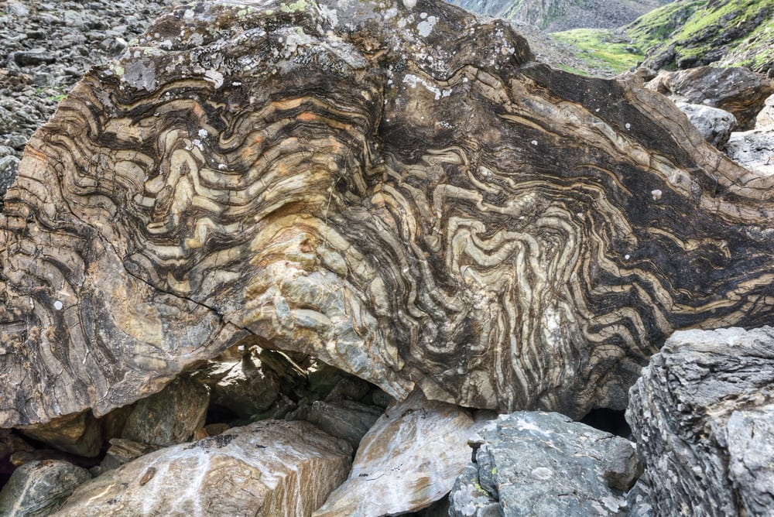
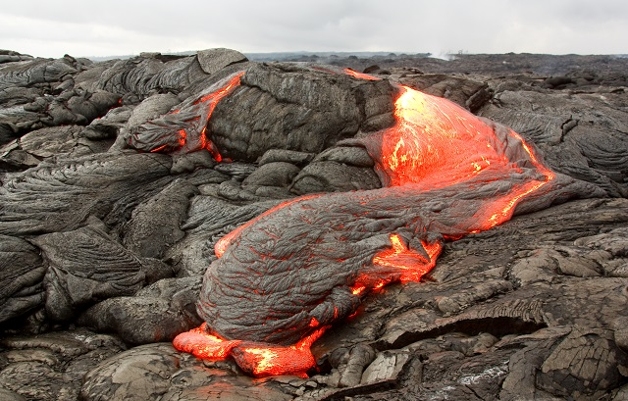
There are three types of rocks. Each type forms differently.
Igneous – when lava cools down and solidifies
Sedimentary – when small particles e.g., minerals, organic materials, sand, stick together over time
Metamorphic – when existing rocks undergo temperature, pressure, or chemical change
Notes:
There are three types of rocks. Each type of rock forms differently.
Today, we will be learning about Igneous Rocks.

Slide 10
Notes:
Now let’s pause for a moment to review the information we have covered already.

Slide 11
Minerals are substances that can come from plants and animals
A. True
B. False
Notes:
Minerals are substances that can come from plants and animals
[True]

Slide 12
Minerals are substances that can come from plants and animals.
True
False
Notes:
Minerals do not come from plants or animals, they are the building blocks of rocks
[True]

Slide 13
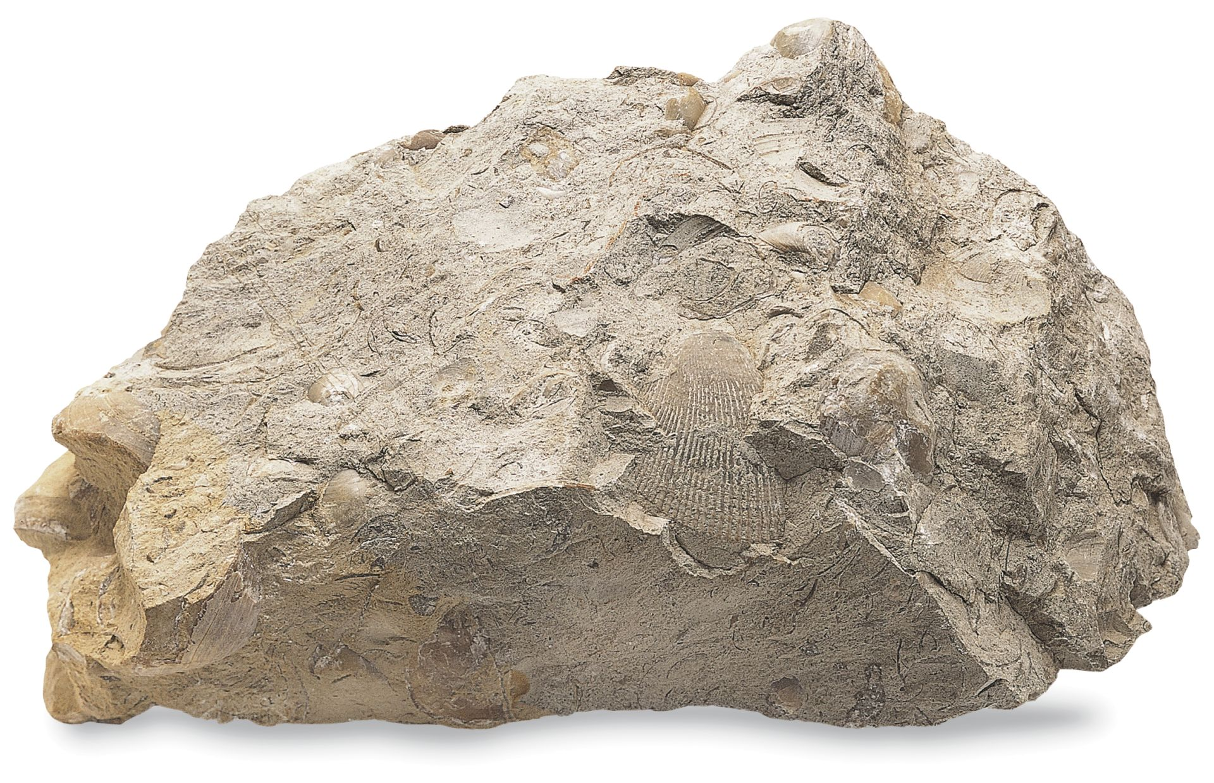
What are the three types of rocks?
Hufflepuff, Ravenclaw, and Slytherin
Glass, Plastic, and Metal
Igneous, Sedimentary, and Metamorphic
Iguana, Sedan, and Metropolis
Notes:
What are the three types of rocks
[D] What type of rocks are in the same region

Slide 14
What are the three types of rocks?
Hufflepuff, Ravenclaw, and Slytherin
Glass, Plastic, and Metal
Igneous, Sedimentary, and Metamorphic
Iguana, Sedan, and Metropolis
Notes:
What are the three types of rocks? Igneous, sedimentary, and metamorphic
[D] What type of rocks are in the same region

Slide 15
Igneous Rock
Notes:
Now that we’ve reviewed, let’s define the phrase Igneous Rock

Slide 16
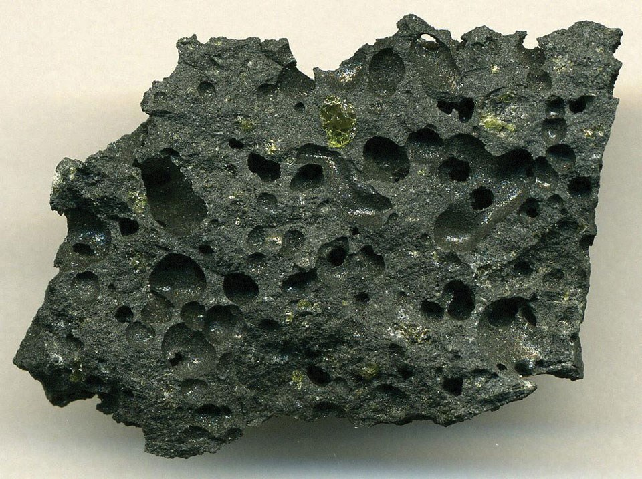
Igneous Rock: Rock that forms when molten earth becomes solid.
Notes:
Igneous Rocks are rocks that form when molten earth becomes solid

Slide 17
Notes:
Let’s check-in for understanding.

Slide 18
What are Igneous Rocks?
Notes:
What are Igneous Rocks?
[Rocks that forms when molten earth becomes solid.]

Slide 19
Notes:
That is the basic definition, but there is a bit more you need to know.

Slide 20
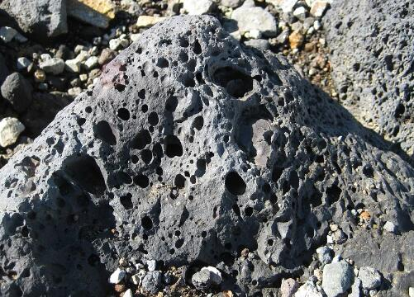
Licensable
Most of the Earth’s crust is igneous rock.
Notes:
Most of the Earth’s crust is igneous rock.

Slide 21
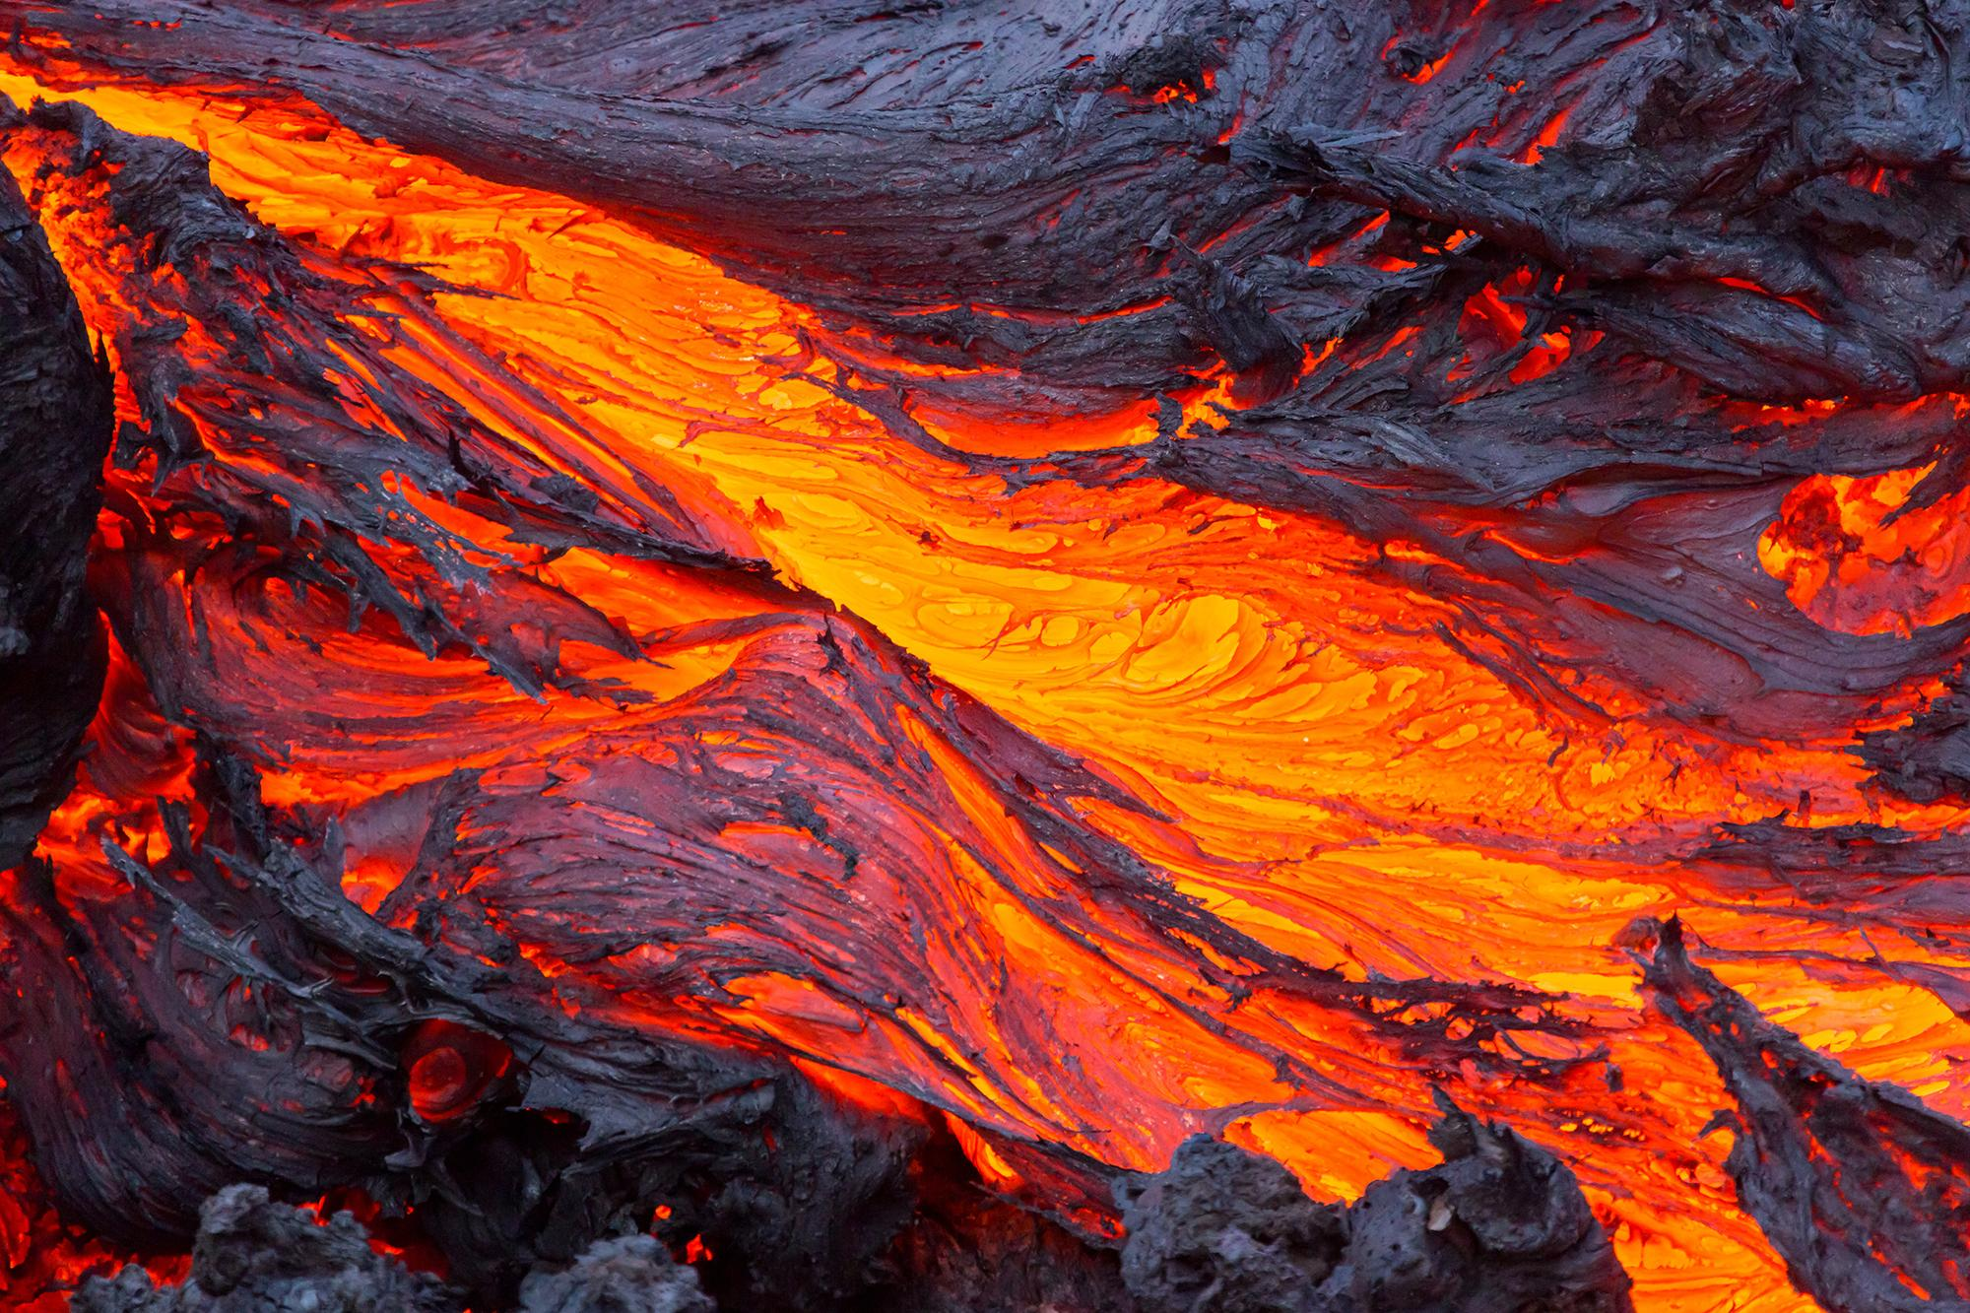
Licensable
Igneous Rocks are formed when magma (melted rock) cools down also known as molten rock. The magma can cool down inside or outside the crust.
Notes:
Igneous Rocks are formed when magma (melted rock) cools down.

Slide 22
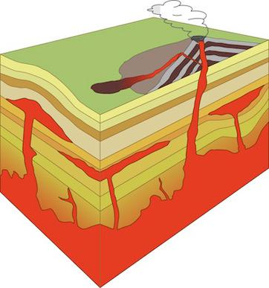
Licensable
If the lava cools down very slowly, because it cools underground (where it is hot), it is intrusive. It is called intrusive because it cools down inside the crust.
Intrusive
Notes:
If the lava cools down very slowly, because it cools underground (where it is hot), it is intrusive. It is called intrusive because it cools down inside the crust.
Emphasize the “in” in intrusive.
They cool down slowly because it is cooling down inside the crust where it is very hot.

Slide 23
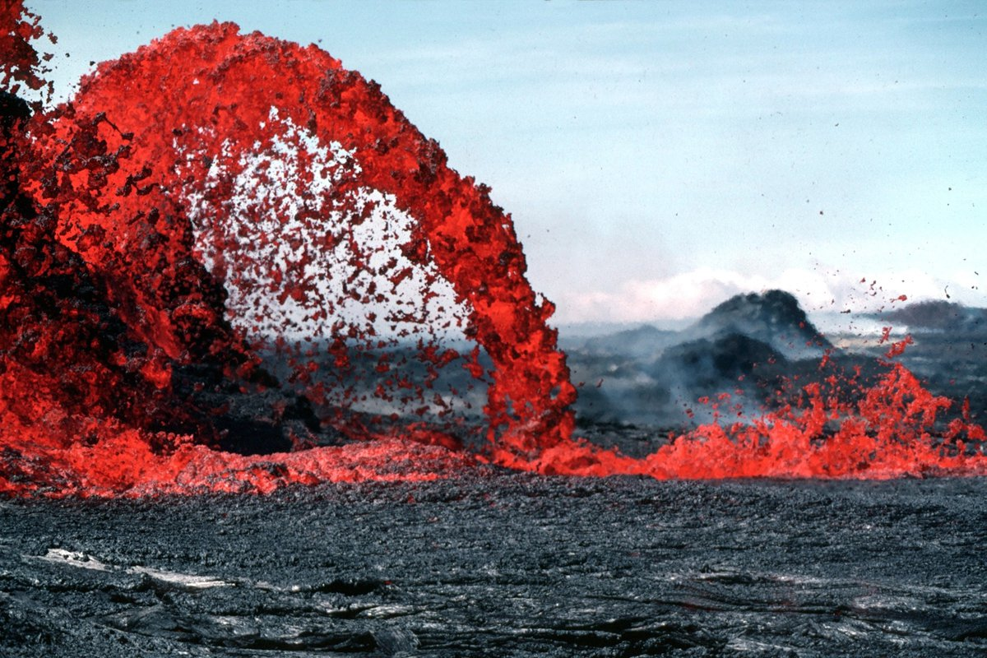
Licensable
If the lava cools down very quickly, because it is on the Earth’s surface (cold), it is extrusive. It is called extrusive because it cools down outside of the crust.
Notes:
If the lava cools down very quickly, because it is on the Earth’s surface (cold), it is extrusive.
Emphasize the “ex” in extrusive.
They cool down quickly because it is cooling down on the Earth’s surface where it is very cold.

Slide 24
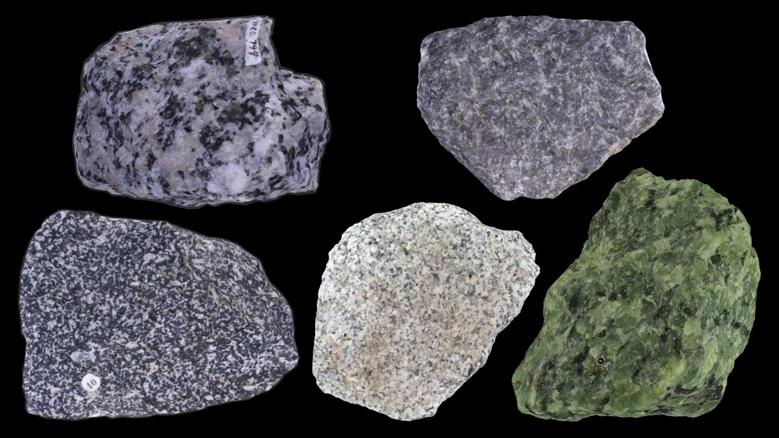
Intrusive Igneous Rocks tend to be larger, have lighter colors, and have larger crystals.
Notes:
Intrusive Igneous Rocks tend to be larger, have lighter colors, and have larger crystals.
The crystals are larger because due to the slow cooling, there is time for the larger crystals to form.

Slide 25
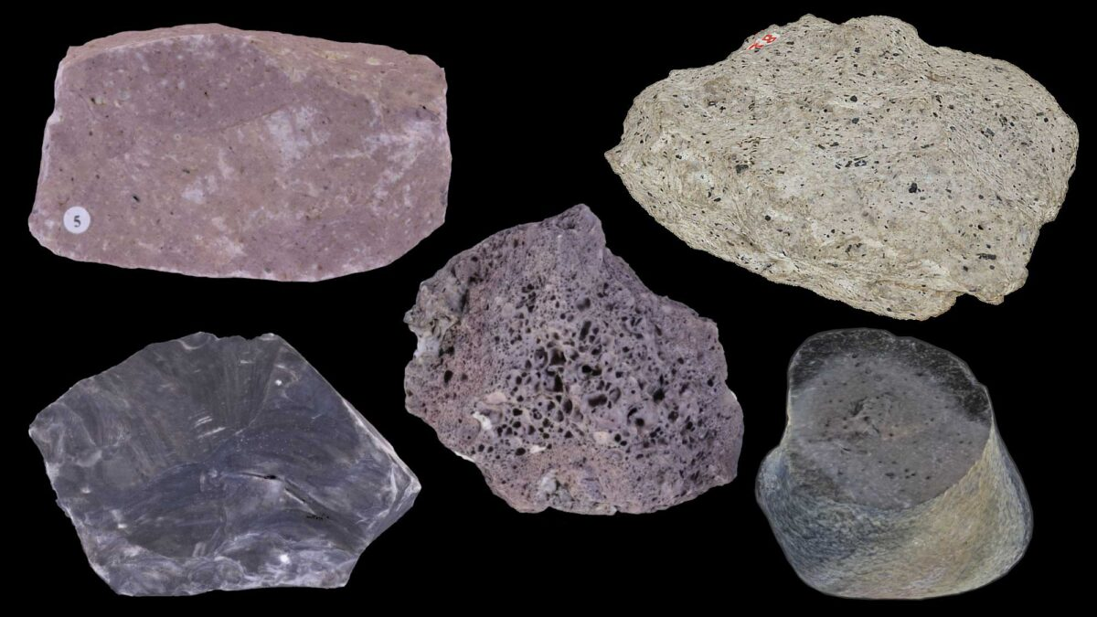
Extrusive igneous rocks tend to be small, have darker colors, small gas bubbles, and small crystals that require a microscope to see.
Notes:
Extrusive igneous rocks to have darker colors, small gas bubbles, and small crystals that require a microscope to see.
The crystals are microscopic because due to the quick cooling, there isn’t sufficient time for the larger crystals to form.

Slide 26
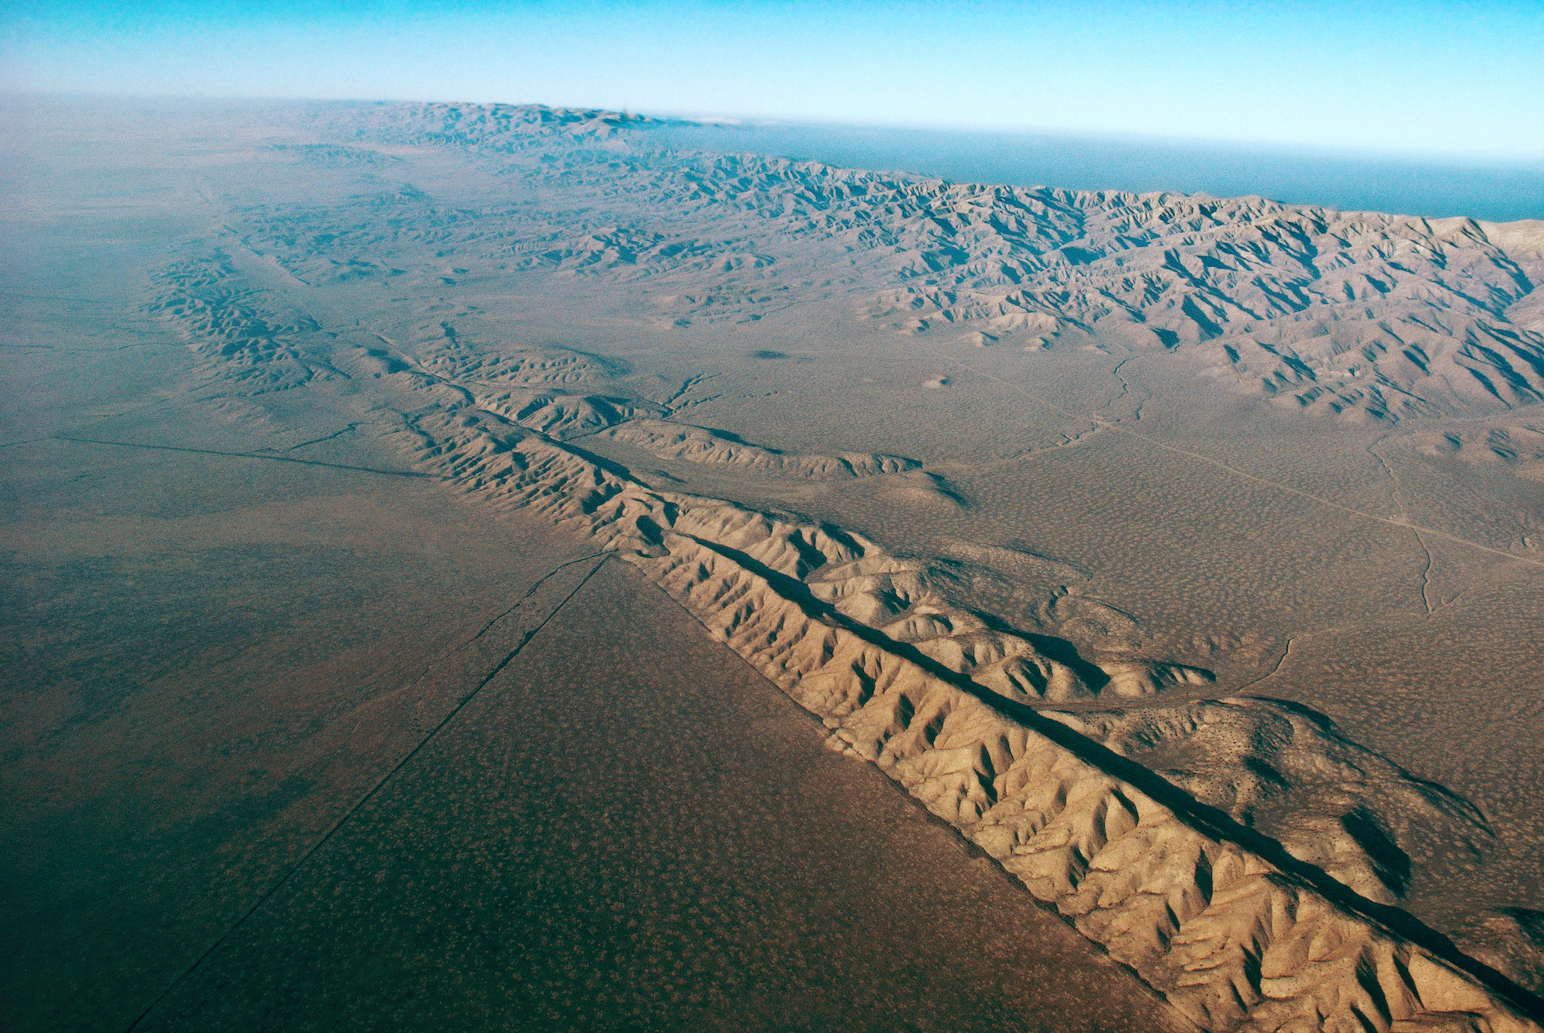
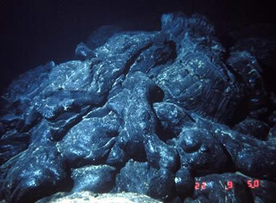
Igneous rocks can come from volcanoes, tectonic plates, and at the bottom of the ocean.
Notes:
Igneous rocks can come from volcanoes, tectonic plates, and at the bottom of the ocean.

Slide 27
Notes:
Let’s check-in for understanding.

Slide 28
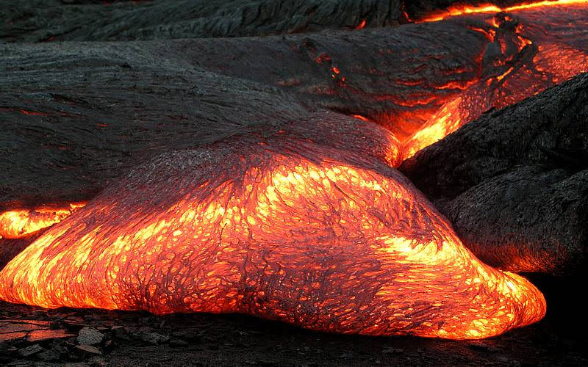
Intrusive igneous rocks mean they cool down _____ _____ the Earth’s crust.
Slowly, inside
Quickly, outside
Notes:
Intrusive igneous rocks mean they cool down _____ _____ the Earth’s crust.
[A] Slowly, inside
They cool down slowly because it is cooling down inside the crust where it is very hot.

Slide 29
Intrusive igneous rocks mean they cool down slowly, inside the Earth’s crust.
Slowly, inside
Quickly, outside
Notes:
Intrusive igneous rocks mean they cool down _____ _____ the Earth’s crust.
[A] Slowly, inside
They cool down slowly because it is cooling down inside the crust where it is very hot.

Slide 30
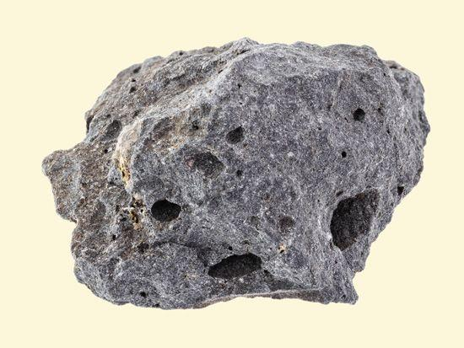
Igneous Rocks contain particles such as former living things and sand.
True
False
Notes:
Igneous Rocks contain particles such as former living things and sand.
[False]

Slide 31
Igneous Rocks contain particles such as former living things and sand.
True
False
Notes:
Igneous Rocks contain particles such as former living things and sand.
[False]

Slide 32
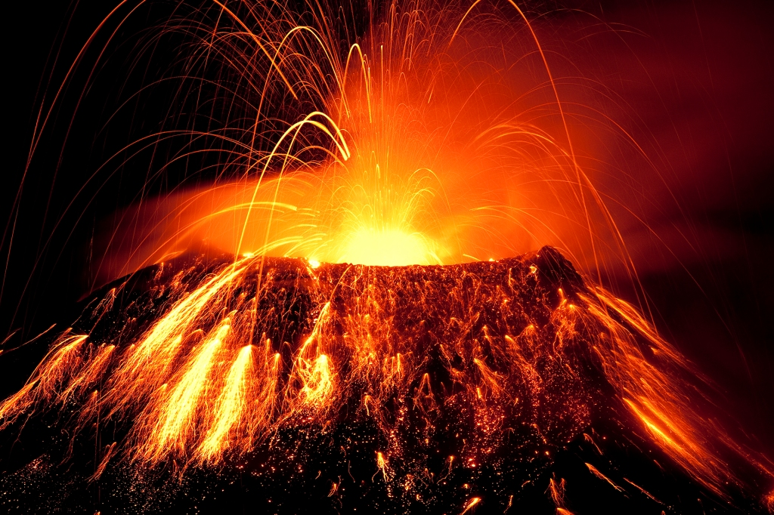
Igneous rocks can only be formed by volcanoes.
True
False
Notes:
Igneous rocks can only be formed by volcanoes.
[False]

Slide 33
Igneous rocks can only be formed by volcanoes.
True
False
Notes:
Igneous rocks can only be formed by volcanoes.
[False]

Slide 34
Notes:
Now, let’s talk about some examples of Igneous Rocks.

Slide 35
Pumice
Notes:
Pumice is an example of am Igneous Rock.
Tell students that the holes in the rock are from the trapped gas bubbles when the magma cools down very quickly.
Ask students if it is intrusive or extrusive.

Slide 36
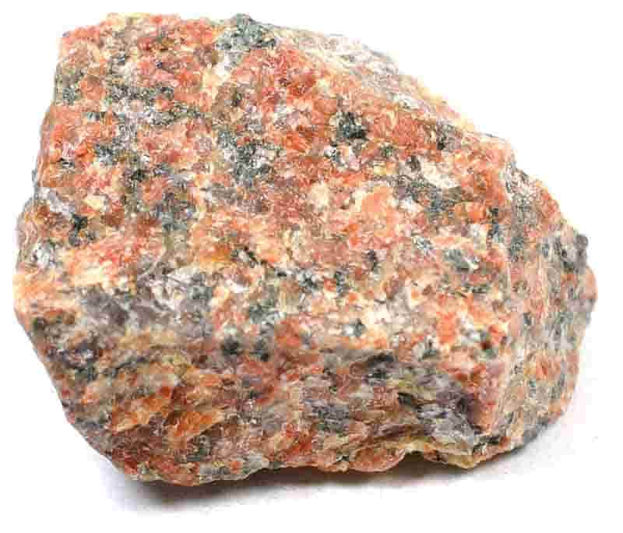
Granite
Notes:
Granite is an example of an Igneous rock.
It is the most widely known igneous rock and intrusive, largely composed of quartz, feldspar, and mica.

Slide 37
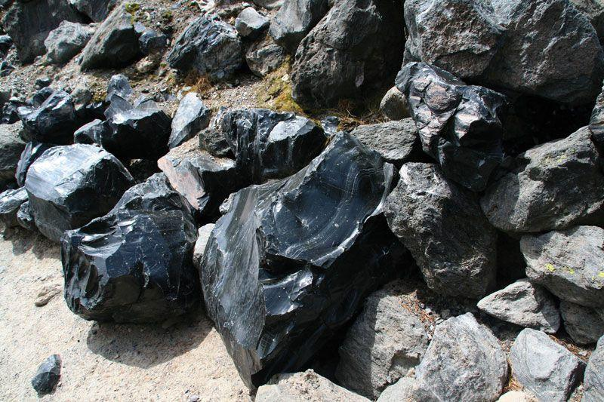
Obsidian
Notes:
Obsidian is an igneous rock that results from cooled lava with minimal crystals.

Slide 38
Notes:
Now, let’s talk about some non-examples of Igneous Rocks.

Slide 39
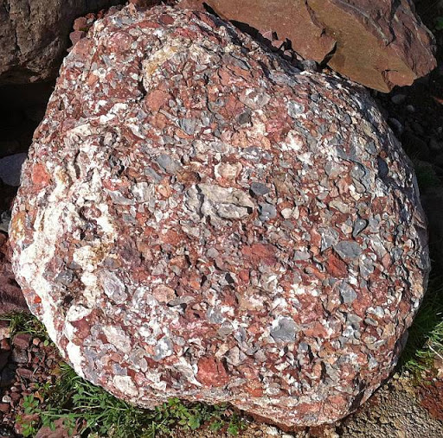
Conglomerate (sedimentary)
Notes:
Conglomerate is not an example of an Igneous Rock.

Slide 40
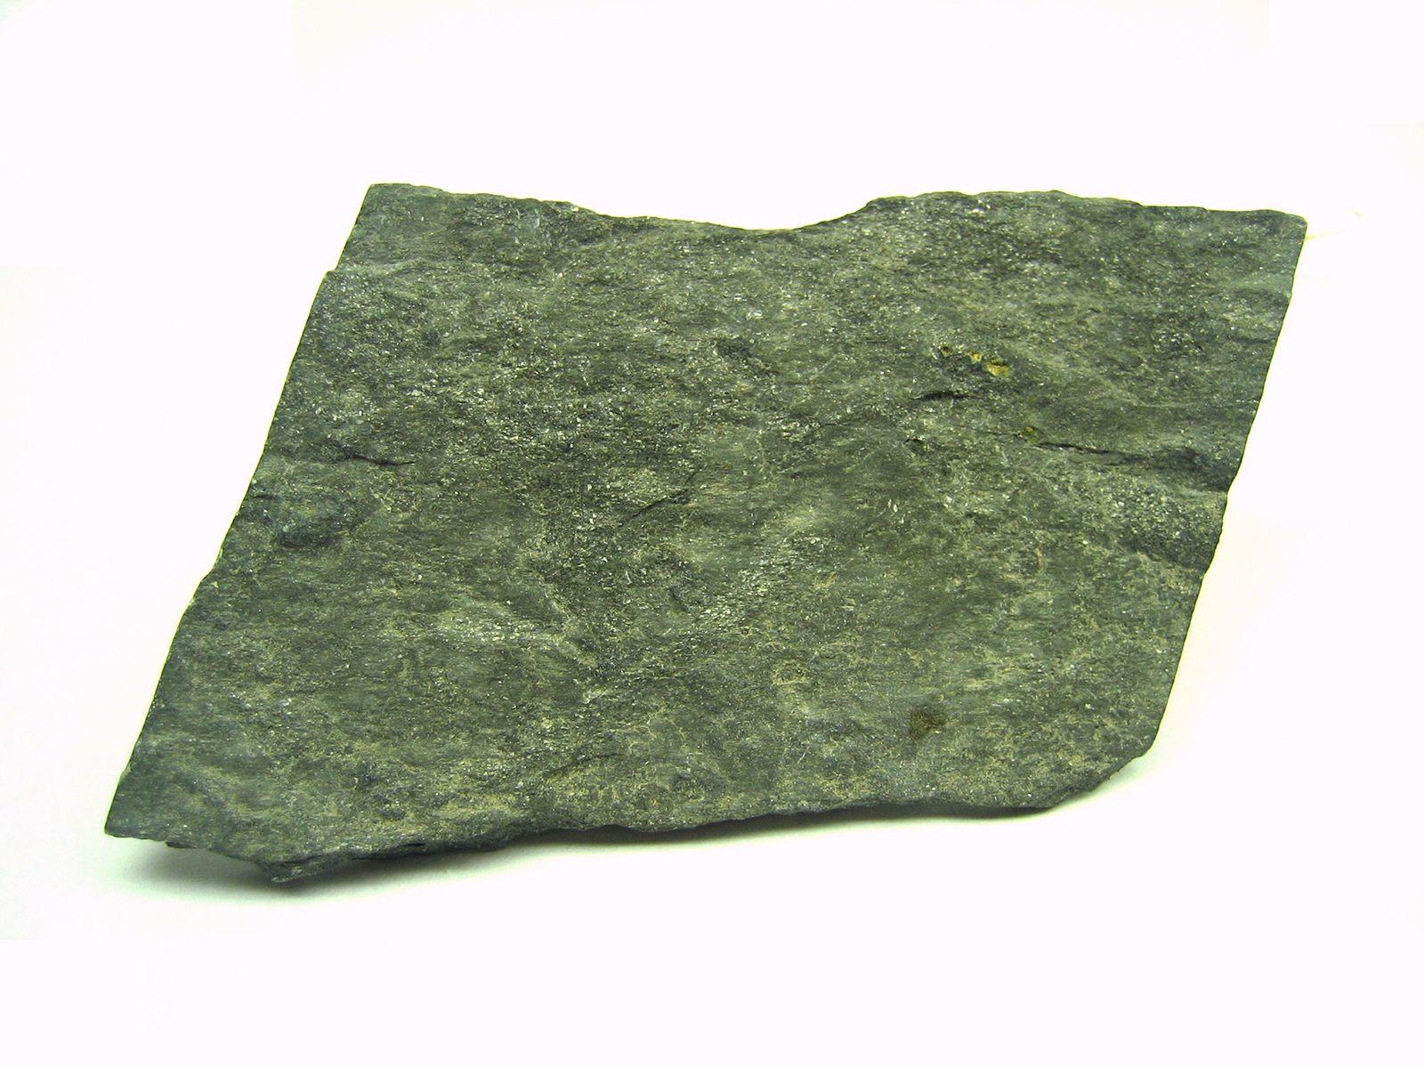
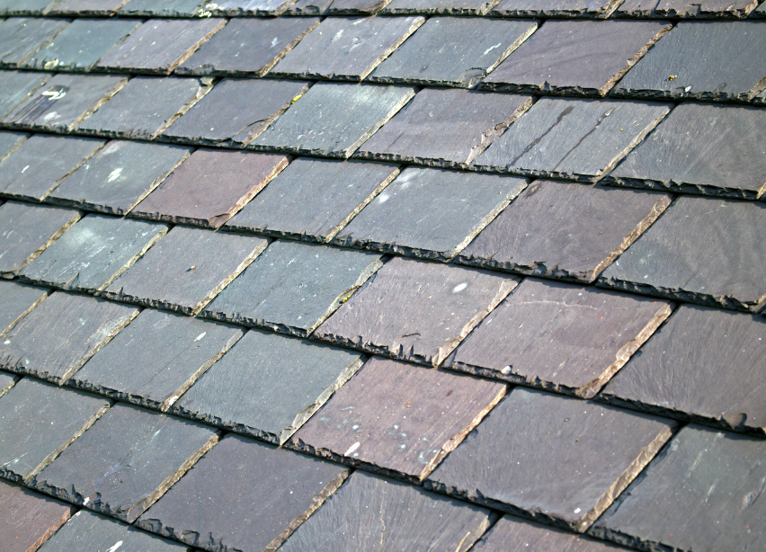
Slate (Metamorphic)
Notes:
Slate (Metamorphic rock) is not igneous because it is metamorphosed shale (sedimentary rock).

Slide 41
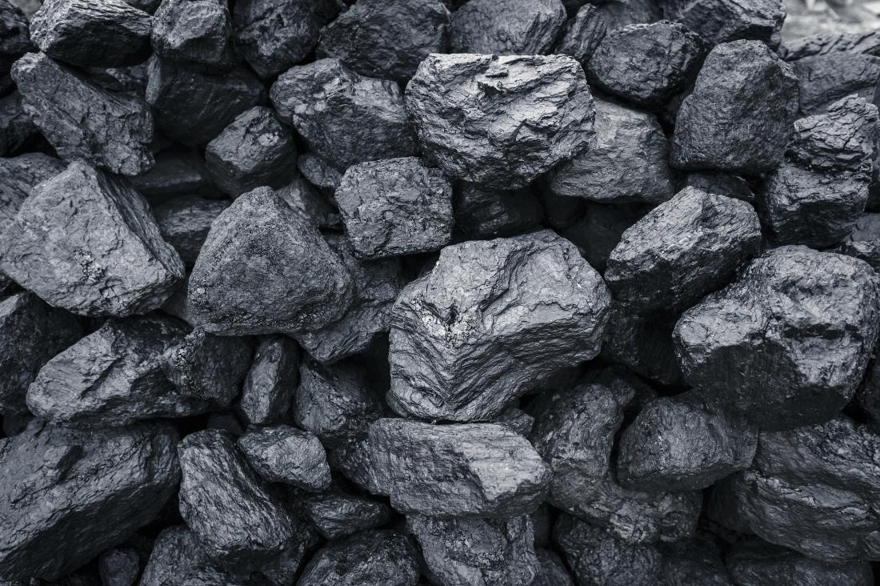
Coal (sedimentary)
Notes:
Coal (sedimentary rock) is not an Igneous Rock. It is a sedimentary rock with high amounts of carbon.

Slide 42
Notes:
Now let’s pause for a moment to check your understanding.

Slide 43
Discuss whether igneous rocks contain fossils and/or sand particles (as compared to sedimentary rocks).
Notes:
Discuss whether igneous rocks contain fossils and/or sand particles (as compared to sedimentary rocks).

Slide 44
Remember!!!
Notes:
So remember!

Slide 45
Igneous Rock: Rock that forms when molten earth becomes solid.
Notes:
Igneous Rock are rocks that forms when molten earth becomes solid

Slide 46
Notes:
We will now complete this concept map, called a Frayer model, to summarize and further clarify what you have learned about the term Igneous Rock.

Slide 47
Definition
Picture
Igneous Rock
How do Igneous Rocks impact my life?
Example
Notes:
To complete the Frayer model, we will choose from four choices the correct picture, definition, example, and response to the question, “How do Igneous Rocks impact my life?” Select the best response for each question using the information you just learned. As we select responses, we will see how this model looks filled in for the term Igneous Rocks.

Slide 48
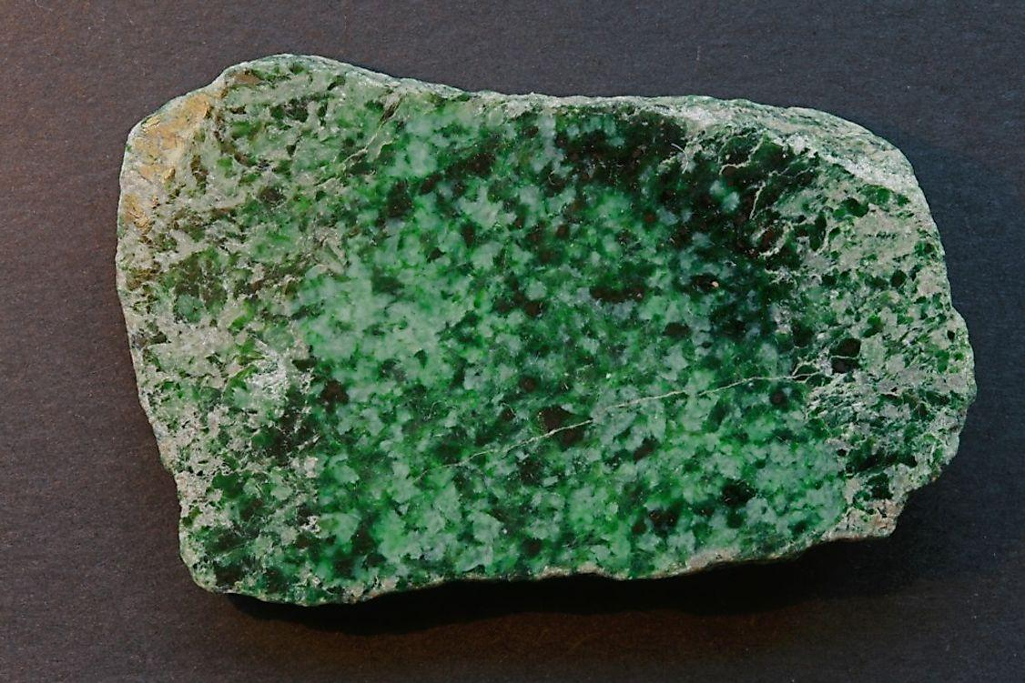
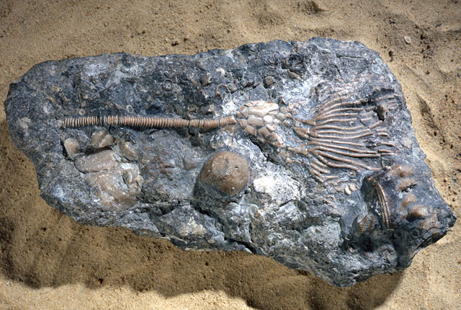
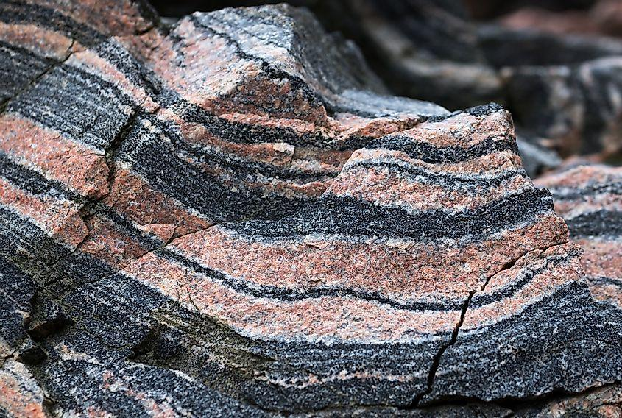
Directions: Choose the correct picture of Igneous Rock from the choices below.
A
B
C
D
Notes:
This is the picture that shows an Igneous Rock.
[A] is correct.
Igneous rock, jade, metamorphic rock, sedimentary rock with fossils

Slide 49
Directions: Choose the correct picture of Igneous Rock from the choices below.
A
B
C
D
Notes:
This is the picture that shows an Igneous Rock.
[A] is correct.
Igneous rock, jade, metamorphic rock, sedimentary rock with fossils

Slide 50
Definition
Picture
Igneous Rock
How do Igneous Rocks impact my life?
Example
Notes:
Here is the Frayer model filled in with a picture of Igneous Rock.

Slide 51
Directions: Choose the correct definition of Igneous Rock from the choices below.
A
Rock that forms when molten earth becomes solid
B
Rock that forms by collection of existing rocks or pieces of former living things
C
A collection of minerals from a volcano
D
What rocks become when you put them in a volcano
Notes:
Choose the one correct definition of Igneous Rock from these four choices.

Slide 52
Directions: Choose the correct definition of Igneous Rock from the choices below.
A
Rock that forms when molten earth becomes solid
B
Rock that forms by collection of existing rocks or pieces of former living things
C
A collection of minerals from a volcano
D
What rocks become when you put them in a volcano
Notes:
“Rock that forms when molten earth becomes solid” is correct! This is the definition of igneous rock.

Slide 53
Definition
Picture
Rock that forms when molten earth becomes solid
Igneous Rock
How do Igneous Rocks impact my life?
Example
Notes:
Here is the Frayer model filled in with the definition of Igneous Rock.

Slide 54
Directions: Choose the correct example of an Igneous Rock from the choices below.
A
Conglomerate
B
Diamond
C
Obsidian
D
Fossil
Notes:
Choose the one correct example of Igneous Rock from these four choices.

Slide 55
Directions: Choose the correct example of an Igneous Rock from the choices below.
A
Conglomerate
B
Diamond
C
Obsidian
D
Fossil
Notes:
“Obsidian” is correct! This is an example of an Igneous Rock.

Slide 56
Definition
Picture
Rock that forms when molten earth becomes solid
Igneous Rock
Obsidian
How do Igneous Rocks impact my life?
Example
Notes:
Here is the Frayer Model with a picture, definition, and an example of Igneous Rock: Obsidian.

Slide 57
Directions: Choose the correct response for “how do Igneous Rocks impact my life?” from the choices below.
A
Igneous rocks tell us about the inside of our Earth.
B
Igneous rocks determine how many volcanic eruptions there are in an area.
C
C
Igneous rocks provide nutrients for plants growing in the region.
D
D
Igneous rocks signal the possibility of a large diamond reserve in an area.
Notes:
Choose the one correct response for “how do Igneous Rocks impact my life?” from these four choices.

Slide 58
Directions: Choose the correct response for “how do Igneous Rocks impact my life?” from the choices below.
A
Igneous rocks tell us about the inside of our Earth.
B
Igneous rocks determine how many volcanic eruptions there are in an area.
C
C
Igneous rocks provide nutrients for plants growing in the region.
D
D
Igneous rocks signal the possibility of a large diamond reserve in an area.
Notes:
“Igneous rocks tell us about the inside of our Earth.” That is correct! This is an example of how Igneous Rocks impacts our lives.
[D] is also correct as a region with plentiful intrusive igneous rocks may suggest that diamond-bearing rock formations via high-pressure, high-temperature conditions may exist.

Slide 59
Definition
Picture
Rock that forms when molten earth becomes solid
Igneous Rock
Igneous rocks tell us about the inside of our Earth.
Obsidian
How do Igneous Rocks impact my life?
Example
Notes:
Here is the Frayer Model with a picture, definition, example, and a correct response to “how do Igneous Rocks impact my life?”: Igneous Rock provide the materials for building construction and foundations for homes, schools, and structures.

Slide 60
Remember!!!
Notes:
So remember!

Slide 61
Intro
Igneous Rock

Slide 62
Big Question: What do igneous rocks tell us about what's under the Earth's surface?
Notes:
Our “big question” is: What do igneous rocks tell us about what's under the Earth's surface? [Pause and illicit predictions from students.]
I love all these thoughtful scientific hypotheses! Be sure to keep this question and your predictions in mind as we move through these next few lessons, and we’ll continue to revisit it.

Slide 63
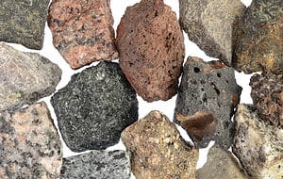
What makes it Igneous?
Have students investigate various igneous rocks and determine any key features that differentiate igneous rocks from other rocks (sedimentary and metamorphic).
Students should share their findings in the next class.
Notes:
Have students investigate various igneous rocks and determine any key features that differentiate igneous rocks from other rocks (sedimentary and metamorphic).
Students should share their findings in the next class.

Slide 64
Notes:
Thanks for watching, and please continue watching CAPs available from this website.

Slide 65
This Was Created With Resources From:
Questions or Comments
Michael Kennedy, Ph.D. MKennedy@Virginia.edu
Rachel L Kunemund, Ph.D. rk8vm@virginia.edu

