Slide 1
Intro
“Big Idea” Question
Review Concepts
Check-In Questions
Teacher Demo
Vocabulary
Student-Friendly Definition
Examples & Non-Examples
Morphological Word Parts
Frayer Model
Simulation/Activity
Notes:
OK everyone, get ready for our next lesson. Just as a reminder, these are the different components that our lesson may include, and you’ll see these icons in the top left corner of each slide so that you can follow along more easily!

Slide 2
Independent Variable
Intro
Notes:
Today we will learn about independent variables.

Slide 3
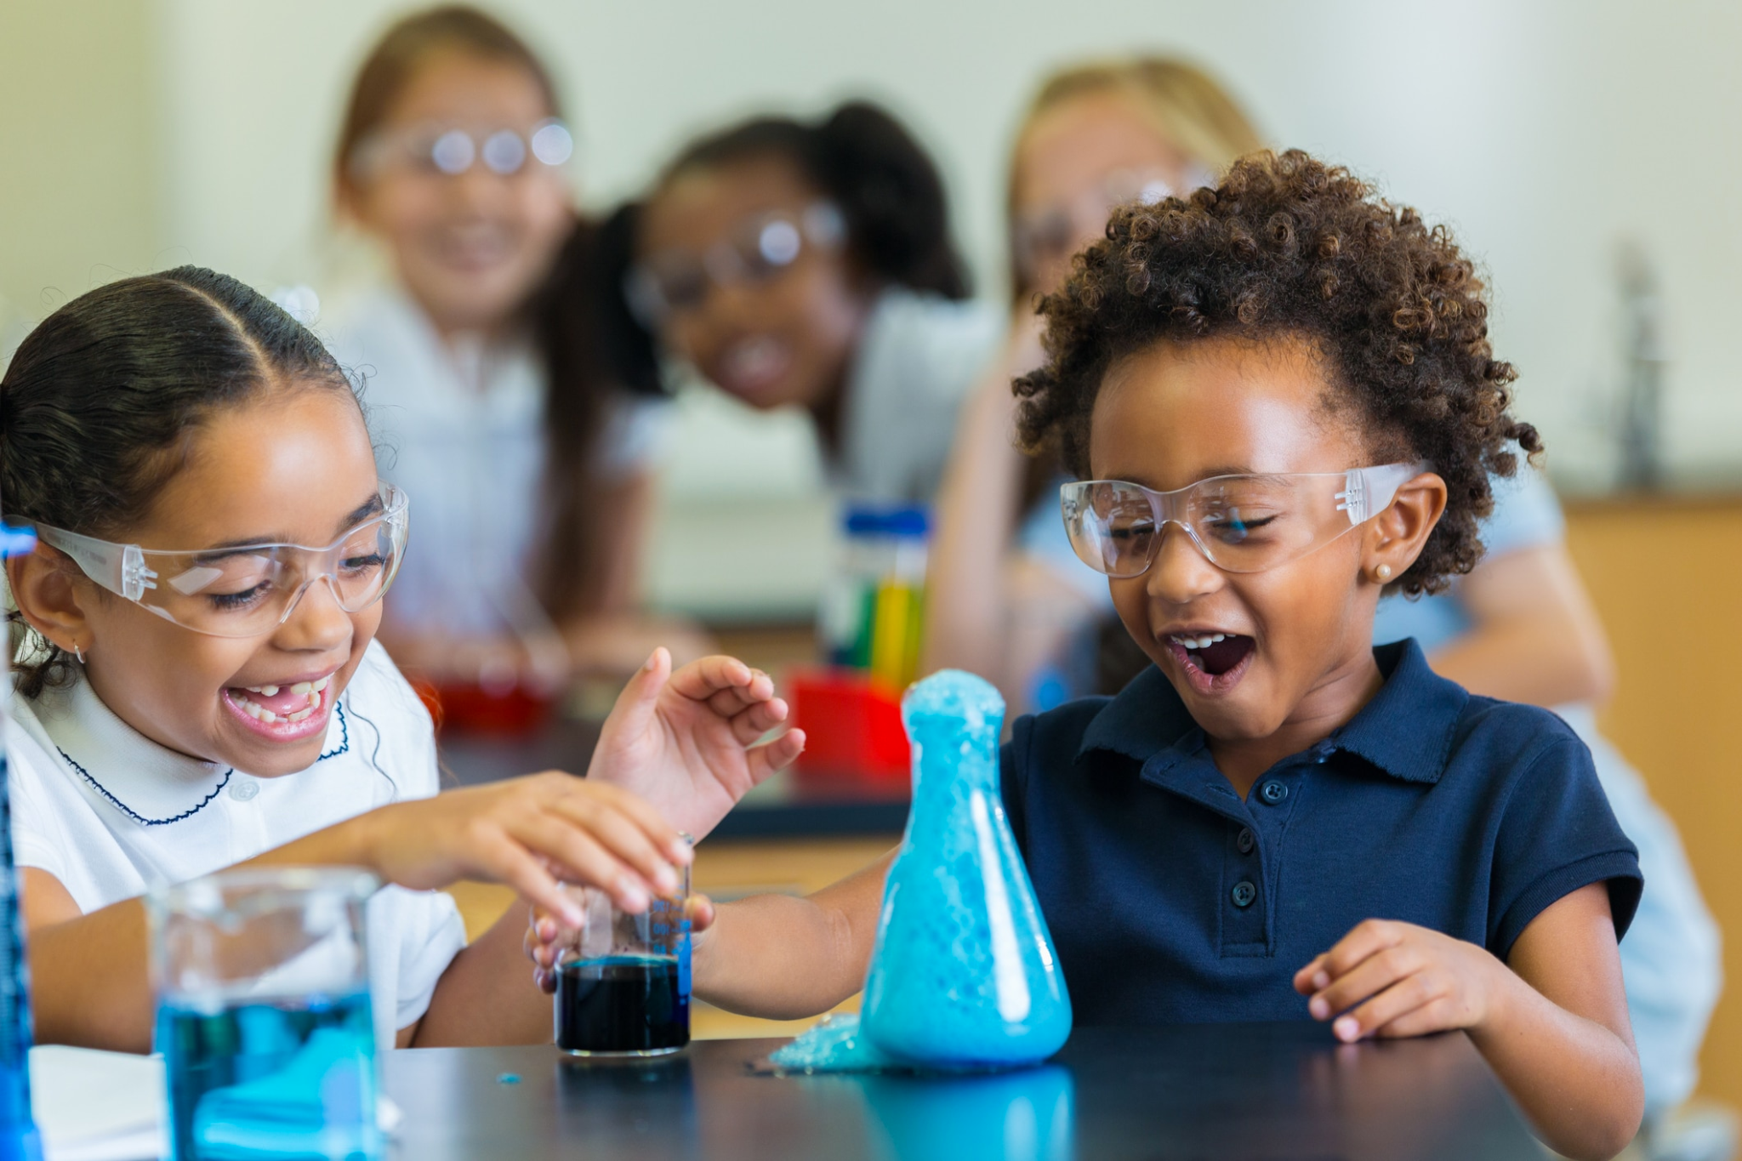
Big Question: How do variables in scientific experiments help us learn about our world?
Notes:
Our “big question” is: How do variables in scientific experiments help us learn about the world?
[Pause and illicit predictions from students.]
I love all these thoughtful scientific hypotheses! Be sure to keep this question and your predictions in mind as we move through these next few lessons, and we’ll continue to revisit it.
Feedback: Asking students to make predictions about how variables are related to our scientific knowledge is a great way to activate and elicit student ideas and prior knowledge. This type of activity is evidence of the teacher planning for students’ engagement with science ideas.

Slide 4
Notes:
Before we move on to our new vocabulary term, let’s review some other words & concepts that you already learned and make sure you are firm in your understanding.

Slide 5
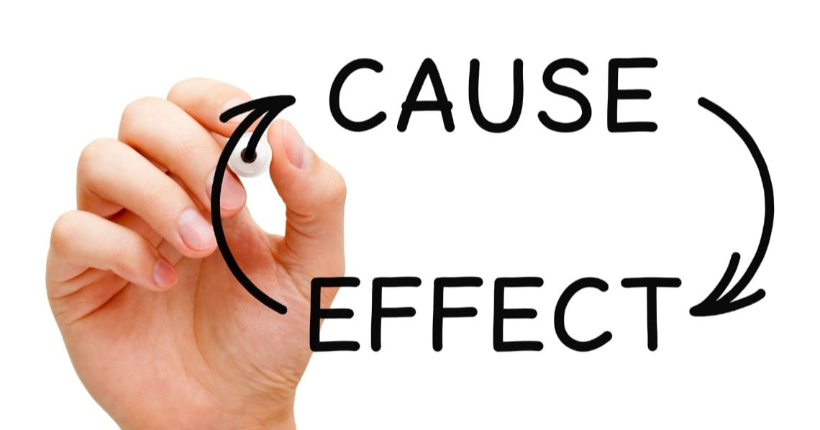
Notes:
"Cause-and-effect" explains the relationship between two things or events. The “cause” tells you why something happens, and the “effect” tell you the result. For example, if I stay up too late (the cause), then I will be tired the next day (the effect). Sciences helps us better understand these cause-and-effect relationships.

Slide 6
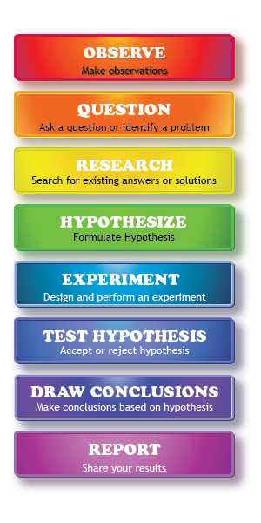
Scientific Method: steps that investigators follow to answer questions about the natural world
Notes:
The scientific method is a series of steps that investigators follow to answer questions about the natural world. By following the same steps, investigators are able to discover new things about our world and check the work of other scientists. A few of the steps are making observations, asking questions, making a hypothesis, and performing an experiment.

Slide 7
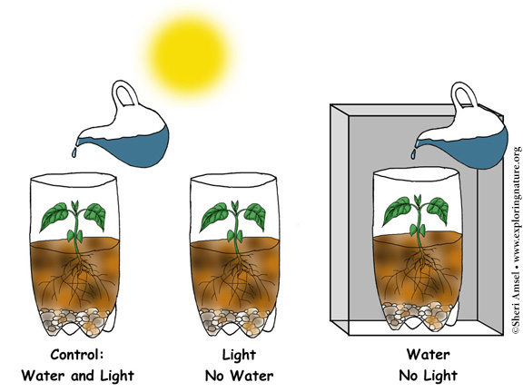
Variable: something that can change or be changed in an experiment
Notes:
A variable is something that can change or be changed in an experiment.

Slide 8
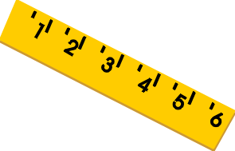
Three kinds of variables:
Independent
Variable
Dependent
Variable
Control
Variable
Notes:
There are three different kinds of variables in an experiment: independent, dependent, and control variables.

Slide 9
Notes:
Now let’s pause for a moment to check your understanding.

Slide 10
The ________ explains why something happens.
Cause
Effect
Notes:
The _____ explains why somethings happens.

Slide 11
The ________ explains why something happens.
Cause
Effect
Notes:
The cause explains why somethings happens.

Slide 12
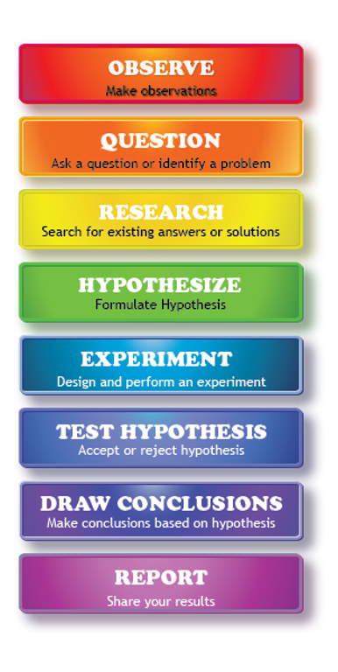
What are the steps that investigators follow to answer questions about the natural world called?
Conclusions
Scientific Method
Hypothesis
Notes:
What are the steps that investigators follow to answer questions about the natural world called?
[B. Scientific Method]

Slide 13
What are the steps that investigators follow to answer questions about the natural world called?
Conclusions
Scientific Method
Hypothesis
Notes:
The steps that investigators follow to answer questions about the natural world are called the scientific method.

Slide 14
What is a variable?
Notes:
What is a variable?
[A variable is something that can change or be changed in an experiment .]

Slide 15
What are the three types of variables?
Notes:
What are the three types of variables?
[Independent, dependent, and control.]
Feedback: Including some visual aids in this portion of the lesson is helpful for students to be able to understand the new content.

Slide 16
What are the three types of variables?
Independent
Variable
Dependent
Variable
Control
Variable
Notes:
What are the three types of variables? Independent, dependent, and control.
Feedback: Including some visual aids in this portion of the lesson is helpful for students to be able to understand the new content.

Slide 17
Independent Variable
Notes:
Now that we’ve reviewed, let’s define our new term, independent variable.
Feedback: Using cues, such as on this slide, helps prepare students for what is coming up next in the lesson. This is important especially for students who may struggle with new vocabulary instruction.

Slide 18
Independent Variable: the part of the experiment that the scientist controls or changes
Notes:
An independent variable is the part of the experiment that the scientist controls or changes.

Slide 19
Notes:
Now let’s pause for a moment to check your understanding.

Slide 20
What is an independent variable?
Notes:
What is an independent variable?
[The independent variable is the part of the experiment that the scientist controls or changes.]

Slide 21
Notes:
That is the basic definition, but there is a bit more you need to know.

Slide 22
Cause
Effect
Notes:
Independent variables are the “cause” part of the experiment. Scientists make changes to the independent variable to see what the results will be.

Slide 23
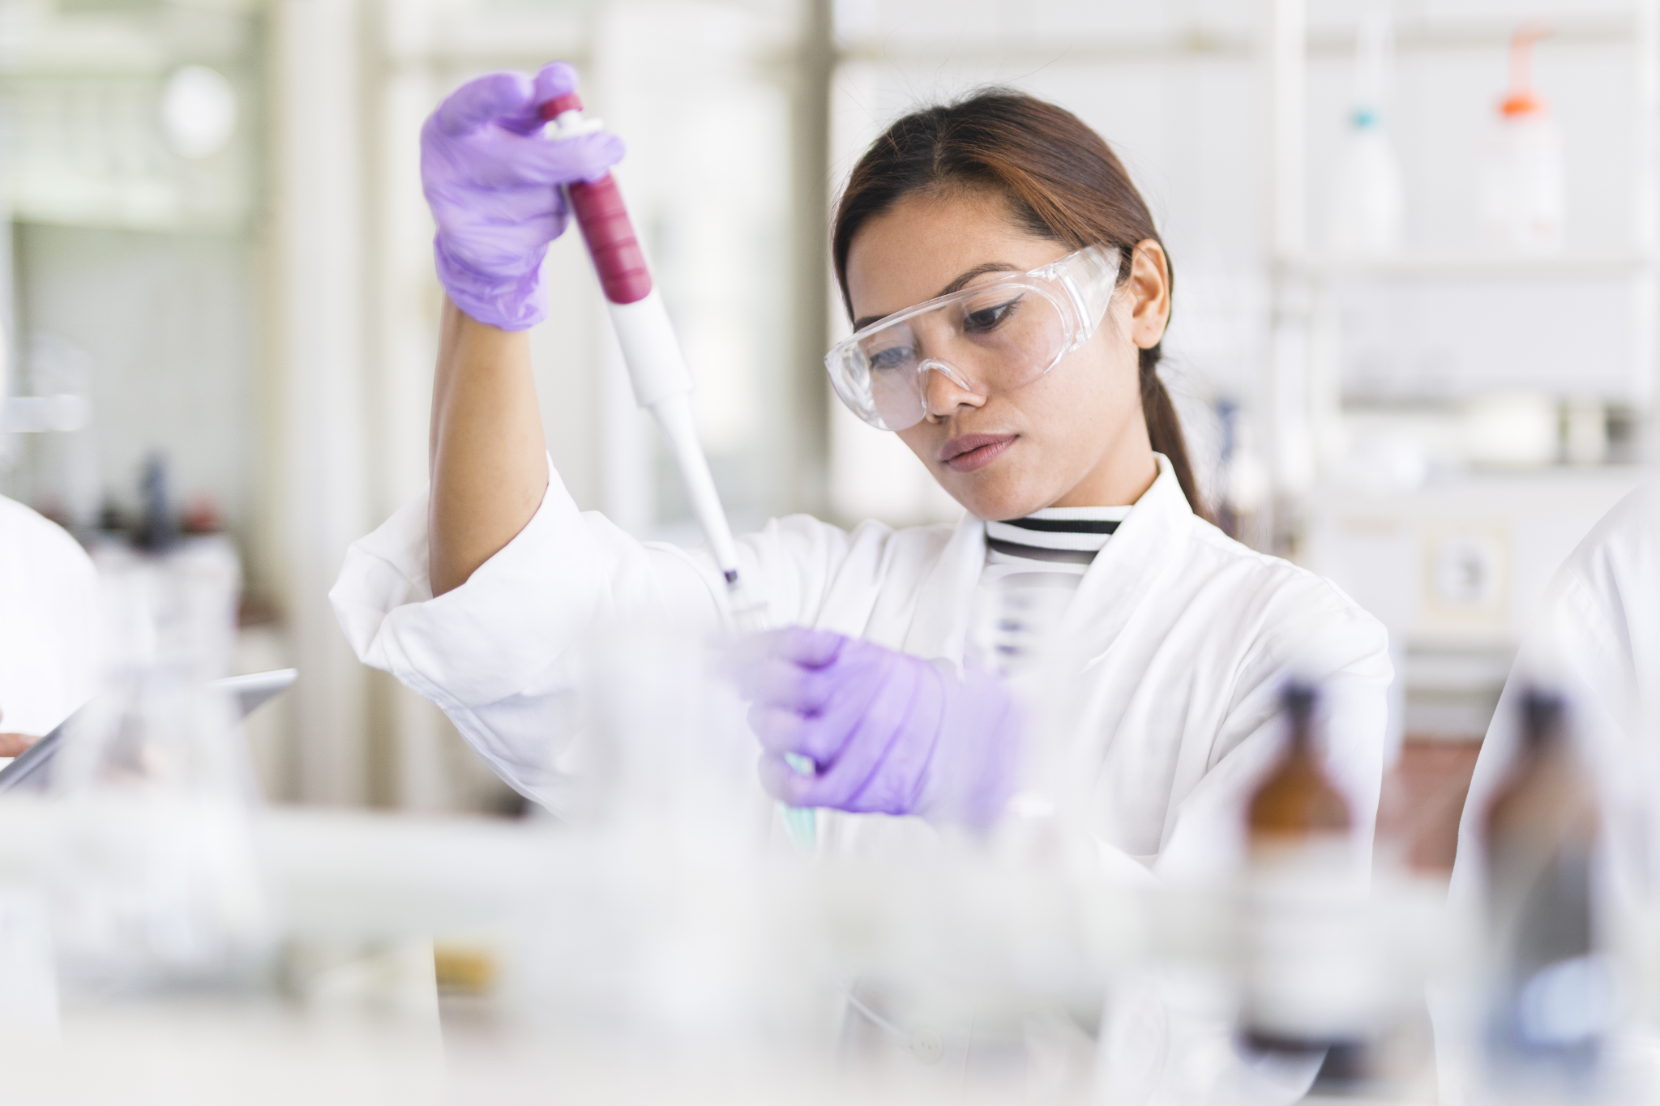
Notes:
Good experiments only change one independent variable at a time. This helps scientists see the impact their changes had on the outcome of the experiment more clearly. Too many independent variables would make the results very confusing!

Slide 24
Notes:
Before beginning an experiment, scientists make a hypothesis, or educated guess, about what they think will happen. The independent variable is an important part of the hypothesis. It explains why they think a certain outcome will occur.

Slide 25
Notes:
Now let’s pause for a moment to check your understanding.

Slide 26
What is an independent variable?
Notes:
What is an independent variable?
[The independent variable is the part of the experiment that the scientist controls or changes.]

Slide 27
The independent variable is the _______ part of the experiment.
Notes:
The independent variable is the _____ part of the experiment.
[Cause.]

Slide 28
The independent variable is the cause part of the experiment.
Notes:
The independent variable is the cause part of the experiment.

Slide 29
How many independent variables does an experiment have?
One
Two
None
Notes:
How many independent variables does an experiment have?
[One]

Slide 30
How many independent variables does an experiment have?
One
Two
None
Notes:
How many independent variables does an experiment have? One.

Slide 31
Notes:
Now, let’s talk about some examples of independent variables.

Slide 32
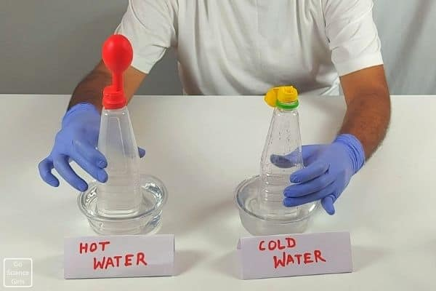
Notes:
This is an example of an independent variable. In this experiment, the scientist changes the temperature of the water to see what will happen to the balloon. Temperature is the independent variable.

Slide 33
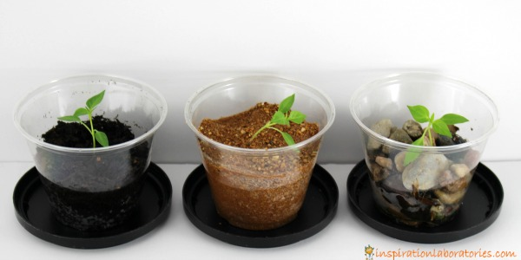
Notes:
This is another example of an independent variable. The scientist are testing different kinds of soil to see which one will grow the tallest plant. Since the scientists are controlling the kinds of soil, this is the independent variable.

Slide 34
Notes:
Next, let’s talk about some non-examples of variables.
Feedback: Offering clear and explicit explanation for non-examples is a great way for students to make sense of the new content. Explanations for non-examples are provided in the slides below.

Slide 35
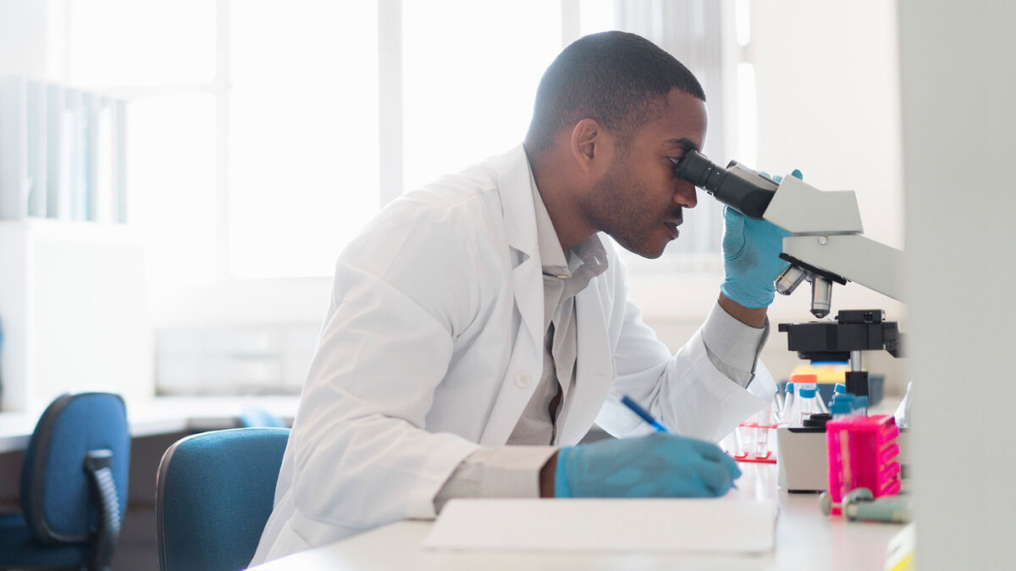
Notes:
A non-example of an independent variable is looking in a microscope. This scientist is not controlling or making changes to anything. Instead, he is making an observation of something that already exists.

Slide 36
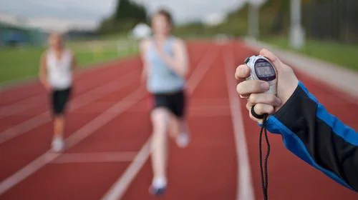
Notes:
Another non-example of an independent variable is timing a race. The person timing is not controlling how quickly the runners finish their race. He is only measuring how long it takes for them to run.

Slide 37
Notes:
Now let’s pause for a moment to check your understanding.

Slide 38
An independent variable is the part of the experiment that the scientist _________ or _________.
Notes:
An independent variable is the part of the experiment that the scientist ________ or _________.
[Controls / Changes]

Slide 39
An independent variable is the part of the experiment that the scientist controls or changes.
Notes:
An independent variable is the part of the experiment that the scientist controls or changes.

Slide 40
Which one of these is an example of an independent variable?
Changing the temperature of water
Watching a bird make a nest
Notes:
Which one of these is an example of an independent variable?
[A. changing the temperature of water]

Slide 41
Which one of these is an example of an independent variable?
Changing the temperature of water
Watching a bird make a nest
Notes:
Which one of these is an example of an independent variable? A. changing the temperature of water

Slide 42
Who can give me an example of an independent variable and explain why it is one?
Notes:
Who can give me an example of an independent variable and explain why it is one?
Pause and illicit student responses

Slide 43
Remember!!!
Notes:
So remember!

Slide 44
Independent Variable: the part of the experiment that the scientist controls or changes
Notes:
An independent variable is the part of the experiment that the scientist controls or changes.

Slide 45
Notes:
We can also break down the term independent variable into different word parts to help us remember the meaning. Let’s take a look!

Slide 46
Vari able
Vari = different or changing
-able = able to be
Notes:
Remember that the word “variable” is made up of two parts: The root word “vari” which means “changing” and the suffix “-able” means something “able to be”.

Slide 47
Vari able
Variable
able to be changed
Notes:
So when we put it all together, variable means something that is able to be changed. In an experiment, the variable is something that is able to be changed or observed changing by the investigators.

Slide 48
Independent
(prefix)
(root word)
Notes:
Now let’s take a look at the word Independent. This word is also broken up into two part: a prefix and a root word.

Slide 49
Independent
In= not or without
Notes:
The prefix “in” means not or without.

Slide 50
Independent
dependent = rely on or affect by
Notes:
And the root word “dependent” means to rely on or affect by.

Slide 51
In dependent
Independent
not affect by
Notes:
So when we put those piece together, independent means something that is not affected or does not rely on anything else.

Slide 52
Independent
Variable
not affect by
able to be changed
Notes:
Let’s look at both words together. A variable is something that is able to be changed. If that variable is independent, this change does not rely on something else. Independent variables “cause” the change, they are not affected by the other variables.

Slide 53
Notes:
We will now complete this concept map, called a Frayer model, to summarize and further clarify what you have learned about the term independent variable.

Slide 54
Definition
Picture
Independent Variable
How do
independent variables impact my life?
Example
Notes:
To complete the Frayer model, we will choose from four choices the correct picture, definition, example, and response to the question, “How do independent variables impact my life?” Select the best response for each question using the information you just learned. As we select responses, we will see how this model looks filled in for the term independent variable.

Slide 55
Directions: Choose the correct picture of an
independent variable from the choices below.
A
B
C
D
Notes:
Choose the one correct picture of independent variable from these four choices.

Slide 56
Directions: Choose the correct picture of an
independent variable from the choices below.
A
B
C
D
Notes:
This is the picture that shows a independent variable.

Slide 57
Definition
Picture
Independent Variable
How do
independent variables impact my life?
Example
Notes:
Here is the Frayer model filled in with a picture of independent variable.

Slide 58
Directions: Choose the correct definition of
independent variable from the choices below.
A
a type of measurement that tells us how much matter is in an object​
B
the part of the experiment that the scientist controls or changes
C
smallest whole unit of matter
D
theory of how the surface of the earth was formed from movements underneath the earth's surface
Notes:
Choose the one correct definition of independent variable from these four choices.

Slide 59
Directions: Choose the correct definition of
independent variable from the choices below.
A
a type of measurement that tells us how much matter is in an object​
B
the part of the experiment that the scientist controls or changes
C
smallest whole unit of matter
D
theory of how the surface of the earth was formed from movements underneath the earth's surface
Notes:
“The part of the experiment that the scientist controls or changes” is correct! This is the definition of independent variable.

Slide 60
Definition
Picture
the part of the experiment that the scientist controls or changes
Independent Variable
How do
independent variables impact my life?
Example
Notes:
Here is the Frayer Model with a picture and the definition filled in for independent variable:

Slide 61
Directions: Choose the correct example of
an independent variable from the choices below.
A
Painting a picture of a park in springtime
B
Raking leaves in the fall
C
Watching birds migrate south for the winter
D
Studying different amounts of time to see changes in math test scores
Notes:
Choose the one correct example of an independent variable from these four choices.

Slide 62
Directions: Choose the correct example of
an independent variable from the choices below.
A
Painting a picture of a park in springtime
B
Raking leaves in the fall
C
Watching birds migrate south for the winter
D
Studying different amounts of time to see changes in math test scores
Notes:
“Studying different amounts of time to see changes in math test scores” is correct! This is an example of a independent variable.

Slide 63
Definition
Picture
the part of the experiment that the scientist controls or changes
Independent Variable
Studying different amounts of time to see changes in math test scores
How do
independent variables impact my life?
Example
Notes:
Here is the Frayer Model with a picture, definition, and an example of independent variable: studying different amounts of time to see changes in math test scores.

Slide 64
Directions: Choose the correct response for “how do independent variables impact my life?” from the choices below.
A
Independent variables explain how magnets attract and repel each other
B
Independent variables explain how our ears hear and understand sound
C
Independent variables are important part of experiments that help explain why things happen in our world.
D
Independent variables explain the different phases of the moon each month.
Notes:
Choose the one correct response for “how do independent variables impact my life?” from these four choices.

Slide 65
Directions: Choose the correct response for “how do independent variables impact my life?” from the choices below.
A
Independent variables explain how magnets attract and repel each other
B
Independent variables explain how our ears hear and understand sound
C
Independent variables are important part of experiments that help explain why things happen in our world.
D
Independent variables explain the different phases of the moon each month.
Notes:
“Independent variables are important part of experiments that help explain why things happen in our world.” That is correct! This is an example of how independent variables impact your life.

Slide 66
Definition
Picture
the part of the experiment that the scientist controls or changes
Independent Variable
Independent
variables are important
part of experiments that help explain why things happen in our world.
Studying different amounts of time to see changes in math test scores
How do
independent variables impact my life?
Example
Notes:
Here is the Frayer Model with a picture, definition, example, and a correct response to “how do independent variables impact my life?”: Independent variables are important part of experiments that help explain why things happen in our world.

Slide 67
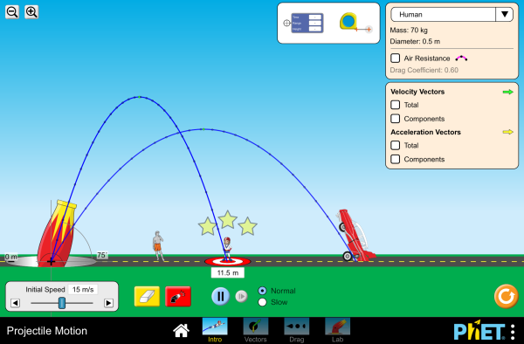
Simulation Activity
PhET Projectile Motion Lab
Control your own independent variable and see what happens to the projectile.
Notes:
Now it’s your turn to control the independent variables. Choose one independent variable (initial speed or cannon angle) and make small changes to see what effect you can create. Can you make a guess why that happened?
Feedback: Providing a simulation activity is a great way to make science thinking visible. In this simulation, students have the opportunity to make predictions and apply an idea to a new situation by changing the variables in the simulation (i.e., mass, position, angle).

Slide 68
Big Question: How do variables in science experiments help us learn about our world?
Notes:
Our “big question” is: How do variables in science experiments help us learn about our world?
[Pause and illicit predictions from students.]
I love all these thoughtful scientific hypotheses! Be sure to keep this question and your predictions in mind as we move through these next few lessons, and we’ll continue to revisit it.

Slide 69
Notes:
Thanks for watching, and please continue watching CAPs available from this website.

Slide 70
This Video Was Created With Resources From:
Questions or Comments
Michael Kennedy, Ph.D. MKennedy@Virginia.edu
Rachel L Kunemund, Ph.D. rk8vm@virginia.edu

