Slide 1
Intro
“Big Idea” Question
Review Concepts
Check-In Questions
Teacher Engagement
Vocabulary
Student-Friendly Definition
Examples & Non-Examples
Morphological Word Parts
Frayer Model
Simulation/Activity
Notes:
OK everyone, get ready for our next lesson. Just as a reminder, these are the different components that our lesson may include, and you’ll see these icons in the top left corner of each slide so that you can follow along more easily!

Slide 2
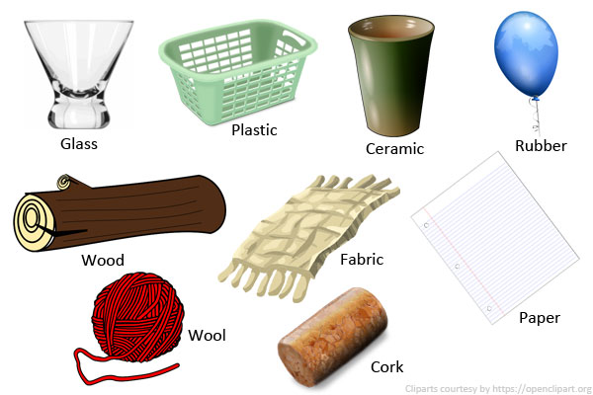
Intro
Insulator
Notes:
Today, we’ll be learning about the word: Insulator.

Slide 3
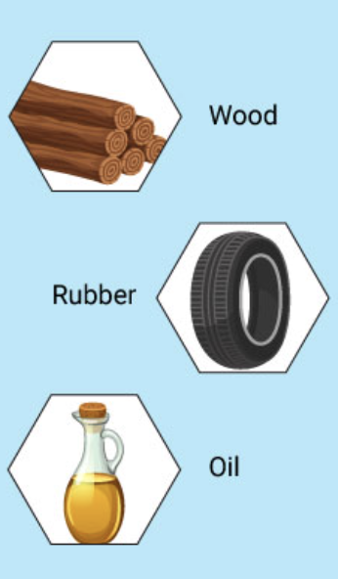
Big Question: How do insulators help keep us safe and power our homes?
Notes:
Our “big question” is: How do insulators help keep us safe and power our homes?
[Pause and illicit predictions from students.]
I love all these thoughtful scientific hypotheses! Be sure to keep this question and your predictions in mind as we move through these next few lessons, and we’ll continue to revisit it.

Slide 4
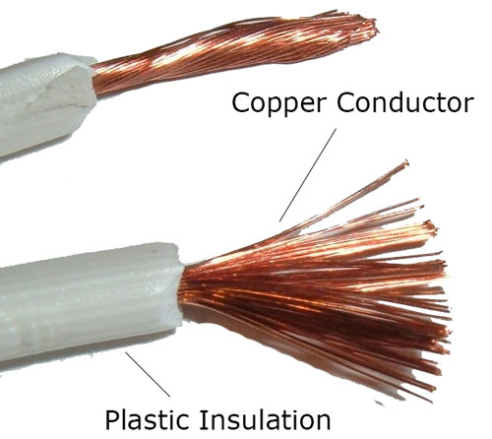
Demonstration
How do I charge?
Bring in an electronic cable. Ask students why we don’t just use the copper wire to charge our electronics or why the whole cable can’t be made of wire. Explain that we need something to cover the conductor to protect ourselves from the electrical currents which is what we will learn about today.
Notes:
Bring in an electronic cable. Ask students why we don’t just use the copper wire to charge our electronics or why the whole cable can’t be made of wire. Explain that we need something to cover the conductor to protect ourselves from the electrical currents which is what we will learn about today.

Slide 5
Notes:
Before we move on to our new topic, let’s review some other words & concepts that you already learned and make sure you are firm in your understanding.

Slide 6
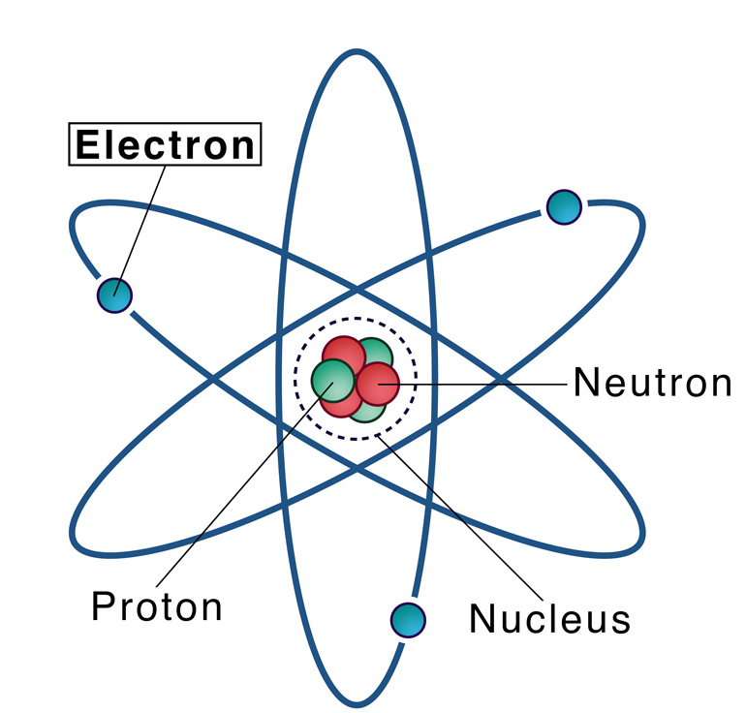
Electron: negatively charged particle that orbits the nucleus of an atom
Notes:
An electron is a negatively charged particle that orbits the nucleus of an atom

Slide 7
Electricity: electrical energy transformed into different forms of energy to meet needs
Notes:
Electricity is electrical energy transformed into different forms of energy to meet needs.

Slide 8
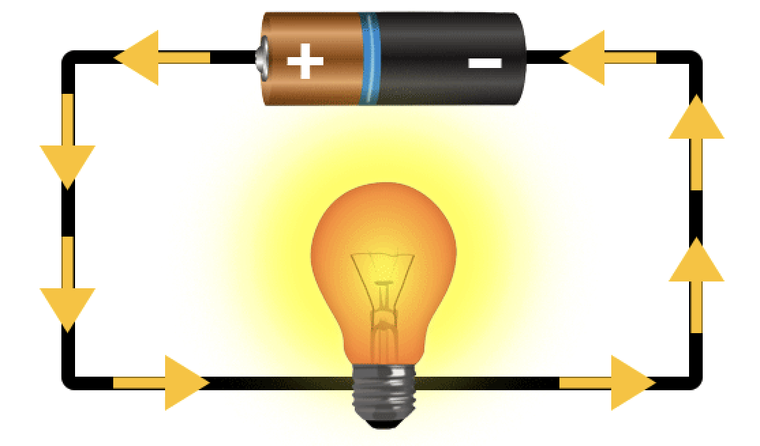
Current: an electrical charge in motion
Notes:
A current is an electrical charge in motion.

Slide 9
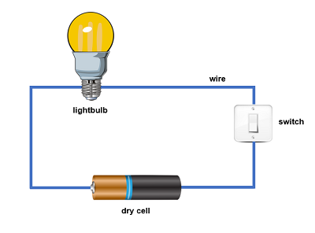
Circuit: the path electricity travels on
Notes:
A circuit is the path electricity travels on.

Slide 10
Conductor: a material that electricity can flow through
Notes:
Conductor: a material that electricity can flow through
The filament is the conductor.

Slide 11
Notes:
Now let’s pause for a moment to review the information we have covered already.

Slide 12
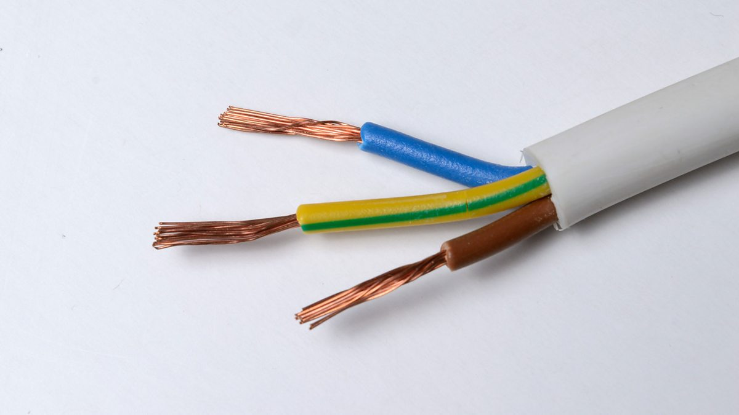
A conductor is a material that electricity can flow through.
Easily
Not
Notes:
A conductor is a material that electricity can easily flow through.

Slide 13
A conductor is a material that electricity can easily flow through.
Easily
Not
Notes:
A conductor is a material that electricity can easily flow through.

Slide 14
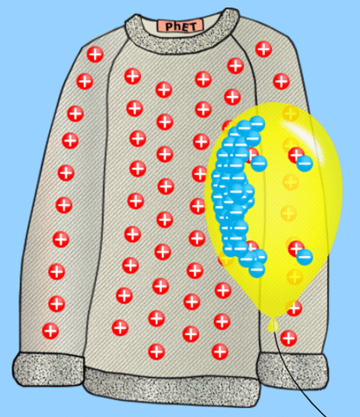
A static charge is when two objects rub together and one can ____ electrons from the other, leaving them with _____ charges.
Take, opposite
Do nothing, the same
Notes:
A. Take, opposite

Slide 15
A static charge is when two objects rub together and one can take electrons from the other, leaving them with opposite charges.
Take, opposite
Do nothing, the same
Notes:
A. Take, opposite

Slide 16
Insulator
Notes:
Now that we’ve reviewed, let’s define the phrase Insulator.

Slide 17
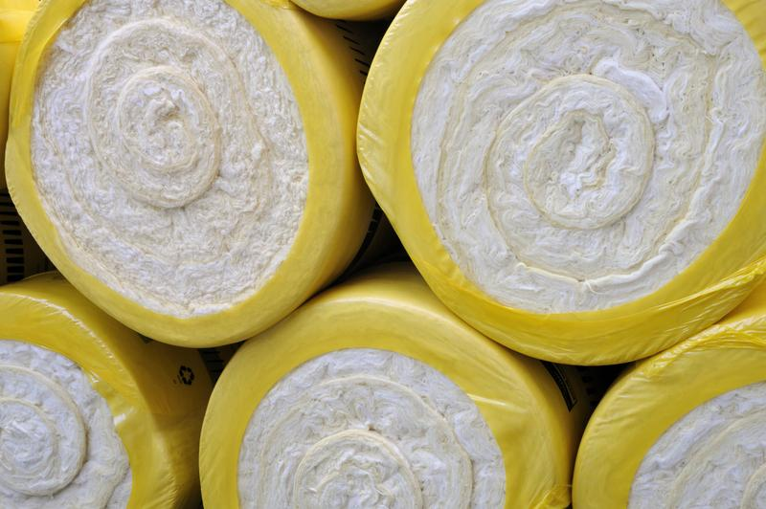
Insulator: a material that electricity cannot flow through easily
Notes:
An insulator is a material that electricity cannot flow through easily

Slide 18
Notes:
Let’s check-in for understanding.

Slide 19
What is an insulator?
Notes:
What is an Insulator?
[a material that electricity cannot flow through]

Slide 20
Notes:
That is the basic definition, but there is a bit more you need to know.

Slide 21
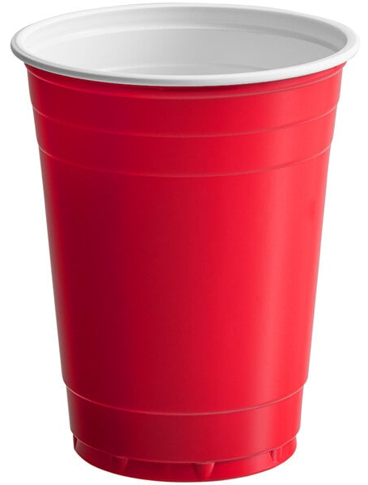
Licensable
Insulators make it difficult for electricity to pass through.
Notes:
Some materials make it difficult for electricity to pass through.

Slide 22
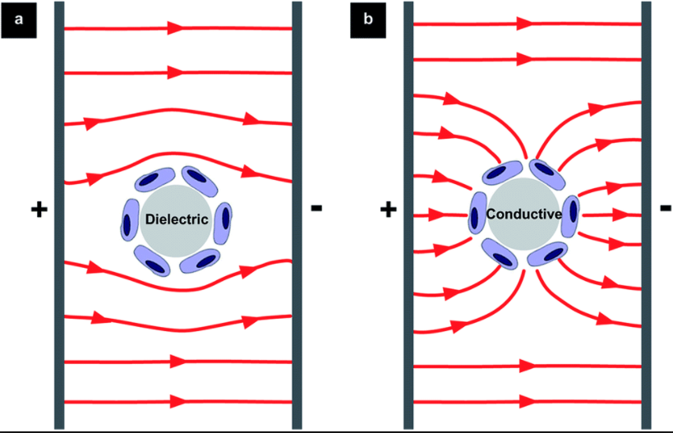
Licensable
Insulators have electrons that are tightly packed so electricity cannot easily flow through them.
Notes:
Look at how much space the electrons have for moving around.

Slide 23
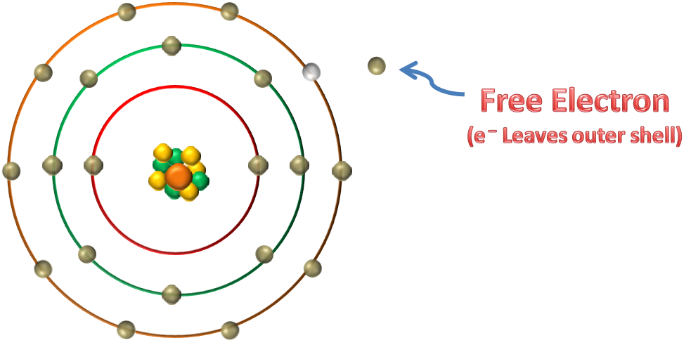
Licensable
Materials that have no free electrons cannot generate electricity.
Notes:
Free electrons: electrons free to move around because they are in the outer orbit of an atom
If electrons cannot flow to other materials, electricity cannot be generated. This means they are better insulators.

Slide 24
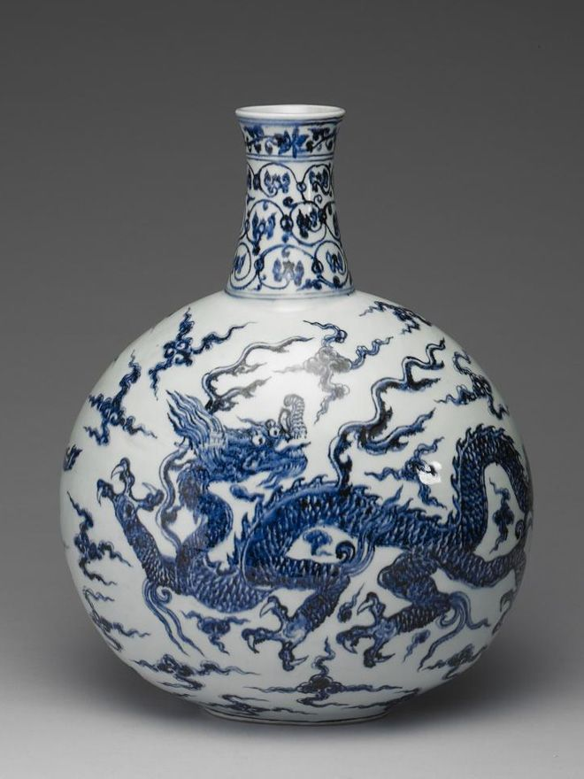
Licensable
Not every material has the same level of insulation.
Notes:
Not every material has the same level of insulation.
One factor that determines insulation level is how tightly bonded the electrons are. The more tightly bonded they are, they more they insulate.
Wood has weaker insulation because it can absorb moisture and ions that allow for conduction.
Ceramic e.g., porcelain is a strong insulator because it does not absorb moisture. Also, it is made of materials that have no free electrons e.g., aluminum oxide.

Slide 25
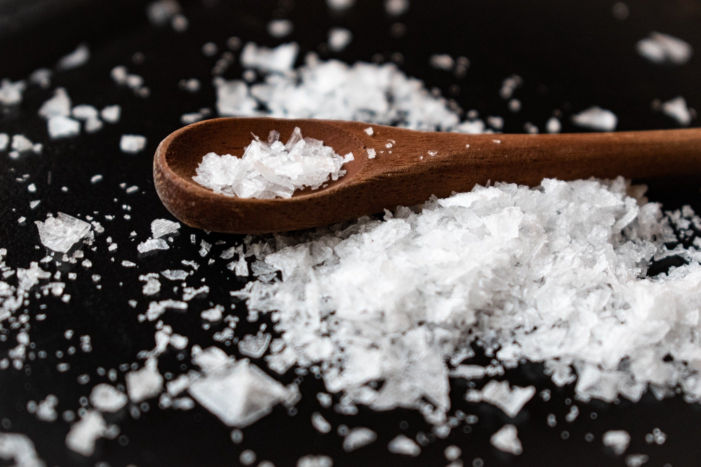
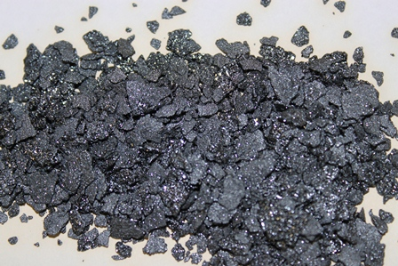
Licensable
Nonmetals are good insulators.
Notes:
Nonmetals are good insulators.
This is because they often gain/share electrons with other atoms so there are no free electrons.
Images: Chloride, Iodine

Slide 26
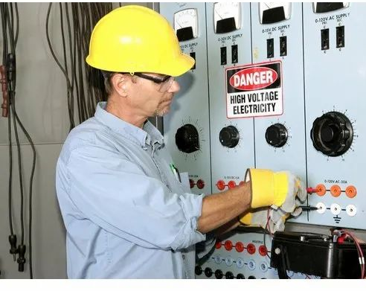
Licensable
Insulators protect us when we handle electricity.
Notes:
Insulators protect us when we handle electricity.
The electrician is wearing insulating gloves. Why?

Slide 27
Notes:
Let’s check-in for understanding.

Slide 28
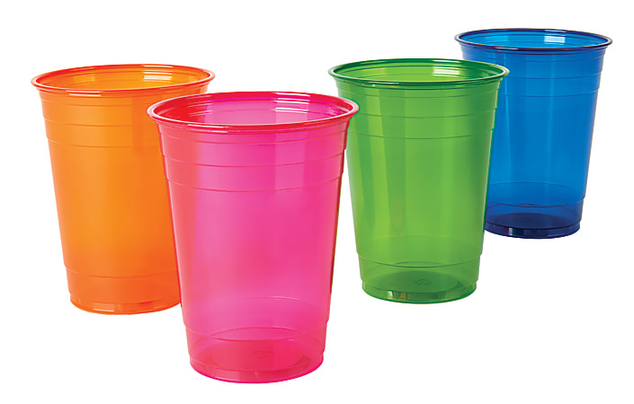
Which is true about insulators?
Every metal has the same conductivity.
Insulators have tightly packed electrons.
Electricity moves faster in insulators.
Insulators have a positive charge.
Notes:
[B] Insulators have tightly packed electrons is true.

Slide 29
Which is true about insulators?
Every metal has the same conductivity.
Insulators have tightly packed electrons.
Electricity moves faster in insulators.
Insulators have a positive charge.
Notes:
[B] Insulators have tightly packed electrons is true.

Slide 30
Can electrons easily move in insulators?
Yes
No
Notes:
[B] No

Slide 31
Can electrons easily move in insulators?
Yes
No
Notes:
[B] No

Slide 32
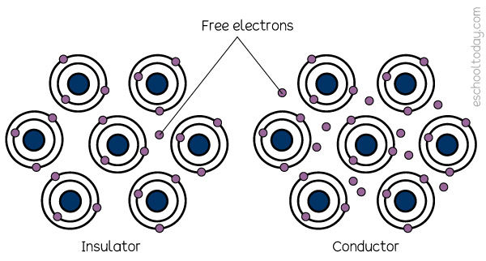
Conductors have lots of free electrons that can move easily. This allows electricity to flow through the material.
True
False
Notes:
Conductors have lots of free electrons that can move easily. This allows electricity to flow through the material.
True.
Also, explain how there are more free electrons in conductors.

Slide 33
Conductors have lots of free electrons that can move easily. This allows electricity to flow through the material.
True
False
Notes:
Conductors have lots of free electrons that can move easily. This allows electricity to flow through the material.
True.
Also, explain how there are more free electrons in conductors.

Slide 34
Notes:
Now, let’s talk about some examples of Insulator.

Slide 35
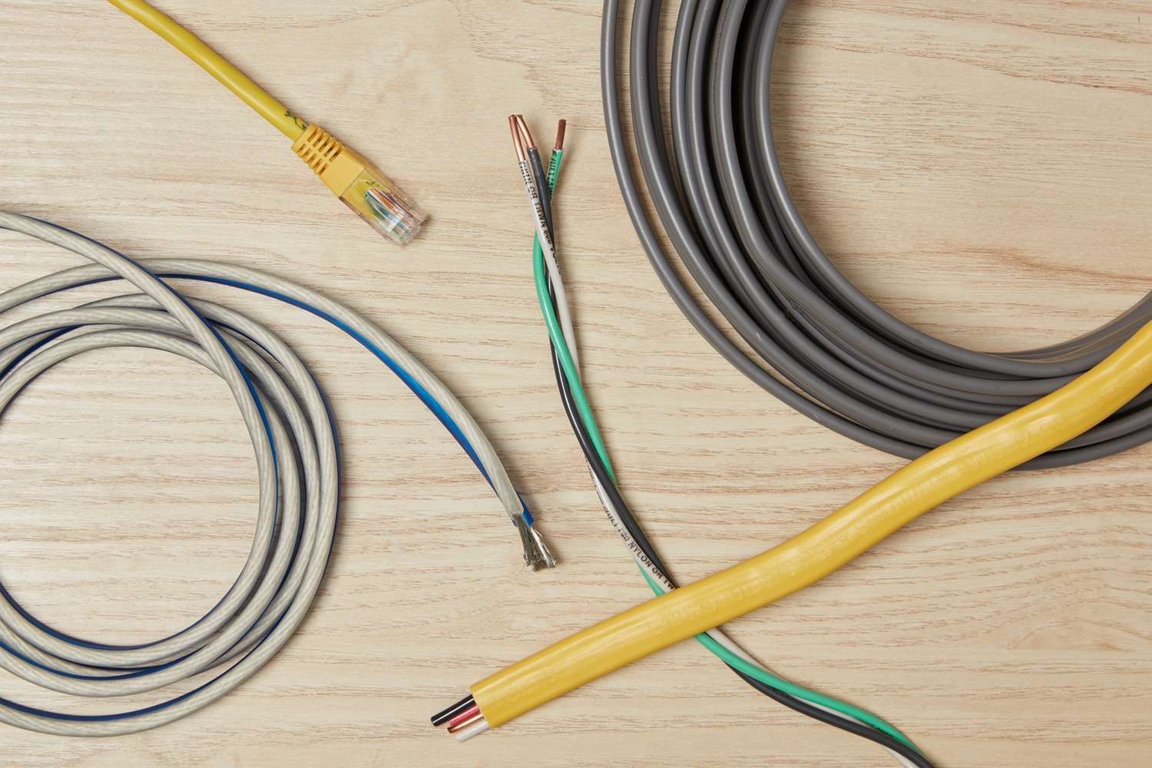
The Coating Outside Electrical Wires
Notes:
The Coating Outside Electrical Wires is an insulator because it doesn’t allow electricity to easily flow through it. It protects you from the electricity going through the wires underneath.

Slide 36
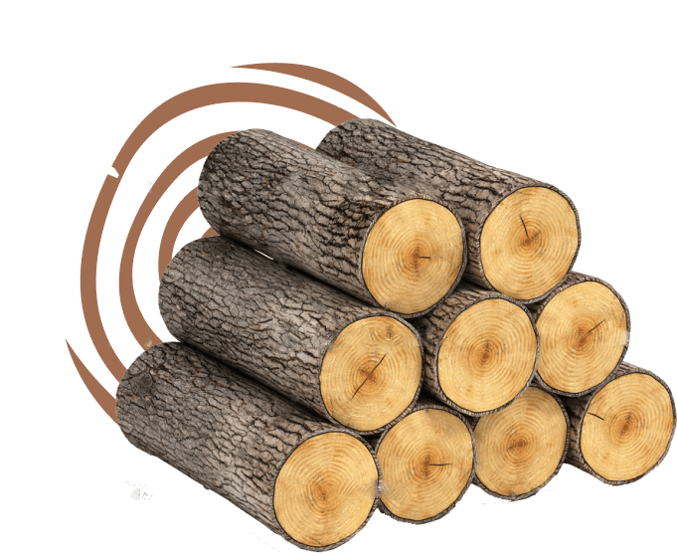
Wood
Notes:
Wood is an insulator because it doesn’t allow electricity to easily flow through it.

Slide 37
Glass
Notes:
Glass isn’t a good insulator because it is difficult for electricity to flow through it.

Slide 38
Electric field inside insulators
Notes:
You can see these electric fields are of insulators because the electricity is not easily flowing through them.

Slide 39
Notes:
Now, let’s talk about some non-examples of Insulator.

Slide 40
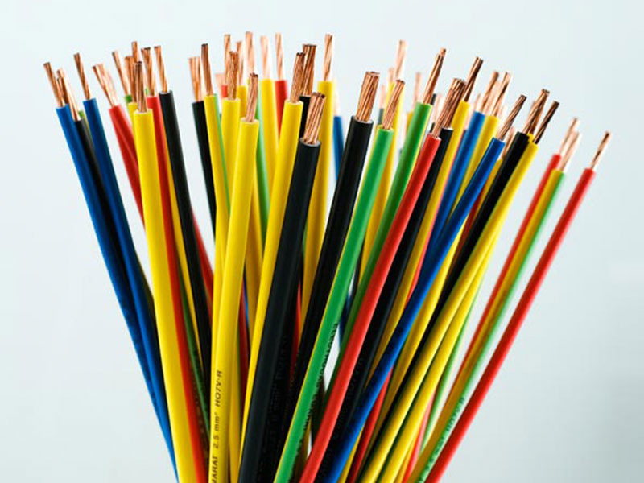
Copper
Notes:
Copper is an example of a conductor. It is one of the most popular materials used for conductors.

Slide 41
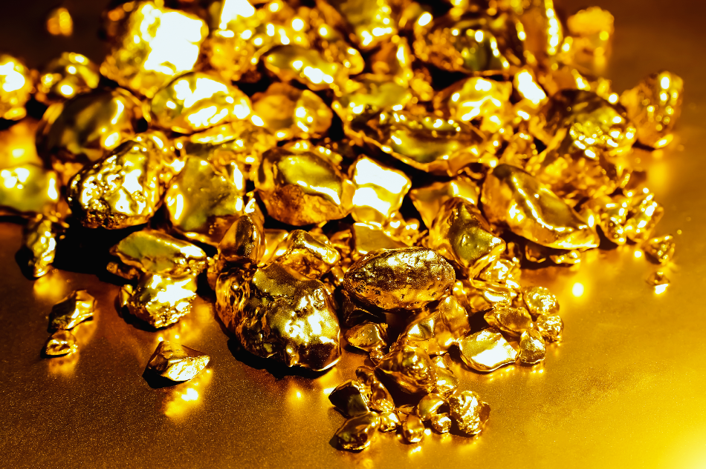
Gold
Notes:
Gold is another nonexample of an insulator.
Gold is a metal that is a conductor.

Slide 42
Notes:
Now let’s pause for a moment to check your understanding.

Slide 43
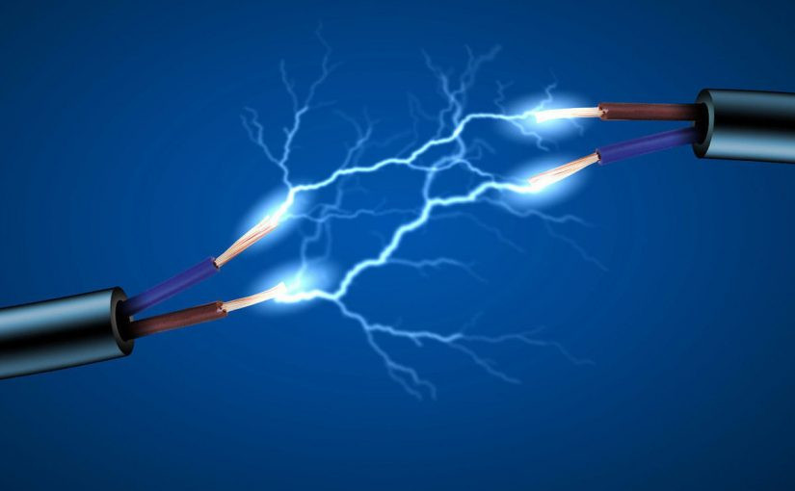
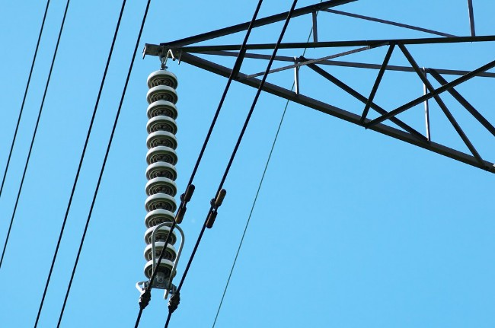
What is the relationship between conductors and insulators?
Notes:
What is the relationship between conductors and insulators?

Slide 44
Conductors make it easy for electricity to flow through. Insulators make it hard for electricity to flow through. But why?
Notes:
Because the electrons in conductors are not tightly packed so electricity can more easily flow through them. Also, they have many free electrons.
This is not true for insulators.

Slide 45
Remember!!!
Notes:
So remember!

Slide 46
Insulator: a material that electricity cannot flow through easily
Notes:
An insulator is a material that electricity cannot flow through easily

Slide 47
Notes:
We will now complete this concept map, called a Frayer model, to summarize and further clarify what you have learned about the term insulator.

Slide 48
Definition
Picture
Insulator
Example
How do Insulators impact my life?
Notes:
To complete the Frayer model, we will choose from four choices the correct picture, definition, example, and response to the question, “How do Insulators impact my life?” Select the best response for each question using the information you just learned. As we select responses, we will see how this model looks filled in for the term Insulator.

Slide 49
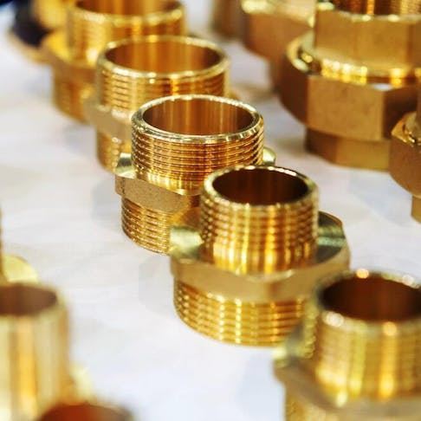
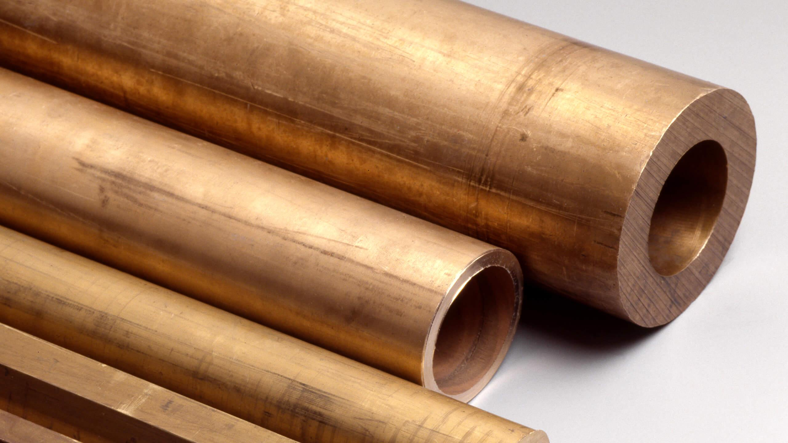
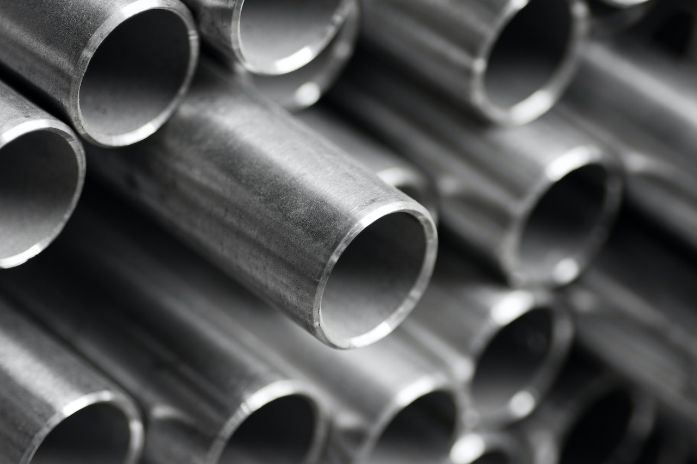
Directions: Choose the correct picture of an insulator from the choices below.
A
B
Copper
Brass
C
D
Iron
Diamond
Notes:
Choose the correct picture of an insulator from the choices below.

Slide 50
Directions: Choose the correct picture of insulators from the choices below.
A
B
Copper
Brass
C
D
Iron
Diamond
Notes:
This is the picture that shows an insulator.
Diamond is a correct picture of insulators. The electrons in diamond are tightly packed which makes it both hard and an insulator.
A – Brass
B – Bronze
C – Iron
D – Diamond

Slide 51
Definition
Picture
Insulator
Example
How do Insulators impact my life?
Notes:
Here is the Frayer model filled in with a picture of an insulator.

Slide 52
Directions: Choose the correct definition of an insulator from the choices below.
A
A material that electricity cannot flow through easily
B
Materials that take electrons
C
A material that electricity can flow through
D
The electric charge of an atom
Notes:
Choose the one correct definition of an insulator from these four choices.
[A] A material that electricity cannot easily flow through

Slide 53
Directions: Choose the correct definition of an insulator from the choices below.
A
A material that electricity cannot flow through easily
B
Materials that take electrons
C
A material that electricity can flow through
D
The electric charge of an atom
Notes:
“A material that electricity cannot flow through easily” is correct! This is the definition of an interrelationship.

Slide 54
Definition
Picture
A material that electricity cannot flow through easily
Insulator
Example
How do Insulators impact my life?
Notes:
Here is the Frayer Model with a picture and the definition filled in for an insulator: A material that electricity cannot flow through easily

Slide 55
Directions: Choose the correct example of an insulator from the choices below.
A
Untreated tap water with traces of metals
B
A sheet of steel
C
Plastic
D
Aluminum foil
Notes:
Choose the one correct example of an insulator from these four choices.
Plastic

Slide 56
Directions: Choose the correct example of an insulator from the choices below.
A
Untreated tap water with traces of metals
B
A sheet of steel
C
Plastic
D
Aluminum foil
Notes:
“Plastic” is correct! This is an example of an insulator.

Slide 57
Definition
Picture
a material that electricity cannot easily flow through
Insulators
Plastic
Example
How do Insulators impact my life?
Notes:
Here is the Frayer Model with a picture, definition, and an example of an insulator: Plastic.

Slide 58
Directions: Choose the correct response for “how do Insulators impact my life?” from the choices below.
A
Insulators allow electricity to flow freely through devices I use.
B
Insulators prevent electric shocks and make appliances safe.
C
Insulators absorb extra electrons to prevent static buildup.
D
Insulators speed up transmission of electricity to homes.
Notes:
Choose the one correct response for “How do insulators impact my life?” from these four choices.

Slide 59
Directions: Choose the correct response for “how do Insulators impact my life?” from the choices below.
A
Insulators allow electricity to flow freely through devices I use.
B
Insulators prevent electric shocks and make appliances safe.
C
Insulators absorb extra electrons to prevent static buildup.
D
Insulators speed up transmission of electricity to homes.
Notes:
“Insulators prevent electric shocks and make appliances safe.” That is correct! This is an example of how insulators impact your life.

Slide 60
Definition
Picture
a material that electricity cannot easily flow through
Insulators
Insulators prevent electric shocks and make appliances safe.
Plastic
Example
How do Insulators impact my life?
Notes:
Here is the Frayer Model with a picture, definition, example, and a correct response to “how do Insulators impact my life?”: Insulators prevent electric shocks and make appliances safe.

Slide 61
Remember!!!
Notes:
So remember!

Slide 62
Insulator: a material that electricity cannot flow through easily
Notes:
An insulator is a material that electricity cannot flow through easily

Slide 63
Big Question: How do insulators help keep us safe and power our homes?
Notes:
Let’s reflect once more on our big question. Our “big question” is: How do insulators help keep us safe and power our homes?
Does anyone have any additional examples to share that haven’t been discussed yet?

Slide 64
Insulation Time
Does it insulate?
Provide students a list of insulators e.g., a glass cup, ceramic, a rubber balloon.
Have students look at what the materials are for the insulators and the most common materials for insulators.
Notes:
Provide students a list of insulators e.g., a glass cup, ceramic, a rubber balloon.
Have students look at what the materials are for the insulators and the most common materials for insulators.

Slide 65
Notes:
Thanks for watching, and please continue watching CAPs available from this website.

Slide 66
This Was Created With Resources From:
Questions or Comments
Michael Kennedy, Ph.D. MKennedy@Virginia.edu
Rachel L Kunemund, Ph.D. rk8vm@virginia.edu

