Slide 1
Intro
“Big Idea” Question
Review Concepts
Check-In Questions
Teacher Engagement
Vocabulary
Student-Friendly Definition
Examples & Non-Examples
Morphological Word Parts
Frayer Model
Simulation/Activity
Notes:
OK everyone, get ready for our next lesson. Just as a reminder, these are the different components that our lesson may include, and you’ll see these icons in the top left corner of each slide so that you can follow along more easily!

Slide 2
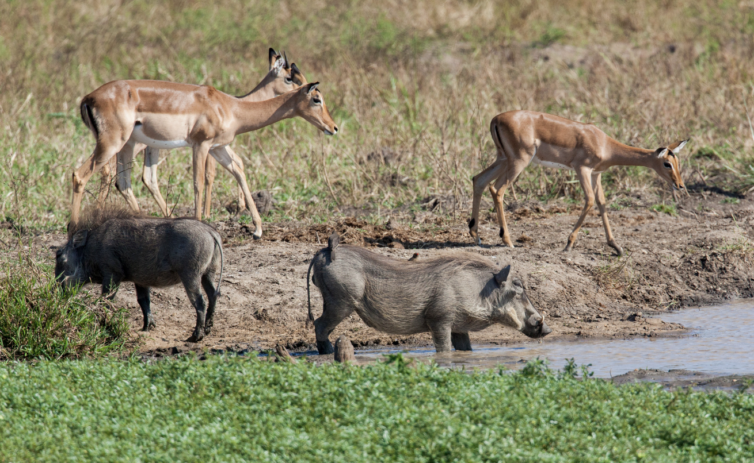
Interrelationship
Intro
Notes:
Today, we’ll be learning about the word: Photosynthesis.

Slide 3
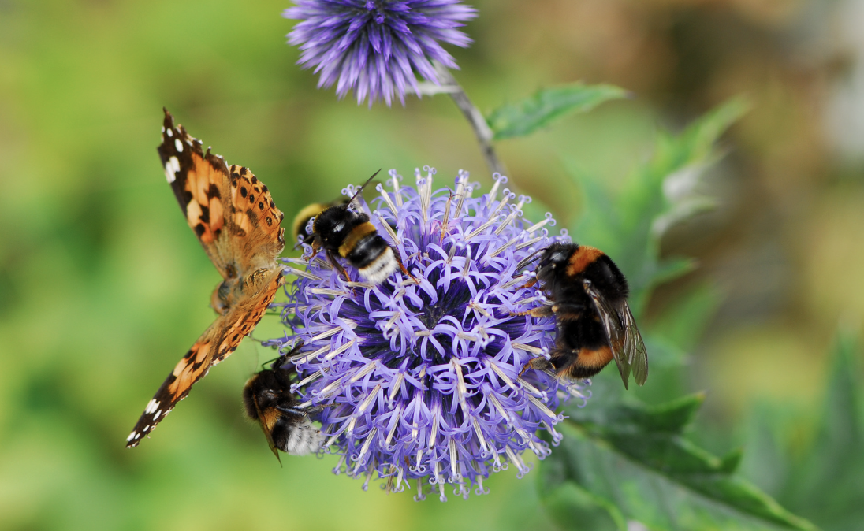
Big Question: Why are interrelationships between things important to an environment?
Notes:
Our “big question” is: Why are interrelationships between things important to an environment?
[Pause and illicit predictions from students.]
I love all these thoughtful scientific hypotheses! Be sure to keep this question and your predictions in mind as we move through these next few lessons, and we’ll continue to revisit it.

Slide 4
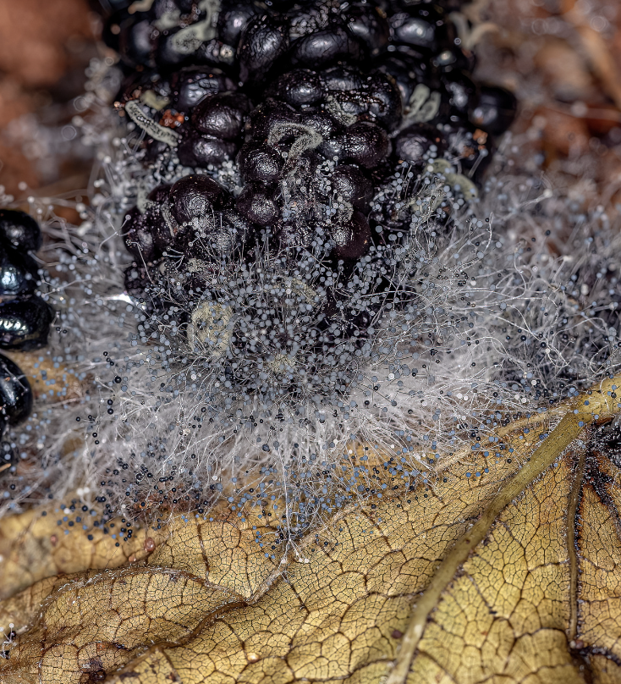
Demonstration
Decomposition video
For this topic, one optional demonstration would involve explaining decomposition: an interrelationship between decomposers and waste or dead things.
Notes:
For this topic, one optional demonstration would involve explaining decomposition, an interrelationship between decomposers and waste and dead things.

Slide 5
Notes:
Before we move on to our new topic, let’s review some other words & concepts that you already learned and make sure you are firm in your understanding.

Slide 6
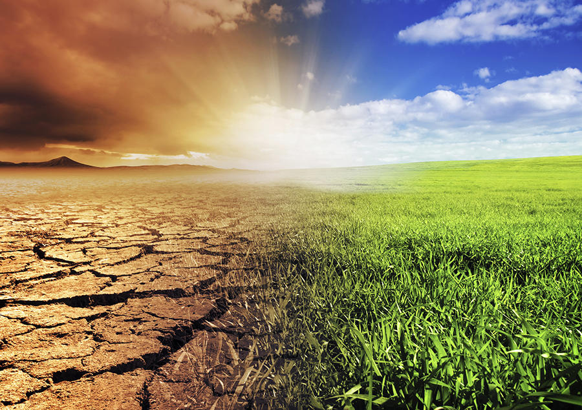
Environment: the surroundings of a person, animal, plant or thing
Notes:
An environment is the surroundings of a person, animal, plant or thing.

Slide 7
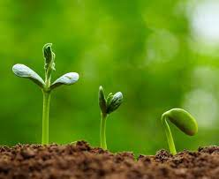
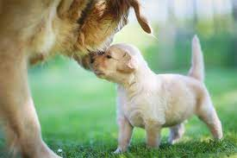
Living Things: things that move, grow, change, and respond to their environment
Notes:
Living things are things that grow, change, and respond to their environment.

Slide 8
Notes:
Now let’s pause for a moment to review the information we have covered already.

Slide 9
True/False: An environment is a non-living thing that influences or affects an ecosystem
Notes:
True/False: An environment is a non-living thing that influences or affects an ecosystem
[False]

Slide 10
True/False: An environment is a non-living thing that influences or affects an ecosystem
Notes:
False: An environment is a non-living thing that influences or affects an ecosystem

Slide 11
Living Things: things that move, grow, change, and respond to their .
Notes:
Living things are things that grow, change, and respond to their .
[environment]

Slide 12
Living Things: things that move, grow, change, and respond to their environment.
Notes:
Living things are things that grow, change, and respond to their environment. .

Slide 13
Interrelationship
Notes:
Now that we’ve reviewed, let’s define the phrase photosynthesis.

Slide 14
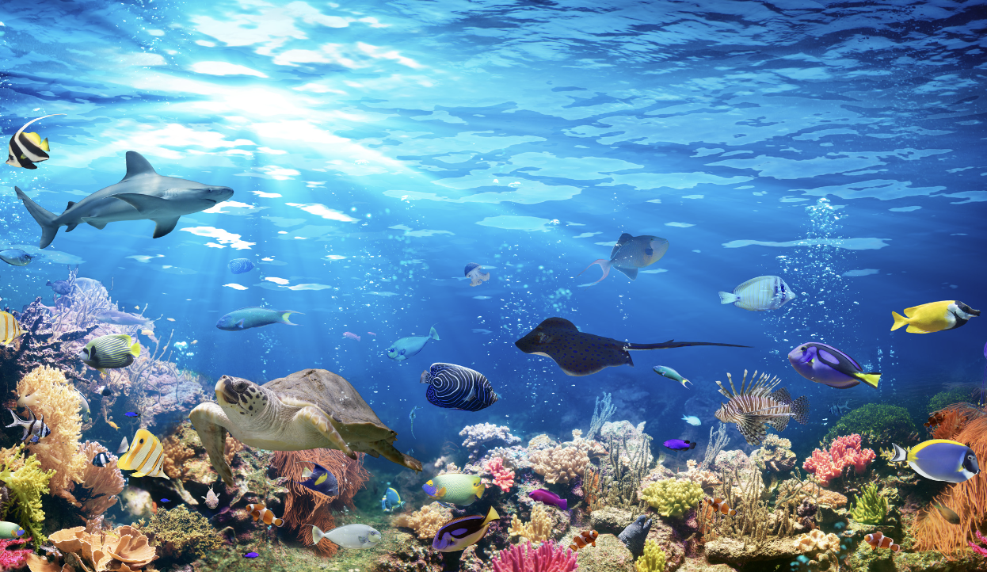
Interrelationship: the way living things interact with and affect each other within their environment
Notes:
An interrelationship is the way living things interact with and affect each other within their environment.

Slide 15
Notes:
Let’s check-in for understanding.

Slide 16
What is an interrelationship?
Notes:
What is an interrelationship?
[the way living things interact with and affect each other within their environment]

Slide 17
Notes:
That is the basic definition, but there is a bit more you need to know.

Slide 18
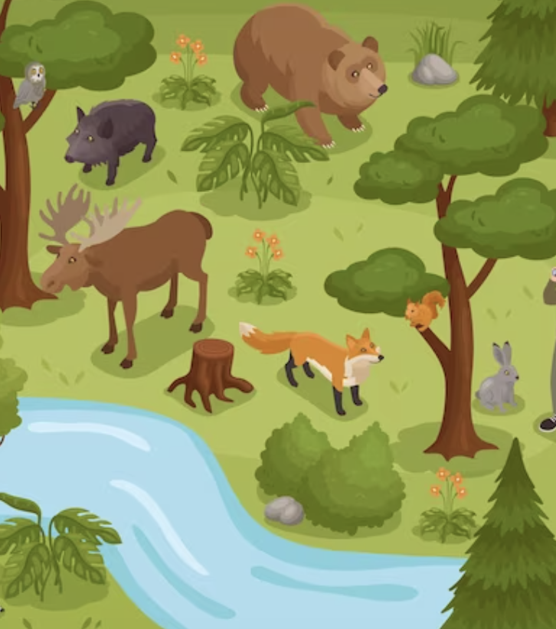
Interrelationships maintain the balance in places.
Notes:
Interrelationships maintain the balance in places. For example, in a forest, plants provide food and oxygen for animals, herbivores eat these plants, and predators keep herbivore
populations in check.

Slide 19
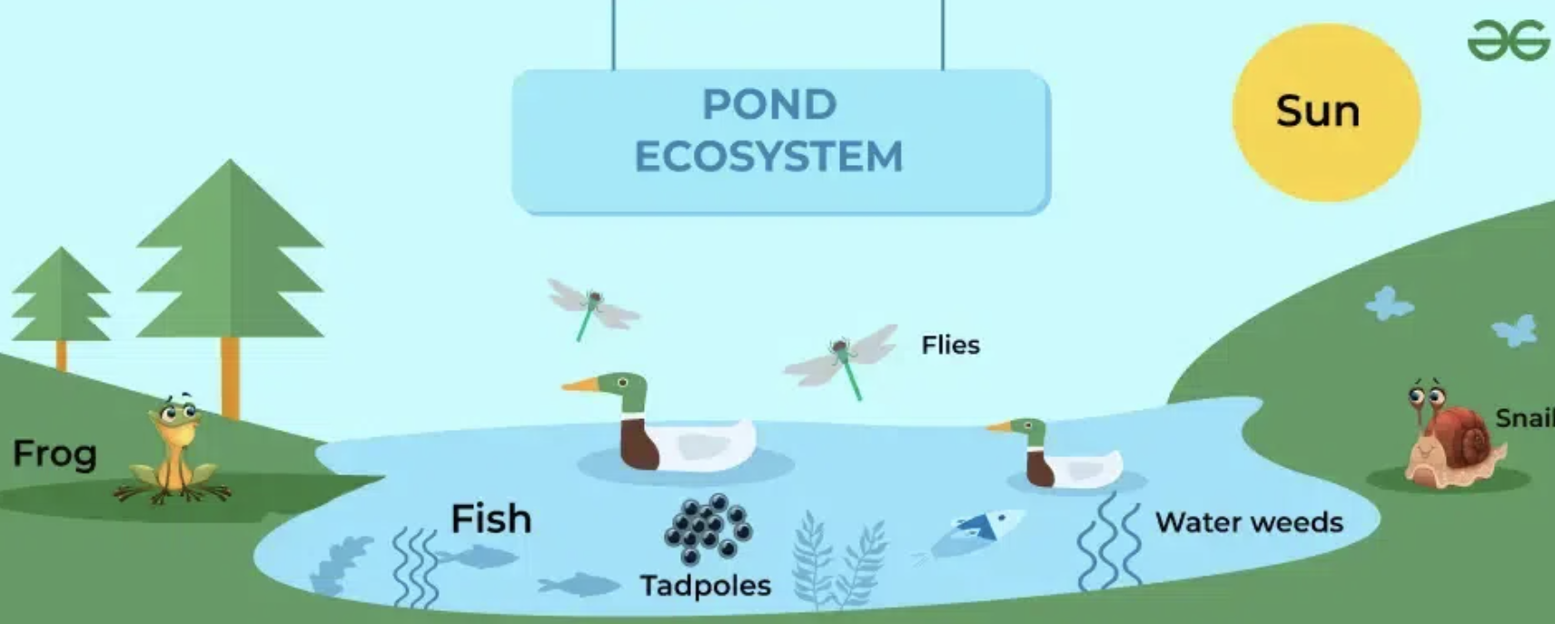
Interrelationships directly impact the variety of living things in an area.
Notes:
Interrelationships directly impact the variety of living things in an area. The more different plants and animals in one place, the better they can help each other survive. Imagine it like a big team where
each player has a special job. In places like coral reefs, there are lots of different sea creatures, and each one has a special role. This teamwork makes the whole place strong and healthy.

Slide 20
Things people do can disturb natural interrelationships.
Notes:
Sometimes, the things people do can upset the balance of nature. For example, cutting down too many trees, making the water dirty, or catching too many fish can hurt different animals and plants. If we
learn about these relationships, we can make better choices to protect our environment and the animals that live in it.

Slide 21
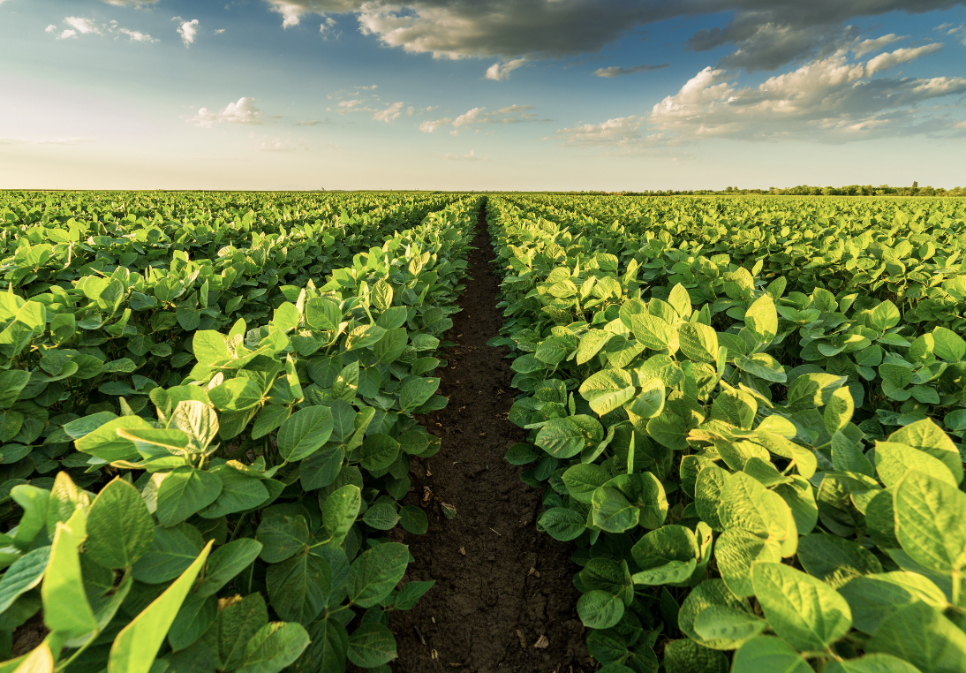
Interrelationships are needed for plants to grow.
Notes:
Interrelationships are needed for plants to grow. Many plants rely on animals for pollination. Bees, butterflies, and other insects transfer pollen between flowers, enabling plants to produce fruits and seeds.
Without these interrelationships, farming would be severely impacted, affecting our food supply.

Slide 22
Notes:
Let’s check-in for understanding.

Slide 23
True/False: Interrelationships do NOT directly impact the variety of living things in an area.
Notes:
True/False: Interrelationships do NOT directly impact the variety of living things in an area.
[False]

Slide 24
True/False: Interrelationships do NOT directly impact the variety of living things in an area.
Notes:
False: Interrelationships DO directly impact the variety of living things in an area.

Slide 25
Interrelationships are needed
.
for plants to grow
to take a selfie
Notes:
Interrelationships are needed .
[for plants to grow]

Slide 26
Interrelationships are needed
.
for plants to grow
to take a selfie

Slide 27
Things do can disturb natural interrelationships.
Notes:
Things do can disturb natural interrelationships.
[people or humans]

Slide 28
Notes:
Now, let’s talk about some examples of photosynthesis.

Slide 29
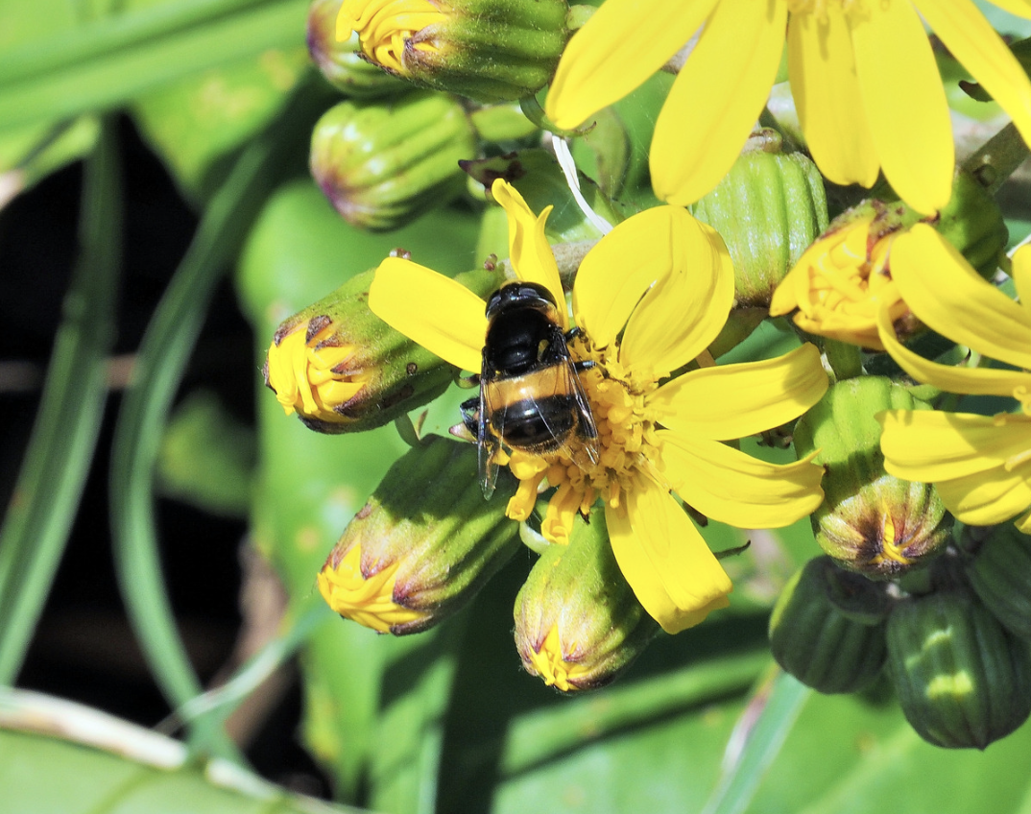
Bees pollinating flowers is an example of an interrelationship
Notes:
Bees pollinating flowers is an example of an interrelationship. Bees, butterflies, and other insects transfer pollen between flowers, enabling plants to produce fruits and seeds. Without these interrelationships, agricultural productivity would be severely impacted, affecting our food supply.

Slide 30
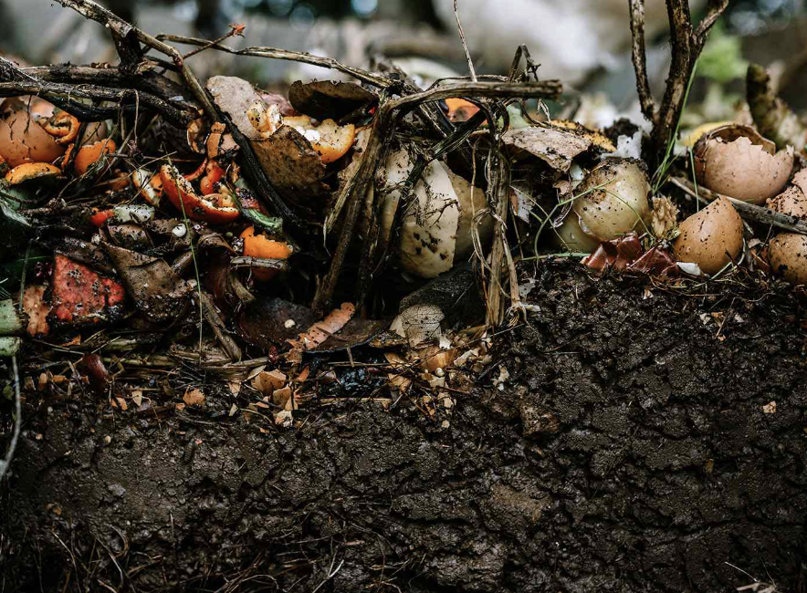
Bacteria and fungi breaking down dead organisms and releasing nutrients back into the soil is an example of an interrelationship.
Notes:
Bacteria and fungi breaking down dead organisms and releasing nutrients back into the soil is an example of an interrelationship. This process enriches the soil, supporting plant growth and agriculture.

Slide 31
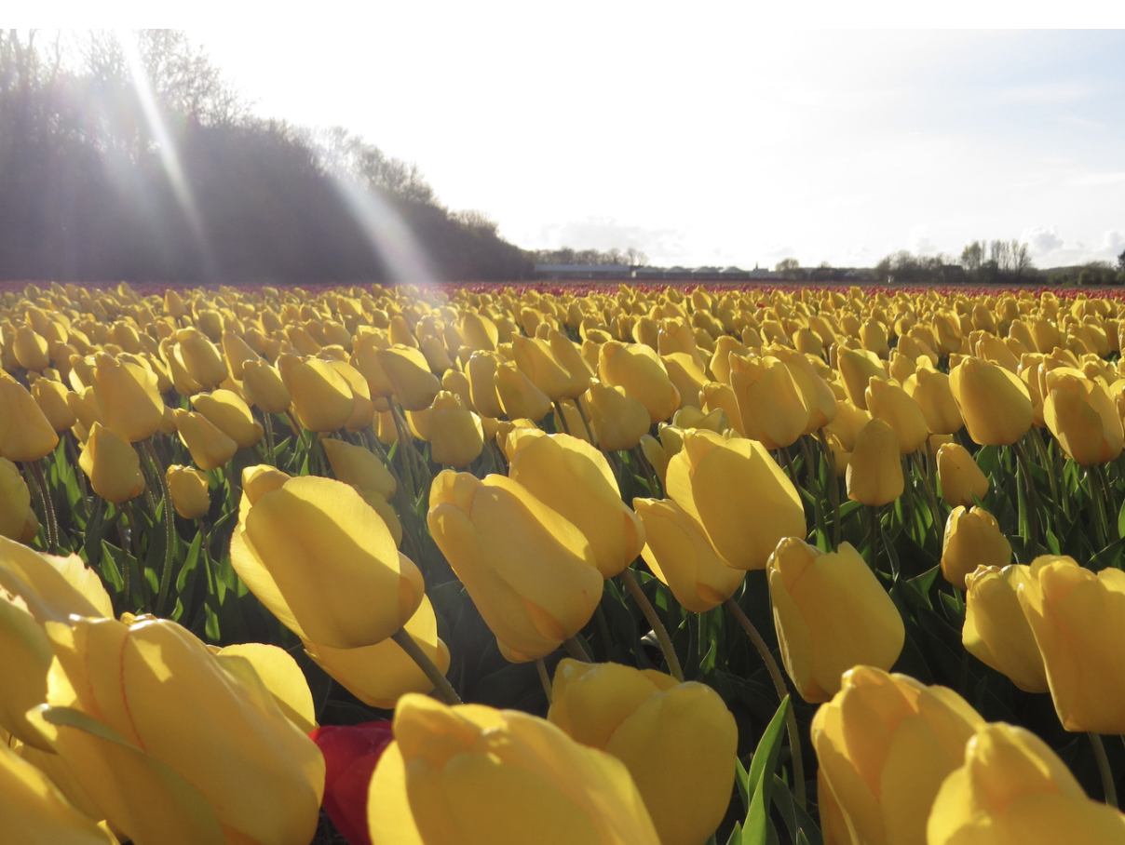
Flowers reacting to the sun is an example of an interrelationship
Notes:
Flowers reacting to the sun is an example of an interrelationship. This interaction is known as phototropism. Phototropism is the growth or movement of a plant in response to light, especially sunlight.

Slide 32
Notes:
Now, let’s talk about some non-examples of photosynthesis.

Slide 33
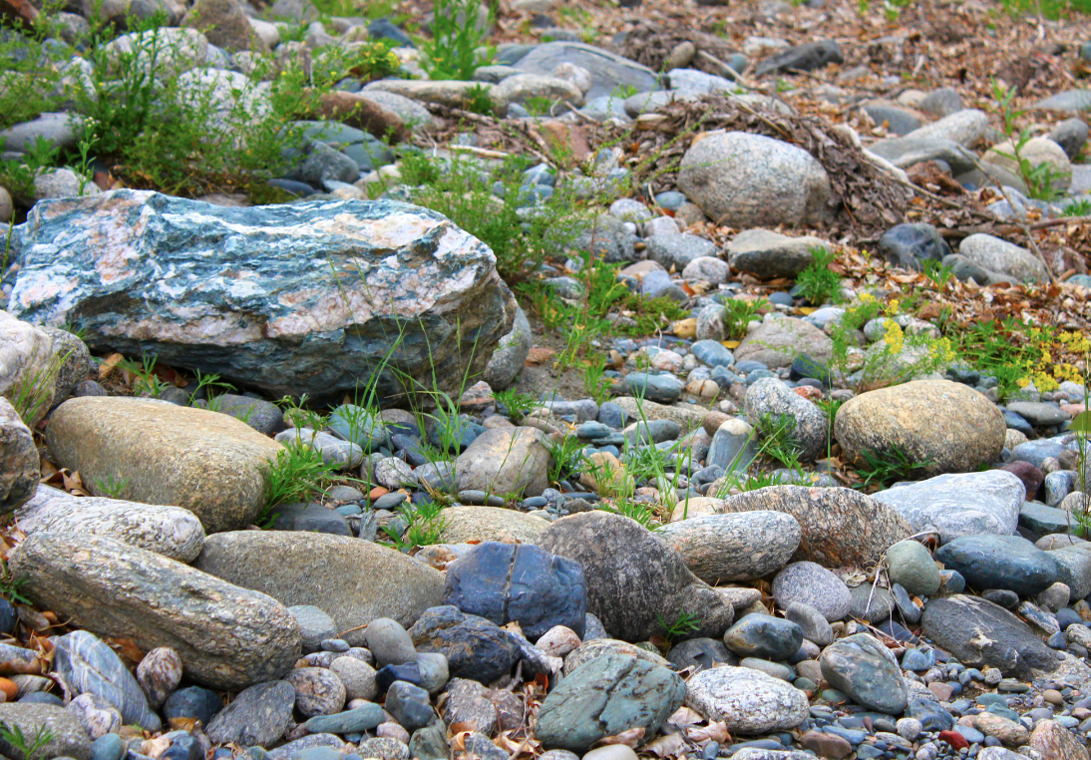
Rocks and plants are NOT an example of an interrelationship.
Notes:
Rocks and plants are NOT an example of an interrelationship. Rocks do not provide any direct benefits or support to plant life. Plants do grow in soil, which consists of minerals, but this relationship is more about the physical environment rather than a direct interrelationship between rocks and plants.

Slide 34
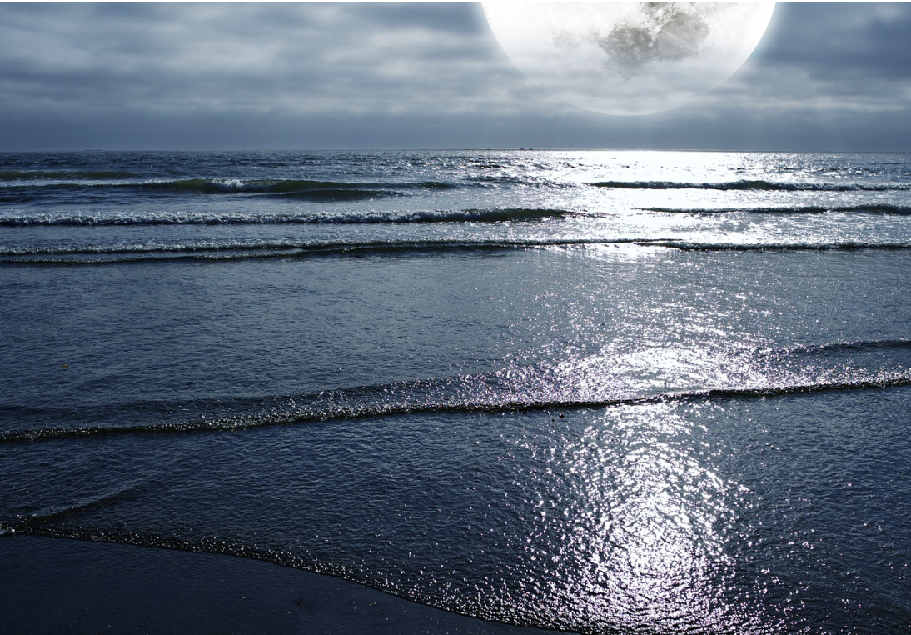
The gravitational pull of the moon creating the tides in oceans is NOT an example of an interrelationship.
Notes:
The gravitational pull of the moon creating the tides in oceans is NOT an example of an interrelationship. This is a physical phenomenon, not a biological interrelationship. There are no living organisms
directly interacting in this process.

Slide 35
Notes:
Now let’s pause for a moment to check your understanding.

Slide 36
Why are rocks and plants not an example of an interrelationship?
Notes:
Why are rocks and plants not an example of an interrelationship?
[Rocks do not provide any direct benefits or support to plant life. Plants do grow in soil, which consists of minerals, but this relationship is more about the physical environment rather than a direct interrelationship between rocks and plants.]

Slide 37
Remember!!!
Notes:
So remember!

Slide 38
Interrelationship: the way living things interact with and affect each other within their environment
Notes:
An interrelationship is the way living things interact with and affect each other within their environment.

Slide 39
Notes:
We will now complete this concept map, called a Frayer model, to summarize and further clarify what you have learned about the term interrelationships.

Slide 40
Definition
Picture
Interrelationship
How do interrelationships between living things impact my life?
Example
Notes:
To complete the Frayer model, we will choose from four choices the correct picture, definition, example, and response to the question, “How do interrelationships between living things impact my life?” Select the best response for each question using the information you just learned. As we select responses, we will see how this model looks filled in for the term interrelationship.

Slide 41
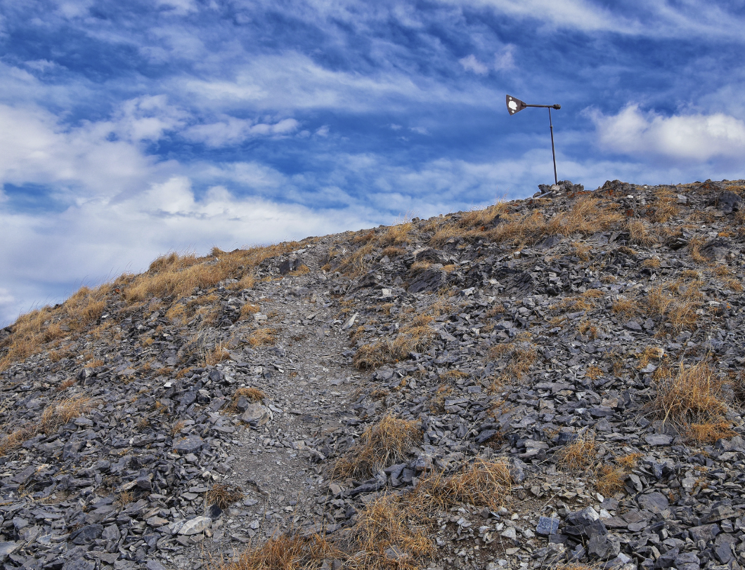
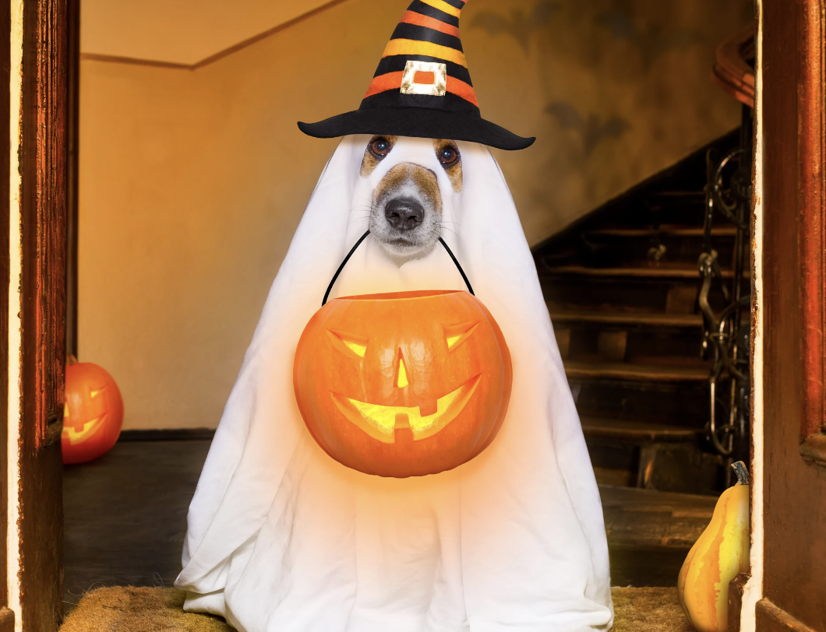
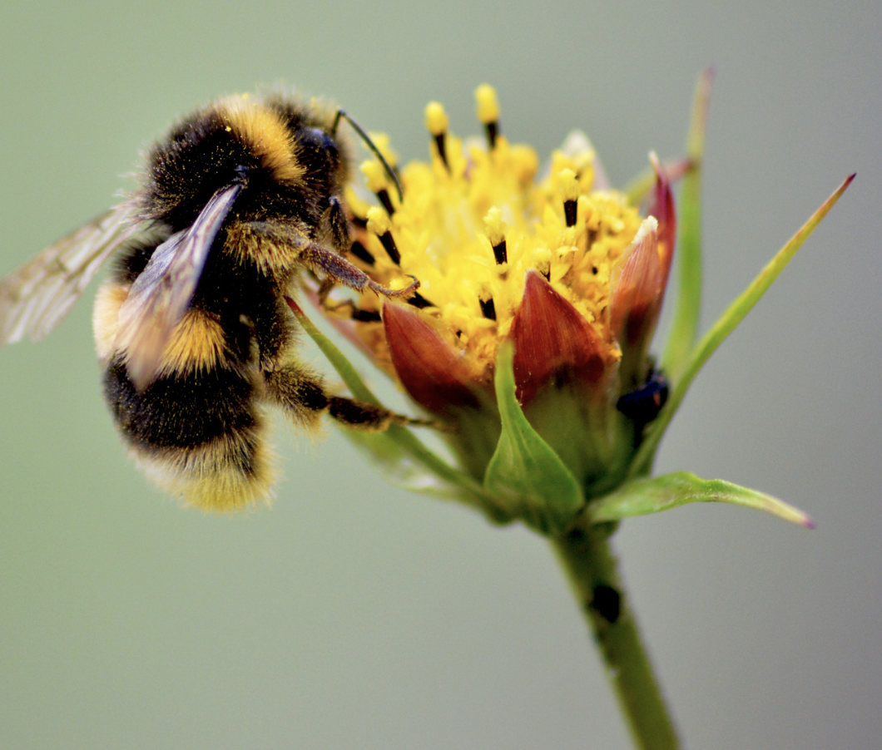
Directions: Choose the correct picture of an interrelationship from the choices below.
A
B
C
D
Notes:
Choose the one correct picture of an interrelationship from these four choices.

Slide 42
Directions: Choose the correct picture of an interrelationship from the choices below.
A
B
C
D
Notes:
This is the picture that shows an interrelationship.

Slide 43
Definition
Picture
Interrelationship
How do interrelationships between living things impact my life?
Example
Notes:
Here is the Frayer model filled in with a picture of an interrelationship.

Slide 44
Directions: Choose the correct definition of an interrelationship from the choices below.
A
Any living thing
B
the way living things interact with and affect each other within their environment
C
The process that green plants use to make their own food
D
Any non-living thing
Notes:
Choose the one correct definition of an interrelationship from these four choices.

Slide 45
Directions: Choose the correct definition of an interrelationship from the choices below.
A
Any living thing
B
The way living things interact with and affect each other within their environment
C
The process that green plants use to make their own food
D
Any non-living thing
Notes:
“The way living things interact with and affect each other within their environment” is correct! This is the definition of an interrelationship.

Slide 46
Definition
Picture
The way living things interact with and affect each other within their environment
Interrelationship
How do interrelationships between living things impact my life?
Example
Notes:
Here is the Frayer Model with a picture and the definition filled in for an interrelationship: The way living things interact with and affect each other within their environment.

Slide 47
Directions: Choose the correct example of an interrelationship from the choices below.
A
A teenager driving a car
B
A lion eating a zebra
C
Making your bed in the morning
D
A fish swimming in a lake
Notes:
Choose the one correct example of an interrelationship from these four choices.

Slide 48
Directions: Choose the correct example of an interrelationship from the choices below.
A
A teenager driving a car
B
A lion eating a zebra
C
Making your bed in the morning
D
A fish swimming in a lake
Notes:
“A lion eating a zebra” is correct! This is an example of an interrelationship.

Slide 49
Definition
Picture
The way living things interact with and affect each other within their environment
Interrelationship
A lion eating a zebra
How do interrelationships between living things impact my life?
Example
Notes:
Here is the Frayer Model with a picture, the definition, and an example filled in for an interrelationship: A lion eating a zebra.

Slide 50
Directions: Choose the correct response for “How do interrelationships between living things impact my life?” from the choices below.
A
The bicycle I ride comes from an interrelationship between the pedals and the handlebar.
B
Waves hitting the beach is an interrelationship that creates energy for me to use to power the lights in my house.
C
Interrelationships help me play basketball.
Many of the foods I eat, like fruits, vegetables, and nuts, come from plants that have interrelationships with bees, butterflies, and other insects for pollination.
D
Notes:
Choose the one correct response for “How do interrelationships between living things impact my life?” from these four choices.

Slide 51
Directions: Choose the correct response for “How do interrelationships between living things impact my life?” from the choices below.
A
The bicycle I ride comes from an interrelationship between the pedals and the handlebar.
B
Waves hitting the beach is an interrelationship that creates energy for me to use to power the lights in my house.
C
Interrelationships help me play basketball.
Many of the foods I eat, like fruits, vegetables, and nuts, come from plants that have interrelationships with bees, butterflies, and other insects for pollination.
D
Notes:
“Many of the foods I eat, like fruits, vegetables, and nuts, come from plants that have interrelationships with bees, butterflies, and other insects for pollination.” That is correct! This is an example of how interrelationships between living things impact your life.

Slide 52
Definition
Picture
The way living things interact with and affect each other within their environment
Interrelationship
Many of the foods I eat, like fruits, vegetables, and nuts, come from plants that have interrelationships with bees, butterflies, and other insects for pollination.
A lion eating a zebra
How do interrelationships between living things impact my life?
Example
Notes:
Here is the Frayer Model with a picture, definition, example, and a correct response to “how do interrelationships between living things impact my life?”: Many of the foods I eat, like fruits, vegetables, and nuts, come from plants that have interrelationships with bees, butterflies, and other insects for pollination.

Slide 53
Remember!!!
Notes:
So remember!

Slide 54
Interrelationships: the ways living things interact with and affect each other within their environment
Notes:
Interrelationships are the ways living things interact with and affect each other within their environment.

Slide 55
Big Question: Why are interrelationships between things important to an environment?
Notes:
Let’s reflect once more on our big question. Our “big question” is: Why are interrelationships between things important to an environment?
Does anyone have any additional examples to share that haven’t been discussed yet?

Slide 56
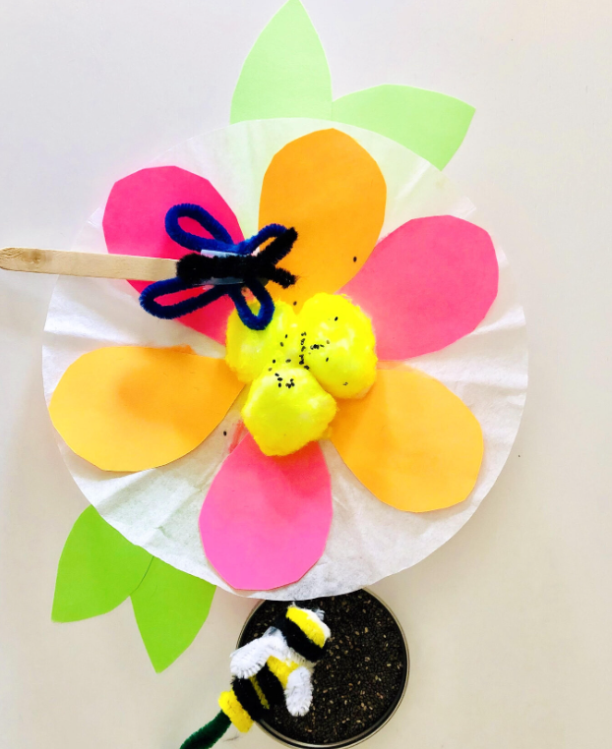
Simulation Activity
Pollination/Interrelationship Video
Click the link above for a video to deepen your understanding of interrelationships.
Notes:
Click the link above for a video to deepen your understanding of interrelationships.
Feedback: Providing a simulation activity is a great way to make science thinking visible. In this simulation, students color the centers of paper flowers with different colored chalk. Then each student takes a cotton ball to simulate a bee. The students land their cotton balls gently on the different colored chalk-covered centers of the paper flowers, to observe how the “bee” accumulates “pollen.”
MATERIALS: Copy of flower picture for each student Sticks of chalk in five different colors (Divide the class into groups of five. You will need one of each of the five colors for each group.) One cotton ball for each student
PROCEDURE: Start a class discussion about flowers and bees. Ask students what they know about bees. Ask students why they think bees visit flowers.

Slide 57
Notes:
Thanks for watching, and please continue watching CAPs available from this website.

Slide 58
This Was Created With Resources From:
Questions or Comments
Michael Kennedy, Ph.D. MKennedy@Virginia.edu
Rachel L Kunemund, Ph.D. rk8vm@virginia.edu

