Slide 1
Intro
“Big Idea” Question
Review Concepts
Check-In Questions
Teacher Demo
Vocabulary
Student-Friendly Definition
Examples & Non-Examples
Morphological Word Parts
Frayer Model
Simulation/Activity
Notes:
OK everyone, get ready for our next lesson. Just as a reminder, these are the different components that our lesson may include, and you’ll see these icons in the top left corner of each slide so that you can follow along more easily!

Slide 2
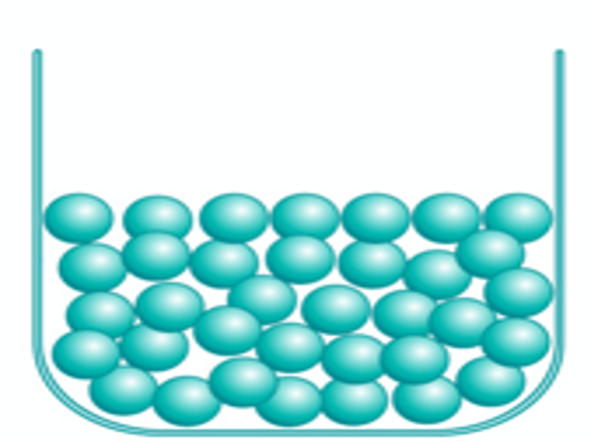
Liquid
Intro
Notes:
Today we will learn about liquids.

Slide 3
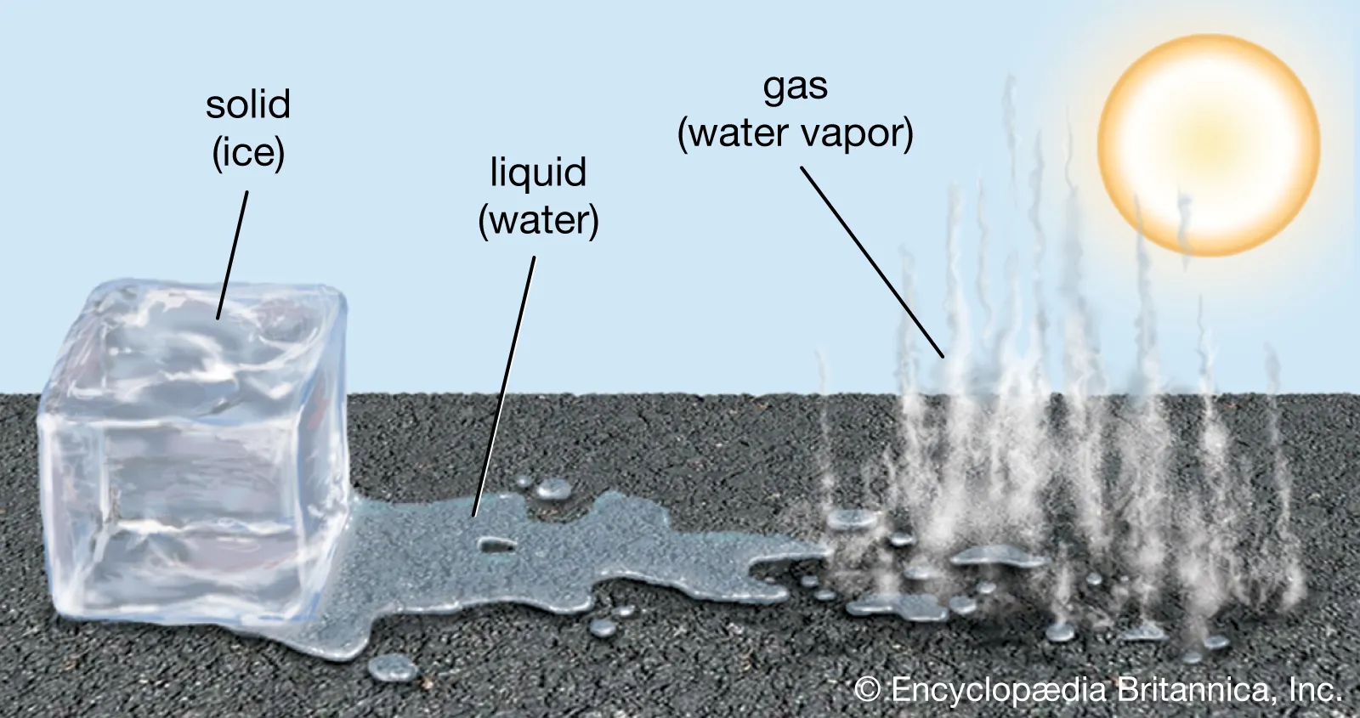
Big Question: How does temperature affect the matter around us?
Notes:
Our “big question” is: How does temperature affect the matter around us?
[Pause and illicit predictions from students.]
I love all these thoughtful scientific hypotheses! Be sure to keep this question and your predictions in mind as we move through these next few lessons, and we’ll continue to revisit it.
Feedback: Asking students to make predictions about how temperature is related to states of matter is a great way to activate and elicit student ideas and prior knowledge. This type of activity is evidence of the teacher planning for students’ engagement with science ideas.

Slide 4
Notes:
Before we move on to our new vocabulary term, let’s review some other words & concepts that you already learned and make sure you are firm in your understanding.

Slide 5
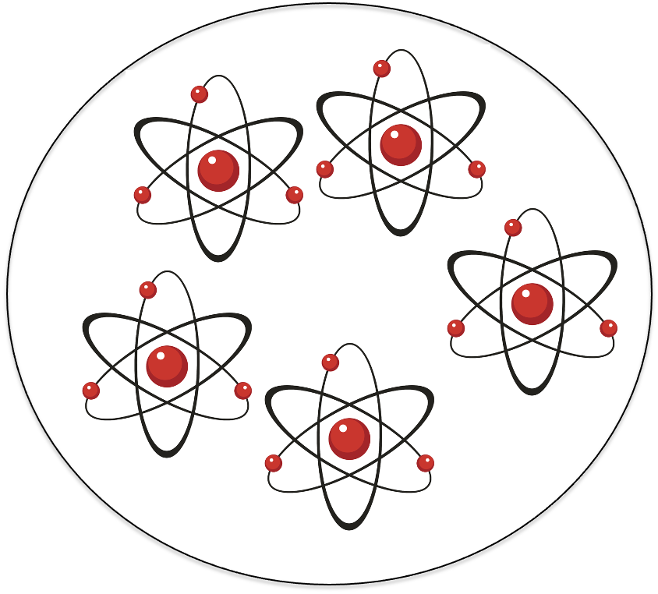
Matter: has mass and takes up space
Notes:
Matter is anything that has mass and takes up space.

Slide 6
Mass: amount of matter in an object.
Notes:
Mass is the amount of matter in an object.

Slide 7
Atom: smallest whole unit of matter.
Notes:
An atom is the smallest whole unit of matter. All matter is made up of tiny atoms.

Slide 8
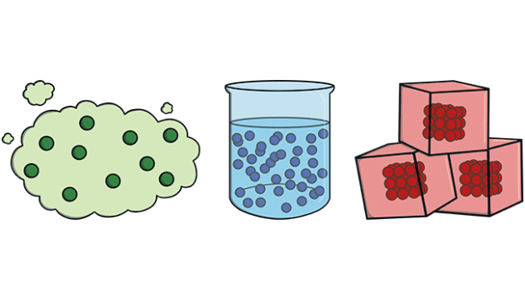
States of Matter
Gas
Liquid
Solid
Notes:
Matter exists in three different states: solid, liquid, and gas.

Slide 9
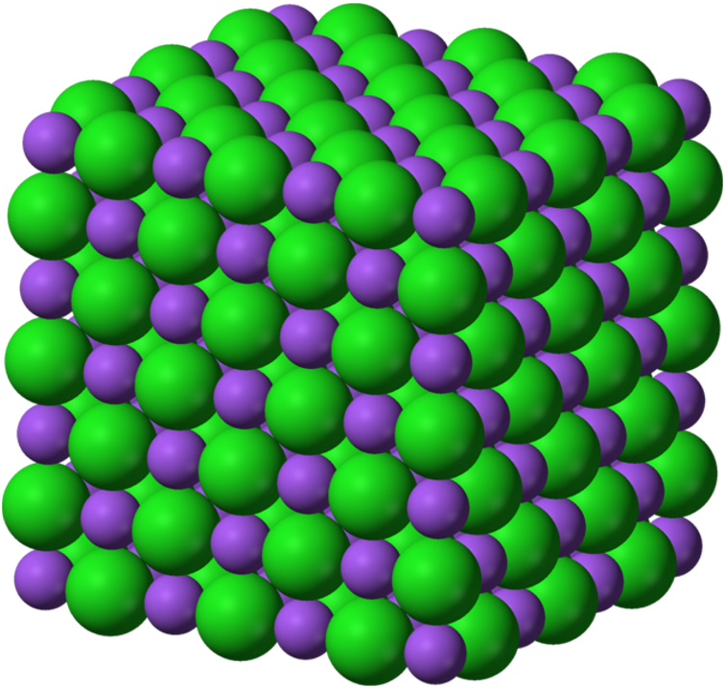
Solid: has particles that are tightly packed together in a fixed pattern
Notes:
A solid has particles that are tightly packed together in a fixed pattern.

Slide 10
Notes:
Now let’s pause for a moment to check your understanding.

Slide 11
What has mass and takes up space?
Matter
Force
Light
Notes:
What has mass and takes up space?
[A. Matter]

Slide 12
What has mass and takes up space?
Matter
Force
Light
Notes:
What has mass and takes up space? A. Matter

Slide 13
The amount of matter in an object is called its ________.
Notes:
The amount of matter in an object is called its _________.
[mass]

Slide 14
The amount of matter in an object is called its mass.
Notes:
The amount of matter in an object is called its mass.

Slide 15
An atom is the __________ whole unit of matter.
Notes:
An atom is the ________ whole unit of matter.
[smallest]

Slide 16
An atom is the smallest whole unit of matter.
Notes:
An atom is the smallest whole unit of matter.

Slide 17
Name the three states of matter.
Notes:
Name the three states of matter.
[gas, liquid, solid]

Slide 18
Name the three states of matter.
Gas
Liquid
Solid
Notes:
Name the three states of matter: gas, liquid, solid.

Slide 19
What is a solid?
Notes:
What is a solid?
[A solid has particles that are tightly packed together in a fixed pattern.]

Slide 20
Solid: has particles that are tightly packed together in a fixed pattern
Notes:
A solid has particles that are tightly packed together in a fixed pattern
[A solid has particles that are tightly packed together in a fixed pattern.]

Slide 21
Liquid
Notes:
Now that we’ve reviewed, let’s define our new term, liquid.
Feedback: Using cues, such as on this slide, helps prepare students for what is coming up next in the lesson. This is important especially for students who may struggle with new vocabulary instruction.

Slide 22
Liquid: has particles that are close together but can move around
Notes:
A liquid has particles that are close together but can move around.

Slide 23
Notes:
Now let’s pause for a moment to check your understanding.

Slide 24
What is a liquid?
Notes:
What is a liquid?
[A liquid has particles that are close together but can move around.]

Slide 25
Liquid: has particles that are close together but can move around
Notes:
A liquid had particles that are close together but can move around
[A liquid has particles that are close together but can move around.]

Slide 26
Notes:
That is the basic definition, but there is a bit more you need to know.

Slide 27
Notes:
Unlike solids, liquids do not have a clear shape. Instead, they take the shape of the container they are in. As you can see, the lemonade is a different shape in the pitcher than in the glass.

Slide 28
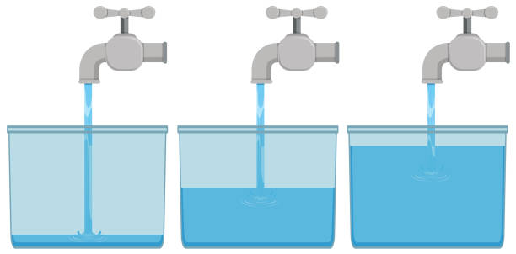
Notes:
When you pour a liquid into a new container, it spreads out evenly to fill that container. No matter how much liquid is in a container, it will also be evenly spaced out.

Slide 29
Notes:
The particles in a liquid have more space between them and have the energy to move around freely. This movement is what allows the liquid to flow from one place to another.

Slide 30
temperature
Notes:
When a solid is heated, its particles begin to move around and it loses its shape. Once it is melted, the solid has turned into a liquid.

Slide 31
temperature
Notes:
When the temperature of a liquid goes down, its particles begin to slow down and stop moving. It takes on a more defined shape and eventually turns into a solid. This is called freezing.

Slide 32
Notes:
Now let’s pause for a moment to check your understanding.

Slide 33
Liquids take the shape of their ______________.
Notes:
Liquids take the shape of their _________.
[container]

Slide 34
Liquids take the shape of their container.
Notes:
Liquids take the shape of their container.

Slide 35
Why can liquids flow?
Notes:
Why can liquids flow?
[there is space between the particles so they can move]

Slide 36
When matter melts, it turns from a ________ to a ________.
temperature
Notes:
When matter melts, it turns from a ______ to a _______.
[solid, liquid]

Slide 37
When matter melts, it turns from a solid to a liquid.
temperature
Notes:
When matter melts, it turns from a solid to a liquid.

Slide 38
What happens when the temperature of a liquid decreases?
It disappears
It glows
It freezes
Notes:
What happens when the temperature of a liquid decreases?
[c. It freezes]

Slide 39
What happens when the temperature of a liquid decreases?
It disappears
It glows
It freezes
Notes:
What happens when the temperature of a liquid decreases? c. It freezes

Slide 40
Notes:
Now, let’s talk about some examples of liquids.

Slide 41
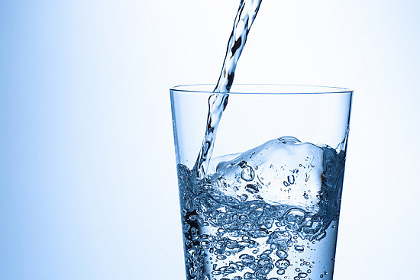
Notes:
This is an example of a liquid. Water is the most common liquid on Earth. It is an essential part of life.

Slide 42
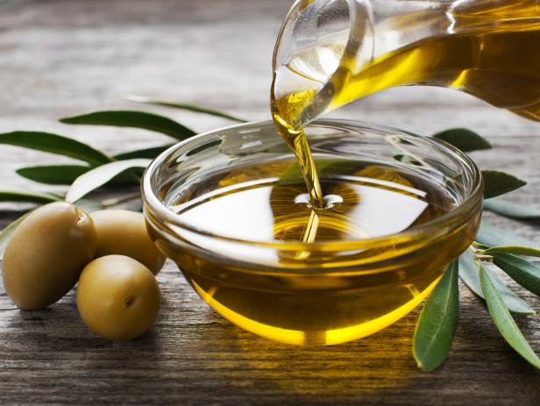
Notes:
This is another example of a liquid. Oils are liquids that are often used to help cook our food.

Slide 43
Notes:
Next, let’s talk about some non-examples of liquids.
Feedback: Offering clear and explicit explanation for non-examples is a great way for students to make sense of the new content. Explanations for non-examples are provided in the slides below.

Slide 44
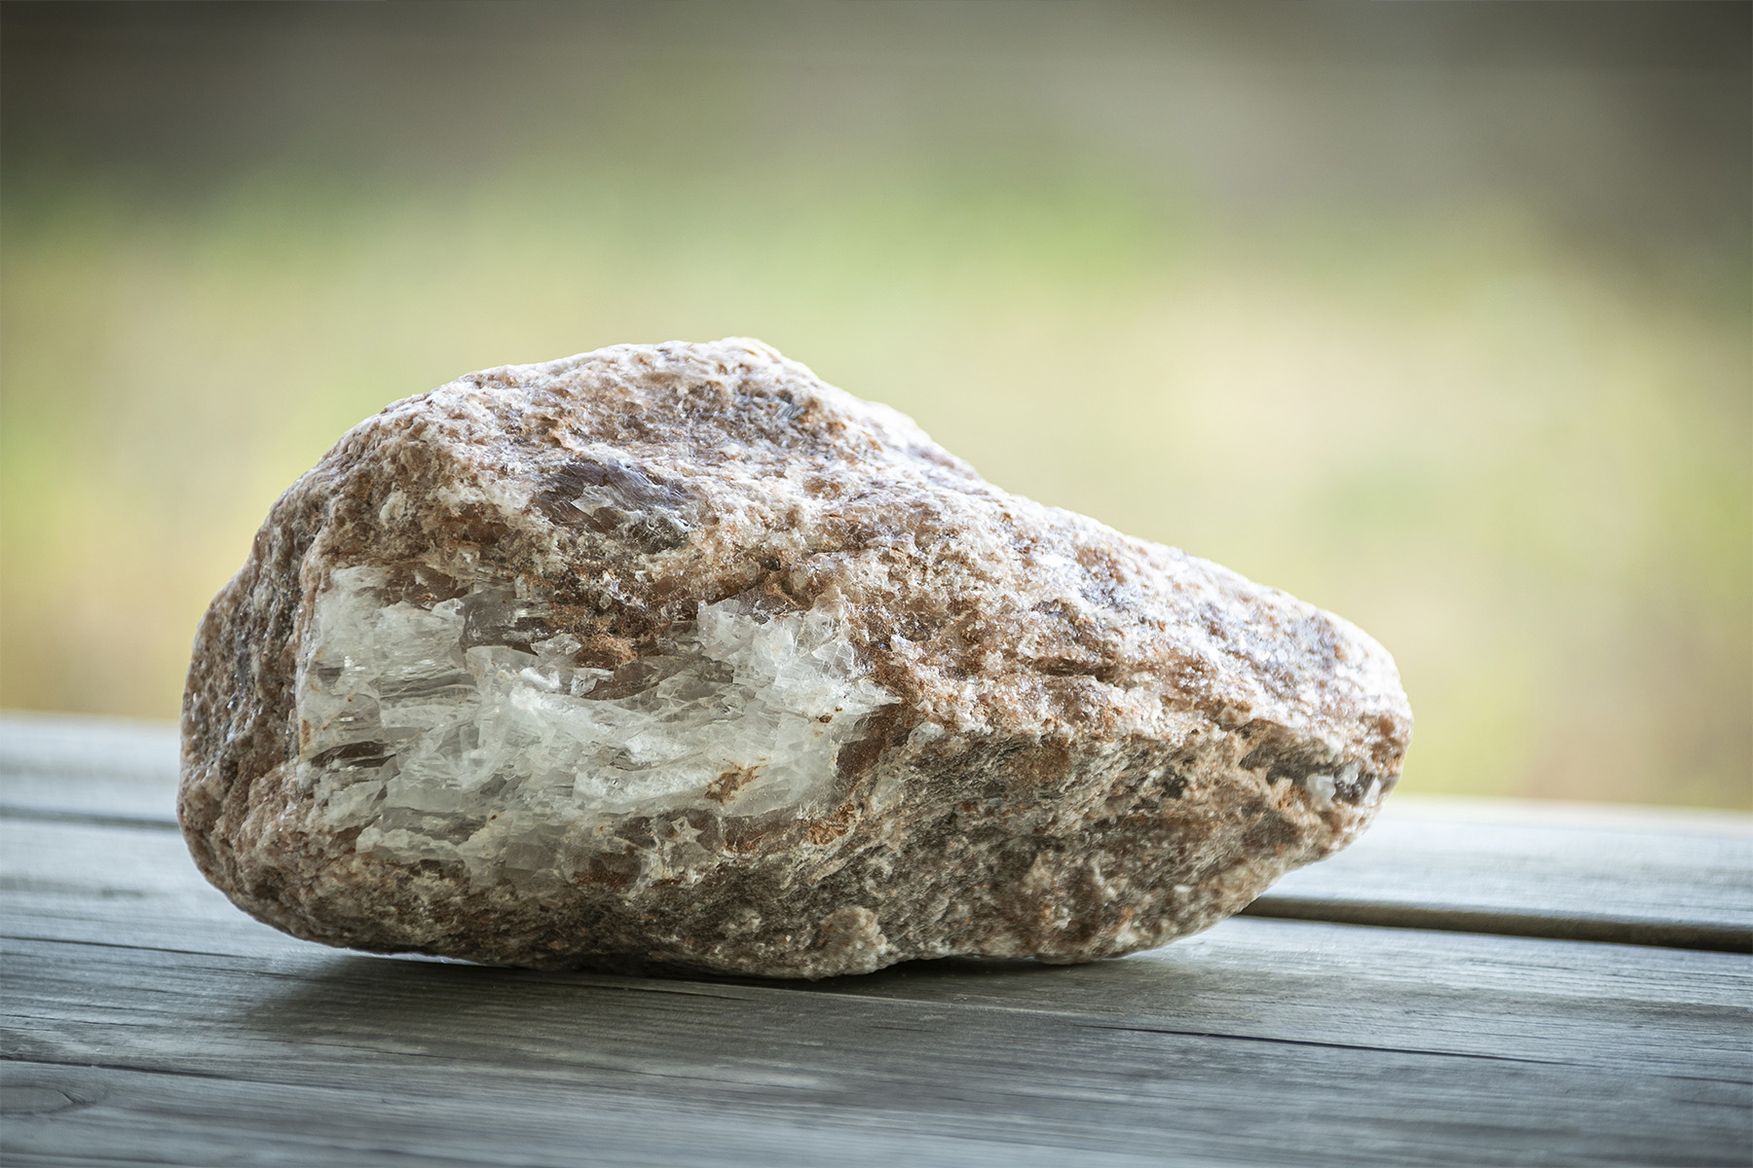
Notes:
A rock is a non-example of a liquid. Rocks do not take the shape of their container and they cannot flow.

Slide 45
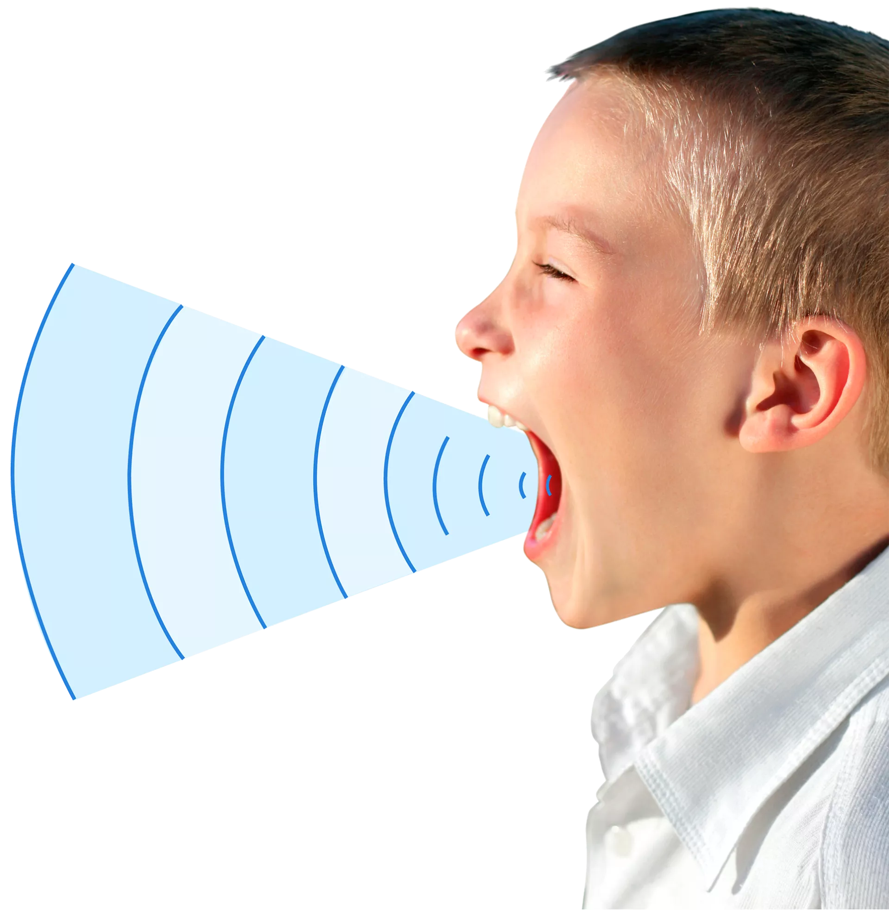
Notes:
Sounds ia another non-example of a liquid. Sound is made up of vibrations through the air. It does not have mass and it is not made of matter.

Slide 46
Notes:
Now let’s pause for a moment to check your understanding.

Slide 47
Which one is NOT an example of a liquid?
Rock
Soda
Oil
Notes:
Which one is NOT an example of a liquid?
[rock]

Slide 48
Which one is NOT an example of a liquid?
Rock
Soda
Oil
Notes:
Which one is NOT an example of a liquid? rock

Slide 49
Remember!!!
Notes:
So remember!

Slide 50
Liquid: has particles that are close together but can move around
Notes:
A liquid has particles that are close together but can move around.

Slide 51
Notes:
We will now complete this concept map, called a Frayer model, to summarize and further clarify what you have learned about the term liquid.

Slide 52
Definition
Picture
Liquid
Example
How do liquids impact my life?
Notes:
To complete the Frayer model, we will choose from four choices the correct picture, definition, example, and response to the question, “How do liquids impact my life?” Select the best response for each question using the information you just learned. As we select responses, we will see how this model looks filled in for the term liquid.

Slide 53
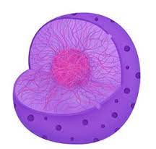
Directions: Choose the correct picture of a
liquid from the choices below.
A
B
C
D
Notes:
Choose the one correct picture of liquid from these four choices.

Slide 54
Directions: Choose the correct picture of a
liquid from the choices below.
A
B
C
D
Notes:
This is the picture that shows a liquid.

Slide 55
Definition
Picture
Liquid
Example
How do liquids impact my life?
Notes:
Here is the Frayer model filled in with a picture of liquid.

Slide 56
Directions: Choose the correct definition of
liquid from the choices below.
A
has particles that are close together but can move around
B
a material in which electrons can not move around easily
C
Earth materials (rock, soil) are worn away and moved by wind and water​
D
wavelengths that are visible to the human eye
Notes:
Choose the one correct definition of liquid from these four choices.

Slide 57
Directions: Choose the correct definition of
liquid from the choices below.
A
has particles that are close together but can move around
B
a material in which electrons can not move around easily
C
Earth materials (rock, soil) are worn away and moved by wind and water​
D
wavelengths that are visible to the human eye
Notes:
“A liquid has particles that are close together but can move around” is correct! This is the definition of liquid.

Slide 58
Definition
Picture
has particles that are close together but can move around
Liquid
Example
How do liquids impact my life?
Notes:
Here is the Frayer Model with a picture and the definition filled in for liquid: has particles that are close together but can move around.

Slide 59
Directions: Choose the correct example of
a liquid from the choices below.
A
A wooden bench in a park
B
Apples baked in a pie
C
Olive oil used for cooking
D
Light from a lightbulb
Notes:
Choose the one correct example of a liquid from these four choices.

Slide 60
Directions: Choose the correct example of
a liquid from the choices below.
A
A
A wooden bench in a park
B
B
Apples baked in a pie
C
C
Olive oil used for cooking
D
D
Light from a lightbulb
Notes:
“Olive oil used for cooking.” is correct! This is an example of a liquid.

Slide 61
Definition
Picture
has particles that are close together but can move around
Liquid
Olive oil used for cooking
Example
How do liquids impact my life?
Notes:
Here is the Frayer Model with a picture, definition, and an example of liquid: olive oil used for cooking.

Slide 62
Directions: Choose the correct response for “how do liquids impact my life?” from the choices below.
A
They provide shelter and warmth for animals, including humans, in their ecosystems.
B
They move through the air to our eyes so we can see the world around us.
C
They make up the rivers, lakes, and oceans that provide us water to drink.
D
It provides heat warmth and light so that we stay warm and we can cook our food.
Notes:
Choose the one correct response for “how do liquids impact my life?” from these four choices.

Slide 63
Directions: Choose the correct response for “how do liquids impact my life?” from the choices below.
A
A
Va
They provide shelter and warmth for animals, including humans, in their ecosystems.
B
B
Va
They move through the air to our eyes so we can see the world around us.
C
C
They make up the rivers, lakes, and oceans that provide us water to drink.
D
D
Va
It provides heat warmth and light so that we stay warm and we can cook our food.
Notes:
“They make up the rivers, lakes, and oceans that provide us water to drink.” That is correct! This is an example of how liquids impact your life.

Slide 64
Definition
Picture
has particles that are close together but can move around
Liquid
Olive oil used for cooking
They make up the rivers, lakes, and oceans that provide us water to drink.
Example
How do liquids impact my life?
Notes:
Here is the Frayer Model with a picture, definition, example, and a correct response to “how do liquids impact my life?”:

Slide 65
Big Question: How does temperature affect the matter around us?
Notes:
Our “big question” is: How does temperature affect the matter around us?
[Pause and illicit predictions from students.]
I love all these thoughtful scientific hypotheses! Be sure to keep this question and your predictions in mind as we move through these next few lessons, and we’ll continue to revisit it.

Slide 66
Notes:
Thanks for watching, and please continue watching CAPs available from this website.

Slide 67
This Video Was Created With Resources From:
Questions or Comments
Michael Kennedy, Ph.D. MKennedy@Virginia.edu
Rachel L Kunemund, Ph.D. rk8vm@virginia.edu

