Slide 1
Intro
“Big Idea” Question
Review Concepts
Check-In Questions
Teacher Engagement
Vocabulary
Student-Friendly Definition
Examples & Non-Examples
Frayer Model
Simulation/Activity
Notes:
OK everyone, get ready for our next lesson. Just as a reminder, these are the different components that our lesson may include, and you’ll see these icons in the top left corner of each slide so that you can follow along more easily!

Slide 2
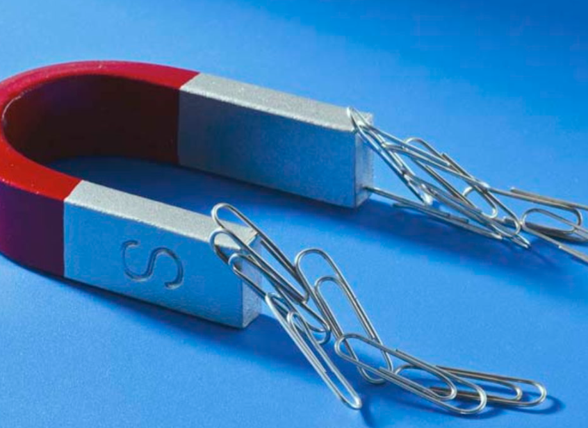
Intro
Magnet
Notes:
Today, we’ll be learning about the word: Magnet

Slide 3
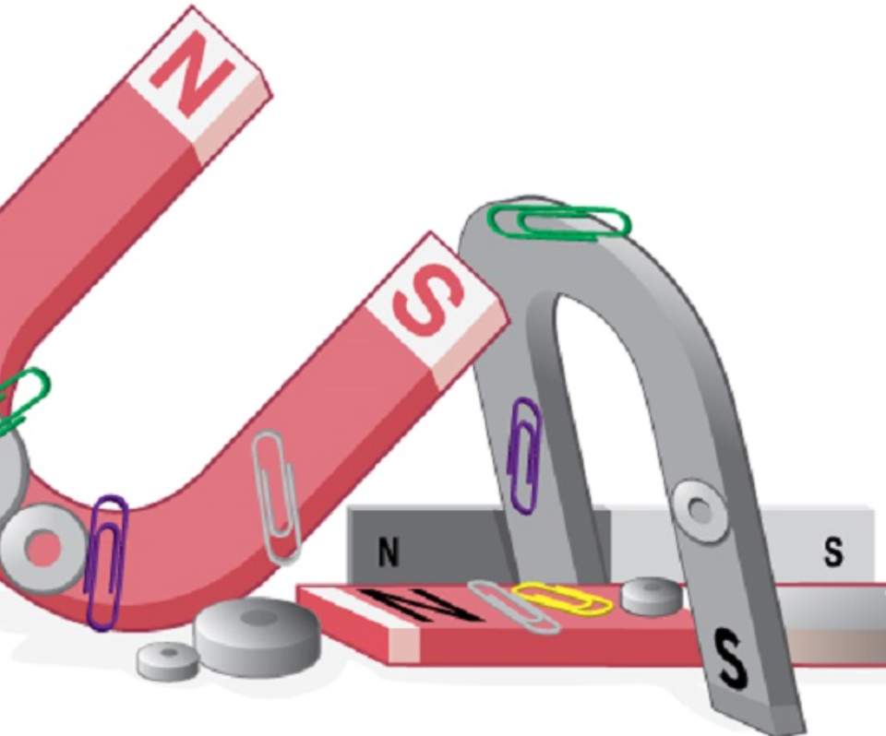
Big Question: How are you able to tell if an object is magnetic?
Notes:
Our “big question” is: How are you able to tell if an object is magnetic?
[Pause and illicit predictions from students.]
I love all these thoughtful scientific hypotheses! Be sure to keep this question and your predictions in mind as we move through these next few lessons, and we’ll continue to revisit it.

Slide 4
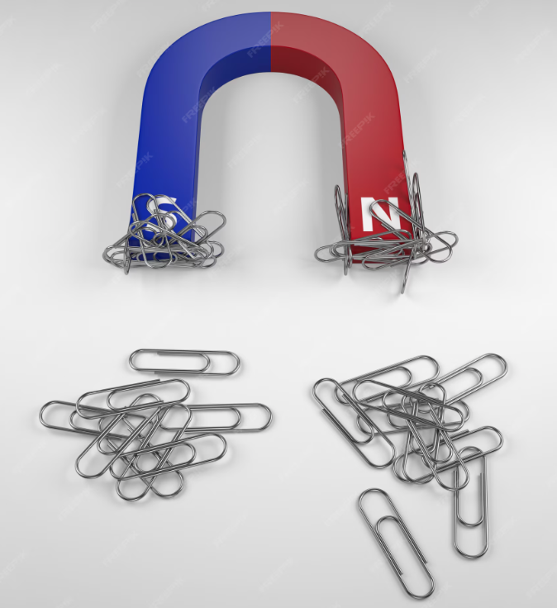
Demonstration
A magnet and paper clips
For this topic one optional demonstration would be showing students how paper clips, which are made of iron are attracted to magnets. Before starting the demonstration ask students to make predictions about what will happen when you bring the magnet close to the paper clip. After students make predictions hold the magnet in your hand and bring it close to a paper clip without touching it. Have students observe how the paper clip is attracted to the magnet. You can try picking up a single paper clip with the magnet or allow multiple paper clips to stick together. Then give students independent opportunities.

Slide 5
Notes:
Before we move on to our new topic, let’s review some other words & concepts that you already learned and make sure you are firm in your understanding.

Slide 6
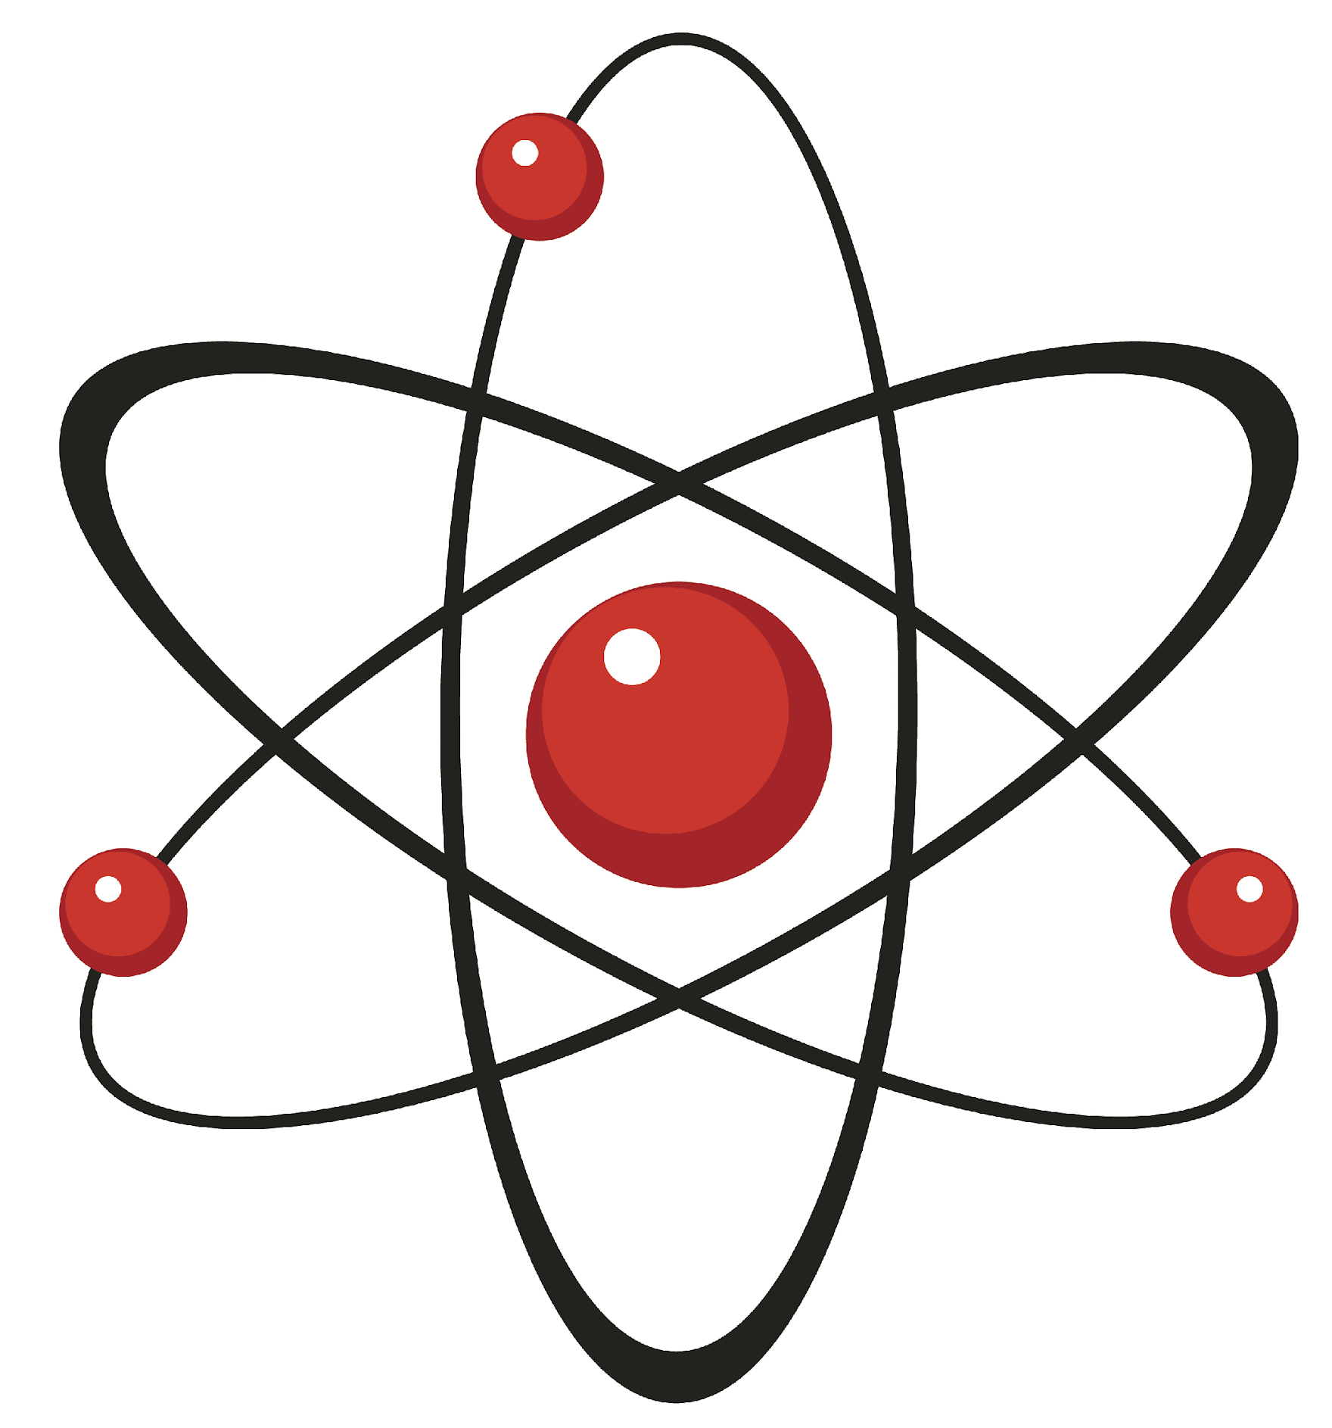
Atom: smallest whole unit of matter
Atom
Atom
Atom
Atom
Atom
Notes:
An atom is the smallest whole unit of matter.

Slide 7
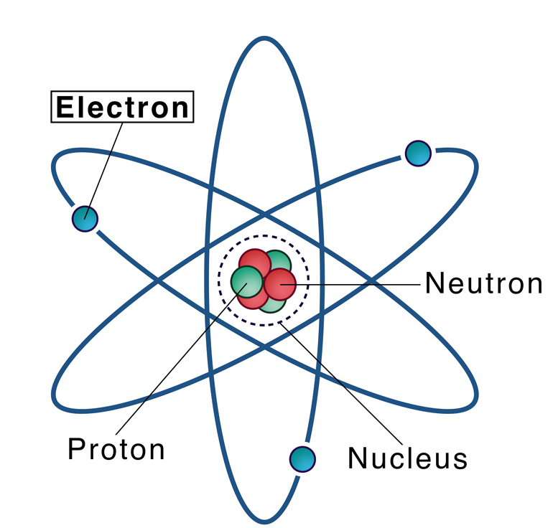
Electron: negatively charged particle that orbits the nucleus of an atom
Notes:
An electron is a negatively charged particle that orbits the nucleus of an atom

Slide 8
Electricity: the movement of electrons between atoms
Notes:
Electricity is the movement of electrons between atoms

Slide 9
Notes:
Let’s check-in for understanding.

Slide 10
Electricity: the movement of
between atoms
Notes:
Electricity is the movement of between atoms
[electrons]

Slide 11
Electricity: the movement of
electrons between atoms
Notes:
Electricity is the movement of electrons between atoms
[electrons]

Slide 12
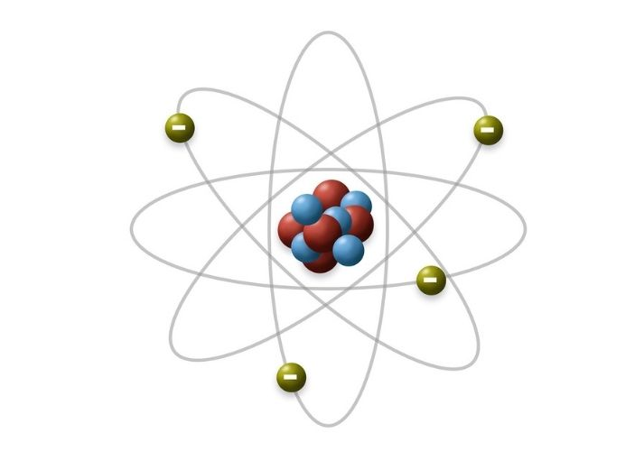
What charge does an electron have?
Positive charge
Negative charge
Notes:
What charge does an electron have? [A. Negative charge]

Slide 13
What charge does an electron have?
Positive charge
Negative charge
Notes:
What charge does an electron have? [A. Negative charge]

Slide 14
Magnet
Notes:
Now that we’ve reviewed, let’s define the phrase Magnet.

Slide 15
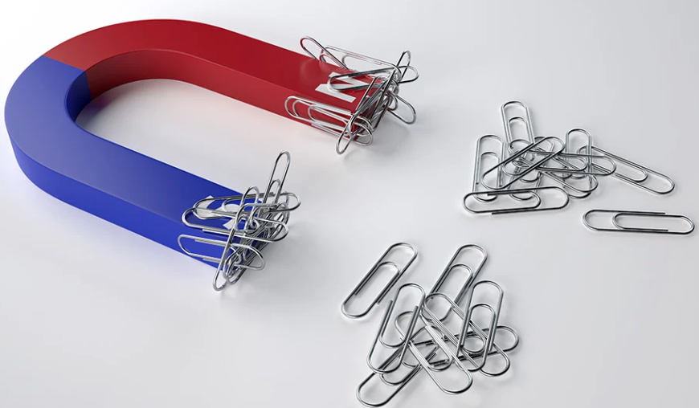
Magnet: a material or object that can attract certain metals
Notes:
Magnet: a material or object that can attract certain metals

Slide 16
Notes:
Let’s check-in for understanding.

Slide 17
What is a magnet?
Notes:
What is a magnet?
[a material or object that can attract certain metals]

Slide 18
Notes:
That is the basic definition, but there is a bit more you need to know.

Slide 19
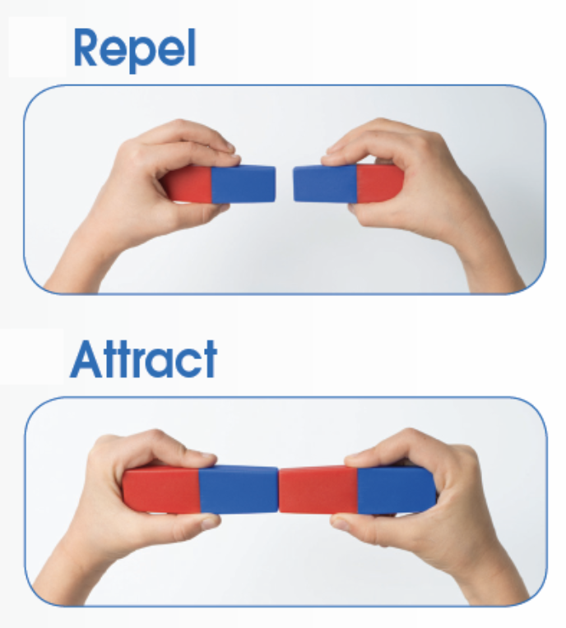
Every magnet has two ends called poles – a north pole and a south pole. Similar poles repel each other, while opposite poles attract.
Notes:
Every magnet has two ends called poles – a north pole and a south pole. Similar poles repel each other, while opposite poles attract.

Slide 20
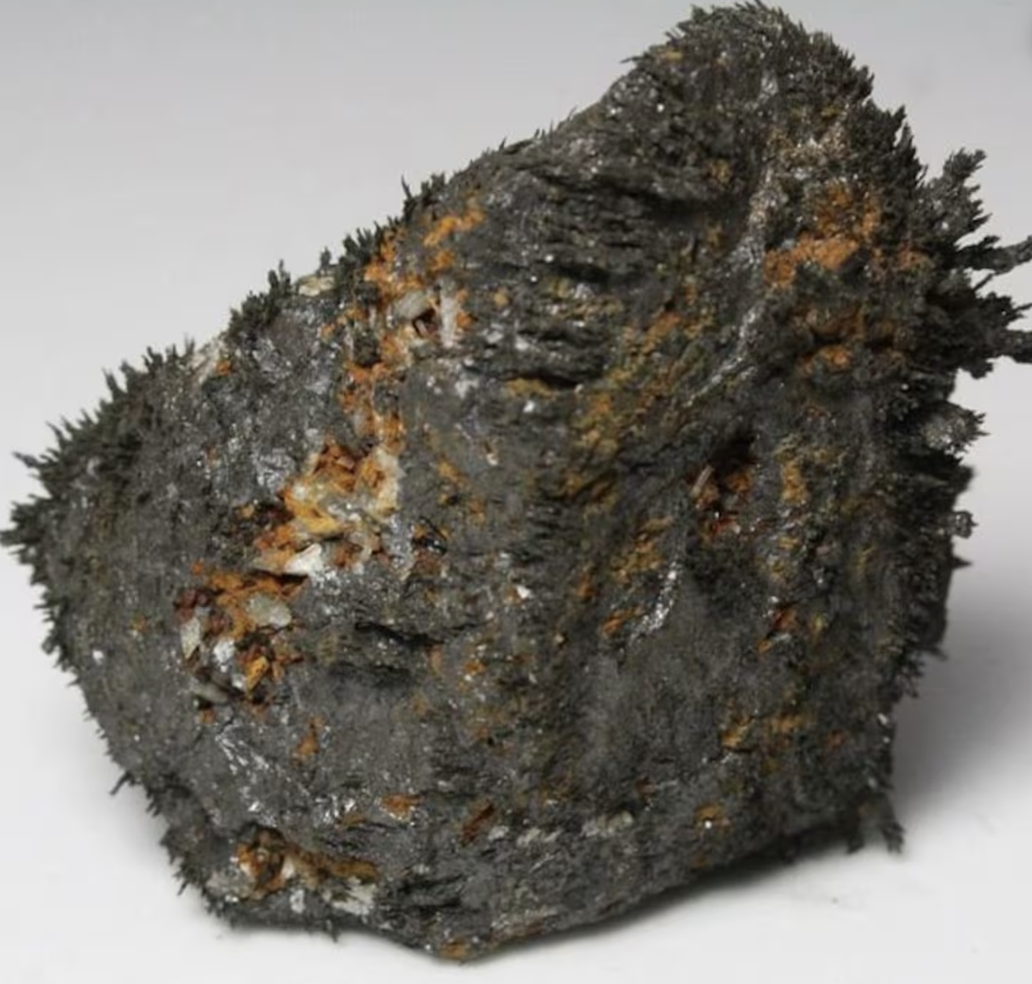
Magnets can be found in nature, like in certain rocks called lodestones. Humans also create magnets using materials like iron or steel.
Notes:
Magnets can be found in nature, like in certain rocks called lodestones. Humans also create magnets using materials like iron or steel.

Slide 21
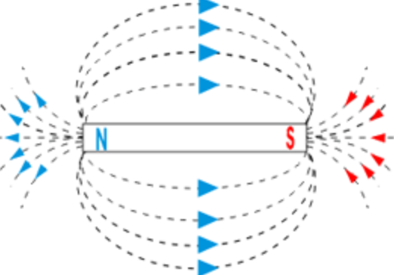
Magnets create an invisible force field around them called a magnetic field
Notes:
Magnets create an invisible force field around them called a magnetic field. This field is what allows them to attract or repel other objects.

Slide 22
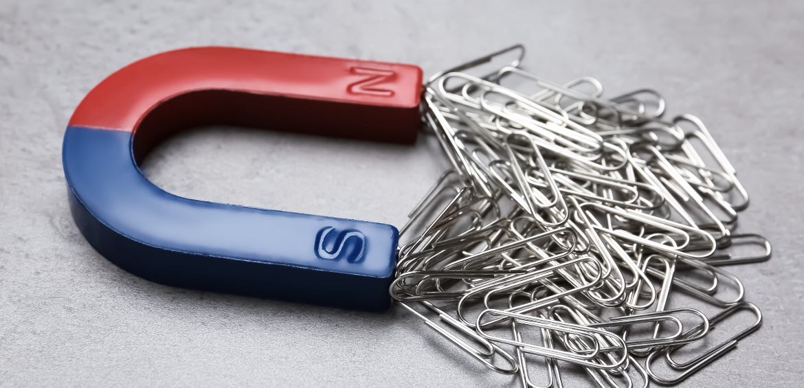
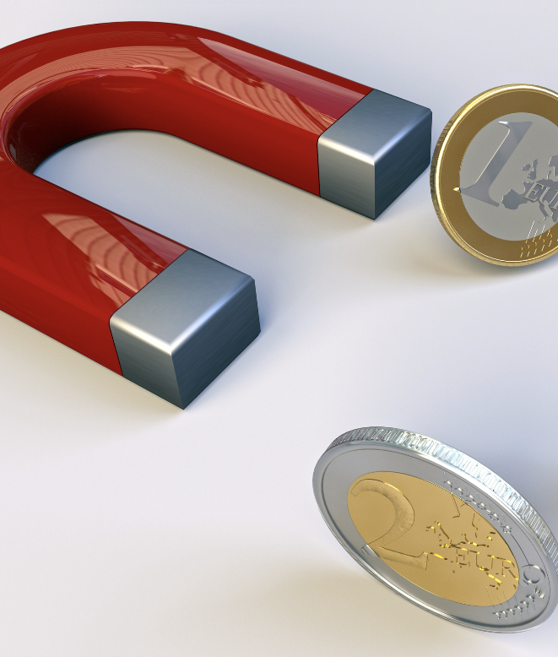
Many everyday items can be attracted by magnets, such as paperclips, certain coins, and some types of metals. This is because these objects contain materials that respond to magnetism.
Notes:
Many everyday items can be attracted by magnets, such as paperclips, certain coins, and some types of metals. This is because these objects contain materials that respond to magnetism.

Slide 23
Compass needles are tiny magnets that align with the Earth's magnetic field. This is how a compass always points north, helping people navigate.
Notes:
Compass needles are tiny magnets that align with the Earth's magnetic field. This is how a compass always points north, helping people navigate.

Slide 24
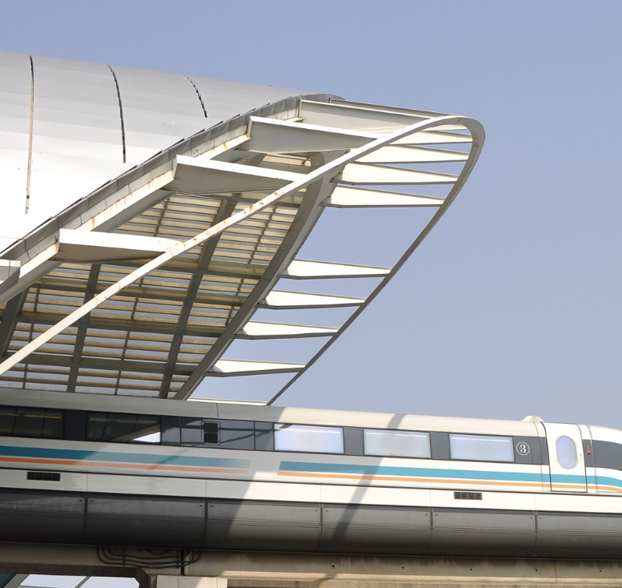
Some trains use magnets to levitate above the tracks, reducing friction and allowing for faster and smoother travel. This technology is called maglev.
Notes:
Some trains use magnets to levitate above the tracks, reducing friction and allowing for faster and smoother travel. This technology is called maglev.

Slide 25
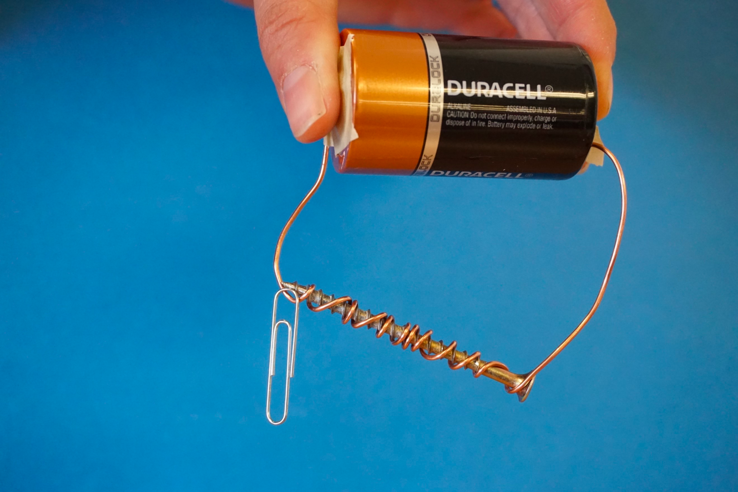
Scientists can create temporary magnets called electromagnets by running electricity through a coil of wire. These are used in many electronic devices and technologies.
Notes:
Scientists can create temporary magnets called electromagnets by running electricity through a coil of wire. These are used in many electronic devices and technologies.

Slide 26
A magnet creates a “magnetic field” because magnets have 2 poles called “North” and “South”. The magnetic field is created by these poles.
Notes:
A magnet creates a “magnetic field” because magnets have 2 poles called “North” and “South”. The magnetic field is created by these poles.

Slide 27
Notes:
Let’s check-in for understanding.

Slide 28
A magnet creates a “magnetic field” because magnets have ___poles called ____ and ____. The magnetic field is created by these poles.
.
2,North,South
South, North, 2
Notes:
A magnet creates a “magnetic field” because magnets have ___poles called____and ____. The magnetic field is created by these poles.
[2,North,South]

Slide 29
A magnet creates a “magnetic field” because magnets have 2 poles called North and South. The magnetic field is created by these poles.
.
2,North,South
South, North, 2
Notes:
A magnet creates a “magnetic field” because magnets have 2 poles called North and South. The magnetic field is created by these poles.

Slide 30
Notes:
Now, let’s talk about some examples of Magnets.

Slide 31
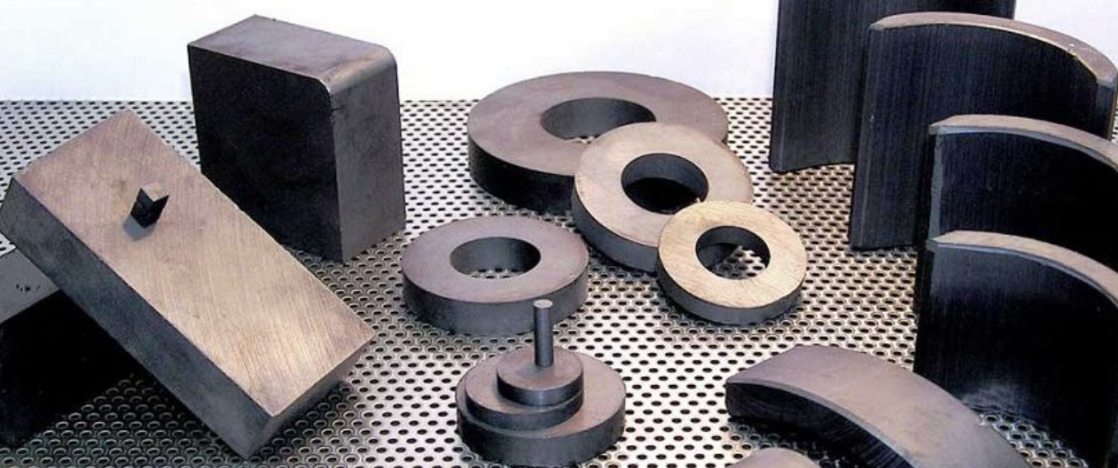
Ferrite is an example of a type of magnet. They contain iron and are much weaker than neodymium or samarium cobalt magnets.
Notes:
Ferrite is an example of a type of magnet. They contain iron and are much weaker than neodymium or samarium cobalt magnets.

Slide 32
Refrigerator magnets are an example of magnets. They stick to the type of steel most refrigerators are made from.
Notes:
Refrigerator magnets are an example of magnets. They stick to the type of steel most refrigerators are made from (martensitic stainless steels–which have a ferritic microstructure–are magnetic).

Slide 33
Notes:
Now, let’s talk about some non-examples of magnets.

Slide 34
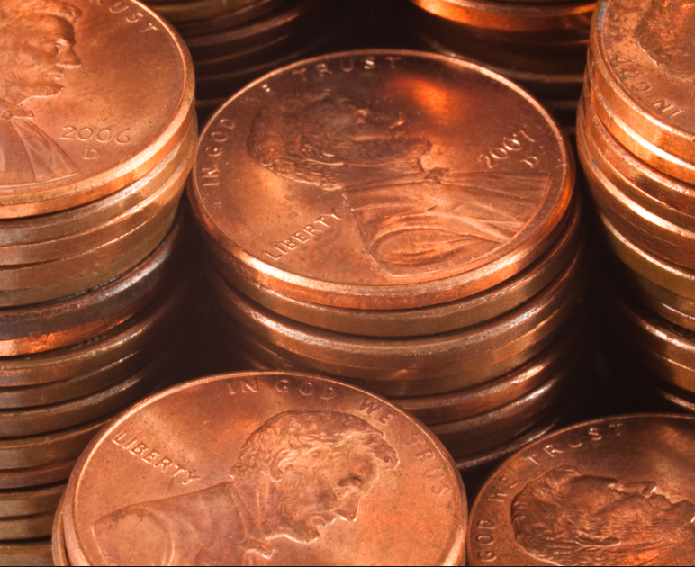
Pennies which are made from copper are NOT examples of a magnet. Pennies do not attract any type of metal
Notes:
Pennies which are made from copper are NOT examples of a magnet. Pennies do not attract any type of metal

Slide 35
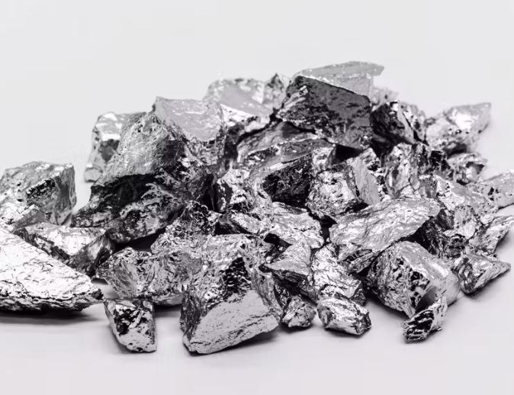
Aluminum is NOT an example of a magnet. It does not attract any type of metal.
Notes:
Aluminum is NOT an example of a magnet. It does not attract any type of metal.

Slide 36
Notes:
Now let’s pause for a moment to check your understanding.

Slide 37
Why are copper and aluminum not examples of magnets?
Notes:
Why are copper and aluminum not examples of magnets?”
[Neither copper (pennies) or aluminum attract iron using a magnetic field]

Slide 38
Remember!!!
Notes:
So remember!

Slide 39
Magnet: a material or object that can attract certain metals
Notes:
Magnet: a material or object that can attract certain metals

Slide 40
Notes:
We will now complete this concept map, called a Frayer model, to summarize and further clarify what you have learned about the term magnet.

Slide 41
Definition
Picture
Magnet
Example
How do magnets impact my life?
Notes:
To complete the Frayer model, we will choose from four choices the correct picture, definition, example, and response to the question, “Why does a paper clip stick to a magnet?” Select the best response for each question using the information you just learned. As we select responses, we will see how this model looks filled in for the term Magnet.

Slide 42
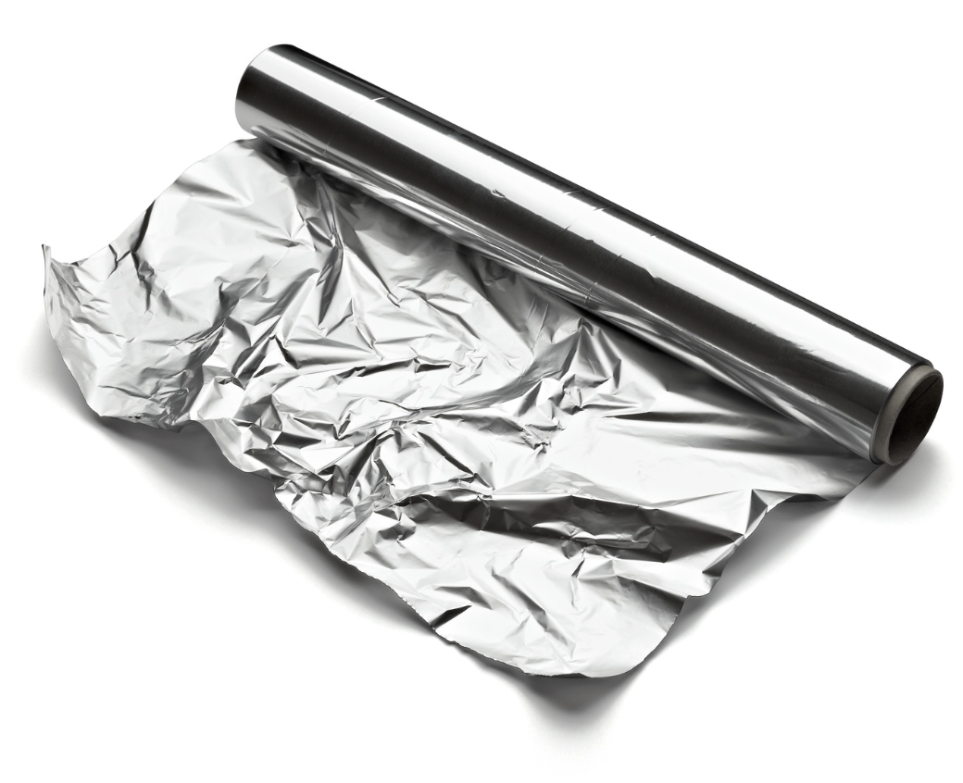
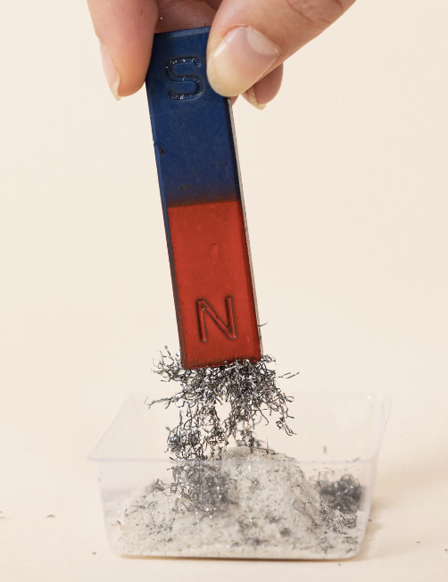
Directions: Choose the correct picture of magnets from the choices below.
A
B
C
D
Notes:
Choose the one correct picture of a Magnet from these four choices.

Slide 43
Directions: Choose the correct picture of magnets from the choices below.
A
B
C
D
Notes:
This is the picture that shows a magnet.

Slide 44
Definition
Picture
Magnet
Example
How do magnets impact my life?
Notes:
Here is the Frayer model filled in with a picture of a magnet.

Slide 45
Directions: Choose the correct definition of magnet from the choices below.
A
Invisible hug that the earth gives everything to keep it close
B
A force that surrounds all magnets, that moves electronically charged particles in a circular path
C
The smallest unit of matter
D
a material or object that can attract certain metals
Notes:
Choose the one correct definition of Magnet from these four choices.

Slide 46
Directions: Choose the correct definition of magnet from the choices below.
A
Invisible hug that the earth gives everything to keep it close
B
A force that surrounds all magnets, that moves electronically charged particles in a circular path
C
The smallest unit of matter
D
a material or object that can attract certain metals
Notes:
The correct answer is D: a material or object that can attract certain metals

Slide 47
Definition
Picture
a material or object that can attract certain metals
Magnet
Example
How do magnets impact my life?
Notes:
Here is the Frayer Model with a picture and the definition filled in for magnet: a material or object that can attract certain metals

Slide 48
Directions: Choose the correct example of a magnet from the choices below.
A
Aluminum
B
Ferrite
C
Penny
D
Copper
Notes:
Choose the one correct example of a magnet from these four choices.

Slide 49
Directions: Choose the correct example of a magnet from the choices below.
A
Aluminum
B
Ferrite
C
Penny
D
Copper
Notes:
The correct answer is B: Ferrite.

Slide 50
Definition
Picture
a material or object that can attract certain metals
Magnet
Ferrite
Example
How do magnets impact my life?
Notes:
Here is the Frayer Model with a picture, the definition, and an example filled in for magnet: ferrite

Slide 51
Directions: Choose the correct response for “How do magnets impact my life?” .
A
Magnets are used to help a compass work and a compass can help me find my way home if I am lost.
B
Magnets are used as an ingredient in my favorite chocolate chip cookies.
C
Magnets are used to help babies teethe and they soothe their gums.
D
Magnets release a sticky substance that attaches to paper clips.
Notes:
Choose the one correct response for “How do magnets impact our lives?” from these four choices.

Slide 52
Directions: Choose the correct response for “How do magnets impact my life?” .
A
Magnets are used to help a compass work and a compass can help me find my way home if I am lost.
B
Magnets are used as an ingredient in my favorite chocolate chip cookies.
C
Magnets are used to help babies teethe and they soothe their gums.
D
Magnets release a sticky substance that attaches to paper clips.
Notes:
The correct answer is A: Magnets are used to help a compass work and a compass can help me find my way home if I am lost.

Slide 53
Definition
Picture
a material or object that can attract certain metals
Magnet
Magnets are used to help a compass work and a compass can help me find my way home if I am lost.
Ferrite
Example
How do magnets impact my life?
Notes:
Here is the Frayer Model with a picture, the definition, an example, and the response to “how do magnets impact my life?” filled in for magnet: Magnets are used to help a compass work and a compass can help me find my way home if I am lost.

Slide 54
Remember!!!
Notes:
So remember!

Slide 55
Magnet: a material or object that can attract certain metals
Notes:
Magnet: a material or object that can attract certain metals

Slide 56
Big Question: How are you able to tell if an object is magnetic?
Notes:
Let’s reflect once more on our big question. Our “big question” is: How are you able to tell if an object is magnetic?
Does anyone have any additional examples to share that haven’t been discussed yet?

Slide 57
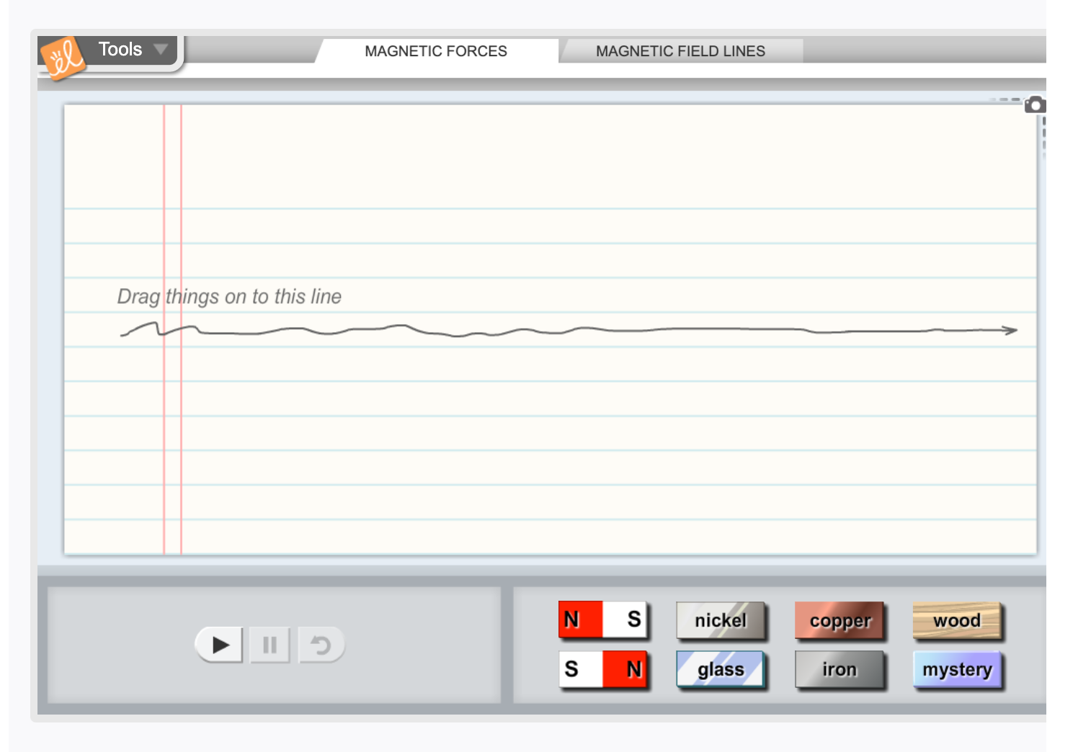
Simulation Activity
Magnetism Lab
(Gizmos)
Click the link above for a simulation to deepen your understanding of Magnets.
Notes:
Click the link above for a simulation to deepen your understanding of magnets.

Slide 58
Notes:
Thanks for watching, and please continue watching CAPs available from this website.

Slide 59
This Was Created With Resources From:
Questions or Comments
Michael Kennedy, Ph.D. MKennedy@Virginia.edu
Rachel L Kunemund, Ph.D. rk8vm@virginia.edu

