Slide 1
Intro
“Big Idea” Question
Review Concepts
Check-In Questions
Teacher Engagement
Vocabulary
Student-Friendly Definition
Examples & Non-Examples
Morphological Word Parts
Frayer Model
Simulation/Activity
Notes:
OK everyone, get ready for our next lesson. Just as a reminder, these are the different components that our lesson may include, and you’ll see these icons in the top left corner of each slide so that you can follow along more easily!

Slide 2
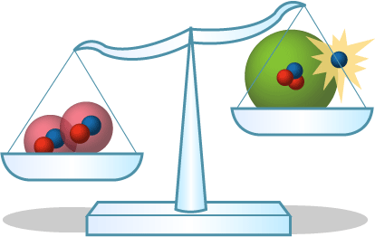
Mass
Intro
Notes:
Today, we’ll be learning about the word: Mass.

Slide 3
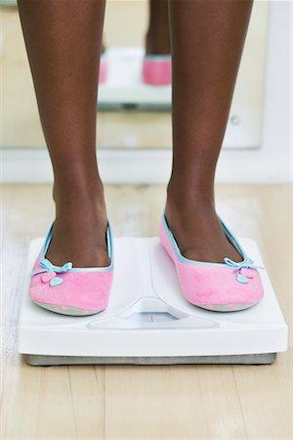
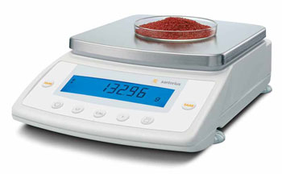
Big Question: What is the difference between mass and weight?
Notes:
Our “big question” is: What is the difference between mass and weight?
[Pause and illicit predictions from students.]
I love all these thoughtful scientific hypotheses! Be sure to keep this question and your predictions in mind as we move through these next few lessons, and we’ll continue to revisit it.

Slide 4
Notes:
Before we move on to our new topic, let’s review some other words & concepts that you already learned and make sure you are firm in your understanding.

Slide 5
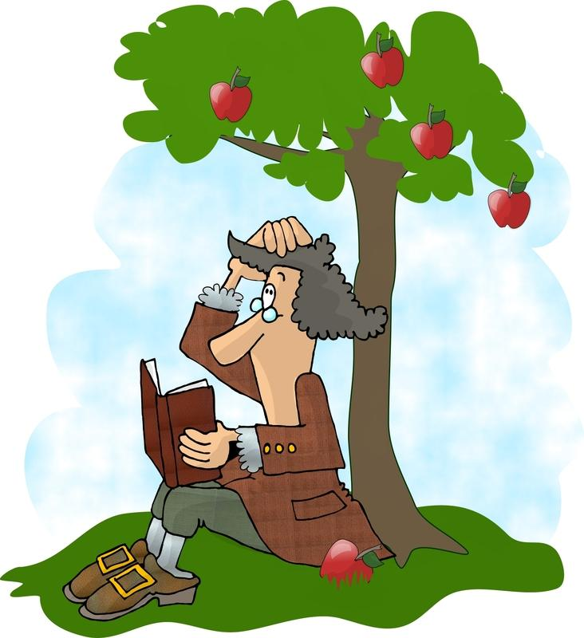
Gravity: a noncontact force that attracts any object with mass toward another object with mass
Notes:
Gravity is a noncontact force that attracts any object with mass towards another object with mass.

Slide 6
Matter: has mass and takes up space
Notes:
Matter is anything that has mass and takes up space.

Slide 7
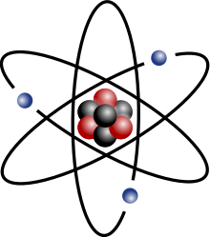
Atom: smallest whole unit of matter
Notes:
An atom is the smallest whole unit of matter. All matter is made up of atoms.

Slide 8
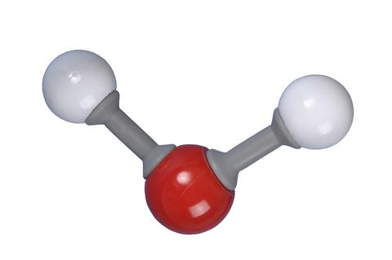
Molecule: particle containing two or more atoms of the same OR different elements
Notes:
A molecule is a particle containing 2 or more atoms of the same OR different elements. Molecules are the smallest pieces of compounds.

Slide 9
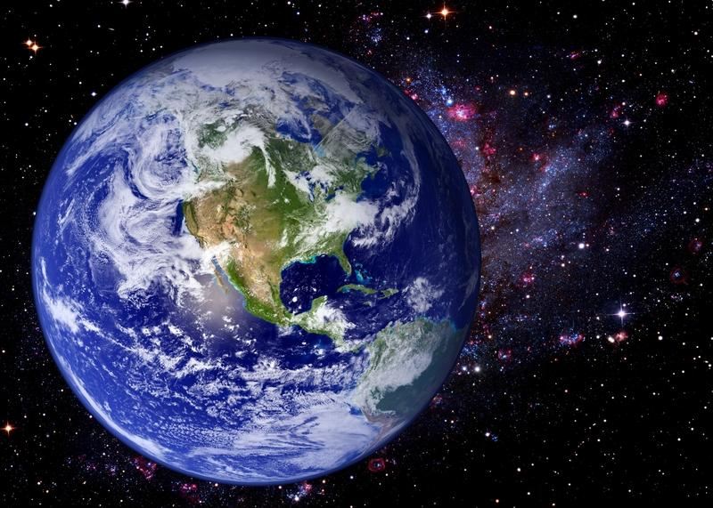
Weight: the gravitational force exerted on an object
Notes:
Weight is the gravitational force, or amount of gravity, exerted on an object.

Slide 10
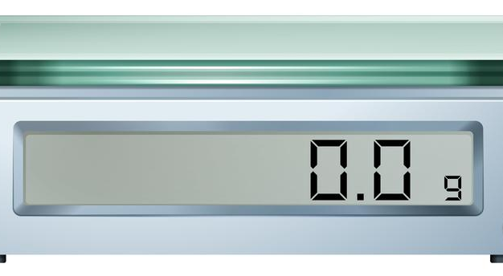
Grams: a unit used to measure mass
Notes:
Grams are a unit used to measure mass.

Slide 11
Notes:
Now let’s pause for a moment to review the information we have covered already.

Slide 12
A molecule is a particle containing two or more atoms.
True
False
Notes:
A molecule is a particle containing two or more atoms.

Slide 13
A molecule is a particle containing two or more atoms.
True
False
Notes:
A molecule is a particle containing two or more atoms.
[True]

Slide 14
Gravity is an attractive force between objects that have ________.
Volume
Mass
Distance
Notes:
Gravity is an attractive force between objects that have ________.
[Mass]

Slide 15
Gravity is an attractive force between objects that have ________.
Volume
Mass
Distance
Notes:
Gravity is an attractive force between objects that have ________.
[Mass]

Slide 16
_______ is the gravitational force exerted on an object.
Weight
Mass
Notes:
_____ is the gravitational force exerted on an object.
[Weight]

Slide 17
_______ is the gravitational force exerted on an object.
Weight
Mass
Notes:
Weight is the gravitational force exerted on an object.

Slide 18
Grams are a unit used to measure _______.
Weight
Mass
Notes:
Grams are used to measure ________.
[Mass]

Slide 19
Grams are a unit used to measure _______.
Weight
Mass
Notes:
Grams are used to measure ________.
[Mass]

Slide 20
What is matter?
Notes:
What is matter?
[Matter is anything that takes up space and has mass. Matter can be in the form of a liquid, solid, or gas.]

Slide 21
Mass
Notes:
Now that we’ve reviewed, let’s define the phrase mass.

Slide 22
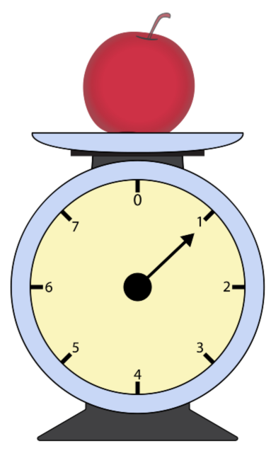
Mass: amount of matter in an object
Notes:
Mass is the amount of matter in an object.

Slide 23
Notes:
Let’s check-in for understanding.

Slide 24
What is mass?
Notes:
What is mass?
[Mass is the amount of matter in an object.]

Slide 25
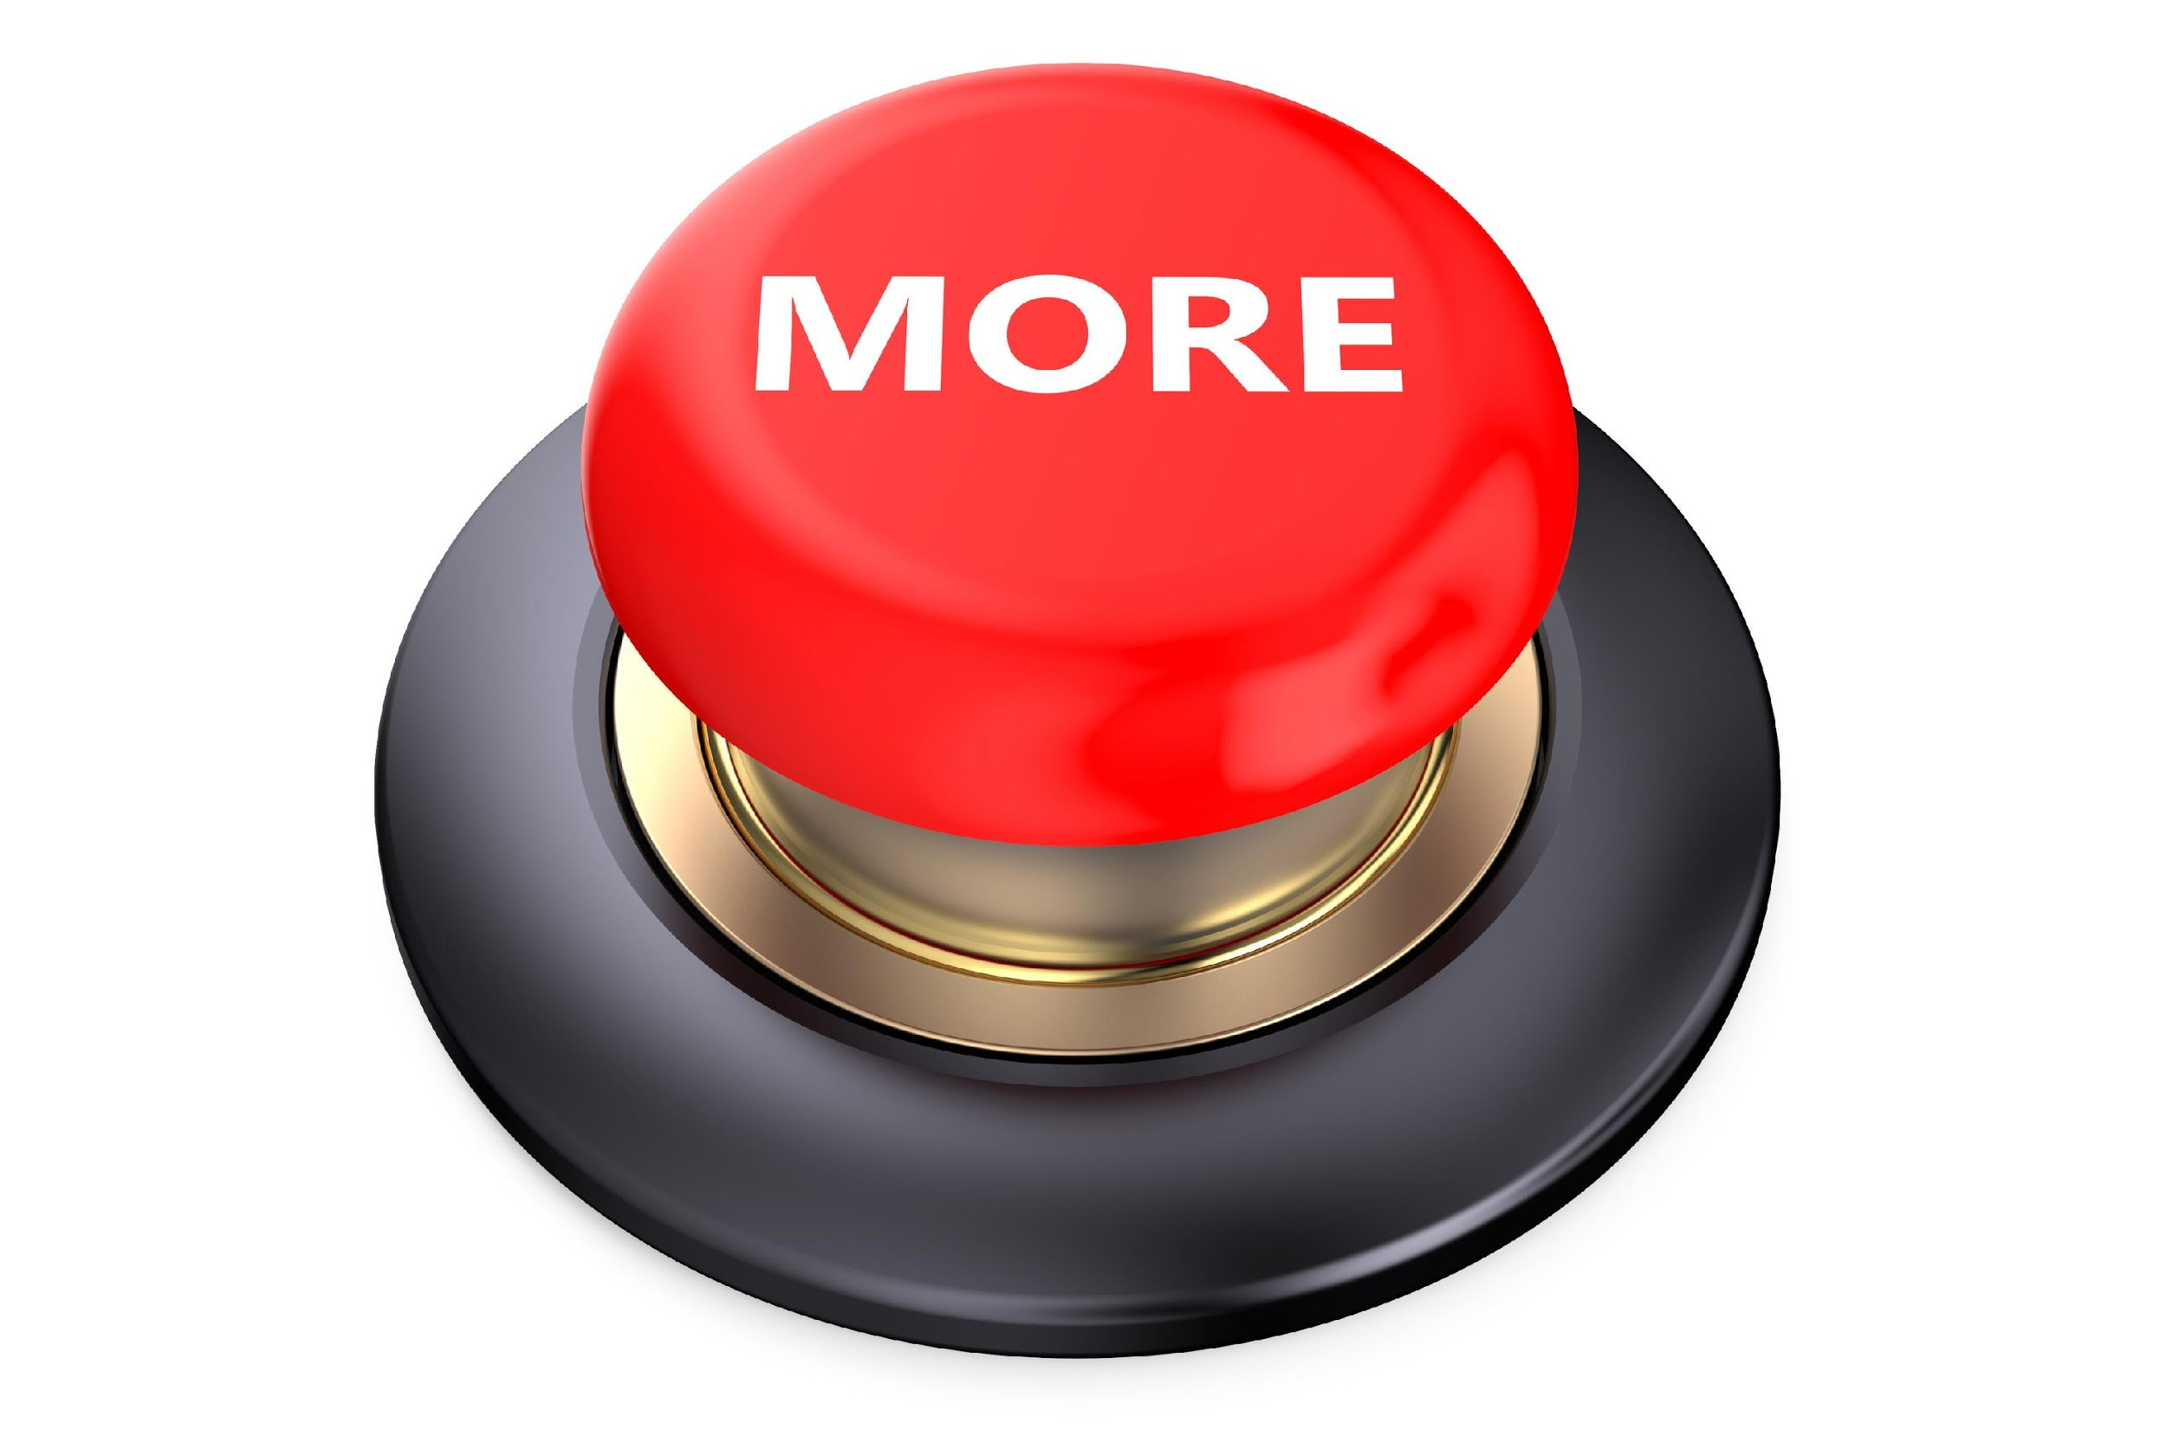
Notes:
That is the basic definition, but there is a bit more you need to know.

Slide 26
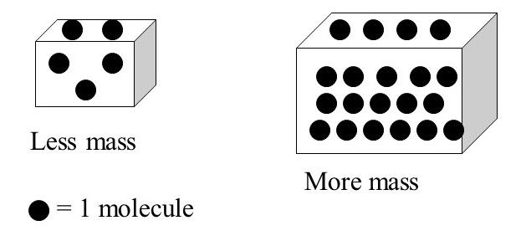
Notes:
Mass tells you how much matter is in an object. If an object has less mass, it will feel lighter when it is picked up. It may also have molecules that are not as tightly packed in the object. If an object has more mass, it will feel heavier when it is picked up. It may also have molecules that are more tightly packed in the object.

Slide 27
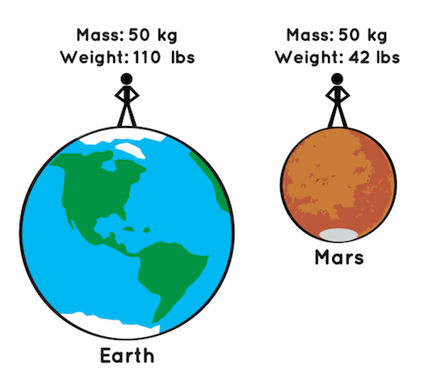
Notes:
Mass is different from weight because weight is the gravitational force exerted on an object. For example, the person in the picture has a weight on Earth of 110 pounds. This is due to Earth’s gravitational force that is on put on them. The person’s weight on Mars is 42 pounds, which is less than their weight on Earth because Mars has less gravitational force than Earth. Yet, their mass is always 50kg regardless of whether they are on Earth or Mars. Therefore, Mass is not impacted by gravity like weight is.

Slide 28
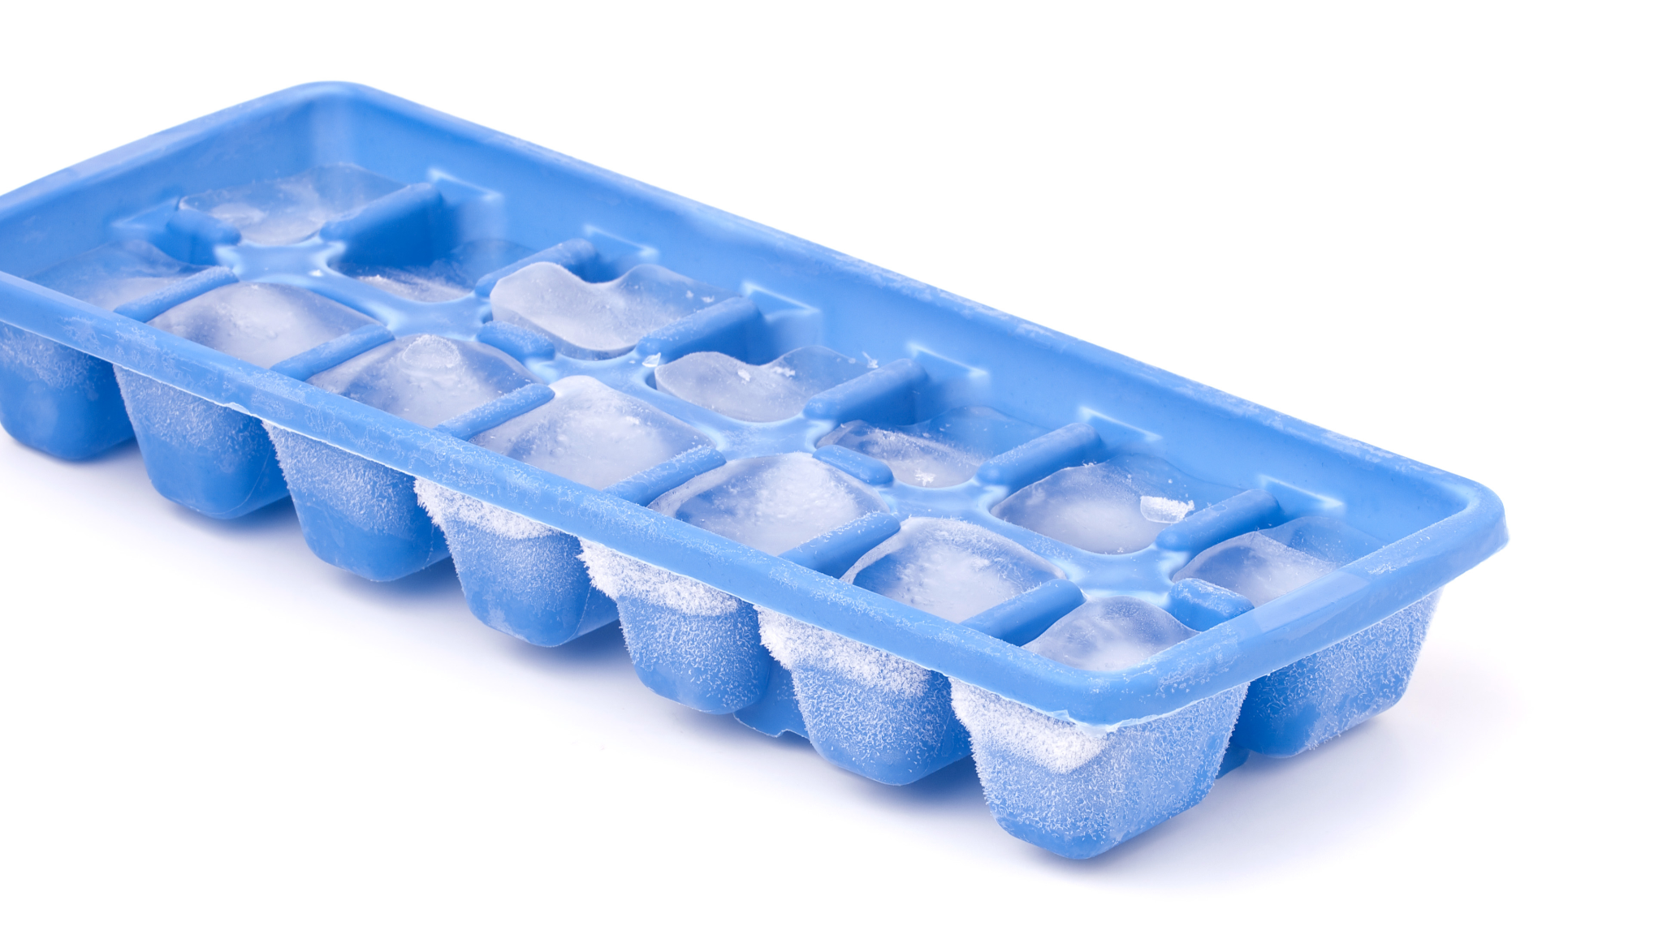
Notes:
Matter does not gain or lose mass during phase changes. For example, when you pour in 100g of water to an ice cube tray and freeze it, you will then have 100 g of ice once the water freezes. Even though the water changed phases of matter from liquid to solid, it did not lose mass.

Slide 29
Notes:
Let’s check-in for understanding.

Slide 30
Mass tells you how much _____ is in an object.
Notes:
Mass tells you how much ______ is in an object.
[Matter]

Slide 31
Mass tells you how much matter is in an object.
Notes:
[Mass tells you how much matter is in an object.]

Slide 32
True or False: Mass is not impacted by gravitational force, weight is.
True
False
Notes:
True or False: Mass is not impacted by gravitational force, weight is.
True
False

Slide 33
True or False: Mass is not impacted by gravitational force, weight is.
True
False
Notes:
True: Mass is not impacted by gravitational force, weight is.

Slide 34
Matter does not lose or gain ____ during phase changes.
Notes:
Matter does not lose or gain ___ during phase changes.
[mass]

Slide 35
Matter does not lose or gain mass during phase changes.
Notes:
[Matter does not lose or gain mass during phase changes.]

Slide 36
Notes:
Now, let’s talk about some examples of mass.

Slide 37
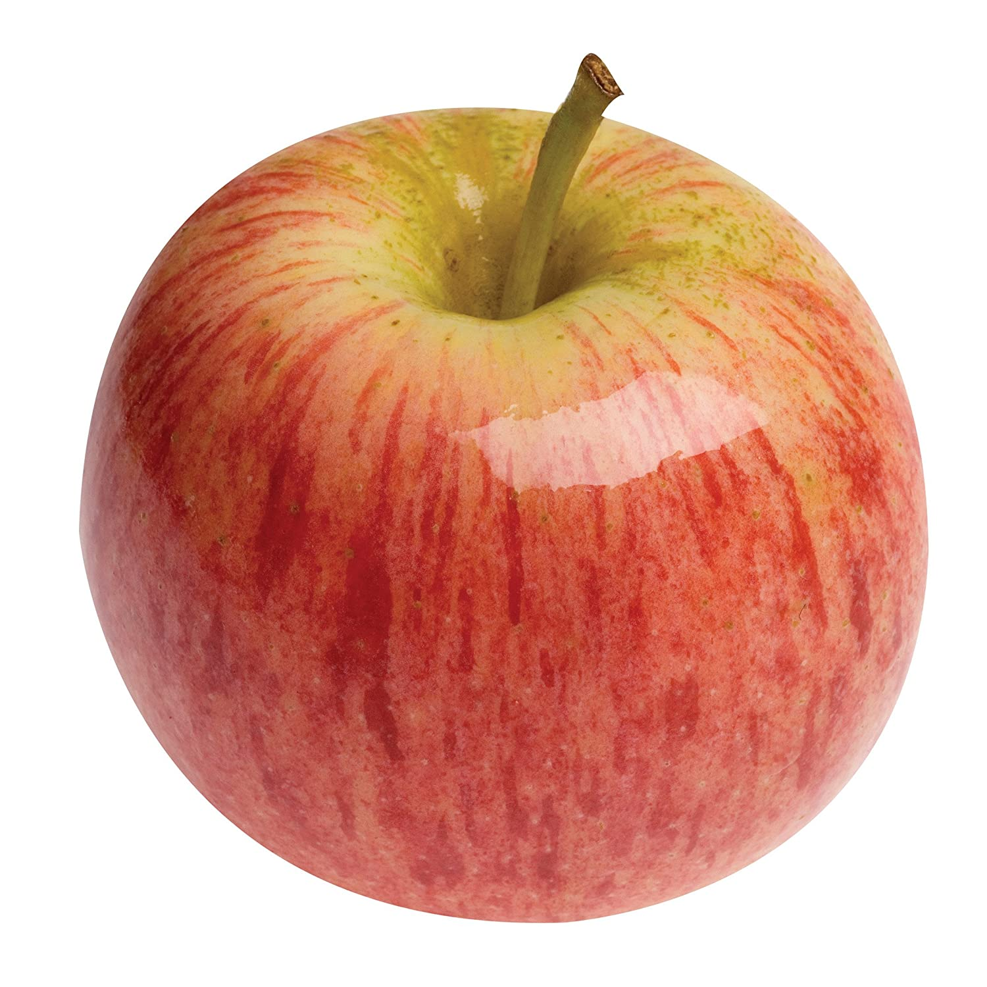
Notes:
This apple is a solid with mass. Its mass is the amount of space it takes up (matter).

Slide 38
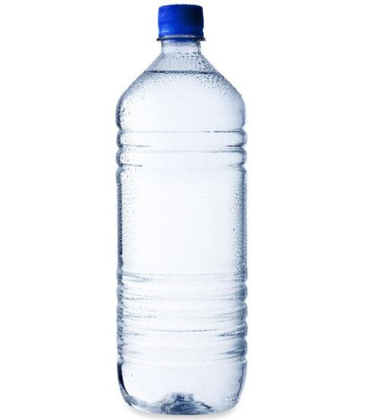
Notes:
This water is a liquid with mass. Its mass is the amount of space it takes up (matter).

Slide 39
Notes:
Let’s check-in for understanding.

Slide 40
What is mass?
Notes:
What is mass?
[Mass is the amount of matter in an object.]

Slide 41
Notes:
Now, let’s talk about some non-examples of mass.

Slide 42
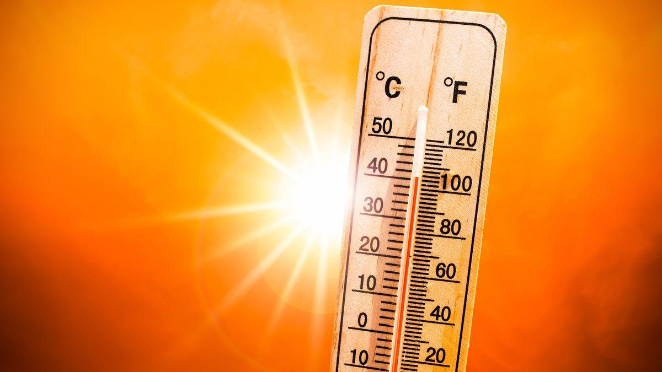
Notes:
Temperature is a measure of how hot or cold something is, but it does not have mass.

Slide 43
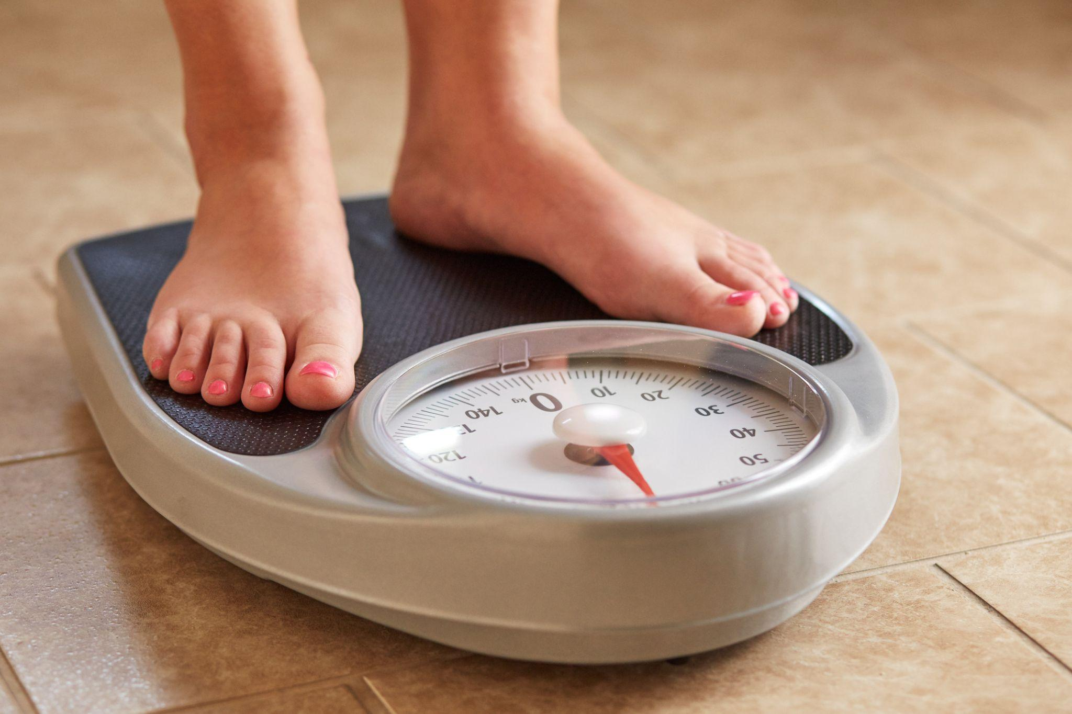
Notes:
A person’s weight is not an example of mass. Remember, weight is impacted by gravitational force. On Earth, gravity is stronger than other places in our solar system. So, you may have a higher weight on Earth than on another planet, such as Mars, with less gravity. Yet, your mass, or the amount of matter you are made up of, will always stay the same.

Slide 44
Notes:
Now let’s pause for a moment to check your understanding.

Slide 45
How is mass different from weight?
Notes:
How is mass different from weight?
[Mass is the total amount of matter in an object. This amount does not change like weight does since weight is influenced by gravitational force.]

Slide 46
Notes:
We can also break down the term mass into different word parts to help us remember the meaning. Let’s take a look!

Slide 47
Mass
(root)
Notes:
We can break up the term mass into one part: the root.

Slide 48
Mass
the amount of matter in an object
Notes:
The root “mass” means the amount of matter in an object.

Slide 49
Mass
The amount of matter in an object
Notes:
So when look at the word mass it means the amount of matter in an object.

Slide 50
Notes:
Let’s check-in for understanding.

Slide 51
How can we use the word parts of mass to help us remember the definition of the term?
Mass
(root)
Notes:
How can we use the word parts of mass to help us remember the definition of the term?
[The root mass means the amount of matter in an object.
So when we put it all together, mass is the amount of matter in an object.]

Slide 52
Remember!!!
Notes:
So remember!

Slide 53
Mass: amount of matter in an object
Notes:
Mass is the amount of matter in an object.

Slide 54
Notes:
We will now complete this concept map, called a Frayer model, to summarize and further clarify what you have learned about the term mass.

Slide 55
Definition
Picture
Mass
Example
How does mass impact my life?
Notes:
To complete the Frayer model, we will choose from four choices the correct picture, definition, example, and response to the question, “How does mass impact my life?” Select the best response for each question using the information you just learned. As we select responses, we will see how this model looks filled in for the term mass.

Slide 56
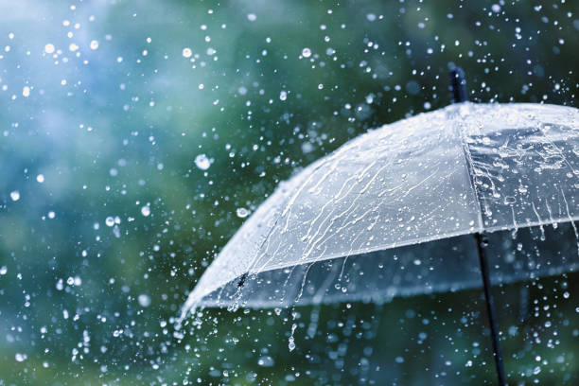
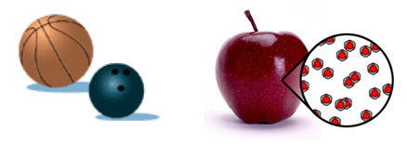
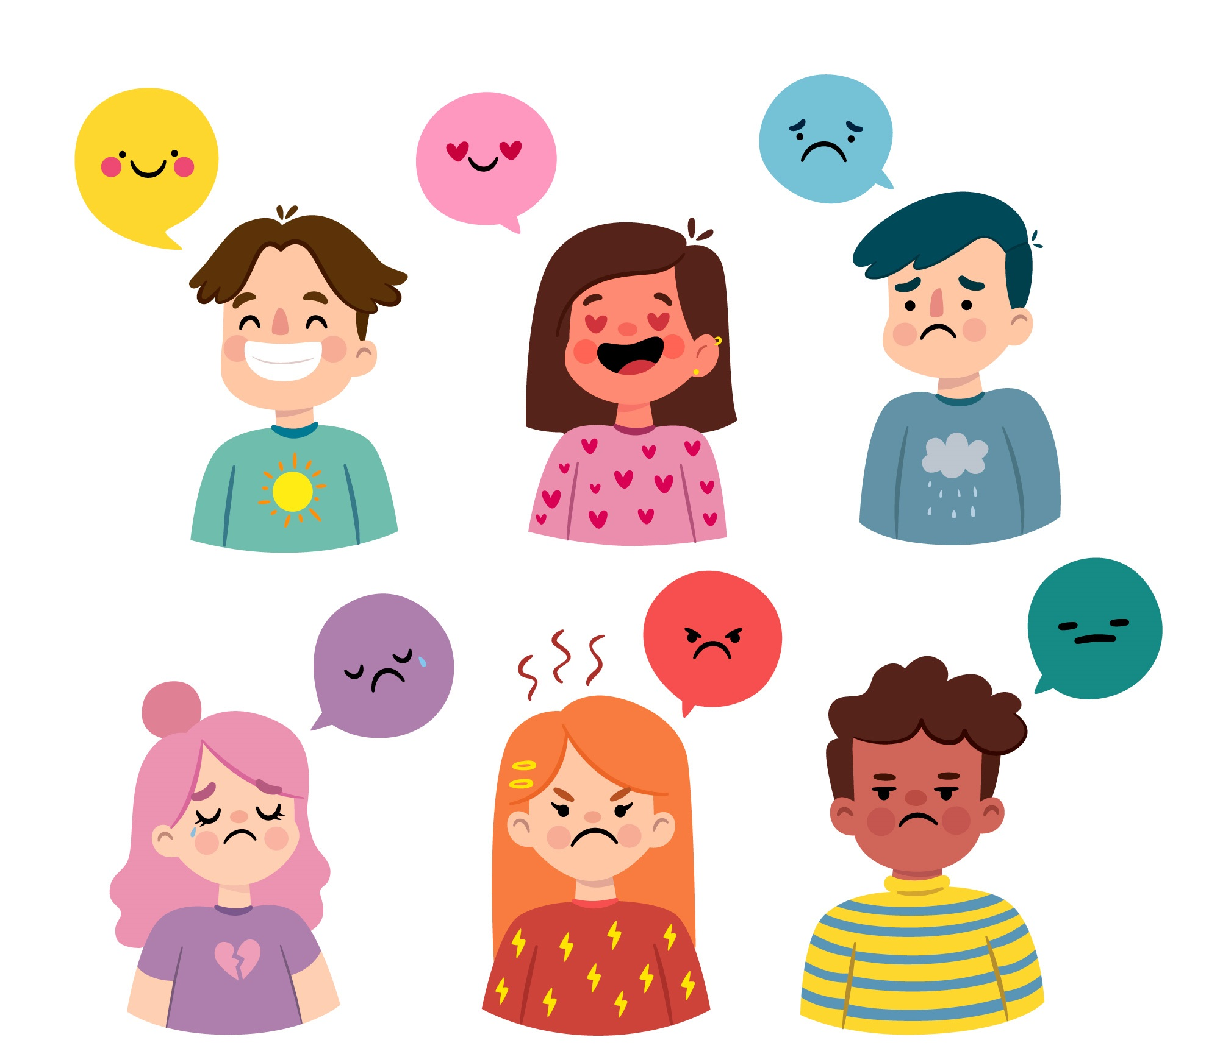
Directions: Choose the correct picture of Mass from the choices below.
A
B
C
D
Notes:
Choose the one correct picture of mass from these four choices.

Slide 57
Directions: Choose the correct picture of Mass from the choices below.
A
B
C
D
Notes:
This is the picture that shows mass.

Slide 58
Definition
Picture
Mass
Example
How does mass impact my life?
Notes:
Here is the Frayer model filled in with a picture of mass.

Slide 59
Directions: Choose the correct definition of Mass from the choices below.
A
The smallest whole unit of matter
B
Anything that has mass and takes up space
C
The powerhouse of a cell
D
Amount of matter in an object
Notes:
Choose the one correct definition of mass from these four choices.

Slide 60
Directions: Choose the correct definition of Mass from the choices below.
A
The smallest whole unit of matter
B
Anything that has mass and takes up space
C
The powerhouse of a cell
D
Amount of matter in an object
Notes:
“Amount of matter in an object” is correct! This is the definition of mass.

Slide 61
Definition
Picture
Amount of matter in an object
Mass
Example
How does mass impact my life?
Notes:
Here is the Frayer Model with a picture and the definition filled in for mass: Amount of matter in an object.

Slide 62
Directions: Choose the correct example of Mass from the choices below.
A
A big book that is heavy
B
A dam turning flowing water into energy
C
A person running
D
A hawk hunting and eating a field mouse
Notes:
Choose the one correct example of mass from these four choices.

Slide 63
Directions: Choose the correct example of Mass from the choices below.
A
A big book that is heavy
B
A dam turning flowing water into energy
C
A person running
D
A hawk hunting and eating a field mouse
Notes:
“A big book that is heavy” is correct! This is an example of mass.

Slide 64
Definition
Picture
Amount of matter in an object
Mass
A big book that is heavy
Example
How does mass impact my life?
Notes:
Here is the Frayer Model with a picture, definition, and an example of mass: A big book that is heavy.

Slide 65
Directions: Choose the correct response for “how does mass impact my life?” from the choices below.
A
Mass shows us which animals hunt and eat other animals so that we can be safe.
B
Mass helps us understand our world through learning about plants and animals from long ago.
C
Mass creates electricity to power our buildings and help us survive.
Mass helps us understand how heavy objects are and therefore how they move and interact in our environment.
D
Notes:
Choose the one correct response for “how does mass impact my life?” from these four choices.

Slide 66
Directions: Choose the correct response for “how does mass impact my life?” from the choices below.
A
Mass shows us which animals hunt and eat other animals so that we can be safe.
B
Mass helps us understand our world through learning about plants and animals from long ago.
C
Mass creates electricity to power our buildings and help us survive.
Mass helps us understand how heavy objects are and therefore how they move and interact in our environment.
D
Notes:
“Mass helps us understand how heavy objects are and therefore how they move and interact in our environment.” That is correct! This is an example of how mass impacts your life.

Slide 67
Definition
Picture
Amount of matter in an object
Mass
A big book that is heavy
Mass helps us understand how heavy objects are and therefore how they move and interact in our environment.
Example
How does mass impact my life?
Notes:
Here is the Frayer Model with a picture, definition, example, and a correct response to “how does mass impact my life?”: Mass helps us understand how heavy objects are and therefore how they move and interact in our environment.

Slide 68
Remember!!!
Notes:
So remember!

Slide 69
Mass: amount of matter in an object
Notes:
Mass is the amount of matter in an object.

Slide 70
Big Question: What is the difference between mass and weight?
Notes:
Let’s reflect once more on our big question. Our “big question” is: What is the difference between mass and weight?
Does anyone have any additional examples to share that haven’t been discussed yet?

Slide 71
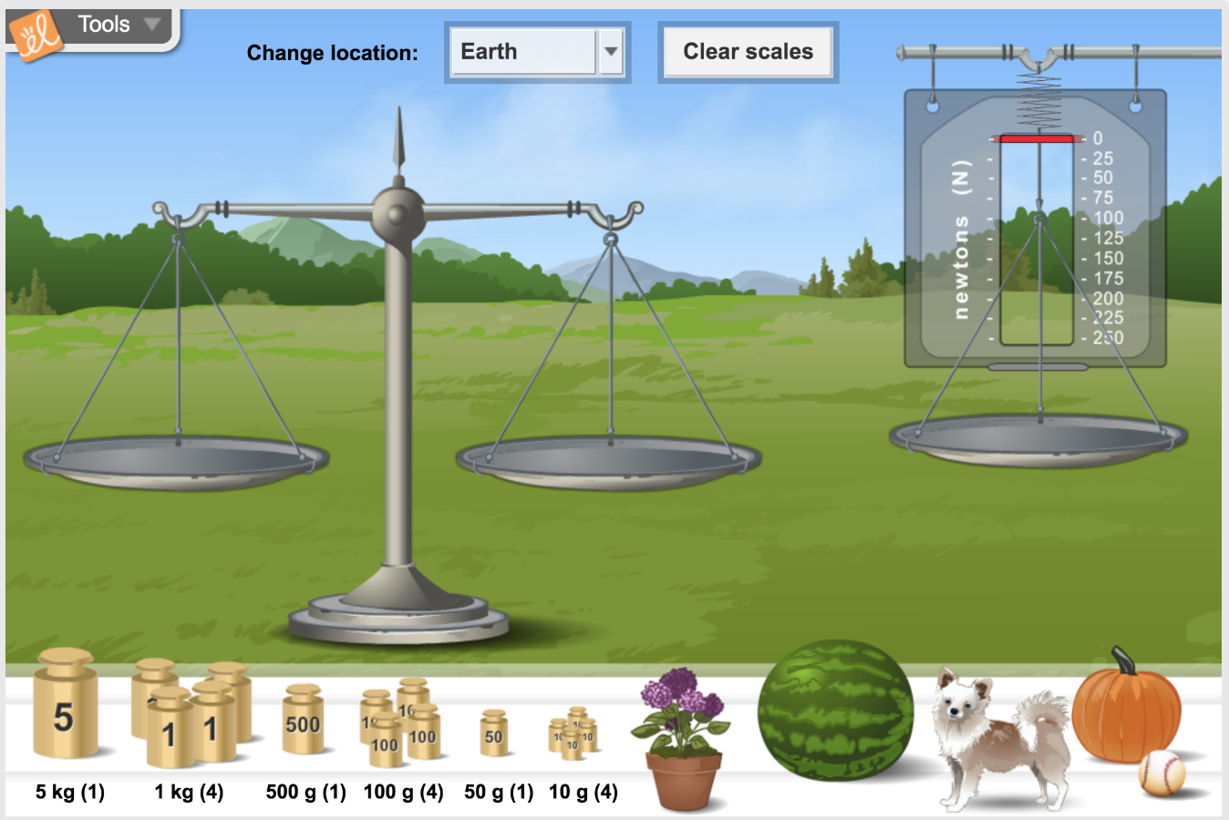
Simulation Activity
Mass
(Gizmos)
Click the link above for a simulation to explore mass.
In this activity, you’ll compare the mass and weight of objects on Earth, Mars, Jupiter, and the Moon .
Notes:
*This is the same simulation for weight – could potentially wait to have the students do it once
Feedback: Providing a rationale during this activity helps students make connections and promotes understanding of the content.

Slide 72
Notes:
Thanks for watching, and please continue watching CAPs available from this website.

Slide 73
This Was Created With Resources From:
Questions or Comments
Michael Kennedy, Ph.D. MKennedy@Virginia.edu
Rachel L Kunemund, Ph.D. rk8vm@virginia.edu

