Slide 1
Intro
“Big Idea” Question
Review Concepts
Check-In Questions
Teacher Engagement
Vocabulary
Student-Friendly Definition
Examples & Non-Examples
Frayer Model
Simulation/Activity
Notes:
OK everyone, get ready for our next lesson. Just as a reminder, these are the different components that our lesson may include, and you’ll see these icons in the top left corner of each slide so that you can follow along more easily!

Slide 2
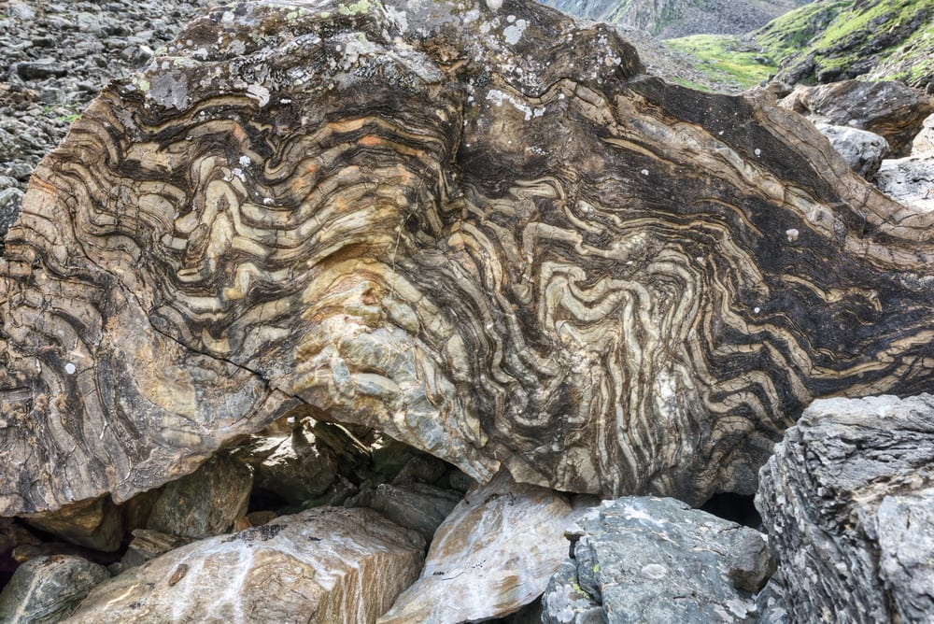
Intro
Metamorphic Rock
Notes:
Today, we’ll be learning about the word: Metamorphic Rock.

Slide 3
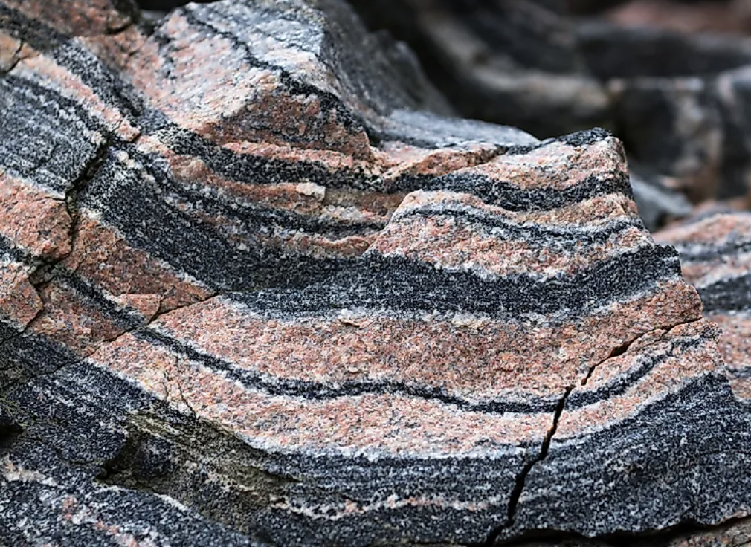
Big Question: In what ways do metamorphic rocks play a role in shaping the Earth's surface, and how do they add to the differences of ecosystems around us?
Notes:
Our “big question” is: In what ways do metamorphic rocks play a role in shaping the Earth's surface, and how do they add to the differences of ecosystems around us?
[Pause and illicit predictions from students.]
I love all these thoughtful scientific hypotheses! Be sure to keep this question and your predictions in mind as we move through these next few lessons, and we’ll continue to revisit it.

Slide 4
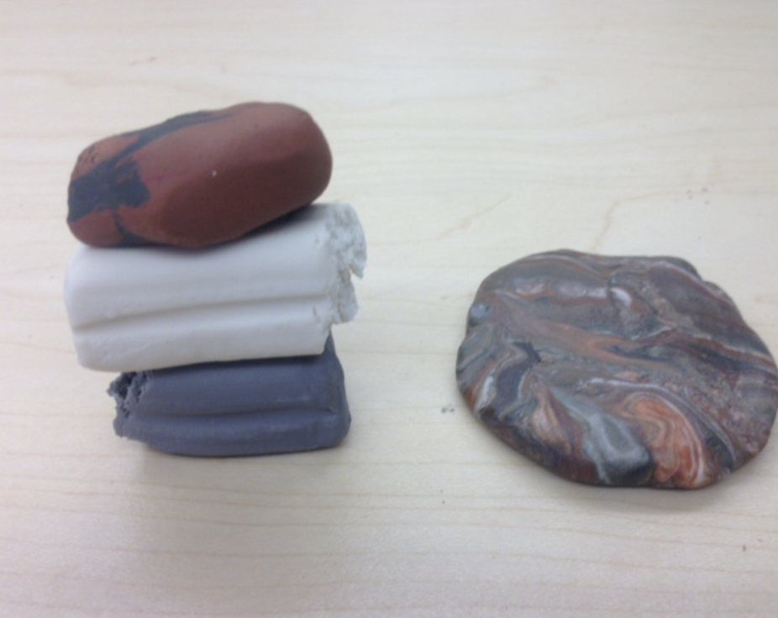
Demonstration
TEACHER DIRECTIONS:
Before viewing: Ask students what they already know about metamorphic rocks. Tell students today they will be learning about the term metamorphic rocks.
During: Have students discuss how pressure and heat cause the minerals to recrystallize and form a new rock, like how metamorphic rocks are created in the Earth's crust.
After: Tell students that today they will be learning more about the term metamorphic rocks.
Notes:
Activity: Model Metamorphic Rock Formation
Materials:
Different colors of modeling clay (representing different minerals)
Plastic sandwich bags
Rolling pin or flat surface
Procedure:
Divide the modeling clay into several small portions, each of a different color.
Explain to the students that each color represents a different mineral within a rock.
Ask students to stack the clay portions on top of each other inside a plastic sandwich bag.
Seal the bag and have students use a rolling pin or their hands to apply pressure and heat to the clay layers.
Discuss how pressure and heat cause the minerals to recrystallize and form a new rock, similar to how metamorphic rocks are created in the Earth's crust.
This hands-on activity helps students visualize the process of metamorphism and understand how pressure and heat lead to the formation of metamorphic rocks.

Slide 5
Notes:
Before we move on to our new topic, let’s review some other words & concepts that you already learned and make sure you are firm in your understanding.

Slide 6
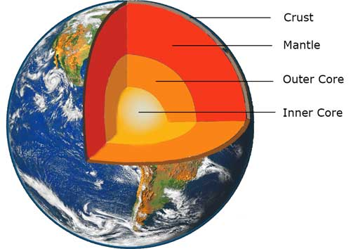
The Layers of the Earth
Notes:
Review the layers of the Earth.

Slide 7
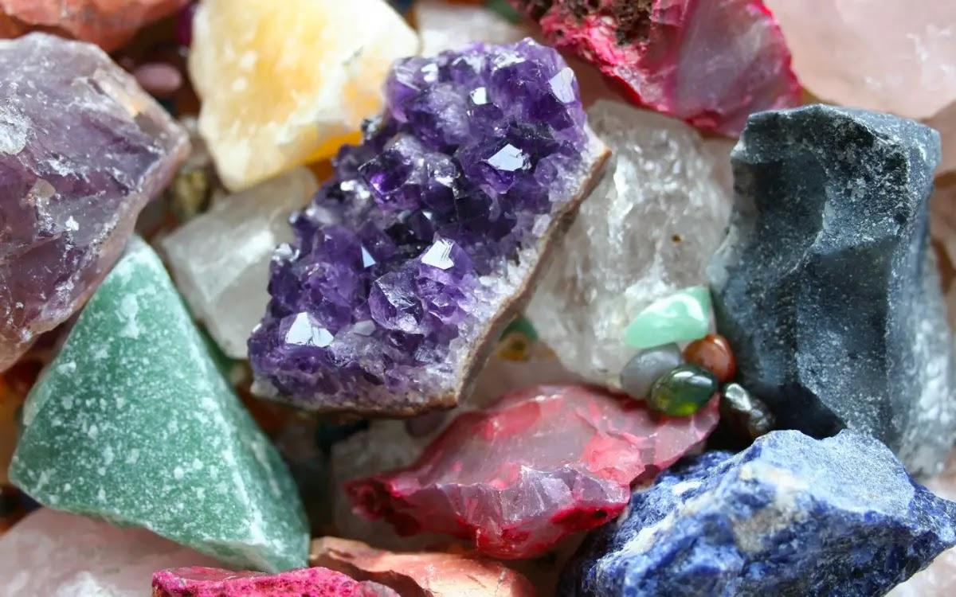
Mineral: Substances that do not come from an animal or plant, the building blocks that make up rocks
Notes:
Mineral: Substances that do not come from an animal or plant, the building blocks that make up rocks

Slide 8
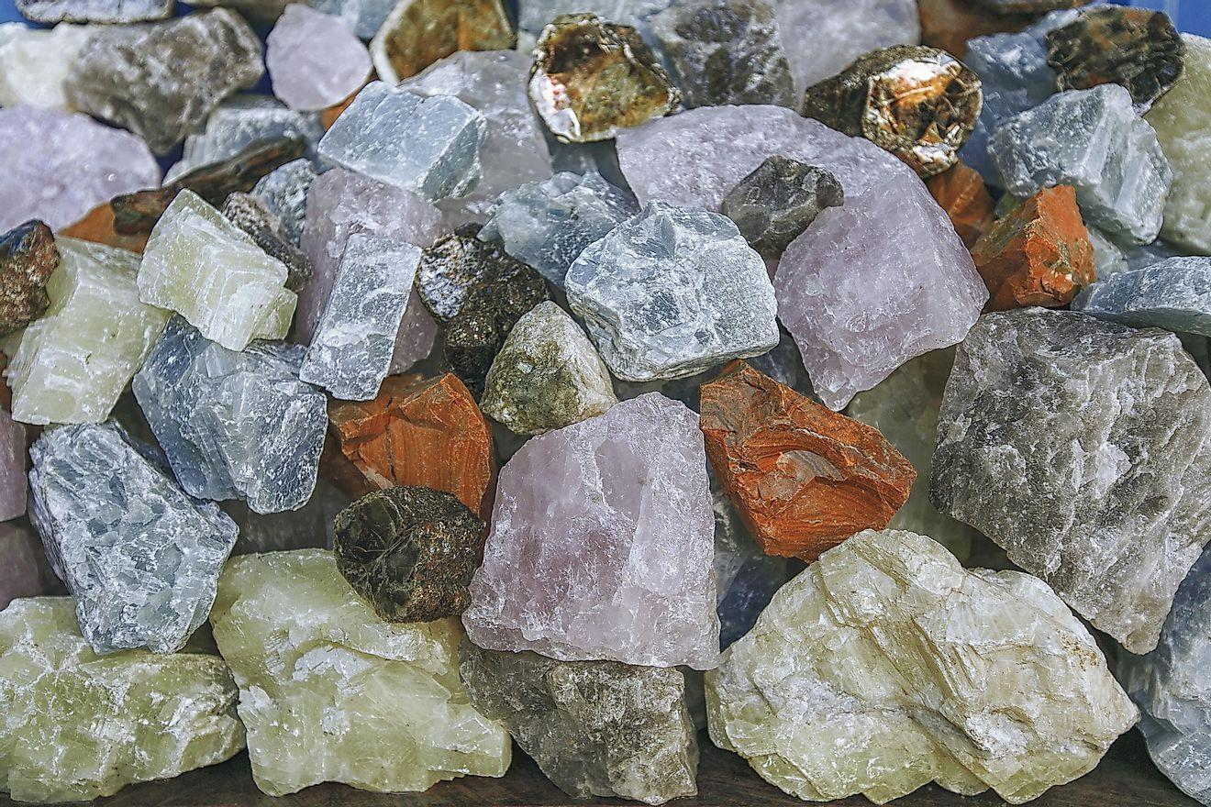
Rock: A solid collection of minerals.
Notes:
Rock: A solid collection of minerals.

Slide 9
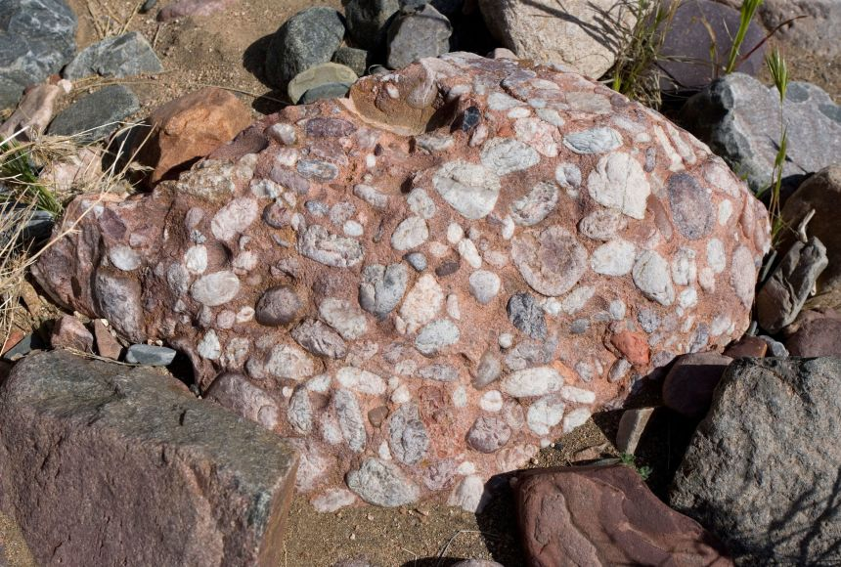
Sedimentary Rock: Rock that forms by collection of existing rocks or pieces of former living things.
Notes:
Sedimentary Rock are rocks that forms by collection of existing rocks or pieces of former living things

Slide 10
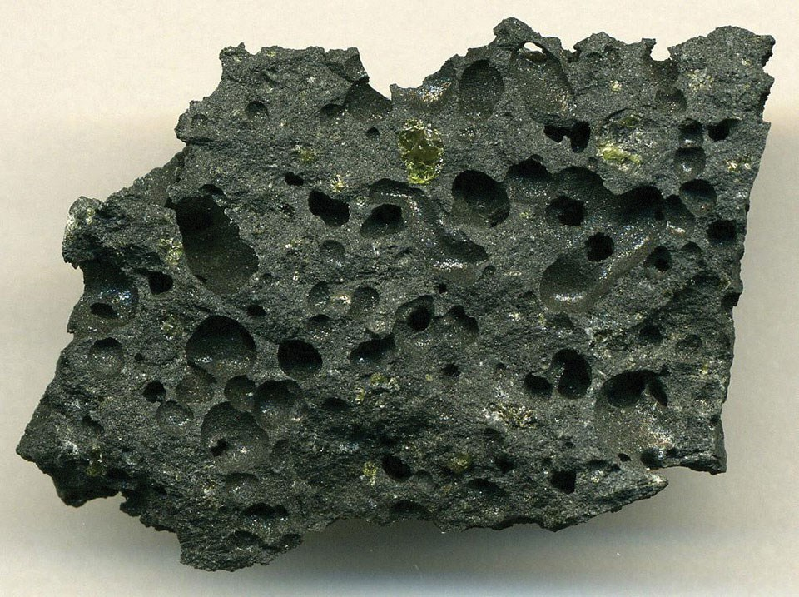
Igneous Rock: Rock that forms when molten earth becomes solid.
Notes:
Igneous Rocks are rocks that form when molten earth becomes solid

Slide 11
Notes:
Now let’s pause for a moment to review the information we have covered already.

Slide 12
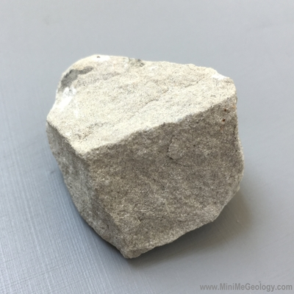
What is the relationship between rocks and minerals?
Rocks are created when minerals go through changes in temperature and pressure.
Rocks are tiny pieces of minerals that stick together over time.
Rocks are made up of one or more mineral.
Notes:
What is the relationship between rocks and minerals?
[C] Rocks are made up of one or more mineral.

Slide 13
What is the relationship between rocks and minerals?
Rocks are created when minerals go through changes in temperature and pressure.
Rocks are tiny pieces of minerals that stick together over time.
Rocks are made up of one or more mineral.
Notes:
What is the relationship between rocks and minerals? Rocks are made up of one or more mineral.
[C] Rocks are made up of one or more mineral.

Slide 14
True or False: A sedimentary rock is a rock that forms when molten earth becomes solid.
Notes:
True or False: A sedimentary rock is a rock that forms when molten earth becomes solid.
[False]

Slide 15
True or False: A sedimentary rock is a rock that forms when molten earth becomes solid.
Notes:
False: A sedimentary rock is a rock that forms by collection of existing rocks or pieces of former living things.

Slide 16
Metamorphic Rock
Notes:
Now that we’ve reviewed, let’s define the phrase Sedimentary Rock

Slide 17
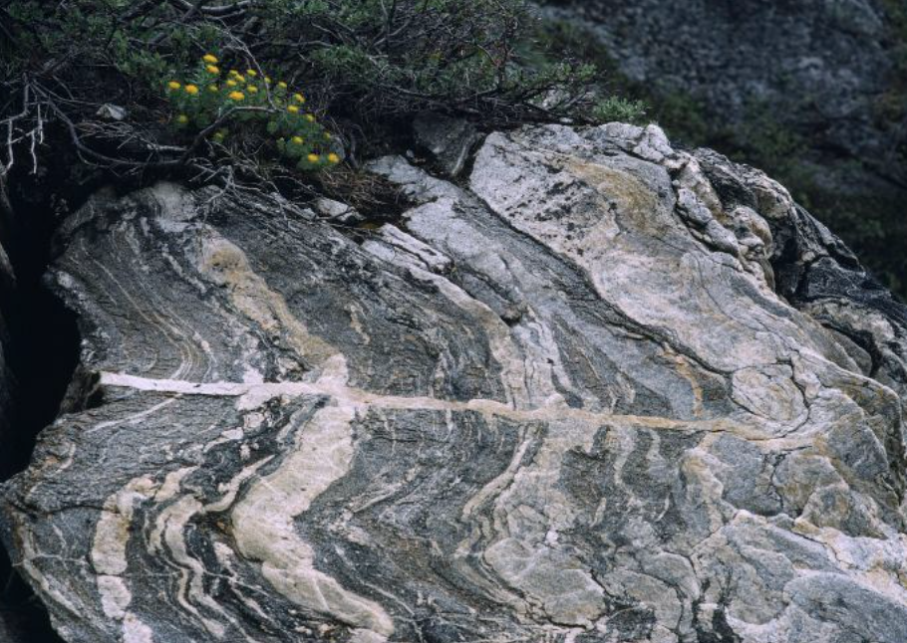
Metamorphic Rock: A rock that forms when sedimentary or igneous rocks are changed under a lot of heat and pressure.
Notes:
Metamorphic Rock: A rock that forms when sedimentary or igneous rocks are changed under a lot of heat and pressure.

Slide 18
Notes:
Let’s check-in for understanding.

Slide 19
What are Metamorphic Rocks?
Notes:
What are Metamorphic Rocks?
[A rock that forms when sedimentary or igneous rocks are changed under a lot of heat and pressure.]

Slide 20
Notes:
That is the basic definition, but there is a bit more you need to know.

Slide 21
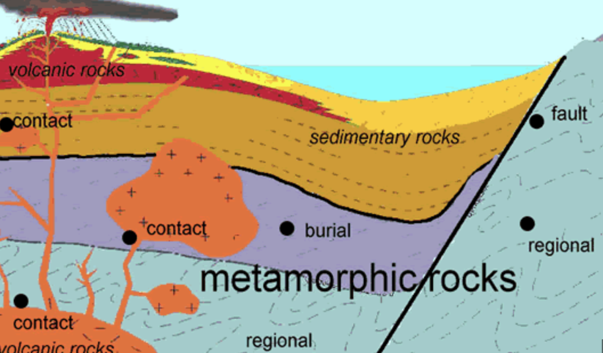
Metamorphic rocks form deep within the Earth's crust where there is intense heat and pressure. This can happen due to tectonic forces, like colliding continents or the sinking of one tectonic plate beneath another.
Notes:
Metamorphic rocks form deep within the Earth's crust where there is intense heat and pressure. This can happen due to tectonic forces, like colliding continents or the sinking of one tectonic plate beneath another.

Slide 22
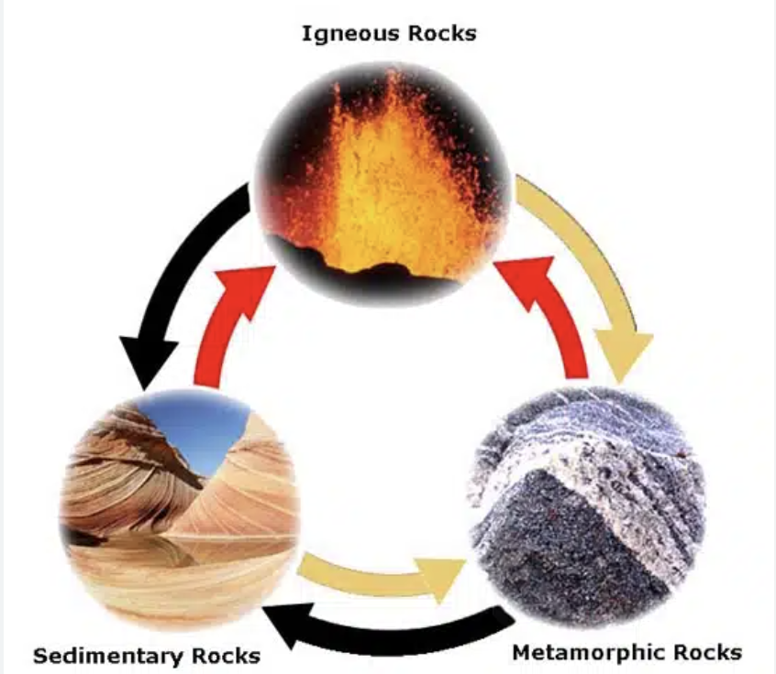
Metamorphic rocks often have a different texture than the rocks they formed from. The minerals in the original rock recrystallize, meaning they rearrange into new patterns, giving the metamorphic rock a distinctive appearance.
Notes:
Metamorphic rocks often have a different texture than the rocks they formed from. The minerals in the original rock recrystallize, meaning they rearrange into new patterns, giving the metamorphic rock a distinctive appearance.

Slide 23
Metamorphic rocks can come from different parent rocks, including sedimentary rocks and igneous rocks. The specific type of parent rock impacts the characteristics of the resulting metamorphic rock.
Notes:
Metamorphic rocks can come from different parent rocks, including sedimentary rocks (formed from layers of sediments) and igneous rocks (formed from molten magma or lava). The specific type of parent rock impacts the characteristics of the resulting metamorphic rock.

Slide 24
Notes:
Let’s check-in for understanding.

Slide 25
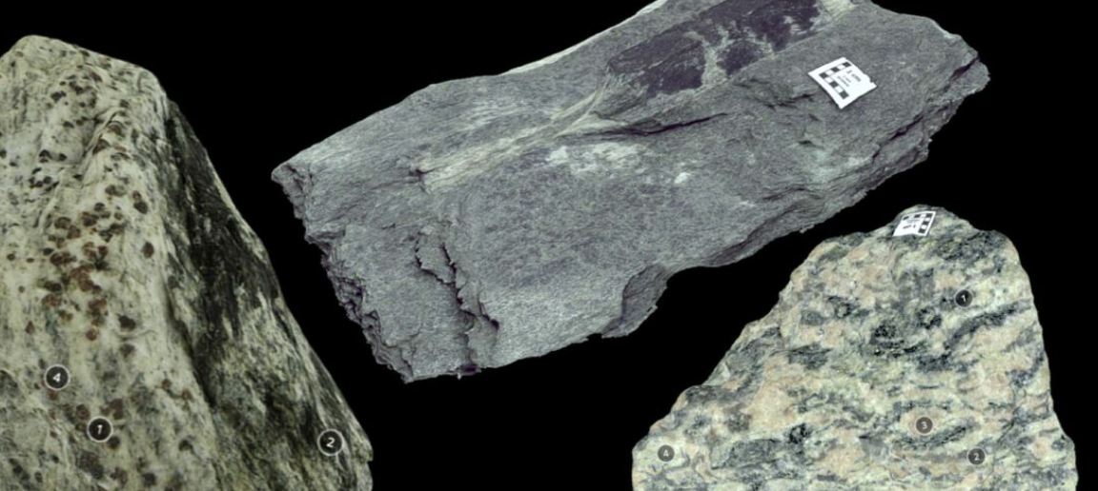
Metamorphic rocks form under intense heat and pressure.
True
False
Notes:
Metamorphic rocks form under intense heat and pressure.
[True]

Slide 26
Metamorphic rocks form under intense heat and pressure.
True
False
Notes:
Metamorphic rocks form under intense heat and pressure.
[True]

Slide 27
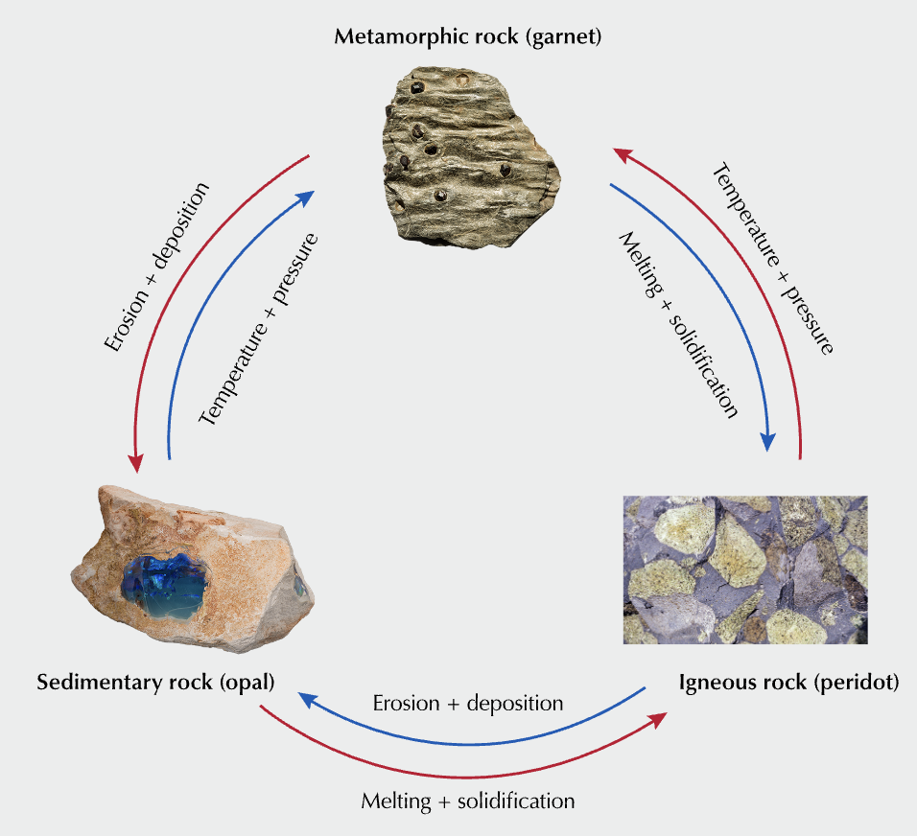
Metamorphic rocks have the same texture as the rocks they formed from..
True
False
Notes:
Metamorphic rocks have the same texture as the rocks they formed from..
[False]

Slide 28
Metamorphic rocks have the same texture as the rocks they formed from..
True
False
Notes:
Metamorphic rocks have the same texture as the rocks they formed from..
[False]

Slide 29
Notes:
Now, let’s talk about some examples of rocks.

Slide 30
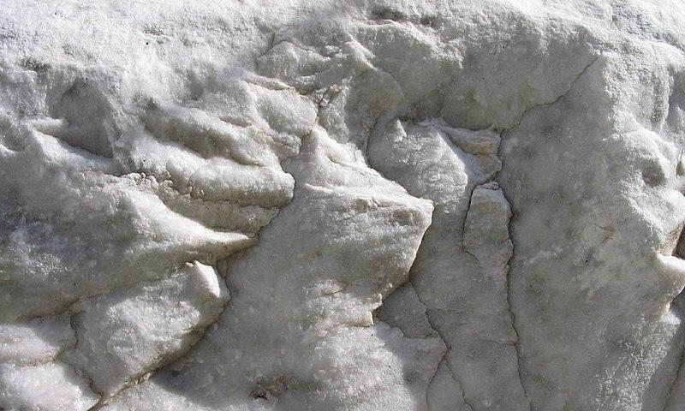
Marble is an example of a metamorphic rock. Marble is made from limestone.
Notes:
Marble is an example of a metamorphic rock. Marble is made from limestone.

Slide 31
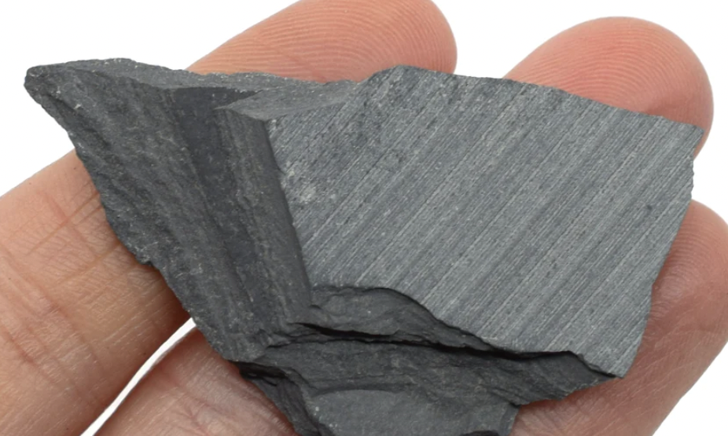
Slate is an example of a metamorphic rock. It is made from shale.
Notes:
Slate is an example of a metamorphic rock. It is made from shale.

Slide 32
Notes:
Now, let’s talk about some non-examples of sedimentary rocks.

Slide 33
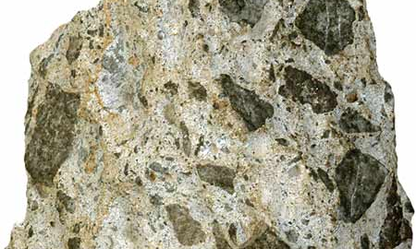
Breccia is NOT an example of a metamorphic rock. It is a sedimentary rock.
Notes:
Breccia is NOT an example of a metamorphic rock. It is a sedimentary rock.

Slide 34
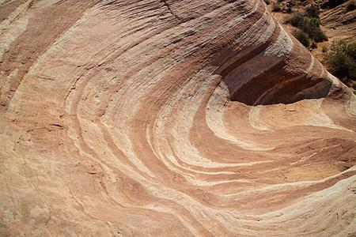
Sandstone is NOT an example of a metamorphic rock. Sandstone is a sedimentary rock.
Notes:
Sandstone is NOT an example of a metamorphic rock. Sandstone is a sedimentary rock.
Sandstone is composed of mostly grains of sand being compacted together for millions of years. Sandstone can contain quartz and feldspar.

Slide 35
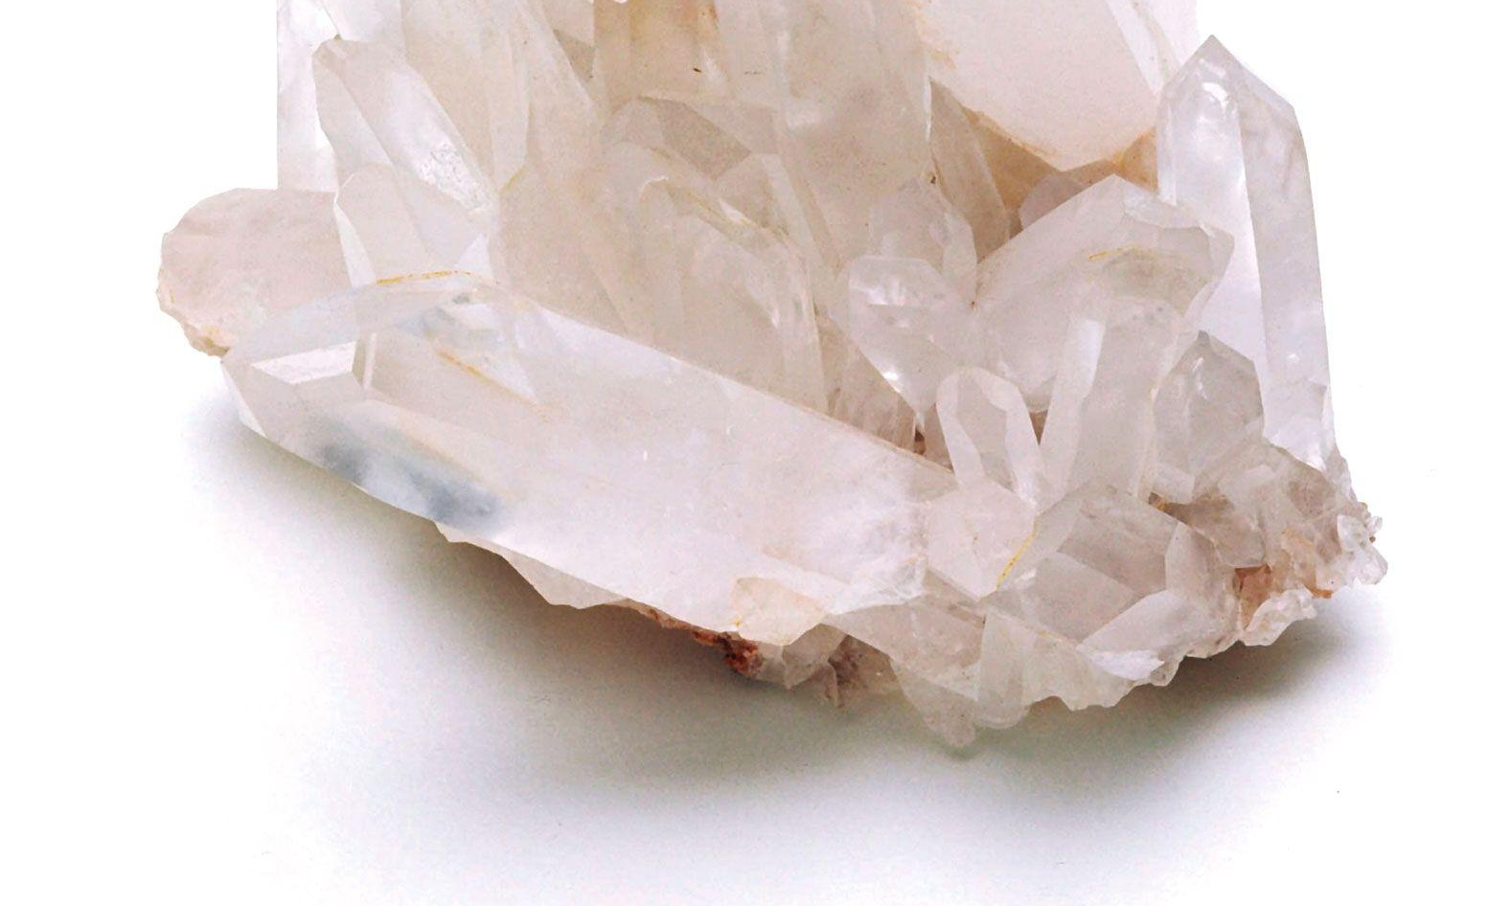
Quartz is NOT an example of a metamorphic rock. It is a mineral.
Notes:
Quartz is NOT an example of a metamorphic rock. It is a mineral. It can be found in sedimentary rocks.

Slide 36
Notes:
Now let’s pause for a moment to check your understanding.

Slide 37
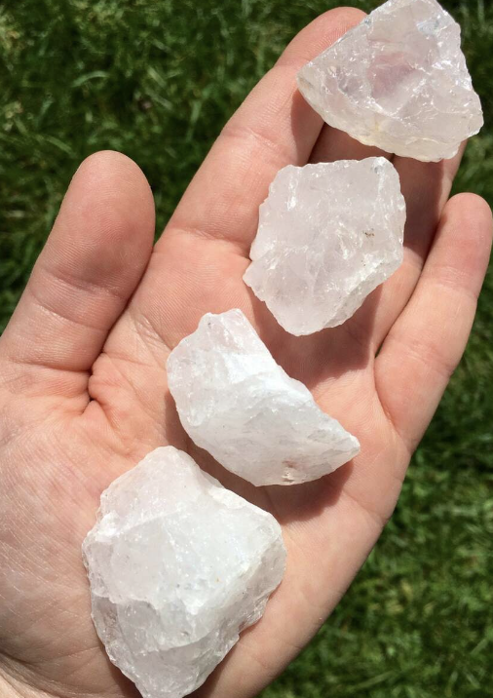
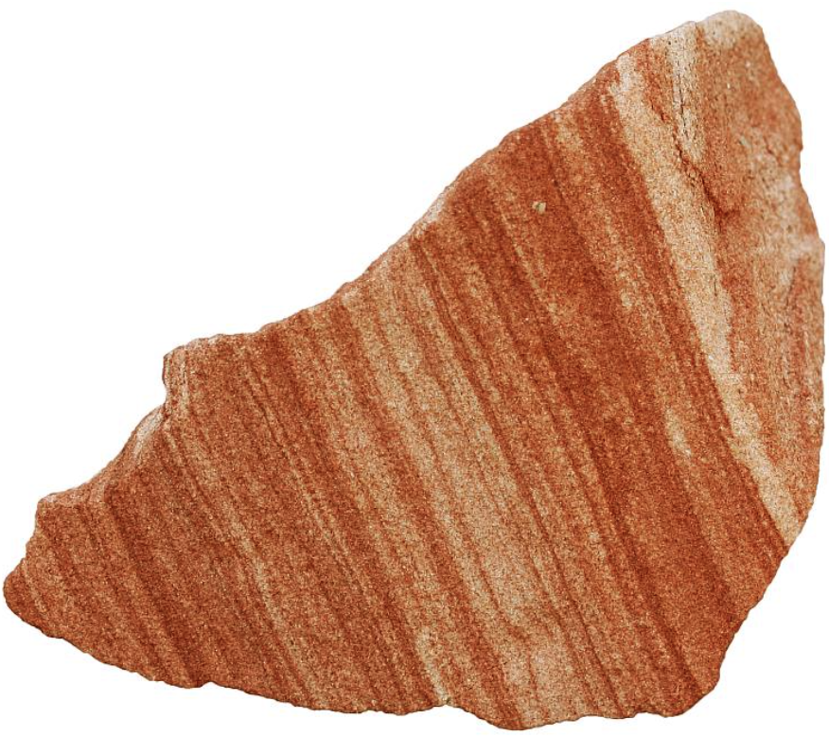
Why are sandstone and quartz not examples of metamorphic rocks?
Notes:
Why are sandstone and quartz not examples of metamorphic rocks?
[Quartz is NOT an example of a metamorphic rock because it is a mineral.. Sandstone is NOT an example of a metamorphic rock because sandstone is a sedimentary rock.

Slide 38
Remember!!!
Notes:
So remember!

Slide 39
Metamorphic Rock: A rock that forms when sedimentary or igneous rocks are changed under a lot of heat and pressure.
Notes:
Metamorphic Rock: A rock that forms when sedimentary or igneous rocks are changed under a lot of heat and pressure.

Slide 40
Notes:
We will now complete this concept map, called a Frayer model, to summarize and further clarify what you have learned about the term metamorphic rock.

Slide 41
Definition
Picture
Metamorphic Rock
How do metamorphic rocks impact my life?
Example
Notes:
To complete the Frayer model, we will choose from four choices the correct picture, definition, example, and response to the question, “How do metamorphic rocks impact my life?” Select the best response for each question using the information you just learned. As we select responses, we will see how this model looks filled in for the term metamorphic rocks.

Slide 42
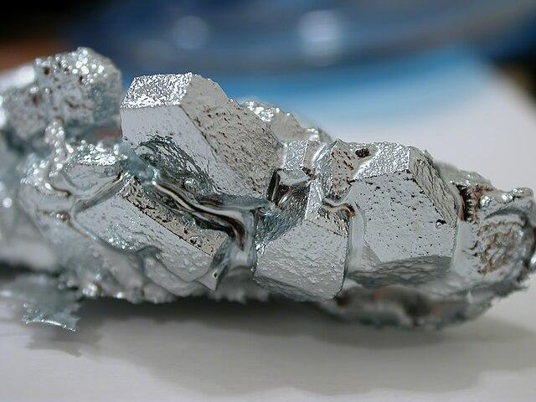
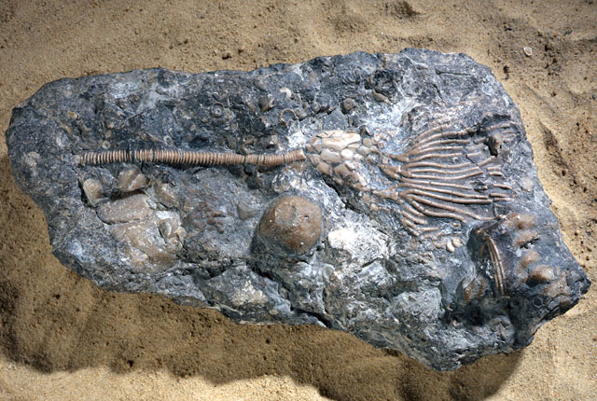
Directions: Choose the correct picture of a metamorphic rock from the choices below.
A
B
C
D
Notes:
Choose the correct picture of a metamorphic rock from these four choices.

Slide 43
Directions: Choose the correct picture of a metamorphic rock from the choices below.
A
B
C
D
Notes:
This is the picture that shows a metamorphic rock.

Slide 44
Definition
Picture
Metamorphic Rock
How do metamorphic rocks impact my life?
Example
Notes:
Here is the Frayer model filled in with a picture of a metamorphic rock.

Slide 45
Directions: Choose the correct definition of metamorphic rock from the choices below.
A
Rock that forms by collection of existing rocks or pieces of former living things
B
A collection of crystals
C
Rock that forms when molten earth becomes solid
D
A rock that forms when sedimentary or igneous rocks are changed under a lot of heat and pressure.
Notes:
Choose the one correct definition of a metamorphic rock from these four choices.

Slide 46
Directions: Choose the correct definition of metamorphic rock from the choices below.
A
Rock that forms by collection of existing rocks or pieces of former living things
B
A collection of crystals
C
Rock that forms when molten earth becomes solid
D
A rock that forms when sedimentary or igneous rocks are changed under a lot of heat and pressure.
Notes:
“A rock that forms when sedimentary or igneous rocks are changed under a lot of heat and pressure.” is correct! This is the definition of a metamorphic rock.

Slide 47
Definition
Picture
A rock that forms when sedimentary or igneous rocks are changed under a lot of heat and pressure.
Metamorphic Rock
How do metamorphic rocks impact my life?
Example
Notes:
Here is the Frayer Model with a picture and the definition filled in for metamorphic rock: A rock that forms when sedimentary or igneous rocks are changed under a lot of heat and pressure.

Slide 48
Directions: Choose the correct example of a metamorphic rock from the choices below.
A
Plastic
B
Marble
C
Sandstone
D
Quartz
Notes:
Choose the one correct example of metamorphic rock from these four choices.

Slide 49
Directions: Choose the correct example of a metamorphic rock from the choices below.
A
Plastic
B
Marble
C
Sandstone
D
Quartz
Notes:
“Marble” is correct! This is an example of a metamorphic rock.

Slide 50
Definition
Picture
A rock that forms when sedimentary or igneous rocks are changed under a lot of heat and pressure.
Metamorphic Rock
Marble
How do metamorphic rocks impact my life?
Example
Notes:
Here is the Frayer Model with a picture, definition, and an example of metamorphic rock: Marble.

Slide 51
Directions: Choose the correct response for “how do metamorphic rocks impact my life?” from the choices below.
A
Metamorphic rocks, like marble, can be used to sculpt and create artwork. We can enjoy looking at this art.
B
Metamorphic rocks influence our climate.
C
Metamorphic rocks are used to start fires when you are out in the forest.
C
D
Metamorphic rocks are used as baby teethers and help them to soothe themselves.
D
Notes:
Choose the one correct response for “how do metamorphic rocks impact my life?” from these four choices.

Slide 52
Directions: Choose the correct response for “how do metamorphic rocks impact my life?” from the choices below.
A
Metamorphic rocks, like marble, can be used to sculpt and create artwork. We can enjoy looking at this art.
B
Metamorphic rocks influence our climate.
C
Metamorphic rocks are used to start fires when you are out in the forest.
C
D
Metamorphic rocks are used as baby teethers and help them to soothe themselves.
D
Notes:
“Metamorphic rocks, like marble, can be used to sculpt and create artwork. We can enjoy looking at this art.” That is correct! This is an example of how metamorphic rocks impacts our lives.

Slide 53
Definition
Picture
A rock that forms when sedimentary or igneous rocks are changed under a lot of heat and pressure.
Metamorphic Rock
Metamorphic rocks, like marble, can be used to sculpt and create artwork. We can enjoy looking at this art.
Marble
How do metamorphic rocks impact my life?
Example
Notes:
Here is the Frayer Model with a picture, definition, example, and a correct response to “how do metamorphic rocks impact my life?”: Metamorphic rocks, like marble, can be used to sculpt and create artwork. We can enjoy looking at this art.

Slide 54
Remember!!!
Notes:
So remember!

Slide 55
Metamorphic Rock: A rock that forms when sedimentary or igneous rocks are changed under a lot of heat and pressure.
Notes:
Metamorphic Rock: A rock that forms when sedimentary or igneous rocks are changed under a lot of heat and pressure.

Slide 56
Big Question: In what ways do metamorphic rocks play a role in shaping the Earth's surface, and how do they add to the differences of ecosystems around us?
Notes:
Let’s reflect once more on our big question. Our “big question” is: In what ways do metamorphic rocks play a role in shaping the Earth's surface, and how do they add to the differences of ecosystems around us?
Does anyone have any additional examples to share that haven’t been discussed yet?

Slide 57
Notes:
Thanks for watching, and please continue watching CAPs available from this website.

Slide 58
This Was Created With Resources From:
Questions or Comments
Michael Kennedy, Ph.D. MKennedy@Virginia.edu
Rachel L Kunemund, Ph.D. rk8vm@virginia.edu

