Slide 1
Intro
“Big Idea” Question
Review Concepts
Check-In Questions
Teacher Engagement
Vocabulary
Student-Friendly Definition
Examples & Non-Examples
Morphological Word Parts
Frayer Model
Simulation/Activity
Notes:
OK everyone, get ready for our next lesson. Just as a reminder, these are the different components that our lesson may include, and you’ll see these icons in the top left corner of each slide so that you can follow along more easily!

Slide 2
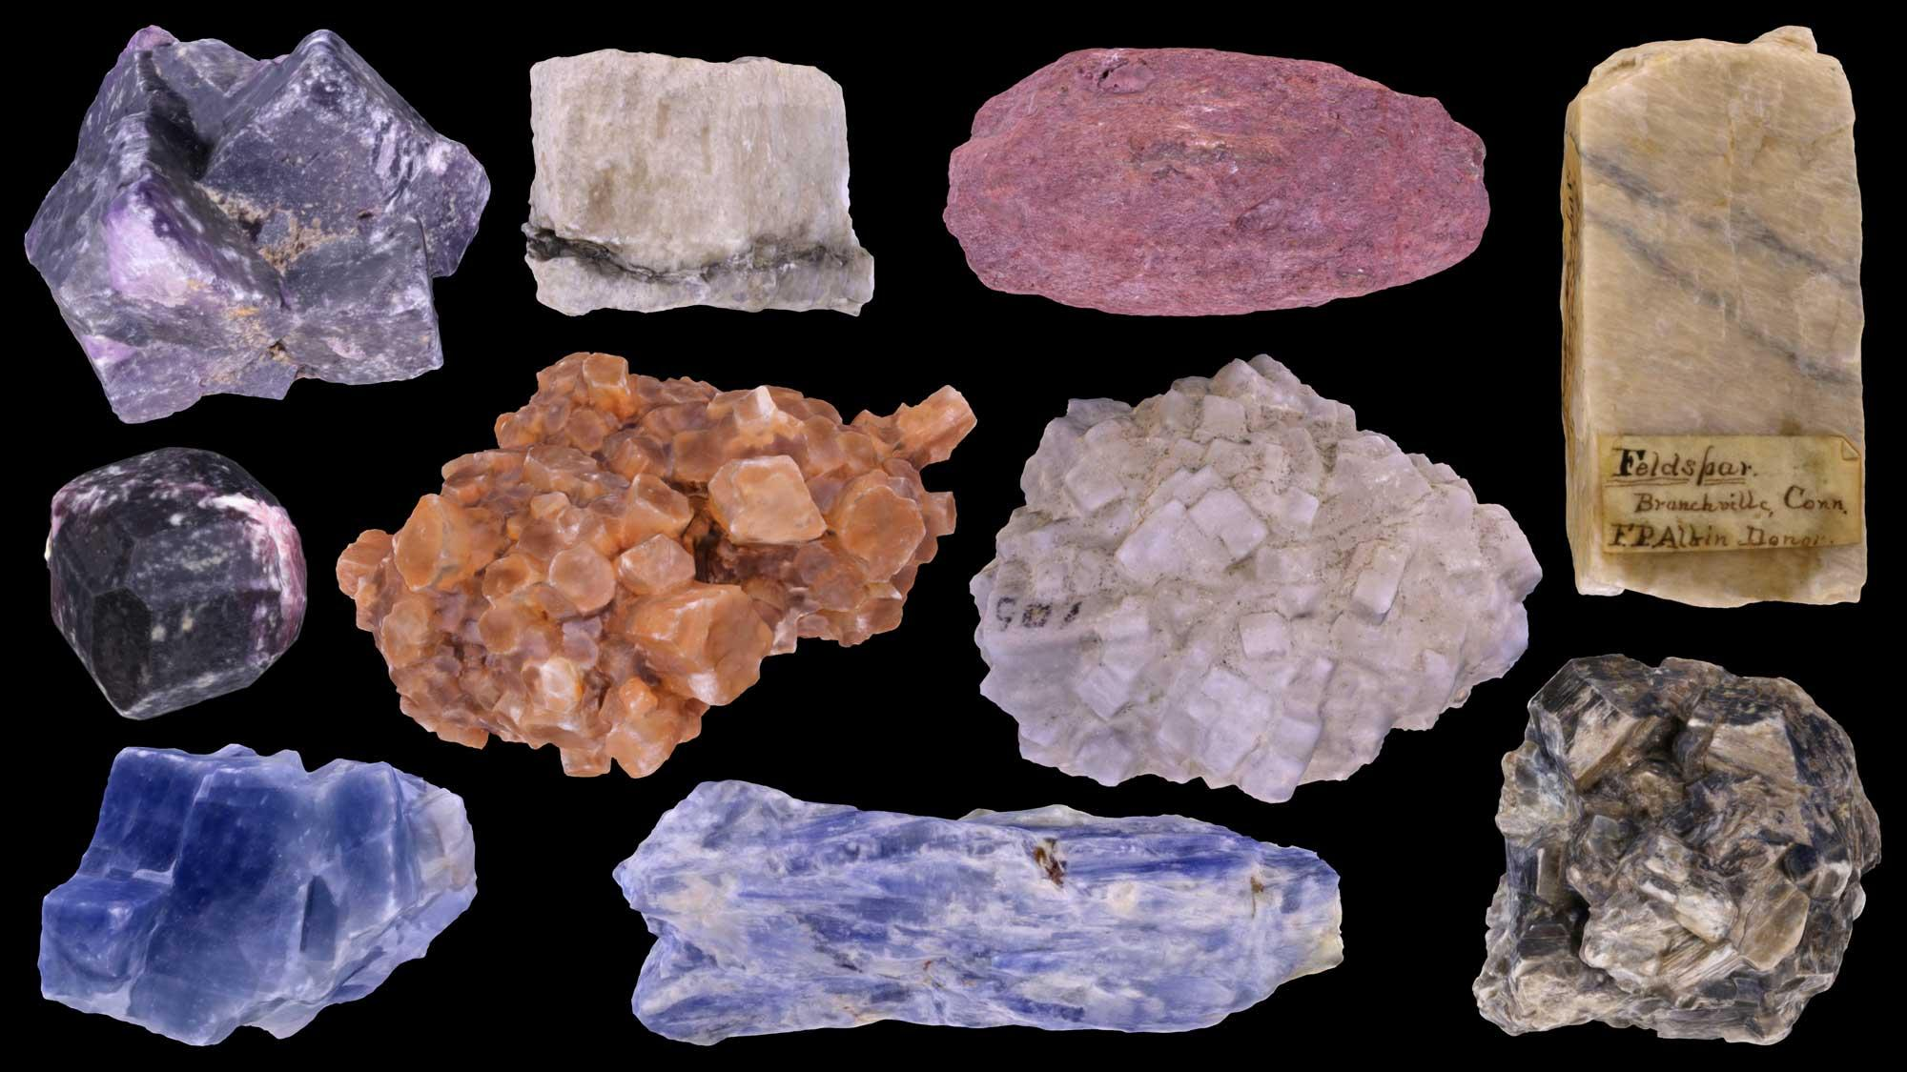
Intro
Mineral
Notes:
Today, we’ll be learning about the word: Mineral.

Slide 3
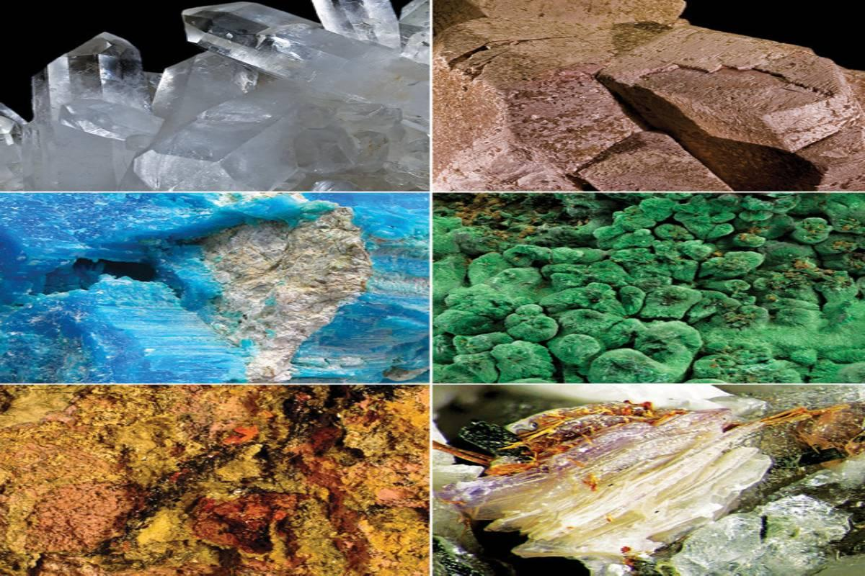
Big Question: How do minerals contribute to changes in the Earth, and what role do they play in shaping the planet over time?
Notes:
Our “big question” is: How do minerals contribute to changes in the Earth, and what role do they play in shaping the planet over time?
[Pause and illicit predictions from students.]
I love all these thoughtful scientific hypotheses! Be sure to keep this question and your predictions in mind as we move through these next few lessons, and we’ll continue to revisit it.

Slide 4
Notes:
Before we move on to our new topic, let’s review some other words & concepts that you already learned and make sure you are firm in your understanding.

Slide 5
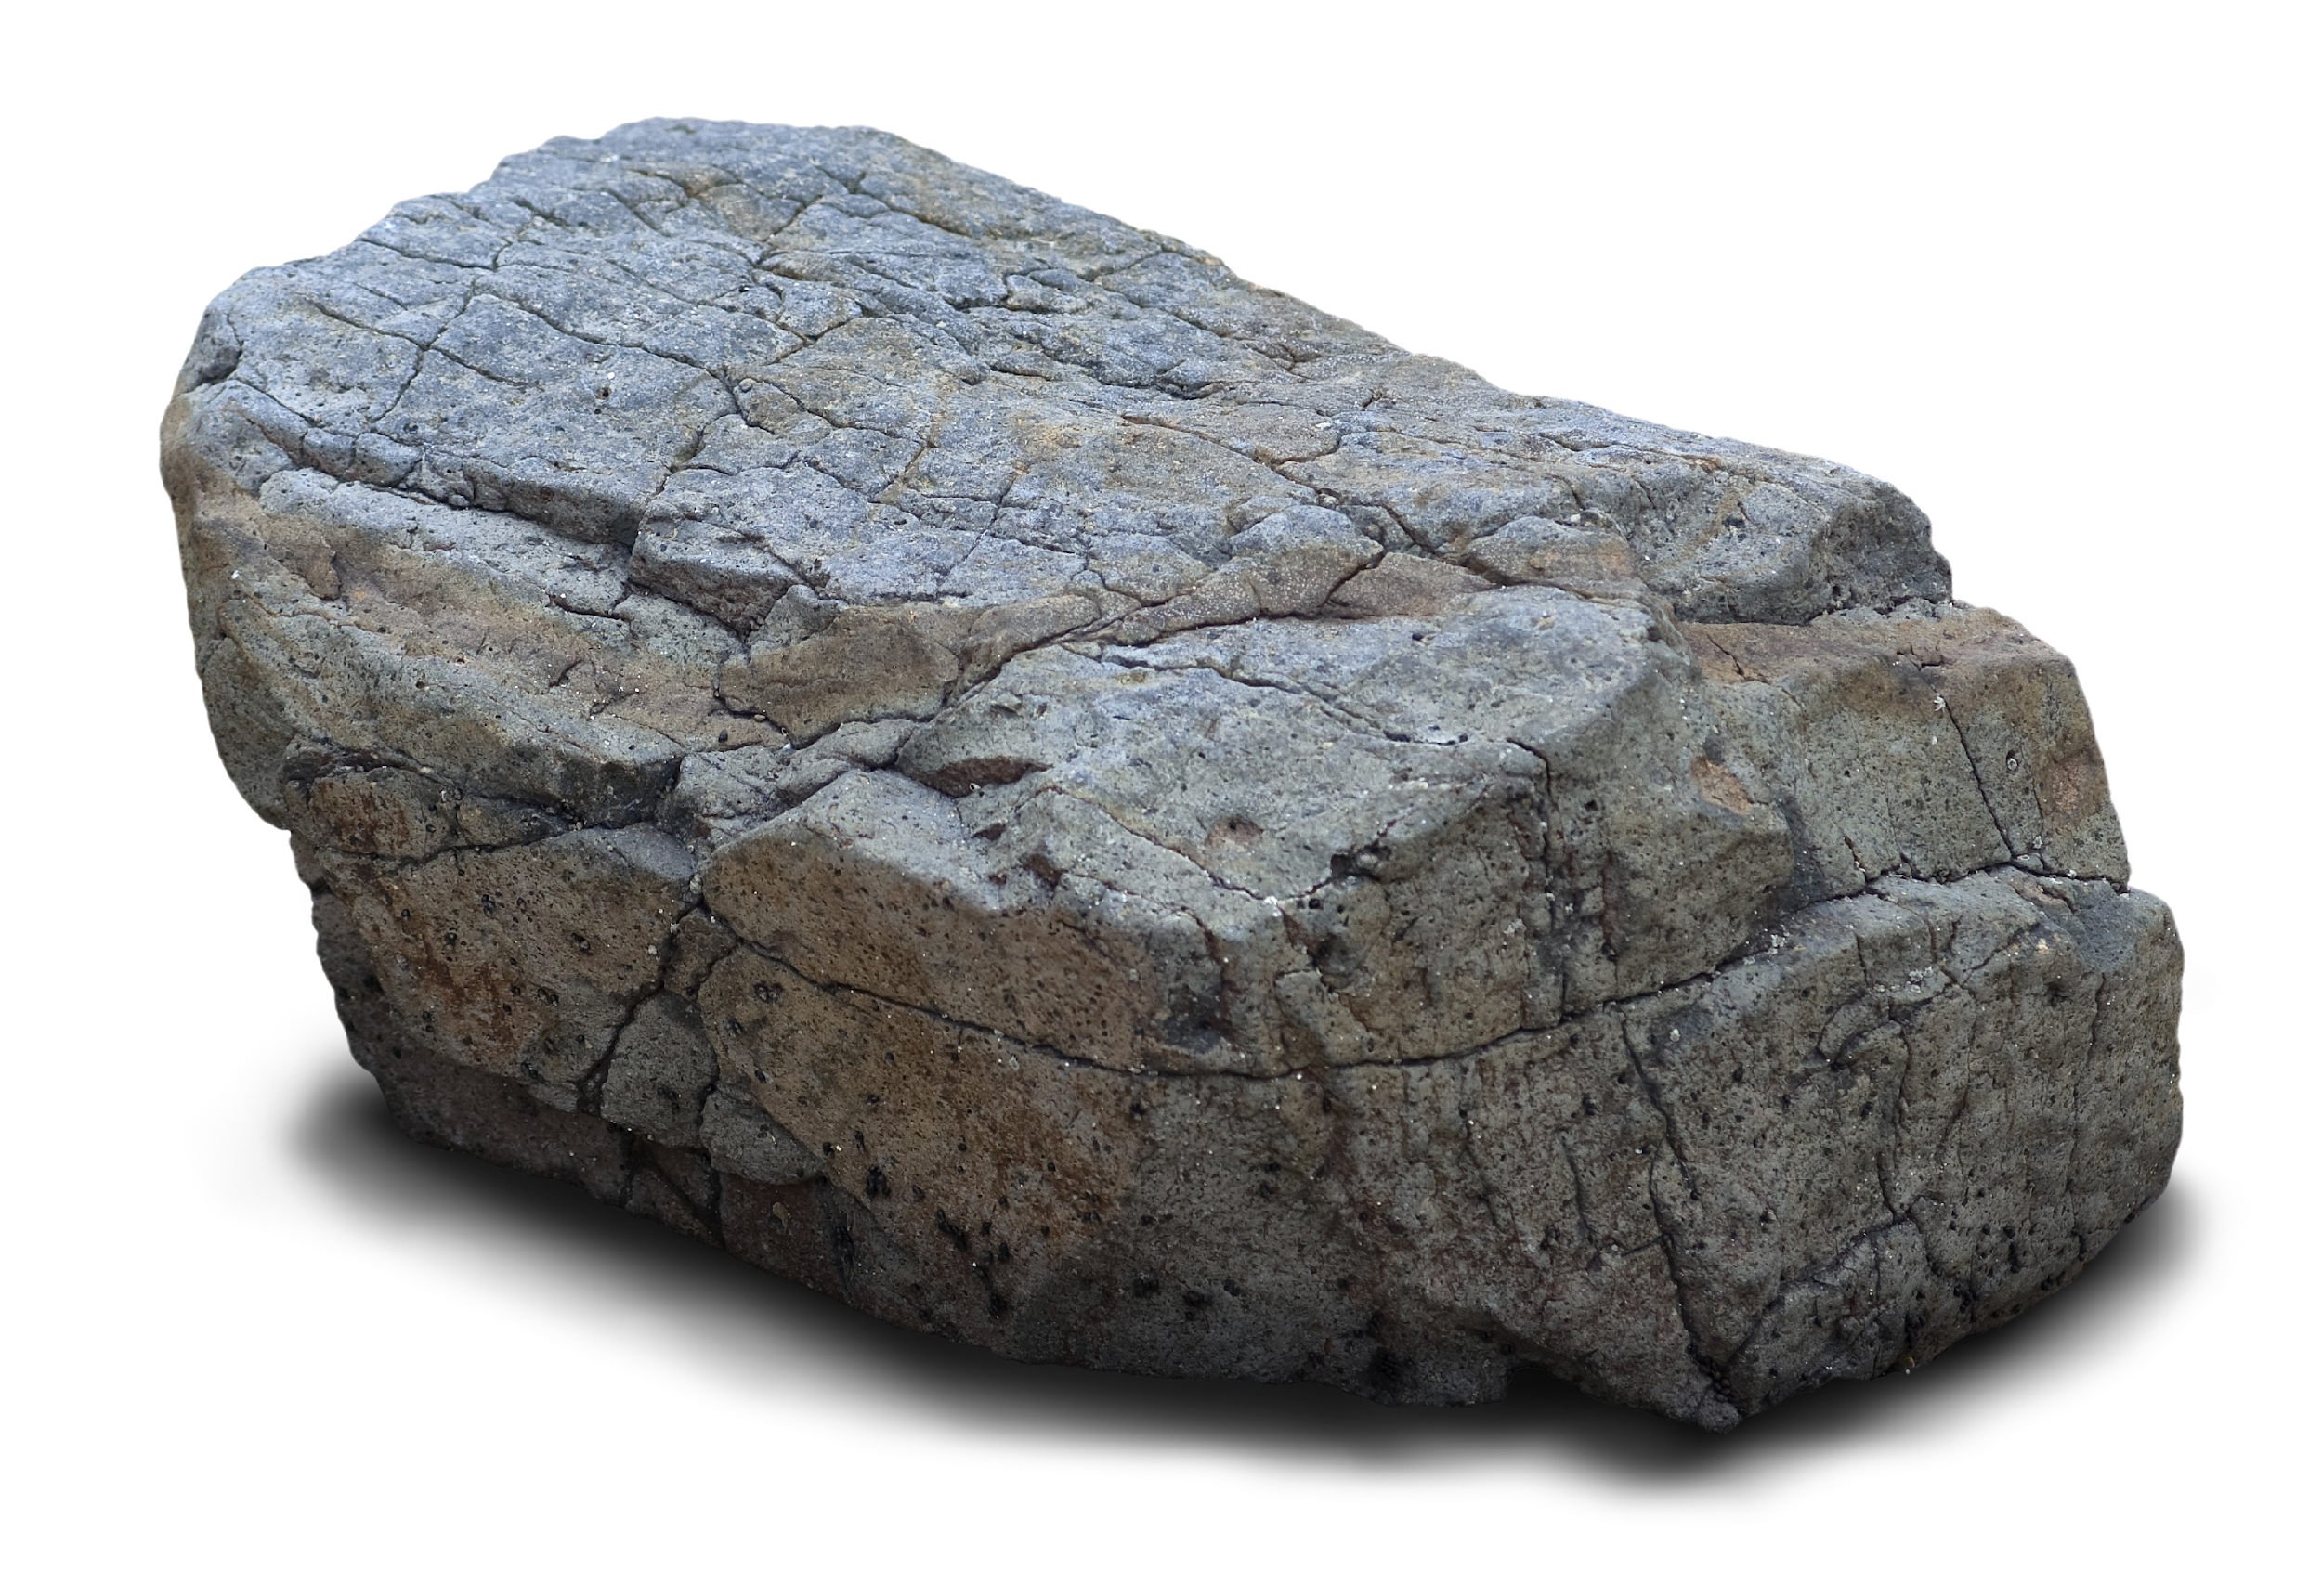
Matter: anything that has mass and take up space
Notes:
Matter is anything that has mass and takes up space.

Slide 6
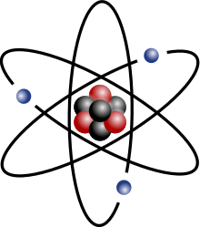
Atom: smallest whole unit of matter
Notes:
An atom is the smallest whole unit of matter.

Slide 7
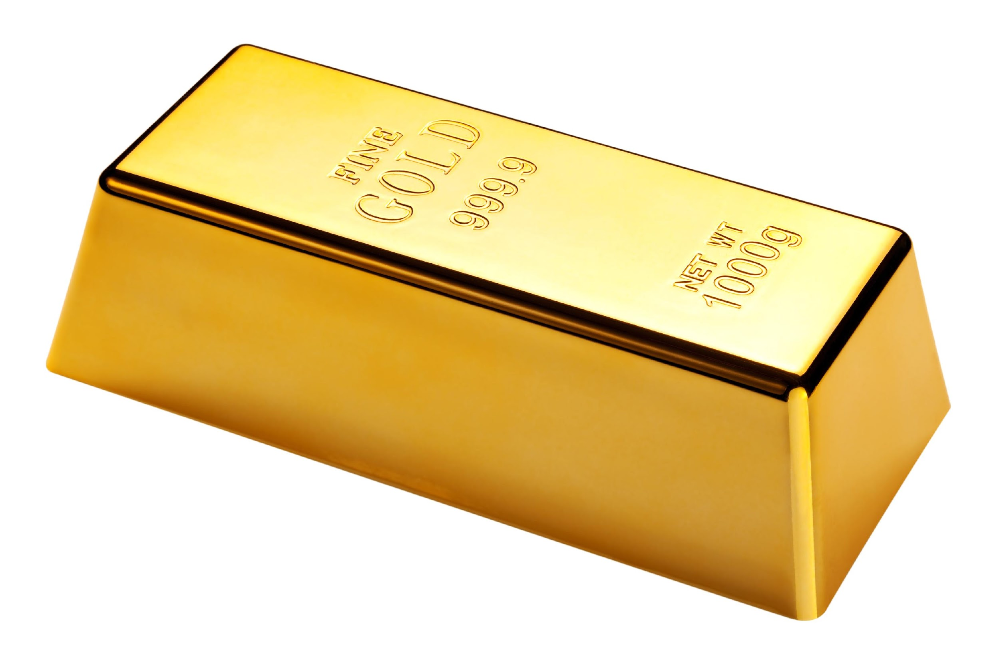
Element: a pure substance containing only one type of atom
Notes:
An element is a pure substance containing only one type of atom.

Slide 8
Notes:
Now let’s pause for a moment to review the information we have covered already.

Slide 9
True or False: Atoms are the smallest whole unit of matter.
Notes:
True or False: Atoms are the smallest whole unit of matter.
[True]

Slide 10
True or False: Atoms are the smallest whole unit of matter.
Notes:
[True]: Atoms are the smallest whole unit of matter.

Slide 11
A pure substance containing one type of atom is…
Matter
An element
Notes:
A pure substance containing one type of atom is…

Slide 12
A pure substance containing one type of atom is…
Matter
An element
Notes:
A pure substance containing one type of atom is…
[An element]

Slide 13
Elements are an example of ________.
Notes:
Elements are an example of ________.
[Matter]

Slide 14
Elements are an example of matter.
Notes:
Elements are an example of matter.

Slide 15
Mineral
Notes:
Now that we’ve reviewed, let’s define the phrase mineral.

Slide 16
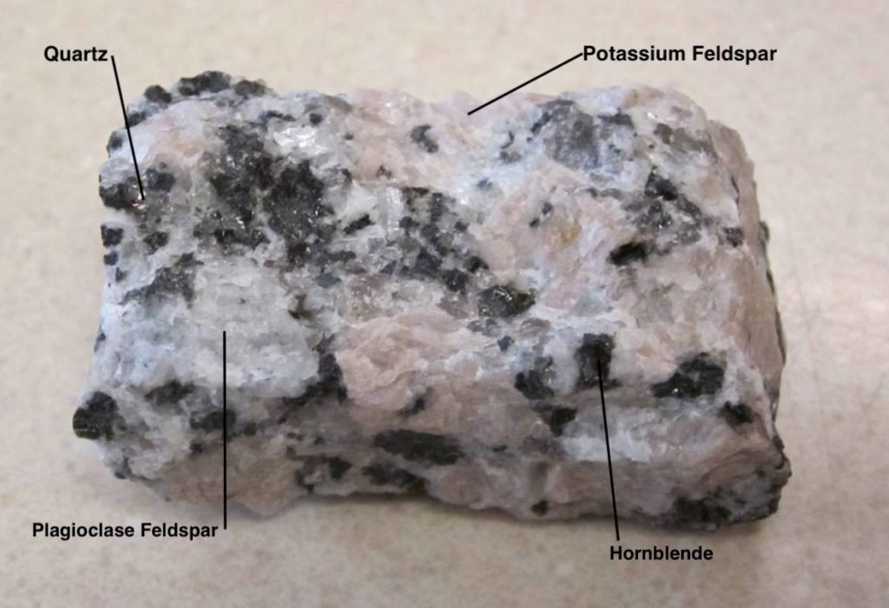
Mineral: Substance that does not come from an animal or plant; the building blocks that make up rocks
mineral
mineral
mineral
mineral
Notes:
A mineral is a substance that does not come from an animal or plant; the building blocks that make up rocks.

Slide 17
Notes:
Let’s check-in for understanding.

Slide 18
What is a mineral?
mineral
mineral
mineral
mineral
Notes:
What is a mineral?
[A mineral is a substance that does not come from an animal or a plant; the building blocks that make up rocks.]

Slide 19
Notes:
That is the basic definition, but there is a bit more you need to know.

Slide 20
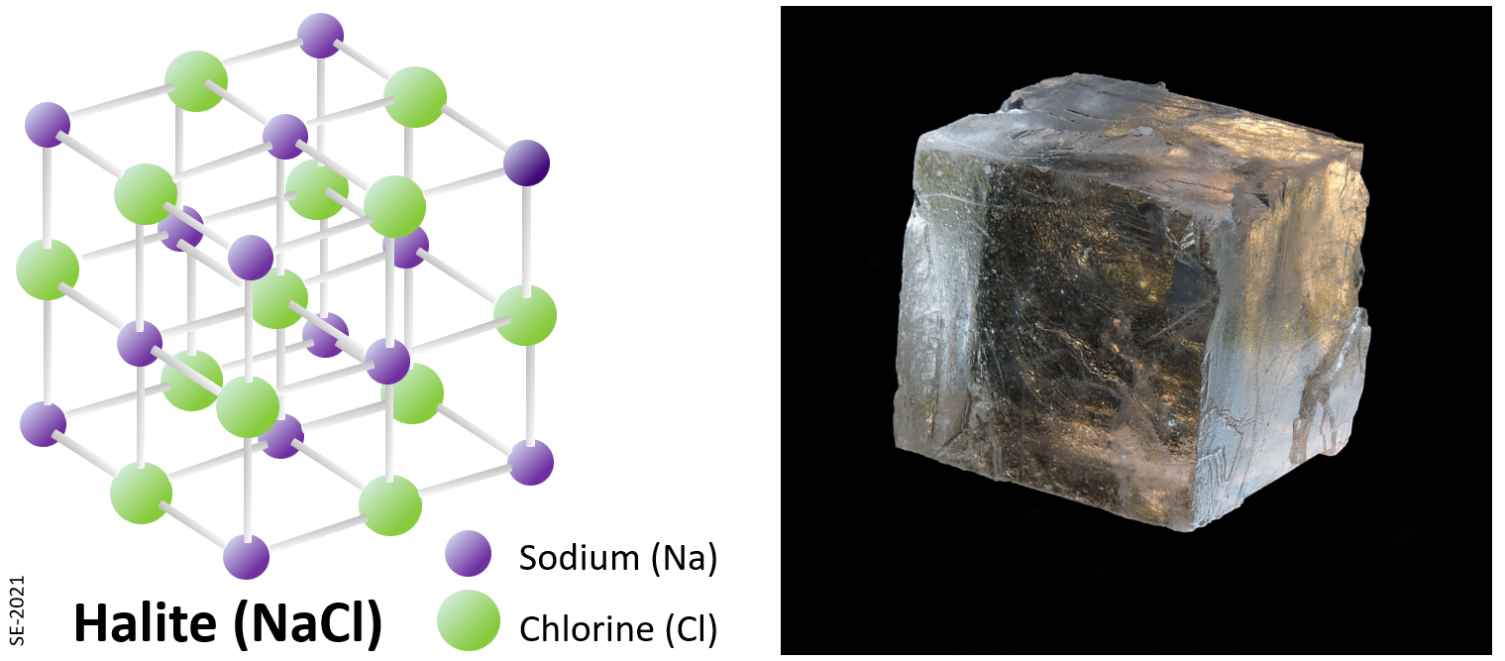
Minerals come to life through processes like cooling molten rock or drying up water. Each mineral, like quartz or iron, has its unique combination of elements and a neat arrangement of tiny parts called atoms.
Notes:
Minerals come to life through processes like cooling molten rock or drying up water. Each mineral, like quartz or iron, has its unique combination of elements and a neat arrangement of tiny parts called atoms.

Slide 21
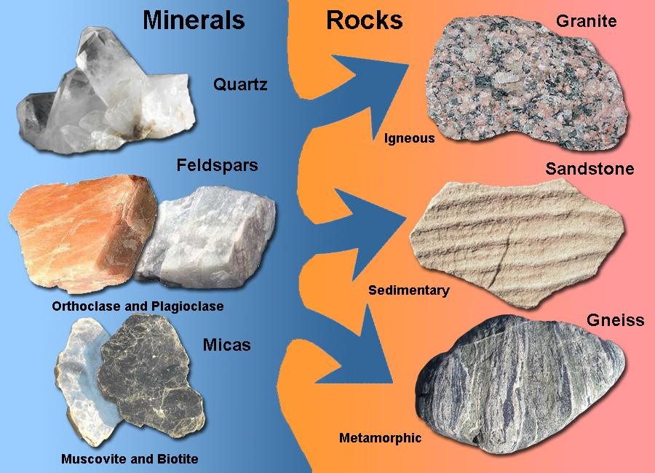
Minerals are like the Earth’s tiny building blocks, forming naturally with specific recipes of elements. Think of them as nature’s own ingredients for making rocks.
Notes:
Minerals are like the Earth's tiny building blocks, forming naturally with specific recipes of elements. Think of them as nature's own ingredients for making rocks.

Slide 22
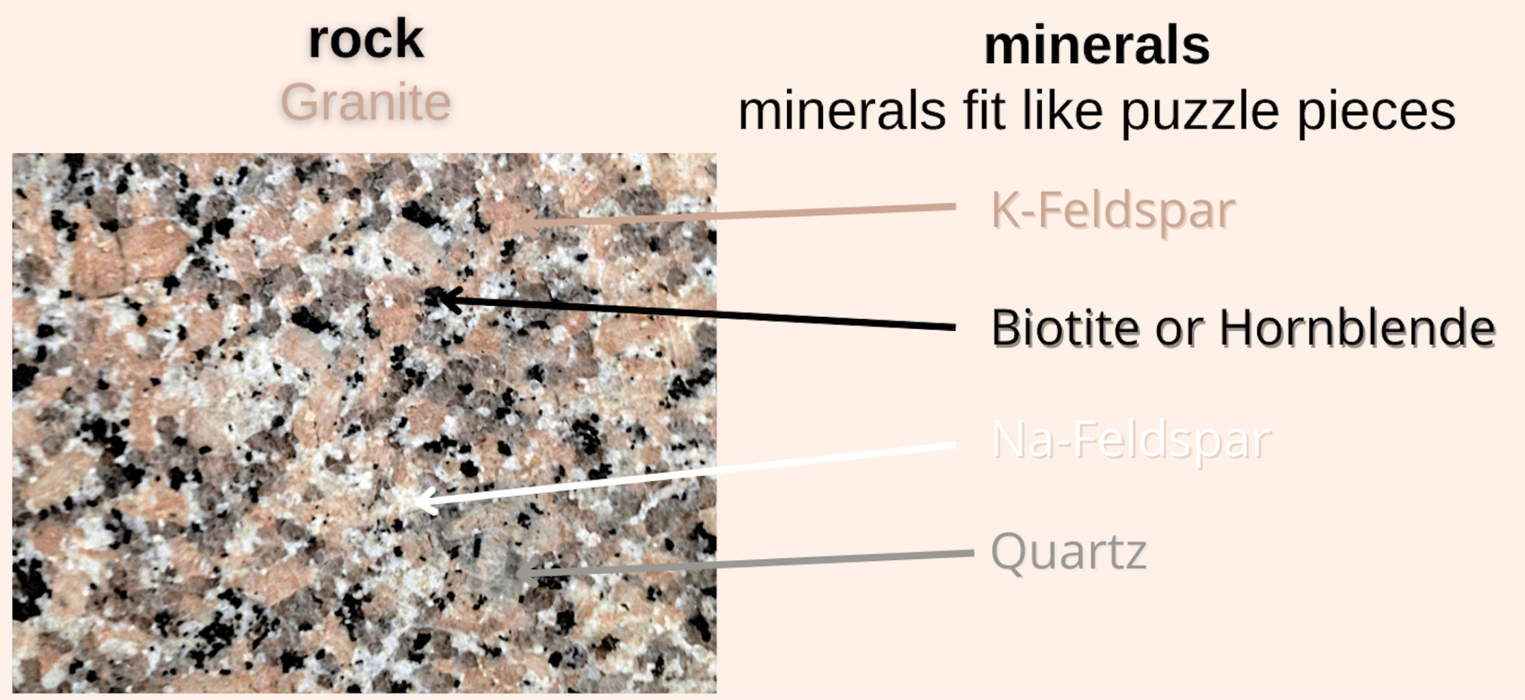
Minerals are like puzzle pieces that make up rocks. A rock is a solid made up of minerals.
Notes:
Minerals are like the puzzle pieces that make up rocks. A rock is a solid made up of minerals.

Slide 23
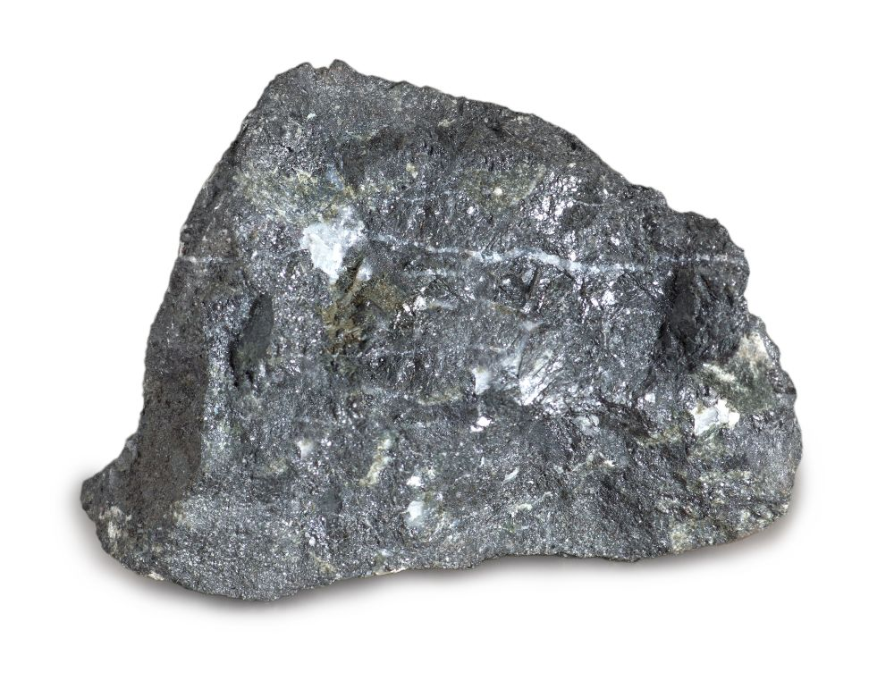
Minerals are not just pretty substances; they are useful too. Iron, one of these minerals, helps us make strong things like cars and buildings.
Notes:
Minerals are not just pretty substances; they are useful too. Iron, one of these minerals, helps us make strong things like cars and buildings.

Slide 24
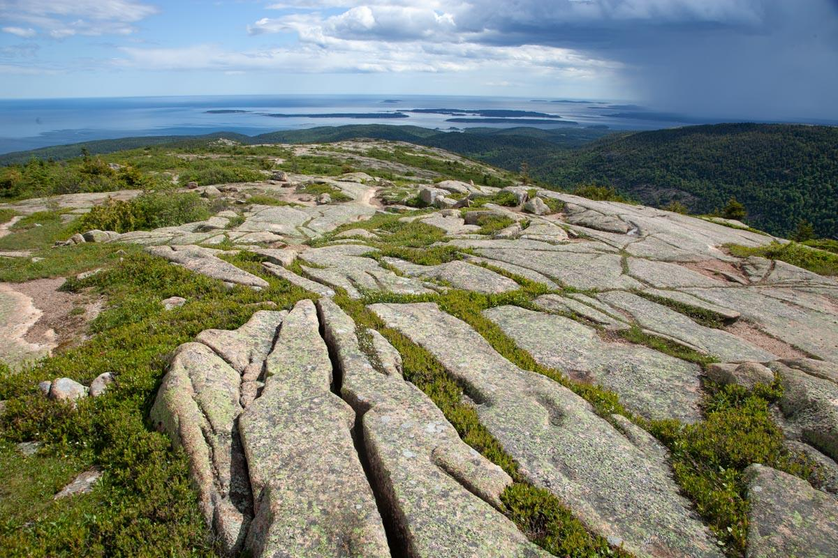
Minerals are also the sculptors of our landscapes. They shape mountains, create the ground we walk on, and even guide how rivers flow.
Notes:
Minerals are also the sculptors of our landscapes. They shape mountains, create the ground we walk on, and even guide how rivers flow.

Slide 25
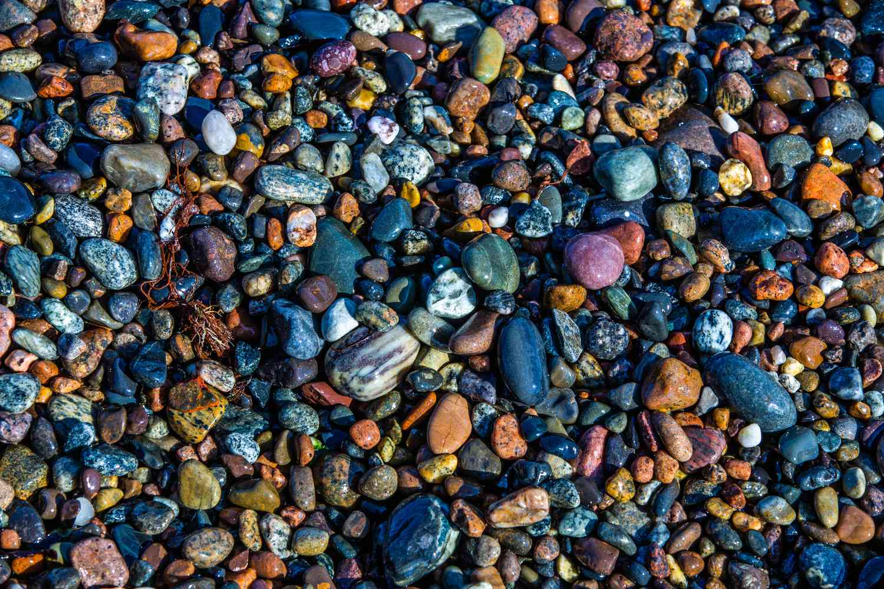
From sparkly gems to everyday things like salt, minerals are Earth’s incredible ingredients, making our world interesting and beautiful.
Notes:
From sparkly gems to everyday things like salt, minerals are Earth's incredible ingredients, making our world interesting and beautiful.

Slide 26
Notes:
Let’s check-in for understanding.

Slide 27
Each mineral, like quartz or iron, has its unique combination of ______ and a neat arrangement of tiny parts called _____.
Notes:
Each mineral, like quartz or iron, has its unique combination of ______ and a neat arrangement of tiny parts called _____.
[elements, atoms]

Slide 28
Each mineral, like quartz or iron, has its unique combination of elements and a neat arrangement of tiny parts called atoms.
Notes:
Each mineral, like quartz or iron, has its unique combination of elements and a neat arrangement of tiny parts called atoms.

Slide 29
True or False: Rocks are made up of minerals.
Notes:
True or False: Rocks are made up of minerals.
[True]

Slide 30
True or False: Rocks are made up of minerals.
Notes:
True or False: Rocks are made up of minerals.
[True]

Slide 31
Minerals make up:
Buildings
Landscapes
All of the above
Notes:
Minerals make up:
[All of the above]

Slide 32
Minerals make up:
Buildings
Landscapes
All of the above
Notes:
Minerals make up:
[All of the above]

Slide 33
Notes:
Now, let’s talk about some examples of minerals.

Slide 34
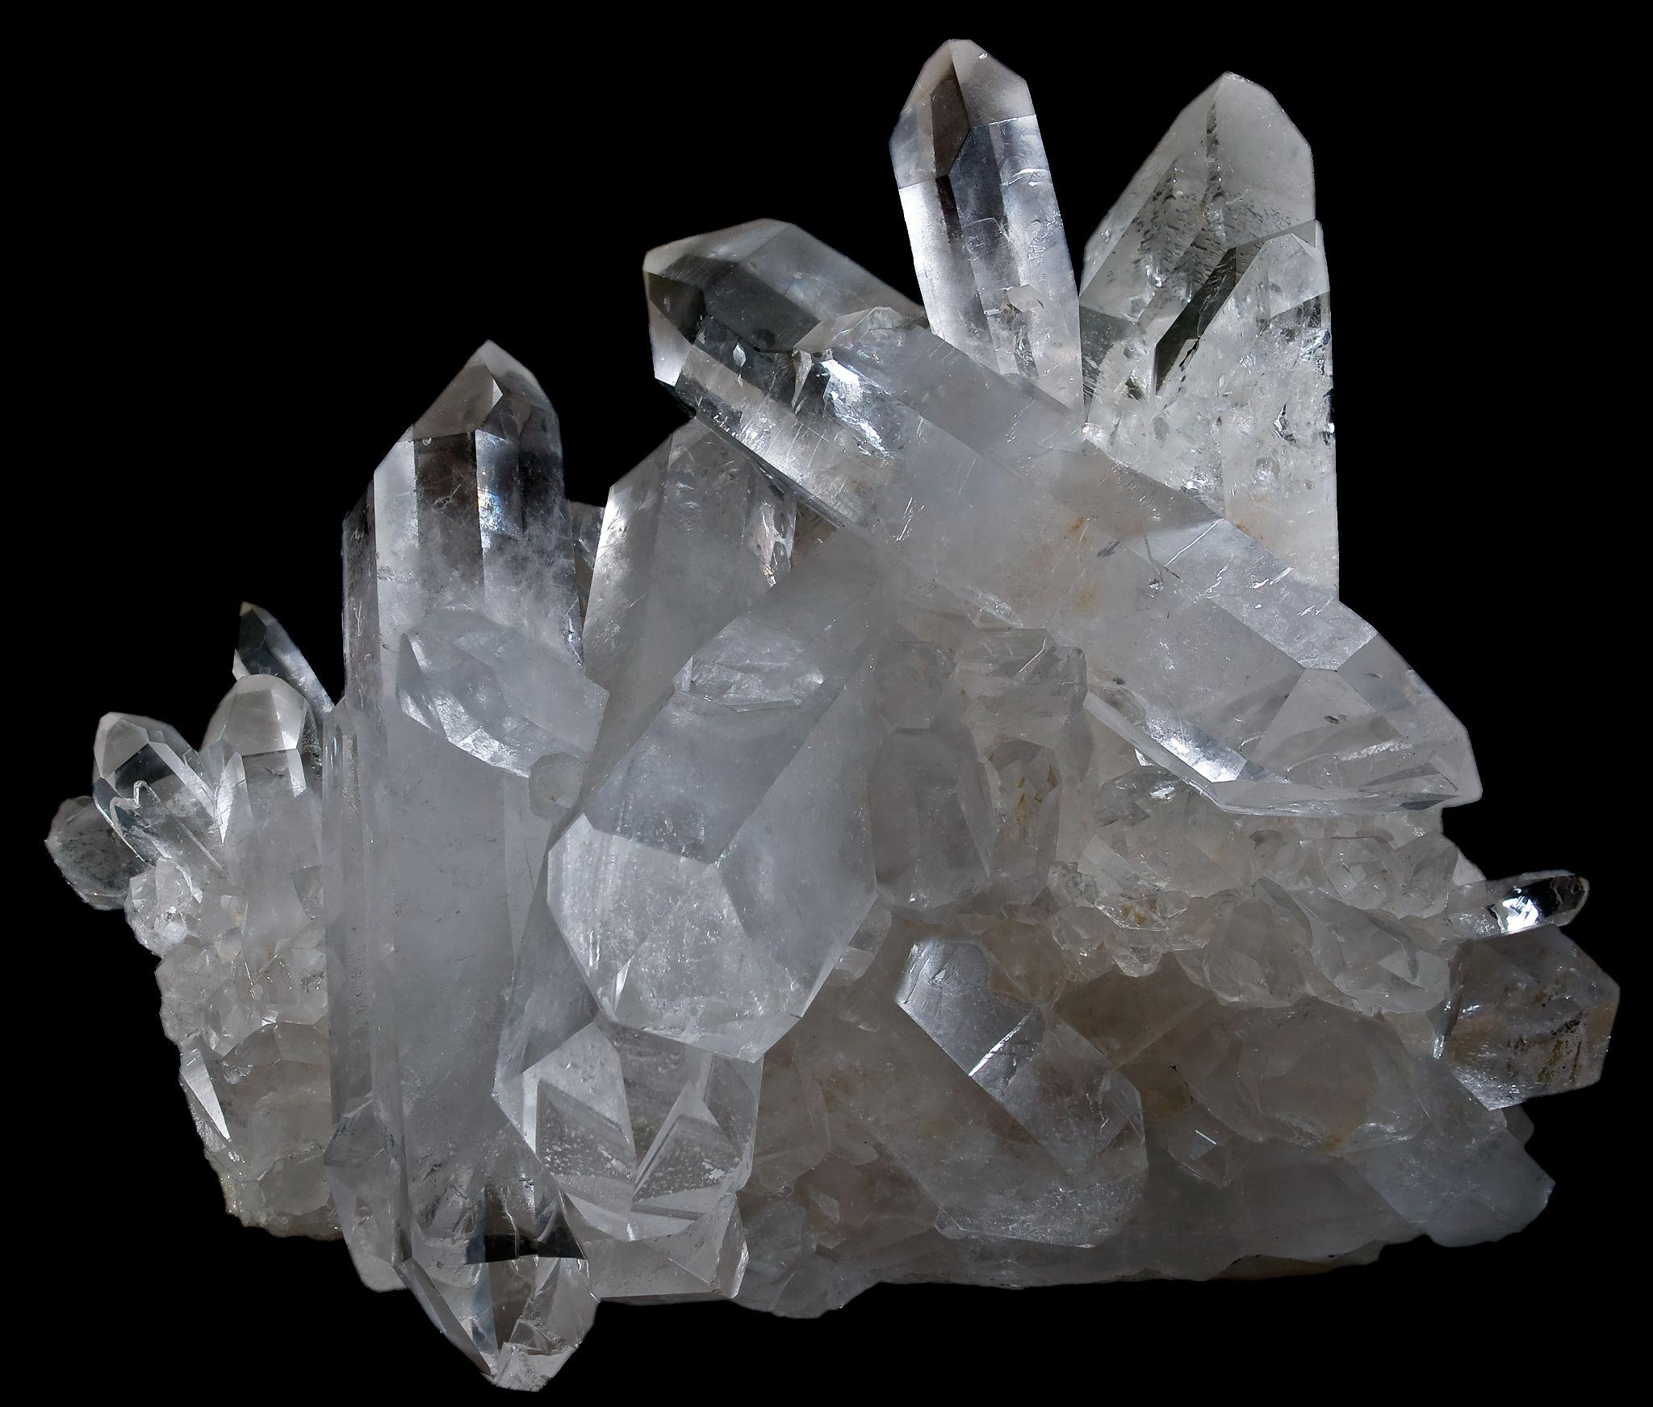
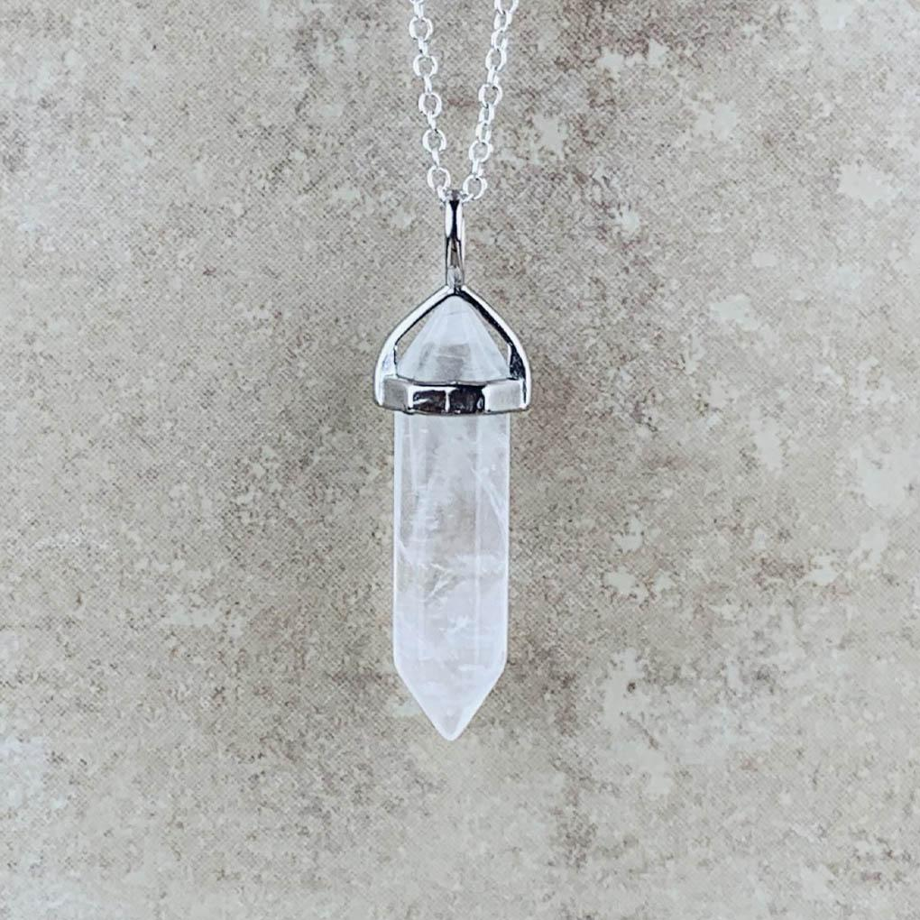
An example of a mineral is quartz. It is found in many types of rocks and known for its hexagonal crystal structure. It is frequently used in jewelry.
Notes:
An example of a mineral is quartz. It is found in many types of rocks and known for its hexagonal crystal structure. It is frequently used in jewelry.

Slide 35
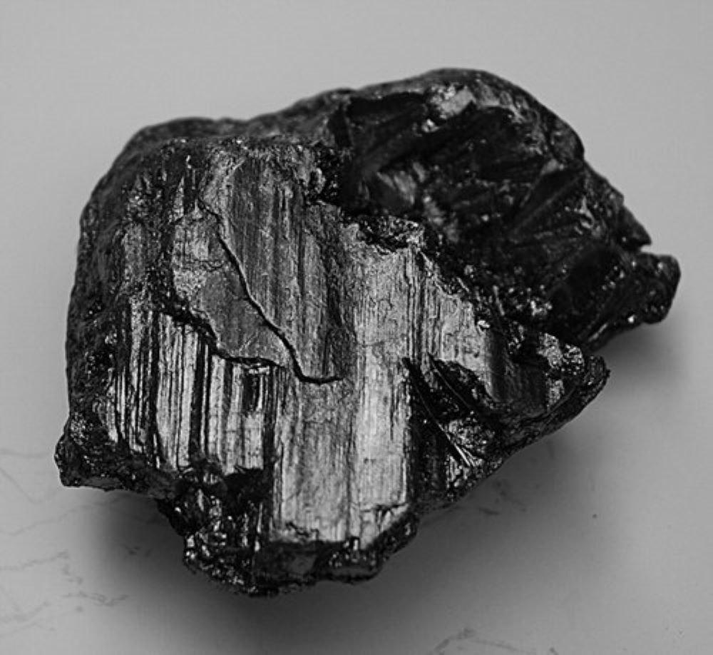
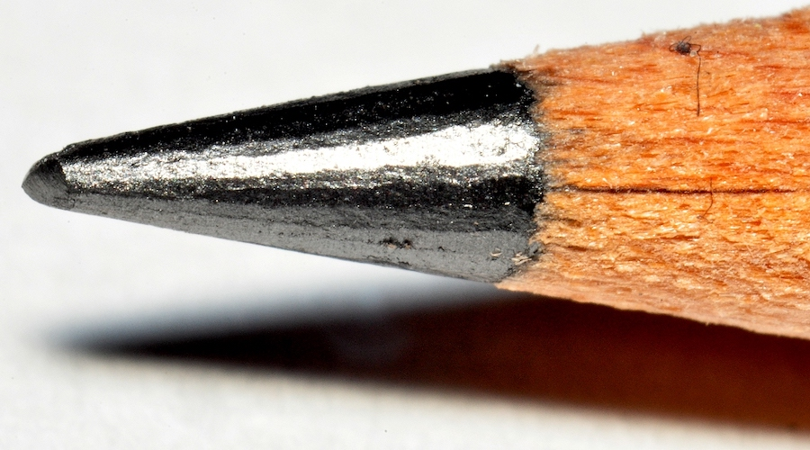
Another example of a mineral is graphite, which is made up of carbon atoms. Graphite is found in pencils.
Notes:
Another example of a mineral is graphite, which is made up of carbon atoms. Graphite is found in pencils.

Slide 36
Notes:
Now, let’s talk about some non-examples of minerals.

Slide 37
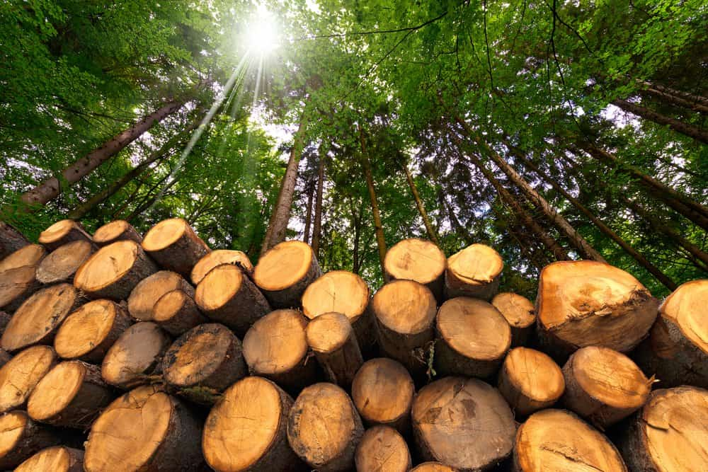
Wood is not an example of a mineral. It is made from trees and plants and does not make up rocks.
Notes:
Wood is not an example of a mineral. It is made from trees and plants and does not make up rocks.

Slide 38
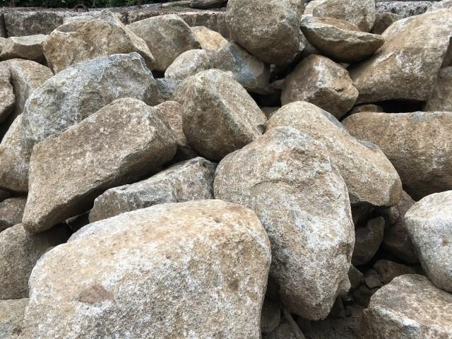
Rocks are not examples of minerals themselves, but instead are made up of minerals.
Notes:
Rocks are not examples of minerals themselves, but instead are made up of minerals.

Slide 39
Notes:
Now let’s pause for a moment to check your understanding.

Slide 40
Why are rocks not examples of minerals?
Notes:
Why are rocks not examples of minerals?
[Rocks are not examples of minerals because they are made up of different minerals. A mineral has its unique combination of elements and atoms, and many minerals together make a rock.]

Slide 41
Remember!!!
Notes:
So remember!

Slide 42
Mineral: Substance that does not come from an animal or plant; the building blocks that make up rocks
mineral
mineral
mineral
mineral
Notes:
A mineral is a substance that does not come from an animal or plant; the building blocks that make up rocks.

Slide 43
Notes:
We will now complete this concept map, called a Frayer model, to summarize and further clarify what you have learned about the term mineral.

Slide 44
Definition
Picture
Mineral
Example
How do minerals impact my life?
Notes:
To complete the Frayer model, we will choose from four choices the correct picture, definition, example, and response to the question, “How do minerals impact my life?” Select the best response for each question using the information you just learned. As we select responses, we will see how this model looks filled in for the term mineral.

Slide 45
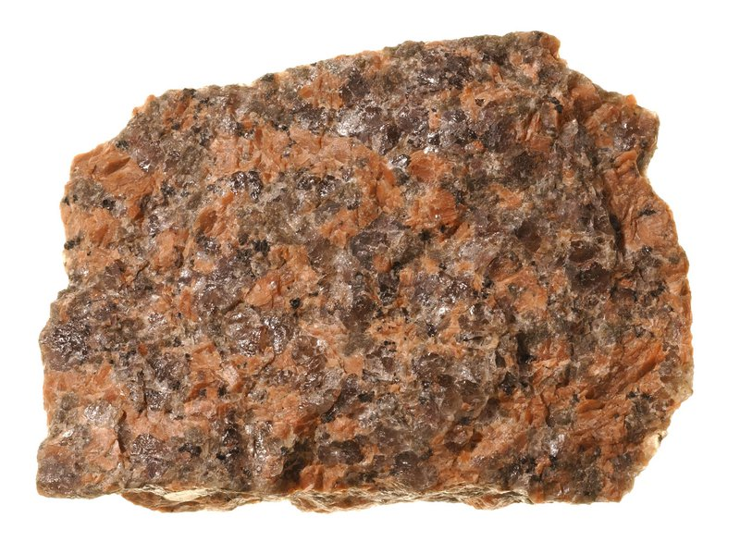
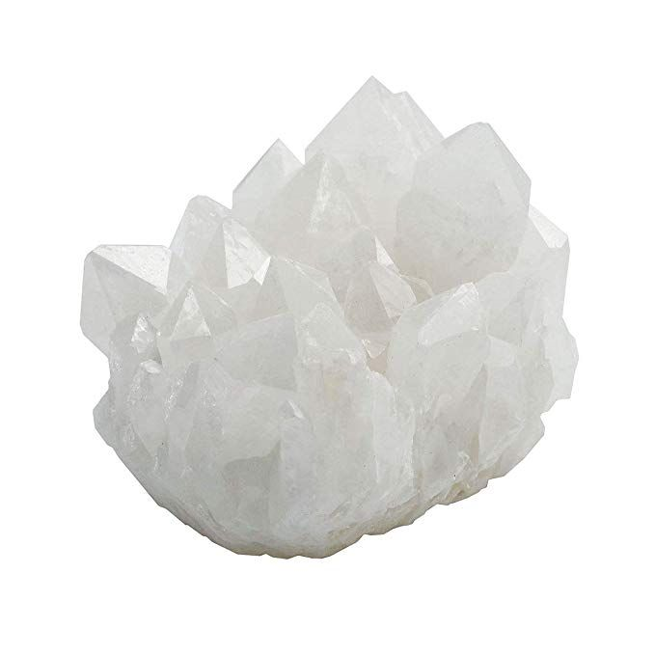
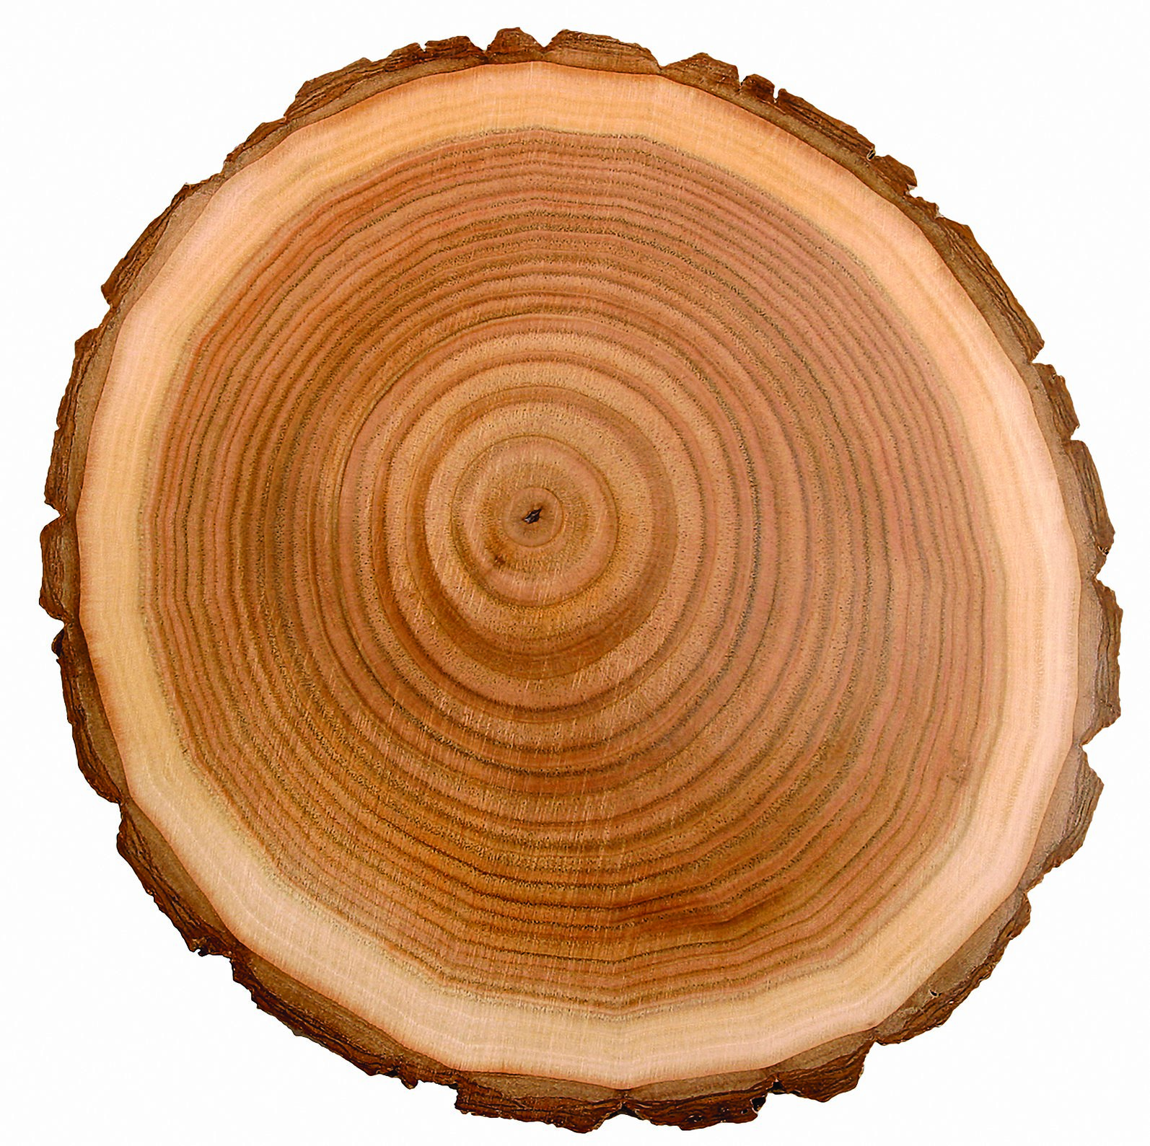
Directions: Choose the correct picture of a mineral from the choices below.
A
B
C
D
Notes:
Choose the one correct picture of a mineral from these four choices.

Slide 46
Directions: Choose the correct picture of a mineral from the choices below.
A
B
C
D
Notes:
This is the picture that shows a mineral.

Slide 47
Definition
Picture
Mineral
Example
How do minerals impact my life?
Notes:
Here is the Frayer model filled in with a picture of a mineral.

Slide 48
Directions: Choose the correct definition of a mineral from the choices below.
A
Substances that does not come from an animal or plant; the building blocks that make up rocks
B
The outermost shell of Earth
C
The process of breaking down a rock over a long period of time
D
Dropping of sediment to a new location
Notes:
Choose the one correct definition of a mineral from these four choices.

Slide 49
Directions: Choose the correct definition of a mineral from the choices below.
A
Substances that does not come from an animal or plant; the building blocks that make up rocks
B
The outermost shell of Earth
C
The process of breaking down a rock over a long period of time
D
Dropping of sediment to a new location
Notes:
“Substances that does not come from an animal or plant; the building blocks that make up rocks” is correct! This is the definition of a mineral.

Slide 50
Definition
Picture
Substances that does not come from an animal or plant; the building blocks that make up rocks
Mineral
Example
How do minerals impact my life?
Notes:
Here is the Frayer Model with a picture and the definition filled in for a mineral: Substances that does not come from an animal or plant; the building blocks that make up rocks.

Slide 51
Directions: Choose the correct example of a mineral from the choices below.
A
Wood in a tree
B
Graphite in pencils
C
Rocks in a river
D
Water pushing sand around
Notes:
Choose the one correct example of a mineral from these four choices.

Slide 52
Directions: Choose the correct example of a mineral from the choices below.
A
Wood in a tree
B
Graphite in pencils
C
Rocks in a river
D
Water pushing sand around
Notes:
“Graphite in pencils” is correct! This is an example of a mineral.

Slide 53
Definition
Picture
Substances that does not come from an animal or plant; the building blocks that make up rocks
Mineral
Graphite in pencils
Example
How do minerals impact my life?
Notes:
Here is the Frayer Model with a picture, definition, and an example of a mineral: Graphite in pencils.

Slide 54
Directions: Choose the correct response for “how do minerals impact my life?” from the choices below.
A
Minerals showcase the different types of elements we have on Earth including fire, water, and air.
B
Minerals create the seasons on Earth because of the gravitational pull from the Moon,
C
Minerals give our bodies nutrients to be healthy and strong.
Minerals are materials that have different uses in our daily lives, such as building materials and jewelry, and also make up rocks and Earth’s landscapes.
D
Notes:
Choose the one correct response for “how do minerals impact my life?” from these four choices.

Slide 55
Directions: Choose the correct response for “how do minerals impact my life?” from the choices below.
A
Minerals showcase the different types of elements we have on Earth including fire, water, and air.
B
Minerals create the seasons on Earth because of the gravitational pull from the Moon,
C
Minerals give our bodies nutrients to be healthy and strong.
Minerals are materials that have different uses in our daily lives, such as building materials and jewelry, and also make up rocks and Earth’s landscapes.
D
Notes:
“Minerals are materials that have different uses in our daily lives, such as building materials and jewelry, and also make up rocks and Earth’s landscapes.” That is correct! This is an example of how minerals impacts your life.

Slide 56
Definition
Picture
Substances that does not come from an animal or plant; the building blocks that make up rocks
Mineral
Minerals are materials that have different uses in our daily lives, such as building materials and jewelry, and also make up rocks and Earth’s landscapes.
Graphite in pencils
Example
How do minerals impact my life?
Notes:
Here is the Frayer Model with a picture, definition, example, and a correct response to “how do minerals impact my life?”: Minerals are materials that have different uses in our daily lives, such as building materials and jewelry, and also make up rocks and Earth’s landscapes.

Slide 57
Remember!!!
Notes:
So remember!

Slide 58
Mineral: Substance that does not come from an animal or plant; the building blocks that make up rocks
mineral
mineral
mineral
mineral
Notes:
A mineral is a substance that does not come from an animal or plant; the building blocks that make up rocks.

Slide 59
Big Question: How do minerals contribute to changes in the Earth, and what role do they play in shaping the planet over time?
Notes:
Let’s reflect once more on our big question. Our “big question” is: How do minerals contribute to changes in the Earth, and what role do they play in shaping the planet over time?
Does anyone have any additional examples to share that haven’t been discussed yet?

Slide 60
Demonstration
What’s A Mineral?
As you watch this video, answer the following questions:
What is mineral?
What are the items on the checklist that is a mineral?
What are some examples of minerals?
Notes:
Have students watch the video (link: https://www.youtube.com/watch?v=wzTRPlG1L0o) and answer the questions on the slide.

Slide 61
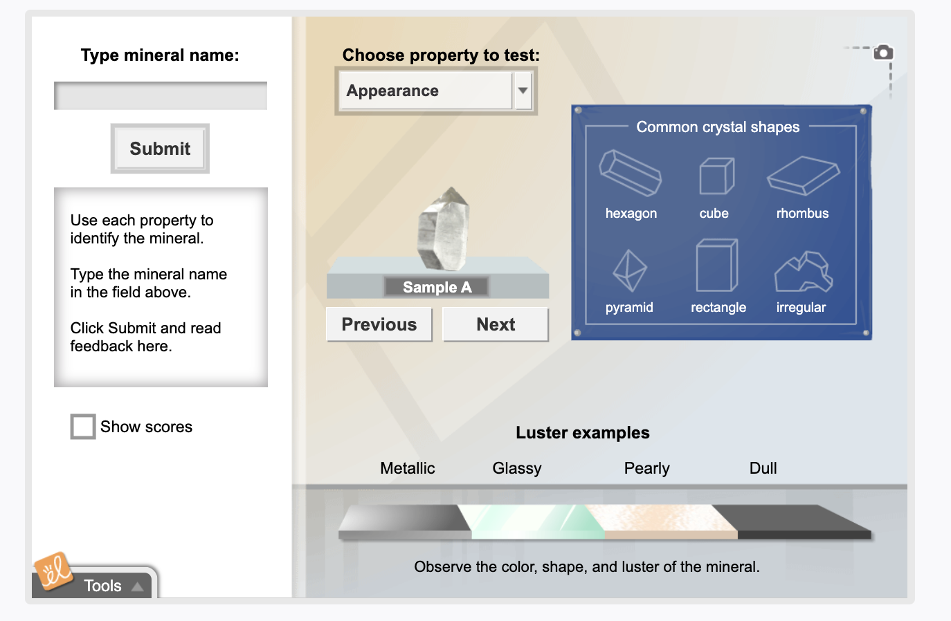
Simulation Activity
Mineral Identification
(Gizmos)
Click the link above for a simulation to deepen your knowledge of different types of minerals.
Notes:
Click the link above for a simulation to deepen your understanding of minerals. In this simulation, you will identify different minerals.

Slide 62
Notes:
Thanks for watching, and please continue watching CAPs available from this website.

Slide 63
This Was Created With Resources From:
Questions or Comments
Michael Kennedy, Ph.D. MKennedy@Virginia.edu
Rachel L Kunemund, Ph.D. rk8vm@virginia.edu

