Slide 1
Intro
“Big Idea” Question
Review Concepts
Check-In Questions
Teacher Demo
Vocabulary
Student-Friendly Definition
Examples & Non-Examples
Morphological Word Parts
Extension Activity
Notes:
OK everyone, get ready for our next lesson. Just as a reminder, these are the different components that our lesson may include, and you’ll see these icons in the top left corner of each slide so that you can follow along more easily!

Slide 2
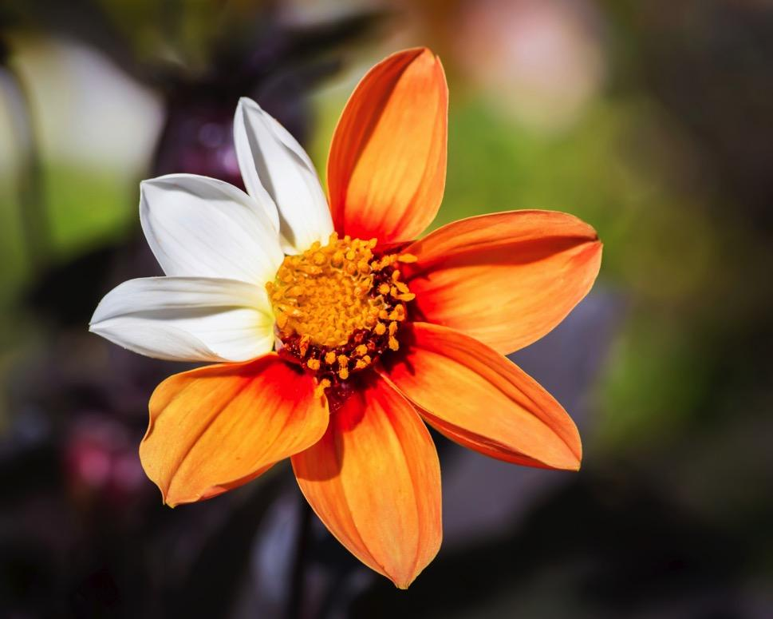
Mutations
Notes:
In this lesson we talk about mutations.

Slide 3
Big Question: How do mutation, adaptation, and extinction change populations of species over time?
Notes:
Our “big question” is: How do mutation, adaptation, and extinction change populations of species over time?
[Pause and illicit predictions from students.]
I love all these thoughtful scientific hypotheses! Be sure to keep this question and your predictions in mind as we move through these next few lessons, and we’ll continue to revisit it.

Slide 4
Notes:
Next, let’s review some other words that you already learned, and make sure you are firm in your understanding.

Slide 5
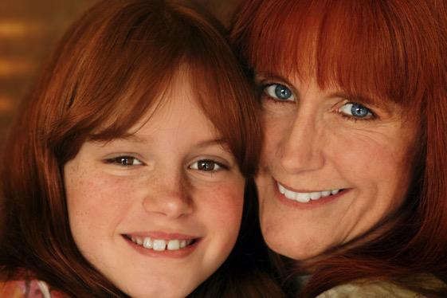
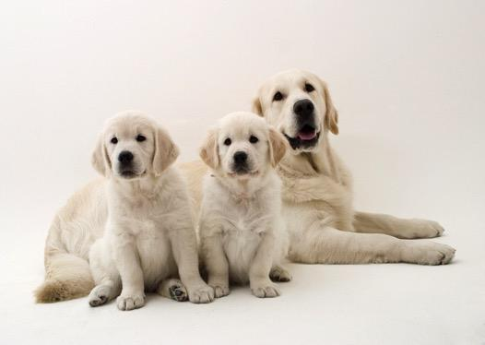
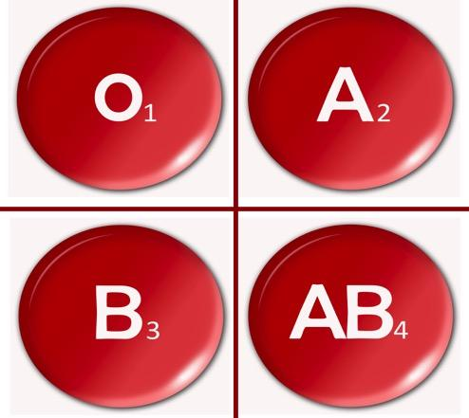
Inheritable
Notes:
Parents’ hereditary material gives traits—such as eye color, hair color, blood type, or height—to their offspring, or children.
Humans have hereditary traits. So do animals, plants, and other organisms.

Slide 6
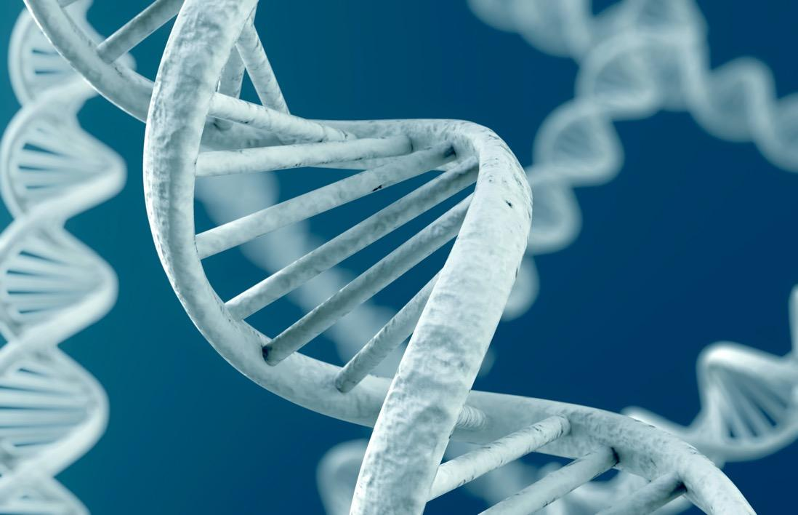
DNA: the hereditary material in
almost all organisms
Notes:
DNA is the hereditary material in all organisms.

Slide 7
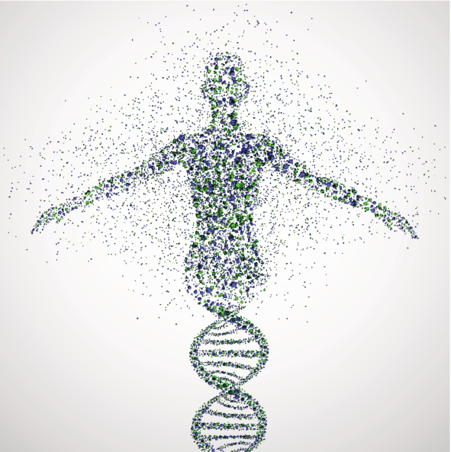
Genes: parts of DNA that carry
information that determines your
traits
Notes:
Genes are the parts of DNA that carry the information that determines your traits—such as hair color, height, baldness, and blood type.

Slide 8
Notes:
Now let’s pause for a moment to review the information we have covered already.

Slide 9
What does inheritable mean?
A trait that is received by choice
A trait that is received by hard work
A trait that is received by genes
A trait that is received by the environment
Notes:
What does inheritable mean?

Slide 10
What does inheritable mean?
A trait that is received by choice
A trait that is received by hard work
A trait that is received by genes
A trait that is received by the environment
Notes:
What does inheritable mean?
[Inheritable traits are those that are received by genes.]

Slide 11
What part of DNA carries the
information that determines our traits?
Notes:
What part of DNA carries the information that determines our traits?
[Genes are the parts of DNA that carry information that determines your traits.]

Slide 12
Demonstration
Mutation Telephone
Students perform an activity similar to the childhood “telephone” game in which each communication step represents a biological process related to the passage of DNA from one cell to another. This game tangibly illustrates how DNA mutations can happen over several cell generations and the effects the mutations can have on the proteins that cells need to produce. Detailed instructions are linked above.

Slide 13
Mutation
Notes:
Now, let’s define mutation.

Slide 14
Mutation: a permanent change in the DNA sequence that makes up a gene
Notes:
A mutation is a permanent change in the DNA sequence that makes up a gene.

Slide 15
Notes:
Now let’s pause for a moment to review the information we have covered already.

Slide 16
What is a mutation?
Notes:
What is a mutation?
[A mutation is a permanent change in the DNA sequence that makes up a gene.]

Slide 17
Notes:
That is the basic definition, but there is a bit more you need to know.

Slide 18
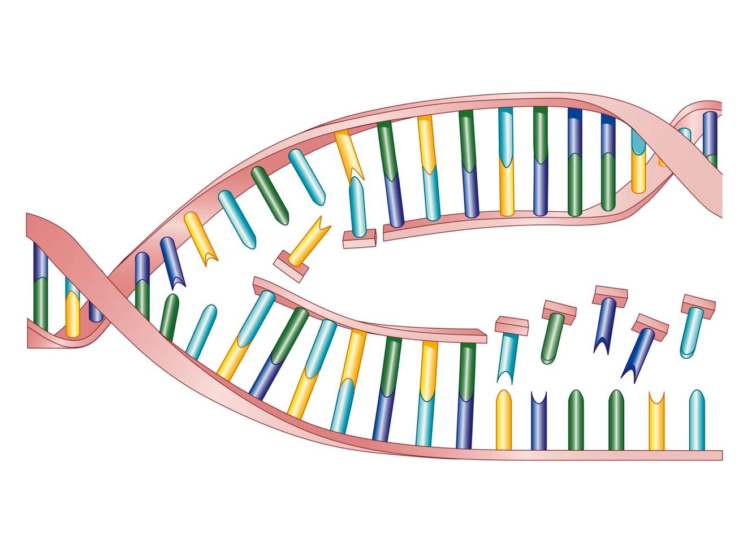
Notes:
Mutations are caused by unrepaired damage to DNA or problems when DNA makes a copy of, or replicates, itself.

Slide 19
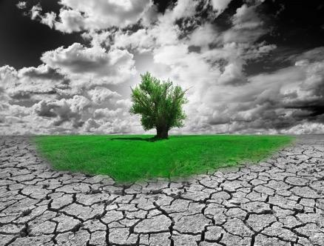
Mutation
Beneficial Neutral Harmful
Improved Ability
to Survive!
Notes:
A mutation can be beneficial and improve an organism’s ability to survive in its environment…

Slide 20
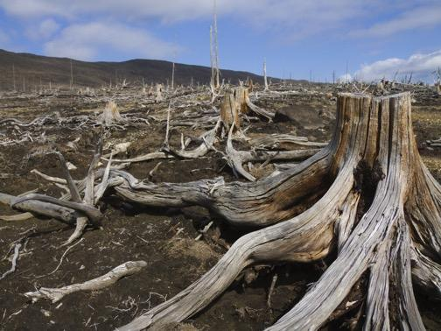
Mutation
Beneficial Neutral Harmful
Notes:
A mutation can also be harmful and hurt the organism’s chance of survival…

Slide 21
Mutation
Beneficial Neutral Harmful
Notes:
Mutations can be neutral and have no effect at all on the likelihood that the organism will survive and reproduce.

Slide 22
Notes:
Now let’s pause for a moment to review the information we have covered already.

Slide 23
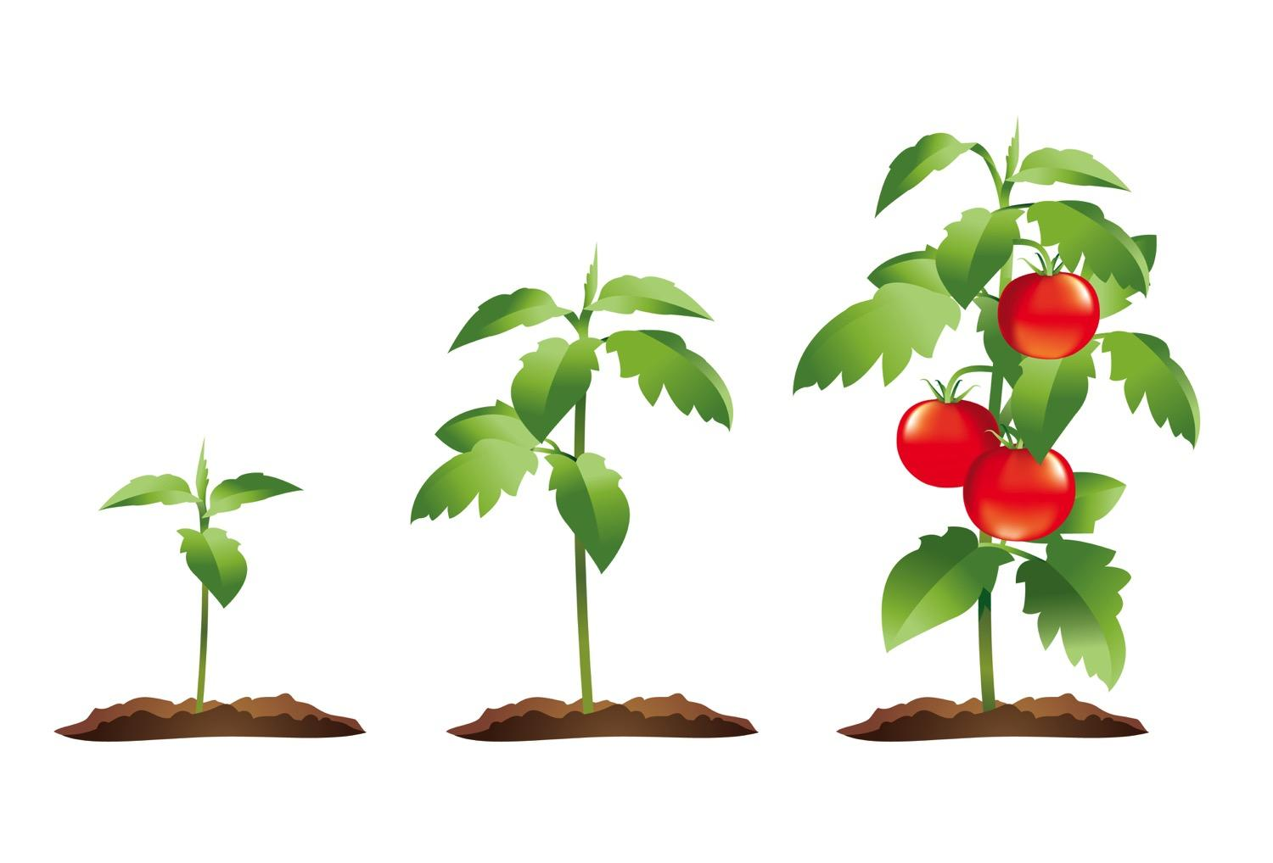
What is a mutation?
A permanent change in the DNA sequence
that makes up a gene
B. A change in physical features such as a
broken bone
C. A change in an organism that only helps
improve its survival chances
D. A change in an organism that has no effect on
its chances of survival
Notes:
What is a mutation?

Slide 24
What is a mutation?
A permanent change in the DNA sequence
that makes up a gene
B. A change in physical features such as a
broken bone
C. A change in an organism that only helps
improve its survival chances
D. A change in an organism that has no effect on
its chances of survival
Notes:
What is a mutation?
[A mutation is a permanent change in the DNA sequence that makes up a gene.]

Slide 25
Explain how a mutation could be beneficial, harmful, or neutral.
Notes:
Explain how a mutation could be beneficial, harmful, or neutral.
[Sometimes mutations cause changes that provide the organism with a benefit for surviving in its environment, while at other times that can cause the organism to be at a disadvantage. Sometimes mutations have no effect on the survival and reproduction of the organism.]

Slide 26
Notes:
Now, let’s talk about some examples of mutations.

Slide 27
Notes:
An example of a beneficial mutation is a special type of tomato plant that can survive with less water.
This is a beneficial mutation because the plant is able to survive in a drought.

Slide 28
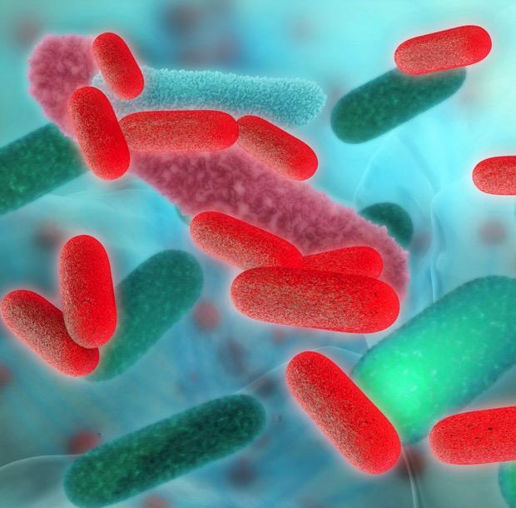
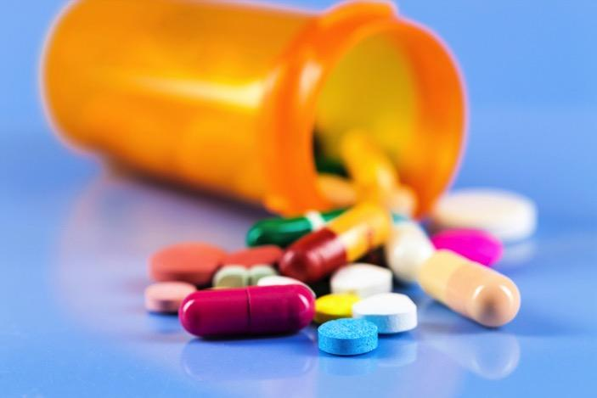
Notes:
Another example of a beneficial mutation is that bacteria can have a mutation that makes it resistant to an antibiotic.
This is a beneficial mutation because it helps bacteria survive and pass on its resistant genes. IT is beneficial for the bacteria, but could be a problem for the humans who are trying to get rid of an infection.

Slide 29
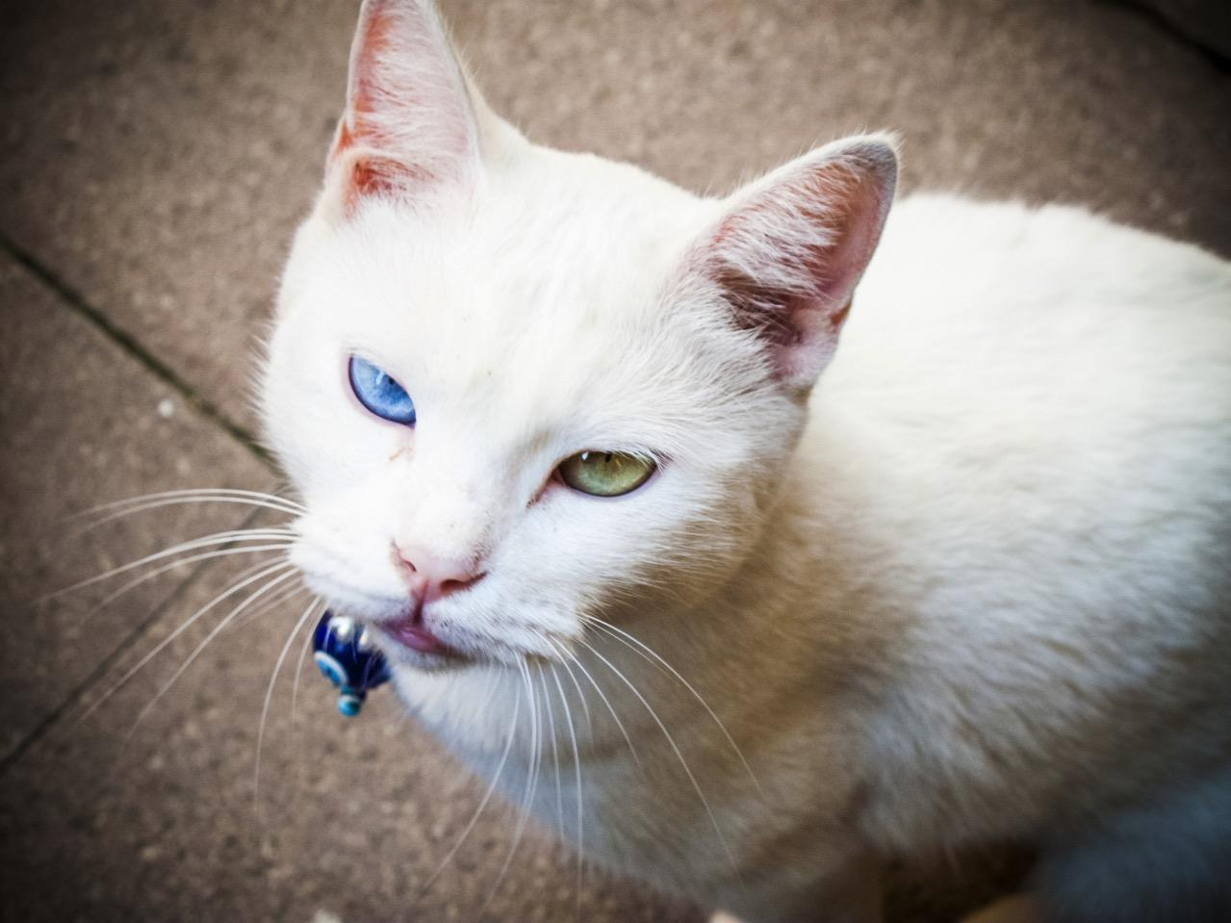
Notes:
There is a mutation that causes an animal to have two different colored eyes.
This is a neutral mutation because it does not help a species survive but it also does not harm the species’ chance of survival--it has no effect.

Slide 30
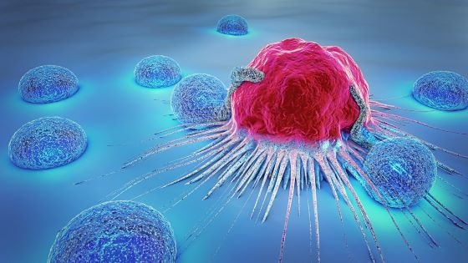
Notes:
An example of a harmful mutation is cancer.
Cancer in humans is caused by mutations in the genes.
These mutations are harmful because cancer makes someone sick and does not help people survive.

Slide 31
Notes:
Let’s check-in for understanding.

Slide 32
Which is an example of a neutral mutation?
Notes:
Which is an example of a neutral mutation?

Slide 33
Which is an example of a neutral mutation?
Notes:
Which is an example of a neutral mutation?
[Right - the two different eye colors is a neutral mutation because it has no effect on survival.]

Slide 34
Notes:
Now, let’s talk about some non-examples mutations.

Slide 35
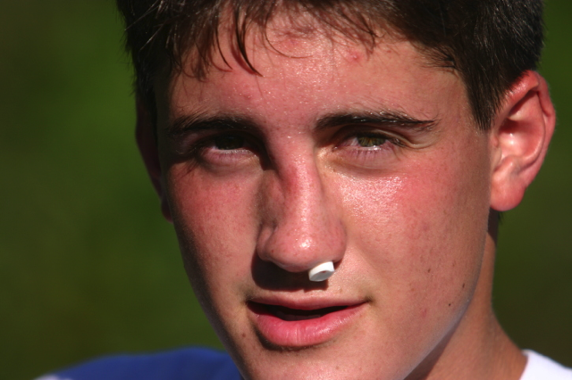
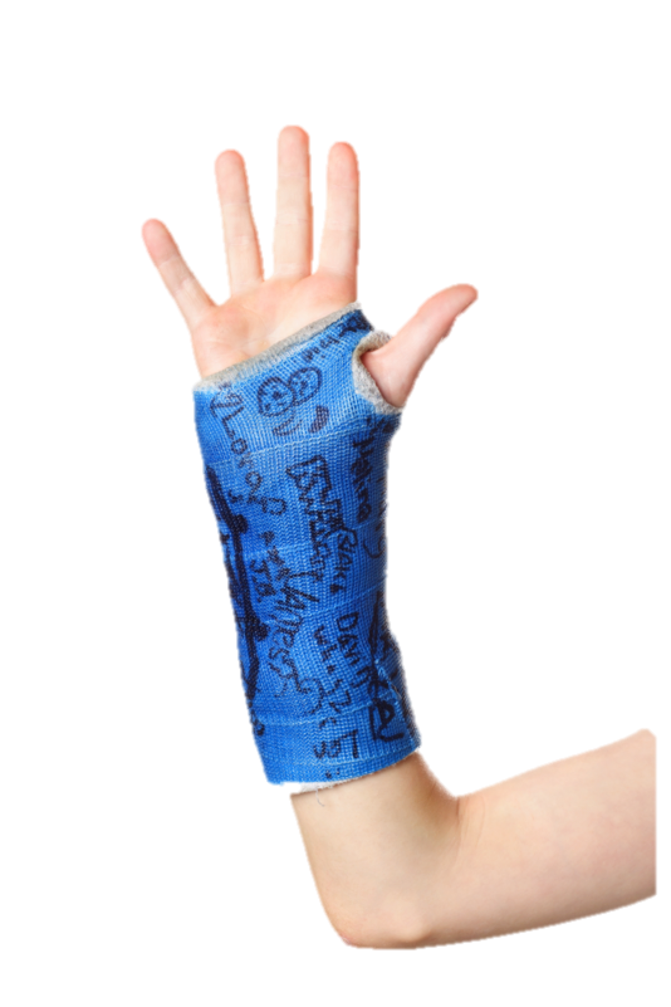
Injuries
are NOT
Mutations
Notes:
A non example is an injury like a broken nose or a broken arm. Even though they change an organism's body, they are not a mutation because it is not the result of a change in DNA.

Slide 36
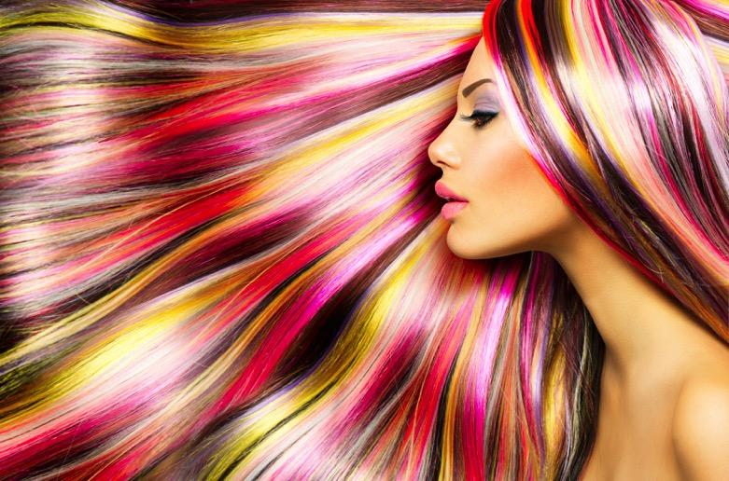
Dying your
hair is NOT a
mutation
Notes:
A non example is dying your hair. Even though this changes an organism's hair color, this are not a mutation because it is not the result of a change in DNA.

Slide 37
Notes:
Let’s check-in for understanding.

Slide 38
What is a mutation?
Notes:
What is a mutation?
[A mutation is a permanent change in the DNA sequence that makes up a gene.]

Slide 39
Which of the following is NOT a type of
mutation?
Resistance to medicine
Different colored eyes
Cancer
Broken arm
Notes:
Which of the following is NOT a type of mutation?

Slide 40
Which of the following is NOT a type of
mutation?
Resistance to medicine
Different colored eyes
Cancer
Broken arm
Notes:
Which of the following is NOT a type of mutation?
[Broken arm]

Slide 41
List the three types of mutations.
Mutation
_______ _______ _______
Notes:
List the three types of mutations.

Slide 42
List the three types of mutations.
Mutation
Beneficial Neutral Harmful
Notes:
List the three types of mutations.
[Beneficial, neutral, harmful]

Slide 43
Remember!!!
Notes:
So remember!

Slide 44
Mutation: a permanent change in the DNA sequence that makes up a gene
Notes:
A mutation is a permanent change in the DNA sequence that makes up a gene.

Slide 45
Big Question: How do mutation, adaptation, and extinction change populations of species over time?
Notes:
Explicit cue to revisit the big question at the end of the lesson: Okay everyone. Now that we’ve learned the term mutation, let’s reflect once more on our big question. Was there anything that we predicted earlier that was correct or incorrect? Do you have any new hypotheses to share?

Slide 46
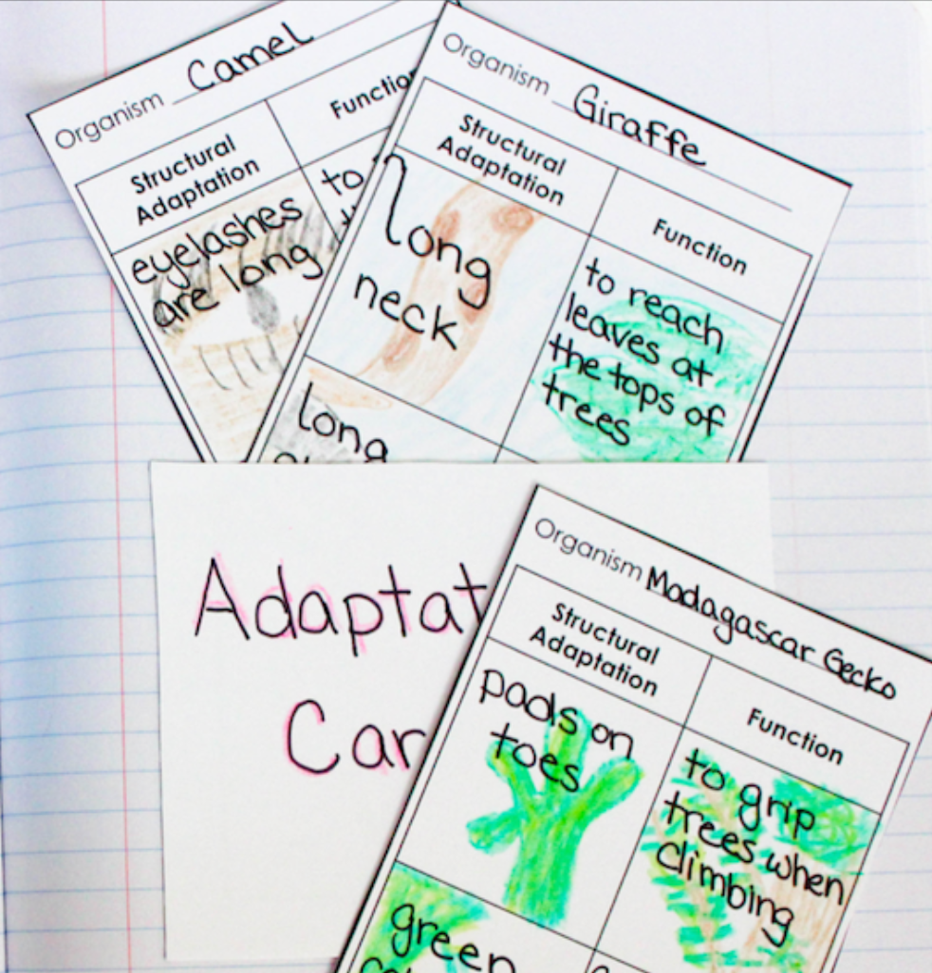
Extension Activity
Form and Function Activity
Linked above are cards that can be used for reviewing the topic of mutations and adaptations with your class. Students will consider the connection between form and function as they research organisms that they choose or are assigned. Decide ahead of time if you want the students to work independently or with a partner/group.

Slide 47
Notes:
Thanks for watching, and please continue watching CAPs available from this website.

Slide 48
This Video Was Created With Resources From:
Questions or Comments
Michael Kennedy, Ph.D. MKennedy@Virginia.edu
Rachel L Kunemund, Ph.D. rk8vm@virginia.edu

Slide 49
Intro
“Big Idea” Question
Review Concepts
Check-In Questions
Teacher Demo
Vocabulary
Student-Friendly Definition
Examples & Non-Examples
Morphological Word Parts
Extension Activity
Notes:
OK everyone, get ready for our next lesson. Just as a reminder, these are the different components that our lesson may include, and you’ll see these icons in the top left corner of each slide so that you can follow along more easily!

Slide 50
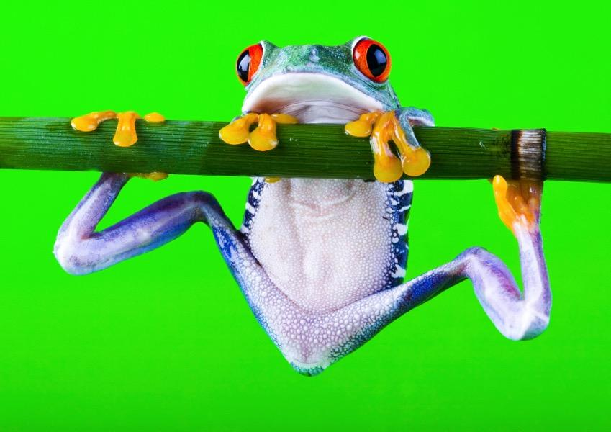
Adaptations
Notes:
In this lesson we talk about adaptations.

Slide 51
Big Question: How do mutation, adaptation, and extinction change populations of species over time?
Notes:
Our “big question” is: How do mutation, adaptation, and extinction change populations of species over time?
[Pause and illicit predictions from students.]
I love all these thoughtful scientific hypotheses! Be sure to keep this question and your predictions in mind as we move through these next few lessons, and we’ll continue to revisit it.

Slide 52
Notes:
Next, let’s review some other words that you already learned, and make sure you are firm in your understanding.

Slide 53
Inheritable
Notes:
Parents’ hereditary material gives traits—such as eye color, hair color, blood type, or height—to their offspring, or children.
Humans have hereditary traits. So do animals, plants, and other organisms.

Slide 54
DNA: the hereditary material in
almost all organisms
Notes:
DNA is the hereditary material in all organisms.

Slide 55
Genes: parts of DNA that carry
information that determines your
traits
Notes:
Genes are the parts of DNA that carry the information that determines your traits—such as hair color, height, baldness, and blood type.

Slide 56
Mutation: a permanent change in the DNA sequence that makes up a gene
Notes:
A mutation is a permanent change in the DNA sequence that makes up a gene.

Slide 57
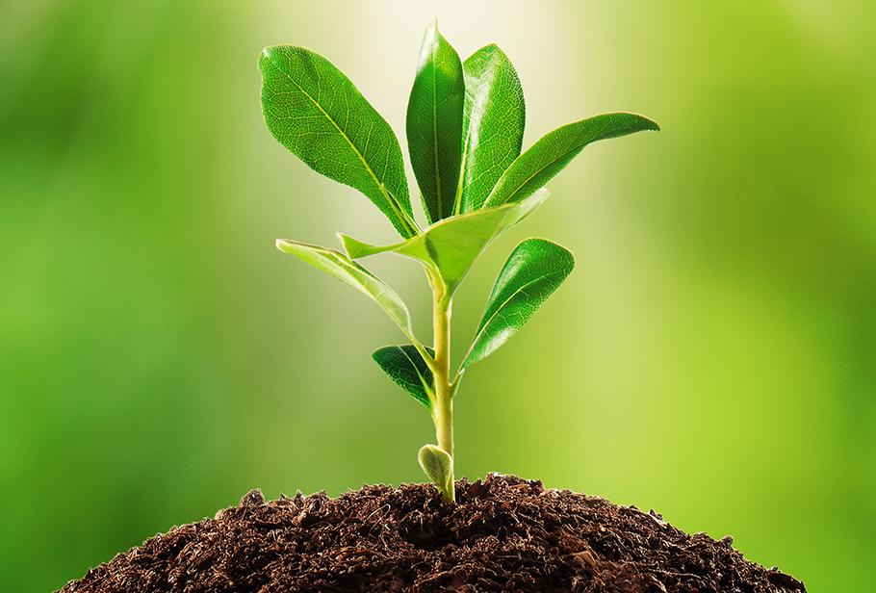
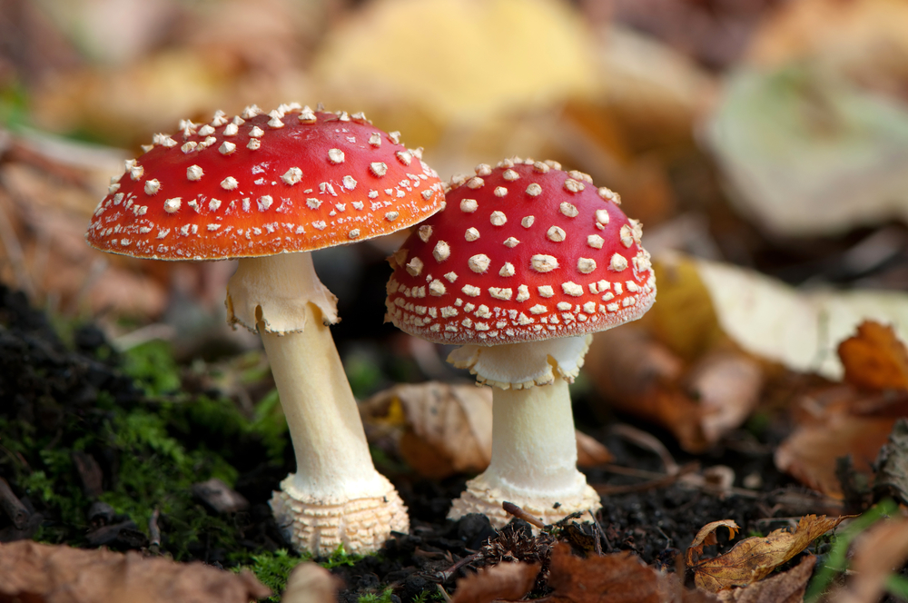
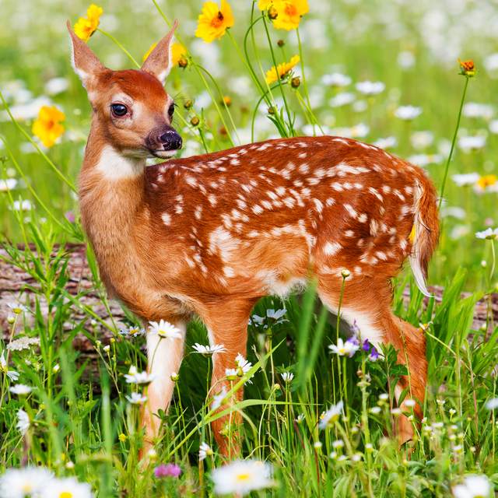
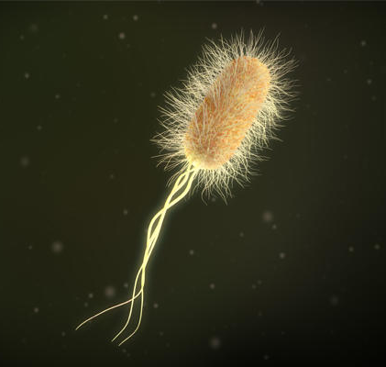
Biotic Factors: living things, plants or animals, that influence or affect an ecosystem
Notes:
Biotic factors are the living things that influence or affect an ecosystem. And, we will learn more about ecosystems later in the unit.

Slide 58
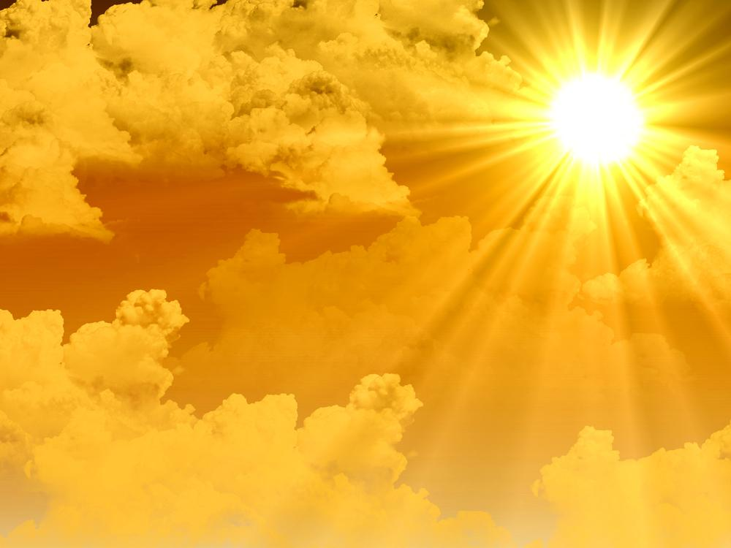
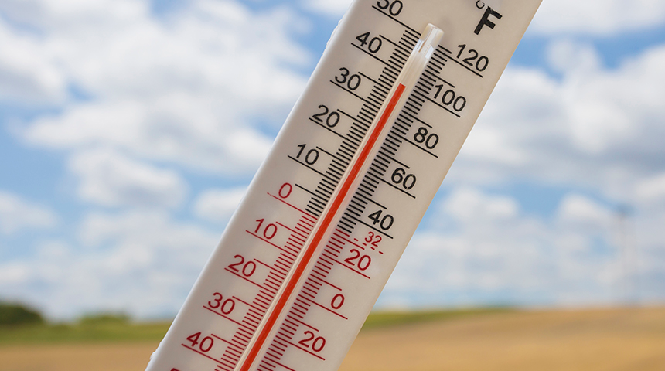
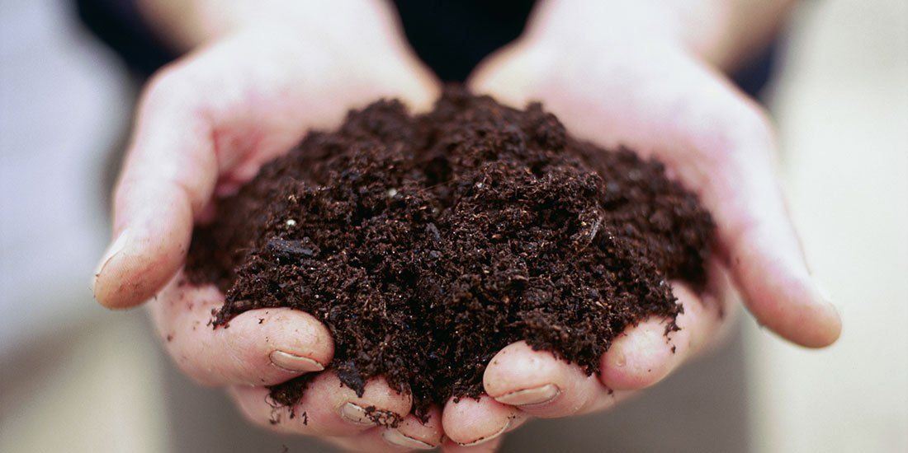
Abiotic Factors: non-living things that influence or affect an ecosystem
Notes:
Abiotic factors are the non-living things that influence or affect an ecosystem.

Slide 59
Notes:
Now let’s pause for a moment to review the information we have covered already.

Slide 60
What does inheritable mean?
A trait that is received by choice
A trait that is received by hard work
A trait that is received by genes
A trait that is received by the environment
Notes:
What does inheritable mean?

Slide 61
What does inheritable mean?
A trait that is received by choice
A trait that is received by hard work
A trait that is received by genes
A trait that is received by the environment
Notes:
What does inheritable mean?
[Inheritable traits are those that are received by genes.]

Slide 62
What part of DNA carries the
information that determines our traits?
Notes:
What part of DNA carries the information that determines our traits?
[Genes are the parts of DNA that carry information that determines your traits.]

Slide 63
What is a mutation?
Notes:
What is a mutation?
[A mutation is a permanent change in the DNA sequence that makes up a gene.]

Slide 64
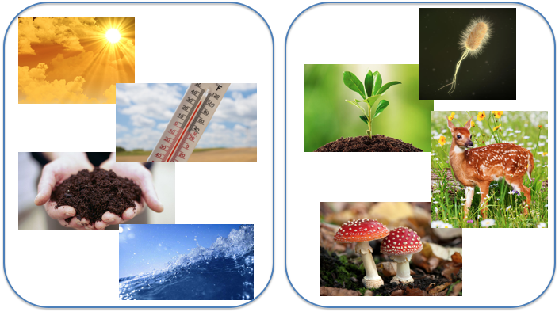
What is the difference between biotic and abiotic factors?
Notes:
What is the difference between biotic and abiotic factors?
[Biotic factors are the living things, or organisms, that interact with each other in an ecosystem. Abiotic factors are the non-living things in an ecosystem’s environment that organisms interact with.]

Slide 65
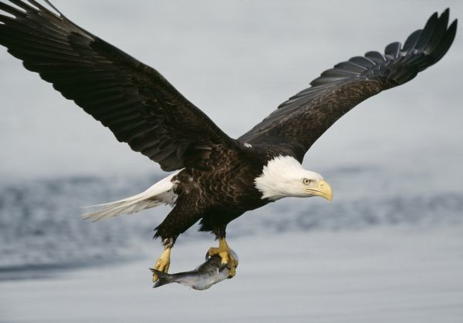
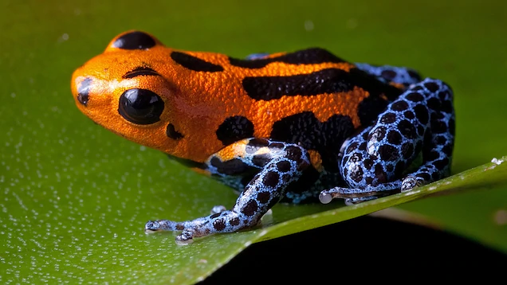
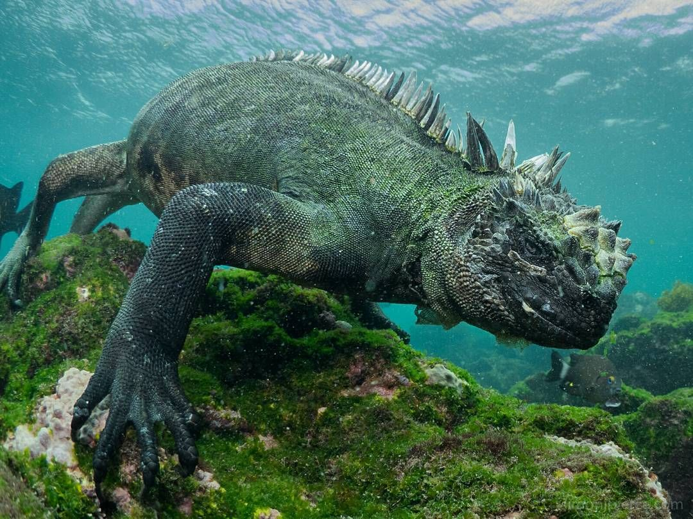
Demonstration
Fit for Survival
Use the presentation linked above to engage students with the topic of adaptations. For each of the slides, ask students to identify the features that make each organism fit for survival in their environment.

Slide 66
Adaptation
Notes:
Now that we’ve reviewed, let’s define our new term, adaptation.

Slide 67
Adaptation: a change or characteristic that helps an organism survive in its environment
Notes:
An adaptation is a change or characteristic that helps an organism survive in its environment.

Slide 68
Notes:
Let’s check-in for understanding.

Slide 69
What is an adaptation?
Notes:
What is an adaptation?
[An adaptation is a change or characteristic that helps an organism survive in its environment.]

Slide 70
Notes:
That is the basic definition, but there is a bit more you need to know.

Slide 71
Can be in response to biotic or abiotic factors.
Notes:
Adaptations can develop in response to biotic or abiotic factors.

Slide 72
Notes:
Let’s check-in for understanding.

Slide 73
What are adaptations in response to?
Notes:
What are adaptations in response to?
[They can be in response to the biotic and abiotic factors in an organism’s environment.]

Slide 74
Notes:
Now, let’s talk about some examples of adaptations.

Slide 75
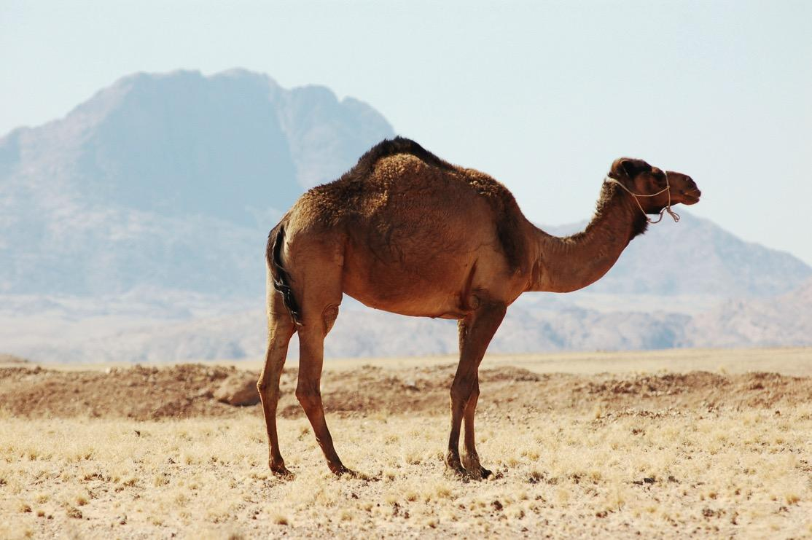
Water conservation
Notes:
Camels have an adaptation that allows them to store water for long periods of time. This makes camels well-suited for survival in hot and dry climates.

Slide 76
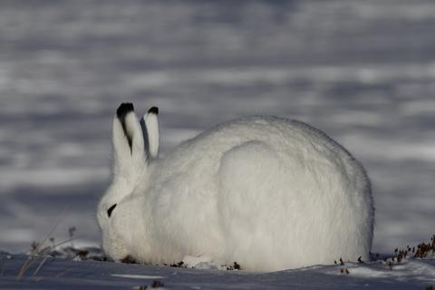
Notes:
The rabbit’s white fur is an adaptation because it allows the rabbit to evade predators and increases survival chances.

Slide 77
Notes:
Now, let’s talk about some non-examples of adaptations.

Slide 78
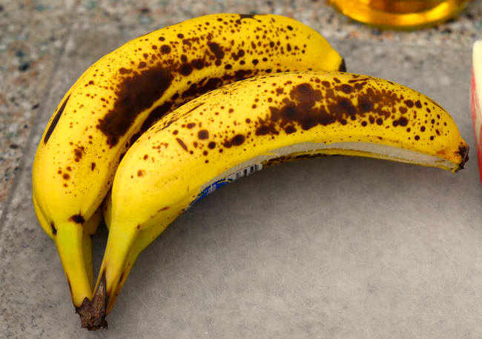
Notes:
A banana ripening is not an adaptation because it does not help the banana survive.

Slide 79
Notes:
Let’s check-in for understanding.

Slide 80
What is an example of an adaptation?
Notes:
What is an example of an adaptation?

Slide 81
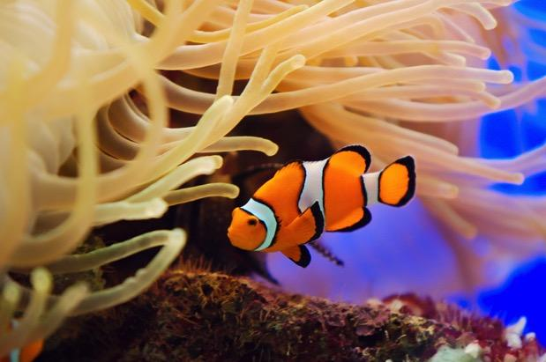
Sea anemones are poisonous, but clownfish have developed a layer of mucus that protects them from the stinging cells. The mucus is best described as ---
An adaptation
A relationship
An energy requirement
A social hierarchy
A mutation
Notes:
Sea anemones are poisonous, but clownfish have developed a layer of mucus that protects them from the stinging cells. The mucus is best described as ---
Taken from Practice Test (item #1)

Slide 82
Sea anemones are poisonous, but clownfish have developed a layer of mucus that protects them from the stinging cells. The mucus is best described as ---
An adaptation
A relationship
An energy requirement
A social hierarchy
A mutation
Notes:
Sea anemones are poisonous, but clownfish have developed a layer of mucus that protects them from the stinging cells. The mucus is best described as ---
[An adaptation]
Taken from Practice Test (item #1)

Slide 83
What is an adaptation?
Notes:
What is an adaptation?
[An adaptation is a change or characteristic that helps an organism survive in its environment.]

Slide 84
How is an adaptation the
same as/different from a mutation?
Notes:
How is an adaptation the same as/different from a mutation?
[An adaptation is a change or characteristic that helps an organism survive in its environment.
A mutation is a permanent change in the DNA sequence that makes up a gene.
Both CAN be beneficial!]

Slide 85
Remember!!!
Notes:
So remember!

Slide 86
Adaptation: a change or characteristic that helps an organism survive in its environment
Notes:
An adaptation is a change or characteristic that helps an organism survive in its environment.

Slide 87
Extension Activity
Form and Function Activity
Linked above are cards that can be used for reviewing the topic of adaptations with your class. Students will consider the connection between form and function as they research organisms that they choose or are assigned. Decide ahead of time if you want the students to work independently or with a partner/group.

Slide 88
Big Question: How do mutation, adaptation, and extinction change populations of species over time?
Notes:
Explicit cue to revisit the big question at the end of the lesson: Okay everyone. Now that we’ve learned the term adaptation, let’s reflect once more on our big question. Was there anything that we predicted earlier that was correct or incorrect? Do you have any new hypotheses to share?

Slide 89
Notes:
Thanks for watching, and please continue watching CAPs available from this website.

Slide 90
This Video Was Created With Resources From:
Questions or Comments
Michael Kennedy, Ph.D. MKennedy@Virginia.edu
Rachel L Kunemund, Ph.D. rk8vm@virginia.edu

Slide 91
Intro
“Big Idea” Question
Review Concepts
Check-In Questions
Teacher Demo
Vocabulary
Student-Friendly Definition
Examples & Non-Examples
Morphological Word Parts
Extension Activity
Notes:
OK everyone, get ready for our next lesson. Just as a reminder, these are the different components that our lesson may include, and you’ll see these icons in the top left corner of each slide so that you can follow along more easily!

Slide 92
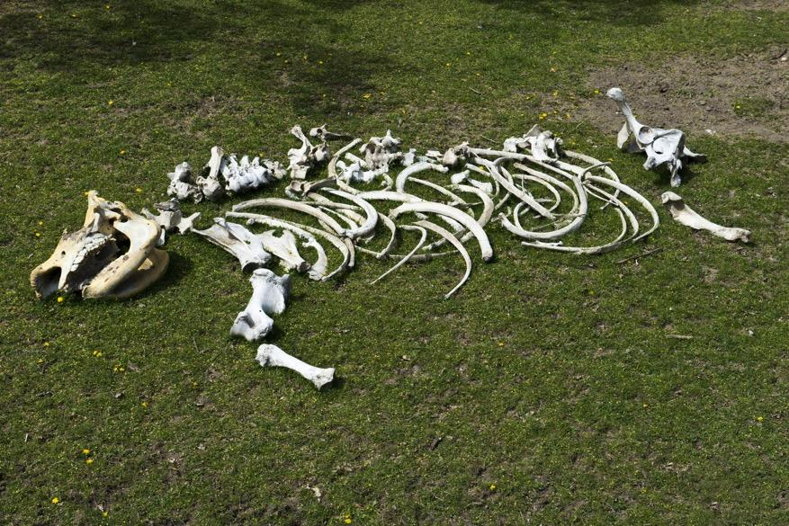
Extinction
Notes:
In this lesson we talk about extinction.

Slide 93
Big Question: How do mutation, adaptation, and extinction change populations of species over time?
Notes:
Our “big question” is: How do mutation, adaptation, and extinction change populations of species over time?
[Pause and illicit predictions from students.]
I love all these thoughtful scientific hypotheses! Be sure to keep this question and your predictions in mind as we move through these next few lessons, and we’ll continue to revisit it.

Slide 94
Notes:
Next, let’s review some other words that you already learned, and make sure you are firm in your understanding.

Slide 95
Inheritable
Notes:
Parents’ hereditary material gives traits—such as eye color, hair color, blood type, or height—to their offspring, or children.
Humans have hereditary traits. So do animals, plants, and other organisms.

Slide 96
DNA: the hereditary material in
almost all organisms
Notes:
DNA is the hereditary material in all organisms.

Slide 97
Genes: parts of DNA that carry
information that determines your
traits
Notes:
Genes are the parts of DNA that carry the information that determines your traits—such as hair color, height, baldness, and blood type.

Slide 98
Mutation: a permanent change in the DNA sequence that makes up a gene
Notes:
A mutation is a permanent change in the DNA sequence that makes up a gene.

Slide 99
Adaptation: a change or characteristic that helps an organism survive in its environment
Notes:
An adaptation is a change or characteristic that helps an organism survive in its environment.

Slide 100
Notes:
Now let’s pause for a moment to review the information we have covered already.

Slide 101
What does inheritable mean?
A trait that is received by choice
A trait that is received by hard work
A trait that is received by genes
A trait that is received by the environment
Notes:
What does inheritable mean?

Slide 102
What does inheritable mean?
A trait that is received by choice
A trait that is received by hard work
A trait that is received by genes
A trait that is received by the environment
Notes:
What does inheritable mean?
[Inheritable traits are those that are received by genes.]

Slide 103
What part of DNA carries the
information that determines our traits?
Notes:
What part of DNA carries the information that determines our traits?
[Genes are the parts of DNA that carry information that determines your traits.]

Slide 104
What is the difference between a mutation and an adaptation?
Notes:
What is the difference between a mutation and an adaptation?
[An adaptation is a change or characteristic that helps an organism survive in its environment.
A mutation is a permanent change in the DNA sequence that makes up a gene.
Both CAN be beneficial!]

Slide 105
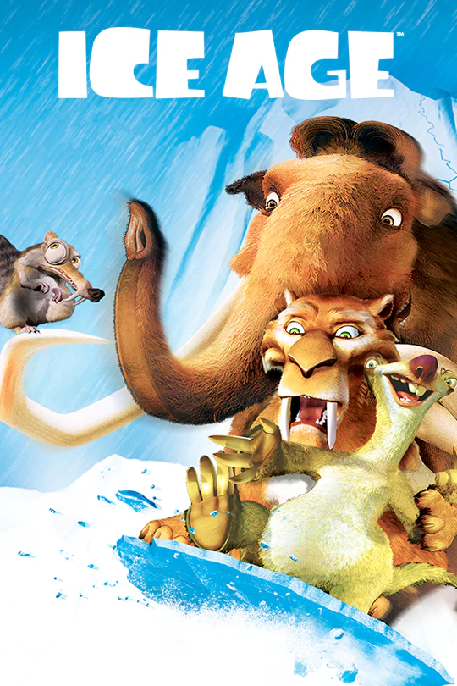
Demonstration
To engage students with the topic of extinction, you might consider playing a clip from one of the Ice Age films. While not completely accurate, the film includes some real historic species that have gone extinct.

Slide 106
Extinction
Notes:
Now that we’ve reviewed, let’s define our new term, extinction.

Slide 107
Extinction: occurs when every individual of a species has died
Notes:
Extinction occurs when every individual of a species has died.

Slide 108
Notes:
Let’s check-in for understanding.

Slide 109
What is extinction?
Notes:
What is extinction?
[Extinction occurs when every individual of a species has died.]

Slide 110
Notes:
Now, let’s talk about some examples of extinction.

Slide 111
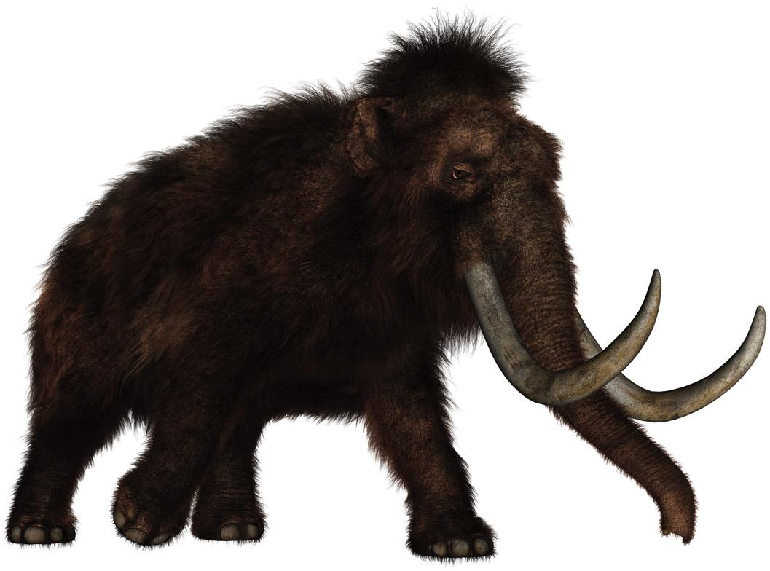
Notes:
Woolly mammoths are extinct - they died during the ice age.

Slide 112
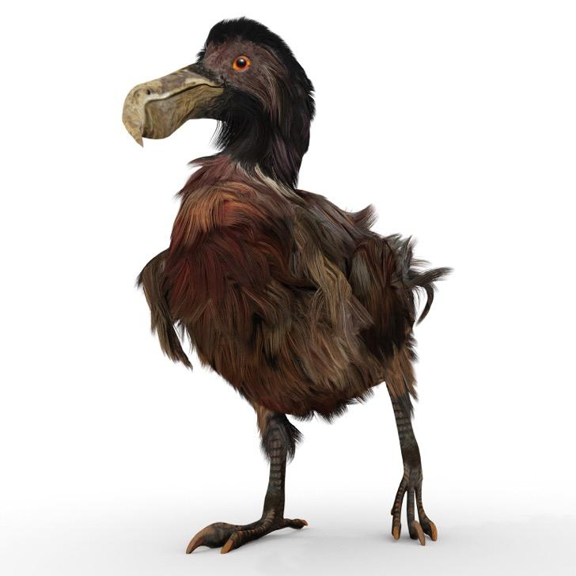
Notes:
Dodo bird is extinct.

Slide 113
Notes:
Now, let’s talk about some non-examples of extinction.

Slide 114
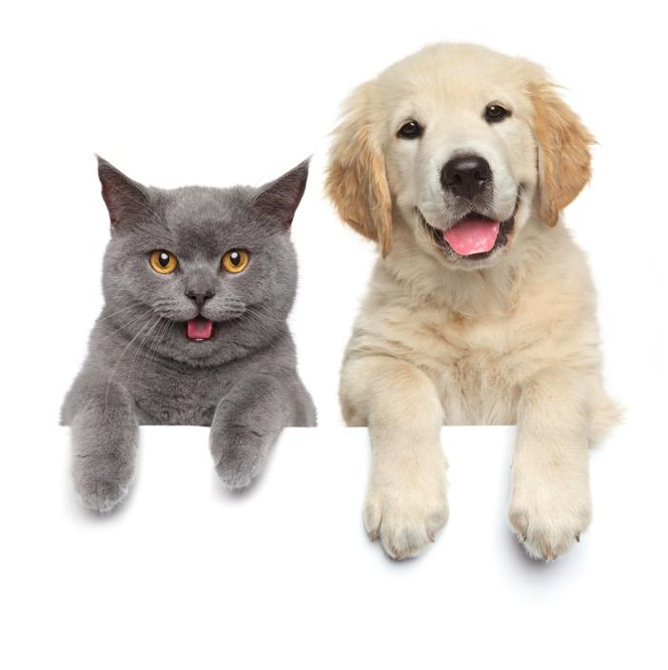
Notes:
Cats and dogs are not extinct - they are still living.

Slide 115
Notes:
Let’s check-in for understanding.

Slide 116
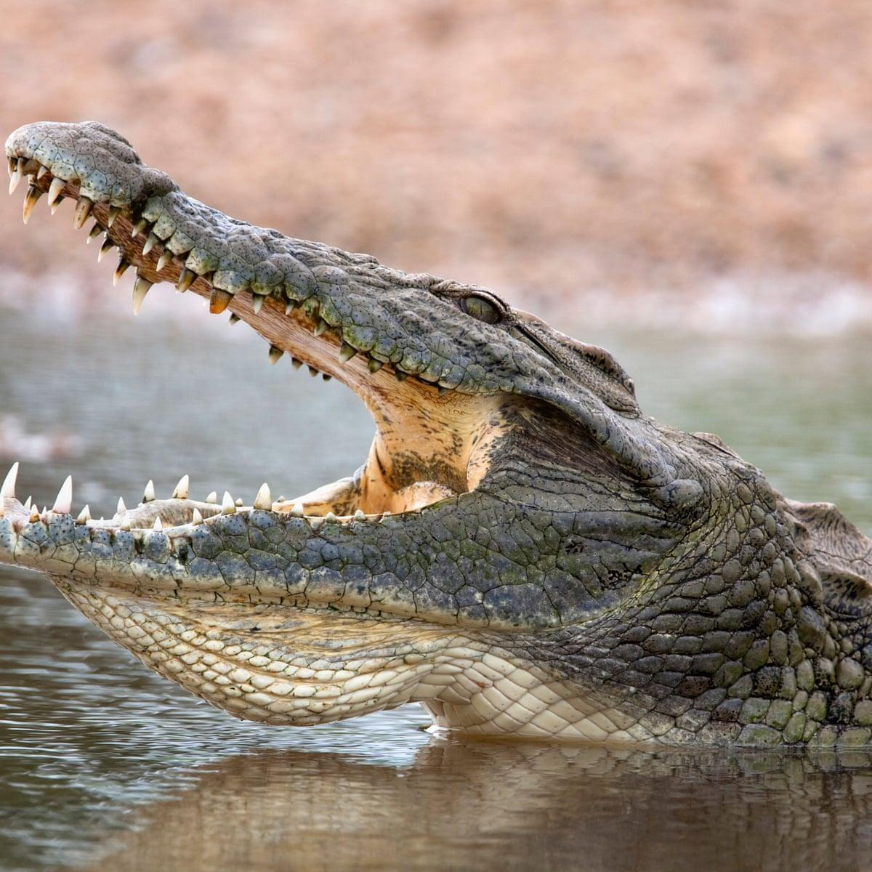
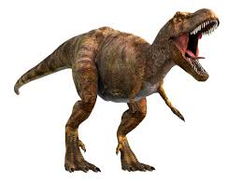
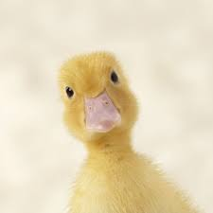
Which is an example of a species that is extinct?
Notes:
Which is an example of a species that is extinct?

Slide 117
Which is an example of a species that is extinct?
Notes:
Which is an example of a species that is extinct?
[Dinosaurs are extinct.]

Slide 118
What is another example of a species that is extinct?
Notes:
What is another example of a species that is extinct?

Slide 119
What is extinction?
Notes:
What is extinction?
[Extinction occurs when every individual of a species has died.]

Slide 120
Remember!!!
Notes:
So remember!

Slide 121
Extinction: occurs when every individual of a species has died
Notes:
Extinction occurs when every individual of a species has died.

Slide 122
Term | Meaning
Mutation | A permanent change in the DNA sequence that makes up a gene
Adaptation | A change or characteristic that helps an organism survive in its environment
Extinction | Occurs when every individual of a species has died
Notes:
Summary

Slide 123
Extension Activity
Saving the Rhinos from Extinction
Use the WWF website page linked above to have students explore the threats that rhino species are facing today. After a quick Think-Pair-Share, engage the class in discussing what types of human activities threaten other species and how we can improve our efforts in species conservation.

Slide 124
Big Question: How do mutation, adaptation, and extinction change populations of species over time?
Notes:
Explicit cue to revisit the big question at the end of the lesson: Okay everyone. Now that we’ve learned the term extinction, let’s reflect once more on our big question. Was there anything that we predicted earlier that was correct or incorrect? Do you have any new hypotheses to share?

Slide 125
Notes:
Thanks for watching, and please continue watching CAPs available from this website.

Slide 126
This Video Was Created With Resources From:
Questions or Comments
Michael Kennedy, Ph.D. MKennedy@Virginia.edu
Rachel L Kunemund, Ph.D. rk8vm@virginia.edu

Slide 127
Intro
“Big Idea” Question
Review Concepts
Check-In Questions
Teacher Demo
Vocabulary
Student-Friendly Definition
Examples & Non-Examples
Morphological Word Parts
Simulation Activities
Notes:
OK everyone, get ready for our next lesson. Just as a reminder, these are the different components that our lesson may include, and you’ll see these icons in the top left corner of each slide so that you can follow along more easily!

Slide 128
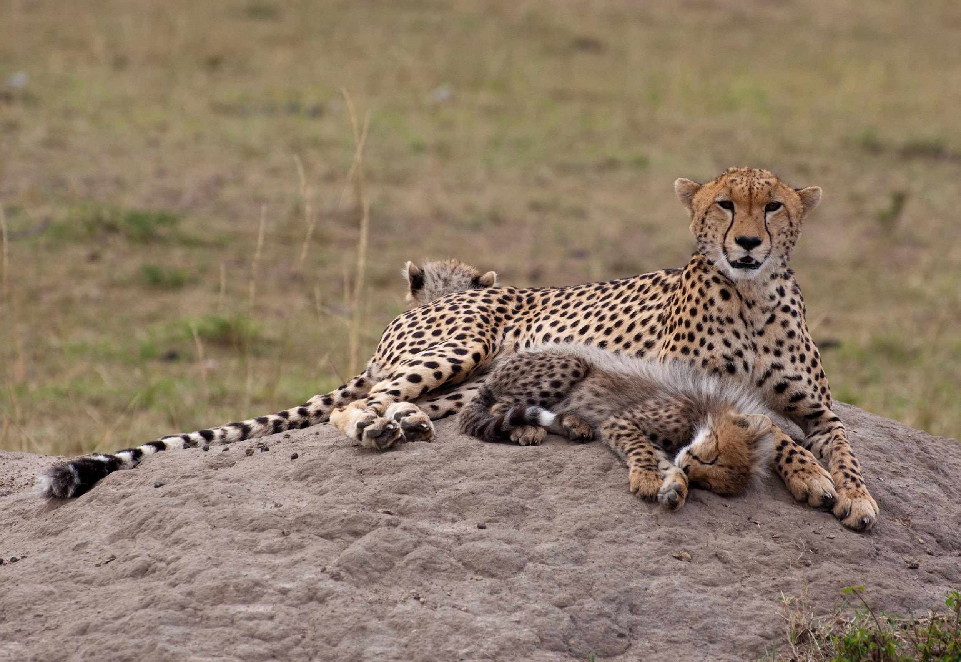
Natural Selection
Notes:
In this lesson we talk about natural selection.

Slide 129
Big Question: How do mutation, adaptation, and extinction change populations of species over time?
Notes:
Our “big question” is: How do mutation, adaptation, and extinction change populations of species over time?
[Pause and illicit predictions from students.]
I love all these thoughtful scientific hypotheses! Be sure to keep this question and your predictions in mind as we move through these next few lessons, and we’ll continue to revisit it.

Slide 130
Inheritable
Notes:
Parents’ hereditary material gives traits—such as eye color, hair color, blood type, or height—to their offspring, or children.
Humans have hereditary traits. So do animals, plants, and other organisms.

Slide 131
DNA: the hereditary material in
almost all organisms
Notes:
DNA is the hereditary material in all organisms.

Slide 132
Genes: parts of DNA that carry
information that determines your
traits
Notes:
Genes are the parts of DNA that carry the information that determines your traits—such as hair color, height, baldness, and blood type.

Slide 133
Mutation: a permanent change in the DNA sequence that makes up a gene
Notes:
A mutation is a permanent change in the DNA sequence that makes up a gene.

Slide 134
Adaptation: a change or characteristic that helps an organism survive in its environment
Notes:
An adaptation is a change or characteristic that helps an organism survive in its environment.

Slide 135
Extinction: occurs when every individual of a species has died
Notes:
Extinction occurs when every individual of a species has died.

Slide 136
Notes:
Now let’s pause for a moment to review the information we have covered already.

Slide 137
What does inheritable mean?
A trait that is received by choice
A trait that is received by hard work
A trait that is received by genes
A trait that is received by the environment
Notes:
What does inheritable mean?

Slide 138
What does inheritable mean?
A trait that is received by choice
A trait that is received by hard work
A trait that is received by genes
A trait that is received by the environment
Notes:
What does inheritable mean?
[Inheritable traits are those that are received by genes.]

Slide 139
What part of DNA carries the
information that determines our traits?
Notes:
What part of DNA carries the information that determines our traits?
[Genes are the parts of DNA that carry information that determines your traits.]

Slide 140
What is the difference between a mutation and an adaptation?
Notes:
What is the difference between a mutation and an adaptation?
[An adaptation is a change or characteristic that helps an organism survive in its environment.
A mutation is a permanent change in the DNA sequence that makes up a gene.
Both CAN be beneficial!]

Slide 141
What is extinction?
Notes:
What is extinction?
[Extinction occurs when every individual of a species has died.]

Slide 142
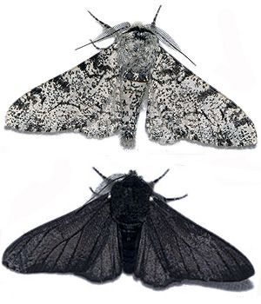
Demonstration
The Peppered Moth’s Dark History
The resource linked above includes a video describing the transformation of the peppered moth species due to a changing environment in England in the 19th century. Peppered moths provide a great example of how individuals who are better suited to survive in their environments will be more likely to survive and reproduce.

Slide 143
Natural Selection
Notes:
Let’s define our new term, natural selection.

Slide 144
Natural Selection: the process where capable organisms survive and pass their genetic traits to their offspring
Notes:
Natural selection is the process where capable organisms survive and pass their genetic traits to their offspring.

Slide 145
Notes:
Now let’s pause for a moment to review the information we have covered already.

Slide 146
What is natural selection?
Notes:
What is natural selection?
[Natural selection is the process where capable organisms survive and pass their genetic traits to their offspring.]

Slide 147
Notes:
That is the basic definition, but there is a bit more you need to know.

Slide 148
Survival of the fittest
Notes:
It is also called “survival of the fittest” because the organisms most fit for their environment are those that are more likely to have offspring and pass their traits to their offspring.

Slide 149
Notes:
Now let’s pause for a moment to review the information we have covered already.

Slide 150
Why is natural selection called “survival of the fittest”?
Notes:
Why is natural selection called “survival of the fittest?
[It is also called “survival of the fittest” because the organisms most fit for their environment are those that are more likely to have offspring and pass their traits to their offspring.]

Slide 151
Notes:
Now, let’s talk about some examples of natural selection.

Slide 152
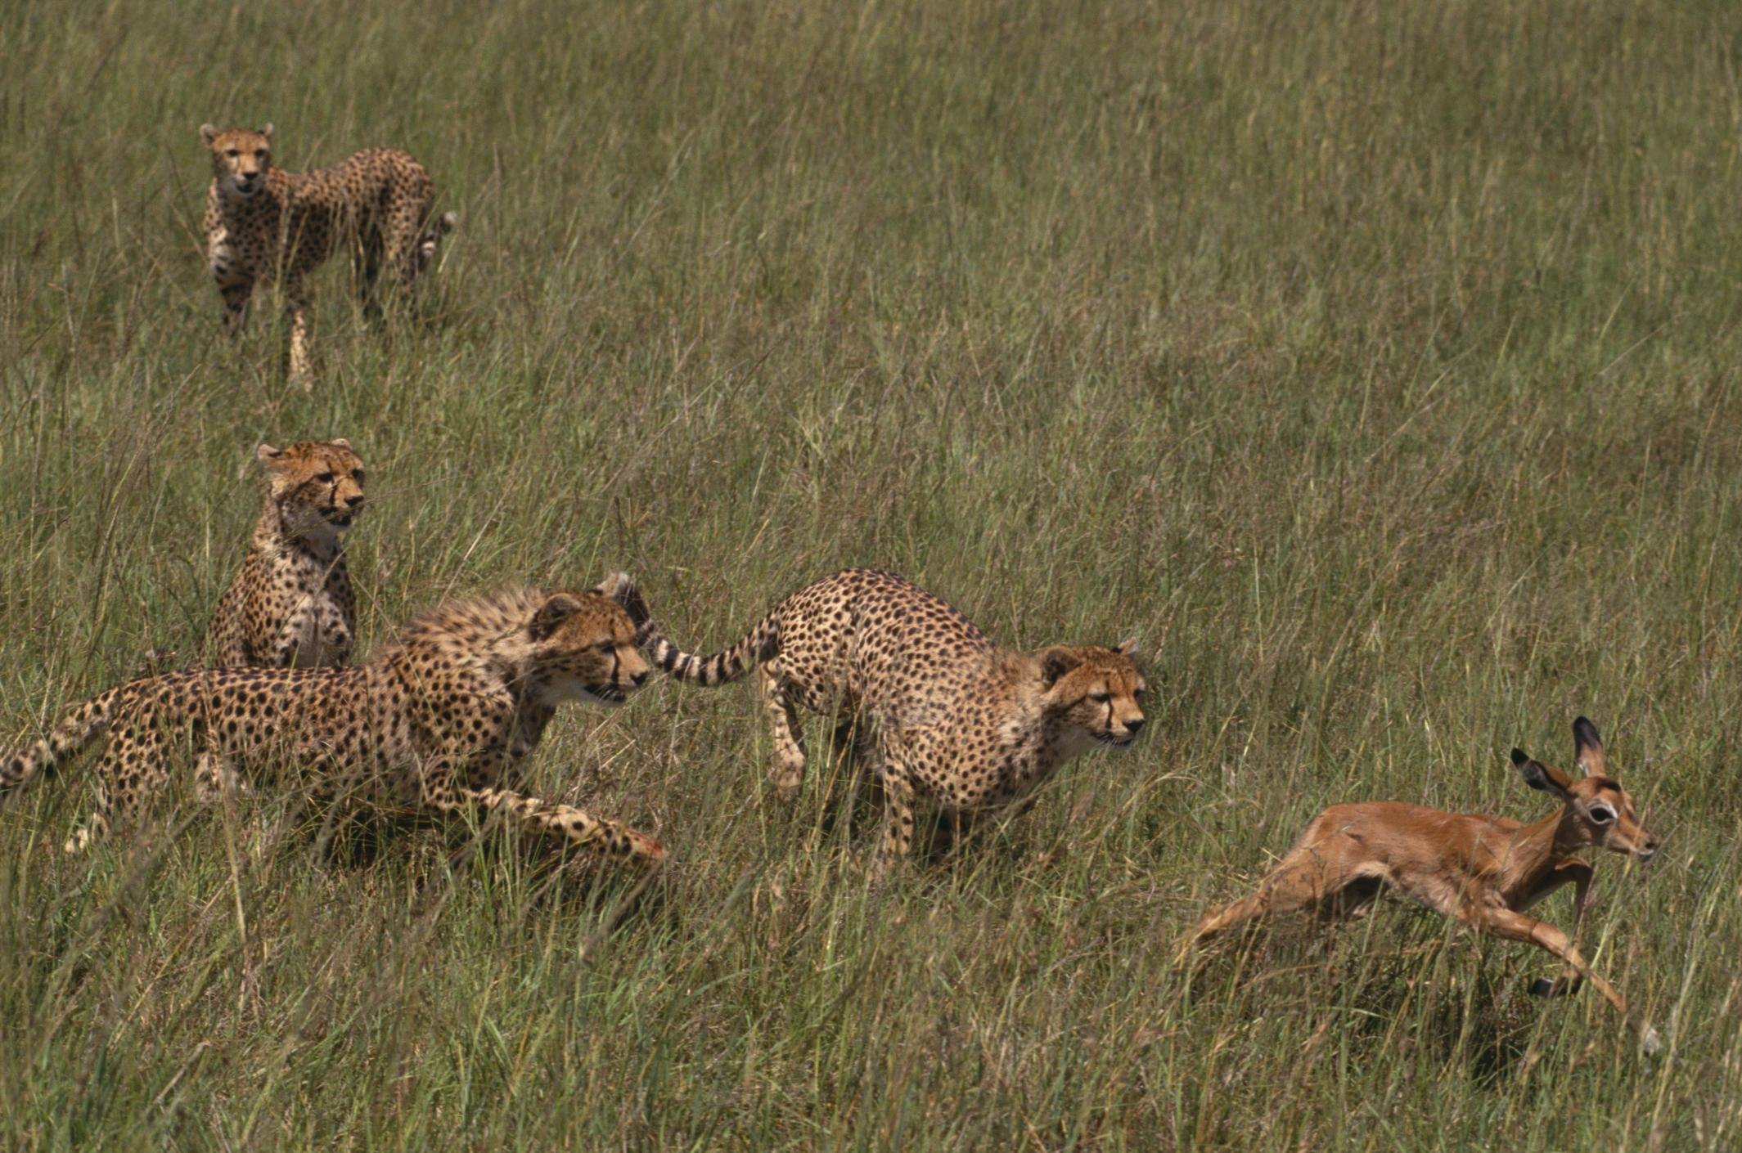
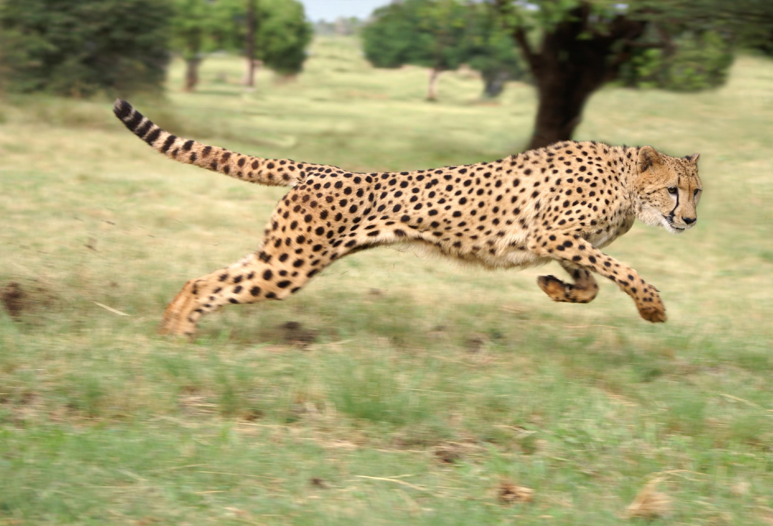
Notes:
In this picture, you can see that the cheetah is chasing a deer. ‘
The cheetah’s speed is the trait that gives the cheetahs the best chance for survival.
The cheetahs that are the fastest are more likely to live long enough to pass its speed to its offspring.
The cheetahs who are not fast are more likely to be eaten and not pass their genes.
Over time, the genetic characteristic for speed will become more frequent in the population as a result of natural selection.

Slide 153
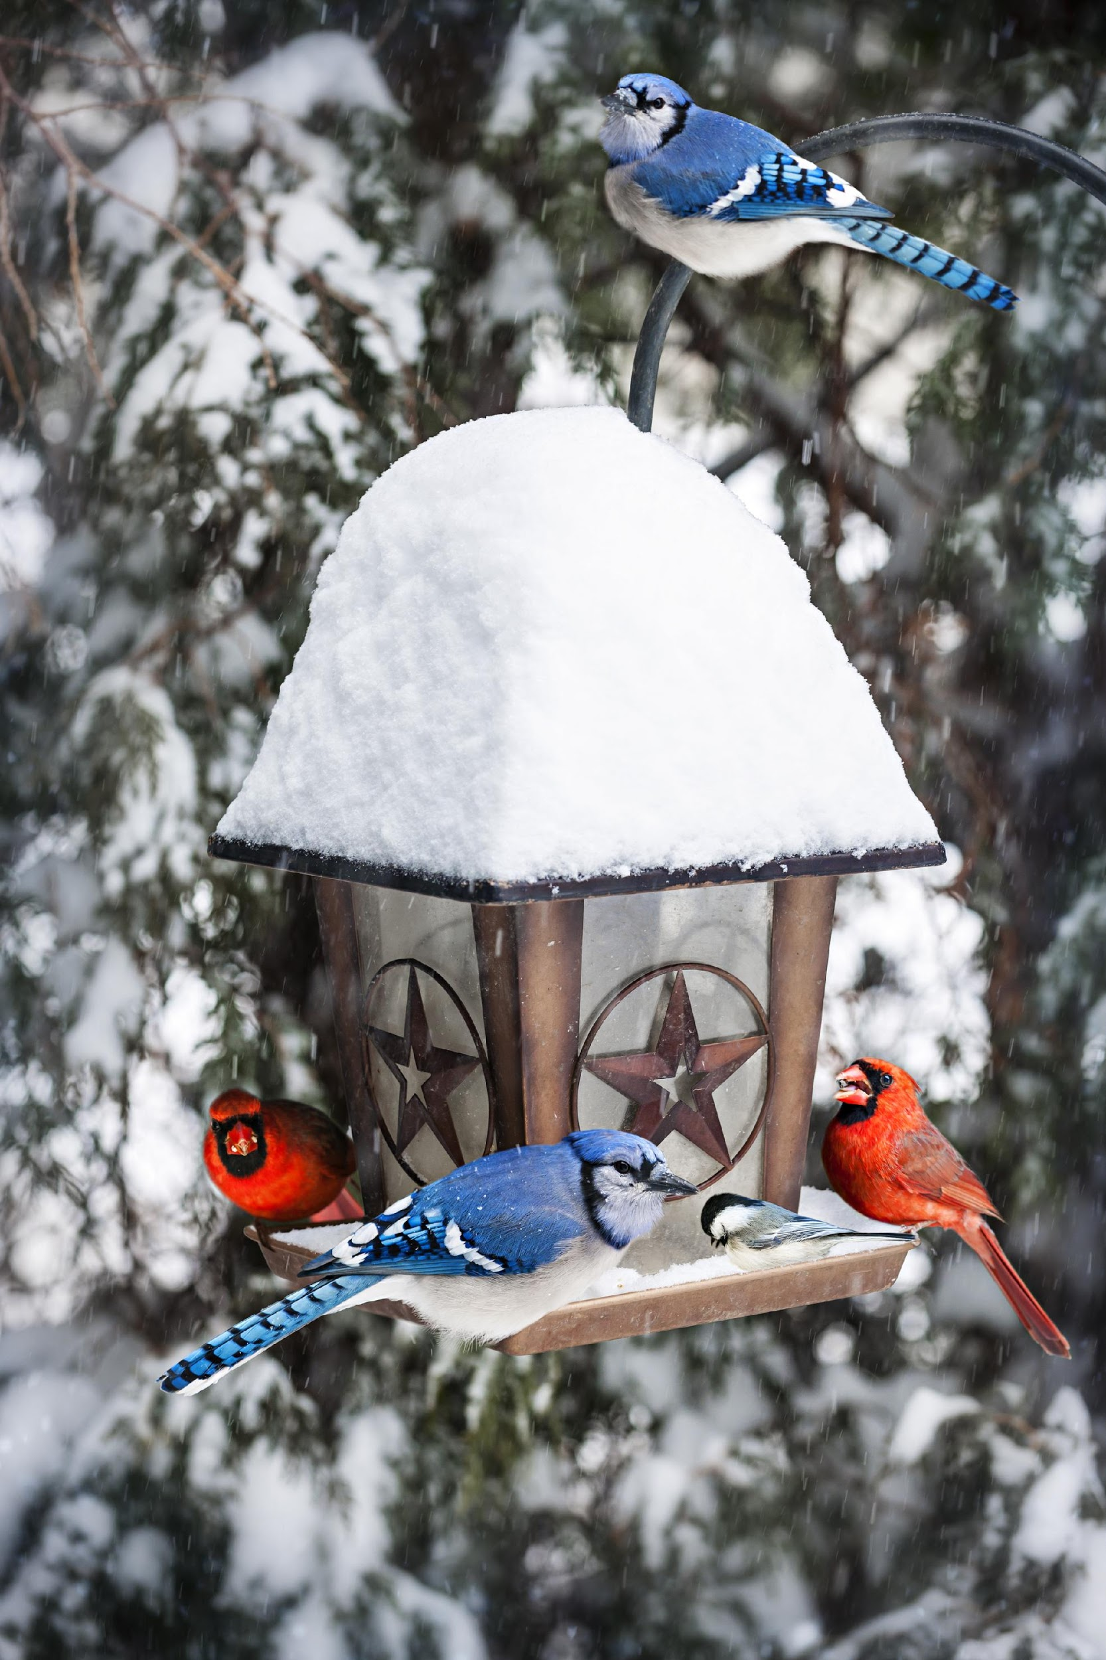
Notes:
Another example of natural selection is when, over time, male birds develop very colorful feathers.
These feathers attract female birds.
The brightly colored birds have more offspring.
Over time, the genetic characteristic for bright feathers will become more frequent in the population as a result of natural selection.

Slide 154
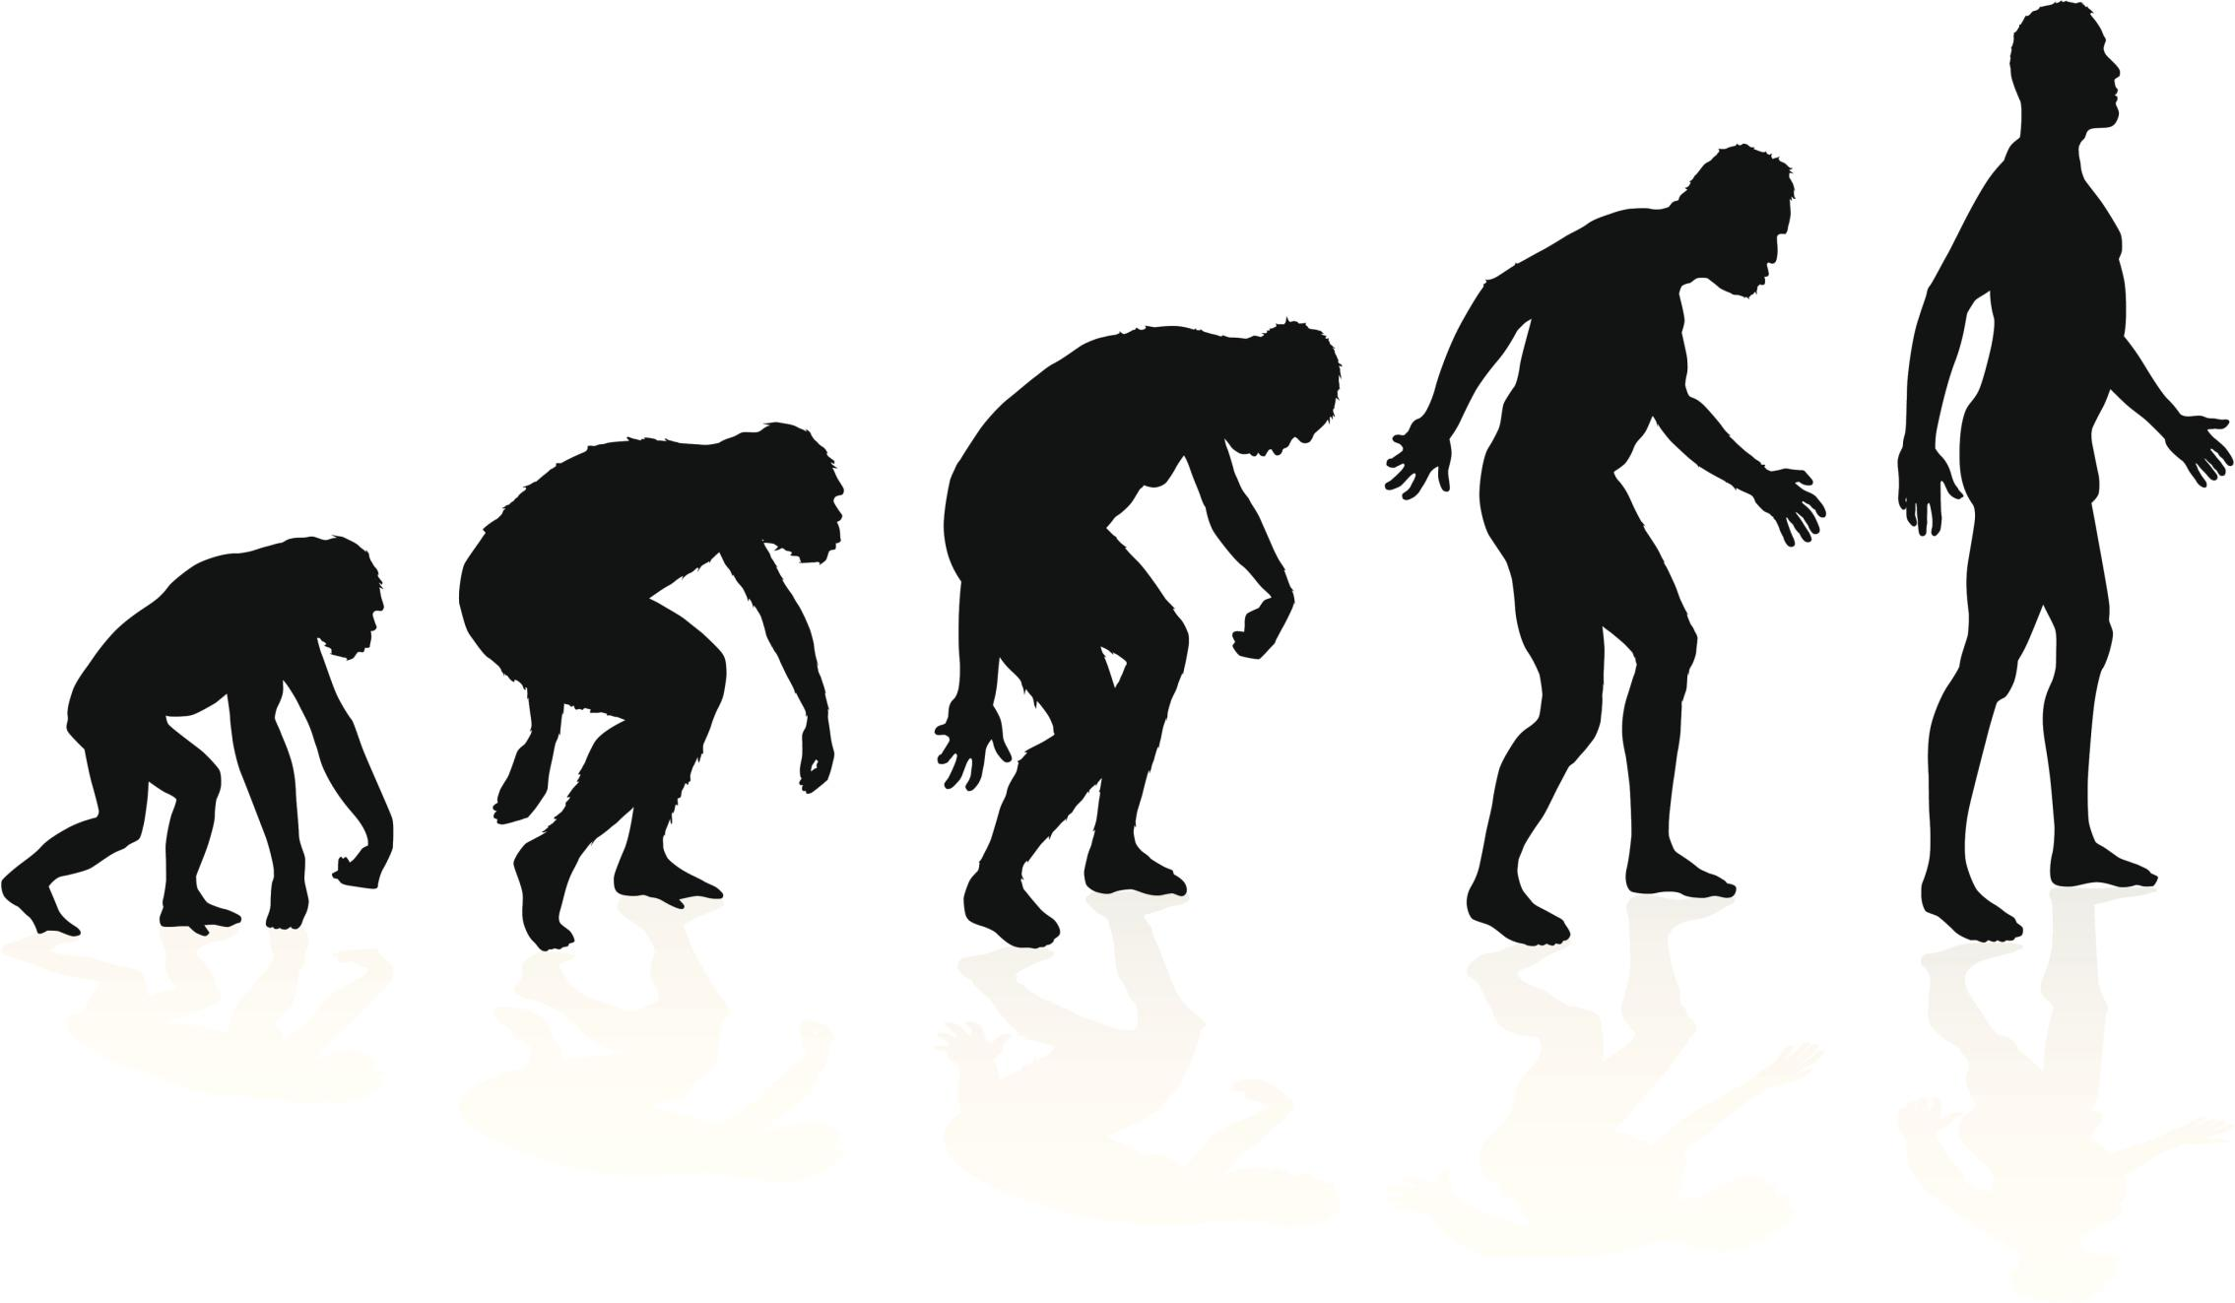
Evolution
Notes:
Natural selection results in the evolution of a population. Evolution is the process that changes species genetically over time.

Slide 155
Notes:
Let’s check-in for understanding.

Slide 156
What are some examples of natural selection?
Notes:
What are some examples of natural selection?

Slide 157
Notes:
We can also break down the term natural selection into different word parts to help us remember the meaning. Let’s take a look!

Slide 158
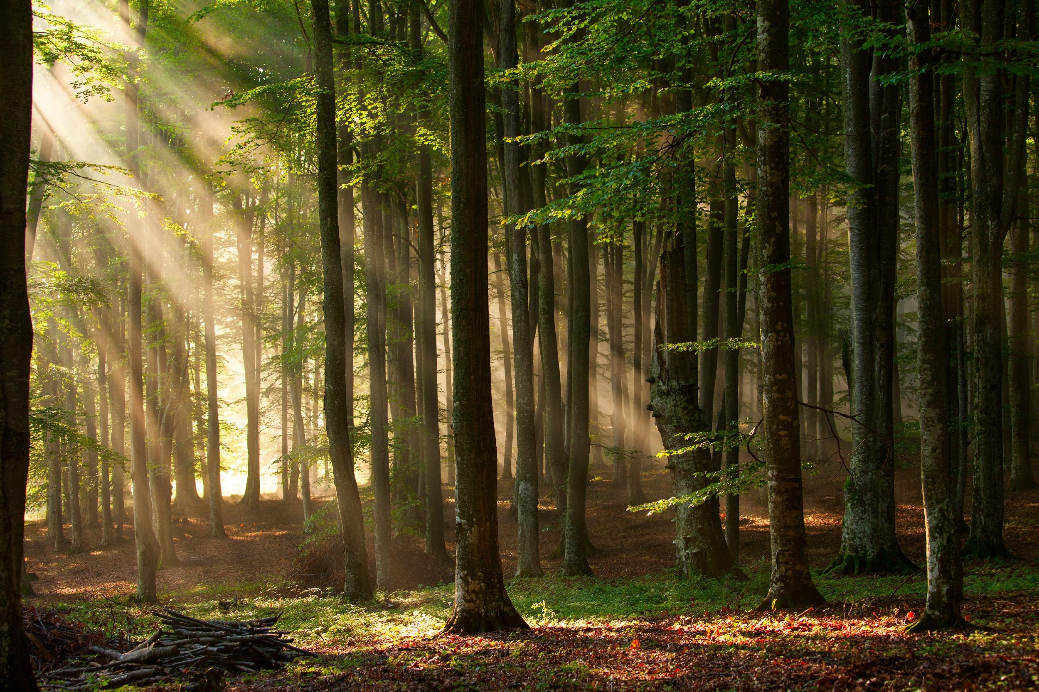
Natural Selection
Notes:
The word natural sounds like nature.

Slide 159
Natural Selection
Notes:
Selection has the word select in it. When you select something you carefully choose something as being the best.

Slide 160
Natural Selection
Notes:
So the term natural selection is the process through which nature selects which species will survive.
During natural selection nature “selects” the genetic traits that give an organism the best chance for survival.

Slide 161
Notes:
Let’s check-in for understanding.

Slide 162
What is natural selection?
Notes:
What is natural selection?
[Natural selection is the process where capable organisms survive and pass their genetic traits to their offspring.]

Slide 163
Remember!!!
Notes:
So remember!

Slide 164
Natural Selection: the process where capable organisms survive and pass their genetic traits to their offspring
Notes:
Natural selection is the process where capable organisms survive and pass their genetic traits to their offspring.

Slide 165
Big Question: How do mutation, adaptation, and extinction change populations of species over time?
Notes:
Explicit cue to revisit the big question at the end of the lesson: Okay everyone. Now that we’ve learned the term natural selection, let’s reflect once more on our big question. Was there anything that we predicted earlier that was correct or incorrect? Do you have any new hypotheses to share?

Slide 166
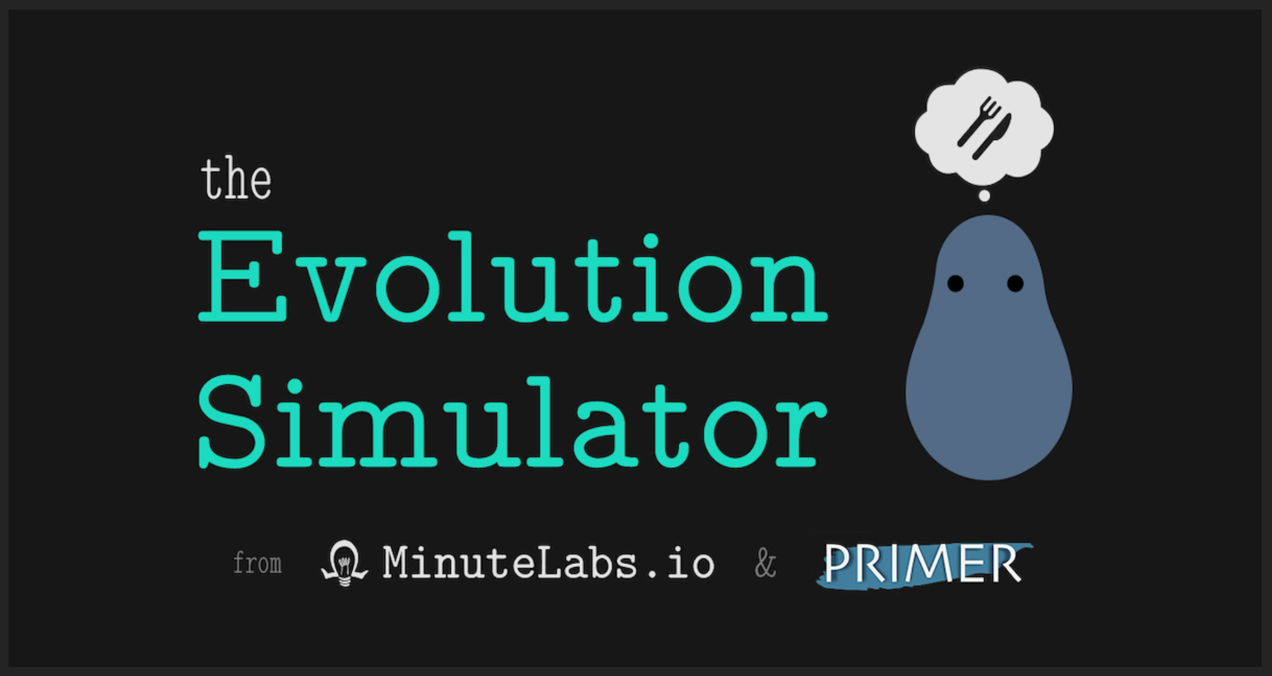
Simulation Activity
The Evolution Simulator
Linked above is a resource for engaging students with an evolution simulator. Students will watch blob creatures seek out food and be able to observe changes in their three important traits over time. The homepage for this resource includes an explanation of the simulation along with instructions for how to use the program.
Notes:
Feedback: Simulations are a great way to help make science thinking visible for students. In this simulation, offer students opportunities to make predictions about changes in traits over time for the blob creatures. This simulation is a great opportunity for students to work independently or in pairs since a large component of inquiry-based activities is encouraging student thinking and independence. Facilitate this activity with open-ended questions, followed by providing explicit explanations, and then asking probing questions to engage students in a discussion while also providing clear explanations.

Slide 167
Simulation Activity
Beak of Finch Lab Simulation Game
Linked above is a resource for engaging students with a lab simulation of the Galapagos finches.Students will compete with different “beaks” to collect “seeds” around the classroom. The activity does a great job of driving home the concept of natural selection as a process that acts upon individuals.
Notes:
Feedback: Simulations are a great way to help make science thinking visible for students. In this simulation, offer students opportunities to make predictions about changes in traits over time for the blob creatures. This simulation is a great opportunity for students to work independently or in pairs since a large component of inquiry-based activities is encouraging student thinking and independence. Facilitate this activity with open-ended questions, followed by providing explicit explanations, and then asking probing questions to engage students in a discussion while also providing clear explanations.

Slide 168
Big Question: How do mutation, adaptation, and extinction change populations of species over time?
Notes:
Explicit cue to revisit the big question at the end of the lesson: Okay everyone. Now that we’ve learned the term, let’s reflect once more on our big question. Was there anything that we predicted earlier that was correct or incorrect? Do you have any new hypotheses to share?

Slide 169
Notes:
Thanks for watching, and please continue watching CAPs available from this website.

Slide 170
This Video Was Created With Resources From:
Questions or Comments
Michael Kennedy, Ph.D. MKennedy@Virginia.edu
Rachel L Kunemund, Ph.D. rk8vm@virginia.edu

